Slide 1
ESRD: Précis An introduction to end-stage renal disease in the U.S.
United States Renal Data System
2013 Annual Data Report

Slide 2
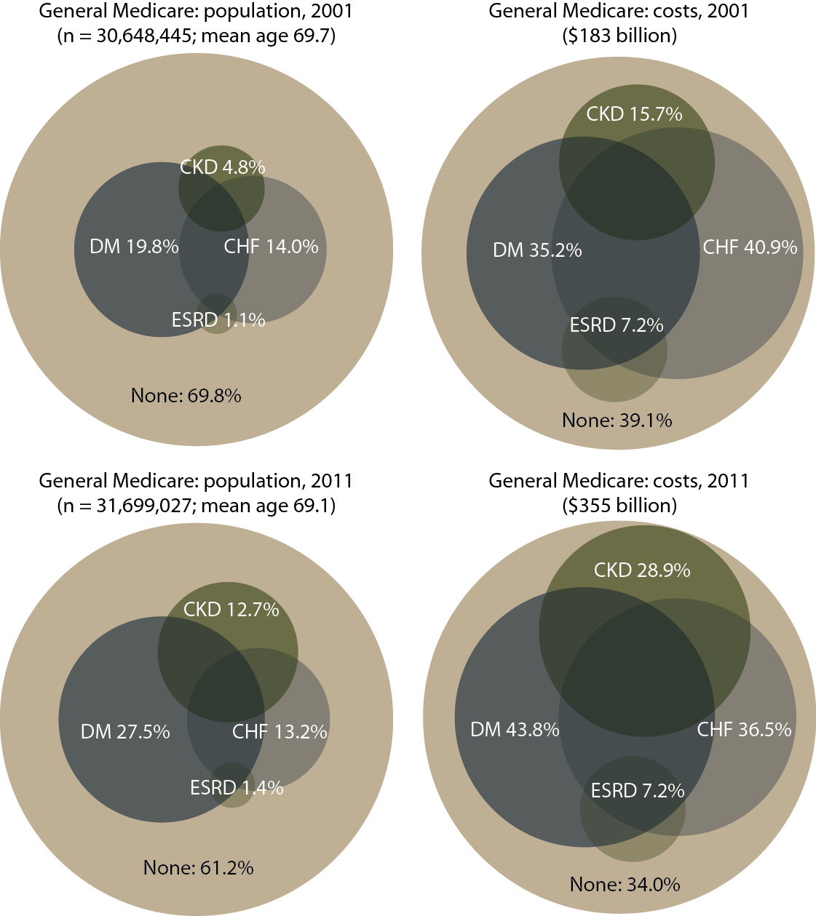
Distribution of general (fee-for-service) Medicare patients & costs for CKD, CHF, diabetes, & ESRD, 2001 Figure p.1 (Volume 2)
Period prevalent general (fee-for-service) Medicare patients. Diabetes, CKD, & congestive heart failure determined from claims, 2000–2001; costs are for calendar year 2001.

Slide 3
Distribution of general (fee-for-service) Medicare patients & costs for CKD, CHF, diabetes, & ESRD, 2011 Figure p.1 (continued; Volume 2)
Period prevalent general (fee-for-service) Medicare patients. Diabetes, CKD, & congestive heart failure determined from claims, 2010–2011; costs are for calendar year 2011.

Slide 4
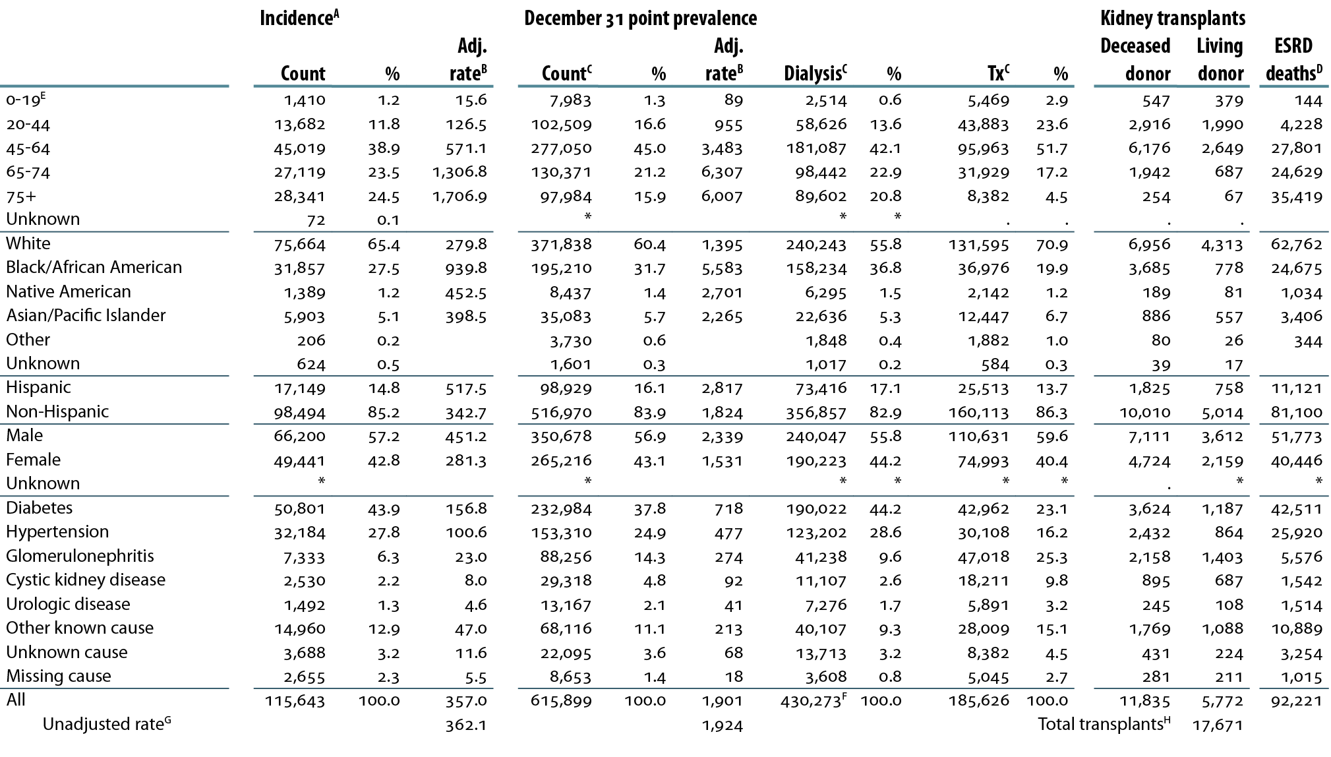
Summary statistics on reported ESRD therapy in the United States, by age, race, ethnicity, gender, & primary diagnosis, 2011 Table p.a (Volume 2)
Dialysis & transplant patients, 2011.

Slide 5
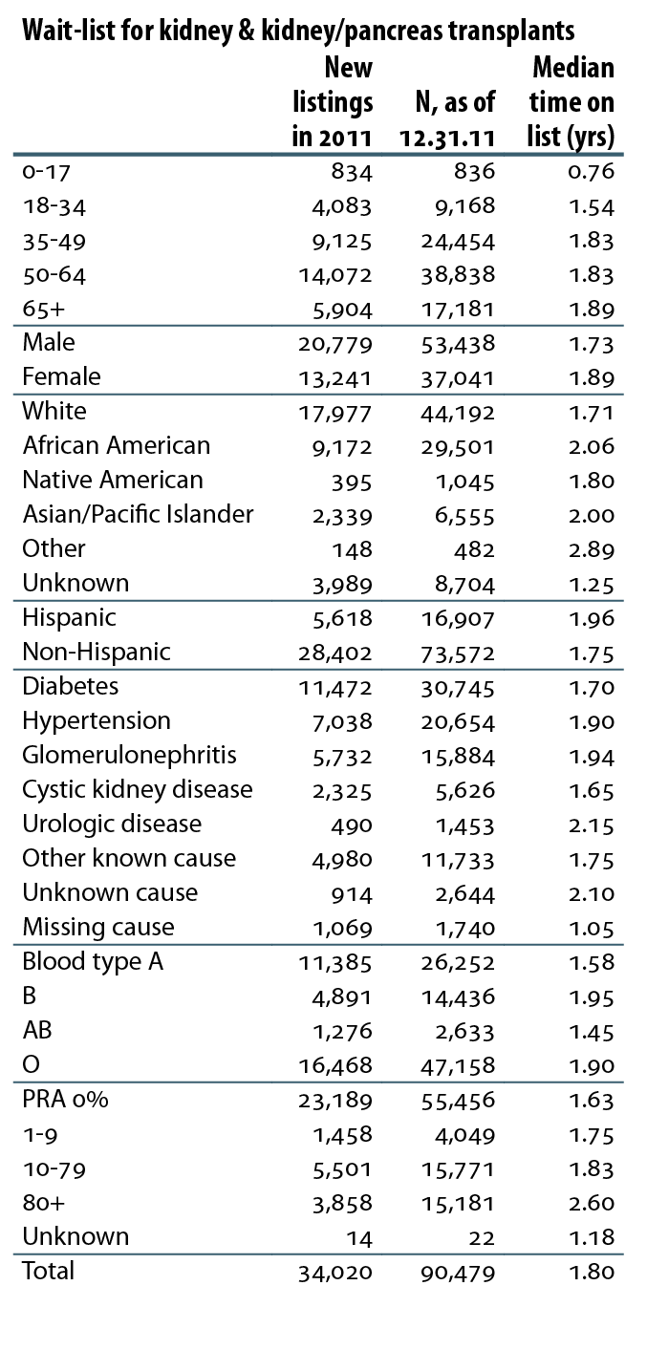
Wait-list for kidney & kidney/pancreas transplants, 2011 Table p.a (continued; Volume 2)
Dialysis & transplant patients, 2011.

Slide 6
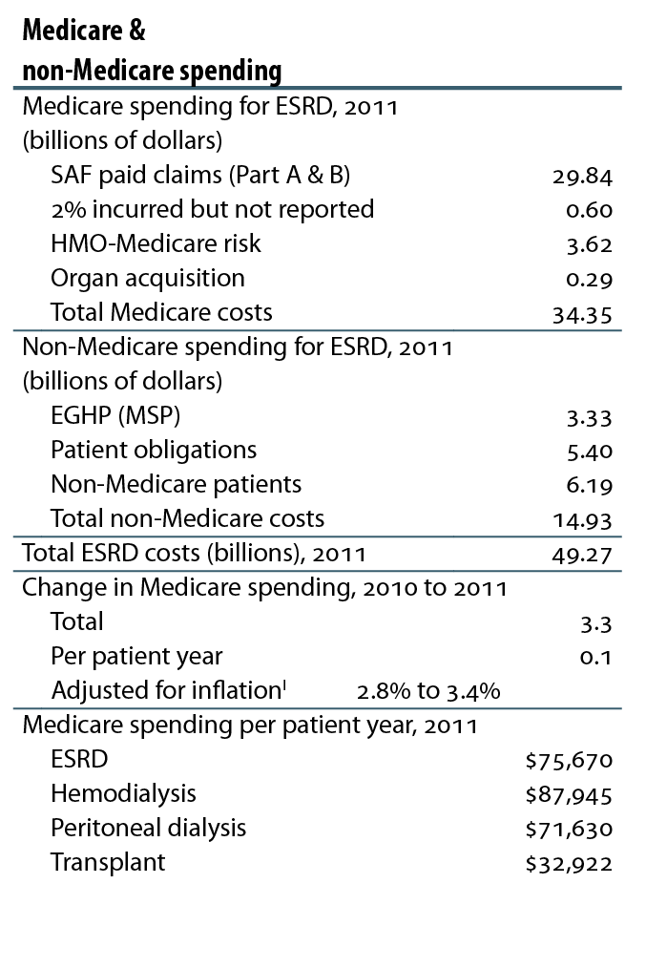
Medicare & non-Medicare spending, 2011 Table p.a (continued; Volume 2)
Dialysis & transplant patients, 2011.

Slide 7
Counts of new & returning dialysis patients Figure p.2 (Volume 2)
CMS Annual Facility Survey.

Slide 8
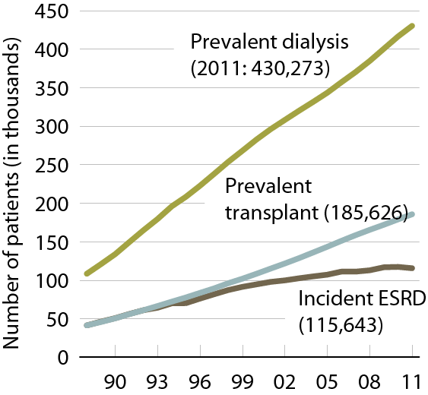
Patient counts, by modality Figure p.3 (Volume 2)
Incident & December 31 point prevalent ESRD patients.

Slide 9
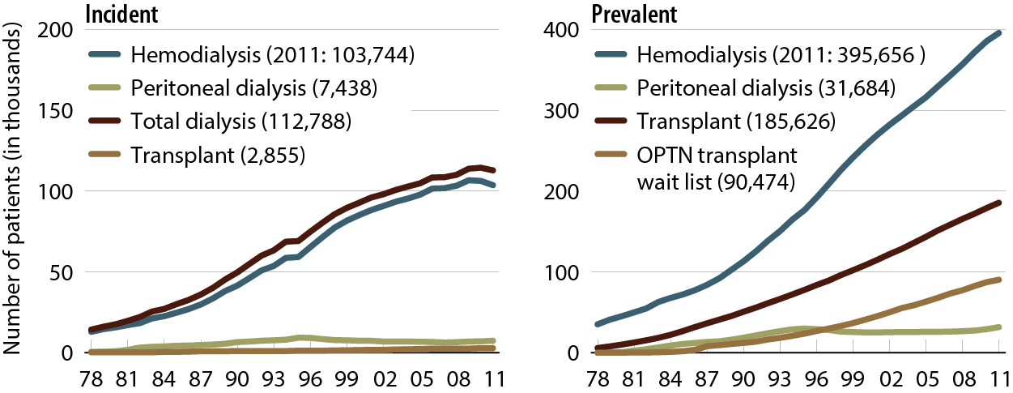
Incident & prevalent patient counts (USRDS), by modality Figure 1.1 (Volume 2)
Incident & December 31 point prevalent ESRD patients; peritoneal dialysis consists of CAPD & CCPD.

Slide 10
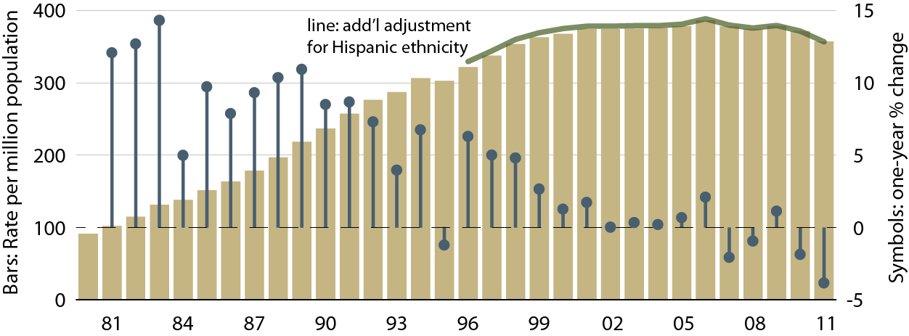
Adjusted incident rates of ESRD & annual percent change Figure 1.2 (Volume 2)
Incident ESRD patients. Adj: age/gender/race; ref: 2010 ESRD patients.

Slide 11
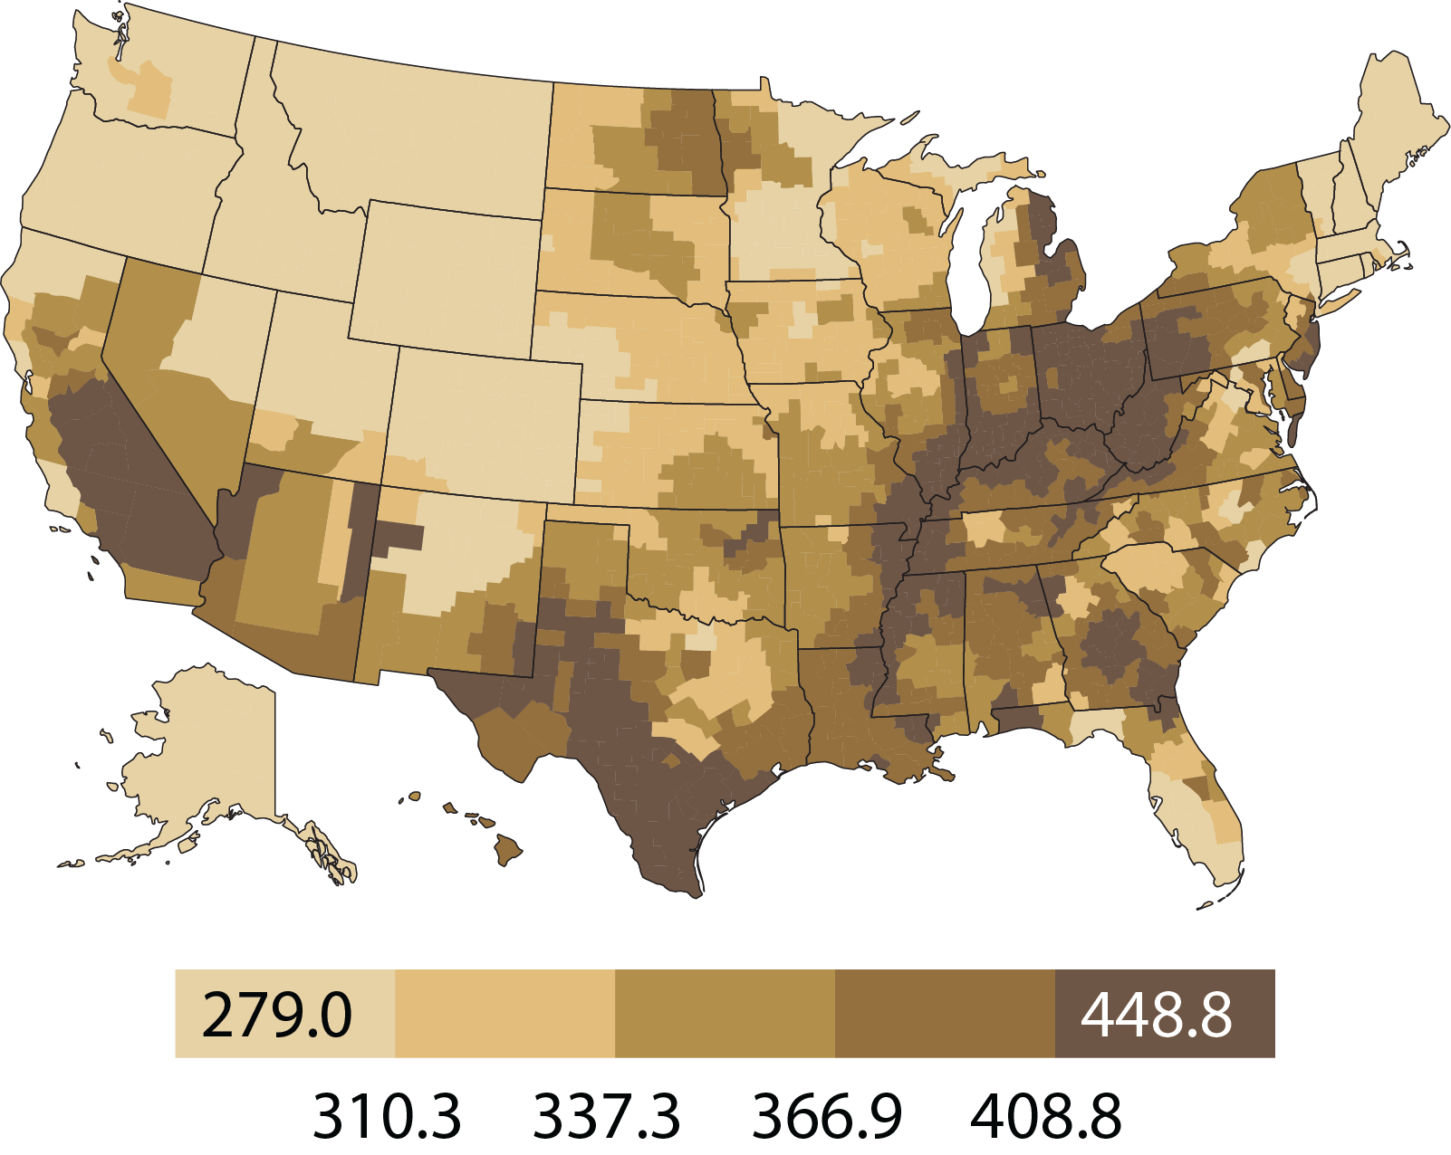
Geographic variations in adjusted incident rates of ESRD per million population, 2011, by HSA Figure 1.3 (Volume 2)
Incident ESRD patients. Adj: age/gender/race/ethnicity ; ref: 2010 ESRD patients.

Slide 12
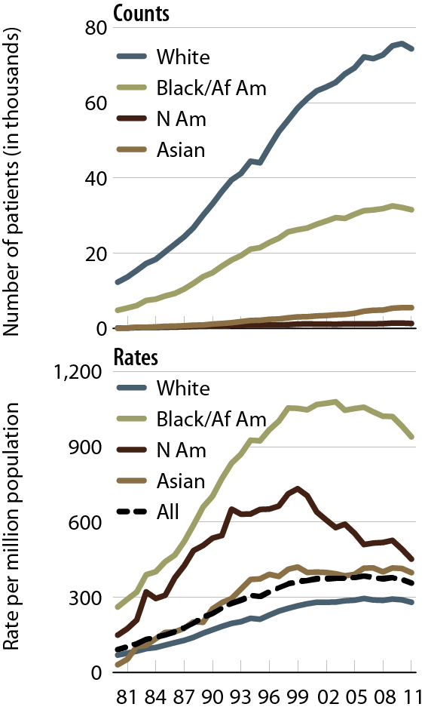
Incident counts & adjusted rates of ESRD, by race Figure 1.5 (Volume 2)
Incident ESRD patients. Adj: age/gender; ref: 2010 ESRD patients.

Slide 13
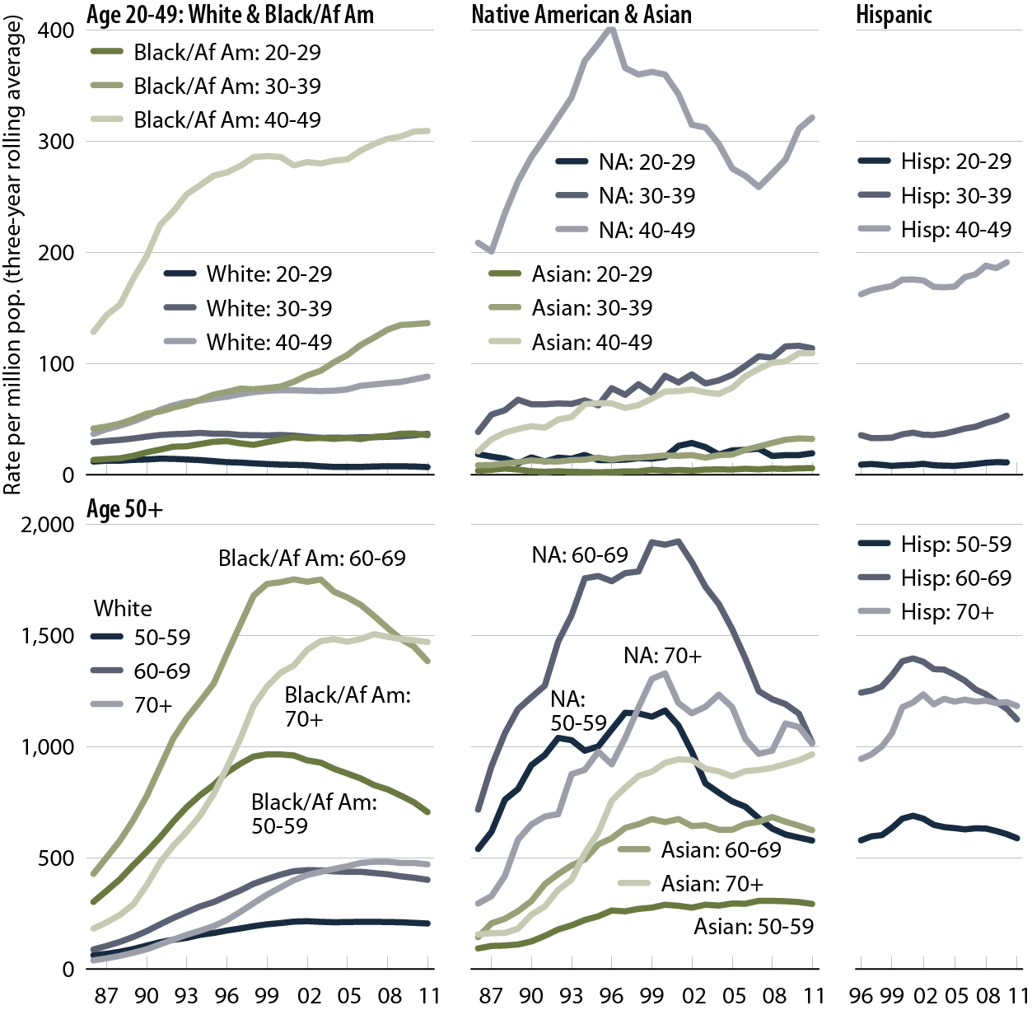
Adjusted incident rates of ESRD due to diabetes, by age, race, & ethnicity Figure 1.8 (Volume 2)
Incident ESRD patients; rates are three-year rolling averages. Adj: gender; ref: 2010 ESRD patients.

Slide 14
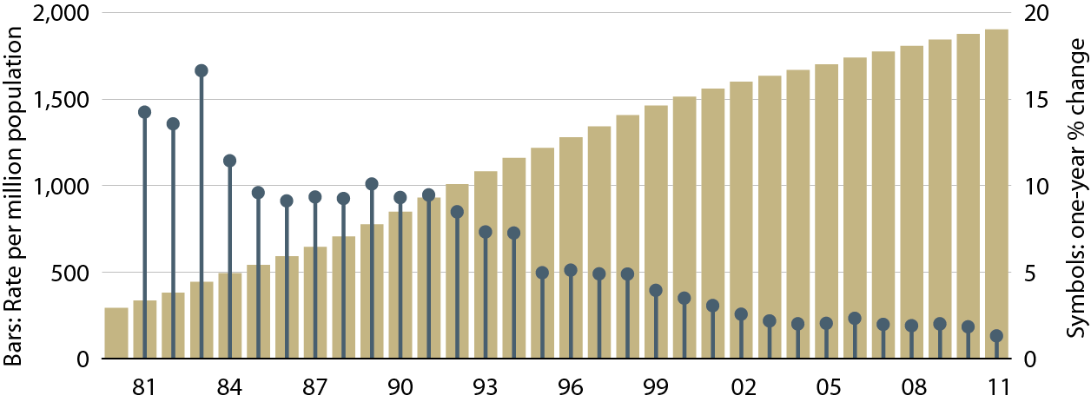
Adjusted prevalent rates of ESRD & annual percent change Figure 1.10 (Volume 2)
December 31 point prevalent ESRD patients. Adj: age/gender/race; ref: 2010 ESRD patients.

Slide 15
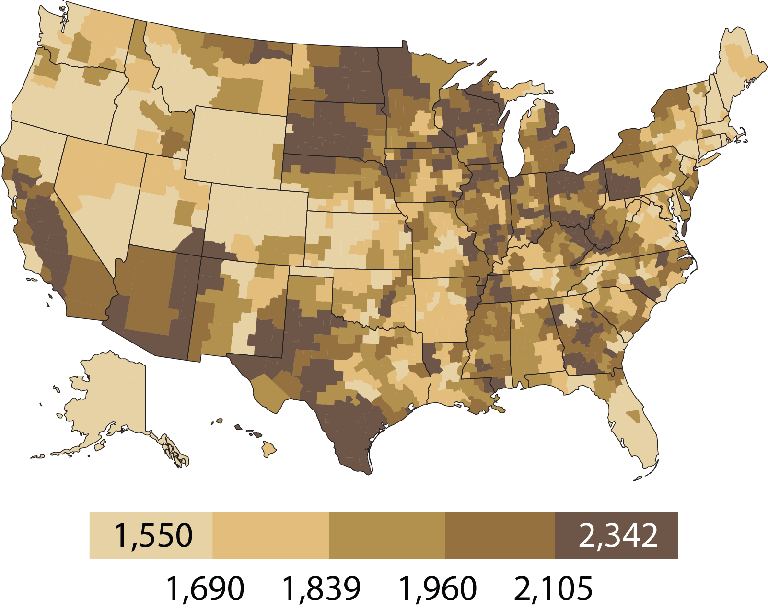
Geographic variations in adjusted prevalent rates of ESRD per million population, 2011, by HSA Figure 1.11 (Volume 2)
Incident ESRD patients. Adj: age/gender/race/ethnicity; ref: 2010 ESRD patients.

Slide 16
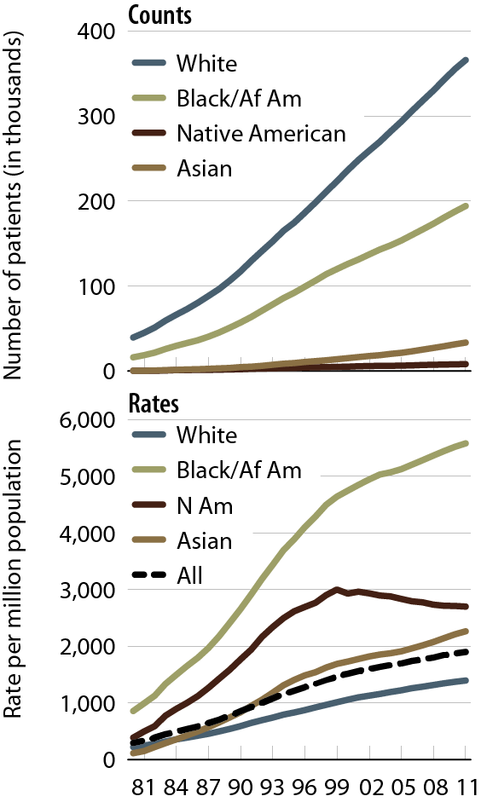
Prevalent counts & adjusted rates of ESRD, by race Figure 1.13 (Volume 2)
December 31 point prevalent ESRD patients. Adj: age/gender; ref: 2010 ESRD patients.

Slide 17
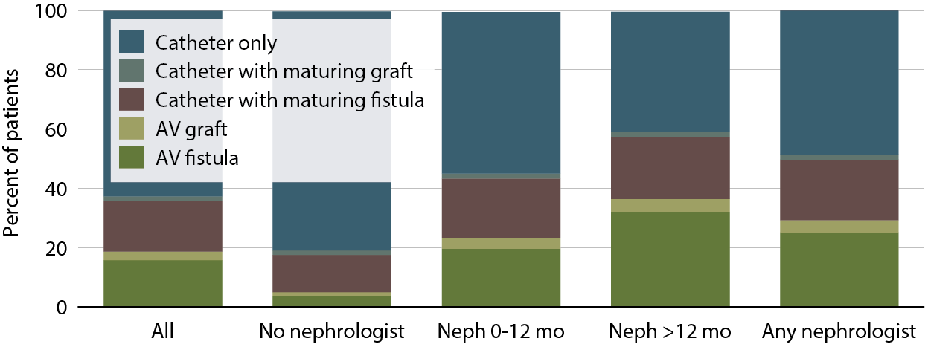
Access use at first outpatient hemodialysis, by pre-ESRD nephrology care, 2011 Figure 1.22 (Volume 2)
Incident hemodialysis patients, 2011.

Slide 18
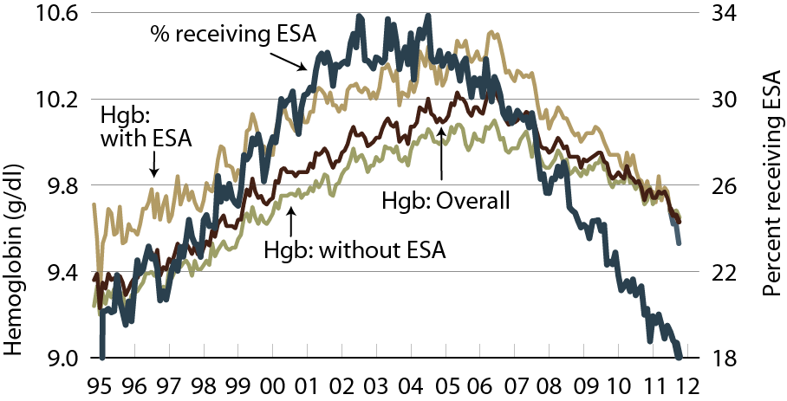
Mean hemoglobin at initiation, by pre-ESRD ESA treatment Figure 1.23 (Volume 2)
Incident ESRD patients.

Slide 19
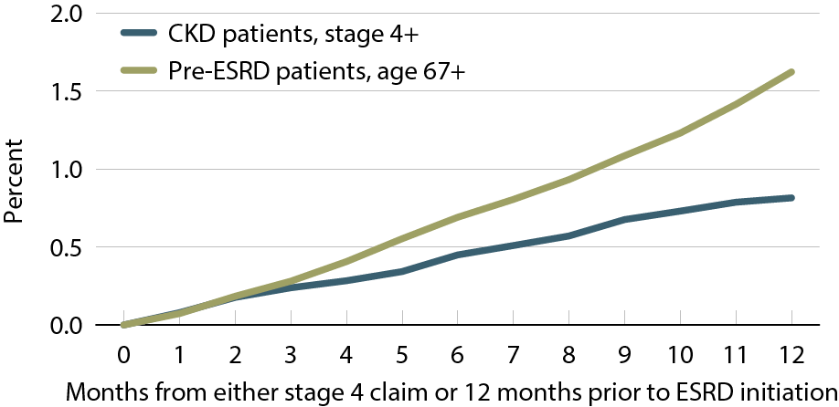
Cumulative percent of receiving the CMS Kidney Disease Education System benefit, 2010–2011 Figure 7.26 (Volume 1)
General Medicare patients with CKD age 65 & older, & Pre-ESRD patients age 67 or older at initiation of ESRD.

Slide 20
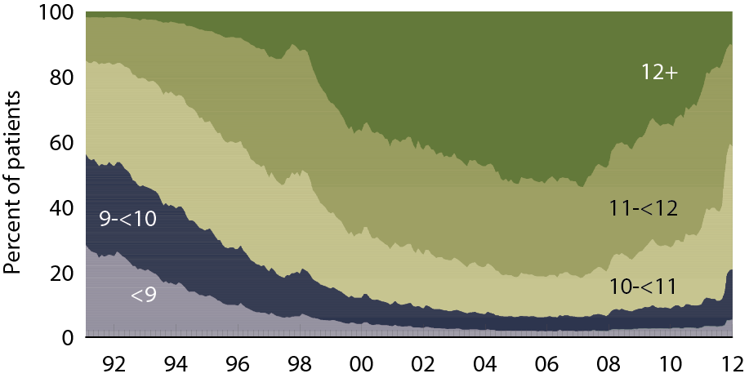
Patient distribution, by mean monthly hemoglobin (g/dl): hemodialysis patients Figure 2.2 (Volume 2)
Period prevalent hemodialysis patients.

Slide 21
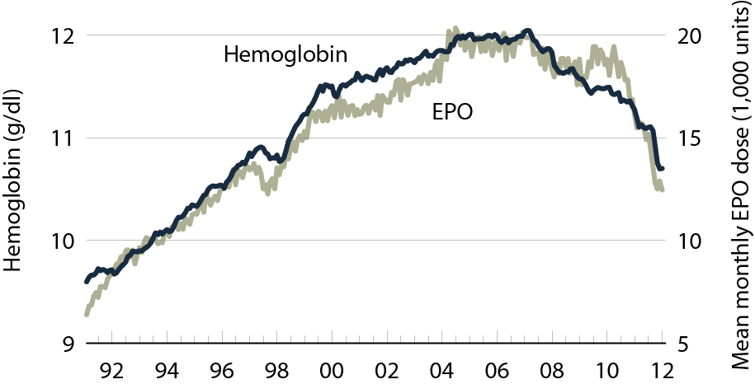
Mean monthly hemoglobin & mean EPO dose per week: hemodialysis patients Figure 2.3 (Volume 2)
Period prevalent hemodialysis patients.

Slide 22
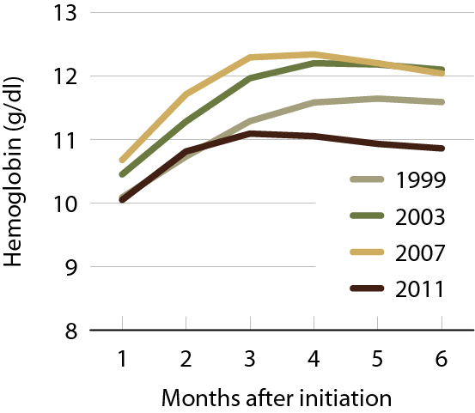
Mean monthly hemoglobin after hemodialysis initiation, by year Figure 2.4 (Volume 2)
Incident hemodialysis patients.

Slide 23
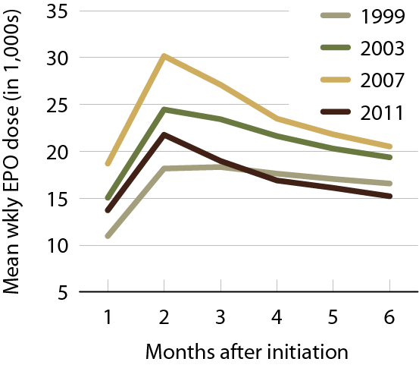
Mean EPO dose per week after hemodialysis initiation, by year Figure 2.5 (Volume 2)
Incident hemodialysis patients.

Slide 24
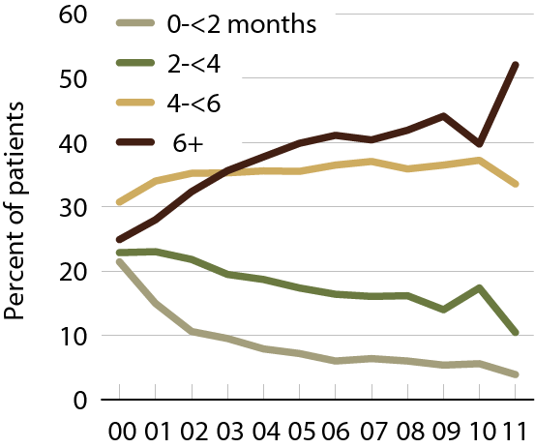
Months with IV iron in the first six months of hemodialysis (EPO-treated patients) Figure 2.6 (Volume 2)
Incident hemodialysis patients.

Slide 25
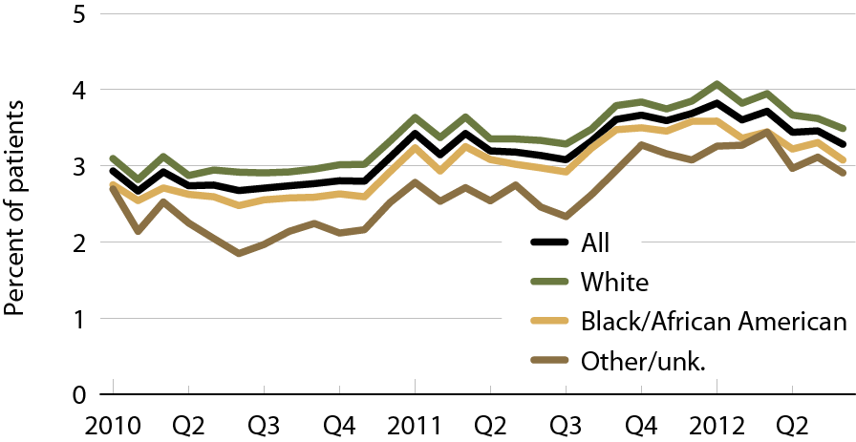
Hemodialysis patients receiving transfusions, by race Figure 2.7 (Volume 2)
Incident hemodialysis patients. (Each month includes patients with a claim for hemodialysis.)

Slide 26
Change in adjusted all-cause & cause- specific hospitalization rates, by modality Figure 3.1 (Volume 2)
Period prevalent ESRD patients. Adj: age/gender/race/primary diagnosis; ref: ESRD patients, 2010.

Slide 27
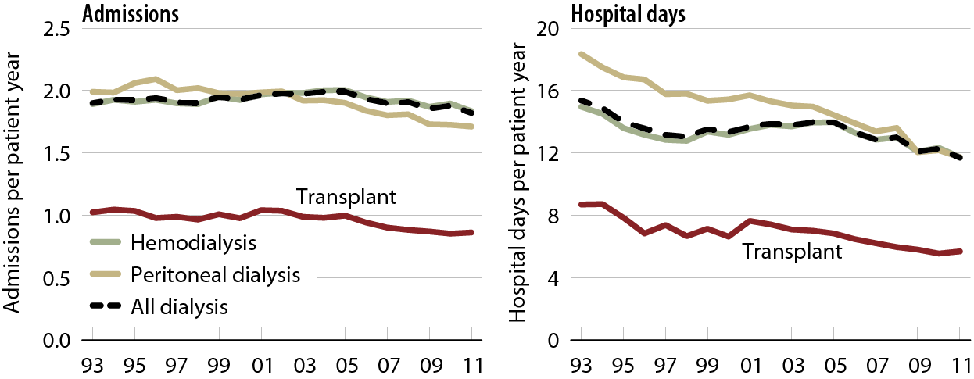
Adjusted all-cause hospital admission rates & days, by modality Figure 3.2 (Volume 2)
Period prevalent ESRD patients. Adj: age/gender/race/primary diagnosis; ref: ESRD patients, 2010.

Slide 28
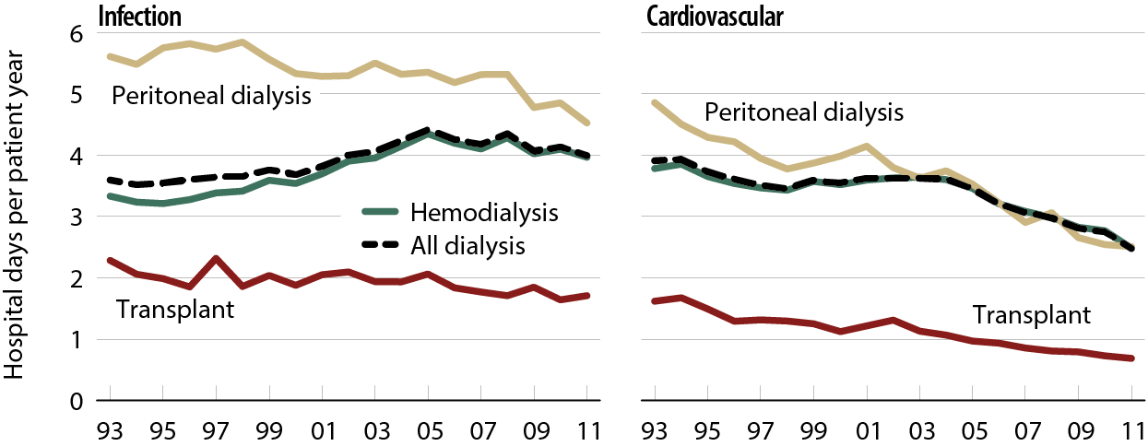
Adjusted infection & cardiovascular hospital days, by modality Figure 3.3 (Volume 2)
Period prevalent ESRD patients. Adj: age/gender/race/primary diagnosis; ref: ESRD patients, 2010.

Slide 29
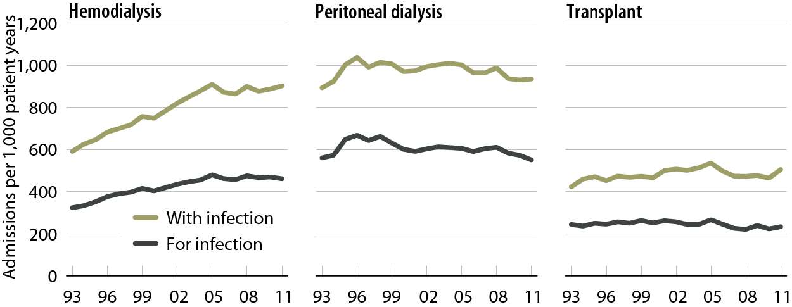
Adjusted rates of hospital admissions, by modality & diagnosis code type: infection Figure 3.4 (Volume 2)
Period prevalent ESRD patients. Adj: age/gender/race/primary diagnosis; ref: ESRD patients, 2010.

Slide 30
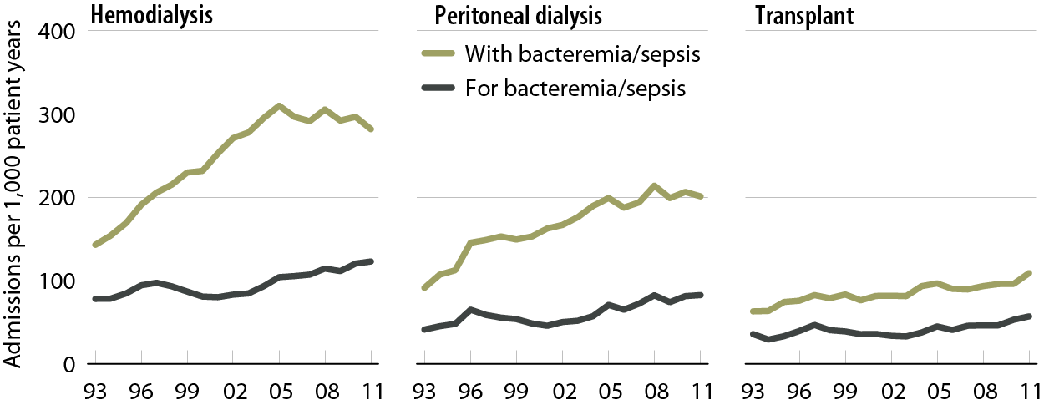
Adjusted rates of hospital admissions, by modality & diagnosis code type: bacteremia/sepsis Figure 3.5 (Volume 2)
Period prevalent ESRD patients. Adj: age/gender/race/primary diagnosis; ref: ESRD patients, 2010.

Slide 31
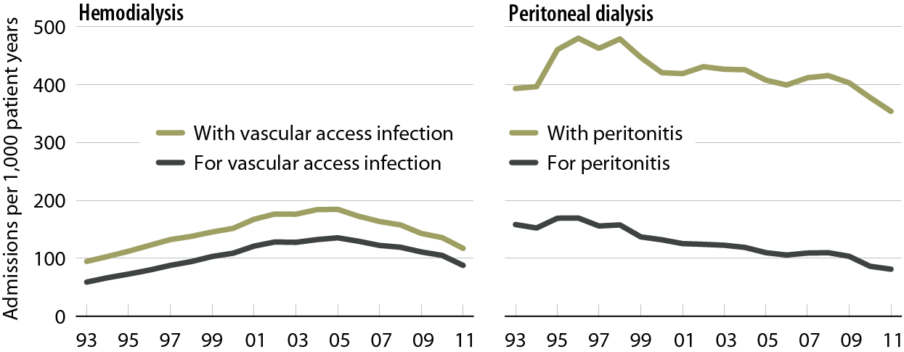
Adjusted rates of hospital admissions, by modality & diagnosis code type: dialysis-related infection Figure 3.6 (Volume 2)
Period prevalent dialysis patients. Adj: age/gender/race/primary diagnosis; ref: ESRD patients, 2010.

Slide 32
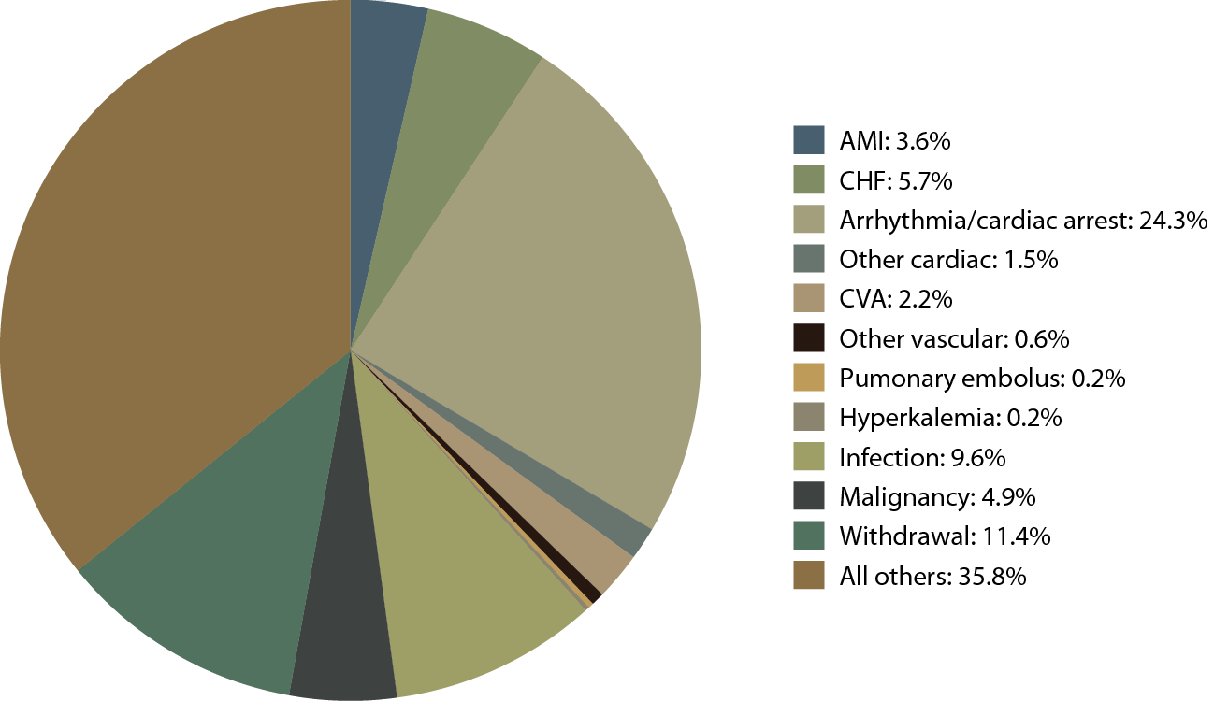
Causes of death in incident dialysis patients, 2009-2011, first 180 days Figure 4.1 (Volume 2)
Incident & prevalent dialysis patients, 2009–2011.

Slide 33
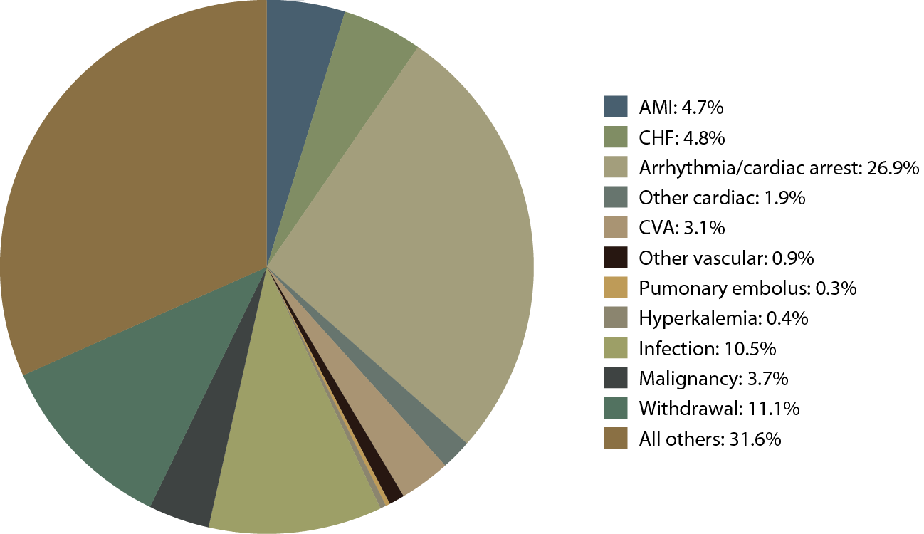
Causes of death in prevalent dialysis patients, 2009-2011 Figure 4.1 (continued; Volume 2)
Incident & prevalent dialysis patients, 2009–2011.

Slide 34
Cardiovascular disease & pharmacological interventions (row percent), by diagnosis & modality, 2011 Table 4.c (Volume 2)
January 1 point prevalent patients with Medicare Parts A, B, & D enrollment with a first cardiovascular diagnosis or procedure in 2011.

Slide 35
Cardiovascular disease & pharmacological interventions (row percent), by diagnosis & modality, 2011 Table 4.c (continued; Volume 2)
January 1 point prevalent patients with Medicare Parts A, B, & D enrollment with a first cardiovascular diagnosis or procedure in 2011.

Slide 36
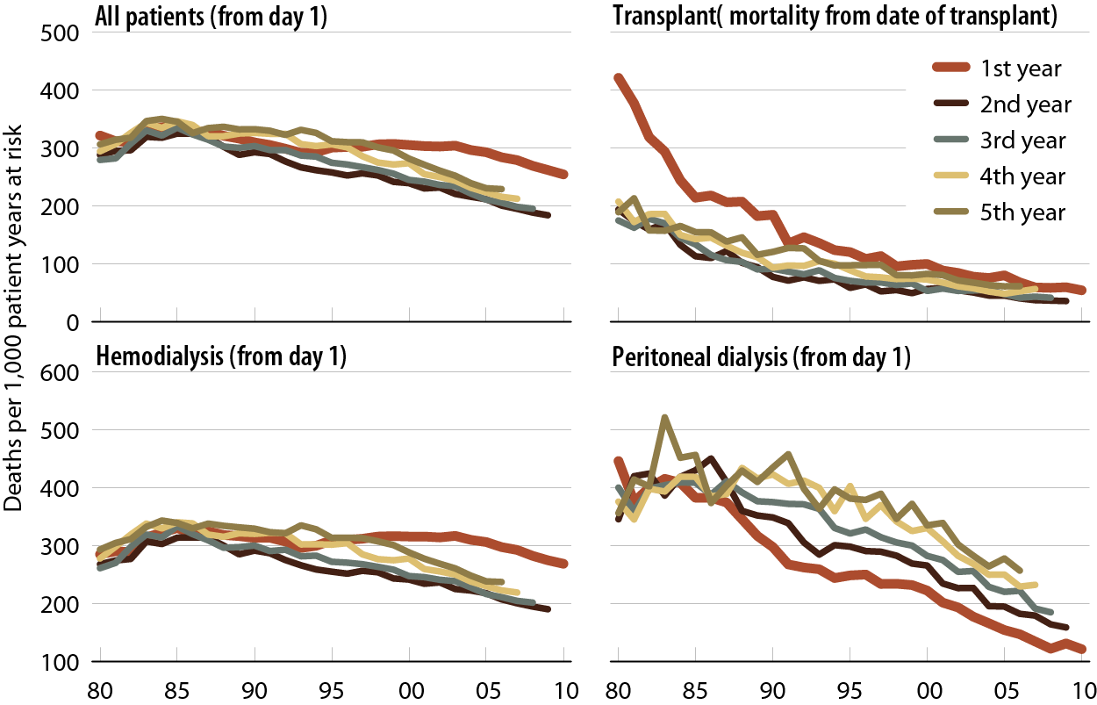
Adjusted all-cause mortality rates (from day 1 and day 90), by modality & year of treatment Figure 5.1 (Volume 2)
Incident ESRD patients. Adj: age/gender/race /primary diagnosis; ref: incident ESRD patients, 2010.

Slide 37
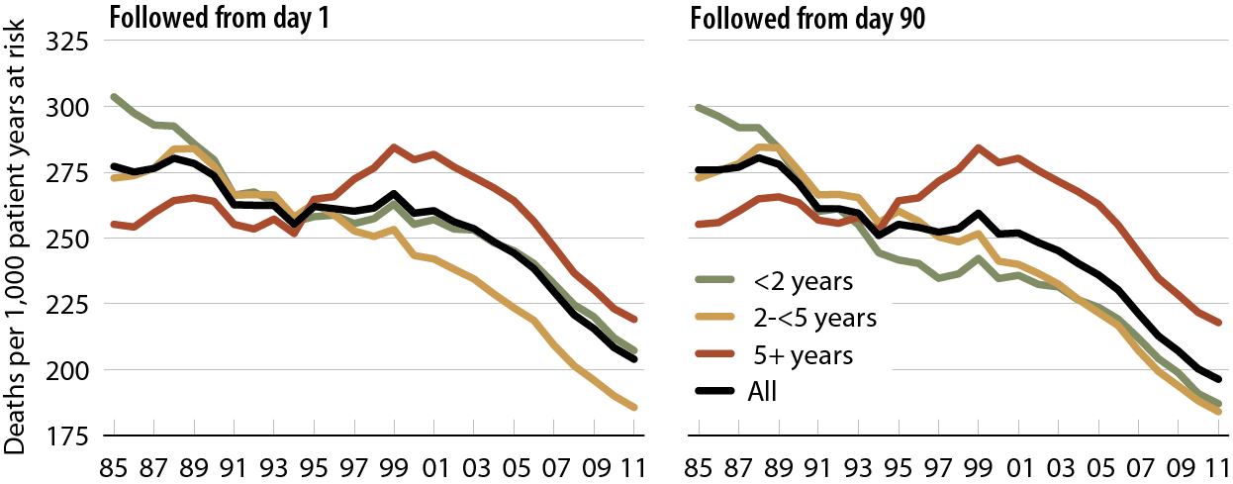
Adjusted all-cause mortality in prevalent hemodialysis patients, by vintage Figure 5.4 (Volume 2)
Period prevalent dialysis patients defined on day one or day 90 of dialysis. Adj: age/gender/race/primary diagnosis. Ref: incident hemodialysis patients, 2010.

Slide 38
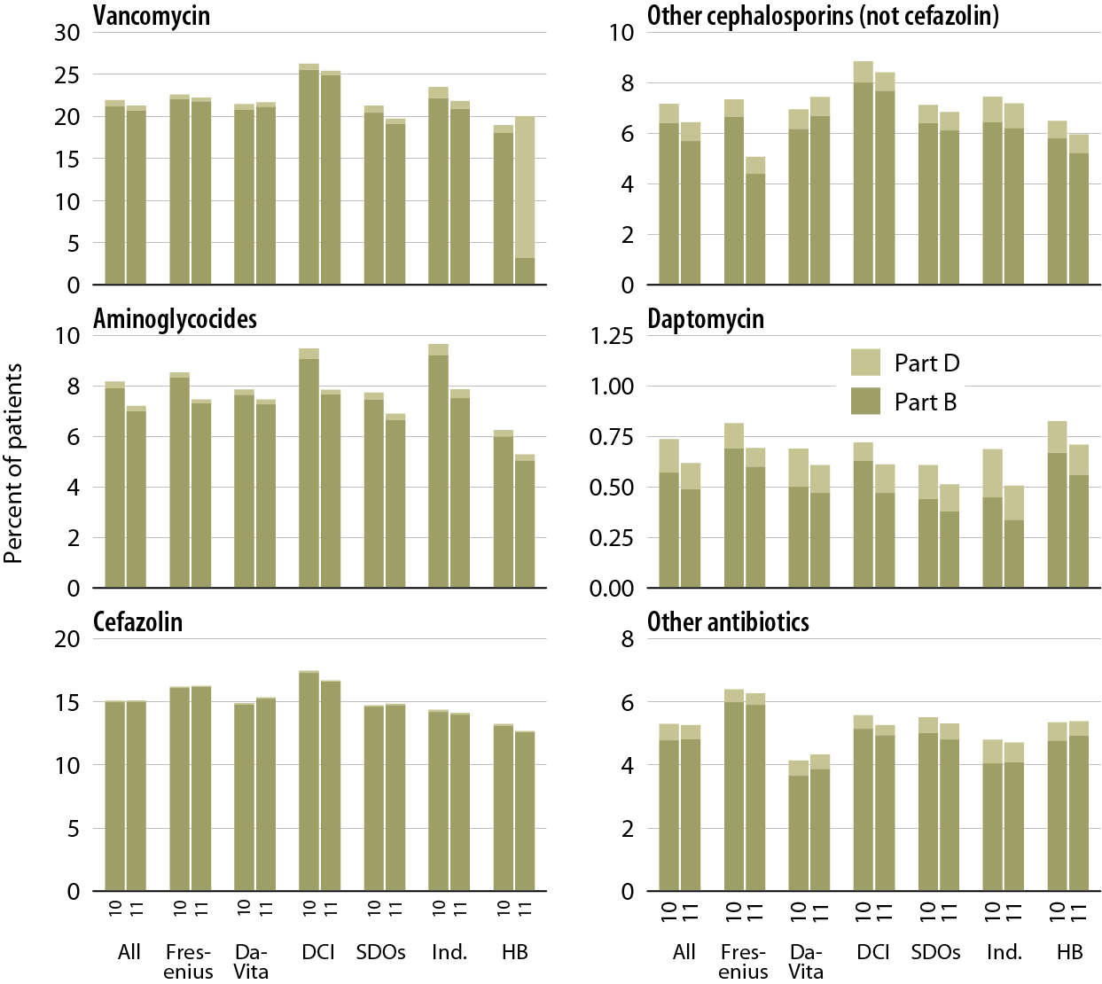
Patients receiving intravenous antibiotics under Medicare Parts B & D pre- & post-dialysis bundle, by unit affiliation Figure 6.14 (Volume 2)
Point prevalent Medicare enrollees alive on January 1.

Slide 39
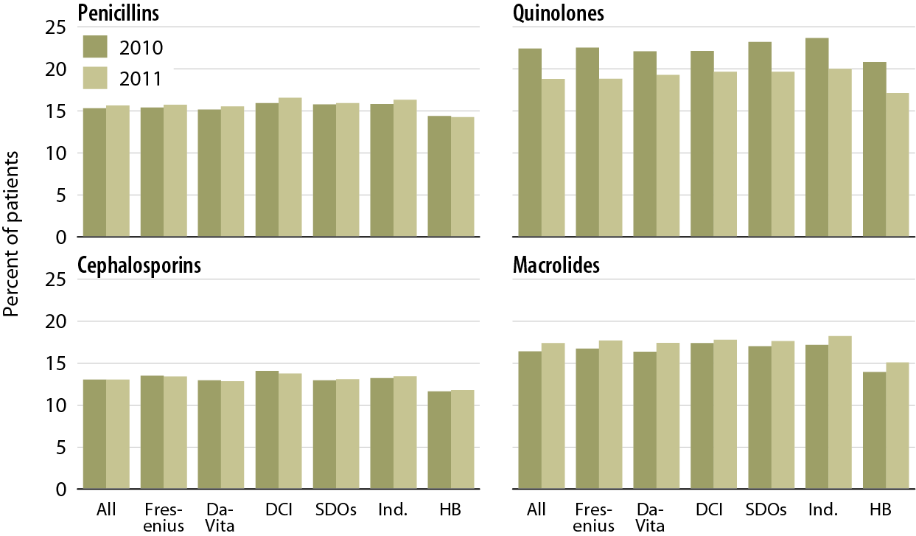
Patients receiving oral antibiotics under Medicare Parts B & D pre- & post-dialysis bundle, by unit affiliation Figure 6.15 (Volume 2)
Point prevalent Medicare enrollees alive on January 1.

Slide 40
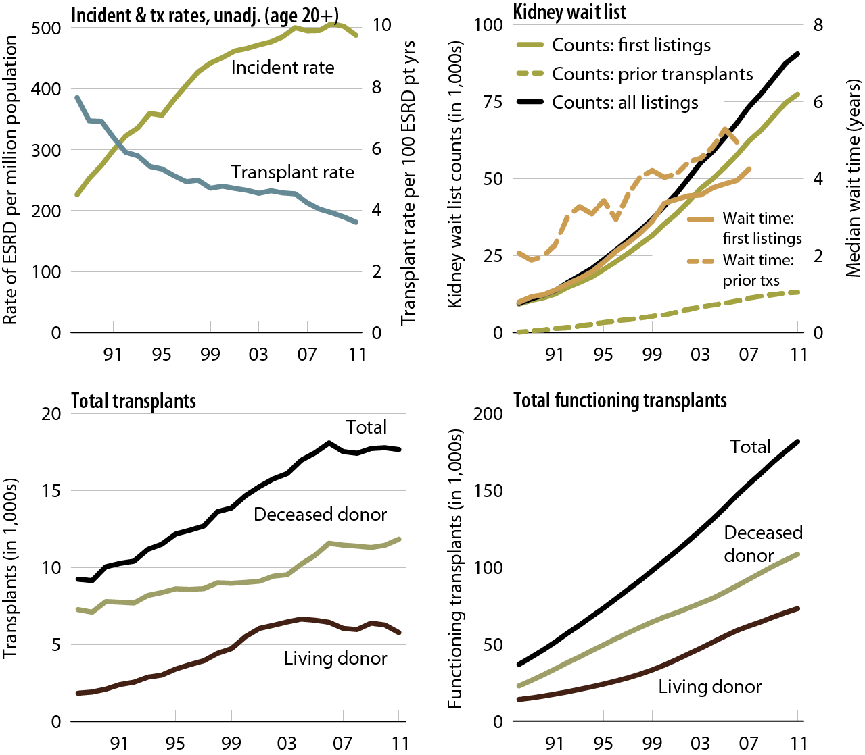
Trends in transplantation: unadjusted rates, wait list, & total & functioning transplants Figure 7.1 (Volume 2)
Unadjusted incident & transplant rates: limited to ESRD patients age 20 & older, thus yielding a computed incident rate higher than the overall rate presented elsewhere in the Annual Data Report. Wait list counts: all patients listed for a kidney or kidney-pancreas transplant on December 31 of each year. Wait time: all patients entering wait list in the given year. Transplant counts: all patients known to the USRDS. Functioning transplant: annual status of all patients who received a kidney or kidney-pancreas transplant, regardless of transplant date.

Slide 41
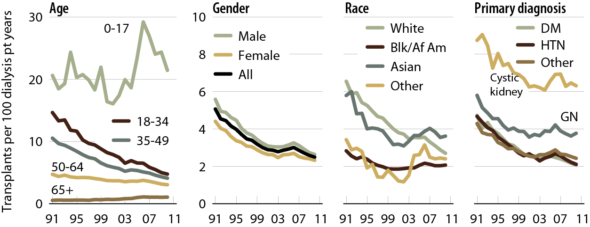
Adjusted transplant rates, by age, gender, race, & primary diagnosis: deceased donors Figure 7.13 (Volume 2)
Adj: age/gender/race/ethnicity/primary diagnosis (rates by one factor adjusted for remaining four).

Slide 42
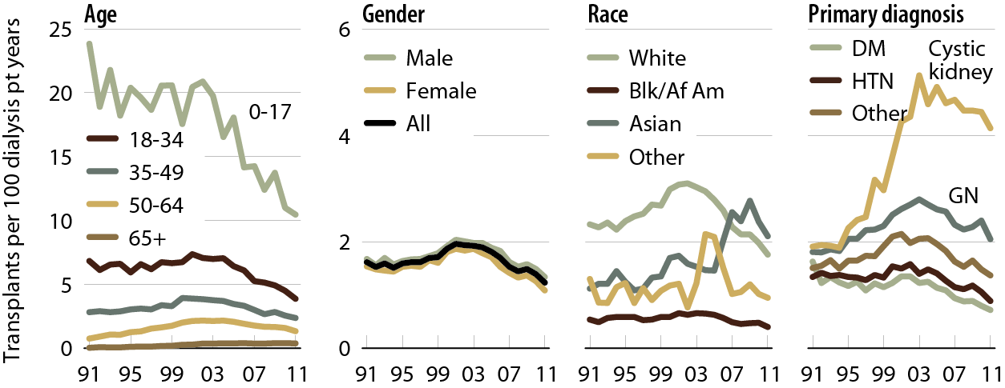
Adjusted transplant rates, by age, gender, race, & primary diagnosis: living donors Figure 7.15 (Volume 2)
Patients age 18 & older. Adj: age/gender/race/ethnicity/primary diagnosis (rates by one factor adjusted for remaining four).

Slide 43
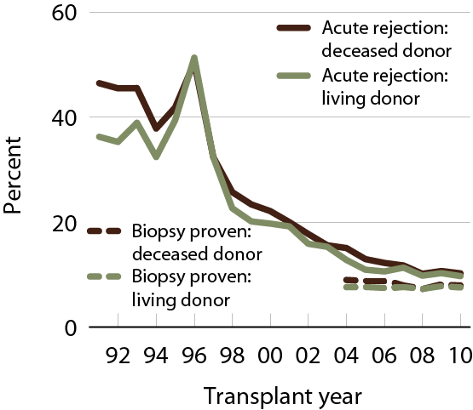
Acute rejection within the first year post-transplant Figure 7.19 (Volume 2)
Patients age 18 & older with a functioning graft at discharge.

Slide 44
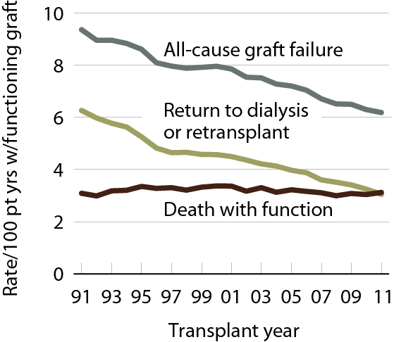
Adjusted rate of outcomes after transplant Figure 7.25 (Volume 2)
Patients age 18 & older at transplant; adj: age/gender/race.

Slide 45
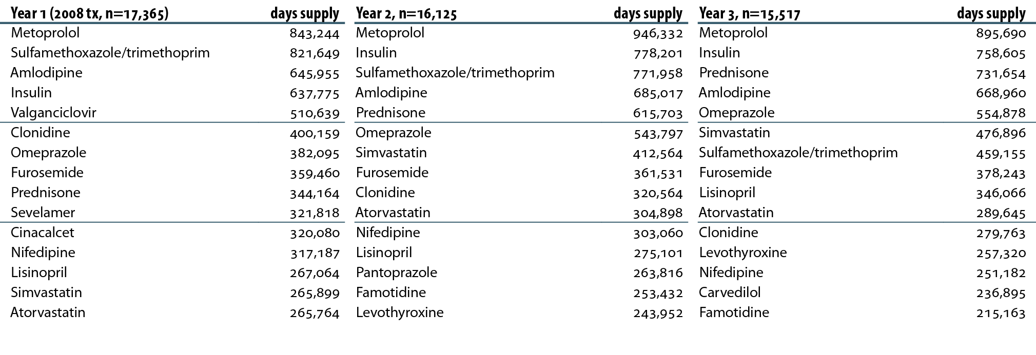
Top 15 medications used by Part D-enrolled kidney recipients transplanted in 2008, by days supply Table 7.a (Volume 2)
Patients enrolled in Medicare Part D & transplanted in 2008. Costs are estimated Medicare payment, defined as the sum of plan covered payment amount & low income subsidy amount. “Year 1” is the period from transplant to one year later. Years 2 & 3 are similarly defined.

Slide 46
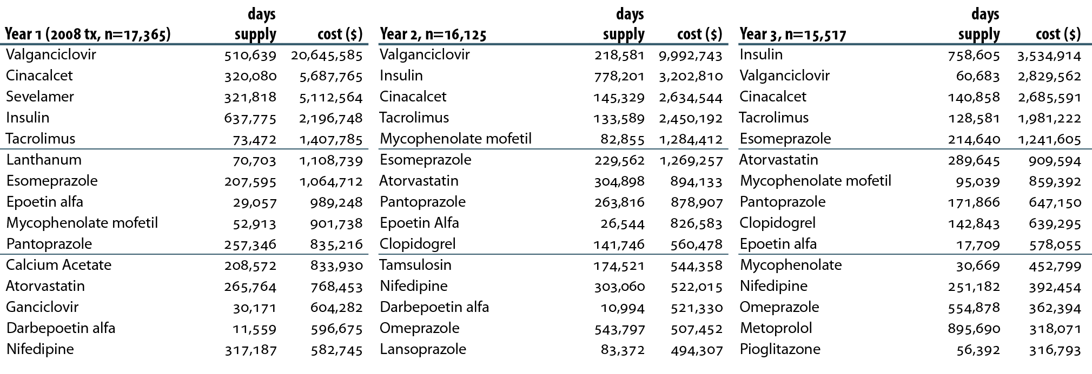
Top 15 medications used by Part D-enrolled kidney recipients transplanted in 2008, by days supply & cost Table 7.b (Volume 2)
Patients enrolled in Medicare Part D & transplanted in 2008. Costs are estimated Medicare payment, defined as the sum of plan covered payment amount & low income subsidy amount. “Year 1” is the period from transplant to one year later. Years 2 & 3 are similarly defined.

Slide 47
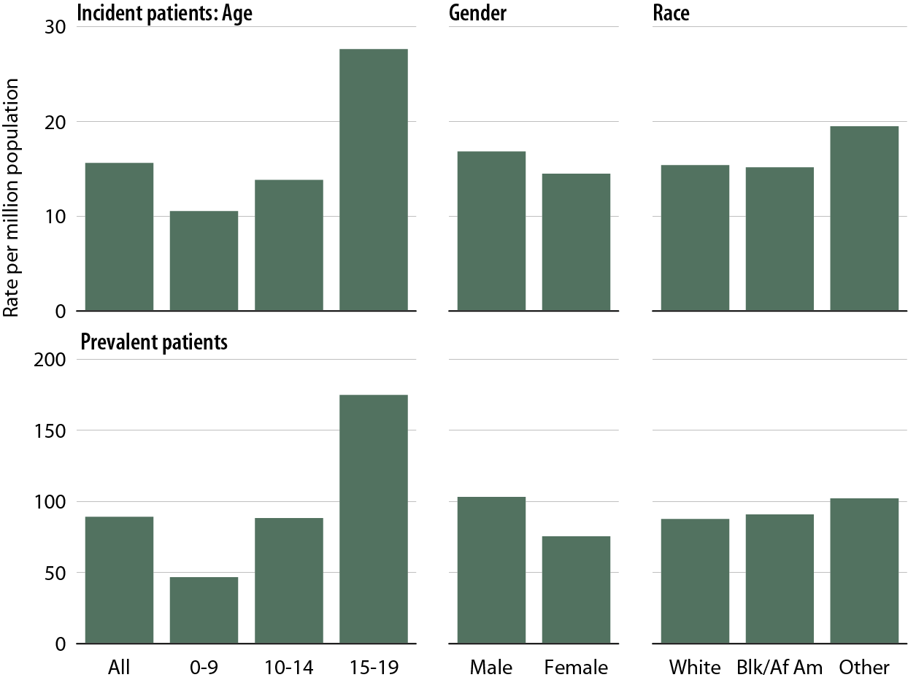
Adjust incident & prevalent rates for pediatric ESRD patients, by age, gender, & race Figure 8.1 (Volume 2)
Incident & prevalent ESRD patients age 0–19, 2011. Adj: rates by age adjusted for gender & race, rates by gender adjusted for age & race, rates by race adjusted for age & gender.

Slide 48
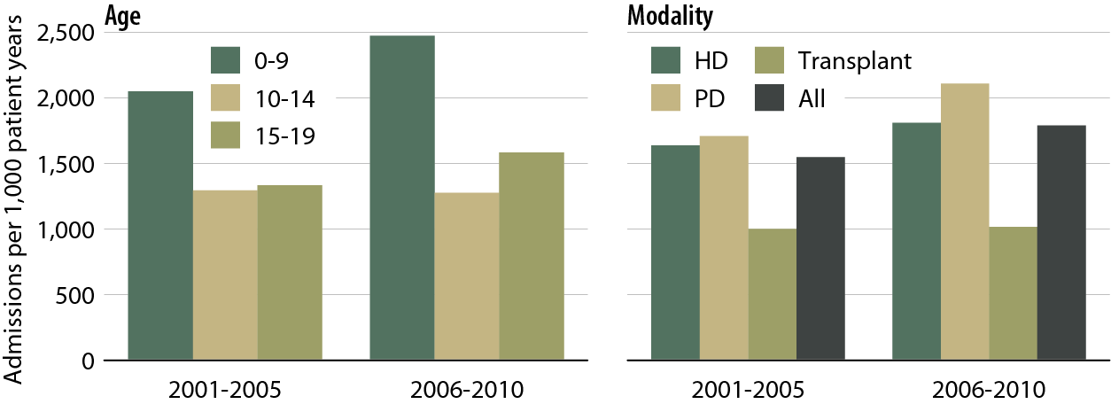
One-year adjusted all-cause hospitalization rates in pediatric patients (from day 90), by age & modality Figure 8.7 (Volume 2)
Incident ESRD patients age 0–19, 2001–2010. Adj: gender/race/Hispanic ethnicity/primary diagnosis. Ref: incident ESRD patients age 0–19, 2009–2010. Included patients survived the first 90 days after ESRD initiation & are followed from day 90.

Slide 49
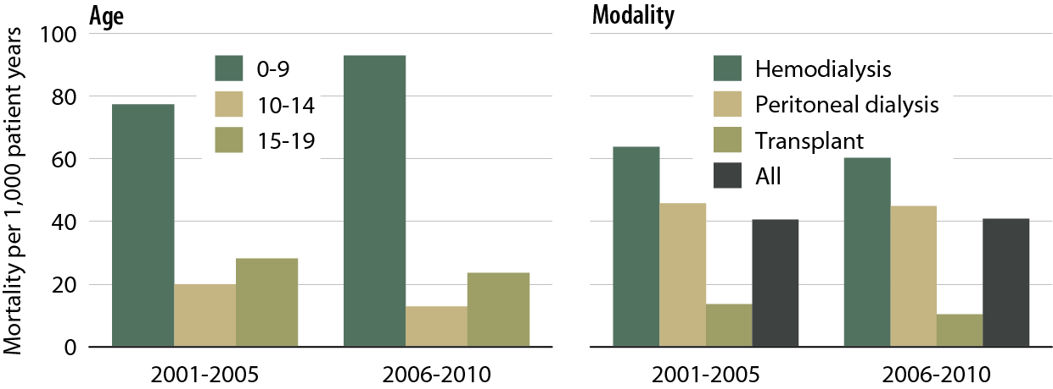
One-year adjusted all-cause mortality rates in pediatric patients (from day one), by age & modality Figure 8.10 (Volume 2)
Incident dialysis & transplant patients defined at the onset of dialysis or the day of transplant without the 60-day rule; followed to December 31, 2011. Adj: age/gender/race/Hispanic ethnicity/primary diagnosis. Ref: incident ESRD patients age 0–19, 2009–2010.

Slide 50
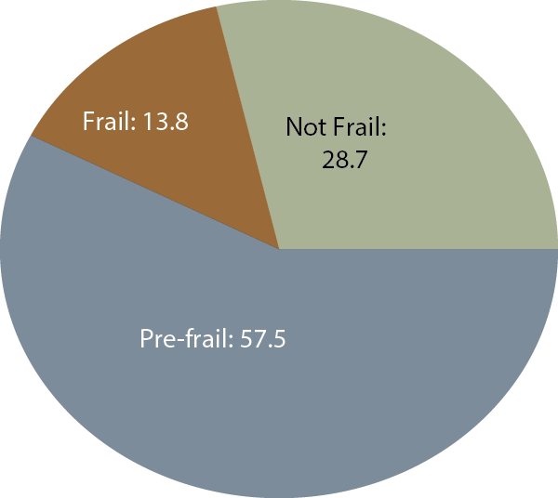
Distribution of patients based on Fried Frailty Index Figure 9.1 (Volume 2)

Slide 51
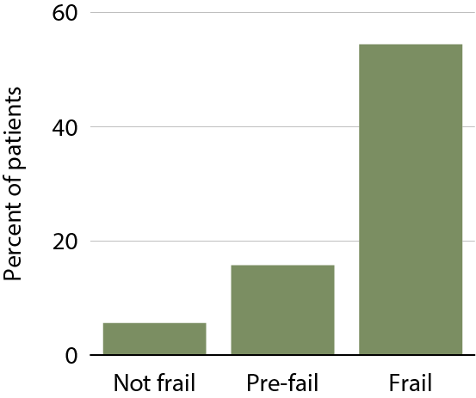
Patients needing assistance with activities of daily living, by frailty status Figure 9.3 (Volume 2)

Slide 52
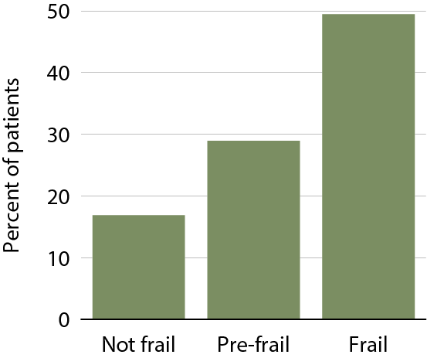
Patient falls, by frailty status Figure 9.7 (Volume 2)

Slide 53
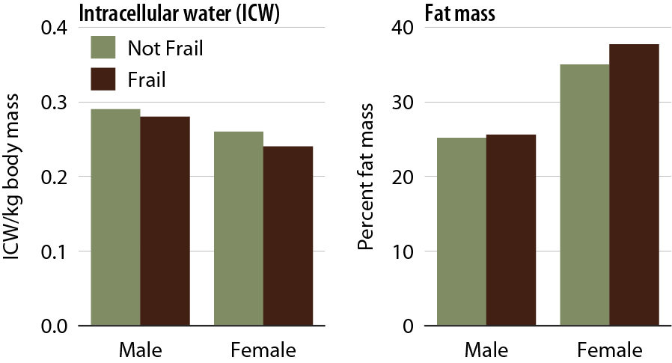
Association of frailty with body composition, by gender Figure 9.10 (Volume 2)

Slide 54
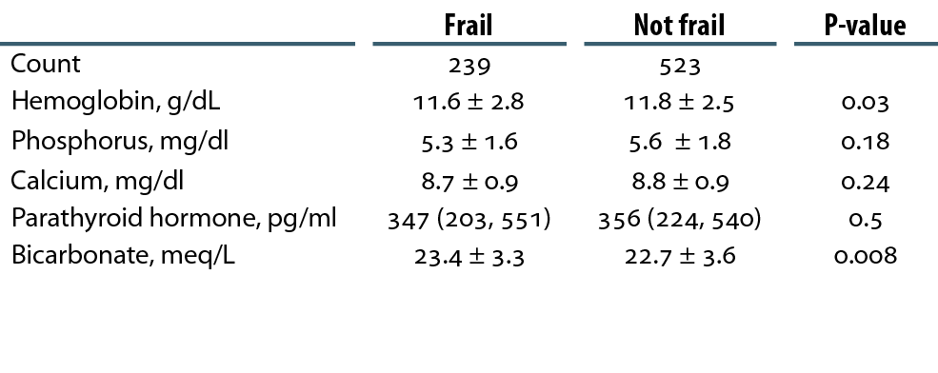
Association of frailty with anemia, bone & mineral metabolism, & serum bicarbonate level* Table 9.d (Volume 2)
*Mean +/- S.D. or median (25th & 75th percentile).

Slide 55
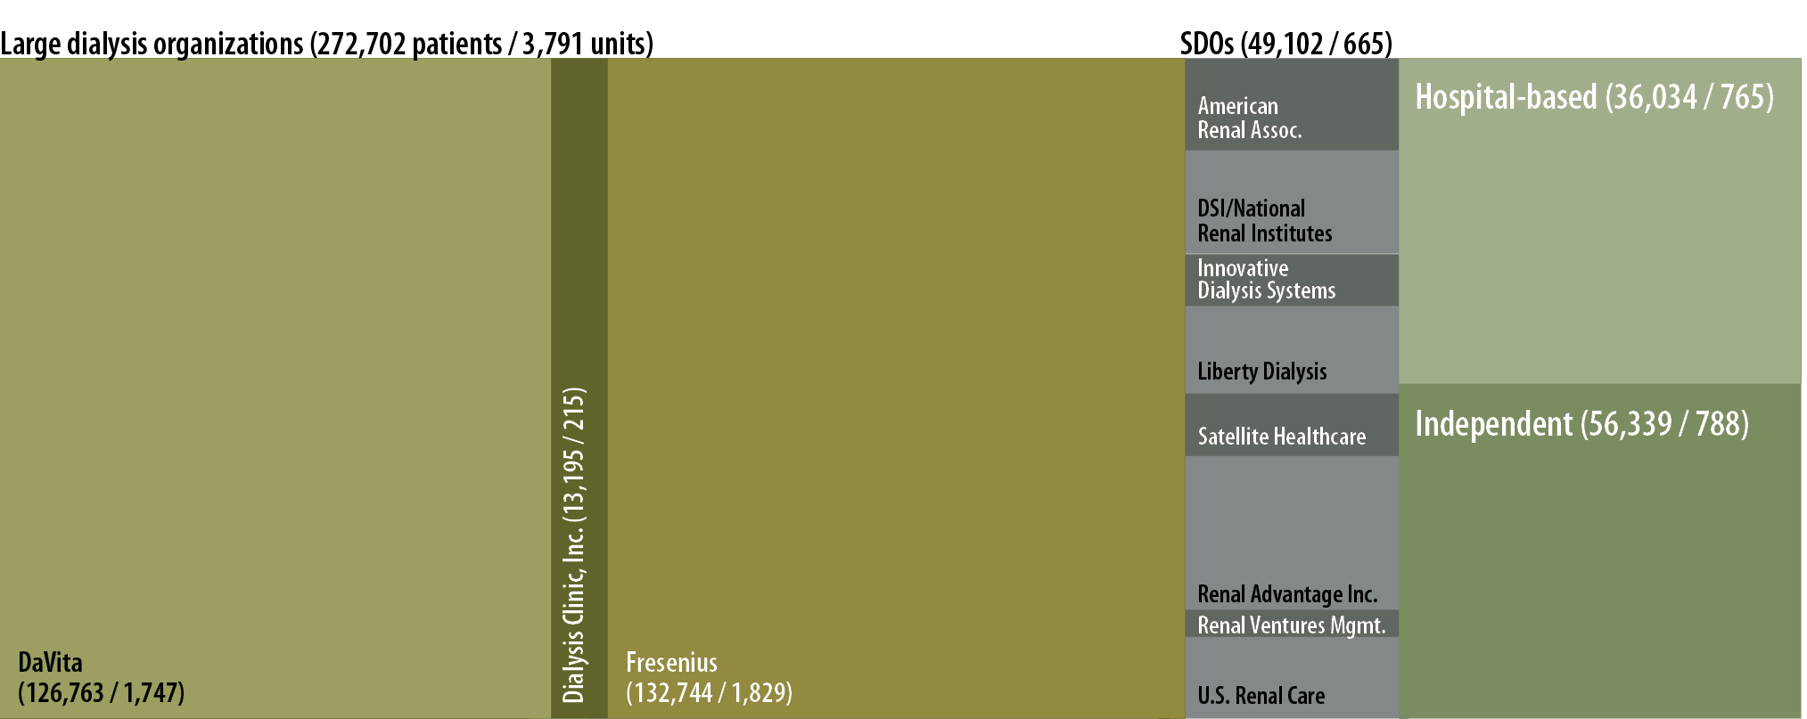
Distribution of patients, by unit affiliation, 2011 Figure 10.1 (Volume 2)
CMS Annual Facility Survey, 2011.

Slide 56
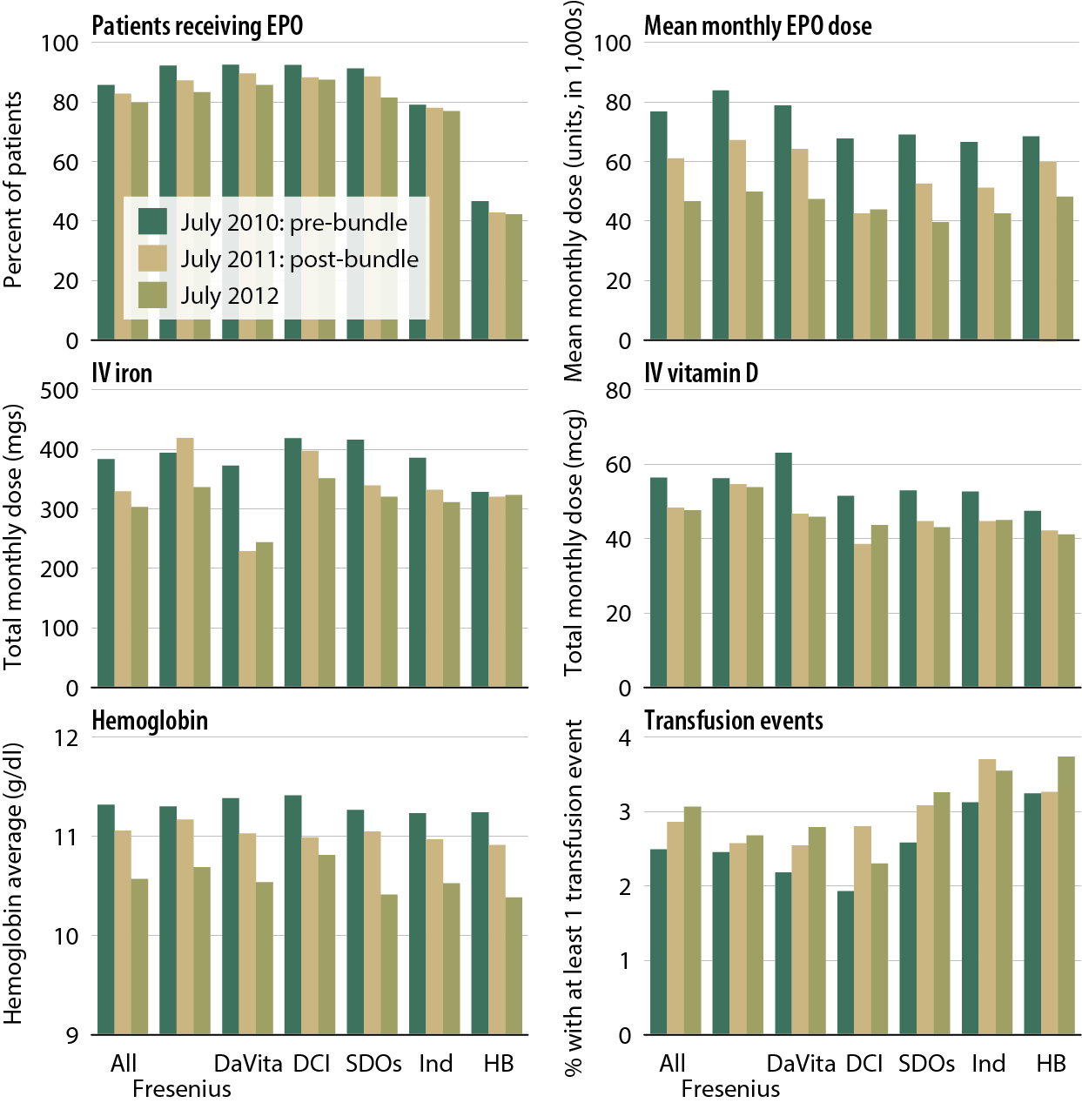
Total monthly dose of anemia treatment therapeutics, hemoglobin levels, & transfusion events, pre- & post- dialysis bundle, by unit affiliation Figure 10.7 (Volume 2)
Point prevalent dialysis patients.

Slide 57
Distribution of providers opting into the new dialysis composite rate, 2012 Table 10.a (Volume 2)

Slide 58
Geographic variations in the percentage of patients with at least one transfusion, by HSA: July, 2010 Figure 10.8 (Volume 2)
Period prevalent dialysis patients.

Slide 59
Geographic variations in the percentage of patients with at least one transfusion, by HSA: July, 2011 Figure 10.8 (Volume 2, continued)
Period prevalent dialysis patients.

Slide 60
Geographic variations in the percentage of patients with at least one transfusion, by HSA: July, 2012 Figure 10.8 (Volume 2, continued)
Period prevalent dialysis patients.

Slide 61
All-cause standardized hospitalization & mortality ratios, by unit affiliation, 2010 & 2011 Figure 10.9 (Volume 2)
January 1 point prevalent hemodialysis patients with Medicare as primary payor (SHRs); January 1 point prevalent hemodialysis patients (SMRS). SHRS & SMRS are calculated based on national hospitalization & death rates; adjusted for age, gender, race, & dialysis vintage.

Slide 62
Total Medicare ESRD expenditures per person per year, by modality Figure 11.7 (Volume 2)
Period prevalent ESRD patients; patients with Medicare as secondary payor are excluded.

Slide 63
Total Part D net costs, by low income subsidy (LIS) status & modality, 2011 Figure 11.10 (Volume 2)
Part D-enrolled general Medicare patients from the 5 percent sample & period prevalent dialysis & transplant patients, 2011.

Slide 64
Total per person per year Part D net & out-of pocket costs, by low income subsidy (LIS) status, 2011 Figure 11.11 (Volume 2)
Part D-enrolled general Medicare patients from the 5 percent sample & period prevalent dialysis & transplant patients, 2011.

Slide 65
Total per person per year (PPPY) Part D costs, by low income subsidy (LIS) status, & provider, 2011 Figure 11.12 (Volume 2)
Part D-enrolled dialysis patients, 2011.

Slide 66
Total per person per year (PPPY) Part D costs for phosphate binders, by provider, 2011 Figure 11.13 (Volume 2)
Part D-enrolled dialysis patients, 2011.

Slide 67
Total per person per year (PPPY) Part D costs for cinacalcet, by provider, 2011 Figure 11.14 (Volume 2)
Part D-enrolled dialysis patients, 2011.

