Slide 1
ESRD: Chapter Two Clinical indicators & preventive care
United States Renal Data System
2013 Annual Data Report

Slide 2
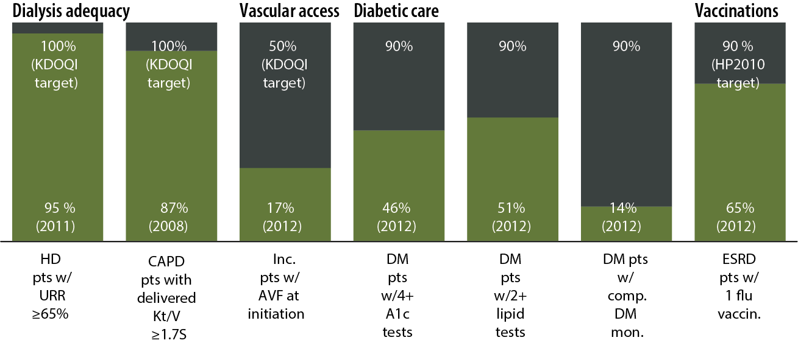
Quality indicators: percentage of patients meeting clinical & preventive care guidelines Figure 2.1 (Volume 2)

Slide 3
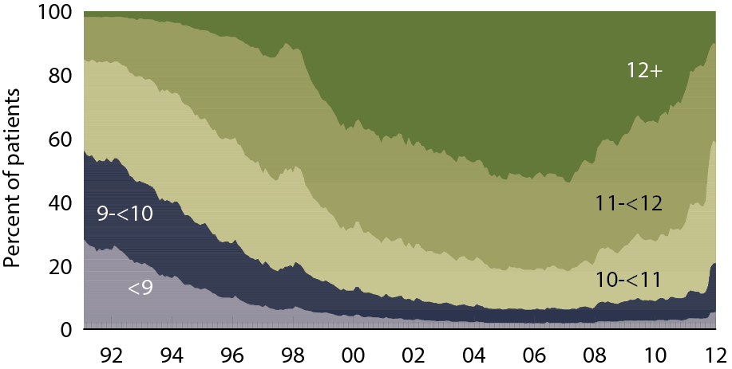
Patient distribution, by mean monthly hemoglobin (g/dl): hemodialysis patients Figure 2.2 (Volume 2)
Period prevalent hemodialysis patients.

Slide 4
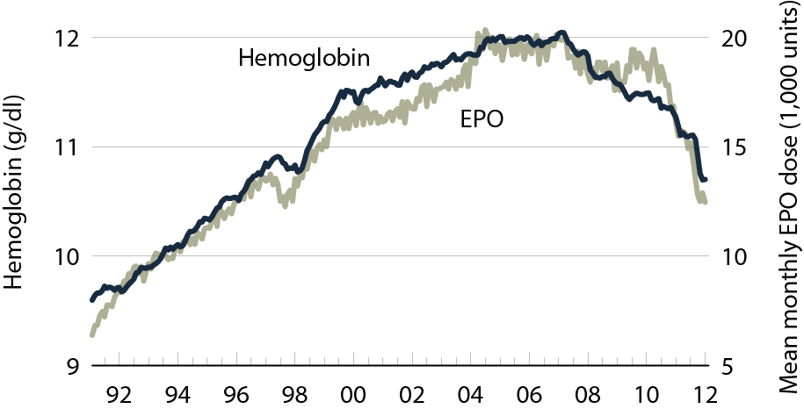
Mean monthly hemoglobin & mean EPO dose per week: hemodialysis patients Figure 2.3 (Volume 2)
Period prevalent hemodialysis patients.

Slide 5
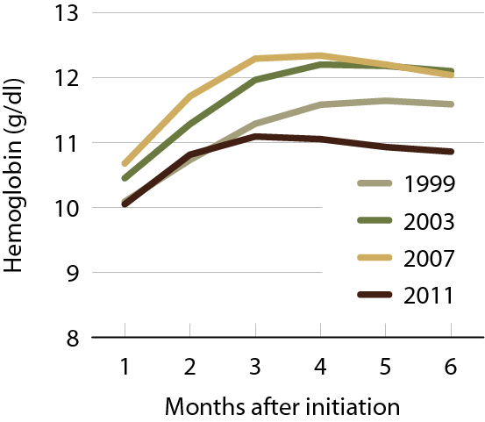
Mean monthly hemoglobin after hemodialysis initiation, by year Figure 2.4 (Volume 2)
Incident hemodialysis patients.

Slide 6
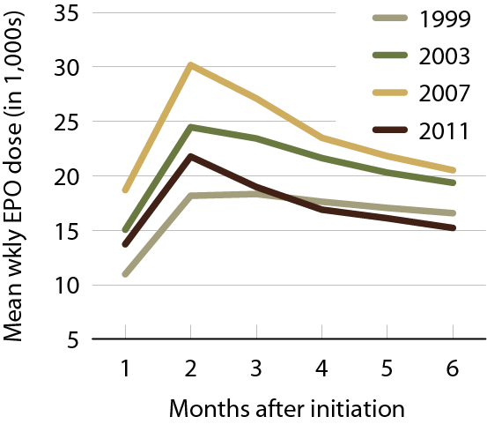
Mean EPO dose per week after hemodialysis initiation, by year Figure 2.5 (Volume 2)
Incident hemodialysis patients.

Slide 7
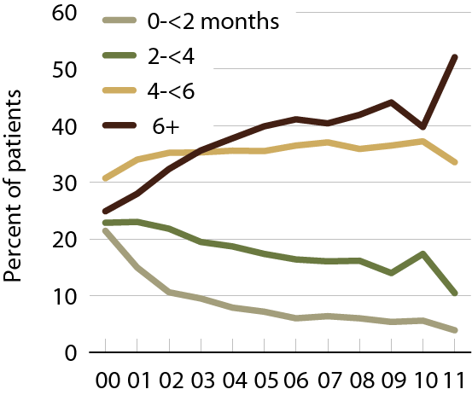
Months with IV iron in the first six months of hemodialysis (EPO-treated patients) Figure 2.6 (Volume 2)
Incident hemodialysis patients.

Slide 8
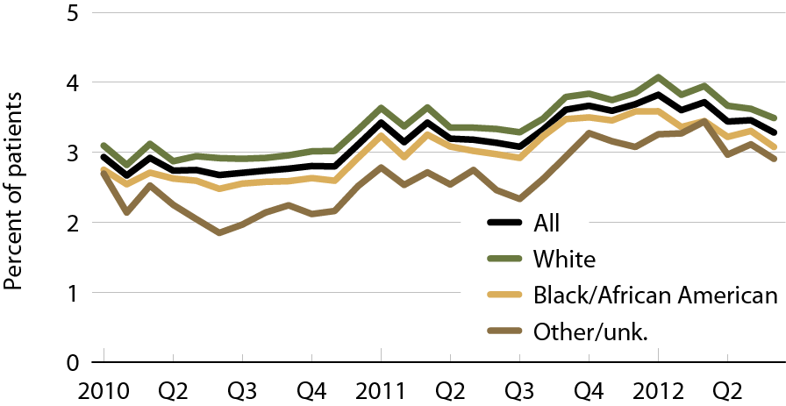
Hemodialysis patients receiving transfusions, by race Figure 2.7 (Volume 2)
Incident hemodialysis patients. (Each month includes patients with a claim for hemodialysis.)

Slide 9
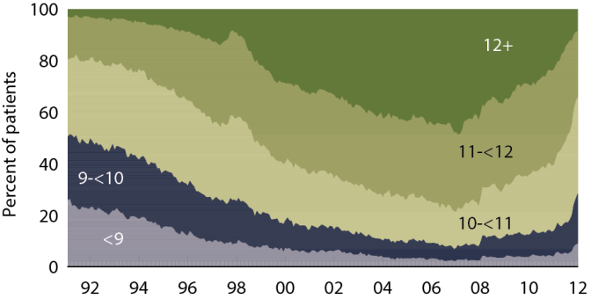
Patient distribution, by mean monthly hemoglobin (g/dl): peritoneal dialysis patients Figure 2.8 (Volume 2)
Period prevalent peritoneal dialysis patients.

Slide 10
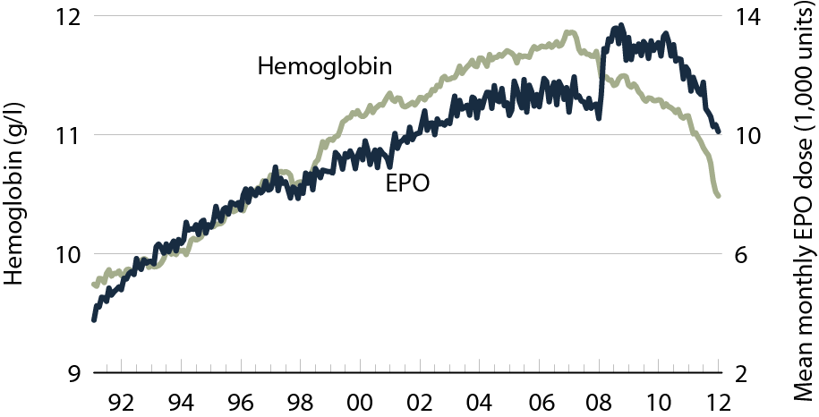
Mean monthly hemoglobin & mean EPO dose per week: peritoneal dialysis patients Figure 2.9 (Volume 2)
Incident peritoneal dialysis patients.

Slide 11
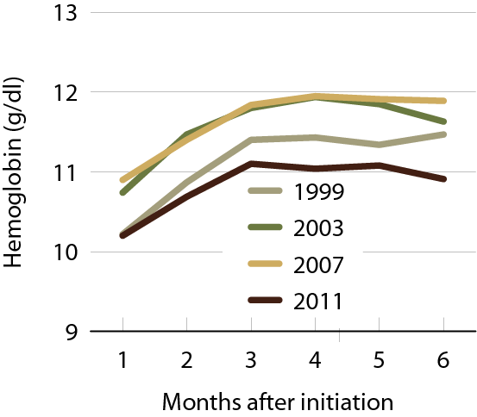
Mean monthly hemoglobin after peritoneal dialysis initiation, by year Figure 2.10 (Volume 2)
Incident peritoneal dialysis patients.

Slide 12
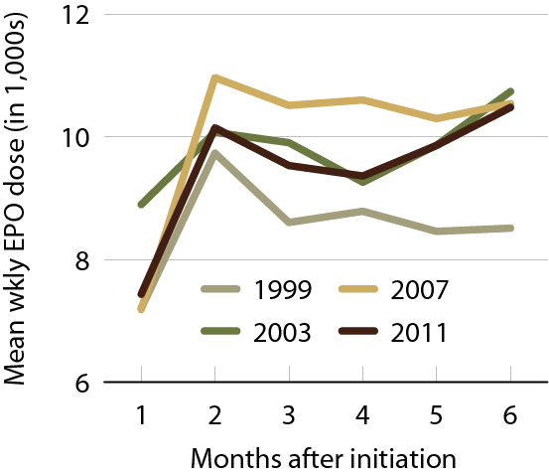
Mean EPO dose per week after peritoneal dialysis initiation, by year Figure 2.11 (Volume 2)
Incident peritoneal dialysis patients, adjusted for inpatient days.

Slide 13
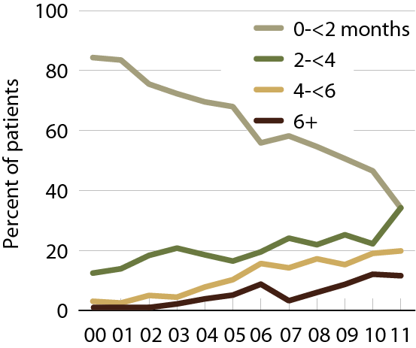
Months with IV iron in the first six months of peritoneal dialysis (EPO-treated patients) Figure 2.12 (Volume 2)
Incident peritoneal dialysis patients.

Slide 14
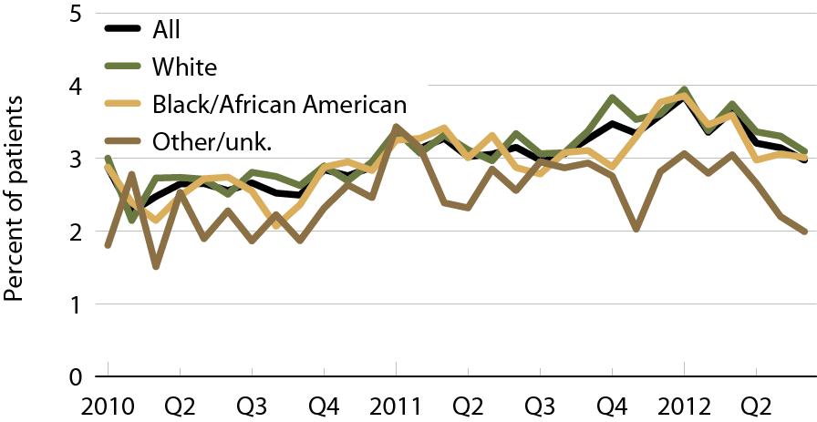
Peritoneal dialysis patients receiving transfusions, by race Figure 2.13 (Volume 2)
Incident peritoneal dialysis patients. (Each month includes patients with a claim for peritoneal dialysis.)

Slide 15
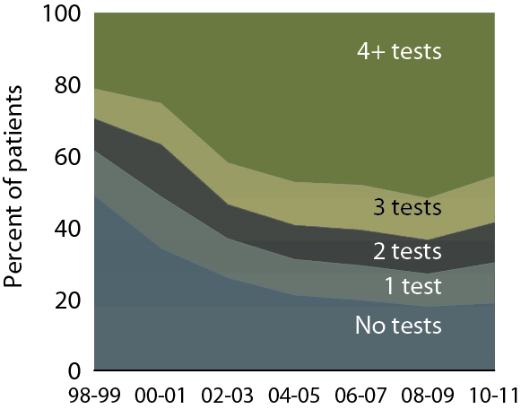
A1c testing in ESRD patients with diabetes, by number of tests Figure 2.14 (Volume 2)
Point prevalent Medicare ESRD patients with diabetes, age 18–75.

Slide 16
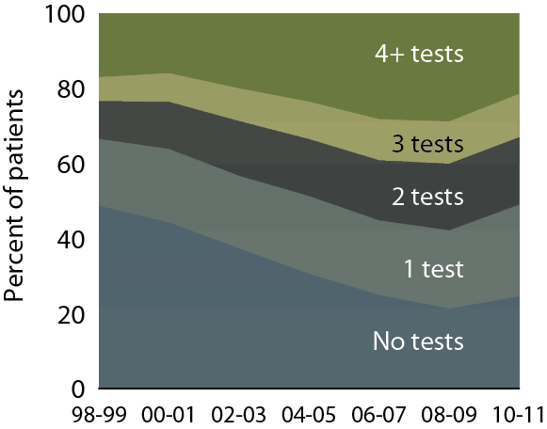
Lipid testing in ESRD patients with diabetes, by number of tests Figure 2.15 (Volume 2)
Point prevalent Medicare ESRD patients with diabetes, age 18–75.

Slide 17
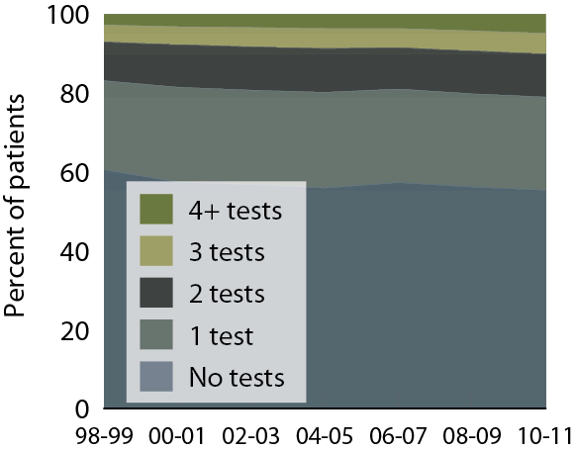
Diabetic eye examinations in ESRD patients with diabetes, by number of tests Figure 2.16 (Volume 2)
Point prevalent Medicare ESRD patients with diabetes, age 18–75.

Slide 18
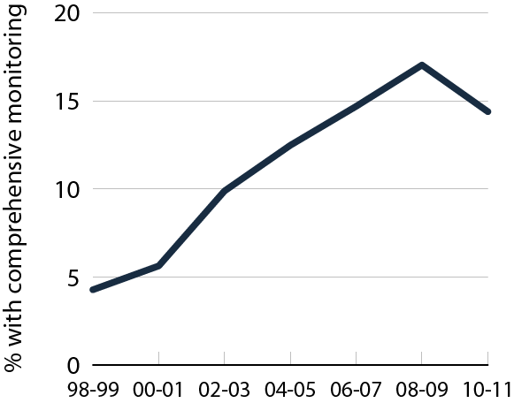
Comprehensive diabetic monitoring in ESRD patients with diabetes Figure 2.17 (Volume 2)
Point prevalent Medicare ESRD patients with diabetes, age 18–75; monitoring tracked in second year.

Slide 19
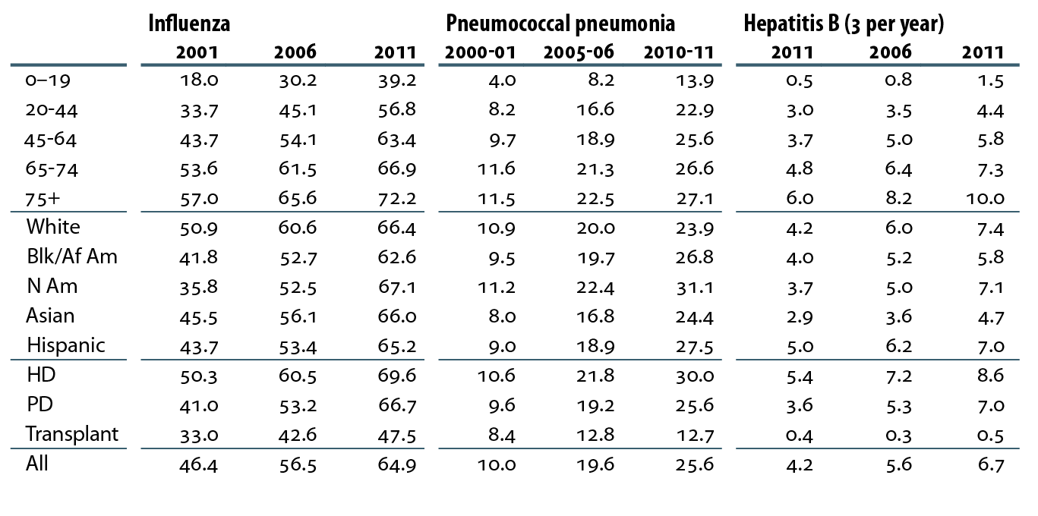
Vaccination rates (percent), by age, race/ethnicity, & modality Table 2.a (Volume 2)
ESRD patients initiating treatment at least 90 days before tracking period: September 1–December 31 for influenza, a two-year period for pneumococcal pneumonia, yearly for hepatitis B; patients alive on the period’s last day & vaccinations tracked during the period.

Slide 20
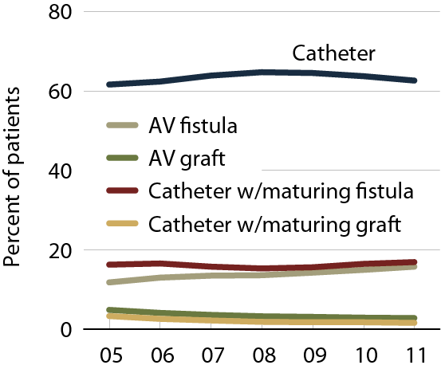
Vascular access at first outpatient dialysis Figure 2.18 (Volume 2)
Incident hemodialysis patients.

Slide 21
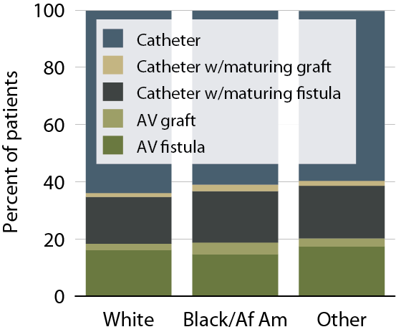
Vascular access use at initiation, by race, 2011 Figure 2.19 (Volume 2)
Incident hemodialysis patients, 2011.

Slide 22
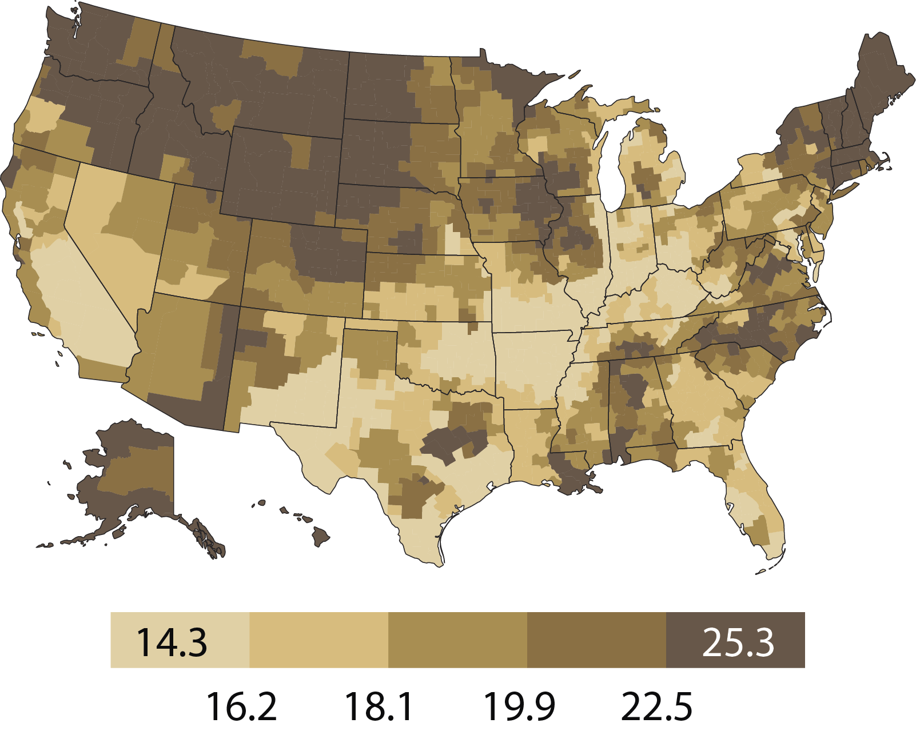
Geographic variations in the percent of hemodialysis patients using an internal access at initiation, by HSA, 2011: whites Figure 2.20 (Volume 2)
Incident hemodialysis patients, 2011.

Slide 23
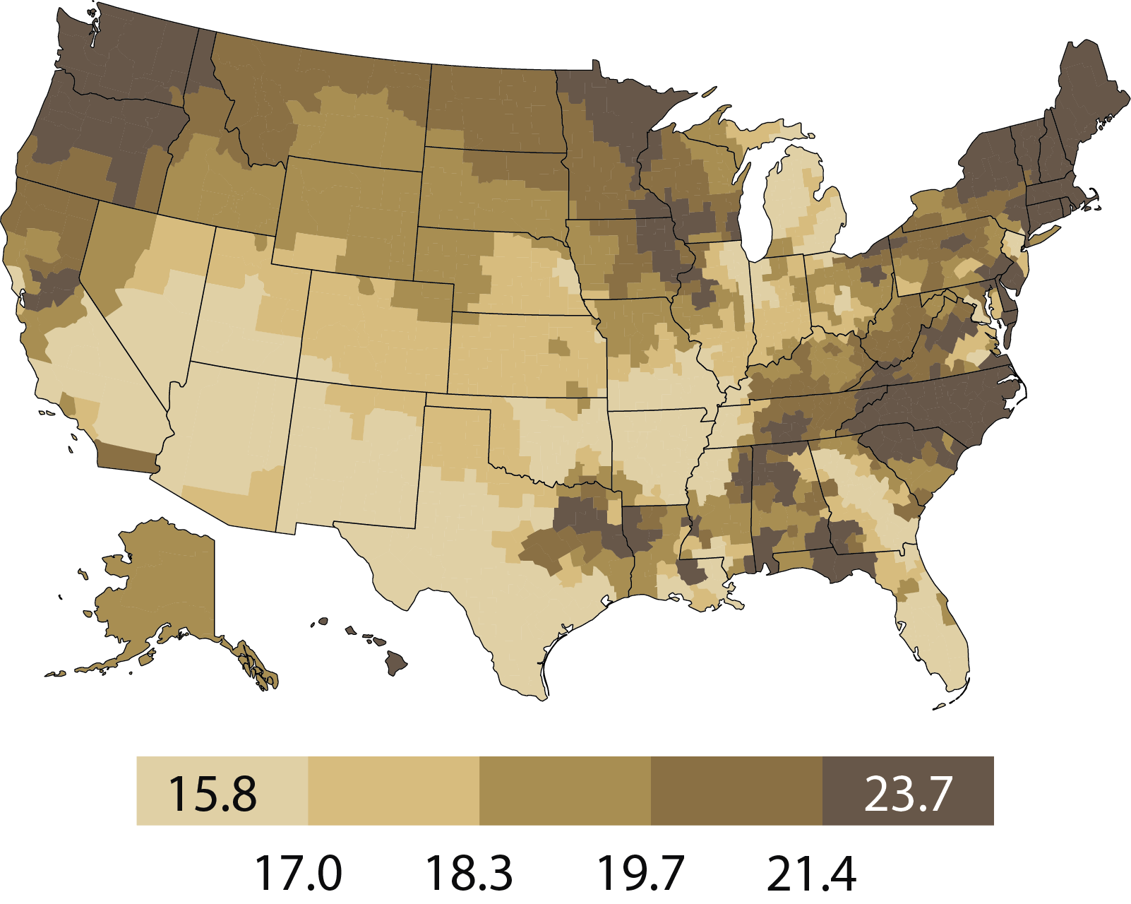
Geographic variations in the percent of hemodialysis pts using an internal access at initiation, by HSA, 2011: blacks/African Americans Figure 2.20 (continued; Volume 2)
Incident hemodialysis patients, 2011.

