Slide 1
ESRD: Chapter Six Prescription drug coverage Medicare Part D & private insurance
United States Renal Data System
2013 Annual Data Report

Slide 2
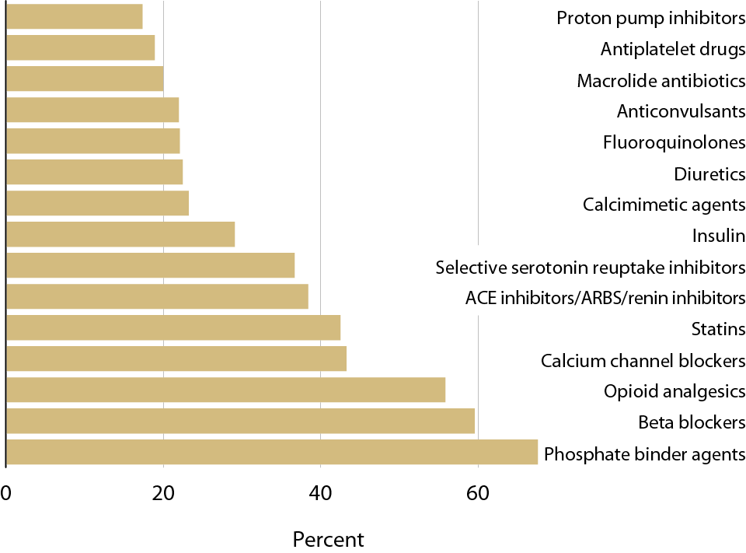
Top 15 drug classes used by Part D-enrolled dialysis patients, by percent of patients & drug class, 2011 Figure 6.1 (Volume 2)
Includes Part D claims for all adult dialysis patients. Therapeutic classification based on the Medi-Span’s generic product identifier (GPI) therapeutic classification system.

Slide 3
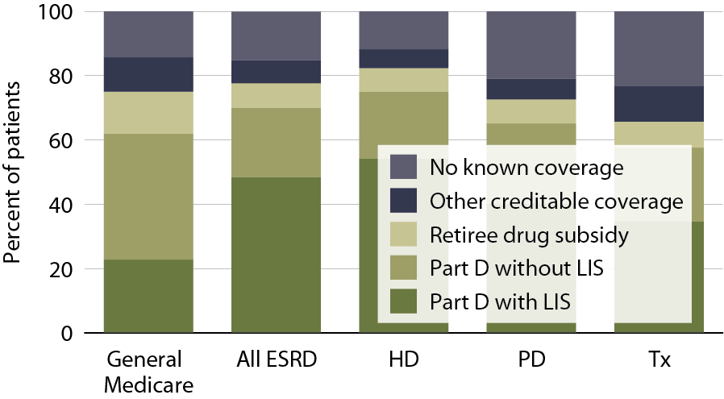
Sources of prescription drug coverage in Medicare ESRD enrollees, by population, 2011 Figure 6.2 (Volume 2)
Point prevalent Medicare enrollees alive on January 1, 2011.

Slide 4
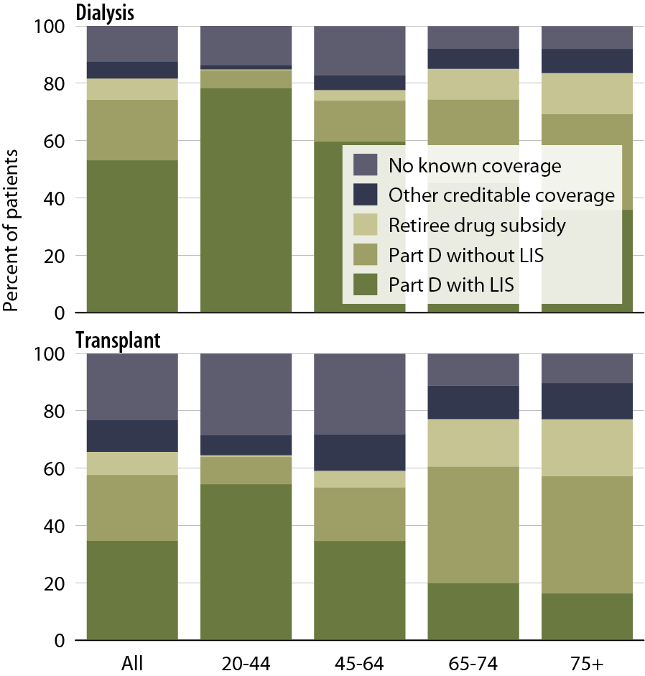
Sources of prescription drug coverage in Medicare ESRD enrollees, by age & modality, 2011 Figure 6.3 (Volume 2)
Point prevalent Medicare enrollees alive on January 1, 2011.

Slide 5
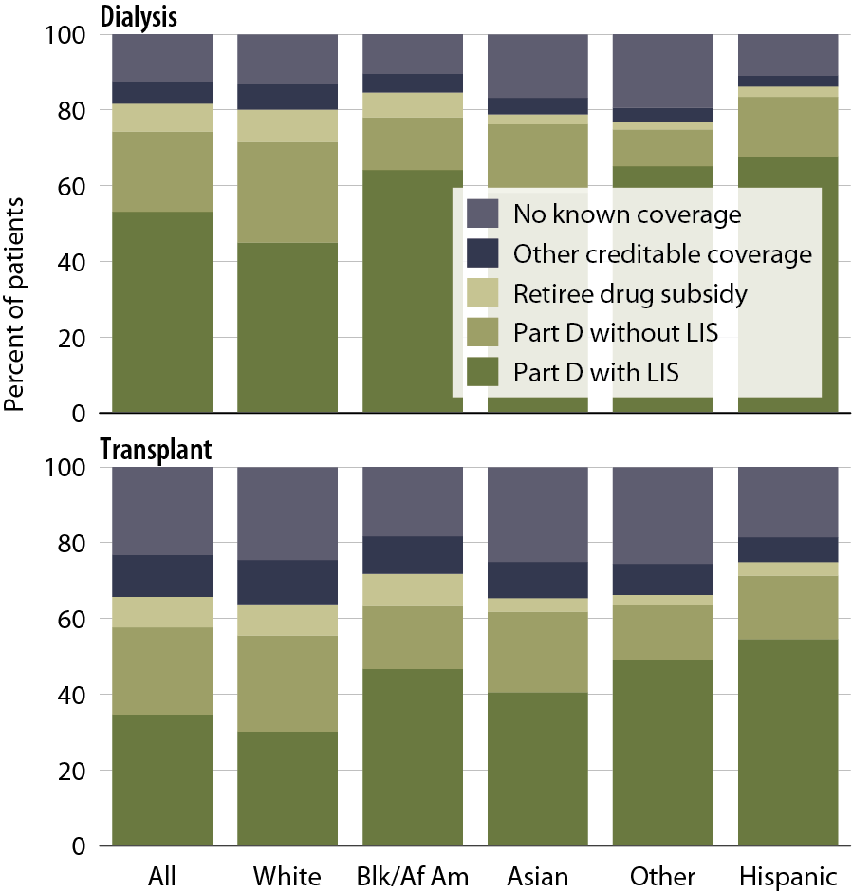
Sources of prescription drug coverage in Medicare ESRD enrollees, by race/ethnicity & modality, 2011 Figure 6.4 (Volume 2)
Point prevalent Medicare enrollees alive on January 1, 2011.

Slide 6
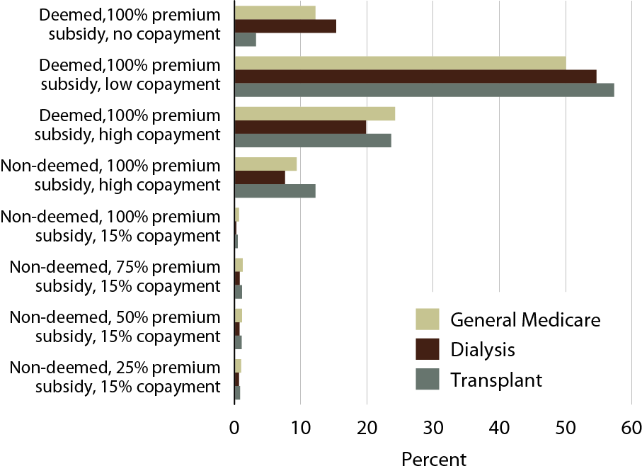
Distribution of low income subsidy (LIS) categories in Part D general Medicare & ESRD patients, 2011 Figure 6.5 (Volume 2)
Point prevalent Medicare enrollees alive on January 1, 2011.

Slide 7
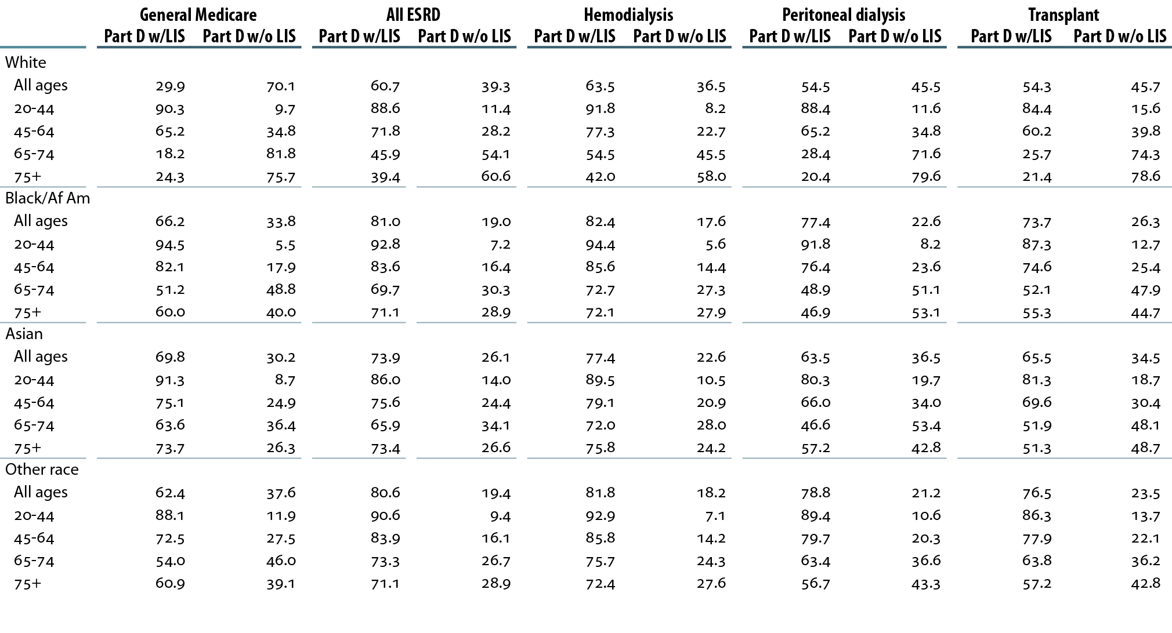
Medicare Part D enrollees (%) with or without the low income subsidy (LIS), by age & race, 2011 Table 6.a (Volume 2)
Point prevalent Medicare enrollees alive on January 1, 2011.

Slide 8
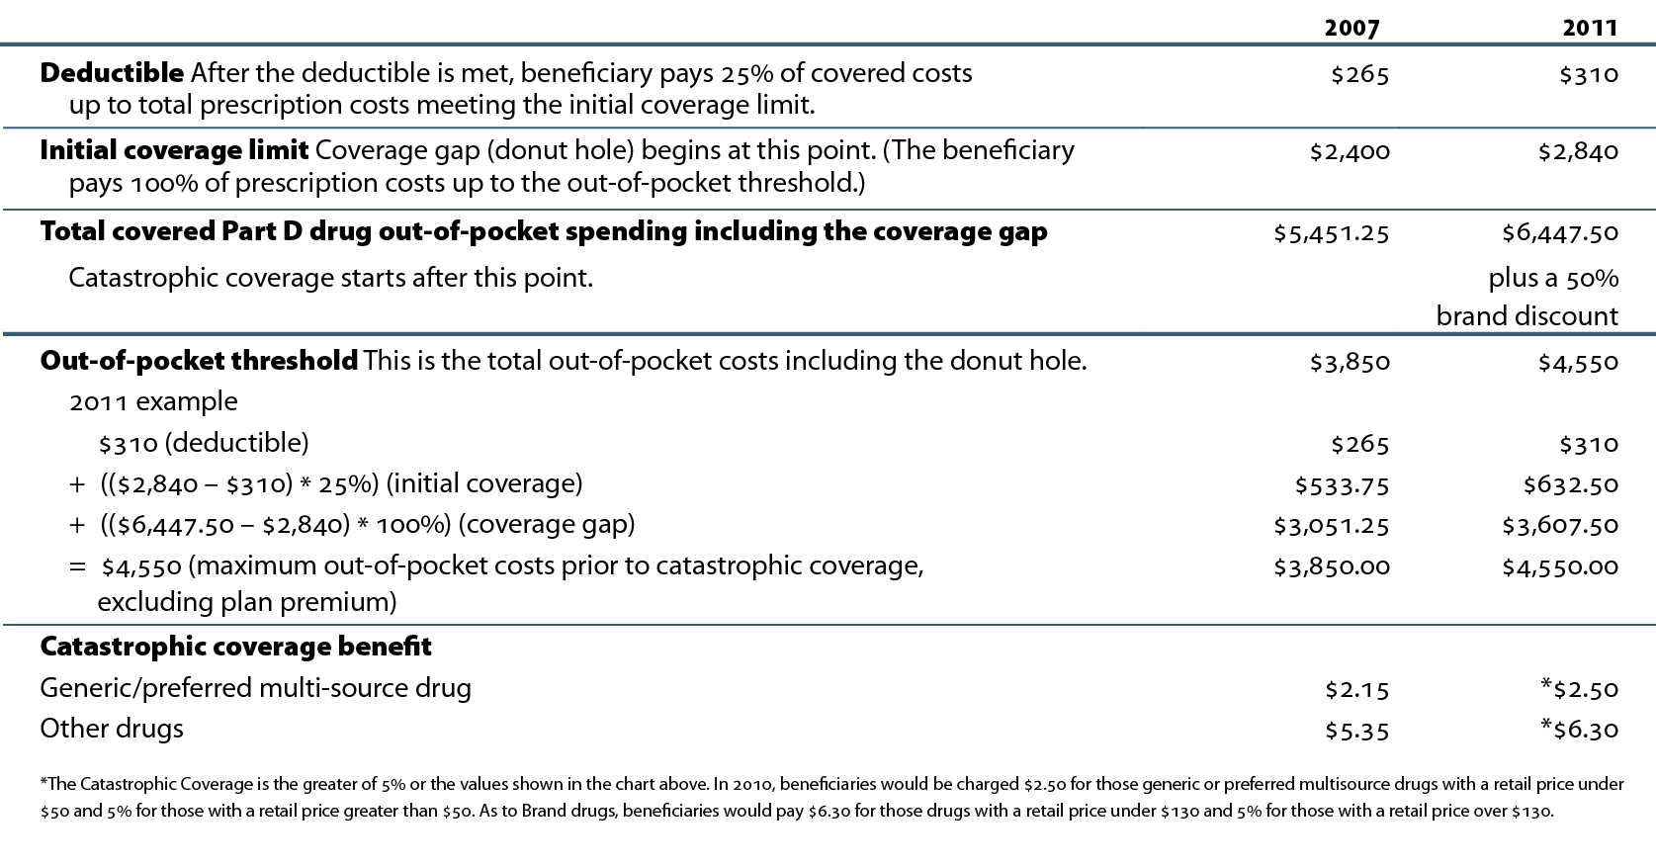
Medicare Part D benefit parameters for defined standard benefit Table 6.b (Volume 2)
http://www.q1medicare.com/PartD-The-2011-Medicare-Part-D-Outlook.php. *http://kaiserfamilyfoundation.files.wordpress.com/2013/01/8237.pdf.

Slide 9
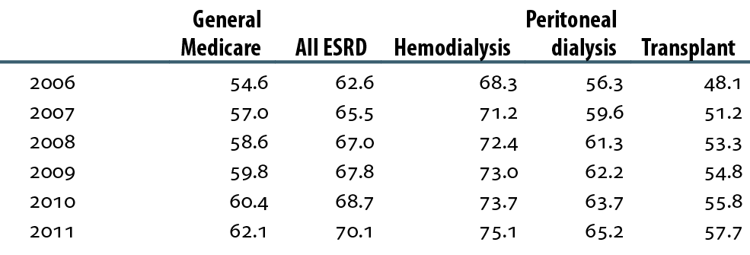
General Medicare & ESRD patients enrolled in Part D (percent) Table 6.c (Volume 2)
Point prevalent Medicare enrollees alive on January 1 of each year.

Slide 10
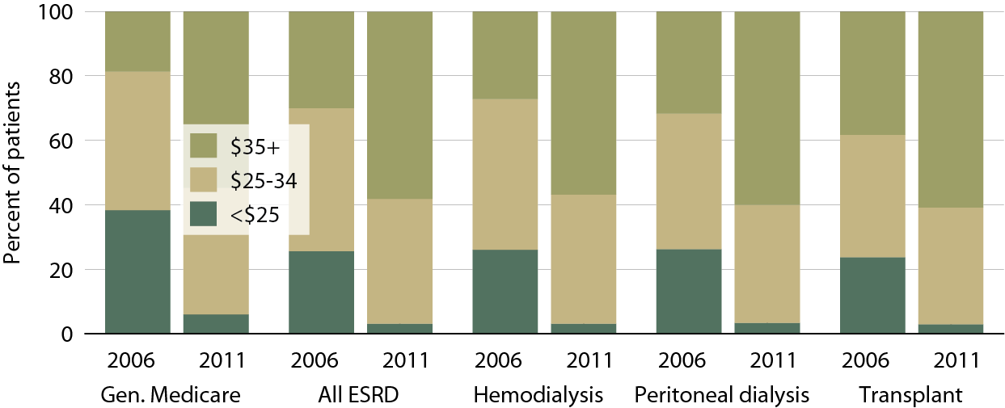
Part D non-LIS enrollees with specified monthly premium, 2006 & 2011 Figure 6.6 (Volume 2)
Point prevalent Medicare enrollees alive on January 1, excluding those in Medicare Advantage Part D plans.

Slide 11
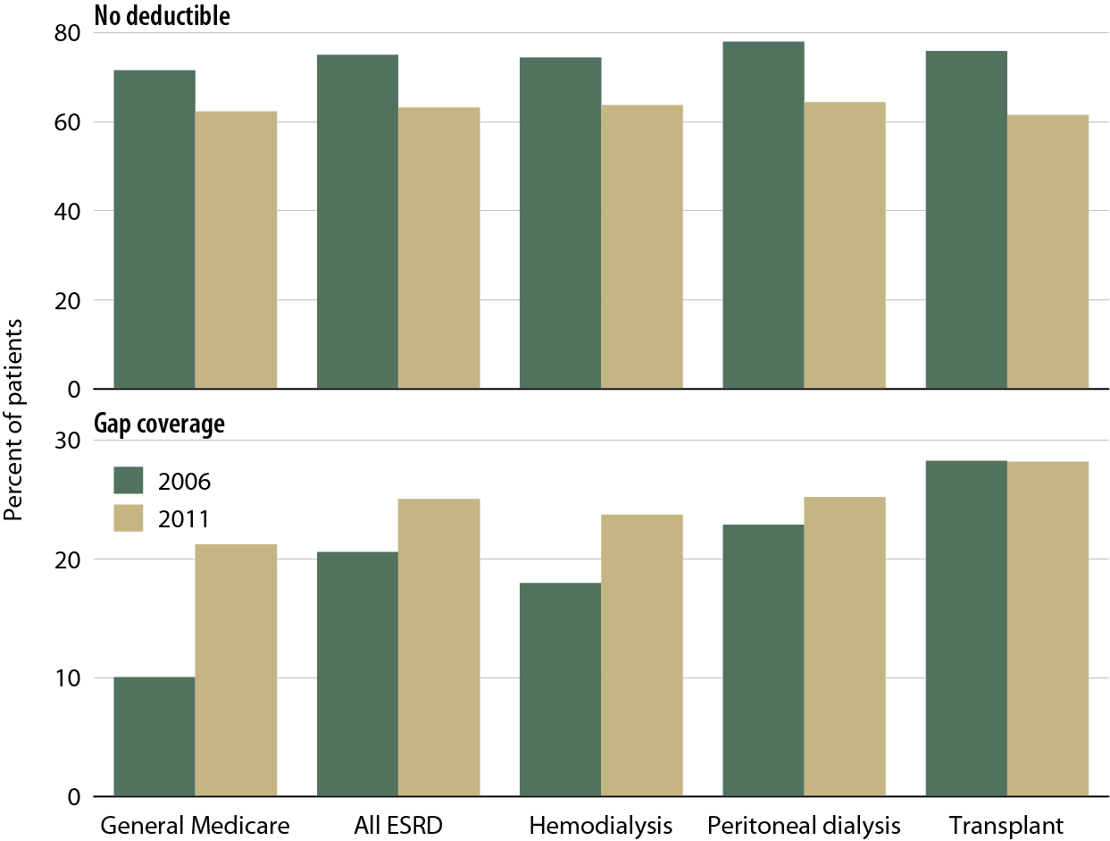
Part D non-LIS enrollees with no deductible & with gap coverage, 2006 & 2011 Figure 6.7 (Volume 2)
Point prevalent Medicare enrollees alive on January 1, excluding those in Medicare Advantage Part D plans.

Slide 12
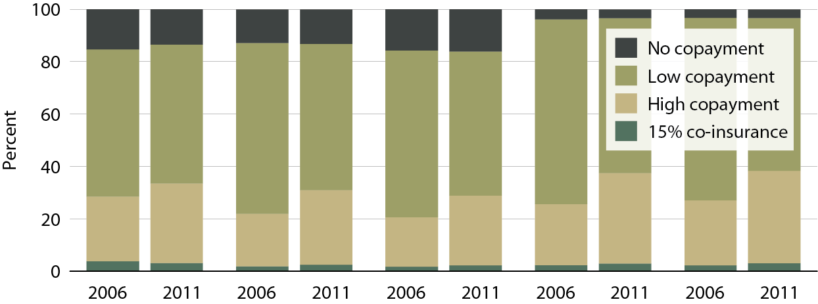
Part D LIS enrollees with specified co-insurance/copayment, 2006 & 2011 Figure 6.8 (Volume 2)
Point prevalent Medicare enrollees alive on January 1, excluding those in Medicare Advantage Part D plans.

Slide 13
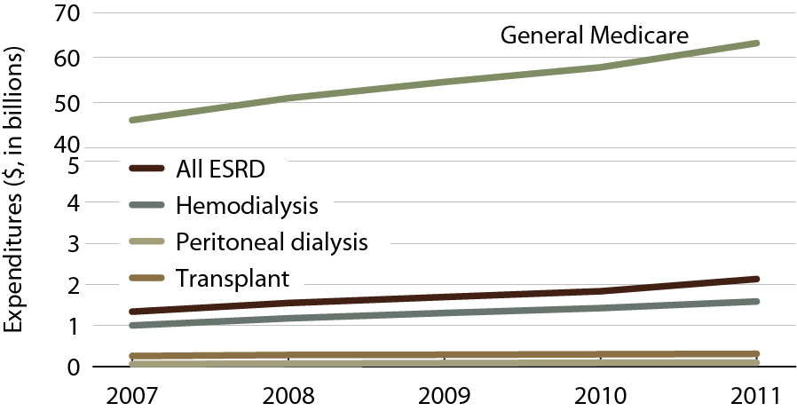
Total estimated net Medicare Part D costs for enrollees Figure 6.9 (Volume 2)
All patients enrolled in Part D.

Slide 14
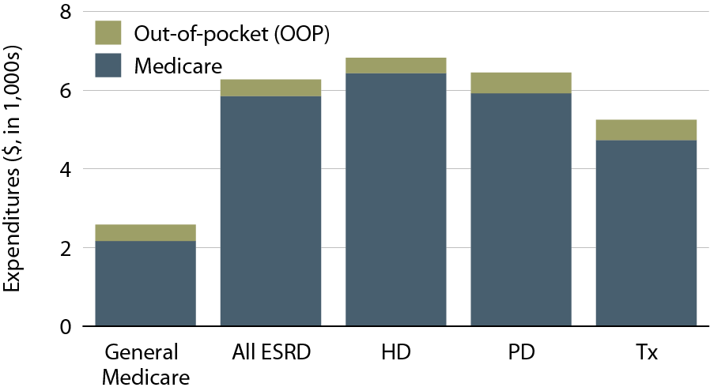
Per person per year Medicare & out-of-pocket Part D costs for enrollees, 2011 Figure 6.10 (Volume 2)
All patients enrolled in Part D.

Slide 15
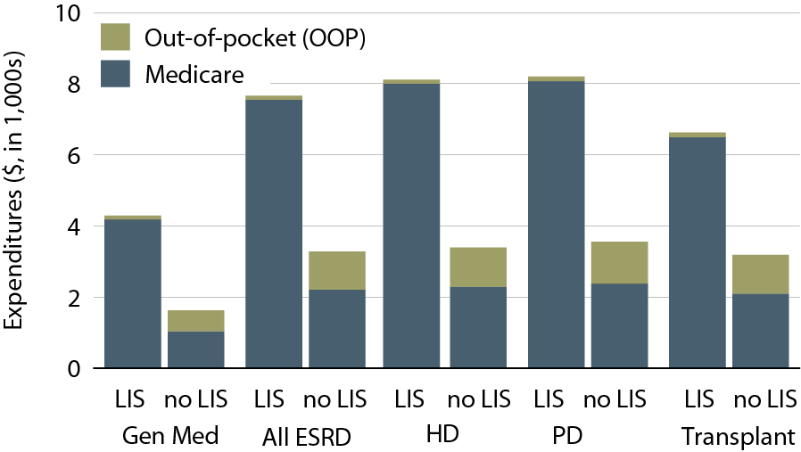
Per person per year Medicare & out-of-pocket Part D costs for enrollees, by low income subsidy (LIS) status, 2011 Figure 6.11 (Volume 2)
All patients enrolled in Part D.

Slide 16
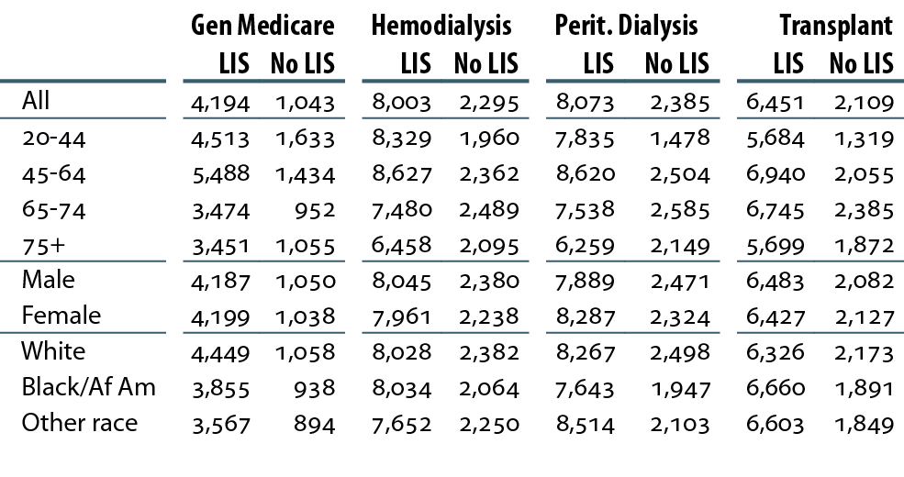
Total per person per year Part D costs ($) for enrollees, by low income subsidy (LIS) status, 2011 Table 6.d (Volume 2)
All patients enrolled in Part D.

Slide 17
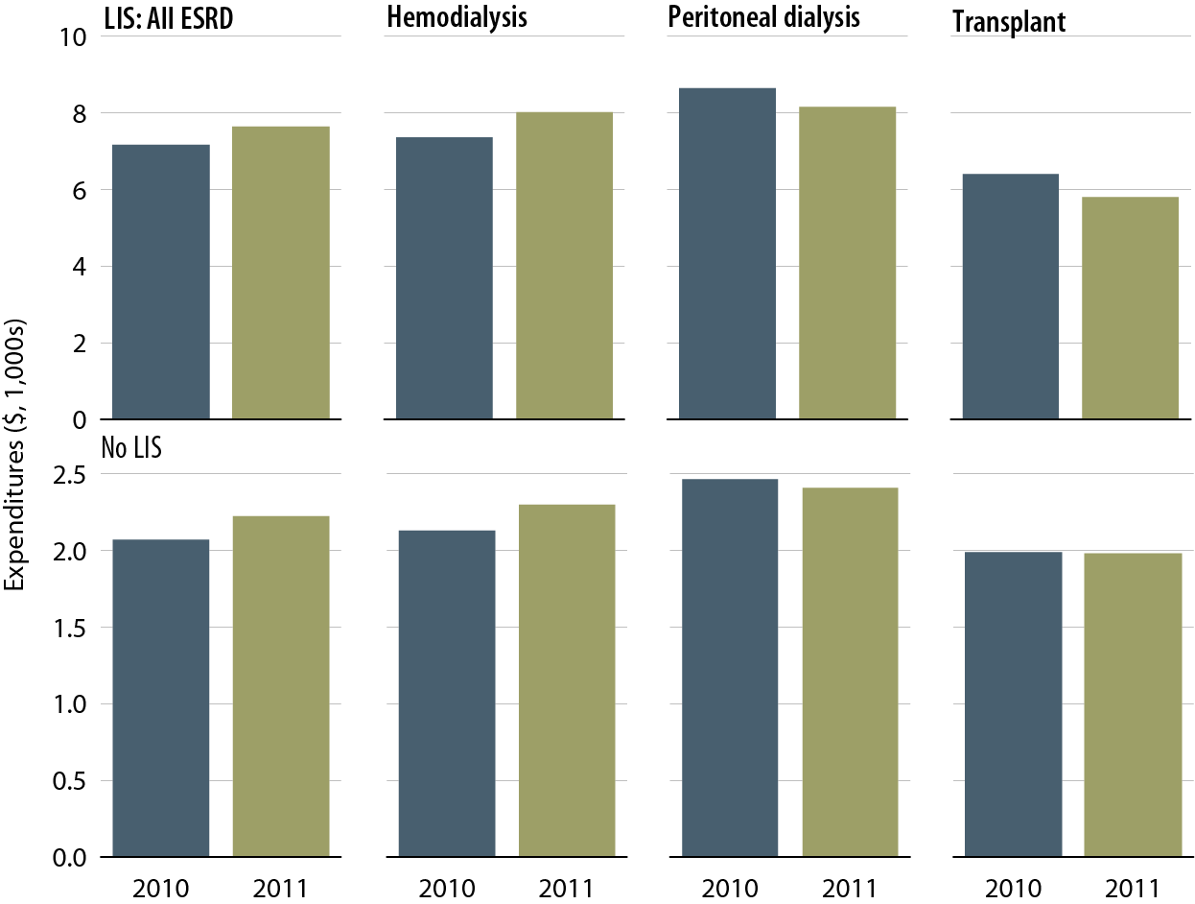
Total per person per year Medicare costs for Part D-covered medications, by low income subsidy (LIS) status, modality, & year Figure 6.12 (Volume 2)
Period prevalent ESRD patients.

Slide 18
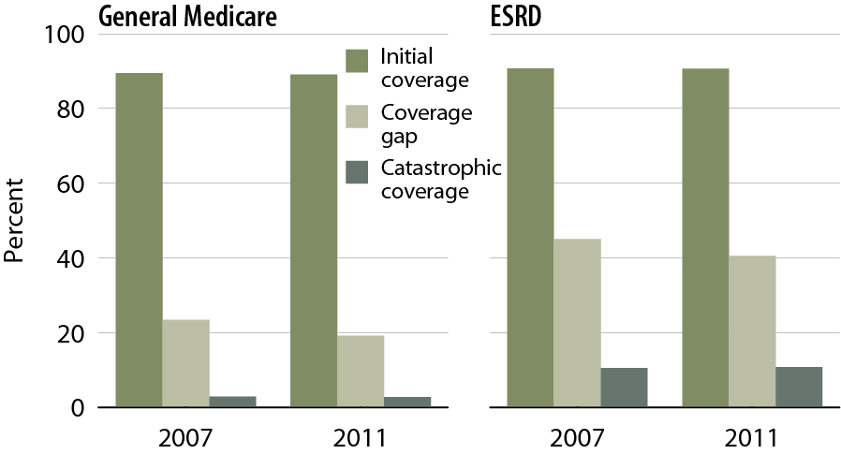
Part D enrollees without the low income subsidy (LIS) who reach each coverage phase Figure 6.13 (Volume 2)
Point prevalent Medicare enrollees alive on January 1, excluding those in employer-sponsored & national PACE Part D plans.

Slide 19
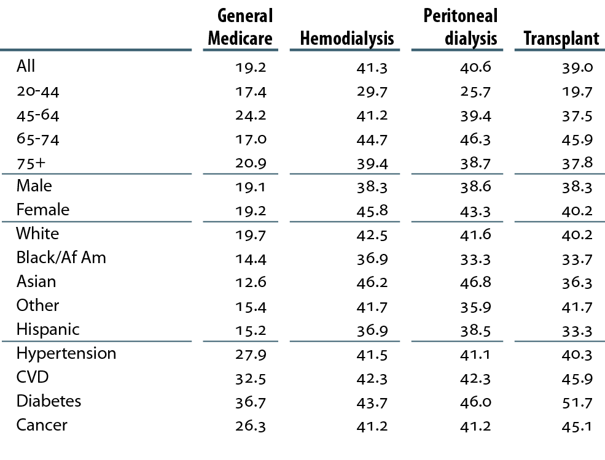
Twelve-month probability of reaching the coverage gap in Part D non-LIS enrollees (percent), by modality, 2011 Table 6.e (Volume 2)
Point prevalent Medicare enrollees alive on January 1, excluding those in employer-sponsored & national PACE Part D plans.

Slide 20
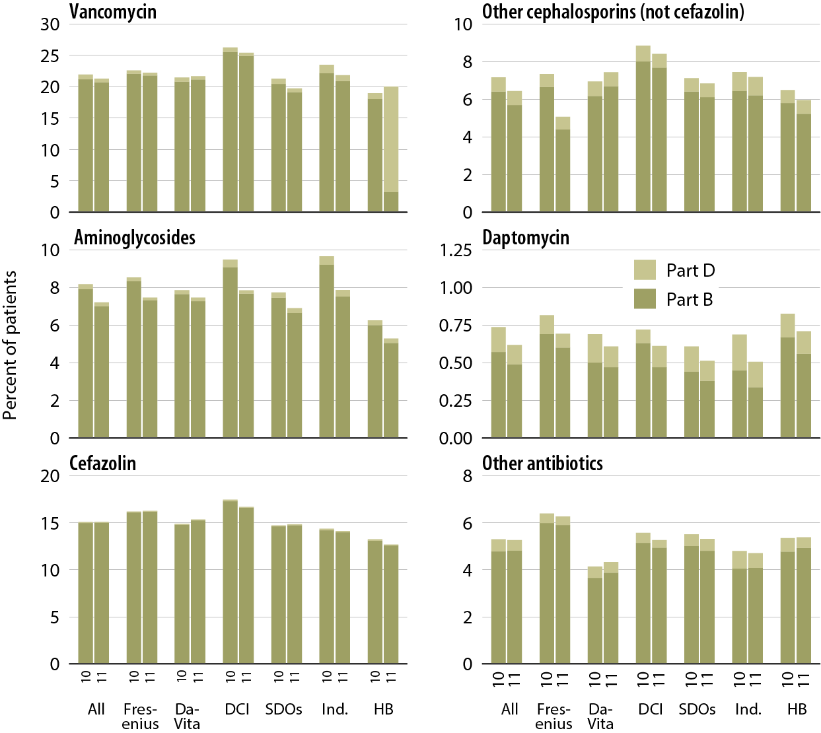
Patients receiving intravenous antibiotics under Medicare Parts B & D pre- & post-dialysis bundle, by unit affiliation Figure 6.14 (Volume 2)
Point prevalent Medicare enrollees alive on January 1.

Slide 21
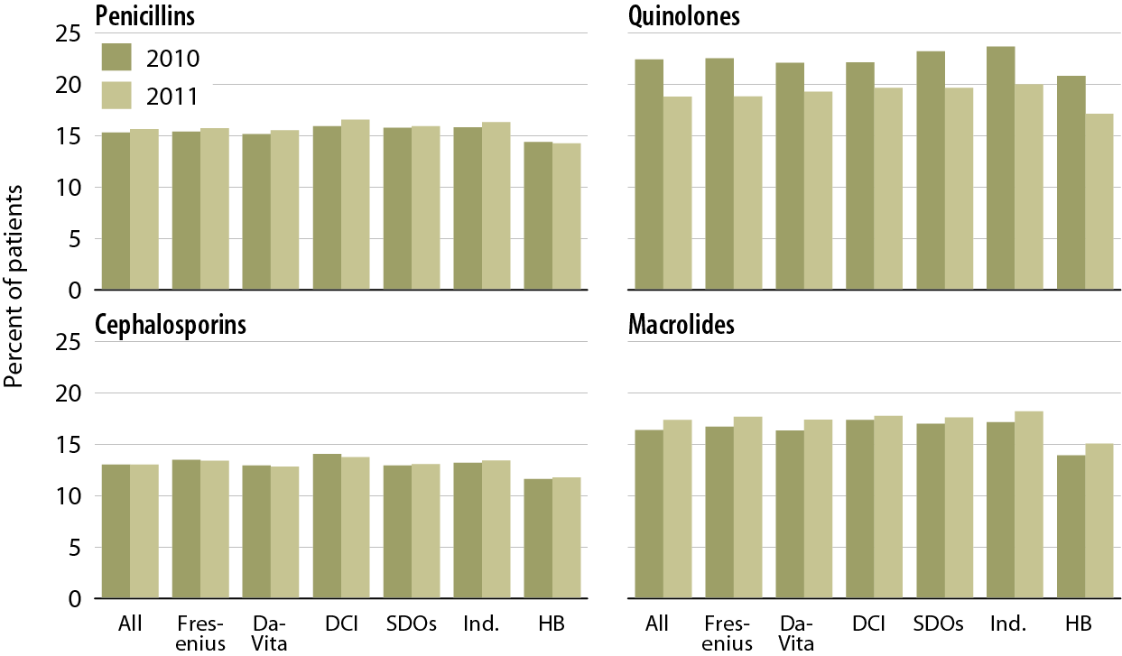
Patients receiving oral antibiotics under Medicare Parts B & D pre- & post-dialysis bundle, by unit affiliation Figure 6.15 (Volume 2)
Point prevalent Medicare enrollees alive on January 1.

Slide 22
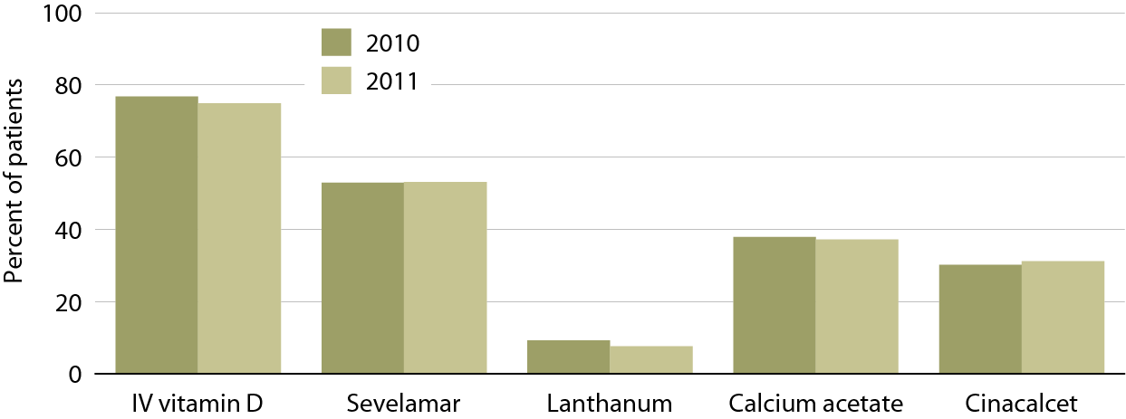
Patients receiving bone & mineral medications pre- & post-dialysis bundle, by type of medication, 2010 & 2011 Figure 6.16 (Volume 2)
Point prevalent Medicare enrollees alive on January 1.

Slide 23
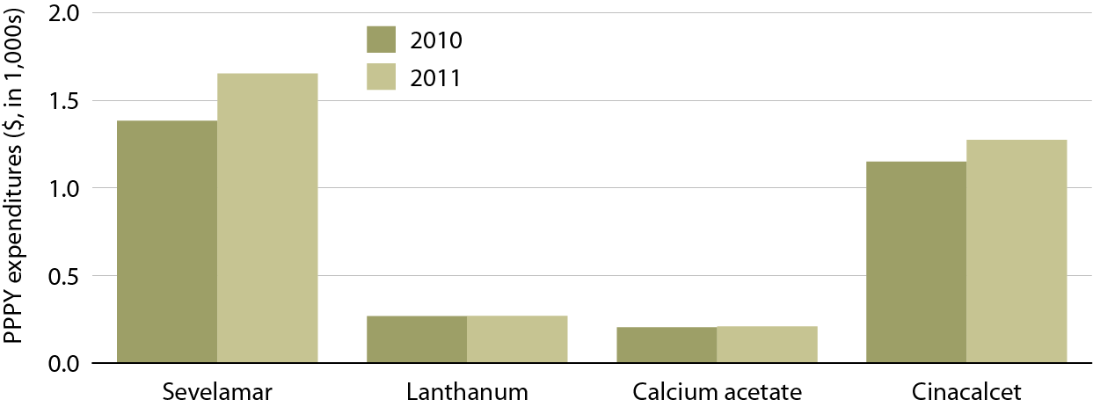
PPPY costs of bone & mineral medications pre- & post-dialysis bundle, by type of medication, 2010 & 2011 Figure 6.17 (Volume 2)
Point prevalent Medicare enrollees alive on January 1.

Slide 24
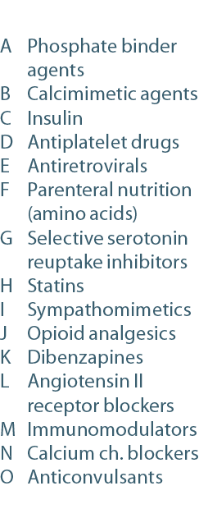
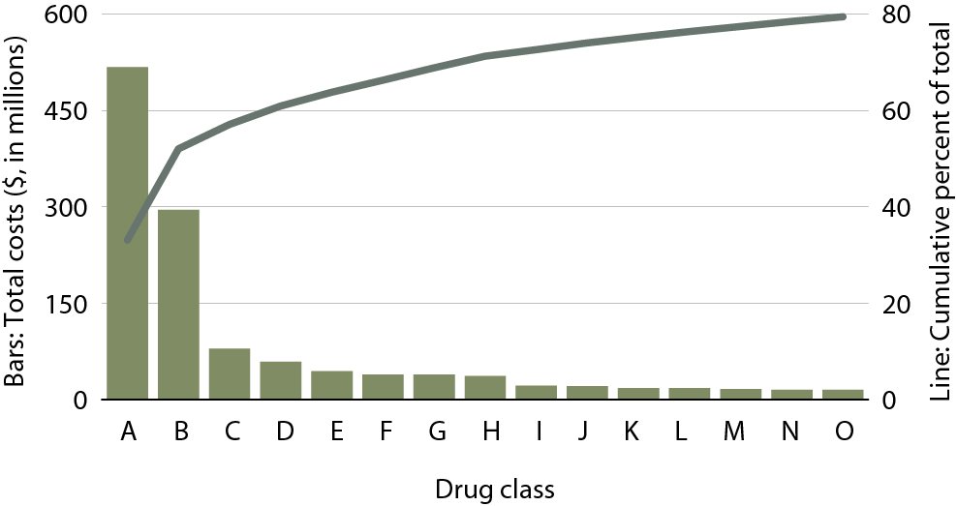
Top 15 drug classes used by Part D-enrolled dialysis patients, by net cost, 2011 Figure 6.18 (Volume 2)
Point prevalent Medicare enrollees alive on January 1.

