Slide 2
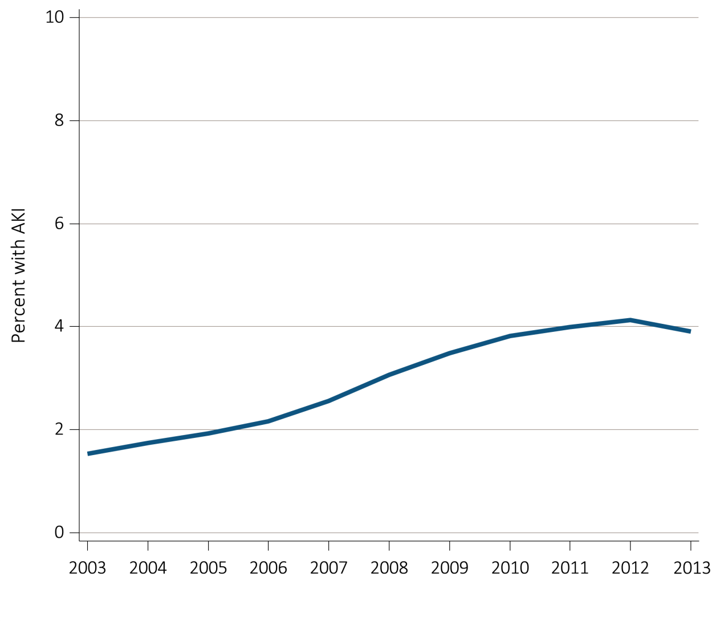
Figure 5.1 Percent of Medicare patients aged 66+, (a) with at least one AKI hospitalization, and (b) with an AKI hospitalization that had dialysis by year, 2003-2013
(a) Percent with an AKI hospitalization
Data Source: Special analyses, Medicare 5 percent sample. Panel 5.1.a: Percent with an AKI hospitalization among all Medicare patients aged 66 and older who had both Medicare Parts A & B, no Medicare Advantage plan, no ESRD by first service date from Medical Evidence form, and were alive on January 1 of year shown. Abbreviations: AKI, acute kidney injury; ESRD, end-stage renal disease.

Slide 3
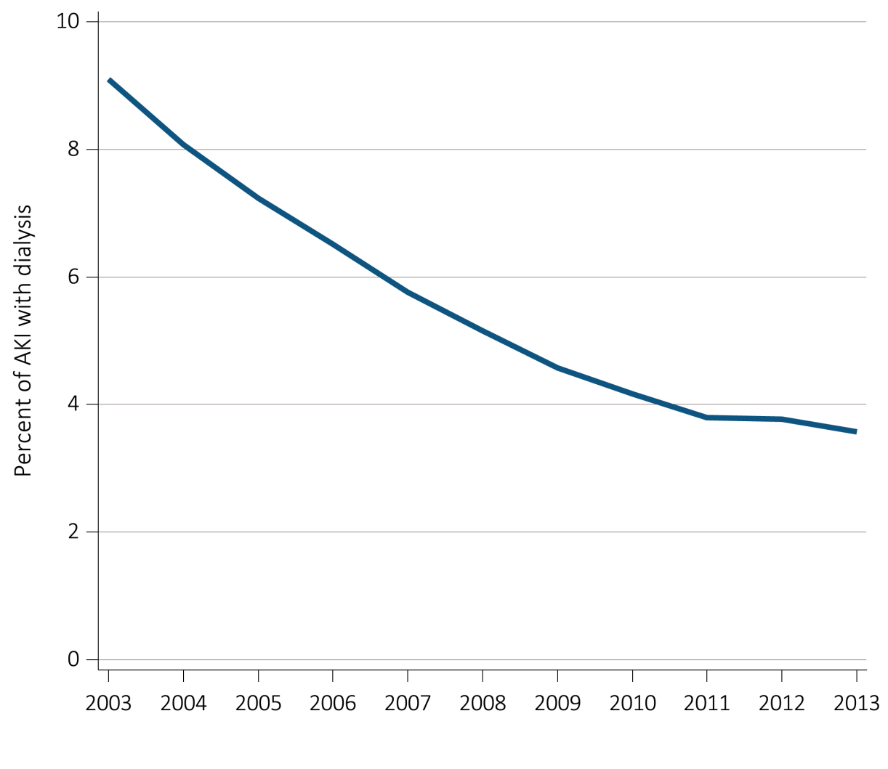
Figure 5.1 Percent of Medicare patients aged 66+, (a) with at least one AKI hospitalization, and (b) with an AKI hospitalization that had dialysis by year, 2003-2013
(b) Percent of first AKI hospitalizations with dialysis
Data Source: Special analyses, Medicare 5 percent sample. Medicare patients aged 66 and older who had both Medicare Parts A & B, no Medicare Advantage plan, no ESRD by first service date from Medical Evidence form, and were alive on January 1 of year shown. Panel 5.1.b: Percent of patients receiving dialysis during their first AKI hospitalization among patients with a first AKI hospitalization. Dialysis is identified by a diagnosis or charge for dialysis on the AKI hospitalization inpatient claim or a physician/supplier (Part B) claim for dialysis during the time period of the AKI inpatient claim. Abbreviations: AKI, acute kidney injury; ESRD, end-stage renal disease.

Slide 4
Table 5.1 Characteristics of Medicare patients aged 66+ with at least
one AKI hospitalization, by age, sex, race, CKD, DM, and year, 2003-2013
 |  |  | 2003 | 2004 | 2005 | 2006 | 2007 | 2008 | 2009 | 2010 | 2011 | 2012 | 2013
Age
 | 66-69 |  | 10.6 | 10.5 | 10.3 | 10.6 | 10.6 | 10.3 | 10.8 | 10.8 | 11.3 | 11.3 | 11.4
 | 70-74 |  | 16.5 | 16.3 | 16.0 | 15.3 | 15.4 | 15.5 | 15.4 | 15.6 | 15.6 | 15.9 | 16.1
 | 75-79 |  | 21.8 | 21.3 | 21.0 | 20.2 | 19.4 | 18.5 | 18.6 | 18.0 | 17.7 | 18.0 | 17.9
 | 80-84 |  | 22.5 | 22.9 | 22.9 | 22.3 | 22.4 | 22.4 | 21.5 | 21.3 | 20.7 | 19.9 | 19.5
 | 85+ |  | 28.6 | 29.0 | 29.9 | 31.6 | 32.1 | 33.4 | 33.7 | 34.3 | 34.7 | 34.8 | 35.2
Sex
 | Female |  | 47.9 | 48.0 | 47.7 | 48.1 | 47.8 | 47.8 | 47.8 | 47.5 | 47.7 | 48.2 | 47.7
 | Male |  | 52.1 | 52.0 | 52.3 | 51.9 | 52.2 | 52.2 | 52.2 | 52.5 | 52.3 | 51.8 | 52.3
Race
 | White |  | 82.9 | 82.6 | 81.7 | 82.0 | 82.8 | 83.2 | 83.2 | 83.1 | 83.1 | 82.7 | 83.1
 | Black/African American |  | 12.7 | 13.0 | 13.7 | 13.5 | 12.5 | 12.0 | 12.0 | 12.1 | 12.0 | 12.2 | 11.6
 | Native American |  | 0.4 | 0.3 | 0.4 | 0.4 | 0.4 | 0.4 | 0.4 | 0.5 | 0.5 | 0.5 | 0.5
 | Asian |  | 1.0 | 1.3 | 1.2 | 1.2 | 1.2 | 1.4 | 1.4 | 1.4 | 1.5 | 1.5 | 1.6
 | Other |  | 3.0 | 2.9 | 3.1 | 2.9 | 3.0 | 3.0 | 3.0 | 3.0 | 2.9 | 3.1 | 3.2
Pre-existing comorbidities
 |  | No DM or CKD, prior year | 55.0 | 53.3 | 52.2 | 51.2 | 49.4 | 48.2 | 47.2 | 46.0 | 44.5 | 43.5 | 42.7
 |  | DM no CKD, prior year | 24.6 | 25.2 | 25.1 | 25.1 | 23.1 | 23.0 | 22.5 | 22.5 | 22.0 | 21.2 | 21.3
 |  | CKD no DM, prior year | 8.8 | 9.5 | 9.5 | 10.0 | 12.1 | 12.8 | 13.5 | 13.9 | 14.8 | 15.2 | 15.7
 |  | Both CKD & DM, prior year | 11.7 | 12.0 | 13.2 | 13.7 | 15.4 | 16.0 | 16.8 | 17.7 | 18.7 | 20.1 | 20.3
Data Source: Special analyses, Medicare 5 percent sample. Medicare patients aged 66 and older who had both Medicare Parts A & B, no Medicare Advantage plan, no ESRD by first service date from Medical Evidence form, and were alive on January 1 of year shown. Abbreviations: AKI, acute kidney injury; CKD, chronic kidney disease; DM, diabetes mellitus; ESRD, end-stage renal disease.

Slide 5
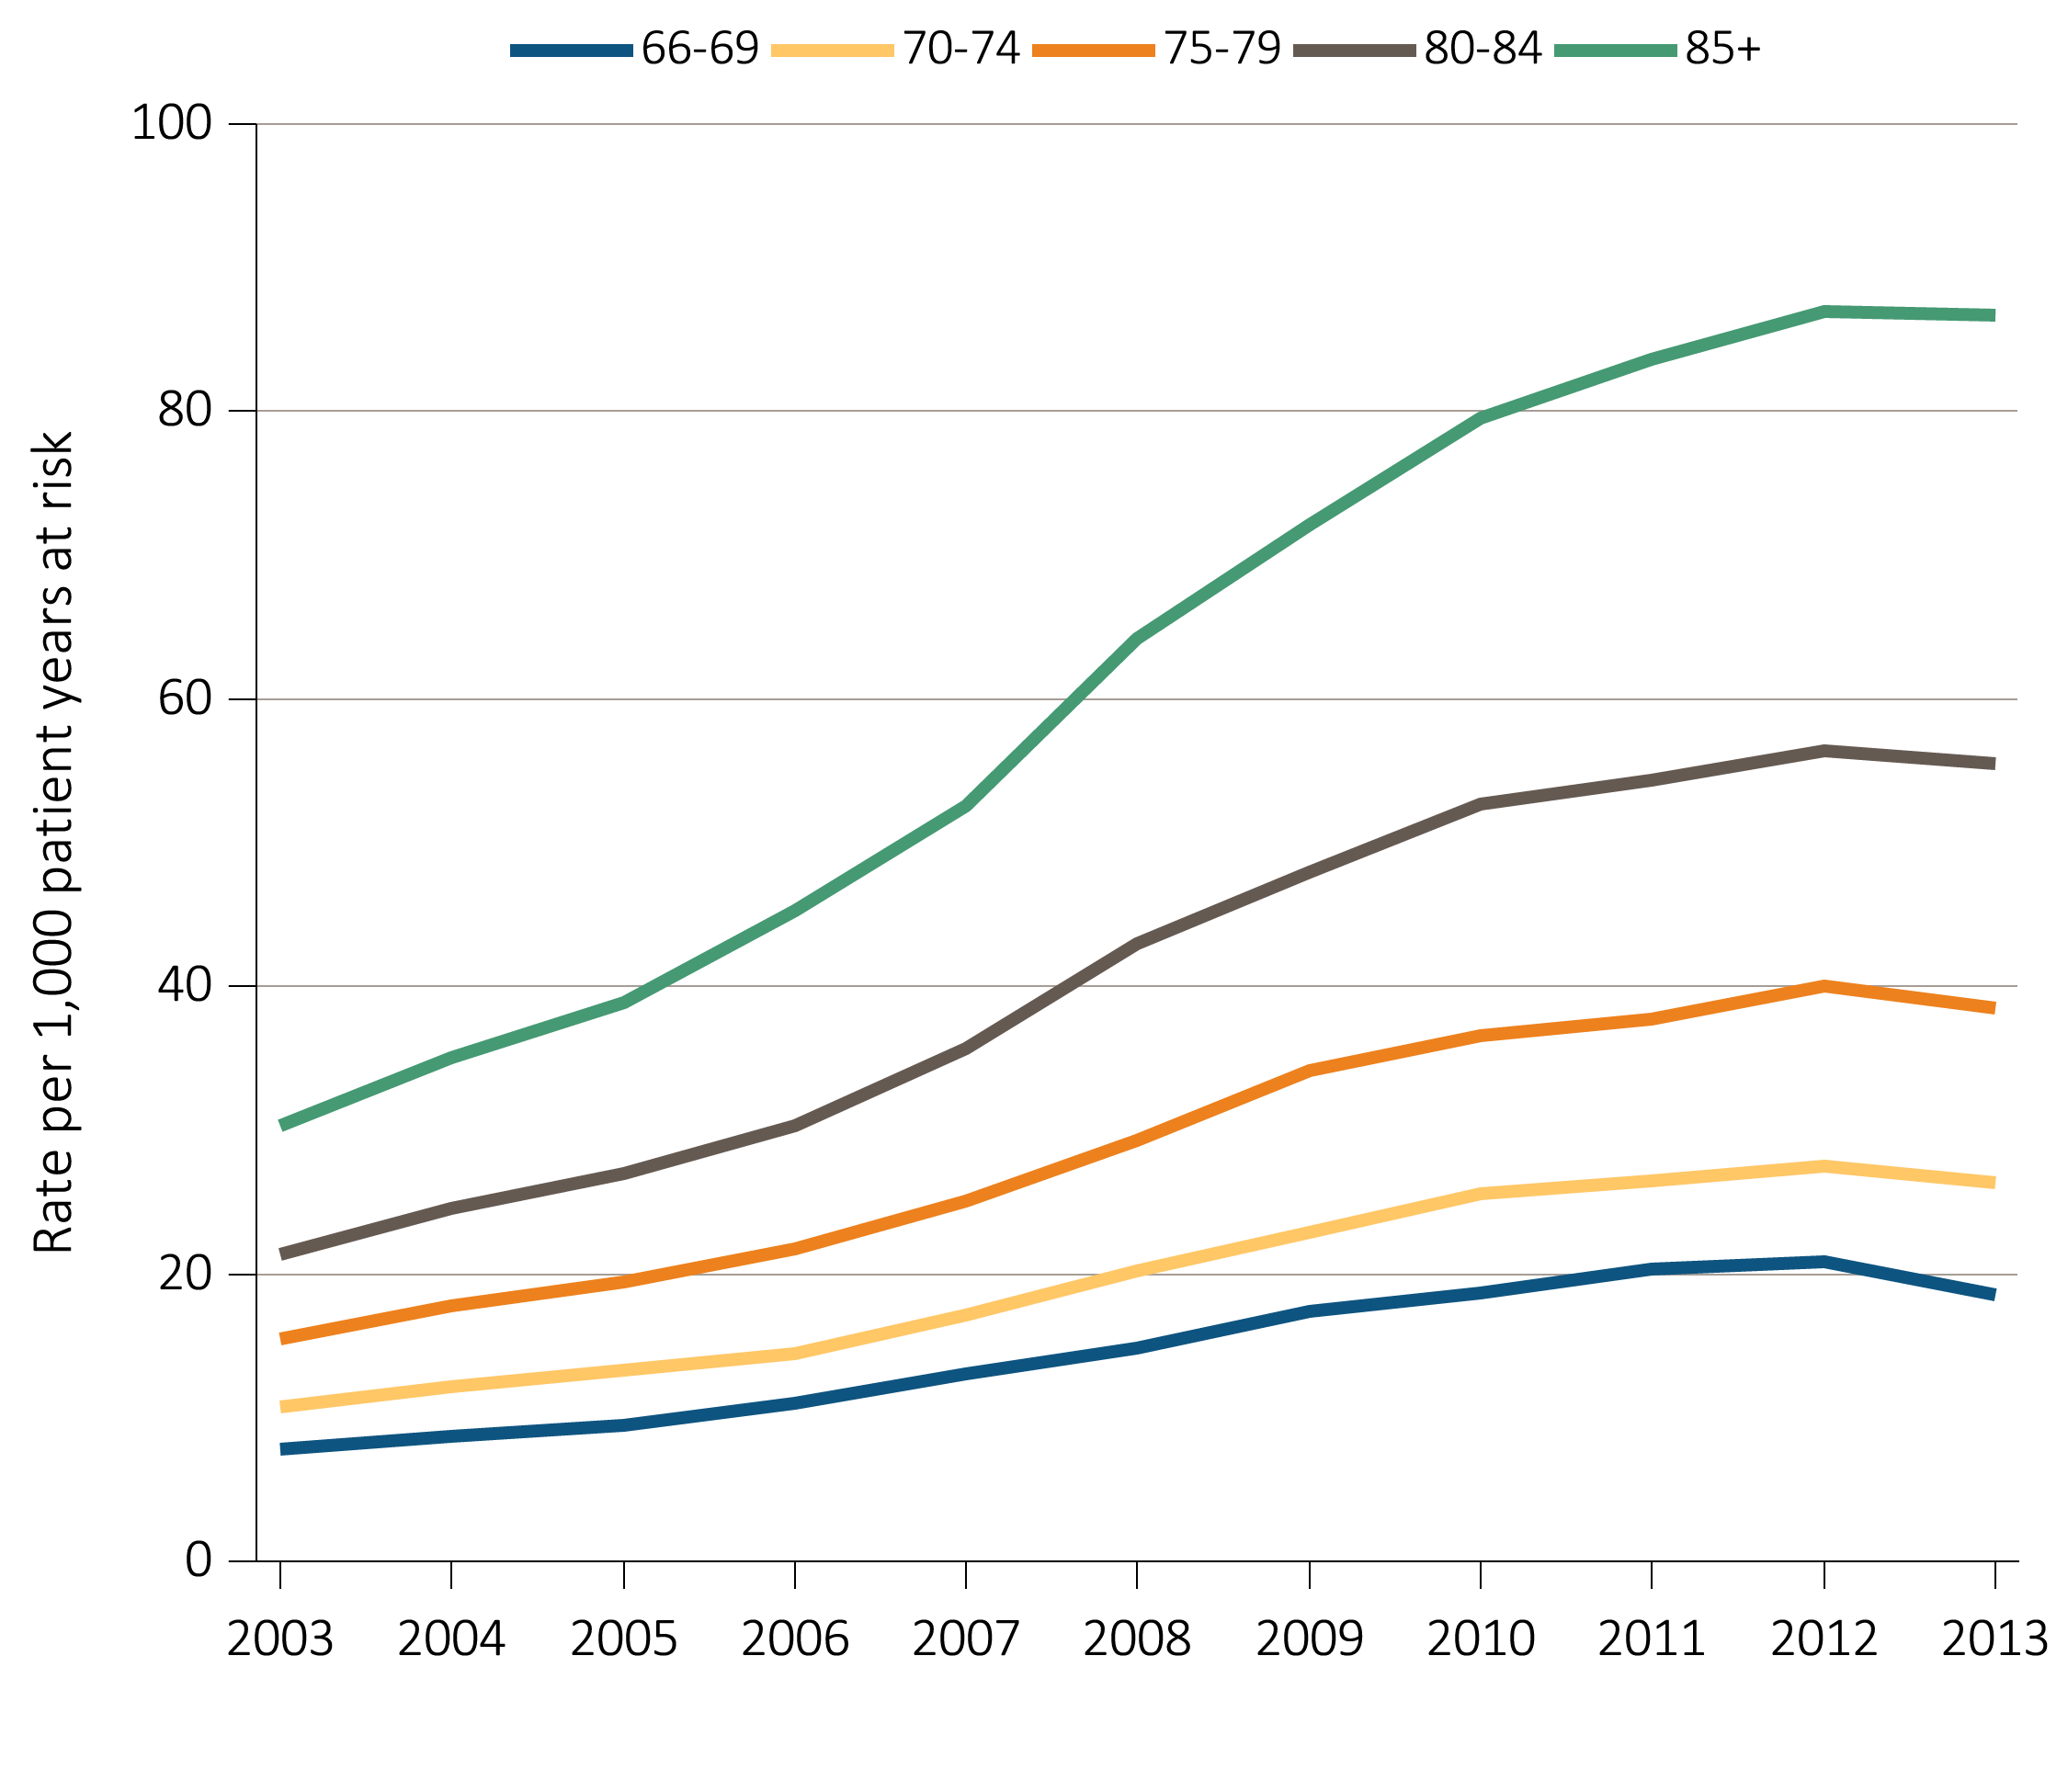
Figure 5.2 Unadjusted rates of first hospitalization with AKI for Medicare patients
aged 66+, by age and year, 2003-2013
Data Source: Special analyses, Medicare 5 percent sample. Age as of January 1 of specified year. All patient-years at risk for Medicare patients aged 66 and older who had both Medicare Parts A & B, no Medicare Advantage plan, no ESRD by first service date from Medical Evidence form, and were alive on January 1 of year shown. Censored at death, ESRD, end of Medicare Parts A & B participation, or switch to Medicare Advantage program. Abbreviations: AKI, acute kidney injury; ESRD, end-stage renal disease.

Slide 6
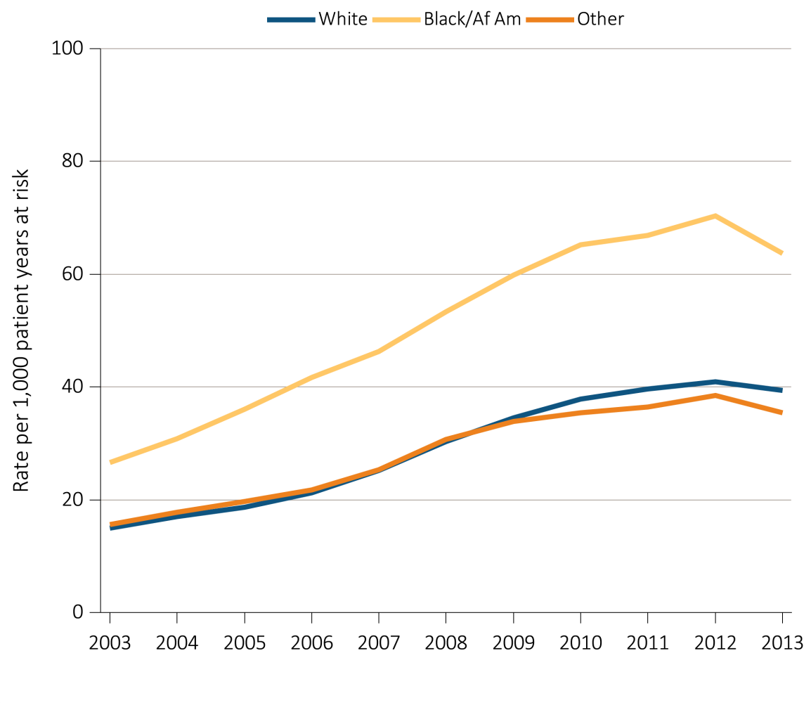
Figure 5.3 Unadjusted rates of first hospitalization with AKI for Medicare patients
aged 66+, by race and year, 2003-2013
Data Source: Special analyses, Medicare 5 percent sample. All patient-years at risk for Medicare patients aged 66 or older who had both Medicare Parts A & B, no Medicare Advantage plan, no ESRD by first service date from Medical Evidence form, and were alive on January 1 of year shown. Censored at death, ESRD, end of Medicare Parts A & B participation, or switch to Medicare Advantage program. Abbreviations: Af Am, African American; AKI, acute kidney injury; ESRD, end-stage renal disease.

Slide 7
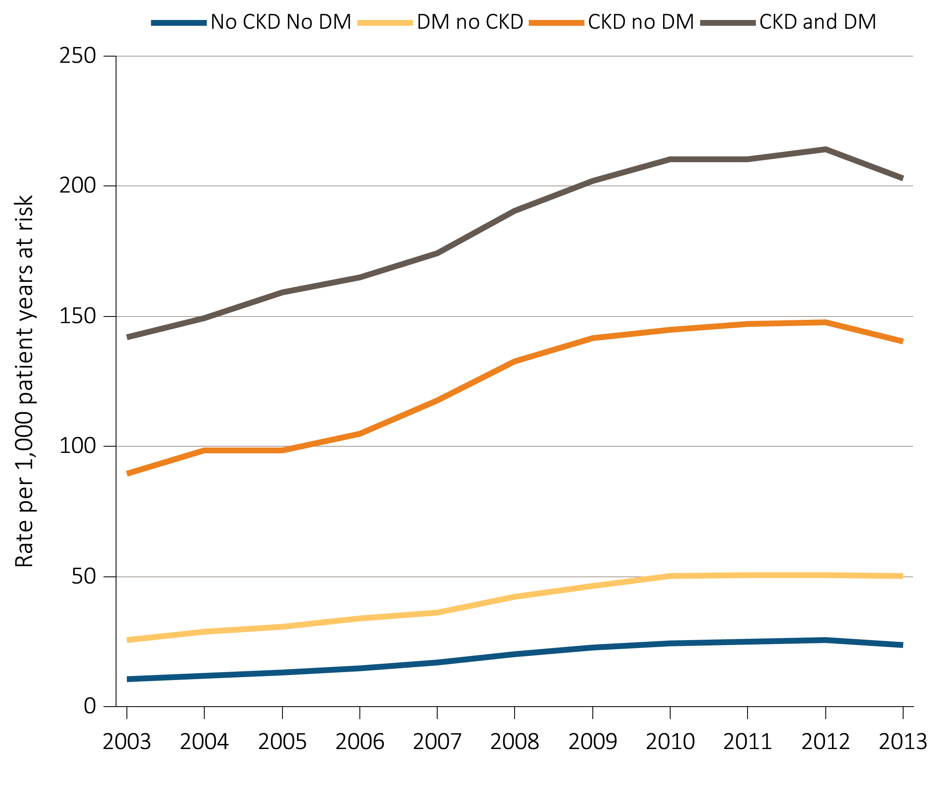
Figure 5.4 Unadjusted rates of first hospitalization with AKI for Medicare patients
aged 66+, by CKD, DM, and year, 2003-2013
Data Source: Special analyses, Medicare 5 percent sample. All patient-years at risk for Medicare patients aged 66 and older who had both Medicare Parts A & B, no Medicare Advantage plan, no ESRD by first service date from Medical Evidence form, and were alive on January 1 of year shown. Censored at death, ESRD, end of Medicare Parts A & B participation, or switch to Medicare Advantage program. Abbreviations: AKI, acute kidney injury; CKD, chronic kidney disease; DM, diabetes mellitus; ESRD, end-stage renal disease.

Slide 8
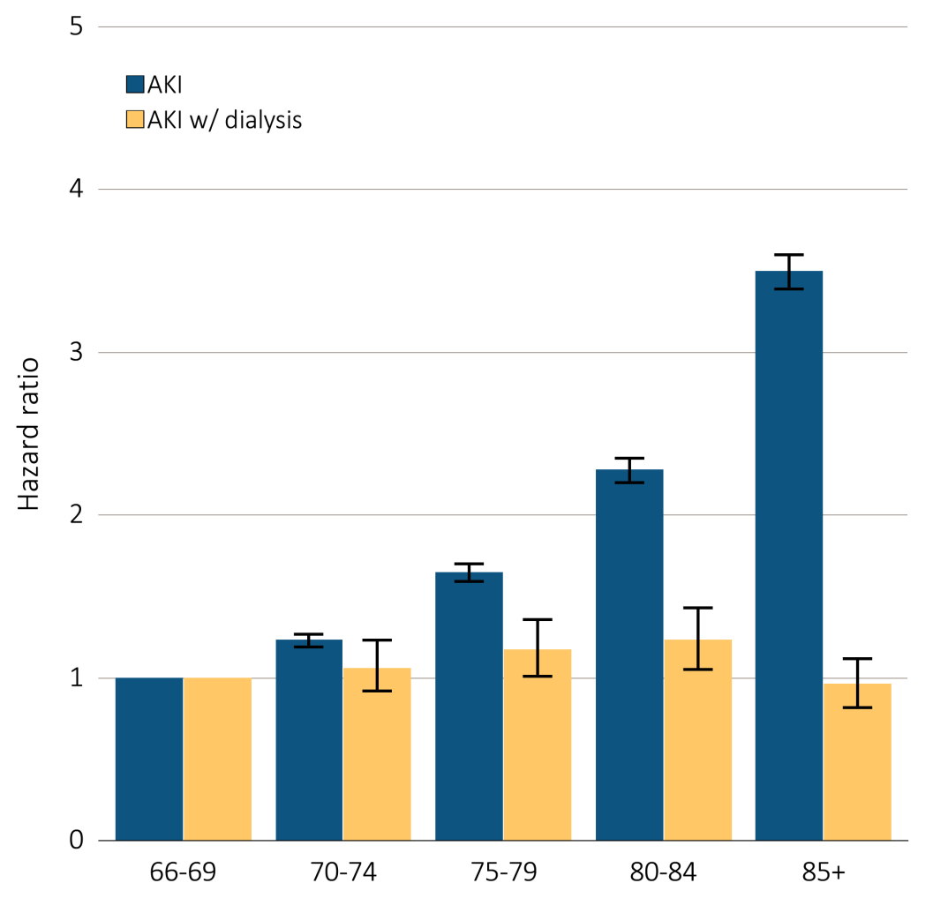
Figure 5.5 Adjusted hazard of a first AKI hospitalization in Medicare patients
aged 66+, overall and dialysis-requiring, by age, 2013
Data Source: Special analyses, Medicare 5 percent sample. Medicare patients aged 66 or older who had both Medicare Parts A & B, no Medicare Advantage plan, no ESRD by first service date from Medical Evidence form, and were alive on 1/1/2013. Dialysis is identified by a diagnosis or charge for dialysis on the AKI inpatient claim or a physician/supplier (Part B) claim for dialysis during the time period of the AKI inpatient claim. Models each include age, race, sex, DM, and CKD status in prior year. Censored at death, ESRD, end of Medicare Parts A & B participation, or switch to Medicare Advantage program. Error bars represent 95% confidence interval of estimates. Abbreviations: AKI, acute kidney injury; ESRD, end-stage renal disease.

Slide 9
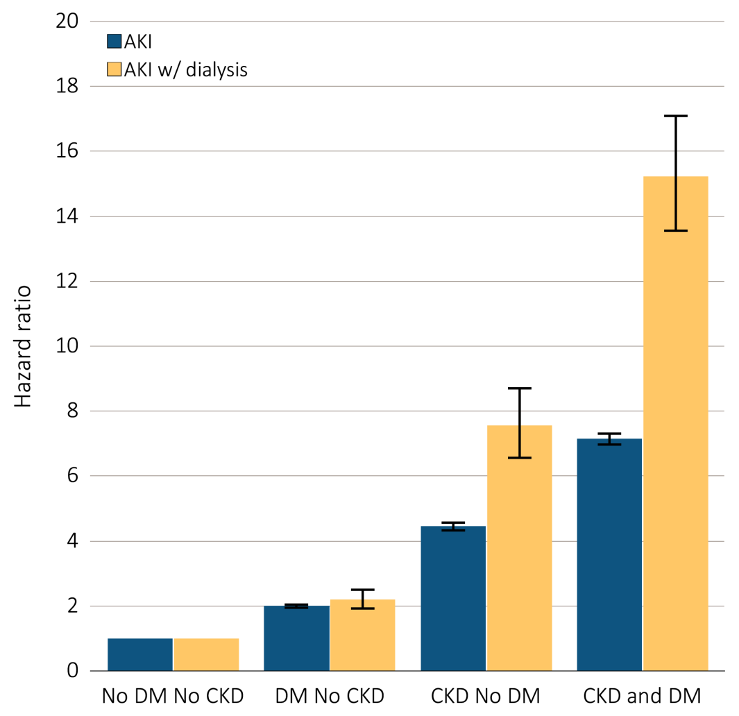
Figure 5.6 Adjusted hazard of a first AKI hospitalization in Medicare patients
aged 66+, overall and dialysis-requiring, by DM & CKD status, 2013
Data Source: Special analyses, Medicare 5 percent sample. Medicare patients aged 66 and older who had both Medicare Parts A & B, no Medicare Advantage plan, no ESRD by first service date from Medical Evidence form, and were alive on 1/1/2013. Dialysis is identified by a diagnosis or charge for dialysis on the AKI inpatient claim or a physician/supplier (Part B) claim for dialysis during the time period of the AKI inpatient claim. Models each include age, race, sex, DM, and CKD status in prior year. Censored at death, ESRD, end of Medicare Parts A & B participation, or switch to Medicare Advantage program. Error bars represent 95% confidence interval of estimates. Abbreviations: AKI, acute kidney injury; CKD, chronic kidney disease; DM, diabetes mellitus; ESRD, end-stage renal disease.

Slide 10
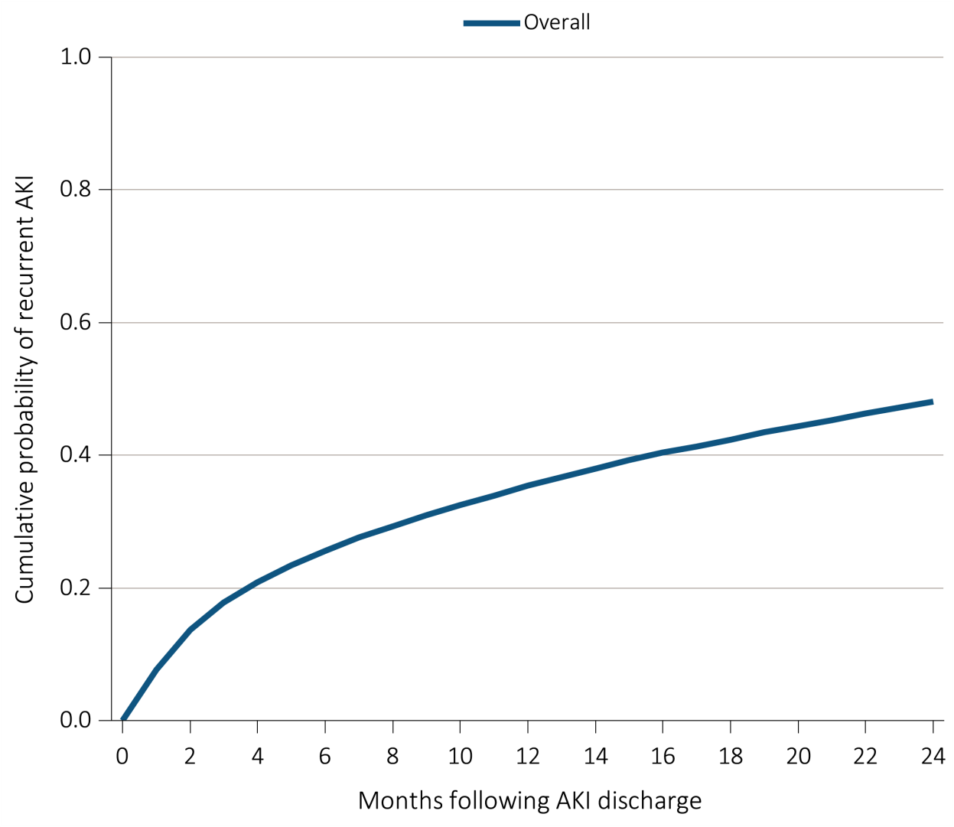
Figure 5.7 Cumulative probability of a recurrent AKI hospitalization within two years of live discharge from first AKI hospitalization in 2011 for Medicare patients aged 66+, (a) overall,
(b) by age, (c) by race, and (d) by chronic kidney disease and diabetes mellitus
(a) Overall
Data Source: Special analyses, Medicare 5 percent sample. Age on January 1, 2011. Medicare patients aged 66 and older who had both Medicare Parts A & B, no Medicare Advantage plan, no ESRD by first service date from Medical Evidence form on 1/1/2011 and were discharged alive from an AKI hospitalization in 2011. Censored at death, ESRD, end of Medicare Parts A & B participation, or switch to Medicare Advantage program. Abbreviations: AKI, acute kidney injury; ESRD, end-stage renal disease.

Slide 11
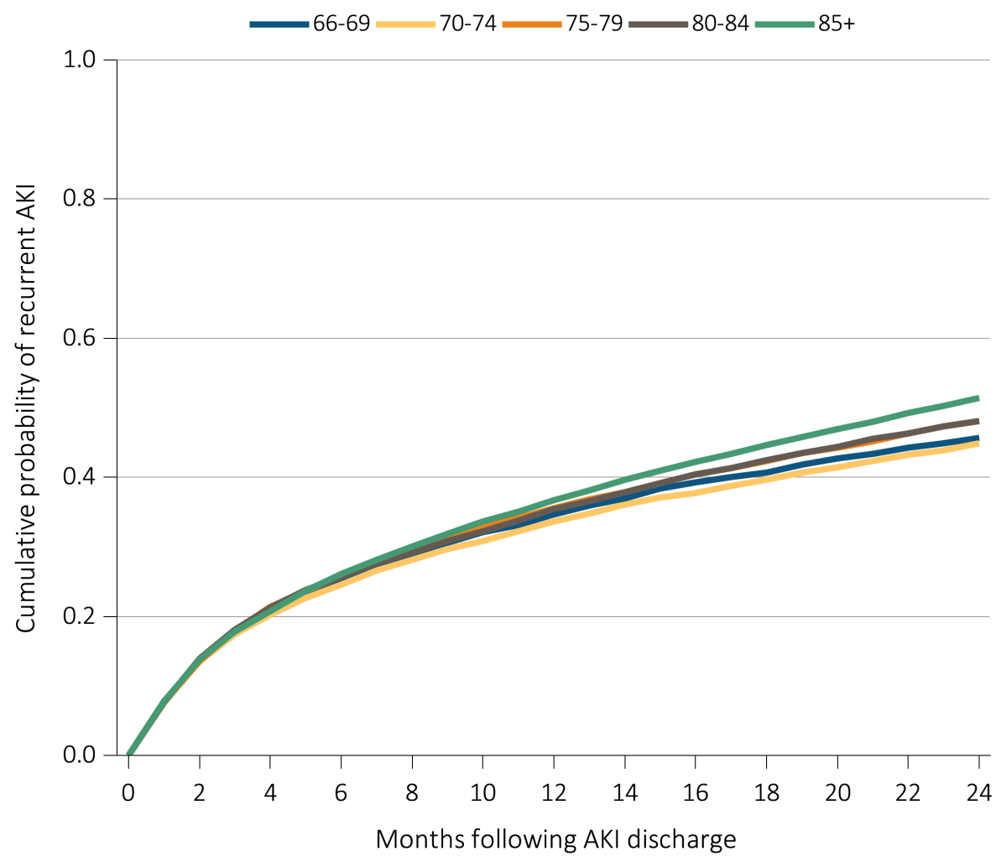
Figure 5.7 Cumulative probability of a recurrent AKI hospitalization within two years of live discharge from first AKI hospitalization in 2011 for Medicare patients aged 66+, (a) overall,
(b) by age, (c) by race, and (d) by chronic kidney disease and diabetes mellitus
(b) Age
Data Source: Special analyses, Medicare 5 percent sample. Age on January 1, 2011. Medicare patients aged 66 and older who had both Medicare Parts A & B, no Medicare Advantage plan, no ESRD by first service date from Medical Evidence form on 1/1/2011 and were discharged alive from an AKI hospitalization in 2011. Censored at death, ESRD, end of Medicare Parts A & B participation, or switch to Medicare Advantage program. Abbreviations: AKI, acute kidney injury; ESRD, end-stage renal disease.

Slide 12
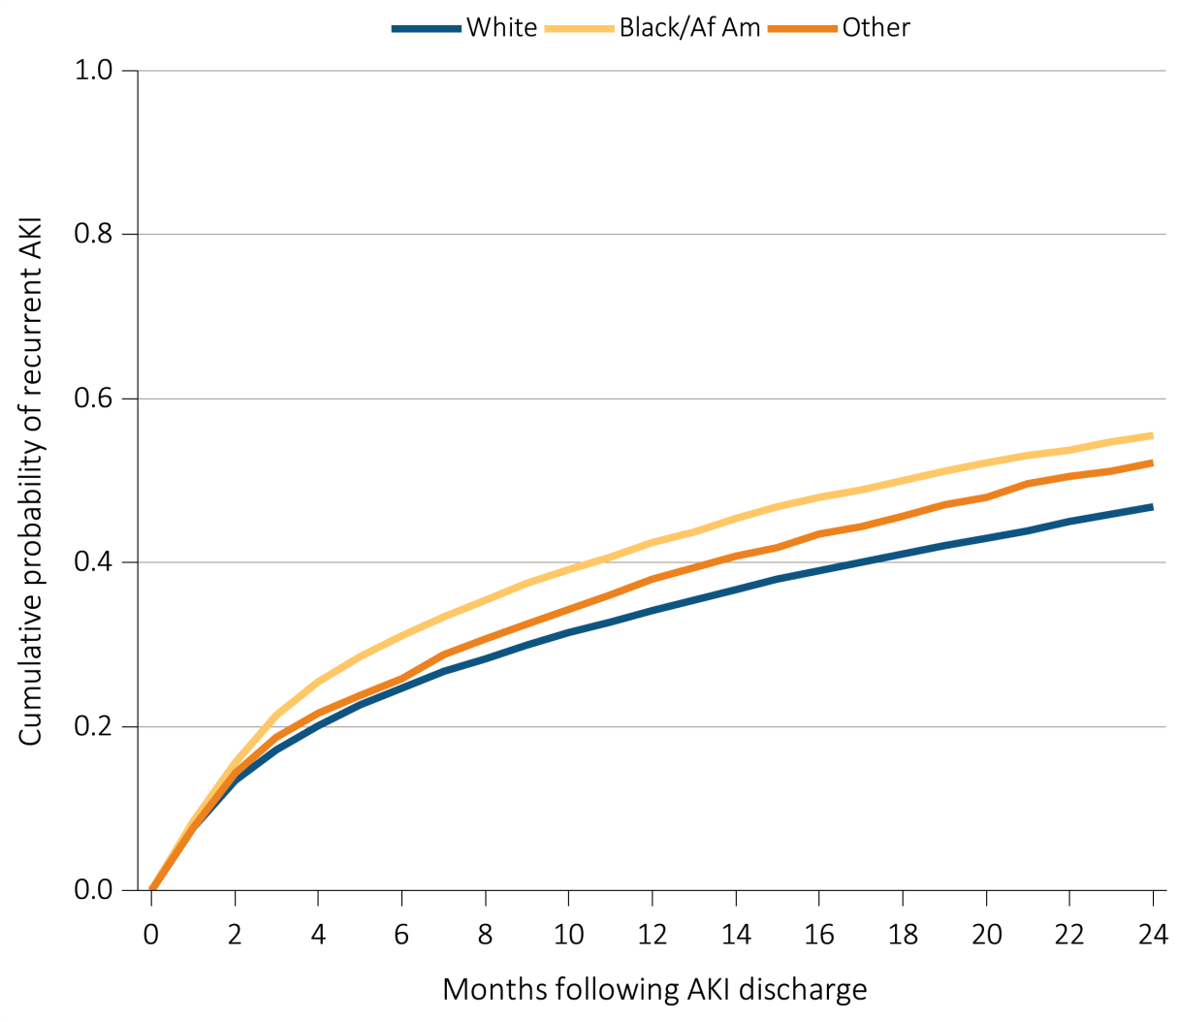
Figure 5.7 Cumulative probability of a recurrent AKI hospitalization within two years of live discharge from first AKI hospitalization in 2011 for Medicare patients aged 66+, (a) overall,
(b) by age, (c) by race, and (d) by chronic kidney disease and diabetes mellitus
(c) Race
Data Source: Special analyses, Medicare 5 percent sample. Age on January 1, 2011. Medicare patients aged 66 and older who had both Medicare Parts A & B, no Medicare Advantage plan, no ESRD by first service date from Medical Evidence form on 1/1/2011 and were discharged alive from an AKI hospitalization in 2011. Censored at death, ESRD, end of Medicare Parts A & B participation, or switch to Medicare Advantage program. Abbreviations: AKI, acute kidney injury; ESRD, end-stage renal disease.

Slide 13
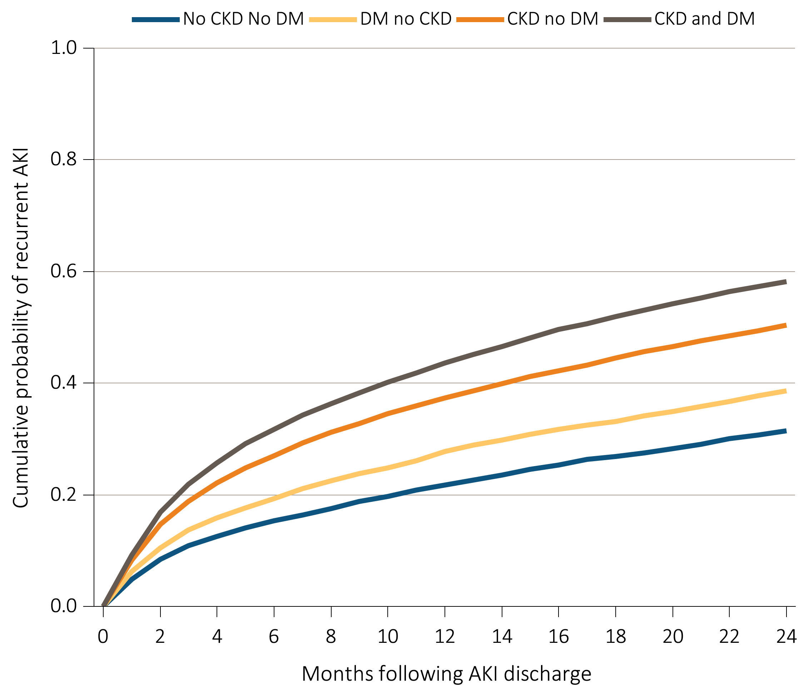
Figure 5.7 Cumulative probability of a recurrent AKI hospitalization within two years of live discharge from first AKI hospitalization in 2011 for Medicare patients aged 66+, (a) overall,
(b) by age, (c) by race, and (d) by chronic kidney disease and diabetes mellitus
(d) Chronic Kidney Disease and Diabetes Mellitus
Data Source: Special analyses, Medicare 5 percent sample. Age on January 1, 2011. Medicare patients aged 66 and older who had both Medicare Parts A & B, no Medicare Advantage plan, no ESRD by first service date from Medical Evidence form on 1/1/2011 and were discharged alive from an AKI hospitalization in 2011. Censored at death, ESRD, end of Medicare Parts A & B participation, or switch to Medicare Advantage program. Abbreviations: AKI, acute kidney injury; ESRD, end-stage renal disease.

Slide 14
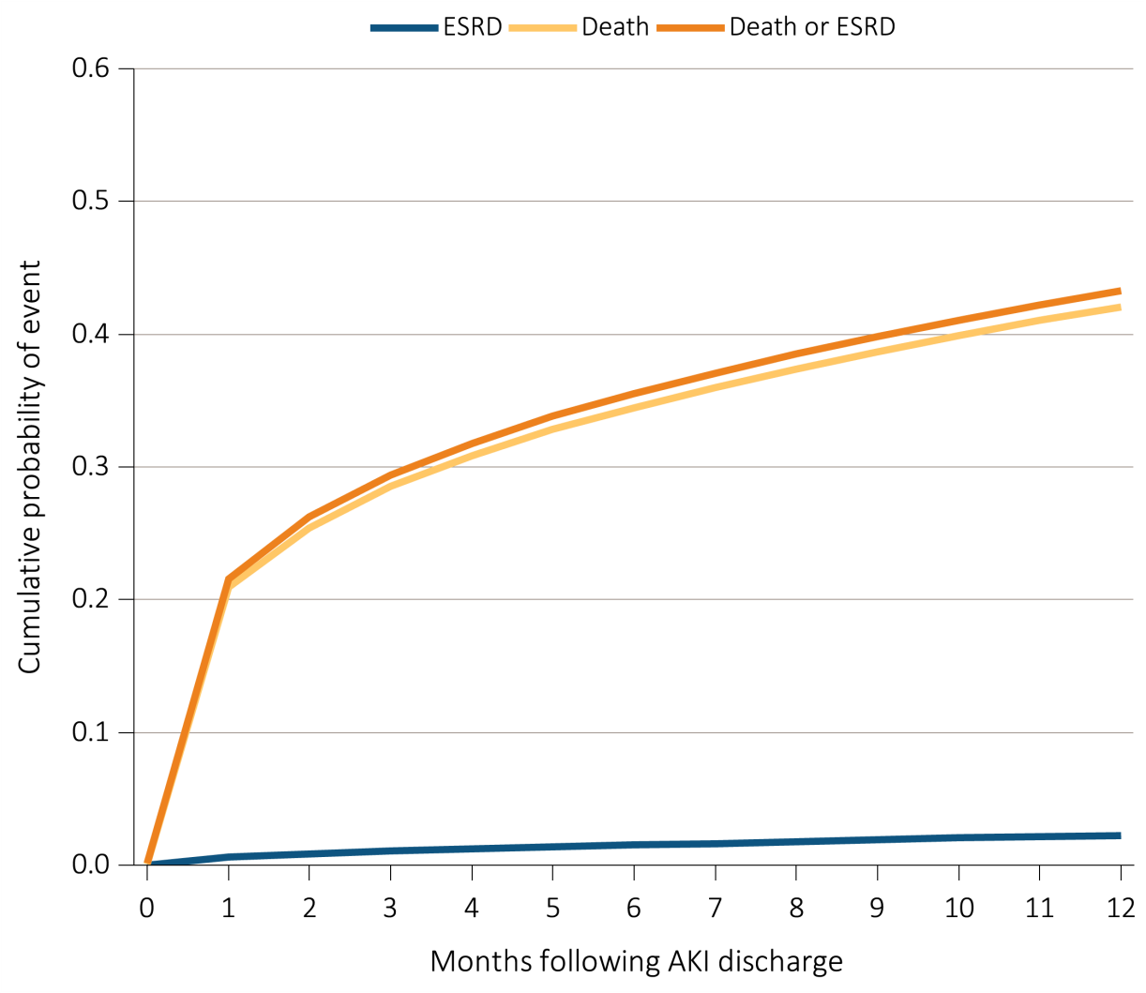
Figure 5.8 Cumulative probability of death-censored ESRD, death, and the composite of death or ESRD within one year of live discharge from first AKI hospitalization
occurring in 2011-2012 for Medicare patients aged 66+
Data Source: Special analyses, Medicare 5 percent sample. Medicare patients aged 66 or older who had both Medicare Parts A & B, no Medicare Advantage plan, no ESRD by first service date from Medical Evidence form, and were discharged alive from a first AKI hospitalization in 2011 or 2012. All models censored at the end of Medicare Parts A & B participation, switch to Medicare Advantage program, or 365 days after AKI discharge. Model for ESRD also is censored at death. Model for death is not censored at the start of ESRD. Abbreviations: AKI, acute kidney injury; ESRD, end-stage renal disease.

Slide 15
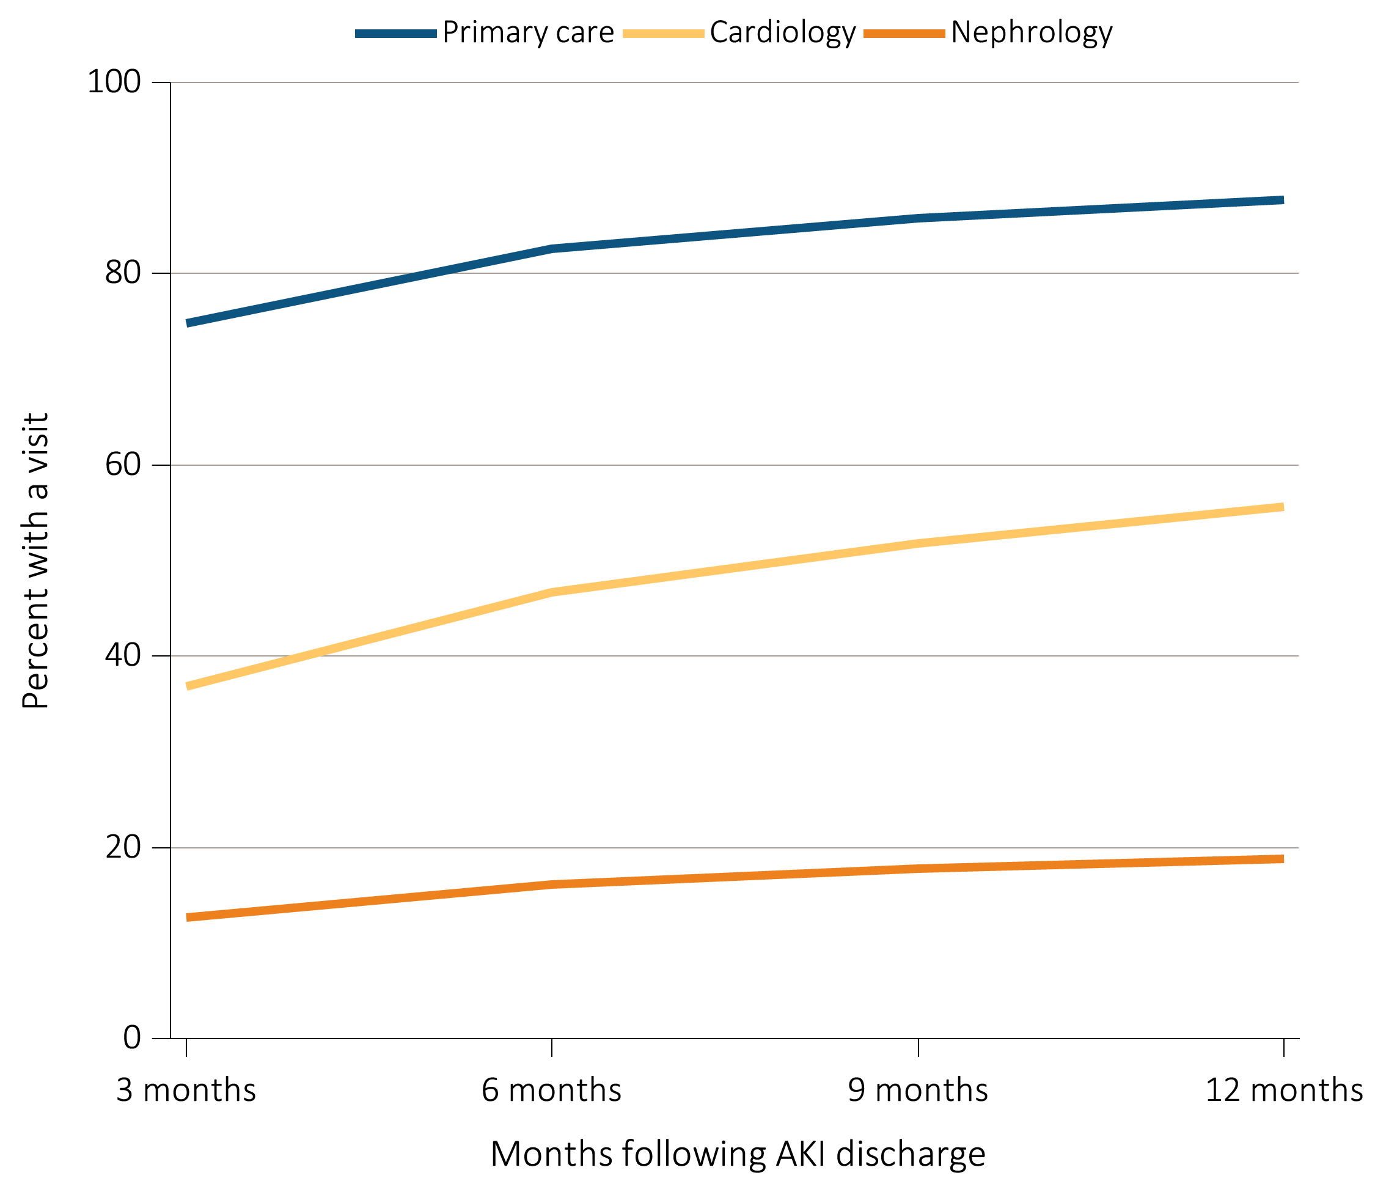
Figure 5.9 Outpatient physician visits within one year of live discharge from first AKI hospitalization in 2012 for Medicare patients aged 66+, by physician specialty and time
Data Source: Special analyses, Medicare 5 percent sample. Medicare patients aged 66 and older who had both Medicare Parts A & B, no Medicare Advantage plan, no ESRD by first service date from Medical Evidence form on 1/1/2012, and were discharged alive from a first AKI hospitalization in 2012. For each time point, the denominator is all patients alive, without ESRD, not in a Medicare Advantage plan and with Medicare Parts A & B. Physician visits are from physician/supplier claims with provider specialty codes for primary care (01, 08-family practice, 11-internal medicine), cardiology (06), and nephrology (39) and claim source indicating an outpatient setting. Abbreviations: AKI, acute kidney injury; ESRD, end-stage renal disease.

Slide 16
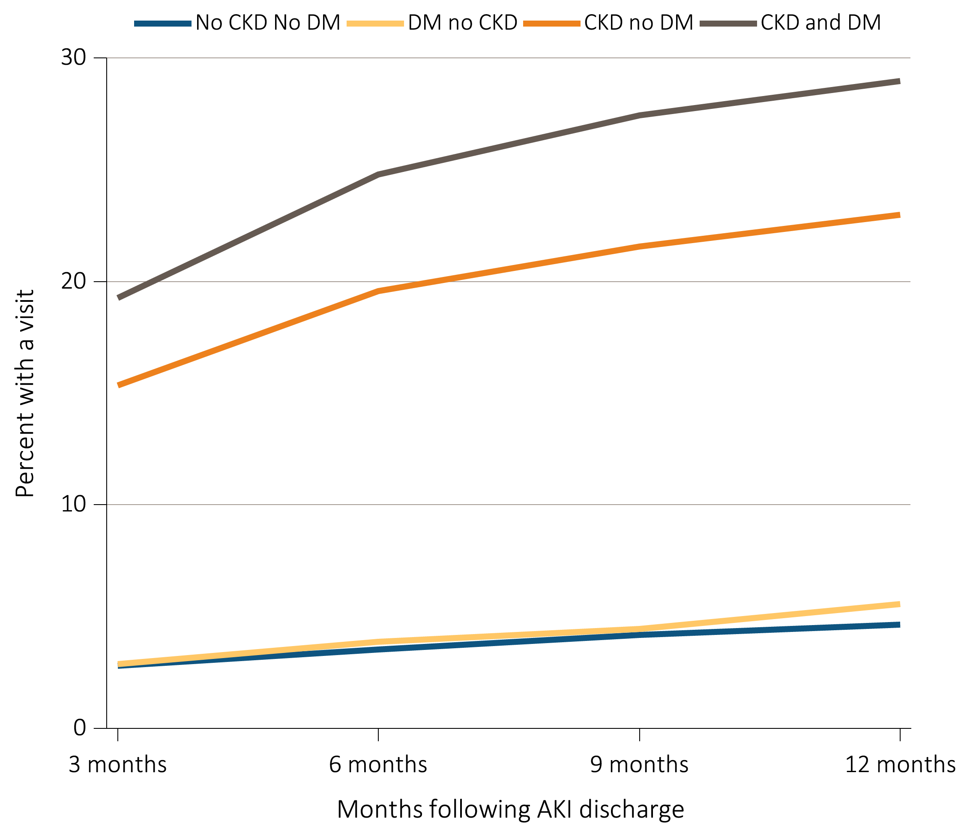
Figure 5.10 Outpatient nephrology visits within one year of live discharge from first AKI hospitalization in 2012 for Medicare patients aged 66+, by CKD, DM, and time
Data Source: Special analyses, Medicare 5 percent sample. Medicare patients aged 66 and older who had both Medicare Parts A & B, no Medicare Advantage plan, no ESRD by first service date from Medical Evidence form on 1/1/2012, and were discharged alive from a first AKI hospitalization in 2012. For each time point, the denominator is all patients alive, without ESRD, not in a Medicare Advantage plan and with Medicare Parts A & B. Physician visits are from physician/supplier claims with provider specialty codes for nephrology (39) and claim source indicating an outpatient setting. Abbreviations: AKI, acute kidney injury; CKD, chronic kidney disease; DM, diabetes mellitus; ESRD, end-stage renal disease.

Slide 17
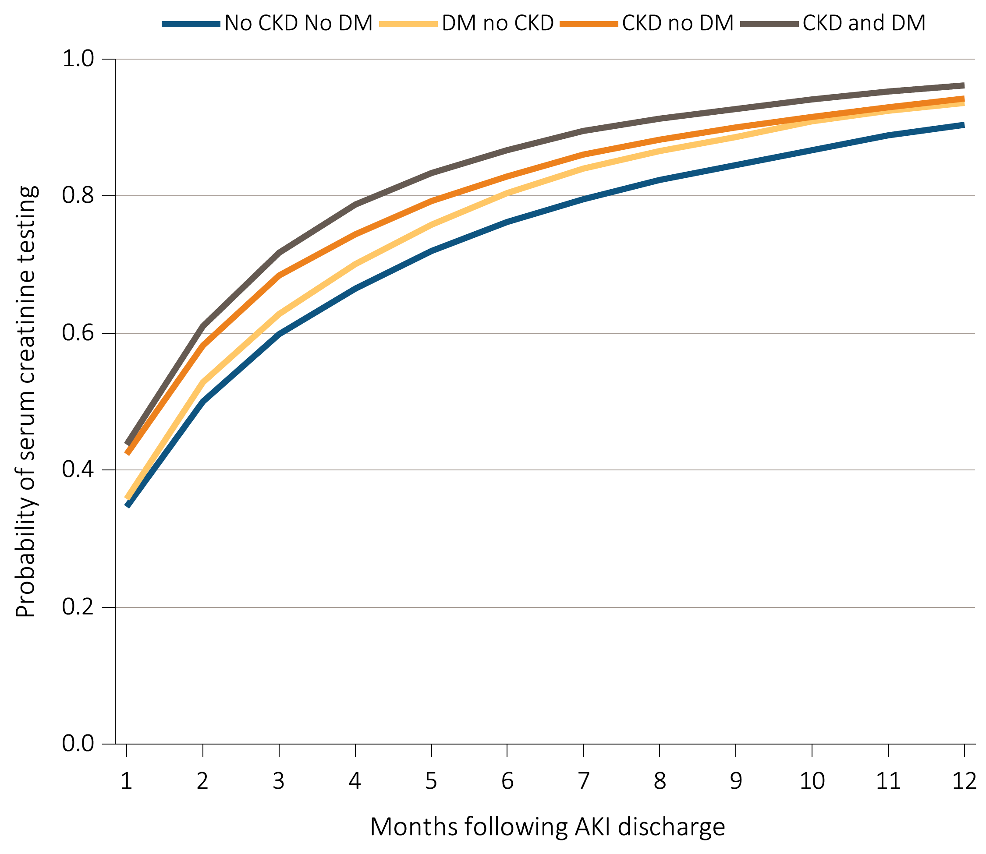
Figure 5.11 Cumulative probability of a claim for a serum creatinine test within one year of live discharge from first AKI hospitalization in 2012 for Medicare patients aged 66+,
^{by CKD, DM, and time}
Data Source: Special analyses, Medicare 5 percent sample. Medicare patients aged 66 and older who had both Medicare Parts A & B, no Medicare Advantage plan, no ESRD by first service date from Medical Evidence form on 1/1/2012, and were discharged alive from a first AKI hospitalization in 2012. Date of first serum creatinine test following AKI discharge is from inpatient and outpatient claims with healthcare common procedure coding system (HCPCS) codes of 80048, 80050, 80053, 80069, or 82565. Censored at death, ESRD, end of Medicare Parts A & B participation, or switch to Medicare Advantage program. Abbreviations: AKI, acute kidney injury; CKD, chronic kidney disease; DM, diabetes mellitus; ESRD, end-stage renal disease.

Slide 18
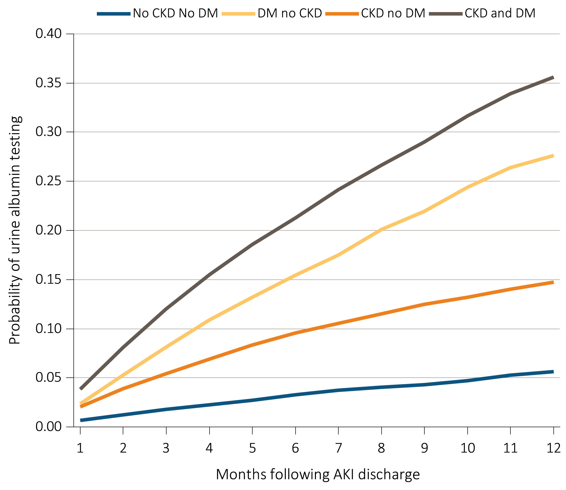
Figure 5.12 Cumulative probability of a claim for an urine albumin test within one year of
live discharge from first AKI hospitalization in 2012 for Medicare patients aged 66+,
^{by CKD, DM, and time}
Data Source: Special analyses, Medicare 5 percent sample. Medicare patients aged 66 and older who had both Medicare Parts A and B, no Medicare Advantage plan, no ESRD by first service date from Medical Evidence form on 1/1/2012, and were discharged alive from a first AKI hospitalization in 2012. Date of first urine albumin test following AKI discharge is from inpatient and outpatient claims with healthcare common procedure coding system (HCPCS) codes of 82042, 82043, 82044, or 84156. Censored at death, ESRD, end of Medicare Parts A & B participation, or switch to Medicare Advantage program. Abbreviations: AKI, acute kidney injury; CKD, chronic kidney disease; DM, diabetes mellitus; ESRD, end-stage renal disease.

Slide 19
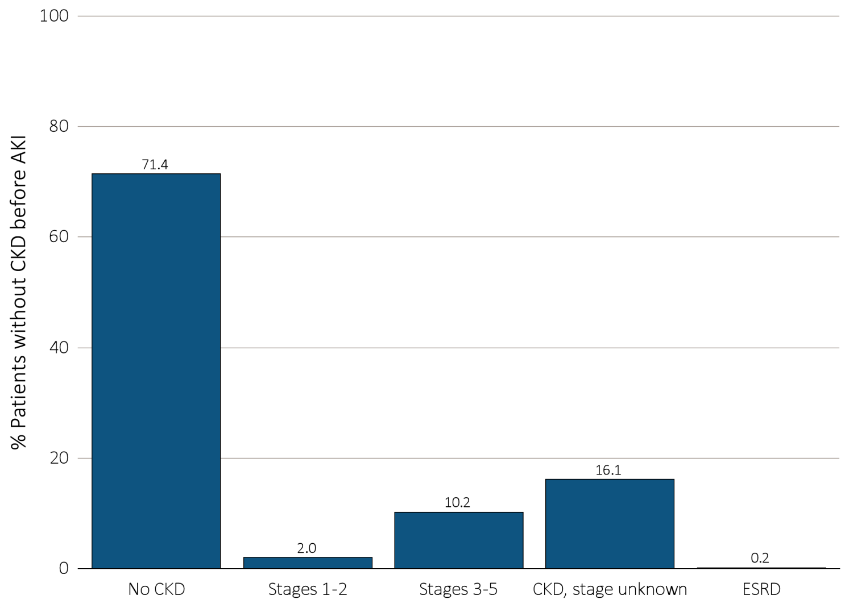
Figure 5.13 Renal status one year following discharge from AKI hospitalization in 2011-2012, among surviving Medicare patients aged 66+ without kidney disease
prior to AKI hospitalization, by CKD stage and ESRD status
Data Source: Special analyses, Medicare 5 percent sample. Medicare patients aged 66 and older who had both Medicare Parts A & B, no Medicare Advantage plan, did not have ESRD, were discharged alive from a first AKI hospitalization in 2011 or 2012, and did not have any claims with a diagnosis of CKD in the 365 days prior to the AKI. Renal status after AKI determined from claims between discharge from AKI hospitalization and 365 days after discharge. Stage determined by 585.x claim closest to 365 days after discharge; ESRD by first service date on Medical Evidence form. Abbreviations: AKI, acute kidney injury; CKD, chronic kidney disease; ESRD, end-stage renal disease.

Slide 20
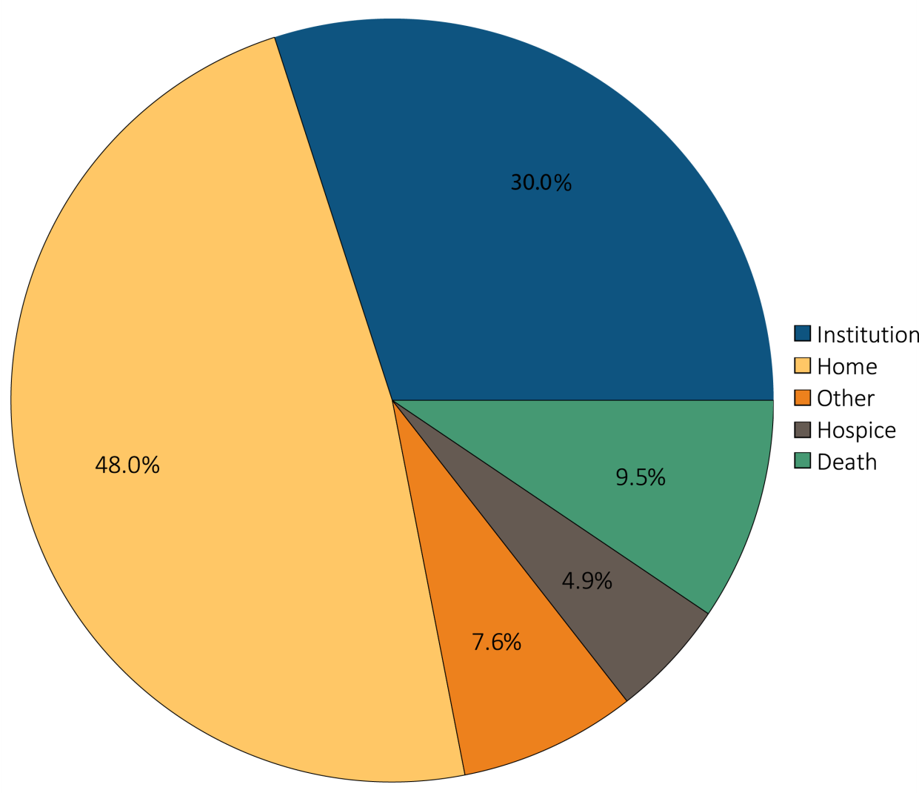
Figure 5.14 Hospital discharge status of first AKI hospitalization for
Medicare patients aged 66+, 2013
Data Source: Special analyses, Medicare 5 percent sample. Medicare patients aged 66 or older who had both Medicare Parts A & B, no Medicare Advantage plan, did not have ESRD on 1/1/2013 and had a first AKI hospitalization in 2013. Institution includes short-term skilled nursing facilities, rehabilitation hospitals, and long-term care facilities. Home also includes patients receiving home health care services. Excludes patients admitted to the acute care hospital from a skilled nursing facility. Abbreviations: AKI, acute kidney injury; ESRD, end-stage renal disease.

