Slide 2
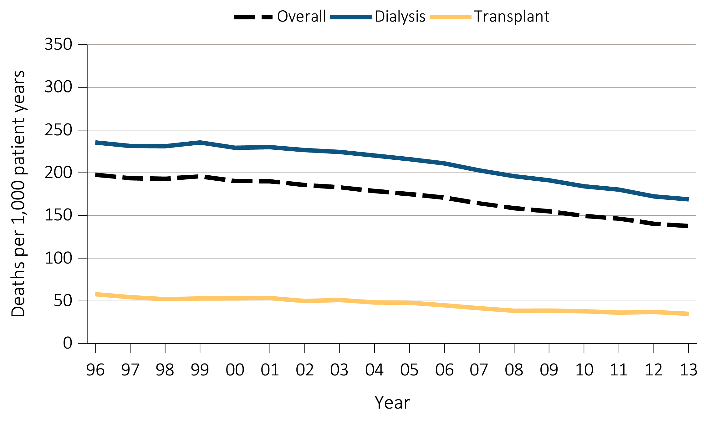
Figure 6.1a Adjusted all-cause mortality (deaths per 1,000 patient-years) by treatment modality: overall, dialysis, and transplant for period-prevalent patients, 1996-2013
Data Source: Reference Tables H.2_adj, H4_adj, H.8_adj, H.9_adj, and H.10_adj; and special analyses, USRDS ESRD Database. Adjusted for age, sex, race, ethnicity, primary diagnosis and vintage. Ref: period prevalent ESRD patients, 2011. Abbreviations: HD, hemodialysis; PD, peritoneal dialysis.

Slide 3
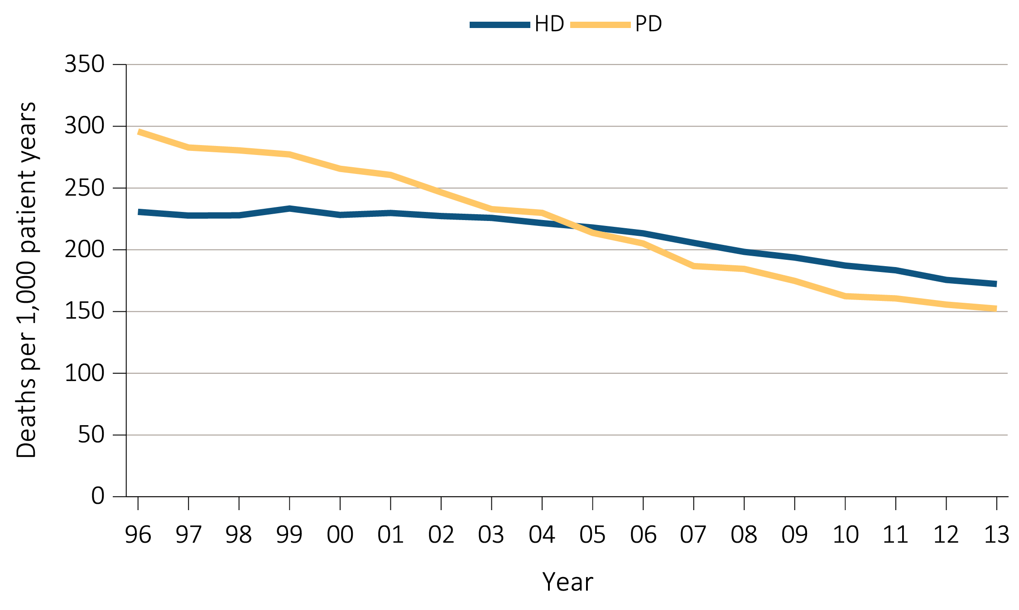
Figure 6.1b Adjusted all-cause mortality (deaths per 1,000 patient-years) by treatment modality: hemodialysis and peritoneal dialysis for period-prevalent patients, 1996-2013
Data Source: Reference Tables H.2_adj, H4_adj, H.8_adj, H.9_adj, and H.10_adj; and special analyses, USRDS ESRD Database. Adjusted for age, sex, race, ethnicity, primary diagnosis and vintage. Ref: period prevalent ESRD patients, 2011. Abbreviations: HD, hemodialysis; PD, peritoneal dialysis.

Slide 4
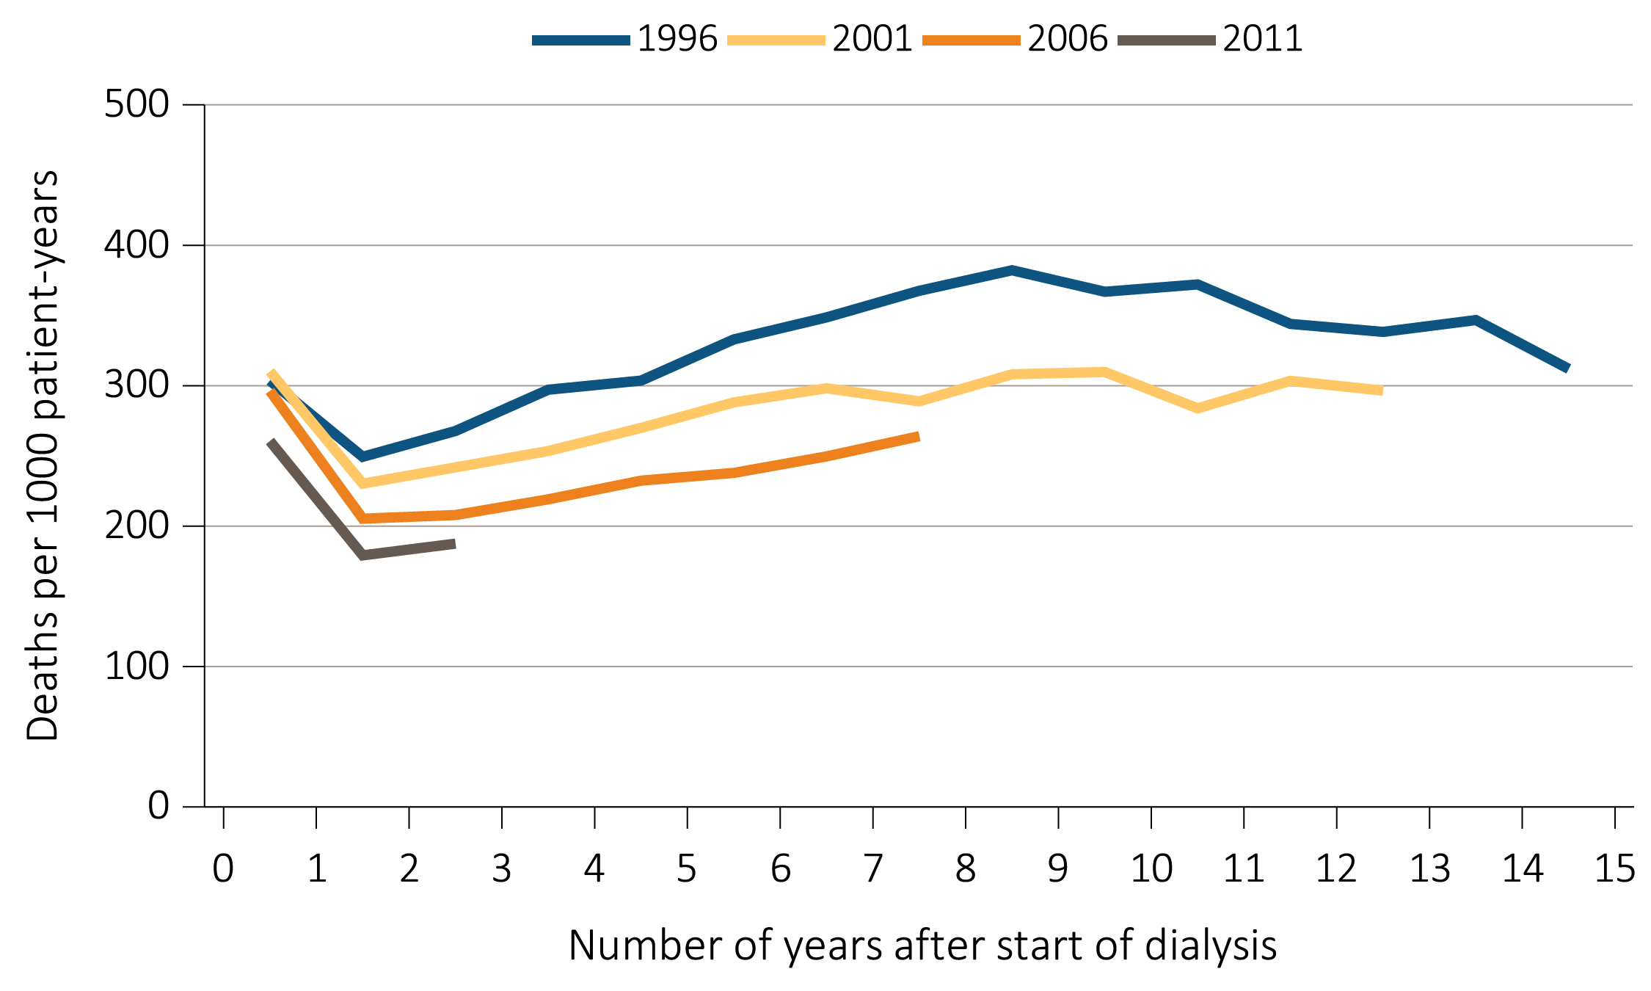
Figure 6.2a Adjusted all-cause mortality (deaths per 1,000 patient-years) by treatment modality, cohort (year of ESRD onset), and number of years after start of dialysis among incident hemodialysis patients, 1996, 2001, 2006, and 2011
Data Source: Special analyses, USRDS ESRD Database. Adjusted for age, sex, race, and primary diagnosis. Ref: period prevalent ESRD patients, 2011. Abbreviation: ESRD, end-stage renal disease.

Slide 5
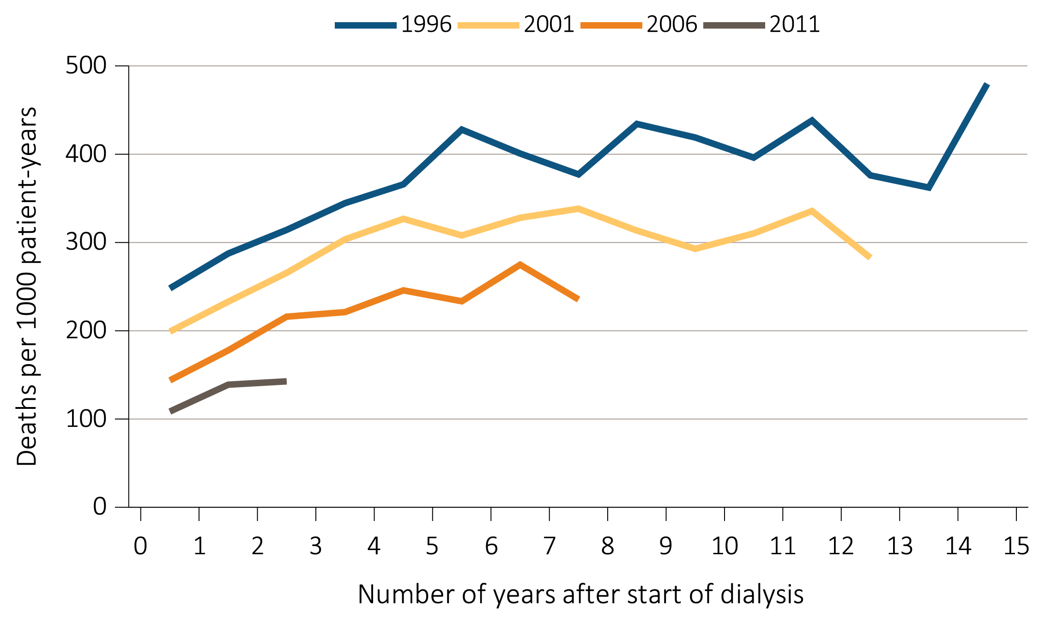
Figure 6.2b Adjusted all-cause mortality (deaths per 1,000 patient-years) by treatment modality, cohort (year of ESRD onset), and number of years after start of dialysis among incident peritoneal dialysis patients, 1996, 2001, 2006, and 2011
Data Source: Special analyses, USRDS ESRD Database. Adjusted for age, sex, race, and primary diagnosis. Ref: period prevalent ESRD patients, 2011. Abbreviation: ESRD, end-stage renal disease.

Slide 6
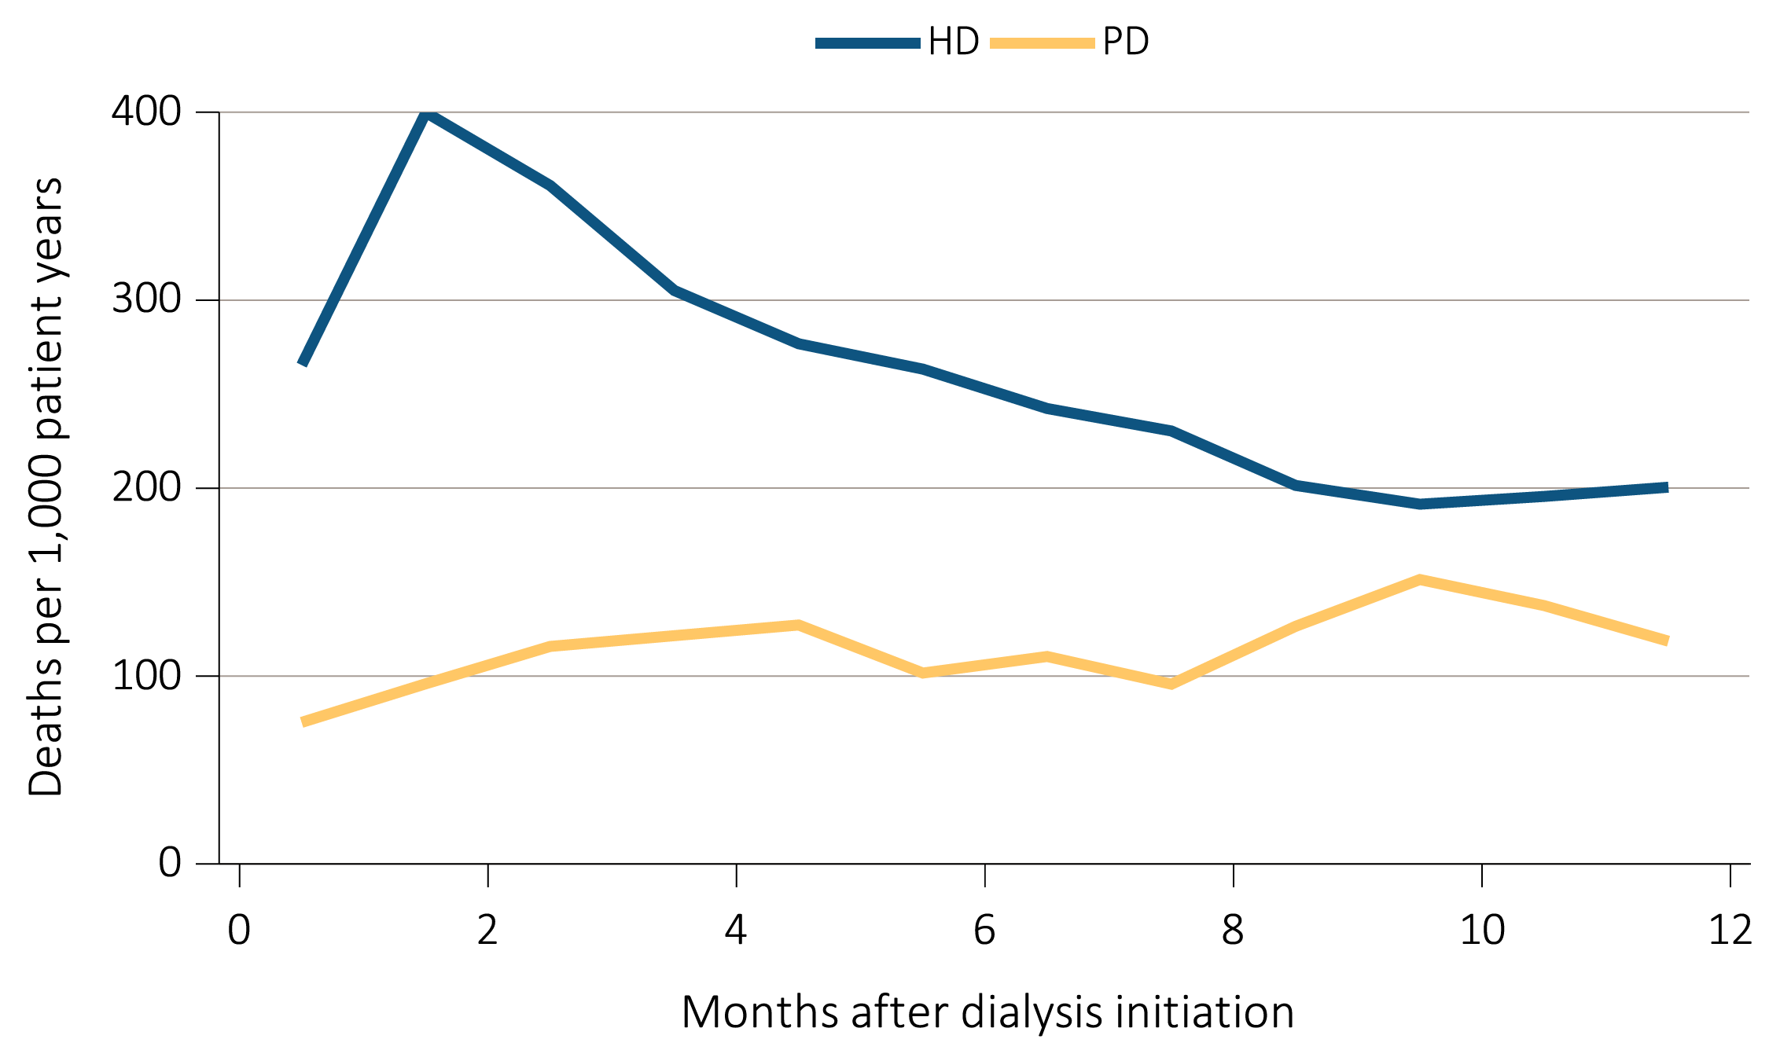
Figure 6.3 Adjusted mortality (deaths per 1000 patient-years) by treatment modality and number of months after treatment initiation among ESRD patients, 2012
Data Source: Special analyses, USRDS ESRD Database. Adjusted (age, race, sex, ethnicity, and primary diagnosis) mortality among 2012 incident ESRD patients during the first year of therapy. Ref: incident ESRD patients, 2011. Abbreviations: ESRD, end-stage renal disease; HD, hemodialysis; PD, peritoneal dialysis.

Slide 7
Table 6.1 Adjusted all-cause mortality (deaths per 1,000 patient-years)
by patient age and race among ESRD patients, 2012
Age | Race | ESRD | Dialysis | Transplant
0-21 | White | 12 | 31 | 4
 | Black/African American | 20 | 35 | 4
 | Other | 14 | 29 | 7
22-44 | White | 37 | 62 | 9
 | Black/African American | 48 | 60 | 10
 | Other | 24 | 38 | 6
45-64 | White | 99 | 143 | 30
 | Black/African American | 98 | 114 | 29
 | Other | 71 | 99 | 21
65-74 | White | 197 | 245 | 70
 | Black/African American | 167 | 183 | 71
 | Other | 137 | 171 | 61
75+ | White | 359 | 382 | 136
 | Black/African American | 275 | 283 | 132
 | Other | 239 | 254 | 112
Data Source: Special analyses, USRDS ESRD Database. Adjusted (sex and primary diagnosis) all-cause mortality among 2012 period prevalent patients. Ref: period prevalent ESRD patients, 2011. Abbreviation: ESRD, end-stage renal disease.

Slide 8
Table 6.2 Unadjusted percentages of deaths due to cardiovascular disease (CVD), infection, other specified causes, and with missing data, by modality among ESRD patients, 2012
 | Cause-specific mortality
 | CVD | Infection | Other cause | Missing cause
Modality
ESRD | 39% | 9% | 26% | 26%
Dialysis | 41% | 9% | 27% | 23%
Transplant | 11% | 6% | 16% | 68%
Data Source: Special analyses, USRDS ESRD Database. Adjusted (age, race, sex, ethnicity, and primary diagnosis) all-cause mortality among 2012 prevalent patients. Ref: period prevalent ESRD patients, 2011. Abbreviations: CVD, cardiovascular disease; ESRD, end-stage renal disease.

Slide 9
Table 6.3a Adjusted survival (%) by treatment modality and incident cohort year (year of ESRD onset),
for ESRD patients in the 2008 incident cohort (initiating ESRD treatment in 2008)
 | 3 months | 12 months | 24 months | 36 months | 60 months
Hemodialysis
2000 | 91.0 | 74.4 | 60.6 | 50.1 | 34.5
2002 | 91.0 | 74.6 | 61.1 | 50.7 | 35.9
2004 | 91.0 | 74.8 | 61.9 | 51.8 | 37.3
2006 | 91.1 | 75.4 | 63.0 | 53.4 | 38.8
2008 | 91.4 | 76.3 | 64.4 | 54.7 | 40.2
Peritoneal dialysis
2000 | 94.7 | 80.3 | 64.3 | 52.8 | 37.3
2002 | 95.8 | 82.9 | 68.4 | 57.0 | 41.6
2004 | 96.1 | 84.8 | 71.8 | 60.8 | 45.7
2006 | 96.9 | 86.4 | 73.7 | 62.4 | 47.1
2008 | 97.4 | 88.5 | 76.4 | 66.4 | 50.3
Deceased-donor transplant
2000 | 94.5 | 88.1 | 82.7 | 77.9 | 65.8
2002 | 95.1 | 89.9 | 84.4 | 79.5 | 68.8
2004 | 96.1 | 90.4 | 85.5 | 79.8 | 69.7
2006 | 96.0 | 91.4 | 86.9 | 82.7 | 72.4
2008 | 96.8 | 92.8 | 88.7 | 84.6 | 74.6
Living donor transplant
2000 | 97.0 | 93.2 | 88.7 | 84.9 | 74.8
2002 | 97.6 | 94.2 | 90.0 | 86.3 | 77.6
2004 | 98.2 | 95.3 | 92.4 | 88.9 | 81.8
2006 | 98.6 | 96.3 | 93.7 | 90.8 | 83.5
2008 | 98.7 | 97.1 | 94.9 | 92.2 | 86.9
Data Source: Reference Tables I.1_adj-I.36_adj. Adjusted survival probabilities, from day one, in the ESRD population. Ref: incident ESRD patients, 2011. Adjusted for age, sex, race, Hispanic ethnicity, and primary diagnosis. Abbreviation: ESRD, end-stage renal disease.

Slide 10
Table 6.3b Adjusted survival (%) by age, sex, race, and primary cause of ESRD, for ESRD patients
in the 2008 incident cohort (initiating ESRD treatment in 2008)
2008 cohort | 3 months | 12 months | 24 months | 36 months | 60 months
Age
0-21 | 98.5 | 95.3 | 93.2 | 91.8 | 88.7
22-44 | 97.6 | 91.8 | 86.4 | 81.7 | 73.8
45-64 | 95.3 | 85.6 | 76.4 | 68.3 | 54.5
65-74 | 91.1 | 75.0 | 61.8 | 50.9 | 34.1
75+ | 85.1 | 62.2 | 45.6 | 33.2 | 17.1
Sex
Male | 91.8 | 77.6 | 65.9 | 56.4 | 42.4
Female | 92.0 | 77.9 | 66.5 | 57.2 | 42.8
Race
White | 91.2 | 76.3 | 64.2 | 54.6 | 40.2
Black/African American | 93.1 | 79.7 | 69.1 | 60.1 | 46.1
Native American | 92.5 | 78.6 | 65.8 | 55.9 | 42.4
Asian | 95.3 | 85.1 | 75.4 | 67.0 | 53.9
Other | 90.1 | 71.6 | 57.7 | 47.2 | 34.4
Primary cause of ESRD
Diabetes | 92.9 | 78.3 | 65.2 | 54.3 | 37.9
Hypertension | 92.2 | 78.8 | 67.7 | 58.6 | 44.6
Glomerulonephritis | 94.4 | 83.8 | 74.6 | 66.8 | 55.1
Other | 90.1 | 71.6 | 57.7 | 47.2 | 34.4
All patients | 91.9 | 77.7 | 66.2 | 56.8 | 42.6
Data Source: Reference Tables I.1_adj-I.36_adj. Adjusted survival probabilities, from day one, in the ESRD population. Ref: incident ESRD patients, 2011. Adjusted for age, sex, race, Hispanic ethnicity, and primary diagnosis. Abbreviation: ESRD, end-stage renal disease.

Slide 11
Table 6.4 Expected remaining lifetime (years) by age, sex, and treatment modality of prevalent dialysis patients, prevalent transplant patients, and the general U.S. population (2012), based on USRDS data and the National Vital Statistics Report (2013)
 | ESRD patients, 2013 |  |  |  |  | General U.S. population, 2012
 | Dialysis |  | Transplant
Age | Male | Female | Male | Female |  | Male | Female
0-14 | 24.1 | 22.4 | 59.2 | 61.2 |  | 70.7 | 75.4
15-19 | 20.9 | 19.3 | 46.8 | 48.6 |  | 59.7 | 64.4
20-24 | 18.1 | 16.5 | 42.5 | 44.2 |  | 55.0 | 59.5
25-29 | 15.8 | 14.3 | 38.6 | 40.2 |  | 50.3 | 54.6
30-34 | 14.1 | 13.0 | 34.7 | 36.4 |  | 45.7 | 49.7
35-39 | 12.5 | 11.7 | 30.8 | 32.4 |  | 41.0 | 45.0
40-44 | 10.8 | 10.3 | 26.9 | 28.6 |  | 36.4 | 40.3
45-49 | 9.1 | 8.8 | 23.2 | 24.8 |  | 31.9 | 35.6
50-54 | 7.7 | 7.7 | 19.8 | 21.3 |  | 27.7 | 31.1
55-59 | 6.5 | 6.6 | 16.6 | 18.1 |  | 23.7 | 26.8
60-64 | 5.5 | 5.7 | 13.8 | 15.2 |  | 19.8 | 22.6
65-69 | 4.5 | 4.8 | 11.4 | 12.7 |  | 16.2 | 18.5
70-74 | 3.8 | 4.0 | 9.4 | 10.4 |  | 12.8 | 14.7
75-79 | 3.2 | 3.5 | 7.7a | 8.6a |  | 9.8 | 11.3
80-84 | 2.6 | 2.9 |  |  |  | 7.1 | 8.4
85+ | 2.1 | 2.4 |  |  |  | 4.9 | 5.8
Data Source: Reference Table H.13; special analyses, USRDS ESRDS Database; and National Vital Statistics Report. “Table 7. Life expectancy at selected ages, by race, Hispanic origin, race for non-Hispanic population, and sex: United States, 2012 (2015).” Expected remaining lifetimes (years) of the general U.S. population and of period prevalent dialysis and transplant patients. acell values combine ages 75+. Abbreviation: ESRD, end-stage renal disease.

Slide 12
Table 6.5 Adjusted mortality (deaths per 1,000 patient-years) by age, sex, treatment modality, and Medicare comorbidity among ESRD patients and people covered
by Medicare in 2013, based on USRDS and CMS data, 2013
Age | Sex | Dialysis | Transplant | All Medicare | Cancer | Diabetes | CHF | CVA/TIA | AMI
65-74 | Male | 235 | 68 | 27 | 75 | 42 | 107 | 75 | 91
 | Female | 214 | 60 | 18 | 69 | 31 | 99 | 56 | 96
75+ | Male | 357 | 126 | 91 | 135 | 109 | 232 | 167 | 202
 | Female | 321 | 122 | 85 | 139 | 104 | 229 | 156 | 212
Data Source: Special analyses, USRDS ESRD Database and Medicare 5 percent sample. Adjusted for race. Medicare data limited to patients with at least one month of Medicare eligibility in 2013. Ref: Medicare patients, 2013. Abbreviations: AMI, acute myocardial infarction; CHF, congestive heart failure; CMS, Centers for Medicare & Medicaid; CVA/TIA, cerebrovascular accident/transient ischemic attack; ESRD, end-stage renal disease.

Slide 13
Table 6.6a Adjusted mortality (deaths per 1,000 patient-years) by calendar year, treatment modality, and Medicare comorbidity among ESRD patients and comorbidity-specific Medicare populations aged 65 & older, 1996-2005
 | 1996 | 1997 | 1998 | 1999 | 2000 | 2001 | 2002 | 2003 | 2004 | 2005
Modality
ESRD | 338 | 357 | 382 | 390 | 375 | 382 | 380 | 391 | 406 | 335
Dialysis | 349 | 368 | 392 | 402 | 389 | 399 | 400 | 415 | 437 | 365
Transplant | 79 | 87 | 110 | 82 | 73 | 76 | 81 | 118 | 100 | 95
Medicare data comorbidities | 151 | 146 | 137 | 140 | 142 | 113 | 122 | 120 | 118 | 107
Cancer | 80 | 76 | 76 | 82 | 77 | 68 | 69 | 66 | 61 | 61
Diabetes | 170 | 155 | 154 | 155 | 154 | 141 | 143 | 138 | 132 | 131
CHF | 124 | 117 | 116 | 126 | 116 | 105 | 111 | 102 | 97 | 96
CVA/TIA | 157 | 132 | 126 | 148 | 142 | 118 | 128 | 119 | 109 | 106
AMI | 338 | 357 | 382 | 390 | 375 | 382 | 380 | 391 | 406 | 335
Data Source: Special analyses, USRDS ESRD Database, and Medicare 5 percent sample. Unadjusted and adjusted (sex and race) mortality rates starting with the January 1 point prevalent sample in the ESRD and general populations, aged 65 and older (per 1,000 patient-years at risk). Ref: period prevalent ESRD patients, 2012. Abbreviations: AMI, acute myocardial infarction; CHF, congestive heart failure; CVA/TIA, cerebrovascular accident/transient ischemic attack; ESRD, end-stage renal disease.

Slide 14
Table 6.6b Adjusted mortality (deaths per 1,000 patient-years) by calendar year, treatment modality, and Medicare comorbidity among ESRD patients and comorbidity-specific Medicare populations aged 65 & older, 1996, 2006-2013
 | 1996 | … | 2005 | 2006 | 2007 | 2008 | 2009 | 2010 | 2011 | 2012 | 2013 | Decline 1996- 2012
Modality
ESRD | 338 |  | 335 | 280 | 271 | 261 | 266 | 257 | 265 | 222 | 174 | 48%
Dialysis | 349 |  | 365 | 310 | 307 | 298 | 313 | 307 | 328 | 288 | 219 | 37%
Transplant | 79 |  | 95 | 82 | 74 | 96 | 91 | 91 | 94 | 85 | 72 | 9%
Medicare data comorbidities | 151 |  | 107 | 110 | 106 | 107 | 102 | 98 | 99 | 100 | 99 | 34%
Cancer | 80 |  | 61 | 60 | 58 | 57 | 55 | 52 | 52 | 53 | 54 | 32%
Diabetes | 170 |  | 131 | 130 | 134 | 131 | 128 | 125 | 120 | 128 | 131 | 23%
CHF | 124 |  | 96 | 98 | 95 | 90 | 89 | 89 | 84 | 92 | 91 | 27%
CVA/TIA | 157 |  | 106 | 118 | 113 | 117 | 109 | 121 | 117 | 127 | 125 | 20%
AMI | 338 |  | 335 | 280 | 271 | 261 | 266 | 257 | 265 | 222 | 174 | 48%
Data Source: Special analyses, USRDS ESRD Database, and Medicare 5 percent sample. Unadjusted and adjusted (sex and race) mortality rates starting with the January 1 point prevalent sample in the ESRD and general populations, aged 65 and older (per 1,000 patient-years at risk). Ref: period prevalent ESRD patients, 2012. Abbreviations: AMI, acute myocardial infarction; CHF, congestive heart failure; CVA/TIA, cerebrovascular accident/transient ischemic attack; ESRD, end-stage renal disease.

