Slide 2
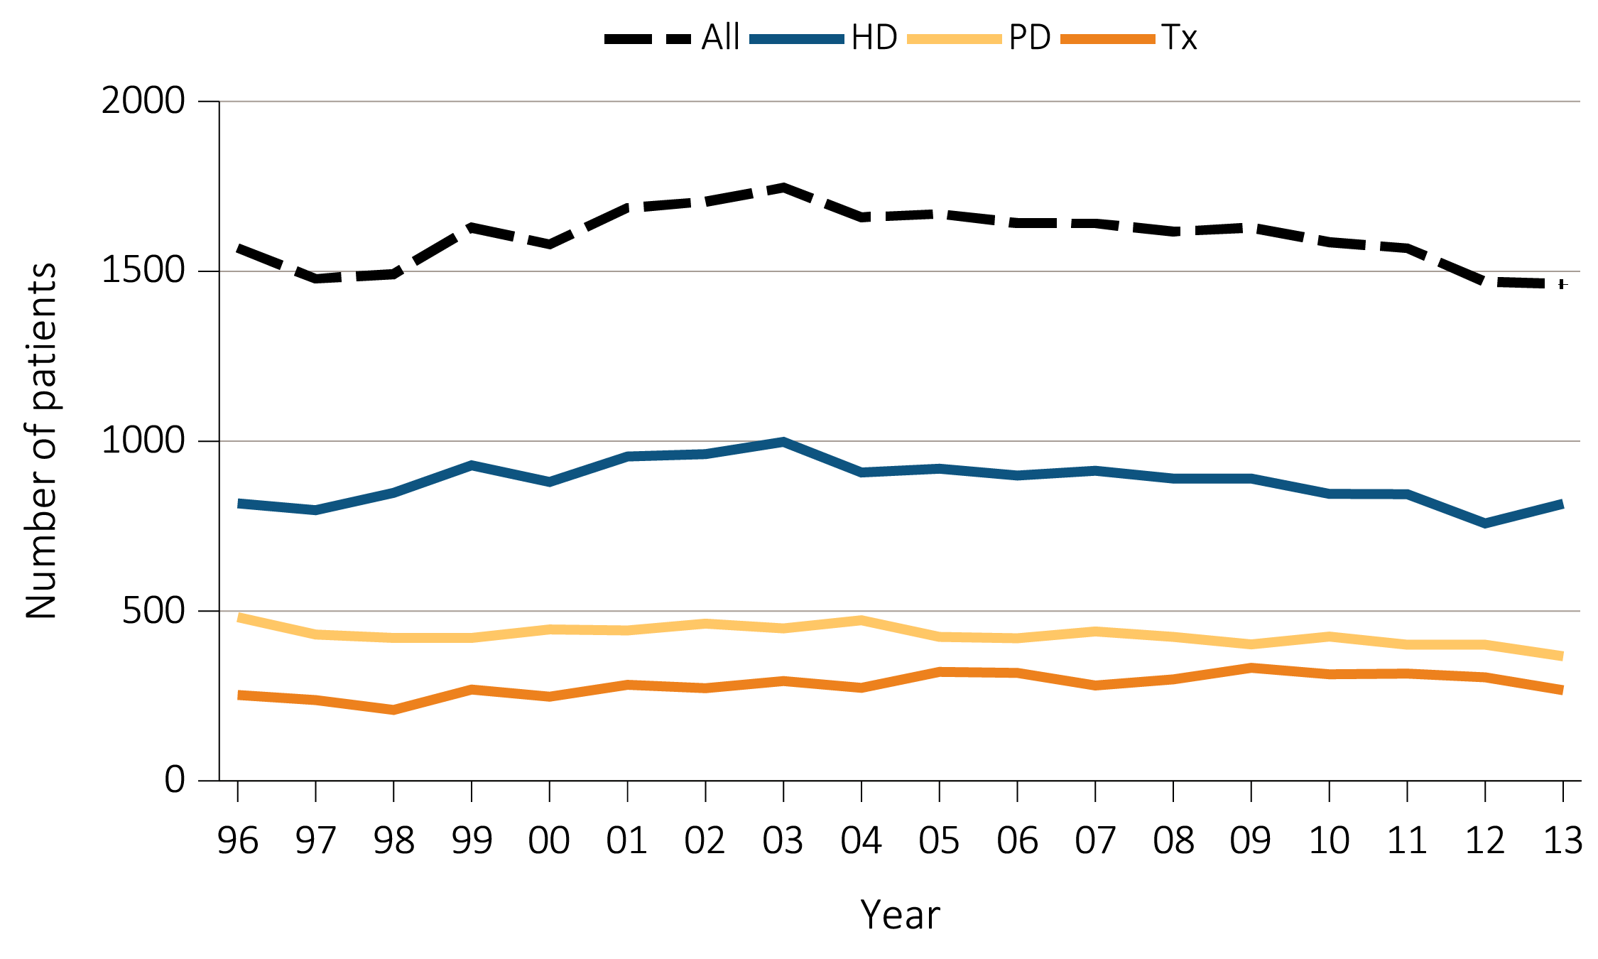
Figure 8.1 Number of (a) incident and (b) December 31 point prevalent ESRD
pediatric patients (aged 0–21 years), by modality, 1996-2013
Incident
Data Source: Special analyses, USRDS ESRD Database. Peritoneal dialysis consists of continuous ambulatory peritoneal dialysis and continuous cycling peritoneal dialysis. All consists of hemodialysis, peritoneal dialysis, uncertain dialysis, and transplant. Abbreviations: ESRD, end-stage renal disease; HD, hemodialysis; PD, peritoneal dialysis; Tx, transplant.

Slide 3
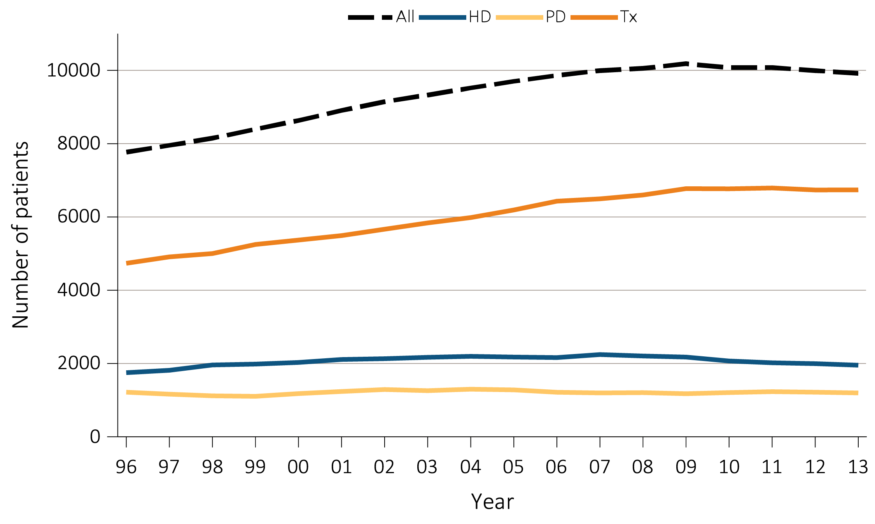
Figure 8.1 Number of (a) incident and (b) December 31 point prevalent ESRD
pediatric patients (aged 0–21 years), by modality, 1996-2013
(b) Point prevalent
Data Source: Special analyses, USRDS ESRD Database. Peritoneal dialysis consists of continuous ambulatory peritoneal dialysis and continuous cycling peritoneal dialysis. All consists of hemodialysis, peritoneal dialysis, uncertain dialysis, and transplant. Abbreviations: ESRD, end-stage renal disease; HD, hemodialysis; PD, peritoneal dialysis; Tx, transplant.

Slide 4
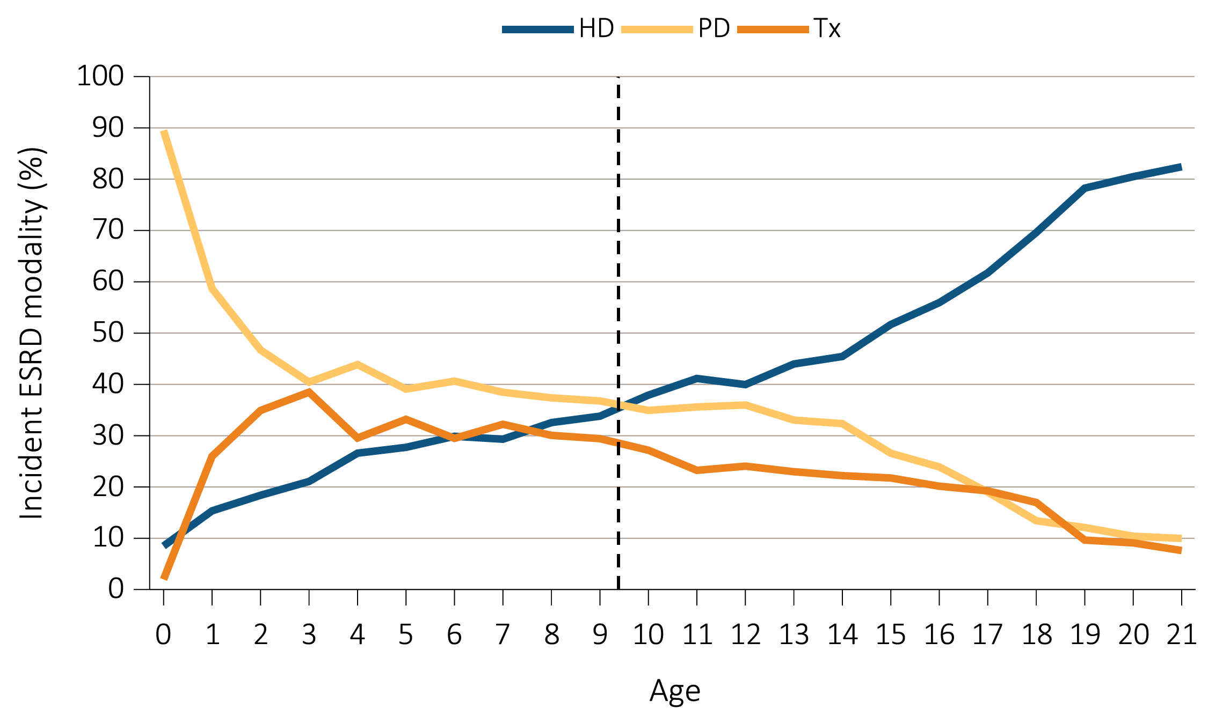
Figure 8.2 Trends in ESRD modality at initiation,
by (a) patient age, and (b) weight, 1996-2013
Age
Data Source: Special analyses, USRDS ESRD Database. Includes incident ESRD patients in the years 1996-2013. Abbreviations: ESRD, end-stage renal disease; HD, hemodialysis; PD, peritoneal dialysis; Tx, transplant.

Slide 5
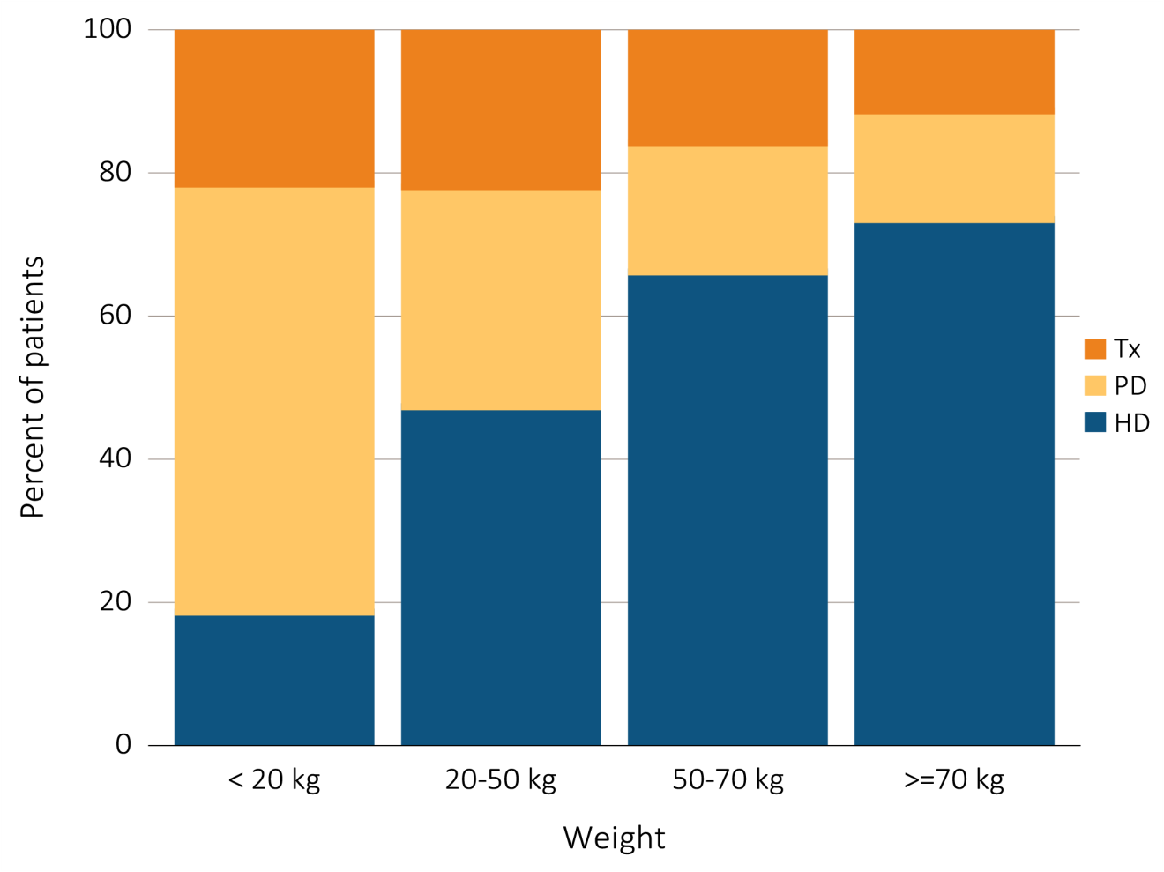
Figure 8.2 Trends in ESRD modality at initiation,
by (a) patient age, and (b) weight, 1996-2013
(b) Weight
Data Source: Special analyses, USRDS ESRD Database. Includes incident ESRD patients in the years 1996-2013. Abbreviations: ESRD, end-stage renal disease; HD, hemodialysis; PD, peritoneal dialysis; Tx, transplant.

Slide 6
Table 8.1 Distribution of reported incident pediatric ESRD patients
by primary cause of ESRD (aged 0-21 years), and by demographic characteristics,
2004-2008 (period A) and 2009-2013 (period B)
(Continued on next slide)

Slide 7
Table 8.1 Distribution of reported incident pediatric ESRD patients by primary cause of ESRD (aged 0-21 years), and by demographic characteristics,
2004-2008 (period A) and 2009-2013 (period B) (Continued)
Data Source: Special analyses, USRDS ESRD Database. Abbreviations: African Am, African American; AIDS, acquired-immune deficiency syndrome; Congenital obstructive uropathy, combination of congenital ureterpelvic junction obstruction, congenital uretrovesical junction obstruction, and other congenital anomalies; ESRD, end-stage renal disease; GN glomerulonephritis; IgA immunoglobulin A; IgM, immunoglobulin M; incl., including; MPGN, membranoproliferative glomerulonephritis; SBE, sub-acute bacterial endocarditis.

Slide 8
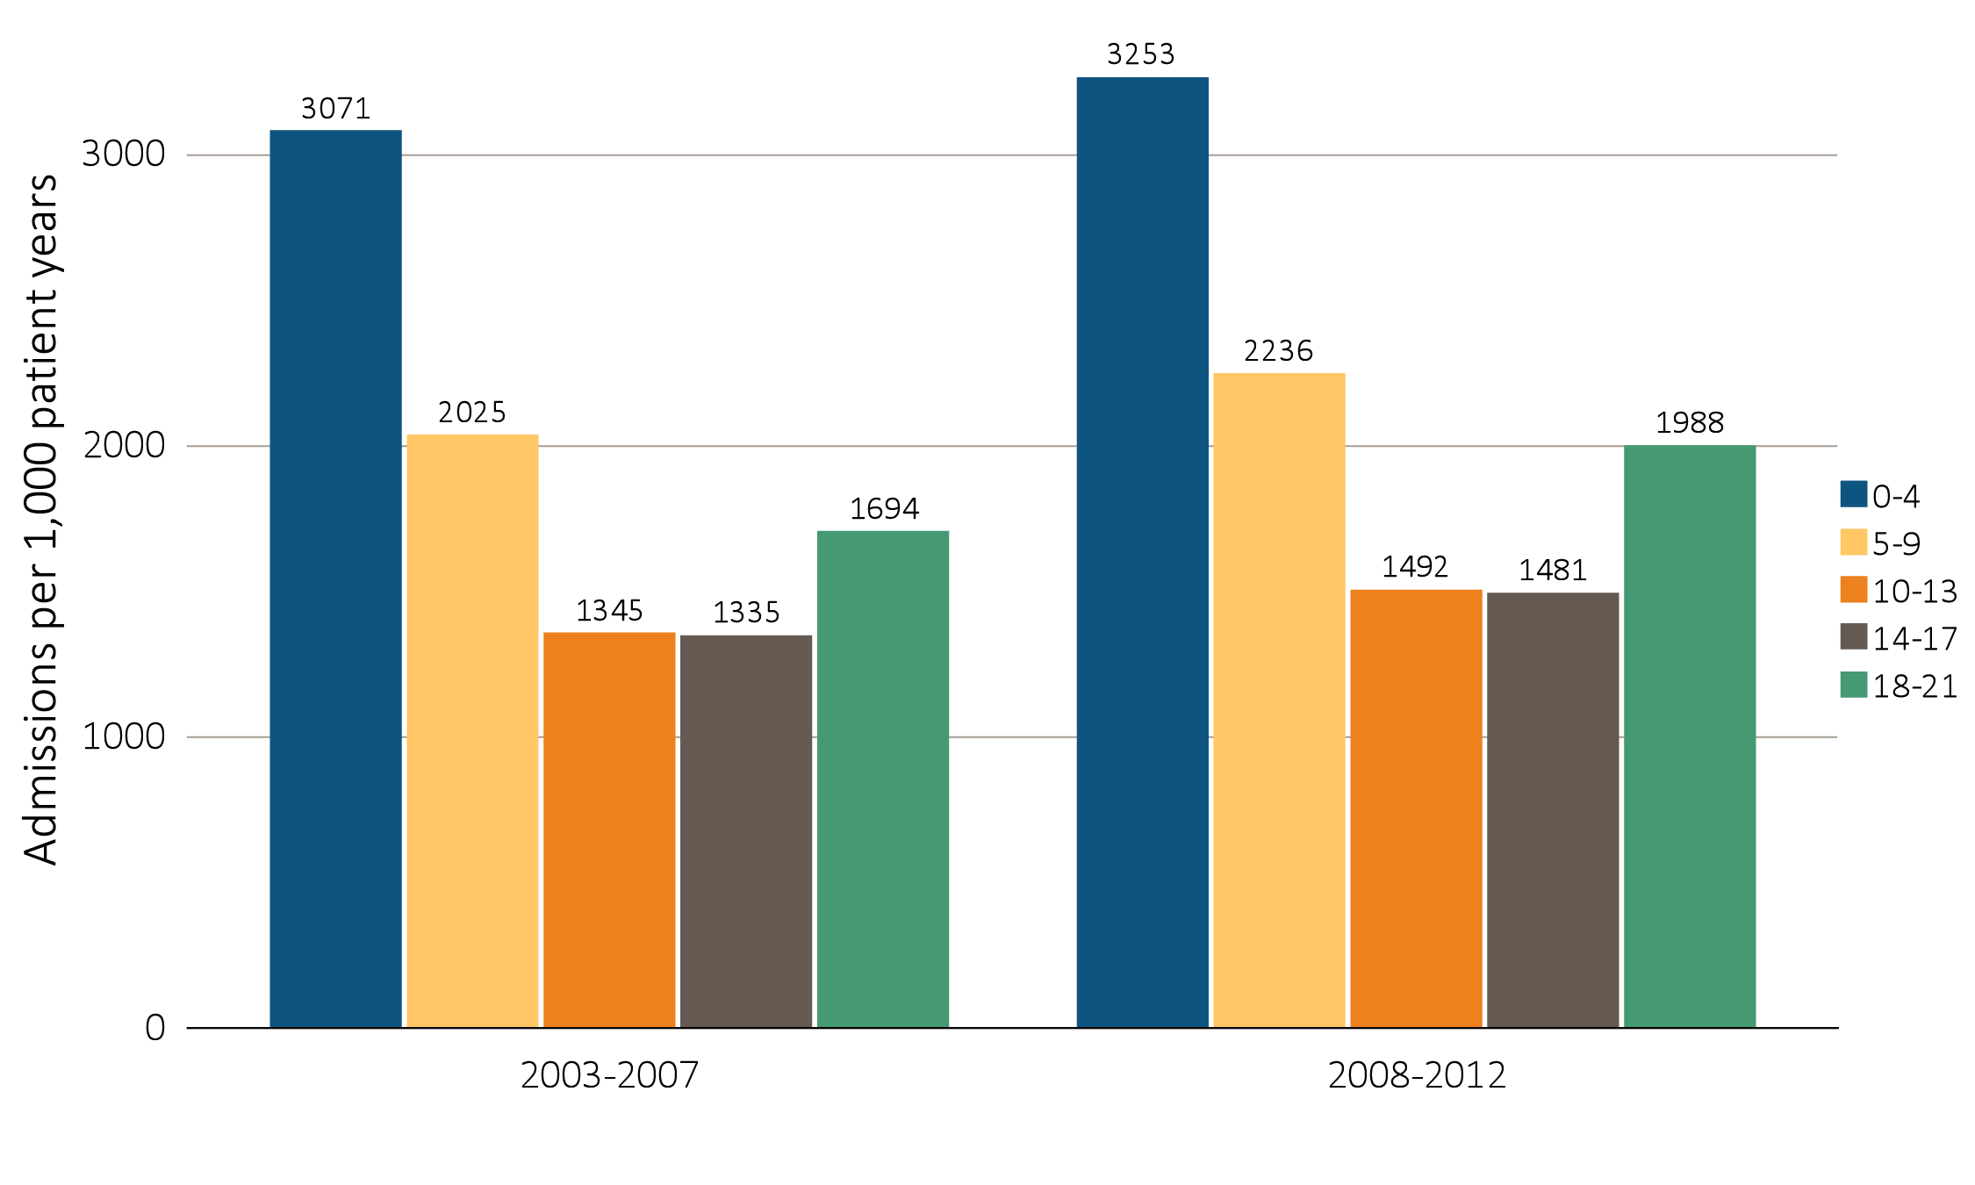
Figure 8.3 One-year adjusted all-cause hospitalization rates in incident pediatric patients (aged 0-21 years), by (a) age and (b) modality, 2003-2007 and 2008-2012
Age
Data Source: Special analyses, USRDS ESRD Database. Includes incident pediatric ESRD patients in the years 2003-2012, surviving the first 90 days after ESRD initiation and followed from day 90. Adjusted for sex, race, primary cause of ESRD, and Hispanic ethnicity. Ref: incident ESRD patients aged 0-21, 2010-2011. Abbreviations: HD, hemodialysis; PD, peritoneal dialysis; Tx, transplant.

Slide 9
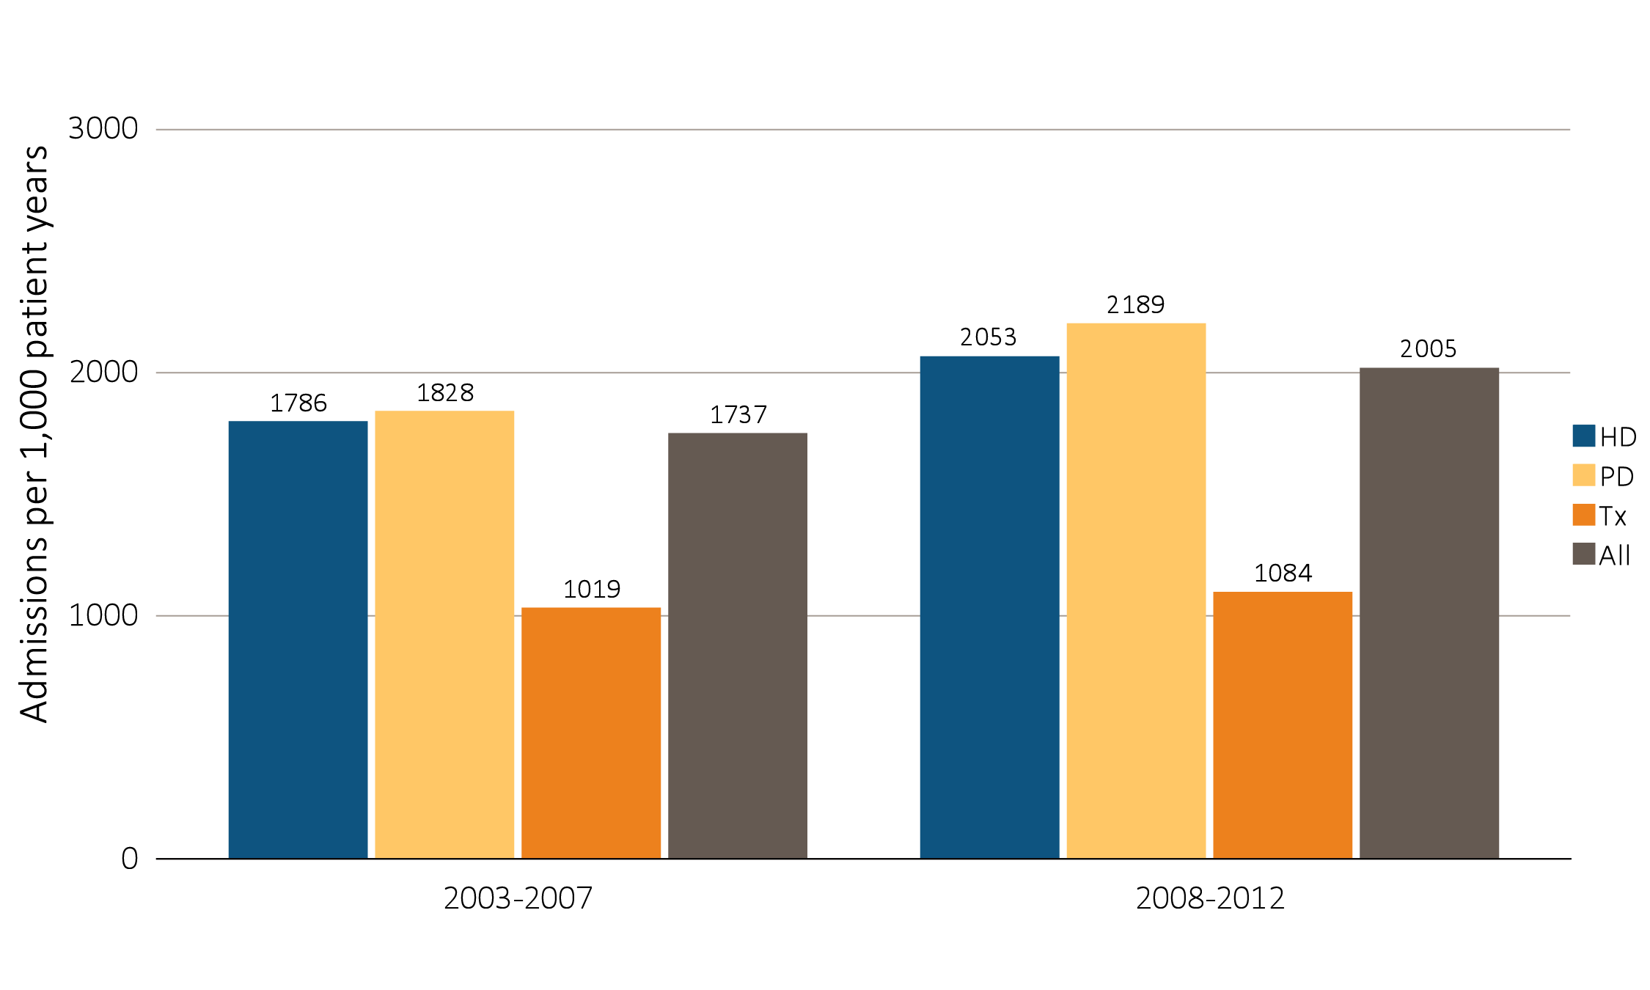
Figure 8.3 One-year adjusted all-cause hospitalization rates in incident pediatric patients (aged 0-21 years), by (a) age and (b) modality, 2003-2007 and 2008-2012
(b) Modality
Data Source: Special analyses, USRDS ESRD Database. Includes incident pediatric ESRD patients in the years 2003-2012, surviving the first 90 days after ESRD initiation and followed from day 90. Adjusted for sex, race, primary cause of ESRD, and Hispanic ethnicity. Ref: incident ESRD patients aged 0-21, 2010-2011. Abbreviations: HD, hemodialysis; PD, peritoneal dialysis; Tx, transplant.

Slide 10
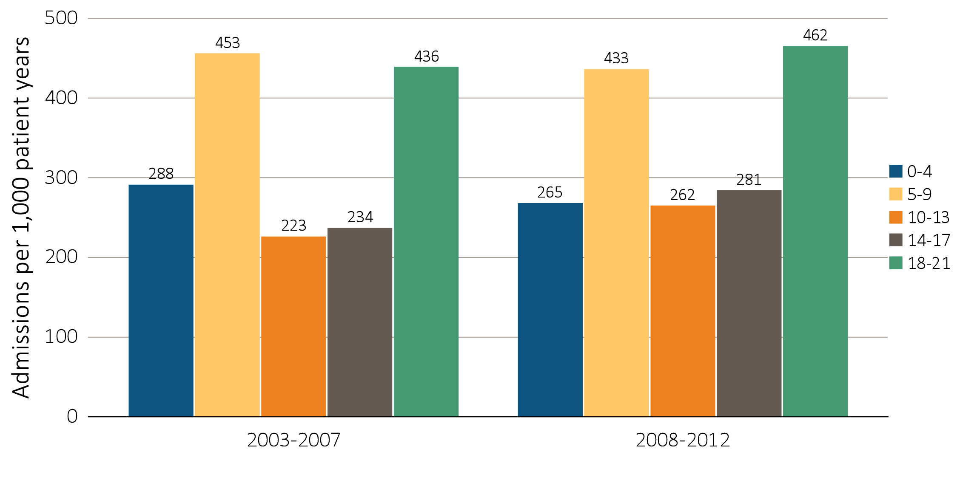
Figure 8.4 One-year adjusted cardiovascular hospitalization rates in incident pediatric patients (aged 0-21 years), by (a) age and (b) modality, 2003-2007 and 2008-2012
Age
Data Source: Special analyses, USRDS ESRD Database. Includes incident pediatric ESRD patients in the years 2003-2012, surviving the first 90 days after ESRD initiation and followed from day 90. Adjusted for sex, race, primary cause of ESRD, and Hispanic ethnicity. Ref: incident ESRD patients aged 0-21, 2010-2011. Abbreviations: HD, hemodialysis; PD, peritoneal dialysis; Tx, transplant.

Slide 11
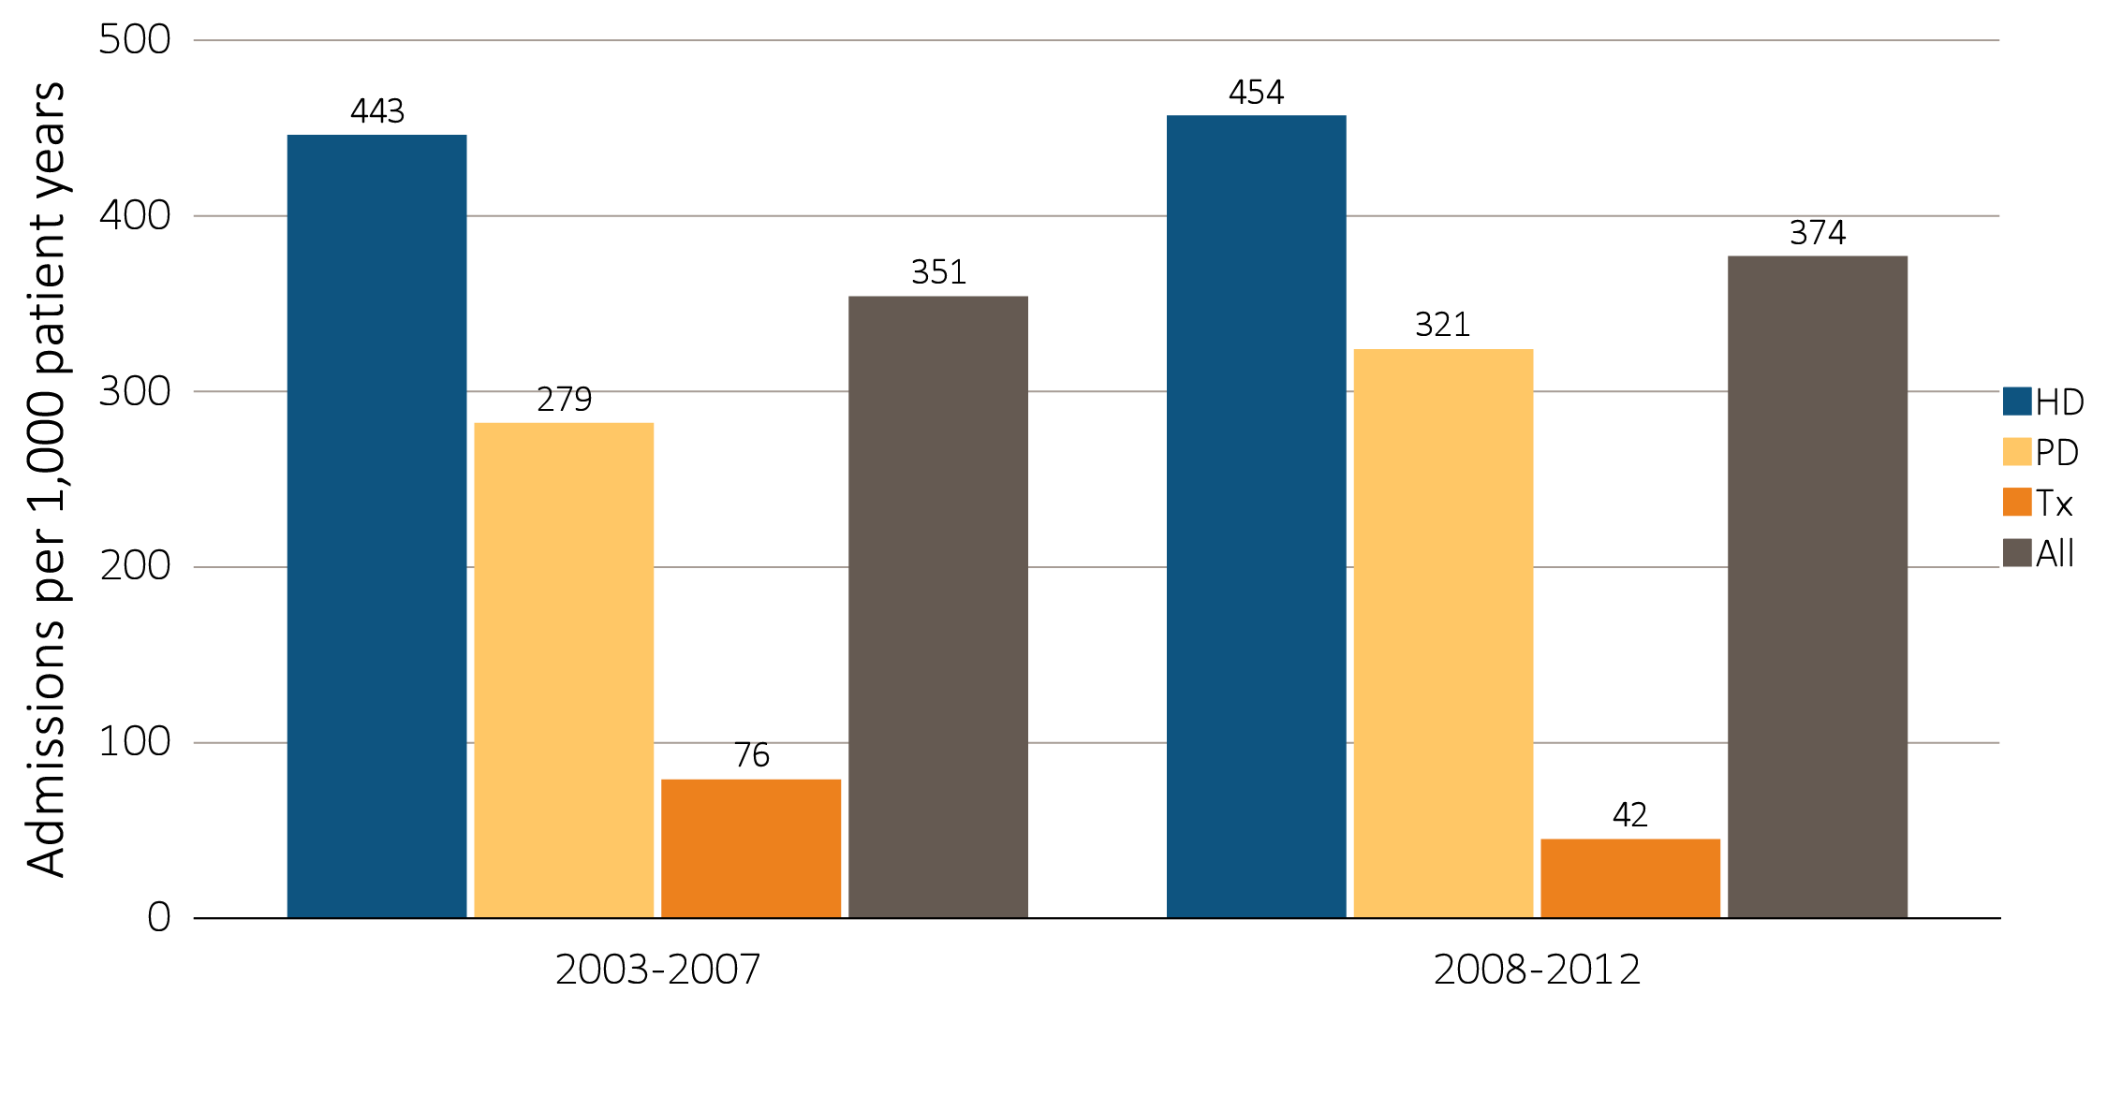
Figure 8.4 One-year adjusted cardiovascular hospitalization rates in incident pediatric patients (aged 0-21 years), by (a) age and (b) modality, 2003-2007 and 2008-2012
(b) Modality
Data Source: Special analyses, USRDS ESRD Database. Includes incident pediatric ESRD patients in the years 2003-2012, surviving the first 90 days after ESRD initiation and followed from day 90. Adjusted for sex, race, primary cause of ESRD, and Hispanic ethnicity. Ref: incident ESRD patients aged 0-21, 2010-2011. Abbreviations: HD, hemodialysis; PD, peritoneal dialysis; Tx, transplant.

Slide 12
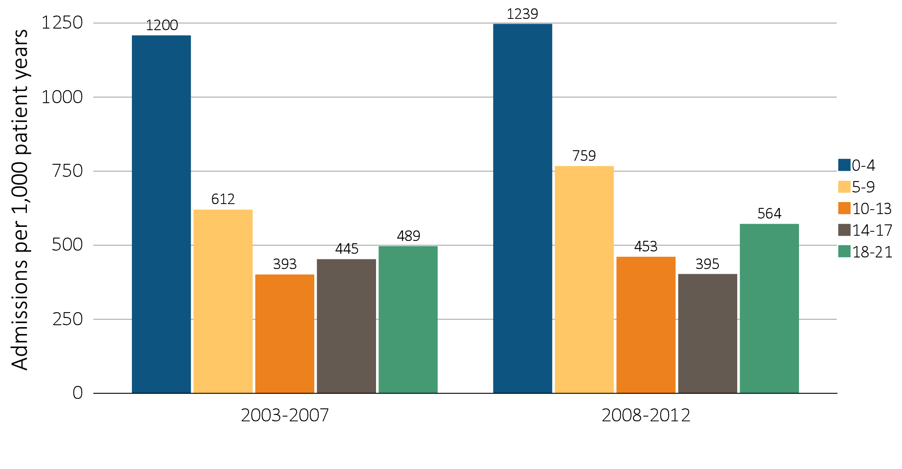
Figure 8.5 One-year adjusted hospitalization rates for infection in incident pediatric patients (aged 0-21 years), by (a) age and (b) modality, 2003-2007 and 2008-2012
Age
Data Source: Special analyses, USRDS ESRD Database. Includes incident pediatric ESRD patients in the years 2003-2012, surviving the first 90 days after ESRD initiation and followed from day 90. Adjusted for sex, race, primary cause of ESRD, and Hispanic ethnicity. Ref: incident ESRD patients aged 0-21, 2010-2011. Abbreviations: HD, hemodialysis; PD, peritoneal dialysis; Tx, transplant.

Slide 13
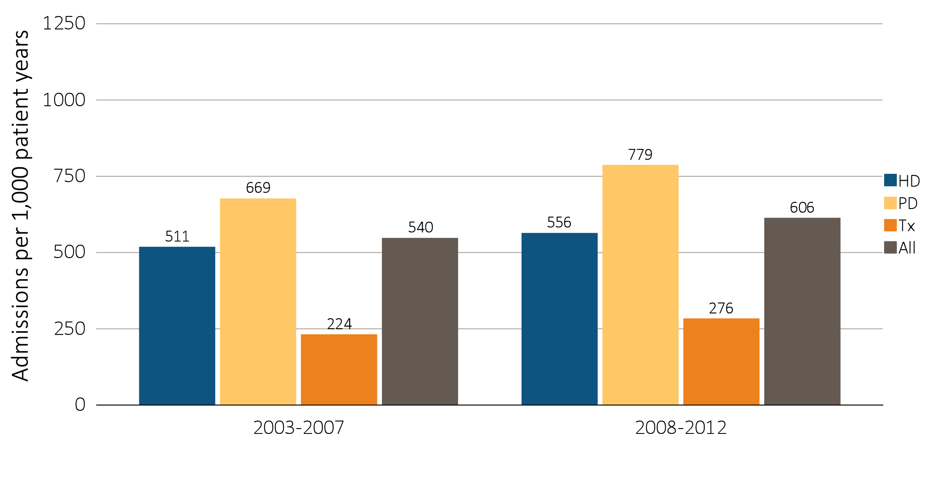
Figure 8.5 One-year adjusted hospitalization rates for infection in incident pediatric patients (aged 0-21 years), by (a) age and (b) modality, 2003-2007 and 2008-2012
(b) Modality
Data Source: Special analyses, USRDS ESRD Database. Includes incident pediatric ESRD patients in the years 2003-2012, surviving the first 90 days after ESRD initiation and followed from day 90. Adjusted for sex, race, primary cause of ESRD, and Hispanic ethnicity. Ref: incident ESRD patients aged 0-21, 2010-2011. Abbreviations: HD, hemodialysis; PD, peritoneal dialysis; Tx, transplant.

Slide 14
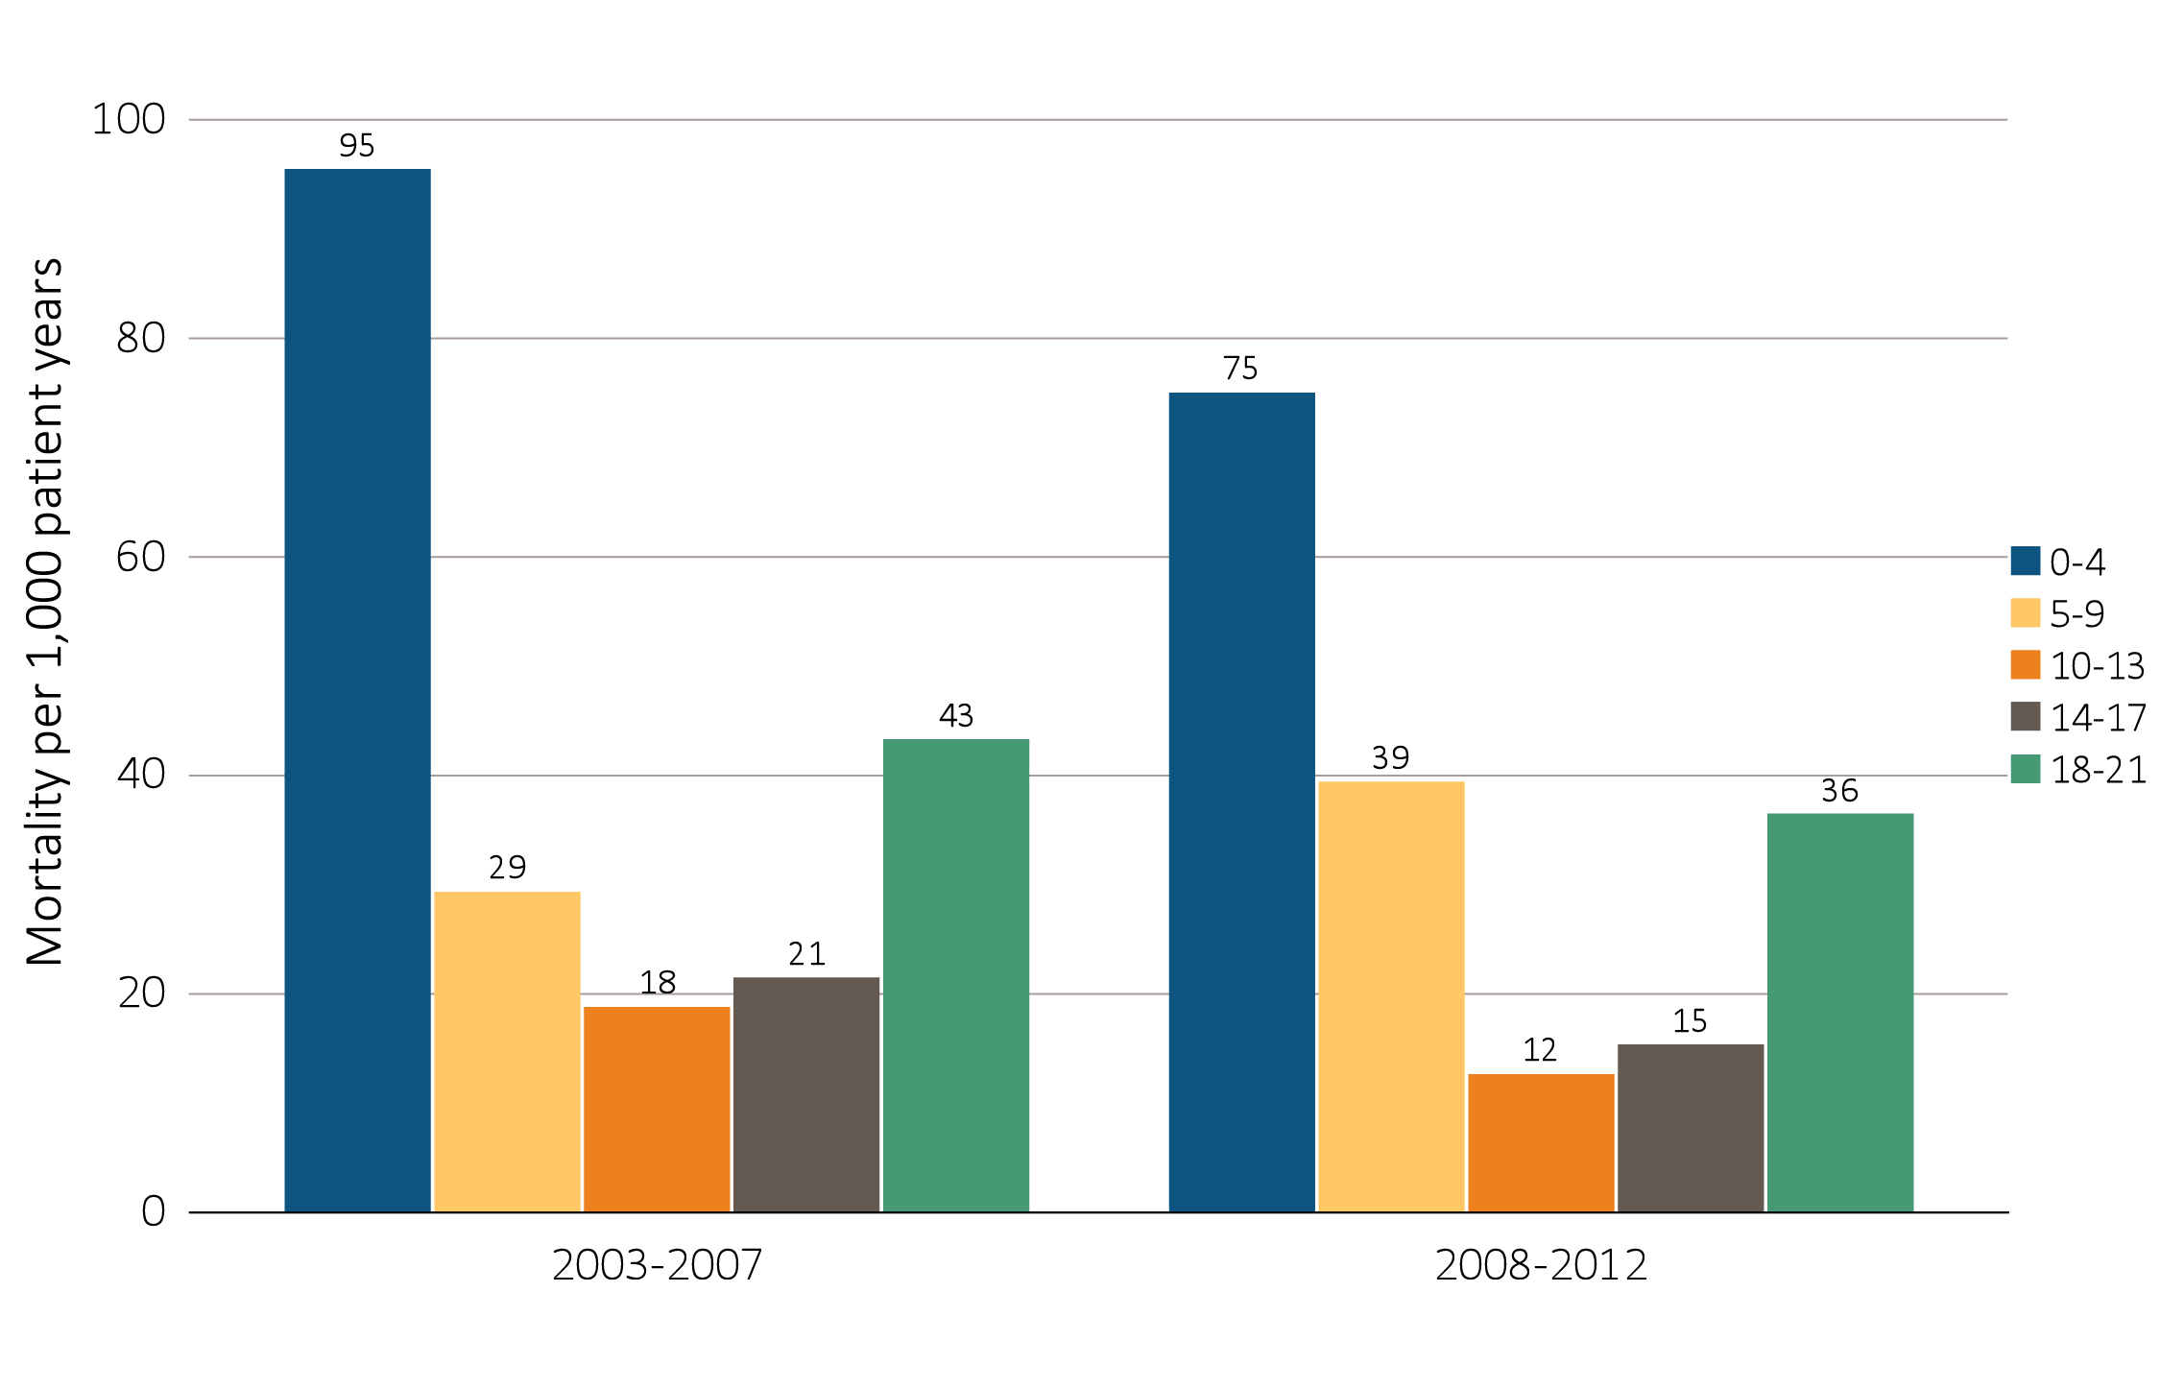
Figure 8.6 One-year adjusted all-cause mortality rates in incident pediatric patients with ESRD (aged 0-21 years), by (a) age and (b) modality, 2003-2007 and 2008-2012
Age
Data Source: Special analyses, USRDS ESRD Database. Incident dialysis and transplant patients defined at the onset of dialysis or the day of transplant without the 60-day rule; followed to December 31, 2013. Adjusted for age, sex, race, Hispanic ethnicity, and primary cause of ESRD. Ref: incident ESRD patients aged 0-21, 2010-2011. Abbreviations: HD, hemodialysis; PD, peritoneal dialysis; Tx, transplant.

Slide 15
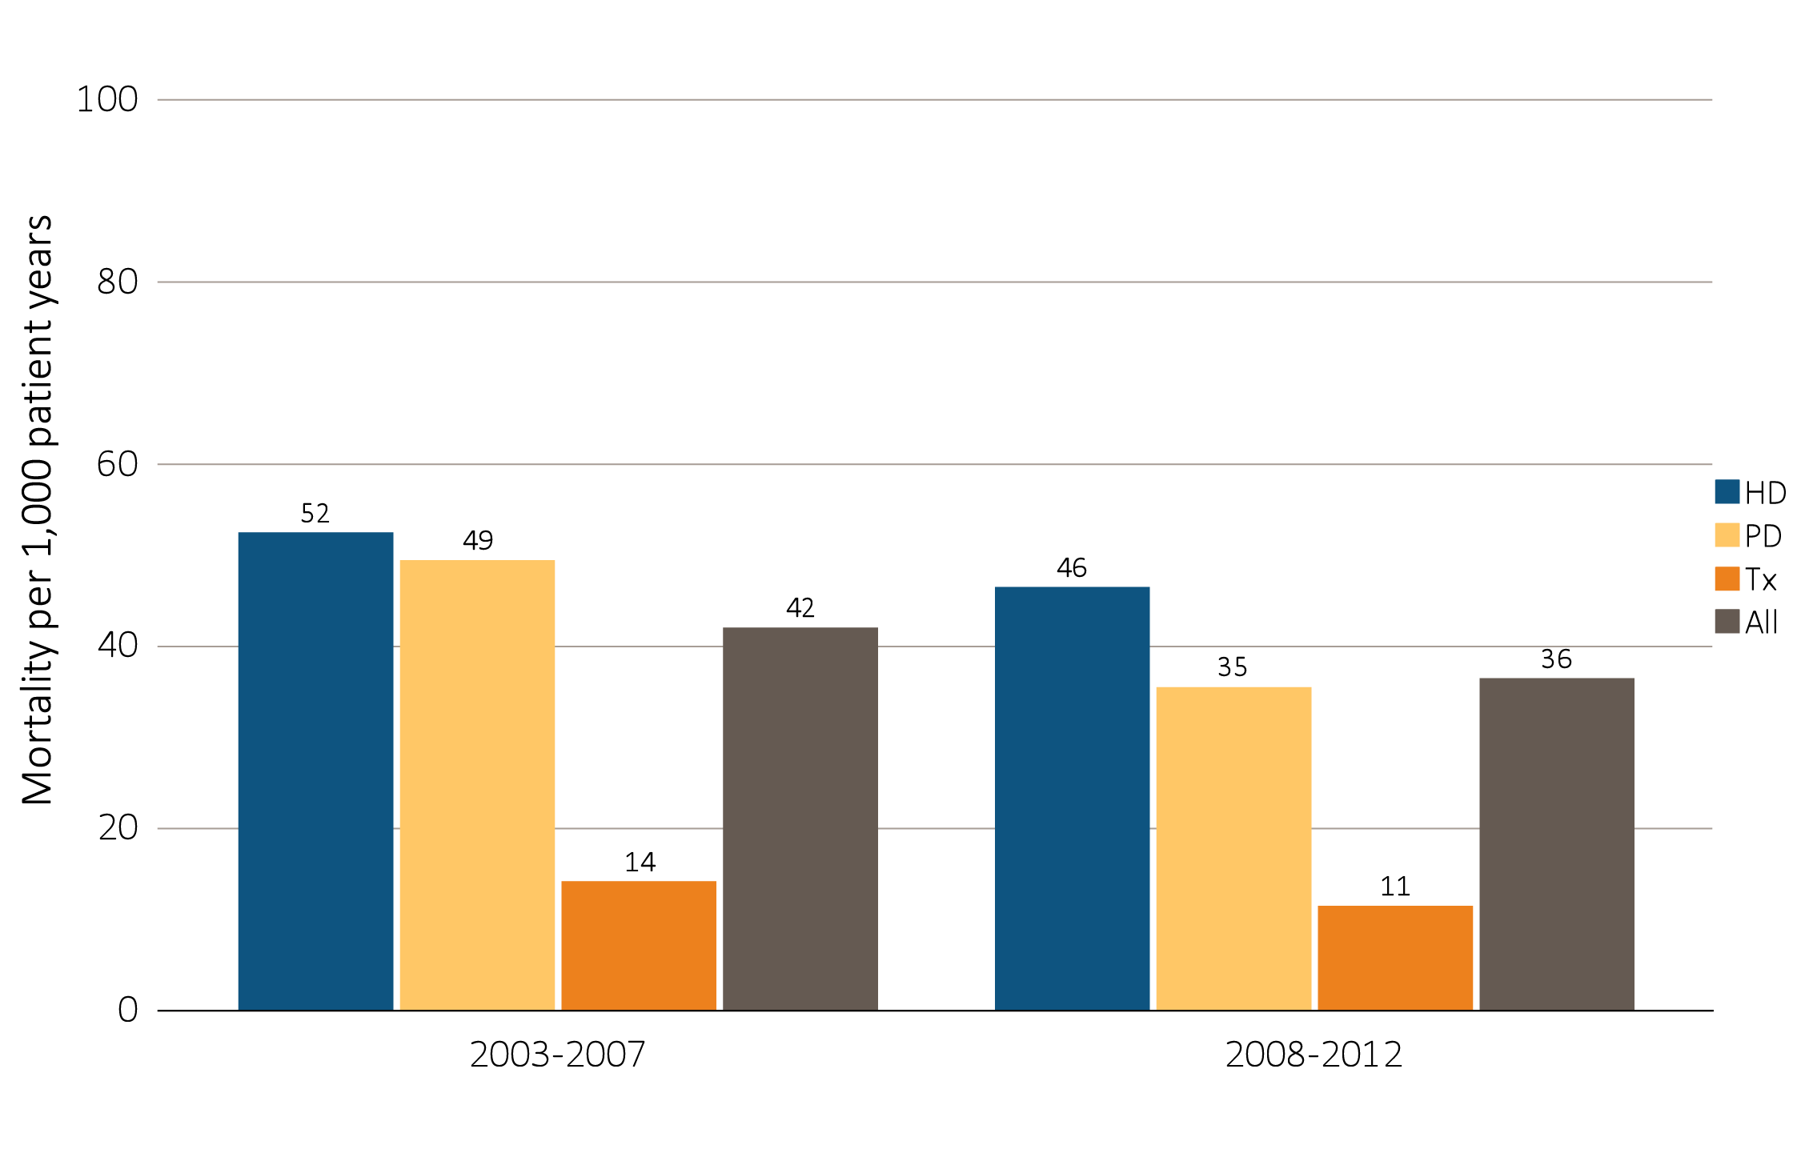
Figure 8.6 One-year adjusted all-cause mortality rates in incident pediatric patients with ESRD (aged 0-21 years), by (a) age and (b) modality, 2003-2007 and 2008-2012
(b) Modality
Data Source: Special analyses, USRDS ESRD Database. Incident dialysis and transplant patients defined at the onset of dialysis or the day of transplant without the 60-day rule; followed to December 31, 2013. Adjusted for age, sex, race, Hispanic ethnicity, and primary cause of ESRD. Ref: incident ESRD patients aged 0-21, 2010-2011. Abbreviations: HD, hemodialysis; PD, peritoneal dialysis; Tx, transplant.

Slide 16
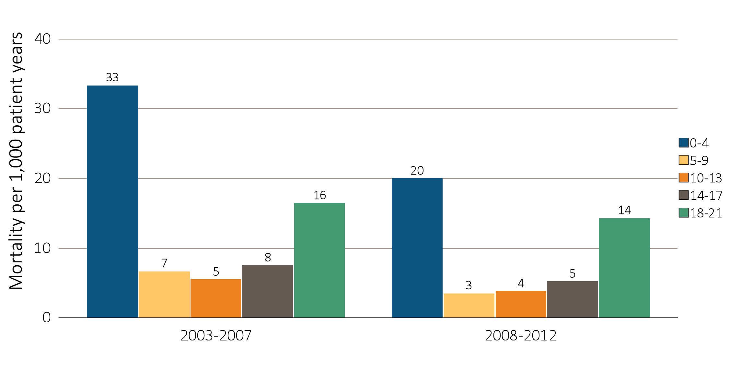
Figure 8.7 One-year adjusted cardiovascular mortality rates in incident pediatric patients with ESRD (aged 0-21 years), by (a) age and (b) modality, 2003-2007 and 2008-2012
Age
Data Source: Special analyses, USRDS ESRD Database. Incident dialysis and transplant patients defined at the onset of dialysis or the day of transplant without the 60-day rule; followed to December 31, 2013. Adjusted for age, sex, race, Hispanic ethnicity, and primary cause of ESRD. Ref: incident ESRD patients aged 0-21, 2010-2011. Abbreviations: HD, hemodialysis; PD, peritoneal dialysis; Tx, transplant.

Slide 17
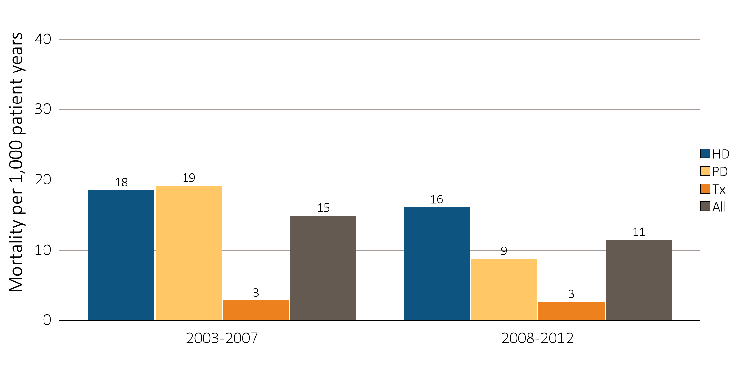
Figure 8.7 One-year adjusted cardiovascular mortality rates in incident pediatric patients with ESRD (aged 0-21 years), by (a) age and (b) modality, 2003-2007 and 2008-2012
(b) Modality
Data Source: Special analyses, USRDS ESRD Database. Incident dialysis and transplant patients defined at the onset of dialysis or the day of transplant without the 60-day rule; followed to December 31, 2013. Adjusted for age, sex, race, Hispanic ethnicity, and primary cause of ESRD. Ref: incident ESRD patients aged 0-21, 2010-2011. Abbreviations: HD, hemodialysis; PD, peritoneal dialysis; Tx, transplant.

Slide 18
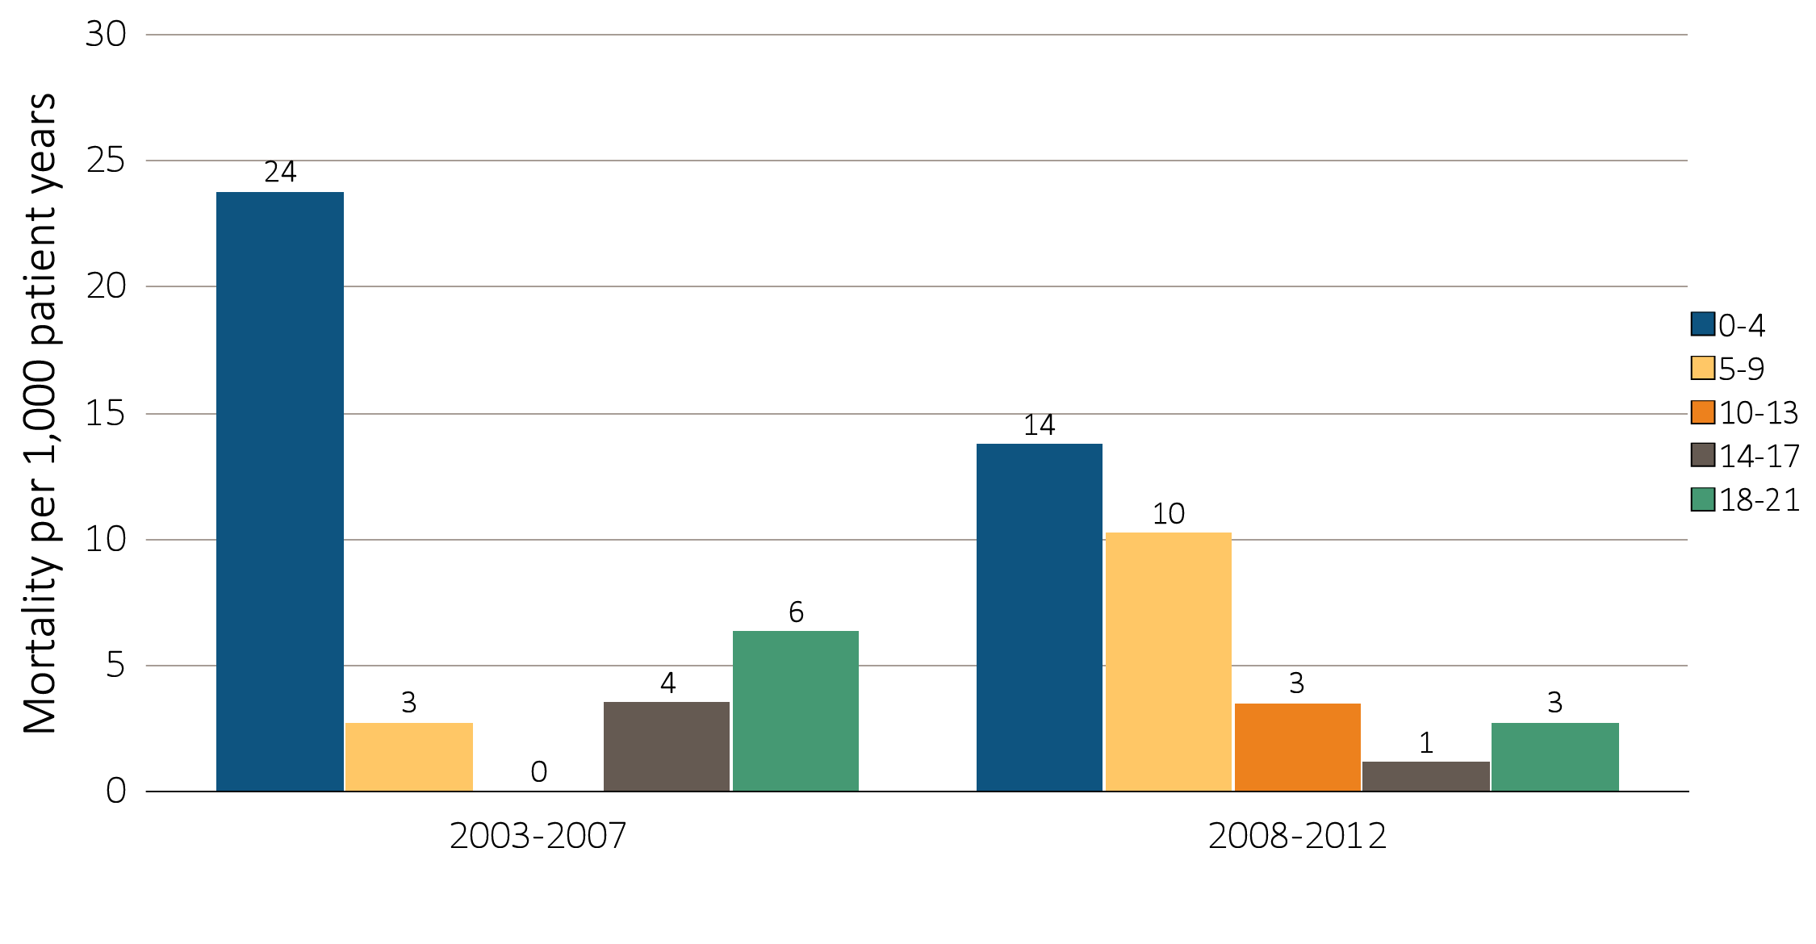
Figure 8.8 One-year adjusted rates of mortality due to infection in incident pediatric patients with ESRD (aged 0-21 years), by (a) age and (b) modality,
^{2003-2007 and 2008-2012}
Age
Data Source: Special analyses, USRDS ESRD Database. Incident dialysis and transplant patients defined at the onset of dialysis or the day of transplant without the 60-day rule; followed to December 31, 2013. Adjusted for age, sex, race, Hispanic ethnicity, and primary cause of ESRD. Ref: incident ESRD patients aged 0-21, 2010-2011. Abbreviations: HD, hemodialysis; PD, peritoneal dialysis; Tx, transplant.

Slide 19
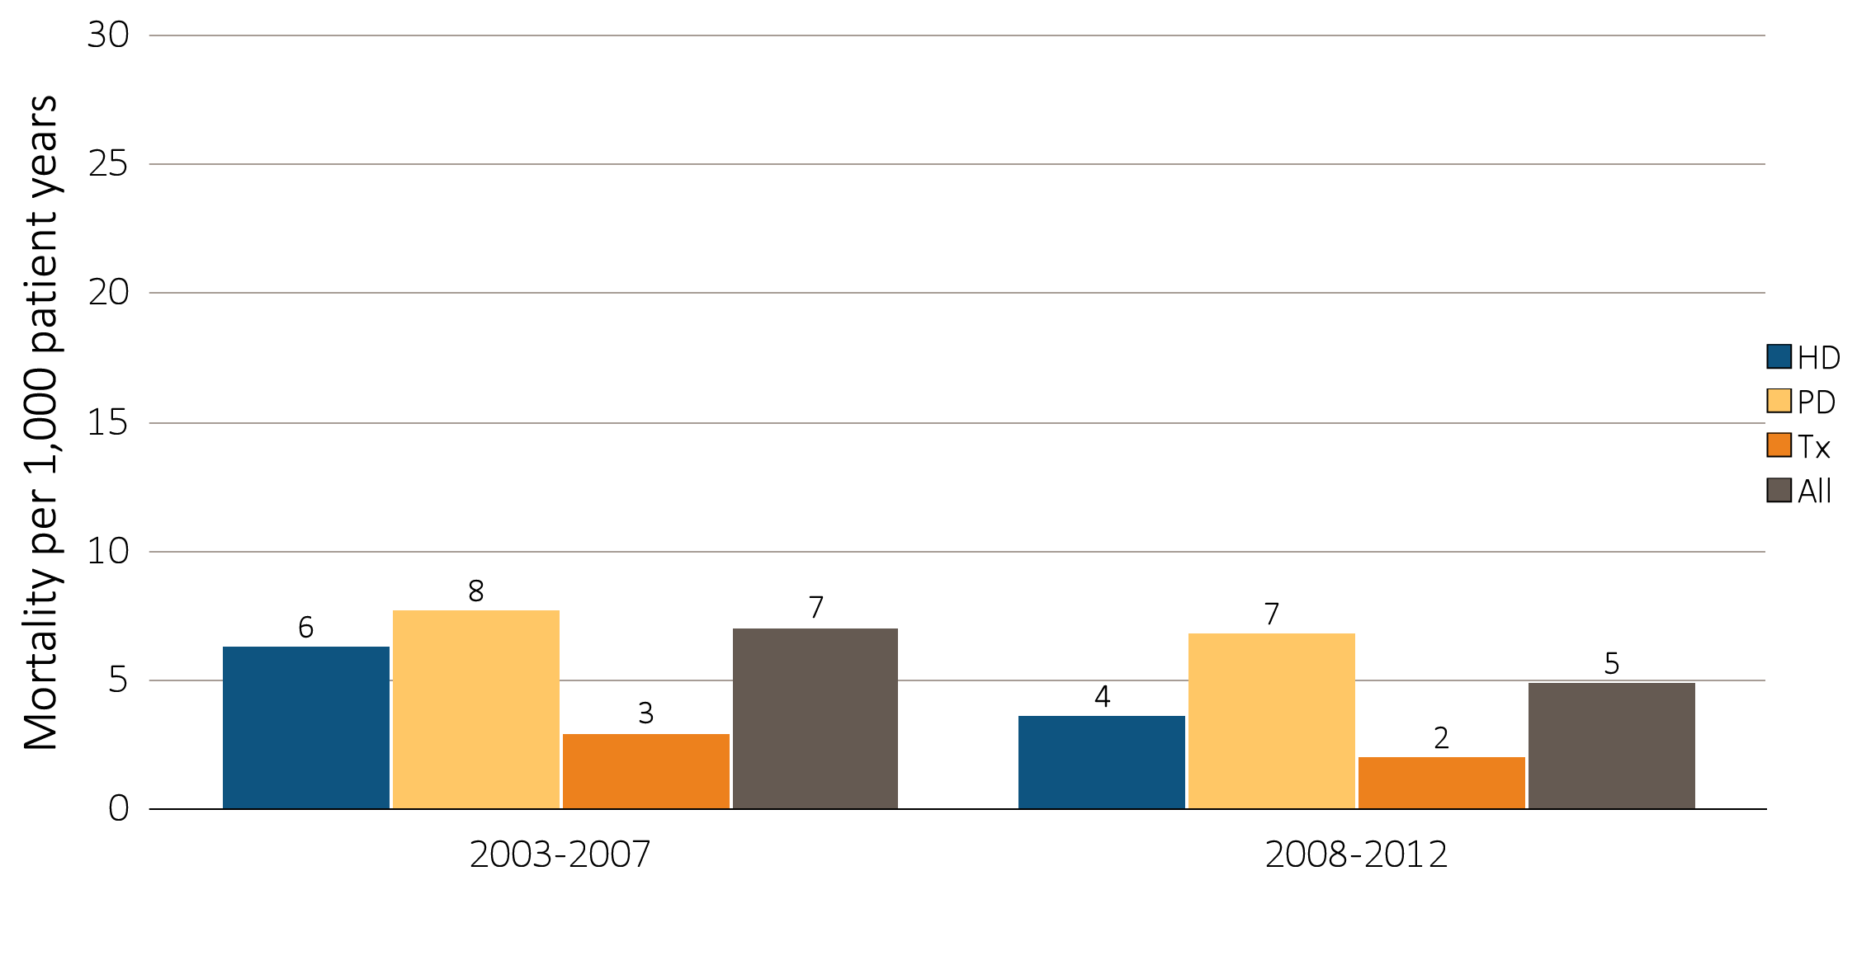
Figure 8.8 One-year adjusted rates of mortality due to infection in incident pediatric patients with ESRD (aged 0-21 years), by (a) age and (b) modality,
^{2003-2007 and 2008-2012}
(b) Modality
Data Source: Special analyses, USRDS ESRD Database. Incident dialysis and transplant patients defined at the onset of dialysis or the day of transplant without the 60-day rule; followed to December 31, 2013. Adjusted for age, sex, race, Hispanic ethnicity, and primary cause of ESRD. Ref: incident ESRD patients aged 0-21, 2010-2011. Abbreviations: HD, hemodialysis; PD, peritoneal dialysis; Tx, transplant.

Slide 20
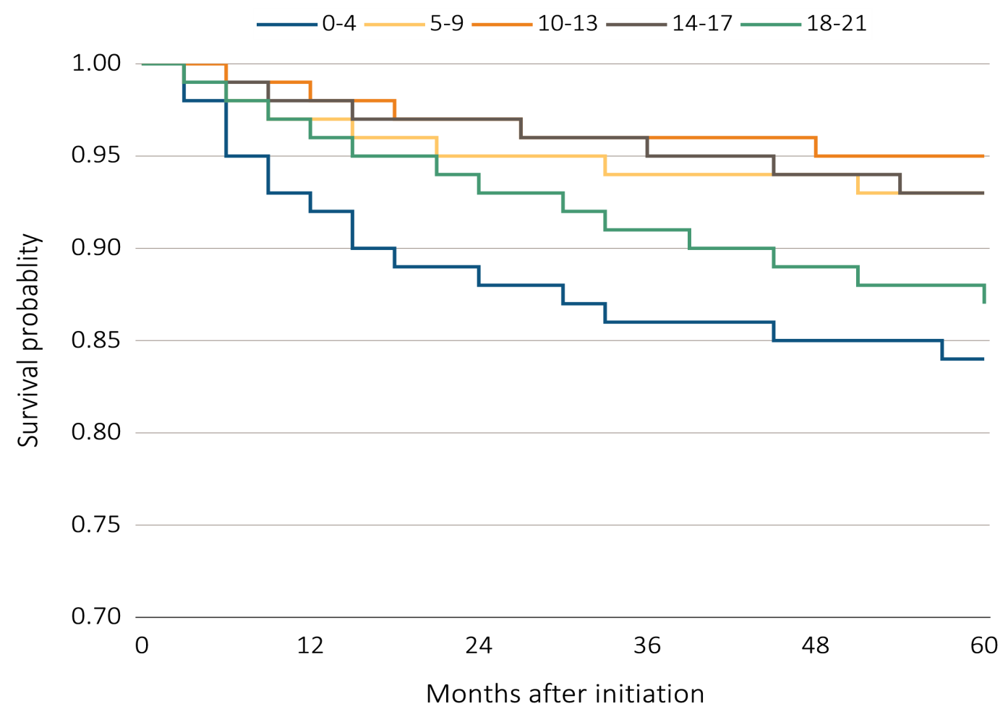
Figure 8.9 Monthly adjusted five-year survival in incident pediatric patients
(aged 0-21 years) from day 1, by (a) age and (b) modality, 2004-2008
(a) Age
Data Source: Special analyses, USRDS ESRD Database. Incident dialysis and transplant patients defined at the onset of dialysis or the day of transplant without the 60-day rule; followed to December 31, 2013. Adjusted for age, sex, race, Hispanic ethnicity, and primary cause of ESRD. Ref: incident ESRD patients aged 0-21, 2010-2011. Abbreviations: HD, hemodialysis; PD, peritoneal dialysis; Tx, transplant.

Slide 21
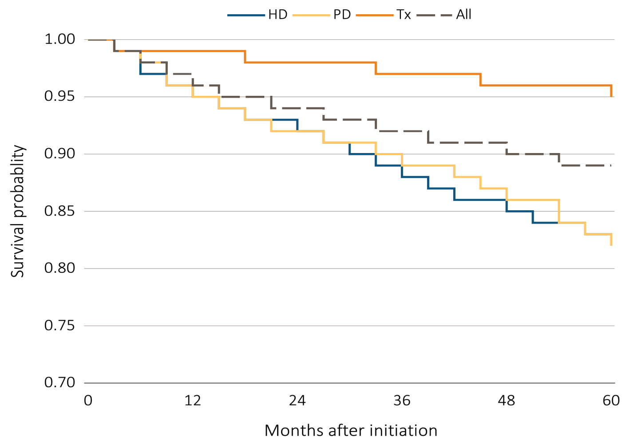
Figure 8.9 Monthly adjusted five-year survival in incident pediatric patients
(aged 0-21 years) from day 1, by (a) age and (b) modality, 2004-2008
(b) Modality
Data Source: Special analyses, USRDS ESRD Database. Incident dialysis and transplant patients defined at the onset of dialysis or the day of transplant without the 60-day rule; followed to December 31, 2013. Adjusted for age, sex, race, Hispanic ethnicity, and primary cause of ESRD. Ref: incident ESRD patients aged 0-21, 2010-2011. Abbreviations: HD, hemodialysis; PD, peritoneal dialysis; Tx, transplant.

Slide 22
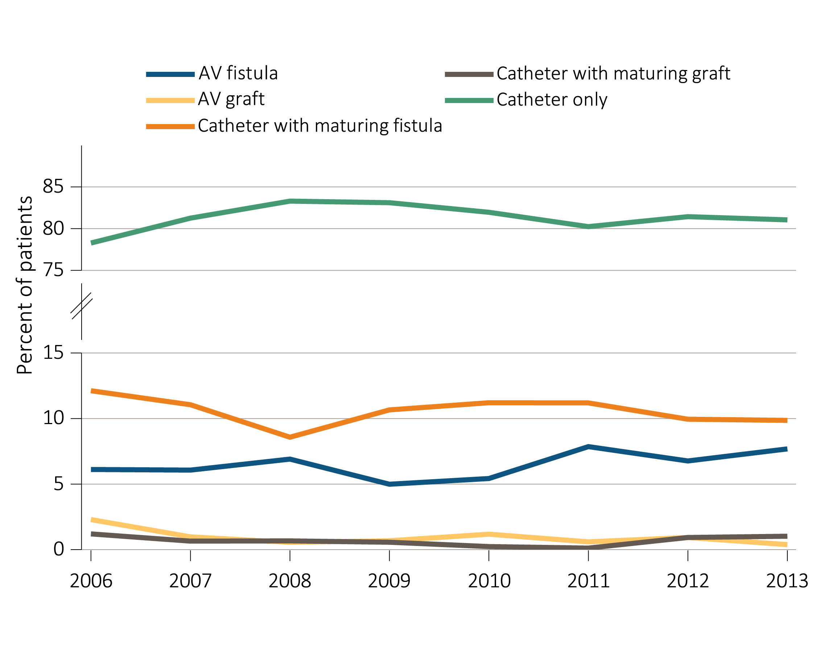
Figure 8.10 Vascular access type at initiation of incident pediatric hemodialysis patients (aged 0-21 years) by (a) year and (b) age, 2006-2013
(a) Year
Data Source: Special analyses, USRDS ESRD Database. ESRD patients initiating hemodialysis in 2006-2013. Abbreviations: AV, arteriovenous; ESRD, end-stage renal disease.

Slide 23
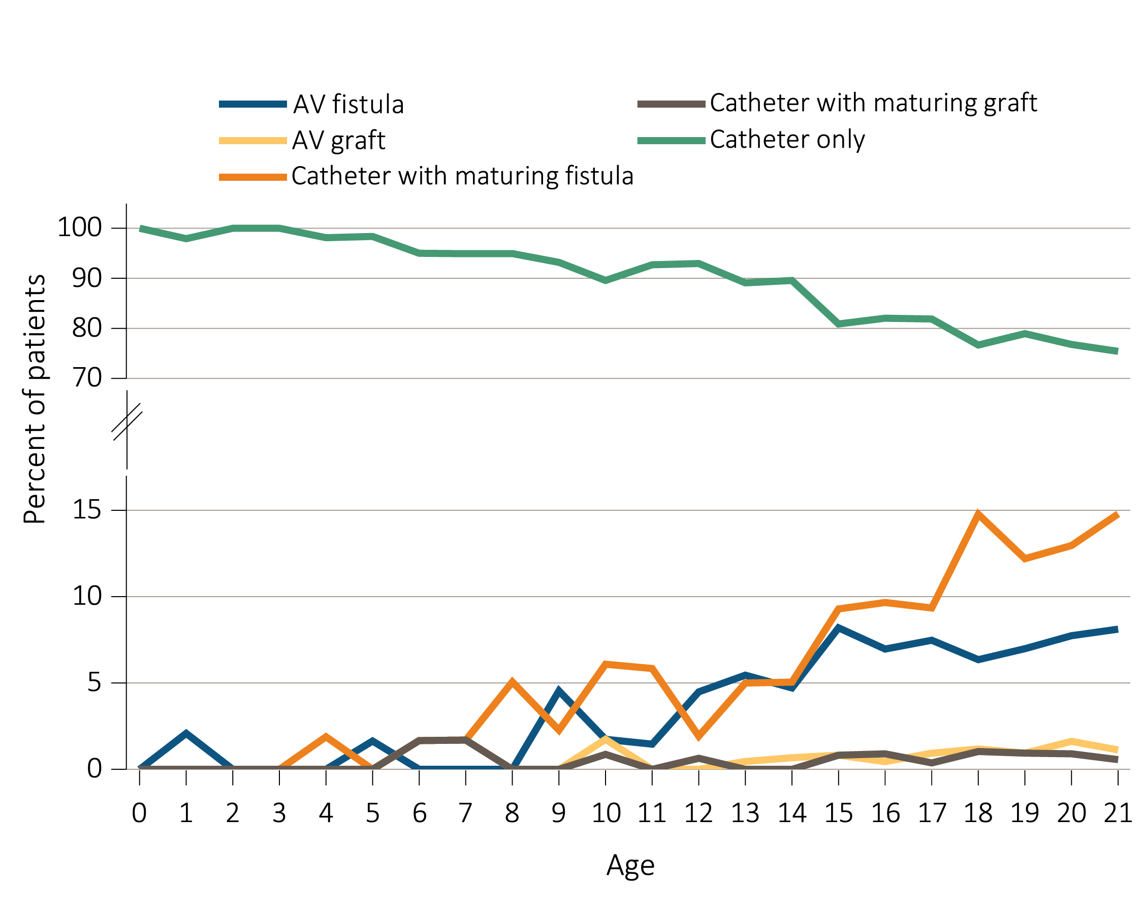
Figure 8.10 Vascular access type at initiation of incident pediatric hemodialysis patients (aged 0-21 years) by (a) year and (b) age, 2006-2013
(b) Age
Data Source: Special analyses, USRDS ESRD Database. ESRD patients initiating hemodialysis in 2006-2013. Abbreviations: AV, arteriovenous; ESRD, end-stage renal disease.

Slide 24
Table 8.2 Percent of vascular access type in incident pediatric hemodialysis patients (aged 0-21 years), by age, sex, race, ethnicity, and primary cause of ESRD, 2006-2009 and 2010-2013
 | 2006-2009 |  |  |  |  | 2010-2013
 | AV Fistula | AV Graft | Catheter with maturing fistula | Catheter with maturing graft | Catheter only | AV Fistula | AV Graft | Catheter with maturing fistula | Catheter with maturing graft | Catheter only
Age
0-4 | . | . | . | . | 100.0 | 0.8 | . | 0.8 | . | 98.5
5-9 | 2.7 | . | 0.7 | 0.7 | 95.9 | 0.5 | 1.0 | 3.5 | 0.5 | 94.5
10-13 | 4.0 | 0.7 | 5.6 | 0.3 | 89.4 | 3.4 | 0.3 | 3.7 | 0.3 | 92.3
14-17 | 7.1 | 0.7 | 8.6 | 0.6 | 83.1 | 6.9 | 0.8 | 8.7 | 0.5 | 83.0
18-21 | 6.4 | 1.5 | 13.3 | 1.0 | 77.8 | 8.7 | 0.9 | 14.0 | 0.7 | 75.7
Sex
Male | 7.1 | 1.3 | 10.9 | 0.8 | 79.9 | 8.1 | 0.6 | 12.7 | 0.5 | 78.0
Female | 4.7 | 0.9 | 10.2 | 0.8 | 83.4 | 5.5 | 1.0 | 8.0 | 0.6 | 84.9
Race
White | 6.7 | 1.4 | 9.7 | 0.7 | 81.5 | 7.3 | 0.7 | 9.6 | 0.4 | 82.0
Black/Af Am | 5.3 | 0.9 | 12.8 | 1.1 | 79.9 | 6.7 | 0.7 | 12.8 | 1.0 | 78.9
Other | 2.9 | . | 8.8 | . | 88.3 | 4.9 | 1.8 | 8.4 | 0.4 | 84.5
Ethnicity
Hispanic | 5.8 | 1.5 | 10.4 | 0.5 | 81.8 | 6.7 | 0.8 | 10.3 | 0.4 | 81.8
Non-hispanic | 6.1 | 1.0 | 10.7 | 0.9 | 81.3 | 7.0 | 0.8 | 10.7 | 0.6 | 80.9
Primary cause of ESRD
Glomerulonephritis | 5.9 | 1.2 | 13.1 | 0.9 | 78.9 | 7.5 | 0.8 | 12.4 | 0.4 | 78.9
Secondary GN | 1.8 | 0.9 | 8.4 | 0.7 | 88.2 | 3.4 | 0.4 | 7.4 | 0.4 | 88.4
CHC | 12.1 | 0.8 | 8.9 | 0.2 | 78.0 | 12.5 | 0.4 | 8.6 | 0.8 | 77.7
Other Cause | 5.7 | 1.2 | 10.1 | 0.9 | 82.0 | 5.6 | 1.1 | 11.2 | 0.6 | 81.5
Data Source: Special analyses, USRDS ESRD Database. ESRD patients initiating hemodialysis in 2006-2013. Abbreviations: AV, arteriovenous; ESRD, end-stage renal disease; GN, glomerulonephritis; CHC, Cystic/hereditary/ congenital diseases.

Slide 25
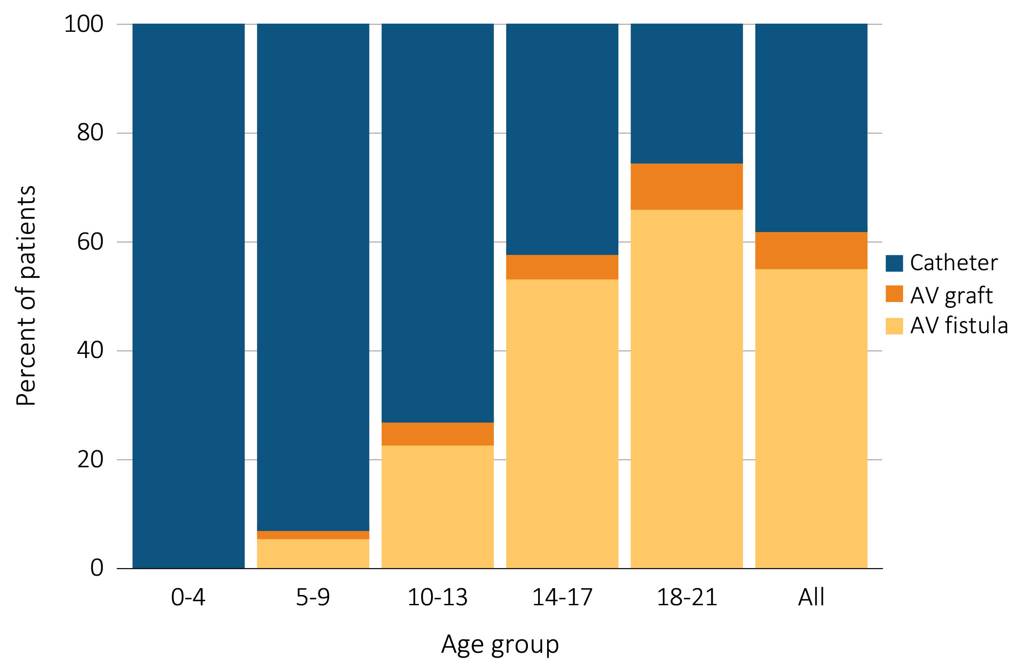
Figure 8.11 Distribution of vascular access type in prevalent pediatric hemodialysis patients (aged 0-21 years* as of December 31, 2014), 2014
Data Source: Special analyses, USRDS ESRD Database. Hemodialysis patients initiating treatment for ESRD at least 90 days prior to December 1, 2014, *who were <22 years old as December 1, 2014, and who were alive through December 31, 2014; Catheter=any catheter use; fistula and graft use shown are without the use of a catheter. Abbreviations: AV, arteriovenous; ESRD, end-stage renal disease.

Slide 26
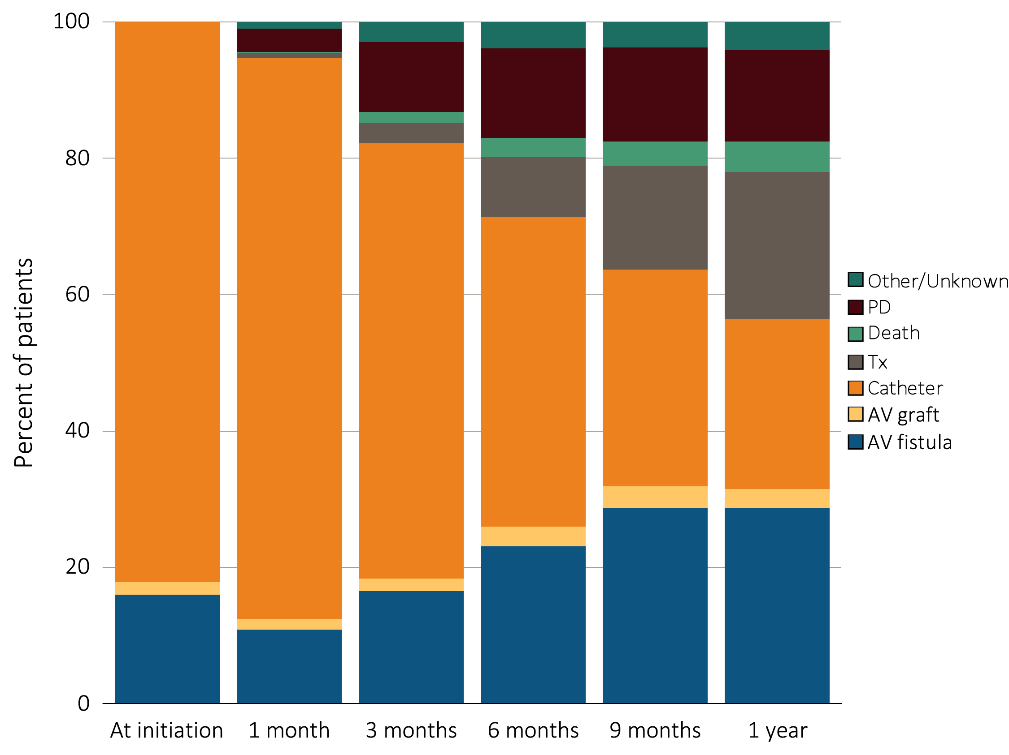
Figure 8.12 One-year longitudinal assessment of vascular access type in
incident pediatric ESRD patients on hemodialysis (aged 0-21 years) in 2012
Data Source: Special analyses, USRDS ESRD Database. ESRD patients initiating hemodialysis from June 1, 2012 to December 31, 2012, who were <22 years of age at initiation. Patients with a maturing AV fistula / AV graft with a catheter in place were classified as having AV fistula or AV graft. The apparent decrease in arteriovenous fistula and arteriovenous graft use at 1 month is related to missing data due to the different data sources used for incident and prevalent patients. Abbreviations: AV, arteriovenous; ESRD, end-stage renal disease; HD, hemodialysis; PD, peritoneal dialysis.

Slide 27
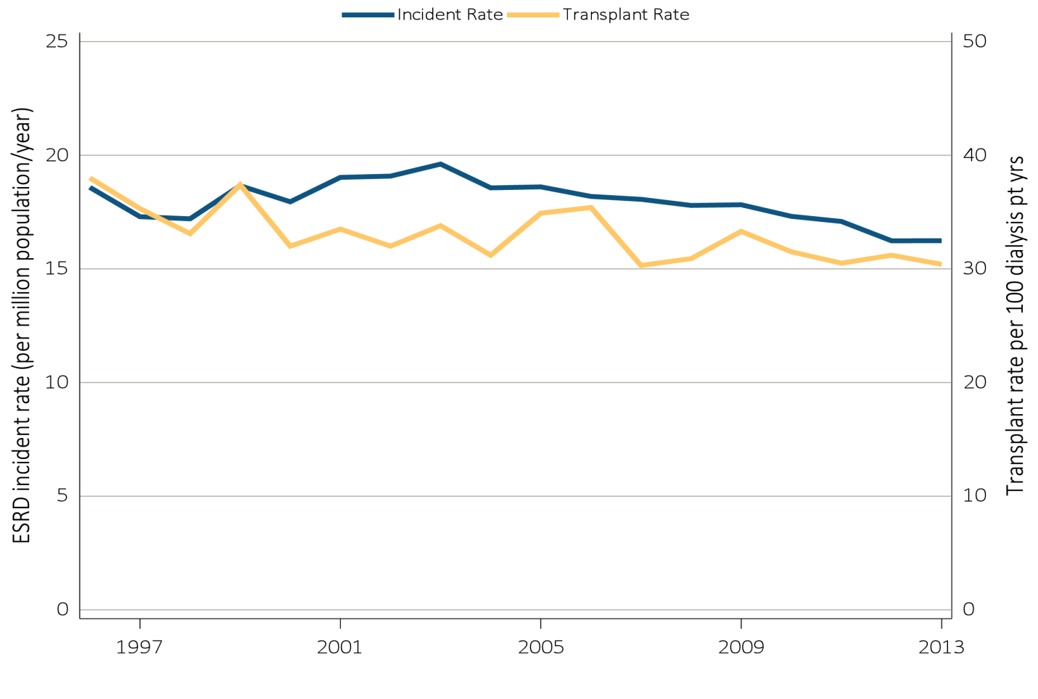
Figure 8.13 Trends in pediatric transplantation (aged 0-21 years), by (a) ESRD incident and kidney transplant rates, (b) Pediatric patient transplant counts and kidney transplant waiting list times, and (c) kidney transplant counts, 1996-2013
(a) ESRD incident and kidney transplant rates
Data Source: Reference Tables A1, E9, M1, and special analyses, USRDS ESRD Database. The rate of ESRD per million among the U.S. population aged 0-21 years and the rate of transplantation in dialysis patients aged 0-21 years at the time of transplant, 1996–2013. Abbreviations: ESRD, end-stage renal disease.

Slide 28
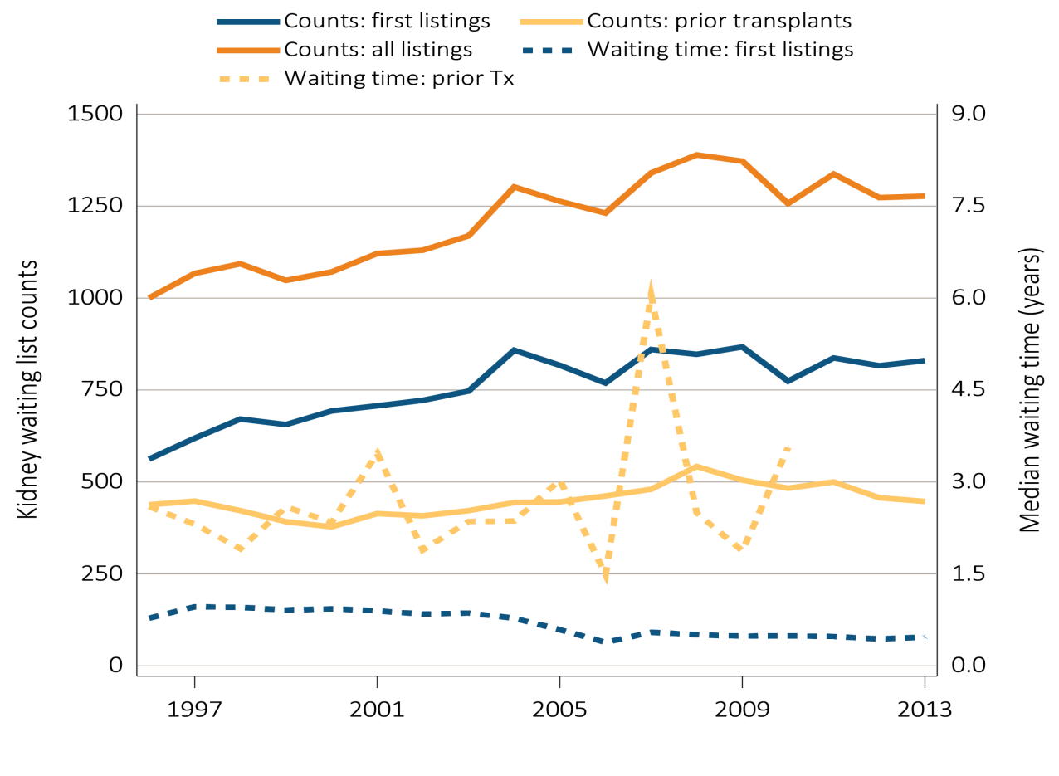
Figure 8.13 Trends in pediatric transplantation (aged 0-21 years), by (a) ESRD incident and kidney transplant rates, (b) Pediatric patient transplant counts and kidney transplant waiting list times, and (c) kidney transplant counts, 1996-2013
(b) Pediatric patient transplant counts and kidney transplant waiting list times
Data Source: Reference Tables E2, E3, and special analyses, USRDS ESRD Database. The waiting list count provides the number of pediatric candidates aged 0-21 years on the Organ Procurement and Transplantation Network kidney transplant waiting list on December 31 of each year for first and subsequent kidney alone or kidney plus pancreas transplantation. Candidates listed at more than one center on December 31 are counted only once. There are no data available for median waiting list time for patients with prior transplants listed after 2010. Abbreviations: Tx, transplant.

Slide 29
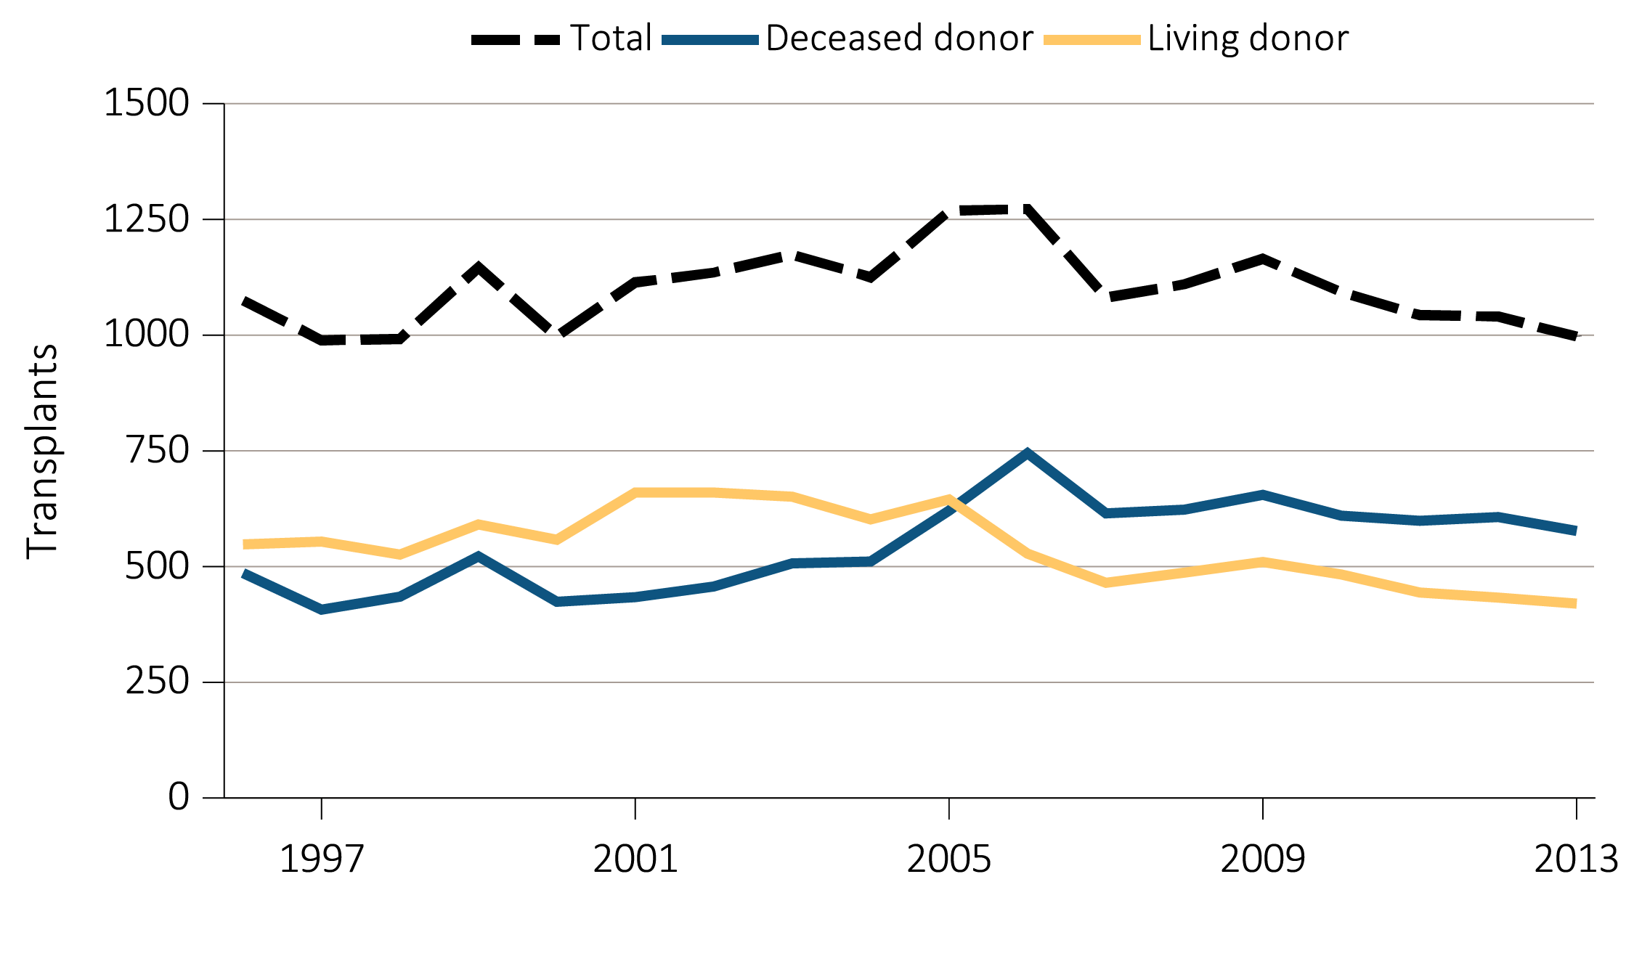
Figure 8.13 Trends in pediatric transplantation (aged 0-21 years), by (a) ESRD incident and kidney transplant rates, (b) Pediatric patient transplant counts and kidney transplant waiting list times, and (c) kidney transplant counts, 1996-2013
(c) Kidney transplant counts
Data Source: Reference Tables E8, E8(2), E8(3), and special analyses, USRDS ESRD Database. This figure represents kidney alone and kidney plus pancreas transplant counts for all pediatric candidates.

Slide 30
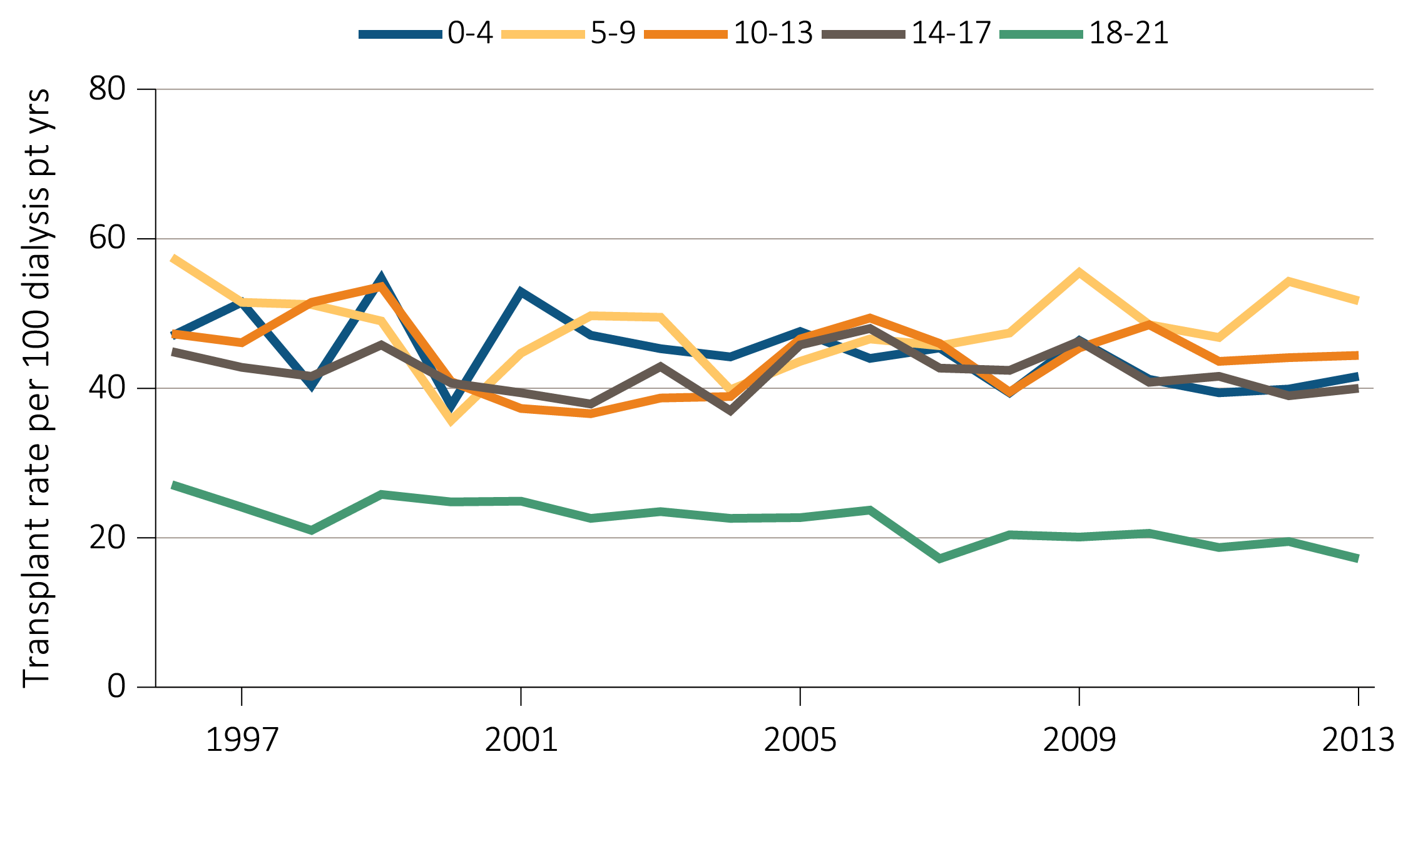
Figure 8.14 Annual rates of live and deceased donor transplants in pediatric dialysis patients (aged 0-21 years), by (a) age and (b) race, 1996-2013
(a) Transplant rates by age
Data Source: Reference Table E9, and special analyses, USRDS ESRD Database. Includes transplant year between 1996–2013.

Slide 31
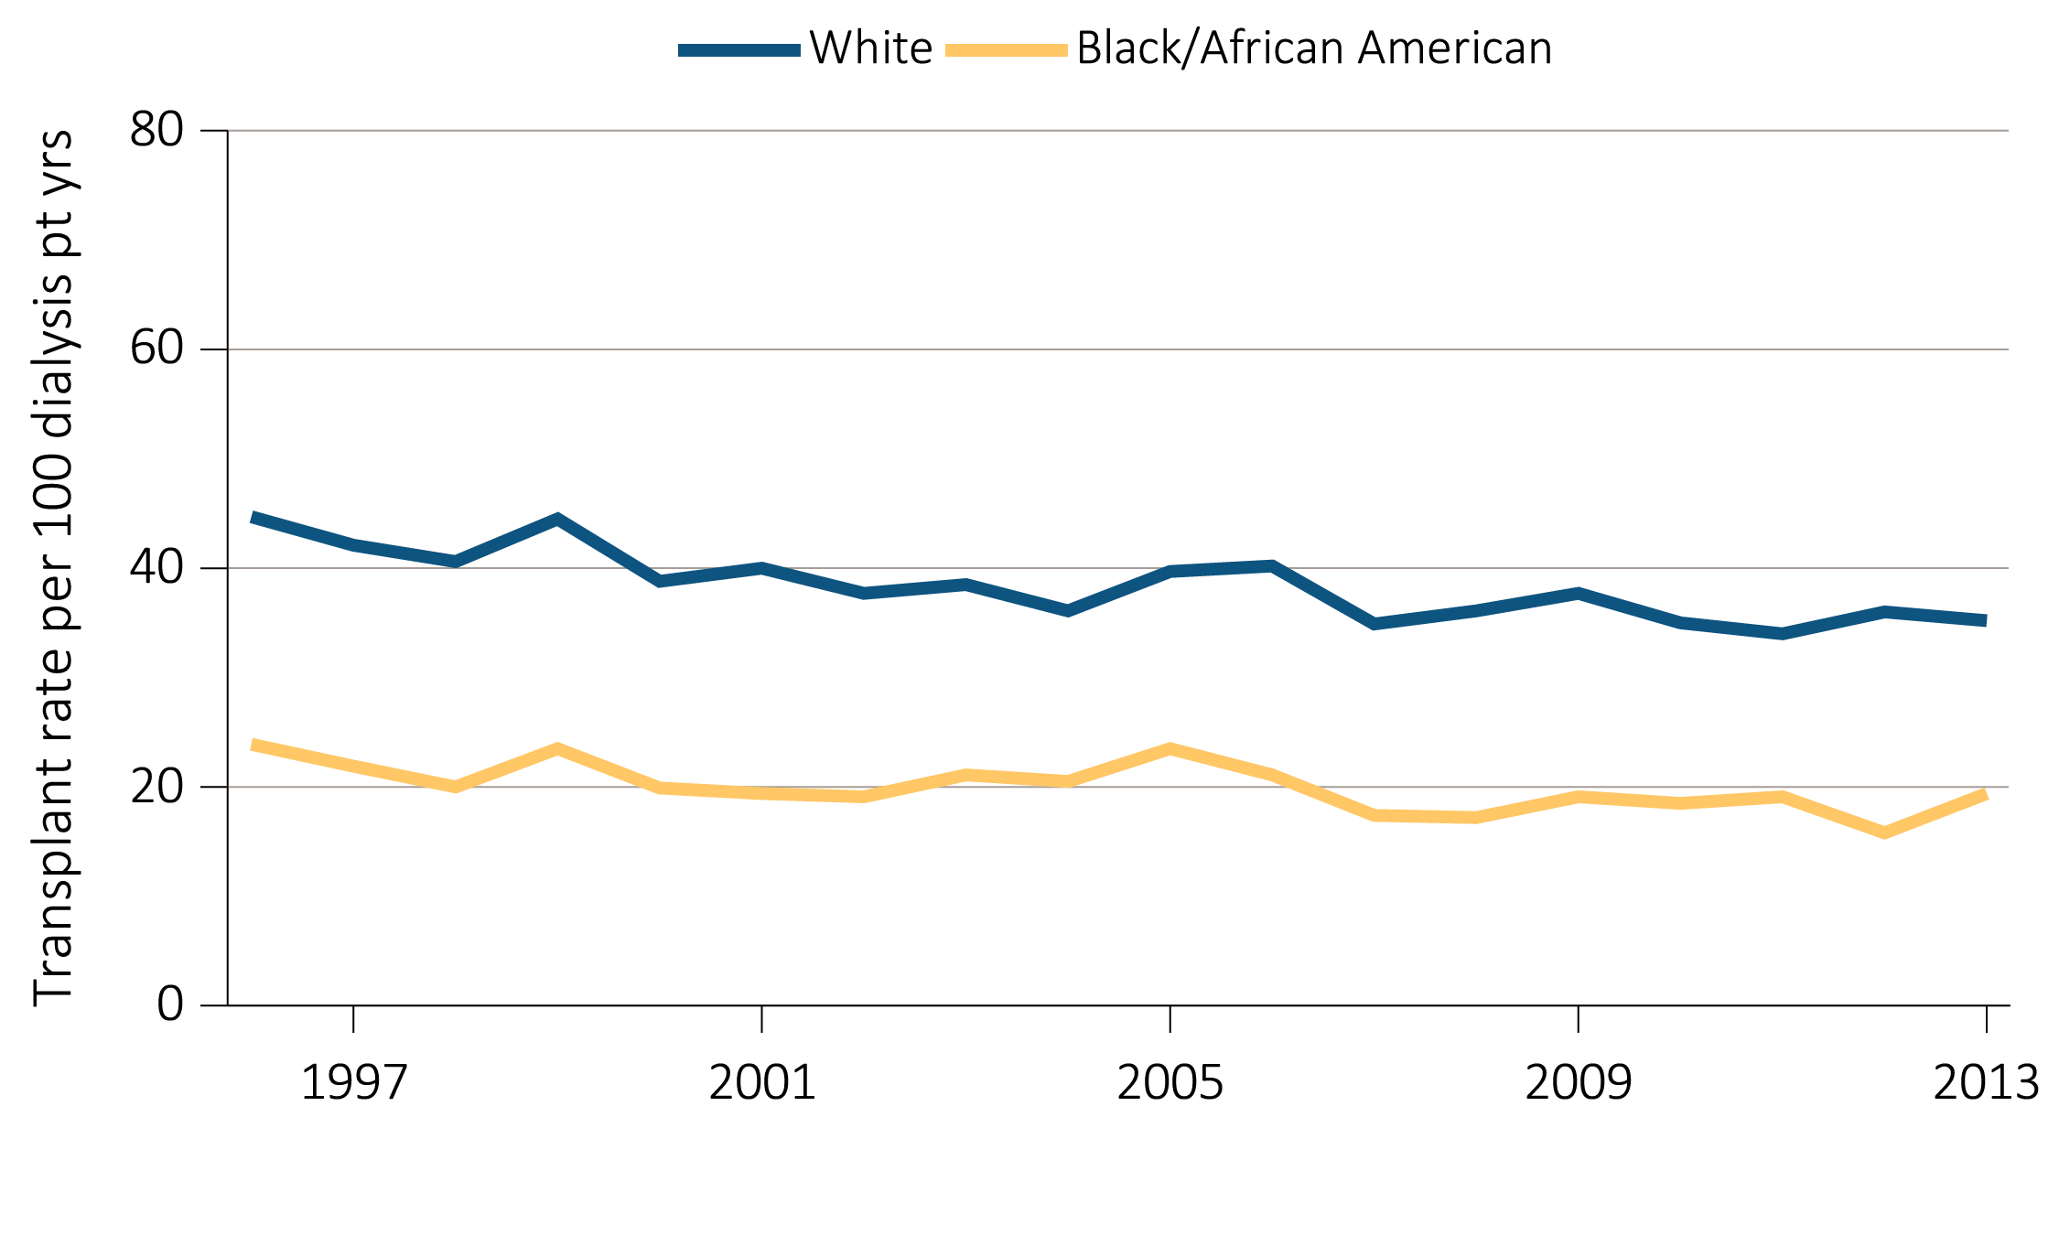
Figure 8.14 Annual rates of live and deceased donor transplants in pediatric dialysis patients (aged 0-21 years), by (a) age and (b) race, 1996-2013
(b) Transplant rates in pediatric dialysis patients by race
Data Source: Reference Table E9, and special analyses, USRDS ESRD Database. Includes transplant year between 1996–2013.

Slide 32
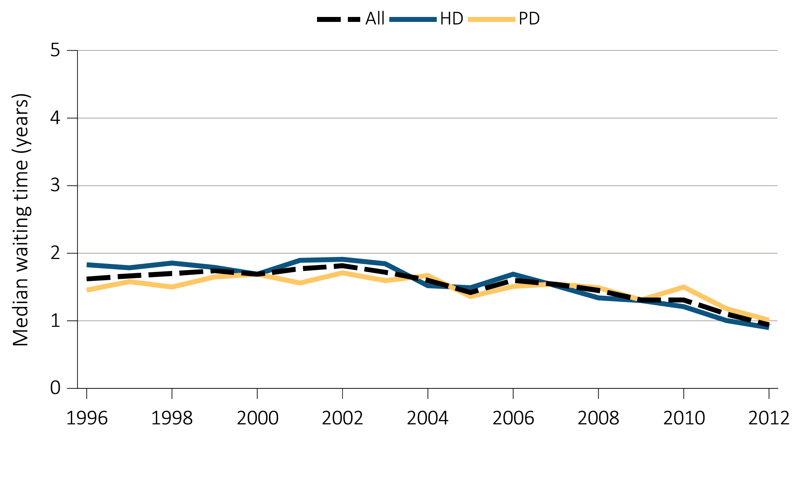
Figure 8.15 Median waiting time from incident hemodialysis (HD) or
peritoneal dialysis (PD) to first transplant, by (a) modality, (b) age,
(c) primary cause of ESRD, and (d) race, 1996-2012
(a) Modality
Data Source: Special analyses, USRDS ESRD Database. Incident dialysis and transplant patients defined at the onset of dialysis or the day of transplant with the 60-day rule. Includes pediatric patients (aged 0-21 years) starting initiation of HD or PD in 1996-2012 and having the first transplant before 12/31/2014. Abbreviations: HD, hemodialysis; PD, peritoneal dialysis.

Slide 33
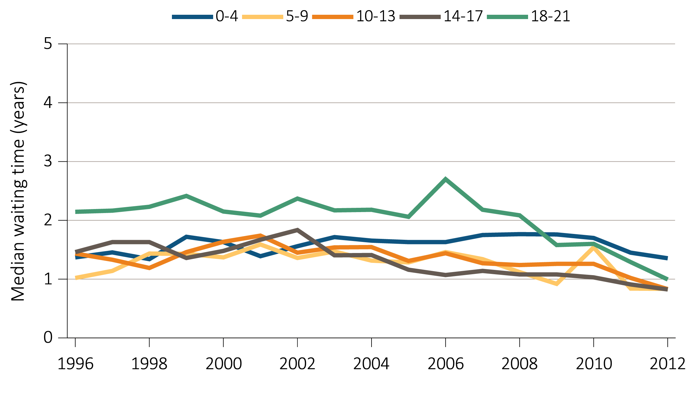
Figure 8.15 Median waiting time from incident hemodialysis (HD) or
peritoneal dialysis (PD) to first transplant, by (a) modality, (b) age,
(c) primary cause of ESRD, and (d) race, 1996-2012
(b) Age
Data Source: Special analyses, USRDS ESRD Database. Incident dialysis and transplant patients defined at the onset of dialysis or the day of transplant with the 60-day rule. Includes pediatric patients (aged 0-21 years) starting initiation of HD or PD in 1996-2012 and having the first transplant before 12/31/2014. Abbreviations: HD, hemodialysis; PD, peritoneal dialysis.

Slide 34
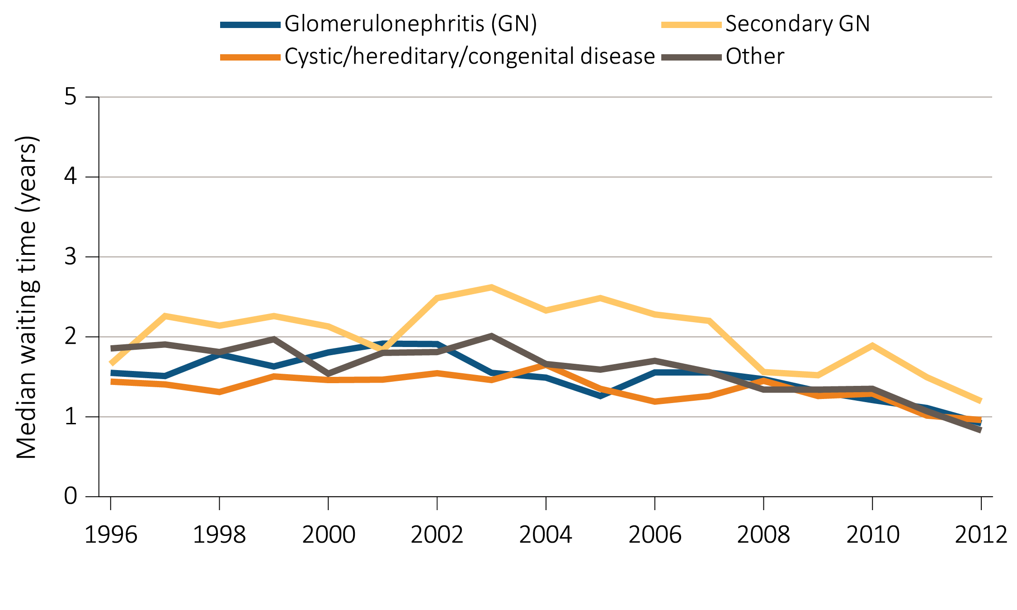
Figure 8.15 Median waiting time from incident hemodialysis (HD) or
peritoneal dialysis (PD) to first transplant, by (a) modality, (b) age,
(c) primary cause of ESRD, and (d) race, 1996-2012
(c) Primary cause of ESRD
Data Source: Special analyses, USRDS ESRD Database. Incident dialysis and transplant patients defined at the onset of dialysis or the day of transplant with the 60-day rule. Includes pediatric patients (aged 0-21 years) starting initiation of HD or PD in 1996-2012 and having the first transplant before 12/31/2014. Abbreviations: HD, hemodialysis; PD, peritoneal dialysis.

Slide 35
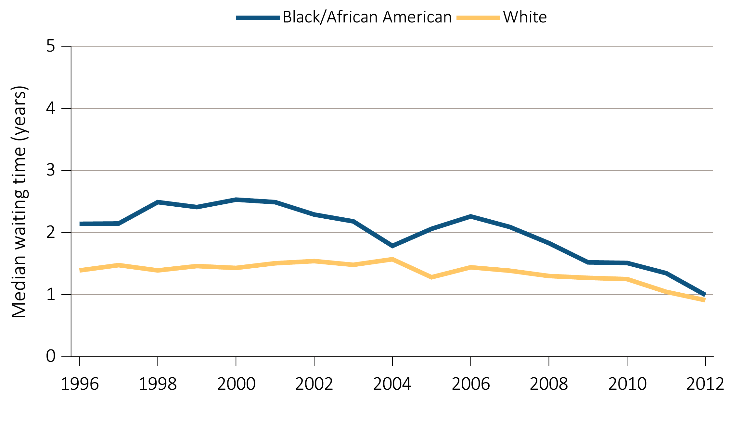
Figure 8.15 Median waiting time from incident hemodialysis (HD) or
peritoneal dialysis (PD) to first transplant, by (a) modality, (b) age,
(c) primary cause of ESRD, and (d) race, 1996-2012
(d) Race
Data Source: Special analyses, USRDS ESRD Database. Incident dialysis and transplant patients defined at the onset of dialysis or the day of transplant with the 60-day rule. Includes pediatric patients (aged 0-21 years) starting initiation of HD or PD in 1996-2012 and having the first transplant before 12/31/2014. Abbreviations: HD, hemodialysis; PD, peritoneal dialysis.

Slide 36
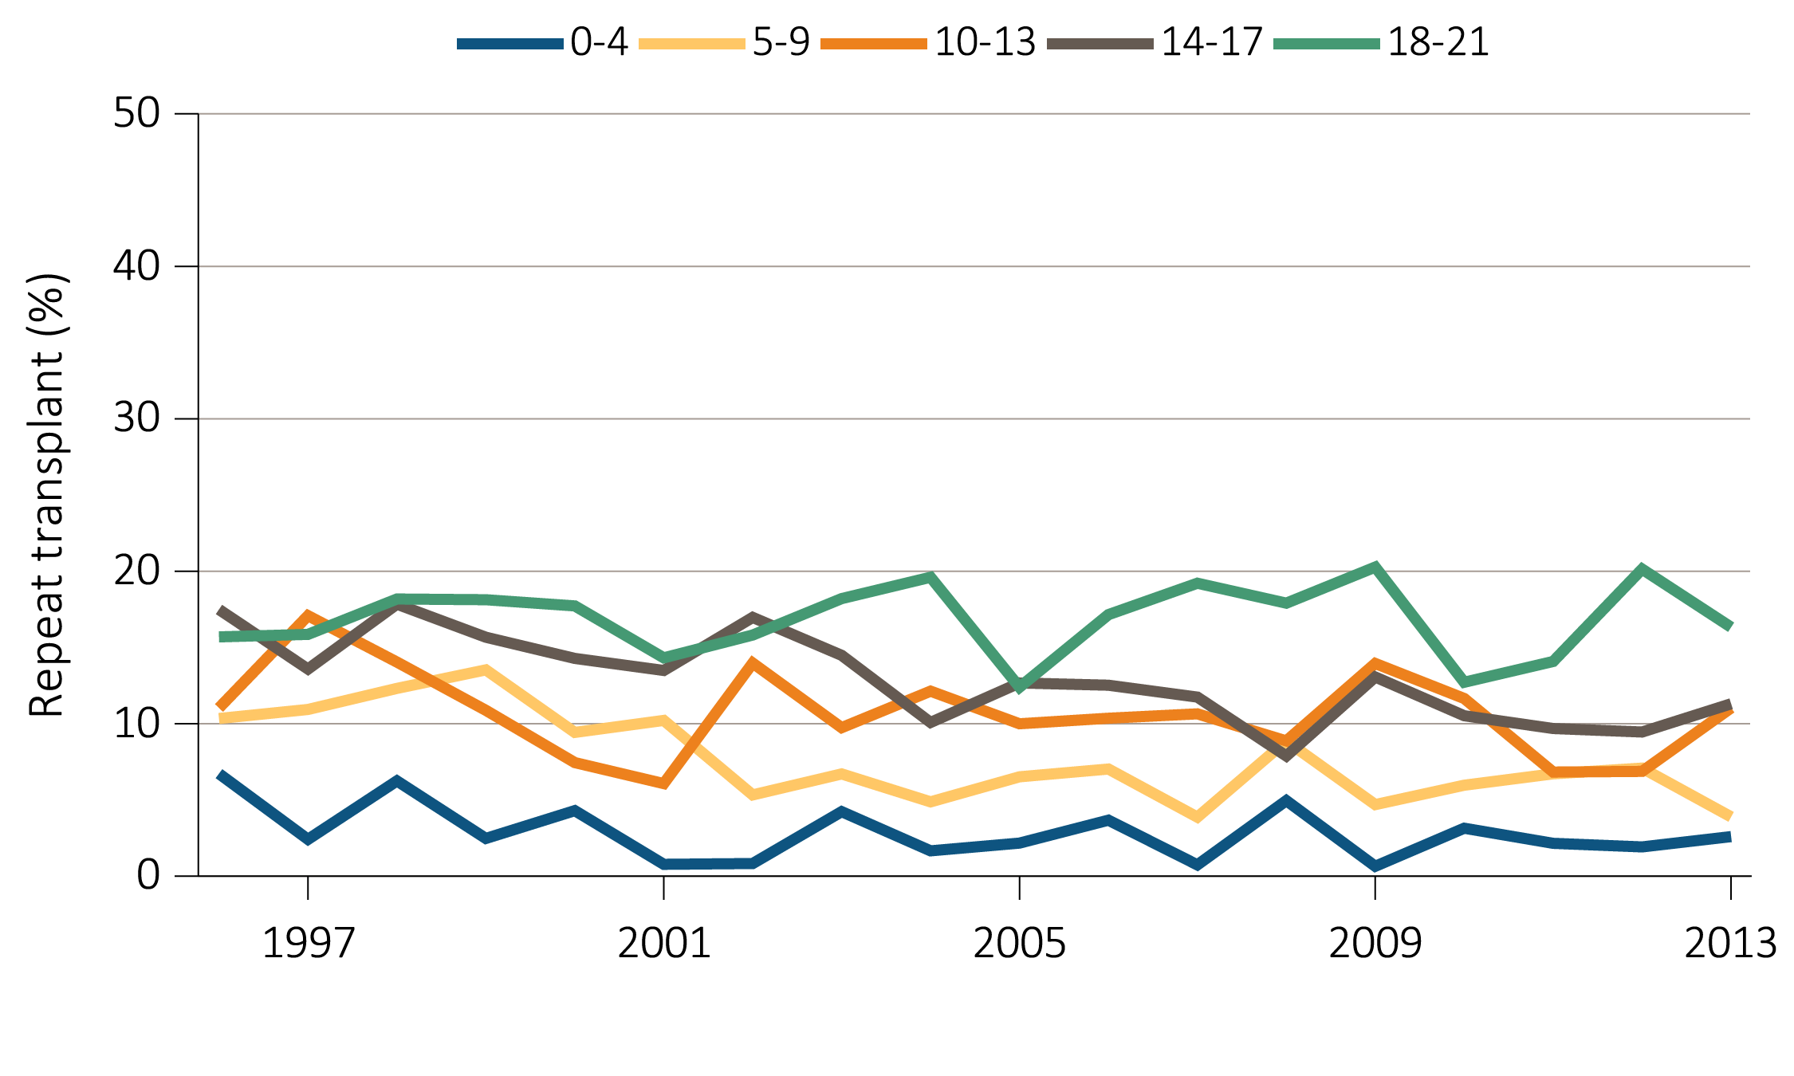
Figure 8.16 Percent of repeat transplantation in pediatric transplant patient population (aged 0-21 years), by (a) age and (b) primary cause of ESRD, 1996-2013
(a) Age
Data Source: Special analyses, USRDS ESRD Database. Includes transplant year between 1996–2013. Numerator: Total number of kidney repeat transplants; Denominator: Total number of kidney transplants. Only includes patients who are 0-21 years old at the time of first transplant and repeat transplant.

Slide 37
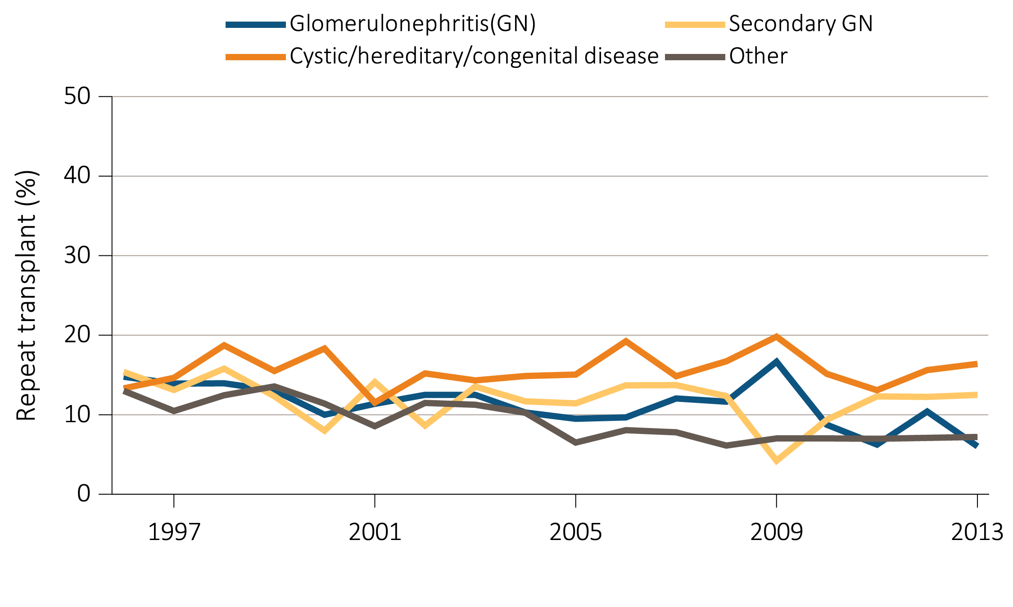
Figure 8.16 Percent of repeat transplantation in pediatric transplant patient population (aged 0-21 years), by (a) age and (b) primary cause of ESRD, 1996-2013
(b) Primary cause of ESRD
Data Source: Special analyses, USRDS ESRD Database. Includes transplant year between 1996–2013. Numerator: Total number of kidney repeat transplants; Denominator: Total number of kidney transplants. Only includes patients who are 0-21 years old at the time of first transplant and repeat transplant.

Slide 38
Table 8.3 Outcomes for kidney transplants in pediatric patients (aged 0-21 years), by donor type and year, (a) adjusted one-year outcomes,
(b) adjusted five-year outcomes, (c) adjusted ten-year outcomes, 1996-2012
(a) Adjusted one-year outcomes
Data Source: Deceased: Reference Tables F2, F14, I26. Live: Reference Tables F8, F20, I32. Probabilities for all-cause graft failure and return to dialysis or repeat transplant are adjusted for age, sex, race, primary cause of ESRD, and first versus subsequent transplant. All-cause graft failure includes repeat transplant, return to dialysis, and death. The death outcome is not censored at graft failure, and includes deaths that occur after repeat transplant or return to dialysis. Probabilities of death are adjusted for age, sex, race, ethnicity and primary cause of ESRD. The reference population for all-cause graft failure and return to dialysis or repeat transplantation is all pediatric patients receiving a kidney alone transplant in 2012. The reference population for death is incident pediatric ESRD patients in 2012.

Slide 39
Table 8.3 Outcomes for kidney transplants in pediatric patients (aged 0-21 years), by donor type and year, (a) adjusted one-year outcomes,
(b) adjusted five-year outcomes, (c) adjusted ten-year outcomes, 1996-2012
(b) Adjusted five-year outcomes
Data Source: Deceased: Reference Tables F5, F17, I29. Live: Reference Tables F11, F23, I35. Probabilities for all-cause graft failure and return to dialysis or repeat transplant are adjusted for age, sex, race, primary cause of ESRD, and first versus subsequent transplant. All-cause graft failure includes repeat transplant, return to dialysis, and death. The death outcome is not censored at graft failure, and includes deaths that occur after repeat transplant or return to dialysis. Probabilities of death are adjusted for age, sex, race, ethnicity and primary cause of ESRD. The reference population for all-cause graft failure and return to dialysis or repeat transplantation is all pediatric patients receiving a kidney alone transplant in 2012. The reference population for death is incident pediatric ESRD patients in 2012.

Slide 40
Table 8.3 Outcomes for kidney transplants in pediatric patients (aged 0-21 years), by donor type and year, (a) adjusted one-year outcomes,
(b) adjusted five-year outcomes, (c) adjusted ten-year outcomes, 1996-2012
(c) Adjusted ten-year outcomes
Data Source: Deceased: Reference Tables F6, F18, I30. Live: Reference Tables F12, F24, I36. Probabilities for all-cause graft failure and return to dialysis or repeat transplant are adjusted for age, sex, race, primary cause of ESRD, and first versus subsequent transplant. All-cause graft failure includes repeat transplant, return to dialysis, and death. The death outcome is not censored at graft failure, and includes deaths that occur after repeat transplant or return to dialysis. Probabilities of death are adjusted for age, sex, race, ethnicity and primary cause of ESRD. The reference population for all-cause graft failure and return to dialysis or repeat transplantation is all pediatric patients receiving a kidney alone transplant in 2012. The reference population for death is incident pediatric ESRD patients in 2012.

Slide 41
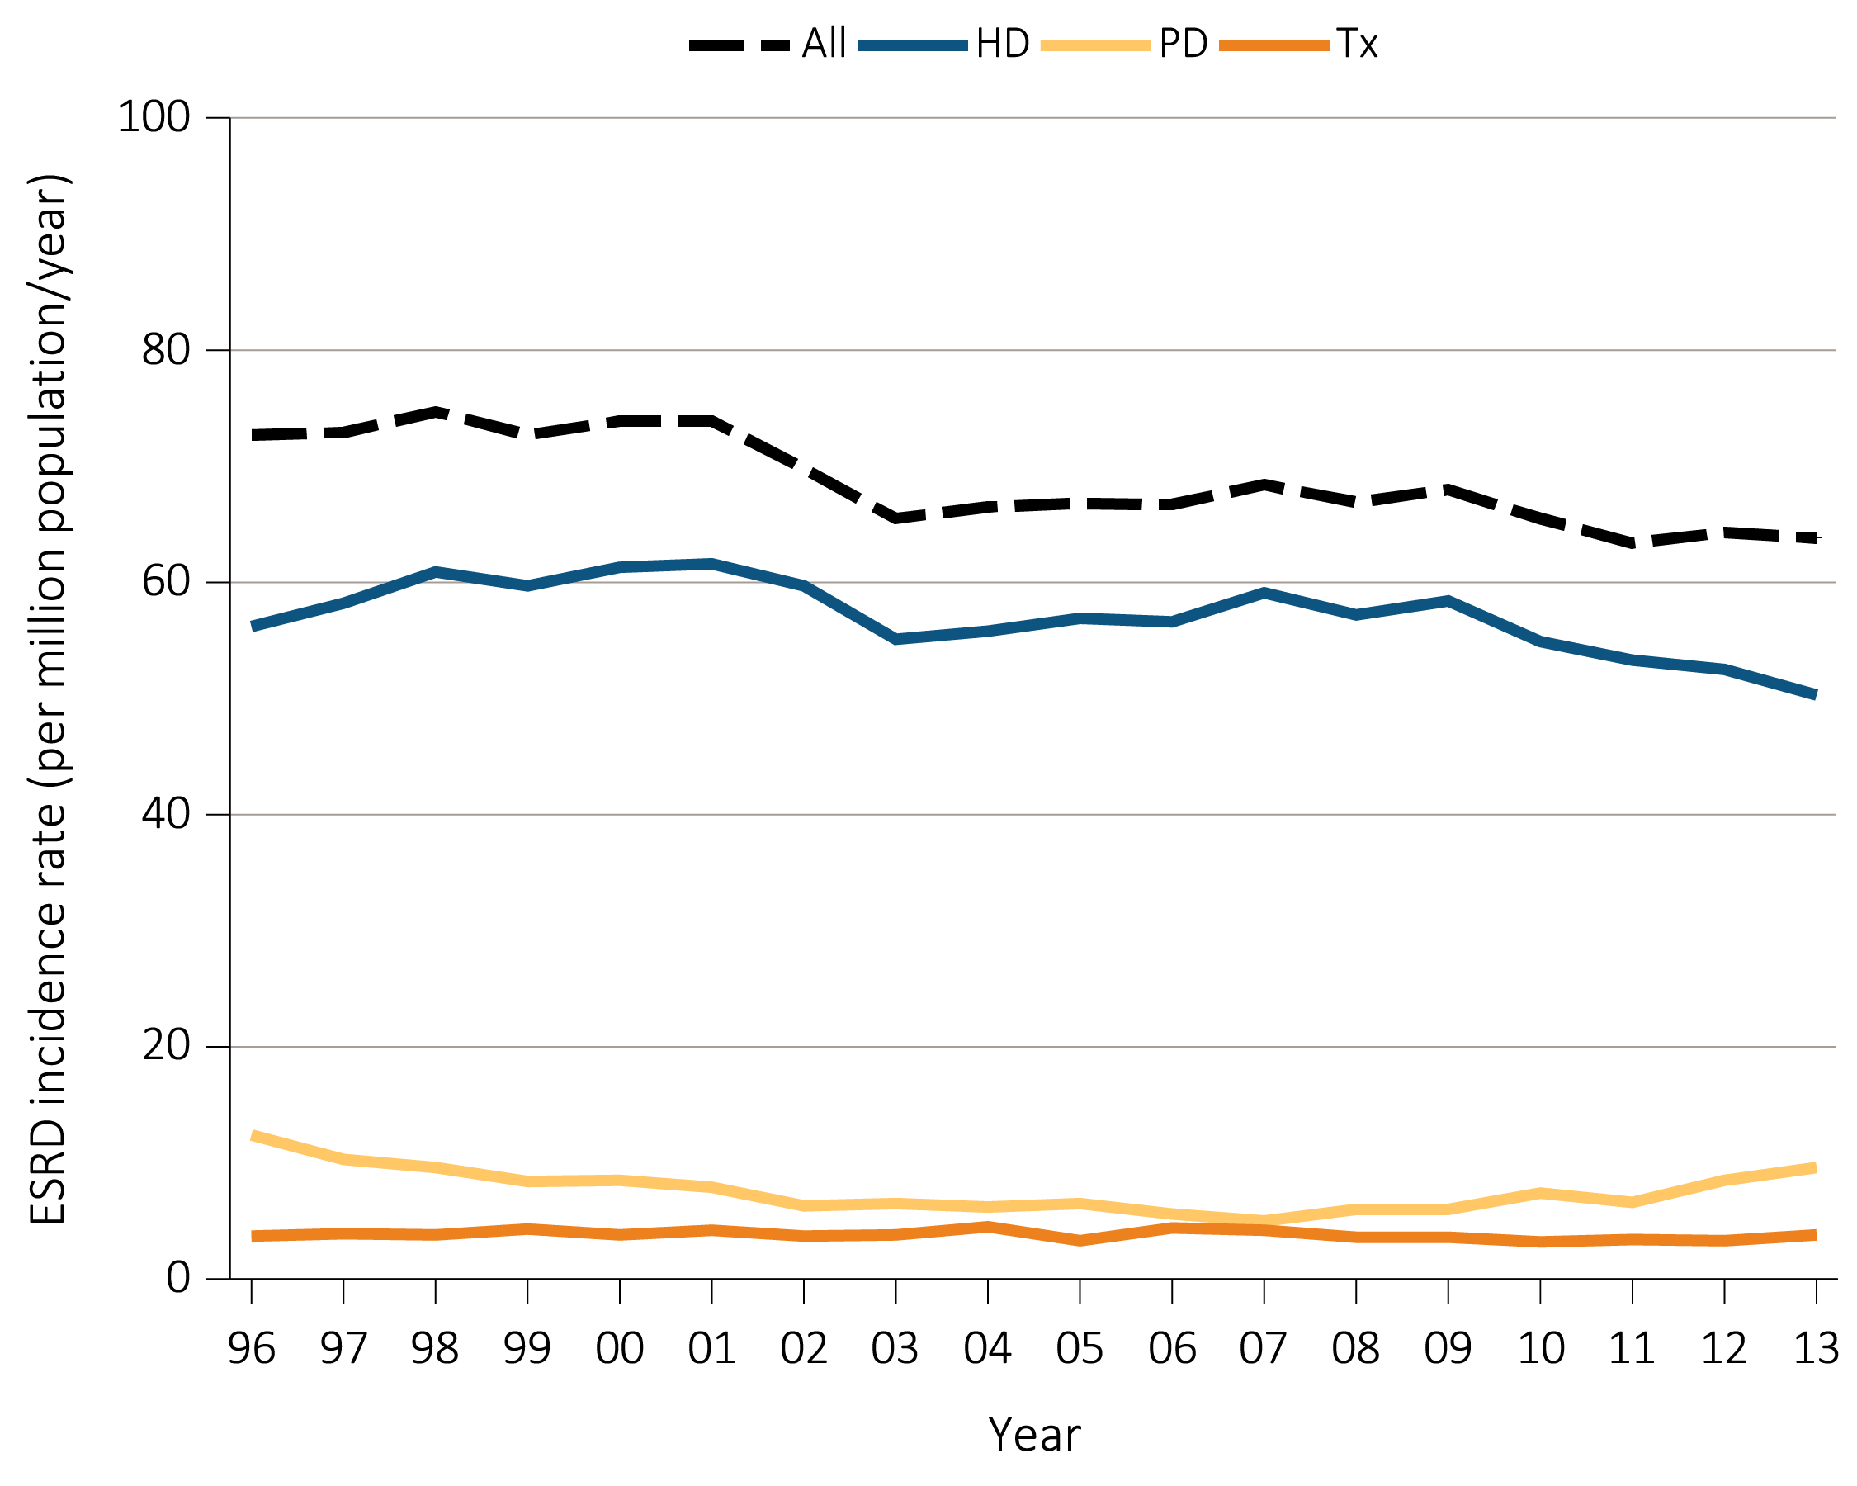
Figure 8.17 Trends in incident rates of ESRD in young adults (aged 22-29 years),
^{by modality, 1996-2013}
Data Source: Special analyses, USRDS ESRD Database. Peritoneal dialysis consists of continuous ambulatory peritoneal dialysis and continuous cycling peritoneal dialysis. Abbreviations: ESRD, end-stage renal disease; HD, hemodialysis; PD, peritoneal dialysis; Tx, transplant.

Slide 42
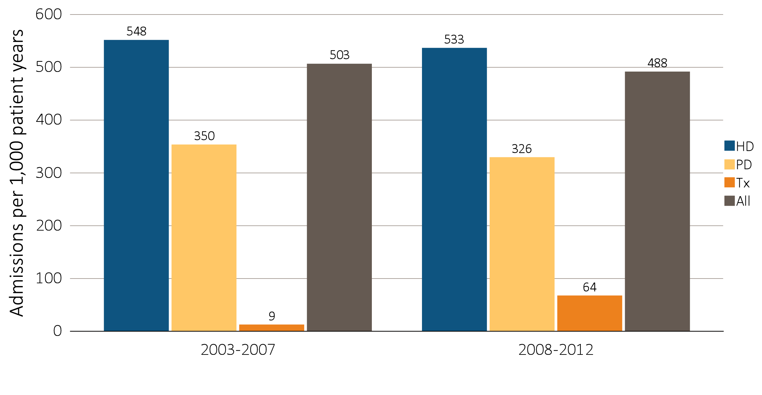
Figure 8.18 One-year adjusted cardiovascular hospitalization rates in young adults with incident ESRD (aged 22-29 years), by modality, 2003-2007 and 2008-2012
Data Source: Special analyses, USRDS ESRD Database. Includes incident pediatric ESRD patients in the years 2003-2012, surviving the first 90 days after ESRD initiation and followed from day 90. Adjusted for sex, race, primary cause of ESRD, and Hispanic ethnicity. Ref: incident ESRD patients aged 22-29, 2010-2011. Abbreviations: HD, hemodialysis; PD, peritoneal dialysis; Tx, transplant.

Slide 43
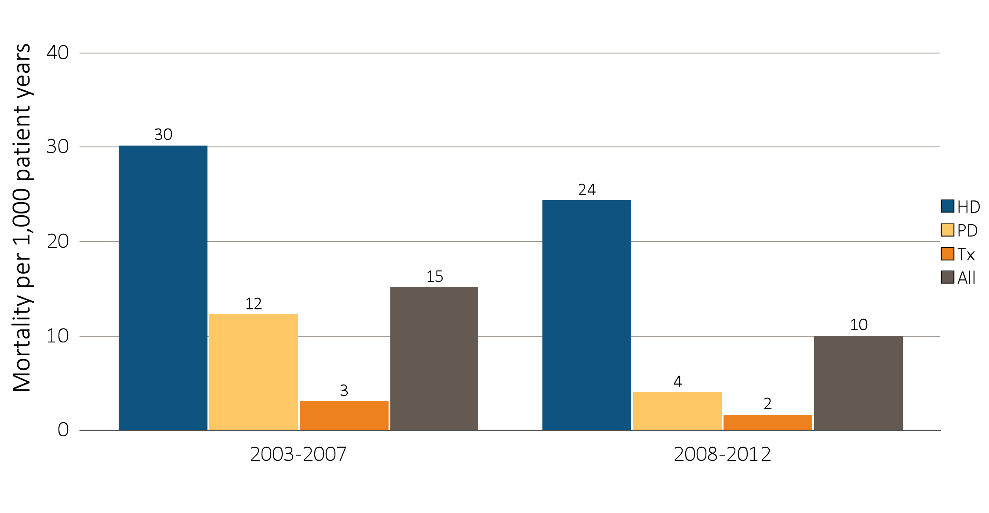
Figure 8.19 One-year adjusted cardiovascular mortality rates in young adults with incident ESRD (aged 22-29 years), by modality, 2003-2007 and 2008-2012
Data Source: Special analyses, USRDS ESRD Database. Incident dialysis and transplant patients defined at the onset of dialysis or the day of transplant without the 60-day rule; followed to December 31, 2013. Adjusted for age, sex, race, Hispanic ethnicity, and primary cause of ESRD. Ref: incident ESRD patients aged 22-29, 2010-2011. Abbreviations: HD, hemodialysis; PD, peritoneal dialysis; Tx, transplant.

Slide 44
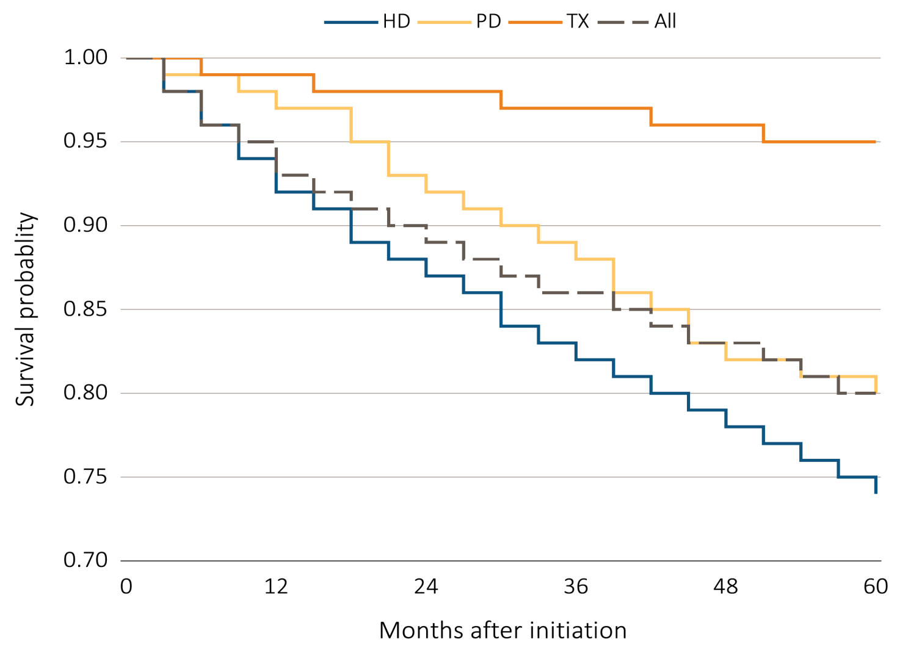
Figure 8.20 Adjusted five-year survival probability of young adults with incident ESRD (aged 22-29 years), by modality and months after initiation, 2004–2008
Data Source: Special analyses, USRDS ESRD Database. Incident dialysis and transplant patients defined at the onset of dialysis or the day of transplant without the 60-day rule; followed to December 31, 2013. Adjusted for age, sex, race, Hispanic ethnicity, and primary cause of ESRD. Ref: incident ESRD patients aged 22-29, 2010-2011. Abbreviations: HD, hemodialysis; PD, peritoneal dialysis; Tx, transplant.

