Slide 2
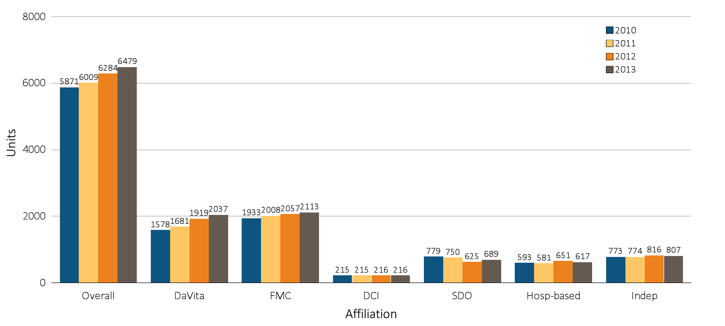
Figure 10.1 Dialysis unit counts, by unit affiliation, 2010–2013
Data source: Special analyses, USRDS ESRD Database. Abbreviations: DCI, Dialysis Clinic, Inc.; FMC, Fresenius; Hosp-based, hospital-based dialysis centers; Indep, independent dialysis providers; SDO, small dialysis organizations.

Slide 3
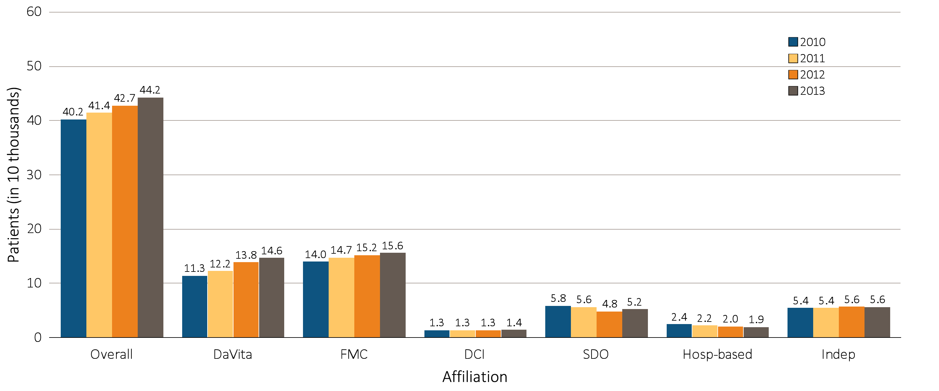
Figure 10.2 Dialysis patient counts, by unit affiliation, 2010–2013
Data source: Special analyses, USRDS ESRD Database. Abbreviations: DCI, Dialysis Clinic, Inc.; FMC, Fresenius; Hosp-based, hospital-based dialysis centers; Indep, independent dialysis providers; SDO, small dialysis organizations.

Slide 4
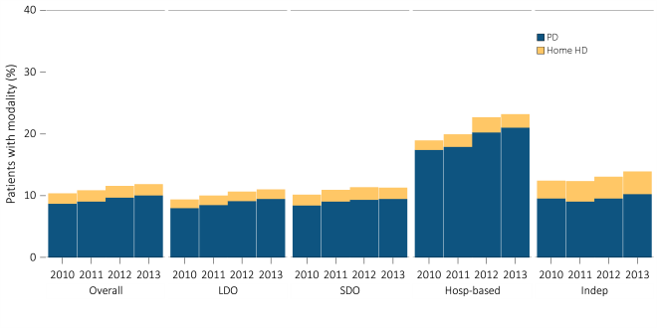
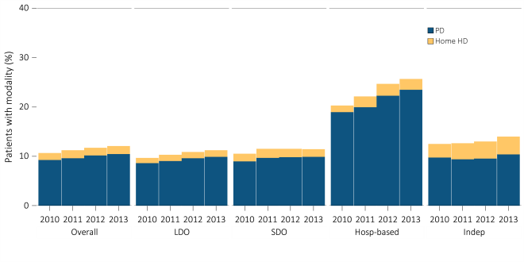
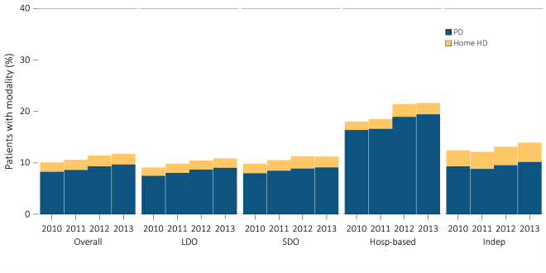
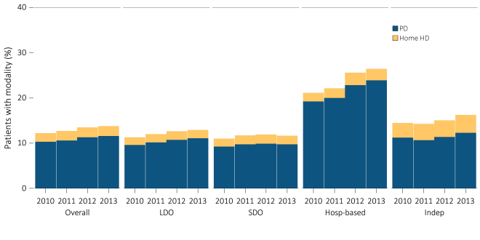
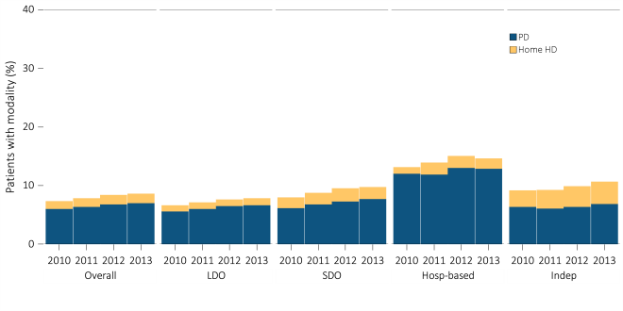
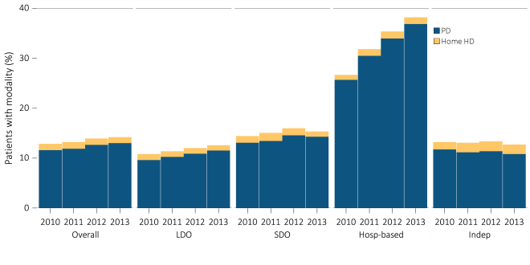
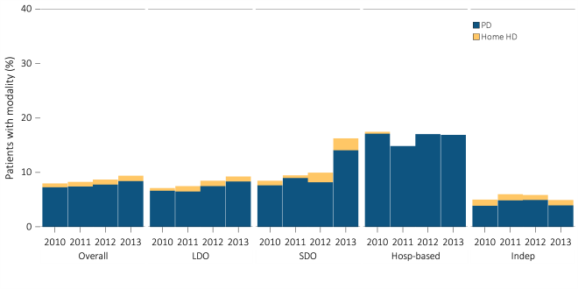
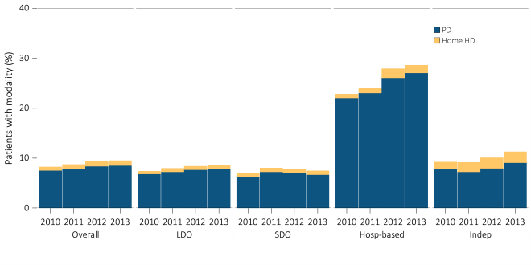
Figure 10.3 Prevalence of dialysis modality, by unit affiliation, 2010–2013
^{All patients}
^{Female patients}
^{Male patients}
^{White patients}
^{African American patients}
^{Asian patients}
^{Native American patients}
^{Hispanic patients}
Data source: Special analyses, USRDS ESRD Database. Abbreviations: HD, hemodialysis; Hosp-based, hospital-based dialysis centers; Indep, independent dialysis providers; LDO, large dialysis organizations; PD, peritoneal dialysis; SDO, small dialysis organizations.

Slide 5
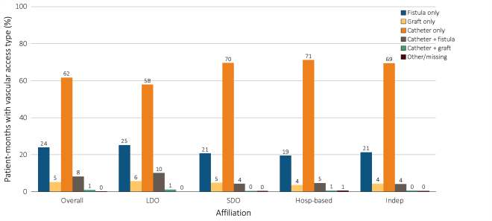
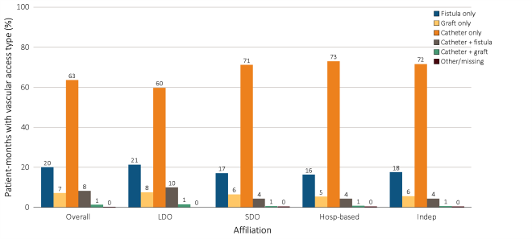
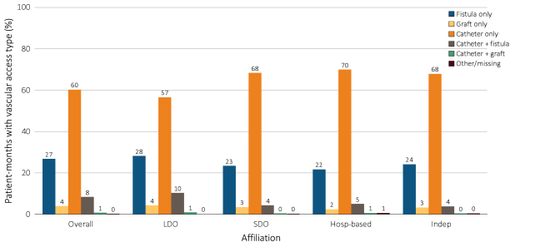
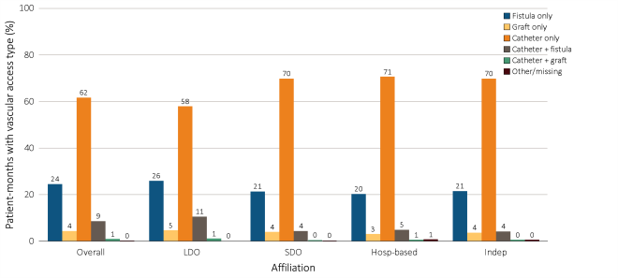
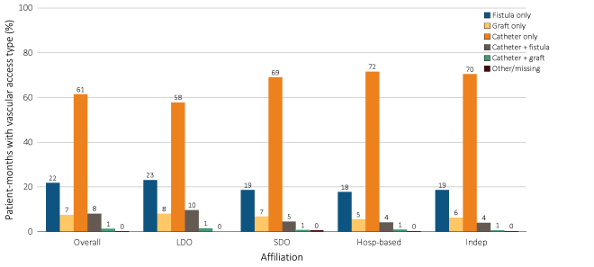
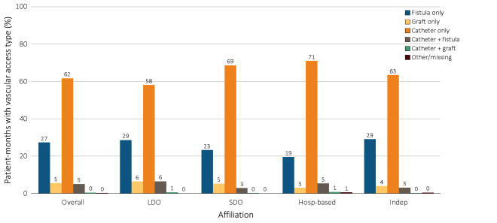
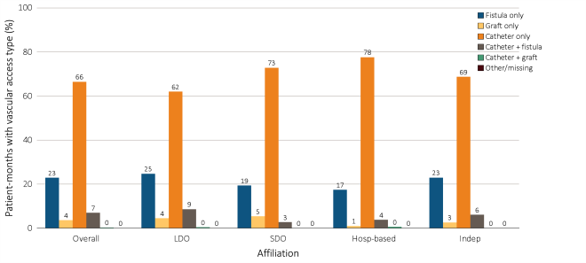
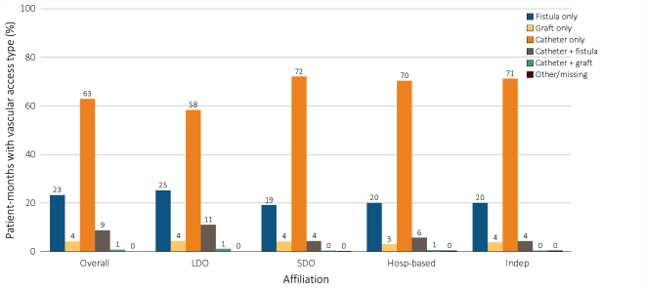
Figure 10.4 Prevalence of vascular access types among incident hemodialysis patients,
^{by unit affiliation, 2013}
^{All patients}
^{Female patients}
^{Male patients}
^{White patients}
^{African American patients}
^{Asian patients}
^{Native American patients}
^{Hispanic patients}
Data source: Special analyses, USRDS ESRD Database. Abbreviations: HD, hemodialysis; Hosp-based, hospital-based dialysis centers; Indep, independent dialysis providers; LDO, large dialysis organizations; PD, peritoneal dialysis; SDO, small dialysis organizations.

Slide 6
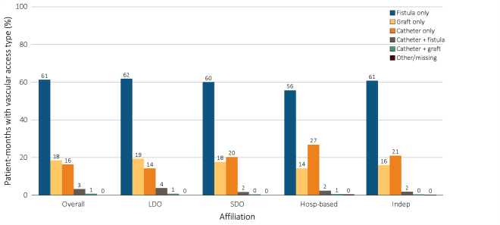
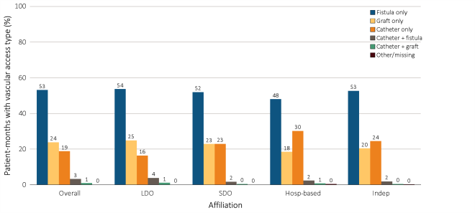
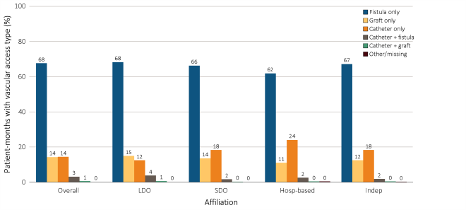
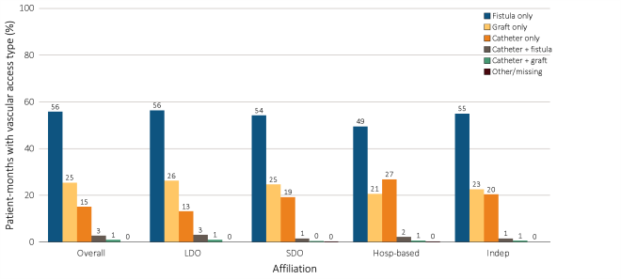
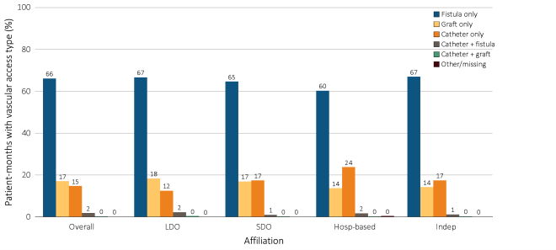
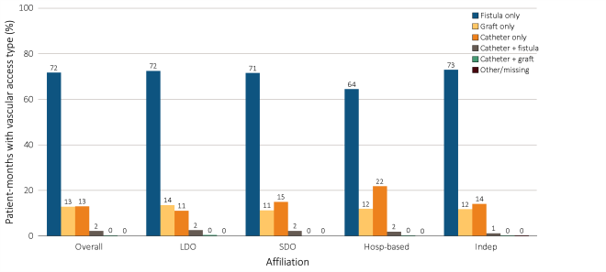
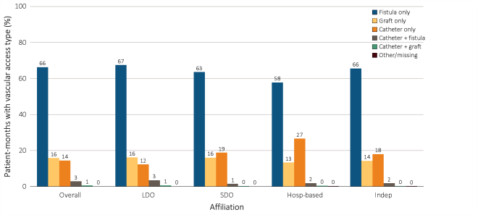
Figure 10.5 Prevalence of vascular access types among prevalent hemodialysis patients,
^{by unit affiliation, 2013}
^{All patients}
^{Female patients}
^{Male patients}
^{White patients}
^{African American patients}
^{Asian patients}
^{Native American patients}
^{Hispanic patients}
Data source: Special analyses, USRDS ESRD Database. Abbreviations: HD, hemodialysis; Hosp-based, hospital-based dialysis centers; Indep, independent dialysis providers; LDO, large dialysis organizations; PD, peritoneal dialysis; SDO, small dialysis organizations.

Slide 7
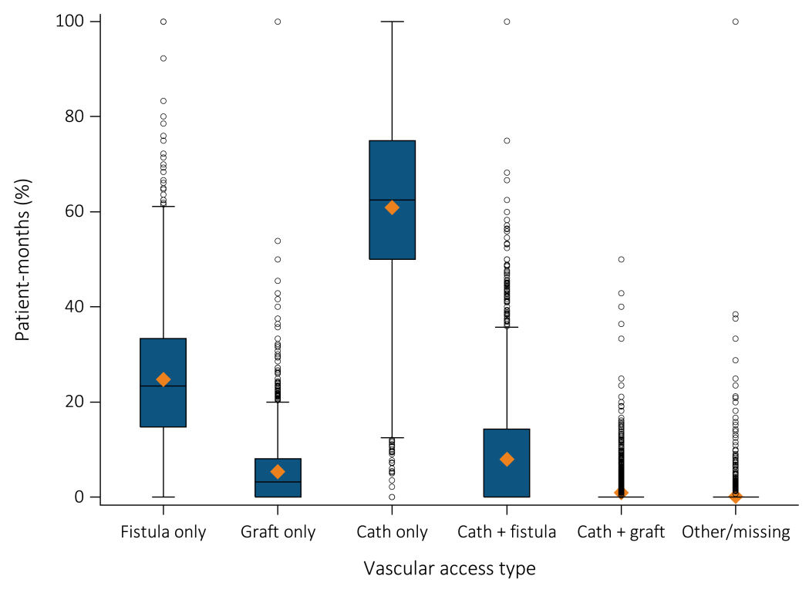
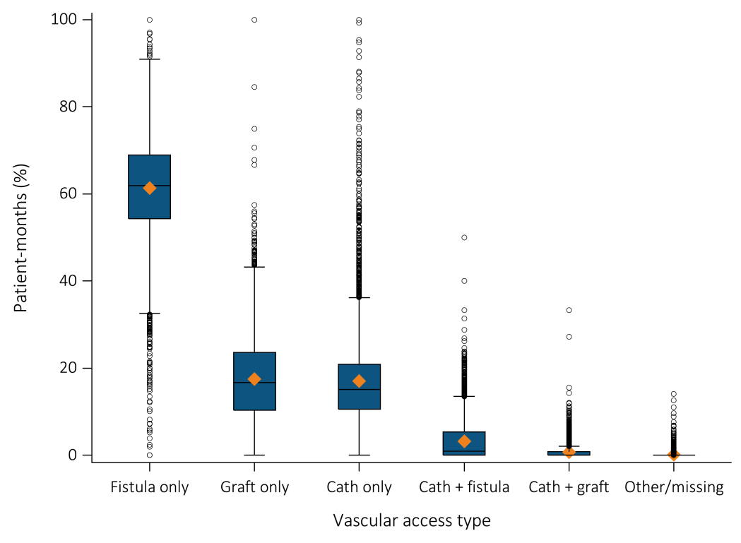
Figure 10.6 Facility-level distribution of vascular access type among HD patients
during the first 30 days of dialysis, 2013
^{Incident hemodialysis patients}
Prevalent hemodialysis patients
Data source: Special analyses, USRDS ESRD Database. The orange diamonds represent the average facility-level rate of each type of vascular access. The bars within each box represent the median. The boxes represent the interquartile range. The vertical lines are capped at the 5th and 95th percentile of these facility-level rates. Abbreviations: Cath, catheter.

Slide 8
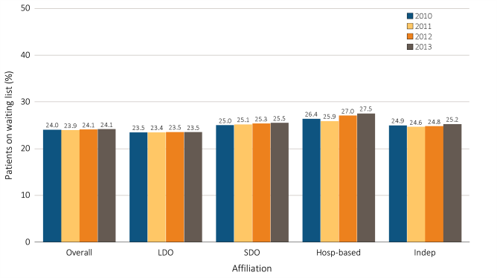
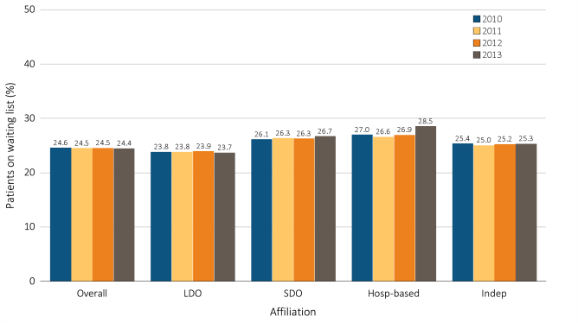
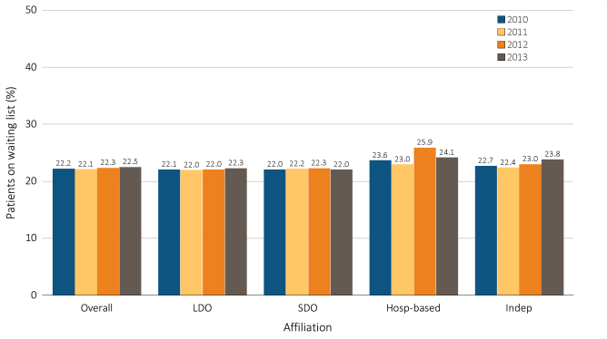
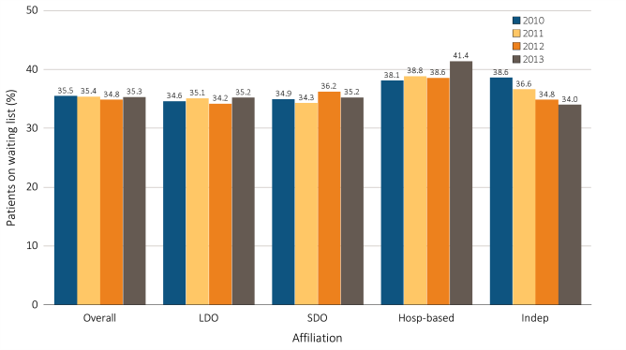
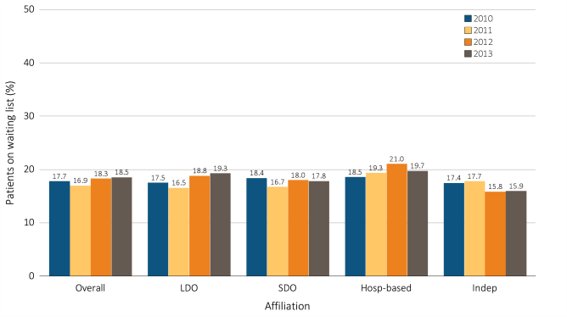
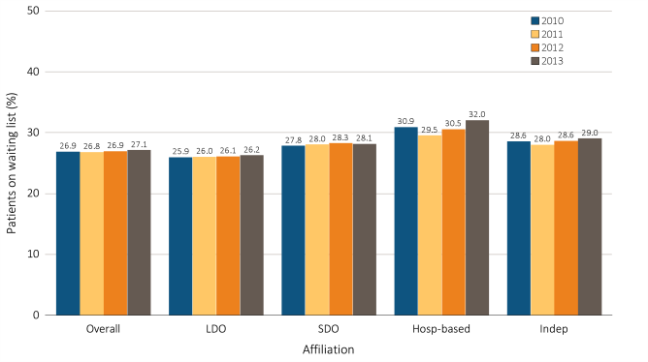
Figure 10.7 Percentage of patients younger than 70 on a kidney transplant waiting list,
^{by unit affiliation, 2010–2013}
^{All patients}
^{White patients}
^{African American patients}
^{Asian patients}
^{Native American patients}
^{Hispanic patients}
Data source: Special analyses, USRDS ESRD Database. Dialysis patients younger than 70 years on December 31. Abbreviations: Hosp-based, hospital-based dialysis centers; Indep, independent dialysis providers; LDO, large dialysis organizations; SDO, small dialysis organizations.

Slide 9
Table 10.1 All-cause standardized mortality ratio, by unit affiliation, 2010–2013
 | Affiliation | 2010 | 2011 | 2012 | 2013
All patients | Overall | 1.03 (1.02-1.04) | 1.01 (1.00-1.02) | 0.99 (0.98-0.99) | 0.98 (0.97-0.98)
 | LDO DaVita | 1.05 (1.04-1.06) | 1.03 (1.02-1.04) | 0.99 (0.98-1.00) | 0.99 (0.98-1.00)
 | Fresenius | 1.04 (1.03-1.05) | 1.03 (1.01-1.04) | 1.00 (0.99-1.01) | 0.98 (0.97-0.99)
 | DCI | 0.95 (0.92-0.99) | 0.93 (0.90-0.96) | 0.95 (0.92-0.99) | 0.92 (0.88-0.95)
 | SDO | 1.03 (1.01-1.04) | 1.03 (1.02-1.05) | 1.01 (0.99-1.03) | 1.00 (0.98-1.02)
 | Hospital-based | 0.98 (0.95-1.00) | 0.93 (0.91-0.96) | 0.95 (0.92-0.98) | 0.95 (0.92-0.98)
 | Independent | 1.05 (1.03-1.06) | 1.03 (1.01-1.05) | 1.02 (1.00-1.04) | 1.00 (0.98-1.01)
White patients | Overall | 1.15 (1.14-1.16) | 1.13 (1.12-1.14) | 1.11 (1.11-1.12) | 1.11 (1.10-1.12)
 | LDO DaVita | 1.18 (1.16-1.19) | 1.16 (1.14-1.18) | 1.12 (1.10-1.13) | 1.13 (1.11-1.14)
 | Fresenius | 1.16 (1.14-1.18) | 1.16 (1.14-1.17) | 1.13 (1.12-1.15) | 1.11 (1.10-1.13)
 | DCI | 1.11 (1.06-1.15) | 1.09 (1.05-1.14) | 1.12 (1.08-1.17) | 1.07 (1.02-1.12)
 | SDO | 1.15 (1.12-1.17) | 1.14 (1.12-1.16) | 1.11 (1.09-1.14) | 1.12 (1.10-1.15)
 | Hospital-based | 1.09 (1.05-1.12) | 1.04 (1.00-1.07) | 1.06 (1.02-1.09) | 1.11 (1.07-1.15)
 | Independent | 1.15 (1.13-1.18) | 1.14 (1.12-1.16) | 1.15 (1.12-1.17) | 1.14 (1.11-1.16)
Black/African American patients | Overall | 0.89 (0.88-0.90) | 0.85 (0.84-0.86) | 0.83 (0.82-0.84) | 0.81 (0.80-0.82)
 | LDO DaVita | 0.90 (0.88-0.92) | 0.85 (0.83-0.87) | 0.81 (0.79-0.83) | 0.83 (0.81-0.84)
 | Fresenius | 0.88 (0.86-0.90) | 0.85 (0.83-0.87) | 0.82 (0.80-0.83) | 0.81 (0.79-0.82)
 | DCI | 0.80 (0.75-0.85) | 0.76 (0.71-0.81) | 0.75 (0.71-0.80) | 0.74 (0.70-0.79)
 | SDO | 0.88 (0.85-0.91) | 0.89 (0.86-0.92) | 0.87 (0.84-0.90) | 0.81 (0.79-0.84)
 | Hospital-based | 0.88 (0.84-0.93) | 0.80 (0.75-0.85) | 0.89 (0.84-0.95) | 0.76 (0.71-0.82)
 | Independent | 0.91 (0.88-0.94) | 0.89 (0.86-0.92) | 0.85 (0.83-0.88) | 0.80 (0.78-0.83)
(Continued on the next slide)
Data source: Special analyses, USRDS ESRD Database. Period prevalent dialysis patients; 95% confidence intervals are shown in parentheses. The overall measure is adjusted for patient age, race, ethnicity, sex, diabetes, duration of ESRD, nursing home status, patient comorbidities at incidence, body mass index (BMI) at incidence, and population death rates. The race-specific measures are adjusted for all the above characteristics except patient race. The Hispanic-specific measure is adjusted for all the above characteristics except patient ethnicity. Abbreviations: DCI, Dialysis Clinic, Inc.; LDO, large dialysis organizations; SDO, small dialysis organizations.

Slide 10
Table 10.1 All-cause standardized mortality ratio, by unit affiliation, 2010–2013 (Continued)
 | Affiliation | 2010 | 2011 | 2012 | 2013
Asian patients | Overall | 0.71 (0.69-0.74) | 0.71 (0.69-0.73) | 0.68 (0.66-0.70) | 0.64 (0.62-0.66)
 | LDO DaVita | 0.73 (0.69-0.78) | 0.77 (0.73-0.82) | 0.73 (0.69-0.78) | 0.64 (0.61-0.68)
 | Fresenius | 0.74 (0.70-0.78) | 0.71 (0.68-0.75) | 0.70 (0.66-0.74) | 0.70 (0.66-0.74)
 | DCI | 0.58 (0.42-0.78) | 0.55 (0.40-0.73) | 0.78 (0.61-1.00) | 0.68 (0.52-0.88)
 | SDO | 0.77 (0.71-0.83) | 0.84 (0.78-0.91) | 0.69 (0.63-0.75) | 0.71 (0.66-0.77)
 | Hospital-based | 0.74 (0.64-0.84) | 0.78 (0.68-0.90) | 0.55 (0.46-0.66) | 0.62 (0.53-0.73)
 | Independent | 0.79 (0.72-0.85) | 0.73 (0.67-0.79) | 0.76 (0.71-0.82) | 0.70 (0.65-0.75)
Native American patients | Overall | 0.85 (0.80-0.90) | 0.83 (0.78-0.88) | 0.83 (0.78-0.88) | 0.81 (0.76-0.86)
 | LDO DaVita | 0.76 (0.67-0.86) | 0.84 (0.74-0.94) | 0.75 (0.67-0.84) | 0.72 (0.64-0.80)
 | Fresenius | 0.99 (0.88-1.11) | 0.92 (0.81-1.03) | 1.01 (0.90-1.13) | 0.88 (0.78-0.99)
 | DCI | 0.67 (0.50-0.88) | 0.75 (0.57-0.98) | 0.71 (0.54-0.92) | 0.77 (0.58-0.99)
 | SDO | 0.74 (0.64-0.85) | 0.65 (0.56-0.76) | 1.20 (0.98-1.46) | 1.06 (0.84-1.31)
 | Hospital-based | 0.75 (0.60-0.92) | 0.80 (0.64-0.98) | 0.78 (0.63-0.96) | 0.79 (0.63-0.97)
 | Independent | 1.09 (0.95-1.25) | 0.98 (0.84-1.13) | 0.71 (0.62-0.82) | 0.80 (0.70-0.90)
Hispanic patients | Overall | 0.81 (0.79-0.82) | 0.80 (0.79-0.82) | 0.77 (0.75-0.78) | 0.74 (0.72-0.75)
 | LDO DaVita | 0.76 (0.73-0.79) | 0.77 (0.75-0.80) | 0.75 (0.72-0.77) | 0.74 (0.72-0.76)
 | Fresenius | 0.85 (0.83-0.88) | 0.84 (0.81-0.86) | 0.79 (0.76-0.81) | 0.74 (0.71-0.76)
 | DCI | 0.77 (0.65-0.91) | 0.67 (0.57-0.80) | 0.82 (0.70-0.96) | 0.81 (0.69-0.95)
 | SDO | 0.85 (0.81-0.88) | 0.85 (0.81-0.88) | 0.82 (0.78-0.86) | 0.79 (0.75-0.82)
 | Hospital-based | 0.83 (0.75-0.90) | 0.80 (0.72-0.88) | 0.76 (0.69-0.85) | 0.68 (0.61-0.76)
 | Independent | 0.83 (0.79-0.87) | 0.82 (0.79-0.86) | 0.79 (0.76-0.83) | 0.80 (0.76-0.83)
Data source: Special analyses, USRDS ESRD Database. Period prevalent dialysis patients; 95% confidence intervals are shown in parentheses. The overall measure is adjusted for patient age, race, ethnicity, sex, diabetes, duration of ESRD, nursing home status, patient comorbidities at incidence, body mass index (BMI) at incidence, and population death rates. The race-specific measures are adjusted for all the above characteristics except patient race. The Hispanic-specific measure is adjusted for all the above characteristics except patient ethnicity. Abbreviations: DCI, Dialysis Clinic, Inc.; LDO, large dialysis organizations; SDO, small dialysis organizations.

Slide 11
Table 10.2 All-cause standardized mortality ratio, by unit affiliation, 2013
Affiliation | All | White | Black/African American | Asian | Native American | Hispanic
Overall | 1.00 (0.99-1.01) | 1.13 (1.13-1.14) | 0.83 (0.83-0.84) | 0.66 (0.64-0.68) | 0.83 (0.78-0.88) | 0.76 (0.75-0.77)
LDO
DaVita | 1.02 (1.01-1.03) | 1.15 (1.14-1.17) | 0.85 (0.83-0.87) | 0.66 (0.63-0.70) | 0.74 (0.66-0.82) | 0.76 (0.74-0.79)
Fresenius | 1.00 (0.99-1.02) | 1.14 (1.12-1.15) | 0.83 (0.81-0.85) | 0.72 (0.68-0.77) | 0.90 (0.80-1.02) | 0.76 (0.73-0.78)
DCI | 0.94 (0.90-0.97) | 1.09 (1.04-1.14) | 0.76 (0.72-0.81) | 0.71 (0.54-0.91) | 0.78 (0.60-1.01) | 0.84 (0.71-0.98)
SDO | 1.02 (1.01-1.04) | 1.15 (1.13-1.18) | 0.84 (0.81-0.87) | 0.73 (0.68-0.79) | 1.08 (0.86-1.35) | 0.81 (0.77-0.85)
Hospital-based | 0.98 (0.95-1.01) | 1.14 (1.10-1.18) | 0.79 (0.74-0.84) | 0.64 (0.54-0.76) | 0.80 (0.64-0.99) | 0.71 (0.63-0.79)
Independent | 1.02 (1.01-1.04) | 1.17 (1.14-1.19) | 0.83 (0.80-0.86) | 0.72 (0.67-0.77) | 0.81 (0.71-0.92) | 0.82 (0.79-0.86)
Data source: Special analyses, USRDS ESRD Database. Period prevalent dialysis patients; 95% confidence intervals are shown in parentheses. The overall measure is adjusted for patient age, race, ethnicity, sex, diabetes, duration of ESRD, nursing home status, patient comorbidities at incidence, body mass index (BMI) at incidence, and population death rates. The race-specific measures are adjusted for all the above characteristics except patient race. The Hispanic-specific measure is adjusted for all the above characteristics except patient ethnicity. Abbreviations: DCI, Dialysis Clinic, Inc.; LDO, large dialysis organizations; SDO, small dialysis organizations.

Slide 12
Table 10.3 All-cause standardized hospitalization ratio, by unit affiliation, 2010–2013
 | Affiliation | 2010 | 2011 | 2012 | 2013
All patients | Overall | 1.03 (1.03-1.03) | 1.02 (1.02-1.02) | 0.99 (0.99-0.99) | 0.97 (0.96-0.97)
 | LDO DaVita | 1.04 (1.03-1.04) | 1.02 (1.02-1.02) | 0.99 (0.99-0.99) | 0.97 (0.97-0.97)
 | Fresenius | 1.02 (1.02-1.03) | 1.01 (1.01-1.02) | 0.98 (0.98-0.98) | 0.95 (0.95-0.96)
 | DCI | 0.92 (0.91-0.93) | 0.92 (0.91-0.93) | 0.90 (0.89-0.91) | 0.87 (0.86-0.88)
 | SDO | 1.03 (1.02-1.03) | 1.03 (1.03-1.04) | 1.00 (0.99-1.00) | 0.95 (0.95-0.96)
 | Hospital-based | 0.97 (0.96-0.98) | 0.94 (0.93-0.95) | 0.95 (0.94-0.96) | 0.91 (0.90-0.92)
 | Independent | 1.01 (1.00-1.02) | 1.01 (1.00-1.01) | 0.99 (0.98-0.99) | 0.95 (0.94-0.95)
White patients | Overall | 1.04 (1.04-1.05) | 1.04 (1.03-1.04) | 1.02 (1.01-1.02) | 0.99 (0.99-0.99)
 | LDO DaVita | 1.05 (1.05-1.06) | 1.04 (1.04-1.05) | 1.02 (1.01-1.02) | 1.00 (0.99-1.00)
 | Fresenius | 1.06 (1.06-1.07) | 1.05 (1.05-1.06) | 1.02 (1.01-1.02) | 0.99 (0.99-1.00)
 | DCI | 0.98 (0.96-1.00) | 0.98 (0.96-1.00) | 0.97 (0.96-0.99) | 0.92 (0.90-0.94)
 | SDO | 1.02 (1.01-1.03) | 1.03 (1.02-1.03) | 0.99 (0.98-1.00) | 0.96 (0.95-0.97)
 | Hospital-based | 0.95 (0.94-0.96) | 0.92 (0.90-0.93) | 0.93 (0.92-0.94) | 0.91 (0.89-0.92)
 | Independent | 1.01 (1.01-1.02) | 1.01 (1.00-1.02) | 1.01 (1.00-1.01) | 0.96 (0.96-0.97)
Black/African American patients | Overall | 1.04 (1.04-1.04) | 1.02 (1.02-1.03) | 0.99 (0.99-0.99) | 0.96 (0.96-0.96)
 | LDO DaVita | 1.05 (1.04-1.06) | 1.02 (1.01-1.02) | 0.99 (0.98-1.00) | 0.97 (0.96-0.98)
 | Fresenius | 1.01 (1.00-1.01) | 0.99 (0.98-0.99) | 0.95 (0.95-0.96) | 0.92 (0.92-0.93)
 | DCI | 0.88 (0.87-0.90) | 0.87 (0.85-0.89) | 0.86 (0.84-0.88) | 0.85 (0.83-0.86)
 | SDO | 1.10 (1.09-1.11) | 1.11 (1.10-1.12) | 1.04 (1.03-1.05) | 0.99 (0.98-1.00)
 | Hospital-based | 1.04 (1.02-1.06) | 1.05 (1.03-1.07) | 1.04 (1.02-1.06) | 0.97 (0.95-0.99)
 | Independent | 1.04 (1.03-1.05) | 1.04 (1.03-1.05) | 1.01 (1.00-1.02) | 0.96 (0.95-0.97)
(Continued on the next slide)
Data source: Special analyses, USRDS ESRD Database. Period prevalent dialysis patients with Medicare as primary payer; 95% confidence intervals are shown in parentheses. Adjusted for patient age, race, ethnicity, sex, diabetes, duration of ESRD, nursing home status, patient comorbidities at incidence, and body mass index (BMI) at incidence. The race-specific measures are adjusted for all the above characteristics except patient race. The Hispanic-specific measure is adjusted for all the above characteristics except patient ethnicity. Abbreviations: DCI, Dialysis Clinic, Inc.; LDO, large dialysis organizations; SDO, small dialysis organizations.

Slide 13
Table 10.3 All-cause standardized hospitalization ratio, by unit affiliation, 2010–2013 (Continued)
 | Affiliation | 2010 | 2011 | 2012 | 2013
Asian patients | Overall | 0.78 (0.77-0.79) | 0.79 (0.78-0.80) | 0.75 (0.74-0.76) | 0.73 (0.72-0.74)
 | LDO DaVita | 0.78 (0.76-0.80) | 0.78 (0.76-0.80) | 0.71 (0.70-0.73) | 0.71 (0.69-0.72)
 | Fresenius | 0.74 (0.72-0.75) | 0.78 (0.77-0.80) | 0.79 (0.77-0.81) | 0.76 (0.75-0.78)
 | DCI | 0.67 (0.61-0.74) | 0.82 (0.75-0.89) | 0.74 (0.67-0.81) | 0.63 (0.57-0.69)
 | SDO | 0.76 (0.74-0.79) | 0.79 (0.77-0.81) | 0.69 (0.67-0.71) | 0.67 (0.65-0.69)
 | Hospital-based | 0.81 (0.77-0.85) | 0.70 (0.66-0.74) | 0.68 (0.63-0.72) | 0.74 (0.69-0.79)
 | Independent | 0.82 (0.80-0.85) | 0.78 (0.75-0.80) | 0.73 (0.71-0.75) | 0.73 (0.71-0.75)
Native American patients | Overall | 0.87 (0.85-0.88) | 0.84 (0.83-0.86) | 0.81 (0.80-0.83) | 0.80 (0.78-0.81)
 | LDO DaVita | 0.89 (0.86-0.93) | 0.85 (0.82-0.88) | 0.80 (0.78-0.83) | 0.79 (0.77-0.82)
 | Fresenius | 0.91 (0.87-0.94) | 0.91 (0.87-0.94) | 0.84 (0.80-0.87) | 0.83 (0.80-0.86)
 | DCI | 0.76 (0.70-0.83) | 0.77 (0.71-0.84) | 0.60 (0.55-0.66) | 0.65 (0.59-0.71)
 | SDO | 0.71 (0.68-0.74) | 0.71 (0.68-0.75) | 0.92 (0.86-0.99) | 0.78 (0.71-0.84)
 | Hospital-based | 1.03 (0.97-1.10) | 0.96 (0.90-1.02) | 0.95 (0.89-1.01) | 0.84 (0.78-0.90)
 | Independent | 0.85 (0.81-0.90) | 0.81 (0.76-0.86) | 0.70 (0.67-0.74) | 0.73 (0.70-0.76)
Hispanic patients | Overall | 0.96 (0.96-0.97) | 0.93 (0.92-0.93) | 0.92 (0.92-0.93) | 0.88 (0.87-0.88)
 | LDO DaVita | 0.93 (0.92-0.94) | 0.91 (0.90-0.92) | 0.90 (0.89-0.91) | 0.86 (0.85-0.87)
 | Fresenius | 0.98 (0.97-0.99) | 0.92 (0.92-0.93) | 0.92 (0.91-0.93) | 0.87 (0.86-0.88)
 | DCI | 0.88 (0.83-0.93) | 0.86 (0.82-0.91) | 0.85 (0.81-0.90) | 0.80 (0.76-0.85)
 | SDO | 0.94 (0.92-0.95) | 0.90 (0.89-0.92) | 0.88 (0.87-0.89) | 0.83 (0.81-0.84)
 | Hospital-based | 0.97 (0.94-1.00) | 0.92 (0.90-0.95) | 0.94 (0.91-0.98) | 0.85 (0.82-0.89)
 | Independent | 0.98 (0.97-1.00) | 0.95 (0.93-0.96) | 0.95 (0.94-0.97) | 0.92 (0.90-0.93)
Data source: Special analyses, USRDS ESRD Database. Period prevalent dialysis patients with Medicare as primary payer; 95% confidence intervals are shown in parentheses. Adjusted for patient age, race, ethnicity, sex, diabetes, duration of ESRD, nursing home status, patient comorbidities at incidence, and body mass index (BMI) at incidence. The race-specific measures are adjusted for all the above characteristics except patient race. The Hispanic-specific measure is adjusted for all the above characteristics except patient ethnicity. Abbreviations: DCI, Dialysis Clinic, Inc.; LDO, large dialysis organizations; SDO, small dialysis organizations.

Slide 14
Table 10.4 All-cause standardized hospitalization ratio, by unit affiliation, 2013
Affiliation | All | White | Black/African American | Asian | Native American | Hispanic
Overall | 1.00 (1.00-1.00) | 1.03 (1.02-1.03) | 1.00 (0.99-1.00) | 0.75 (0.75-0.76) | 0.82 (0.81-0.84) | 0.91 (0.90-0.92)
LDO
DaVita | 1.01 (1.00-1.01) | 1.03 (1.03-1.04) | 1.01 (1.00-1.01) | 0.73 (0.71-0.74) | 0.82 (0.79-0.85) | 0.89 (0.89-0.90)
Fresenius | 0.99 (0.98-0.99) | 1.03 (1.02-1.03) | 0.96 (0.95-0.96) | 0.79 (0.77-0.80) | 0.86 (0.82-0.89) | 0.91 (0.90-0.92)
DCI | 0.90 (0.89-0.91) | 0.95 (0.93-0.97) | 0.88 (0.86-0.90) | 0.64 (0.58-0.71) | 0.67 (0.61-0.74) | 0.83 (0.79-0.88)
SDO | 0.99 (0.98-1.00) | 1.00 (0.99-1.01) | 1.02 (1.01-1.04) | 0.69 (0.67-0.71) | 0.80 (0.74-0.87) | 0.86 (0.84-0.87)
Hospital-based | 0.94 (0.93-0.95) | 0.94 (0.92-0.95) | 1.01 (0.99-1.03) | 0.76 (0.72-0.81) | 0.87 (0.81-0.93) | 0.89 (0.85-0.92)
Independent | 0.98 (0.98-0.99) | 1.00 (0.99-1.01) | 1.00 (0.99-1.01) | 0.75 (0.73-0.77) | 0.75 (0.72-0.79) | 0.95 (0.93-0.96)
Data source: Special analyses, USRDS ESRD Database. Period prevalent dialysis patients with Medicare as primary payer; 95% confidence intervals are shown in parentheses. Adjusted for patient age, race, ethnicity, sex, diabetes, duration of ESRD, nursing home status, patient comorbidities at incidence, and body mass index (BMI) at incidence. The race-specific measures are adjusted for all the above characteristics except patient race. The Hispanic-specific measure is adjusted for all the above characteristics except patient ethnicity. Abbreviations: DCI, Dialysis Clinic, Inc.; LDO, large dialysis organizations; SDO, small dialysis organizations.

