Slide 2
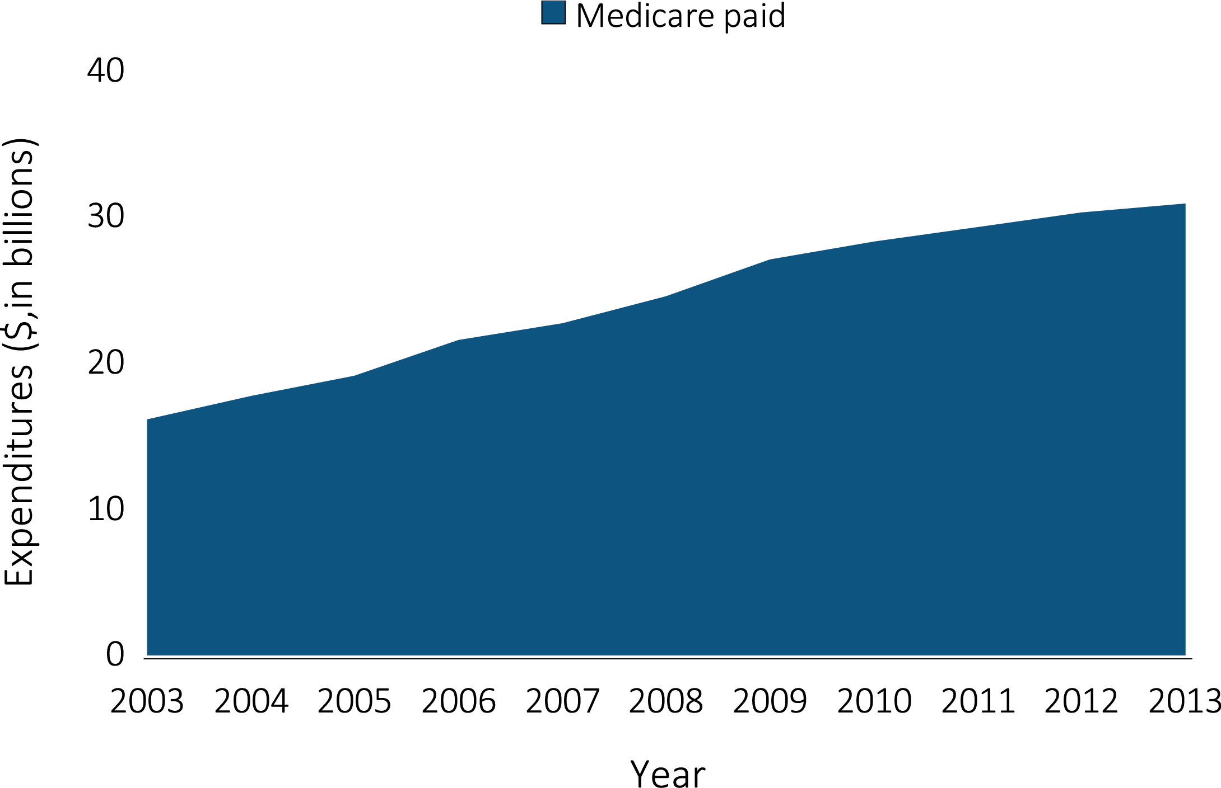
Figure 11.1 Trends in ESRD expenditures by payer, 2003-2013
Data Source: USRDS ESRD Database; Reference Table K.2. Abbreviations: ESRD, end-stage renal disease.

Slide 3
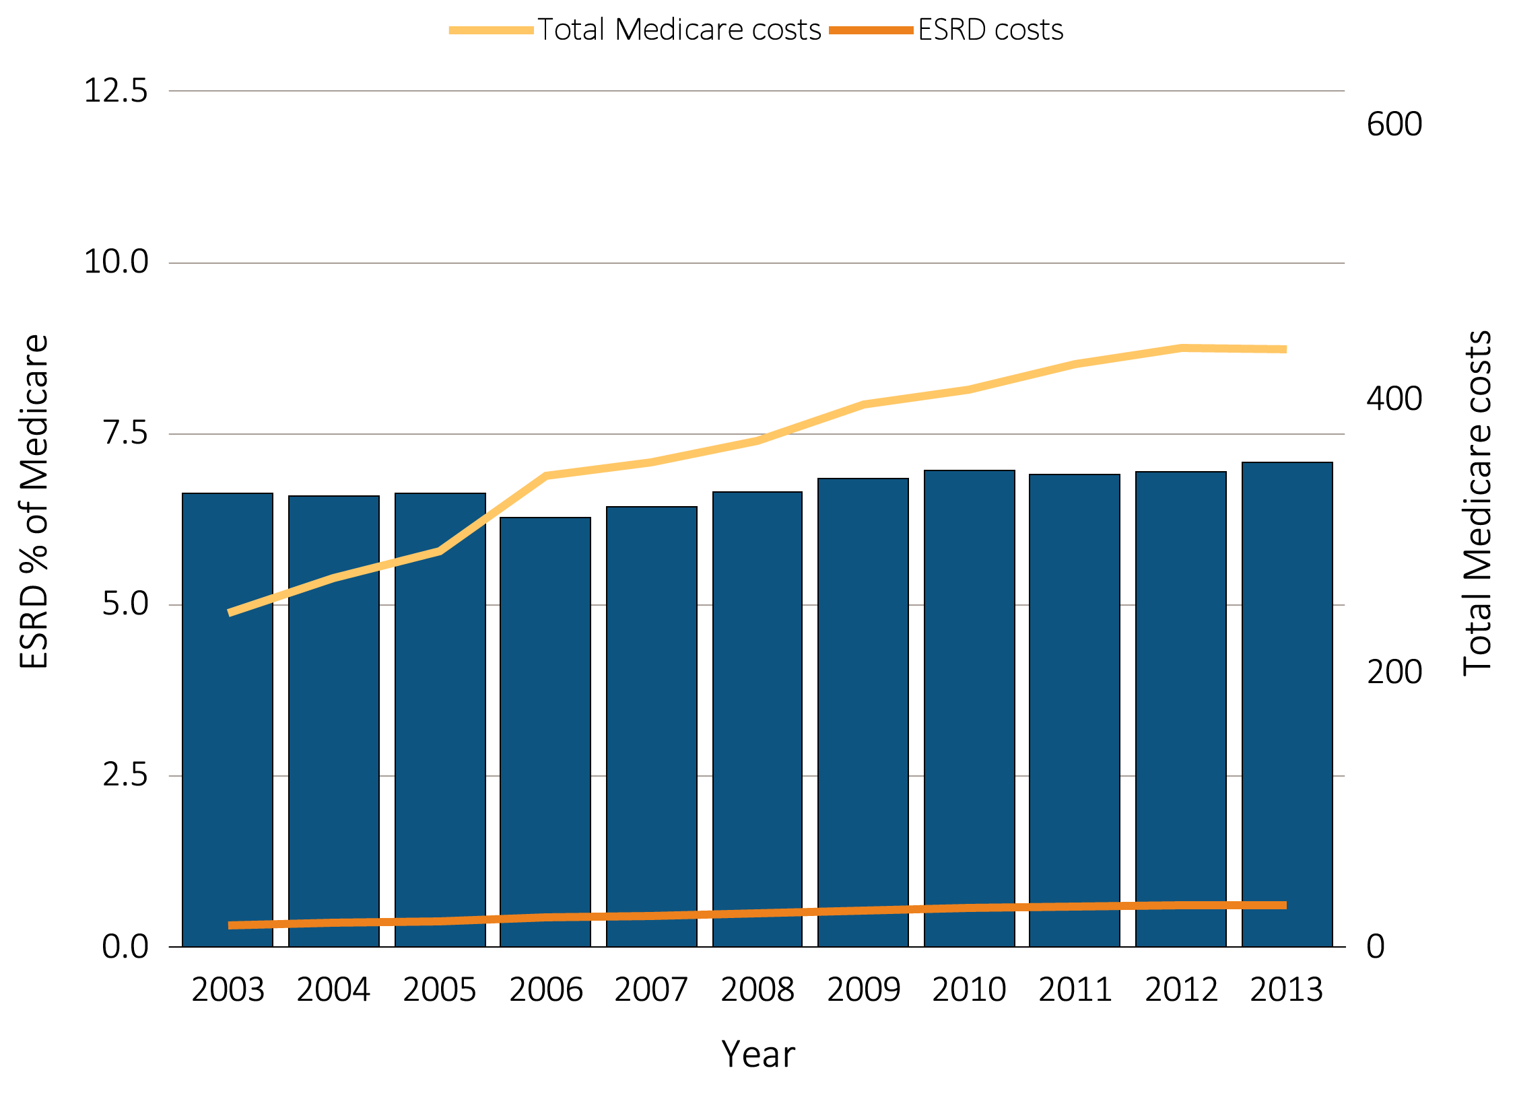
Figure 11.2 Trends in costs of the Medicare & ESRD programs, 2003-1013
Data Source: USRDS ESRD Database. Total Medicare expenditures obtained from https://www.cms.gov/Research-Statistics-Data-and-Systems/Statistics-Trends-and-Reports/NationalHealthExpendData/NationalHealthAccountsHistorical.html , file National Health Expenditures by type of service and source of funds, CY 1960-2013; ESRD Medicare costs from reference table K.2; Abbreviations: ESRD, end-stage renal disease.

Slide 4
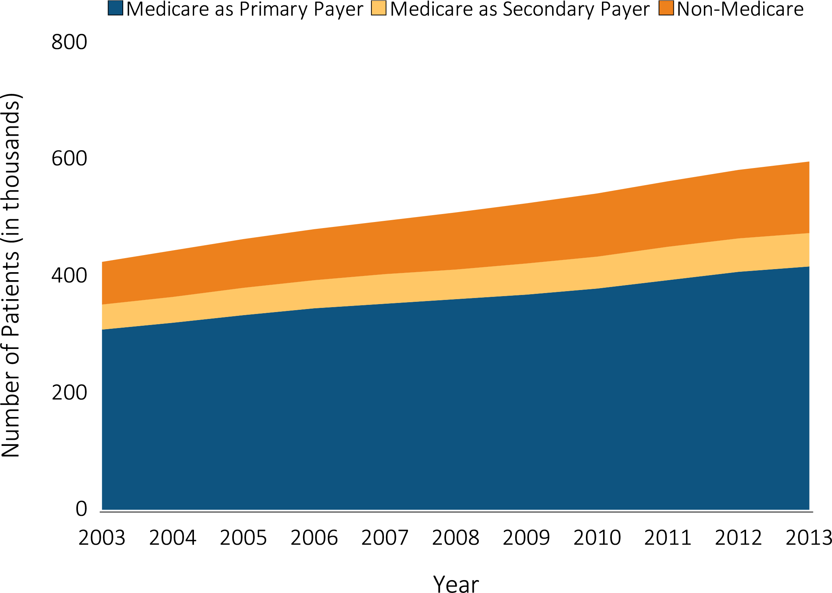
Figure 11.3 Trends in numbers of point prevalent ESRD patients, 2003-2013
Data Source: USRDS ESRD Database. December 31 point prevalent ESRD patients. Abbreviations: ESRD, end-stage renal disease.

Slide 5
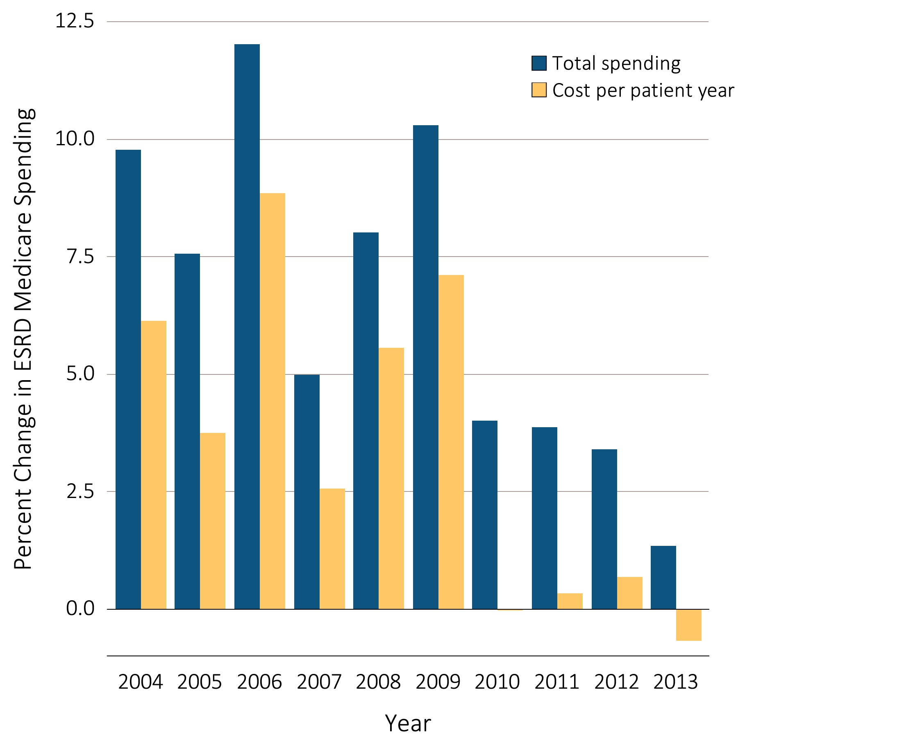
Figure 11.4 Annual percent change in Medicare ESRD spending
Data Source: USRDS ESRD Database; Reference Table K.4; Total Medicare ESRD costs from claims data; excludes claims with Medicare as secondary payer. Abbreviations: ESRD, end-stage renal disease.

Slide 6
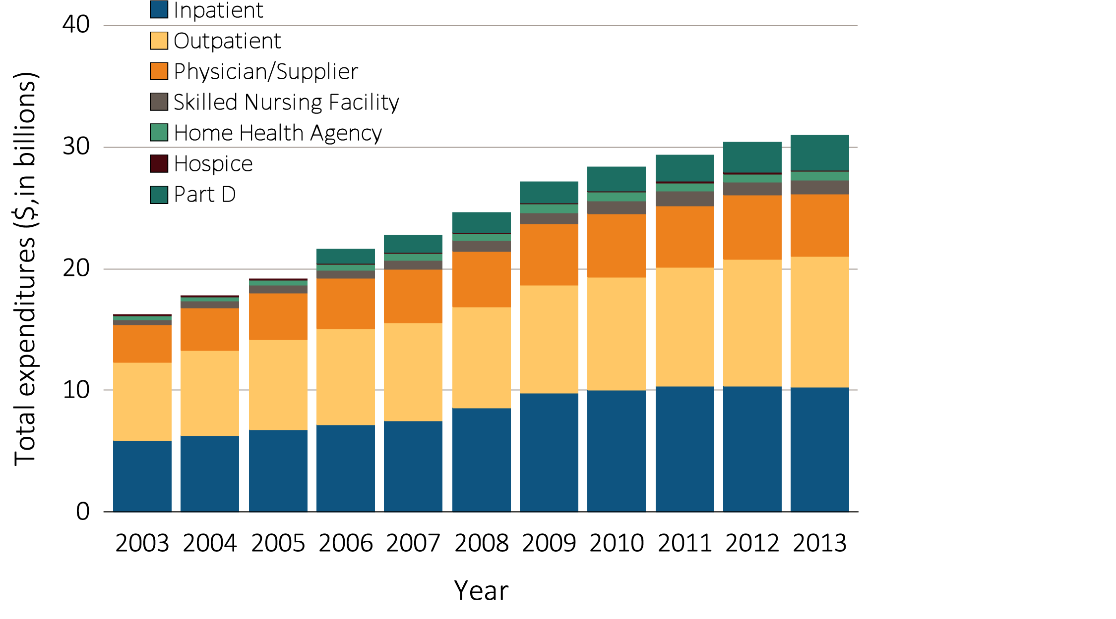
Figure 11.5 Trends in total Medicare spending for ESRD, by type of service, 2003-2013
Data Source: USRDS ESRD Database. Total Medicare costs from claims data; includes all claims with Medicare as primary or payer. Abbreviations: ESRD, end-stage renal disease.

Slide 7
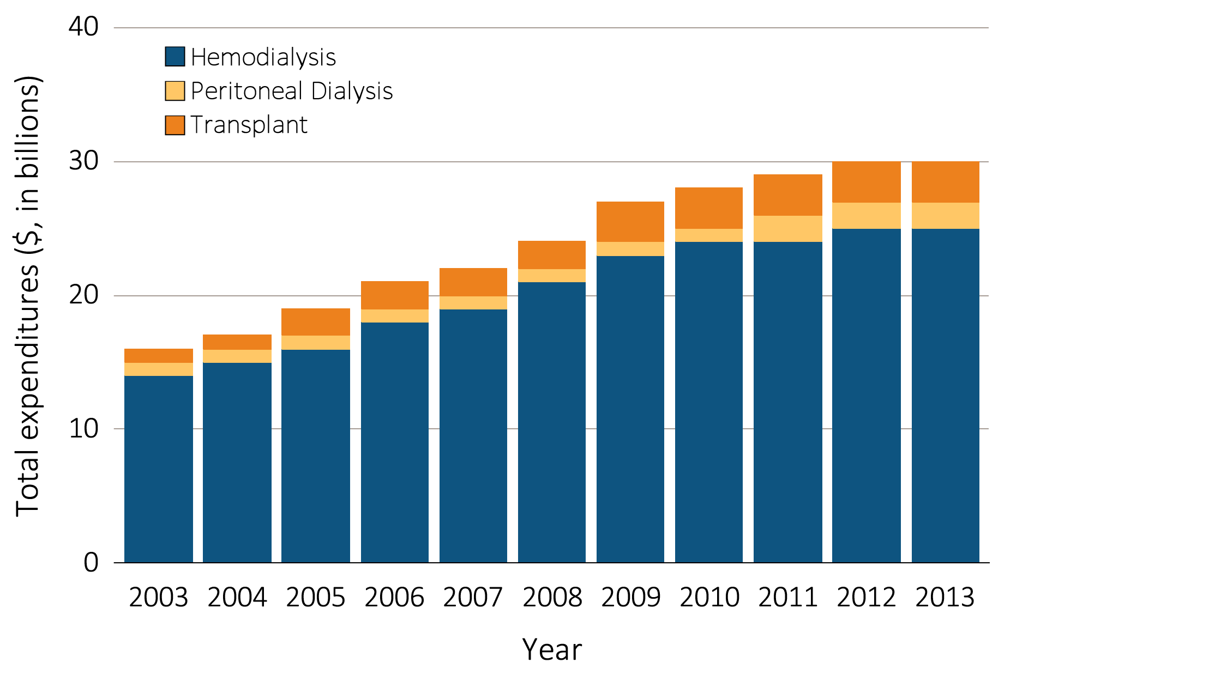
Figure 11.6 Total Medicare ESRD expenditures, by modality
Data Source: USRDS ESRD Database. Total Medicare costs from claims data for period prevalent ESRD patients. Abbreviations: ESRD, end-stage renal disease.

Slide 8
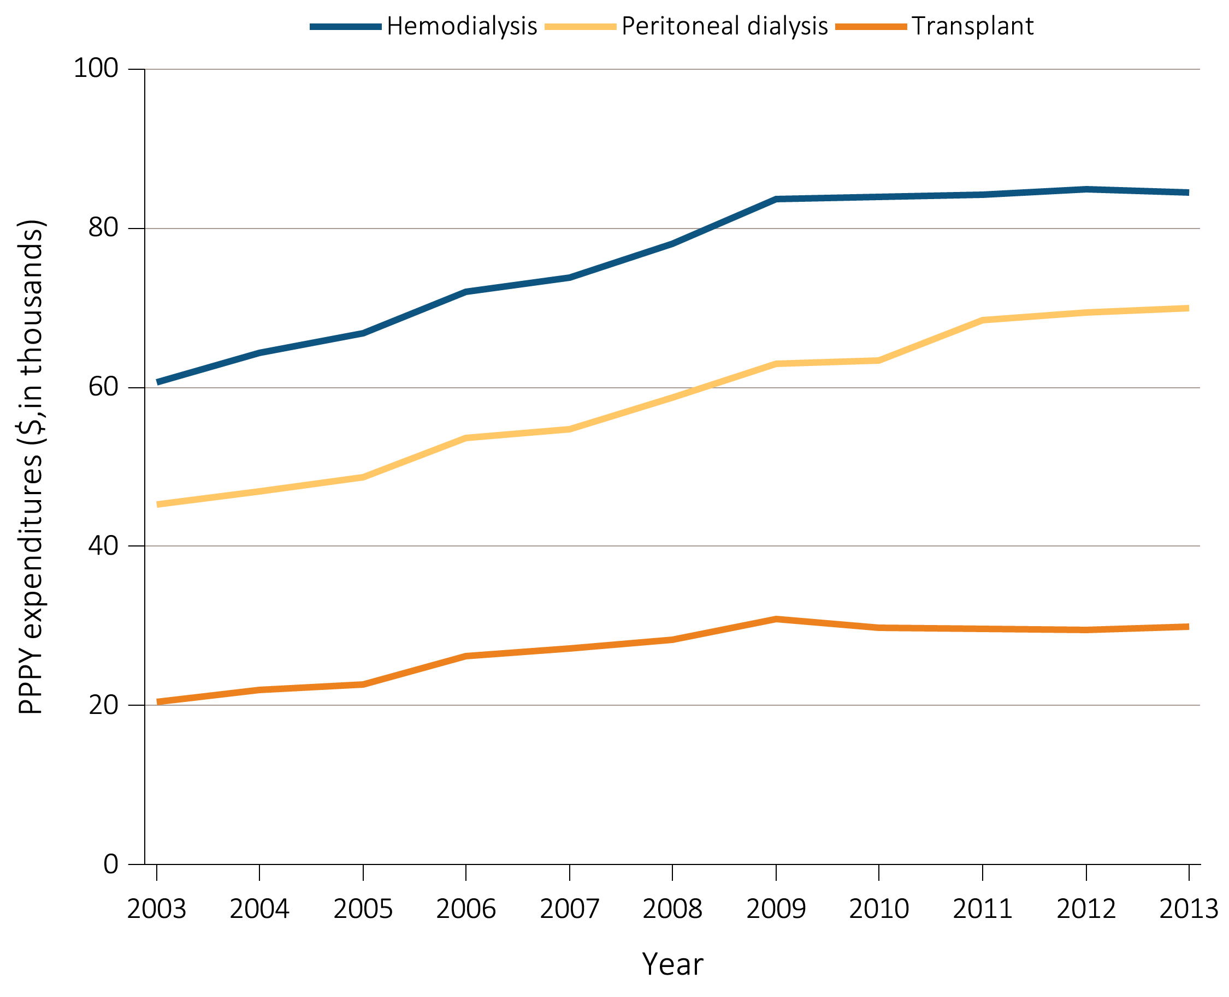
Figure 11.7 Total Medicare ESRD expenditures per person per year, by modality
Data Source: Reference Table K.7,K.8,K.9. Period prevalent ESRD patients; patients with Medicare as secondary payer are excluded. Abbreviations: ESRD, end-stage renal disease.

