Slide 2
Table 14.1 Characteristics of decedents with ESRD by death year, 2000-2012
 | 2000 | 2001 | 2002 | 2003 | 2004 | 2005 | 2006 | 2007 | 2008 | 2009 | 2010 | 2011 | 2012 | Total
n | 72,926 | 77,124 | 79,804 | 82,696 | 84,347 | 86,107 | 87,853 | 87,967 | 88,838 | 90,355 | 91,107 | 91,962 | 89,511 | 1,110,597
% | 6.6 | 6.9 | 7.2 | 7.4 | 7.6 | 7.8 | 7.9 | 7.9 | 8.0 | 8.1 | 8.2 | 8.3 | 8.1 | 100.0
Age (mean) | 67.5 (13.7) | 67.5 (13.8) | 67.8 (13.9) | 67.9 (13.8) | 68.1 (13.8) | 68.4 (13.8) | 68.4 (13.8) | 68.5 (13.8) | 68.75 13.7) | 68.6 (13.7) | 68.9 (13.6) | 69.0 (13.5) | 69.1 (13.4) | 68.4 (13.7)
Age Category
0-19 | 0.2 | 0.2 | 0.2 | 0.2 | 0.2 | 0.2 | 0.2 | 0.1 | 0.1 | 0.1 | 0.2 | 0.1 | 0.1 | 0.2
20-44 | 6.8 | 6.6 | 6.6 | 6.2 | 5.9 | 5.8 | 5.6 | 5.5 | 5.2 | 5.1 | 4.7 | 4.6 | 4.5 | 5.6
45-64 | 28.8 | 29.2 | 29.0 | 29.6 | 29.7 | 29.5 | 30.1 | 30.0 | 29.9 | 30.3 | 30.1 | 30.2 | 30.0 | 29.7
65-74 | 29.1 | 28.4 | 27.9 | 27.3 | 27.0 | 26.6 | 25.9 | 25.9 | 26.4 | 26.6 | 26.7 | 26.7 | 27.7 | 27.1
75-84 | 27.6 | 27.8 | 28.1 | 28.1 | 28.3 | 28.4 | 28.2 | 28.0 | 27.5 | 26.9 | 26.7 | 26.6 | 26.1 | 27.5
≥85 | 7.4 | 7.8 | 8.3 | 8.7 | 8.9 | 9.6 | 10.1 | 10.6 | 10.9 | 11.1 | 11.6 | 11.8 | 11.8 | 10.0
Race
Native American | 1.2 | 1.1 | 1.1 | 1.1 | 1.1 | 1.2 | 1.1 | 1.1 | 1.1 | 1.1 | 1.1 | 1.1 | 1.0 | 1.1
Asian | 2.8 | 2.8 | 2.9 | 3.0 | 3.0 | 3.2 | 3.3 | 3.4 | 3.3 | 3.5 | 3.5 | 3.7 | 3.7 | 3.3
Black | 28.2 | 28.3 | 28.0 | 28.2 | 28.4 | 28.1 | 27.7 | 27.5 | 27.4 | 27.2 | 26.8 | 26.5 | 26.5 | 27.6
White | 65.9 | 65.9 | 66.1 | 65.7 | 65.4 | 66.1 | 66.9 | 67.1 | 67.3 | 67.4 | 68.0 | 68.2 | 68.3 | 66.8
Unknown | 0.3 | 0.2 | 0.2 | 0.2 | 0.3 | 0.2 | 0.2 | 0.2 | 0.2 | 0.1 | 0.1 | 0.1 | 0.1 | 0.2
Other | 1.7 | 1.7 | 1.7 | 1.8 | 1.8 | 1.2 | 0.9 | 0.8 | 0.7 | 0.7 | 0.6 | 0.6 | 0.4 | 1.1
Hispanic
No | 71.2 | 75.1 | 78.1 | 79.8 | 81.3 | 82.4 | 83.3 | 84.1 | 84.4 | 84.4 | 84.6 | 84.5 | 84.3 | 81.6
Yes | 8.3 | 9.0 | 9.4 | 9.8 | 10.0 | 10.3 | 10.4 | 10.4 | 10.7 | 11.0 | 11.1 | 11.6 | 11.7 | 10.4
Unknown | 1.5 | 1.1 | 1.0 | 0.8 | 0.7 | 0.6 | 0.5 | 0.4 | 0.3 | 0.2 | 0.2 | 0.1 | 0.1 | 0.5
Missing | 19.0 | 14.8 | 11.6 | 9.6 | 8.0 | 6.8 | 5.9 | 5.1 | 4.7 | 4.4 | 4.1 | 3.8 | 3.9 | 7.5
^{(Continue on the next slide)}

Slide 3
Table 14.1 Characteristics of decedents with ESRD by death year,
^{2000-2012 (Continued)}
Sex
Male | 52.2 | 52.4 | 52.6 | 53.0 | 53.7 | 54.0 | 54.2 | 54.7 | 55.1 | 55.7 | 55.8 | 56.2 | 56.3 | 54.4
Female | 47.8 | 47.6 | 47.4 | 47.0 | 46.3 | 46.0 | 45.8 | 45.3 | 44.8 | 44.2 | 44.2 | 43.8 | 43.7 | 45.6
Last Treatment Modality
Hemodialysis | 86.3 | 87.1 | 88.0 | 88.3 | 88.5 | 88.6 | 88.8 | 89.1 | 89.0 | 88.9 | 88.8 | 88.2 | 87.8 | 88.3
Peritoneal Dialysis | 7.3 | 6.7 | 6.1 | 5.8 | 5.6 | 5.1 | 4.9 | 4.4 | 4.4 | 4.2 | 4.3 | 4.6 | 5.0 | 5.2
Transplant | 4.6 | 4.5 | 4.5 | 4.5 | 4.4 | 4.7 | 4.8 | 5.0 | 5.0 | 5.4 | 5.4 | 5.7 | 5.8 | 5.0
Missing | 1.9 | 1.7 | 1.5 | 1.5 | 1.5 | 1.5 | 1.6 | 1.5 | 1.6 | 1.6 | 1.5 | 1.5 | 1.4 | 1.5
Medicare Parts A&B as primary payer during last 3 months of life
Yes | 57.4 | 60.6 | 64.3 | 66.6 | 67.8 | 68.5 | 68.1 | 67.1 | 65.8 | 65.2 | 65.0 | 65.1 | 65.5 | 65.3
Data Source: Special analyses, USRDS ESRD Database. Denominator is all decedents.

Slide 4
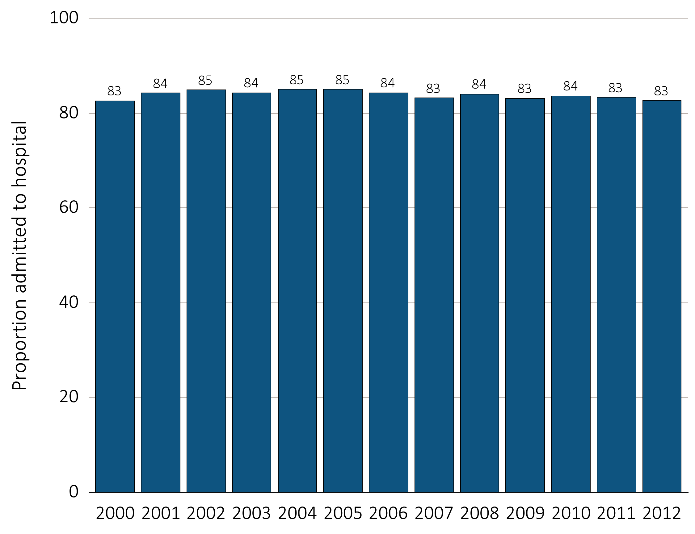
Figure 14.1 Hospital admission during the last 90 days of life among
Medicare beneficiaries with ESRD, 2000-2012
Data Source: Special analyses, USRDS ESRD Database. Denominator is all decedents with Medicare Parts A and B throughout the last 90 days of life. Includes hospital stays in both short and long stay hospitals.

Slide 5
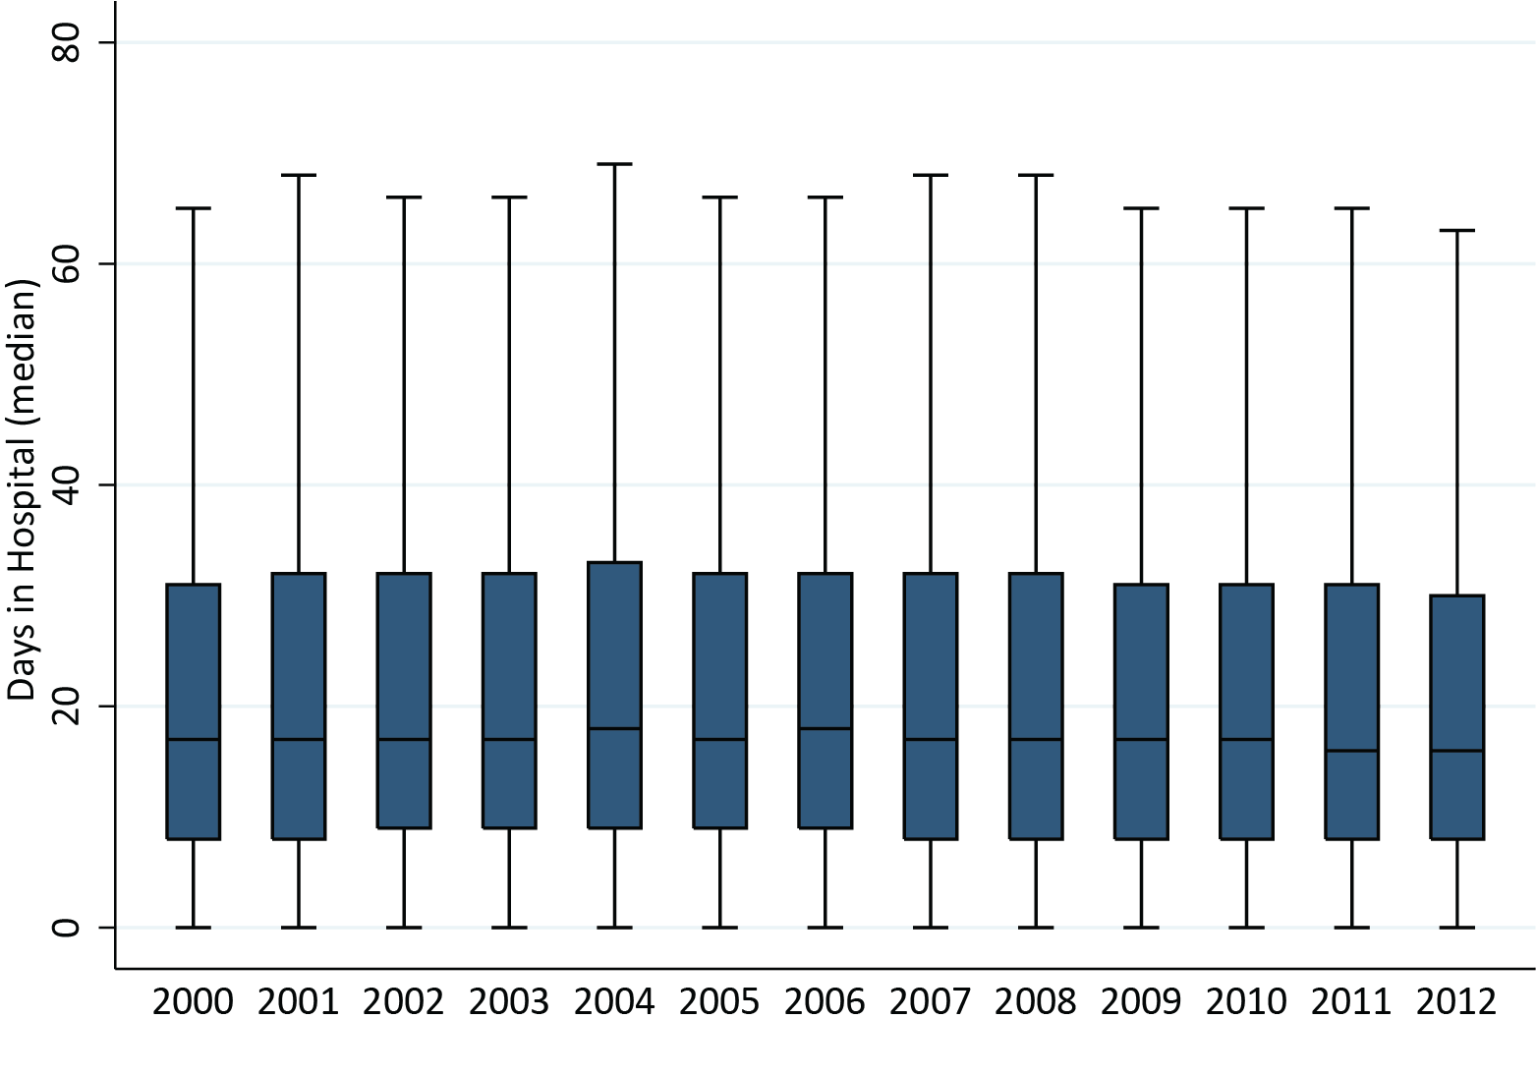
Figure 14.2 Days spent in the hospital during the last 90 days of life among
Medicare beneficiaries with ESRD, 2000-2012
Data Source: Special analyses, USRDS ESRD Database. Denominator is all decedents with Medicare Parts A and B throughout the last 90 days of life who were admitted to the hospital at least once. Includes hospital stays in both short and long stay hospitals. Explanation of box plot: The lower border of the box is the first quartile and the upper border is the third quartile of the distribution, the length of the box is the interquartile range and the line in the middle of the box is the median value. The whiskers (vertical lines above and below each box) extend from the lowest value of the distribution that is ≥ the first quartile minus 1.5 times the interquartile range at the bottom to the highest value of the distribution that is ≤ the third quartile plus 1.5 times the interquartile range at the top. Values outside this range (outliers) are not plotted.

Slide 6
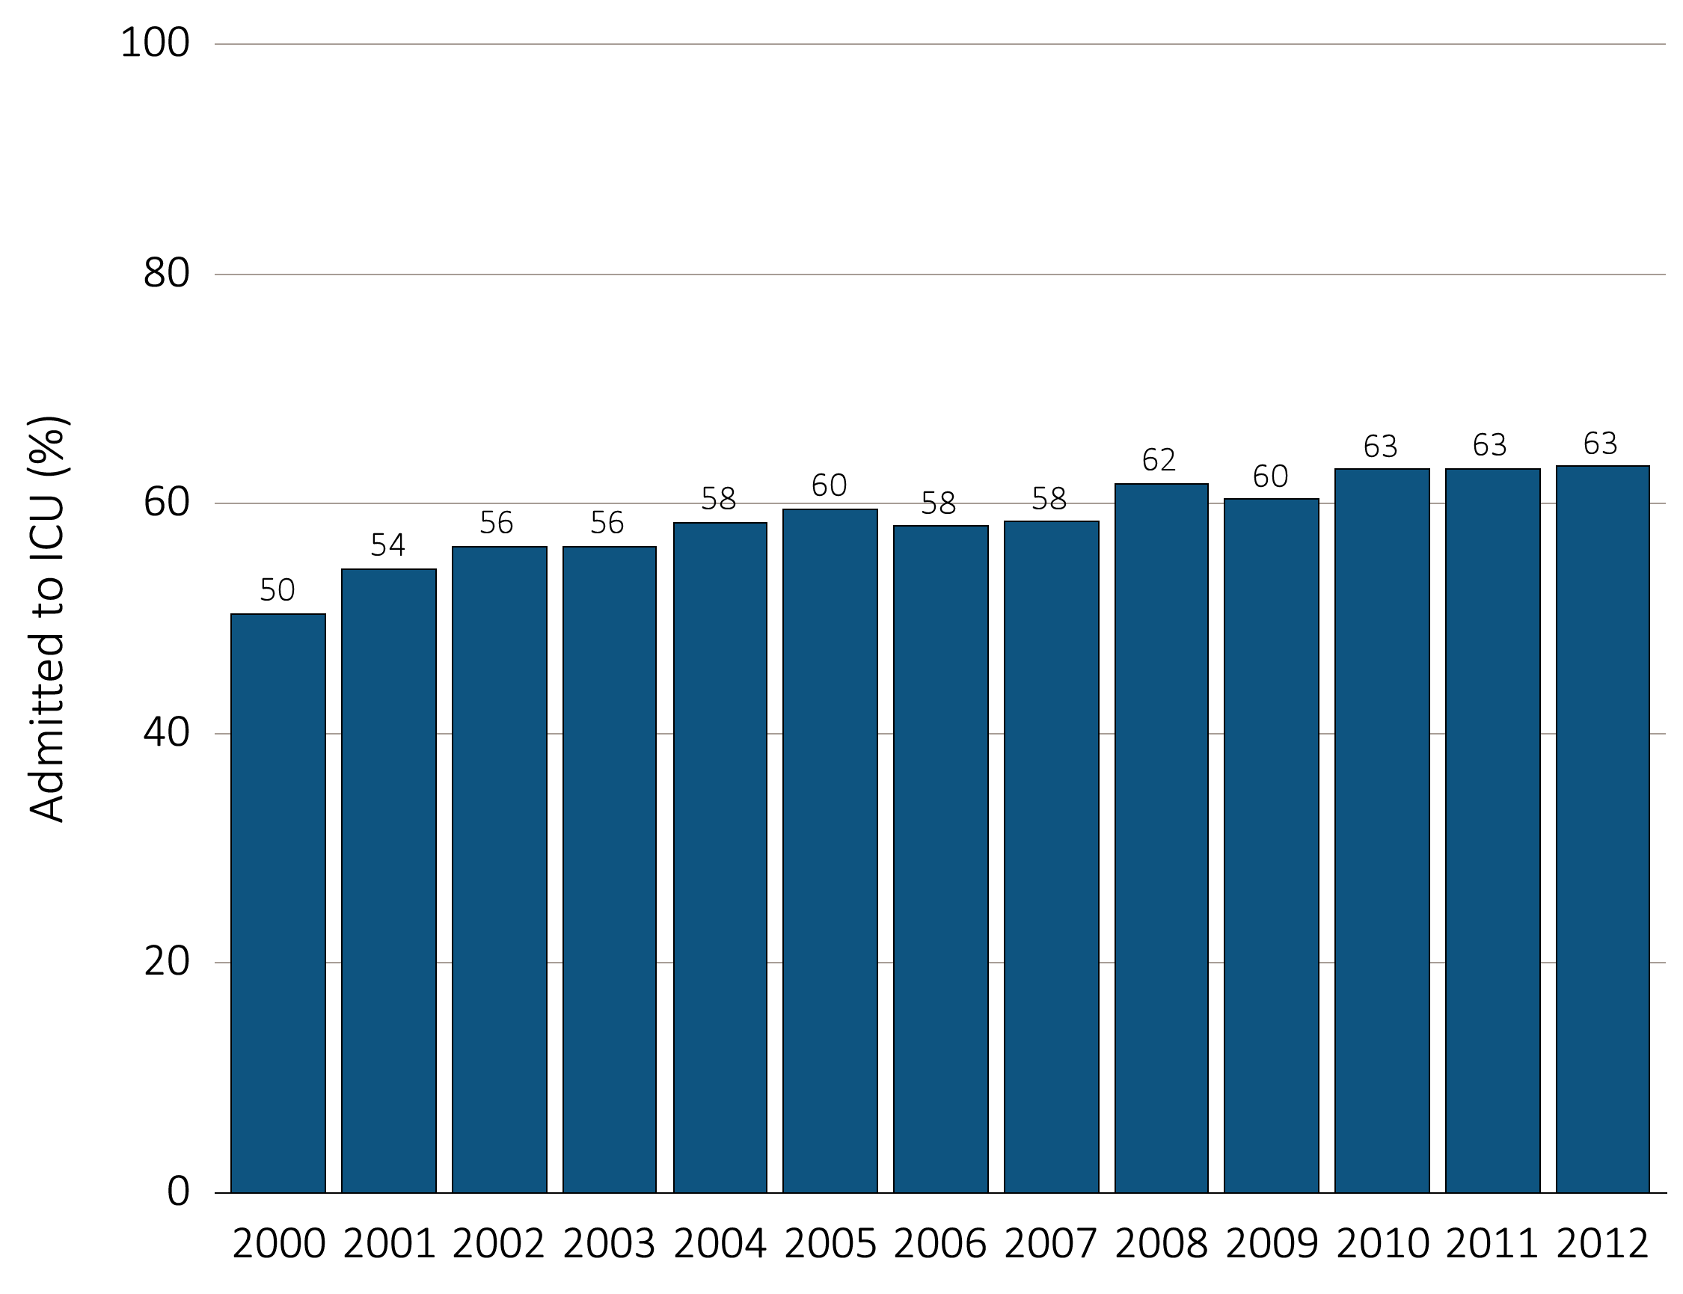
Figure 14.3 Days spent in the hospital during the last 90 days of life among
Medicare beneficiaries with ESRD, 2000-2012
(a) ICU admission by year, overall
Data Source: Special analyses, USRDS ESRD Database. Denominator is all decedents with Medicare Parts A and B throughout the last 90 days of life. ICU admission was identified using ICU revenue center codes in Medicare Institutional claims.

Slide 7
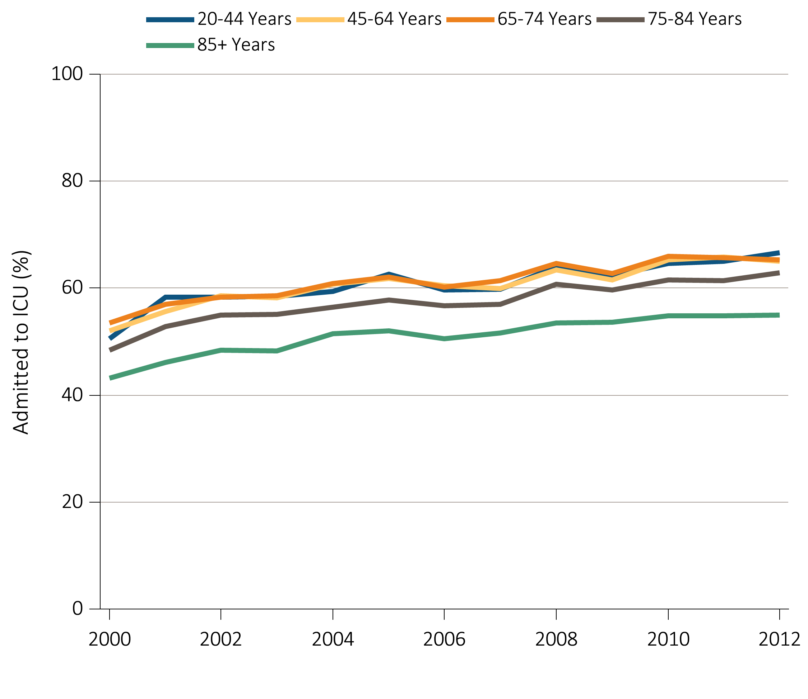
Figure 14.3 Days spent in the hospital during the last 90 days of life among
Medicare beneficiaries with ESRD, 2000-2012
^{(b)} ^{ICU admission by age}
Data Source: Special analyses, USRDS ESRD Database. Denominator is all decedents with Medicare Parts A and B throughout the last 90 days of life. ICU admission was identified using ICU revenue center codes in Medicare Institutional claims.

Slide 8
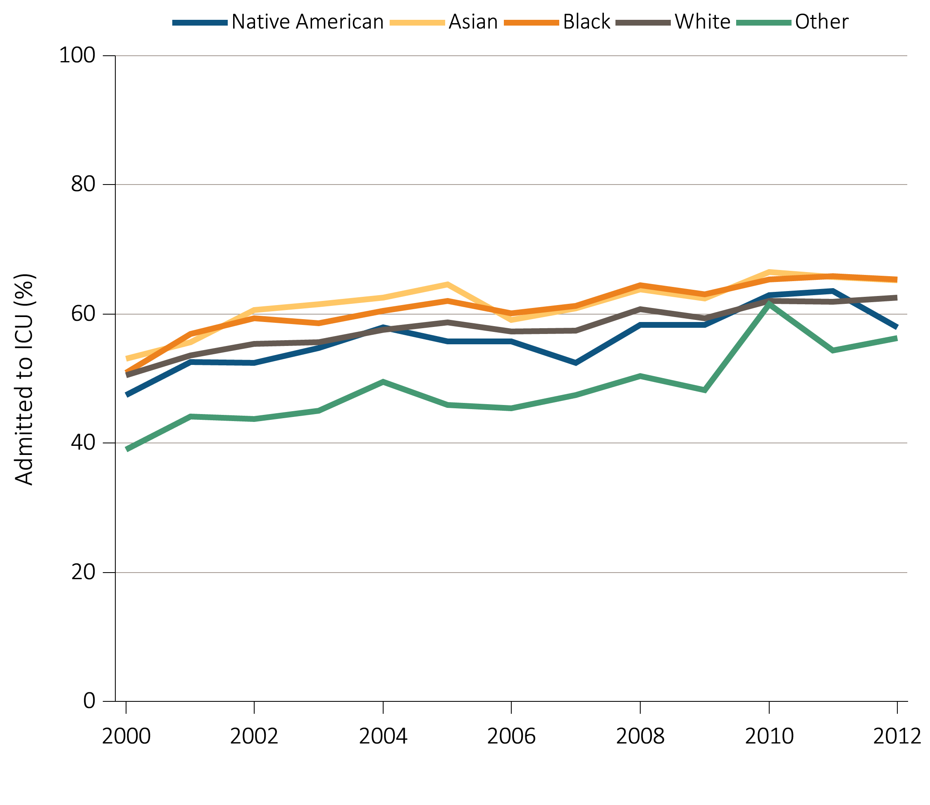
Figure 14.3 Days spent in the hospital during the last 90 days of life among
Medicare beneficiaries with ESRD, 2000-2012
^{(c)} ^{ICU admission by race}
Data Source: Special analyses, USRDS ESRD Database. Denominator is all decedents with Medicare Parts A and B throughout the last 90 days of life. ICU admission was identified using ICU revenue center codes in Medicare Institutional claims.

Slide 9
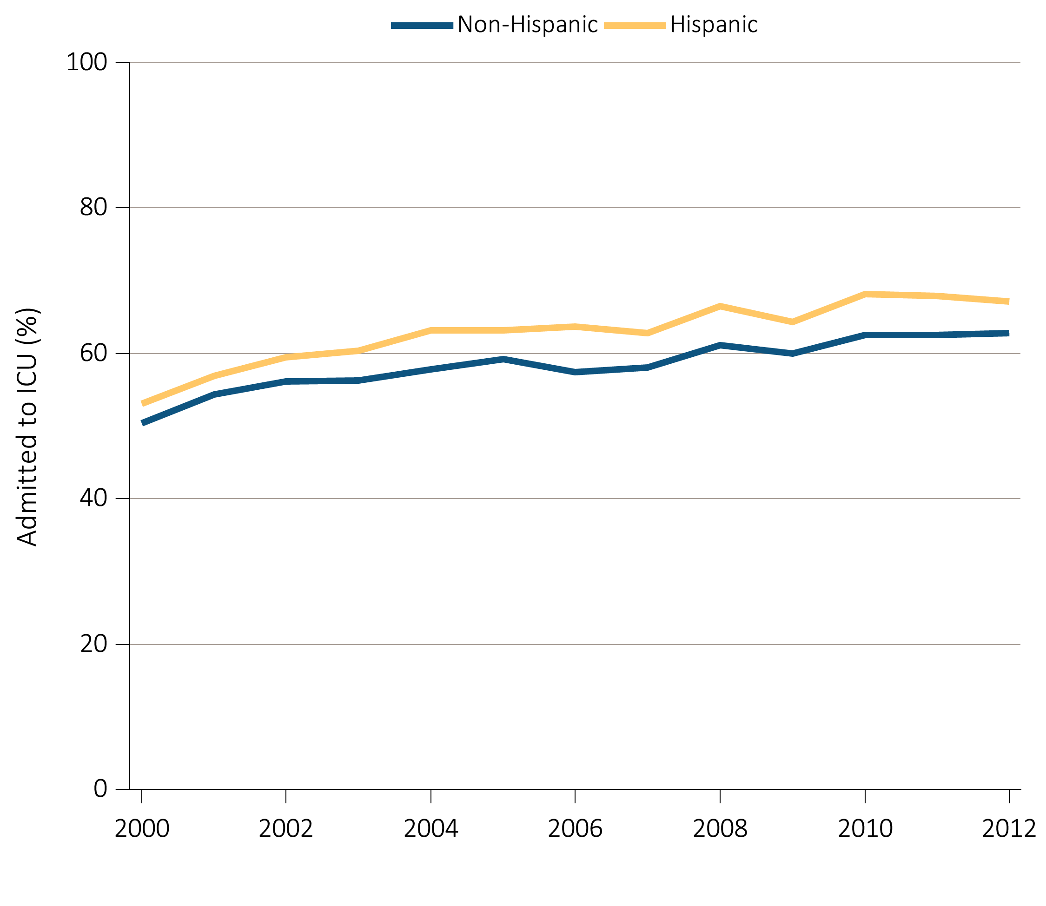
Figure 14.3 Days spent in the hospital during the last 90 days of life among
Medicare beneficiaries with ESRD, 2000-2012
^{(d) ICU admission by ethnicity}
Data Source: Special analyses, USRDS ESRD Database. Denominator is all decedents with Medicare Parts A and B throughout the last 90 days of life. ICU admission was identified using ICU revenue center codes in Medicare Institutional claims.

Slide 10
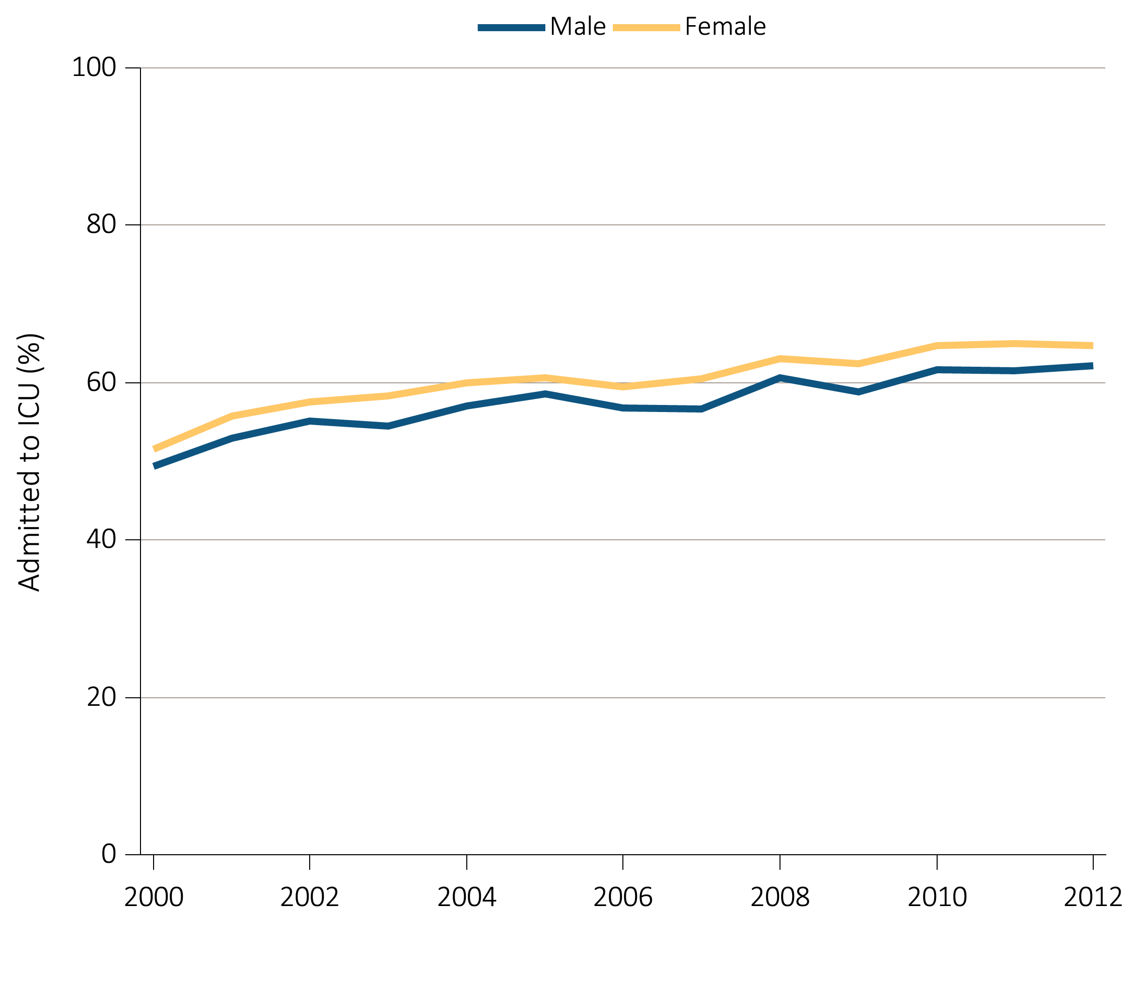
Figure 14.3 Days spent in the hospital during the last 90 days of life among
Medicare beneficiaries with ESRD, 2000-2012
^{(e) ICU admission by sex}
Data Source: Special analyses, USRDS ESRD Database. Denominator is all decedents with Medicare Parts A and B throughout the last 90 days of life. ICU admission was identified using ICU revenue center codes in Medicare Institutional claims.

Slide 11
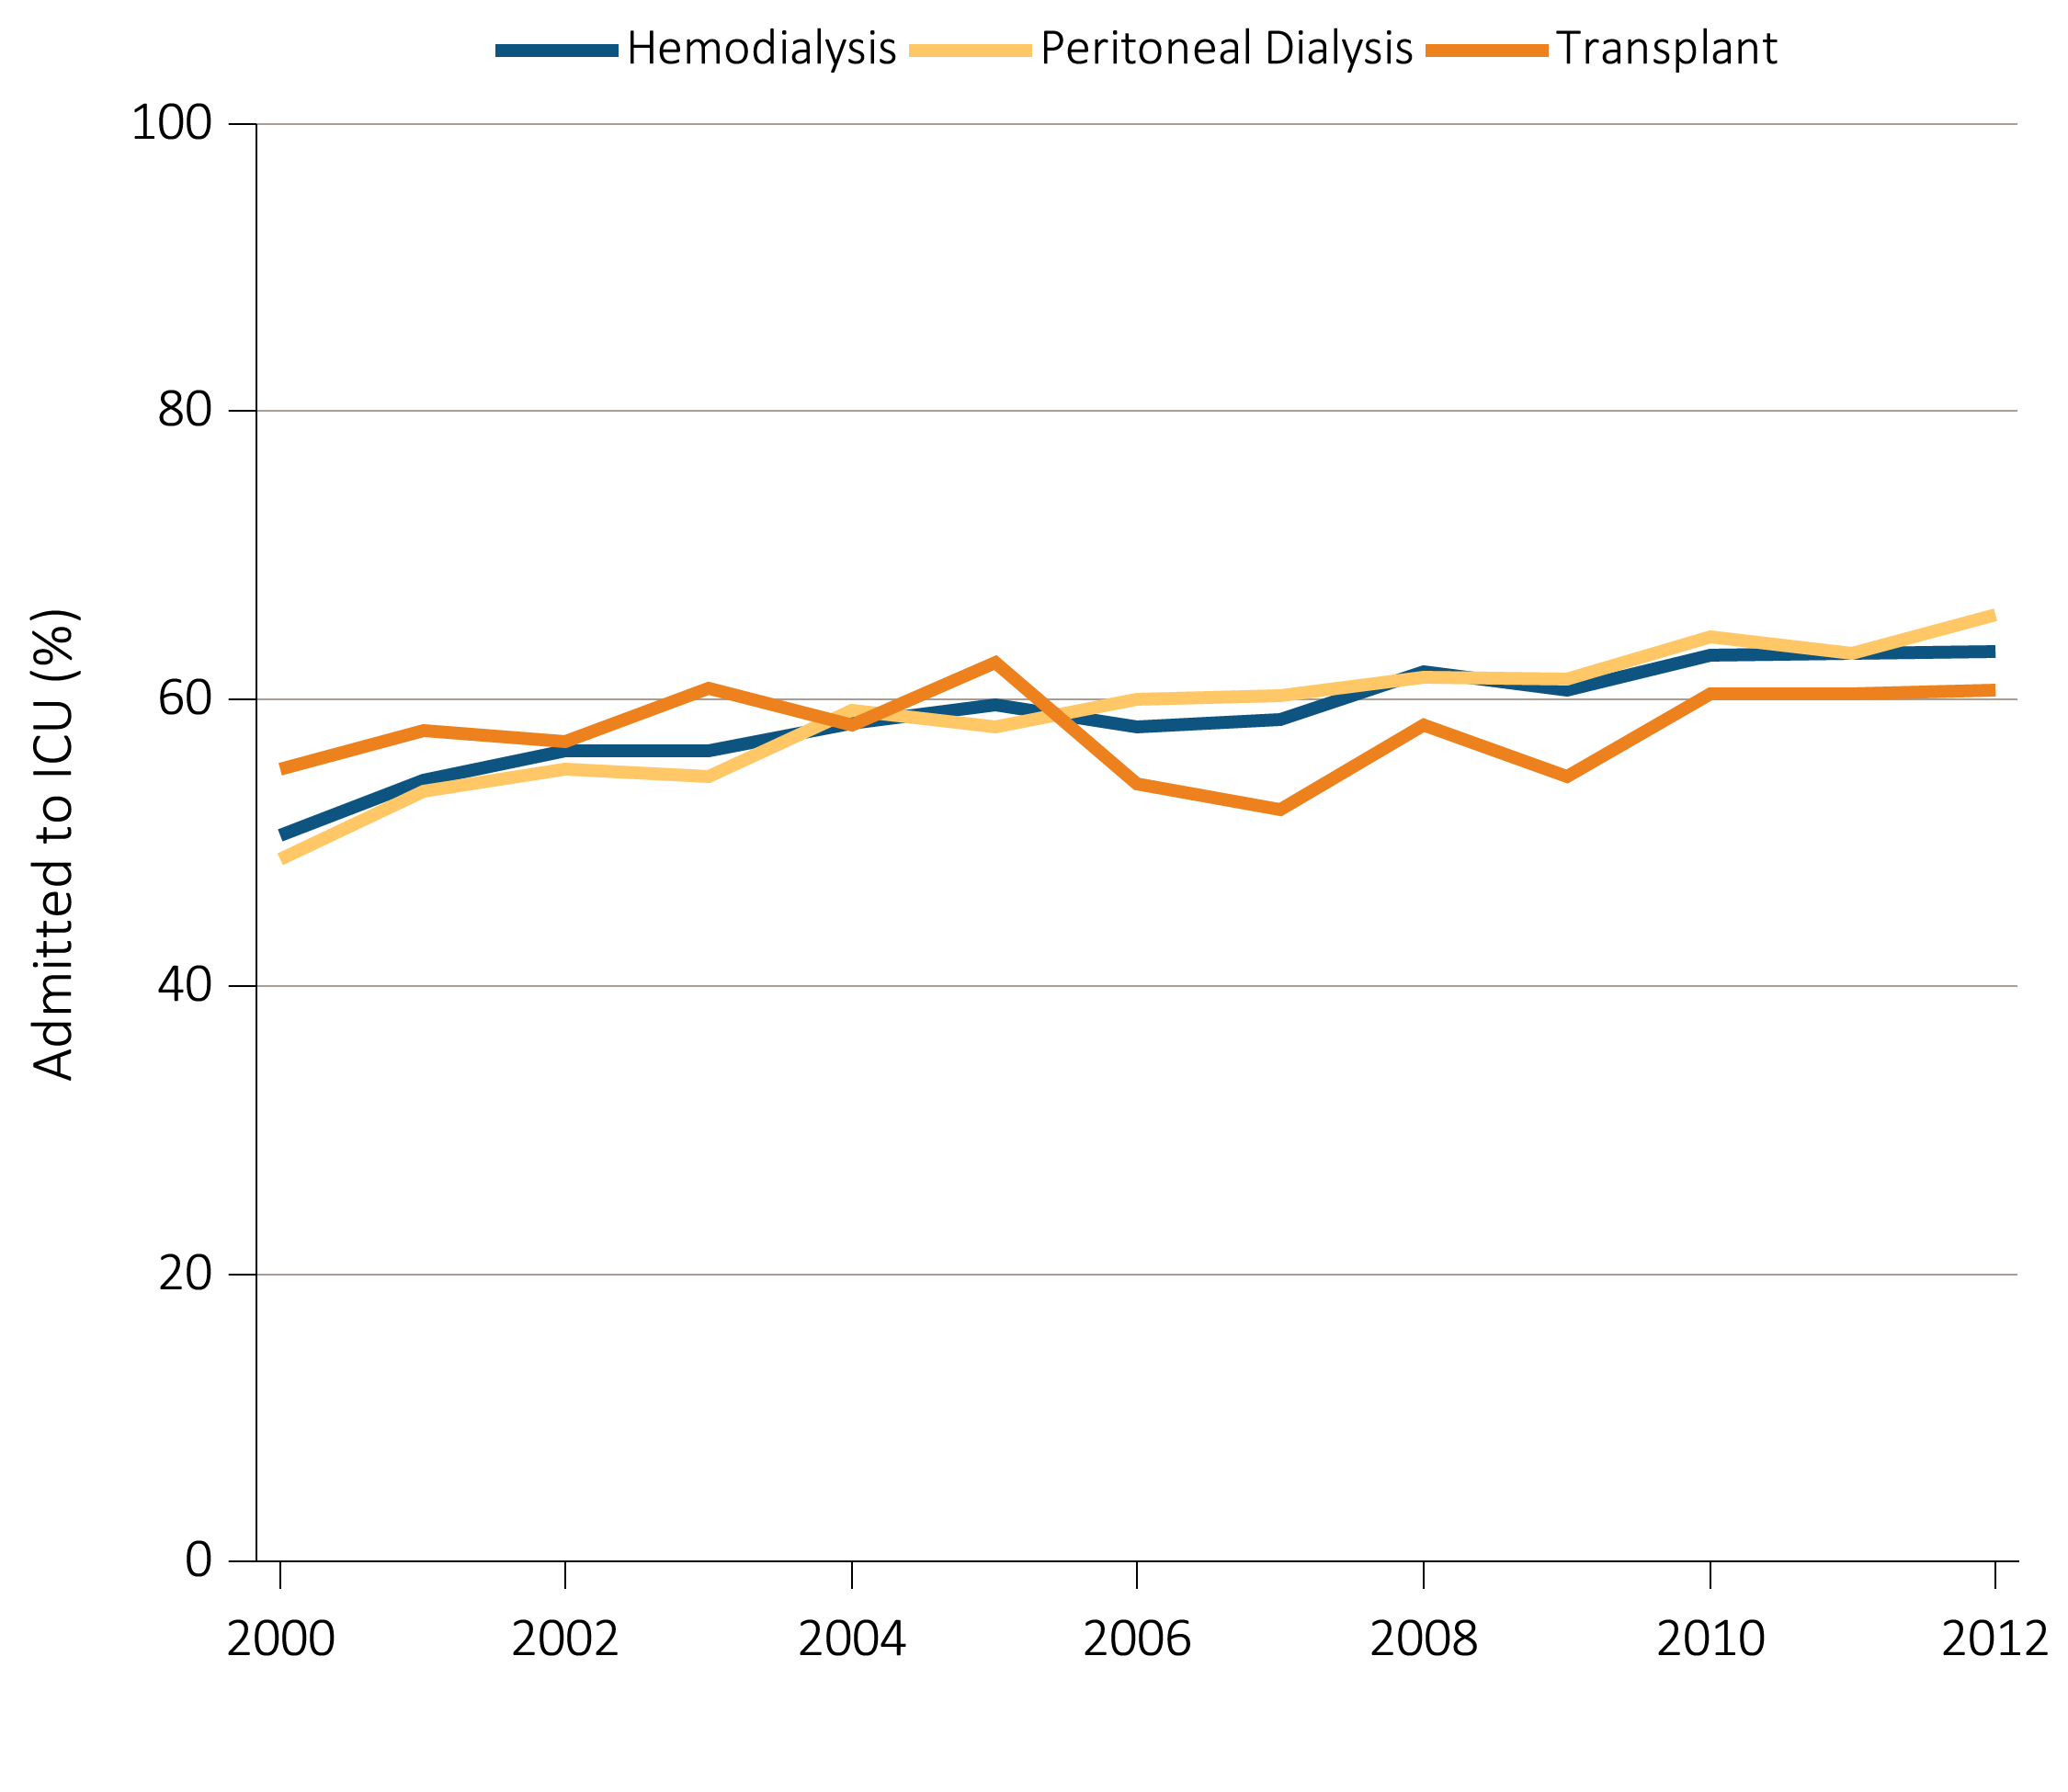
Figure 14.3 Days spent in the hospital during the last 90 days of life among
Medicare beneficiaries with ESRD, 2000-2012
^{(f) ICU admission by modality}
Data Source: Special analyses, USRDS ESRD Database. Denominator is all decedents with Medicare Parts A and B throughout the last 90 days of life. ICU admission was identified using ICU revenue center codes in Medicare Institutional claims.

Slide 12
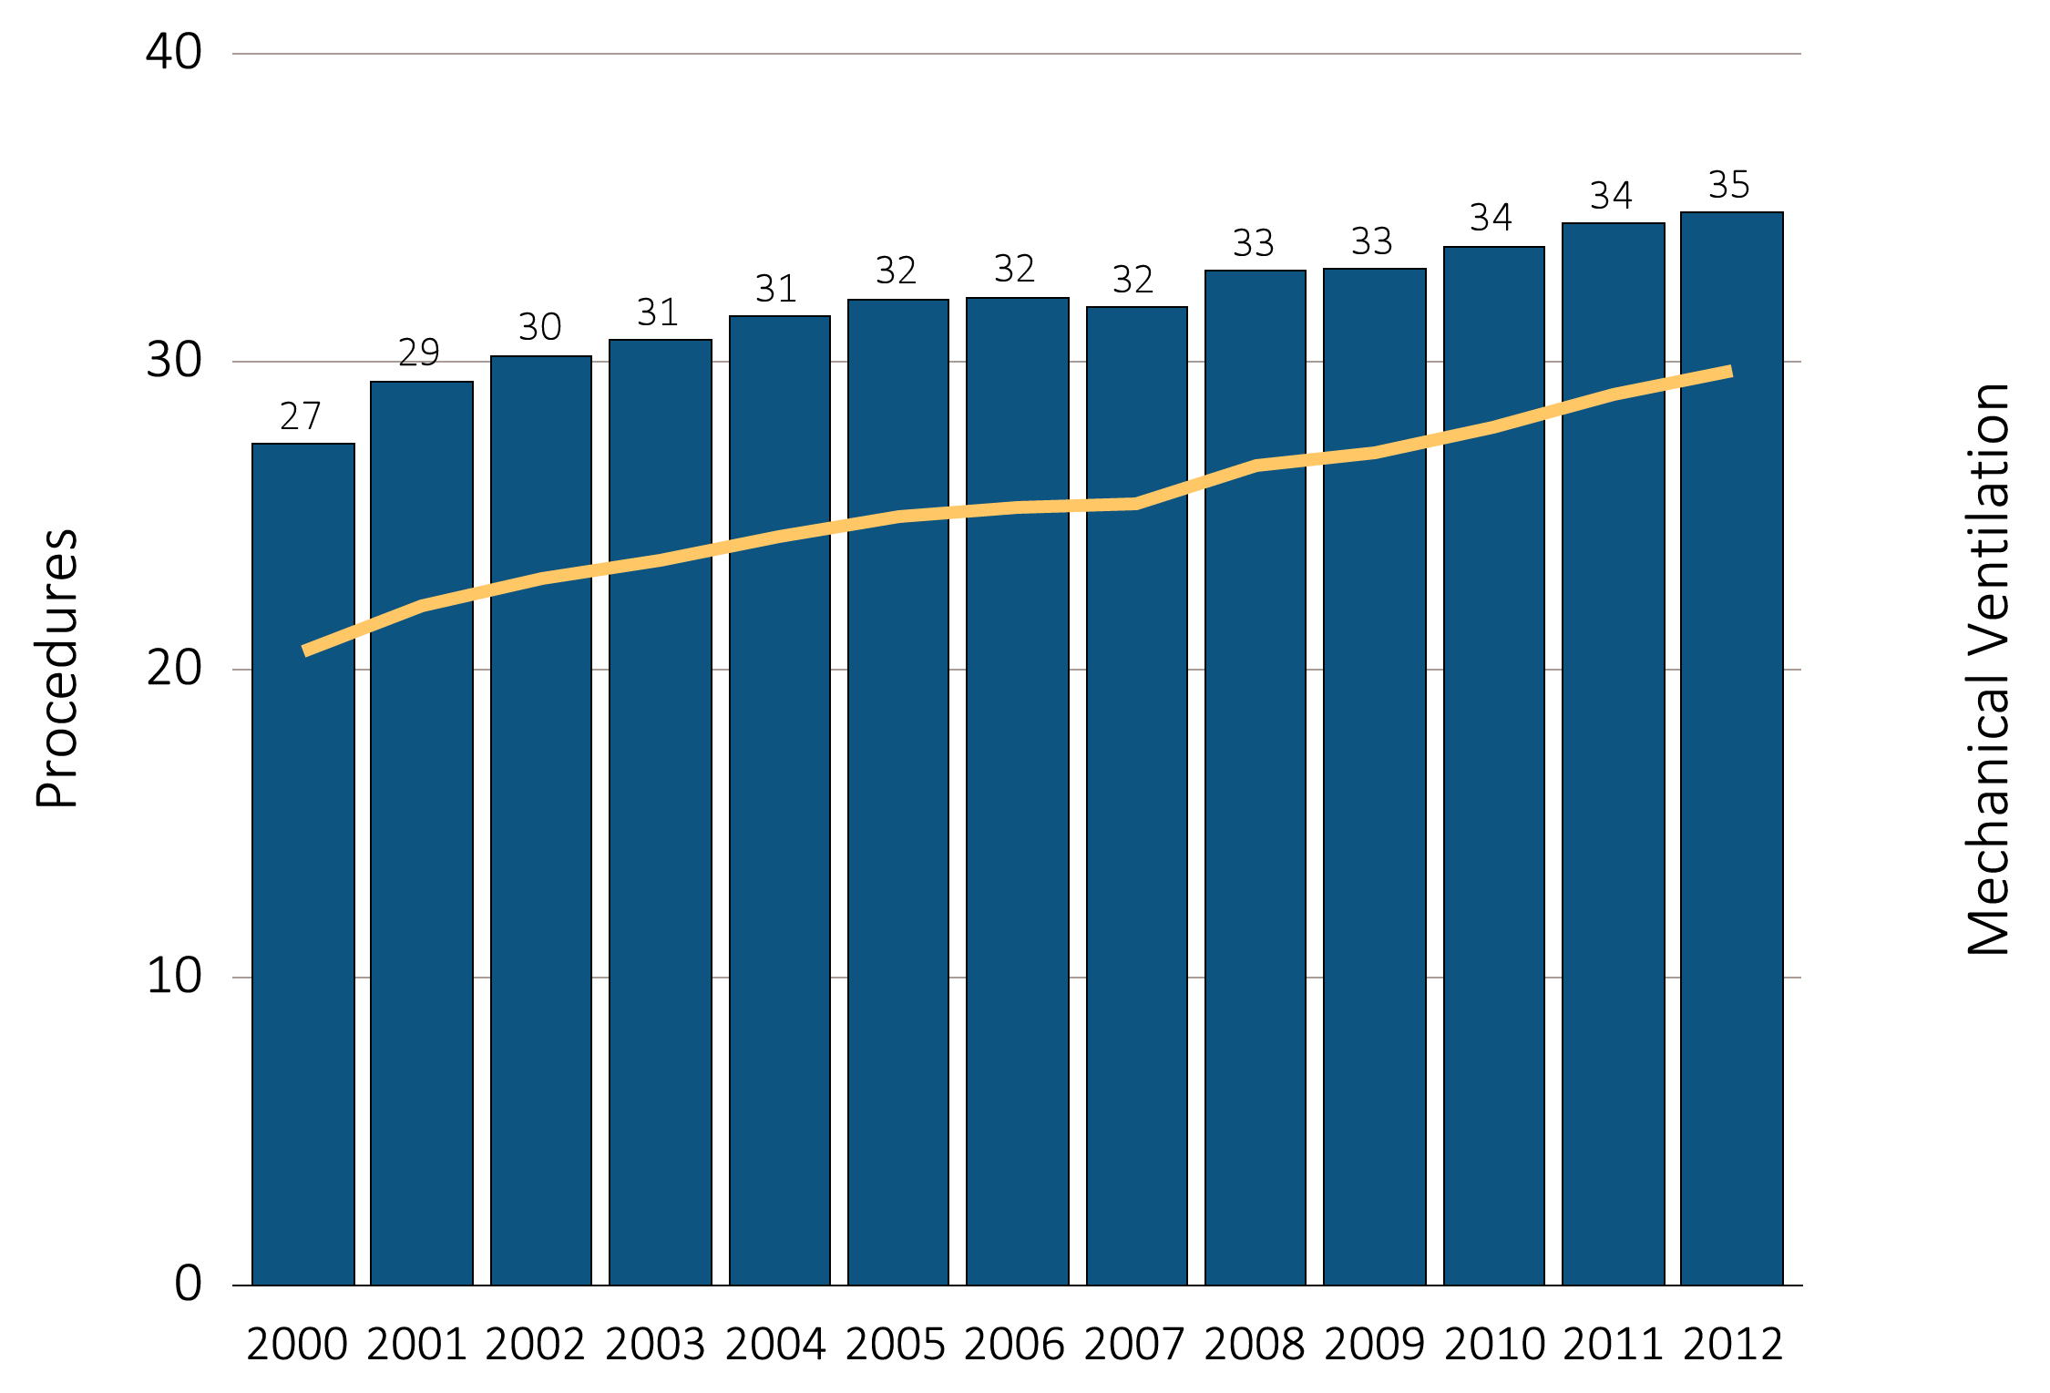
Figure 14.4 Intensive procedures during the last 90 days of life among Medicare beneficiaries with ESRD overall, and by age, race, ethnicity, sex, and modality, 2000-2012
(a) Intensive procedures and mechanical ventilation by year, overall
Data Source: Special analyses, USRDS ESRD Database. Denominator population is all decedents with Medicare Parts A and B throughout the last 90 days of life. Intensive procedures were identified by ICD-9 procedure code search of Medicare Institutional claims from short and long stay hospitals. The yellow line in panel (a) denotes the percentage of patients who were intubated or received mechanical ventilation.

Slide 13
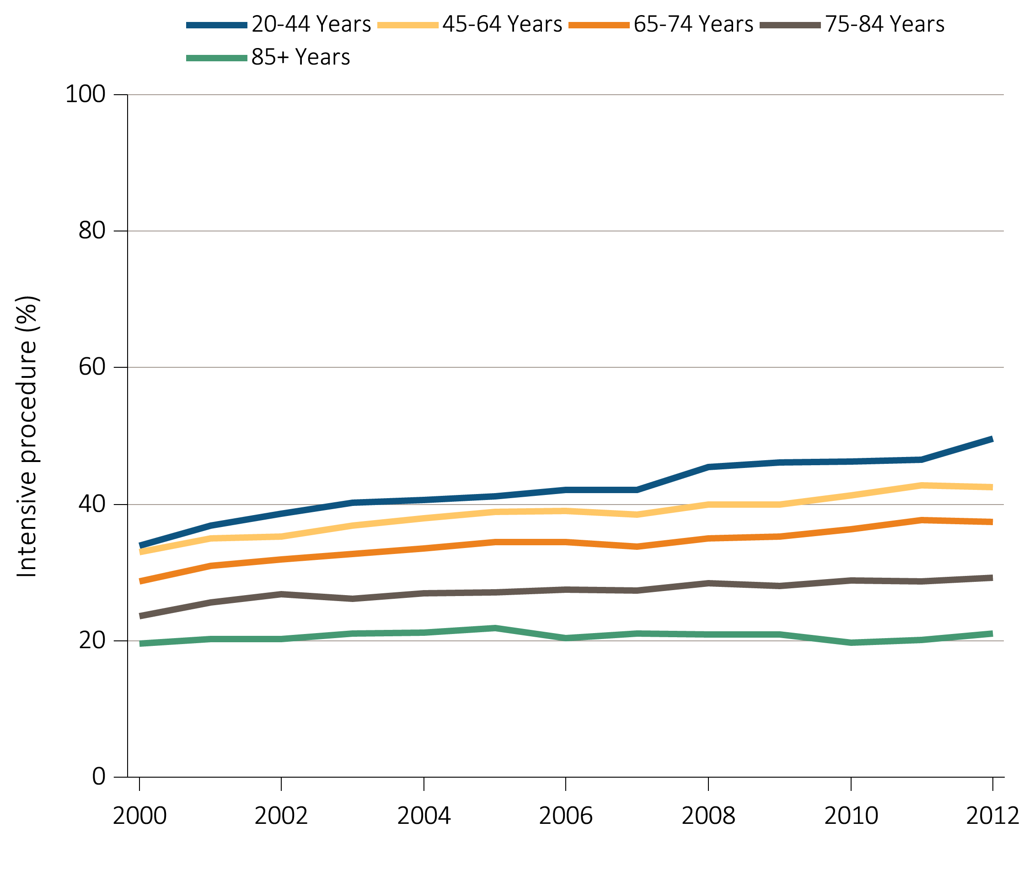
Figure 14.4 Intensive procedures during the last 90 days of life among Medicare beneficiaries with ESRD overall, and by age, race, ethnicity, sex, and modality, 2000-2012
(b) Intensive procedures by age
Data Source: Special analyses, USRDS ESRD Database. Denominator population is all decedents with Medicare Parts A and B throughout the last 90 days of life. Intensive procedures were identified by ICD-9 procedure code search of Medicare Institutional claims from short and long stay hospitals.

Slide 14
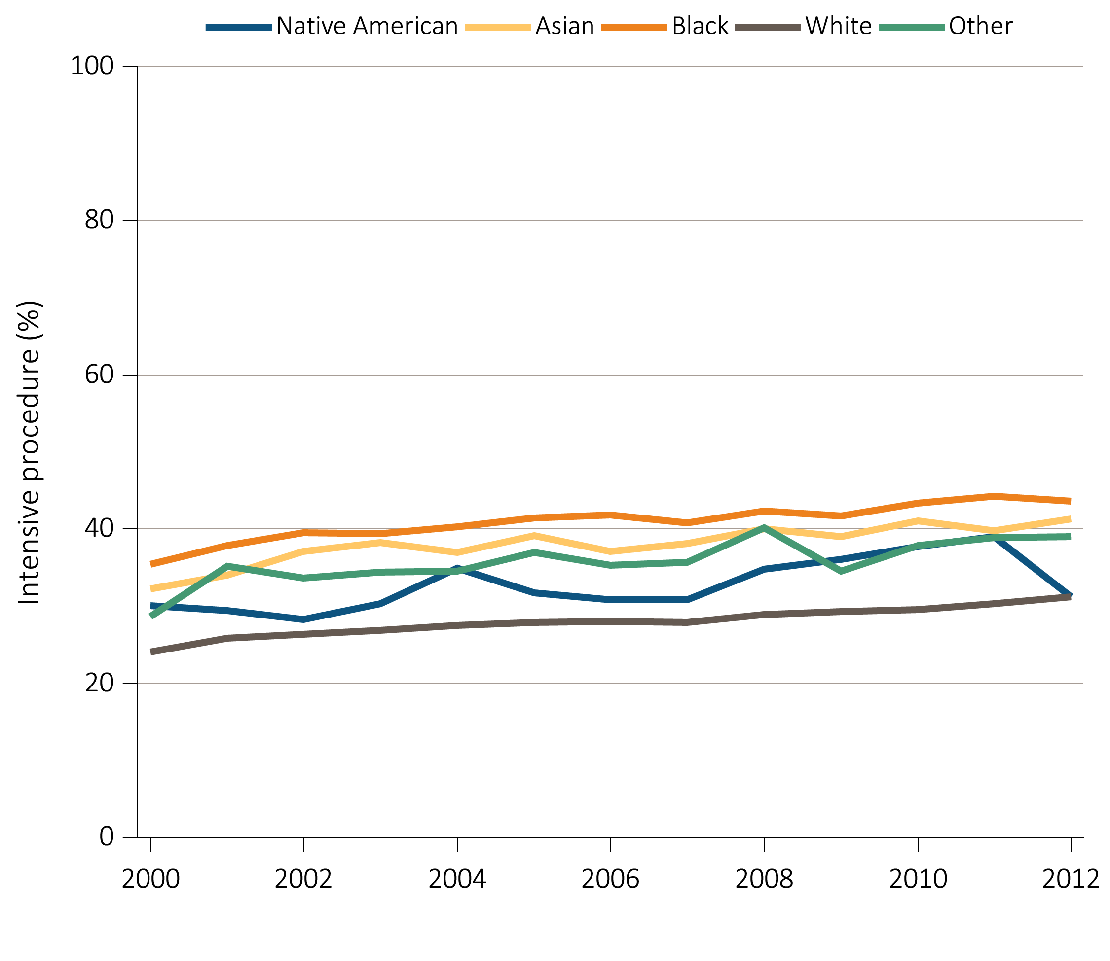
Figure 14.4 Intensive procedures during the last 90 days of life among Medicare beneficiaries with ESRD overall, and by age, race, ethnicity, sex, and modality, 2000-2012
(c) Intensive procedures by race
Data Source: Special analyses, USRDS ESRD Database. Denominator population is all decedents with Medicare Parts A and B throughout the last 90 days of life. Intensive procedures were identified by ICD-9 procedure code search of Medicare Institutional claims from short and long stay hospitals.

Slide 15
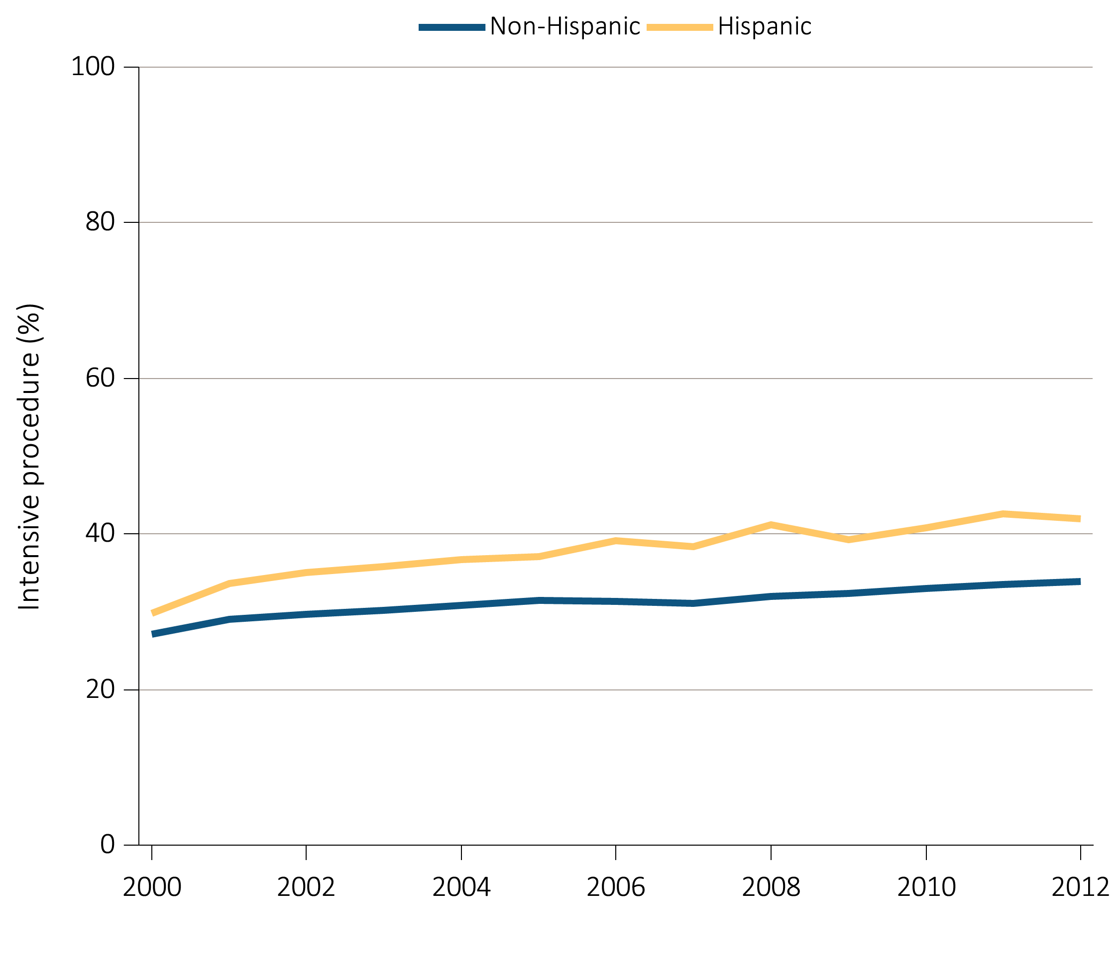
Figure 14.4 Intensive procedures during the last 90 days of life among Medicare beneficiaries with ESRD overall, and by age, race, ethnicity, sex, and modality, 2000-2012
(d) Intensive procedures by ethnicity
Data Source: Special analyses, USRDS ESRD Database. Denominator population is all decedents with Medicare Parts A and B throughout the last 90 days of life. Intensive procedures were identified by ICD-9 procedure code search of Medicare Institutional claims from short and long stay hospitals.

Slide 16
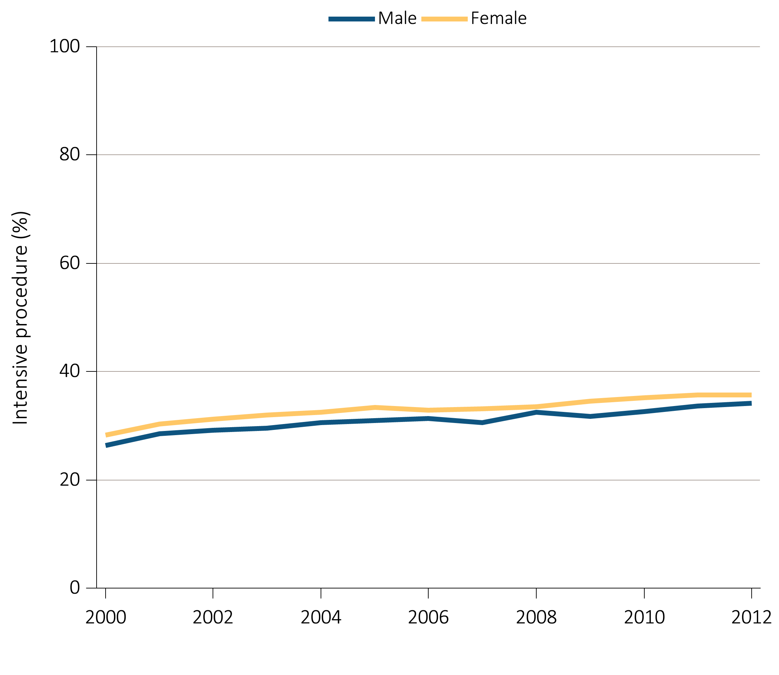
Figure 14.4 Intensive procedures during the last 90 days of life among Medicare beneficiaries with ESRD overall, and by age, race, ethnicity, sex, and modality, 2000-2012
(e) Intensive procedures by sex
Data Source: Special analyses, USRDS ESRD Database. Denominator population is all decedents with Medicare Parts A and B throughout the last 90 days of life. Intensive procedures were identified by ICD-9 procedure code search of Medicare Institutional claims from short and long stay hospitals.

Slide 17
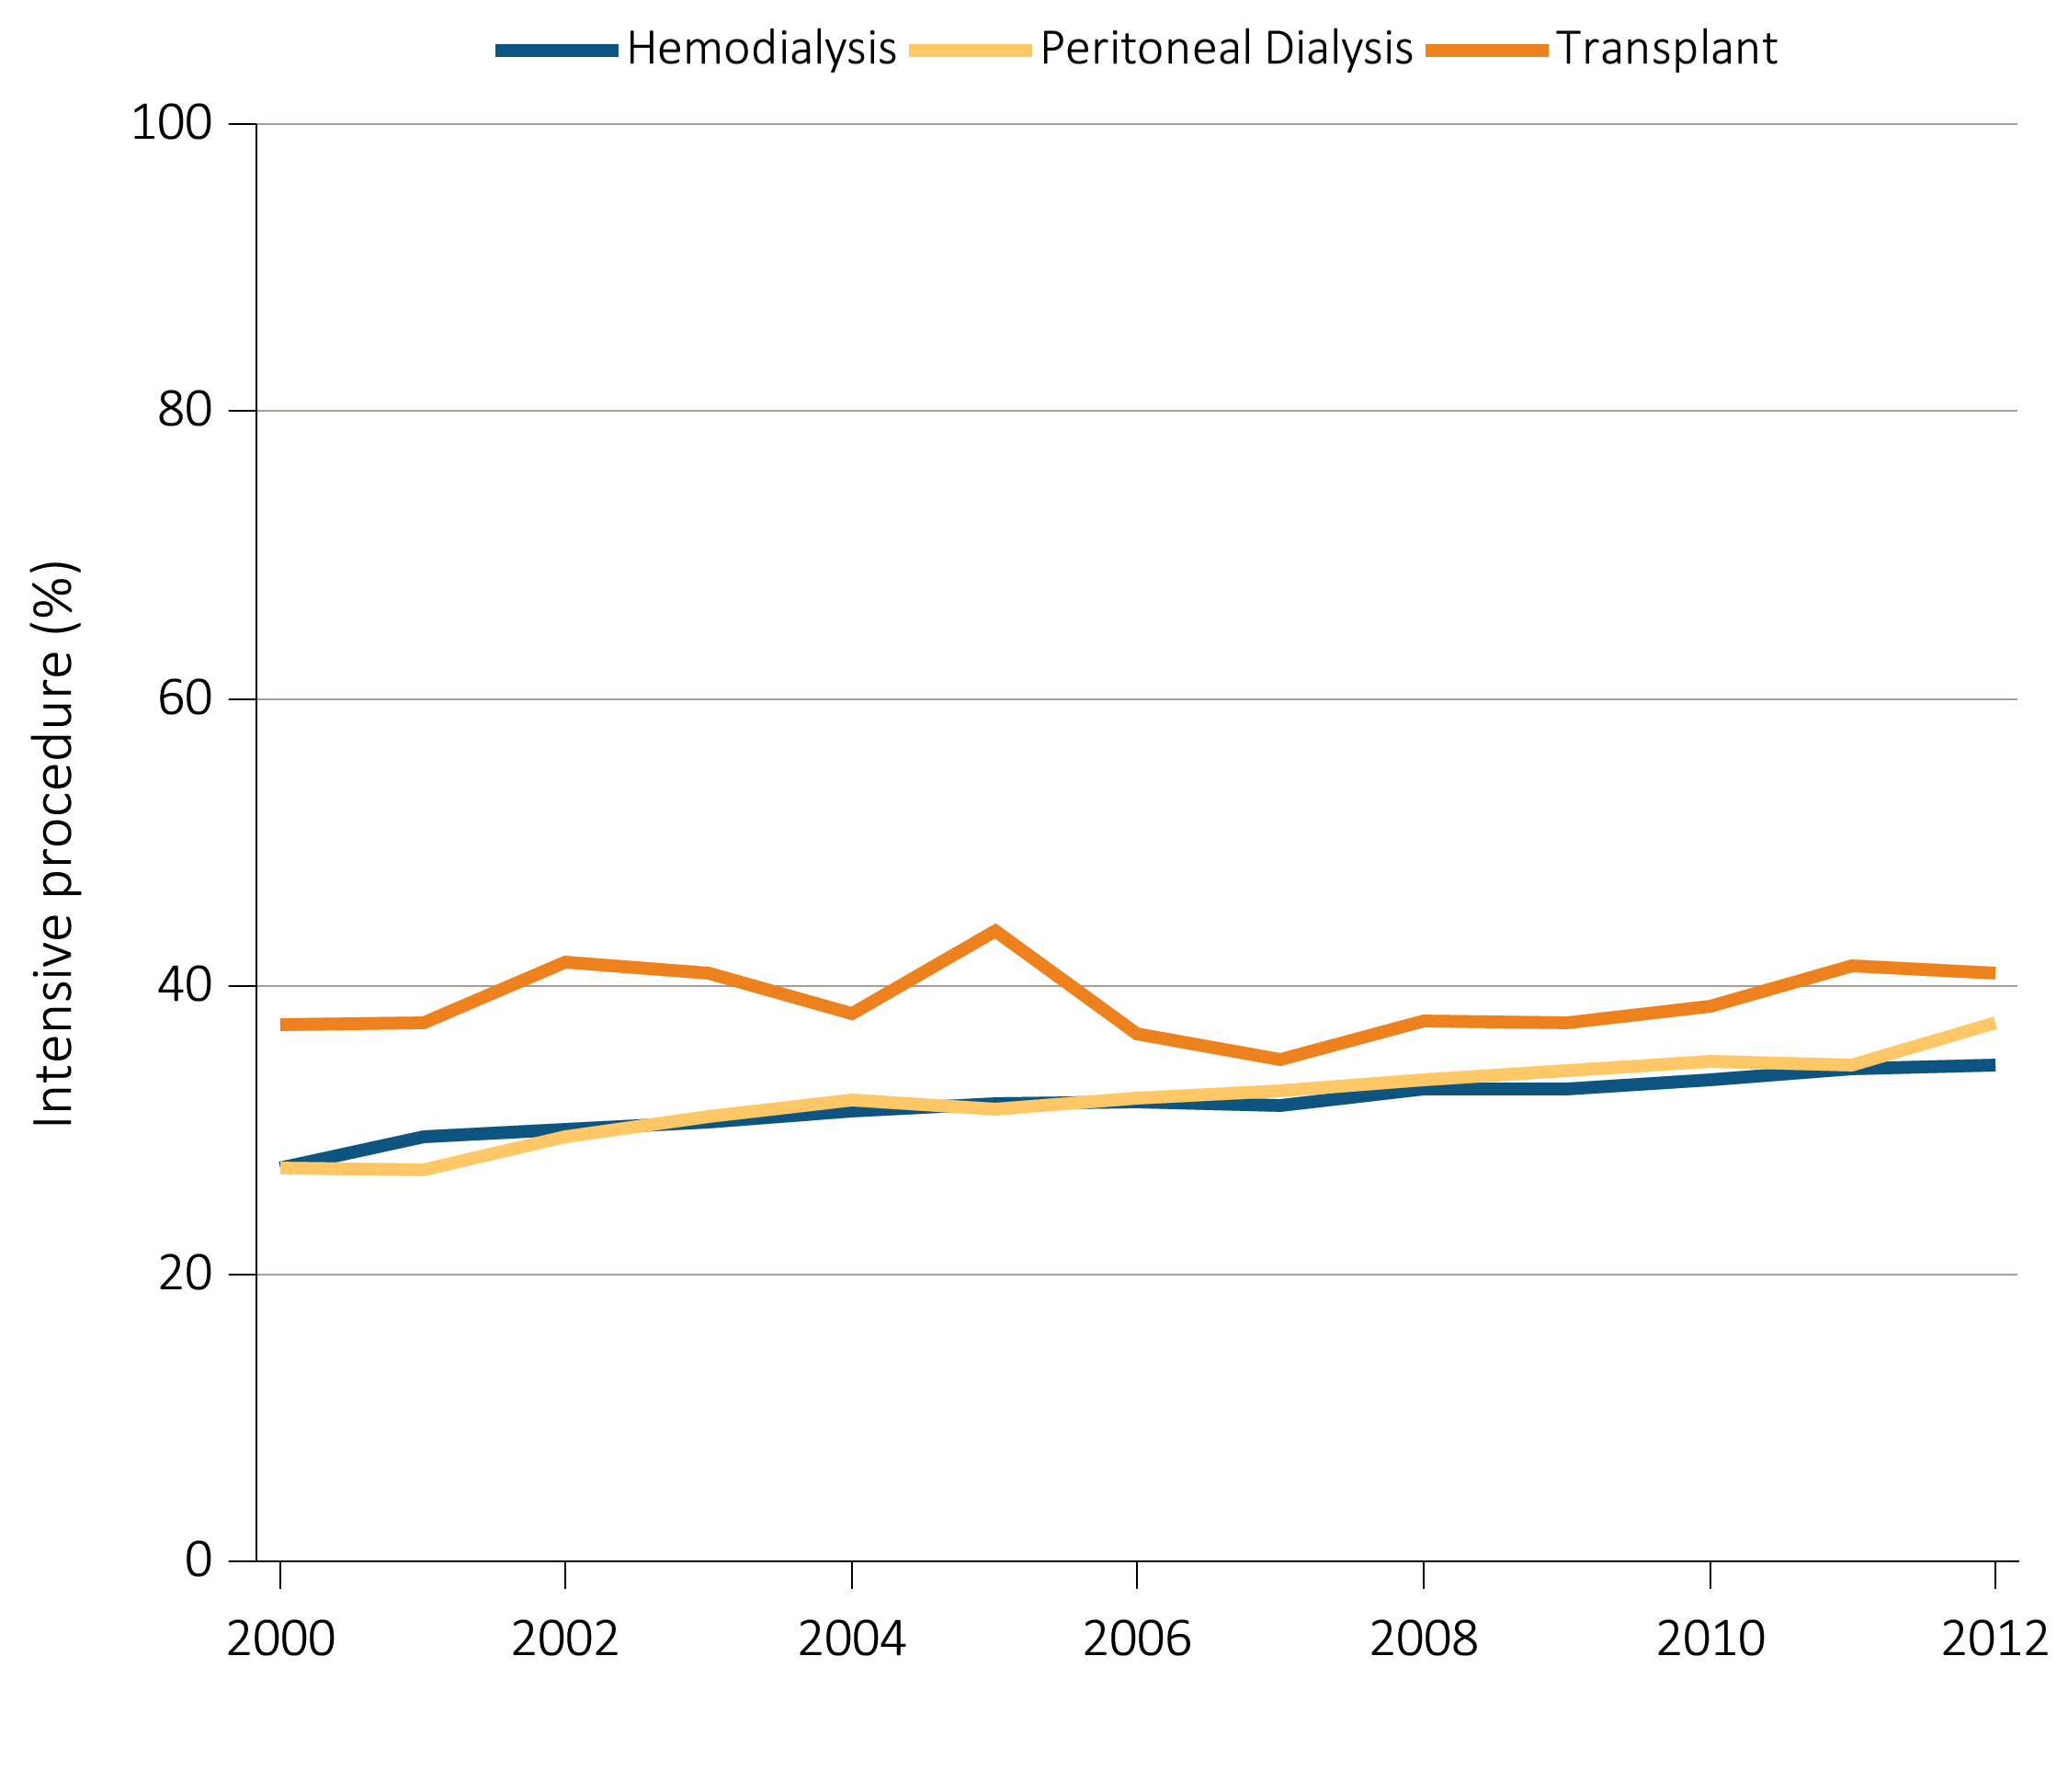
Figure 14.4 Intensive procedures during the last 90 days of life among Medicare beneficiaries with ESRD overall, and by age, race, ethnicity, sex, and modality, 2000-2012
(f) Intensive procedures by modality
Data Source: Special analyses, USRDS ESRD Database. Denominator population is all decedents with Medicare Parts A and B throughout the last 90 days of life. Intensive procedures were identified by ICD-9 procedure code search of Medicare Institutional claims from short and long stay hospitals.

Slide 18
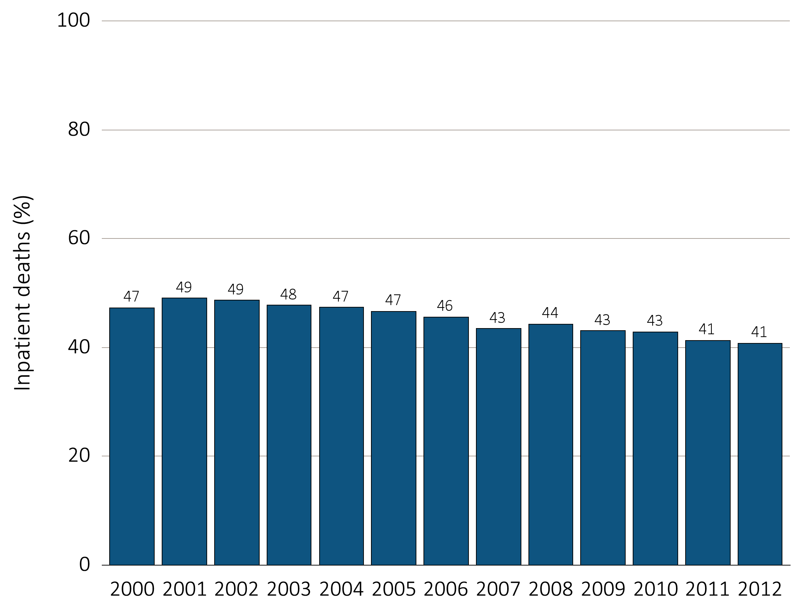
Figure 14.5 Inpatient deaths among Medicare beneficiaries with ESRD overall,
and by age, race, ethnicity, sex, and modality, 2000-2012
(a) Inpatient deaths by year, overall
Data Source: Data Source: Special analyses, USRDS ESRD Database. Denominator population is all decedents with Medicare Parts A and B throughout the last 90 days of life. Includes deaths occurring in short and long stay hospitals.

Slide 19
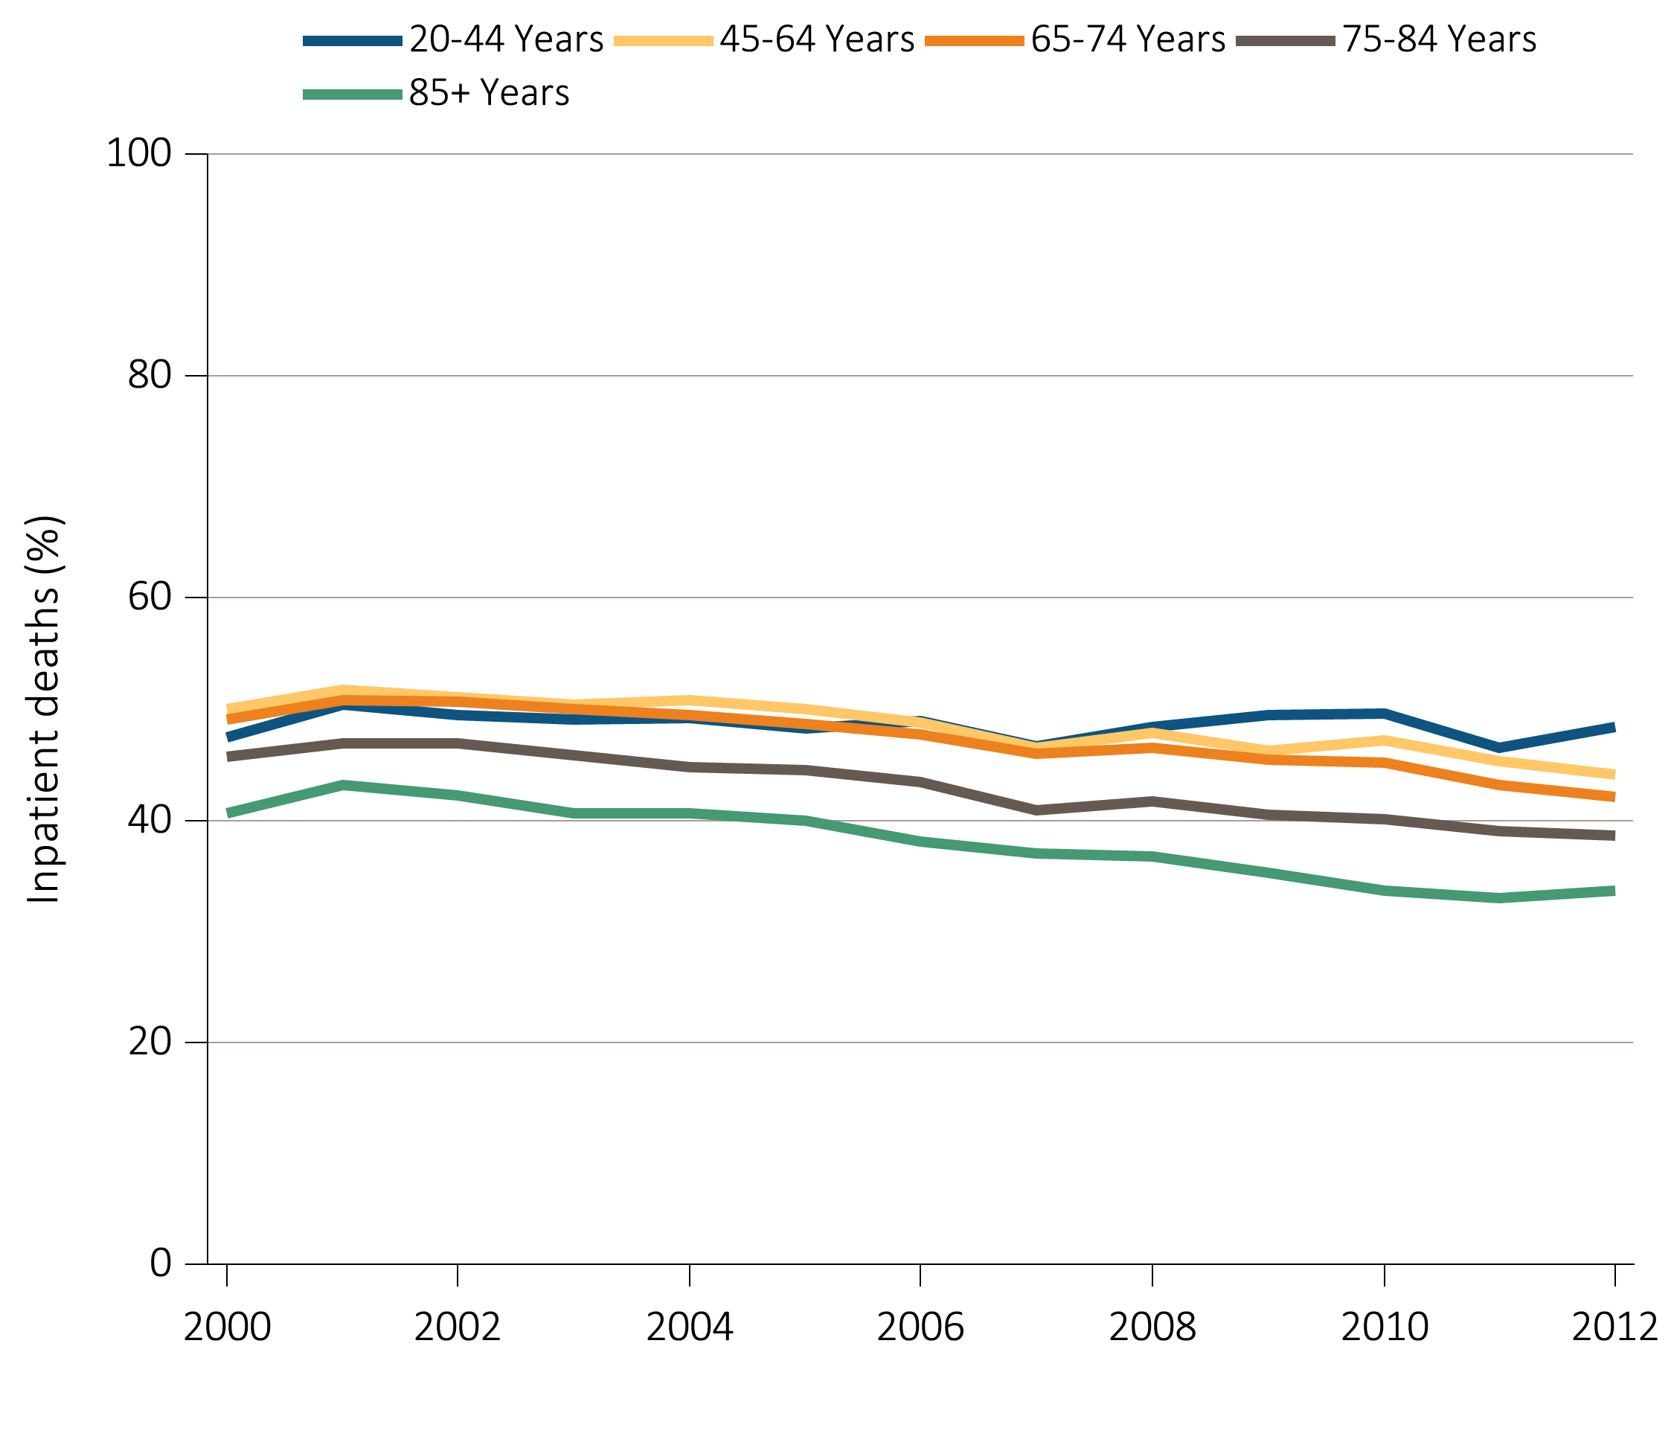
Figure 14.5 Inpatient deaths among Medicare beneficiaries with ESRD overall,
and by age, race, ethnicity, sex, and modality, 2000-2012
^{(b) Inpatient deaths by age}
Data Source: Data Source: Special analyses, USRDS ESRD Database. Denominator population is all decedents with Medicare Parts A and B throughout the last 90 days of life. Includes deaths occurring in short and long stay hospitals.

Slide 20
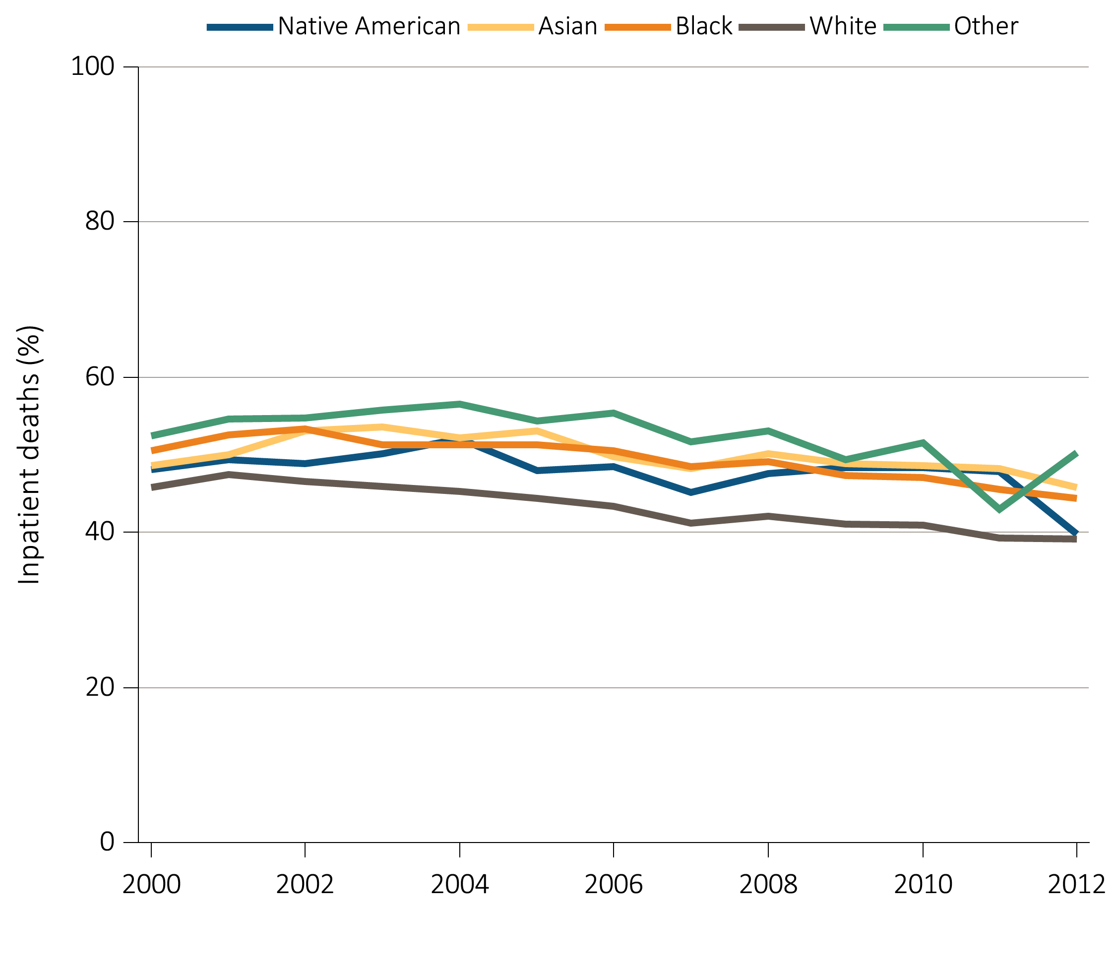
Figure 14.5 Inpatient deaths among Medicare beneficiaries with ESRD overall,
and by age, race, ethnicity, sex, and modality, 2000-2012
^{(c) Inpatient deaths by race}
Data Source: Data Source: Special analyses, USRDS ESRD Database. Denominator population is all decedents with Medicare Parts A and B throughout the last 90 days of life. Includes deaths occurring in short and long stay hospitals.

Slide 21
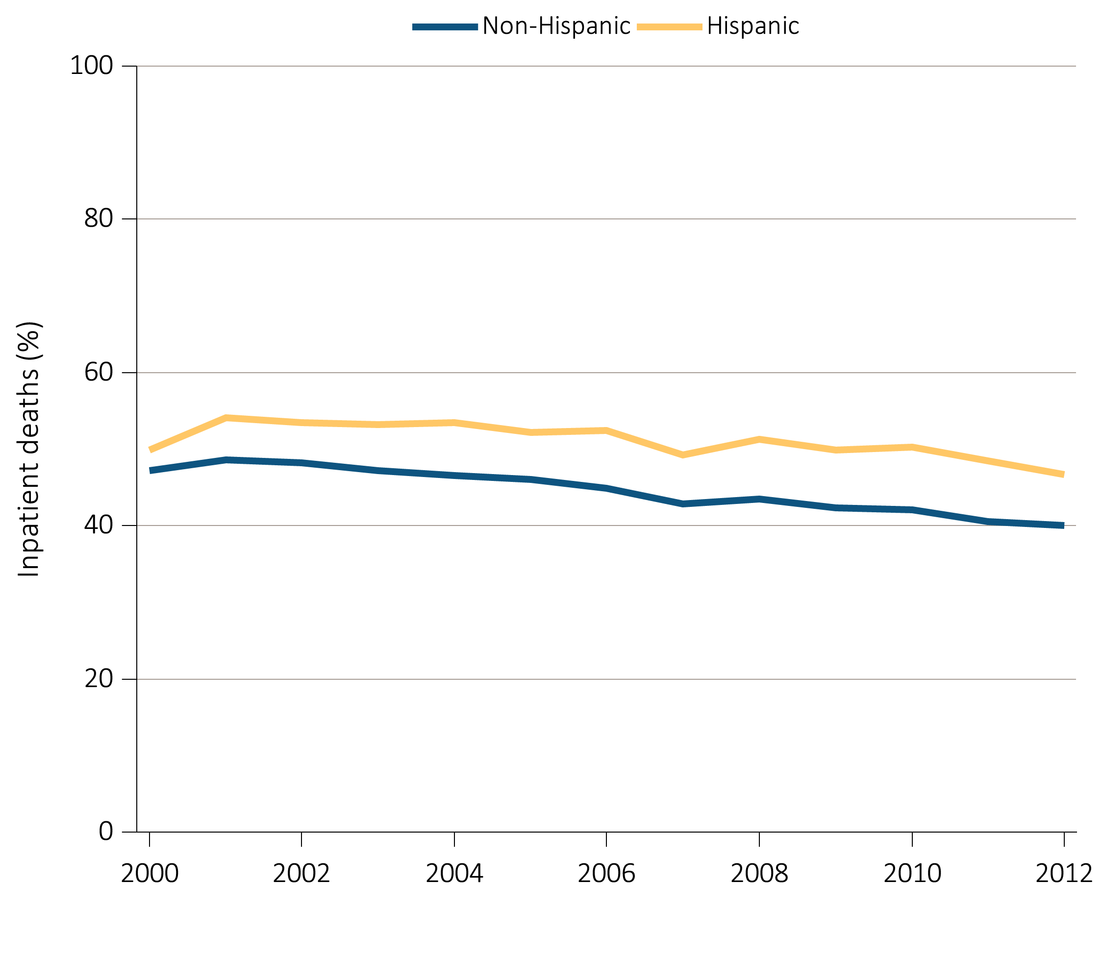
Figure 14.5 Inpatient deaths among Medicare beneficiaries with ESRD overall,
and by age, race, ethnicity, sex, and modality, 2000-2012
(d) Inpatient deaths by ethnicity
Data Source: Data Source: Special analyses, USRDS ESRD Database. Denominator population is all decedents with Medicare Parts A and B throughout the last 90 days of life. Includes deaths occurring in short and long stay hospitals.

Slide 22
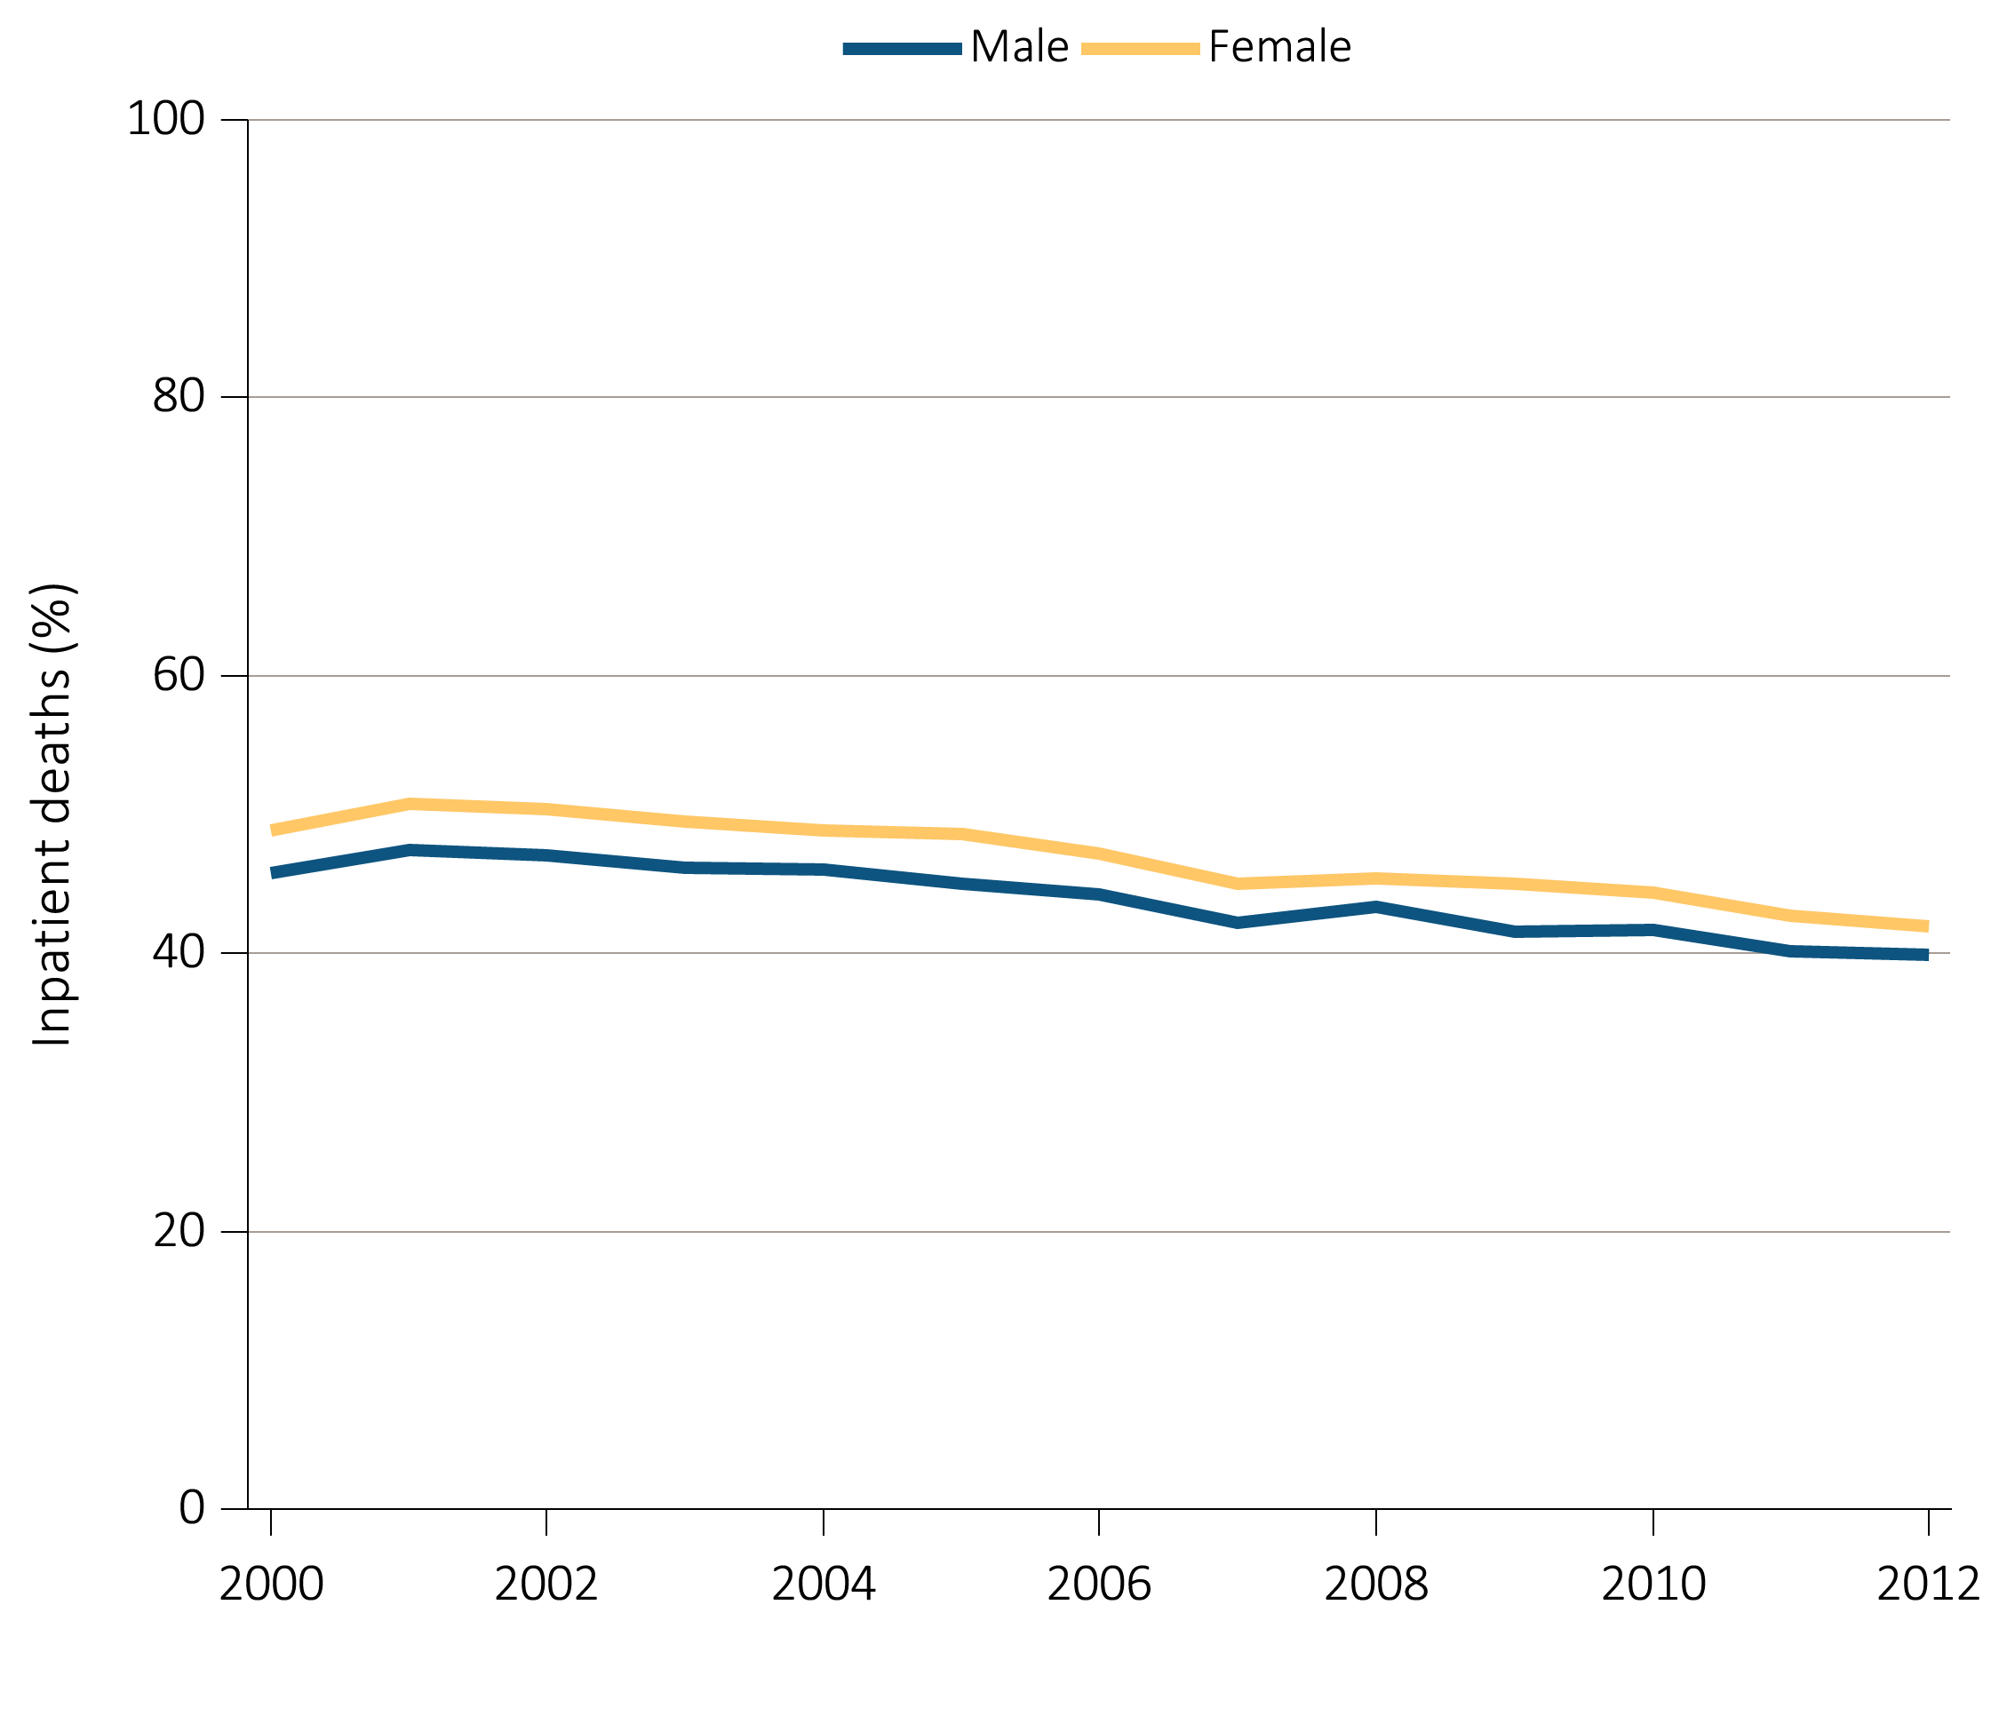
Figure 14.5 Inpatient deaths among Medicare beneficiaries with ESRD overall,
and by age, race, ethnicity, sex, and modality, 2000-2012
^{(e) Inpatient deaths by sex}
Data Source: Data Source: Special analyses, USRDS ESRD Database. Denominator population is all decedents with Medicare Parts A and B throughout the last 90 days of life. Includes deaths occurring in short and long stay hospitals.

Slide 23
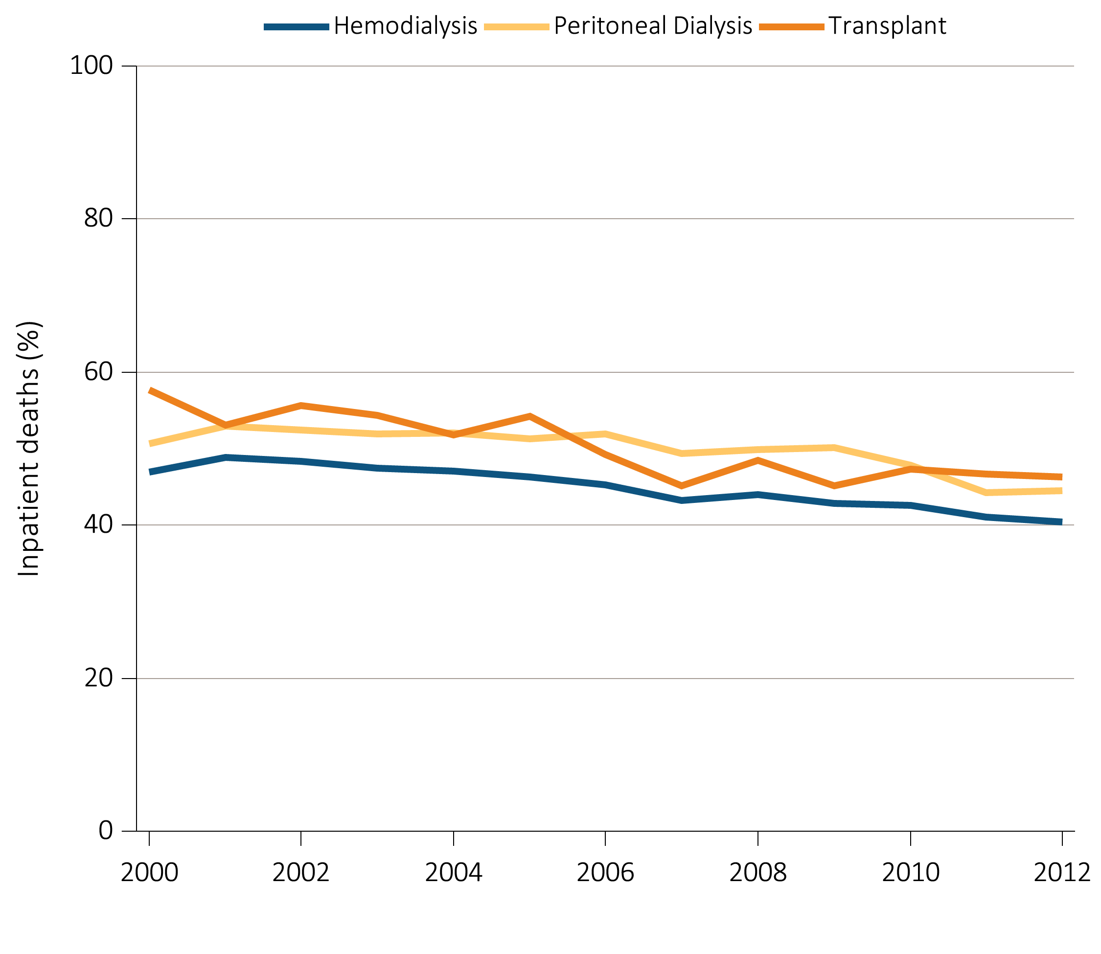
Figure 14.5 Inpatient deaths among Medicare beneficiaries with ESRD overall,
and by age, race, ethnicity, sex, and modality, 2000-2012
(f) Inpatient deaths by modality
Data Source: Data Source: Special analyses, USRDS ESRD Database. Denominator population is all decedents with Medicare Parts A and B throughout the last 90 days of life. Includes deaths occurring in short and long stay hospitals.

Slide 24
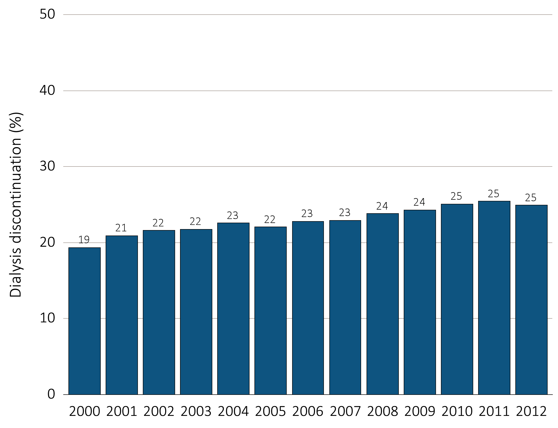
Figure 14.6 Dialysis discontinuation before death among decedents overall,
and by age, race, ethnicity, sex, and modality, 2000-2012
(a) Dialysis discontinuation by year, overall
Data Source: Special analyses, USRDS ESRD Database. Denominator population is all patients with complete data on dialysis discontinuation from the CMS Death Notification form (CMS 2746).

Slide 25
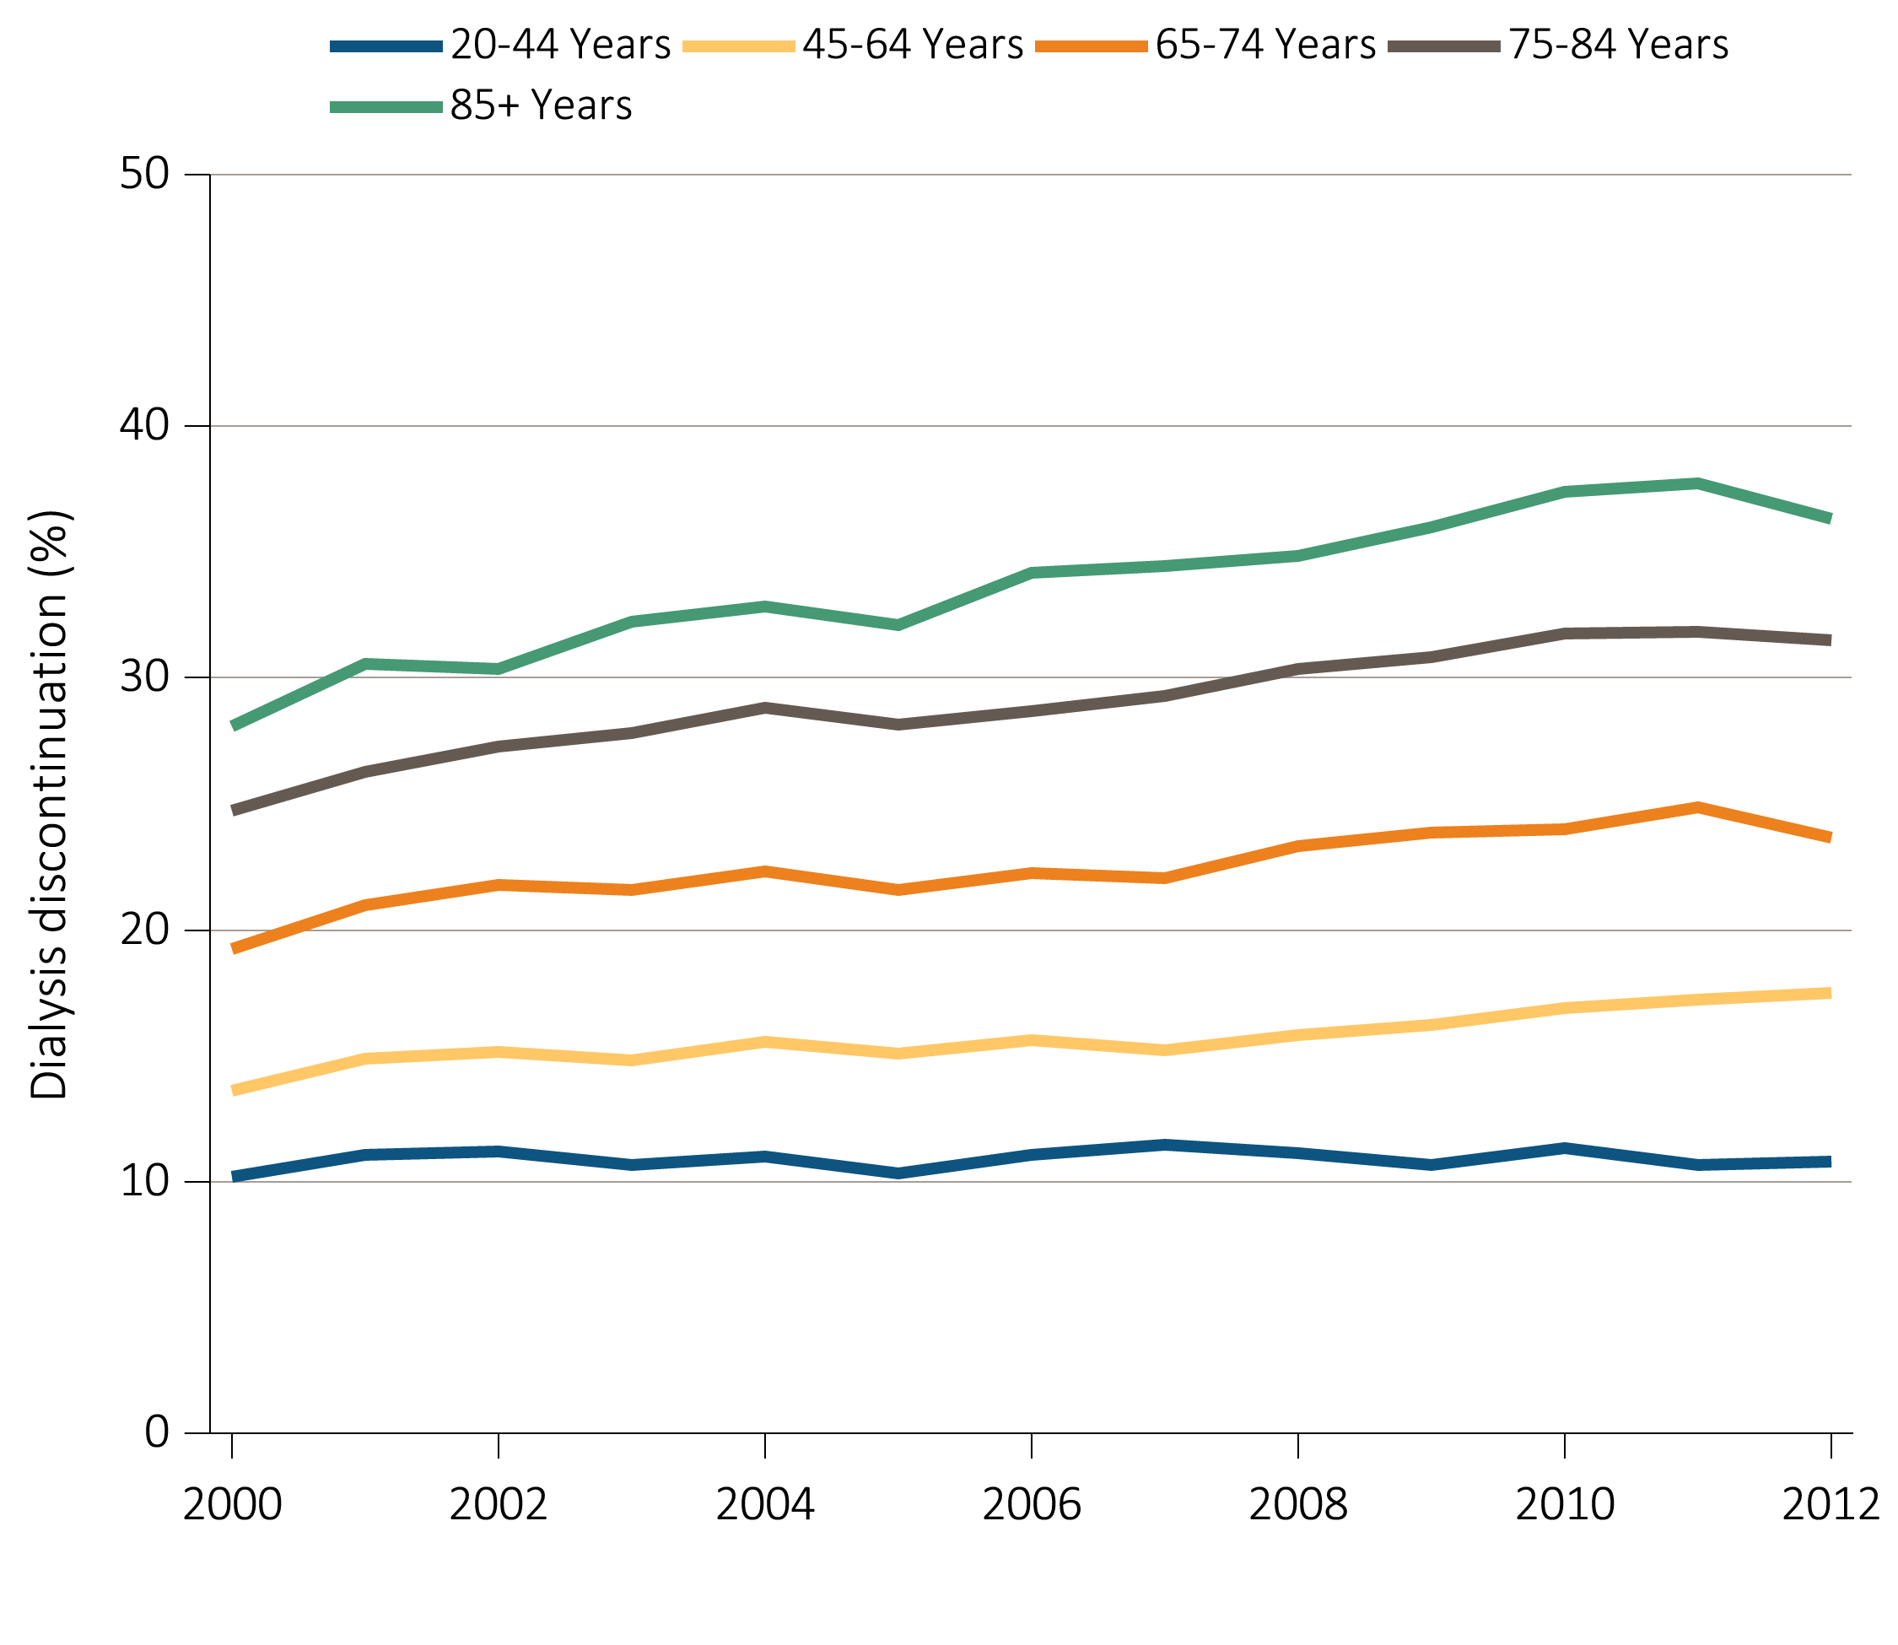
Figure 14.6 Dialysis discontinuation before death among decedents overall,
and by age, race, ethnicity, sex, and modality, 2000-2012
(b) Dialysis discontinuation by age
Data Source: Special analyses, USRDS ESRD Database. Denominator population is all patients with complete data on dialysis discontinuation from the CMS Death Notification form (CMS 2746).

Slide 26
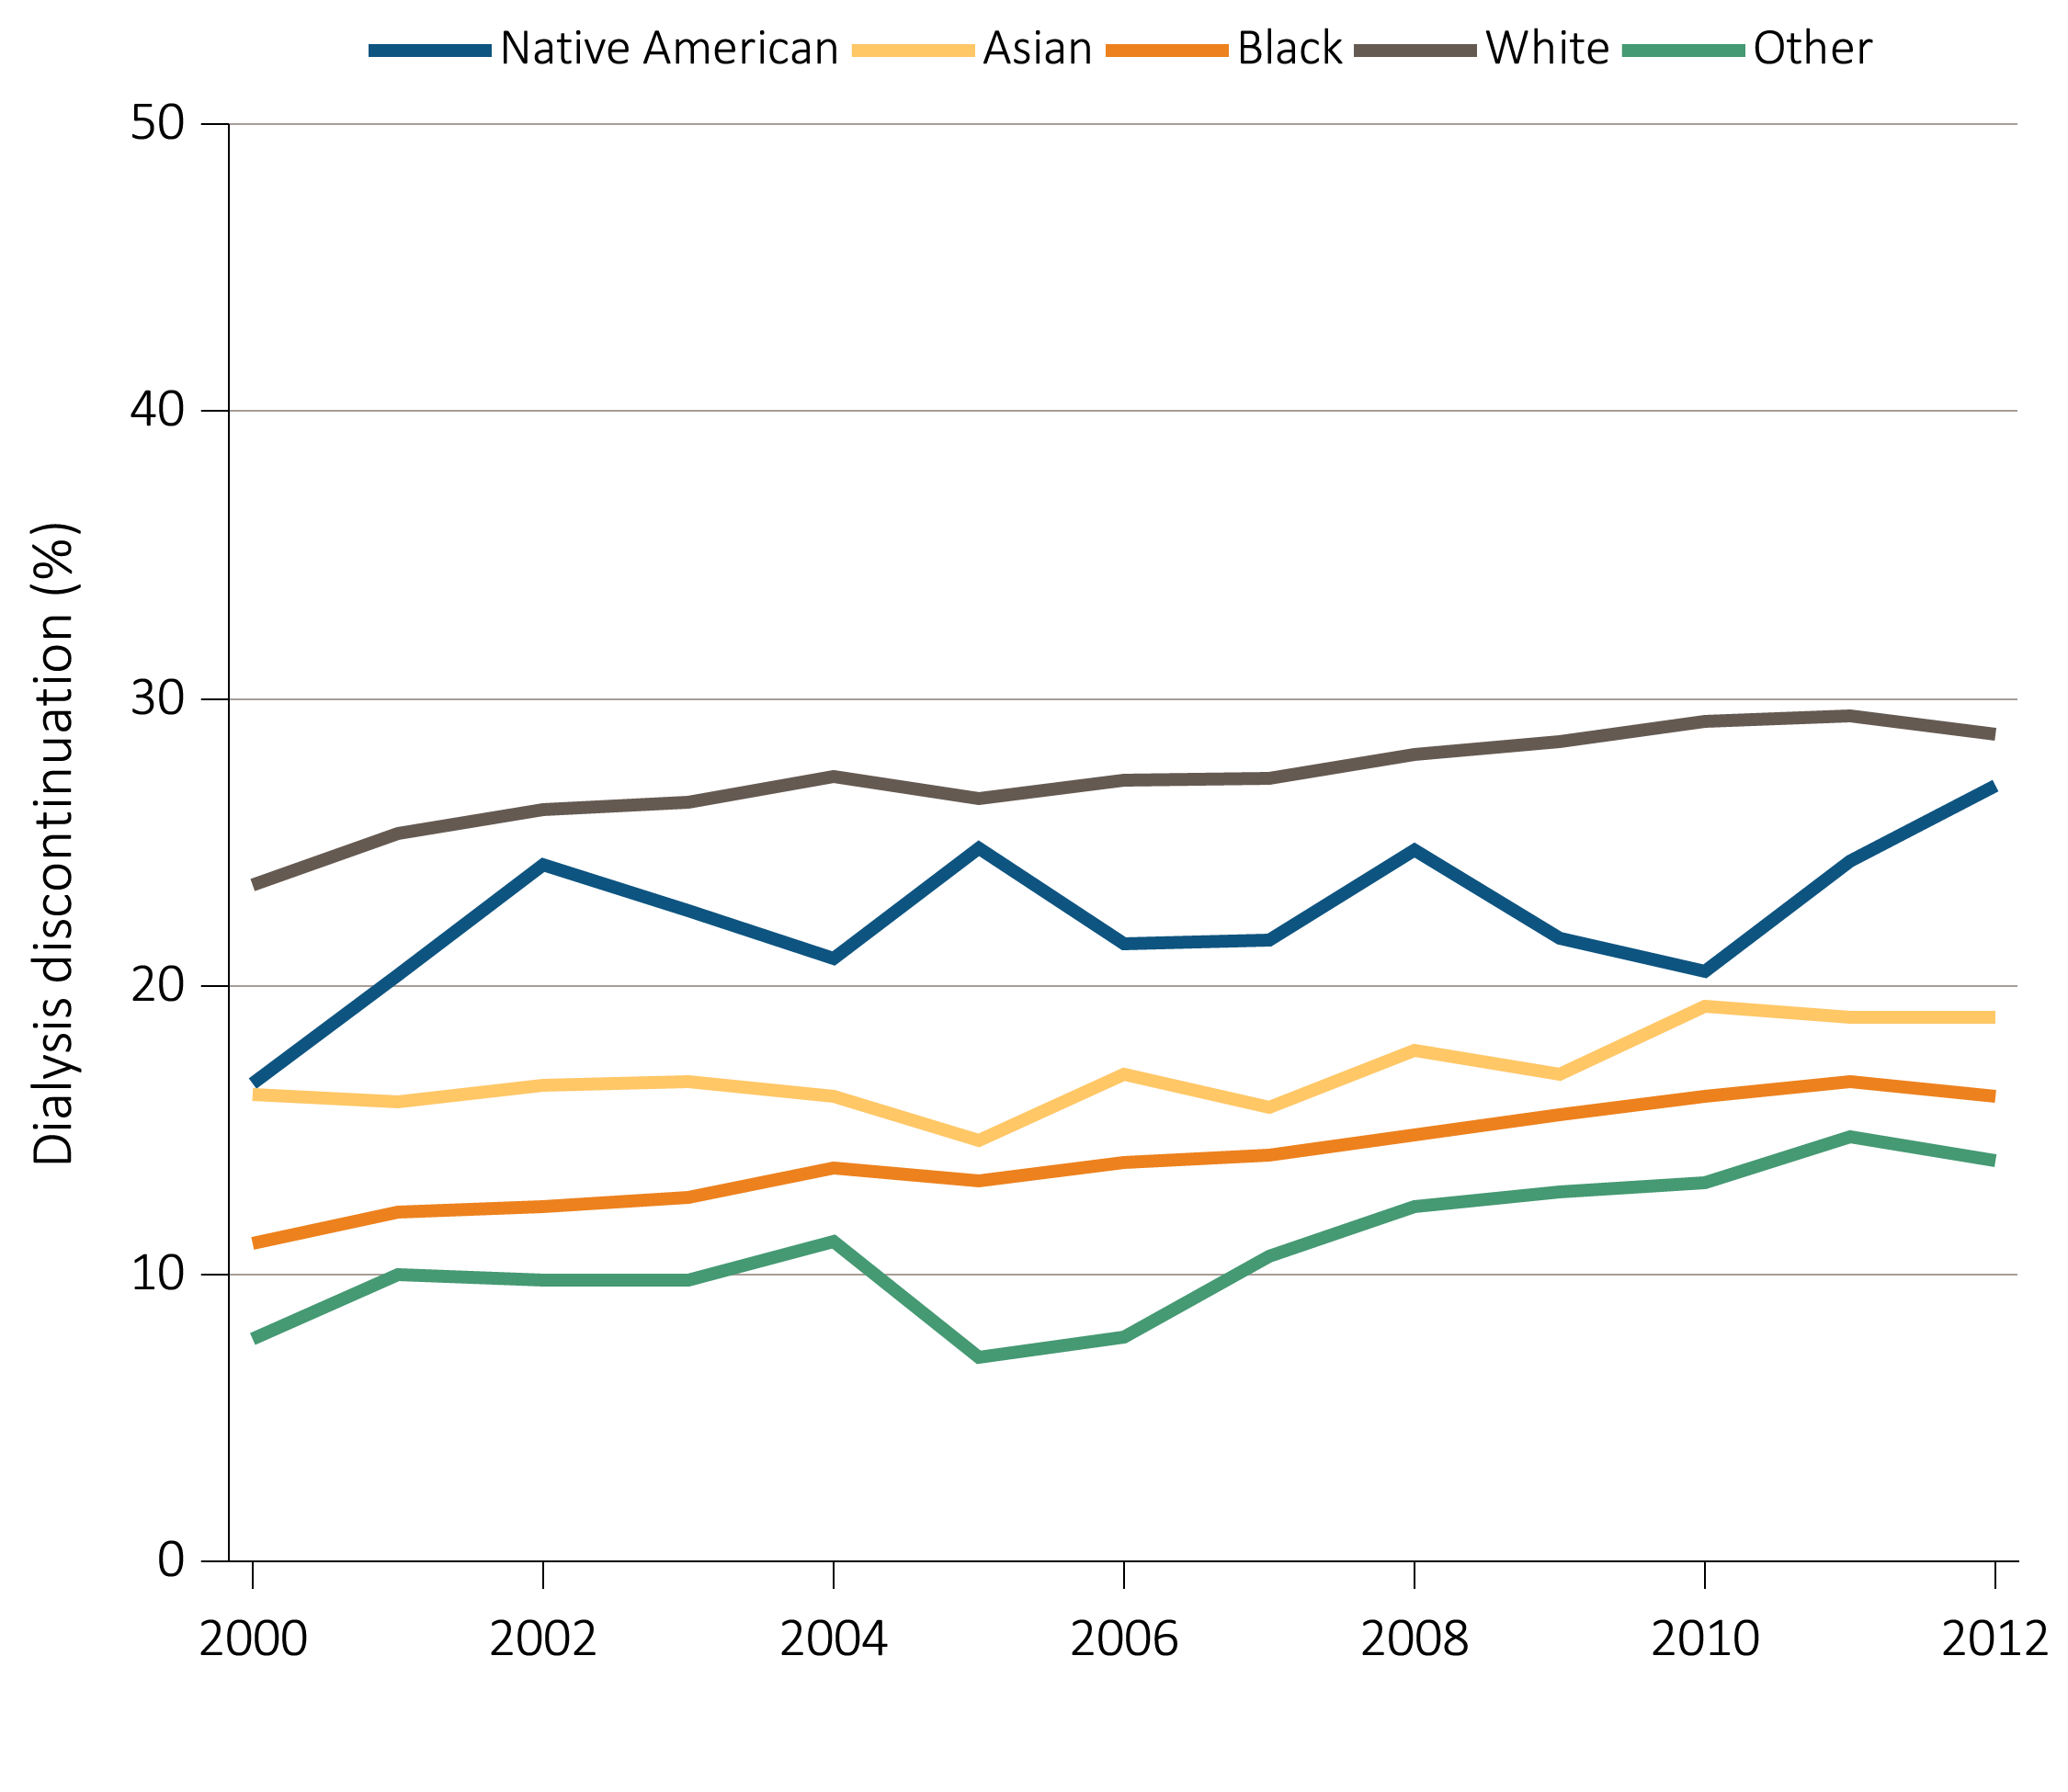
Figure 14.6 Dialysis discontinuation before death among decedents overall,
and by age, race, ethnicity, sex, and modality, 2000-2012
(c) Dialysis discontinuation by race
Data Source: Special analyses, USRDS ESRD Database. Denominator population is all patients with complete data on dialysis discontinuation from the CMS Death Notification form (CMS 2746).

Slide 27
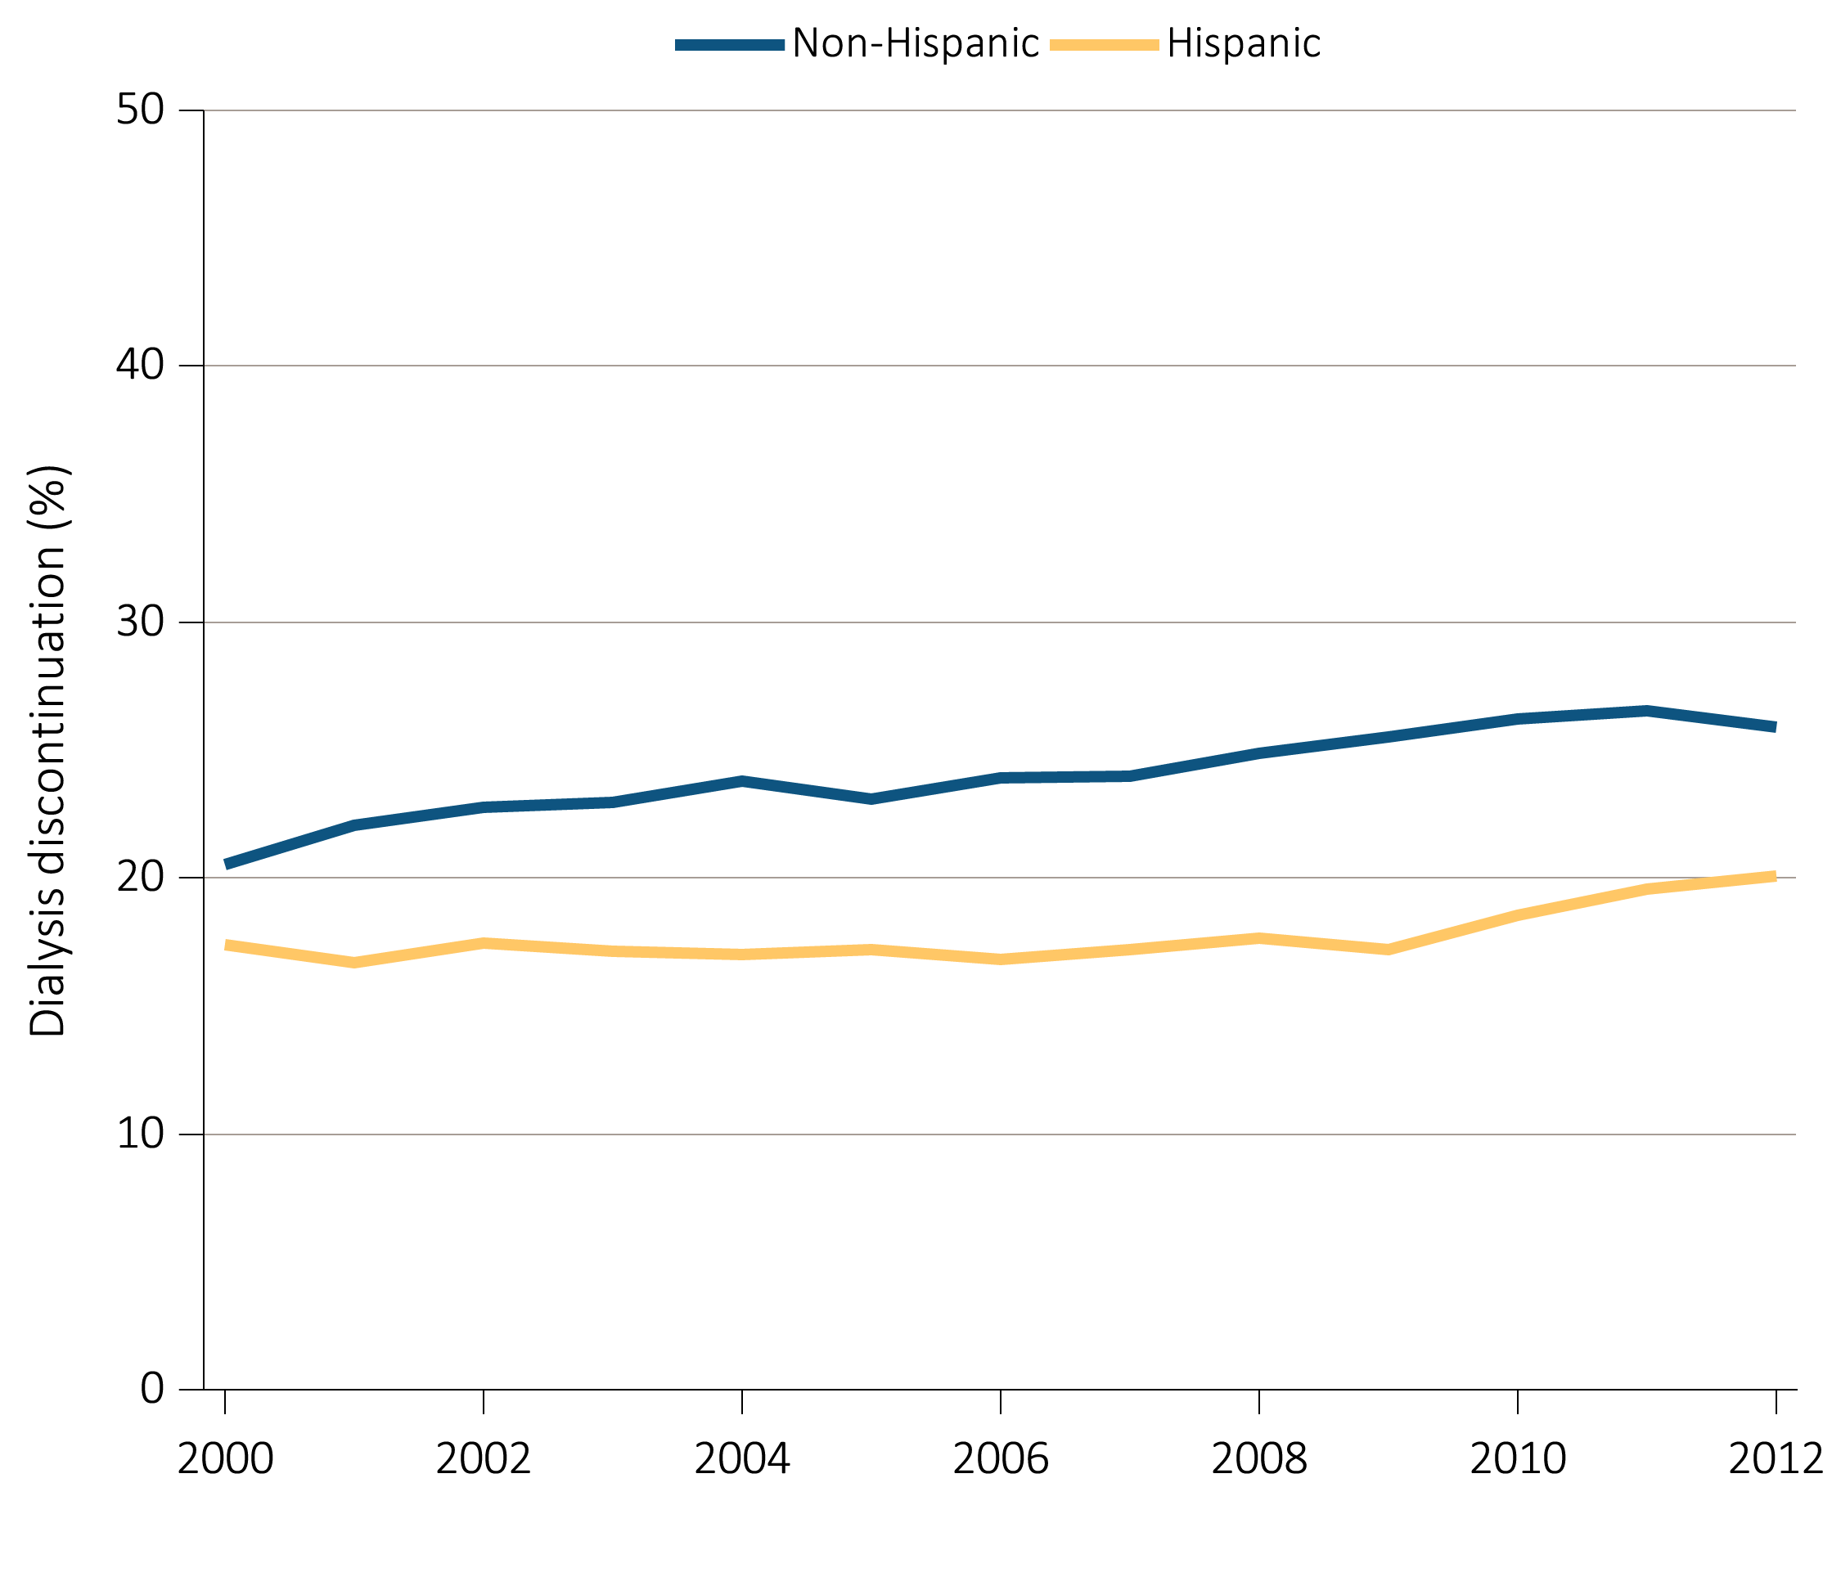
Figure 14.6 Dialysis discontinuation before death among decedents overall,
and by age, race, ethnicity, sex, and modality, 2000-2012
(d) Dialysis discontinuation by ethnicity
Data Source: Special analyses, USRDS ESRD Database. Denominator population is all patients with complete data on dialysis discontinuation from the CMS Death Notification form (CMS 2746).

Slide 28
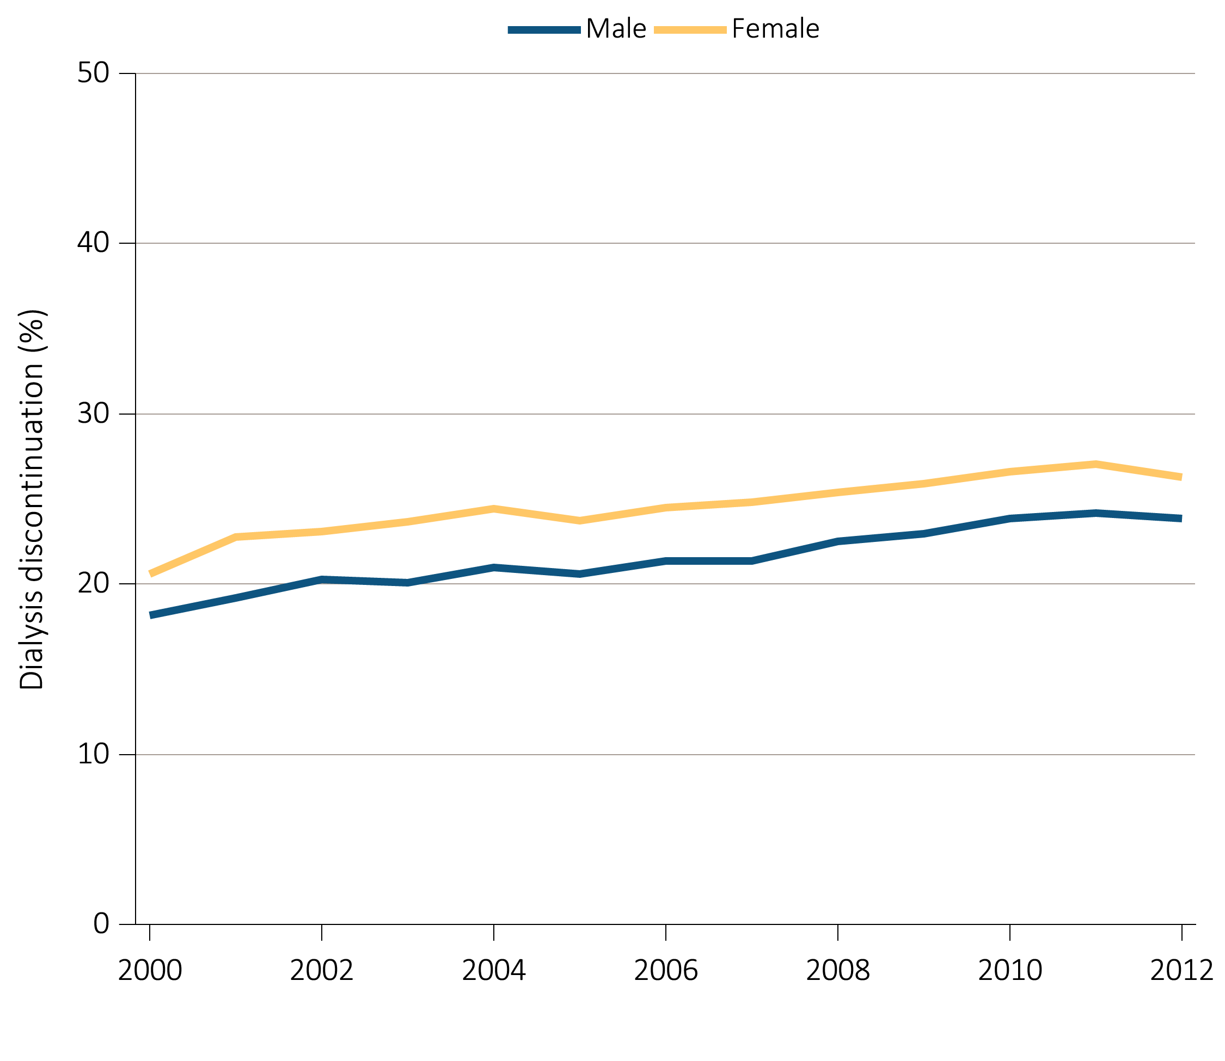
Figure 14.6 Dialysis discontinuation before death among decedents overall,
and by age, race, ethnicity, sex, and modality, 2000-2012
(e) Dialysis discontinuation by sex
Data Source: Special analyses, USRDS ESRD Database. Denominator population is all patients with complete data on dialysis discontinuation from the CMS Death Notification form (CMS 2746).

Slide 29
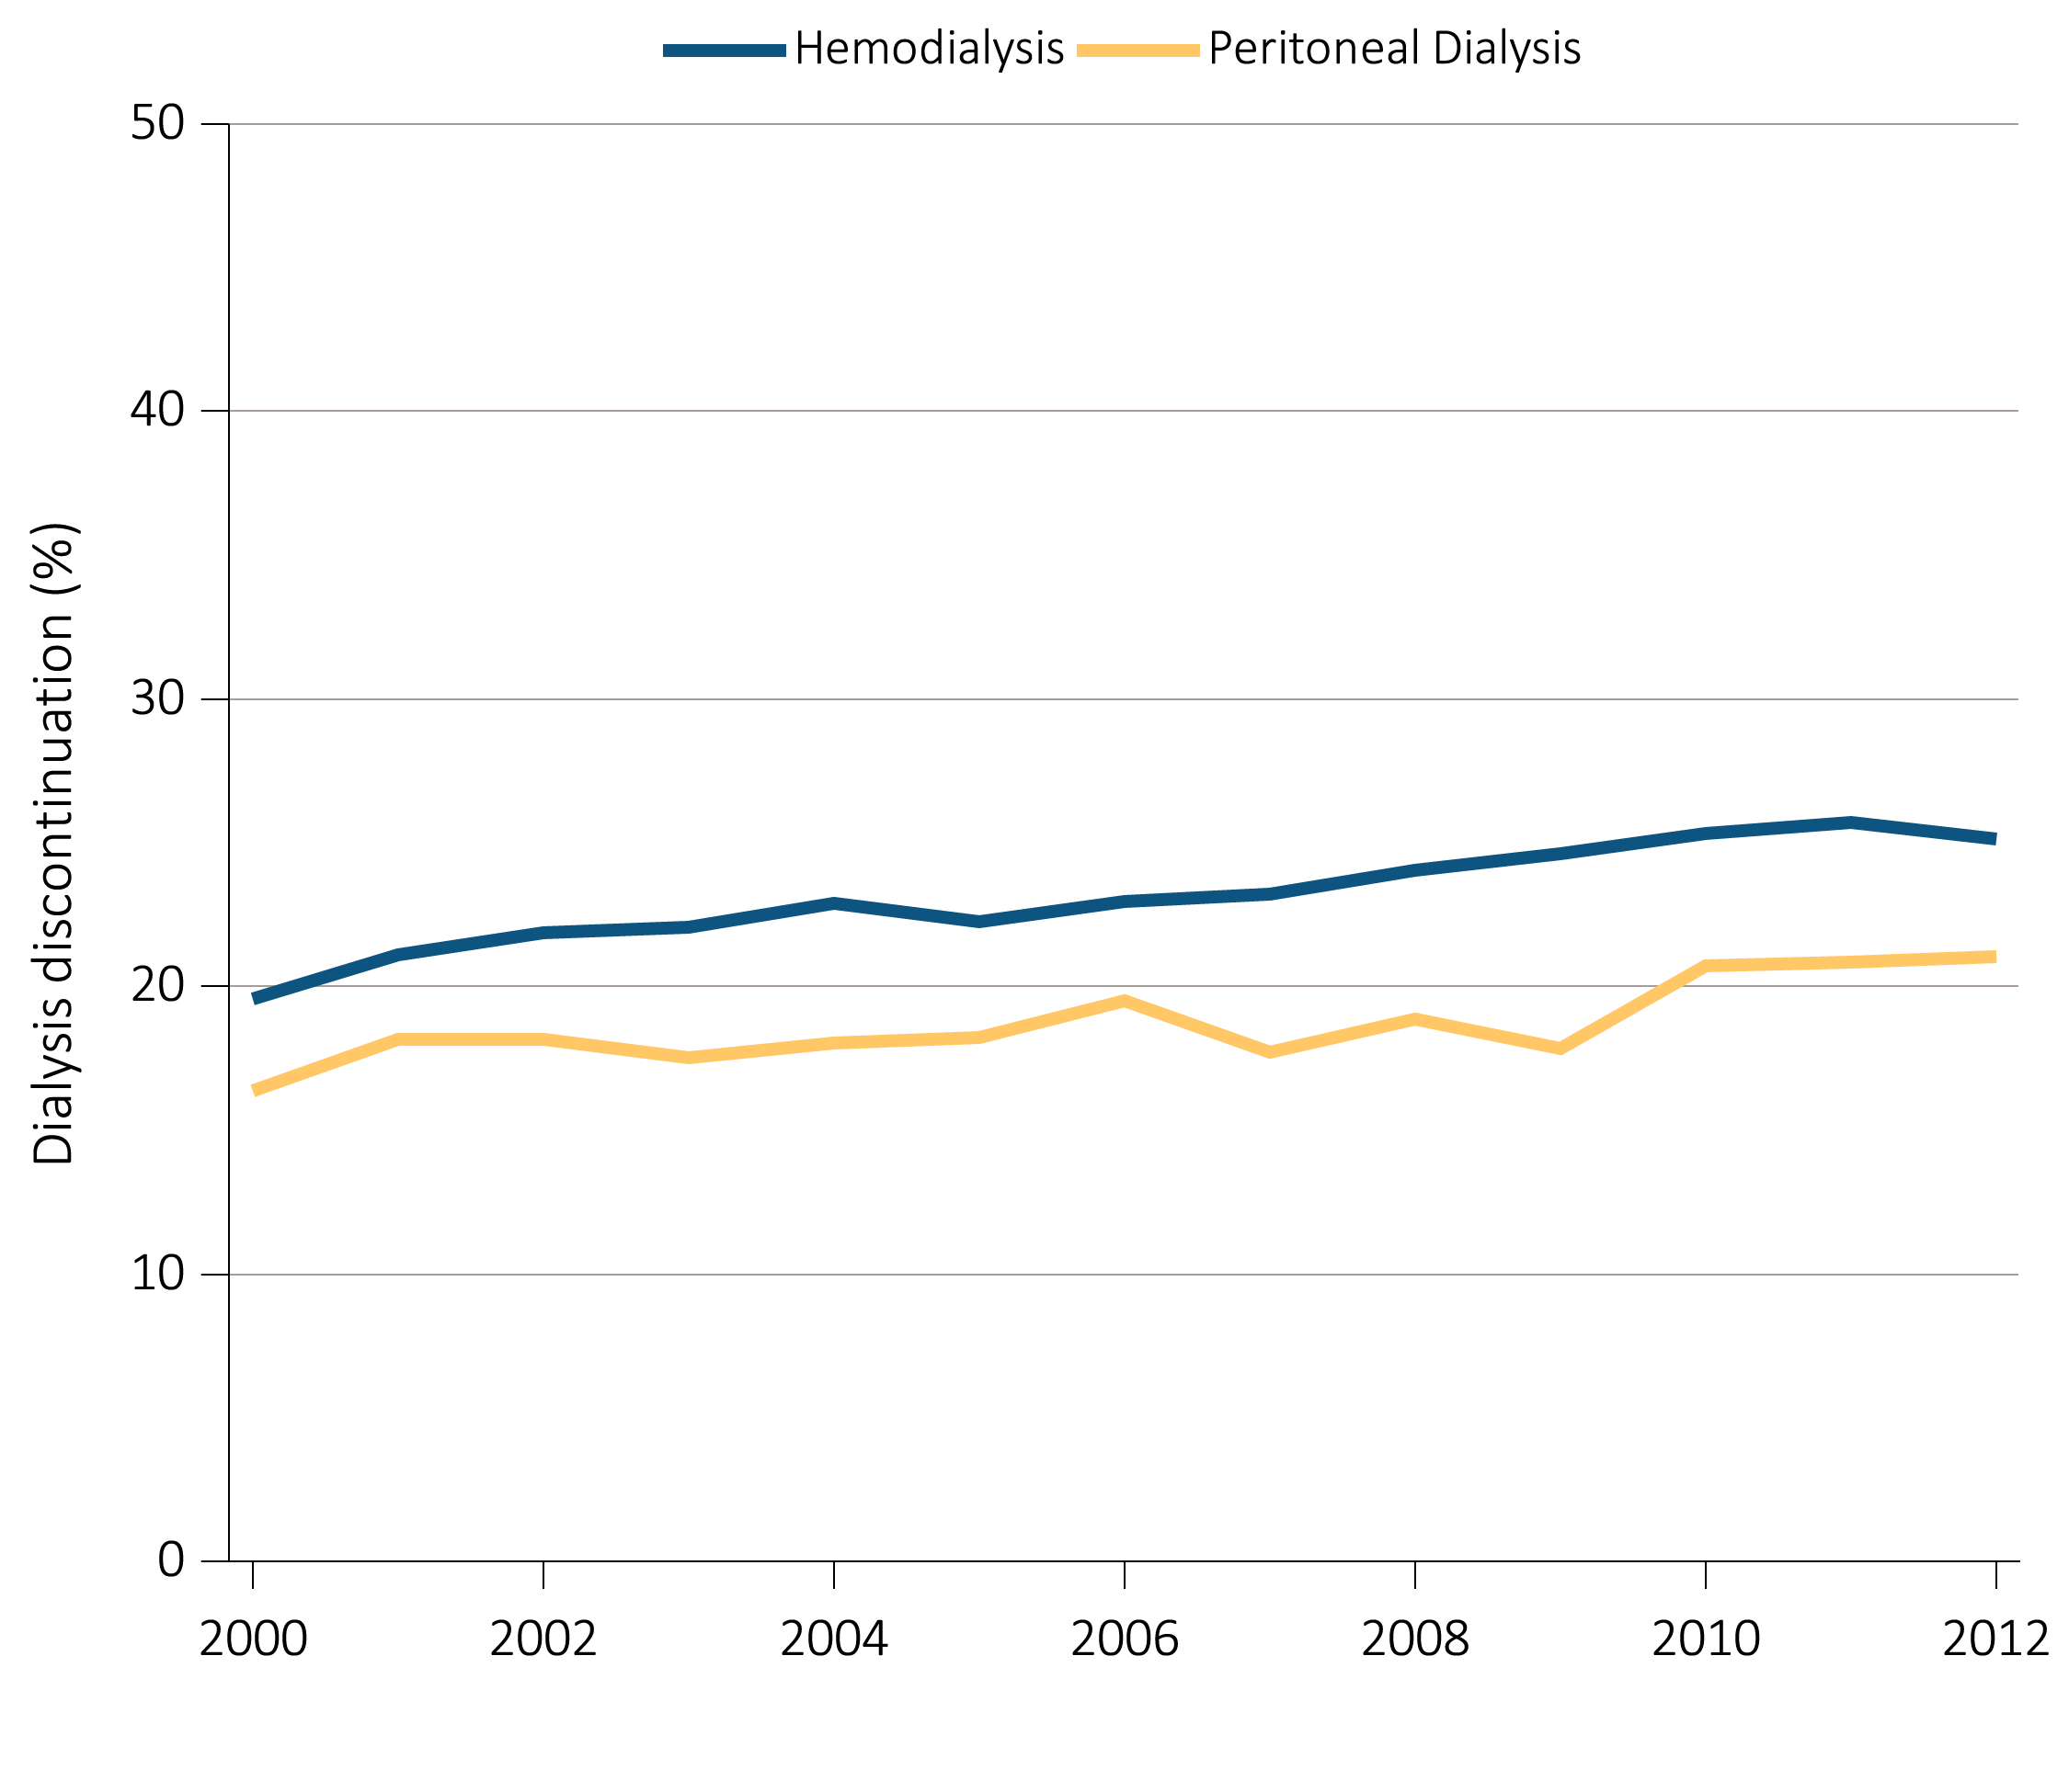
Figure 14.6 Dialysis discontinuation before death among decedents overall,
and by age, race, ethnicity, sex, and modality, 2000-2012
(f) Dialysis discontinuation by modality
Data Source: Special analyses, USRDS ESRD Database. Denominator population is all patients with complete data on dialysis discontinuation from the CMS Death Notification form (CMS 2746).

Slide 30
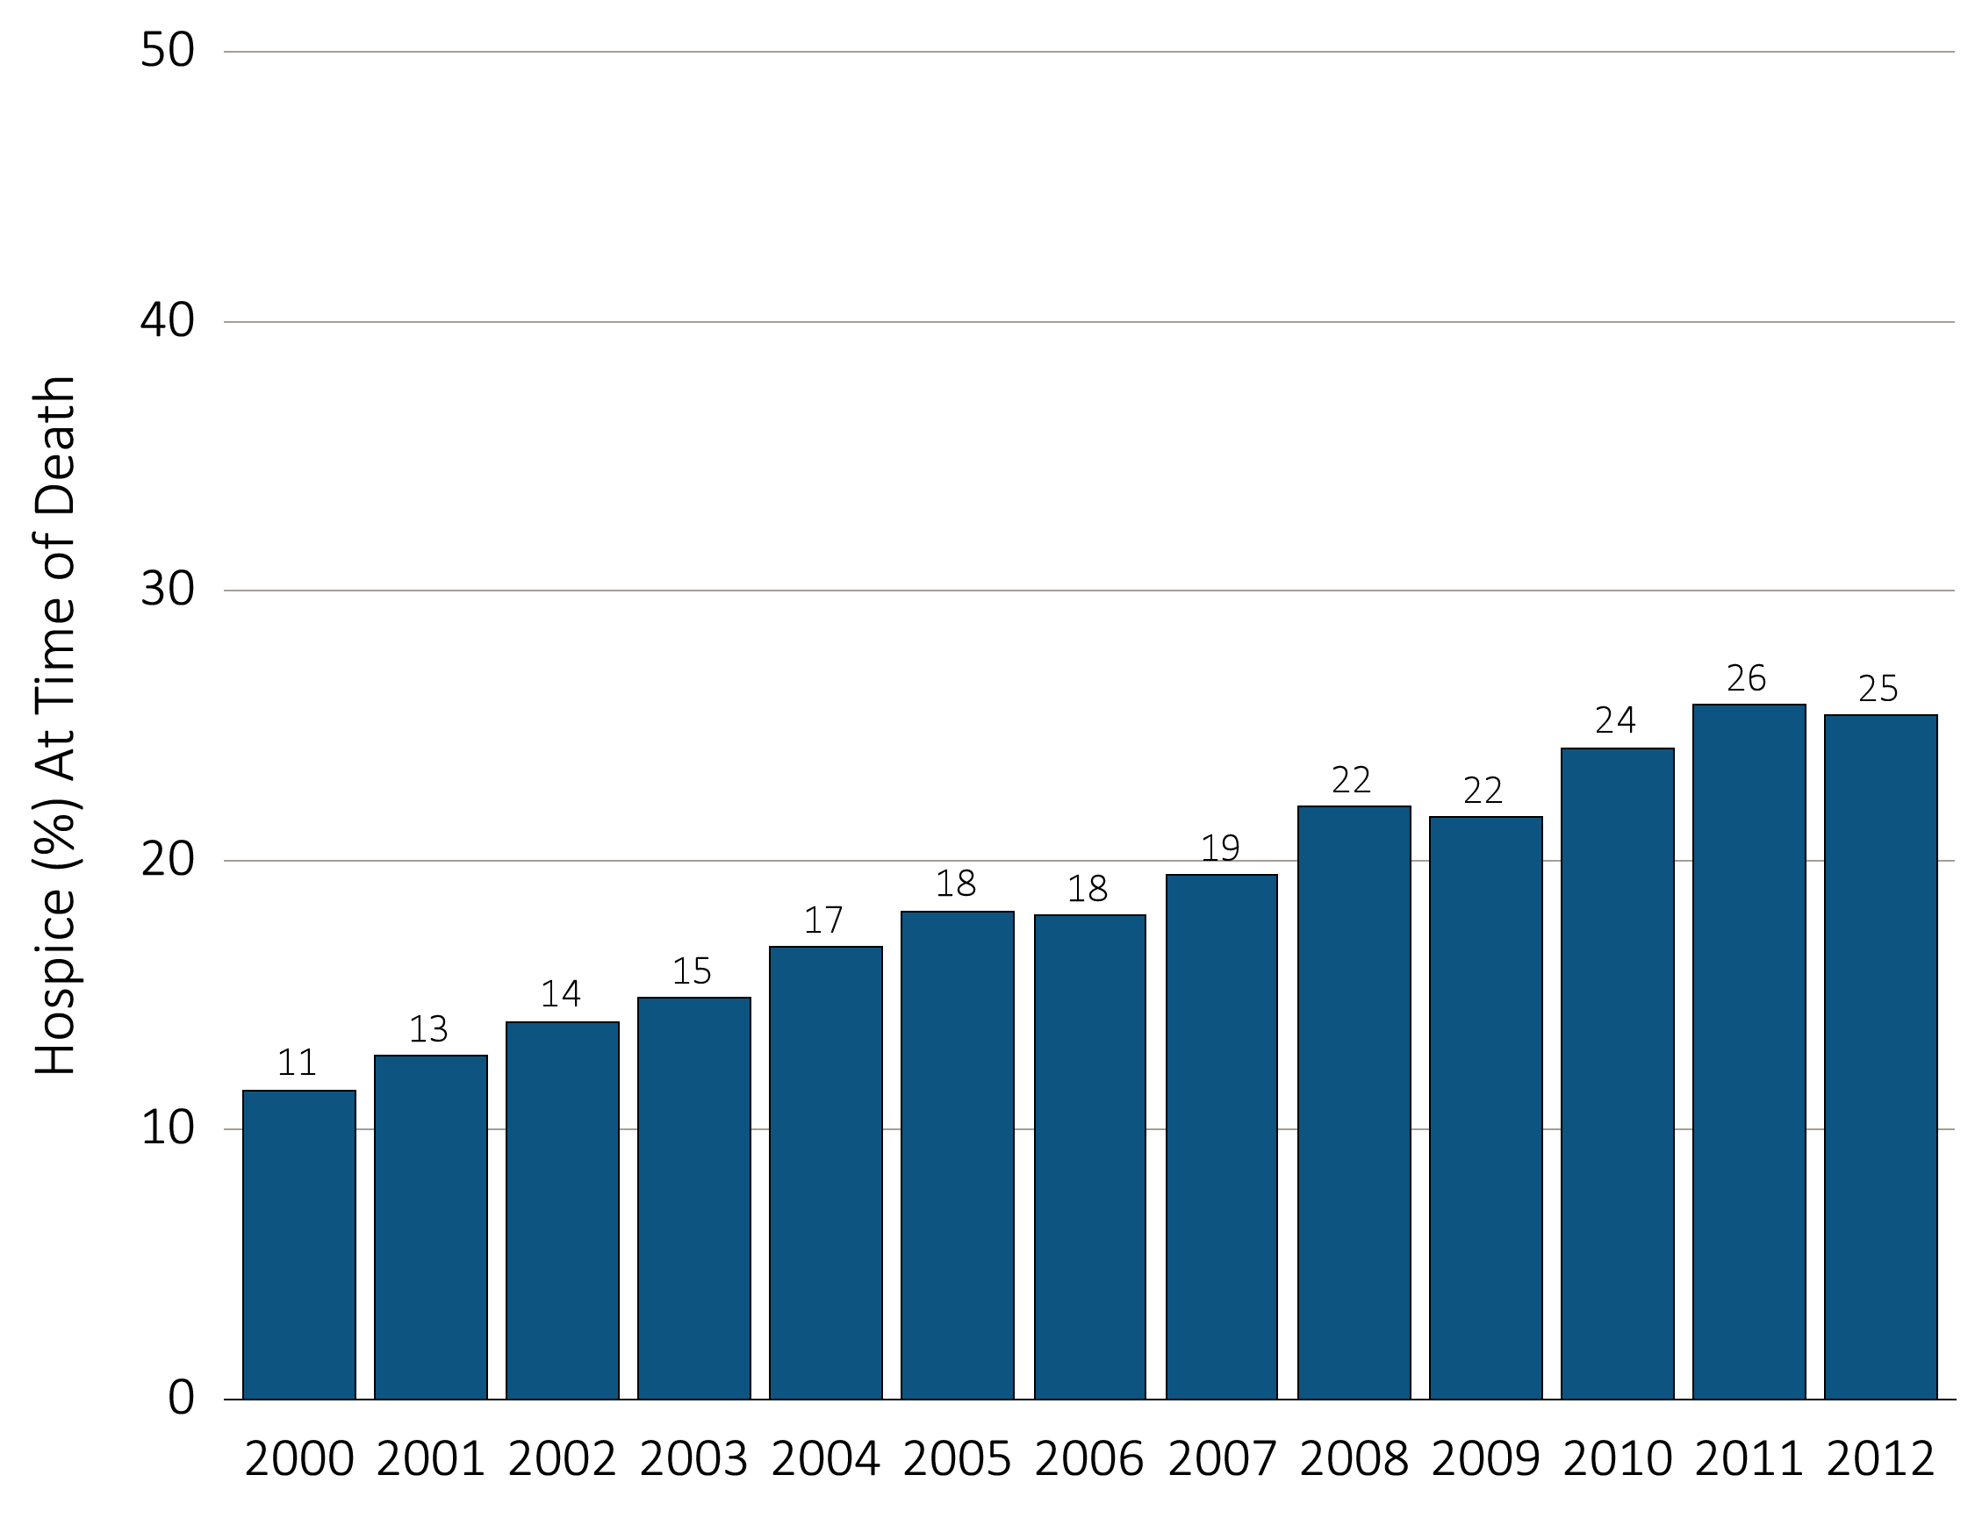
Figure 14.7 Hospice utilization at the time of death among Medicare beneficiaries
with ESRD overall, and by age, race, ethnicity, sex, modality,
and whether dialysis was discontinued, 2000-2012
(a) Hospice utilization by year, overall
Data Source: Special analyses, USRDS ESRD Database. Denominator population is all decedents with Medicare Parts A and B throughout the last 90 days of life. Receipt of hospice care at the time of death was defined as having a claim in the Hospice SAF on or after the date of death or Discharge Status from hospice=40, 41 or 42.

Slide 31
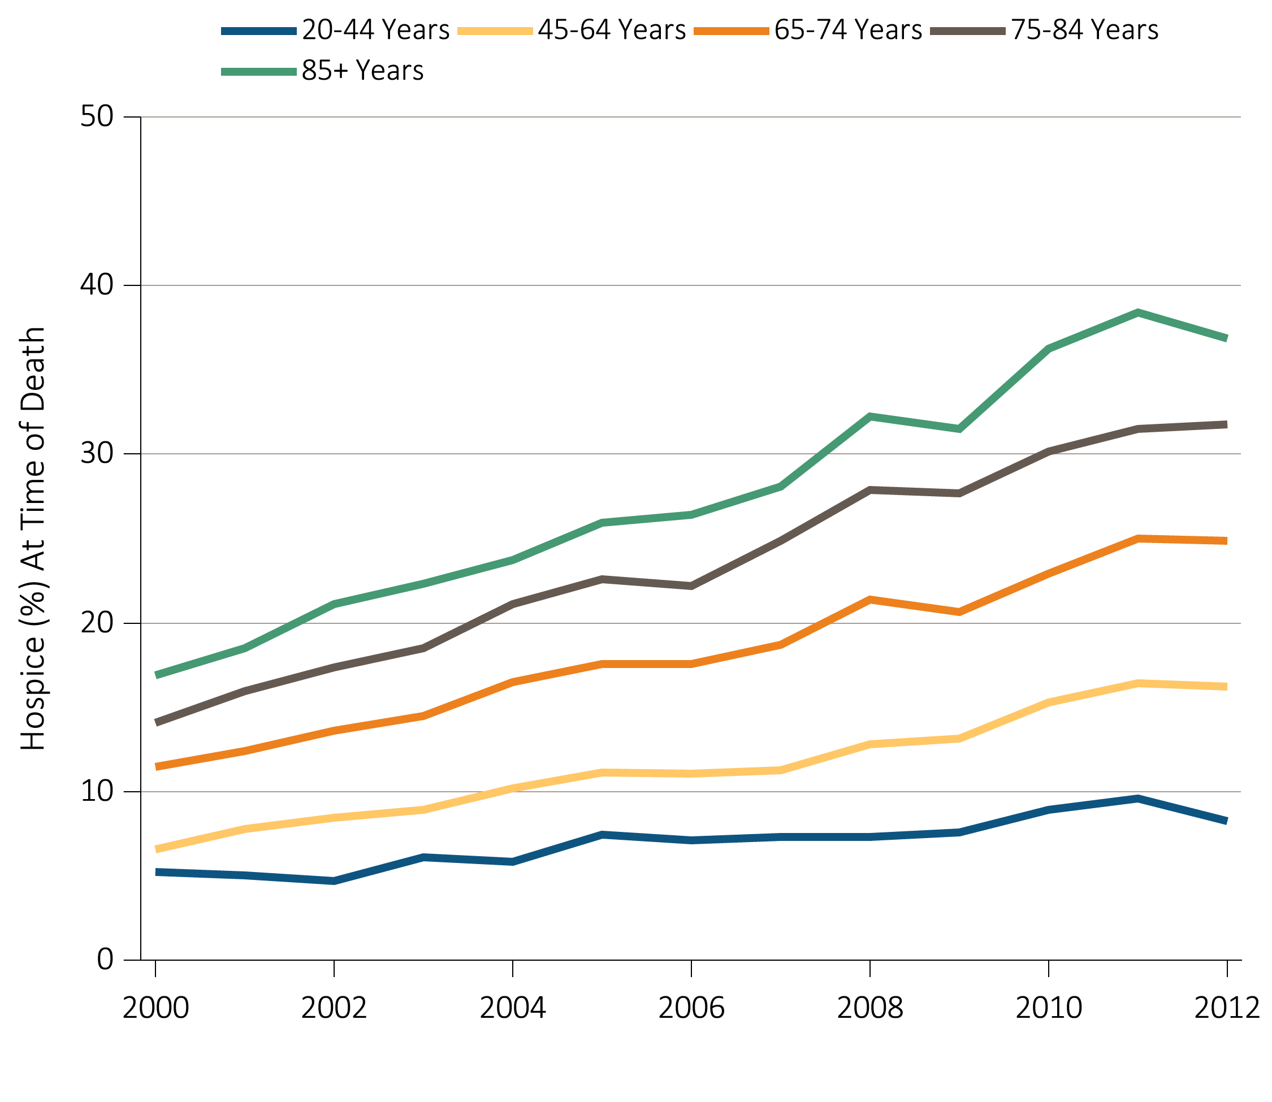
Figure 14.7 Hospice utilization at the time of death among Medicare beneficiaries
with ESRD overall, and by age, race, ethnicity, sex, modality,
and whether dialysis was discontinued, 2000-2012
^{(b) Hospice utilization by age}
Data Source: Special analyses, USRDS ESRD Database. Denominator population is all decedents with Medicare Parts A and B throughout the last 90 days of life. Receipt of hospice care at the time of death was defined as having a claim in the Hospice SAF on or after the date of death or Discharge Status from hospice=40, 41 or 42.

Slide 32
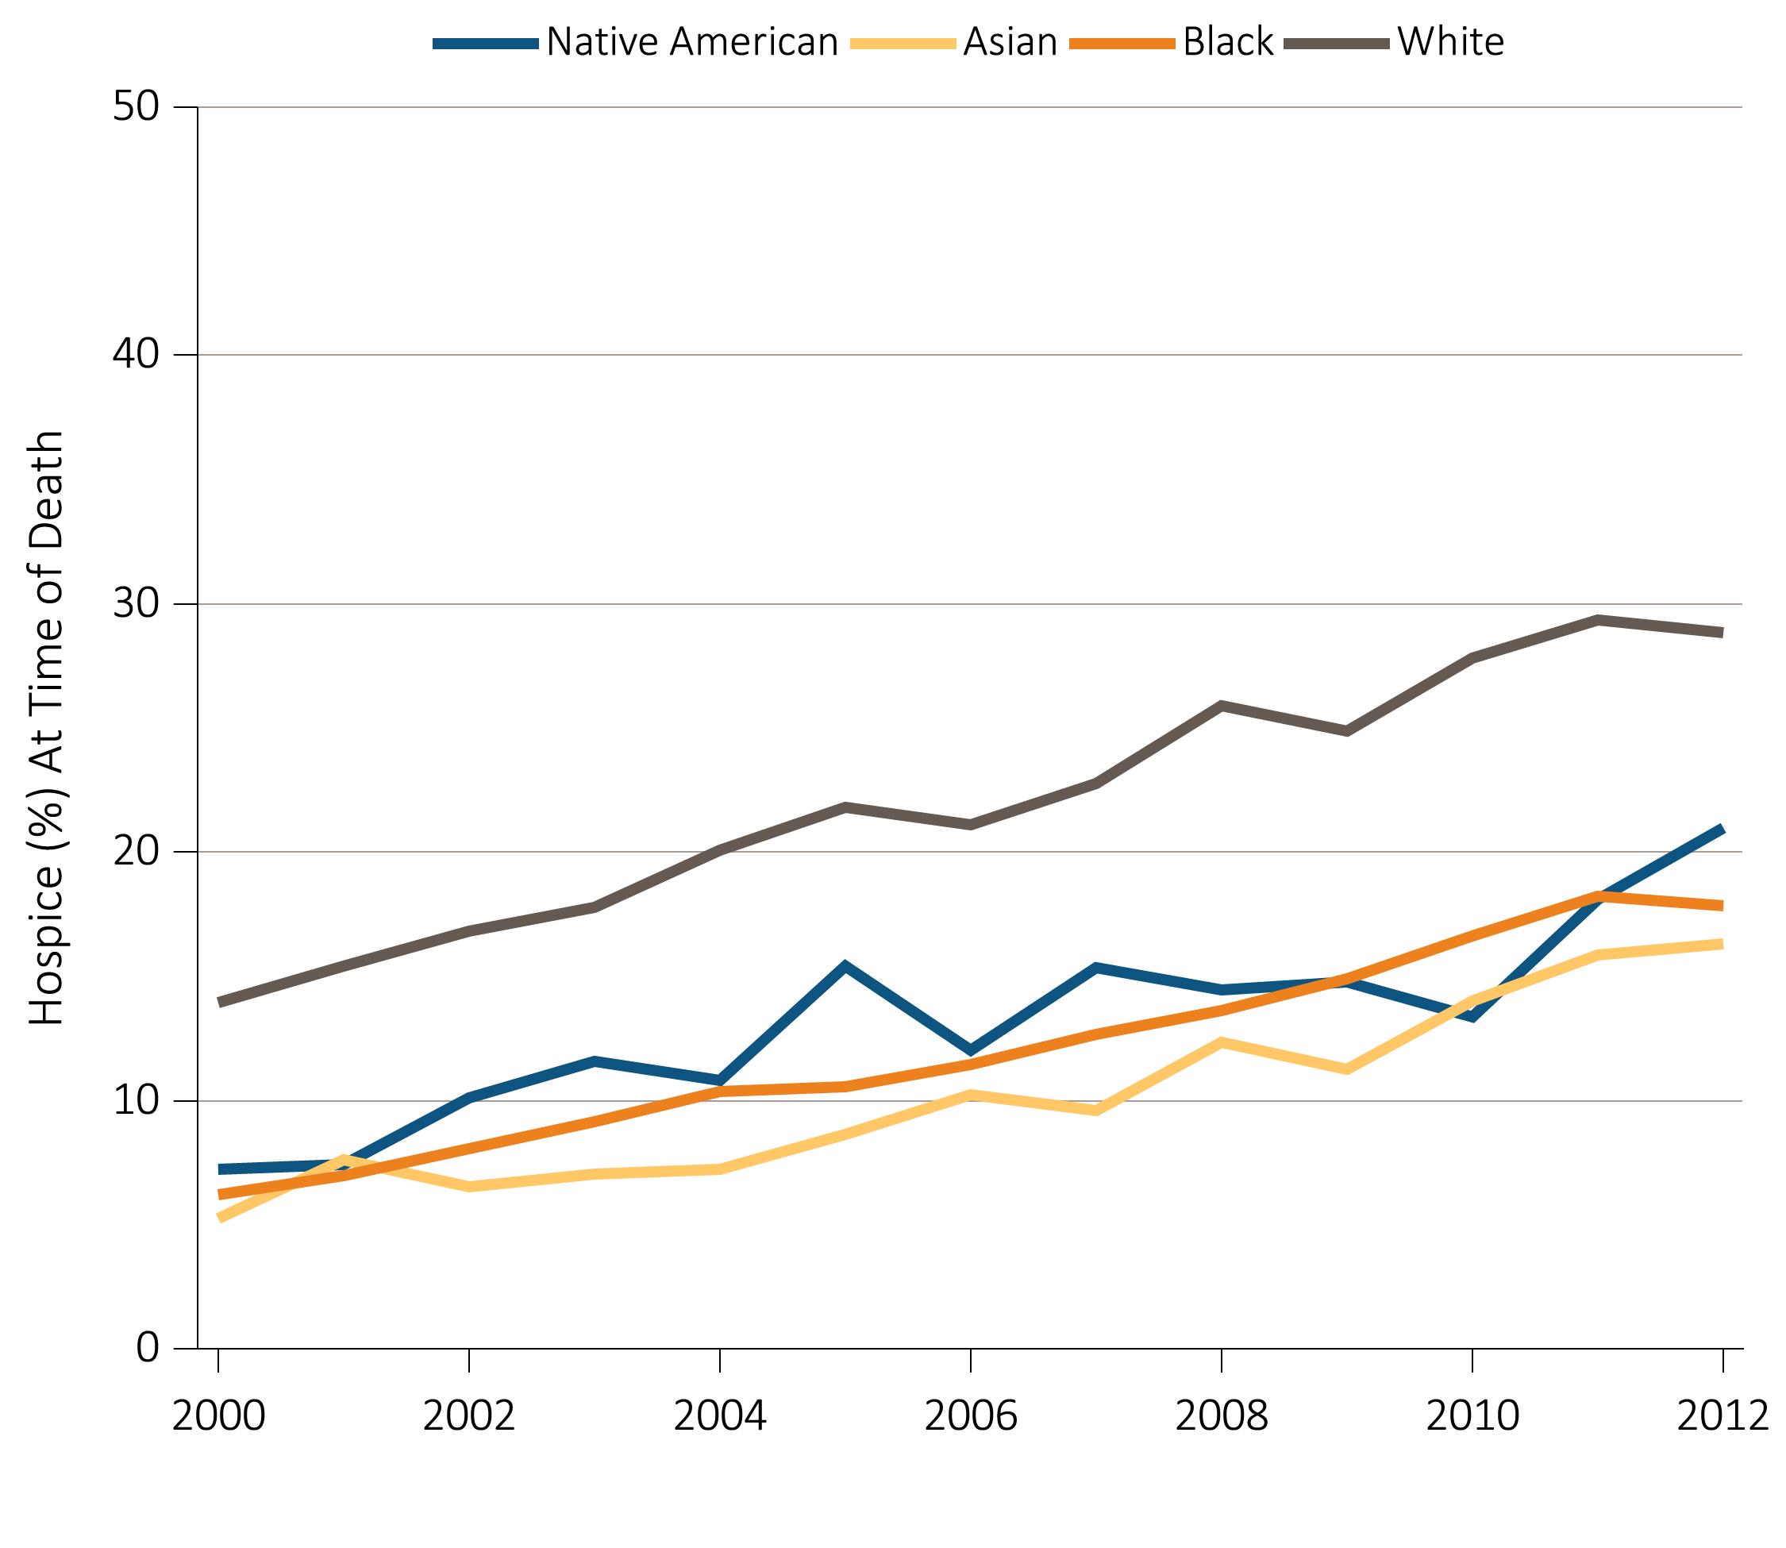
Figure 14.7 Hospice utilization at the time of death among Medicare beneficiaries
with ESRD overall, and by age, race, ethnicity, sex, modality,
and whether dialysis was discontinued, 2000-2012
(c) Hospice utilization by race
Data Source: Special analyses, USRDS ESRD Database. Denominator population is all decedents with Medicare Parts A and B throughout the last 90 days of life. Receipt of hospice care at the time of death was defined as having a claim in the Hospice SAF on or after the date of death or Discharge Status from hospice=40, 41 or 42.

Slide 33
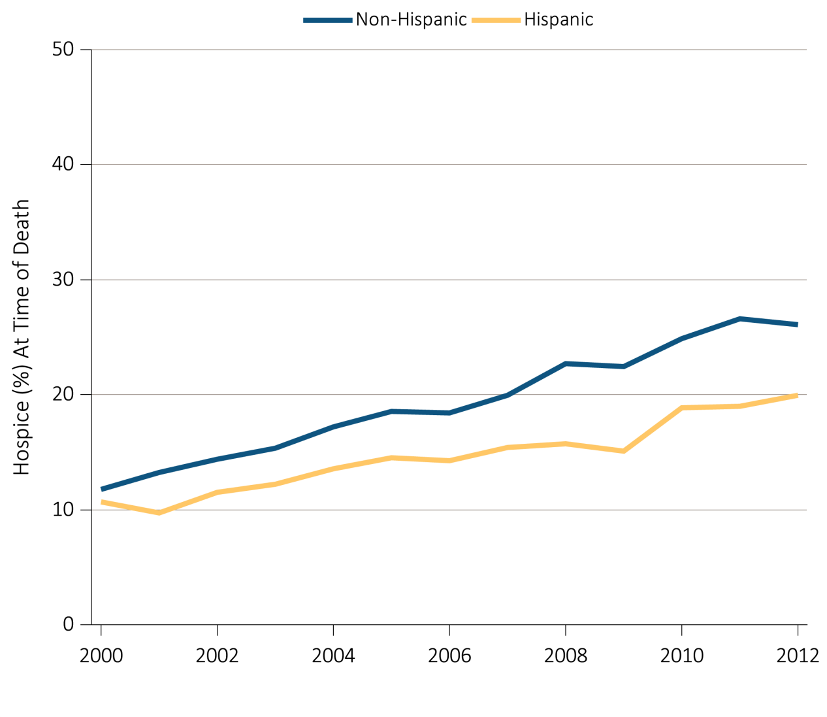
Figure 14.7 Hospice utilization at the time of death among Medicare beneficiaries
with ESRD overall, and by age, race, ethnicity, sex, modality,
and whether dialysis was discontinued, 2000-2012
(d) Hospice utilization by ethnicity
Data Source: Special analyses, USRDS ESRD Database. Denominator population is all decedents with Medicare Parts A and B throughout the last 90 days of life. Receipt of hospice care at the time of death was defined as having a claim in the Hospice SAF on or after the date of death or Discharge Status from hospice=40, 41 or 42.

Slide 34
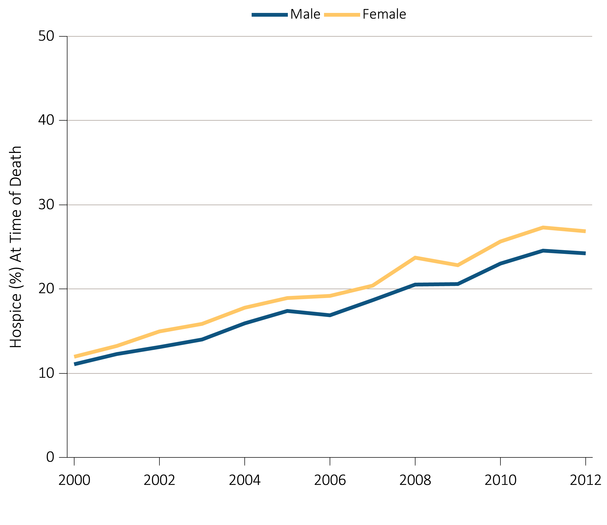
Figure 14.7 Hospice utilization at the time of death among Medicare beneficiaries
with ESRD overall, and by age, race, ethnicity, sex, modality,
and whether dialysis was discontinued, 2000-2012
^{(e) Hospice utilization by sex}
Data Source: Special analyses, USRDS ESRD Database. Denominator population is all decedents with Medicare Parts A and B throughout the last 90 days of life. Receipt of hospice care at the time of death was defined as having a claim in the Hospice SAF on or after the date of death or Discharge Status from hospice=40, 41 or 42.

Slide 35
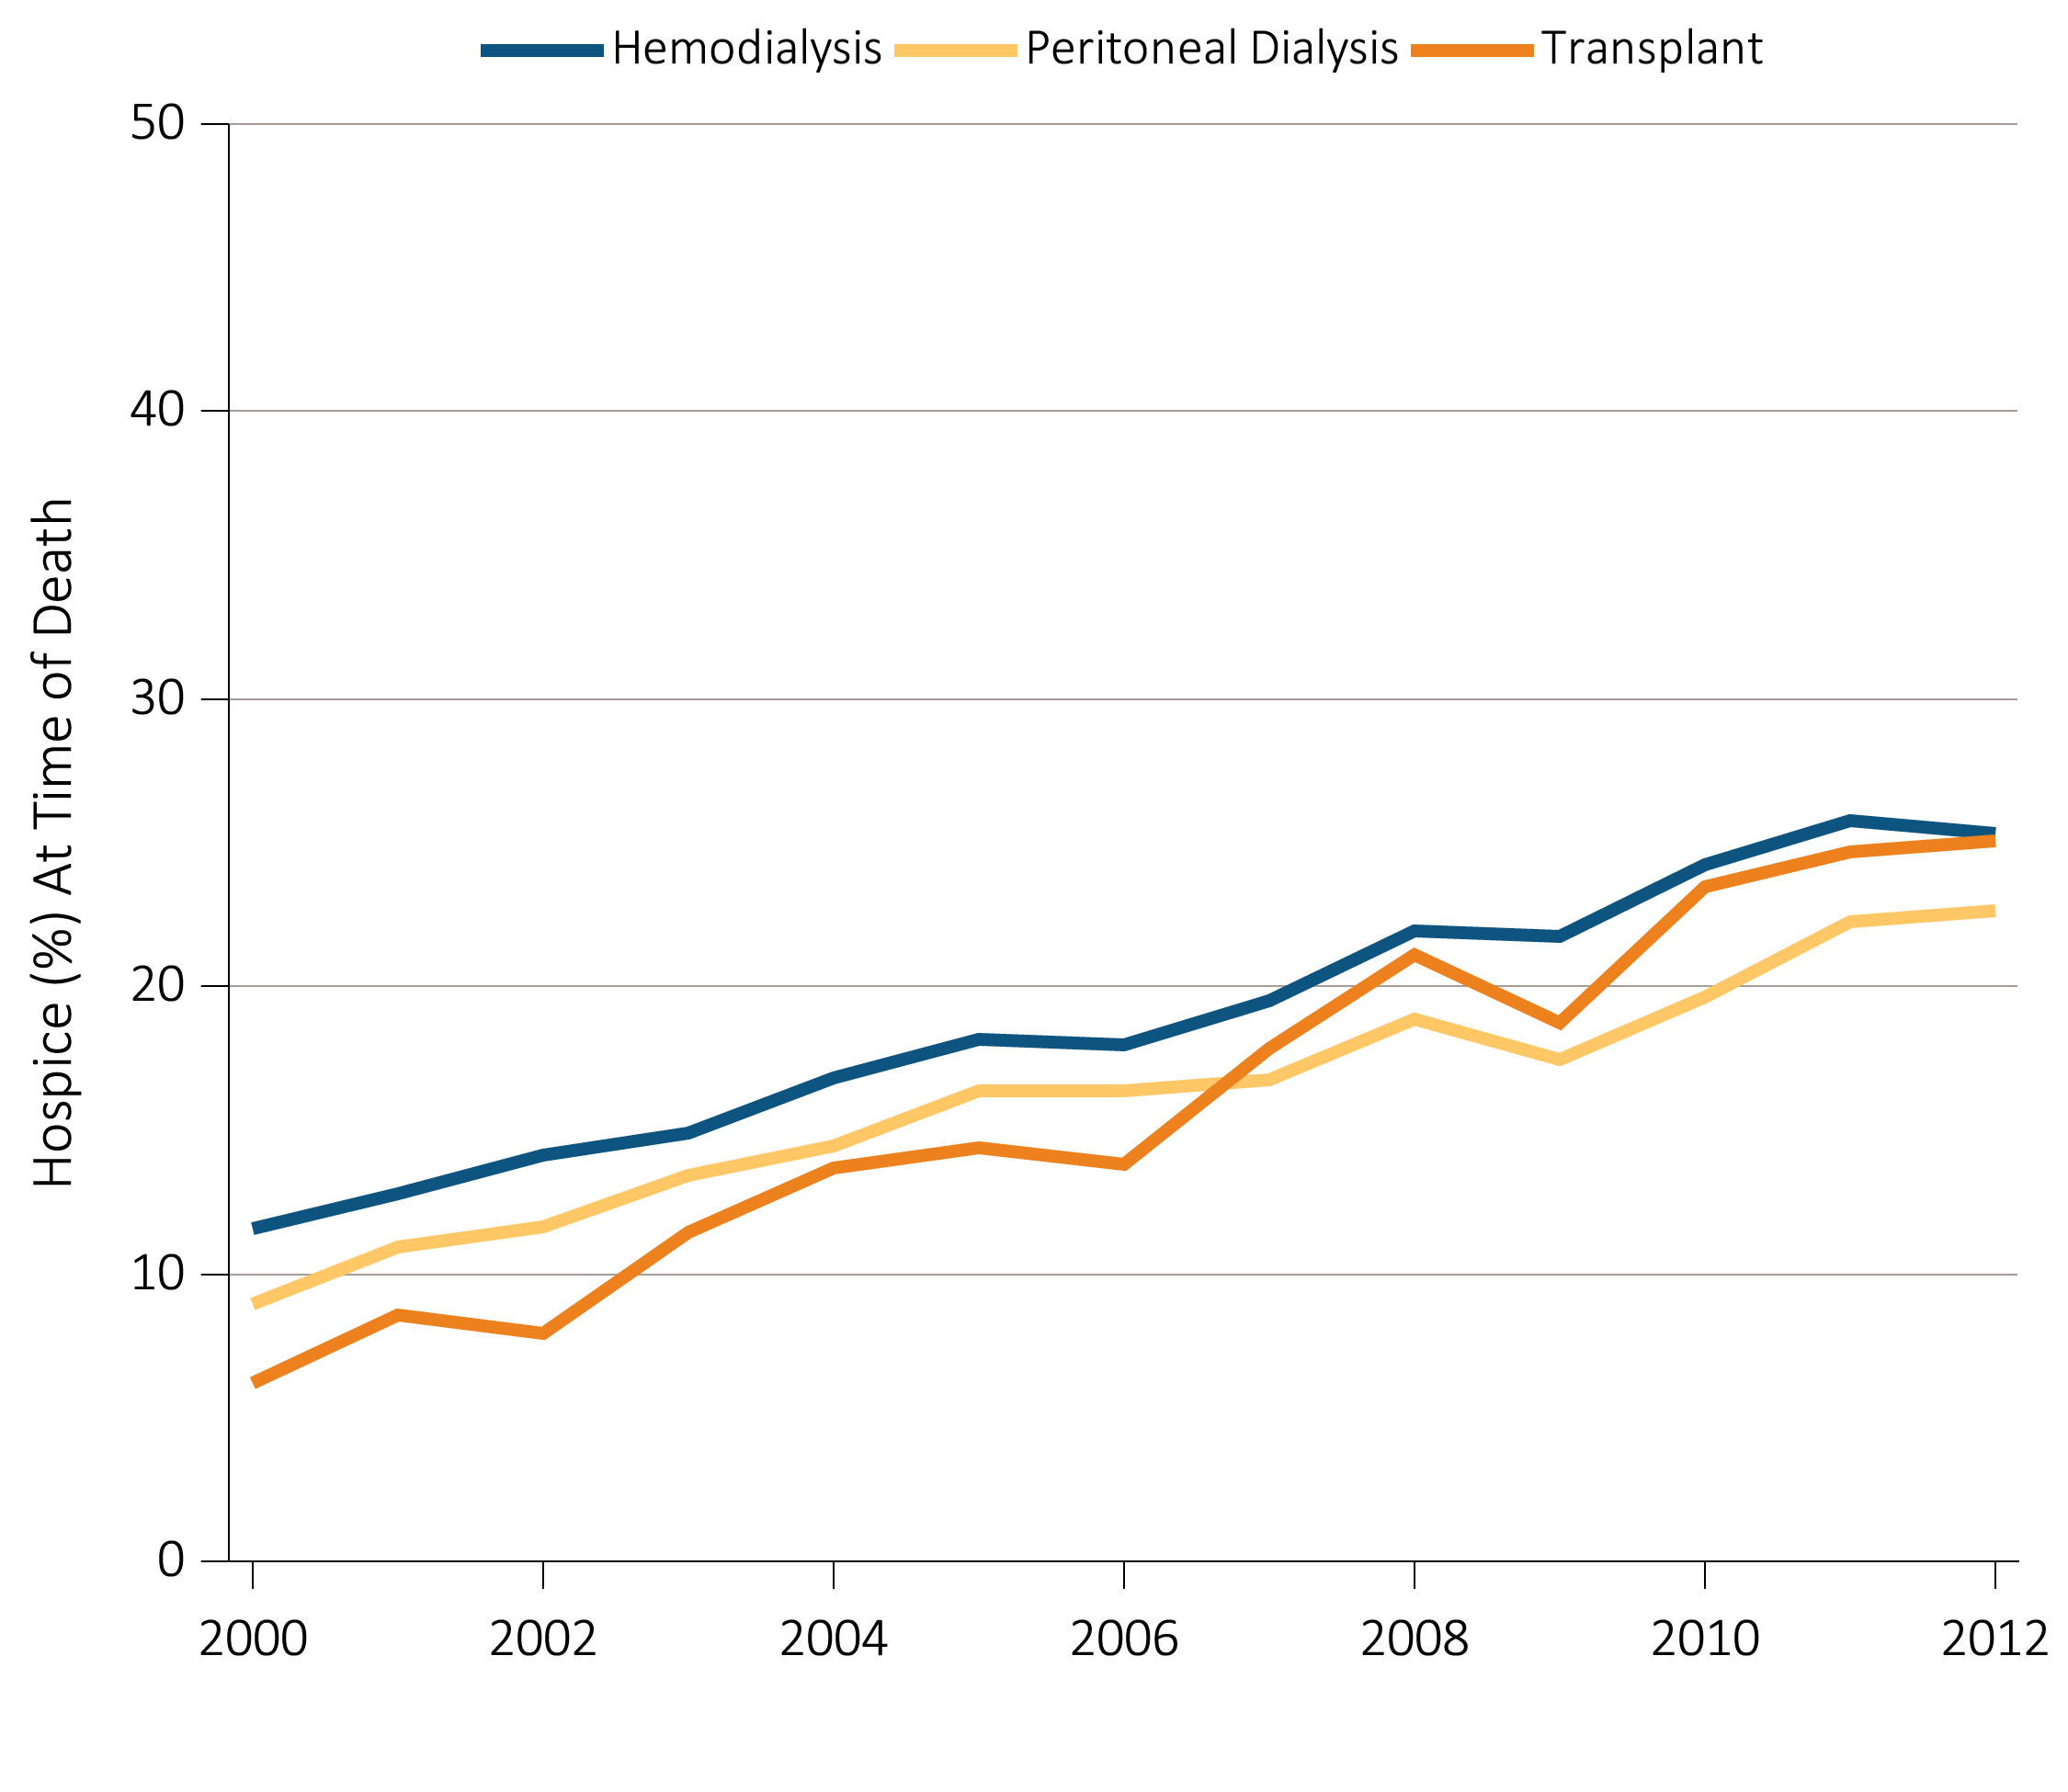
Figure 14.7 Hospice utilization at the time of death among Medicare beneficiaries
with ESRD overall, and by age, race, ethnicity, sex, modality,
and whether dialysis was discontinued, 2000-2012
(f) Hospice utilization by modality
Data Source: Special analyses, USRDS ESRD Database. Denominator population is all decedents with Medicare Parts A and B throughout the last 90 days of life. Receipt of hospice care at the time of death was defined as having a claim in the Hospice SAF on or after the date of death or Discharge Status from hospice=40, 41 or 42.

Slide 36
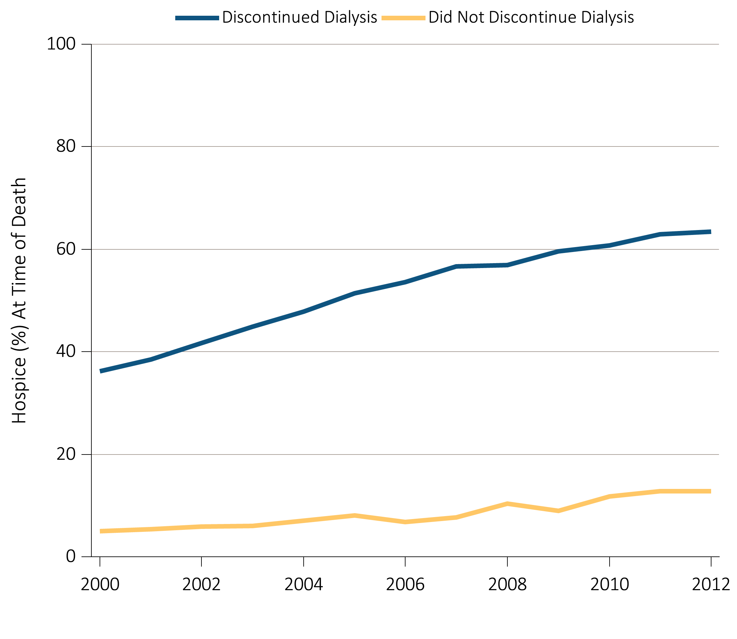
Figure 14.7 Hospice utilization at the time of death among Medicare beneficiaries
with ESRD overall, and by age, race, ethnicity, sex, modality,
and whether dialysis was discontinued, 2000-2012
(g) Hospice utilization by whether patients discontinued dialysis before death
Data Source: Special analyses, USRDS ESRD Database. Denominator population is all decedents with Medicare Parts A and B throughout the last 90 days of life. Receipt of hospice care at the time of death was defined as having a claim in the Hospice SAF on or after the date of death or Discharge Status from hospice=40, 41 or 42.

Slide 37
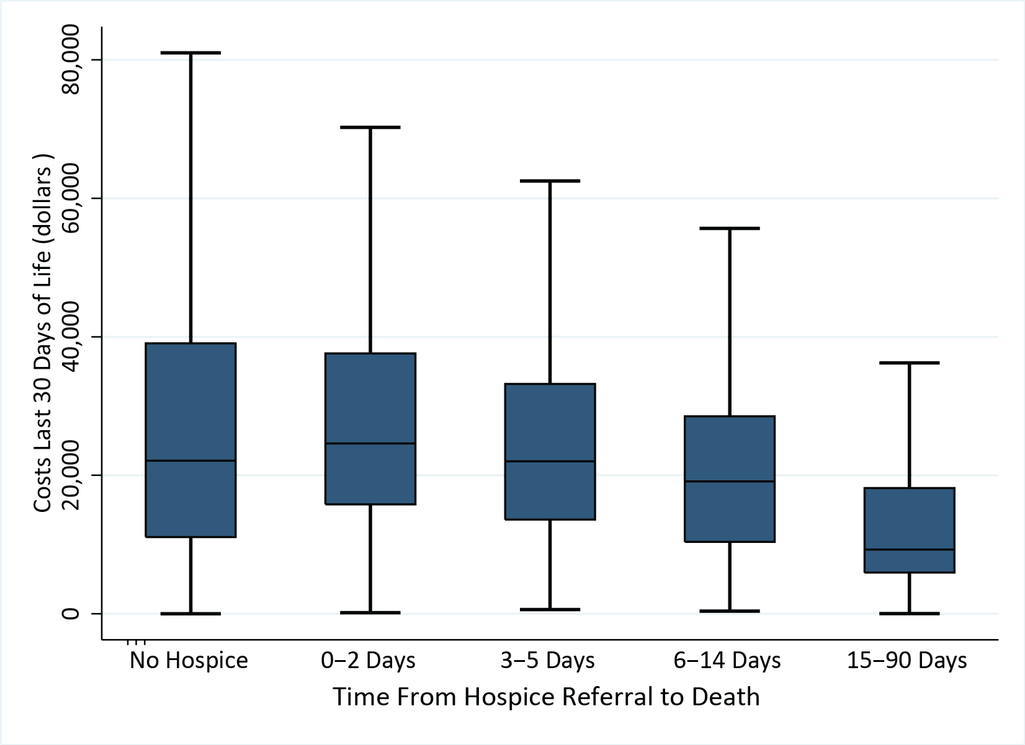
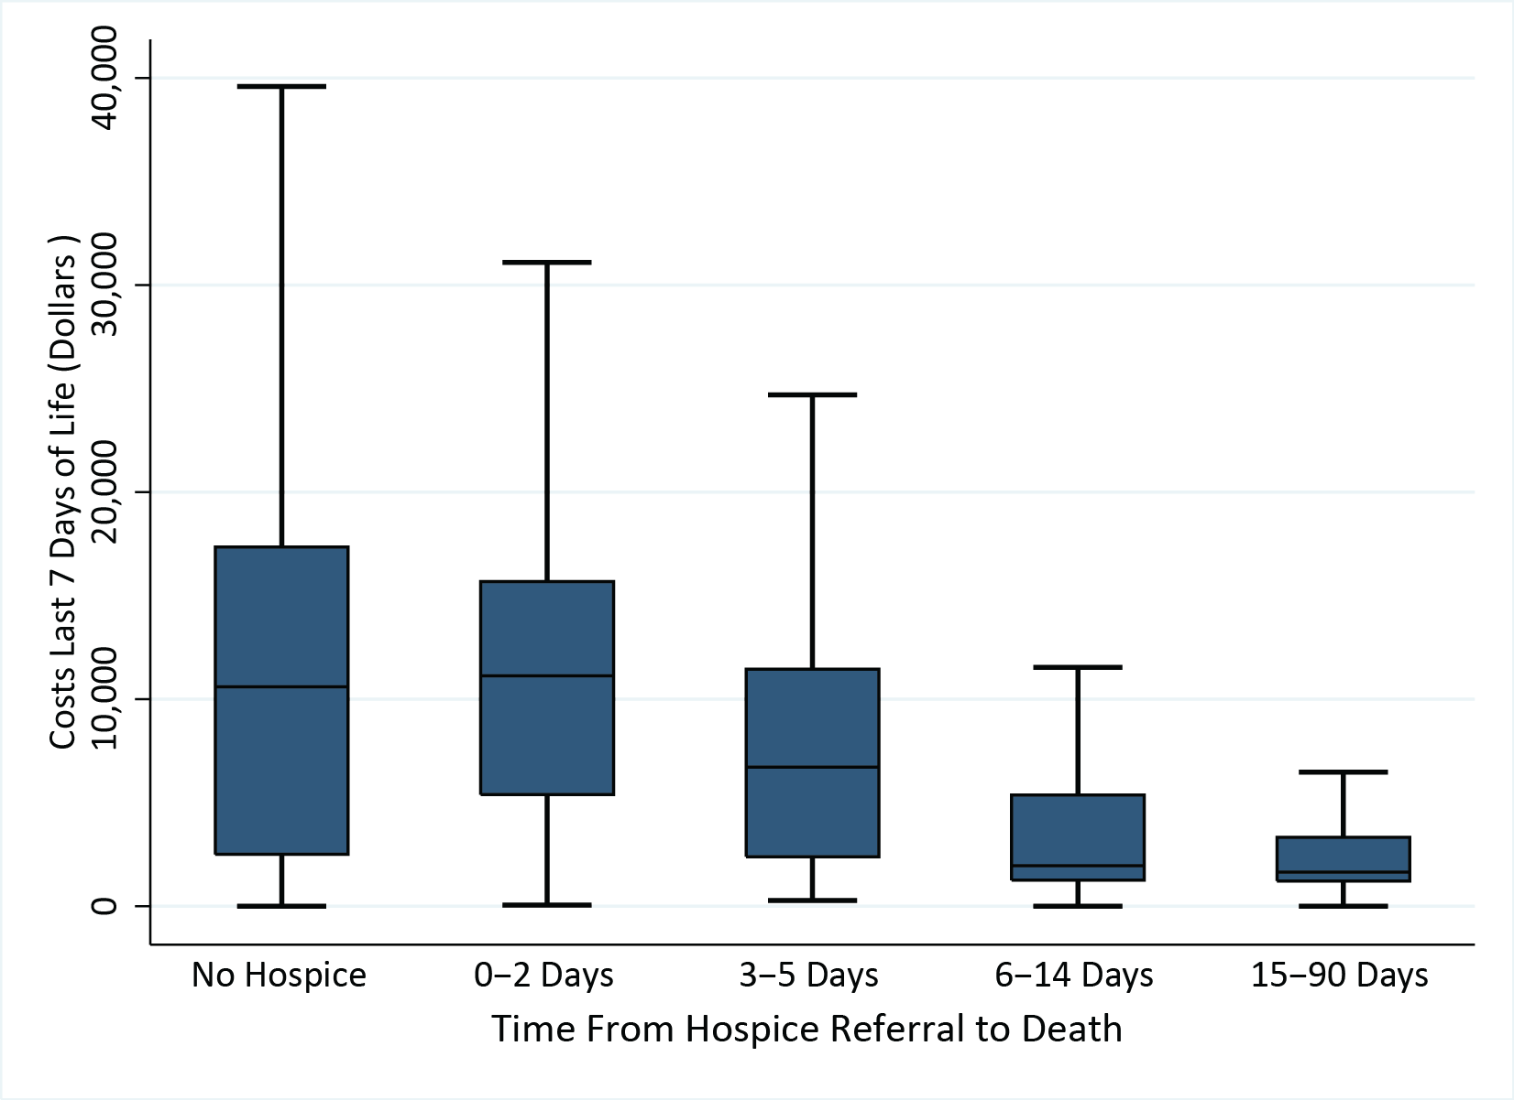
Figure 14.8 Costs in the (a) last 30 days of life, and
(b) last 7 days of life in relation to timing of hospice care, 2012
^{(a) Last 30 days of life}
^{(b) Last 7 days of life}
Data Source: Special analyses, USRDS ESRD Database. Denominator population is all decedents with Medicare Parts A and B throughout the last 90 days of life exclusive of those patients without any costs during the last 30 days of life and those with negative costs. Date of the first claim in the Hospice SAF (HCFASAF=H) within the last 90 days of life is taken as the date of first receipt of hospice services. Timing of hospice referral in relation to death was categorized by quartile (1st quartile 0-2 days, 2nd quartile 3-5 days, 3rd quartile 6-14 days and 4th quartile 15-90 days). Explanation of box plot: the lower border of the box is the first quartile and the upper border is the third quartile of the distribution, the length of the box is the interquartile range, and the line in the middle of the box is the median value. The whiskers extend from the lowest value of the distribution that is ≥ the first quartile minus 1.5 times the interquartile range at the bottom to the highest value of the distribution that is ≤ the third quartile plus 1.5 times the interquartile range at the top. Values outside this range (outliers) are not plotted.

