Slide 2
Table 3.1 Unadjusted and adjusted all-cause mortality rates (per 1,000 patient years at risk) for Medicare patients aged 66 and older, by CKD status, 2014
 | Unadjusted |  | Adjusted
 | No CKD | All CKD | No CKD | All CKD
All | 43.5 | 134.8 | 45.2 | 111.2
Age
66–69 | 15.0 | 62.7 | 14.7 | 60.5
70–74 | 20.8 | 76.4 | 20.6 | 75.5
75–84 | 43.8 | 116.7 | 43.9 | 114.8
85+ | 137.4 | 247.6 | 138.3 | 247.2
Sex
Male | 44.0 | 139.6 | 50.8 | 122.7
Female | 43.2 | 130.4 | 41.1 | 103.6
Race
White | 44.3 | 138.8 | 45.5 | 113.1
Black/African American | 43.5 | 120.3 | 48.8 | 110.6
Other | 32.1 | 102.0 | 36.1 | 82.9
Data source: Medicare 5 percent sample. January 1, 2014 point prevalent patients aged 66 and older. Adj: age/sex/race. Ref: all patients, 2014. Abbreviation: CKD, chronic kidney disease.

Slide 3
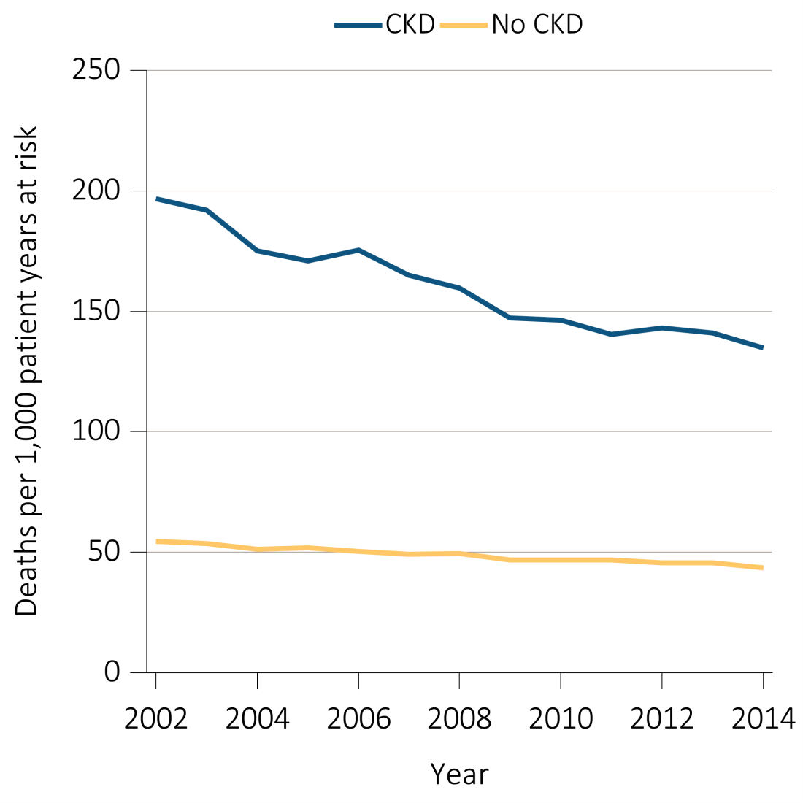
Figure 3.1 Unadjusted and adjusted all-cause mortality rates (per 1,000 patient years at risk) for Medicare patients aged 66 and older, by CKD status and year, 2002-2014
^{(a) Unadjusted}
Data source: Medicare 5 percent sample. January 1 of each reported year, point prevalent Medicare patients aged 66 and older. Adj: age/sex/race. Ref: 2013 patients. Abbreviation: CKD, chronic kidney disease.

Slide 4
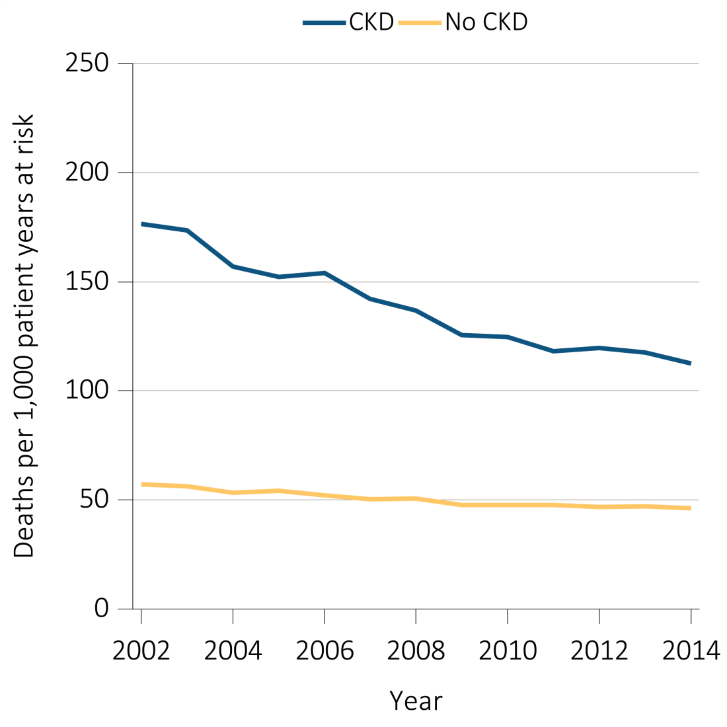
Figure 3.1 Unadjusted and adjusted all-cause mortality rates (per 1,000 patient years at risk) for Medicare patients aged 66 and older, by CKD status and year, 2002-2014
^{(b) Adjusted}
Data source: Medicare 5 percent sample. January 1 of each reported year, point prevalent Medicare patients aged 66 and older. Adj: age/sex/race. Ref: 2013 patients. Abbreviation: CKD, chronic kidney disease.

Slide 5
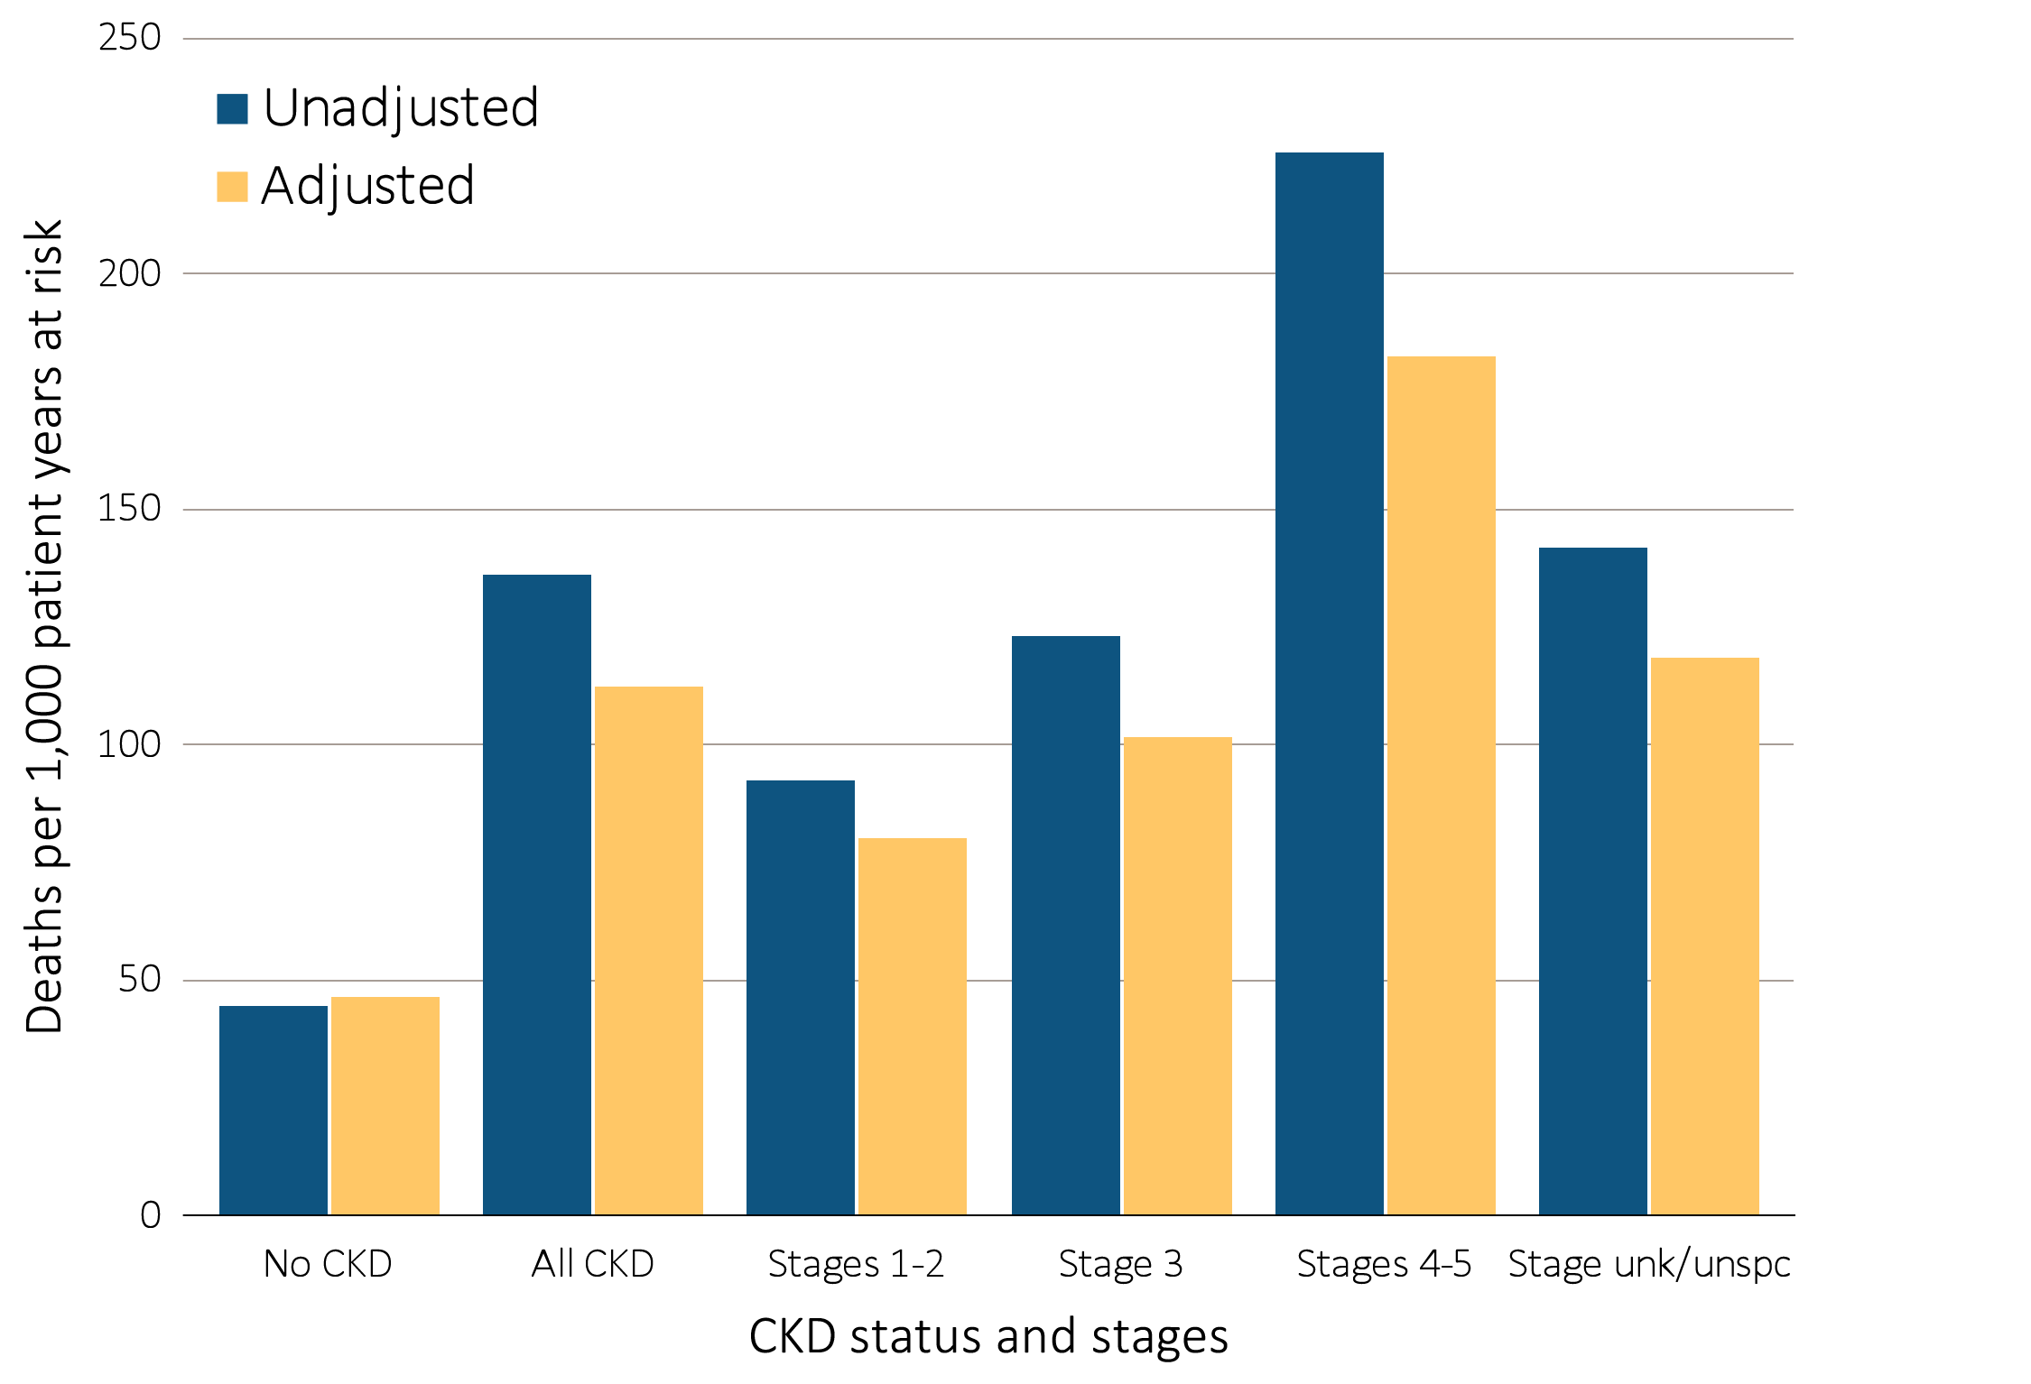
Figure 3.2 Unadjusted and adjusted all-cause mortality rates (per 1,000 patient years at risk) for Medicare patients aged 66 and older, by CKD status and stage, 2014
Data source: Medicare 5 percent sample. January 1, 2014 point prevalent Medicare patients aged 66 and older. Adj: age/sex/race. Ref: all patients, 2014. See Table A for CKD stage definitions. Abbreviations: CKD, chronic kidney disease; unk/unspc, CKD stage unidentified.

Slide 6
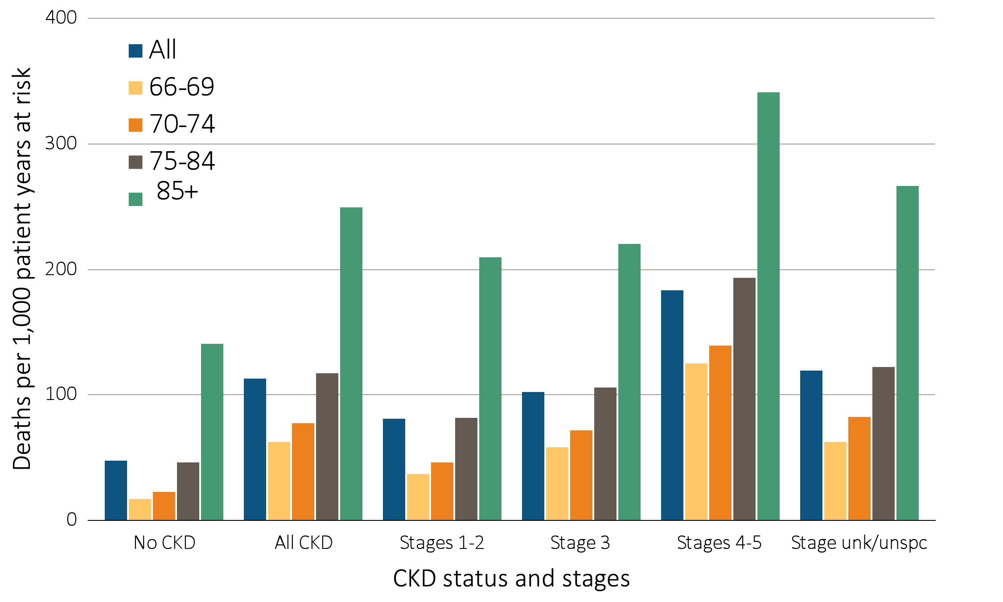
Figure 3.3 Adjusted all-cause mortality rates (per 1,000 patient years at risk) for Medicare patients aged 66 and older, by age, CKD status, and stage, 2014
Data source: Medicare 5 percent sample. January 1, 2014 point prevalent patients aged 66 and older. Adj: age/sex/race. Ref: all patients, 2014. Abbreviations: CKD, chronic kidney disease; unk/unspc, CKD stage unidentified.

Slide 7
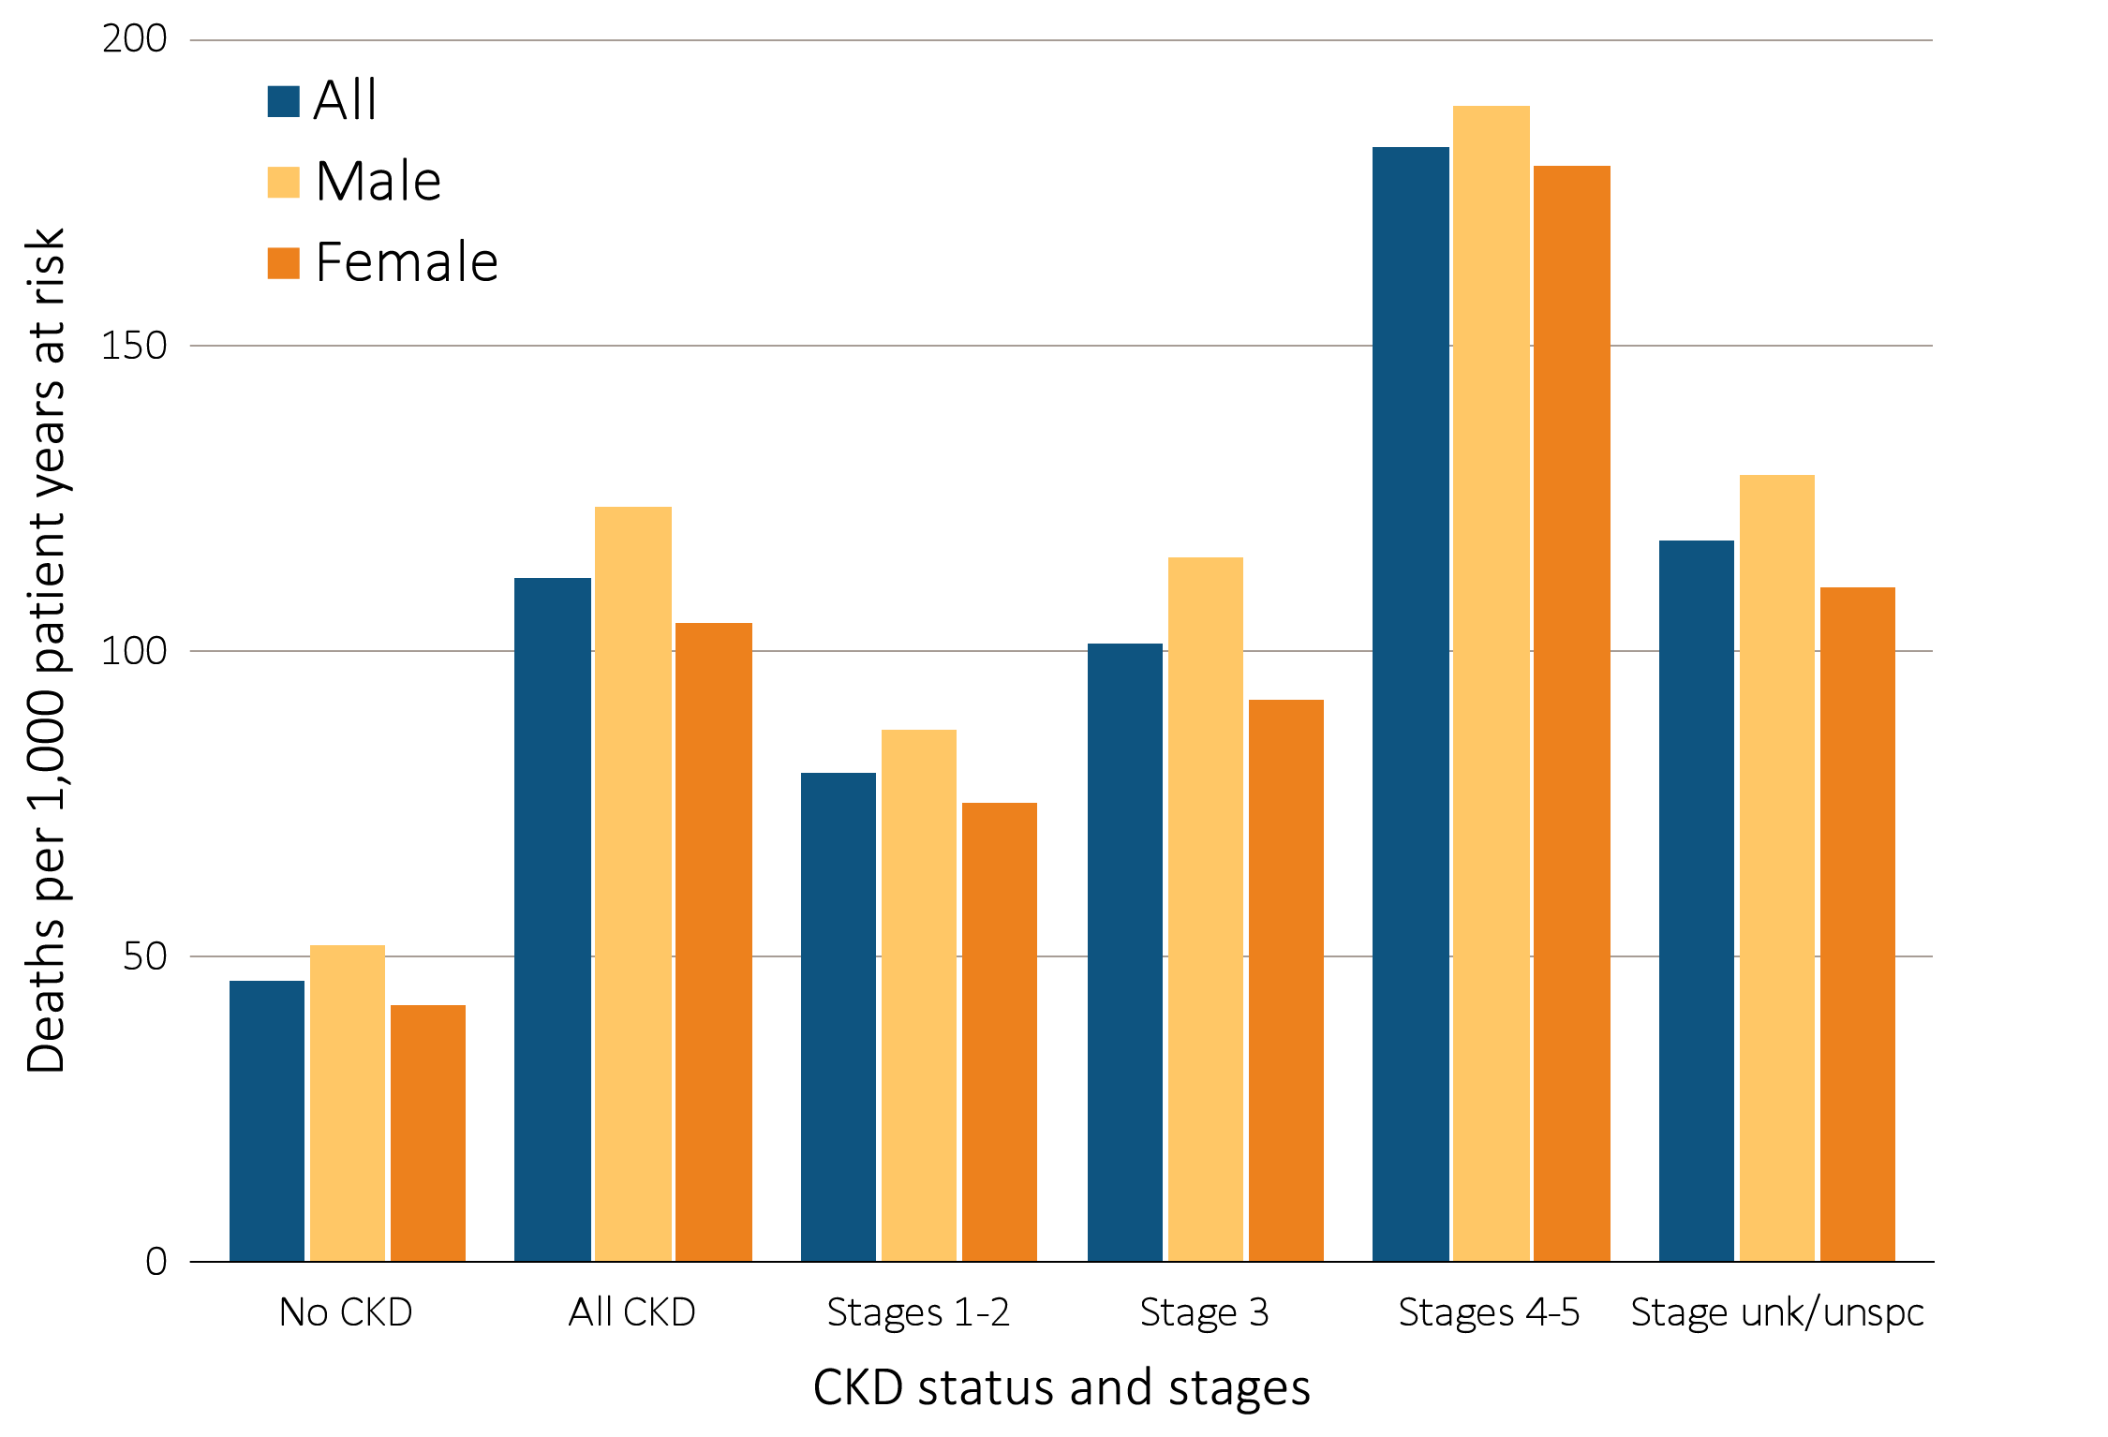
Figure 3.4 Adjusted all-cause mortality rates (per 1,000 patient years at risk) for Medicare patients aged 66 and older, by sex, CKD status, and stage, 2014
Data source: Medicare 5 percent sample. January 1, 2014 point prevalent patients aged 66 and older. Adj: age/sex/race. Ref: all patients, 2014. Abbreviations: CKD, chronic kidney disease; unk/unspc, CKD stage unidentified.

Slide 8
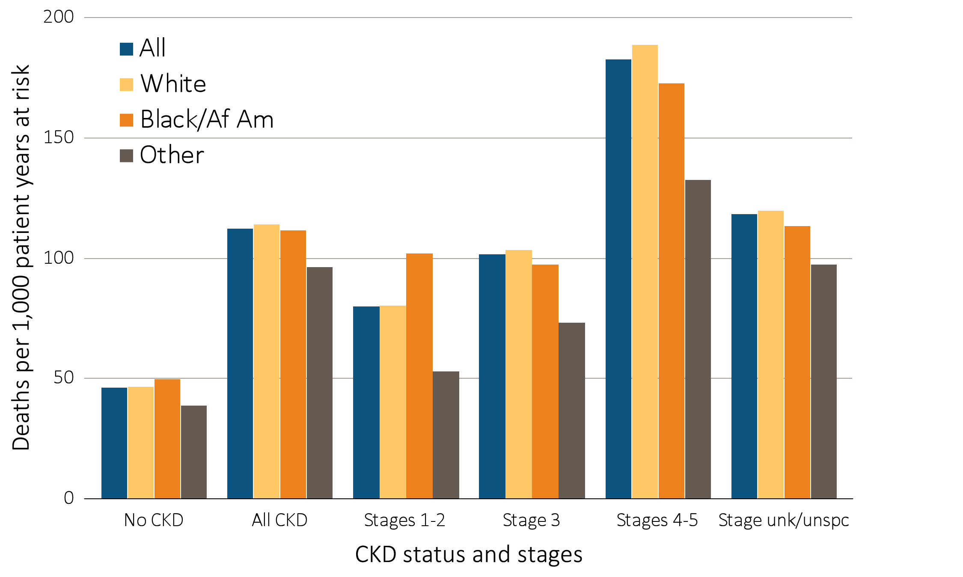
Figure 3.5 Adjusted all-cause mortality rates (per 1,000 patient years at risk) for Medicare patients aged 66 and older, by race, CKD status, and stage, 2014
Data source: Medicare 5 percent sample. January 1, 2014 point prevalent patients aged 66 and older. Adj: age/sex/race. Ref: all patients, 2014. Abbreviations: Af Am, African American; CKD, chronic kidney disease; unk/unspc, CKD stage unidentified.

Slide 9
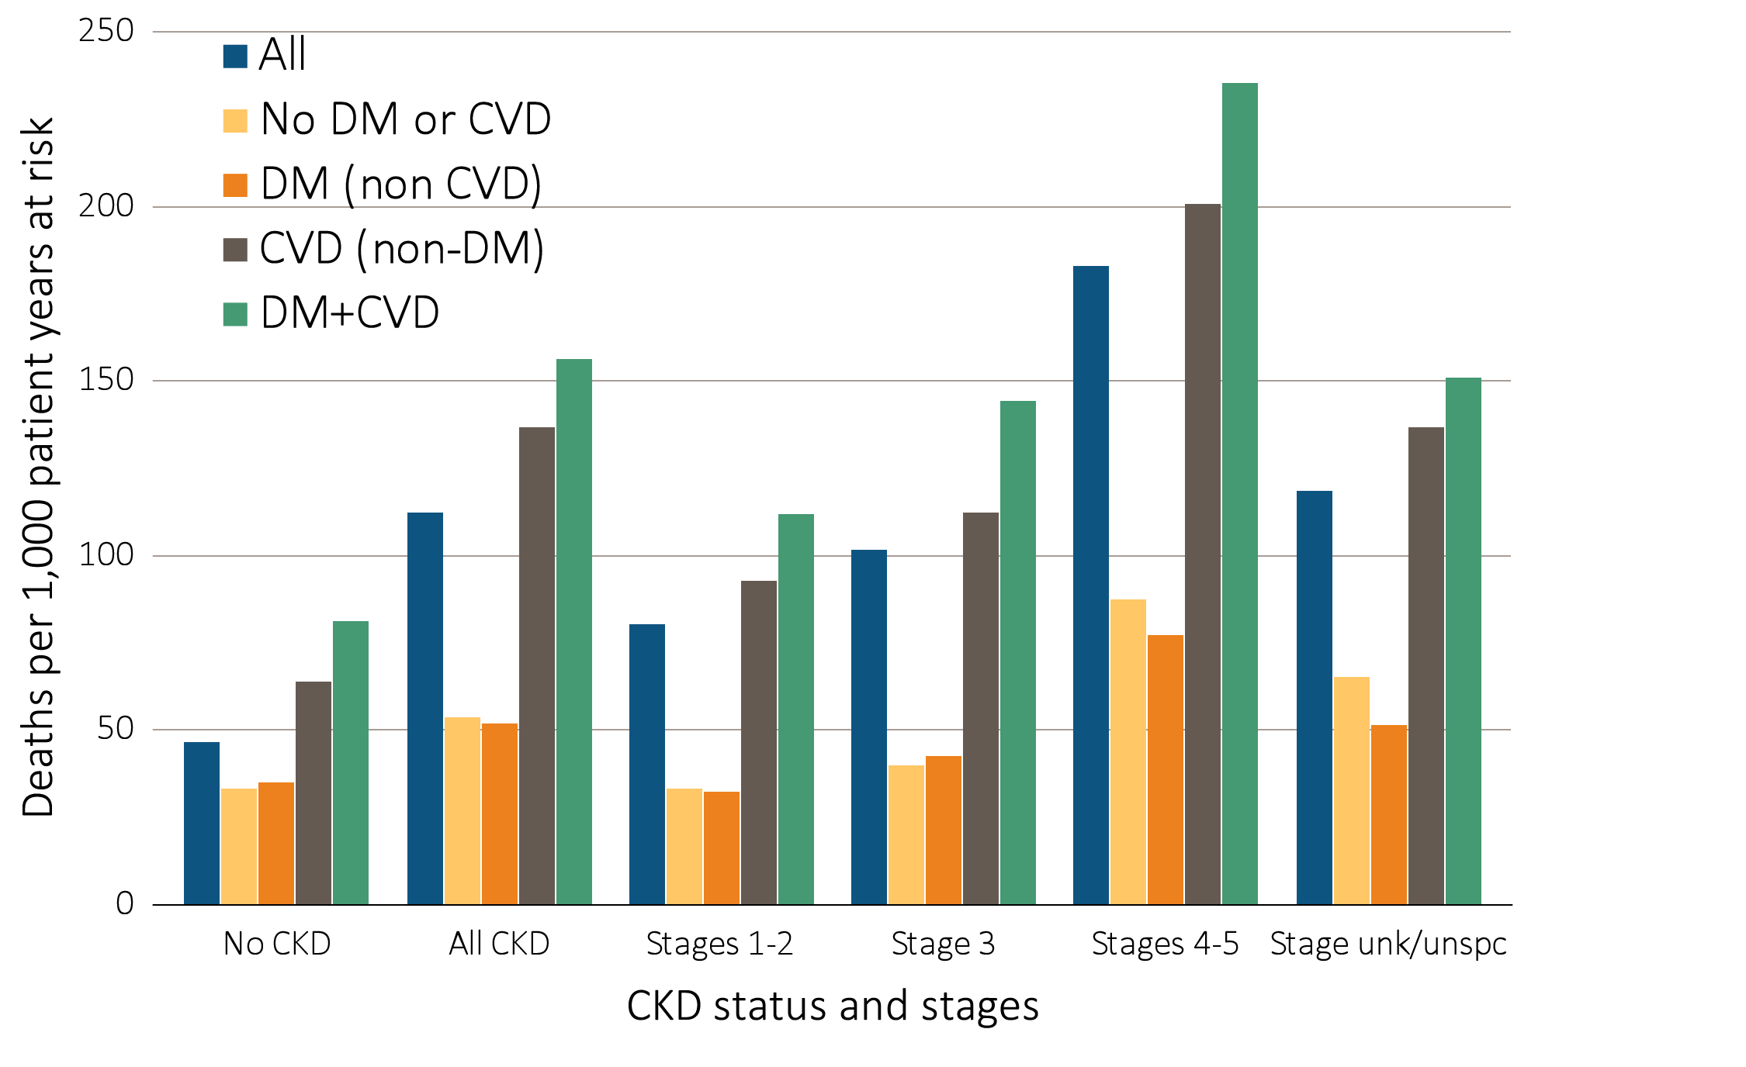
Figure 3.6 Adjusted all-cause mortality rates (per 1,000 patient years at risk) for Medicare patients aged 66 and older, by cardiovascular disease and diabetes mellitus, CKD status, and stage, 2014
Data source: Medicare 5 percent sample. January 1, 2014 point prevalent patients aged 66 and older. Adj: age/sex/race. Ref: all patients, 2014. Abbreviations: CKD, chronic kidney disease; CVD, cardiovascular disease; DM, diabetes mellitus.

Slide 10
Table 3.2 Unadjusted and adjusted all-cause hospitalization rates (per 1,000 patient years at risk) for Medicare patients aged 66 and older, by CKD status, 2014
 | Unadjusted |  | Adjusted
 | No CKD | All CKD | No CKD | All CKD
All | 229.3 | 616.3 | 233.1 | 586.0
Age
66–69 | 141.5 | 514.8 | 142.1 | 511.5
70–74 | 181.1 | 540.3 | 180.8 | 541.4
75–84 | 262.5 | 615.1 | 262.4 | 613.1
85+ | 404.8 | 732.6 | 408.1 | 735.2
Sex
Male | 221.2 | 603.3 | 236.4 | 577.3
Female | 235.2 | 628.1 | 231.4 | 597.3
Race
White | 231.6 | 611.1 | 234.1 | 582.1
Black/African American | 246.3 | 700.0 | 258.3 | 686.8
Other | 174.3 | 541.3 | 186.7 | 512.5
Data source: Medicare 5 percent sample. January 1, 2014 point prevalent Medicare patients, aged 66 and older. Adj: age/sex/race; rates by one factor are adjusted for the others. Ref: all patients, 2014. Abbreviations: CKD, chronic kidney disease.

Slide 11
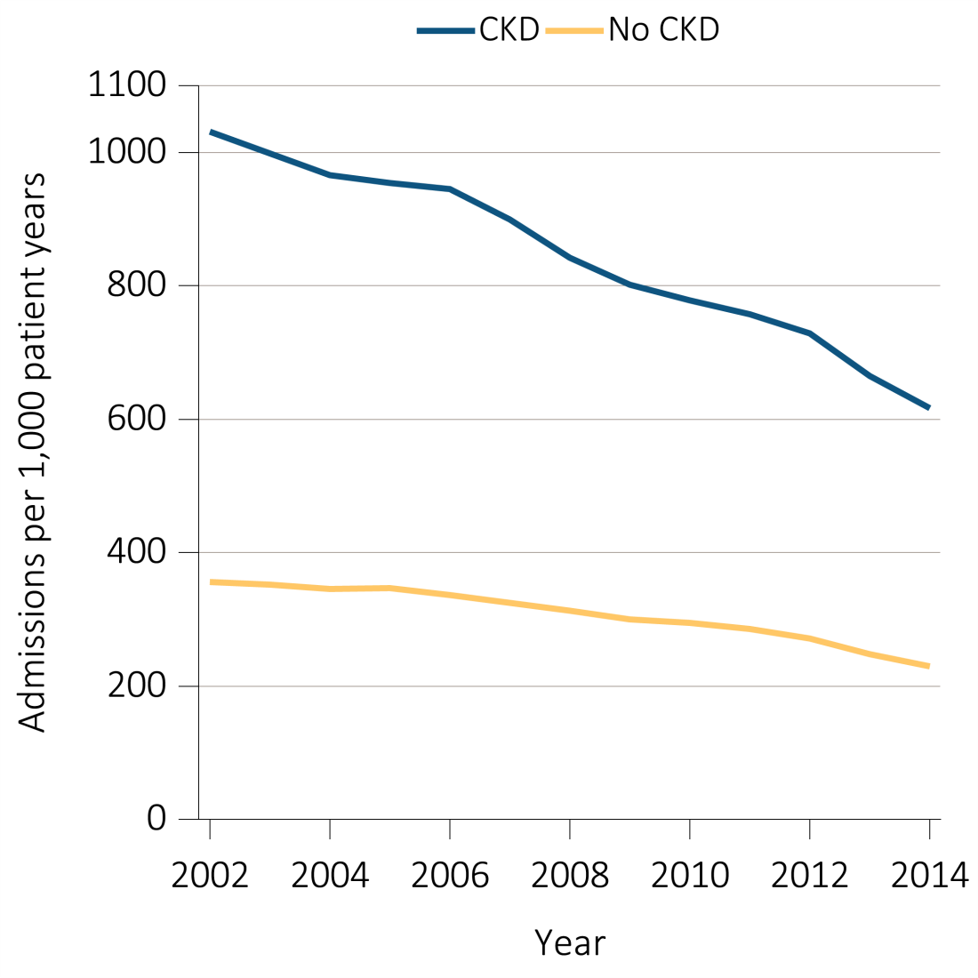
Figure 3.7 Unadjusted and adjusted all-cause hospitalization rates (per 1,000 patient years at risk) for Medicare patients aged 66 and older, by CKD status and year, 2002-2014
^{(a) Unadjusted}
Data source: Medicare 5 percent sample. January 1 of each reported year point prevalent Medicare patients aged 66 and older. Adj: age/sex/race. Ref: 2014 patients. Abbreviations: CKD, chronic kidney disease.

Slide 12
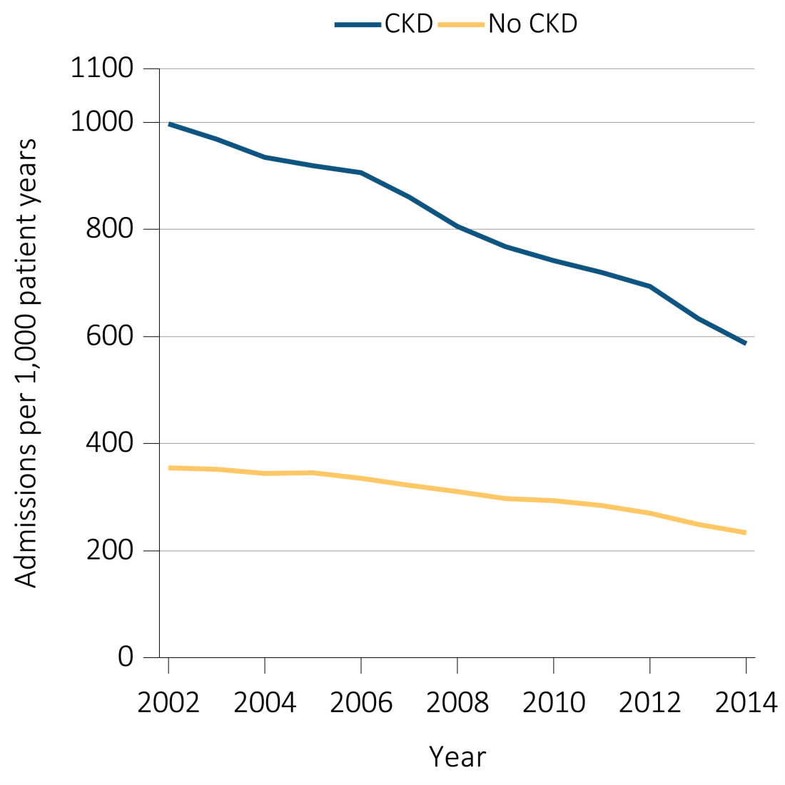
Figure 3.7 Unadjusted and adjusted all-cause hospitalization rates (per 1,000 patient years at risk) for Medicare patients aged 66 and older, by CKD status and year, 2002-2014
^{(b) Adjusted}
Data source: Medicare 5 percent sample. January 1 of each reported year point prevalent Medicare patients aged 66 and older. Adj: age/sex/race. Ref: 2014 patients. Abbreviations: CKD, chronic kidney disease.

Slide 13
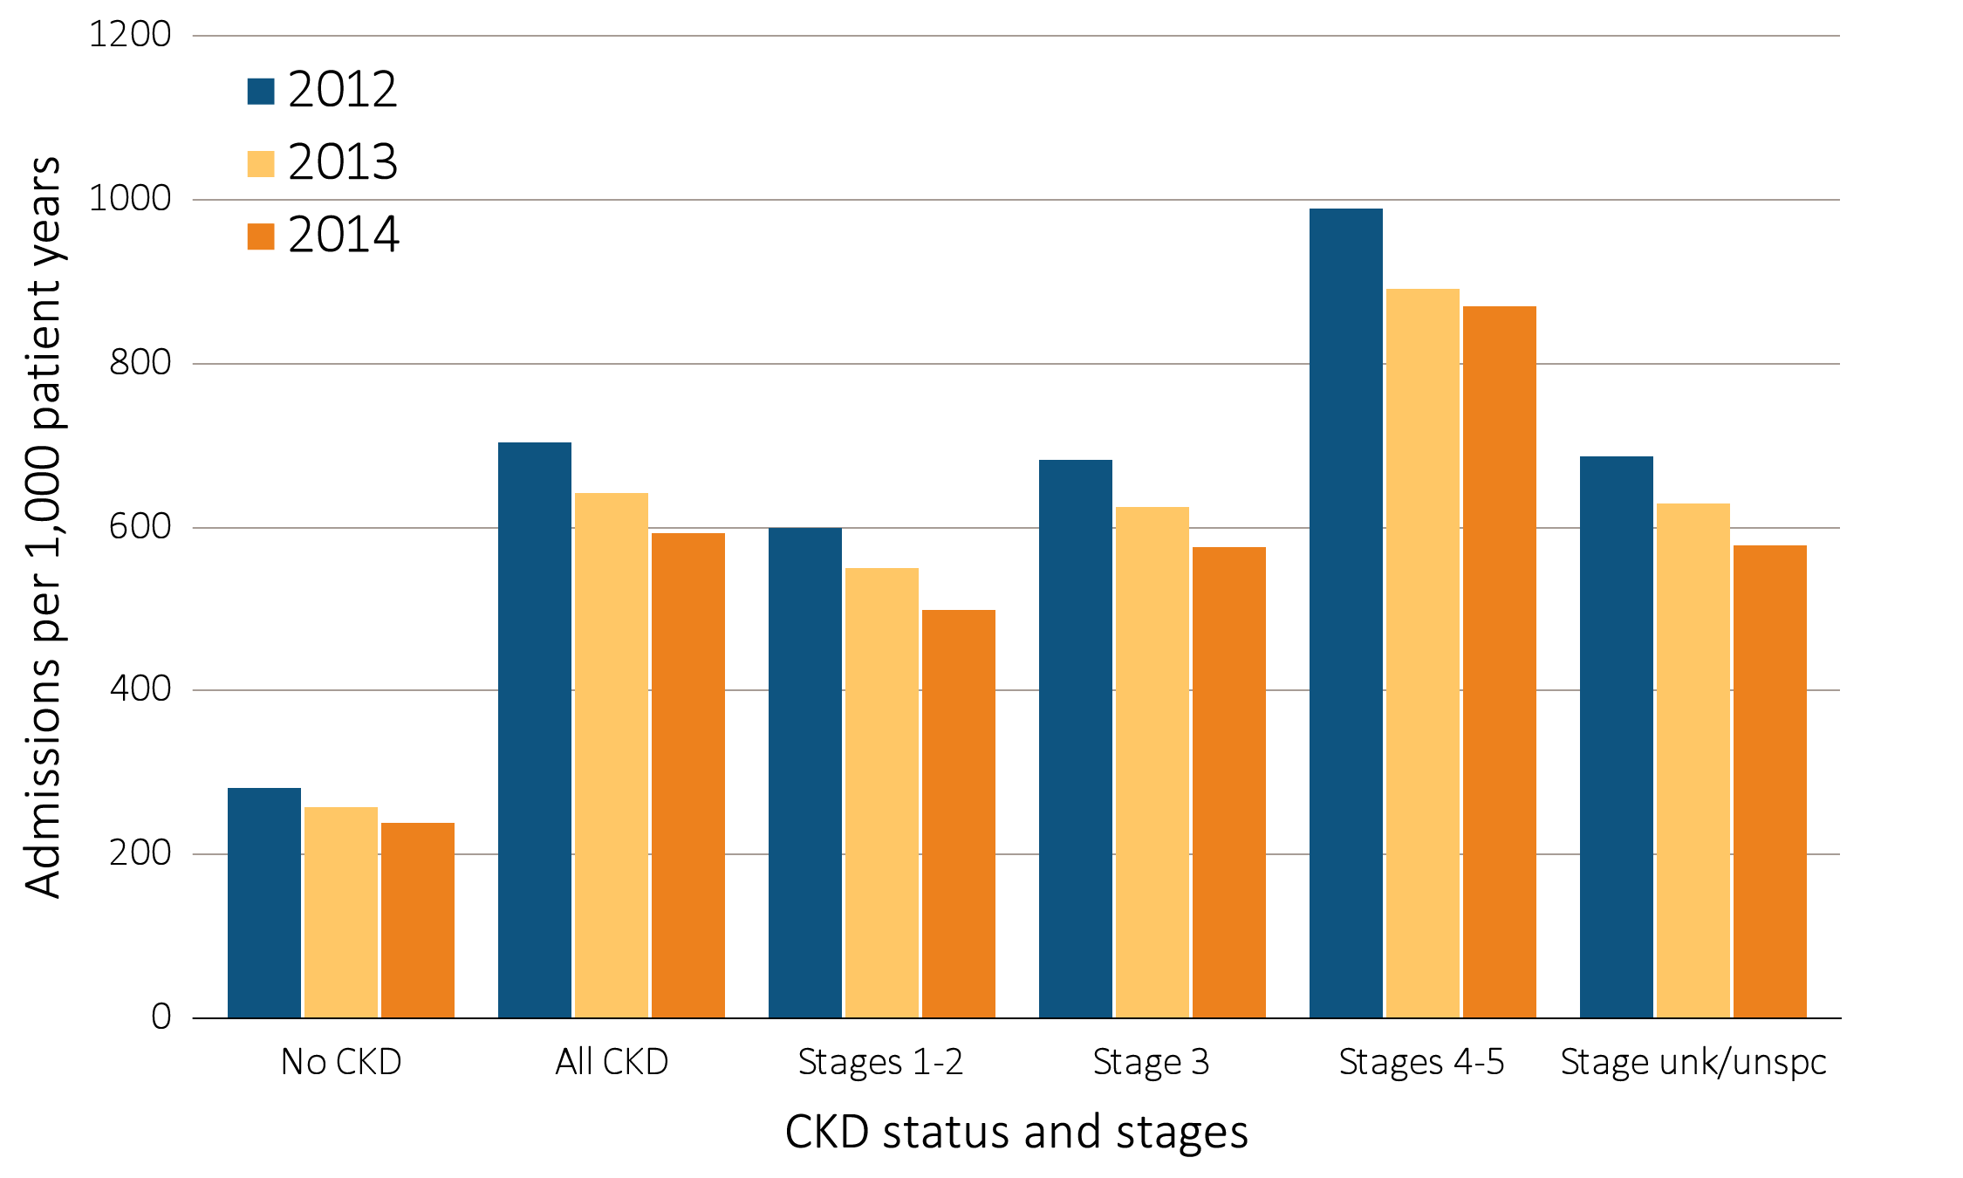
Figure 3.8 Adjusted all-cause hospitalization rates (per 1,000 patient years at risk) for Medicare patients aged 66 and older, by CKD status and stage, 2012-2014
Data source: Medicare 5 percent sample. January 1 of each reported year, point prevalent Medicare patients aged 66 and older. Adj: age/sex/race. Ref: all patients, 2014. See Table A for CKD stage definitions. Abbreviations: CKD, chronic kidney disease; unk/unspc, CKD stage unidentified.

Slide 14
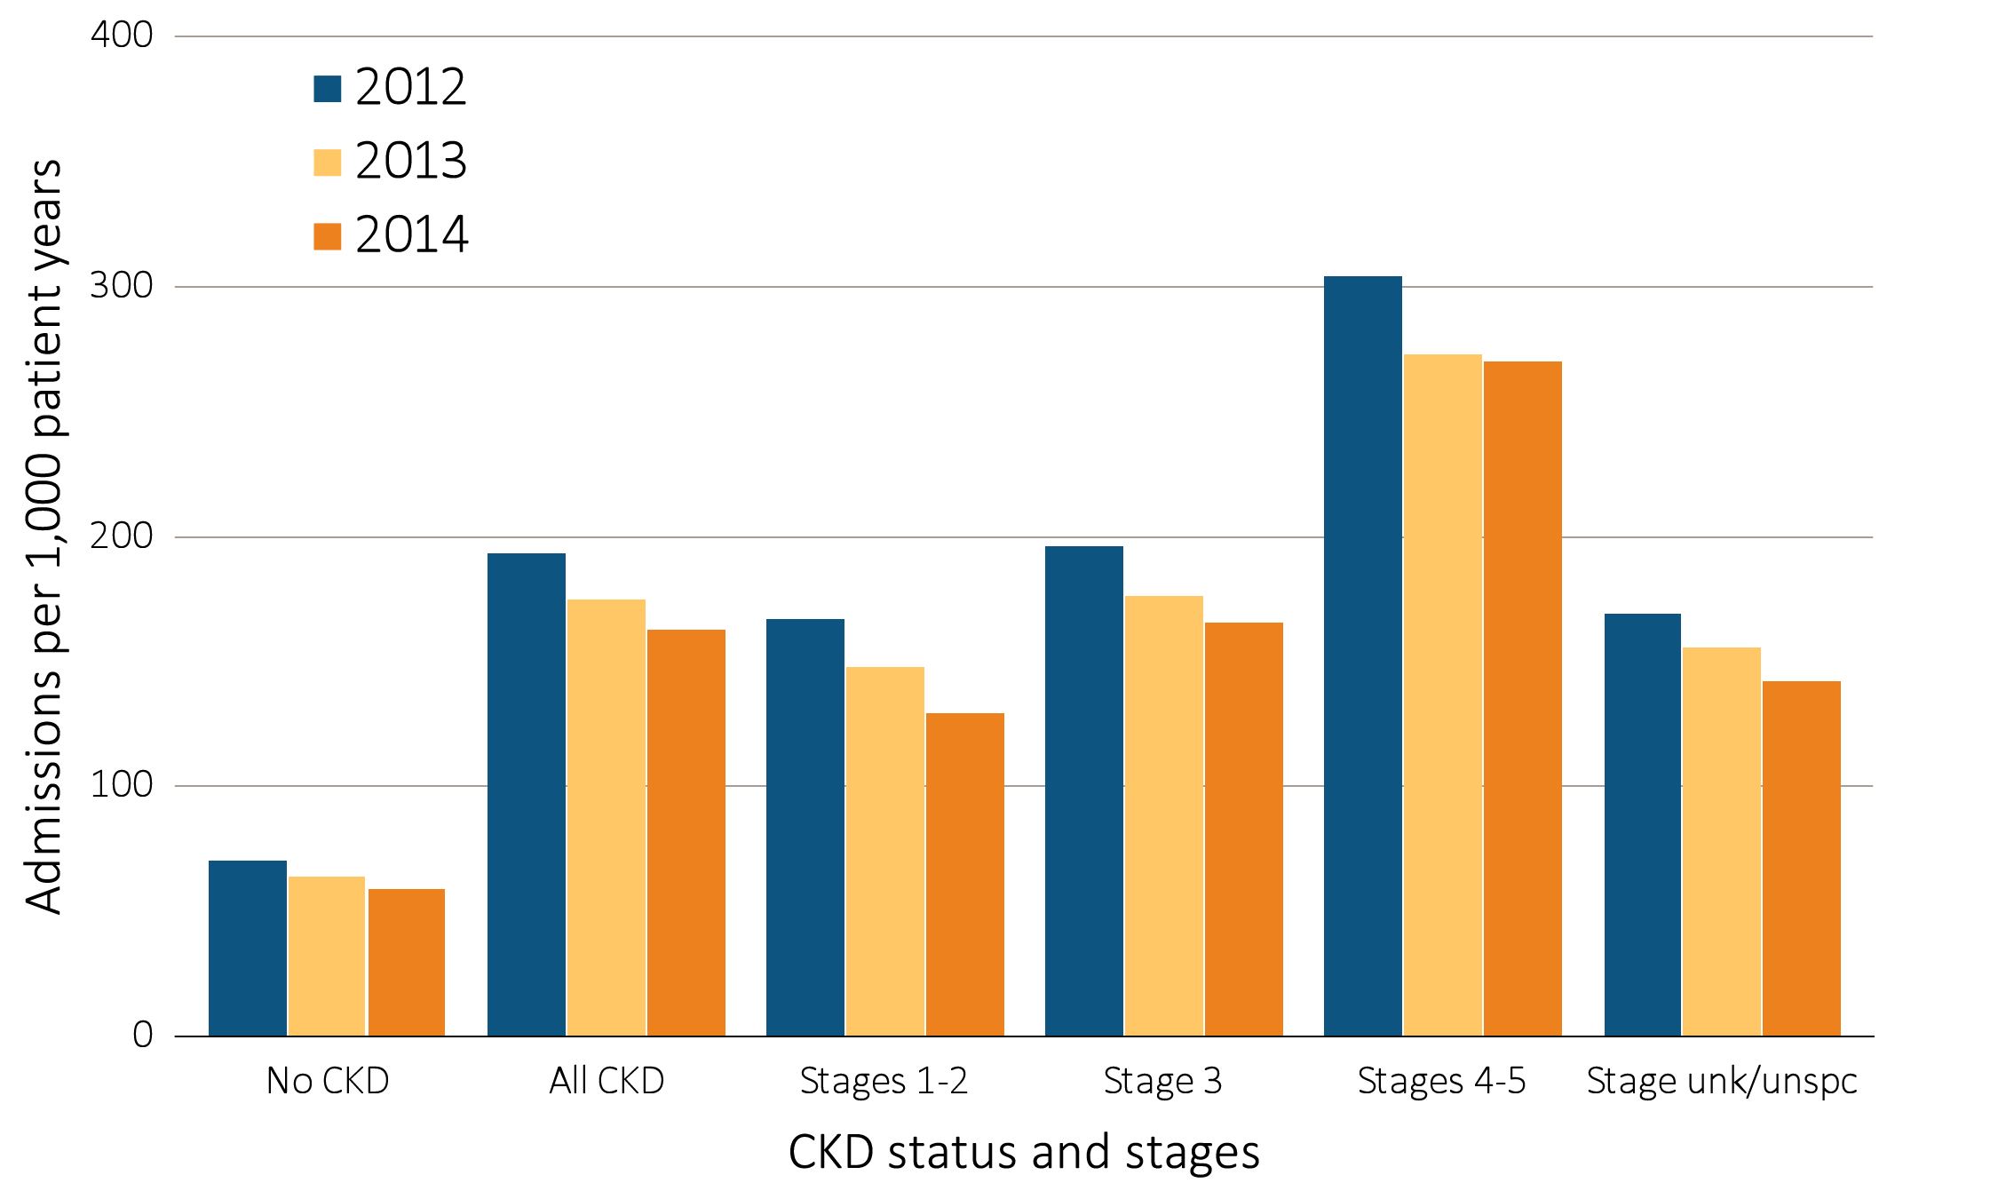
Figure 3.9 Adjusted rates of hospitalization for cardiovascular disease (per 1,000 patient years at risk) for Medicare patients aged 66 and older, by CKD status and stage, 2012-2014
Data source: Medicare 5 percent sample. January 1 of each reported year, point prevalent Medicare patients aged 66 and older. Adj: age/sex/race; rates by one factor are adjusted for the others. Ref: all patients, 2014. See Table A for CKD stage definitions. Abbreviations: CKD, chronic kidney disease; unk/unspc, CKD stage unidentified.

Slide 15
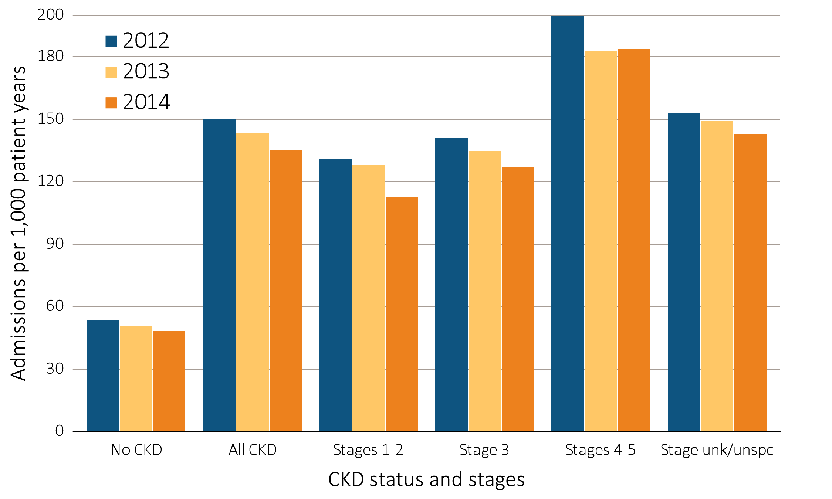
Figure 3.10 Adjusted rates of hospitalization for infection (per 1,000 patient years at risk) for Medicare patients aged 66 and older, by CKD status and stage, 2012-2014
Data source: Medicare 5 percent sample. January 1 of each reported year, point prevalent Medicare patients aged 66 and older. Adj: age/sex/race; rates by one factor are adjusted for the others. Ref: all patients, 2014. See Table A for CKD stage definitions. Abbreviations: CKD, chronic kidney disease; unk/unspc, CKD stage unidentified.

Slide 16
Figure 3.11 Adjusted rates of hospitalization for causes other than cardiovascular disease and infection (per 1,000 patient years at risk) for Medicare patients aged 66 and older, by CKD status and stage, 2012-2014
Data source: Medicare 5 percent sample. January 1 of each reported year, point prevalent Medicare patients aged 66 and older. Adj: age/sex/race; rates by one factor are adjusted for the others. Ref: all patients, 2014. See Table A for CKD stage definitions. Abbreviations: CKD, chronic kidney disease; unk/unspc, CKD stage unidentified.

Slide 17
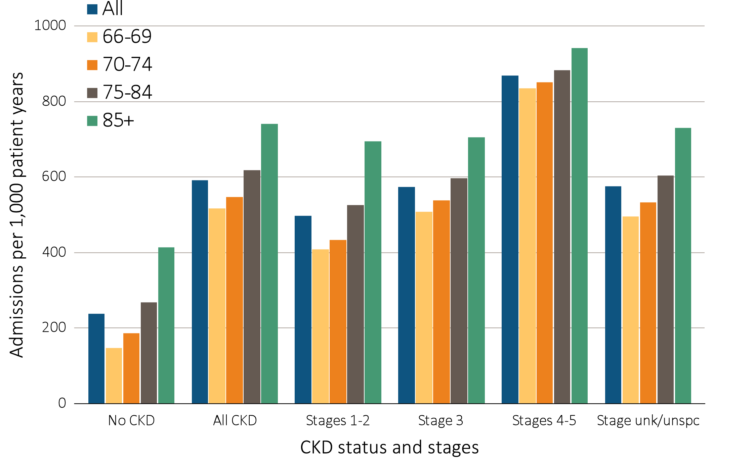
Figure 3.12 Adjusted all-cause hospitalization rates (per 1,000 patient years at risk) for Medicare patients aged 66 and older, by age, CKD status, and stage, 2014
Data source: Medicare 5 percent sample. January 1, 2014 point prevalent Medicare patients aged 66 and older. Adj: age/sex/race; rates by one factor are adjusted for the others. Ref: all patients, 2014. See Table A for CKD stage definitions. Abbreviations: CKD, chronic kidney disease; unk/unspc, CKD stage unidentified.

Slide 18
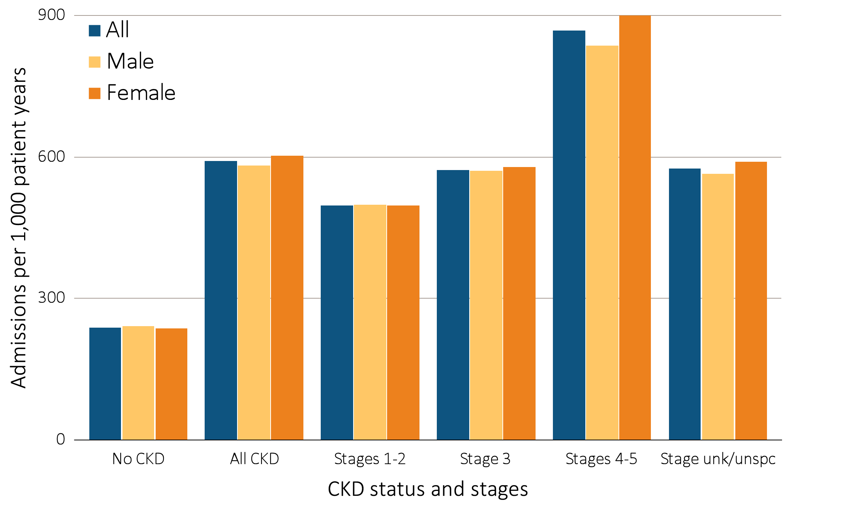
Figure 3.13 Adjusted all-cause hospitalization rates (per 1,000 patient years at risk) for Medicare patients aged 66 and older, by sex, CKD status, and stage, 2014
Data source: Medicare 5 percent sample. January 1, 2014 point prevalent Medicare patients aged 66 and older. Adj: age/sex/race; rates by one factor are adjusted for the others. Ref: all patients, 2014. See Table A for CKD stage definitions. Abbreviations: CKD, chronic kidney disease; unk/unspc, CKD stage unidentified.

Slide 19
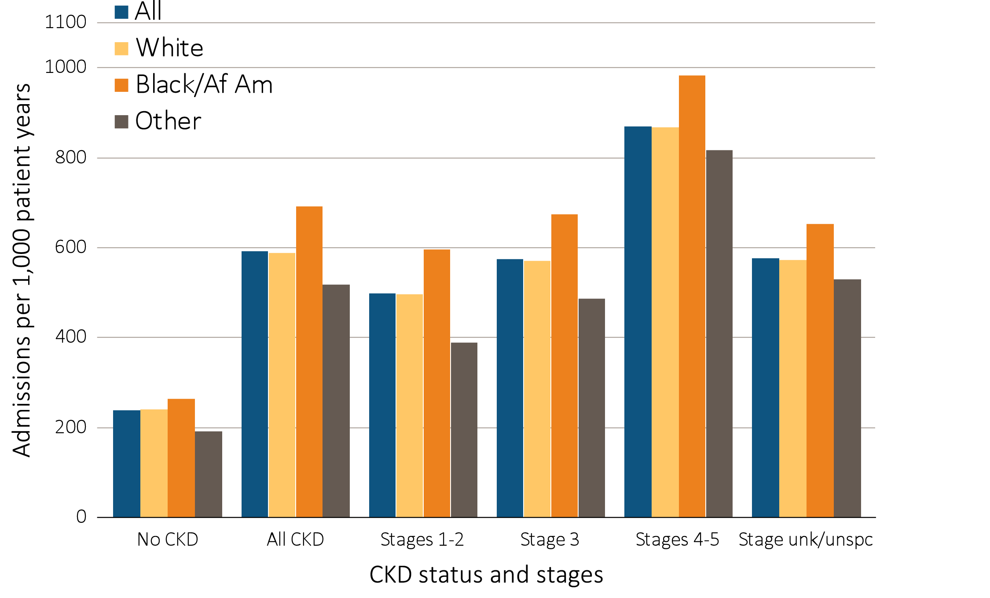
Figure 3.14 Adjusted all-cause hospitalization rates (per 1,000 patient years at risk) for Medicare patients aged 66 and older, by race, CKD status, and stage, 2014
Data source: Medicare 5 percent sample. January 1, 2014 point prevalent Medicare patients aged 66 and older. Adj: age/sex/race; rates by one factor are adjusted for the others. Ref: all patients, 2014. See Table A for CKD stage definitions. Abbreviations: Af Am, African American; CKD, chronic kidney disease; unk/unspc, CKD stage unidentified.

Slide 20
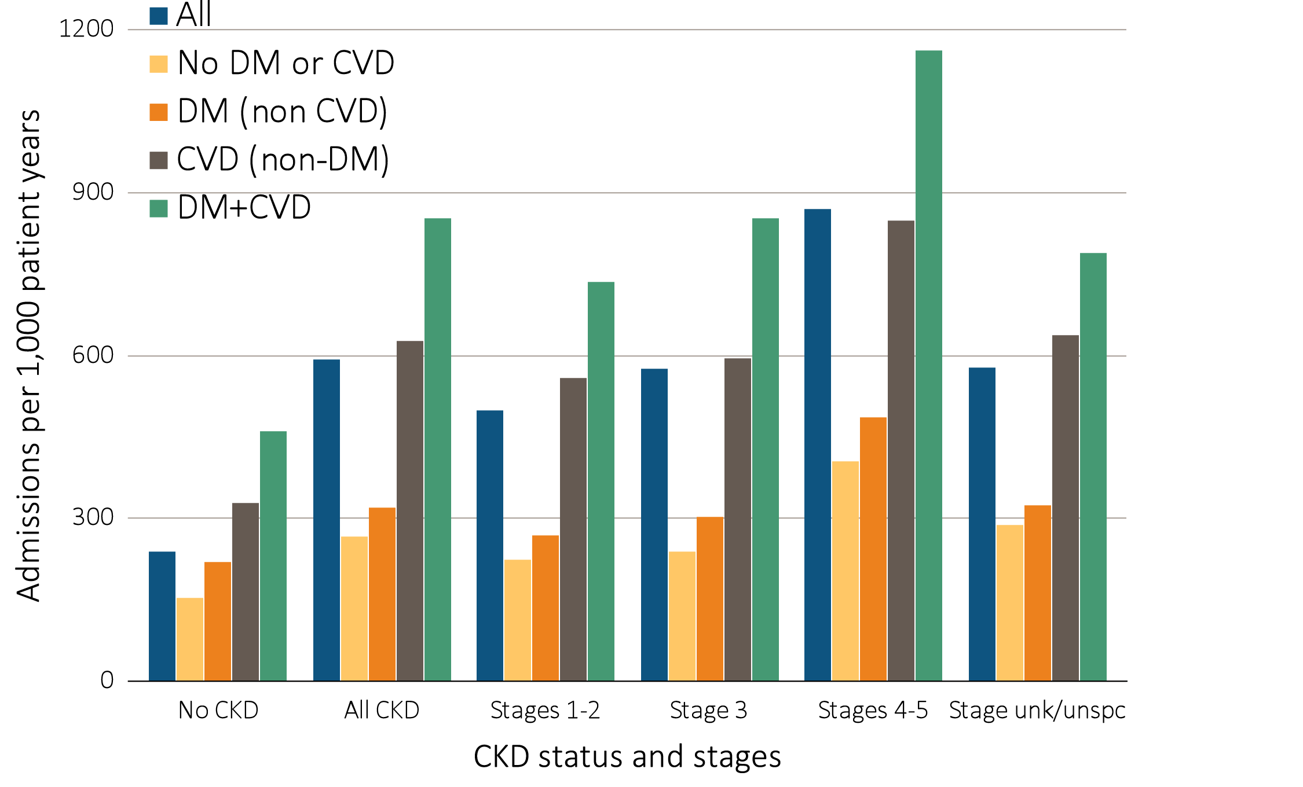
Figure 3.15 Adjusted all-cause hospitalization rates (per 1,000 patient years at risk) for Medicare patients aged 66 and older, by cardiovascular disease and diabetes mellitus, CKD status, and stage, 2014
Data source: Medicare 5 percent sample. January 1, 2014 point prevalent Medicare patients aged 66 and older. Adj: age/sex/race; rates by one factor are adjusted for the others. Ref: all patients, 2014. See Table A for CKD stage definitions. Abbreviations: CKD, chronic kidney disease; CVD, cardiovascular disease; DM, diabetes mellitus; unk/unspc, CKD stage unidentified.

Slide 21
Table 3.3 Unadjusted percentage of patients readmitted to the hospital within 30 days of discharge, among Medicare patients aged 66 and older who were discharged alive from an all-cause index hospitalization between January 1 and December 1, by CKD status and stage, 2014
 | No CKD (%) | All CKD (%) | Stages 1-2 (%) | Stage 3 (%) | Stages 4-5 (%) | Stage Unknown /unspecified (%)
All | 15.3 | 21.4 | 20.3 | 21.4 | 22.9 | 20.9
Age
66-69 | 14.8 | 23.4 | 24.7 | 23.1 | 23.8 | 23.3
70-74 | 15.0 | 22.1 | 19.5 | 22.4 | 25.2 | 21.4
75-84 | 15.8 | 21.6 | 20.8 | 21.8 | 23.2 | 21.0
85+ | 15.3 | 19.8 | 17.8 | 19.8 | 21.4 | 19.6
Sex
Male | 16.4 | 21.7 | 22.0 | 21.7 | 22.7 | 21.5
Female | 14.7 | 21.0 | 18.8 | 21.2 | 23.1 | 20.5
Race
White | 15.2 | 20.8 | 19.6 | 20.9 | 22.0 | 20.6
Black/African American | 17.7 | 24.6 | 24.4 | 25.1 | 26.7 | 22.7
Other | 14.8 | 22.4 | 20.5 | 21.7 | 26.0 | 22.6
No rehospitalization & died | 4.5 | 6.3 | 4.8 | 6.1 | 7.6 | 6.4
Rehospitalization & died | 1.6 | 2.5 | 1.9 | 2.4 | 3.2 | 2.6
Rehospitalization & lived | 13.7 | 18.8 | 18.4 | 19.0 | 19.7 | 18.4
Data source: Medicare 5 percent sample. January 1, 2014 point prevalent Medicare patients aged 66 and older, discharged alive from an all-cause index hospitalization between January 1, 2014, and December 1, 2014; unadjusted. See Table A for CKD stage definitions. Abbreviations: CKD, chronic kidney disease.

Slide 22
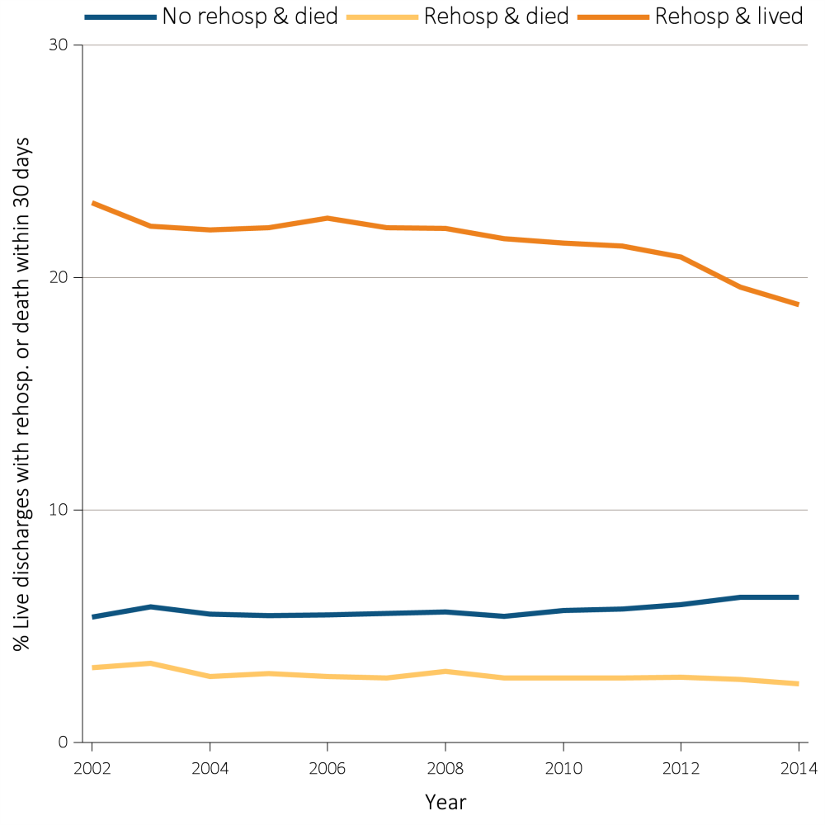
Figure 3.16. Adjusted percentage of patients readmitted to the hospital within 30 days of discharge, among Medicare CKD patients aged 66 and older who were discharged alive from an all-cause index hospitalization between January 1 and December 1, by year, 2002-2014
Data source: Medicare 5 percent sample. January 1 of each reported year, point prevalent Medicare patients aged 66 and older with CKD (defined during the prior year), discharged alive from an all-cause index hospitalization between January 1 and December 1 of the reported year. Adj: age/sex/race. Ref: 2014. Abbreviations: CKD, chronic kidney disease; Rehosp, rehospitalized.

Slide 23
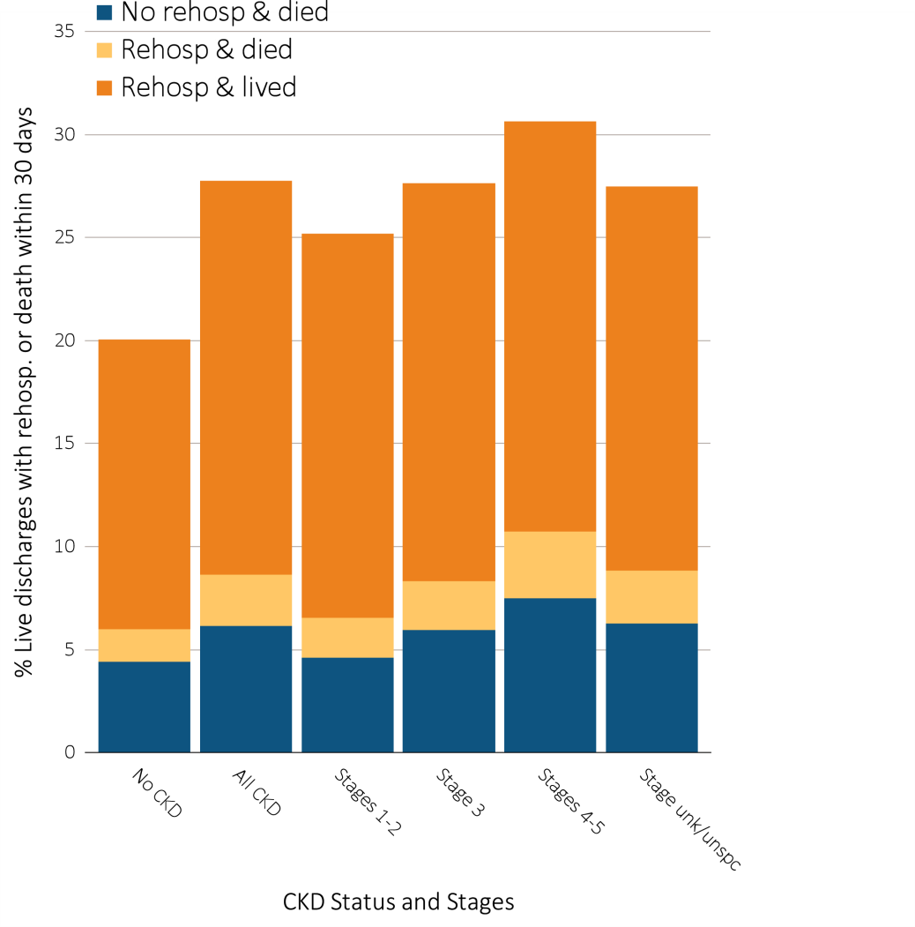
Figure 3.17 Unadjusted percentage of patients readmitted to the hospital within 30 days of discharge, among Medicare patients aged 66 and older who were discharged alive from an all-cause index hospitalization between January 1 and December 1, by CKD status and stage, 2014
Data source: Medicare 5 percent sample. January 1, 2014 point prevalent Medicare patients aged 66 and older, discharged alive from an all-cause index hospitalization between January 1, 2014, and December 1, 2014, unadjusted. Abbreviations: CKD, chronic kidney disease; Rehosp, rehospitalized; unk/unspc, CKD stage unidentified.

Slide 24
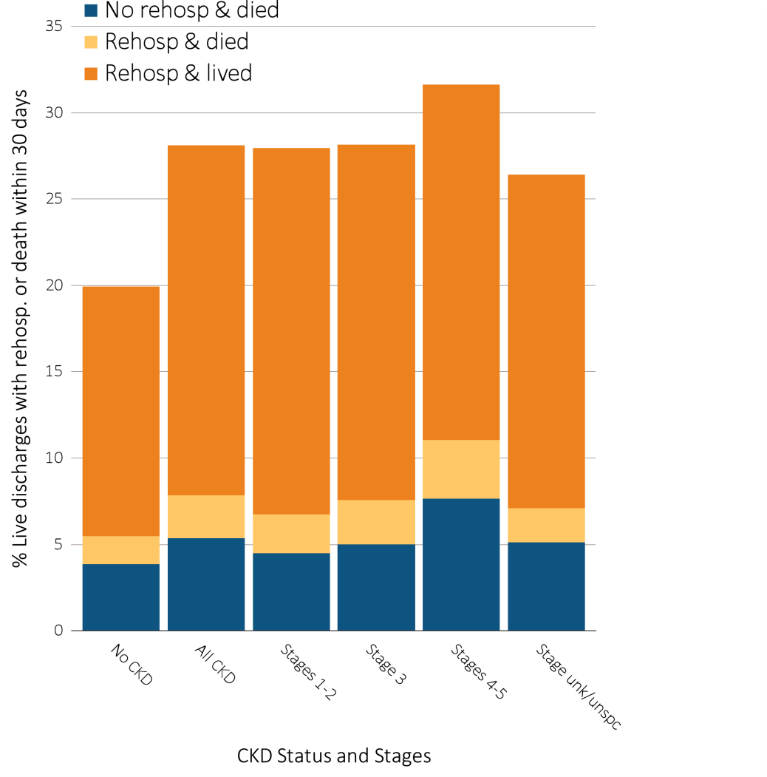
Figure 3.18 Unadjusted percentage of patients readmitted to the hospital within 30 days of discharge, among Medicare patients aged 66 and older who were discharged alive from a cardiovascular-related index hospitalization between January 1 and December 1, by CKD status and stage, 2014
Data source: Medicare 5 percent sample. January 1, 2014 point prevalent Medicare patients aged 66 and older, discharged alive from an all-cause index hospitalization between January 1, 2014, and December 1, 2014; unadjusted. Abbreviations: CKD, chronic kidney disease; Rehosp, rehospitalized; unk/unspc, CKD stage unidentified.

Slide 25
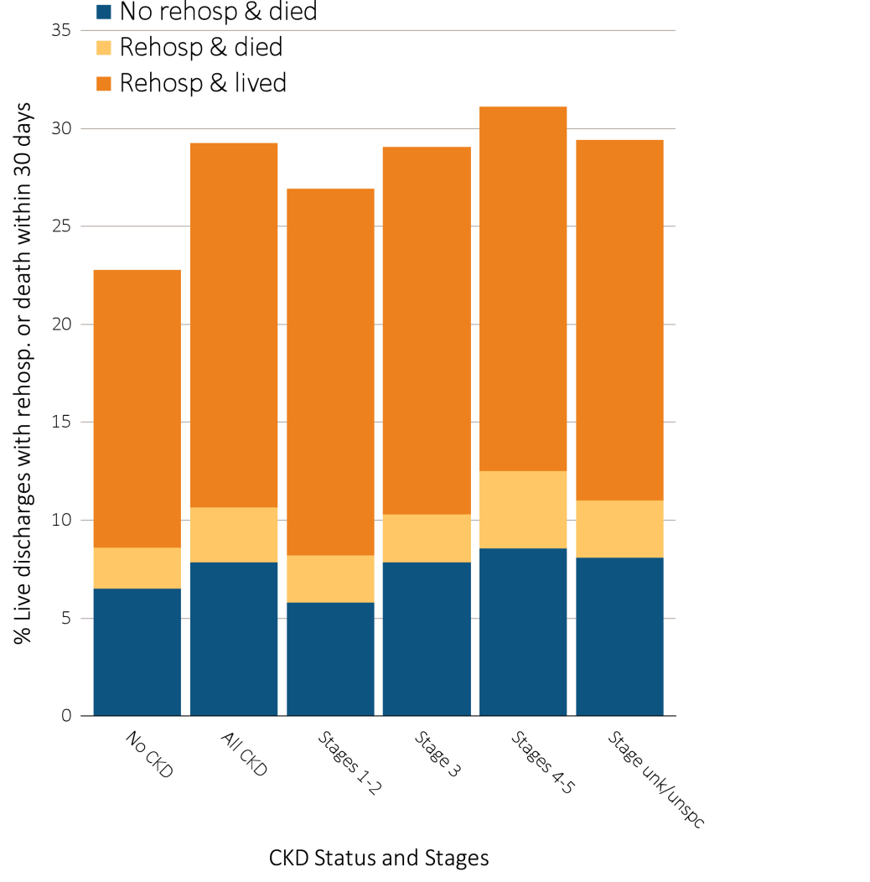
Figure 3.19 Unadjusted percentage of patients readmitted to the hospital within 30 days of discharge, among Medicare patients aged 66 and older who were discharged alive from an infection-related index hospitalization between January 1 and December 1, by CKD status and stage, 2014
Data source: Medicare 5 percent sample. January 1, 2014 point prevalent Medicare patients aged 66 and older, discharged alive from an all-cause index hospitalization between January 1, 2014, and December 1, 2014, unadjusted. Abbreviations: CKD, chronic kidney disease; Rehosp, rehospitalized; unk/unspc, CKD stage unidentified.

Slide 26
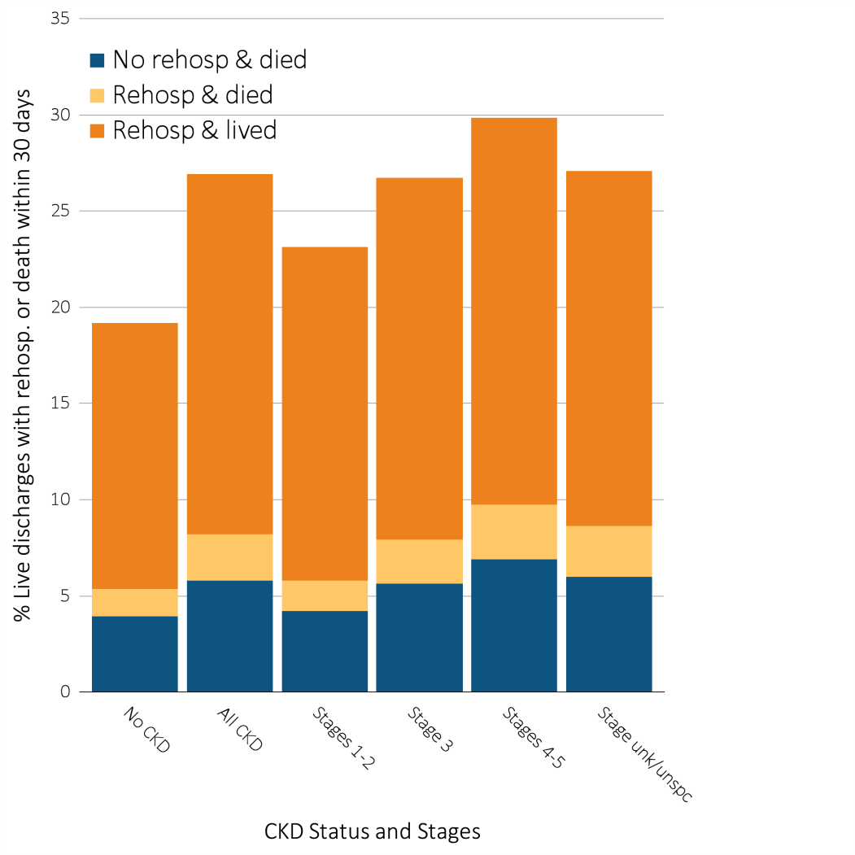
Figure 3.20 Unadjusted percentage of patients readmitted to the hospital within 30 days of discharge, among Medicare patients aged 66 and older who were discharged alive from a no-cardiovascular and no-infection related index hospitalization between January 1 and December 1, by CKD status and stage, 2014
Data Source: Medicare 5 percent sample. January 1, 2014 point prevalent Medicare patients aged 66 and older, discharged alive from an all-cause index hospitalization between January 1, 2014, and December 1, 2014; unadjusted. Abbreviations: CKD, chronic kidney disease; Rehosp, rehospitalized; unk/unspc, CKD stage unidentified.

Slide 27
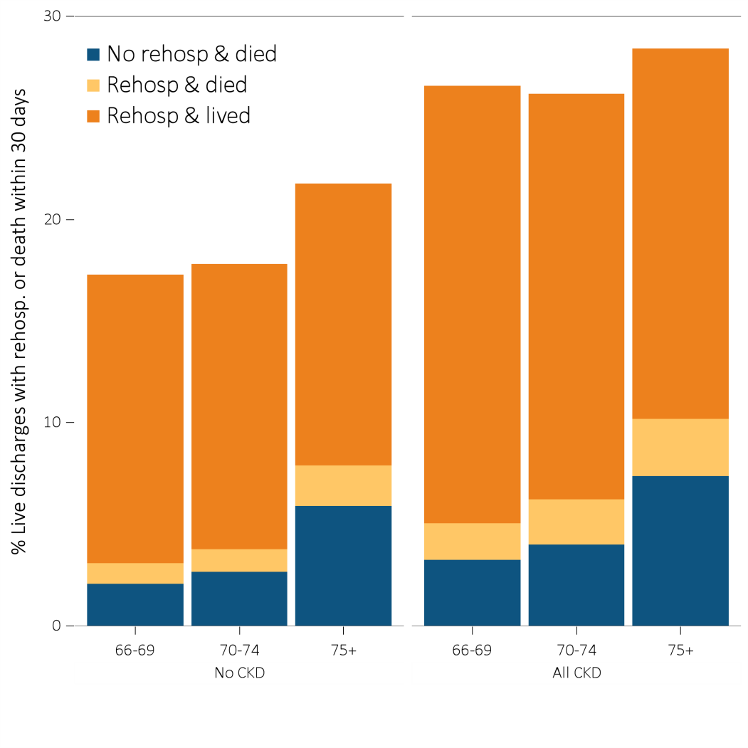
Figure 3.21 Unadjusted percentage of patients readmitted to the hospital within 30 days of discharge, among Medicare patients aged 66 and older who were discharged alive from an all-cause index hospitalization between January 1 and December 1, by age and CKD status, 2014
Data source: Medicare 5 percent sample. January 1, 2014 point prevalent Medicare patients aged 66 and older, discharged alive from an all-cause index hospitalization between January 1, 2014, and December 1, 2014; unadjusted. Abbreviations: CKD, chronic kidney disease; Rehosp, rehospitalized.

Slide 28
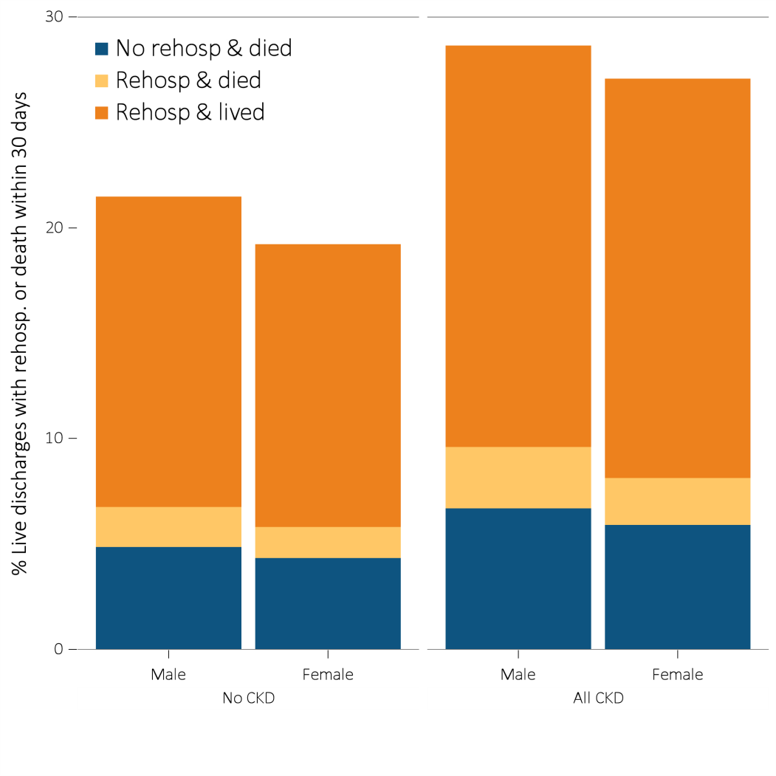
Figure 3.22 Unadjusted percentage of patients readmitted to the hospital within 30 days of discharge, among Medicare patients aged 66 and older who were discharged alive from an all-cause index hospitalization between January 1 and December 1, by sex and CKD status, 2014
Data source: Medicare 5 percent sample. January 1, 2014 point prevalent Medicare patients aged 66 and older, discharged alive from an all-cause index hospitalization between January 1, 2014, and December 1, 2014; unadjusted. Abbreviations: CKD, chronic kidney disease; Rehosp, rehospitalized.

Slide 29
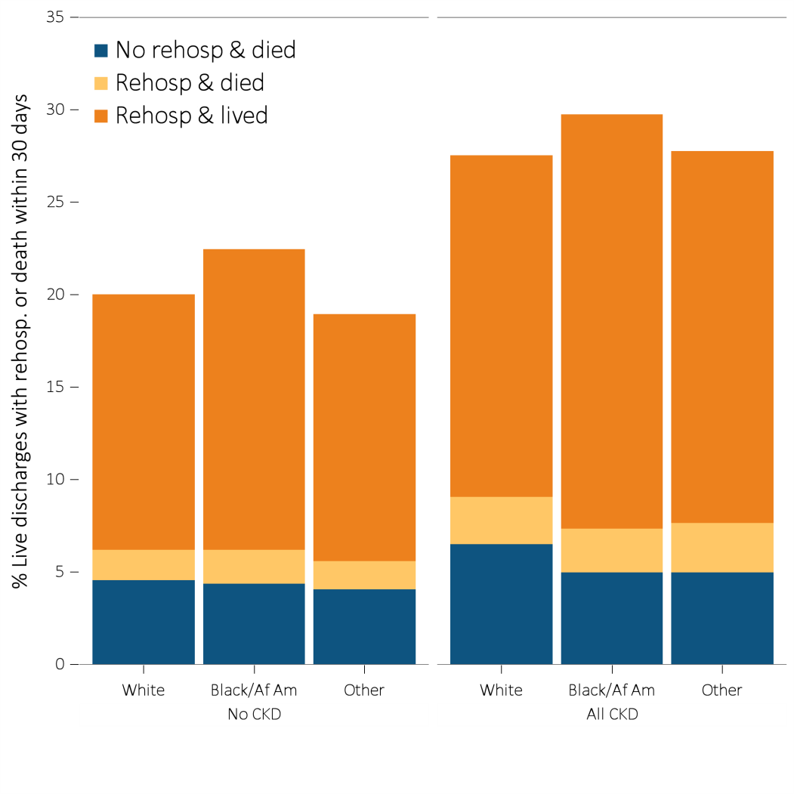
Figure 3.23 Unadjusted percentage of patients readmitted to the hospital within 30 days of discharge, among Medicare patients aged 66 and older who were discharged alive from an all-cause index hospitalization between January 1 and December 1, by race and CKD status, 2014
Data Source: Medicare 5 percent sample. January 1, 2014 point prevalent Medicare patients aged 66 and older, discharged alive from an all-cause index hospitalization between January 1, 2014, and December 1, 2014; unadjusted. Abbreviations: Af Am, African American; CKD, chronic kidney disease; Rehosp, rehospitalized.

