Slide 2
Table 1.1 Trends in annual number of ESRD incident cases, unadjusted and adjusted* incidence rate (per million/year) of ESRD, and annual percent change, in the U.S. population, 1996-2014
 | Incident count |  |  | Unadjusted rate |  |  | Adjusted rate
Year | No. cases | % Change from previous year |  | Unadjusted rate (per million/year) | % Change from previous year |  | Adjusted rate (per million/year) | % Change from previous year
1996 | 77,018 | n/a |  | 278 | n/a |  | 328 | n/a
1997 | 82,116 | 6.6 |  | 293 | 5.3 |  | 343 | 4.4
1998 | 87,353 | 6.4 |  | 308 | 5.3 |  | 360 | 4.8
1999 | 91,431 | 4.7 |  | 319 | 3.4 |  | 368 | 2.4
2000 | 94,662 | 3.5 |  | 327 | 2.5 |  | 374 | 1.5
2001 | 98,005 | 3.5 |  | 336 | 2.6 |  | 380 | 1.8
2002 | 100,233 | 2.3 |  | 340 | 1.3 |  | 381 | 0.1
2003 | 102,770 | 2.5 |  | 345 | 1.5 |  | 382 | 0.3
2004 | 104,560 | 1.7 |  | 349 | 1.2 |  | 382 | -0.1
2005 | 106,662 | 2.0 |  | 353 | 1.2 |  | 382 | 0.0
2006 | 110,342 | 3.5 |  | 362 | 2.5 |  | 387 | 1.4
2007 | 110,381 | 0.0 |  | 359 | -0.9 |  | 379 | -2.1
2008 | 111,899 | 1.4 |  | 360 | 0.3 |  | 375 | -1.0
2009 | 115,508 | 3.2 |  | 369 | 2.5 |  | 379 | 1.1
2010 | 115,920 | 0.4 |  | 367 | -0.6 |  | 372 | -2.0
2011 | 113,796 | -1.8 |  | 358 | -2.5 |  | 358 | -3.8
2012 | 115,602 | 1.6 |  | 360 | 0.7 |  | 355 | -0.8
2013 | 118,119 | 2.2 |  | 366 | 1.7 |  | 355 | 0.2
2014 | 120,688 | 2.2 |  | 370 | 1.1 |  | 354 | -0.3
Data Source: Reference Tables A.1, A.2, A.2(2) and special analyses, USRDS ESRD Database. *Adjusted for age, sex, and race. Abbreviations: ESRD, end-stage renal disease; n/a, not applicable.

Slide 3
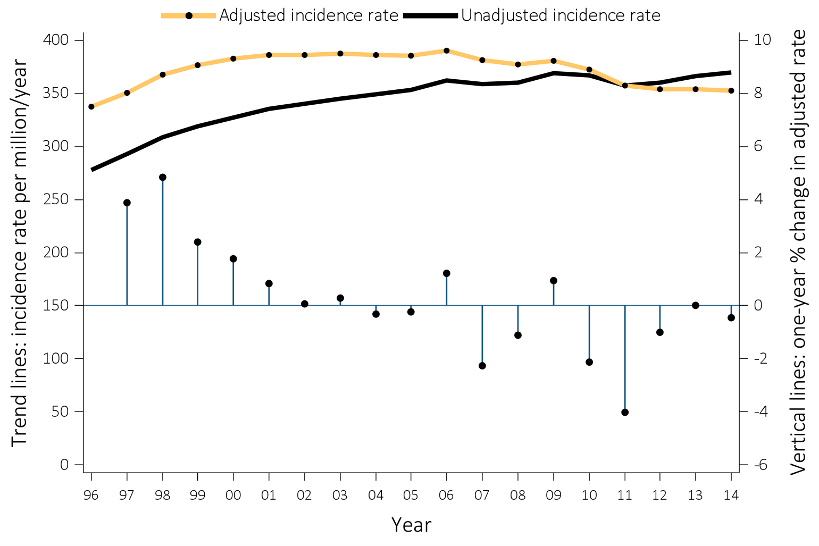
Figure 1.1 Trends in the unadjusted and adjusted* incidence rates (per million/year) of ESRD (trend lines; scale on right), and annual percent (%) change in the adjusted* incidence rate of ESRD (vertical lines; scale on left) in the U.S. population, 1996-2014
Data Source: Reference Table A.2(2) and special analyses, USRDS ESRD Database. *Adjusted for age, sex, race, and ethnicity. The standard population was the U.S. population in 2011. Abbreviation: ESRD, end-stage renal disease.
.

Slide 4
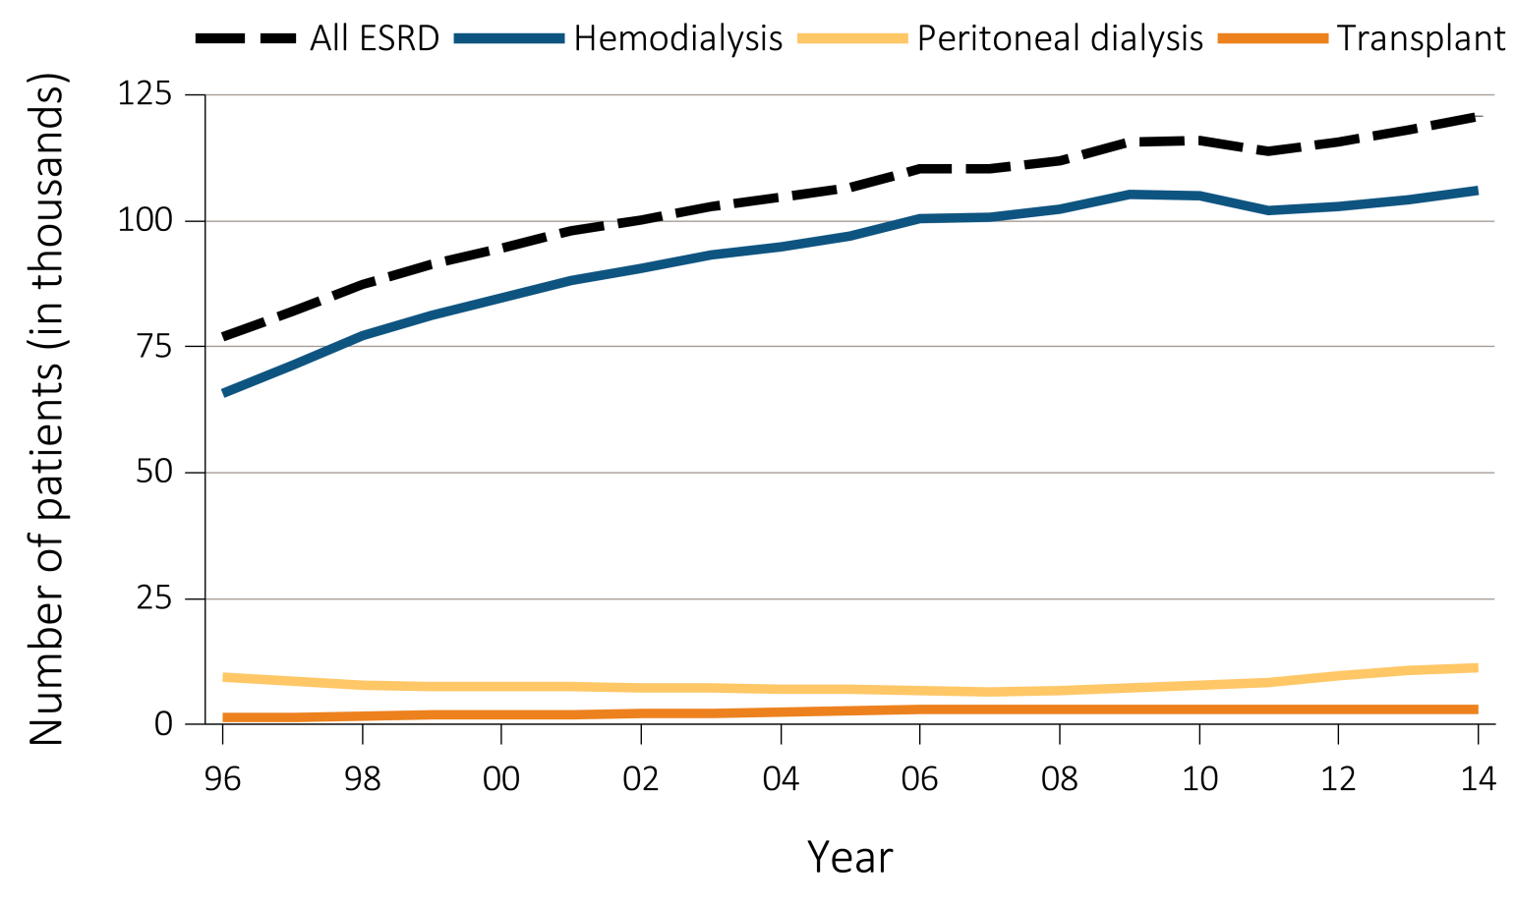
Figure 1.2 Trends in the annual number of ESRD incident cases (in thousands) by modality, in the U.S. population, 1996-2014
Data Source: Reference Table D1. Abbreviation: ESRD, end-stage renal disease.
.

Slide 5
Table 1.2 Unadjusted and adjusted* incidence rates of ESRD (per million/year) and annual number of ESRD incident cases, by modality (hemodialysis, peritoneal dialysis, transplantation) and ESRD Network, in the U.S. population, 2014
 |  | Total ESRD |  |  |  | Hemodialysis |  |  | Peritoneal dialysis |  |  | Transplant
Network | States** in Network | No. of cases | Adjusted incidence rate (per million/year) | Unadjusted incidence rate (per million/year) |  | No. of cases | % of network |  | No. of cases | % of network |  | No. of cases | % of network
14 | TX | 10585 | 432 | 391 |  | 9451 | 89.3 |  | 922 | 8.7 |  | 183 | 1.7
18 | S. CA | 9396 | 430 | 386 |  | 8396 | 89.4 |  | 857 | 9.1 |  | 129 | 1.4
3 | NJ, PR | 5451 | 395 | 429 |  | 3524 | 91.4 |  | 236 | 6.1 |  | 89 | 2.3
9 | IN, KY, OH | 9293 | 390 | 410 |  | 8213 | 88.4 |  | 835 | 9.0 |  | 202 | 2.2
10 | IL | 5217 | 384 | 403 |  | 4517 | 86.6 |  | 536 | 10.3 |  | 143 | 2.7
13 | AR, LA, OK | 4982 | 383 | 431 |  | 4402 | 88.4 |  | 488 | 9.8 |  | 90 | 1.8
8 | AL, MS, TN | 6567 | 364 | 455 |  | 5701 | 86.8 |  | 757 | 11.5 |  | 100 | 1.5
4 | DE, PA | 5368 | 352 | 390 |  | 4730 | 88.1 |  | 471 | 8.8 |  | 159 | 3.0
5 | MD, DC, VA, WV | 7045 | 343 | 418 |  | 6289 | 89.3 |  | 560 | 7.9 |  | 177 | 2.5
11 | MI, MN, ND, SD, WI | 7517 | 343 | 330 |  | 6624 | 88.1 |  | 561 | 7.5 |  | 310 | 4.1
17 | N. CA, HI, GU, AS | 5871 | 341 | 350 |  | 4732 | 83.7 |  | 781 | 13.8 |  | 135 | 2.4
12 | IA, KS, MO, NE | 4428 | 336 | 316 |  | 3768 | 85.1 |  | 522 | 11.8 |  | 131 | 3.0
2 | NY | 7352 | 334 | 370 |  | 6772 | 92.1 |  | 332 | 4.5 |  | 245 | 3.3
6 | NC, SC, GA | 10359 | 326 | 415 |  | 8970 | 86.6 |  | 1176 | 11.4 |  | 204 | 2.0
7 | FL | 7890 | 319 | 395 |  | 6994 | 88.6 |  | 723 | 9.2 |  | 150 | 1.9
15 | AZ, CO, NV, NM, UT, WY | 5682 | 297 | 275 |  | 4852 | 85.4 |  | 608 | 10.7 |  | 216 | 3.8
16 | AK, ID, MT, OR, WA | 3599 | 268 | 248 |  | 3075 | 85.4 |  | 410 | 11.4 |  | 109 | 3.0
1 | CT, MA, ME, NH, RI, VT | 3751 | 250 | 255 |  | 3238 | 86.3 |  | 340 | 9.1 |  | 172 | 4.6
 | All networks | 120688 | 354 | 370 |  | 104248 | 87.9 |  | 11115 | 9.4 |  | 2944 | 2.5
Data Source: Reference Table A.11 and special analyses, USRDS ESRD Database. *Adjusted for age, sex, and race. The standard population was the U.S. population in 2011. Listed from highest to lowest adjusted rate per million/year. **Includes 50 states, Washington, D.C. (DC), Puerto Rico (PR), Guam (GU), and American Samoa (AS). Northern and Southern California (CA) split into Networks 17 and 18. Abbreviations: Af Am, African American; ESRD, end-stage renal disease; Hisp, Hispanic; N Am, Native American.
.

Slide 6
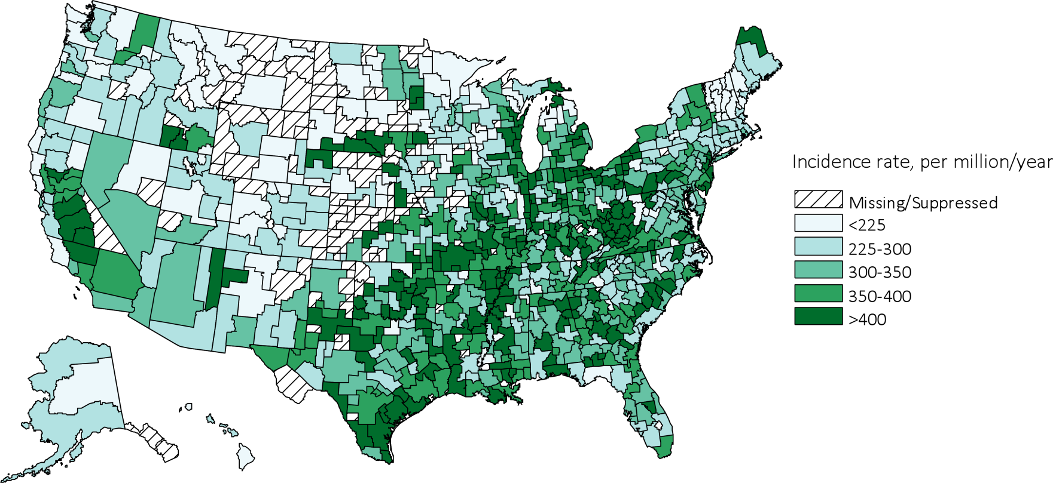
Figure 1.3 Map of the adjusted* incidence rate (per million/year) of ESRD, by Health Service Area, in the U.S. population, 2014
Data Source: Special analyses, USRDS ESRD Database. *Adjusted for age, sex, and race. The standard population was the U.S. population in 2011. Values for cells with 10 or fewer patients are suppressed. Abbreviation: ESRD, end-stage renal disease.
.

Slide 7
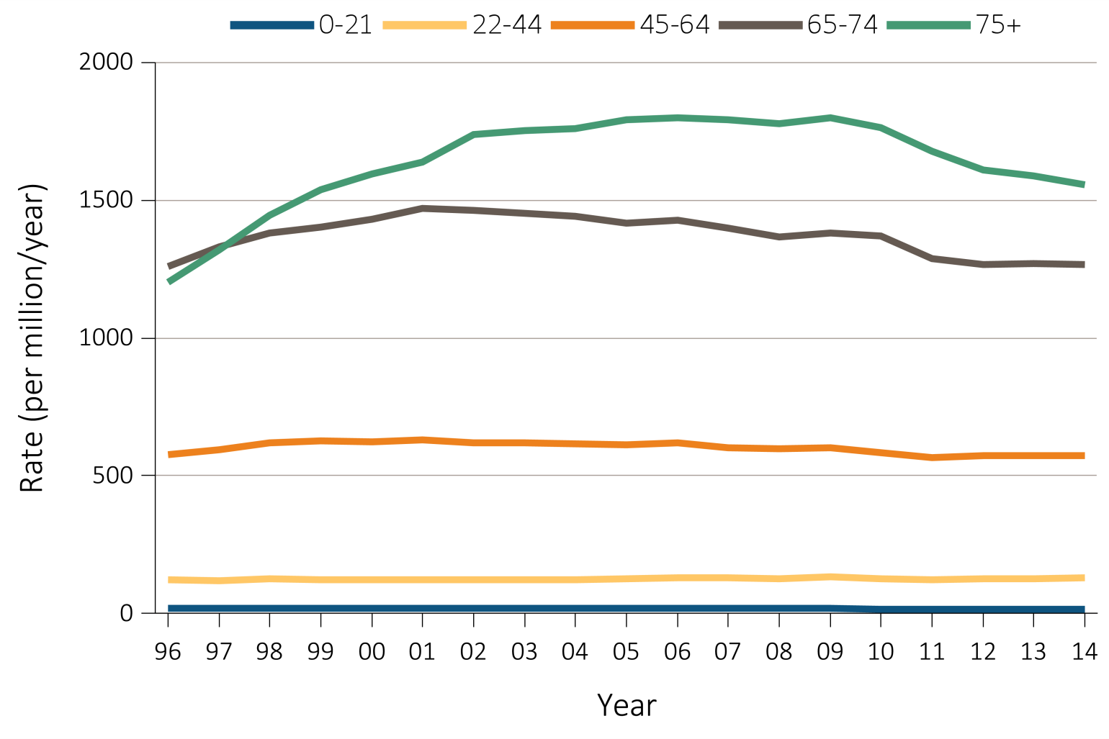
Figure 1.4 Trends in adjusted* ESRD incidence rate (per million/year), by age group, in the U.S. population, 1996-2014
Data Source: Reference Table A.2(2) and special analyses, USRDS ESRD Database. *Adjusted for sex and race. The standard population was the U.S. population in 2011. Abbreviation: ESRD, end-stage renal disease.
.

Slide 8
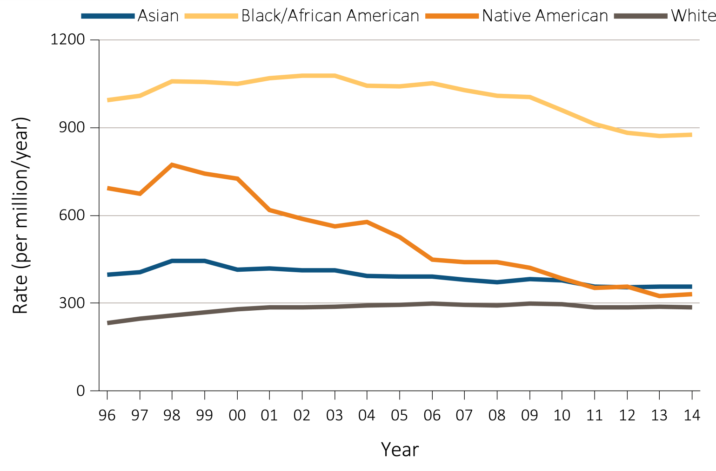
Figure 1.5 Trends in adjusted* ESRD incidence rate (per million/year), by race, in the U.S. population, 1996-2014
Data Source: Reference Table A.2(2) and special analyses, USRDS ESRD Database. *Adjusted for age and sex. The standard population was the U.S. population in 2011. Abbreviations: Af Am, African American; ESRD, end-stage renal disease.
.

Slide 9
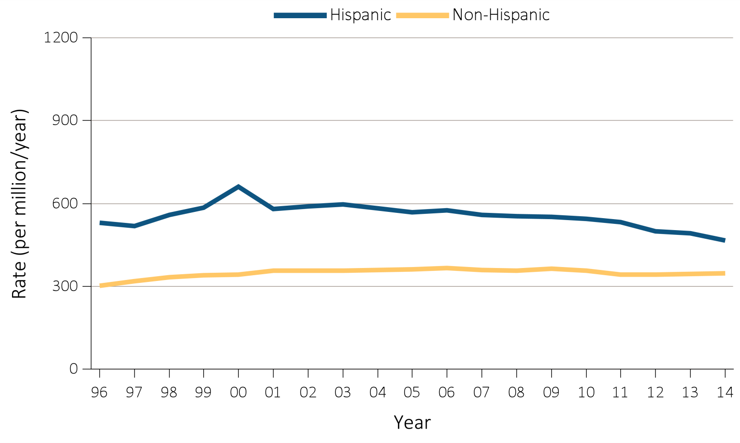
Figure 1.6 Trends in adjusted* ESRD incidence rate (per million/year), by Hispanic ethnicity, in the U.S. population, 1996-2014
Data Source: Reference Tables A.2(2). *Adjusted for age, sex, and race. The standard population was the U.S. population in 2011. Abbreviation: ESRD, end-stage renal disease.
.

Slide 10
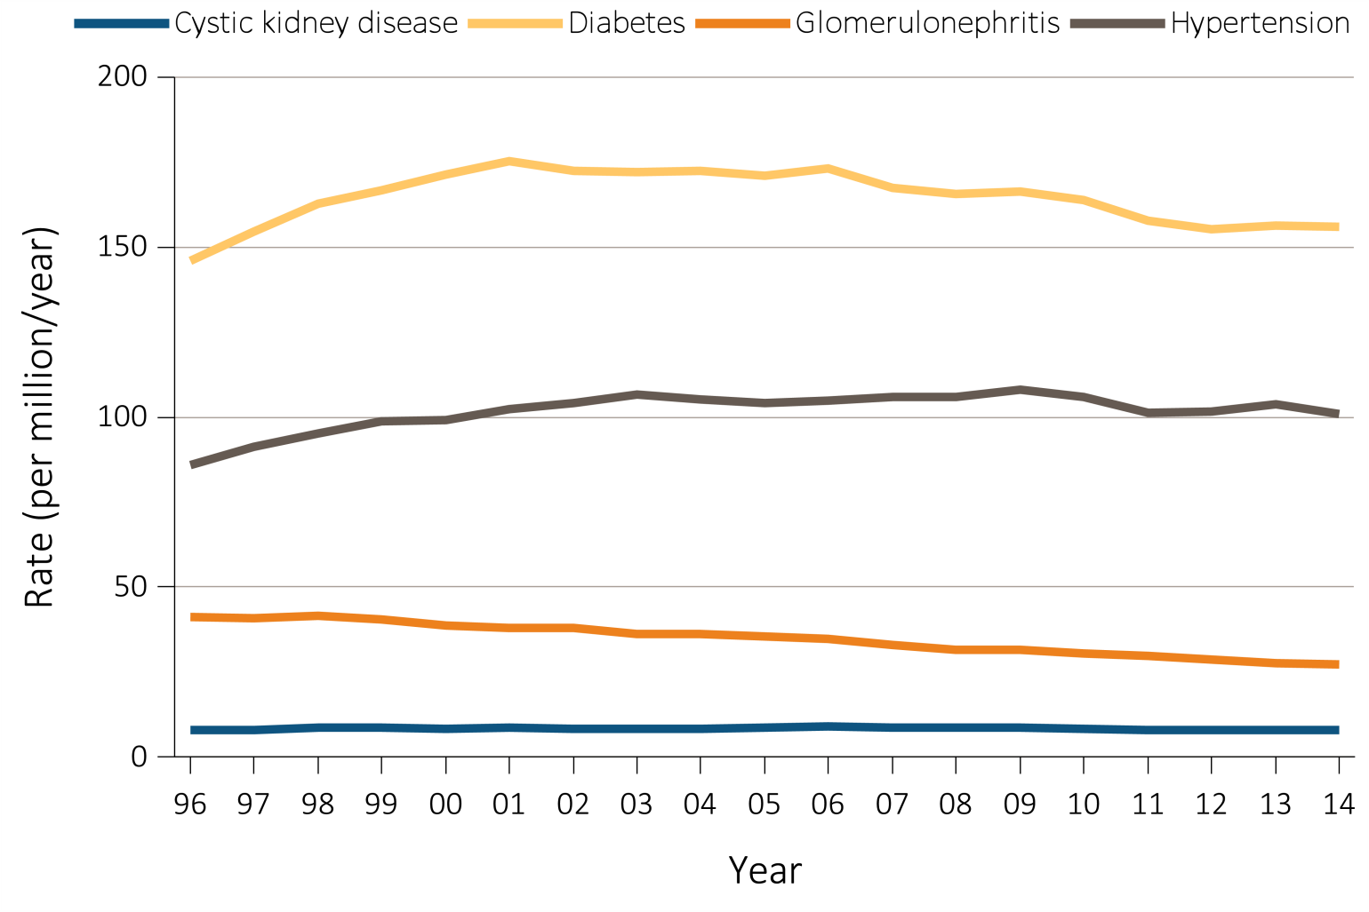
Figure 1.7 Trends in adjusted* ESRD incidence rate (per million/year), by primary cause of ESRD, in the U.S. population, 1996-2014
Data Source: Reference Tables A.2(2). *Adjusted for age, sex, and race. The standard population was the U.S. population in 2011. Abbreviation: ESRD, end-stage renal disease.
.

Slide 11
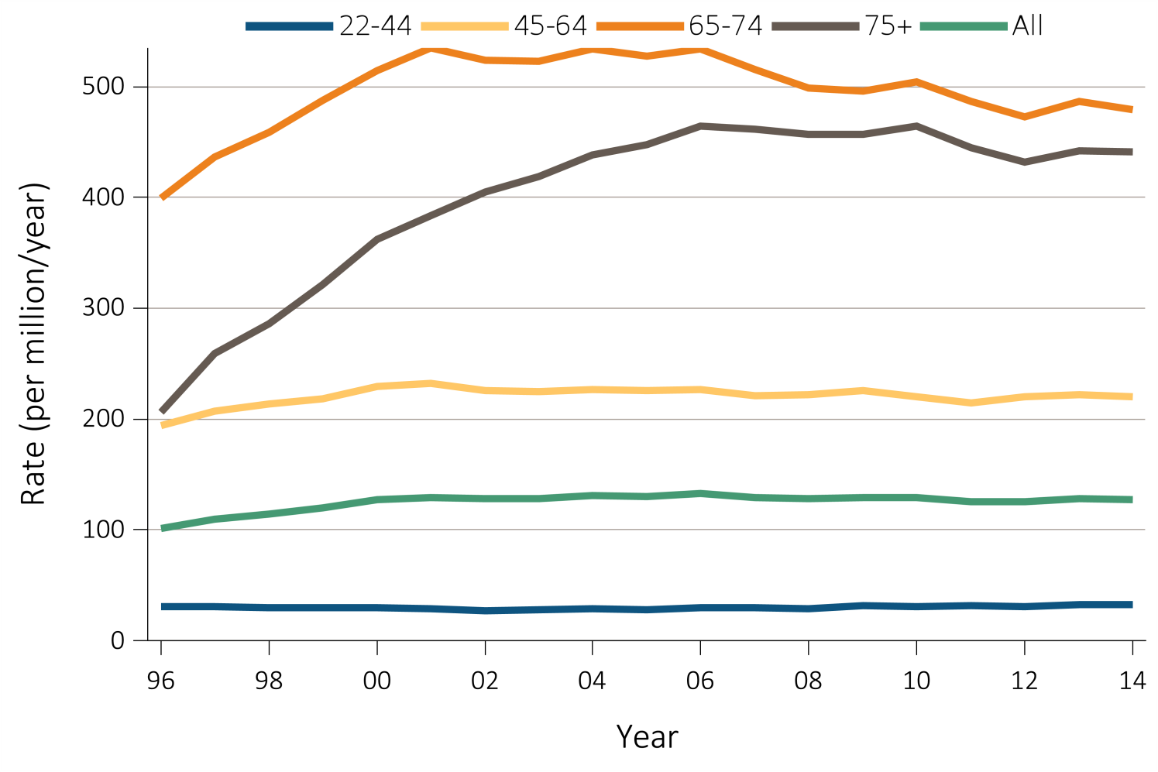
Figure 1.8 Trends in the sex-adjusted incidence rate (per million/year) of ESRD due to diabetes as the primary cause, by age and race (a & b), and by age and ethnicity (c), in the U.S. population, 1996-2014
^{(a) White}
Data Source: Special analyses, USRDS ESRD Database. *Adjusted for sex. The standard population was the U.S. population in 2011. Abbreviations: ESRD, end-stage renal disease.
.

Slide 12
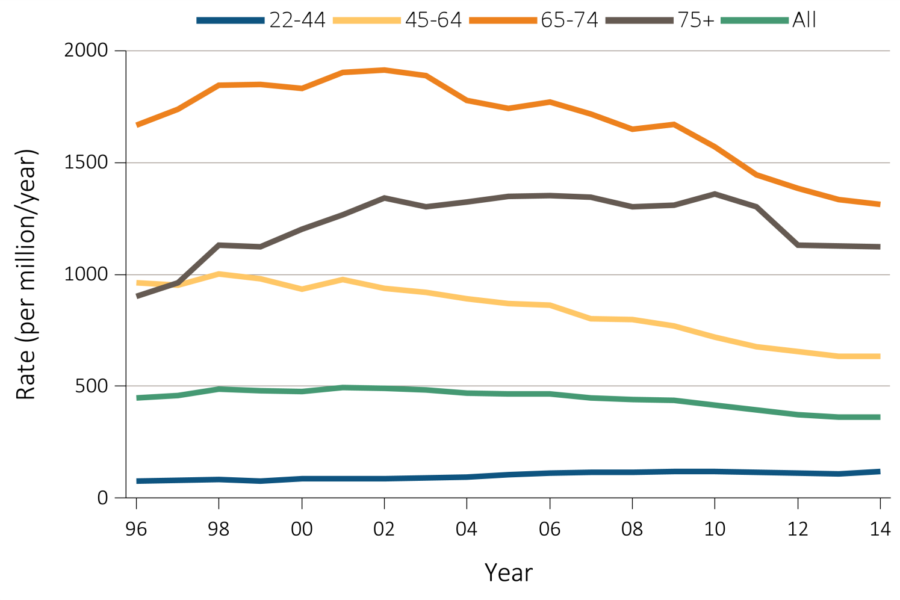
Figure 1.8 Trends in the sex-adjusted incidence rate (per million/year) of ESRD due to diabetes as the primary cause, by age and race (a & b), and by age and ethnicity (c), in the U.S. population, 1996-2014
^{(b) Black}
Data Source: Special analyses, USRDS ESRD Database. *Adjusted for sex. The standard population was the U.S. population in 2011. Abbreviations: ESRD, end-stage renal disease.
.

Slide 13
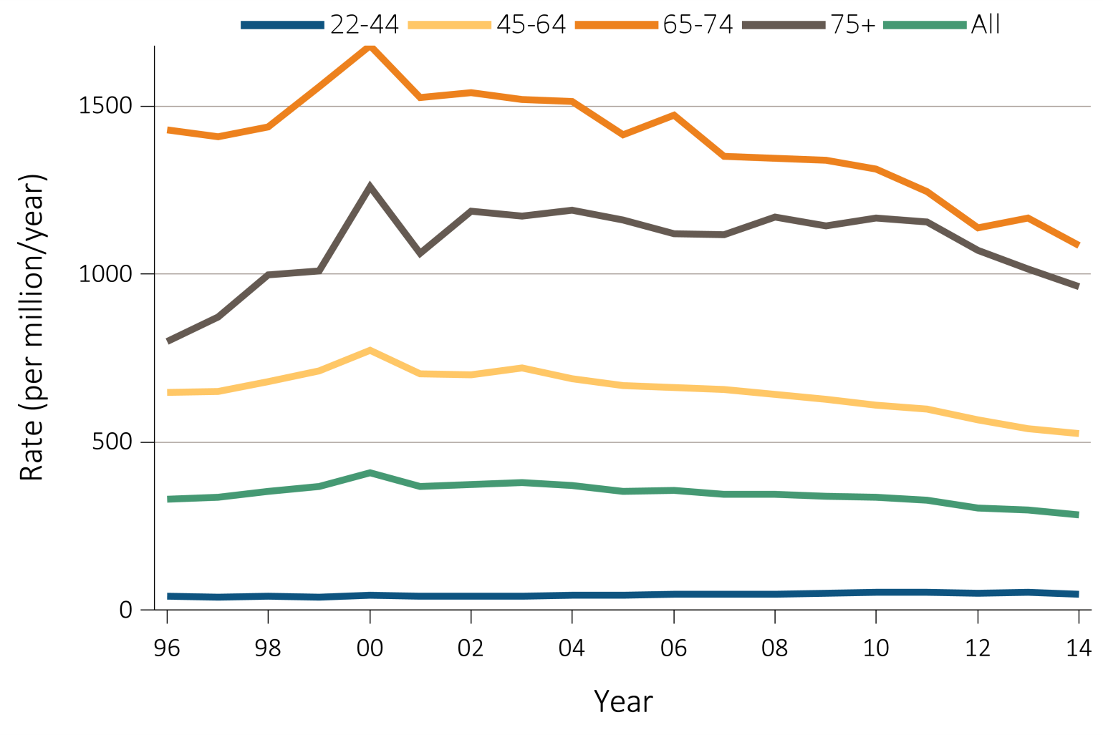
Figure 1.8 Trends in the sex-adjusted incidence rate (per million/year) of ESRD due to diabetes as the primary cause, by age and race (a & b), and by age and ethnicity (c), in the U.S. population, 1996-2014
^{(c) Hispanic}
Data Source: Special analyses, USRDS ESRD Database. *Adjusted for sex. The standard population was the U.S. population in 2011. Abbreviations: ESRD, end-stage renal disease.
.

Slide 14
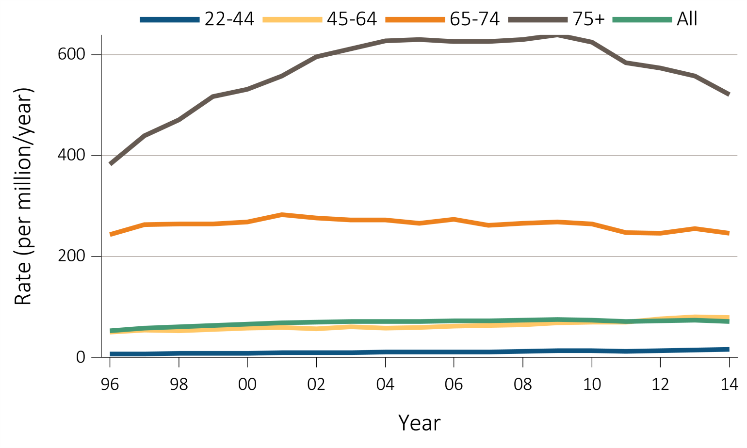
Figure 1.9 Trends in the sex-adjusted incidence rate (per million/year) of ESRD due to hypertension as the primary cause, by (a & b) age and race, and by (c) age and ethnicity, in the U.S. population, 1996-2014
^{(a) White}
Data Source: Special analyses, USRDS ESRD Database. *Adjusted for sex. The standard population was the U.S. population in 2011. Abbreviations: ESRD, end-stage renal disease.
.

Slide 15
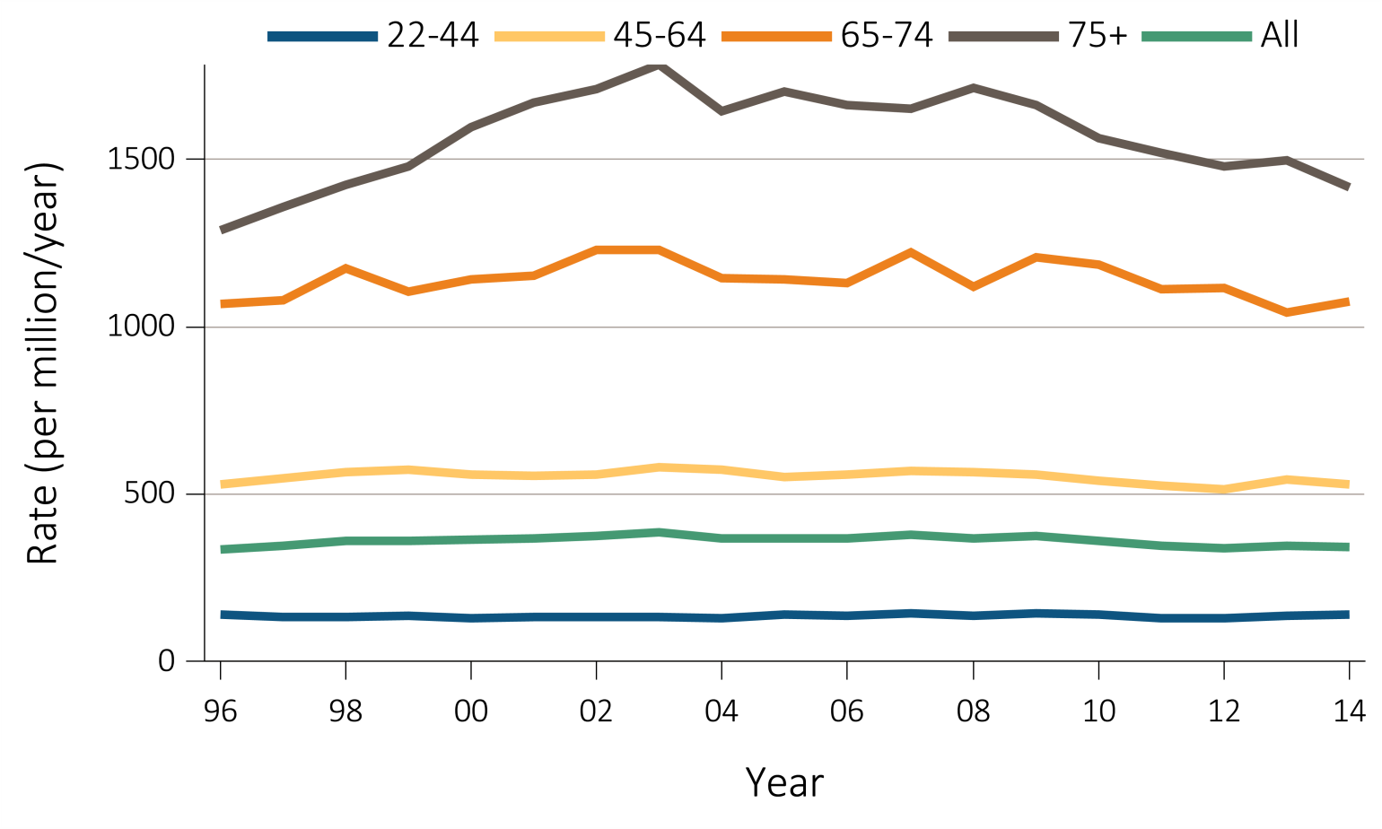
Figure 1.9 Trends in the sex-adjusted incidence rate (per million/year) of ESRD due to hypertension as the primary cause, by (a & b) age and race, and by (c) age and ethnicity, in the U.S. population, 1996-2014
^{(b) Black}
Data Source: Special analyses, USRDS ESRD Database. *Adjusted for sex. The standard population was the U.S. population in 2011. Abbreviations: ESRD, end-stage renal disease.
.

Slide 16
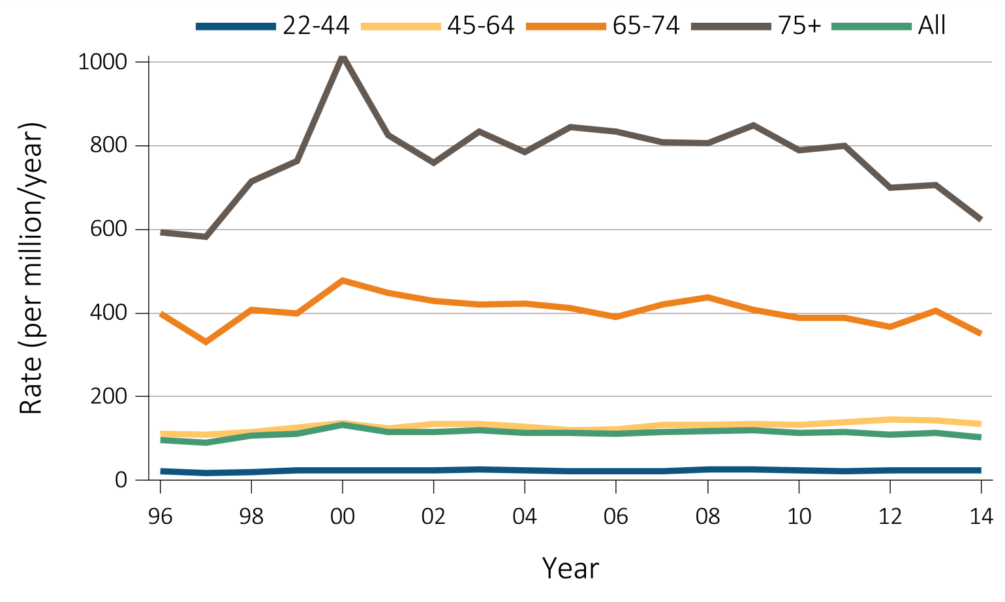
Figure 1.9 Trends in the sex-adjusted incidence rate (per million/year) of ESRD due to hypertension as the primary cause, by (a & b) age and race, and by (c) age and ethnicity, in the U.S. population, 1996-2014
^{(c) Hispanic}
Data Source: Special analyses, USRDS ESRD Database. *Adjusted for sex. The standard population was the U.S. population in 2011. Abbreviations: ESRD, end-stage renal disease.
.

Slide 17
Table 1.3 Trends in annual number of ESRD prevalent cases, unadjusted and adjusted* prevalence (per million) of ESRD, and annual percent change, in the U.S. population, 1996-2014
 | Prevalent count |  |  | Unadjusted prevalence |  |  | Adjusted prevalence
Year | No. cases | % Change from previous year |  | Unadjusted (per million) | % Change from previous year |  | Adjusted (per million) | % Change from previous year
1996 | 303,311 | n/a |  | 1,095 | n/a |  | 1,283 | n/a
1997 | 326,067 | 7.5 |  | 1,159 | 5.8 |  | 1,348 | 5.1
1998 | 348,578 | 6.9 |  | 1,225 | 5.7 |  | 1,415 | 5.0
1999 | 369,375 | 6.0 |  | 1,283 | 4.8 |  | 1,471 | 4.0
2000 | 390,158 | 5.6 |  | 1,341 | 4.5 |  | 1,524 | 3.6
2001 | 409,963 | 5.1 |  | 1,396 | 4.1 |  | 1,572 | 3.2
2002 | 429,172 | 4.7 |  | 1,449 | 3.8 |  | 1,614 | 2.7
2003 | 447,667 | 4.3 |  | 1,499 | 3.4 |  | 1,651 | 2.3
2004 | 466,013 | 4.1 |  | 1,547 | 3.2 |  | 1,685 | 2.1
2005 | 484,935 | 4.1 |  | 1,595 | 3.1 |  | 1,717 | 1.9
2006 | 505,715 | 4.3 |  | 1,647 | 3.3 |  | 1,753 | 2.1
2007 | 525,866 | 4.0 |  | 1,696 | 3.0 |  | 1,785 | 1.8
2008 | 546,918 | 4.0 |  | 1,748 | 3.0 |  | 1,817 | 1.8
2009 | 569,547 | 4.1 |  | 1,805 | 3.3 |  | 1,852 | 1.9
2010 | 591,776 | 3.9 |  | 1,860 | 3.1 |  | 1,884 | 1.8
2011 | 611,456 | 3.3 |  | 1,908 | 2.6 |  | 1,908 | 1.2
2012 | 632,806 | 3.5 |  | 1,960 | 2.7 |  | 1,934 | 1.4
2013 | 655,435 | 3.6 |  | 2,015 | 2.8 |  | 1,964 | 1.5
2014 | 678,383 | 3.5 |  | 2,067 | 2.6 |  | 1,990 | 1.3
Data Source: Reference Tables B.1, B.2, B2(2) and special analyses, USRDS ESRD Database. *Adjusted for age, sex, and race. Abbreviations: ESRD, end-stage renal disease; n/a, not applicable.

Slide 18
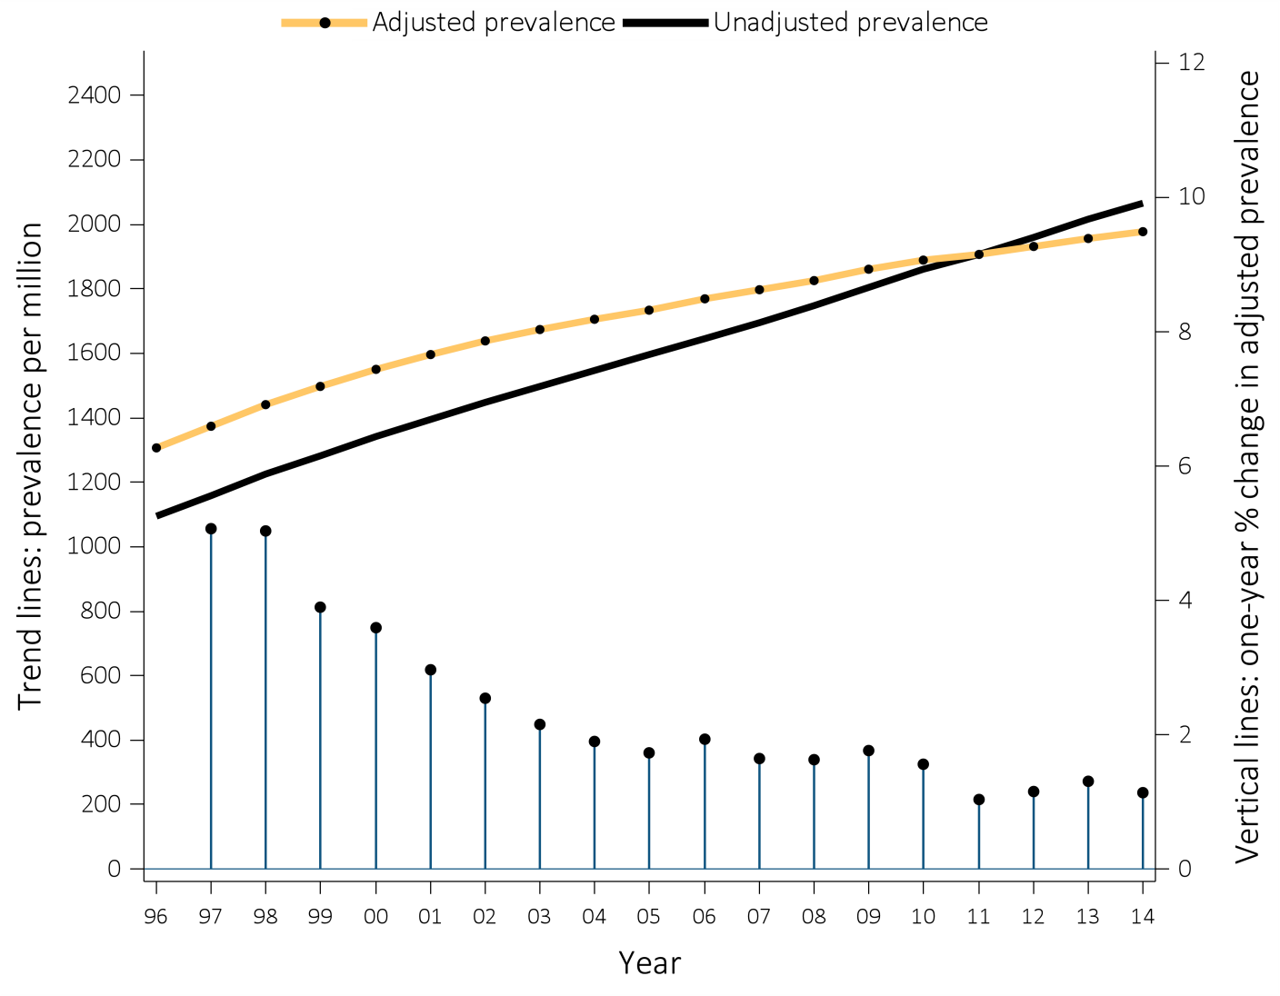
Figure 1.10 Trends in the unadjusted and adjusted* ESRD prevalence (per million) (trend lines; scale on left), and annual percent (%) change in adjusted* prevalence of ESRD (vertical lines; scale on right), in the U.S. population, 1996-2014
Data Source: Reference Table B.2(2) and special analyses, USRDS ESRD Database. *Adjusted for age, sex, race, and ethnicity. The standard population was the U.S. population in 2011. Abbreviation: ESRD, end-stage renal disease..

Slide 19
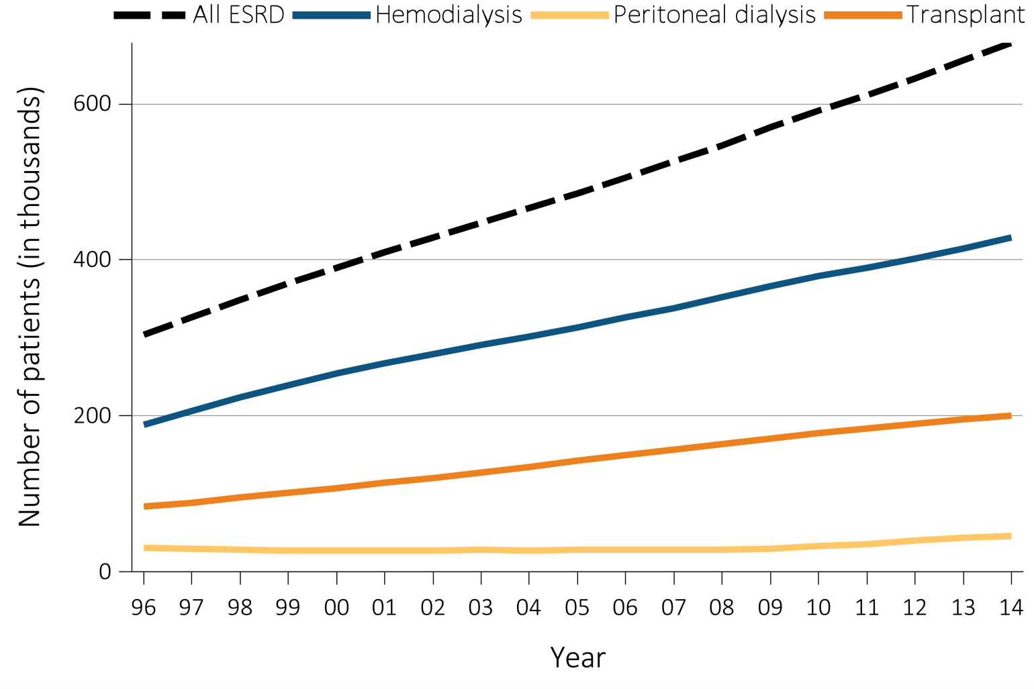
Figure 1.11 Trends in the number of ESRD prevalent cases (in thousands) by modality, in the U.S. population, 1996-2014
Data Source: Reference Table D.1. Abbreviation: ESRD, end-stage renal disease.

Slide 20
Table 1.4 Unadjusted and adjusted* prevalence of ESRD (per million) and annual number of ESRD prevalent cases, by modality (hemodialysis, peritoneal dialysis, and transplantation) and ESRD Network, in the U.S. population, 2014
 |  | Total ESRD |  |  |  | Hemodialysis |  |  | Peritoneal dialysis |  |  | Transplant
Network | States** in network | No. of cases | Adjusted prevalence (per million) | Unadjusted prevalence (per million) |  | No. of cases | % of network |  | No. of cases | % of network |  | No. of cases | % of network
8 | AL, MS, TN | 35140 | 2339 | 2428 |  | 23808 | 67.8 |  | 2802 | 8.0 |  | 8410 | 23.9
6 | NC, SC, GA | 59380 | 2260 | 2365 |  | 40533 | 68.3 |  | 4917 | 8.3 |  | 13774 | 23.2
5 | MD, DC, VA, WV | 39245 | 2231 | 2317 |  | 25003 | 63.7 |  | 2400 | 6.1 |  | 11700 | 29.8
10 | IL | 30102 | 2228 | 2317 |  | 18301 | 60.8 |  | 1917 | 6.4 |  | 9758 | 32.4
18 | S. CA | 55698 | 2177 | 2274 |  | 37558 | 67.4 |  | 4343 | 7.8 |  | 13661 | 24.5
14 | TX | 59670 | 2116 | 2187 |  | 41281 | 69.2 |  | 3926 | 6.6 |  | 14208 | 23.8
17 | N. CA, HI, GU, AS | 36668 | 2112 | 2195 |  | 21879 | 61.3 |  | 3077 | 8.6 |  | 10650 | 29.8
3 | NJ, PR | 27205 | 2103 | 2184 |  | 12712 | 64.2 |  | 877 | 4.4 |  | 6163 | 31.1
13 | AR, LA, OK | 24766 | 2075 | 2141 |  | 16609 | 67.1 |  | 2045 | 8.3 |  | 6015 | 24.3
2 | NY | 42624 | 2047 | 2119 |  | 28040 | 65.8 |  | 1528 | 3.6 |  | 12982 | 30.5
4 | DE, PA | 29182 | 2039 | 2116 |  | 17832 | 61.1 |  | 1843 | 6.3 |  | 9421 | 32.3
9 | IN, KY, OH | 46204 | 1962 | 2032 |  | 28985 | 62.7 |  | 3401 | 7.4 |  | 13561 | 29.4
7 | FL | 40258 | 1926 | 1997 |  | 25976 | 64.5 |  | 2914 | 7.2 |  | 11211 | 27.8
11 | MI, MN, ND, SD, WI | 44363 | 1867 | 1941 |  | 24774 | 55.8 |  | 2434 | 5.5 |  | 17025 | 38.4
12 | IA, KS, MO, NE | 24584 | 1695 | 1750 |  | 13625 | 55.4 |  | 1980 | 8.1 |  | 8893 | 36.2
15 | AZ, CO, NV, NM, UT, WY | 34342 | 1581 | 1653 |  | 20092 | 58.5 |  | 2522 | 7.3 |  | 11596 | 33.8
1 | CT, MA, ME, NH, RI, VT | 23127 | 1498 | 1560 |  | 12563 | 54.3 |  | 1394 | 6.0 |  | 9116 | 39.4
16 | AK, ID, MT, OR, WA | 21512 | 1419 | 1474 |  | 11648 | 54.1 |  | 1801 | 8.4 |  | 7975 | 37.1
 | All networks | 678383 | 1990 | 2067 |  | 421219 | 63.3 |  | 46121 | 6.9 |  | 196119 | 29.5
Data Source: Special analyses, USRDS ESRD Database. *Adjusted for age, sex, and race. The standard population was the U.S. population in 2011. Listed from lowest to highest prevalence per million. **Includes 50 states, Washington, D.C. (DC), Puerto Rico (PR), Guam (GU), and American Samoa (AS). Northern and Southern California (CA) split into Networks 17 and 18. Abbreviations: Af Am, African American; ESRD, end-stage renal disease; Hisp, Hispanic; N Am, Native American.

Slide 21
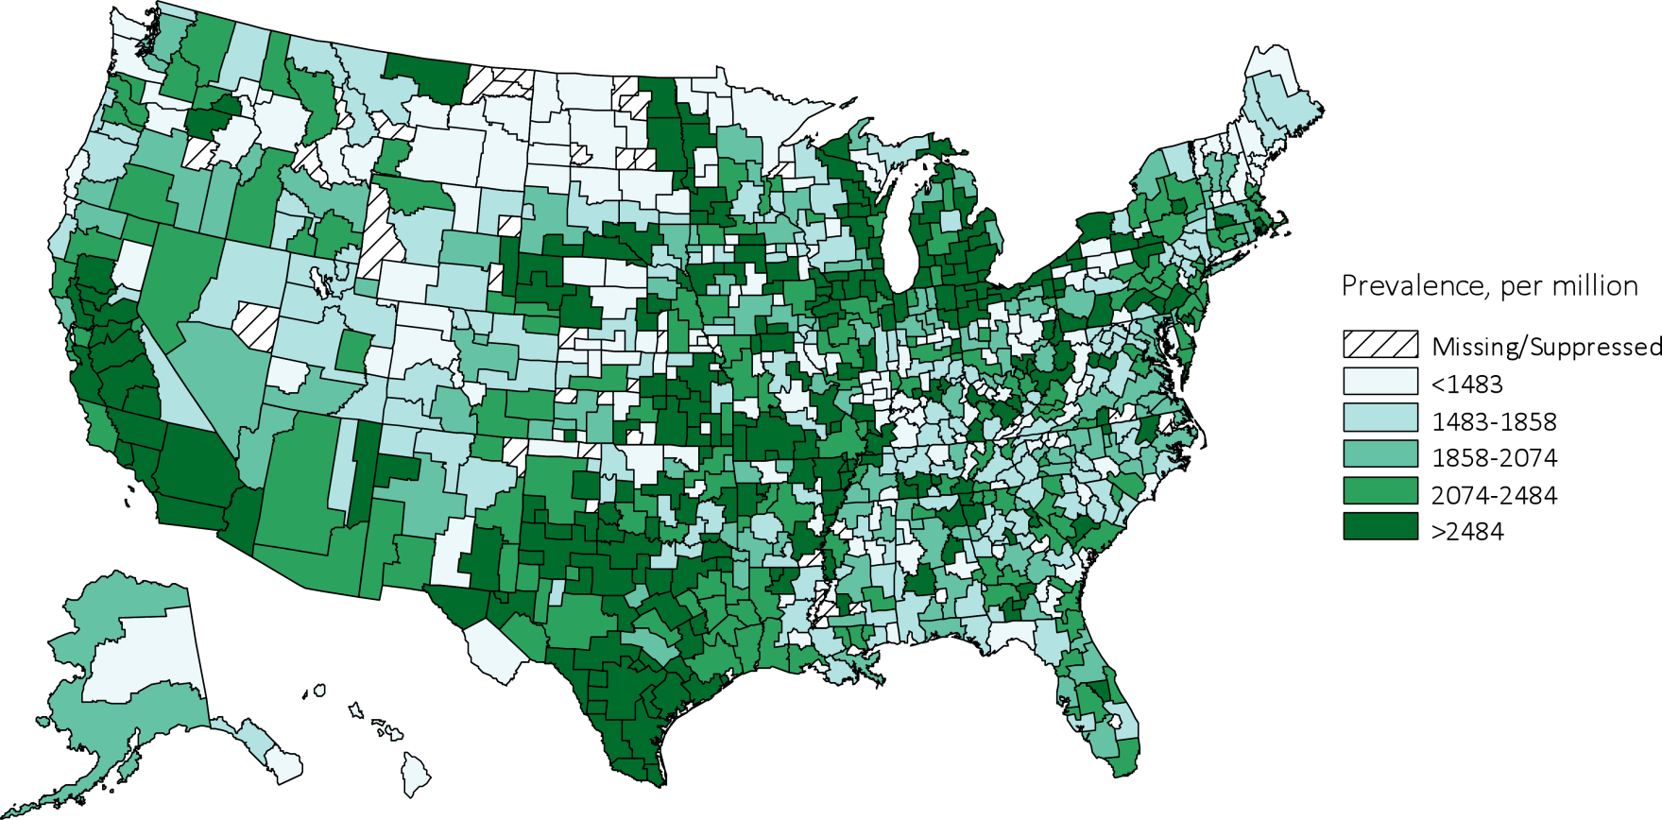
Figure 1.12 Map of the adjusted* prevalence (per million) of ESRD, by Health Service Area, in the U.S. population, 2014**
Data Source: Special analyses, USRDS ESRD Database. *Adjusted for age, sex, and race. The standard population was the U.S. population in 2011. **Three Health Service Areas were suppressed because the ratio of unadjusted rate to adjusted rate or adjusted rate to unadjusted rate was greater than 3. Values for cells with 10 or fewer patients are suppressed. Abbreviation: ESRD, end-stage renal disease.

Slide 22
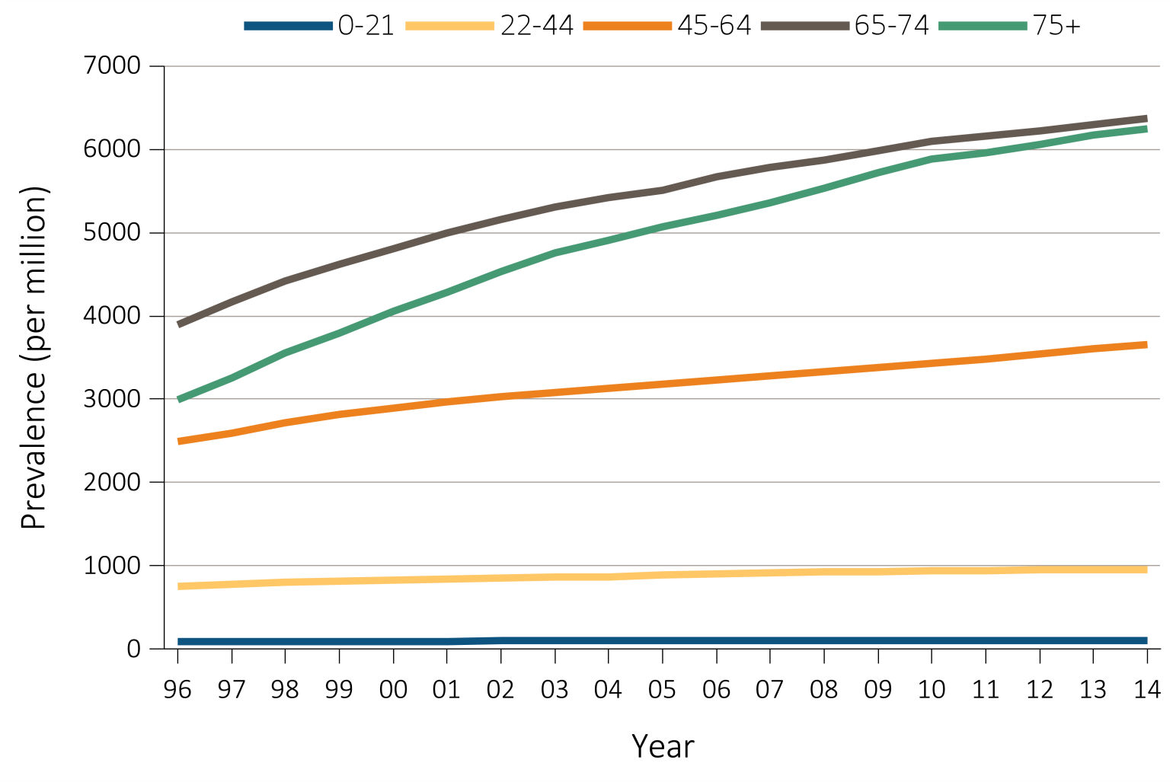
Figure 1.13 Trends in the adjusted* prevalence (per million) of ESRD, by age group, in the U.S. population, 1996-2014
Data Source: Reference Table B.2(2) and special analyses, USRDS ESRD Database. *Point prevalence on December 31 of each year. Adjusted for sex and race. The standard population was the U.S. population in 2011. Abbreviations: ESRD, end-stage renal disease.

Slide 23
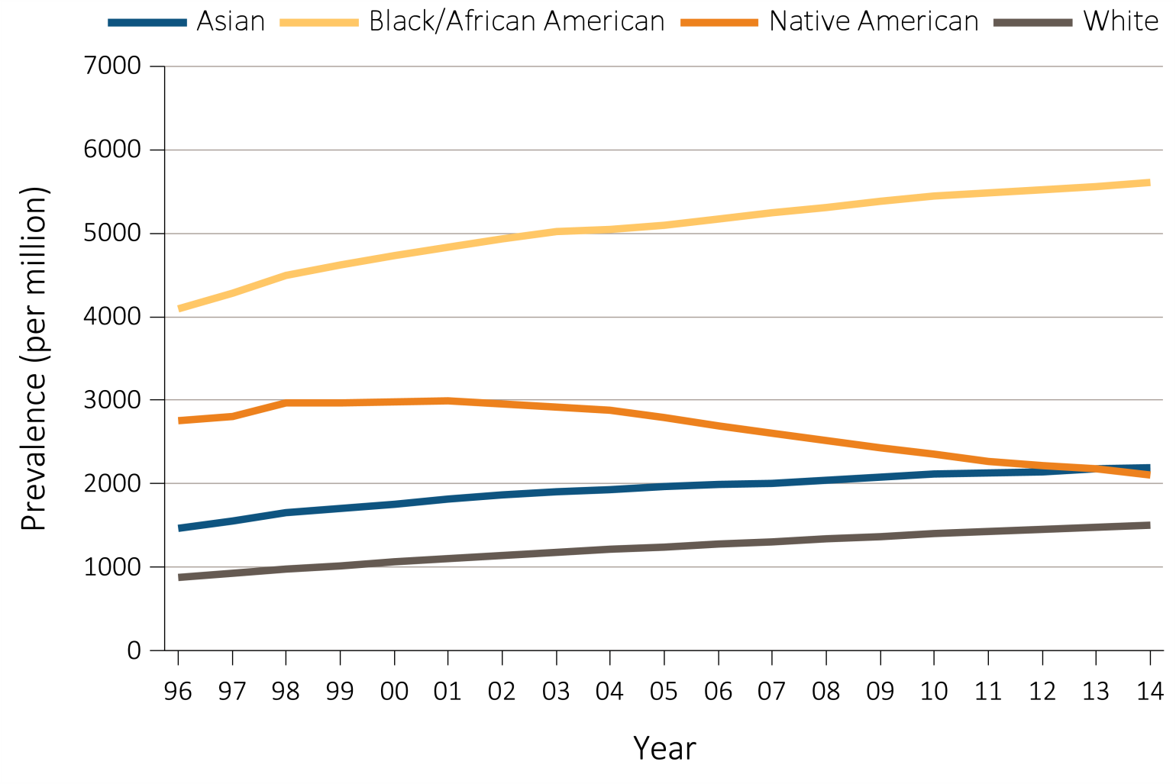
Figure 1.14 Trends in adjusted* prevalence (per million) of ESRD, by race, in the U.S. population, 1996-2014
Data Source: Reference Table B.2(2) and special analyses, USRDS ESRD Database. *Point prevalence on December 31 of each year. Adjusted for age and sex. The standard population was the U.S. population in 2011. Abbreviations: Af Am, African American; ESRD, end-stage renal disease.

Slide 24
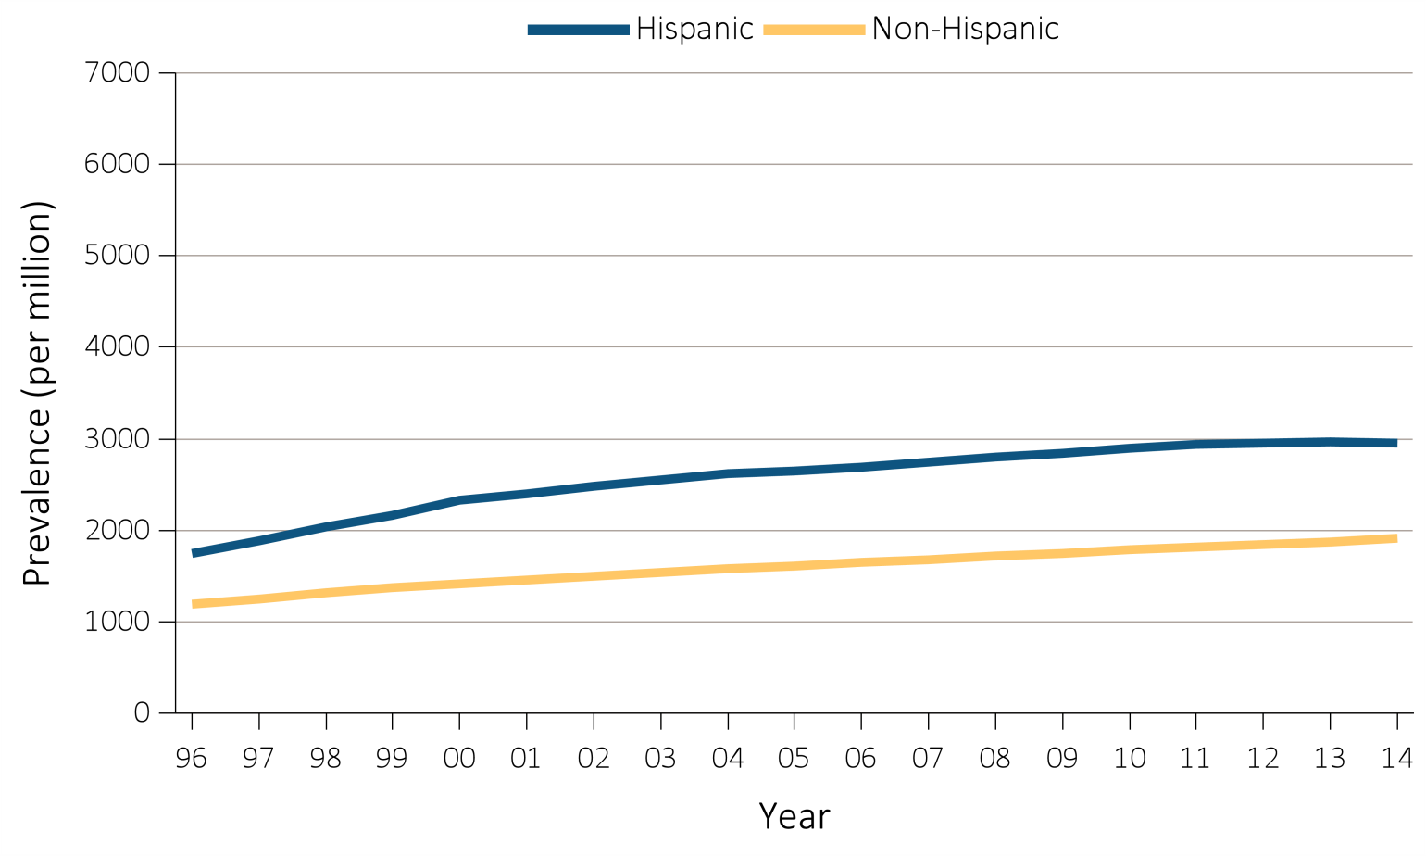
Figure 1.15 Trends in the adjusted* prevalence (per million) of ESRD, by Hispanic ethnicity, in the U.S. population, 1996-2014
Data Source: Reference Tables B.1, B.2(2). *Point prevalence on December 31 of each year. Adjusted for age, sex, and race. The standard population was the U.S. population in 2011. Abbreviation: ESRD, end-stage renal disease.

Slide 25
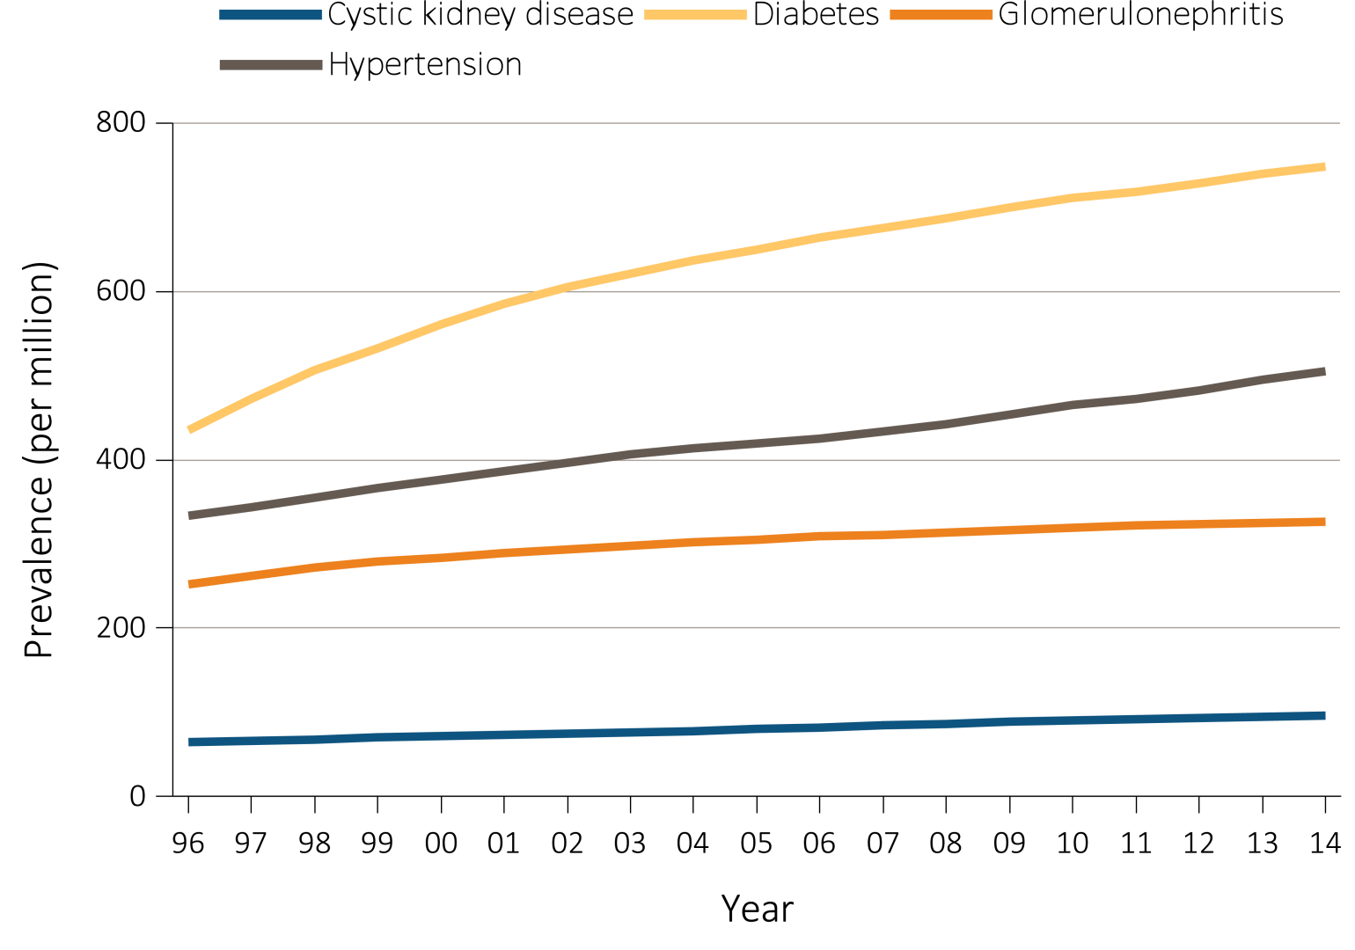
Figure 1.16 Trends in adjusted* prevalence (per million) of ESRD, by primary cause of ESRD, in the U.S. population, 1996-2014
Data Source: Reference Table B.2(2) and special analyses, USRDS ESRD Database. *Point prevalence on December 31 of each year. Adjusted for age, sex, and race. The standard population was the U.S. population in 2011. Abbreviation: ESRD, end-stage renal disease.

Slide 26
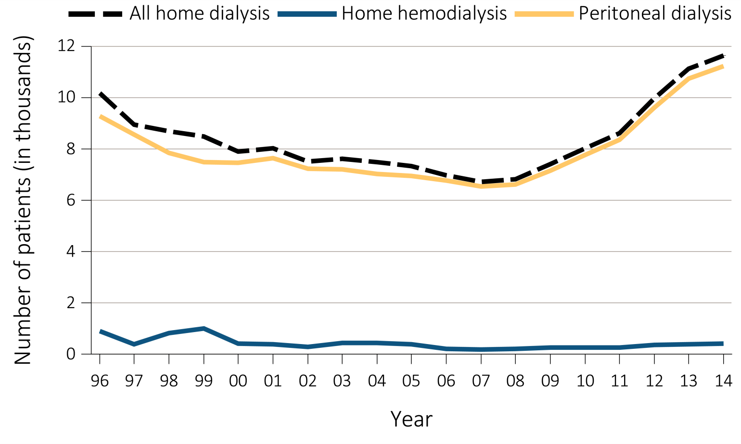
Figure 1.17 Trends in the number of incident ESRD cases (in thousands) using home dialysis, by type of therapy, in the U.S. population, 1996-2014
Data Source: Reference Table D.1. Abbreviations: ESRD, end-stage renal disease; PD, peritoneal dialysis.

Slide 27
Table 1.5 Number and percentage of incident cases of hemodialysis, peritoneal dialysis, and transplantation by age, sex, race, ethnicity, and primary cause of ESRD, in the U.S. population, 2014
 | Total | HD |  |  | PD |  |  | Transplant
 |  | n | % |  | n | % |  | n | %
Age
0-21 | 1,413 | 722 | 51.1 |  | 420 | 29.7 |  | 271 | 19.2
22-44 | 13,630 | 10,926 | 80.2 |  | 1,976 | 14.5 |  | 728 | 5.3
45-64 | 46,674 | 40,437 | 86.6 |  | 4,742 | 10.2 |  | 1,495 | 3.2
65-74 | 30,945 | 27,887 | 90.1 |  | 2,506 | 8.1 |  | 552 | 1.8
75+ | 27,773 | 26,125 | 94.1 |  | 1,592 | 5.7 |  | 56 | 0.2
Sex
Male | 69,968 | 61,612 | 88.1 |  | 6,580 | 9.4 |  | 1,776 | 2.5
Female | 50,467 | 44,485 | 88.1 |  | 4,656 | 9.2 |  | 1,326 | 2.6
Race
White | 80,560 | 70,312 | 87.3 |  | 7,861 | 9.8 |  | 2,387 | 3.0
Black/African American | 31,894 | 29,115 | 91.3 |  | 2,484 | 7.8 |  | 295 | 0.9
Asian | 6,067 | 5,087 | 83.8 |  | 753 | 12.4 |  | 227 | 3.7
Native American | 1,097 | 997 | 90.9 |  | 67 | 6.1 |  | 33 | 3.0
Other/Unknown | 817 | 586 | 71.7 |  | 71 | 8.7 |  | 160 | 19.6
Ethnicity
Hispanic | 17,459 | 15,614 | 89.4 |  | 1,566 | 9.0 |  | 279 | 1.6
Non-Hispanic | 102,976 | 90,483 | 87.9 |  | 9,670 | 9.4 |  | 2,823 | 2.7
Primary Cause of ESRD
Diabetes | 53,525 | 48,311 | 90.3 |  | 4,774 | 8.9 |  | 440 | 0.8
Hypertension | 34,087 | 30,857 | 90.5 |  | 2,950 | 8.7 |  | 280 | 0.8
Glomerulonephritis | 9,038 | 6,991 | 77.4 |  | 1,495 | 16.5 |  | 552 | 6.1
Cystic Kidney | 2,543 | 1,536 | 60.4 |  | 537 | 21.1 |  | 470 | 18.5
Other/Unknown | 21,242 | 18,402 | 86.6 |  | 1,480 | 7.0 |  | 1,360 | 6.4
Total | 120,435 | 106,097 | 88.1 |  | 11,236 | 9.3 |  | 3,102 | 2.6
Data Source: Special analyses, USRDS ESRD Database. The numbers in this table exclude “Other PD” and “Uncertain Dialysis.” Abbreviations: ESRD, end-stage renal disease; HD, hemodialysis; PD, peritoneal dialysis.

Slide 28
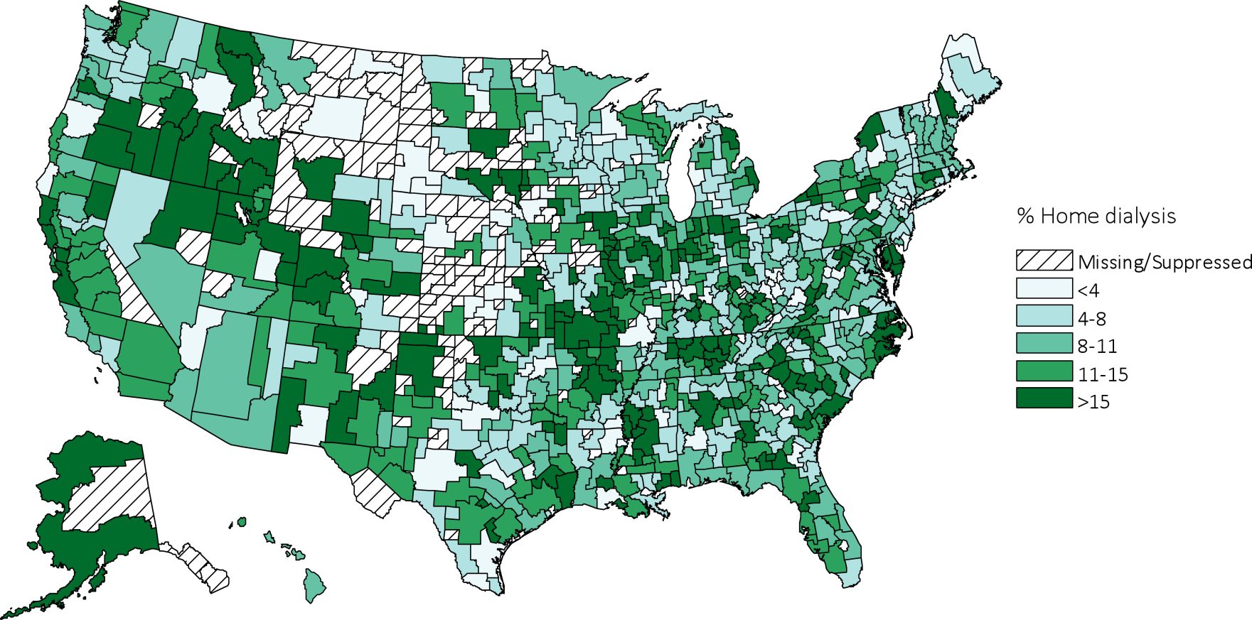
Figure 1.18 Map of the percentage of incident dialysis cases using home dialysis (peritoneal dialysis or home hemodialysis), by Health Service Area, 2014
Data Source: Special analyses, USRDS ESRD Database. Values for cells with 10 or fewer patients are suppressed..

Slide 29
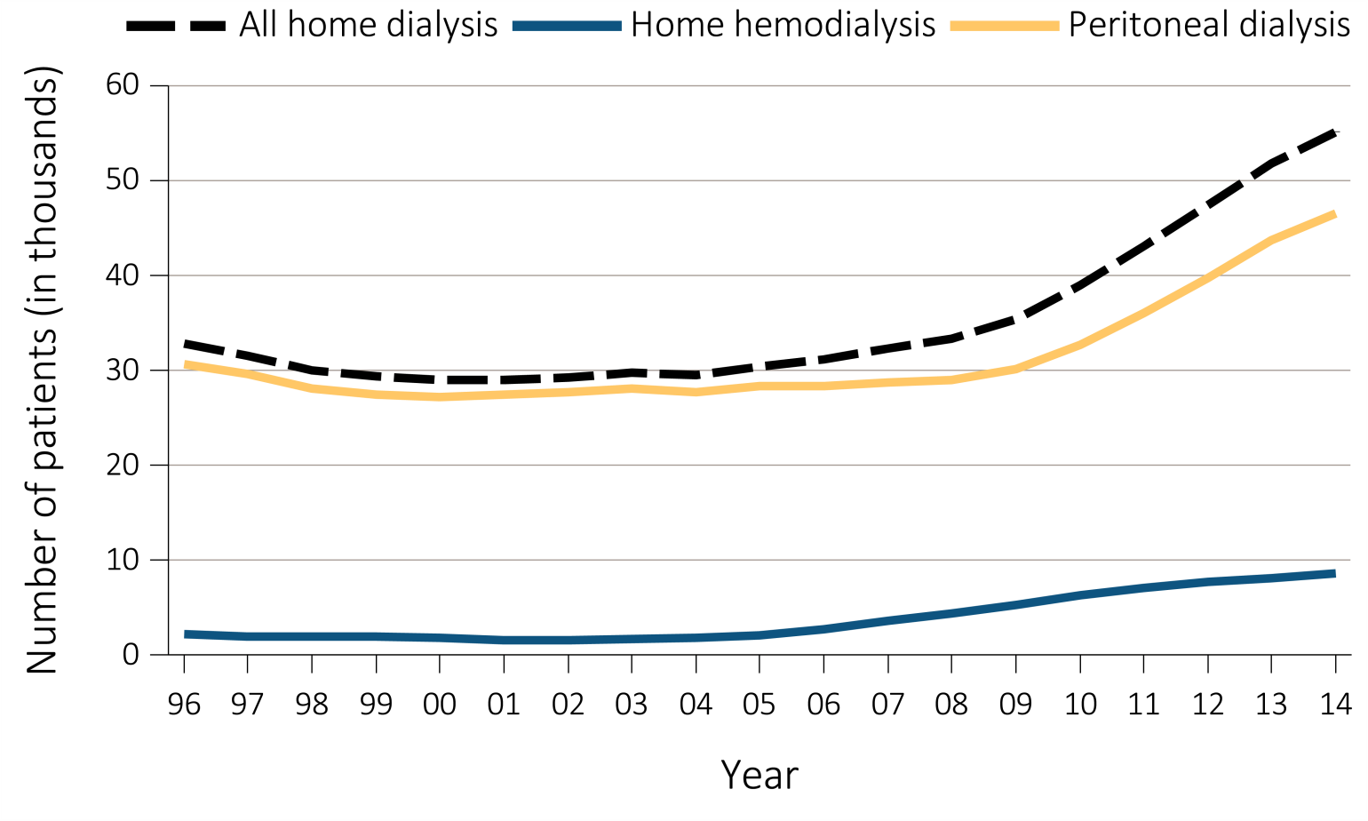
Figure 1.19 Trends in number of prevalent ESRD cases (in thousands) using home dialysis, by type of therapy, in the United States, 1996-2014
Data Source: Reference Table D.1. December 31 prevalent ESRD patients; Peritoneal dialysis consists of CAPD and CCPD only. Abbreviations: CAPD, continuous ambulatory peritoneal dialysis; CCPD, continuous cycler peritoneal dialysis; ESRD, end-stage renal disease.

Slide 30
Table 1.6 Percentage of prevalent cases of in-center hemodialysis, home hemodialysis, peritoneal dialysis, and transplant by age, sex, race, ethnicity, and primary ESRD diagnosis, in the United States, 2014
 | Total |  | HD |  |  | PD |  |  | Transplant
 |  |  | n | % |  | n | % |  | n | %
Age
0-21 | 9,783 |  | 1,783 | 18.2 |  | 1,131 | 11.6 |  | 6,869 | 70.2
22-44 | 101,298 |  | 50,922 | 50.3 |  | 8,797 | 8.7 |  | 41,579 | 41.0
45-64 | 298,786 |  | 177,690 | 59.5 |  | 20,609 | 6.9 |  | 100,487 | 33.6
65-74 | 157,089 |  | 106,869 | 68.0 |  | 9,943 | 6.3 |  | 40,277 | 25.6
75+ | 109,043 |  | 91,294 | 83.7 |  | 6,054 | 5.6 |  | 11,695 | 10.7
Sex
Male | 389,372 |  | 243,883 | 62.6 |  | 25,658 | 6.6 |  | 119,831 | 30.8
Female | 286,562 |  | 184,637 | 64.4 |  | 20,873 | 7.3 |  | 81,052 | 28.3
Race
White | 414,472 |  | 240,919 | 58.1 |  | 30,680 | 7.4 |  | 142,873 | 34.5
Black/African American | 208,419 |  | 156,716 | 75.2 |  | 11,697 | 5.6 |  | 40,006 | 19.2
Asian | 38,644 |  | 23,463 | 60.7 |  | 3,472 | 9.0 |  | 11,709 | 30.3
Native American | 7,325 |  | 5,099 | 69.6 |  | 432 | 5.9 |  | 1,794 | 24.5
Other/Unknown | 7,139 |  | 2,361 | 33.1 |  | 253 | 3.5 |  | 4,525 | 63.4
Ethnicity
Hispanic | 115,330 |  | 78,135 | 67.7 |  | 7,190 | 6.2 |  | 30,005 | 26.0
Non-Hispanic | 560,669 |  | 350,423 | 62.5 |  | 39,344 | 7.0 |  | 170,902 | 30.5
Primary Cause of ESRD
Diabetes | 255,896 |  | 193,487 | 75.6 |  | 17,078 | 6.7 |  | 45,331 | 17.7
Hypertension | 170,487 |  | 125,422 | 73.6 |  | 12,377 | 7.3 |  | 32,688 | 19.2
Glomerulonephritis | 108,406 |  | 44,073 | 40.7 |  | 8,440 | 7.8 |  | 55,893 | 51.6
Cystic Kidney | 31,794 |  | 9,850 | 31.0 |  | 2,064 | 6.5 |  | 19,880 | 62.5
Other/Unknown | 109,416 |  | 55,726 | 50.9 |  | 6,575 | 6.0 |  | 47,115 | 43.1
Total | 675,999 |  | 428,558 | 63.4 |  | 46,534 | 6.9 |  | 200,907 | 29.7
Data Source: Special analyses, USRDS ESRD Database. The numbers in this table exclude “Other PD” and “Uncertain Dialysis.” Abbreviation: ESRD, end-stage renal disease; HD, hemodialysis; PD, peritoneal dialysis.

Slide 31
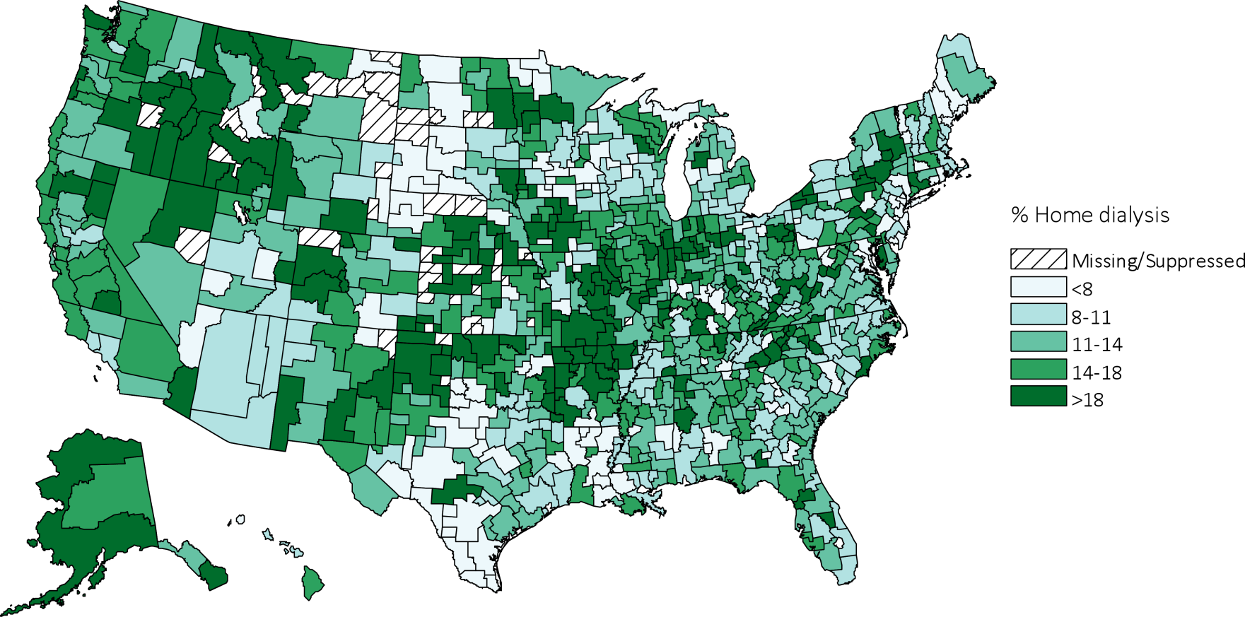
Figure 1.20 Map of the percentage of prevalent dialysis cases using home dialysis, by Health Service Area, 2014
Data Source: Special analyses, USRDS ESRD Database. Values for cells with 10 or fewer patients are suppressed..

Slide 32
Table 1.7 Distribution (%) of the reported duration of pre-ESRD nephrology care, by (a) demographic and (b) clinical characteristics, among incident ESRD cases in the U.S. population, 2014
(a) Demographic characteristics (% within row)
 |  | Duration of pre-ESRD nephrology care
 | No. of cases | >12 mo. | 6-12 mo. | 0-6 mo. | None | Unknown
Total | 116290 | 30.6 | 18.6 | 13.2 | 24.2 | 13.4
Age
0-21 | 1523 | 43.1 | 13.8 | 15.1 | 22.1 | 5.9
22-44 | 13513 | 27.4 | 17.8 | 13.1 | 29.1 | 12.5
45-64 | 44653 | 28.1 | 18.8 | 13.6 | 26 | 13.3
65-74 | 29745 | 32.8 | 18.9 | 12.9 | 21.8 | 13.5
75+ | 26856 | 33.1 | 18.5 | 12.7 | 21.3 | 14.2
Sex
Female | 49041 | 30.8 | 18.6 | 13.4 | 23.6 | 13.5
Male | 67249 | 30.5 | 18.5 | 13 | 24.6 | 13.3
Race
Native American | 1158 | 27.6 | 18.6 | 18.4 | 26.2 | 9.1
Asian | 6029 | 30.5 | 19.5 | 15 | 21.7 | 13.2
Black/African American | 31252 | 26.2 | 18.4 | 12.7 | 26.8 | 15.6
White | 77843 | 32.4 | 18.5 | 13.1 | 23.3 | 12.6
Other/Unknown | * | * | * | 12.5 | 12.5 | 50
Ethnicity
Non-Hispanic | 99715 | 31.8 | 18.6 | 13 | 23.4 | 13.1
Hispanic | 16575 | 23.3 | 18.5 | 14 | 29 | 15.1
Primary Diagnosis
Diabetes | 53642 | 31.4 | 20.6 | 13.7 | 21 | 13.3
Hypertension | 34226 | 27.4 | 17.9 | 13.1 | 25.6 | 15.9
Glomerulonephritis | 9151 | 38.8 | 17.8 | 12.6 | 22.7 | 8
Cystic kidney | 2573 | 58.3 | 16.3 | 8.6 | 9.6 | 7.2
Other/Unknown | 16698 | 25.8 | 13.9 | 12.8 | 34.5 | 12.4
Data Source: Special analyses, USRDS ESRD Database. Population only includes incident cases with CMS form 2728. *Count ≤10. eGFR calculated using the CKD-EPI equation (CKD-EPI eGFR (ml/min/1.73 m2) for those aged ≥18 years and the Schwartz equation for those aged <18 years. Abbreviations: AV, arteriovenous fistula; CKD-EPI, chronic kidney disease epidemiology calculation; CVC, central venous catheter; eGFR, estimated glomerular filtration rate; ESA, erythropoiesis-stimulating agents; ESRD, end-stage renal disease; RRT, renal replacement therapy.

Slide 33
Table 1.7 Distribution (%) of the reported duration of pre-ESRD nephrology care, by (a) demographic and (b) clinical characteristics, among incident ESRD cases in the U.S. population, 2014
(b) Clinical characteristics (% within row)
 |  | Duration of pre-ESRD Nephrology Care
 | No. of cases | >12 mo. | 6-12 mo. | 0-6 mo. | None | Unknown
Dietary care
No | 106987 | 28.7 | 17.9 | 12.5 | 26.2 | 14.5
Yes | 9303 | 52.6 | 25.5 | 20.7 | 0.8 | 0.4
ESA use
No | 99400 | 26.7 | 17.5 | 12.5 | 27.8 | 15.5
Yes | 16890 | 53.7 | 25.1 | 17.2 | 3 | 1
eGFR at RRT start
<5 | 16366 | 25.3 | 16.4 | 11.3 | 33.8 | 13.1
5-<10 | 54384 | 32.4 | 19.3 | 13.1 | 22.8 | 12.5
10-<15 | 31461 | 32.4 | 19.2 | 14.1 | 20.8 | 13.4
>=15 | 13967 | 26.1 | 16.7 | 13.7 | 25.9 | 17.4
Vascular Access
AV fistula | 17253 | 55.1 | 24 | 9.5 | 3.8 | 7.5
AV graft | 2965 | 43.1 | 24.3 | 13.6 | 9.7 | 9.2
CVC with maturing fistula/graft | 19087 | 30.7 | 21.9 | 14.6 | 20.9 | 11.8
CVC only | 63052 | 19 | 14.8 | 13.8 | 35 | 17.4
Other/Unknown | 13933 | 49.8 | 23.1 | 12.7 | 7.9 | 5.7
Data Source: Special analyses, USRDS ESRD Database. Population only includes incident cases with CMS form 2728. *Count ≤10. eGFR calculated using the CKD-EPI equation (CKD-EPI eGFR (ml/min/1.73 m2) for those aged ≥18 years and the Schwartz equation for those aged <18 years. Abbreviations: AV, arteriovenous fistula; CKD-EPI, chronic kidney disease epidemiology calculation; CVC, central venous catheter; eGFR, estimated glomerular filtration rate; ESA, erythropoiesis-stimulating agents; ESRD, end-stage renal disease; RRT, renal replacement therapy.

Slide 34
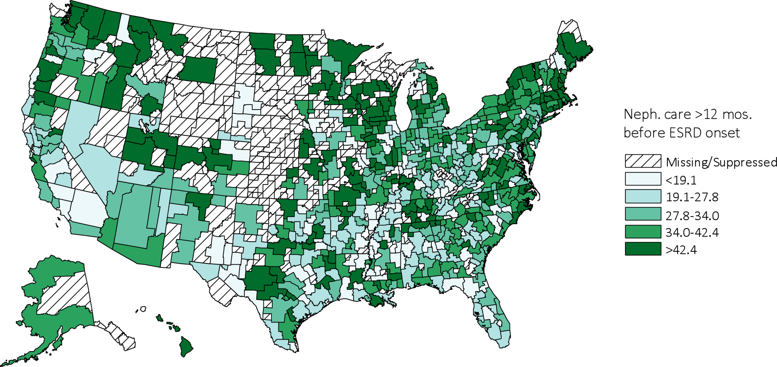
Figure 1.21 Percent of incident cases who had received >12 months of pre-ESRD nephrology care, by Health Service Area, 2014
Data Source: Special analyses, USRDS ESRD Database. Population only includes incident cases with CMS form 2728. Values for cells with 10 or fewer patients are suppressed. Abbreviations: ESRD, end-stage renal disease; Neph., nephrology.

Slide 35
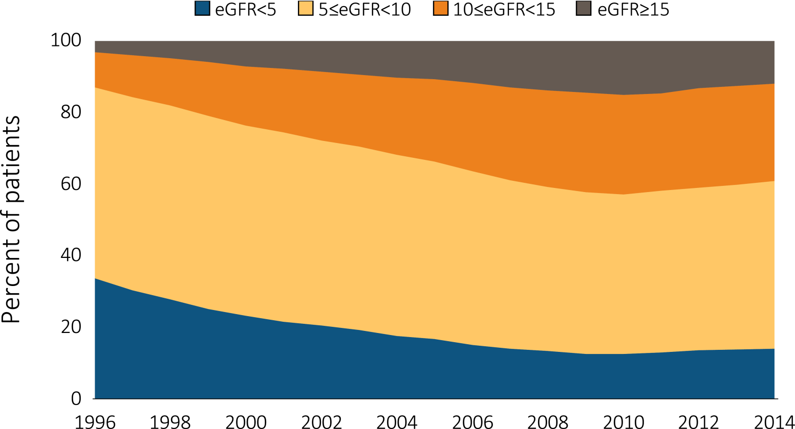
Figure 1.22 Trends in the distribution (%) of eGFR (ml/min/1.73 m2) among incident ESRD patients, 1996-2014
Data Source: Special analyses, USRDS ESRD Database. Population only includes incident cases with CMS form 2728. eGFR calculated using the CKD-EPI equation (CKD-EPI eGFR (ml/min/1.73 m2) for those aged ≥18 and the Schwartz equation for those aged <18. Abbreviations: CKD-EPI; chronic kidney disease epidemiology calculation; eGFR, estimated glomerular filtration rate; ESRD, end-stage renal disease.

Slide 36
Table 1.8 Distributions of laboratory values (mean) and treatment characteristics (%), by age, sex, race, ethnicity, and primary cause of ESRD, among incident ESRD cases, 2014
 | Nutrition |  |  |  | Anemia |  |  |  | Lipids |  |  |  | Diabetes
 | eGFR (mL/min/ 1.73 m²) | Serum albumin (g/dL) | Dietary care (%) |  | Hemoglobin (g/dL) | ESA use (%) |  |  |  | Total cholesterol (mg/dL) | LDL (mg/dL) |  | HbA1c (%)
Age
0-21 | 13.41 | 3.4 | 37.5 |  | 9.7 | 27.7 |  |  | 177 |  | 106.9 |  | 5.27
22-44 | 9.49 | 3.3 | 7.5 |  | 9.4 | 10.3 |  |  | 172 |  | 102.2 |  | 7.03
45-64 | 9.97 | 3.2 | 7.7 |  | 9.4 | 12.0 |  |  | 159 |  | 90.9 |  | 6.87
65-74 | 10.31 | 3.2 | 7.9 |  | 9.5 | 14.9 |  |  | 149 |  | 83.0 |  | 6.68
75+ | 10.44 | 3.2 | 6.8 |  | 9.6 | 16.2 |  |  | 143 |  | 77.5 |  | 6.43
Sex
Male | 10.48 | 3.2 | 8.0 |  | 9.6 | 12.5 |  |  | 148 |  | 84.0 |  | 6.71
Female | 9.71 | 3.2 | 7.6 |  | 9.4 | 15.5 |  |  | 165 |  | 92.9 |  | 6.78
Race
White | 10.43 | 3.2 | 8.2 |  | 9.6 | 13.9 |  |  | 152 |  | 85.3 |  | 6.73
Black/African American | 9.72 | 3.2 | 6.4 |  | 9.2 | 12.4 |  |  | 160 |  | 92.7 |  | 6.71
Native American | 9.36 | 2.9 | 6.6 |  | 9.3 | 13.7 |  |  | 146 |  | 77.1 |  | 7.18
Asian | 8.94 | 3.3 | 10.8 |  | 9.4 | 18.6 |  |  | 164 |  | 91.5 |  | 6.74
Ethnicity
Hispanic | 9.61 | 3.2 | 7.4 |  | 9.4 | 12.0 |  |  | 156 |  | 89.1 |  | 6.80
Non-Hispanic | 10.24 | 3.2 | 7.9 |  | 9.5 | 14.1 |  |  | 155 |  | 87.2 |  | 6.73
Primary Cause of ESRD
Diabetes | 10.35 | 3.1 | 7.5 |  | 9.4 | 15.3 |  |  | 154 |  | 86.6 |  | 7.09
Hypertension | 9.67 | 3.3 | 6.1 |  | 9.6 | 12.2 |  |  | 154 |  | 87.1 |  | 6.17
Glomerulonephritis | 9.19 | 3.3 | 11.2 |  | 9.6 | 18.0 |  |  | 171 |  | 99.3 |  | 5.93
Cystic Kidney | 9.35 | 3.8 | 15.0 |  | 10.3 | 16.1 |  |  | 161 |  | 88.1 |  | 5.68
Total | 10.15 | 3.2 | 7.9 |  | 9.5 | 13.7 |  |  | 155 |  | 87.5 |  | 6.74
Data Source: Special analyses, USRDS ESRD Database. Abbreviations: eGFR, estimated glomerular filtration rate; ESA, erythropoiesis-stimulating agents; ESRD, end-stage renal disease; HbA1c, glycosylated hemoglobin; LDL, low-density lipoprotein.

Slide 37
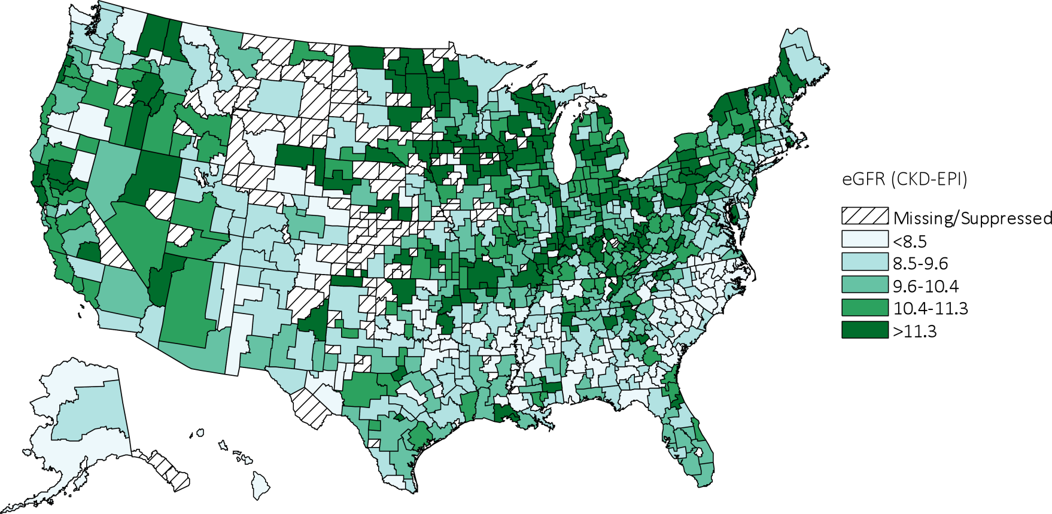
Figure 1.23 Map of mean eGFR at initiation of renal replacement therapy, by Health Service Area, 2014
Data Source: Special analyses, USRDS ESRD Database. Population only includes incident cases with CMS form 2728. eGFR calculated using the CKD-EPI equation (CKD-EPI eGFR (ml/min/1.73 m2) for those aged ≥18 and the Schwartz equation for those aged <18. Values for cells with 10 or fewer patients are suppressed. Abbreviations: eGFR, estimated glomerular filtration rate; CKD-EPI, chronic kidney disease epidemiology calculation.

Slide 38
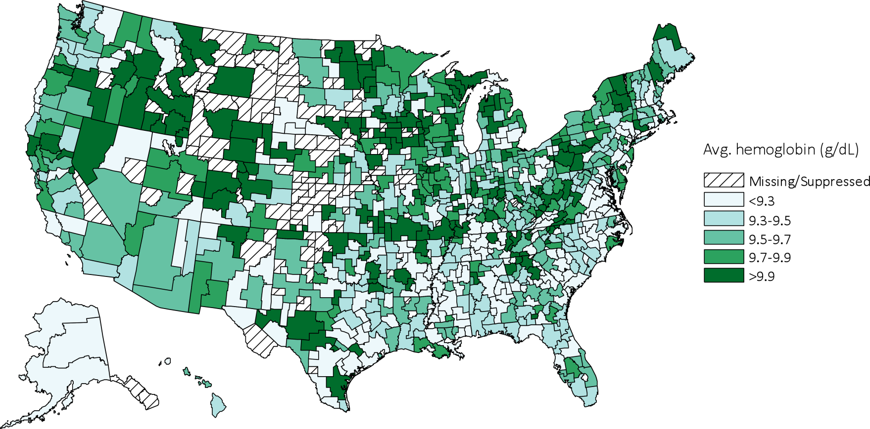
Figure 1.24 Map of average hemoglobin level at initiation of renal replacement therapy, by Health Service Area, 2014
Data Source: Special analyses, USRDS ESRD Database. Population only includes incident cases with CMS form 2728. Values for cells with 10 or fewer patients are suppressed. Abbreviation: ESRD, end-stage renal disease.

Slide 39
Table 1.9 Distribution of duration of pre-ESRD nephrology care, hemoglobin level, and eGFR, by ESRD Network, among incident ESRD cases, 2014
Network | States* in network | Duration of pre-ESRD nephrology care (% in row) |  |  |  |  | Mean eGFR (ml/min/1.73 m²) | Mean Hgb (g/dL)
 |  | >12 months | 6-12 months | 0-6 months | None | Unknown
18 | S. CA | 19.6 | 16.3 | 16.8 | 24.4 | 23.0 | 10.3 | 9.6
14 | TX | 25.0 | 18.4 | 14.6 | 29.0 | 12.9 | 9.4 | 9.5
10 | IL | 25.8 | 16.7 | 13.4 | 22.2 | 21.9 | 10.2 | 9.5
5 | MD, DC, VA, WV | 26.4 | 20.8 | 13.9 | 25.4 | 13.5 | 9.6 | 9.4
7 | FL | 26.5 | 17.7 | 12.9 | 27.0 | 15.9 | 10.0 | 9.4
3 | NJ, PR | 27.4 | 19.6 | 9.9 | 35.3 | 7.7 | 9.6 | 9.5
13 | AR, LA, OK | 28.3 | 18.5 | 11.7 | 26.4 | 15.1 | 9.5 | 9.5
9 | IN, KY, OH | 30.3 | 20.6 | 11.7 | 20.6 | 16.8 | 10.6 | 9.5
8 | AL, MS, TN | 30.5 | 18.9 | 12.6 | 26.1 | 11.9 | 9.1 | 9.3
17 | N. CA, HI, GUAM, AS | 30.7 | 20.7 | 14.8 | 21.3 | 12.5 | 10.1 | 9.5
15 | AZ, CO, NV, NM, UT, WY | 32.2 | 18.1 | 16.2 | 22.5 | 11.0 | 10.4 | 9.7
2 | NY | 32.7 | 17.3 | 11.8 | 23.6 | 14.6 | 9.3 | 9.3
6 | NC, SC, GA | 33.8 | 19.0 | 12.6 | 23.1 | 11.4 | 8.9 | 9.4
12 | IA, KS, MO, NE | 35.4 | 17.9 | 12.2 | 24.8 | 9.8 | 10.5 | 9.8
4 | DE, PA | 36.0 | 19.2 | 13.7 | 21.0 | 10.1 | 10.1 | 9.6
11 | MI, MN, ND, SD, WI | 39.4 | 16.8 | 11.7 | 22.4 | 9.7 | 10.7 | 9.5
16 | AK, ID, MT, OR, WA | 43.5 | 19.3 | 14.6 | 18.6 | 4.1 | 10.1 | 9.7
1 | CT, MA, ME, NH, RI, VT | 47.1 | 19.6 | 10.2 | 15.3 | 7.8 | 9.2 | 9.6
 | All networks | 30.6 | 18.6 | 13.2 | 24.2 | 13.4 | 9.8 | 9.5
Data Source: Special analyses, USRDS ESRD Database. Population only includes incident cases with CMS form 2728. eGFR calculated using the CKD-EPI equation (CKD-EPI eGFR (ml/min/1.73 m2) for those aged ≥18 years and the Schwartz equation for those aged <18 years. Listed from lowest to highest by >12 months duration of pre-ESRD nephrology care. Abbreviations: ESRD, end-stage renal disease; eGFR, estimated glomerular filtration rate; CKD-EPI, chronic kidney disease epidemiology calculation; Hgb, hemoglobin.

