Slide 2
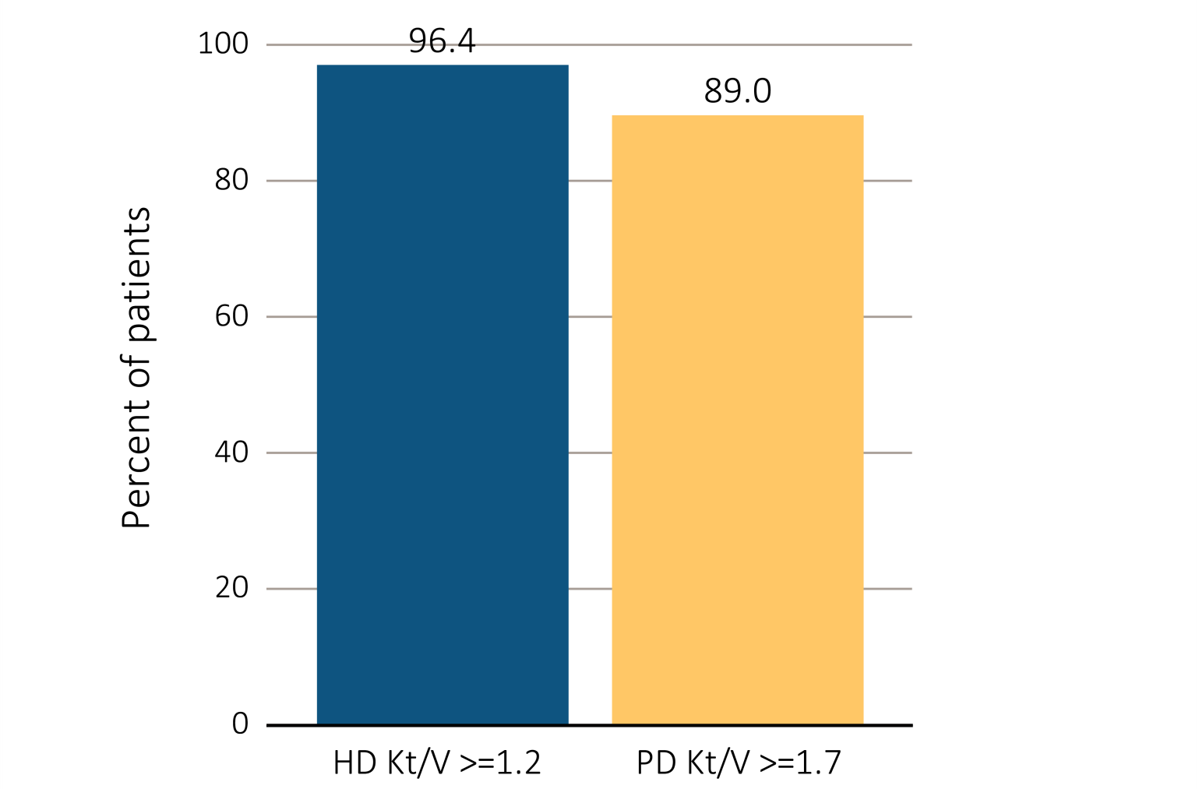
Figure 3.1 ESRD clinical indicators, CROWNWeb data, December 2015
(a) Percentage of prevalent hemodialysis and peritoneal dialysis patients meeting clinical care guidelines for dialysis adequacy by modality
Data Source: Special analyses, USRDS ESRD Database. Results shown are for laboratory values reported to CROWNWeb for December 2015, restricted to patients as follows: (a) Dialysis patients initiating treatment for ESRD at least 1 year prior to December 1, 2015, and who were alive through December 31, 2015. Abbreviations: ESRD, end-stage renal disease; HD, hemodialysis; Hgb, hemoglobin; Kt/V, see Glossary; PD, peritoneal dialysis.

Slide 3
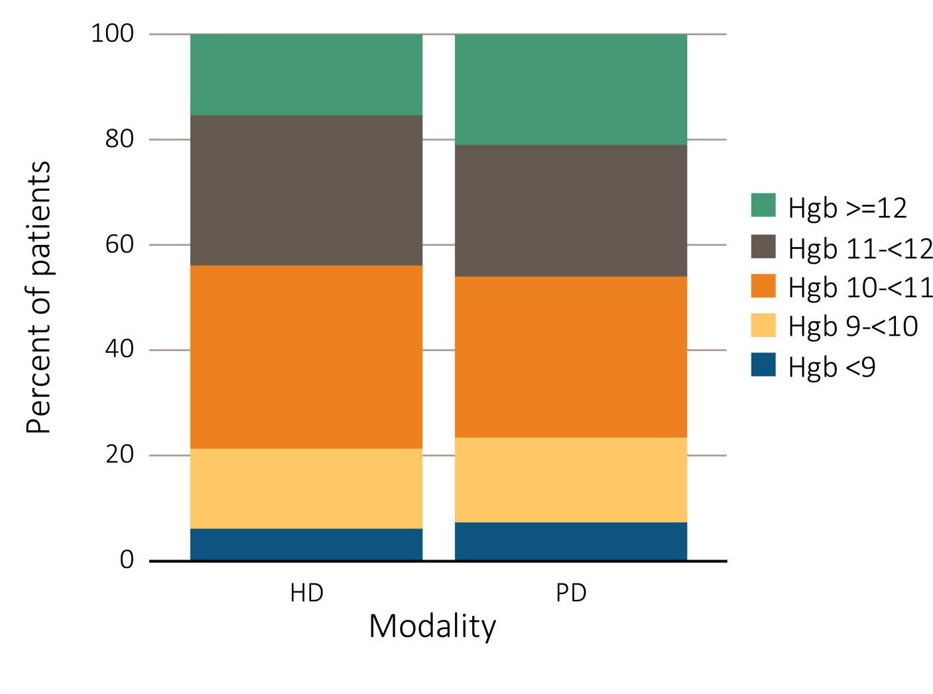
Figure 3.1 ESRD clinical indicators, CROWNWeb data, December 2015 (b) Percentage distribution of achieved mean Hgb among prevalent hemodialysis and peritoneal dialysis patients
Data Source: Special analyses, USRDS ESRD Database. Results shown are for laboratory values reported to CROWNWeb for December 2015, restricted to patients as follows: (b) Dialysis patients initiating treatment for ESRD at least 90 days prior to December 1, 2015, who were ≥18 years old as of December 1, 2015, and who were alive through December 31, 2015. Abbreviations: ESRD, end-stage renal disease; HD, hemodialysis; Hgb, hemoglobin; Kt/V, see Glossary; PD, peritoneal dialysis.

Slide 4
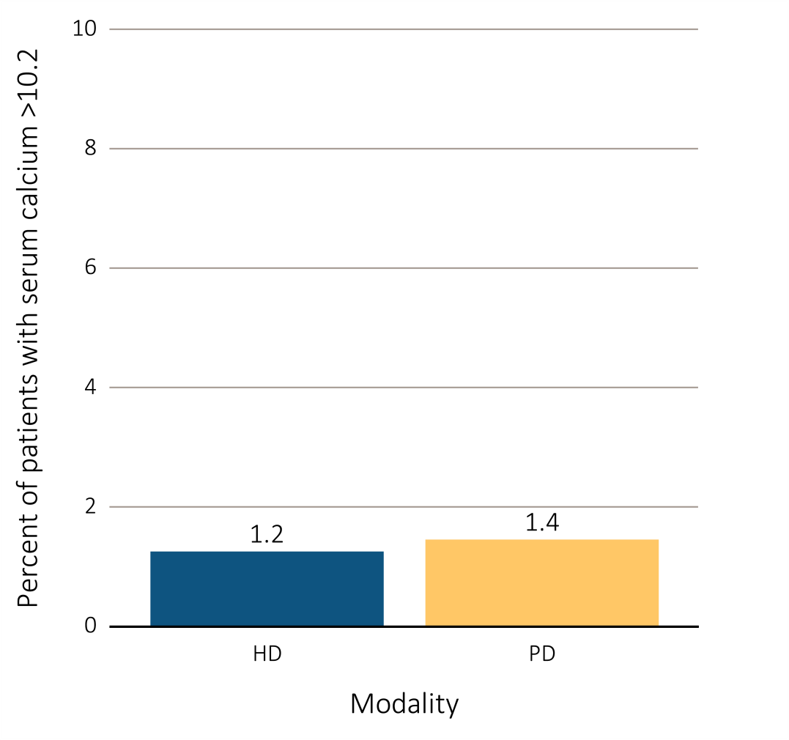
Figure 3.1 ESRD clinical indicators, CROWNWeb data, December 2015 (c) Percentage of dialysis patients with serum calcium >10.2 mg/dL by modality
Data Source: Special analyses, USRDS ESRD Database. Results shown are for laboratory values reported to CROWNWeb for December 2015, restricted to patients as follows: (c) hemodialysis and peritoneal dialysis patients initiating treatment for ESRD at least 90 days prior to December 1, 2015, who were ≥18 years old as of December 1, 2015, and who were alive through December 31, 2015. Abbreviations: CROWNWeb, Consolidated Renal Operations in a Web-Enabled Network; ESRD, end-stage renal disease; HD, hemodialysis; Hgb, hemoglobin; Kt/V, see Glossary; PD, peritoneal dialysis.
.

Slide 5
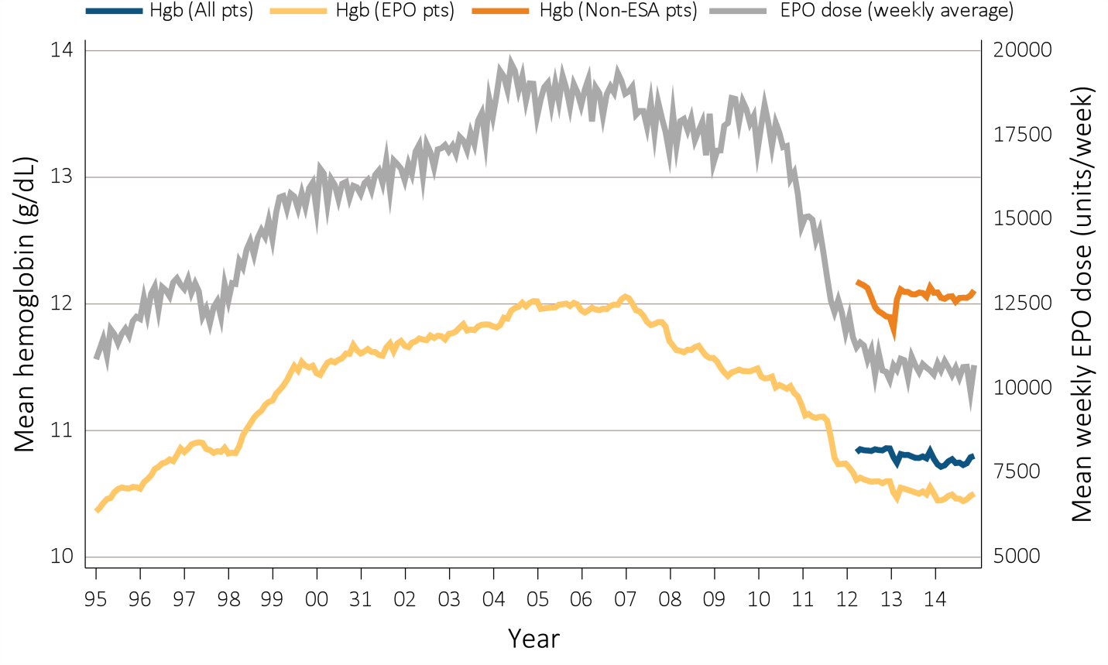
Figure 3.2 Anemia measures among adult hemodialysis patients on dialysis ≥90 days , Medicare claims, 1995-2014 (a) Mean monthly Hgb level and mean weekly EPO dose (averaged over a month)
Data Source: Special analyses, USRDS ESRD Database. (a) Mean monthly Hgb level among ESA-treated adult hemodialysis patients on dialysis ≥90 days (1995 through 2014) or mean monthly Hgb level among all adult hemodialysis patients (April 2012 to December 2014 only) who, within the given month had a Hgb claim (only 1st reported Hgb value in a month was used) and were on dialysis ≥90 days; analyses were restricted to patients ≥18 years old at the start of the month . Mean weekly EPO (epoetin alfa) dose is shown for hemodialysis patients within a given month who had an EPO claim, were on dialysis ≥90 days, and were ≥18 years old at the start of the month. EPO dose is expressed as mean EPO units per week averaged over all EPO claims within a given month. Abbreviations: EPO, erythropoietin; ESA, erythropoiesis-stimulating agents; Hgb, hemoglobin.

Slide 6
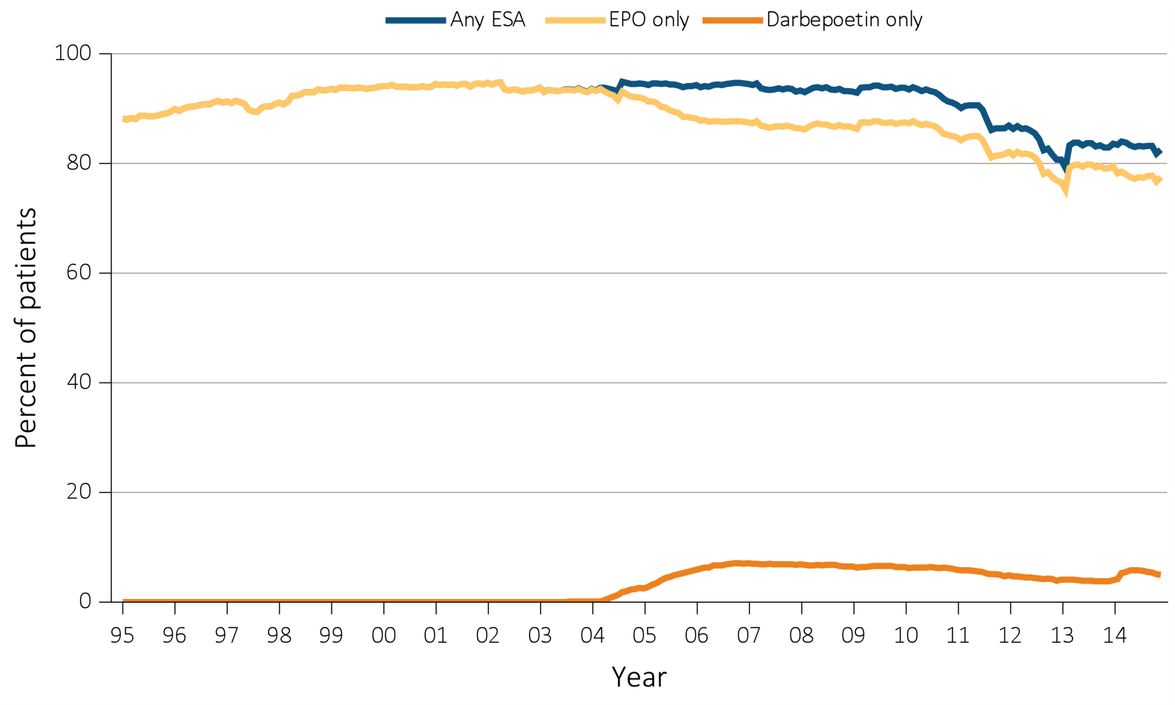
Figure 3.2 Anemia measures among adult hemodialysis patients on dialysis ≥90 days , Medicare claims, 1995-2014 ^{(b) Percent ESA use monthly}
Data Source: Special analyses, USRDS ESRD Database. (b) Monthly ESA use in all hemodialysis patients who were >=18 years old at the start of the month and were on dialysis >=90 days. “EPO only” use is defined as receiving EPO but not darbepoetin; “Darbepoetin Only” use is defined as receiving darbepoetin but not EPO. “Any ESA” use is defined as receiving either or both EPO and darbepoetin. Abbreviations: EPO, erythropoietin; ESA, erythropoiesis-stimulating agents; Hgb, hemoglobin.

Slide 7
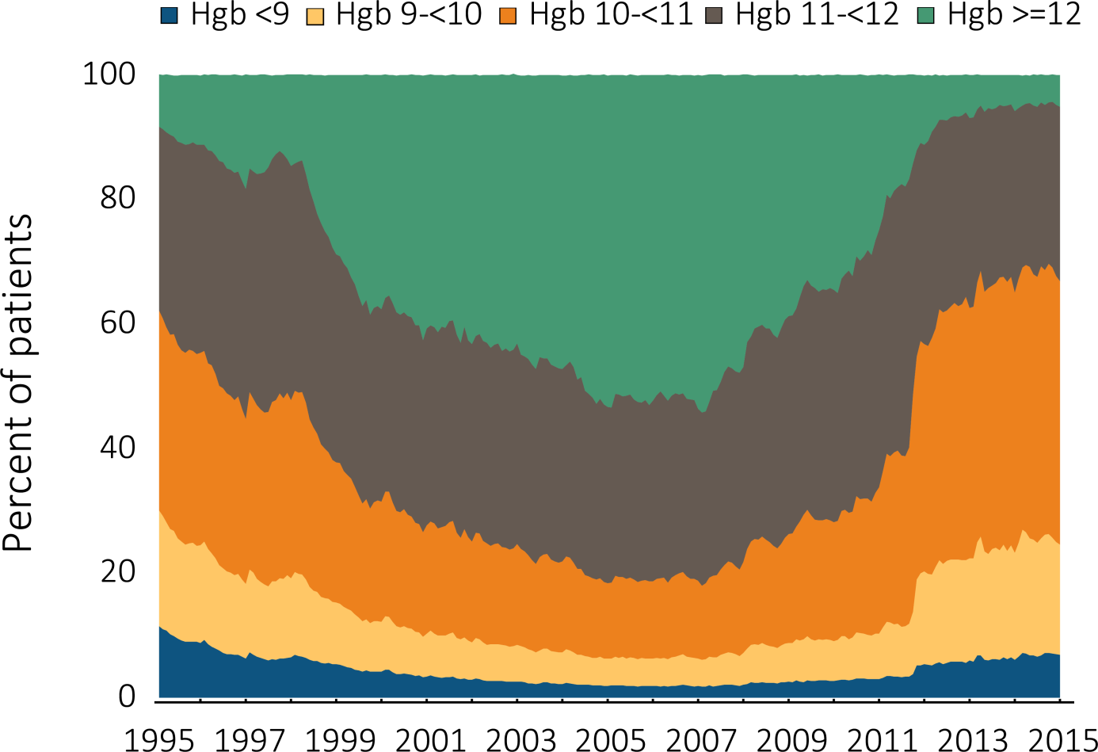
Figure 3.3 Distribution of monthly Hgb (g/dL) levels in ESA-treated adult hemodialysis patients on dialysis ≥90 days, Medicare claims, 1995-2014
Data Source: Special analyses, USRDS ESRD Database. Distribution among hemodialysis patients within a given month who had claims for Hgb level and ESA use, were on dialysis ≥90 days and ≥18 years old at the start of the month. Abbreviations: ESA, erythropoiesis-stimulating agents; Hgb, hemoglobin.

Slide 8
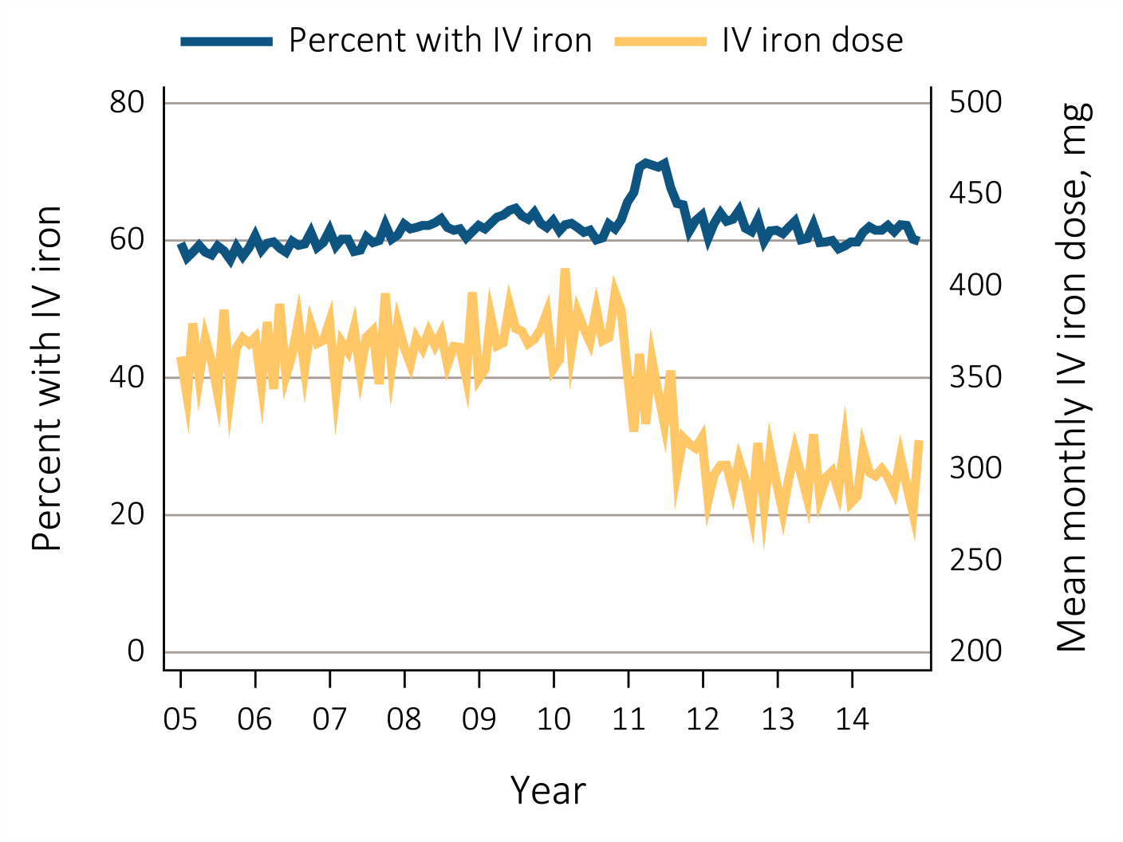
Figure 3.4 Monthly percent IV iron use and mean monthly IV iron dose in adult hemodialysis patients on dialysis ≥90 days, Medicare claims, 2005-2014
Data Source: Special analyses, USRDS ESRD Database. Monthly IV iron use is among hemodialysis patients on dialysis ≥90 days and ≥18 years old at the start of the given month. Mean IV iron dose was calculated as the average number of mg of IV iron given to all such patients during a month, among patients receiving iron during the month. Abbreviation: IV, intravenous.

Slide 9
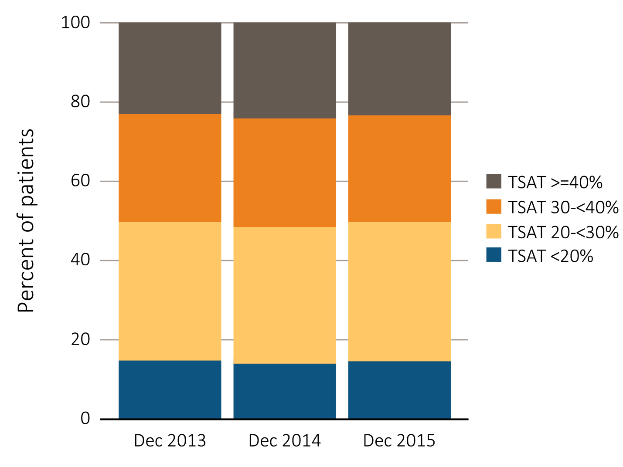
Figure 3.5 Distribution of TSAT levels (%) in adult hemodialysis patients on dialysis for at least 90 days, CROWNWeb data, December 2013, 2014, and 2015
Data Source: Special analyses, USRDS ESRD Database. CROWNWeb clinical extracts for December 2013, December 2014 and December 2015. Dialysis patients on treatment for ESRD at least 90 days at the time of measurement of TSAT level for that year, ≥18 years old as of December 1 of that year and who were alive through December 31 of that year. Abbreviation: TSAT, transferrin saturation.

Slide 10
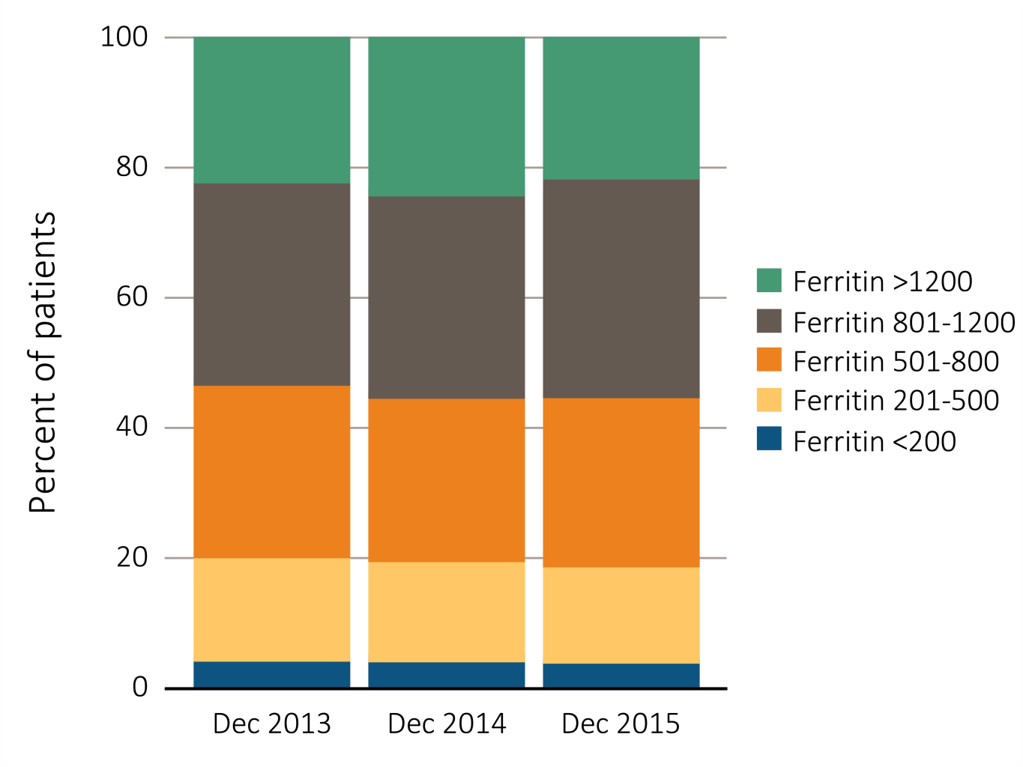
Figure 3.6 Distribution of the most recent value of serum ferritin (ng/mL) level taken between October and December in adult hemodialysis patients on dialysis for at least 90 days, CROWNWeb data, 2013-2015
Data Source: Special analyses, USRDS ESRD Database. CROWNWeb clinical extracts for October to December for years 2013, 2014 and 2015. Dialysis patients initiating treatment for ESRD at least 90 days at the time of measurement of serum ferritin for that year, ≥18 years old as of December 1 of that year and who were alive through December 31 of that year.

Slide 11
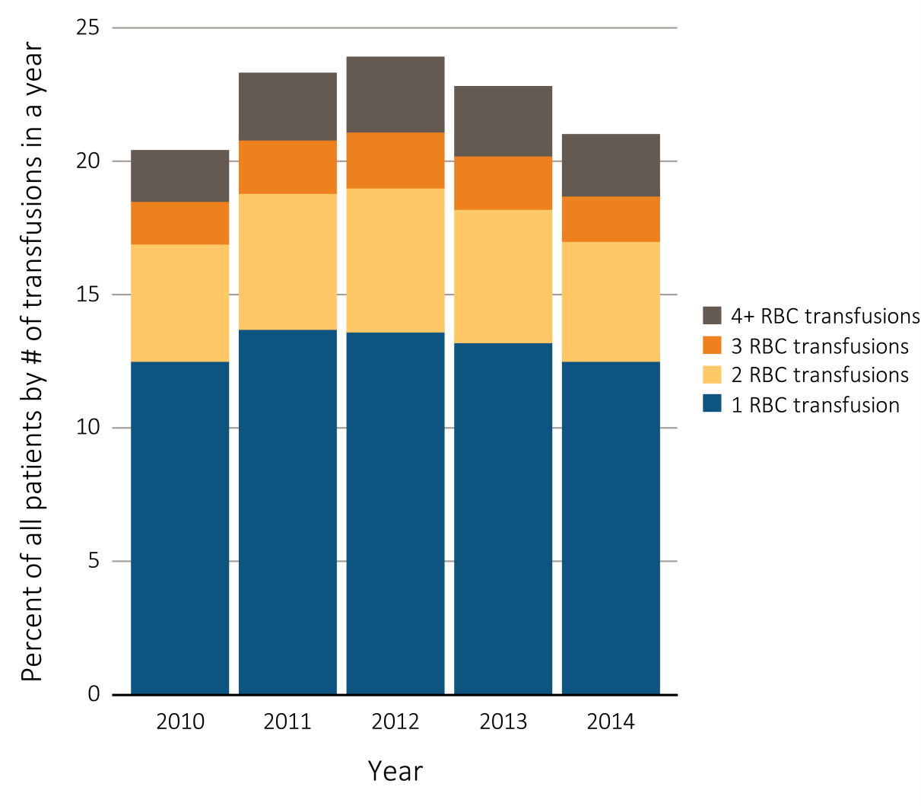
Figure 3.7 Percentage of all adult hemodialysis patients, from Medicare ^{claims data, 2010-2014} (a) Number of red blood cell transfusions received in a year
Data Source: Special analyses, USRDS ESRD Database. The percentage of hemodialysis patients ≥18 years old at the start of the month with ≥1 red blood cell transfusion claims in a given month among hemodialysis patients having a claim for at least one dialysis session during the month. Abbreviation: RBC, red blood cell.

Slide 12
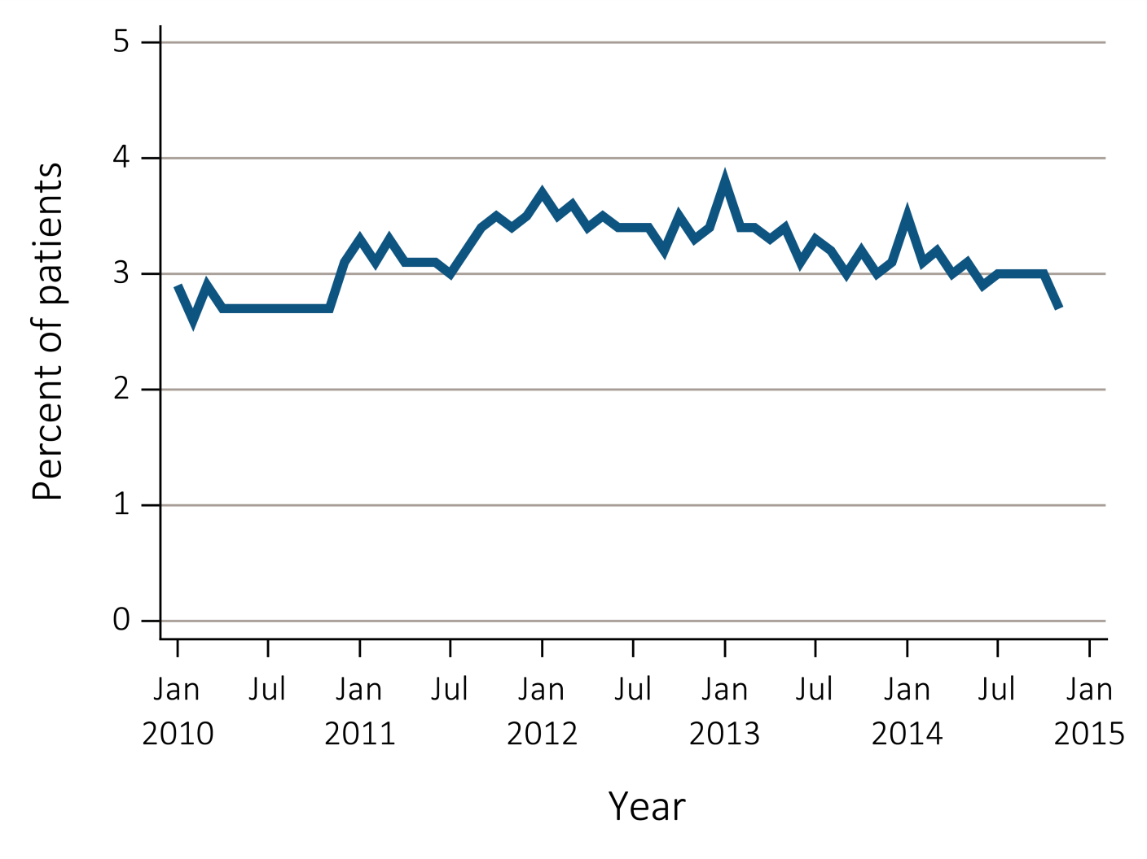
Figure 3.7 Percentage of all adult hemodialysis patients, from Medicare ^{claims data, 2010-2014} (b) With ≥1 claims for a red blood cell transfusion in a month
Data Source: Special analyses, USRDS ESRD Database. The percentage of hemodialysis patients ≥18 years old at the start of the month with ≥1 red blood cell transfusion claims in a given month among hemodialysis patients having a claim for at least one dialysis session during the month. Abbreviation: RBC, red blood cell.

Slide 13
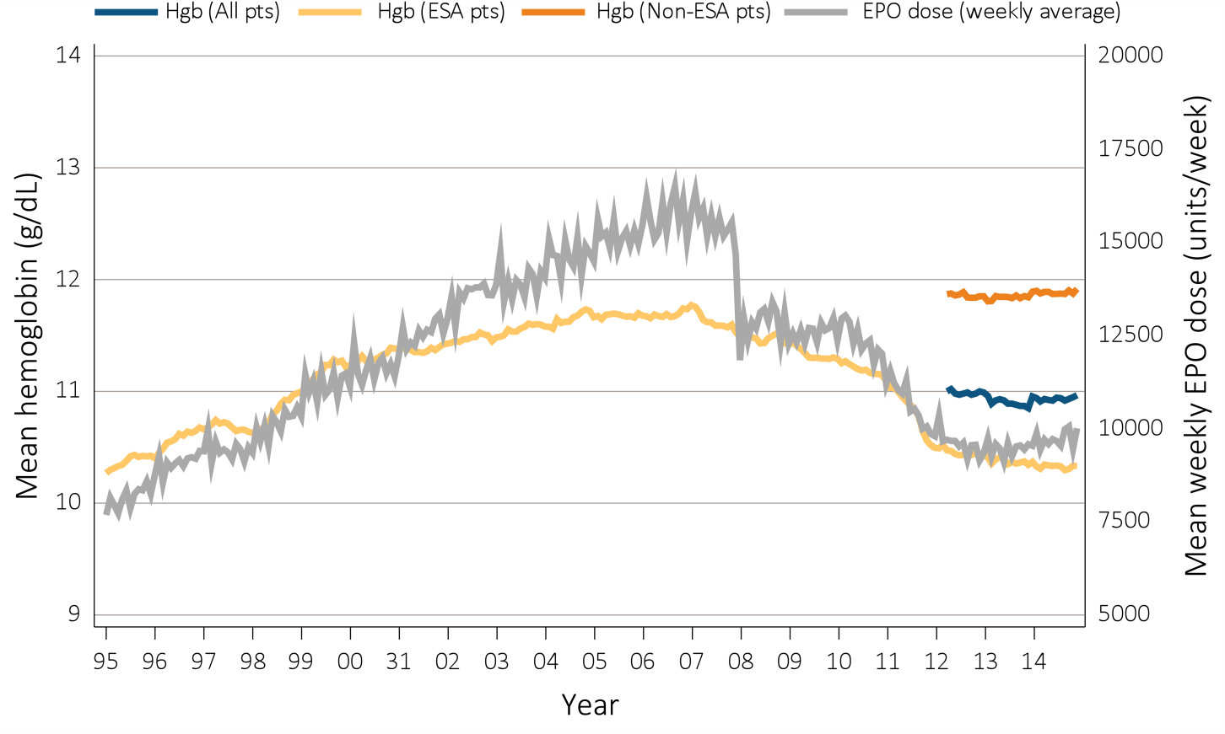
Figure 3.8 Anemia measures among adult peritoneal dialysis patients on dialysis ≥90 days, Medicare claims, 1995-2014 (a) Mean monthly Hgb level and mean weekly EPO dose (averaged over a month)
Data Source: Special analyses, USRDS ESRD Database. (a) Mean monthly Hgb level among ESA-treated adult peritoneal dialysis patients on dialysis ≥90 days (1995 through 2014) or mean monthly Hgb level among all adult peritoneal patients (April 2012 to December 2014 only) who, within the given month had a Hgb claim (only 1st reported Hgb value in a month was used) and were on dialysis ≥90 days; analyses were restricted to patients ≥18 years old at the start of the month. Mean weekly EPO (epoetin alfa) dose is shown for peritoneal patients within a given month who had an EPO claim, were on dialysis ≥90 days, and were ≥18 years old at the start of the month. EPO dose is expressed as mean EPO units per week averaged over all EPO claims within a given month. Abbreviations: EPO, erythropoietin; ESA, erythropoiesis-stimulating agents; Hgb, hemoglobin.

Slide 14
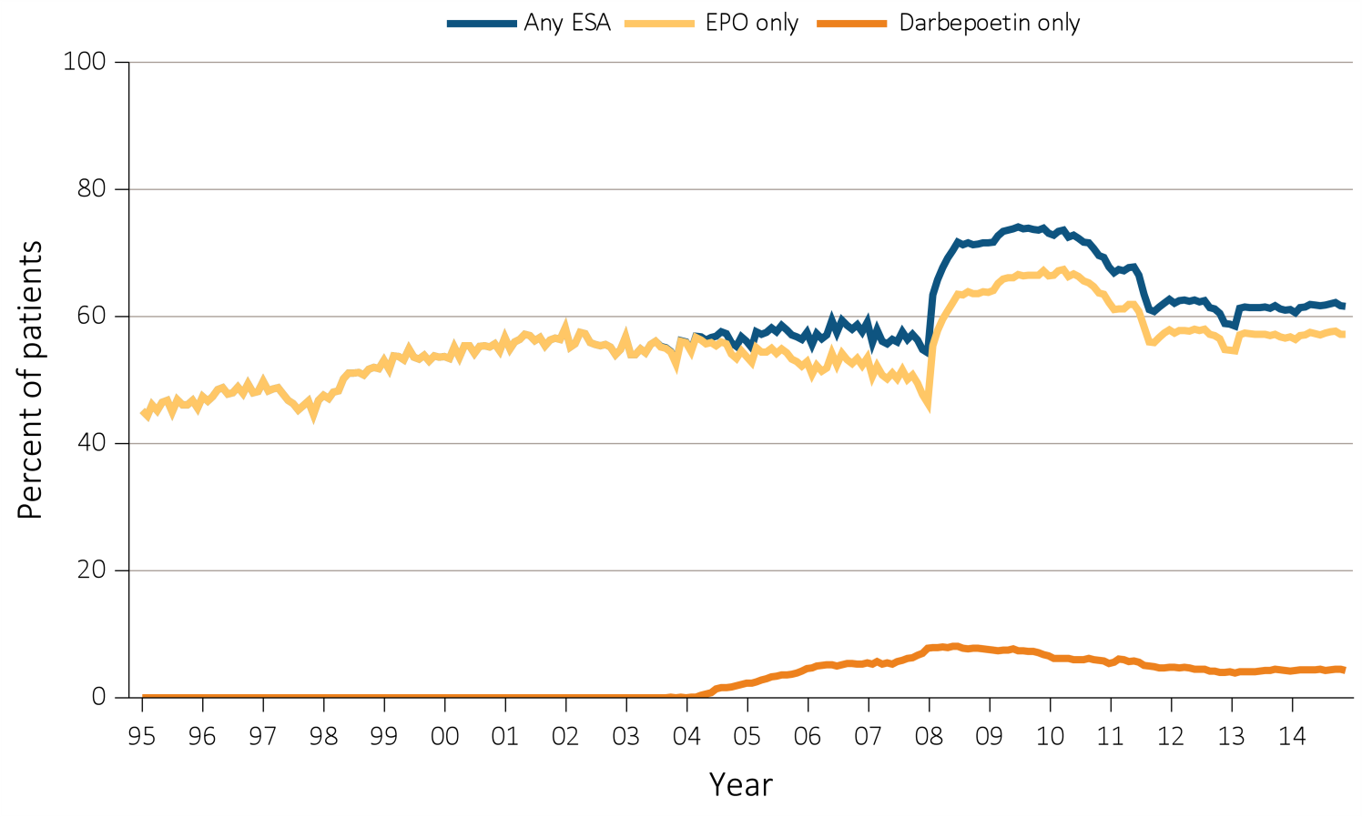
Figure 3.8 Anemia measures among adult peritoneal dialysis patients on dialysis ≥90 days, Medicare claims, 1995-2014 ^{(b) Percent ESA use monthly}
Data Source: Special analyses, USRDS ESRD Database. (b) Monthly ESA use in all peritoneal dialysis patients who were >=18 years old at the start of the month and were on dialysis >=90 days. “EPO only” use is defined as receiving EPO but not darbepoetin; “Darbepoetin Only” use is defined as receiving darbepoetin but not EPO. “Any ESA” use is defined as receiving either or both EPO and Darbepoetin. Abbreviations: EPO, erythropoietin; ESA, erythropoiesis-stimulating agents; Hgb, hemoglobin.

Slide 15
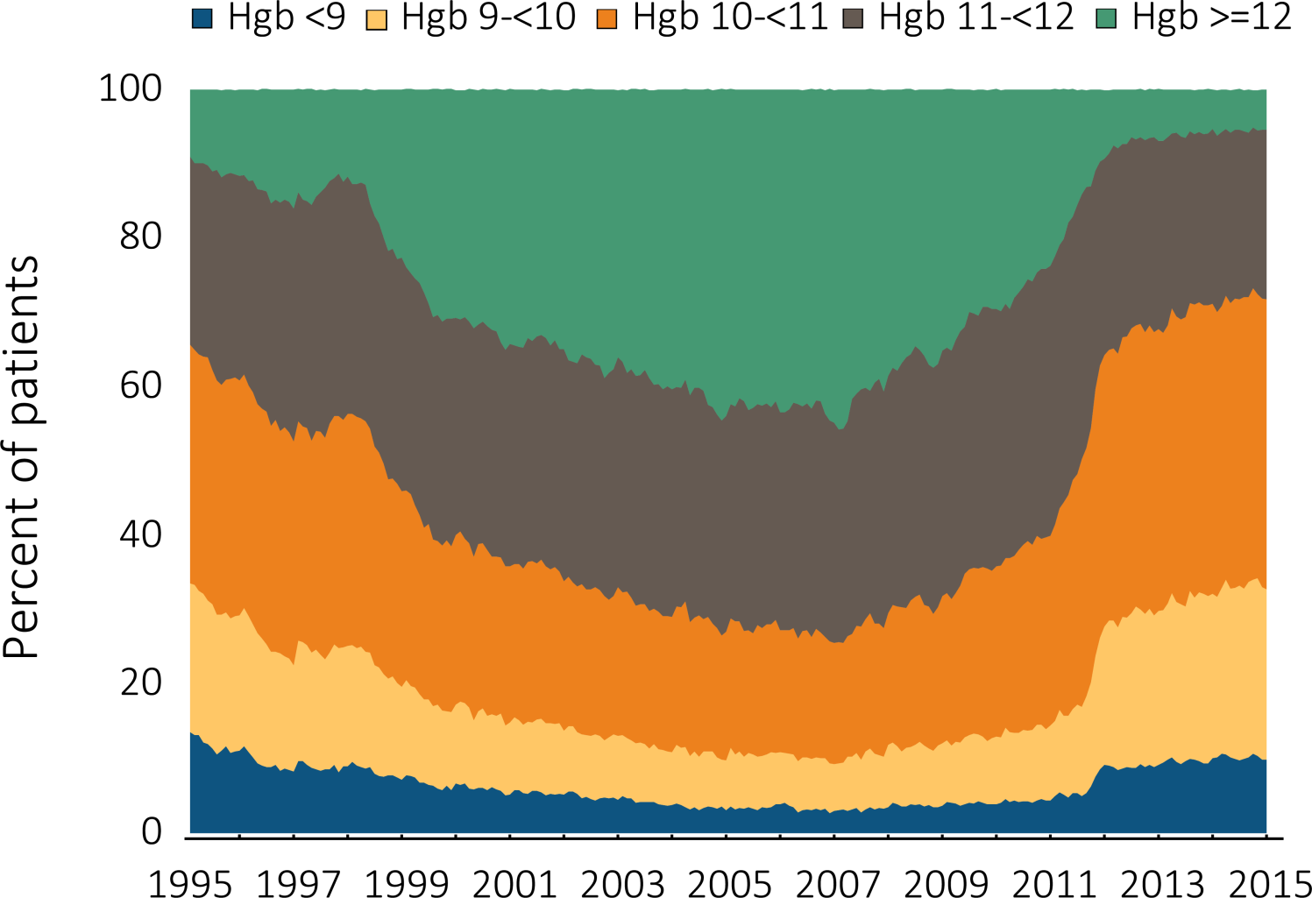
Figure 3.9 Distribution of monthly Hgb (g/dL) levels in ESA-treated adult peritoneal dialysis patients on dialysis ≥90 days, Medicare claims, 1995-2014
Data Source: Special analyses, USRDS ESRD Database. Distribution of Hgb levels among peritoneal dialysis patients within a given month who had claims for Hgb level and ESA use, were on dialysis ≥90 days and ≥18 years old at the start of the month. Abbreviations: ESA, erythropoiesis-stimulating agents; Hgb, hemoglobin.

Slide 16
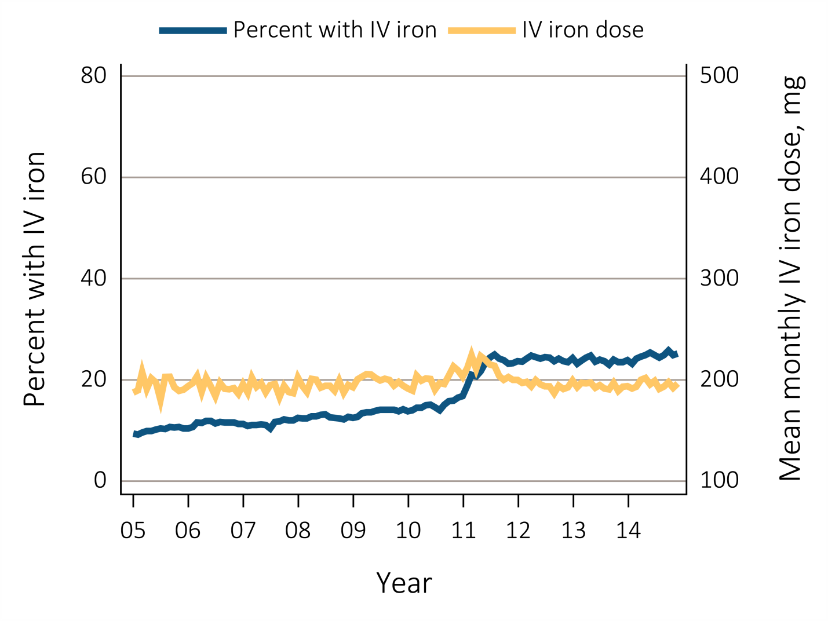
Figure 3.10 Monthly percent IV iron use and mean monthly IV iron dose in adult peritoneal dialysis patients on dialysis ≥90 days, Medicare claims, 2005-2014
Data Source: Special analyses, USRDS ESRD Database. Monthly IV iron use is among peritoneal dialysis patients on dialysis ≥90 days and ≥18 years old at the start of the given month. Mean IV iron dose was calculated as the average number of mg of IV iron given to all such patients during a month, among patients receiving iron during the month. Abbreviation: IV, intravenous.

Slide 17
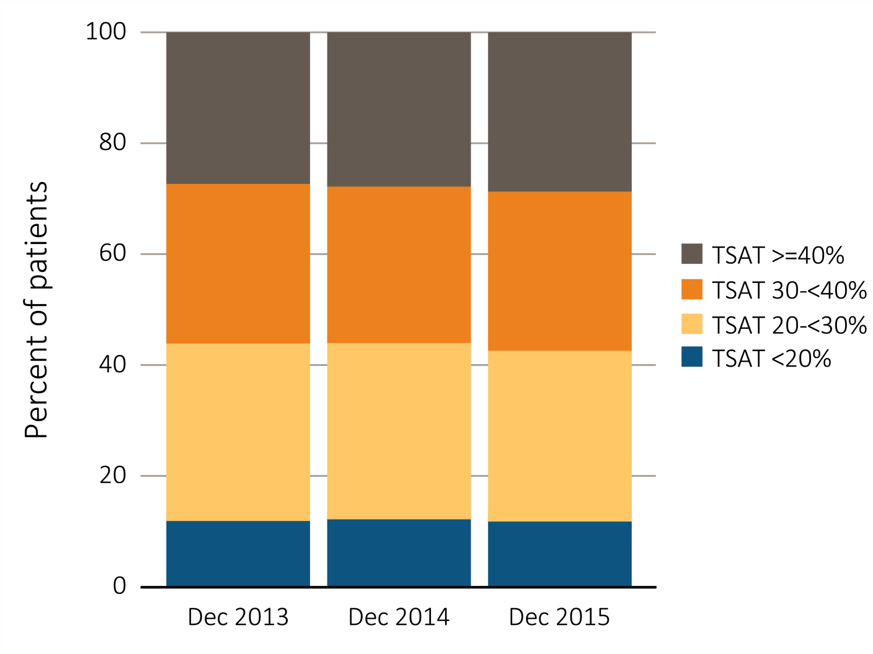
Figure 3.11 Distribution of TSAT levels (%) in adult peritoneal dialysis patients on dialysis for at least 90 days, CROWNWeb data, December 2013, 2014, and 2015
Data Source: Special analyses, USRDS ESRD Database. CROWNWeb clinical extracts for October to December for years 2013, 2014 and 2015. Dialysis patients on treatment for ESRD at least 90 days at the time of measurement of TSAT level for that year, ≥18 years old as of December 1st of that year, and who were alive through December 31 of that year. Abbreviation: TSAT, transferrin saturation.

Slide 18
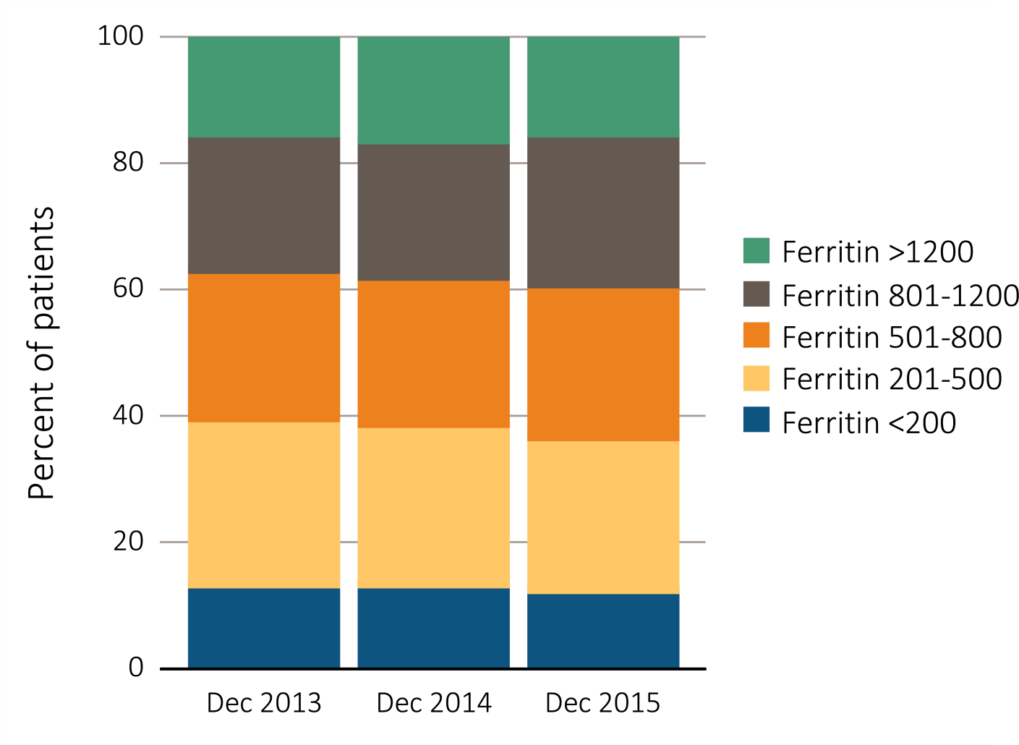
Figure 3.12 Distribution of the most recent serum ferritin (ng/mL) level taken between October and December in adult peritoneal dialysis patients on dialysis for at least 90 days, CROWNWeb data, December 2013, 2014, and 2015
Data Source: Special analyses, USRDS ESRD Database. CROWNWeb clinical extracts for October to December for years 2013, 2014 and 2015. Dialysis patients on treatment for ESRD at least 90 days at the time of measurement of serum ferritin for that year, ≥18 years old as of December 1 of that year, and who were alive through December 31 of that year.

Slide 19
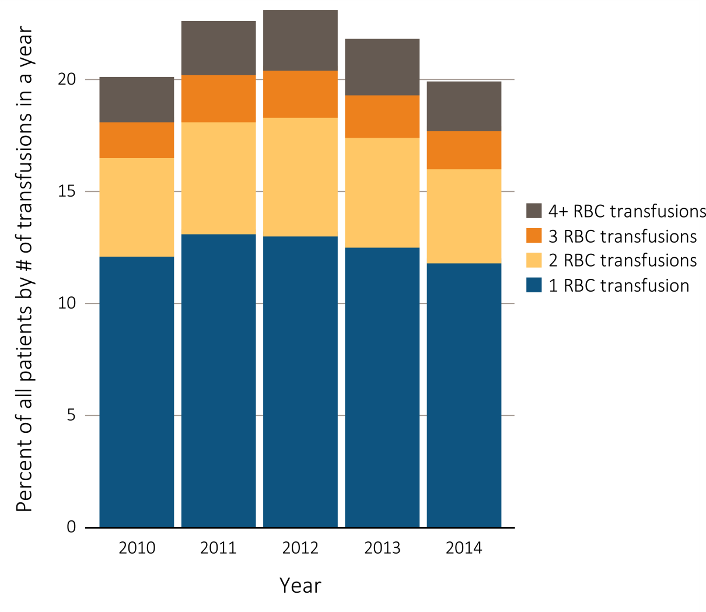
Figure 3.13 Percentage of all adult peritoneal dialysis patients from Medicare claims data, 2010-2013 (a) Number of red blood cell transfusions received in a year
Data Source: Special analyses, USRDS ESRD Database. The percentage of peritoneal dialysis patients with ≥1 red blood cell transfusion claims in a given month was among peritoneal dialysis patients having a claim for at least one dialysis session during the month, and who were ≥18 years old at the start of the month. Abbreviation: RBC, red blood cell.

Slide 20
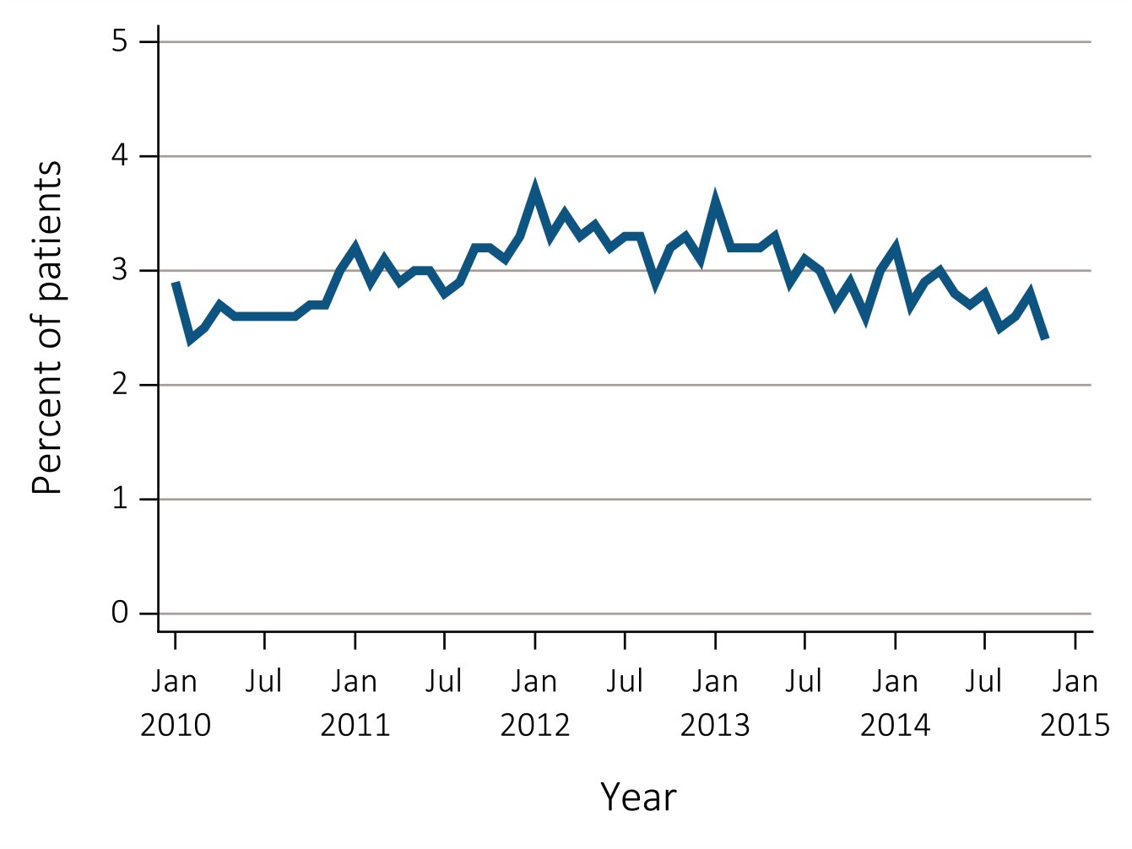
Figure 3.13 Percentage of all adult peritoneal dialysis patients from Medicare claims data, 2010-2013 (b) With ≥1 claims for a red blood cell transfusion in a month
Data Source: Special analyses, USRDS ESRD Database. The percentage of peritoneal dialysis patients with ≥1 red blood cell transfusion claims in a given month was among peritoneal dialysis patients having a claim for at least one dialysis session during the month, and who were ≥18 years old at the start of the month. Abbreviation: RBC, red blood cell.

Slide 21
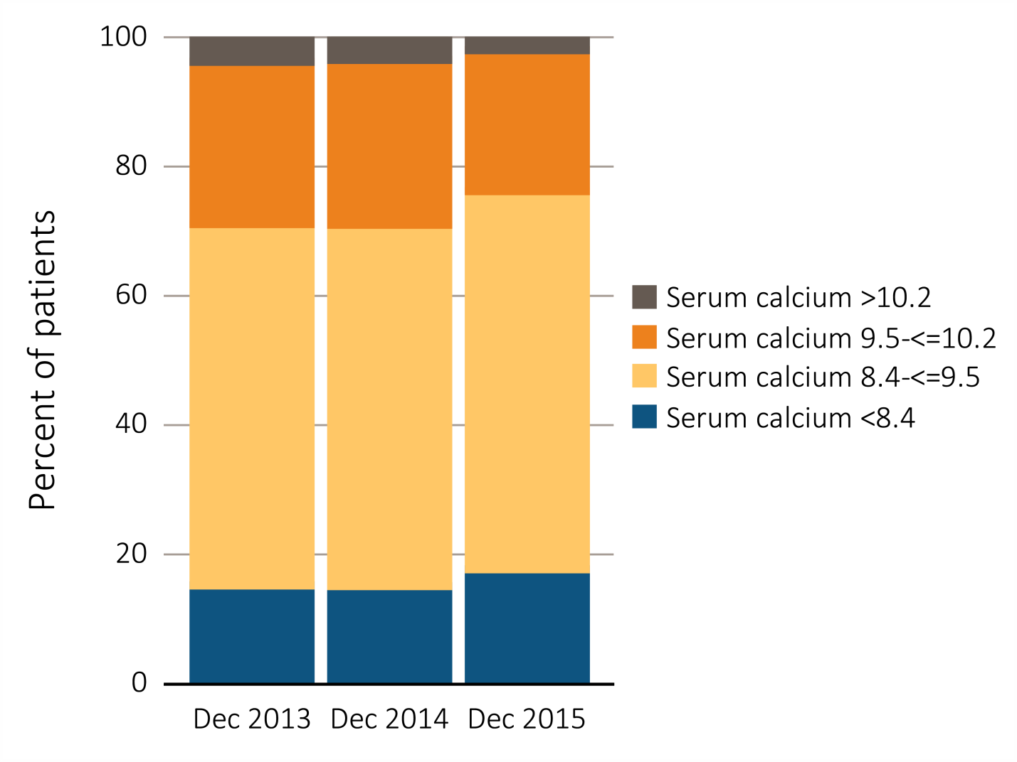
Figure 3.14 Distribution of serum calcium levels in adult hemodialysis patients on dialysis for at least 1 year, CROWNWeb data, December 2013, 2014, and 2015
Data Source: Special analyses, USRDS ESRD Database. CROWNWeb clinical extracts for October to December for years 2013, 2014 and 2015. Dialysis patients on treatment for ESRD at least 1 year at the time of measurement of serum calcium for that year, ≥18 years old as of December 1 of that year and who were alive through December 31 of that year.

Slide 22
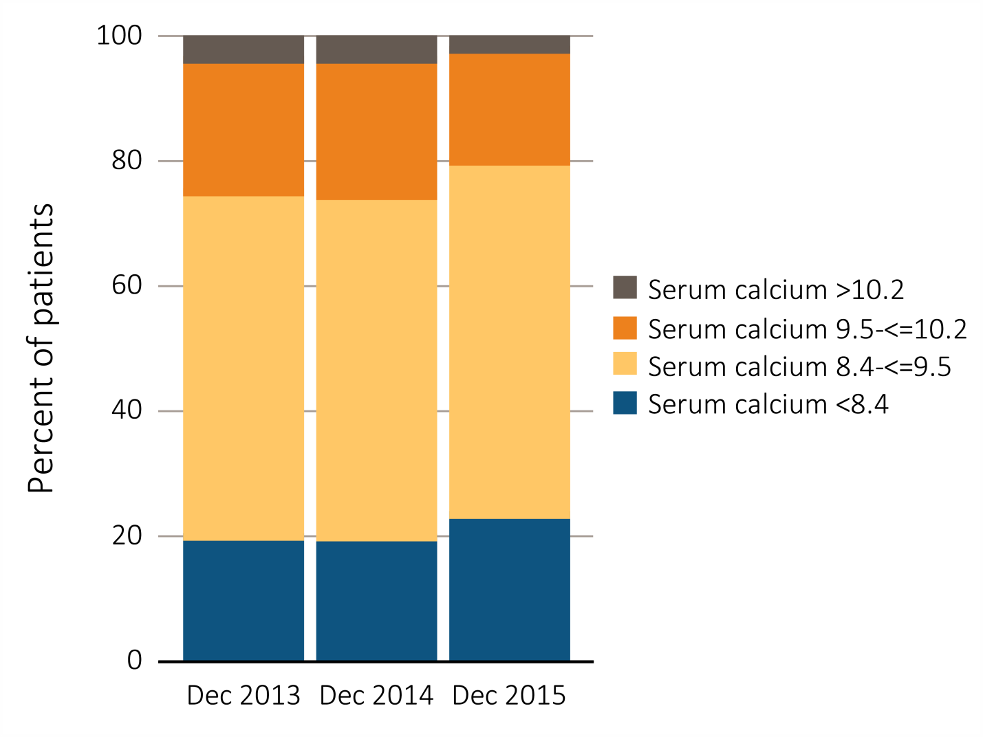
Figure 3.15 Distribution of serum calcium (levels in adult peritoneal dialysis patients on dialysis for at least 1 year, CROWNWeb data, ^{December 2013, 2014, and 2015}
Data Source: Special analyses, USRDS ESRD Database. CROWNWeb clinical extracts for October to December for years 2013, 2014 and 2015. Dialysis patients on treatment for ESRD at least 1 year at the time of measurement of serum calcium for that year, ≥18 years old as of December 1 of that year and who were alive through December 31 of that year.

Slide 23
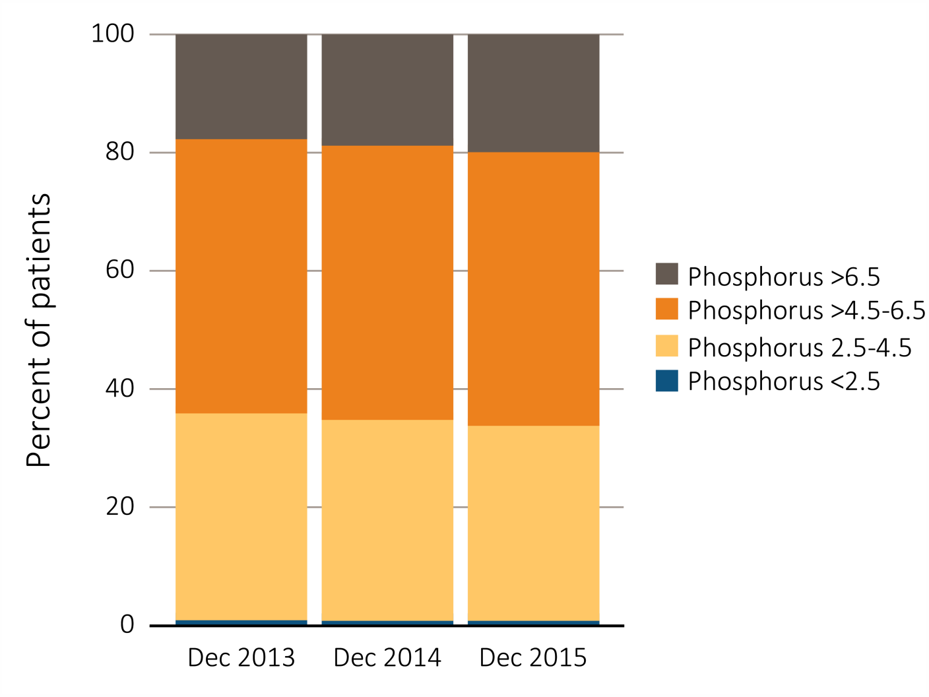
Figure 3.16 Distribution of serum phosphorus (%) levels in adult hemodialysis patients on dialysis for at least 1 year, CROWNWeb data, ^{December 2013, 2014, and 2015}
Data Source: Special analyses, USRDS ESRD Database. CROWNWeb clinical extracts for December 2013, December 2014, and December 2015. Dialysis patients on treatment for ESRD at least 1 year at the time of measurement of serum phosphorus for that year, ≥18 years old as of December 1 of that year and who were alive through December 31 of that year.

Slide 24
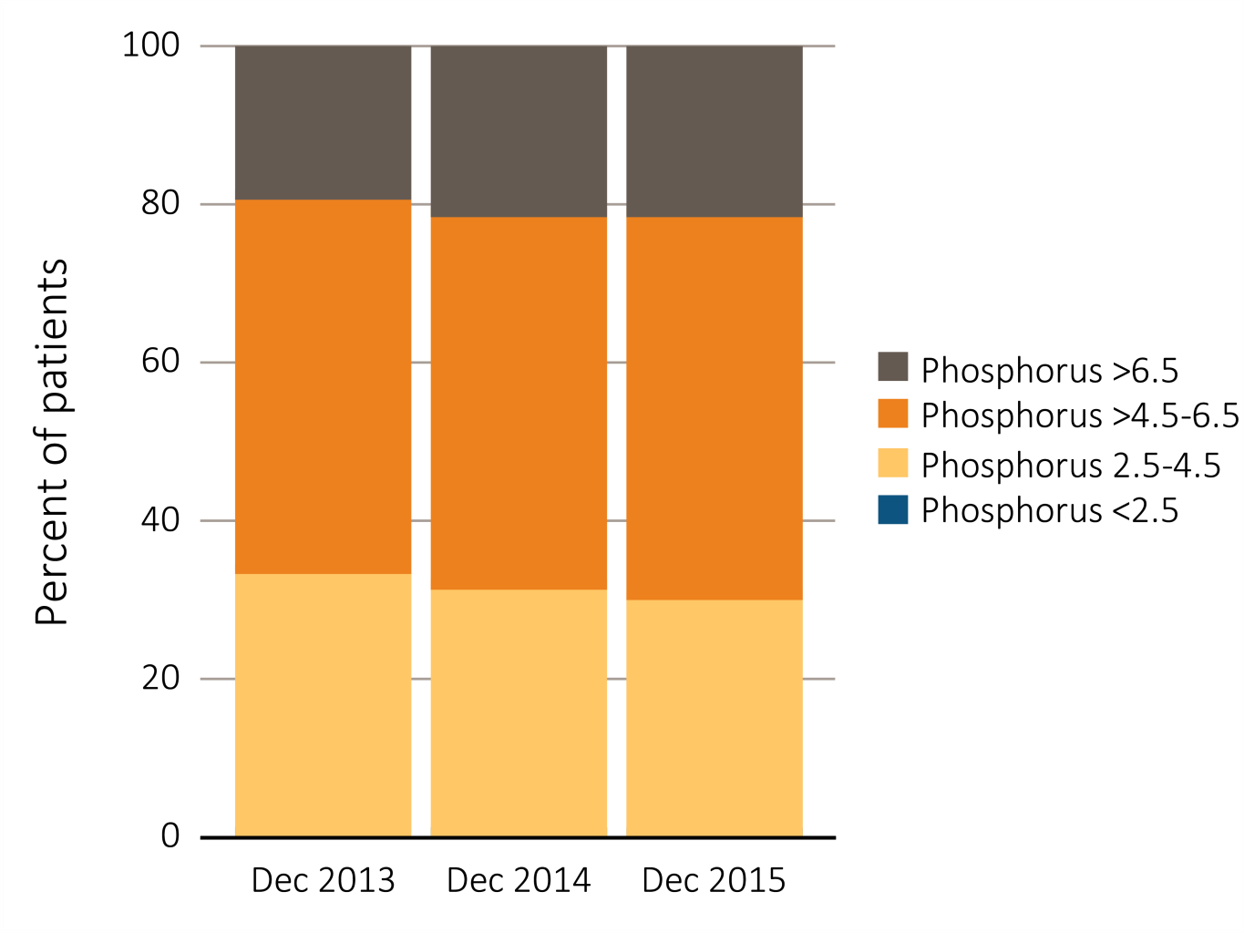
Figure 3.17 Distribution of serum phosphorus (%) levels in adult peritoneal dialysis patients on dialysis for at least 1 year, CROWNWeb data, ^{December 2013, 2014, and 2015}
Data Source: Special analyses, USRDS ESRD Database. CROWNWeb clinical extracts for December 2013, December 2014, and December 2015. Dialysis patients on treatment for ESRD at least 1 year at the time of measurement of serum phosphorus for that year, ≥18 years old as of December 1 of that year and who were alive through December 31 of that year.

Slide 25
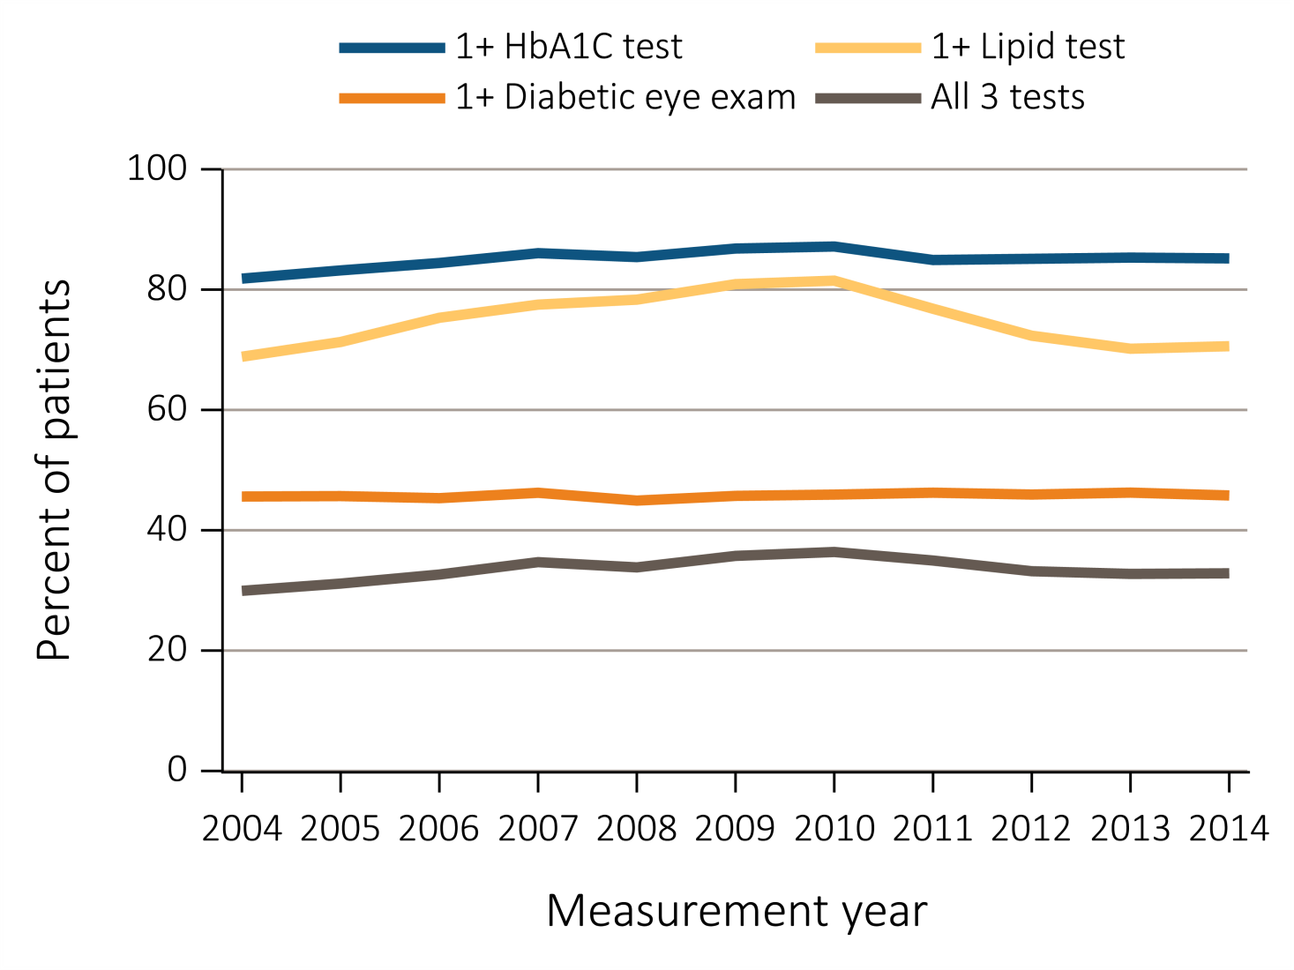
Figure 3.18 Diabetes-related care among ESRD patients with diabetes mellitus aged 18-75 years, Medicare claims, 2004-2014
Data Source: Special analyses, USRDS ESRD Database. Point prevalent Medicare ESRD patients aged 18 to 75 years with a diagnosis claim for diabetes mellitus in the previous year; diabetes-related care in the measurement year. Abbreviations: ESRD, end-stage renal disease; HbA1C, glycosylated hemoglobin.

Slide 26
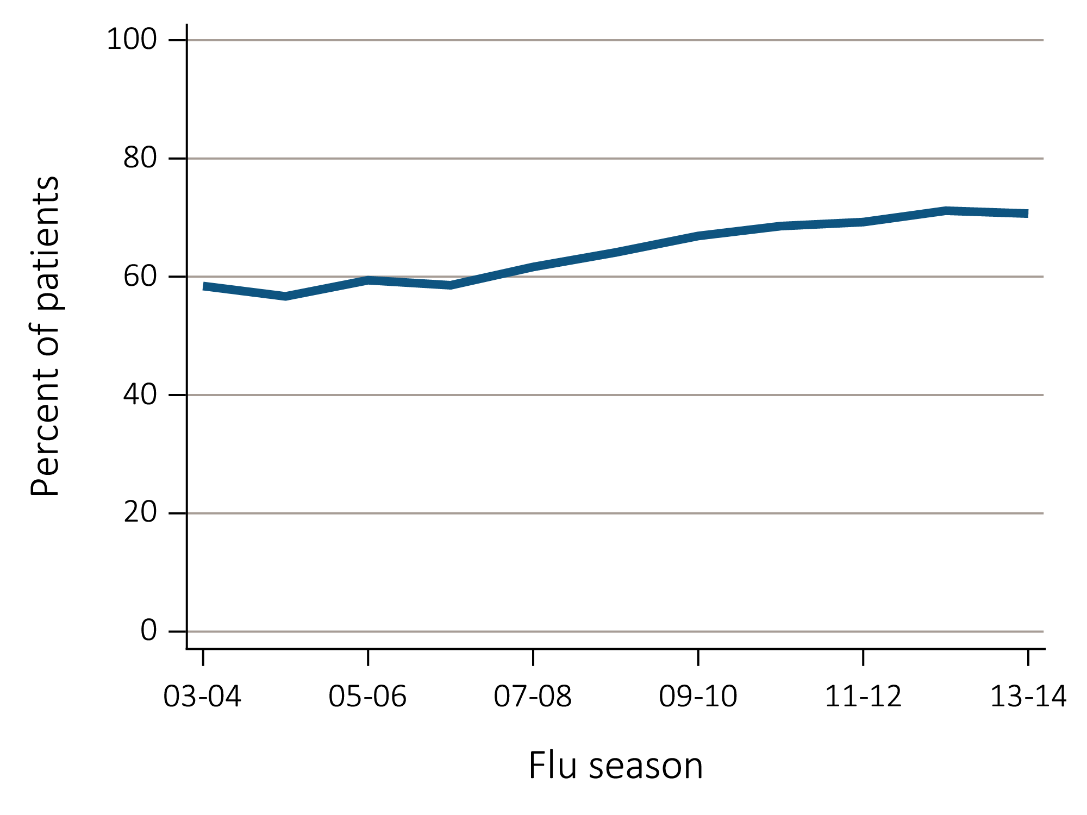
Figure 3.19 Percentage of ESRD patients with a claim for seasonal influenza vaccination (August 1-April 30 of subsequent year) ^{(a) Overall}
Data Source: Special analyses, USRDS ESRD Database. ESRD patients initiating treatment for ESRD at least 90 days before seasonal period: August 1-April 30 for influenza. Abbreviations: Af Am, African American; ESRD, end-stage renal disease; HD, hemodialysis; Nat Am, Native American; PD, peritoneal dialysis; Tx, transplant.

Slide 27
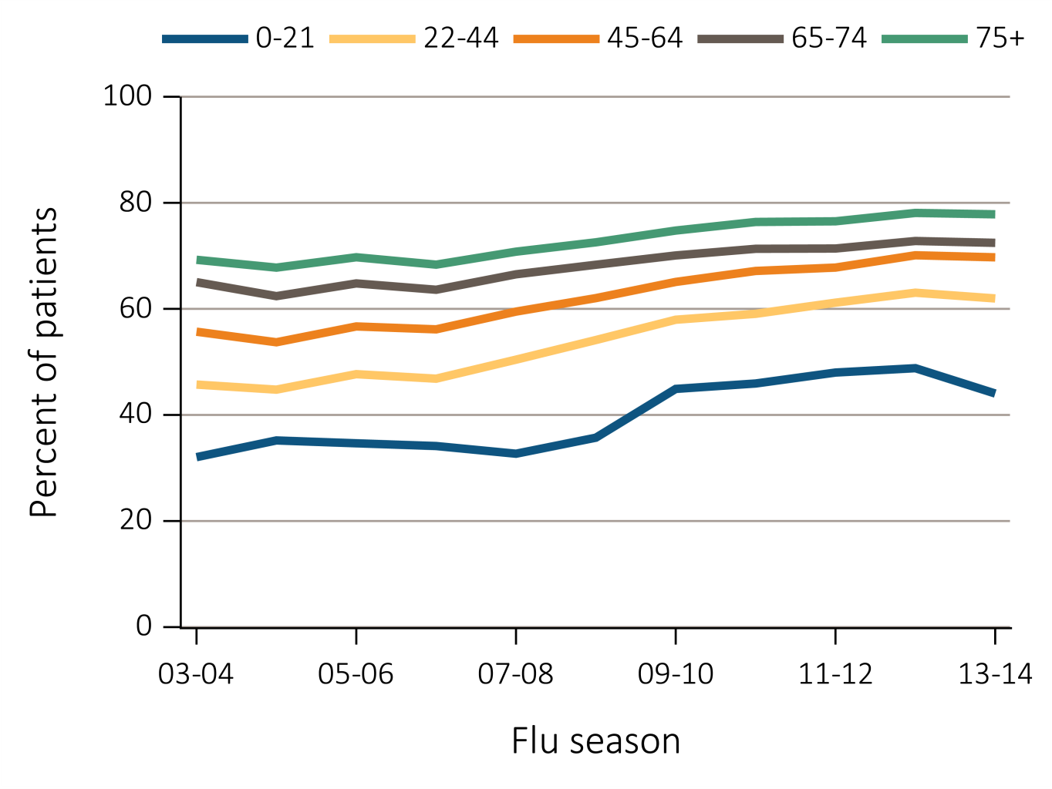
Figure 3.19 Percentage of ESRD patients with a claim for seasonal influenza vaccination (August 1-April 30 of subsequent year) ^{(b) Age}
Data Source: Special analyses, USRDS ESRD Database. ESRD patients initiating treatment for ESRD at least 90 days before seasonal period: August 1-April 30 for influenza. Abbreviations: Af Am, African American; ESRD, end-stage renal disease; HD, hemodialysis; Nat Am, Native American; PD, peritoneal dialysis; Tx, transplant.

Slide 28
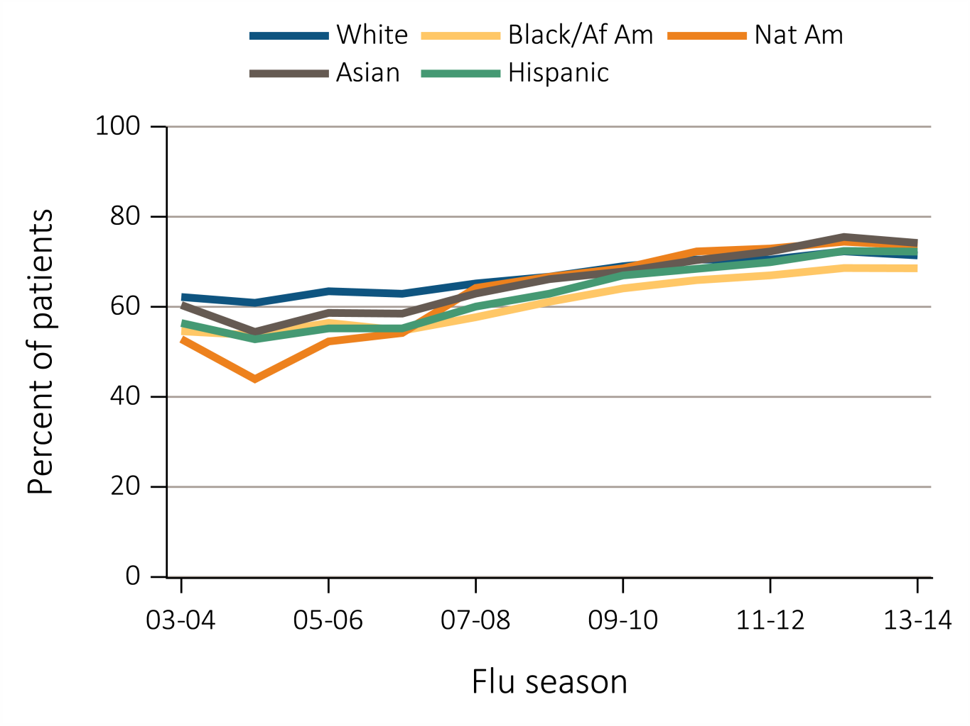
Figure 3.19 Percentage of ESRD patients with a claim for seasonal influenza vaccination (August 1-April 30 of subsequent year) ^{(c) Race/Ethnicity}
Data Source: Special analyses, USRDS ESRD Database. ESRD patients initiating treatment for ESRD at least 90 days before seasonal period: August 1-April 30 for influenza. Abbreviations: Af Am, African American; ESRD, end-stage renal disease; HD, hemodialysis; Nat Am, Native American; PD, peritoneal dialysis; Tx, transplant.

Slide 29
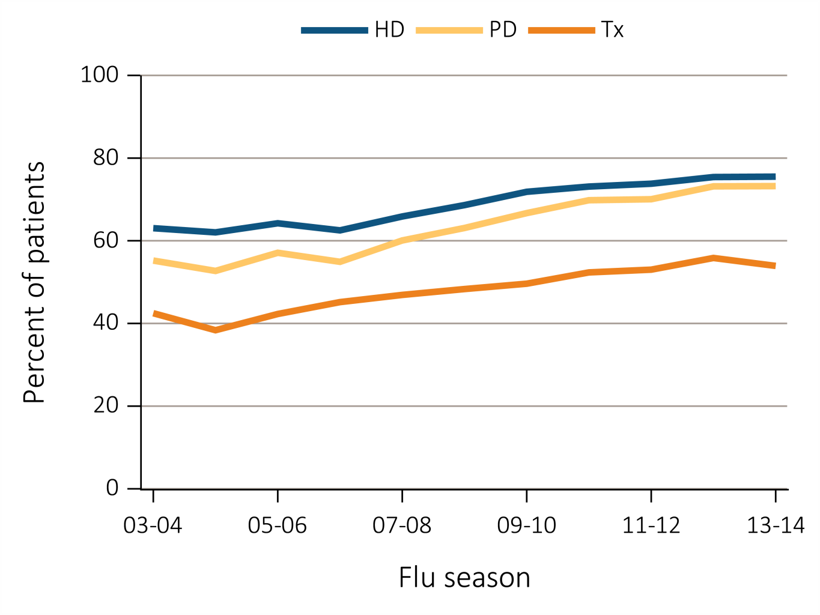
Figure 3.19 Percentage of ESRD patients with a claim for seasonal influenza vaccination (August 1-April 30 of subsequent year) ^{(d) Modality}
Data Source: Special analyses, USRDS ESRD Database. ESRD patients initiating treatment for ESRD at least 90 days before seasonal period: August 1-April 30 for influenza. Abbreviations: Af Am, African American; ESRD, end-stage renal disease; HD, hemodialysis; Nat Am, Native American; PD, peritoneal dialysis; Tx, transplant.

