Slide 2
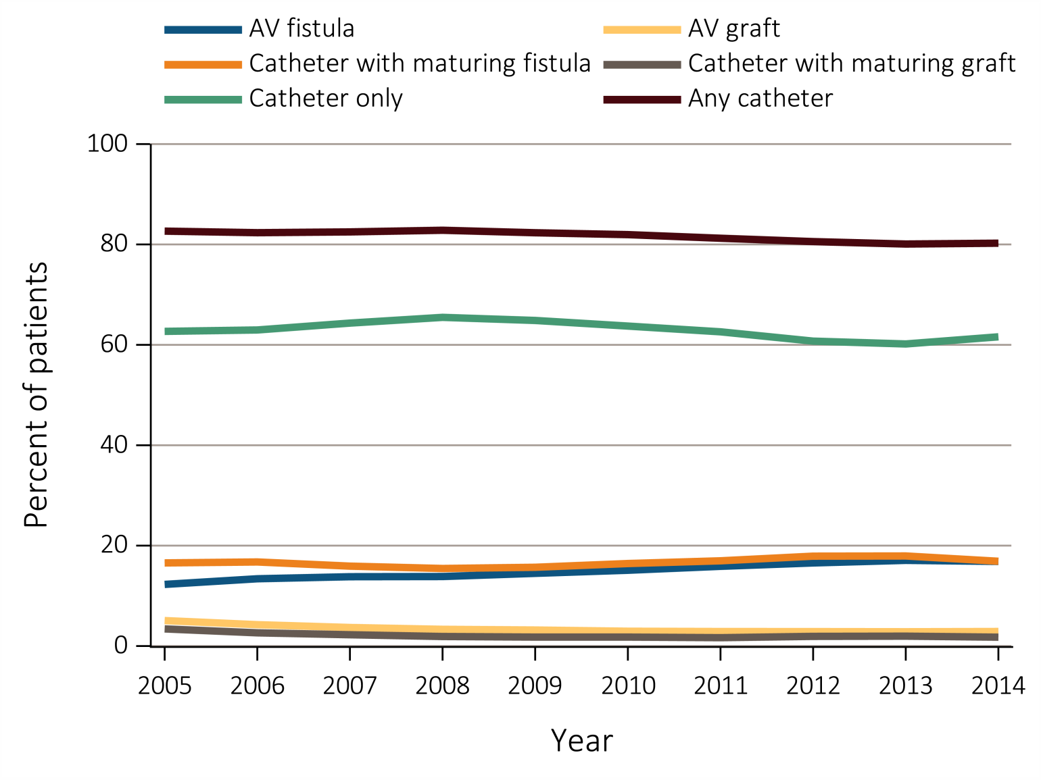
Figure 4.1 Vascular access use at hemodialysis initiation, from the ESRD Medical Evidence form (CMS 2728), 2005-2014
Data Source: Special analyses, USRDS ESRD Database. ESRD patients initiating hemodialysis in 2005-2014. Abbreviations: AV, arteriovenous; CMS, Centers for Medicare & Medicaid; ESRD, end-stage renal disease.

Slide 3
Table 4.1 Vascular access used at hemodialysis initiation by patient characteristics from the ESRD Medical Evidence form (CMS 2728), 2014
 | AV fistula | AV graft | Catheter with maturing fistula | Catheter with maturing graft | Catheter only
All | 16.9 | 2.9 | 16.9 | 1.8 | 61.6
Age
0-21 | 6.6 | 0.7 | 10.8 | 0.4 | 81.4
22-44 | 13.9 | 1.9 | 17.1 | 1.5 | 65.7
45-64 | 16.6 | 2.7 | 18.2 | 1.6 | 60.8
65-74 | 18.4 | 3.1 | 17.0 | 1.8 | 59.7
75+ | 17.1 | 3.4 | 14.8 | 2.1 | 62.6
Sex
Male | 18.4 | 2.2 | 17.5 | 1.5 | 60.4
Female | 14.8 | 3.8 | 16.1 | 2.2 | 63.2
Race/Ethnicity
Hispanic | 11.7 | 1.8 | 15.6 | 1.4 | 69.5
Non-Hispanic
White NH | 17.7 | 2.4 | 16.6 | 1.6 | 61.7
Black/African American NH | 15.3 | 4.2 | 17.6 | 2.3 | 60.6
Native American NH | 15.6 | 1.9 | 23.0 | 0.8 | 58.7
Asian NH | 19.6 | 3.0 | 16.9 | 1.9 | 58.6
Primary Cause of ESRD
Diabetes | 17.6 | 3.1 | 19.4 | 1.9 | 58.1
Hypertension | 17.1 | 3.0 | 16.1 | 1.8 | 61.9
Glomerulonephritis | 18.4 | 2.4 | 15.4 | 1.4 | 62.3
Cystic Kidney | 42.8 | 4.6 | 14.1 | 1.2 | 37.3
Other Urologic | 14.7 | 2.4 | 14.0 | 1.6 | 67.3
Other Cause | 9.3 | 1.9 | 10.6 | 1.4 | 76.8
Unknown/Missing | 11.7 | 2.5 | 12.5 | 1.4 | 72.0
Comorbidities
Diabetes | 16.8 | 2.9 | 18.4 | 1.9 | 60.0
Congestive heart failure | 12.9 | 2.5 | 17.6 | 2.0 | 65.0
Atherosclerotic heart disease | 16.8 | 3.2 | 18.6 | 2.1 | 59.4
Cerebrovascular disease | 14.7 | 3.5 | 18.2 | 2.4 | 61.1
Peripheral vascular disease | 15.3 | 2.7 | 18.7 | 2.1 | 61.2
Hypertension | 17.4 | 3.0 | 17.3 | 1.8 | 60.5
Other cardiac disease | 14.0 | 2.5 | 16.2 | 1.7 | 65.6
Data Source: Special analyses, USRDS ESRD Database. Abbreviations: AV, arteriovenous; CMS, Centers for Medicare & Medicaid; ESRD, end-stage renal disease.

Slide 4
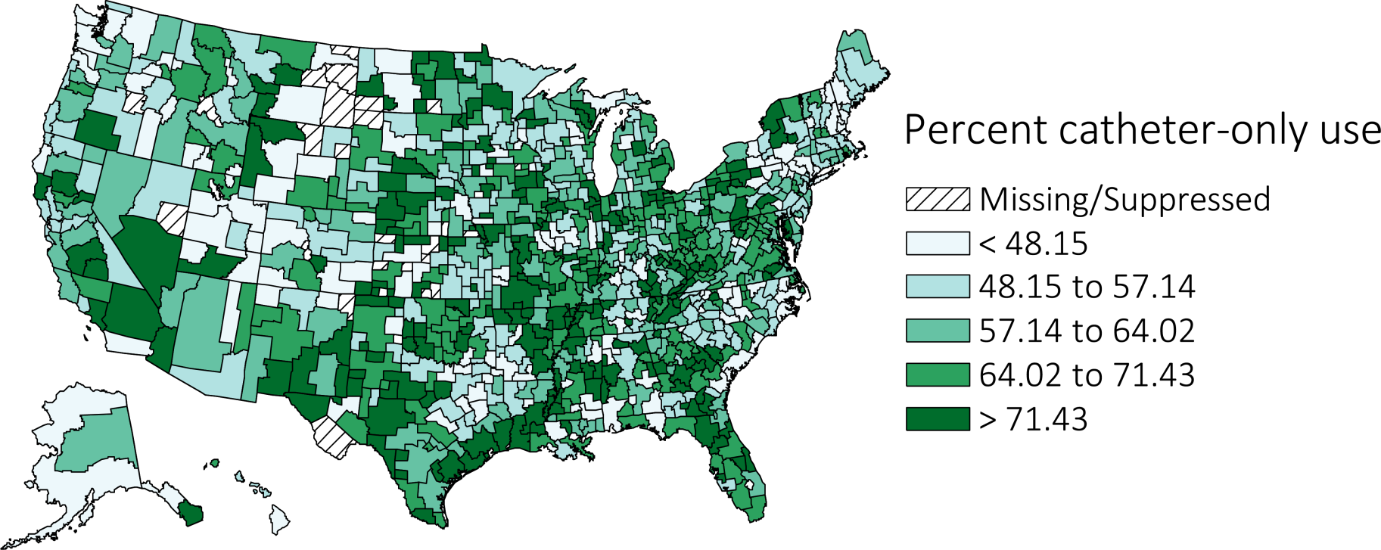
Figure 4.2 Geographic variation in percentage of catheter-only use at hemodialysis initiation, from the ESRD Medical Evidence form (CMS 2728), 2014
Data Source: Special analyses, USRDS ESRD Database. Abbreviations: CMS, Centers for Medicare & Medicaid; ESRD, end-stage renal disease.

Slide 5
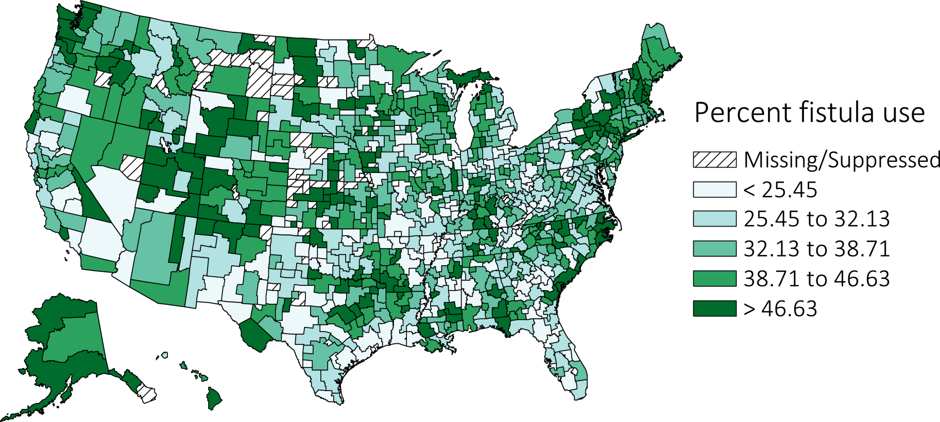
Figure 4.3 Geographic variation in percentage of AV fistula use at hemodialysis initiation, from the ESRD Medical Evidence form (CMS 2728), 2014
Data Source: Special analyses, USRDS ESRD Database. Abbreviations: AV, arteriovenous; CMS, Centers for Medicare & Medicaid; ESRD, end-stage renal disease.

Slide 6
Table 4.2 Distribution of type of vascular access in use among prevalent hemodialysis patients in 2014, from CROWNWeb data, December 2014
 | AV fistula | AV graft | Catheter
All | 63.1 | 18.1 | 18.8
Age
0-21 | 49.6 | 6.2 | 44.2
22-44 | 65.3 | 15.2 | 19.4
45-64 | 64.8 | 17.4 | 17.8
65-74 | 62.5 | 18.8 | 18.7
75+ | 59.4 | 20.4 | 20.1
Sex
Male | 69.1 | 14.0 | 16.9
Female | 55.4 | 23.4 | 21.2
Race/Ethnicity
Hispanic | 68.0 | 15.2 | 16.8
Non-Hispanic
White NH | 64.9 | 13.7 | 21.4
Black/ African American NH | 57.7 | 24.9 | 17.4
Native American NH | 75.1 | 10.8 | 14.1
Asian NH | 67.5 | 16.3 | 16.2
Primary Cause of ESRD
Diabetes | 63.4 | 17.9 | 18.7
Hypertension | 62.5 | 19.0 | 18.5
Glomerulonephritis | 65.3 | 17.9 | 16.8
Cystic Kidney | 70.1 | 16.7 | 13.2
Other Urologic | 61.6 | 17.7 | 20.7
Other Cause | 58.1 | 16.8 | 25.2
Unknown/Missing | 62.8 | 17.6 | 19.7
Data Source: Special analyses, USRDS ESRD Database. CROWNWeb data catheter=any catheter use; fistula and graft use shown are without the use of a catheter. Abbreviations: AV, arteriovenous; ESRD, end-stage renal disease.

Slide 7
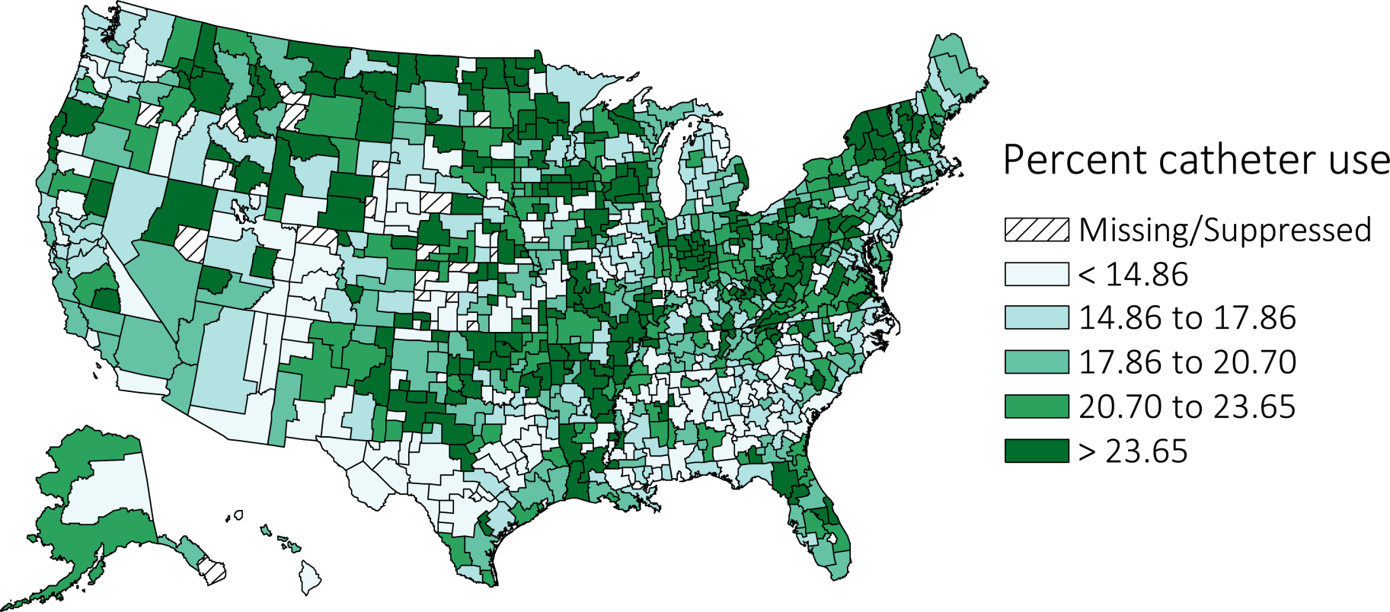
Figure 4.4 Geographic variation in percentage catheter use among prevalent hemodialysis patients by Health Service Area, from CROWNWeb data, December 2014
Data Source: Special analyses, USRDS ESRD Database. Abbreviation: ESRD, end-stage renal disease.

Slide 8
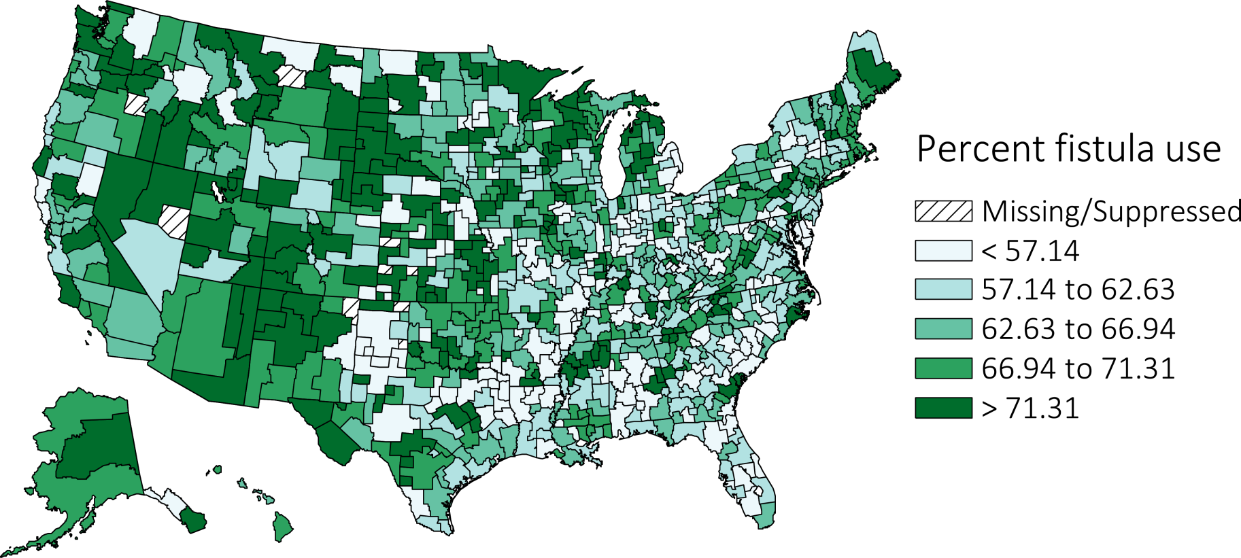
Figure 4.5 Geographic variation in percentage AV fistula use among prevalent hemodialysis patients by Health Service Area, from CROWNWeb data, December 2014
Data Source: Special analyses, USRDS ESRD Database. Abbreviations: AV, arteriovenous; ESRD, end-stage renal disease.

Slide 9
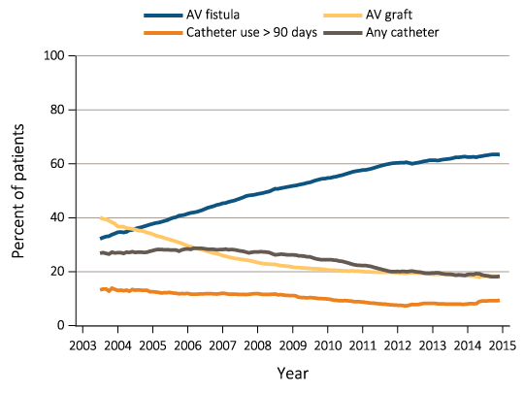
Figure 4.6 Trends in vascular access type use among ESRD prevalent patients, 2003-2014
Data Source: Special analyses, USRDS ESRD Database, and Fistula First data. Fistula First data reported from July 2003 through April 2012, CROWNWeb data are reported from June 2012 through December 2014. Abbreviations: AV, arteriovenous; ESRD, end-stage renal disease.

Slide 10
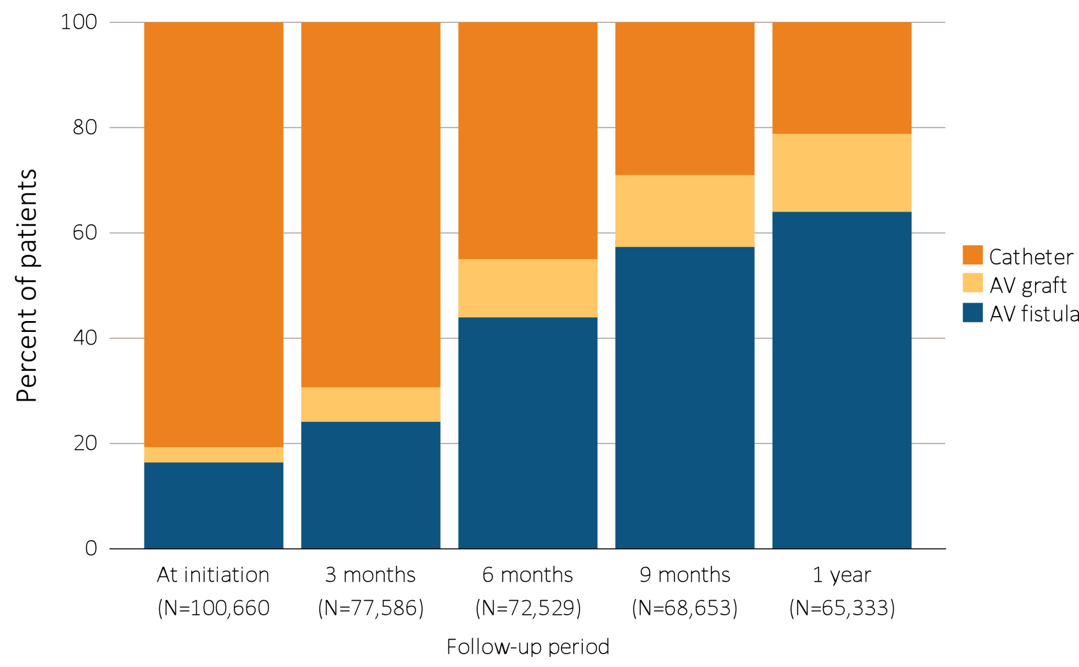
Figure 4.7.a Change in type of vascular access during the first year of dialysis among patients starting ESRD via hemodialysis in 2014 quarterly: (a) type of vascular access in use (cross-sectional), ESRD Medical Evidence form (CMS 2728) and CROWNWeb, 2014-2015
Data Source: Special analyses, USRDS ESRD Database. Data from January 1, 2014 to December 31, 2014: a) Medical Evidence form (CMS 2728) at initiation and CROWNWeb for subsequent time periods. Patients with a maturing AV fistula / AV graft with a catheter in place were classified as having a catheter. Abbreviations: AV, arteriovenous; CMS, Centers for Medicare & Medicaid; ESRD, end-stage renal disease; HD, hemodialysis; PD, peritoneal dialysis.

Slide 11
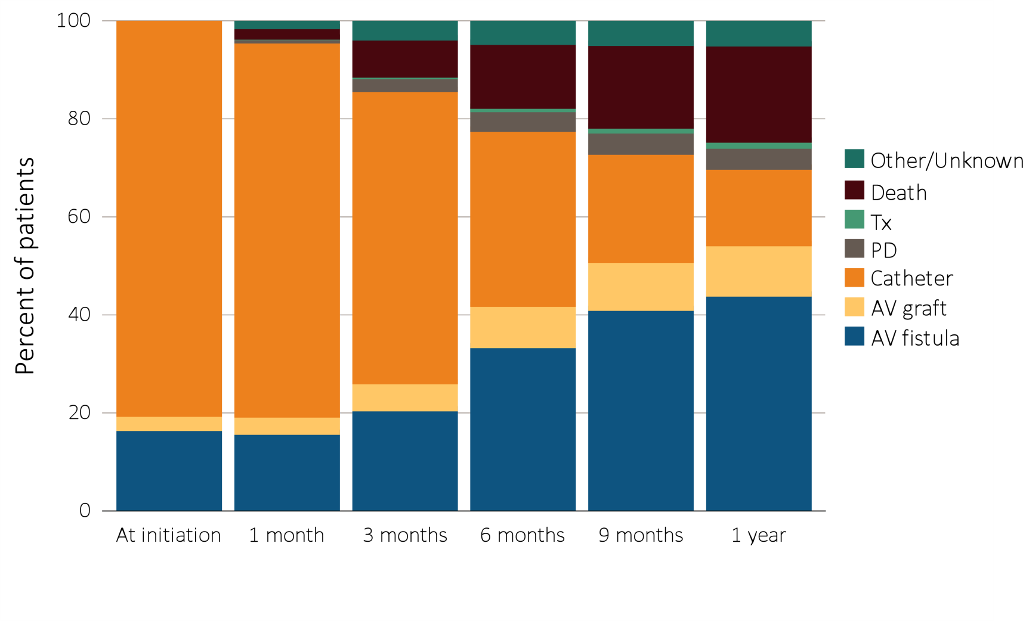
Figure 4.7.b Change in type of vascular access during the first year of dialysis among patients starting ESRD via hemodialysis in 2014 quarterly: (b) longitudinal changes in vascular access use and other outcomes, ESRD Medical Evidence form (CMS 2728) and CROWNWeb, 2014-2015
Data Source: Special analyses, USRDS ESRD Database. Data from January 1, 2014 to December 31, 2014: (b) ESRD patients initiating hemodialysis (N =102,367). Patients with a maturing AV fistula / AV graft with a catheter in place were classified as having a catheter. The apparent decrease in arteriovenous fistula and arteriovenous graft use at 1 month is related to missing data due to the different data sources used for incident and prevalent patients. Abbreviations: AV, arteriovenous; CMS, Centers for Medicare & Medicaid; ESRD, end-stage renal disease; HD, hemodialysis; PD, peritoneal dialysis.

Slide 12
Table 4.3 Cross-sectional distributions of vascular access use, quarterly during the first year of hemodialysis, among patients new to hemodialysis in 2014, by age group, from the ESRD Medical Evidence form (CMS 2728) and CROWNWeb, 2014-2015
Age | Access type | Time
 |  | At initiation | 3 months | 6 months | 9 months | 1 year
0-21 | AV fistula | 6.7 | 12.1 | 32.7 | 40.5 | 47.0
 | AV graft | 0.7 | 0.8 | 1.7 | 3.8 | 3.9
 | Catheter | 92.6 | 87.1 | 65.6 | 55.6 | 49.1
22-44 | AV fistula | 13.9 | 21.5 | 44.3 | 58.6 | 66.3
 | AV graft | 1.9 | 4.5 | 7.6 | 10.0 | 10.6
 | Catheter | 84.3 | 74.0 | 48.1 | 31.4 | 23.1
45-64 | AV fistula | 16.7 | 24.7 | 45.5 | 59.7 | 66.7
 | AV graft | 2.8 | 5.7 | 9.6 | 11.9 | 13.0
 | Catheter | 80.5 | 69.6 | 44.9 | 28.4 | 20.4
65-74 | AV fistula | 18.6 | 26.5 | 45.7 | 58.8 | 65.2
 | AV graft | 3.1 | 6.6 | 11.4 | 14.1 | 15.4
 | Catheter | 78.3 | 66.9 | 42.9 | 27.1 | 19.4
75+ | AV fistula | 17.2 | 24.3 | 41.8 | 53.9 | 59.9
 | AV graft | 3.5 | 9.0 | 15.0 | 18.1 | 19.4
 | Catheter | 79.4 | 66.7 | 43.2 | 28.1 | 20.7
Data Source: Special analyses, USRDS ESRD Database. Medical Evidence form (CMS 2728) at initiation and CROWNWeb for subsequent time periods. Abbreviations: AV, arteriovenous; CMS, Centers for Medicare &
Medicaid; ESRD, end-stage renal disease.

Slide 13
Table 4.4 Cross-sectional distributions of vascular access use, quarterly during the first year of hemodialysis among patients new to hemodialysis in 2014, by race, from the ESRD Medical Evidence form (CMS-2728) and CROWNWeb, ²⁰¹⁴⁻²⁰¹⁵
Race | Access type | Time
 |  | At initiation | 3 months | 6 months | 9 months | 1 year
Native American | AV fistula | 16.0 | 25.9 | 53.9 | 67.8 | 75.0
 | AV graft | 2.0 | 4.0 | 6.9 | 8.3 | 9.4
 | Catheter | 82.0 | 70.0 | 39.2 | 23.9 | 15.6
Asian | AV fistula | 19.3 | 27.1 | 49.4 | 62.5 | 69.7
 | AV graft | 2.9 | 6.7 | 10.3 | 12.2 | 13.0
 | Catheter | 77.8 | 66.2 | 40.3 | 25.3 | 17.3
Black/African American | AV fistula | 15.3 | 21.6 | 39.4 | 52.0 | 58.5
 | AV graft | 4.2 | 9.2 | 15.0 | 18.3 | 20.0
 | Catheter | 80.5 | 69.2 | 45.6 | 29.6 | 21.5
White | AV fistula | 17.5 | 25.8 | 46.3 | 60.1 | 66.9
 | AV graft | 2.4 | 5.4 | 9.4 | 11.7 | 12.5
 | Catheter | 80.1 | 68.7 | 44.3 | 28.2 | 20.6
Other/Unknown | AV fistula | 14.9 | 21.5 | 42.9 | 62.5 | 66.7
 | AV graft | 4.2 | 6.0 | 10.7 | 11.0 | 10.3
 | Catheter | 81.0 | 72.5 | 46.3 | 26.5 | 23.1
Data Source: Special analyses, USRDS ESRD Database. Medical Evidence form (CMS 2728) at initiation and CROWNWeb for subsequent time periods. Abbreviations: AV, arteriovenous; CMS, Centers for Medicare &
Medicaid; ESRD, end-stage renal disease.

Slide 14
Table 4.5 Cross-sectional distributions of vascular access use, quarterly during the first year of hemodialysis among patients new to hemodialysis in 2014, by sex, from the ESRD Medical Evidence form (CMS 2728) and CROWNWeb, 2014-2015
Sex | Access type | Time
 |  | At initiation | 3 months | 6 months | 9 months | 1 year
Male | AV fistula | 18.4 | 27.9 | 50.4 | 64.2 | 70.9
 | AV graft | 2.2 | 5.1 | 8.6 | 10.6 | 11.4
 | Catheter | 79.3 | 66.9 | 41.1 | 25.2 | 17.7
Female | AV fistula | 14.9 | 20.2 | 36.5 | 49.3 | 55.9
 | AV graft | 3.8 | 8.5 | 14.5 | 17.9 | 19.5
 | Catheter | 81.2 | 71.2 | 49.0 | 32.9 | 24.6
Data Source: Special analyses, USRDS ESRD Database. Medical Evidence form (CMS 2728) at initiation and CROWNWeb for subsequent time periods. Abbreviations: AV, arteriovenous; CMS, Centers for Medicare &
Medicaid; ESRD, end-stage renal disease.

Slide 15
Table 4.6 Odds ratios and 95% confidence intervals from logistic regression models of (a) AV fistula use at hemodialysis initiation, and (b) AV fistula or graft use at hemodialysis initiation, from the ESRD Medical Evidence form (CMS 2728), 2014
 | AV fistula use at initiation |  |  |  | AV fistula or graft use at initiation
 | Odds ratio | 95% confidence interval |  |  | Odds ratio | 95% confidence interval
Predictors |  | Lower bound | Upper bound |  |  | Lower bound | Upper bound
Pre-ESRD nephrology care
0 months | 0.05 | 0.05 | 0.06 |  | 0.06 | 0.06 | 0.07
>0 -<6 months | 0.28 | 0.26 | 0.29 |  | 0.29 | 0.28 | 0.31
6-12 months | 0.59 | 0.56 | 0.62 |  | 0.60 | 0.57 | 0.62
>12 months | Ref. |  |  |  | Ref.
Unknown | 0.20 | 0.18 | 0.21 |  | 0.20 | 0.19 | 0.21
Age
0-21 | 0.31 | 0.23 | 0.42 |  | 0.28 | 0.21 | 0.38
22-44 | 0.89 | 0.84 | 0.96 |  | 0.84 | 0.79 | 0.90
45-64 | Ref |  |  |  | Ref
65-74 | 1.01 | 0.97 | 1.06 |  | 1.04 | 0.99 | 1.08
75+ | 0.89 | 0.85 | 0.93 |  | 0.95 | 0.91 | 0.99
Sex
Female | 0.74 | 0.72 | 0.77 |  | 0.85 | 0.83 | 0.88
Male | Ref |  |  |  | Ref
Race
Hispanic | 0.77 | 0.69 | 0.86 |  | 0.76 | 0.69 | 0.84
Non-Hispanic
White NH | Ref |  |  |  | Ref
Black/African American NH | 0.97 | 0.93 | 1.01 |  | 1.13 | 1.09 | 1.18
Native American NH | 0.81 | 0.68 | 0.98 |  | 0.82 | 0.69 | 0.98
Asian NH | 1.03 | 0.95 | 1.12 |  | 1.03 | 0.95 | 1.11
Other/Unknown NH | 0.82 | 0.58 | 1.15 |  | 0.96 | 0.70 | 1.31
Diabetes as cause of ESRD | 0.96 | 0.93 | 0.99 |  | 0.98 | 0.95 | 1.01
Facility census
< 20 | Ref |  |  |  | Ref
20-50 | 0.94 | 0.91 | 0.98 |  | 0.93 | 0.89 | 0.96
51-100 | 0.75 | 0.70 | 0.81 |  | 0.71 | 0.66 | 0.77
101-200 | 0.36 | 0.24 | 0.54 |  | 0.47 | 0.34 | 0.66
>200 | 1.17 | 0.85 | 1.61 |  | 1.38 | 1.03 | 1.84
ESRD network
1 (vs. average network) | 1.13 | 1.04 | 1.23 |  | 1.11 | 1.02 | 1.20
2 (vs. average network) | 1.08 | 1.01 | 1.16 |  | 1.07 | 1.01 | 1.14
3 (vs. average network) | 0.84 | 0.78 | 0.92 |  | 0.87 | 0.80 | 0.94
4 (vs. average network) | 0.97 | 0.89 | 1.04 |  | 1.01 | 0.94 | 1.08
5 (vs. average network) | 0.99 | 0.92 | 1.06 |  | 0.93 | 0.87 | 1.00
6 (vs. average network) | 1.02 | 0.96 | 1.09 |  | 1.01 | 0.96 | 1.07
7 (vs. average network) | 0.68 | 0.63 | 0.73 |  | 0.69 | 0.64 | 0.74
8 (vs. average network) | 0.95 | 0.88 | 1.02 |  | 0.96 | 0.89 | 1.03
9 (vs. average network) | 0.98 | 0.92 | 1.04 |  | 0.97 | 0.92 | 1.03
10 (vs. average network) | 0.91 | 0.83 | 0.99 |  | 0.92 | 0.85 | 1.00
11 (vs. average network) | 1.01 | 0.95 | 1.08 |  | 0.98 | 0.92 | 1.04
12 (vs. average network) | 0.86 | 0.78 | 0.94 |  | 0.86 | 0.79 | 0.94
13 (vs. average network) | 1.08 | 1.00 | 1.17 |  | 1.03 | 0.95 | 1.11
14 (vs. average network) | 0.73 | 0.69 | 0.78 |  | 0.78 | 0.73 | 0.83
15 (vs. average network) | 1.24 | 1.15 | 1.34 |  | 1.16 | 1.08 | 1.25
16 (vs. average network) | 1.42 | 1.30 | 1.54 |  | 1.44 | 1.33 | 1.56
17 (vs. average network) | 1.28 | 1.18 | 1.38 |  | 1.36 | 1.27 | 1.47
18 (vs. average network) | 1.14 | 1.06 | 1.21 |  | 1.13 | 1.06 | 1.20
Data Source: Special analyses, USRDS ESRD Database. Abbreviations: AV, arteriovenous; CMS, Centers for Medicare & Medicaid; ESRD, end-stage renal disease.

Slide 16
Table 4.7 Distribution of number of days between AV fistula placement and first successful use*, overall and by patient characteristics, for new AV fistulas created in 2014 (excludes patients not yet ESRD when fistula was placed), from Medicare claims and CROWNWeb, 2014-20152728) and CROWNWeb, 2014-2015
 | Total AV fistula placements | Percentage of failed placements | Number of days between AV fistula placement and first use
 |  |  | Average | Median | 25th percentile | 75th percentile
Overall | 43,473 | 35.9 | 133 | 112 | 75 | 167
Age
0-21 | 189 | 27 | 152 | 112 | 80 | 174
22-44 | 5,018 | 31.9 | 129 | 106 | 68 | 162
45-64 | 16,458 | 34 | 132 | 111 | 72 | 167
65-74 | 12,048 | 36.7 | 136 | 115 | 78 | 170
75+ | 9,760 | 40.1 | 133 | 113 | 78 | 167
Race
Hispanic | 2,213 | 29.2 | 127 | 104 | 71 | 155
Non-Hispanic
White NH | 24,528 | 35.7 | 134 | 113 | 77 | 166
Black/African American NH | 14,139 | 38.2 | 134 | 112 | 71 | 173
Native American NH | 549 | 33.9 | 133 | 121 | 78 | 163
Asian NH | 1,499 | 30.3 | 127 | 107 | 69 | 161
Other/Unknown NH | 545 | 27.3 | 137 | 112 | 70 | 182
Sex
Male | 24,667 | 31.5 | 127 | 108 | 73 | 158
Female | 18,806 | 41.6 | 143 | 120 | 77 | 183
Primary Cause of ESRD
Diabetes | 20,270 | 36.2 | 135 | 113 | 76 | 171
Hypertension | 13,104 | 36.0 | 131 | 111 | 75 | 164
Glomerulonephritis | 3,860 | 33.4 | 128 | 104 | 66 | 160
Cystic kidney | 717 | 30.8 | 132 | 112 | 70 | 166
Other urologic | 654 | 35.5 | 126 | 109 | 71 | 155
Other cause | 3,615 | 37.9 | 132 | 110 | 74 | 165
Unknown cause | 1,253 | 34.0 | 145 | 115 | 76 | 182
Data Source: Special analyses, USRDS ESRD Database. *With follow-up through the end of 2014; date of first use was the date the given access was first reported in CROWNWeb to be in use in a particular patient. Abbreviations: AV, arteriovenous; ESRD, end-stage renal disease.

