Slide 2
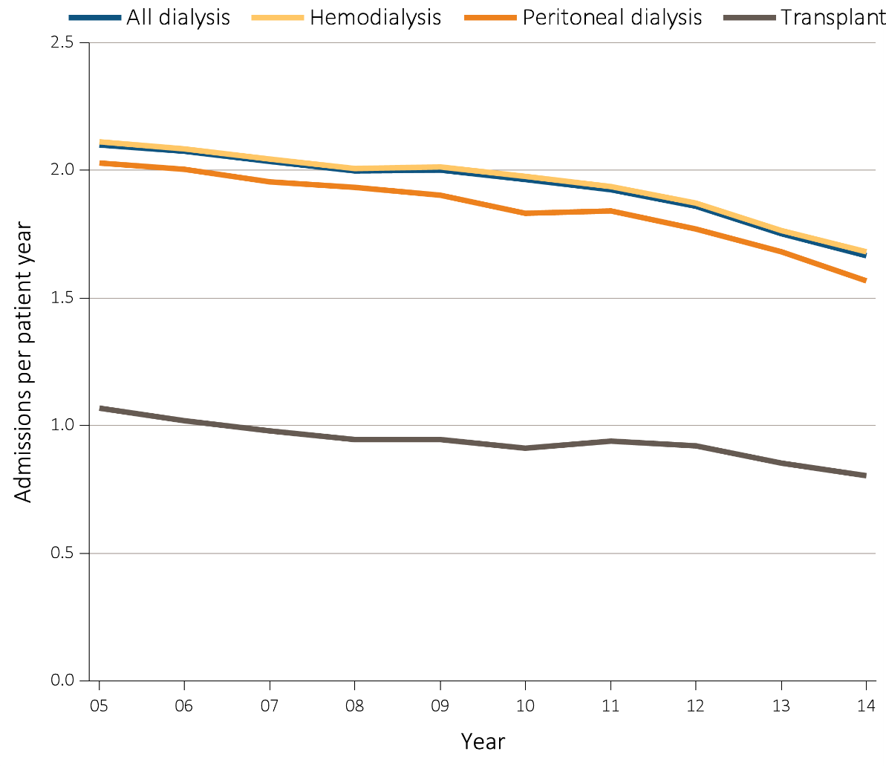
Figure 5.1 Adjusted hospitalization rates for ESRD patients, by treatment modality, 2005-2014
Data Source: Reference Tables G.1, G.3, G.4, G.5, G.6, G.8, G.9, G.10, and special analyses, USRDS ESRD Database. Period prevalent ESRD patients; adjusted for age, sex, race, primary cause of kidney failure & their two-way interactions; reference group, ESRD patients, 2011. Abbreviation: ESRD, end-stage renal disease.

Slide 3
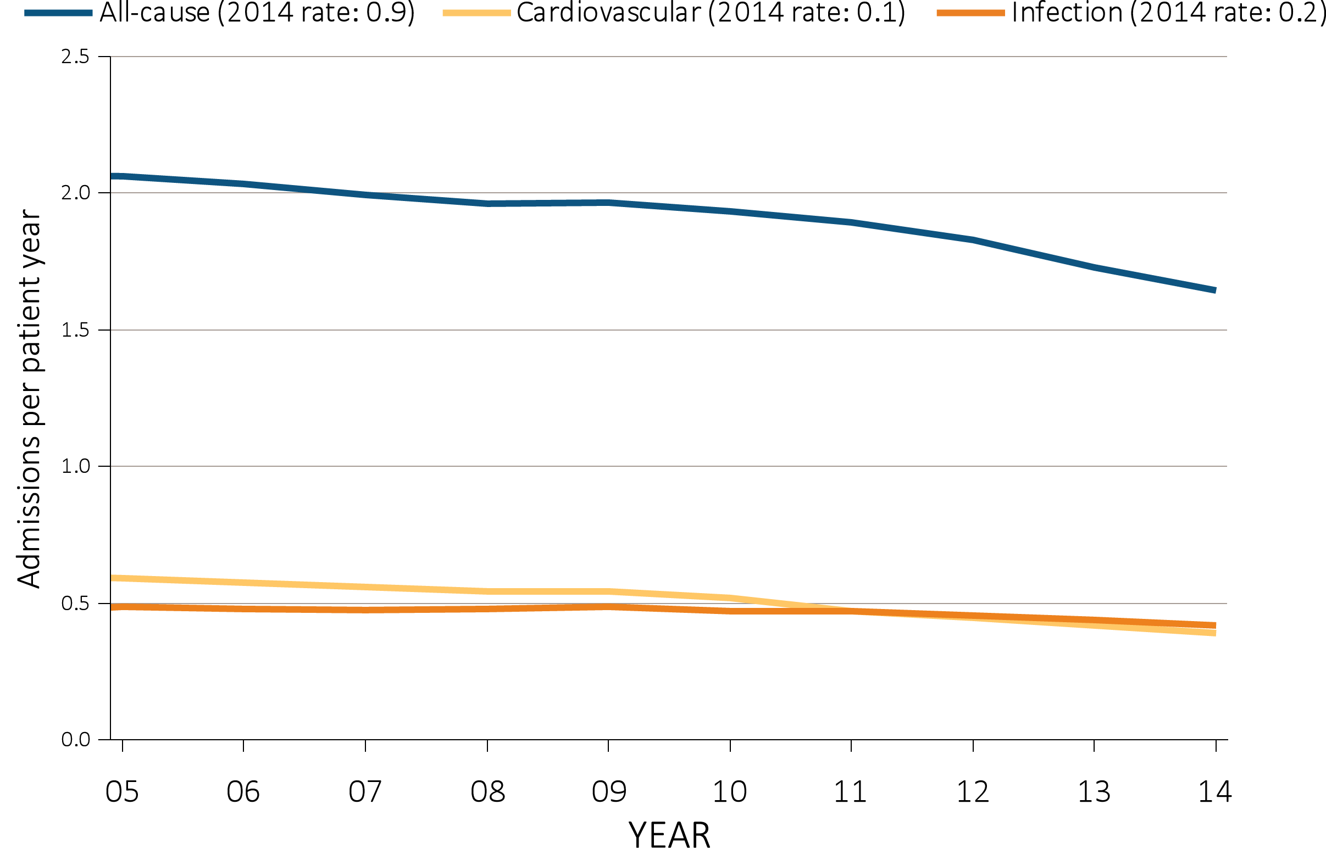
Figure 5.2 Adjusted all-cause & cause-specific hospitalization rates for ESRD patients, by treatment modality, 2005-2014
^{(a) All ESRD}
Data Source: Reference Tables G.1, G.3, G.4, G.5, and special analyses, USRDS ESRD Database. Period prevalent ESRD patients; adjusted for age, sex, race, primary cause of kidney failure & their two-way interactions; reference group : ESRD patients, 2011. Abbreviation: ESRD, end-stage renal disease.

Slide 4
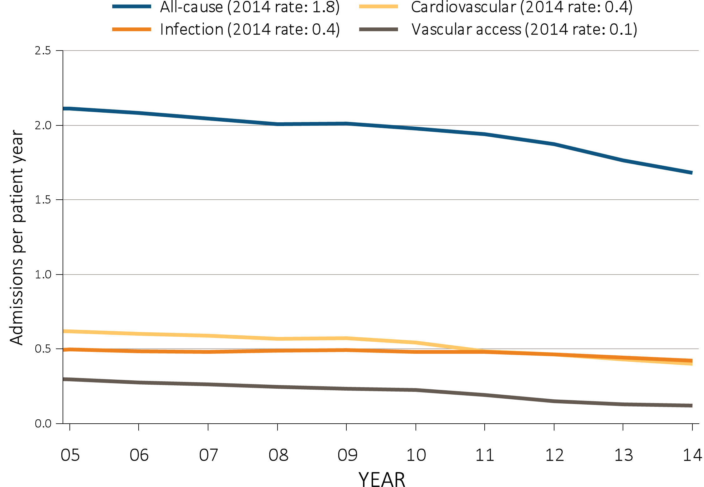
Figure 5.2 Adjusted all-cause & cause-specific hospitalization rates for ESRD patients, by treatment modality, 2005-2014
^{(b) Hemodialysis}
Data Source: Reference Tables G.1, G.3, G.4, G.5, and special analyses, USRDS ESRD Database. Period prevalent ESRD patients; adjusted for age, sex, race, primary cause of kidney failure & their two-way interactions; reference group : ESRD patients, 2011. Abbreviation: ESRD, end-stage renal disease.

Slide 5
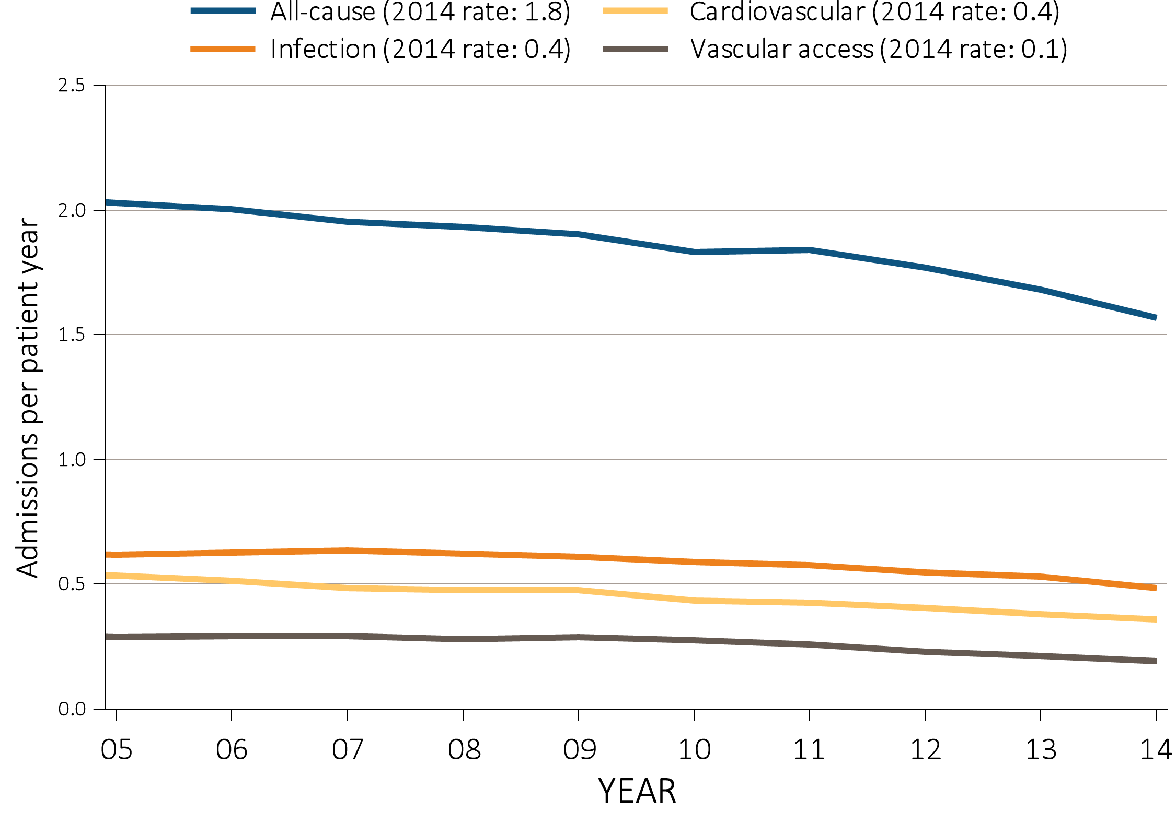
Figure 5.2 Adjusted all-cause & cause-specific hospitalization rates for ESRD patients, by treatment modality, 2005-2014
^{(c) Peritoneal dialysis}
Data Source: Reference Tables G.1, G.3, G.4, G.5, and special analyses, USRDS ESRD Database. Period prevalent ESRD patients; adjusted for age, sex, race, primary cause of kidney failure & their two-way interactions; reference group : ESRD patients, 2011. Abbreviation: ESRD, end-stage renal disease.

Slide 6
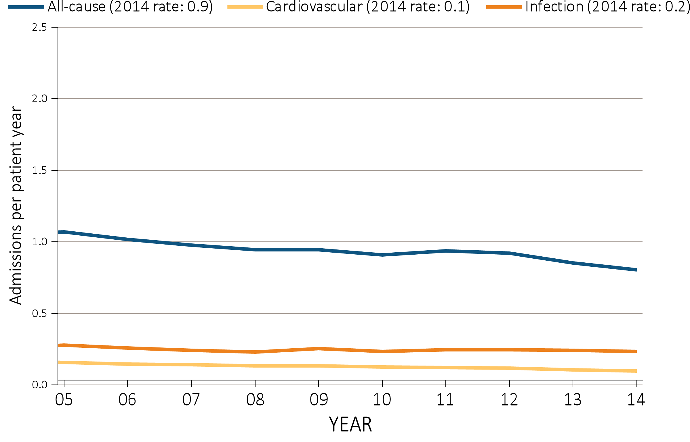
Figure 5.2 Adjusted all-cause & cause-specific hospitalization rates for ESRD patients, by treatment modality, 2005-2014
^{(d) Transplant}
Data Source: Reference Tables G.1, G.3, G.4, G.5, and special analyses, USRDS ESRD Database. Period prevalent ESRD patients; adjusted for age, sex, race, primary cause of kidney failure & their two-way interactions; reference group : ESRD patients, 2011. Abbreviation: ESRD, end-stage renal disease.

Slide 7
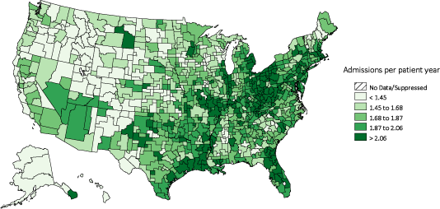
Figure 5.3 Map of the hospitalization rate of ESRD, by Health Service Area, in the U.S. population, 2014
^{(a) Unadjusted}
Data Source: Reference Tables G.1, G.3, G.4, G.5, and special analyses, USRDS ESRD Database. Period prevalent ESRD patients; adjusted for age, sex, race, & primary cause of kidney failure; reference group ESRD patients, 2011. Abbreviation: ESRD, end-stage renal disease.

Slide 8
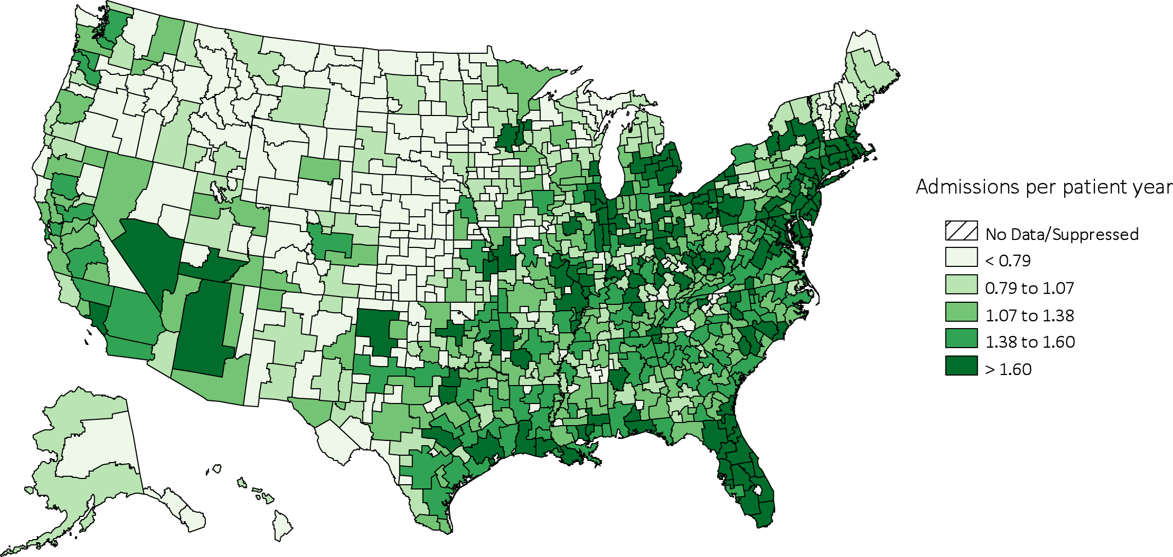
Figure 5.3 Map of the hospitalization rate of ESRD, by Health Service Area, in the U.S. population, 2014
^{(b) Adjusted}
Data Source: Reference Tables G.1, G.3, G.4, G.5, and special analyses, USRDS ESRD Database. Period prevalent ESRD patients; adjusted for age, sex, race, & primary cause of kidney failure; reference group ESRD patients, 2011. Abbreviation: ESRD, end-stage renal disease.

Slide 9
Table 5.1 Rates of all-cause & cause-specific hospitalization per patient year for adult hemodialysis patients, 2005-2014
 | All |  |  |  | Cardiovascular |  |  | Infection (any) |  |  | Vascular access infection
 |  | Unadjusted | Adjusted |  | Unadjusted | Adjusted |  | Unadjusted | Adjusted |  | Unadjusted | Adjusted
2005-2006 |  | 2.12 | 2.13 |  | 0.63 | 0.63 |  | 0.50 | 0.50 |  | 0.14 | 0.14
2007-2008 |  | 2.06 | 2.06 |  | 0.60 | 0.60 |  | 0.49 | 0.49 |  | 0.12 | 0.12
2009-2000 |  | 2.02 | 2.02 |  | 0.57 | 0.57 |  | 0.49 | 0.49 |  | 0.11 | 0.11
2011-2012 |  | 1.93 | 1.93 |  | 0.49 | 0.49 |  | 0.48 | 0.48 |  | 0.07 | 0.07
2013-2014 |  | 1.74 | 1.74 |  | 0.43 | 0.43 |  | 0.44 | 0.44 |  | 0.04 | 0.04
2013-2014
Age
22-44 |  | 1.73 | 1.89 |  | 0.35 | 0.36 |  | 0.41 | 0.44 |  | 0.06 | 0.06
45-64 |  | 1.68 | 1.68 |  | 0.40 | 0.40 |  | 0.41 | 0.41 |  | 0.05 | 0.05
65-74 |  | 1.78 | 1.76 |  | 0.46 | 0.45 |  | 0.45 | 0.44 |  | 0.04 | 0.04
75+ |  | 1.81 | 1.80 |  | 0.48 | 0.47 |  | 0.49 | 0.48 |  | 0.04 | 0.04
Sex
Male |  | 1.61 | 1.62 |  | 0.40 | 0.40 |  | 0.41 | 0.41 |  | 0.04 | 0.04
Female |  | 1.91 | 1.90 |  | 0.46 | 0.45 |  | 0.48 | 0.48 |  | 0.05 | 0.05
Race
White |  | 1.79 | 1.78 |  | 0.43 | 0.43 |  | 0.47 | 0.47 |  | 0.04 | 0.04
Black/African American |  | 1.73 | 1.76 |  | 0.43 | 0.44 |  | 0.40 | 0.41 |  | 0.05 | 0.05
Other race |  | 1.37 | 1.34 |  | 0.33 | 0.33 |  | 0.48 | 0.37 |  | 0.04 | 0.04
Ethnicity
Hispanic |  | 1.60 | 1.69 |  | 0.38 | 0.38 |  | 0.42 | 0.42 |  | 0.04 | 0.04
Non-Hispanic |  | 1.77 | 1.78 |  | 0.44 | 0.44 |  | 0.44 | 0.44 |  | 0.05 | 0.05
Cause of Renal Failure
Diabetes |  | 1.90 | 1.92 |  | 0.46 | 0.46 |  | 0.48 | 0.48 |  | 0.04 | 0.05
Hypertension |  | 1.62 | 1.62 |  | 0.44 | 0.43 |  | 0.39 | 0.39 |  | 0.04 | 0.04
Glomerulonephritis |  | 1.47 | 1.49 |  | 0.35 | 0.37 |  | 0.37 | 0.38 |  | 0.05 | 0.04
Other |  | 1.66 | 1.68 |  | 0.35 | 0.37 |  | 0.45 | 0.46 |  | 0.05 | 0.05
Data Source: Reference Tables G.3, G.13, and special analyses, USRDS ESRD Database. Period prevalent hemodialysis patients aged 22 & older; adjusted for age, sex, race, ethnicity, primary cause of kidney failure & their two-way interactions. Rates by one factor adjusted for the remaining three; reference group, hemodialysis patients, 2011. See Vol. 2, ESRD Analytical Methods for principal ICD-9-CM diagnosis codes included in each cause of hospitalization category.

Slide 10
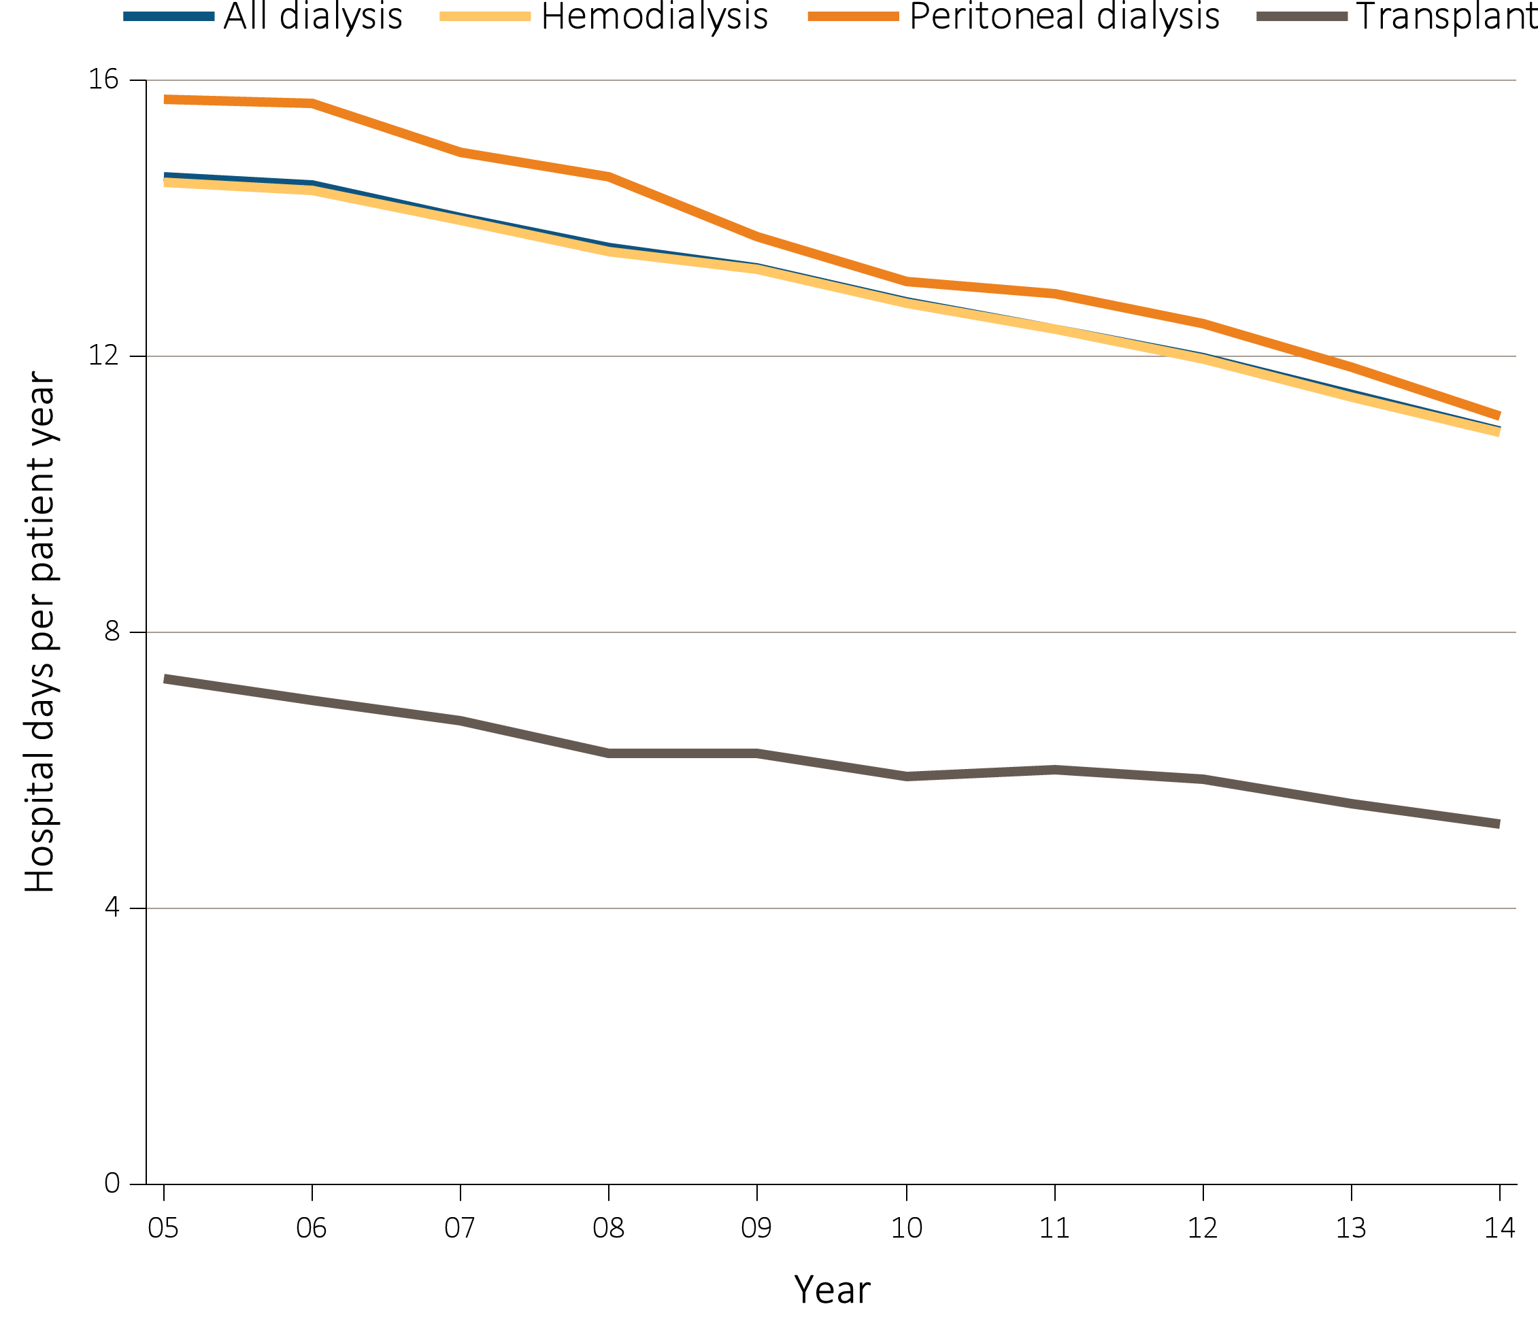
Figure 5.4 Adjusted hospital days for ESRD patients, by treatment modality, 2005-2014
Data Source: Reference Tables G.1, G.3, G.4, G.5, G.6, G.8, G.9, G.10, and special analyses, USRDS ESRD Database. Period prevalent ESRD patients; adjusted for age, sex, race, primary cause of kidney failure & their two-way interactions. Reference group: ESRD patients, 2011. Abbreviation: ESRD, end-stage renal disease.

Slide 11
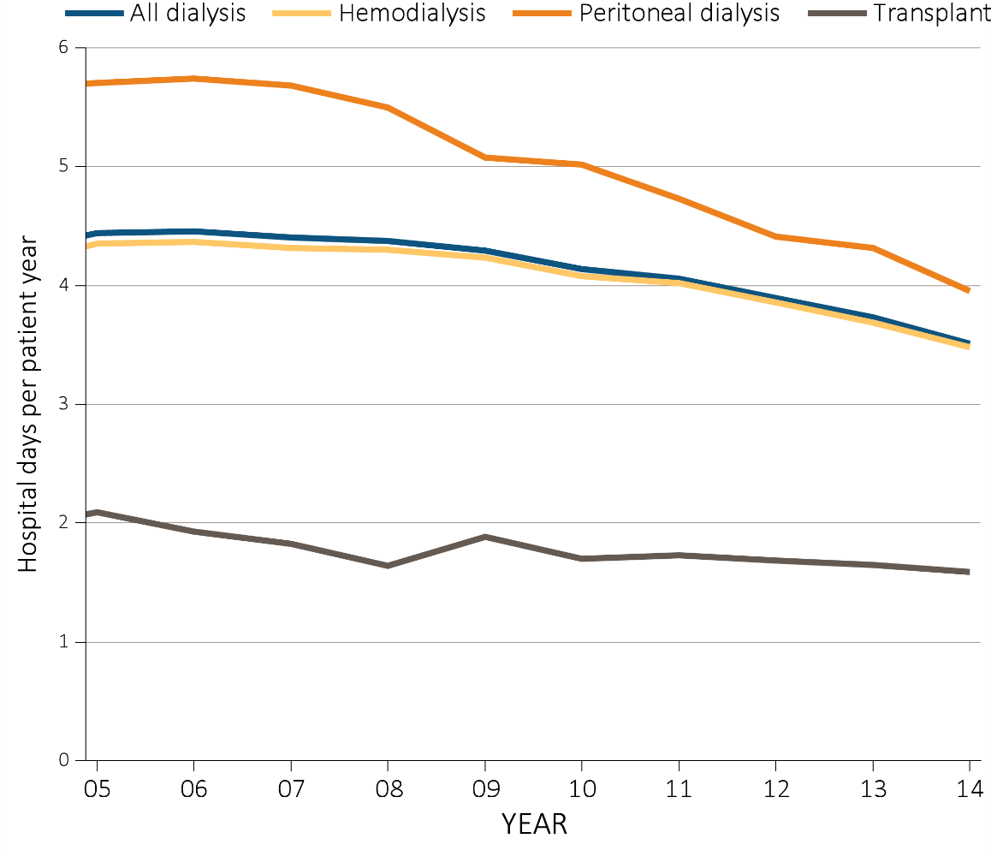
Figure 5.5 Adjusted hospital days for infection & cardiovascular causes, for ESRD patients by their treatment modality, 2005-2014
^{(a)} ^{Infection}
Data Source: Special analyses, USRDS ESRD Database. Period prevalent ESRD patients, adjusted for age, sex, race, primary cause of kidney failure & their two-way interactions; reference group: ESRD patients, 2011. Abbreviation: ESRD, end-stage renal disease.

Slide 12
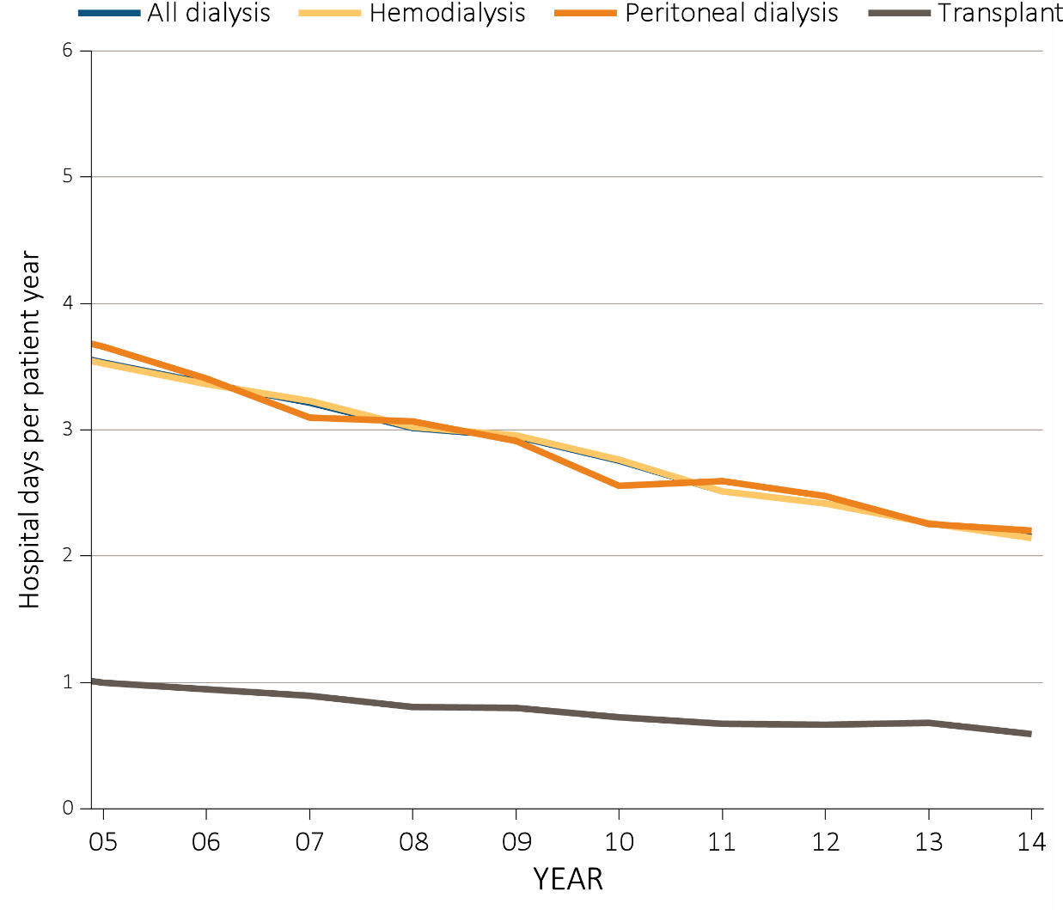
Figure 5.5 Adjusted hospital days for infection & cardiovascular causes, for ESRD patients by their treatment modality, 2005-2014
^{(b) Cardiovascular}
Data Source: Special analyses, USRDS ESRD Database. Period prevalent ESRD patients, adjusted for age, sex, race, primary cause of kidney failure & their two-way interactions; reference group: ESRD patients, 2011. Abbreviation: ESRD, end-stage renal disease.

Slide 13
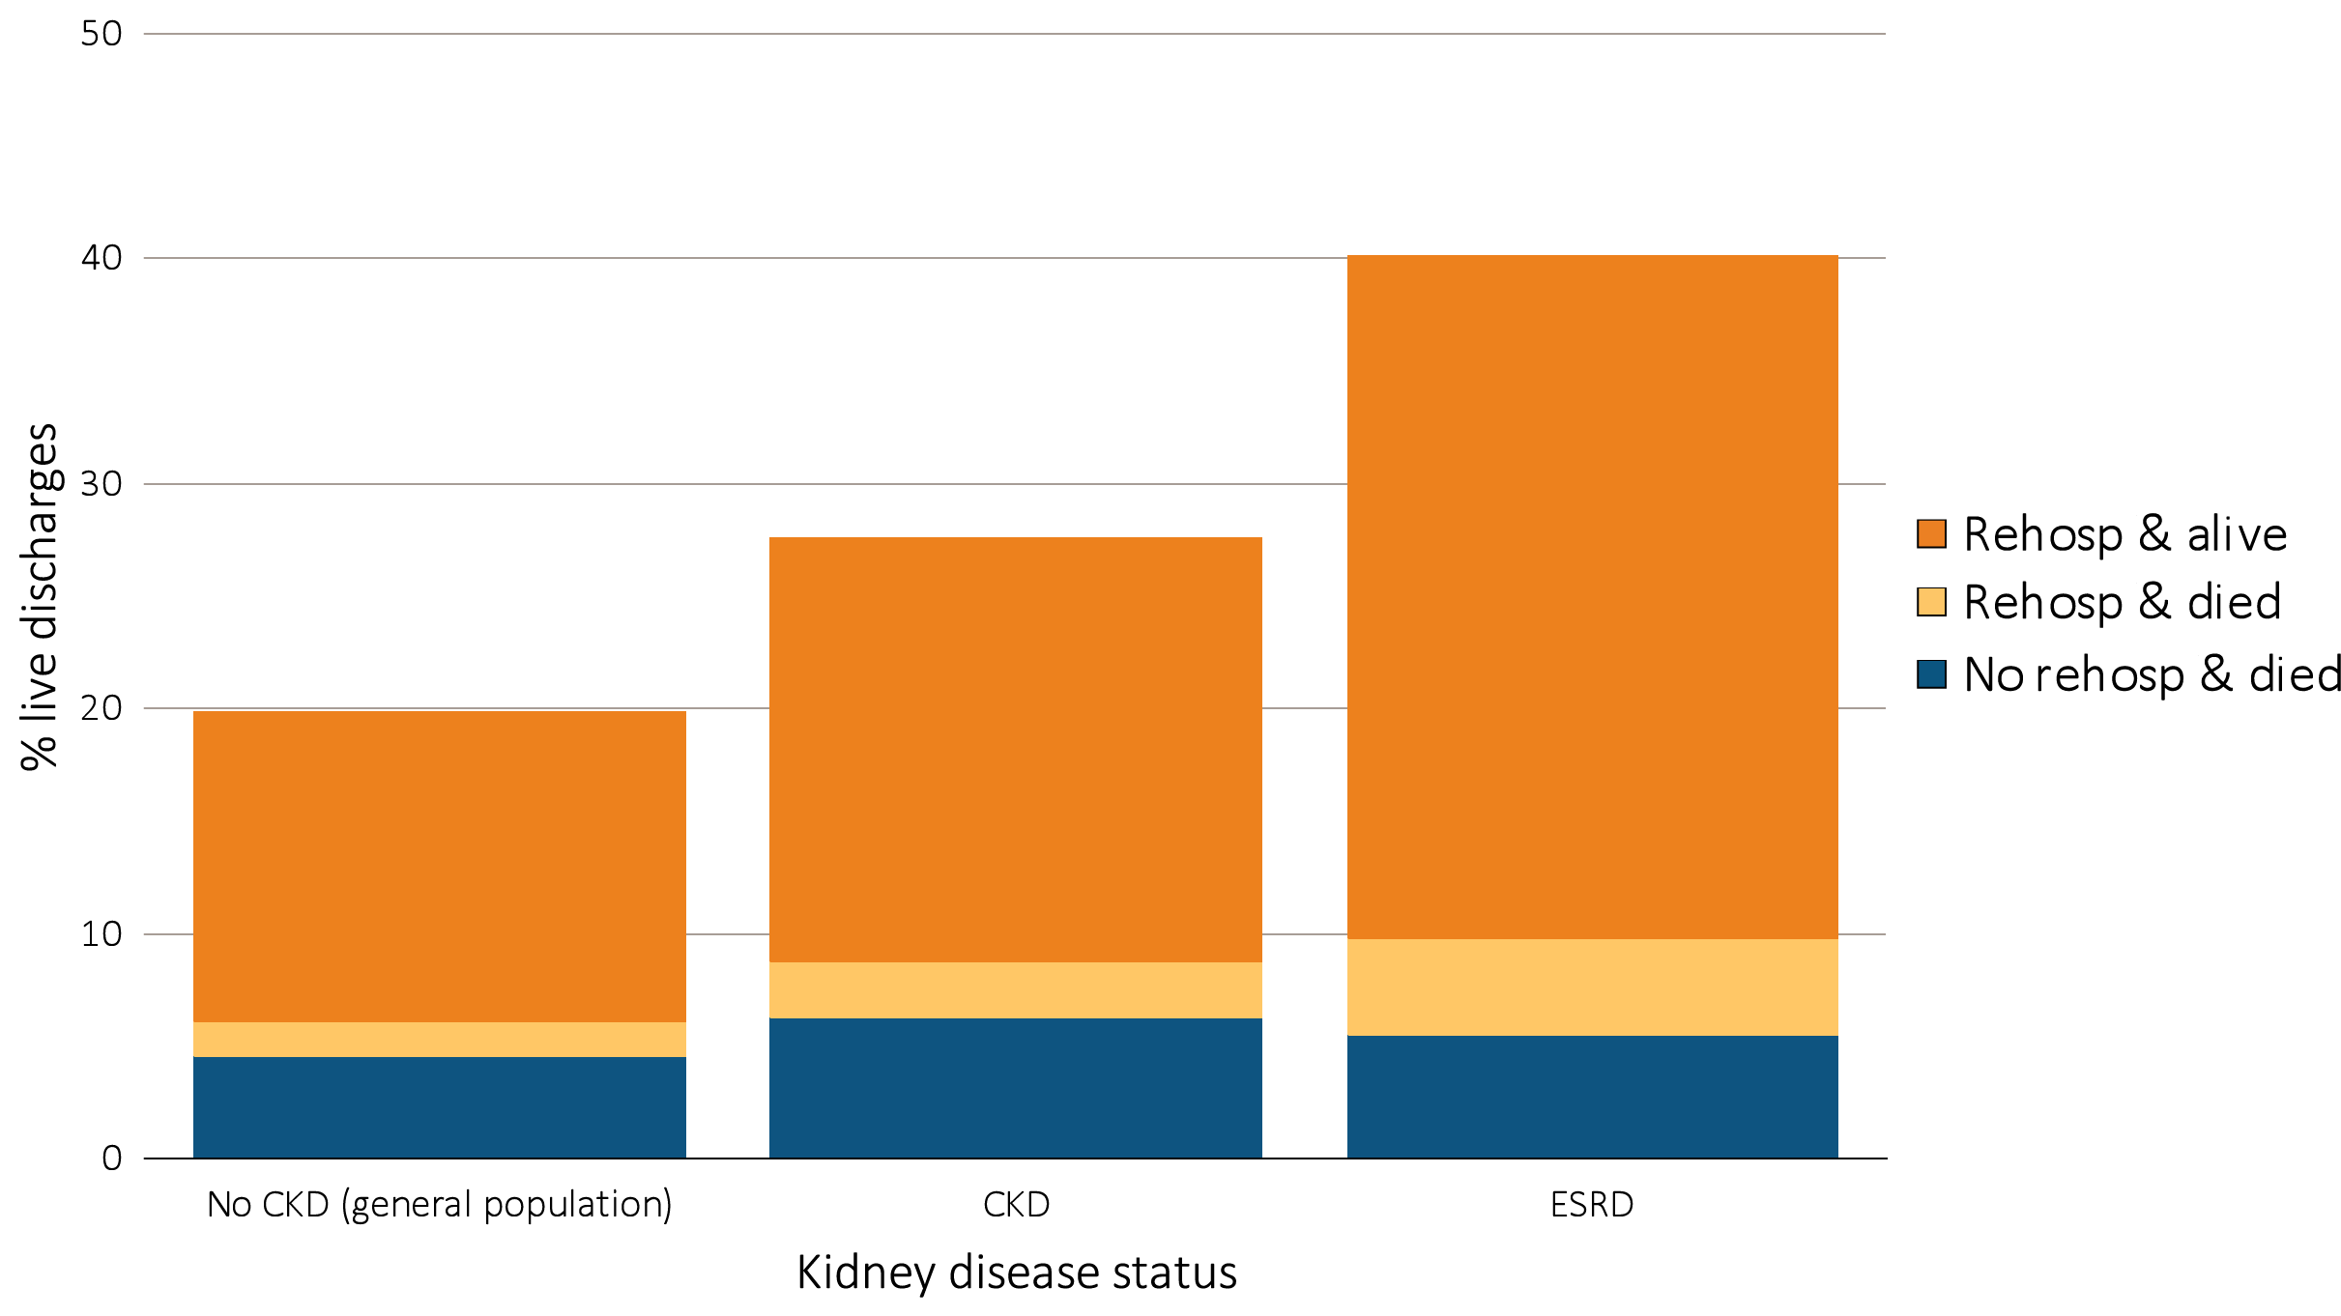
Figure 5.6 Proportion of patients aged 66 & older discharged alive from the hospital who were either rehospitalized or died within 30 days of discharge, by kidney disease status, 2014
Data Source: Special analyses, USRDS ESRD Database and Medicare 5 percent sample. January 1, 2014 point prevalent Medicare patients aged 66 & older on December 31, 2013. For general Medicare: January 1, 2014 point prevalent, Medicare patients aged 66 & older, discharged alive from an all-cause index hospitalization between January 1, 2014, and December 1, 2014, unadjusted. CKD determined using claims for 2013. Abbreviations: CKD, chronic kidney disease; ESRD, end-stage renal disease; rehosp, rehospitalization

Slide 14
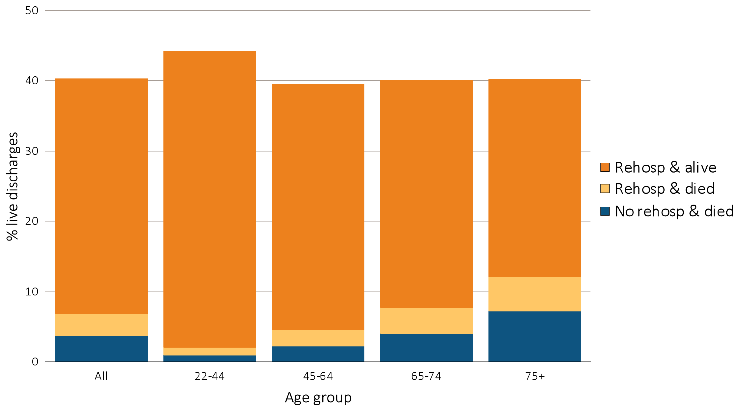
Figure 5.7 Proportion of hemodialysis patients discharged alive from the hospital who either were rehospitalized or died within 30 days of discharge, by demographic characteristics, 2014
^{(a) By age}
Data Source: Data Source: Special analyses, USRDS ESRD Database. Period prevalent hemodialysis patients, all ages, 2014; unadjusted. Includes live hospital discharges from January 1 to December 1, 2014. Cause-specific hospitalizations are defined by principal ICD-9-CM codes. See Vol. 2, ESRD Analytical Methods for principal ICD-9-CM diagnosis codes included in each cause of hospitalization category. Abbreviations: Af Am, African American; ESRD, end-stage renal disease; Nat Am, Native American; Other, other or unidentified race; rehosp, rehospitalization..

Slide 15
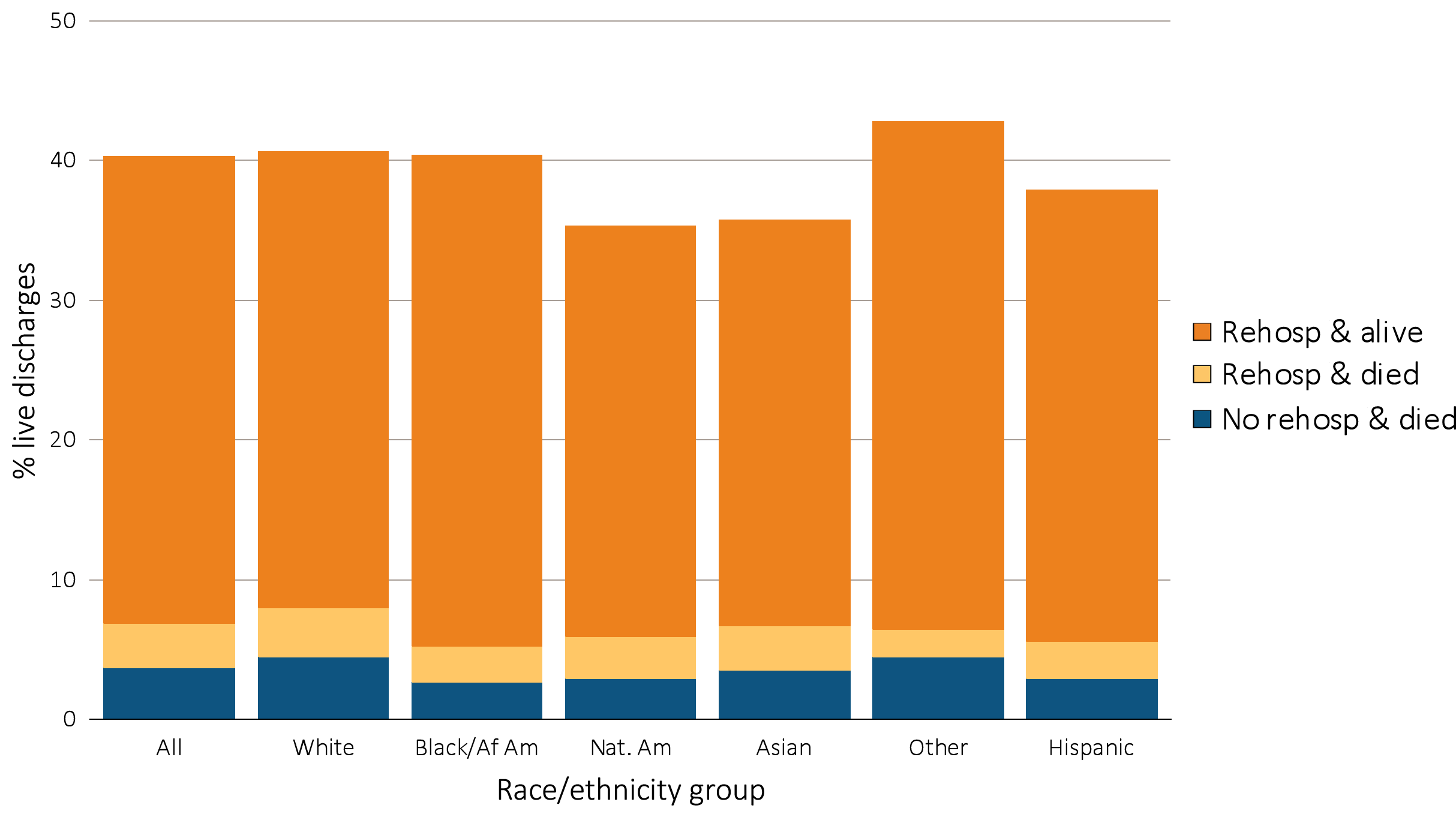
Figure 5.7 Proportion of hemodialysis patients discharged alive from the hospital who either were rehospitalized or died within 30 days of discharge, by demographic characteristics, 2014
^{(b) By race/ethnicity}
Data Source: Data Source: Special analyses, USRDS ESRD Database. Period prevalent hemodialysis patients, all ages, 2014; unadjusted. Includes live hospital discharges from January 1 to December 1, 2014. Cause-specific hospitalizations are defined by principal ICD-9-CM codes. See Vol. 2, ESRD Analytical Methods for principal ICD-9-CM diagnosis codes included in each cause of hospitalization category. Abbreviations: Af Am, African American; ESRD, end-stage renal disease; Nat Am, Native American; Other, other or unidentified race; rehosp, rehospitalization..

Slide 16
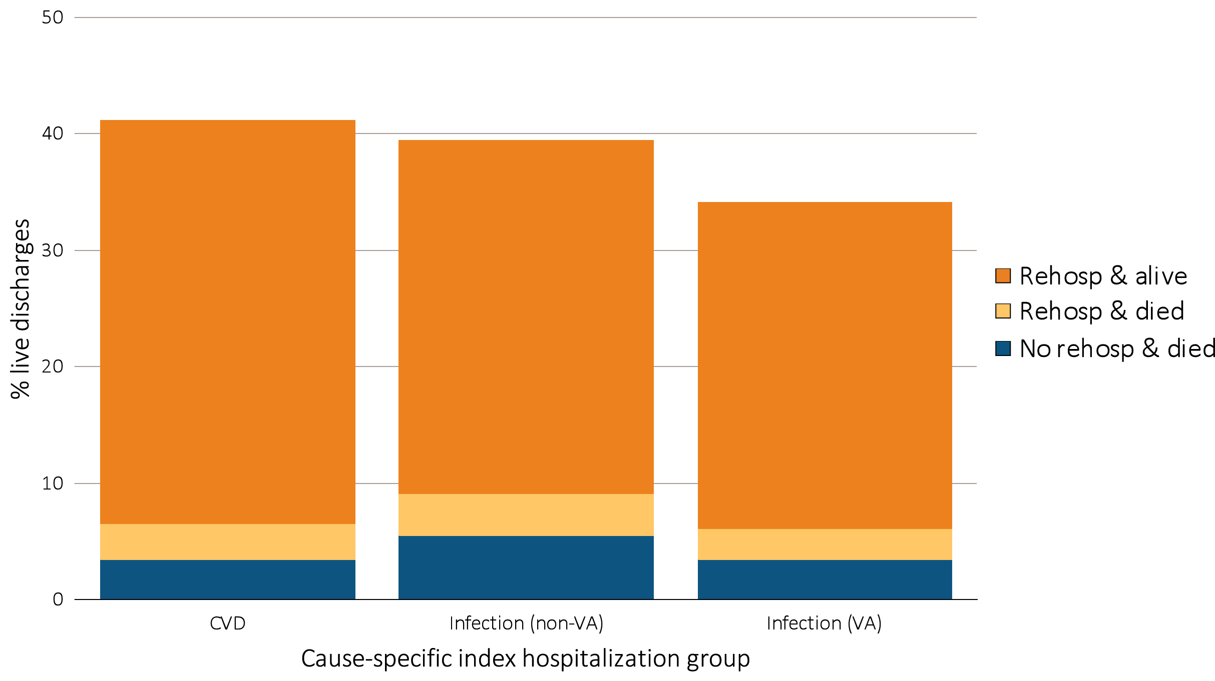
Figure 5.8 Proportion of hemodialysis patients discharged alive that either were rehospitalized or died within 30 days of discharge, by cause of index hospitalization, 2014
Data Source: Data Source: Special analyses, USRDS ESRD Database. Period prevalent hemodialysis patients, all ages, 2014, unadjusted. Includes live hospital discharges from January 1 to December 1, 2014. Cause-specific hospitalizations are defined by principal ICD-9-CM codes. See Vol. 2, ESRD Analytical Methods for principal ICD-9-CM diagnosis codes included in each cause of hospitalization category. Abbreviations: CVD, cardiovascular disease; ESRD, end-stage renal disease; rehosp, rehospitalization; VA, vascular access.

Slide 17
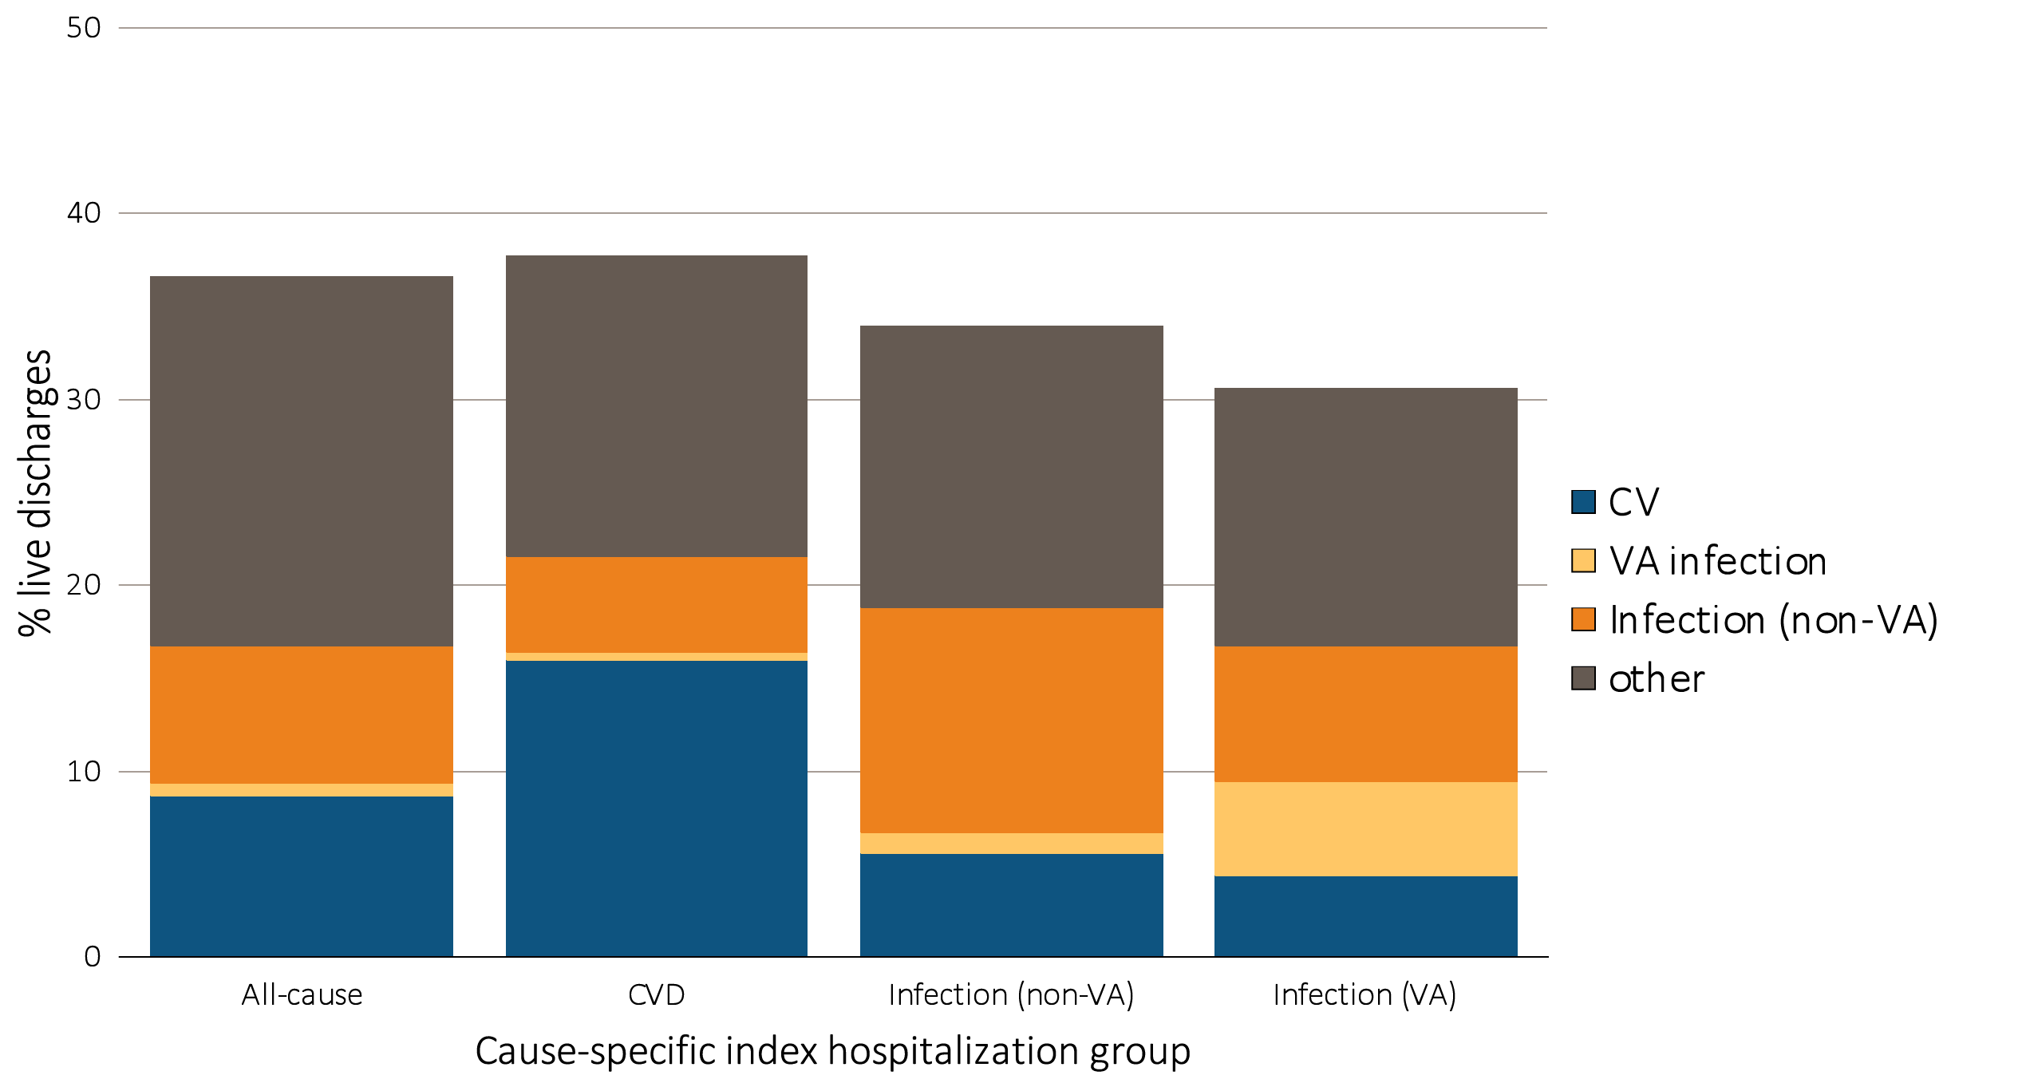
Figure 5.9 Proportion of hemodialysis patients with cause-specific rehospitalizations within 30 days of discharge, by cause of index hospitalization, 2014
Data Source: Data Source: Special analyses, USRDS ESRD Database. Period prevalent hemodialysis patients, all ages, 2014, unadjusted. Includes live hospital discharges from January 1 to December 1, 2014. Cause-specific hospitalizations are defined by principal ICD-9-CM codes. See Vol. 2, ESRD Analytical Methods for principal ICD-9-CM diagnosis codes included in each cause of hospitalization category. Abbreviations: CVD, cardiovascular disease; ESRD, end-stage renal disease; rehosp, rehospitalization; VA, vascular access..

Slide 18
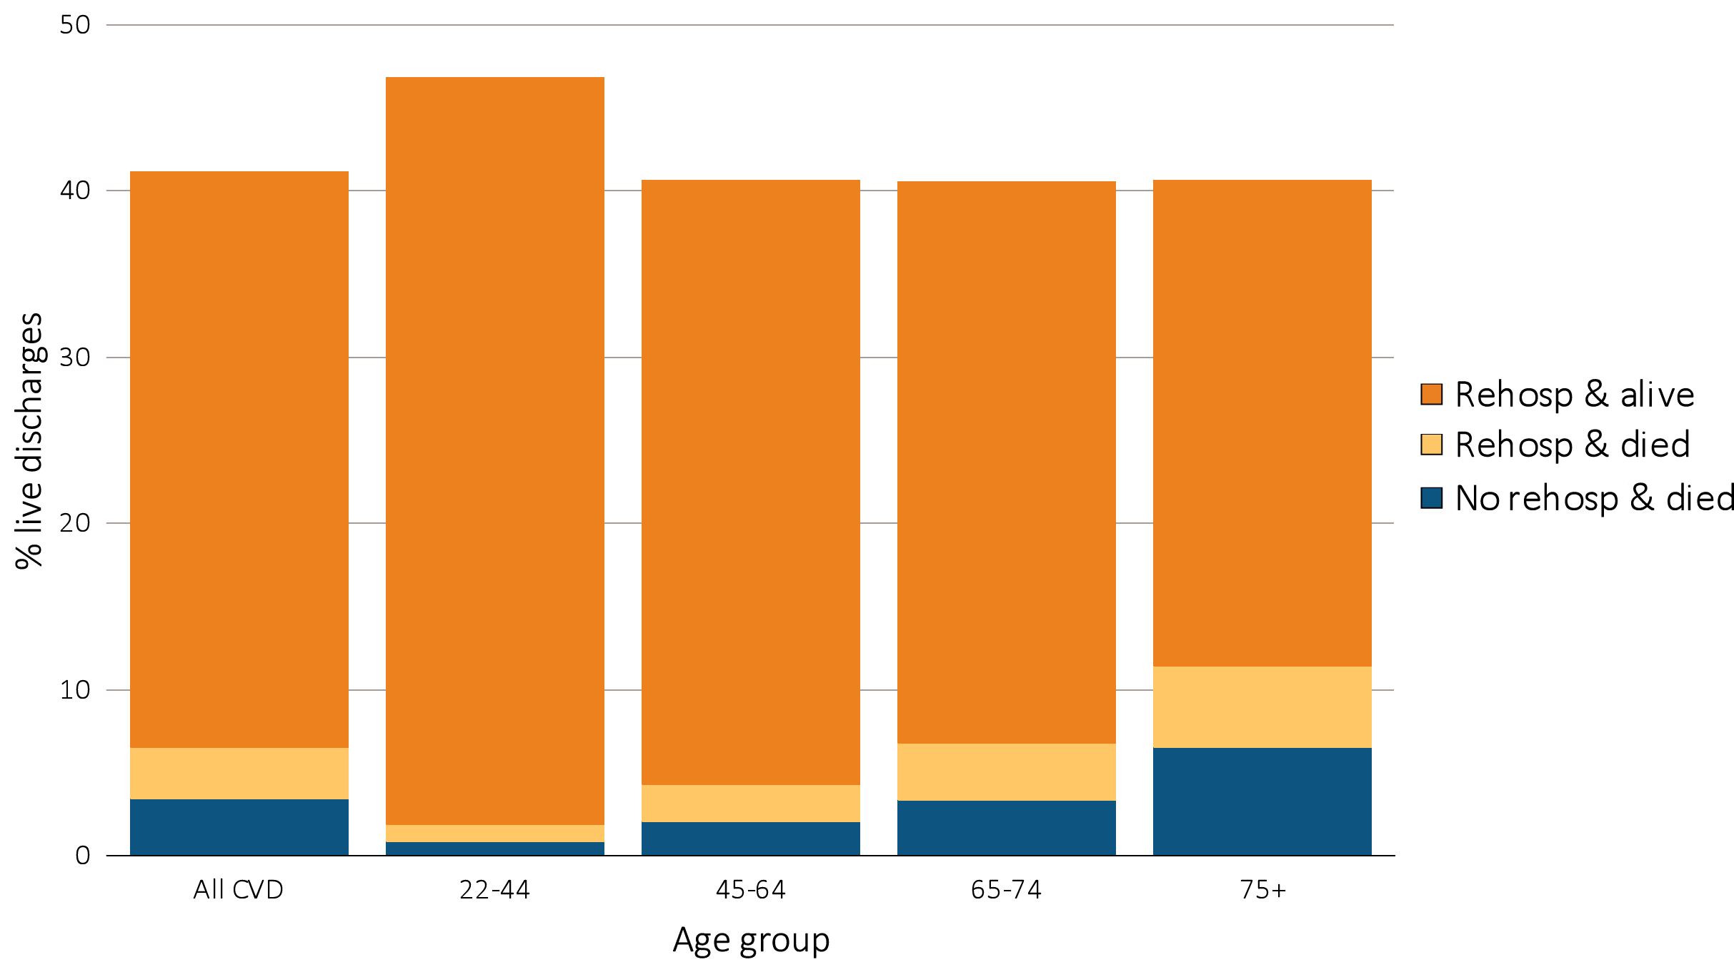
Figure 5.10 Proportion of hemodialysis patients discharged alive that either were rehospitalized or died within 30 days of discharge for cardiovascular index hospitalization, by age, 2014
Data Source: Special analyses, USRDS ESRD Database. Period prevalent hemodialysis patients, all ages, 2014, unadjusted. Patients less than age 22 are not represented as a group due to insufficient sample size. Includes live hospital discharges from January 1 to December 1, 2014. Cause-specific hospitalizations are defined by principal ICD-9-CM codes. See Vol. 2, ESRD Analytical Methods for principal ICD-9-CM diagnosis codes included in each cause of hospitalization category. Abbreviations: CVD, cardiovascular disease; ESRD, end-stage renal disease; rehosp, rehospitalization.

Slide 19
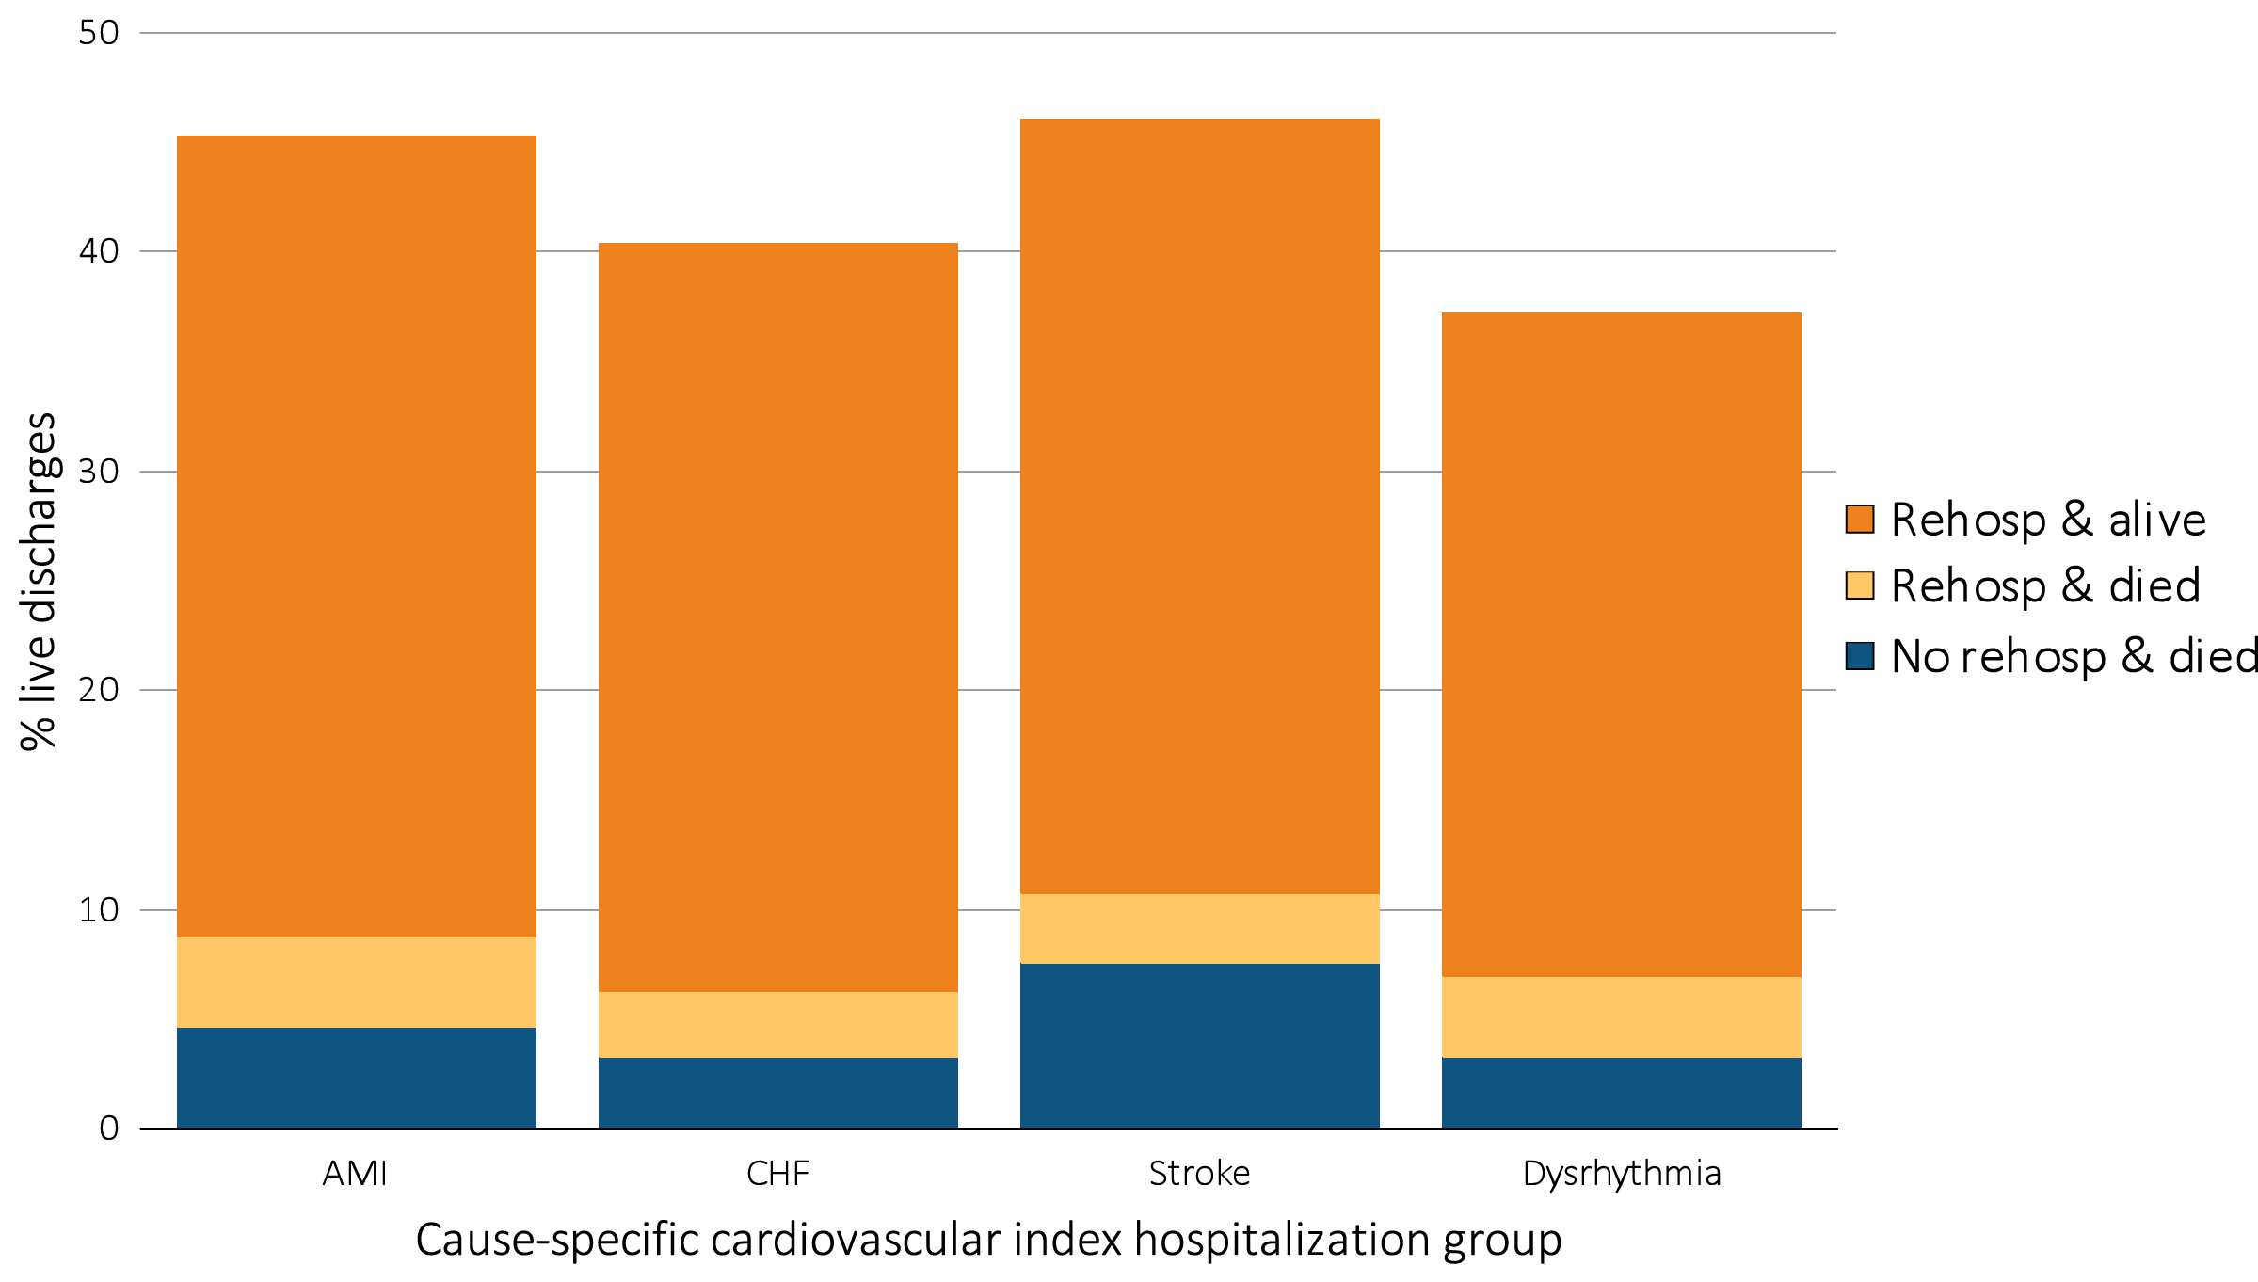
Figure 5.11 Proportion of hemodialysis patients discharged alive that either were rehospitalized or died within 30 days of discharge for cardiovascular index hospitalization, by cause-specific cardiovascular index hospitalization, 2014
Data Source: Special analyses, USRDS ESRD Database. Period prevalent hemodialysis patients, all ages, 2014, unadjusted. Includes live hospital discharges from January 1 to December 1, 2014. Cause-specific hospitalizations are defined by principal ICD-9-CM codes. See Vol. 2, ESRD Analytical Methods for principal ICD-9-CM diagnosis codes included in each cause of hospitalization category. Abbreviations: AMI, acute myocardial infarction; CHF, congestive heart failure; ESRD, end-stage renal disease; rehosp, rehospitalization.

