Slide 2
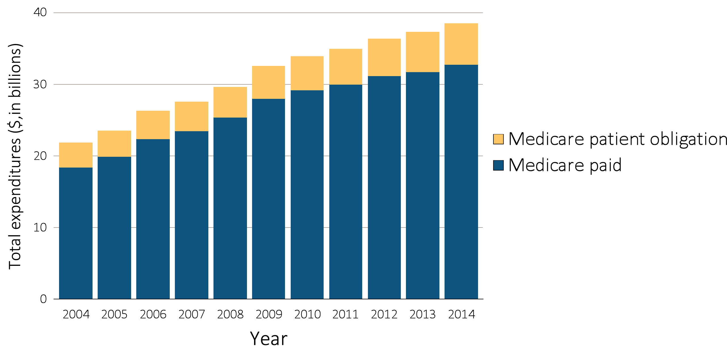
Figure 11.1 Trends in ESRD expenditures, 2004-2014
Data Source: USRDS ESRD Database; “Medicare paid” data were obtained from Reference Table K.1 and “Medicare patient obligation” data from special analyses. Abbreviation: ESRD, end-stage renal disease.

Slide 3
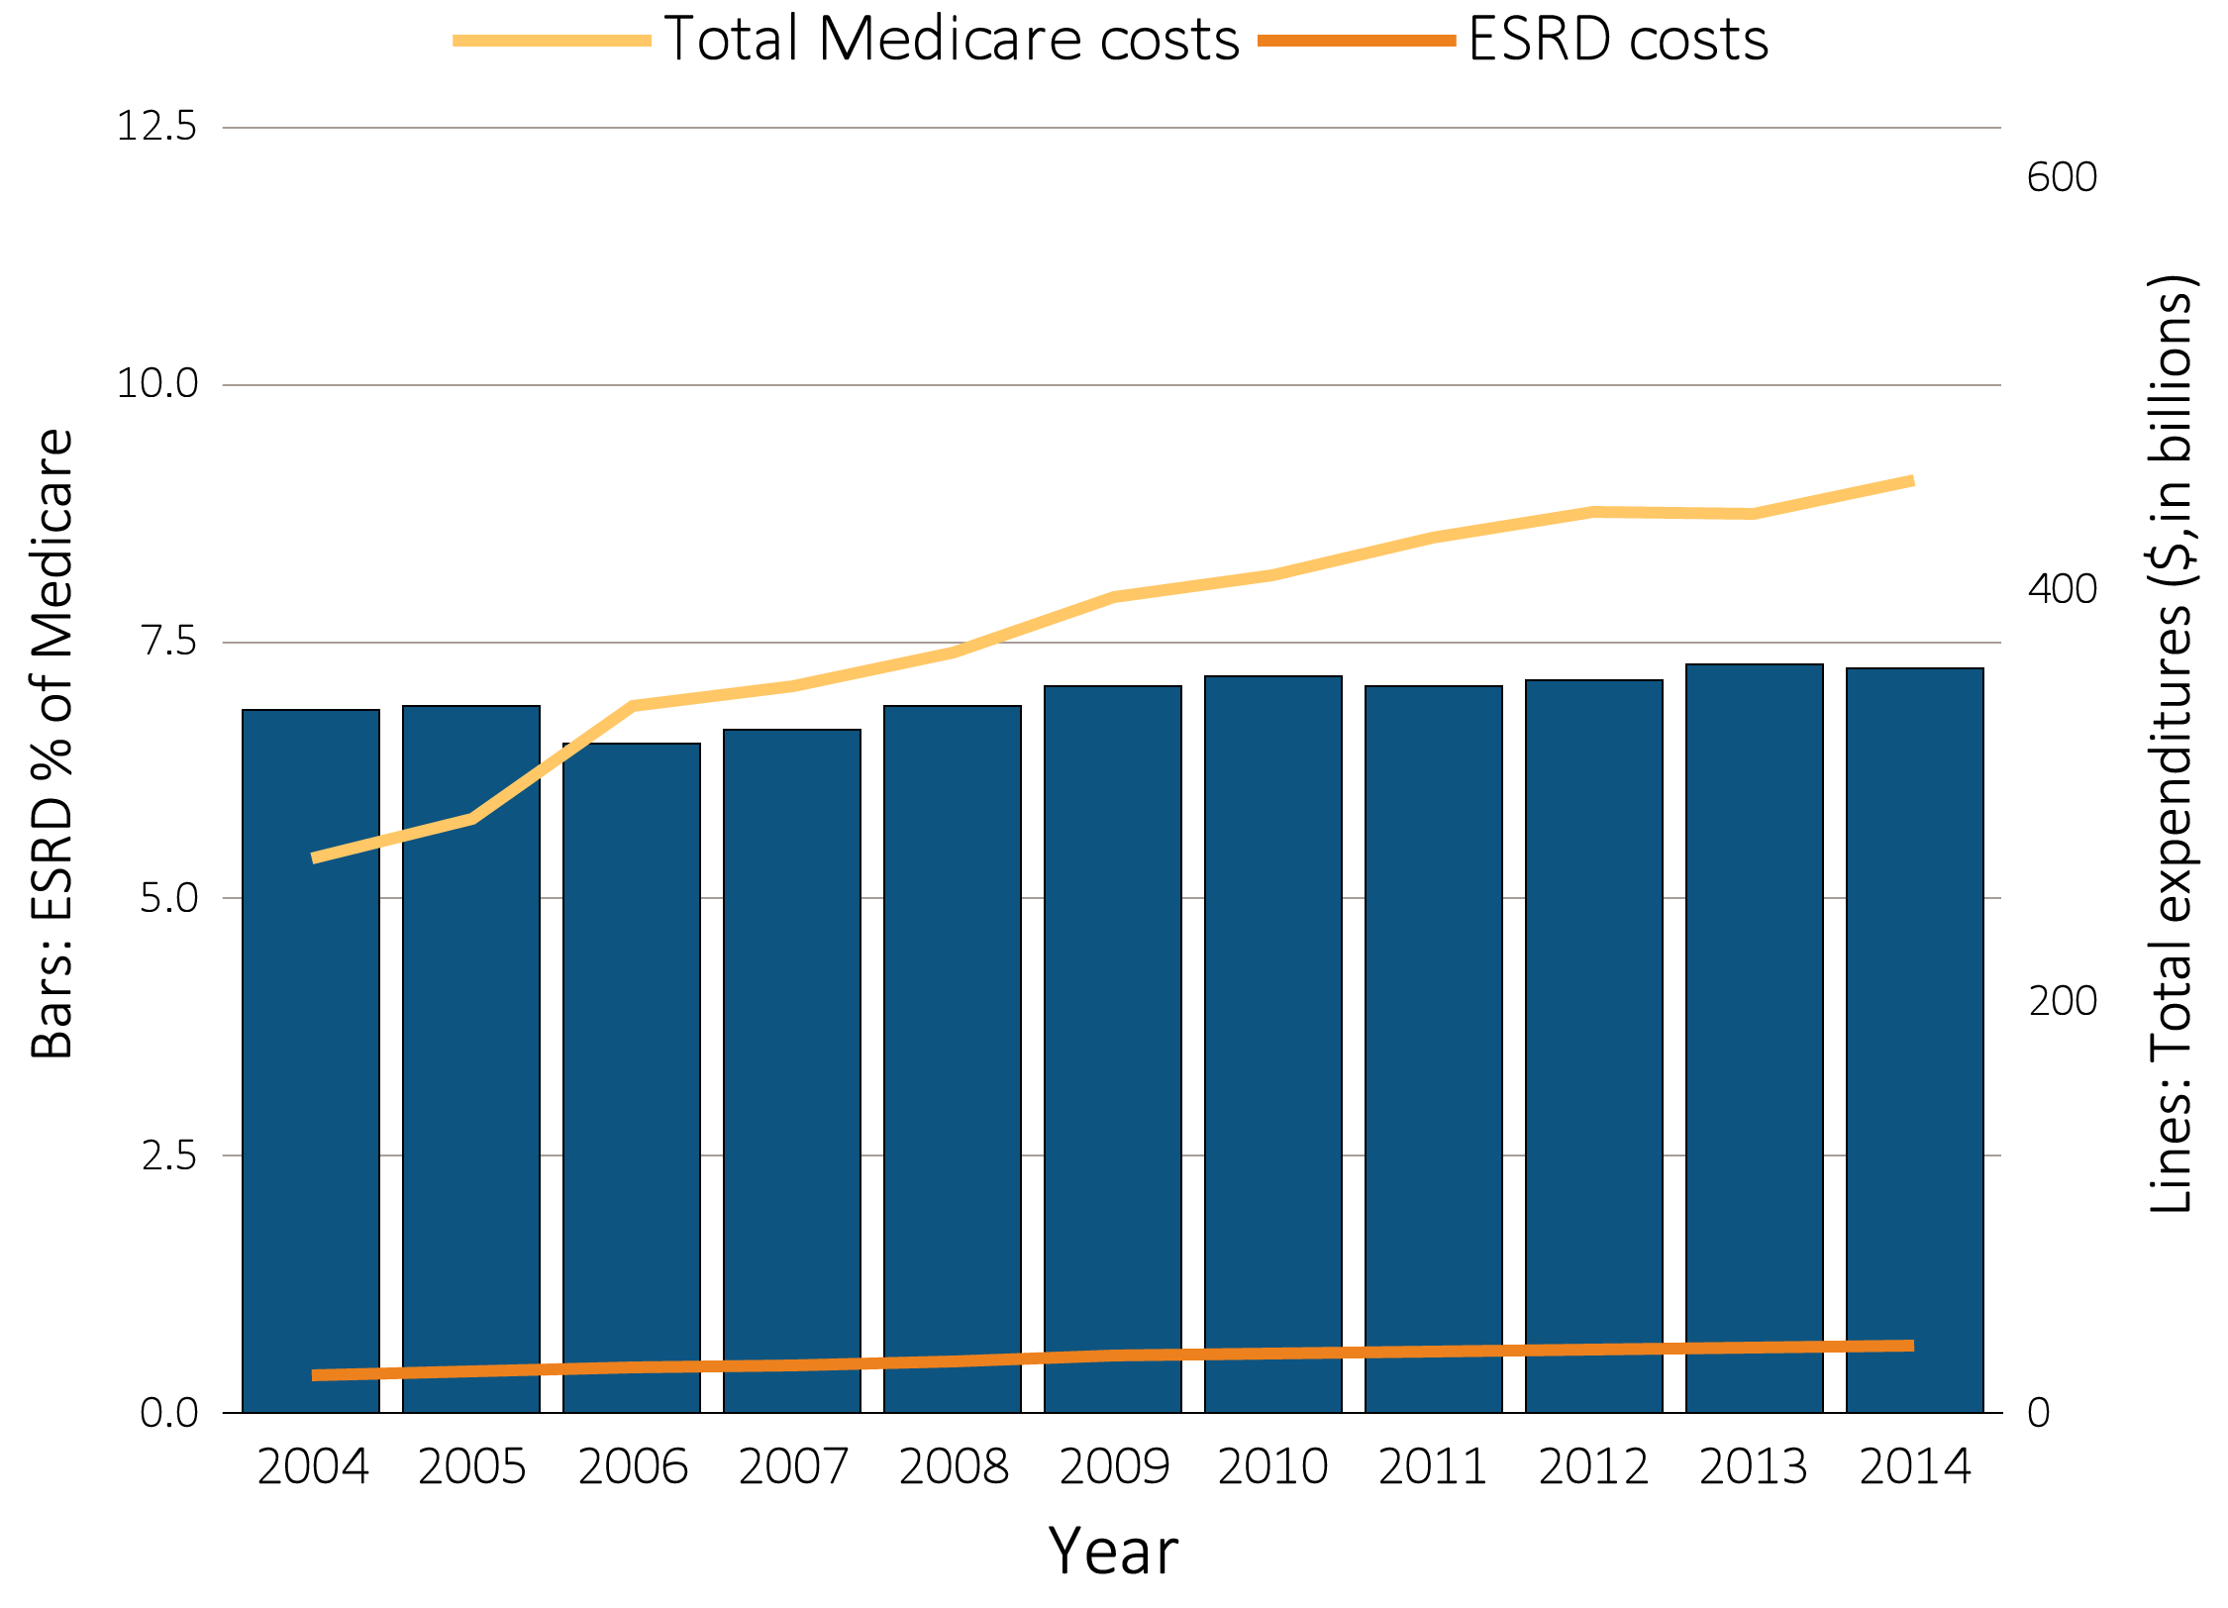
Figure 11.2 Trends in costs of the Medicare & ESRD programs, 2004-2014
Data Source: Total ESRD costs obtained from USRDS ESRD Database; Reference Table K.1. Total Medicare expenditures obtained from Trustees Report, Table II.B1 https://www.cms.gov/Research-Statistics-Data-and-Systems/Statistics-Trends-and-Reports/ReportsTrustFunds/TrusteesReports.html. Abbreviation: ESRD, end-stage renal disease.

Slide 4
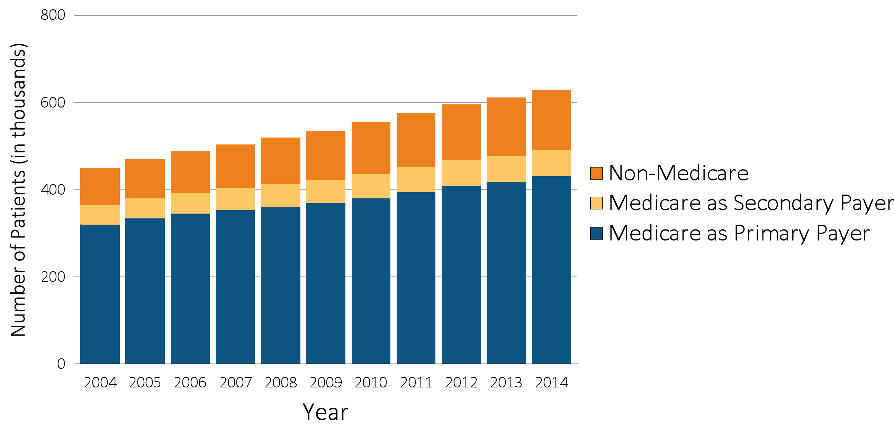
Figure 11.3 Trends in numbers of point prevalent ESRD patients, 2004-2014
Data Source: USRDS ESRD Database. December 31 point prevalent ESRD patients. Abbreviation: ESRD, end-stage renal disease.

Slide 5
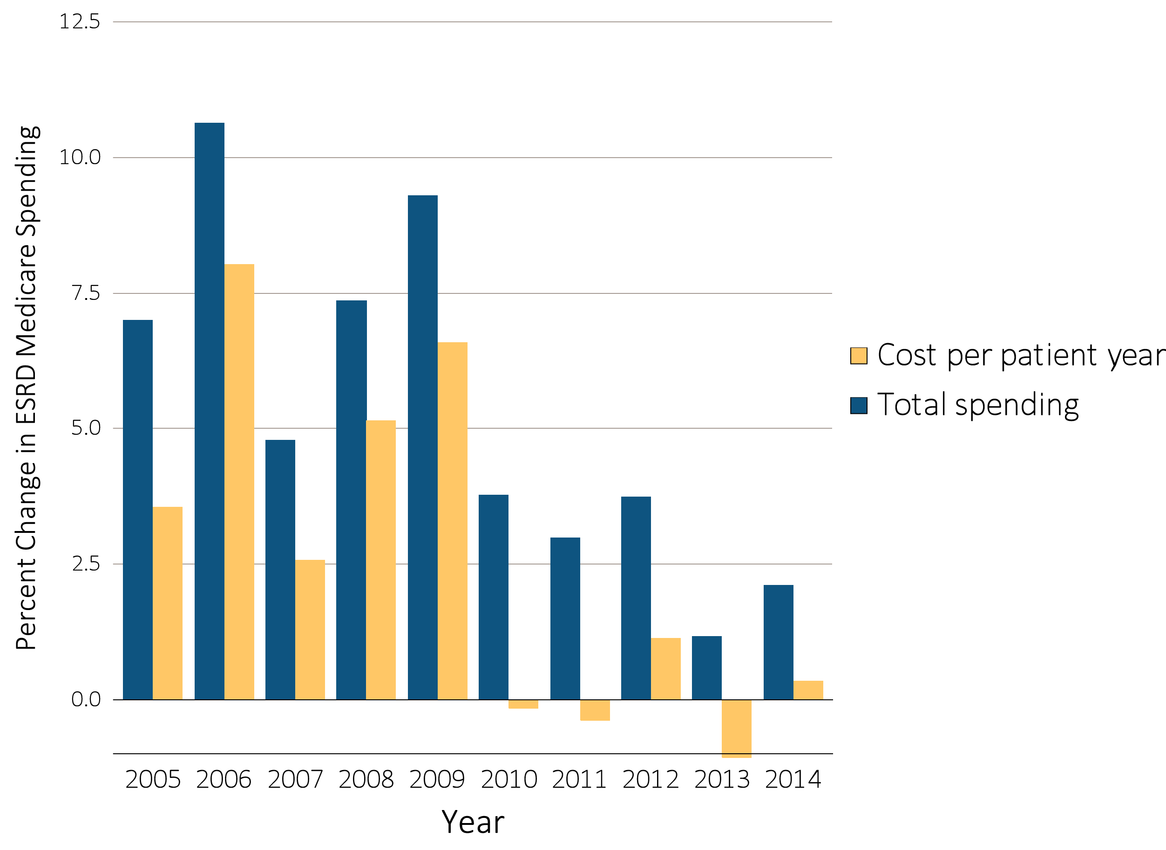
Figure 11.4 Annual percent change in Medicare ESRD spending, 2004-2014
Data Source: USRDS ESRD Database; Reference Table K.4. Total Medicare ESRD costs from claims data; includes all claims with Medicare as primary payer only. Abbreviation: ESRD, end-stage renal disease.

Slide 6
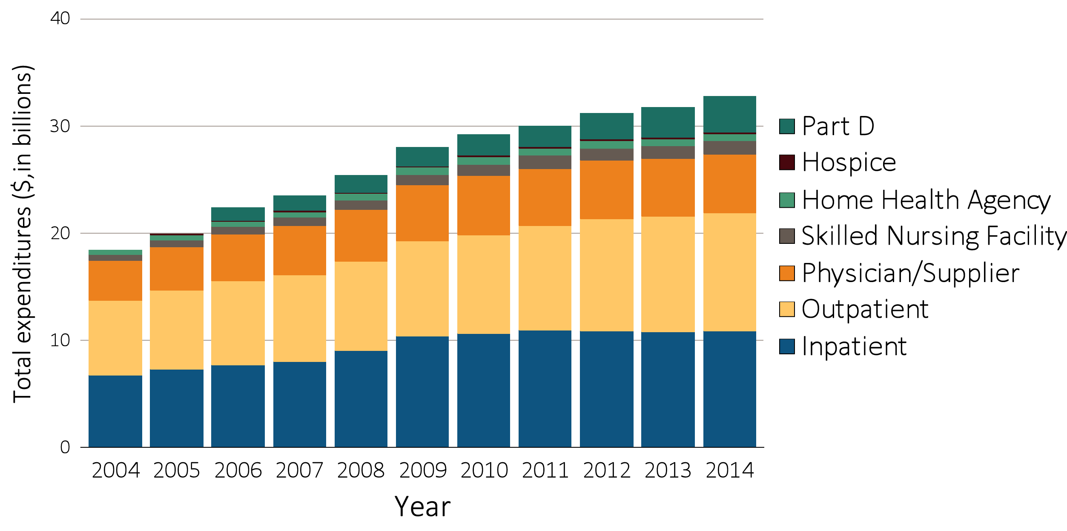
Figure 11.5 Trends in total Medicare fee-for-service spending for ESRD, by type of service, 2004-2014
Data Source: USRDS ESRD Database; Reference Table K.1. Total Medicare costs from claims data. Abbreviation: ESRD, end-stage renal disease.

Slide 7
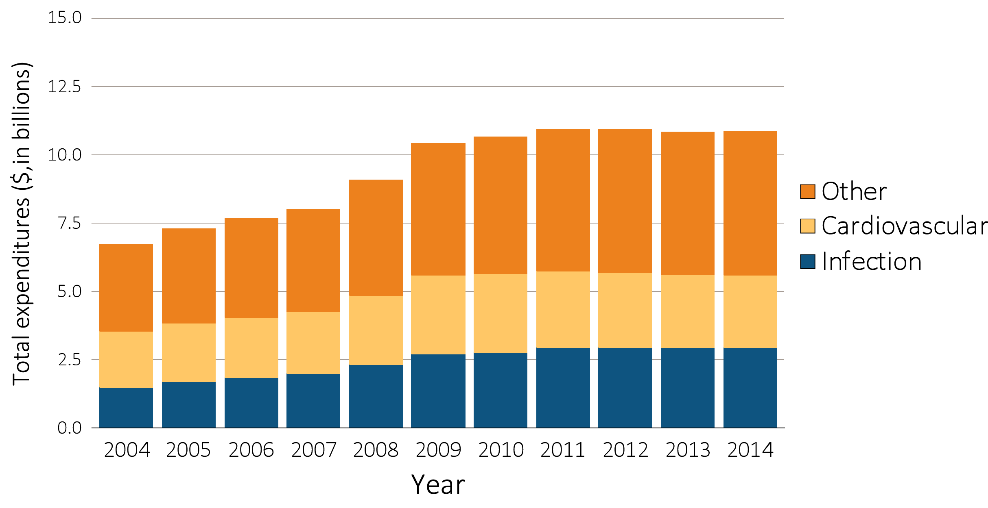
Figure 11.6 Total Medicare fee-for-service inpatient spending by cause of hospitalization, 2004-2014
Data Source: USRDS ESRD Database. Total Medicare costs from claims data. Abbreviation: ESRD, end-stage renal disease. Unknown hospitalization cost (<0.01%) was combined with ‘Other’.

Slide 8
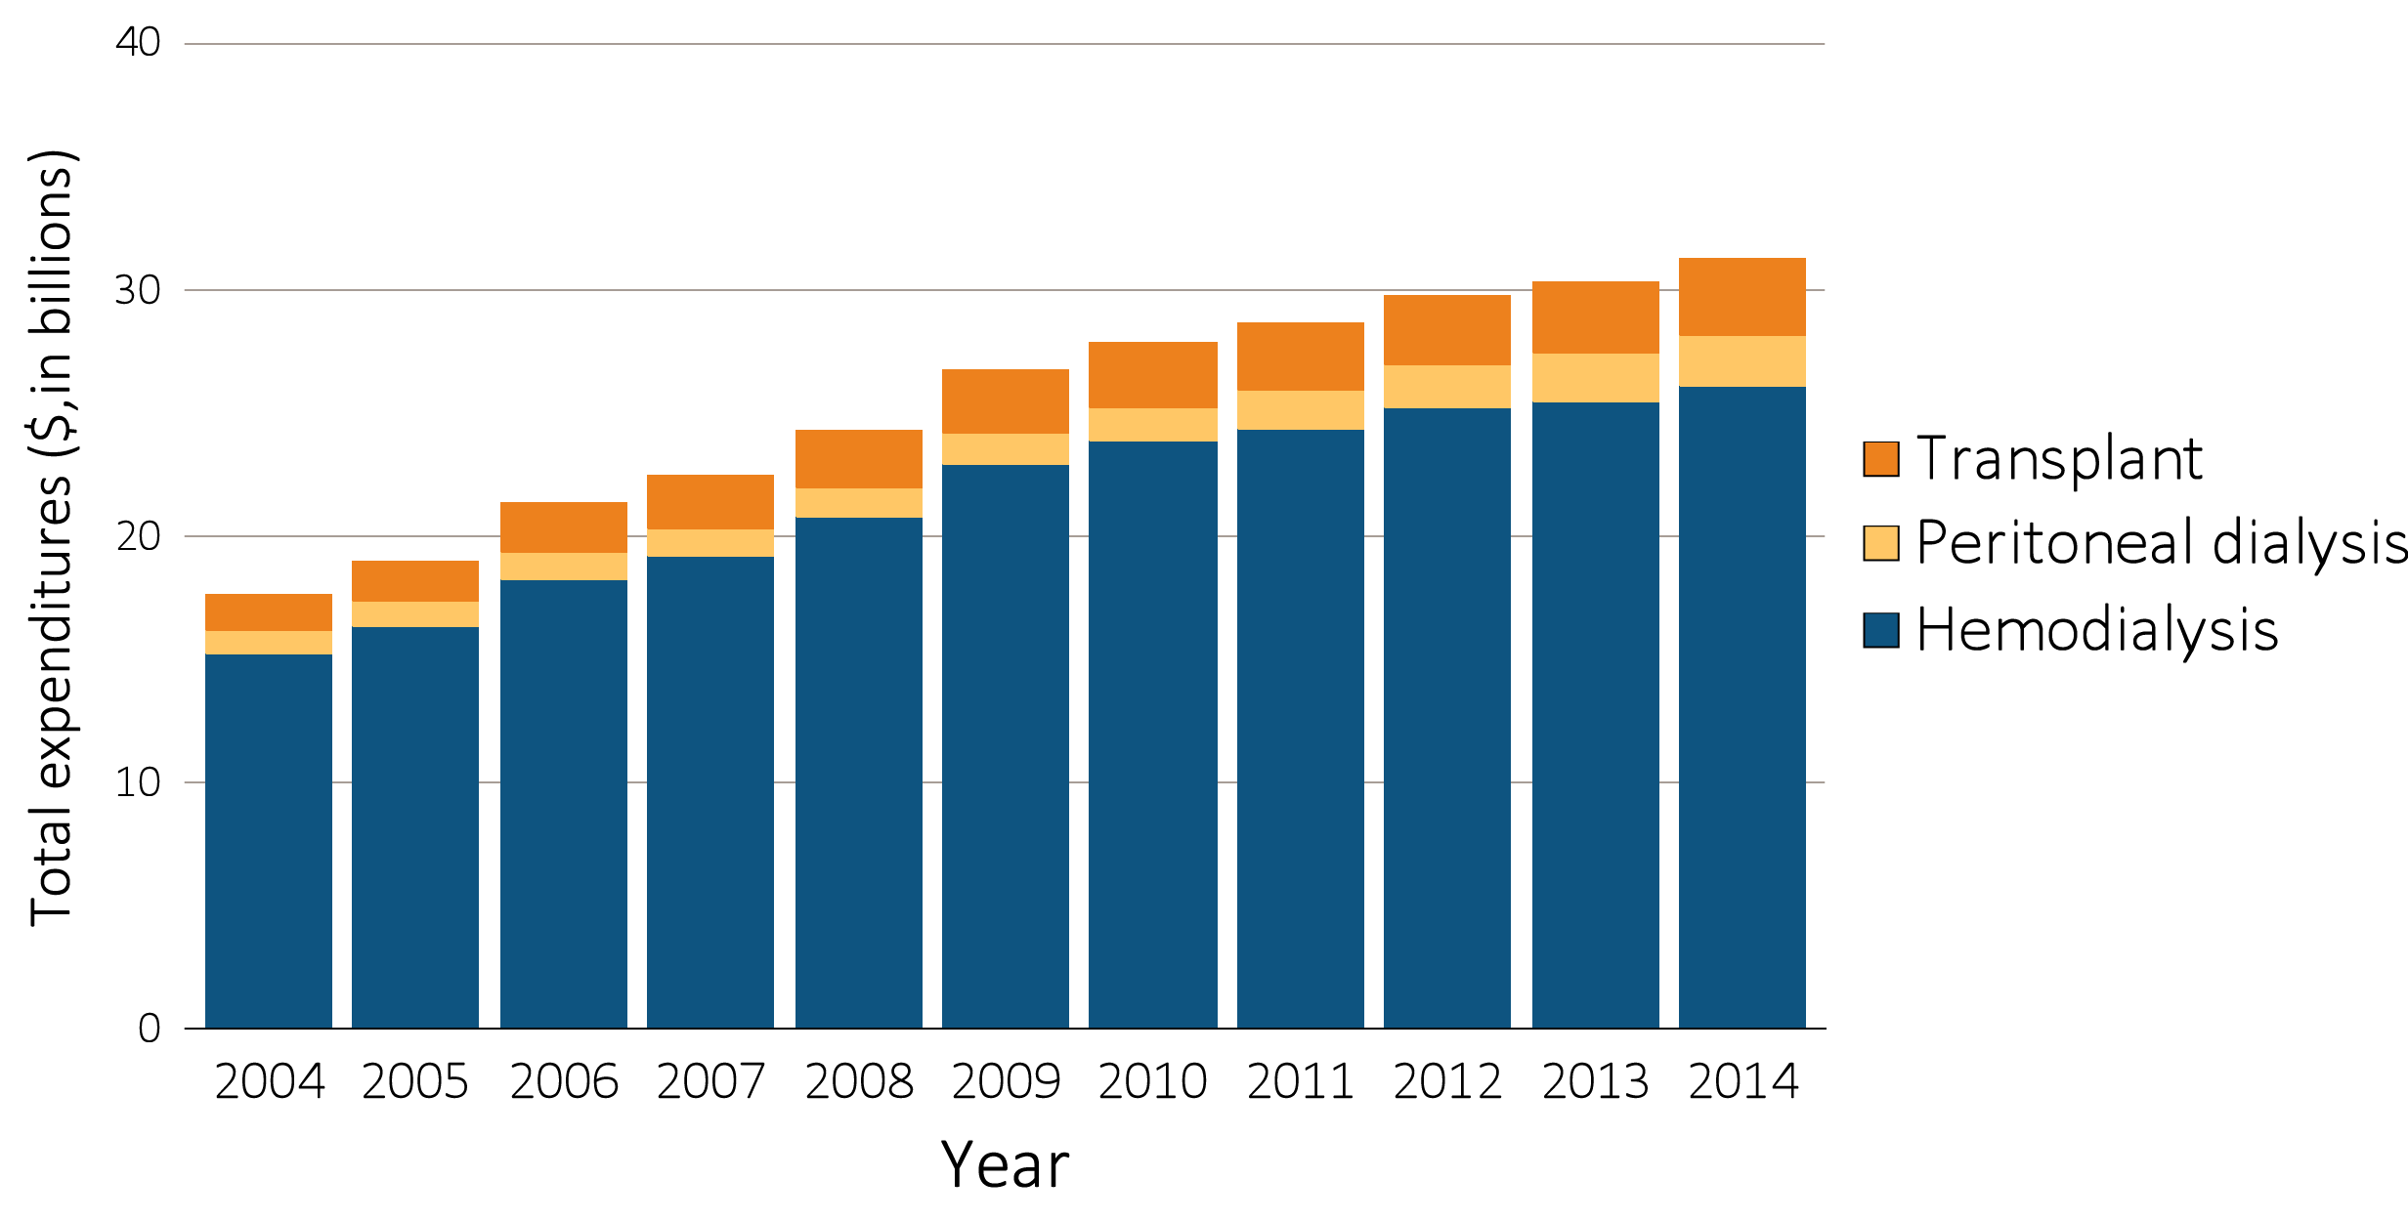
Figure 11.7 Total Medicare ESRD expenditures, by modality, 2004-2014
Data Source: USRDS ESRD Database. Total Medicare costs from claims data for period prevalent ESRD patients. Abbreviation: ESRD, end-stage renal disease.

Slide 9
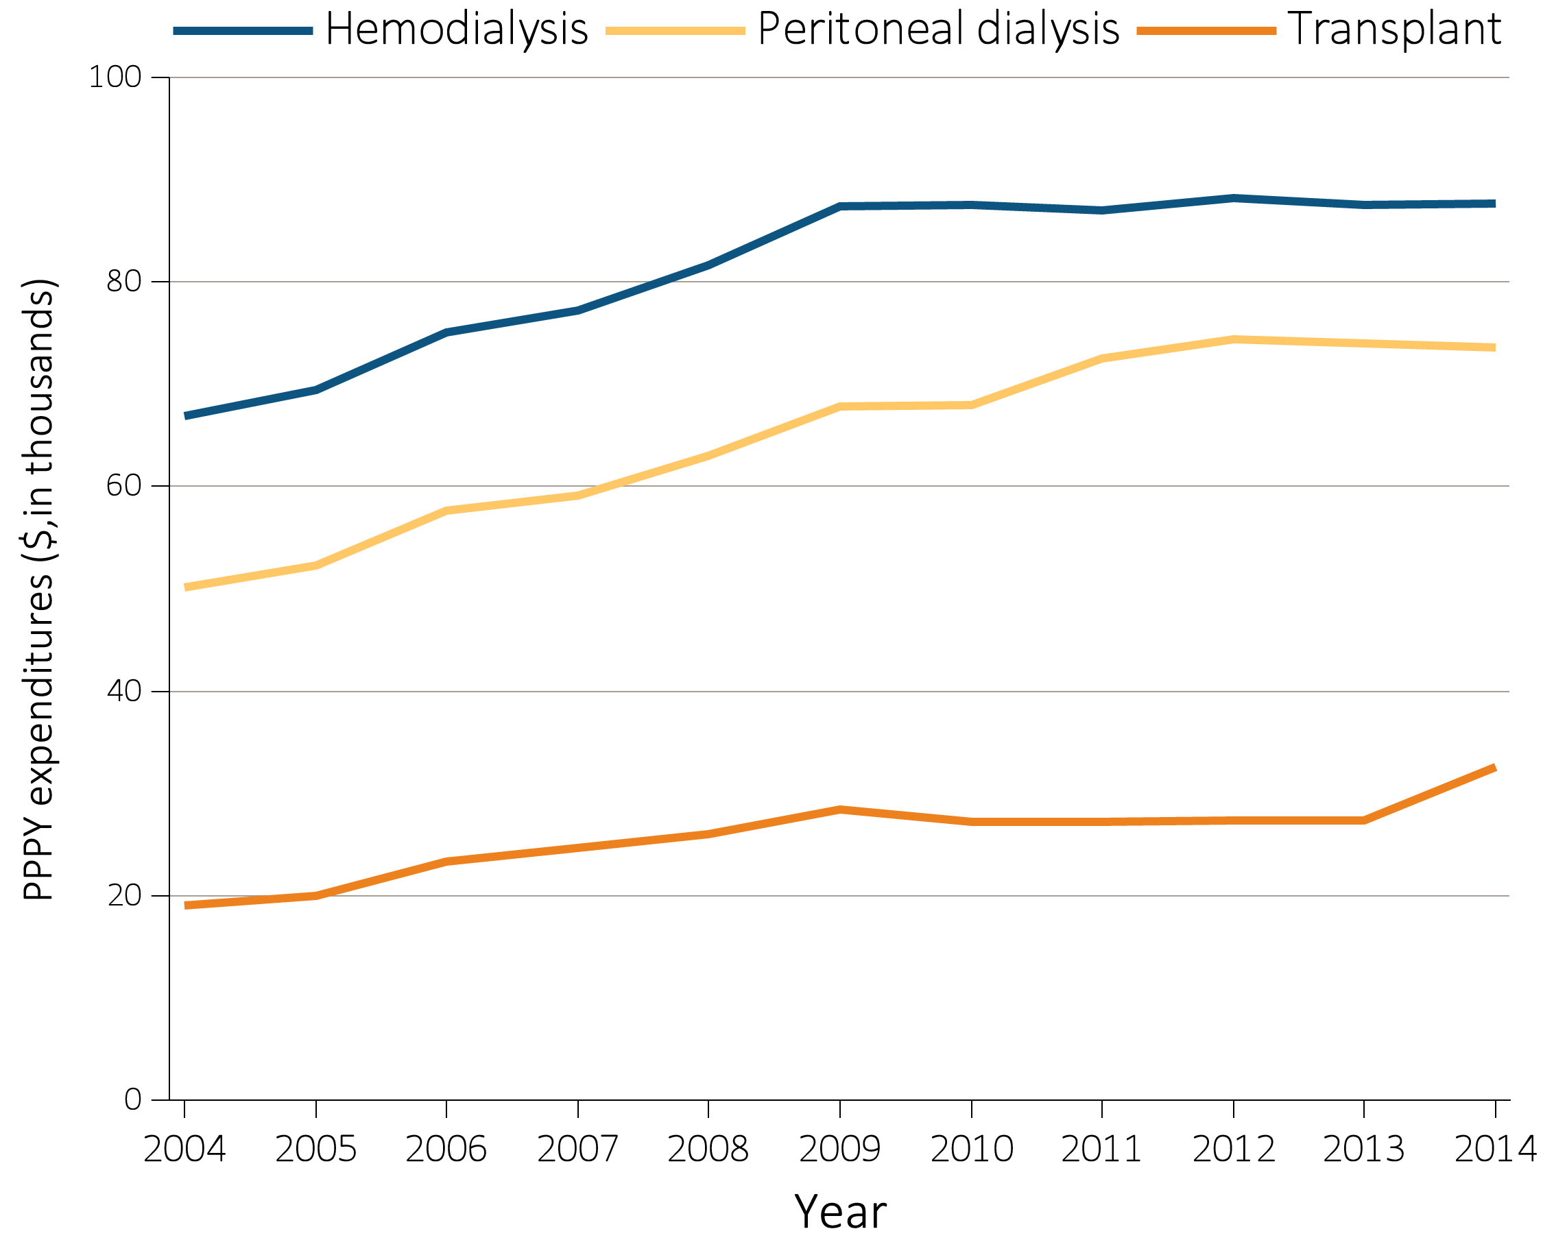
Figure 11.8 Total Medicare ESRD expenditures per person per year, by modality, 2004-2014
Data Source: USRDS ESRD Database; Reference Tables K.7, K.8, & K.9.Period prevalent ESRD patients; includes all claims with Medicare as primary payer only. Abbreviation: ESRD, end-stage renal disease.

