Slide 1
2017 Annual Data Report
Volume 1: Chronic Kidney Disease
Chapter 1:
CKD in the General Population

Slide 2
Table A Kidney Disease Outcomes and Quality Improvement (KDOQI) CKD Staging Guidelines
CKD Stage | Description | GFR (ml/min/1.73 m²)
1 | Kidney damage with normal or ↑ GFR | > 90
2 | Kidney damage with mild ↓ in GFR | 60-89
3 | Moderate ↓ in GFR | 30-59
4 | Severe ↓ in GFR | 15-29
5 | Kidney failure | < 15 (or dialysis)

Slide 3
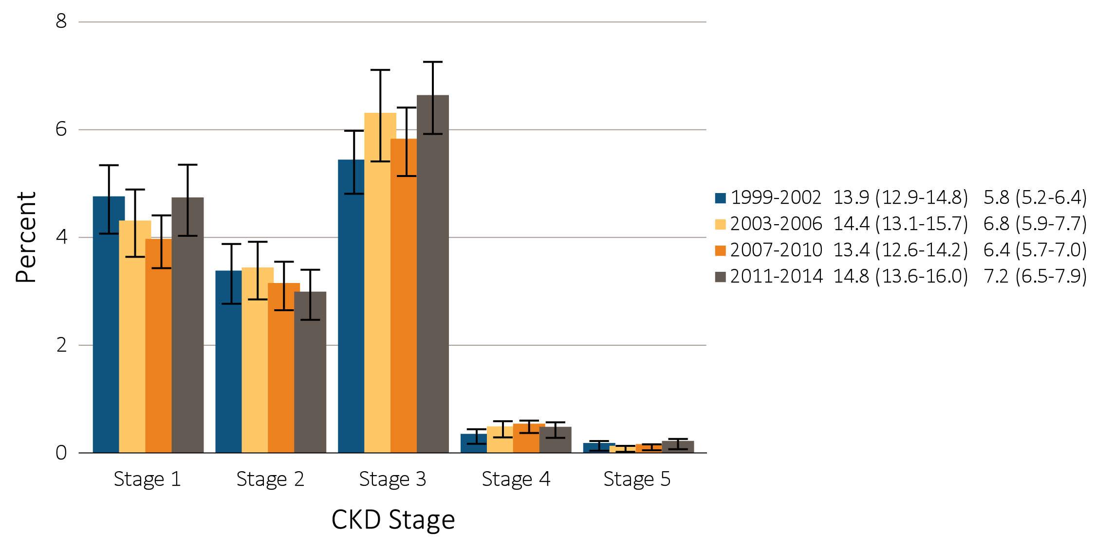
vol 1 Figure 1.1 Prevalence of CKD by stage among NHANES participants, 1999-2014
Data Source: National Health and Nutrition Examination Survey (NHANES), 1999-2002, 2003-2006, 2007-2010 & 2011–2014 participants aged 20 & older. Whisker lines indicate 95% confidence intervals. Abbreviation: CKD, chronic kidney disease.

Slide 4
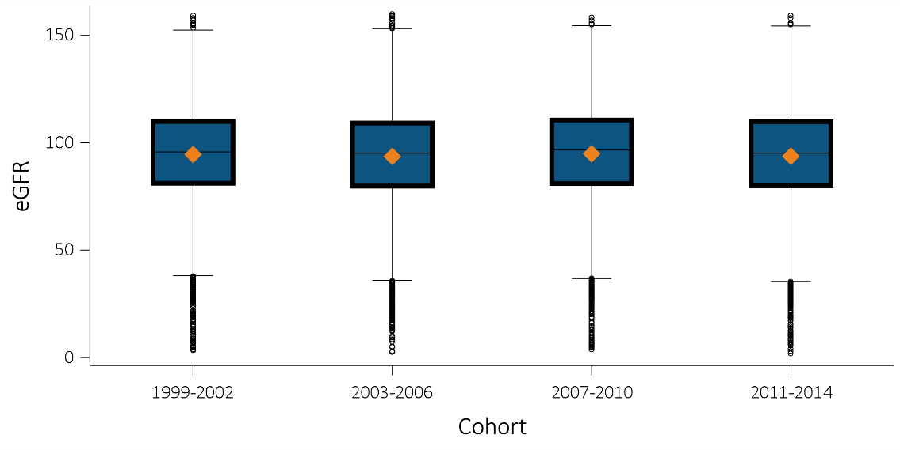
vol 1 Figure 1.2 eGFR distribution among NHANES participants, 1999-2014
(a) All Individuals
Data Source: National Health and Nutrition Examination Survey (NHANES), 1999-2014 participants aged 20 & older. Single-sample estimates of eGFR; eGFR calculated using the CKD-EPI equation. Abbreviations: eGFR, estimated glomerular filtration rate; SE, standard error. Accounts for change in serum creatinine assays.

Slide 5
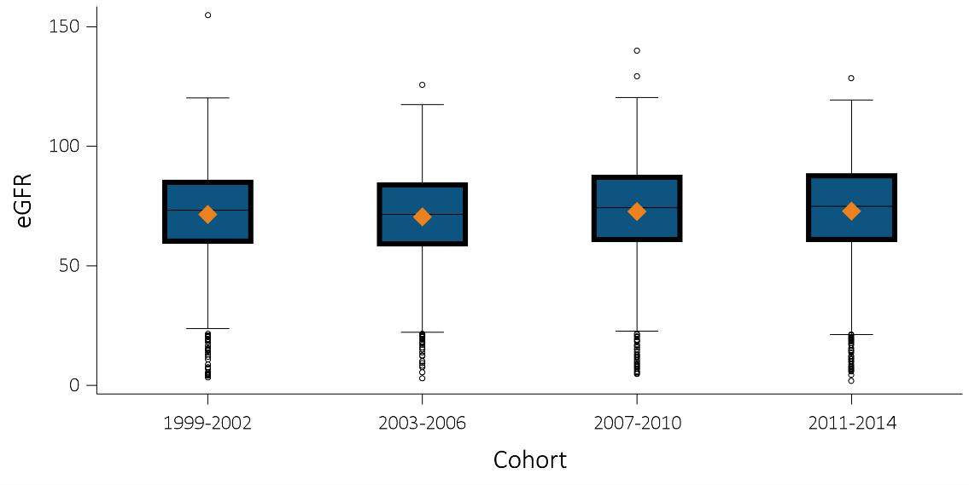
vol 1 Figure 1.2 eGFR distribution among NHANES participants, 1999-2014
(b) Individuals 60+ years
Data Source: National Health and Nutrition Examination Survey (NHANES), 1999-2014 participants aged 20 & older. Single-sample estimates of eGFR; eGFR calculated using the CKD-EPI equation. Abbreviations: eGFR, estimated glomerular filtration rate; SE, standard error. Accounts for change in serum creatinine assays.

Slide 6
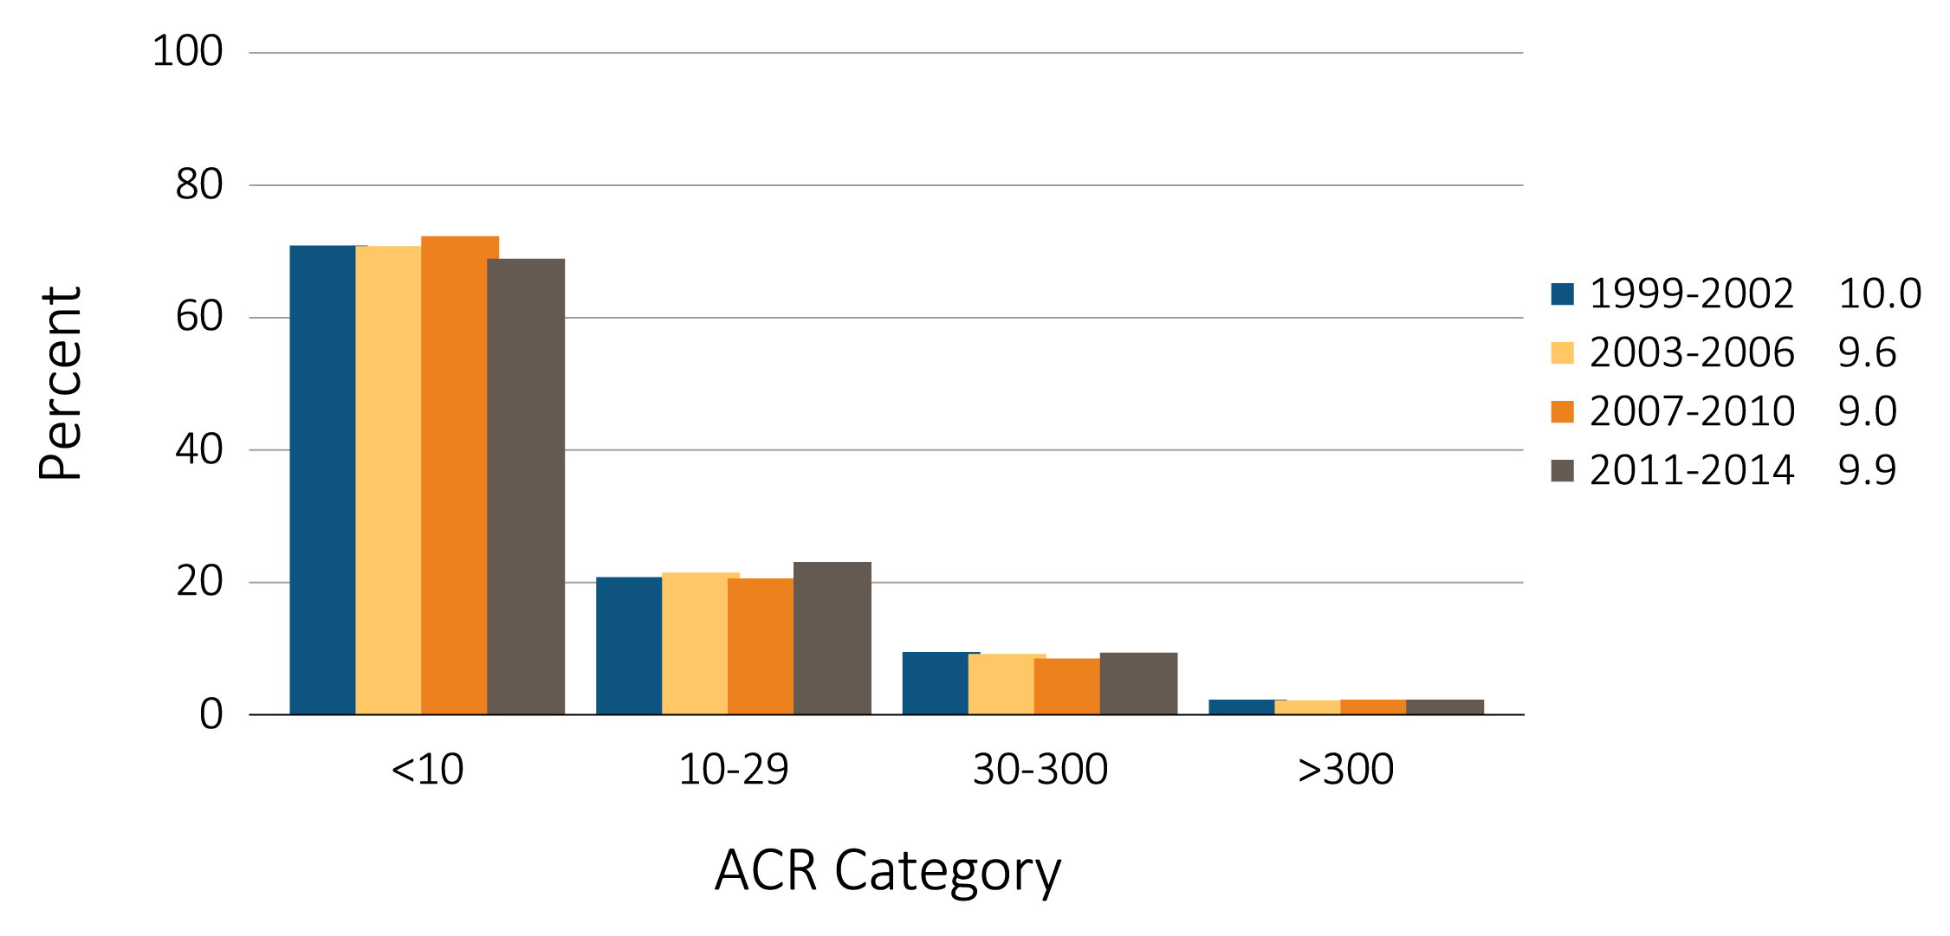
vol 1 Figure 1.3 Urine albumin/creatinine ratio (ACR) distribution among NHANES participants, 1999-2014
Data Source: National Health and Nutrition Examination Survey (NHANES), 1999-2014 participants aged 20 & older. Single-sample estimates of ACR. Abbreviation: ACR, urine albumin (mg)/creatinine (g) ratio.

Slide 7
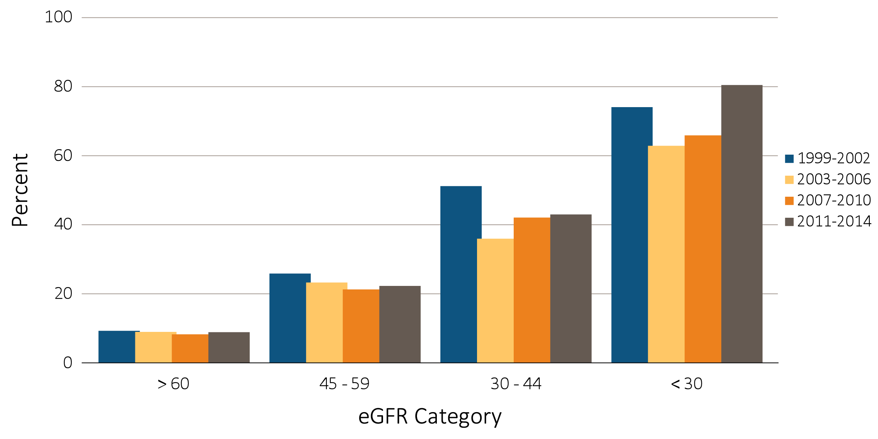
vol 1 Figure 1.4 Percentage of NHANES (1999-2014) participants with ACR >30 mg/g, by eGFR category
Data Source: National Health and Nutrition Examination Survey (NHANES), 1999-2014 participants aged 20 & older. Single-sample estimates of eGFR. Abbreviation: ACR, urine albumin (mg)/creatinine (g) ratio; eGFR, estimated glomerular filtration rate.

Slide 8
vol 1 Table 1.1 Percentage of NHANES 2011-2014 participants, in the various CKD (eGFR and albuminuria) risk categories (KDIGO 2012)
Percentage in each category (2011-2014)
 |  |  |  | Albuminuria categories
 |  |  |  | A1 | A2 | A3
 |  |  |  | Normal to mildly increased | Moderately increased | Severely increased
 |  |  |  | <30 mg/g <3 mg/mmol | 30-300 mg/g 3-30 mg/mmol | >300 mg/g >30 mg/mmol
GFR categories (ml/min/1.73 m²) | G1 | Normal to high | ≥90 | 54.7 | 4.3 | 0.4
 | G2 | Mildly decreased | 60-89 | 30.4 | 2.6 | 0.3
 | G3a | Mildly to moderately decreased | 45-59 | 3.9 | 0.9 | 0.2
 | G3b | Moderately to severely decreased | 30-44 | 1.0 | 0.5 | 0.2
 | G4 | Severely decreased | 15-29 | 0.1 | 0.1 | 0.2
 | G5 | Kidney failure | <15 | <0.001 | 0.001 | 0.01
Data source: National Health and Nutrition Examination Survey (NHANES), 1999-2002, 2003-2006, 2007-2010 & 2011–2014 participants aged 20 and older. Single-sample estimates of eGFR and ACR; eGFR calculated using the CKD-EPI equation. Abbreviations: ACR, urine albumin/creatinine ratio; CKD, chronic kidney disease; eGFR, estimated glomerular filtration rate; GFR, glomerular filtration rate; KDIGO, Kidney Disease: Improving Global Outcomes CKD Work Group. Low risk: eGFR ≥60 ml/min/1.73 m² and ACR <30 mg/g; moderately high risk: eGFR 45-59 ml/min/1.73 m² or eGFR ≥60 ml/min/1.73 m² and ACR 30-300 mg/g; high risk: eGFR 30-44 ml/min/1.73 m² or eGFR 45-59 ml/min/1.73 m² and ACR 30-300 mg/g or eGFR ≥60 ml/min/1.73 m² and ACR >300 mg/g; very high risk: eGFR <30 ml/min/1.73 m² or eGFR 30-44 ml/min/1.73 m² and ACR 30-300 mg/g or eGFR ≥60 ml/min/1.73 m² and ACR >300 mg/g.

Slide 9
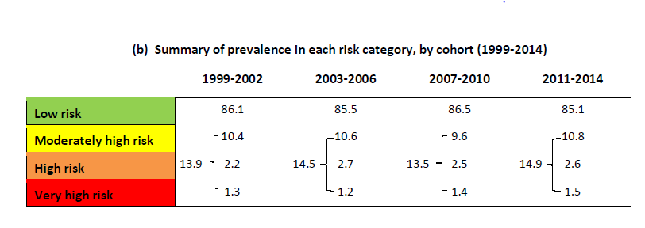
vol 1 Table 1.1 Percentage of NHANES 2011-2014 participants, in the various CKD (eGFR and albuminuria) risk categories (KDIGO 2012)
Data source: National Health and Nutrition Examination Survey (NHANES), 1999-2002, 2003-2006, 2007-2010 & 2011–2014 participants aged 20 and older. Single-sample estimates of eGFR and ACR; eGFR calculated using the CKD-EPI equation. Abbreviations: ACR, urine albumin/creatinine ratio; CKD, chronic kidney disease; eGFR, estimated glomerular filtration rate; GFR, glomerular filtration rate; KDIGO, Kidney Disease: Improving Global Outcomes CKD Work Group. Low risk: eGFR ≥60 ml/min/1.73 m² and ACR <30 mg/g; moderately high risk: eGFR 45-59 ml/min/1.73 m² or eGFR ≥60 ml/min/1.73 m² and ACR 30-300 mg/g; high risk: eGFR 30-44 ml/min/1.73 m² or eGFR 45-59 ml/min/1.73 m² and ACR 30-300 mg/g or eGFR ≥60 ml/min/1.73 m² and ACR >300 mg/g; very high risk: eGFR <30 ml/min/1.73 m² or eGFR 30-44 ml/min/1.73 m² and ACR 30-300 mg/g or eGFR ≥60 ml/min/1.73 m² and ACR >300 mg/g.

Slide 10
vol 1 Table 1.2 Prevalence (%) of CKD in NHANES population within age, sex, race/ethnicity, & risk factor categories, 1999-2014
 | All CKD |  |  |  |  | eGFR <60 ml/min/1.73m² |  |  |  |  | ACR ≥30 mg/g
 | 1999-2002 | 2003-2006 | 2007-2010 | 2011-2014 |  | 1999-2002 | 2003-2006 | 2007-2010 | 2011-2014 |  | 1999-2002 | 2003-2006 | 2007-2010 | 2011-2014
Age
20-39 | 6.0 | 5.9 | 5.4 | 6.6 |  | 0.4 | 0.1 | 0.3 | 0.3
40-59 | 10.0 | 9.8 | 8.5 | 10.6 |  | 1.9 | 2.3 | 2.0 | 3.3 |  | 5.9 | 5.8 | 5.3 | 6.4
60+ | 36.9 | 37.1 | 33.6 | 32.6 |  | 24.0 | 25.8 | 22.9 | 22.6 |  | 8.6 | 8.2 | 7.0 | 8.5
Sex
Male | 12.0 | 12.6 | 11.7 | 13.0 |  | 4.8 | 5.7 | 5.2 | 6.4 |  | 9.1 | 8.9 | 8.4 | 8.8
Female | 15.6 | 16.1 | 15.0 | 16.5 |  | 6.8 | 7.8 | 7.5 | 7.9 |  | 10.9 | 10.2 | 9.4 | 10.9
Race/Ethnicity
Non-Hispanic White | 13.9 | 14.3 | 13.8 | 15.2 |  | 6.6 | 7.9 | 7.5 | 8.5 |  | 9.3 | 8.5 | 8.4 | 9.0
Non-Hispanic Black/African American | 15.1 | 15.8 | 14.8 | 16.9 |  | 5.3 | 5.2 | 5.8 | 6.2 |  | 12.7 | 13.0 | 11.2 | 13.5
Mexican American | 11.6 | 11.6 | 11.8 | 12.5 |  | 1.4 | 1.6 | 2.3 | 2.5 |  | 10.4 | 10.9 | 10.5 | 11.2
Other Hispanic | 13.8 | 15.5 | 11.4 | 12.8 |  | 3.6 | 3.5 | 3.3 | 4.3 |  | 11.7 | 13.3 | 9.5 | 10.5
Other Non-Hispanic | 14.0 | 16.2 | 10.6 | 12.8 |  | 3.9 | 4.2 | 3.1 | 4.3 |  | 12.1 | 13.5 | 9.1 | 10.3
Risk Factor
Diabetes | 41.2 | 41.5 | 39.0 | 39.4 |  | 15.1 | 19.2 | 18.7 | 20.7 |  | 34.8 | 30.9 | 28.4 | 28.7
Self-reported diabetes | 40.8 | 43.0 | 40.6 | 40.6 |  | 16.5 | 20.3 | 19.9 | 22.3 |  | 33.5 | 31.7 | 29.5 | 29.5
Hypertension | 33.4 | 31.7 | 30.6 | 32.1 |  | 16.8 | 17.4 | 16.9 | 17.7 |  | 23.0 | 19.6 | 19.1 | 20.6
Self-reported hypertension | 28.2 | 26.9 | 25.7 | 26.9 |  | 16.3 | 15.3 | 15.0 | 15.8 |  | 17.7 | 16.5 | 15.7 | 16.6
Self-reported cardiovascular disease | 38.2 | 43.5 | 37.2 | 42.6 |  | 26.7 | 29.3 | 25.1 | 29.3 |  | 22.7 | 24.8 | 22.3 | 25.5
Obesity (BMI >30) | 17.2 | 16.8 | 16.1 | 17.6 |  | 6.3 | 7.1 | 7.0 | 7.9 |  | 13.2 | 11.9 | 11.1 | 12.5
All | 13.9 | 14.4 | 13.4 | 14.8 |  | 5.8 | 6.8 | 6.4 | 7.2 |  | 10.1 | 9.6 | 8.9 | 9.9
Data source: National Health and Nutrition Examination Survey (NHANES), 1999-2002, 2003-2006, 2007-2010 & 2011-2014 participants age 20 & older. Single-sample estimates of eGFR & ACR; eGFR calculated using the CKD-EPI equation. Diabetes defined as HbA1c >7 percent, self-reported (SR), or currently taking glucose-lowering medications. Hypertension defined as BP ≥130/≥80 for those with diabetes or CKD, otherwise BP ≥140/≥90, or taking medication for hypertension. Values in Figure 1.12 cannot be directly compared to those in Table 1.3 due to different survey cohorts. The table represents NHANES participants who are classified as hypertensive (measured/treated) but some of those are at target blood pressure. Abbreviations: ACR, urine albumin/creatinine ratio; BMI, body mass index; BP, blood pressure, CKD, chronic kidney disease; eGFR, estimated glomerular filtration rate.

Slide 11
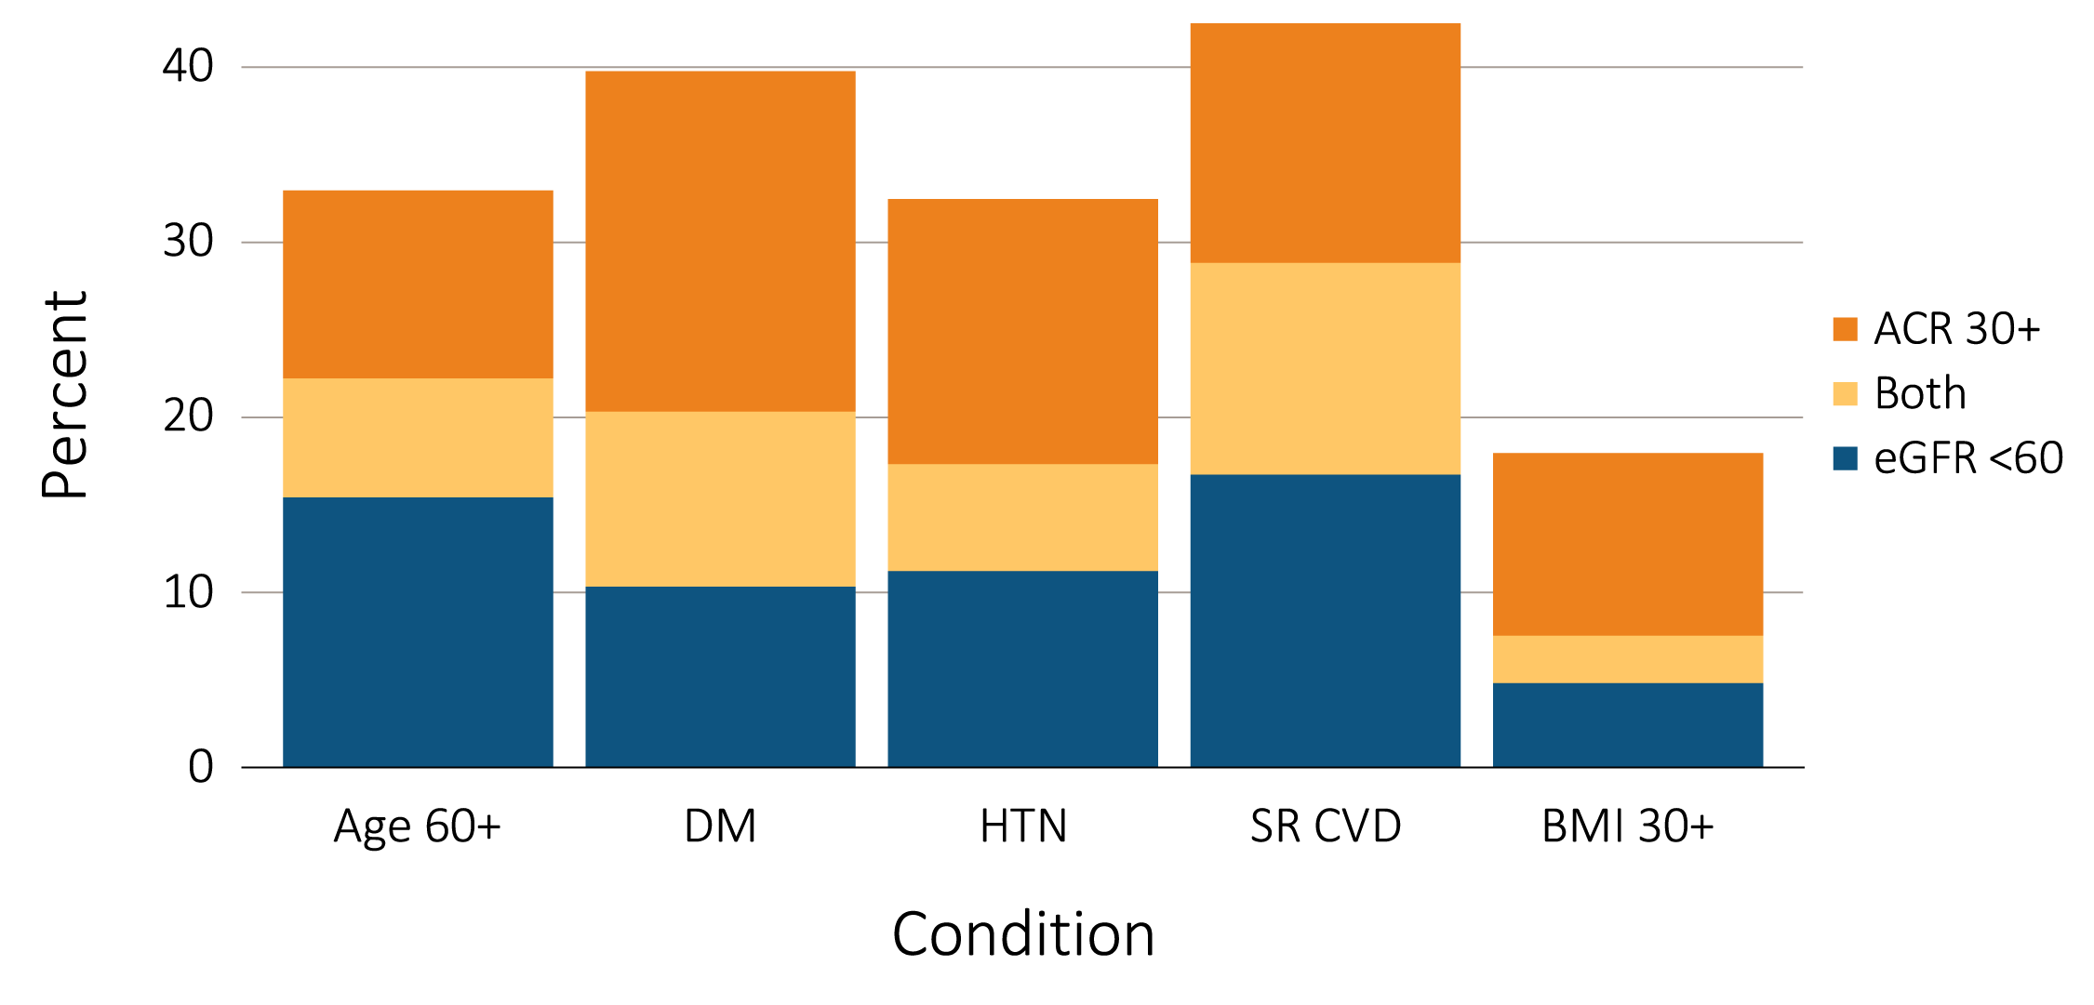
vol 1 Figure 1.5 Distribution of markers of CKD in NHANES participants with diabetes, hypertension, self-reported cardiovascular disease, & obesity, 2011–2014
Data Source: National Health and Nutrition Examination Survey (NHANES), 2011–2014 participants age 20 & older. Single-sample estimates of eGFR & ACR; eGFR calculated using the CKD-EPI equation. Abbreviations: ACR, urine albumin/creatinine ratio; BMI, body mass index; CKD, chronic kidney disease; SR CVD, self-reported cardiovascular disease; eGFR, estimated glomerular filtration rate; HTN, hypertension

Slide 12
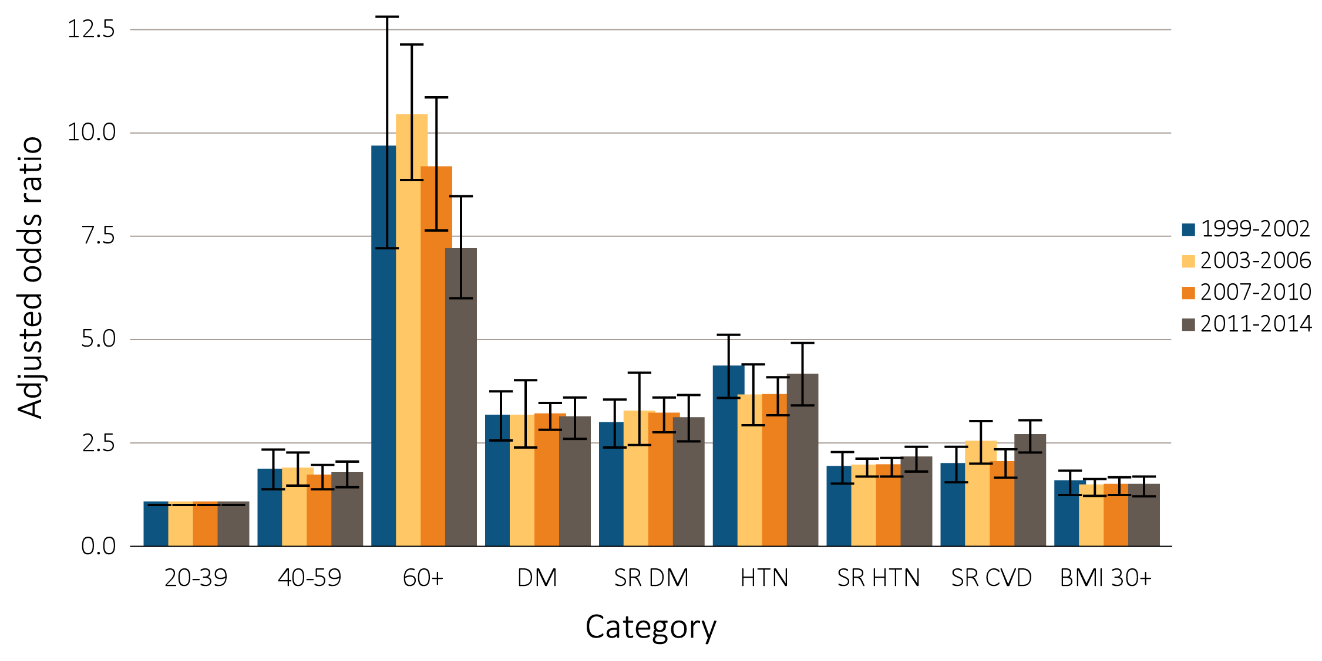
vol 1 Figure 1.6 Adjusted odds ratios of CKD in NHANES participants, by risk factor, 1999-2014
Data Source: National Health and Nutrition Examination Survey (NHANES), 1999–2002, 2003-2006, 2007-2010 & 2011–2014 participants age 20 & older; single-sample estimates of eGFR & ACR. Adj: age, sex, & race; eGFR calculated using the CKD-EPI equation. Whisker lines indicate 95% confidence intervals. Abbreviations: ACR, urine albumin/creatinine ratio; BMI, body mass index; CKD, chronic kidney disease; CVD, cardiovascular disease; DM, diabetes mellitus; eGFR, estimated glomerular filtration rate; HTN, hypertension; SR, self-report.

Slide 13
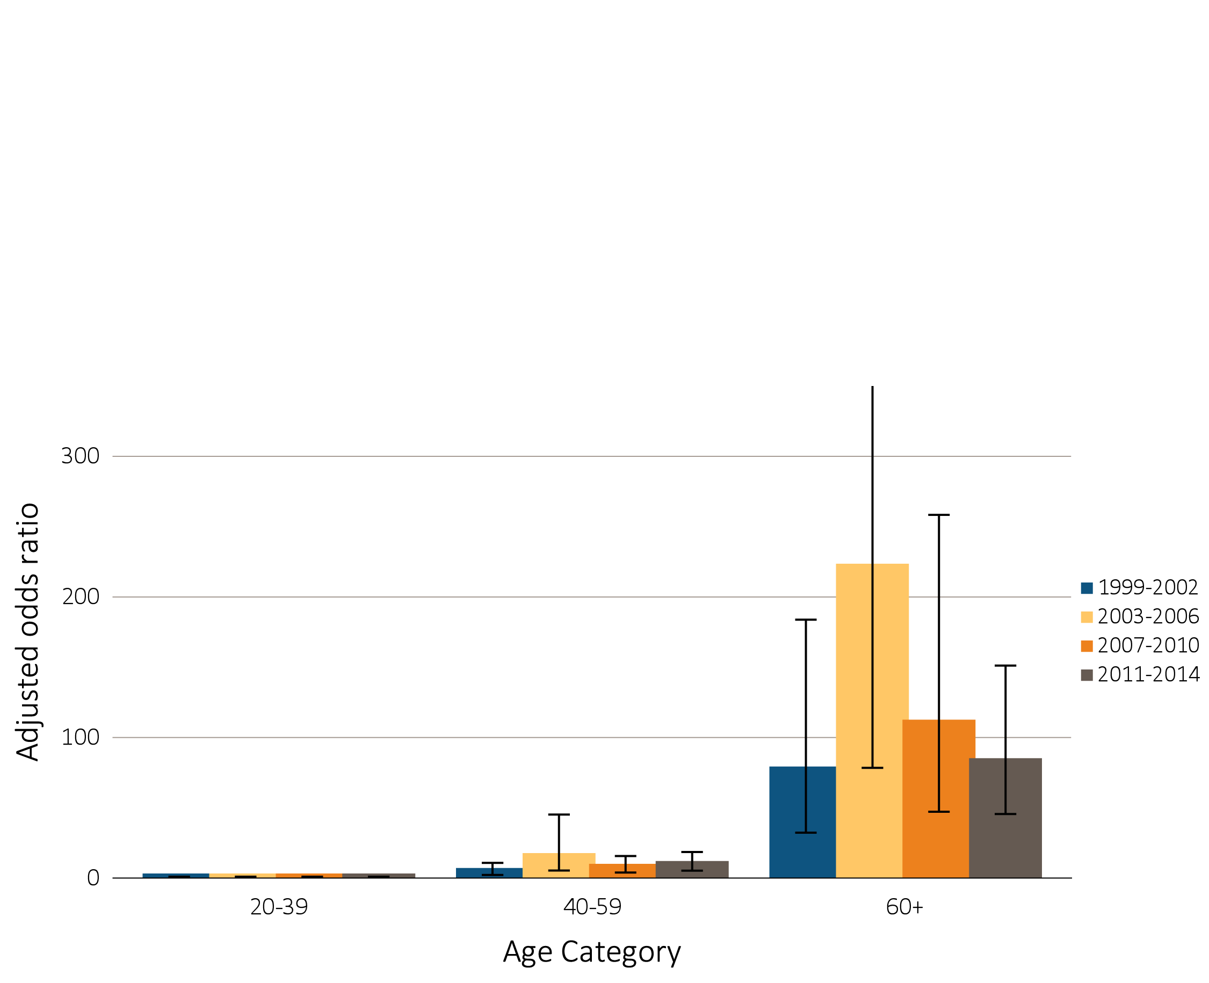
vol 1 Figure 1.7 Adjusted odds ratios of eGFR <60 ml/min/1.73m² in NHANES participants, by age & risk factor, 1999-2014
(a) Age category
Data Source: National Health and Nutrition Examination Survey (NHANES), 1999–2002, 2003-2006, 2007-2010 & 2011–2014 participants age 20 & older; single-sample estimates of eGFR & ACR. Adj: age, sex, & race; eGFR calculated using the CKD-EPI equation. Whisker lines indicate 95% confidence intervals. Abbreviations: ACR, urine albumin/creatinine ratio; BMI, body mass index; CKD, chronic kidney disease; CVD, cardiovascular disease; DM, diabetes mellitus; eGFR, estimated glomerular filtration rate; HTN, hypertension; SR, self-report.

Slide 14
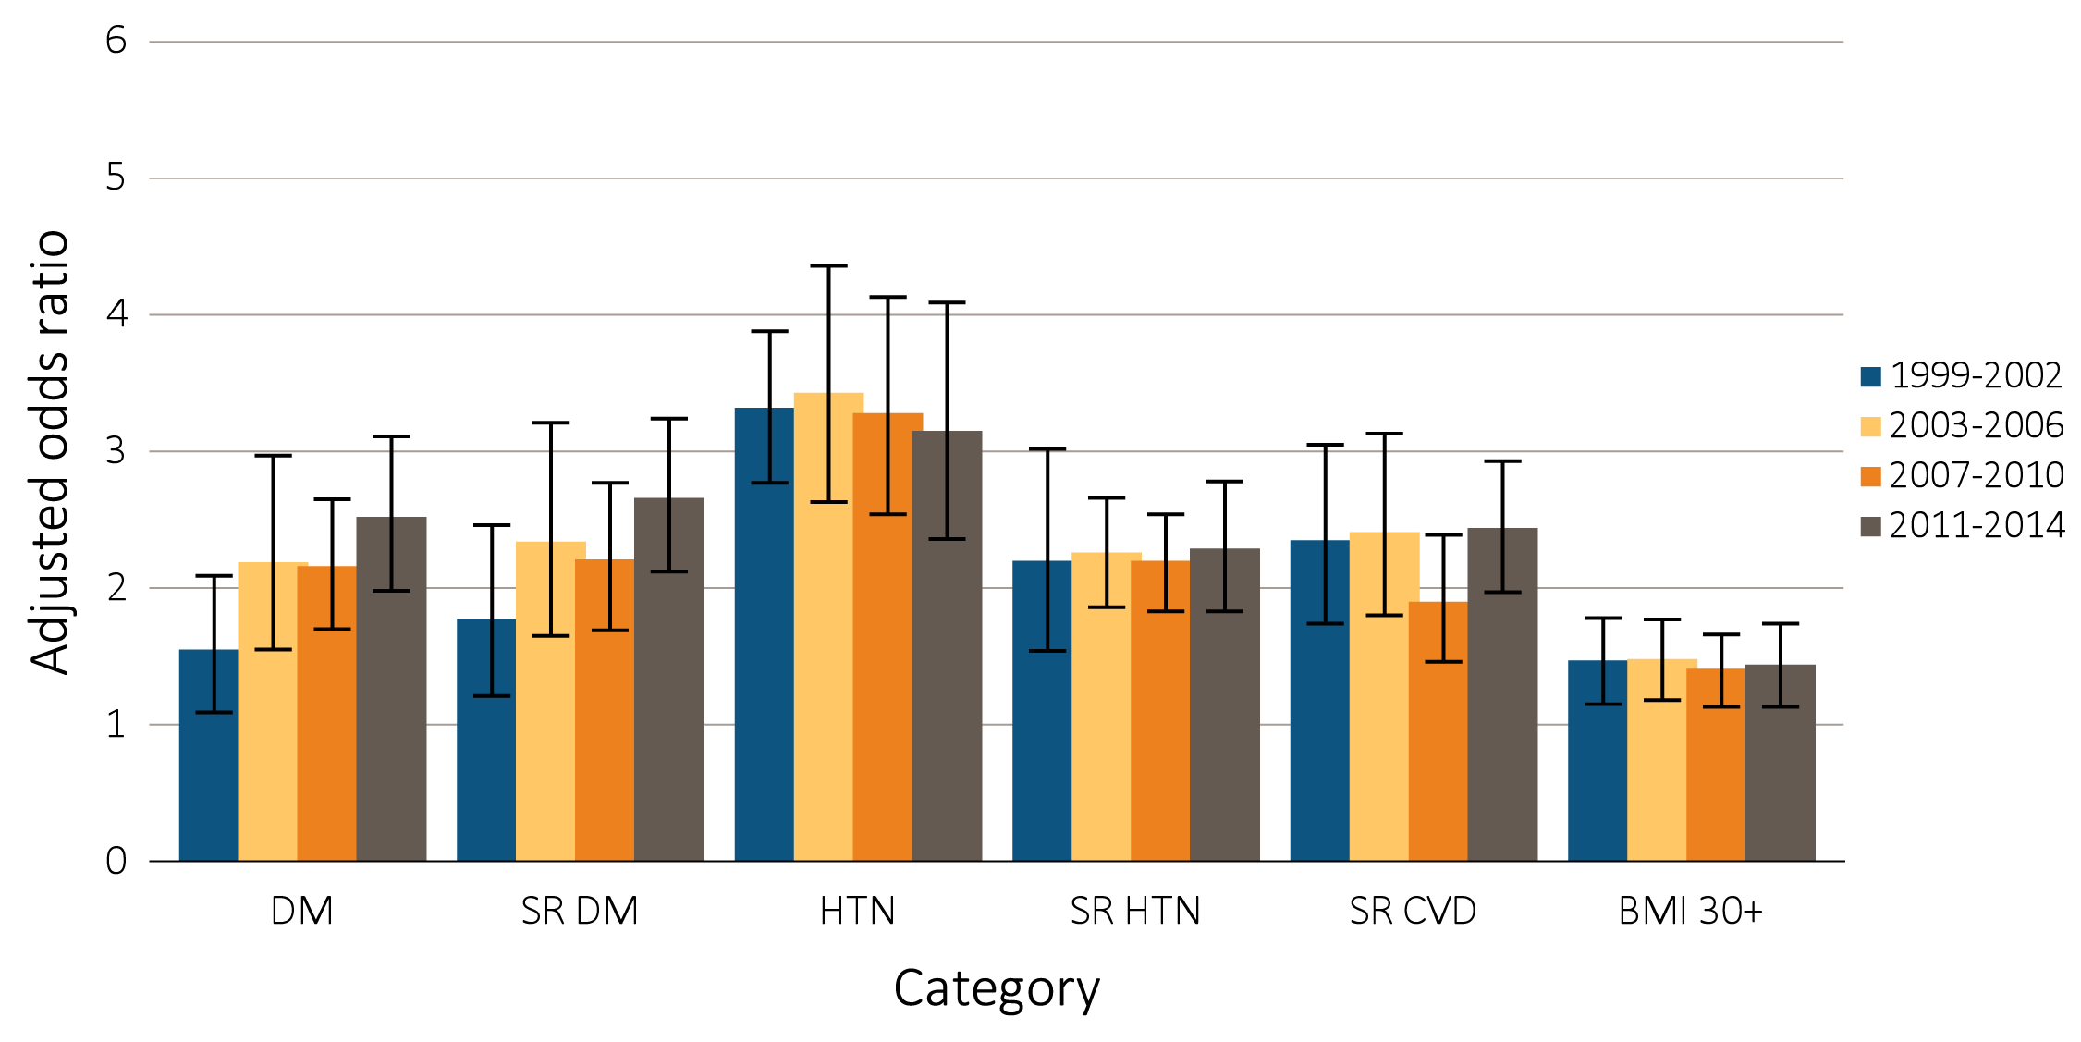
vol 1 Figure 1.7 Adjusted odds ratios of eGFR <60 ml/min/1.73m² in NHANES participants, by age & risk factor, 1999-2014
(b) CKD Risk Factor
Data Source: National Health and Nutrition Examination Survey (NHANES), 1999–2002, 2003-2006, 2007-2010 & 2011–2014 participants age 20 & older; single-sample estimates of eGFR & ACR. Adj: age, sex, & race; eGFR calculated using the CKD-EPI equation. Whisker lines indicate 95% confidence intervals. Abbreviations: ACR, urine albumin/creatinine ratio; BMI, body mass index; CKD, chronic kidney disease; CVD, cardiovascular disease; DM, diabetes mellitus; eGFR, estimated glomerular filtration rate; HTN, hypertension; SR, self-report.

Slide 15
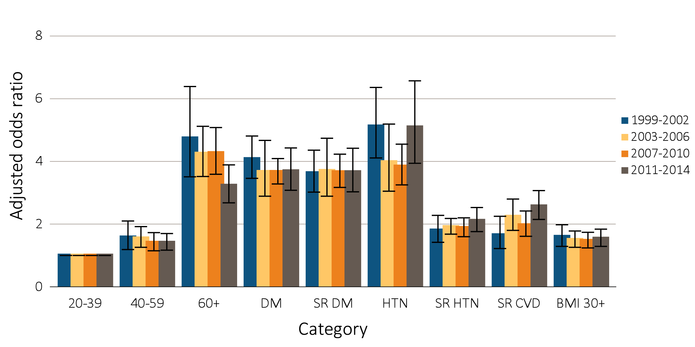
vol 1 Figure 1.8 Adjusted odds ratios of urine albumin/creatinine ratio ≥30 mg/g in NHANES participants, by age & risk factor, 1999-2014
Data Source: National Health and Nutrition Examination Survey (NHANES), 1999–2002, 2003-2006, 2007-2010 & 2011–2014 participants age 20 & older; single-sample estimates of eGFR & ACR. Adjusted: age, sex, & race; eGFR calculated using the CKD-EPI equation. Whisker lines indicate 95% confidence intervals. Abbreviations: ACR, urine albumin/creatinine ratio; BMI, body mass index; CKD, chronic kidney disease; CVD, cardiovascular disease; DM, diabetes mellitus; eGFR, estimated glomerular filtration rate; HTN, hypertension; SR, self-report.

Slide 16
vol 1 Table 1.3 Socioeconomic factors among individuals with CKD, percent of NHANES participants, 1999-2014
 | All CKD |  |  |  |  |  |  |  |  | eGFR <60 ml/min/1.73m² |  |  |  |  |  |  |  |  | ACR ≥30 mg/g
 | 1999-2002 |  | 2003-2006 |  | 2007-2010 |  | 2011-2014 |  |  | 1999-2002 |  | 2003-2006 |  | 2007-2010 |  | 2011-2014 |  |  | 1999-2002 |  |  | 2003-2006 |  |  | 2007-2010 |  |  | 2011-2014
Health Insurance Status
Not Insured | 11.4 |  | 10.1 |  | 11.4 |  | 13.8 |  |  | 3.9 |  | 3.3 |  | 4.2 |  | 3.9 |  |  | 14.7 |  |  | 13.2 |  |  | 14.8 |  |  | 18.9
Insured | 88.6 |  | 89.9 |  | 88.6 |  | 86.2 |  |  | 96.1 |  | 96.7 |  | 95.8 |  | 96.1 |  |  | 85.3 |  |  | 86.8 |  |  | 85.2 |  |  | 81.1
Private Only | 37.2 |  | 30.0 |  | 30.6 |  | 30.8 |  |  | 22.5 |  | 16.8 |  | 18.7 |  | 22.9 |  |  | 42.2 |  |  | 36.2 |  |  | 35.9 |  |  | 33.4
Medicare Only | 17.4 |  | 17.4 |  | 15.6 |  | 15.9 |  |  | 23.8 |  | 23.9 |  | 20.9 |  | 23.0 |  |  | 16.2 |  |  | 14.4 |  |  | 13.3 |  |  | 12.3
Other Government Only | 4.9 |  | 5.9 |  | 5.1 |  | 6.9 |  |  | 2.6 |  | 2.3 |  | 3.0 |  | 5.5 |  |  | 5.8 |  |  | 7.8 |  |  | 6.2 |  |  | 8.7
Private and any Government | 21.7 |  | 26.8 |  | 28.6 |  | 22.9 |  |  | 36.6 |  | 41.1 |  | 44.0 |  | 34.2 |  |  | 14.6 |  |  | 19.3 |  |  | 21.1 |  |  | 17.1
Other/Unknown | 7.4 |  | 9.8 |  | 8.7 |  | 9.7 |  |  | 10.6 |  | 12.6 |  | 9.2 |  | 10.5 |  |  | 6.5 |  |  | 9.1 |  |  | 8.7 |  |  | 9.6
Income
Less than $10,000 | 14.5 |  | 7.5 |  | 6.8 |  | 8.0 |  |  | 13.8 |  | 6.1 |  | 4.6 |  | 5.9 |  |  | 16.3 |  |  | 8.2 |  |  | 8.3 |  |  | 9.4
$10,000 – $24,999 | 29.7 |  | 28.0 |  | 23.9 |  | 24.5 |  |  | 31.8 |  | 31.8 |  | 26.0 |  | 25.4 |  |  | 29.8 |  |  | 27.8 |  |  | 24.2 |  |  | 25.2
$25,000 – $44,999 | 18.8 |  | 23.2 |  | 23.4 |  | 19.8 |  |  | 22.6 |  | 24.7 |  | 24.3 |  | 21.2 |  |  | 17.2 |  |  | 21.0 |  |  | 22.6 |  |  | 19.3
$45,000 – $74,999 | 15.3 |  | 20.8 |  | 18.1 |  | 18.9 |  |  | 13.4 |  | 19.8 |  | 19.5 |  | 19.7 |  |  | 14.8 |  |  | 21.0 |  |  | 16.7 |  |  | 17.8
$75,000 or more | 11.4 |  | 14.2 |  | 20.1 |  | 22.6 |  |  | 8.4 |  | 10.9 |  | 16.6 |  | 22.2 |  |  | 11.5 |  |  | 15.6 |  |  | 20.8 |  |  | 21.1
Missing | 10.2 |  | 6.3 |  | 7.7 |  | 6.6 |  |  | 10.0 |  | 6.7 |  | 9.0 |  | 5.5 |  |  | 10.2 |  |  | 6.4 |  |  | 7.5 |  |  | 7.2
Education
< High School | 33.4 |  | 26.2 |  | 27.1 |  | 22.4 |  |  | 37.0 |  | 27.8 |  | 26.6 |  | 21.3 |  |  | 32.8 |  |  | 26.3 |  |  | 29.2 |  |  | 23.8
High School Graduate/GED | 25.6 |  | 27.1 |  | 26.9 |  | 22.3 |  |  | 26.1 |  | 30.6 |  | 27.5 |  | 22.2 |  |  | 26.3 |  |  | 25.0 |  |  | 26.3 |  |  | 23.5
At least some College | 41.0 |  | 46.7 |  | 46.0 |  | 55.3 |  |  | 36.9 |  | 41.4 |  | 45.9 |  | 56.5 |  |  | 40.9 |  |  | 48.6 |  |  | 44.5 |  |  | 52.7
Data Source: National Health and Nutrition Examination Survey (NHANES), 1999–2002, 2003-2006, 2007-2010 & 2011–2014 participants age 20 & older. Single-sample estimates of eGFR & ACR; eGFR calculated using the CKD-EPI equation. Abbreviations: ACR, urine albumin/creatinine ratio; CKD, chronic kidney disease; eGFR, estimated glomerular filtration rate.

Slide 17
vol 1 Table 1.4 Health Risk Behaviors among individuals with CKD, percent of NHANES participants, 1999-2014
 | All CKD |  |  |  |  |  |  |  |  | eGFR <60 ml/min/1.73m² |  |  |  |  |  |  |  |  | ACR ≥30 mg/g
 | 1999-2002 |  | 2003-2006 |  | 2007-2010 |  | 2011-2014 |  |  | 1999-2002 |  | 2003-2006 |  | 2007-2010 |  | 2011-2014 |  |  | 1999-2002 |  |  | 2003-2006 |  |  | 2007-2010 |  |  | 2011-2014
Physical Activity
Vigorous | 22.4 |  | 20.8 |  | 20.6 |  | 23.3 |  |  | 14.0 |  | 14.8 |  | 13.0 |  | 16.9 |  |  | 24.2 |  |  | 22.9 |  |  | 23.5 |  |  | 24.7
Moderate | 31.5 |  | 35.7 |  | 34.6 |  | 33.1 |  |  | 32.0 |  | 39.0 |  | 35.0 |  | 33.9 |  |  | 30.5 |  |  | 33.6 |  |  | 32.9 |  |  | 31.6
Sedentary | 46.1 |  | 43.5 |  | 44.8 |  | 43.6 |  |  | 53.9 |  | 46.2 |  | 52.0 |  | 49.2 |  |  | 45.3 |  |  | 43.5 |  |  | 43.6 |  |  | 43.7
Smoking
Current | 16.6 |  | 16.2 |  | 15.0 |  | 15.0 |  |  | 7.4 |  | 8.7 |  | 8.4 |  | 9.1 |  |  | 20.4 |  |  | 20.1 |  |  | 18.7 |  |  | 18.6
Former | 31.6 |  | 31.8 |  | 31.6 |  | 33.3 |  |  | 39.2 |  | 38.1 |  | 39.0 |  | 39.8 |  |  | 28.7 |  |  | 29.3 |  |  | 28.9 |  |  | 30.6
Never | 51.8 |  | 52.0 |  | 53.4 |  | 51.7 |  |  | 53.4 |  | 53.2 |  | 52.6 |  | 51.1 |  |  | 50.9 |  |  | 50.6 |  |  | 52.5 |  |  | 50.8
Amount of Sleep
Less than 6 hours | - |  | 15.2 |  | 15.5 |  | 13.5 |  |  | - |  | 8.9 |  | 12.6 |  | 12.4 |  |  | - |  |  | 18.8 |  |  | 17.6 |  |  | 14.6
6 hours | - |  | 21.9 |  | 21.5 |  | 20.5 |  |  | - |  | 21.5 |  | 19.2 |  | 18.1 |  |  | - |  |  | 23.7 |  |  | 22.8 |  |  | 22.3
7-8 hours | - |  | 55.4 |  | 53.2 |  | 54.9 |  |  | - |  | 60.8 |  | 55.4 |  | 53.0 |  |  | - |  |  | 51.3 |  |  | 51.2 |  |  | 54.8
9 hours or more | - |  | 7.6 |  | 9.8 |  | 11.1 |  |  | - |  | 8.8 |  | 12.8 |  | 16.5 |  |  | - |  |  | 6.2 |  |  | 8.4 |  |  | 8.3
Self-Reported Special Diet
Low Fat/Low Cholesterol | - |  | 3.5 |  | 2.8 |  | 2.4 |  |  | - |  | 3.8 |  | 3.3 |  | 2.8 |  |  | - |  |  | 2.9 |  |  | 2.5 |  |  | 2.1
Low Salt/Low Sodium | - |  | 2.5 |  | 3.5 |  | 3.6 |  |  | - |  | 3.1 |  | 4.7 |  | 5.3 |  |  | - |  |  | 2.6 |  |  | 3.6 |  |  | 3.1
Sugar Free/Low Sugar | - |  | 2.0 |  | 1.1 |  | 0.4 |  |  | - |  | 2.5 |  | 1.5 |  | 0.3 |  |  | - |  |  | 1.6 |  |  | 1.1 |  |  | 0.5
Diabetic Diet | - |  | 6.6 |  | 5.2 |  | 5.1 |  |  | - |  | 6.8 |  | 5.4 |  | 6.9 |  |  | - |  |  | 7.4 |  |  | 5.2 |  |  | 5.5
Renal Diet | - |  | - |  | 0.3 |  | 0.6 |  |  | - |  | - |  | 0.7 |  | 1.2 |  |  | - |  |  | - |  |  | 0.5 |  |  | 0.8
Data Source: National Health and Nutrition Examination Survey (NHANES), 1999–2002, 2003-2006, 2007-2010 & 2011–2014 participants age 20 & older. Single-sample estimates of eGFR & ACR; eGFR calculated using the CKD-EPI equation. Abbreviations: ACR, urine albumin/creatinine ratio; CKD, chronic kidney disease; eGFR, estimated glomerular filtration rate.

Slide 18
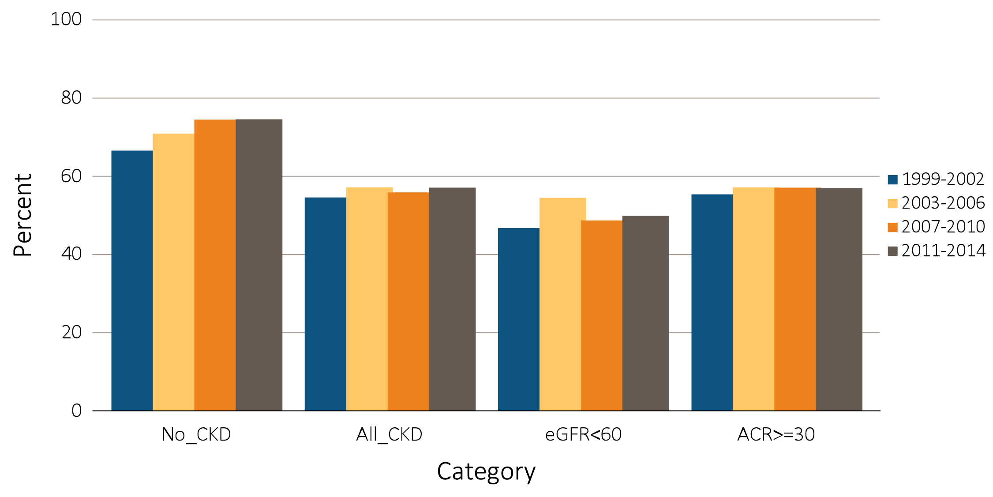
vol 1 Figure 1.9 NHANES participants physically active, 1999-2014
Data Source: National Health and Nutrition Examination Survey (NHANES), 1999-2002, 2003-2006, 2007-2010 & 2011–2014 participants aged 20 & older. Single-sample estimates of eGFR & ACR; eGFR calculated using the CKD-EPI equation. Abbreviations: ACR, urine albumin/creatinine ratio; CKD, chronic kidney disease; eGFR, estimated glomerular filtration rate.

Slide 19
vol 1 Table 1.5 Awareness, treatment, & measures of control of CKD risk factors, percentage of NHANES participants, 1999-2014
 | All CKD |  |  |  |  |  | eGFR <60 ml/min/1.73m² |  |  |  |  |  | ACR ≥30 mg/g
 | 1999-2002 | 2003-2006 | 2007-2010 | 2011-2014 | Trend p-value |  | 1999-2002 | 2003-2006 | 2007-2010 | 2011-2014 | Trend p-value |  | 1999-2002 | 2003-2006 | 2007-2010 | 2011-2014 | Trend p-value
Hypertension, by current hypertensive statusª
Non-hypertensive status | 26.9 | 25.8 | 26.8 | 26.1 | 0.87 |  | 14.8 | 14.6 | 15.6 | 17.0 | 0.20 |  | 29.7 | 30.3 | 31.1 | 28.6 | 0.75
Hypertensive (measured/treated) | 73.1 | 74.2 | 73.2 | 73.9 |  |  | 85.2 | 85.4 | 84.4 | 83.0 |  |  | 70.3 | 69.7 | 68.9 | 71.5
Control of hypertension among hypertensive patients^{b}
Unaware | 64.3 | 25.4 | 19.5 | 22.6 | <0.001 |  | 58.1 | 21.0 | 17.0 | 13.1 | <0.001 |  | 67.7 | 26.8 | 24.7 | 23.0 | <0.001
Aware, not treated | 5.6 | 8.4 | 9.7 | 5.8 |  |  | 3.2 | 5.2 | 2.5 | 4.3 |  |  | 6.6 | 10.3 | 8.2 | 12.6
Aware, treated, uncontrolled | 22.1 | 46.6 | 42.3 | 43.8 |  |  | 26.6 | 51.4 | 45.5 | 45.8 |  |  | 21.1 | 46.3 | 44.9 | 43.9
Aware, treated, controlled | 8.0 | 19.6 | 28.5 | 27.8 |  |  | 12.1 | 22.4 | 35.0 | 36.8 |  |  | 4.7 | 16.5 | 22.1 | 20.5
Total cholesterol^{c}
<200 (desirable) | 43.2 | 53.1 | 59.2 | 61.6 | <0.001 |  | 40.7 | 56.6 | 62.6 | 64.3 | <0.001 |  | 44.9 | 52.8 | 58.2 | 61.3 | <0.001
200–239 (borderline high) | 35.3 | 27.5 | 26.3 | 24.1 |  |  | 37.0 | 25.8 | 23.5 | 22.0 |  |  | 34.2 | 27.7 | 27.2 | 24.8
240+ (high) | 21.5 | 19.4 | 14.5 | 14.4 |  |  | 22.3 | 17.6 | 13.9 | 13.7 |  |  | 20.9 | 19.5 | 14.6 | 13.9
Control of diabetes among patients with diabetes^{d}
Glycohemoglobin <7% (controlled) | 32.8 | 51.1 | 46.9 | 42.9 | 0.20 |  | 45.6 | 62.5 | 55.9 | 49.3 | 0.57 |  | 28.8 | 45.3 | 40.1 | 36.8 | 0.37
Glycohemoglobin 7% or higher (uncontrolled) | 67.2 | 48.9 | 53.1 | 57.1 |  |  | 54.4 | 37.5 | 44.1 | 50.7 |  |  | 71.2 | 54.7 | 59.9 | 63.2
Data Source: National Health and Nutrition Examination Survey (NHANES), 1999–2002, 2003-2006, 2007-2010 & 2011–2014 participants age 20 & older. Single-sample estimates of eGFR & ACR; eGFR calculated using the CKD-EPI equation. Abbreviations: ACR, urine albumin/creatinine ratio; CKD, chronic kidney disease; eGFR, estimated glomerular filtration rate. a. Hypertension defined as blood pressure ≥130/≥80 for those with CKD and diabetes; otherwise ≥140/≥90, or self- reported treatment for hypertension. b. Awareness and treatment are self-reported. Control defined as <130/<80 for those with CKD and diabetes; otherwise <140/<90. c. Total cholesterol classified according to Adult Treatment Panel III blood cholesterol guidelines (ATP III). d. Glycohemoglobin classified according to American Diabetes Association guidelines.

Slide 20
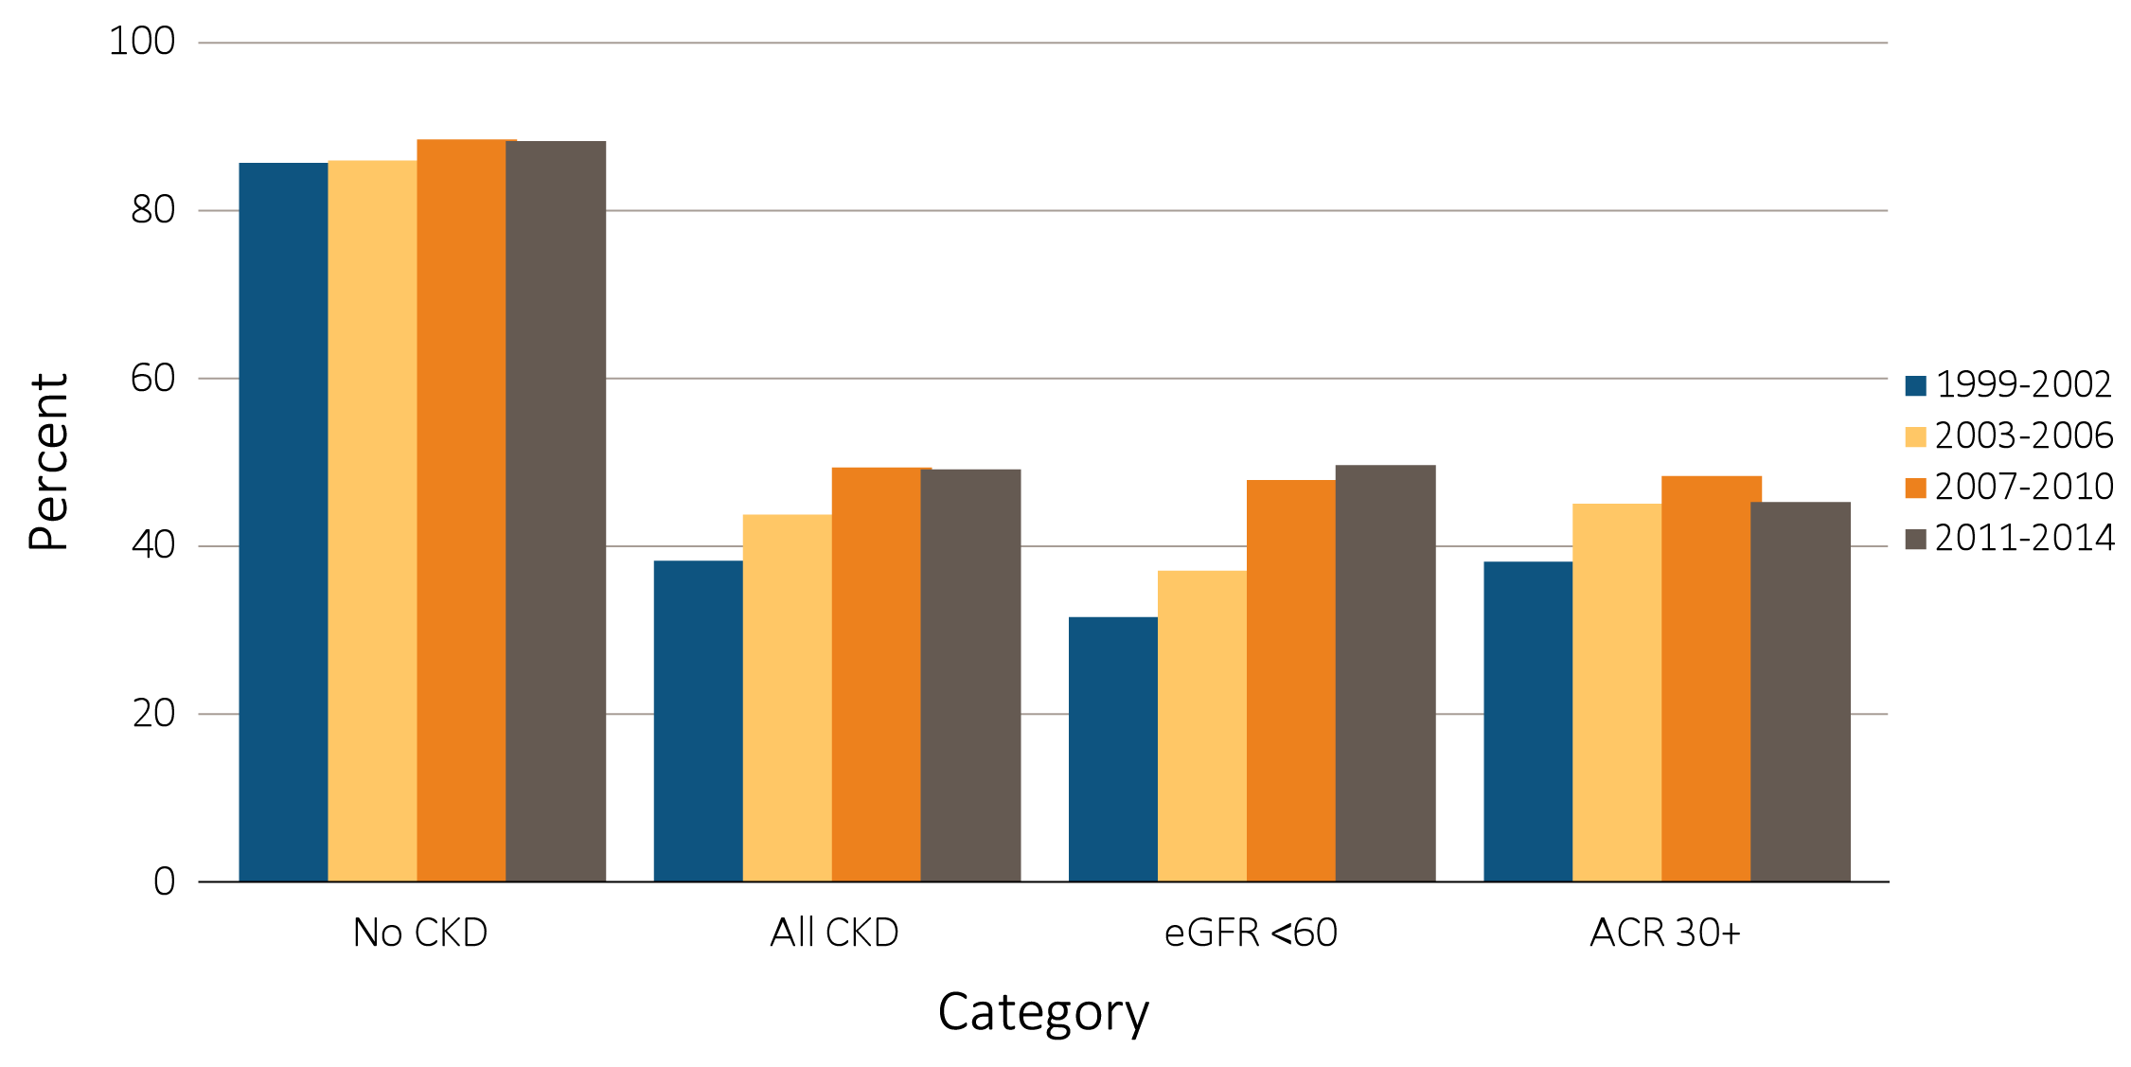
vol 1 Figure 1.10 NHANES participants at target blood pressure, 1999-2014
Data Source: National Health and Nutrition Examination Survey (NHANES), 1999-2002, 2003-2006, 2007-2010 & 2011–2014 participants aged 20 & older. Single-sample estimates of eGFR & ACR; eGFR calculated using the CKD-EPI equation. Figure represents all hypertensive participants including those who were at target blood pressure, probably due to medication. Abbreviations: ACR, urine albumin/creatinine ratio; CKD, chronic kidney disease; eGFR, estimated glomerular filtration rate.

Slide 21
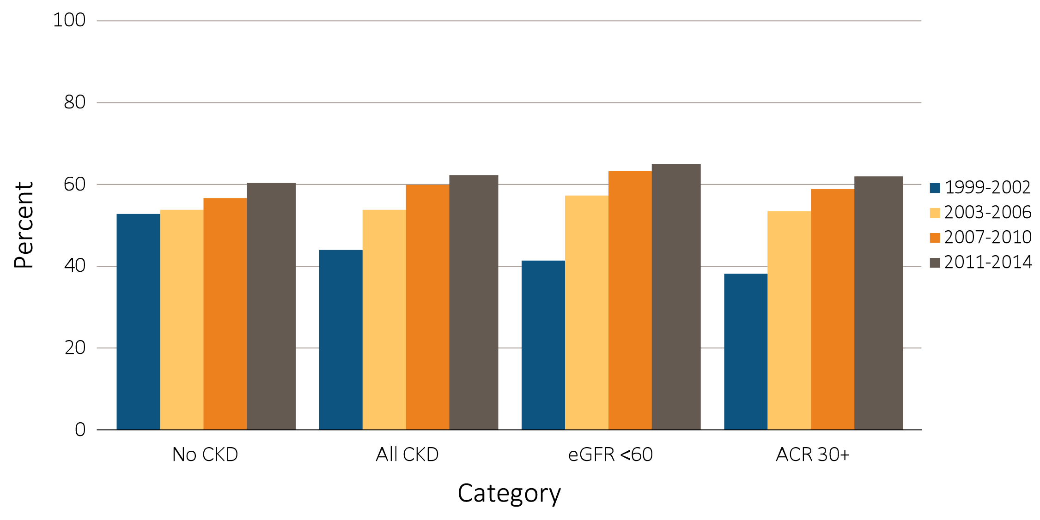
vol 1 Figure 1.11 NHANES participants within cholesterol normal range, 1999-2014
Data Source: National Health and Nutrition Examination Survey (NHANES), 1999-2002, 2003-2006, 2007-2010 & 2011–2014 participants aged 20 & older. Single-sample estimates of eGFR & ACR; eGFR calculated using the CKD-EPI equation. Abbreviations: ACR, urine albumin/creatinine ratio; CKD, chronic kidney disease; eGFR, estimated glomerular filtration rate.

Slide 22
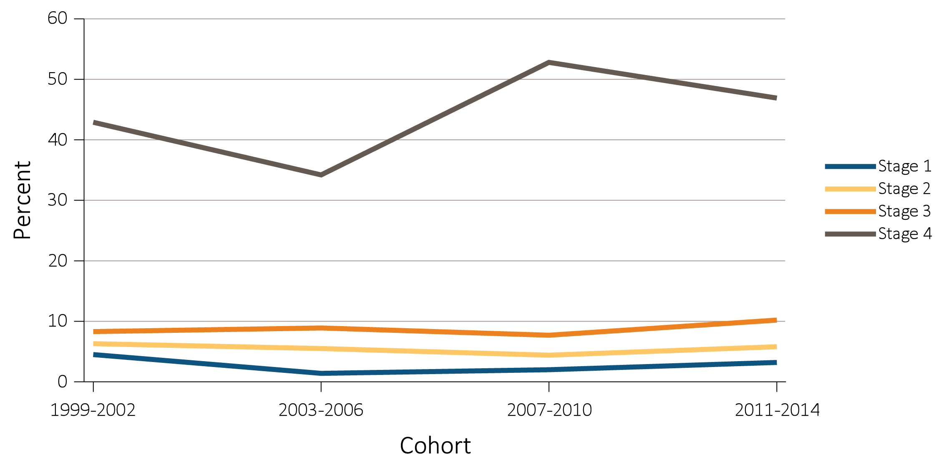
vol 1 Figure 1.12 Diabetic NHANES participants with glycosylated hemoglobin <7%, 1999-2014
Data Source: National Health and Nutrition Examination Survey (NHANES), 1999-2002, 2003-2006, 2007-2010 & 2011–2014 participants aged 20 & older. Single-sample estimates of eGFR & ACR; eGFR calculated using the CKD-EPI equation. Abbreviations: ACR, urine albumin/creatinine ratio; CKD, chronic kidney disease; eGFR, estimated glomerular filtration rate.

Slide 23
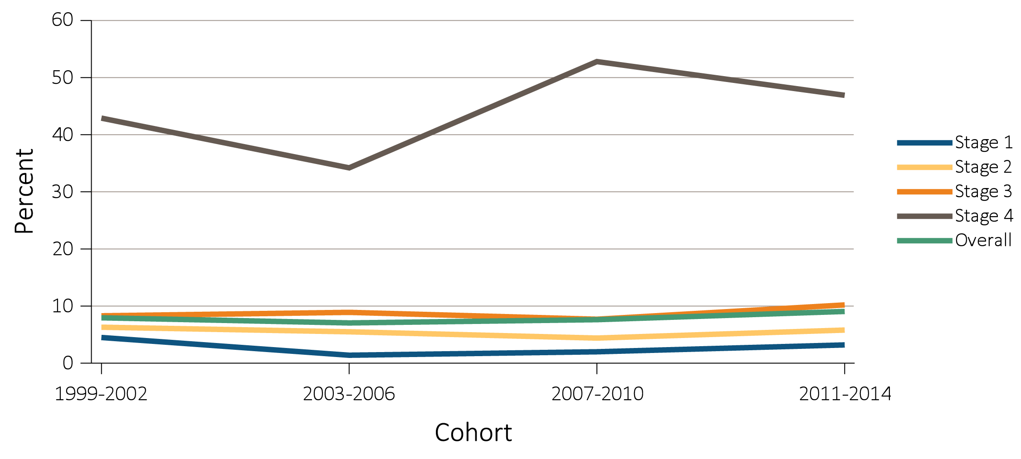
vol 1 Figure 1.13 NHANES participants with CKD aware of their kidney disease, 1999-2014
(a) By stage
Data Source: National Health and Nutrition Examination Survey (NHANES), 2001-2012 participants aged 20 & older. Abbreviations: CKD, chronic kidney disease.

Slide 24
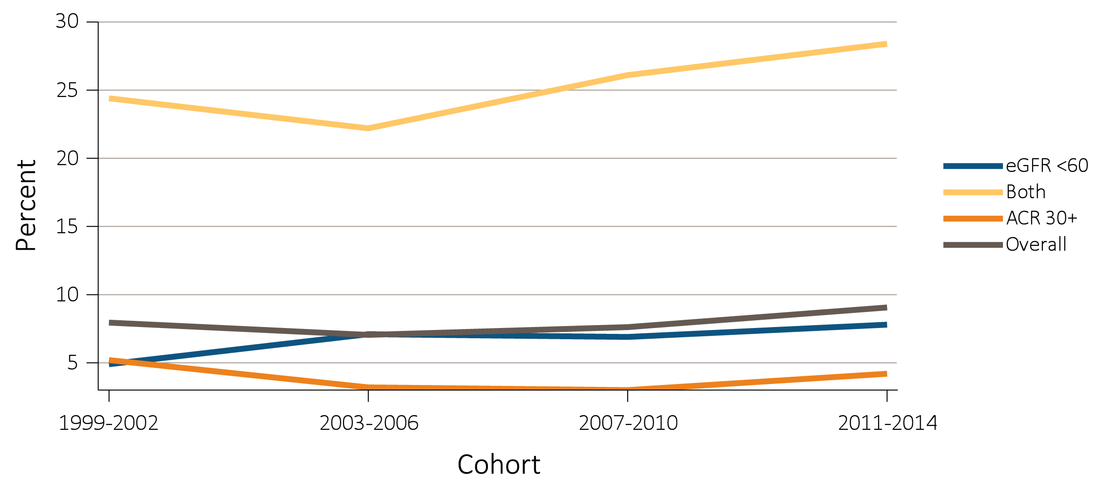
vol 1 Figure 1.13 NHANES participants with CKD aware of their kidney disease, 1999-2014
(b) By low eGFR and albuminuria status
Data Source: National Health and Nutrition Examination Survey (NHANES), 2001-2012 participants aged 20 & older. Abbreviations: CKD, chronic kidney disease.

Slide 25
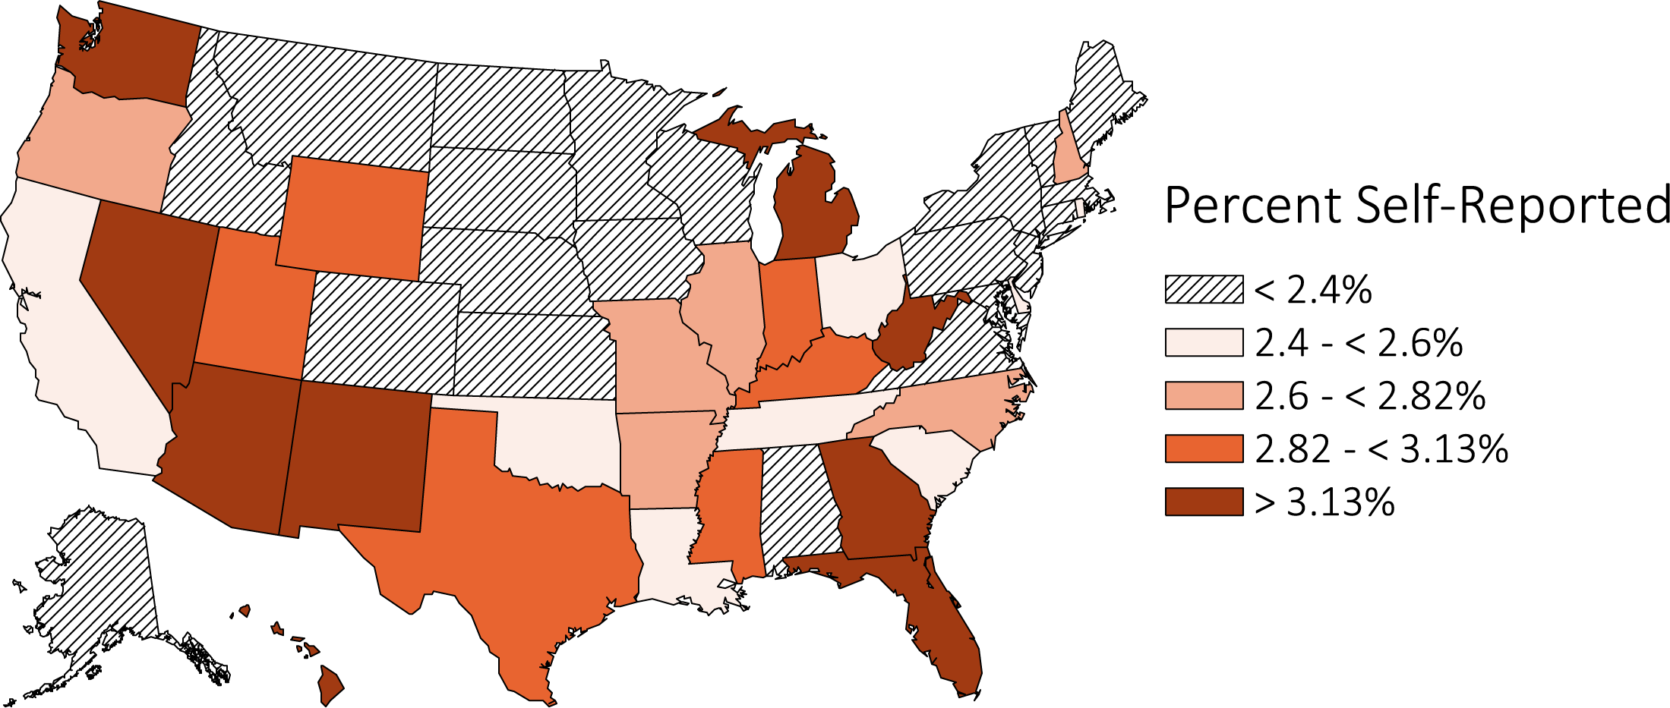
vol 1 Figure 1.14 Estimated prevalence of self-reported kidney disease by state, BRFSS participants ages 18 and older
(a) 2012
Data source: Behavioral Risk Factors Surveillance System (BRFSS), 2012 participants aged 18 & older. 2012 (N=471,107), 2013 (N=491,777), 2014 (N=464,617), and 2015 (N=441,460).

Slide 26
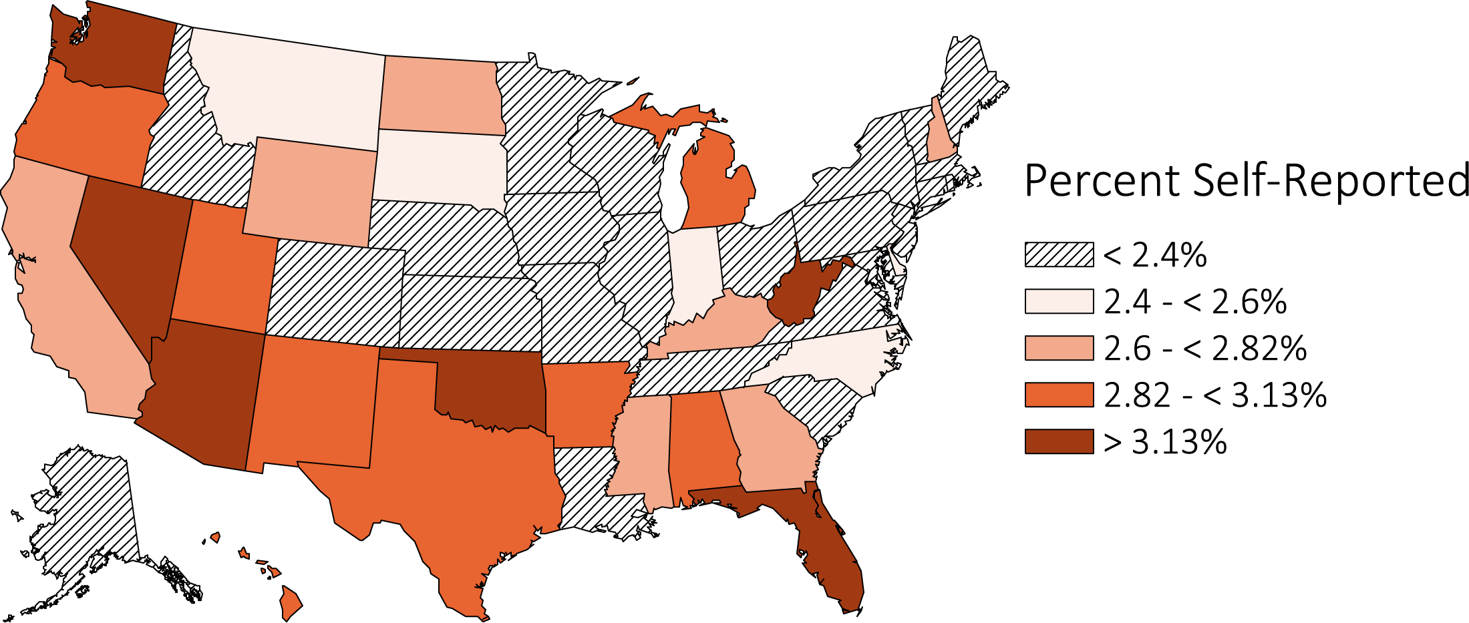
vol 1 Figure 1.14 Estimated prevalence of self-reported kidney disease by state, BRFSS participants ages 18 and older
(b) 2013
Data source: Behavioral Risk Factors Surveillance System (BRFSS), 2012 participants aged 18 & older. 2012 (N=471,107), 2013 (N=491,777), 2014 (N=464,617), and 2015 (N=441,460).

Slide 27
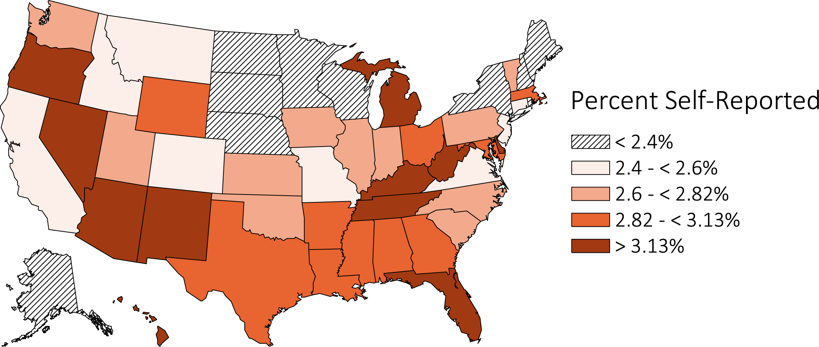
vol 1 Figure 1.14 Estimated prevalence of self-reported kidney disease by state, BRFSS participants ages 18 and older
(c) 2014
Data source: Behavioral Risk Factors Surveillance System (BRFSS), 2012 participants aged 18 & older. 2012 (N=471,107), 2013 (N=491,777), 2014 (N=464,617), and 2015 (N=441,460).

Slide 28
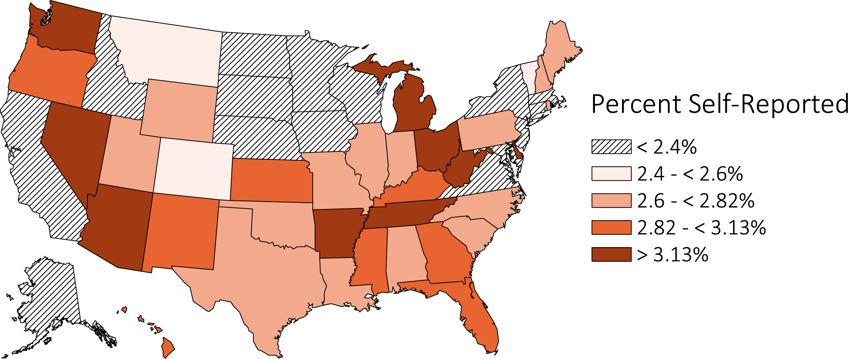
vol 1 Figure 1.14 Estimated prevalence of self-reported kidney disease by state, BRFSS participants ages 18 and older
(d) 2015
Data source: Behavioral Risk Factors Surveillance System (BRFSS), 2012 participants aged 18 & older. 2012 (N=471,107), 2013 (N=491,777), 2014 (N=464,617), and 2015 (N=441,460).

