Slide 1
2017 Annual Data Report
Volume 1: Chronic Kidney Disease
Chapter 2: Identification and Care of Patients With CKD

Slide 2
Table A. ICD-9-CM and ICD-10-CM codes for Chronic Kidney Disease (CKD) stages (introduced in 2006)
Table A. ICD-9-CM and ICD-10-CM codes for Chronic Kidney Disease (CKD) stages
ICD-9-CM codeª | ICD-10-CM codeª | Stage
585.1 | N18.1 | CKD, Stage 1
585.2 | N18.2 | CKD, Stage 2 (mild)
585.3 | N18.3 | CKD, Stage 3 (moderate)
585.4 | N18.4 | CKD, Stage 4 (severe)
585.5 | N18.5 | CKD, Stage 5 (excludes 585.6: Stage 5, requiring chronic dialysis^{b})
CKD Stage-unspecified | CKD Stage-unspecified | For these analyses, identified by multiple codes including 585.9, 250.4x, 403.9x & others for ICD-9-CM and A18.xx, E08.xx, E11.xx and other for ICD-10-CM.
ª For analyses in this chapter, CKD stage estimates require at least one occurrence of a stage-specific code, and the last available CKD stage in a given year is used.
^{b} In USRDS analyses, patients with ICD-9-CM code 585.6 or ICD-10-CM code N 18.6 & with no ESRD 2728 form or other indication of end-stage renal disease (ESRD) are considered to have code 585.5 or N 18.5.

Slide 3
vol 1 Table 2.1 Demographic characteristics of all patients, among Medicare (aged 65+ years) , Optum Clinformatics™ (all ages) and Veterans Affairs (all ages) patients, 2015
 | Medicare 5% |  |  | Optum Clinformatics™ |  |  | Veterans Affairs
 | Sample count | Percent (%) |  | Sample count | Percent (%) |  | Sample count | Percent (%)
All | 1,278,406 | 100 |  | 6,775,263 | 100 |  | 6,400,280 | 100
Age
<4 | - | - |  | 291,291 | 4.3 |  | - | -
5-9 | - | - |  | 425,618 | 6.3 |  | - | -
10-13 | - | - |  | 374,647 | 5.5 |  | 307 | 0.0
14-17 | - | - |  | 392,928 | 5.8 |  | 1,743 | 0.03
18-21 | - | - |  | 389,255 | 5.7 |  | 13,710 | 0.2
22-30 | - | - |  | 845,536 | 12.5 |  | 302,812 | 4.7
31-40 | - | - |  | 1,101,661 | 16.3 |  | 606,039 | 9.5
41-50 | - | - |  | 1,174,557 | 17.3 |  | 621,290 | 9.7
51-64 | - | - |  | 1,533,367 | 22.6 |  | 1,461,005 | 22.8
65-74 | 726,401 | 56.8 |  | 189,645 | 2.8 |  | 1,939,838 | 30.3
75-84 | 385,426 | 30.1 |  | 39,506 | 0.6 |  | 860,366 | 13.4
85+ | 166,579 | 13.0 |  | 17,252 | 0.2 |  | 593,226 | 9.3
Sex
Male | 558,868 | 43.7 |  | 3,325,386 | 49.1 |  | 5,725,195 | 89.5
Female | 719,538 | 56.3 |  | 3,449,026 | 50.9 |  | 675,085 | 10.6
Race/Ethnicity
White | 1,095,386 | 85.7 |  | 4,600,023 | 68.6 |  | 4,501,016 | 70.3
Black/African American | 95,611 | 7.5 |  | 574,327 | 8.6 |  | 987,346 | 15.4
Native American | 5,611 | 0.4 |  |  |  |  | 47,887 | 0.8
Asian | 24,078 | 1.9 |  | 367,328 | 5.5 |  | 65,184 | 1.0
Hispanic | 42,505 | 3.3 |  | 817,247 | 12.2 |  | - | -
Other | 15,215 | 1.2 |  | - | - |  | 798,906 | 12.5
Unknown/Missing | - | - |  | 341,536 | 5.1 |  | - | -
Comorbidity
Diabetes Mellitus | 301,337 | 23.6 |  | 281,945 | 4.4 |  | 1,080,974 | 16.9
Hypertension | 752,521 | 58.9 |  | 663,987 | 10.3 |  | 1,629,982 | 25.5
Cardiovascular Disease | 495,362 | 38.8 |  | 286,632 | 4.5 |  | 847,785 | 13.3
Data Source: Special analyses, Medicare 5% sample (aged 65 and older), Optum Clinformatics™ (all ages) and Veterans Affairs (all ages) alive & eligible for all of 2015. Abbreviation: CKD, chronic kidney disease. CVD is defined as presence of any of the following comorbidities: cerebrovascular accident, peripheral vascular disease, atherosclerotic heart disease, heart failure, dysrhythmia or other cardiac comorbidities. - No available data.

Slide 4
vol 1 Table 2.2 Prevalence of comorbid conditions by diagnosis codes (CKD, CVD & DM), (a) total & (b) one or more, among Medicare (aged 65+ years) , Optum Clinformatics™ (aged 22-64 years) and Veterans Affairs (aged 22-64 years) patients, 2015
(a) Any diagnosis of CKD, CVD, or DM
 | Medicare 5% |  |  | Clinformatics™ |  |  | Veterans Affairs
 | Sample count | % |  | Sample count | % |  | Sample count | %
All | 1,278,406 | 100 |  | 4,655,121 | 100 |  | 2,991,146 | 100
Total CKD | 149,461 | 11.7 |  | 53,554 | 1.1 |  | 100,107 | 3.3
Total CVD | 495,362 | 38.7 |  | 228,843 | 4.9 |  | 151,426 | 5.1
Total DM | 301,337 | 23.6 |  | 249,315 | 5.3 |  | 297,246 | 9.9
Data Source: Special analyses, Medicare 5% sample (aged 65 and older), Optum Clinformatics™ (aged 22-64) and Veterans Affairs (ages 22-64 years) alive & eligible for all of 2015. Abbreviations: CKD, chronic kidney disease; CVD, cardiovascular disease; DM, diabetes mellitus. CVD is defined as presence of any of the following comorbidities: cerebrovascular accident, peripheral vascular disease, atherosclerotic heart disease, congestive heart failure, dysrhythmia or other cardiac comorbidities. CKD in the VA is defined as anyone with at least one inpatient ICD-9 or ICD-10 diagnosis or two outpatient diagnosis codes in 2015 or eGFR<60 ml/min/1.73m² based on at least one outpatient serum creatinine available in 2015; eGFR was calculated using the CKD-EPI formula; if more than one value was available, the last one in the year was used. The denominator included everyone with at least one outpatient visit in 2015.

Slide 5
vol 1 Table 2.2 Prevalence of comorbid conditions by diagnosis codes (CKD, CVD & DM), (a) total & (b) one or more, among Medicare (aged 65+ years) , Optum Clinformatics™ (aged 22-64 years) and Veterans Affairs (aged 22-64 years) patients, 2015
(b) Combinations of CKD, CVD, or DM diagnoses
 | Medicare 5% |  |  | Clinformatics™ |  | Veterans Affairs
 | Sample count | % |  | Sample count | % |  | Sample count | %
All | 1,278,406 | 100 |  | 4,655,121 | 100 |  | 2,991,146 | 100
Only CKD | 26,658 | 2.1 |  | 26,985 | 0.6 |  | 57,170 | 1.9
Only CVD | 278,913 | 21.8 |  | 177,814 | 3.8 |  | 94,266 | 3.2
Only DM | 116,250 | 9.1 |  | 194,651 | 4.2 |  | 226,166 | 7.6
CKD & DM, no CVD | 19,715 | 1.5 |  | 11,730 | 0.2 |  | 23,479 | 0.8
CKD & CVD, no DM | 51,077 | 4.0 |  | 8,095 | 0.2 |  | 9,559 | 0.3
DM & CVD, no CKD | 113,361 | 8.9 |  | 36,190 | 0.8 |  | 37,702 | 1.3
CKD & CVD & DM | 52,011 | 4.1 |  | 6,744 | 0.1 |  | 9,899 | 0.3
At least one comorbidity | 660,344 | 51.6 |  | 462,209 | 9.9 |  | 458,241 | 15.4
At least two comorbidities | 237,238 | 18.6 |  | 62,759 | 1.3 |  | 80,639 | 2.7
No CKD, no CVD, no DM | 620,421 | 48.5 |  | 4,192,912 | 90.1 |  | 2,532,905 | 84.7
Data Source: Special analyses, Medicare 5% sample (aged 65 and older), Optum Clinformatics™ (aged 22-64) and Veterans Affairs (ages 22-64 years) alive & eligible for all of 2015. Abbreviations: CKD, chronic kidney disease; CVD, cardiovascular disease; DM, diabetes mellitus. CVD is defined as presence of any of the following comorbidities: cerebrovascular accident, peripheral vascular disease, atherosclerotic heart disease, congestive heart failure, dysrhythmia or other cardiac comorbidities. CKD in the VA is defined as anyone with at least one inpatient ICD-9 or ICD-10 diagnosis or two outpatient diagnosis codes in 2015 or eGFR<60 ml/min/1.73m² based on at least one outpatient serum creatinine available in 2015; eGFR was calculated using the CKD-EPI formula; if more than one value was available, the last one in the year was used. The denominator included everyone with at least one outpatient visit in 2015.

Slide 6
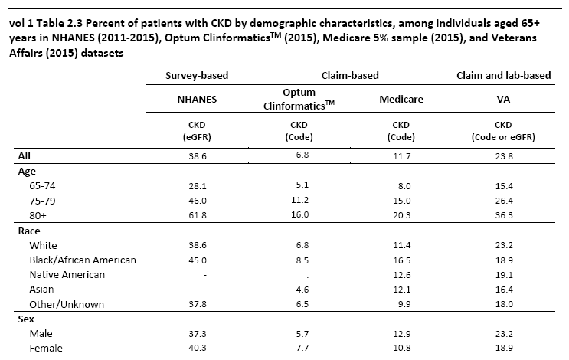
vol 1 Table 2.3 Percent of patients with CKD by demographic characteristics, among individuals aged 65+ years in NHANES (2011-2015), Optum ClinformaticsTM (2015), Medicare 5% sample (2015) and Veterans Affairs (2015) datasets
Data Source: Special analyses, Medicare 5% sample aged 65 and older alive & eligible for all of 2015. NHANES 2011-2015 participants aged 65 and older, and VA aged 65 and older alive & eligible for all of 2015. CKD in the VA is defined as anyone with at least one inpatient ICD-9 or ICD-10 diagnosis or two outpatient diagnosis codes in 2015 or eGFR<60 ml/min/1.73m² based on at least one outpatient serum creatinine available in 2015; eGFR was calculated using the CKD-EPI formula; if more than one value was available, the last one in the year was used. The denominator included everyone with at least one outpatient visit in 2015. Abbreviations: CKD, chronic kidney disease; VA, Veterans Affairs. - No available data

Slide 7
vol 1 Table 2.4 Prevalence of CKD, by demographic characteristics and comorbidities, among Medicare 5% sample (aged 65+ years), Optum Clinformatics™ (all ages) and Veterans Affairs (all ages) patients overall, and with diabetes mellitus or hypertension, 2015
 | All |  |  |  | Diabetes mellitus (with or without hypertension) |  |  |  | Hypertension (without diabetes mellitus)
 | Medicare 5% | Optum ClinformaticsTM | Veterans Affairs |  | Medicare 5% | Optum ClinformaticsTM | Veterans Affairs |  | Medicare 5% | Optum ClinformaticsTM | Veterans Affairs
Overall | 11.7 | 1.1 | 9.7 |  | 23.8 | 8.7 | 23.4 |  | 13.7 | 4.8 | 21.8
Age
< 4 | - | 0.3 | 0 |  | - | -- | 0 |  | - | 26.7 | 0
5-9 | - | 0.1 | 0 |  | - | -- | - |  | - | 28 | -
10-13 | - | 0.1 | 0 |  | - | 0.8 | - |  | - | 16.7 | -
14-17 | - | 0.1 | 0 |  | - | 1 | 0 |  | - | 9.7 | 0
18-21 | - | 0.2 | 0 |  | - | 2.3 | 0 |  | - | 7.1 | -
22-30 | - | 0.3 | 0.2 |  | - | 3.8 | 0.9 |  | - | 4.3 | 1.4
31-40 | - | 0.6 | 0.5 |  | - | 4.5 | 1.5 |  | - | 3.4 | 2.4
41-50 | - | 1 | 1.7 |  | - | 5.7 | 4.4 |  | - | 3.3 | 4.9
51-64 | - | 2.2 | 5.9 |  | - | 8.6 | 12.9 |  | - | 4.3 | 11.8
65-74 | 8 | 5.1 | 15.4 |  | 19.3 | 14.6 | 26 |  | 9.3 | 7.3 | 23.8
75-84 | 15 | 11.2 | 29.4 |  | 27.5 | 24 | 45.5 |  | 15.4 | 14 | 43.2
85+ | 20.3 | 16 | 38.9 |  | 32.9 | 30.5 | 59.3 |  | 22 | 21.9 | 58.7
Sex
Male | 12.9 | 1.2 | 4.7 |  | 25.6 | 9.6 | 18.2 |  | 15.8 | 5.3 | 16.9
Female | 10.8 | 0.9 | 14.9 |  | 22.2 | 7.7 | 28.6 |  | 12.3 | 4.3 | 26.7
Race/Ethnicity
White | 11.4 | 1.1 | 15.4 |  | 23.4 | 8.9 | 29.4 |  | 13.5 | 4.9 | 27.6
Black/African American | 16.5 | 1.3 | 11.2 |  | 27.6 | 9.2 | 23.9 |  | 17.3 | 5 | 21.7
Native American | 12.6 | - | 9.4 |  | 23.2 | - | 22.1 |  | 12.7 | - | 20.9
Asian | 12.1 | 0.6 | 6.8 |  | 23.9 | 6.6 | 20.7 |  | 12.8 | 4.6 | 20
Hispanic | - | 1 | - |  | 21.5 | 8.3 | - |  | 11.8 | 4.4 | -
Other/Unknown | 9.9 | 1 | 8.8 |  | 19.34 | 8.4 | 28.2 |  | 9.3 | 4.9 | 27.1
Data Source: Special analyses, Medicare 5% sample (aged 65 and older), Optum Clinformatics™ data (all ages) and the Veterans Affairs data (all ages) alive & eligible for all of 2015. Abbreviation: CKD, chronic kidney disease. CKD in the VA is defined as anyone with at least one inpatient ICD-9 or ICD-10 diagnosis or two outpatient diagnosis codes in 2015 or eGFR<60 ml/min/1.73m² based on at least one outpatient serum creatinine available in 2015; eGFR was calculated using the CKD-EPI formula; if more than one value was available, the last one in the year was used. The denominator included everyone with at least one outpatient visit in 2015. - No available data.-- data suppressed

Slide 8
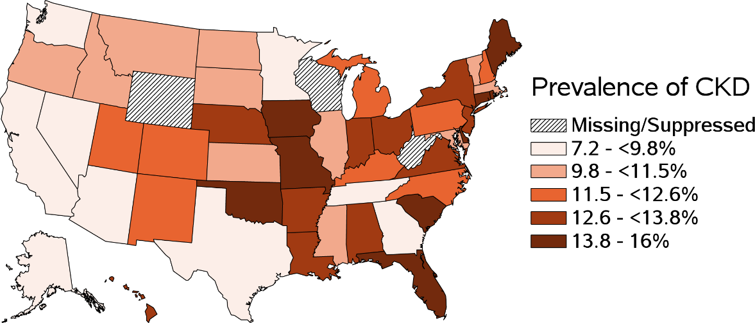
vol 1 Figure 2.1 Prevalence of CKD among Medicare 5% sample (aged 65+ years) and Optum Clinformatics™ (all ages) patients, 2015
(a) Medicare 5%
Data Source: Special analyses, Medicare 5% sample (aged 65 and older) and Optum Clinformatics™ data (all ages) alive & eligible for all of 2015.

Slide 9
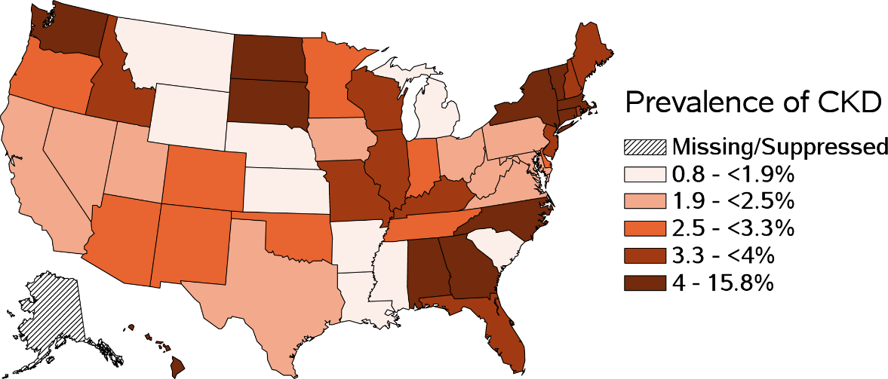
vol 1 Figure 2.1 Prevalence of CKD among Medicare 5% sample (aged 65+ years) and Optum Clinformatics™ (all ages) patients, 2015
(b) Optum Clinformatics™
Data Source: Special analyses, Medicare 5% sample (aged 65 and older) and Optum Clinformatics™ data (all ages) alive & eligible for all of 2015.

Slide 10
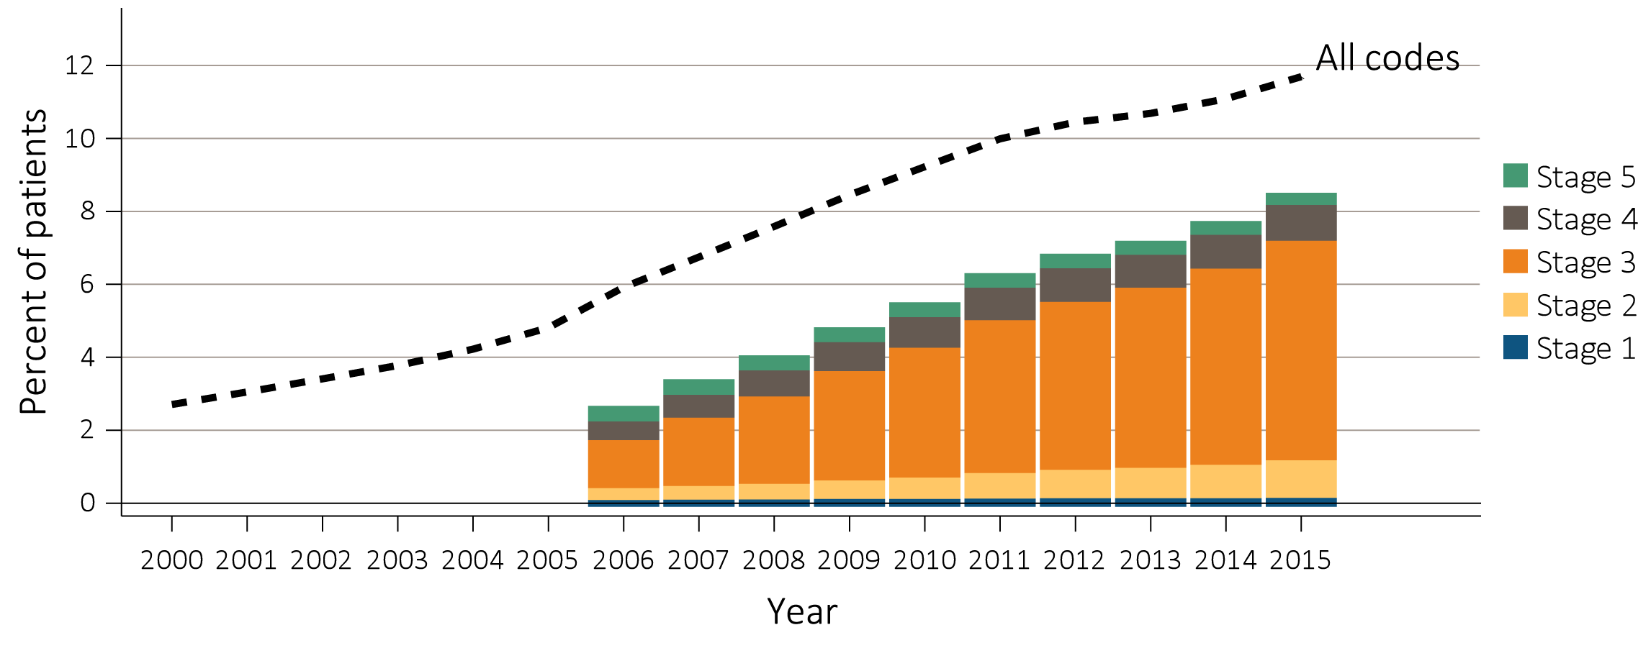
vol 1 Figure 2.2 Trends in prevalence of recognized CKD, overall and by CKD stage, among Medicare patients (aged 65+ years), 2000-2015
Data Source: Special analyses, Medicare 5% sample. Known CKD stages presented as bars; curve showing “All codes” includes known CKD stages (ICD-9 codes 585.1-585.5 or ICD-10 codes N18.1-N18.5) and the CKD-stage unspecified codes (ICD-9 code 585.9, ICD-10 code N18.9 and remaining non-stage specific CKD codes). For years 2000-2015, ICD-9 codes are used to identify CKD; additionally, starting October 1, 2015, ICD-10 codes are used to identify CKD. Note: In previous years, this graph reported 585.9 codes as a component of the stacked bars. Abbreviation: CKD, chronic kidney disease.

Slide 11
vol 1 Table 2.5 Change in CKD status from 2010 to 2015, among Medicare patients (aged 65+ years) alive and without ESRD in 2010
 |  | 2014-2015 Status (row %)
 |  | No CKD Diagnosis | CKD Stage 1 | CKD Stage 2 | CKD Stage 3 | CKD Stage 4 | CKD Stage 5 | CKD Stage-unspecified | ESRD alive | ESRD death | Death without ESRD | Lost to follow-up | Total N
 | No CKD Diagnosis | 55.6 | 0.2 | 0.8 | 4.0 | 0.5 | 0.1 | 4.1 | 0.1 | 0.1 | 21.3 | 13.2 | 1,110,468
 | Any CKD | 12.7 | 0.5 | 2.0 | 16.9 | 4.2 | 0.5 | 7.9 | 1.8 | 2.2 | 42.7 | 8.6 | 112,830
 | CKD Stage 1 | 16.5 | 5.7 | 4.2 | 15.1 | 2.0 | 0.3 | 7.4 | 0.9 | 1.7 | 36.8 | 9.6 | 2,603
2010 | CKD Stage 2 | 15.2 | 0.9 | 9.2 | 18.8 | 2.2 | 0.3 | 7.2 | 0.6 | 0.9 | 34.6 | 10 | 7,186
Status | CKD Stage 3 | 8.1 | 0.3 | 1.8 | 26.6 | 5.2 | 0.6 | 5.1 | 1.6 | 1.9 | 40.3 | 8.5 | 43,530
 | CKD Stage 4 | 2.7 | 0.2 | 0.4 | 7.8 | 11.6 | 1.4 | 2.4 | 7.2 | 8.9 | 50.9 | 6.4 | 10,257
 | CKD Stage 5 | 5.9 | 0.4 | 0.7 | 6.6 | 2.5 | 1.7 | 3.6 | 8.2 | 11 | 53.3 | 6.2 | 2,594
 | CKD Stage-unspecified | 19.1 | 0.4 | 1.5 | 10.1 | 2.1 | 0.3 | 12.0 | 0.6 | 0.7 | 44.1 | 9.1 | 46,660
 | Total | 51.6 | 0.2 | 0.9 | 5.2 | 0.8 | 0.1 | 4.4 | 0.3 | 0.3 | 23.3 | 12.8
 | Total N | 631,759 | 2,599 | 10,784 | 63,709 | 9,758 | 1,686 | 54,378 | 3,253 | 3,733 | 285,004 | 156,635 | 1,223,298
Data Source: Special analyses, Medicare 5% sample. Patients alive & eligible for all of 2009. Death and ESRD status were examined yearly between 2010-2015, and were carried forward if present. Among patients without death or ESRD by 2015, the last CKD diagnosis claim was used; if not available, then the last CKD diagnosis claim from 2014 was used. Lost to follow-up represents the patients who were not enrolled in Medicare Part A and Part B in 2014 or 2015. Abbreviations: CKD, chronic kidney disease; ESRD, end-stage renal disease

Slide 12
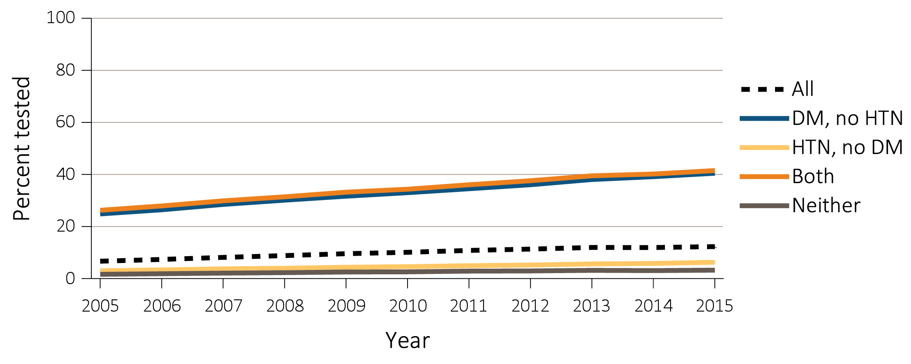
vol 1 Figure 2.3 Trends in percent of patients with testing of urine albumin (a) in Medicare 5% sample (aged 65+ years) & (b) Optum Clinformatics™ (aged 22-64 years) patients without a diagnosis of CKD, by year from 2005 to 2015
(a) Medicare 5%
Data Source: Special analyses, Medicare 5% sample aged 65 and older with Part A & B coverage in the prior year and Optum Clinformatics™ patients aged 22-64 years. Tests tracked during each year. Abbreviations: CKD, chronic kidney disease; DM, diabetes mellitus; HTN, hypertension.

Slide 13
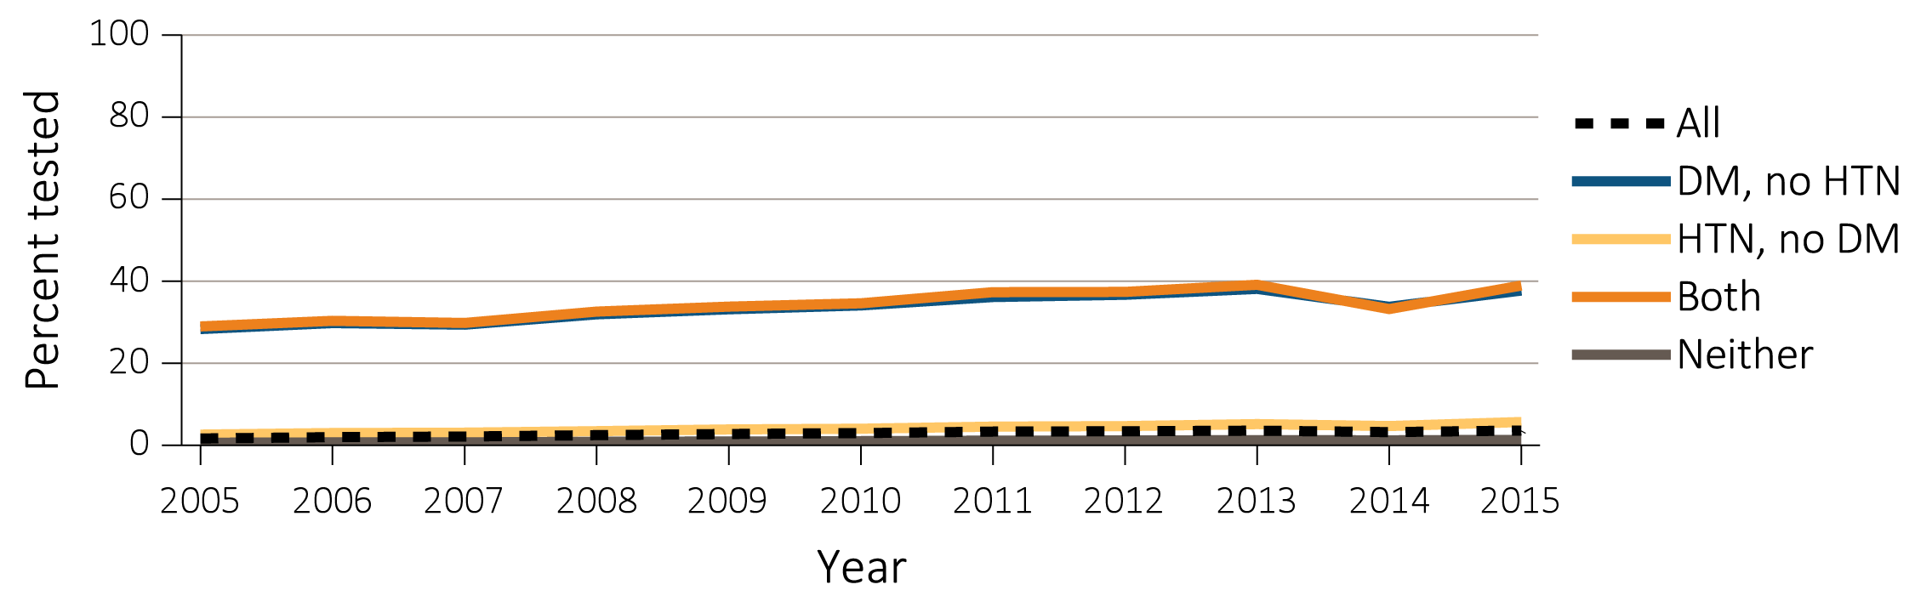
vol 1 Figure 2.3 Trends in percent of patients with testing of urine albumin (a) in Medicare 5% sample (aged 65+ years) & (b) Optum Clinformatics™ (aged 22-64 years) patients without a diagnosis of CKD, by year from 2005 to 2015
(b) Optum Clinformatics™
Data Source: Special analyses, Medicare 5% sample aged 65 and older with Part A & B coverage in the prior year and Optum Clinformatics™ patients aged 22-64 years. Tests tracked during each year. Abbreviations: CKD, chronic kidney disease; DM, diabetes mellitus; HTN, hypertension.

Slide 14
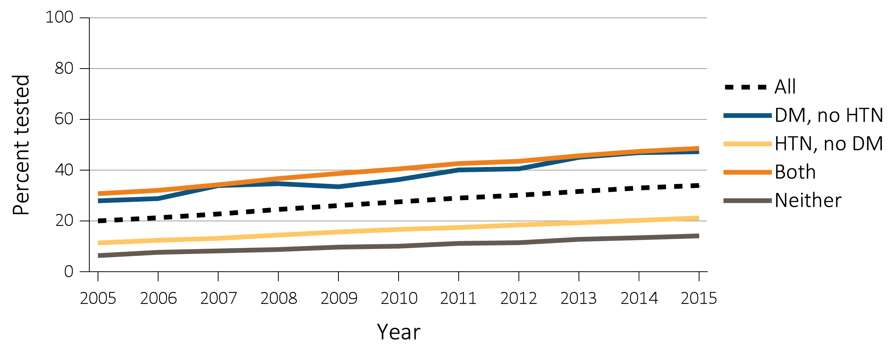
vol 1 Figure 2.4 Trends in percent of patients with testing of urine albumin in (a) Medicare 5% (aged 65+ years) & (b) Optum Clinformatics™ (aged 22-64 years) patients with a diagnosis of CKD, by year from 2005-2015
(a) Medicare 5%
Data Source: Special analyses, Medicare 5% sample (aged 65 and older) with Part A & B coverage in the prior year and Optum Clinformatics™ population (aged 22-64 years). Tests tracked during each year. Abbreviations: CKD, chronic kidney disease; DM, diabetes mellitus; HTN, hypertension.

Slide 15
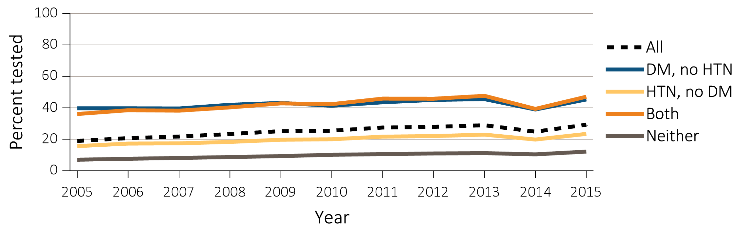
vol 1 Figure 2.4 Trends in percent of patients with testing of urine albumin in (a) Medicare 5% (aged 65+ years) & (b) Optum Clinformatics™ (aged 22-64 years) patients with a diagnosis of CKD, by year from 2005-2015
(b) Optum Clinformatics™
Data Source: Special analyses, Medicare 5% sample (aged 65 and older) with Part A & B coverage in the prior year and Optum Clinformatics™ population (aged 22-64 years). Tests tracked during each year. Abbreviations: CKD, chronic kidney disease; DM, diabetes mellitus; HTN, hypertension.

Slide 16
vol 1 Table 2.6 Percent of patients with a physician visit in 2015 after a CKD diagnosis in 2014, among Medicare 5% patients (aged 65+ years)
 | Any CKD diagnosis |  |  |  | CKD diagnosis code of 585.3 (Stage 3) |  |  |  | CKD diagnosis code of 585.4 (Stage 4) or 585.5 (Stage 5)
 | Primary care | Cardiologist | Nephrologist |  | Primary care | Cardiologist | Nephrologist |  | Primary care | Cardiologist | Nephrologist
Overall | 89.6 | 56.2 | 28.6 |  | 92.7 | 60.1 | 47.1 |  | 92.2 | 65.2 | 68.8
Age
65-74 | 86.9 | 50.6 | 29.8 |  | 90.9 | 55.3 | 53.5 |  | 81.8 | 49.0 | 73.6
75-84 | 91.0 | 60.4 | 29.7 |  | 93.4 | 63.0 | 47.1 |  | 85.8 | 55.3 | 70.8
85+ | 93.0 | 62.5 | 23.1 |  | 94.4 | 64.1 | 34.1 |  | 88.5 | 55.7 | 57.4
Sex
Male | 89.7 | 56.3 | 27.6 |  | 92.9 | 60.6 | 46.1 |  | 85.1 | 53.5 | 68.9
Female | 90.3 | 57.7 | 34.5 |  | 92.1 | 59.5 | 53.2 |  | 84.7 | 51.6 | 70.4
Race
White | 88.4 | 51.2 | 27.8 |  | 90.5 | 53.9 | 45.6 |  | 84.8 | 48.7 | 66.2
Black/African American | 90.3 | 53.4 | 27.8 |  | 93.0 | 56.4 | 44.8 |  | 85.5 | 49.9 | 67.6
Other | 89.0 | 59.1 | 29.1 |  | 92.4 | 64.0 | 49.3 |  | 84.5 | 56.3 | 70.5
Data Source: Special analyses, Medicare 5 sample aged 65 and older alive & eligible for all of 2014. CKD diagnosis is at date of first CKD claim in 2014; claims for physician visits were searched during the 12 months following that date. ICD-9 CKD diagnosis code of 585.4 or higher represents CKD Stages 4-5. Abbreviation: CKD, chronic kidney disease.

Slide 17
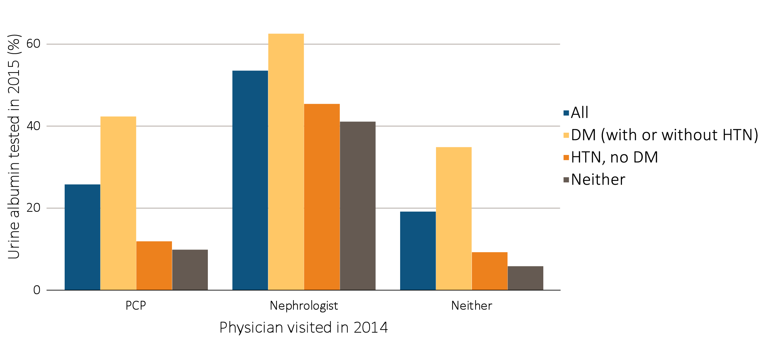
vol 1 Figure 2.5 Percent of CKD patients in 2014 with physician visit (nephrologist, primary care provider, both, and neither), with laboratory testing in the following year (2015), by comorbidity
Data Source: Special analyses, Medicare 5% sample aged 65 and older alive & eligible for all of 2015, with a CKD diagnosis claim based on ICD-9 diagnostic codes and a physician visit in 2014. Patient visits with both PCP and nephrologists are classified as nephrologist. Abbreviations: CKD, chronic kidney disease; DM, diabetes mellitus; HTN, hypertension; PCP, primary care physician.

