Slide 1
2017 Annual Data Report
Volume 1: Chronic Kidney Disease
Chapter 3: Morbidity and Mortality

Slide 2
vol 1 Table 3.1 Unadjusted and adjusted all-cause mortality rates per 1,000 patient-years at risk for Medicare patients aged 66 and older, by CKD status, 2015
 | Unadjusted |  |  | Adjusted
 | No CKD | All CKD |  | No CKD | All CKD
All | 43.8 | 134.8 |  | 45.6 | 109.7
Age
66–69 | 15.4 | 64.6 |  | 15.1 | 63.0
70–74 | 21.3 | 70.6 |  | 21.1 | 68.7
75–84 | 44.0 | 115.9 |  | 44.1 | 113.5
85+ | 142.8 | 255.6 |  | 143.6 | 253.9
Sex
Male | 44.5 | 138.4 |  | 51.5 | 120.2
Female | 43.3 | 131.5 |  | 41.3 | 102.6
Race
White | 44.6 | 137.8 |  | 45.8 | 110.5
Black/African American | 43.8 | 125.9 |  | 49.4 | 114.5
Other | 31.4 | 105.3 |  | 36.5 | 88.3
Data source: Medicare 5% sample. January 1, 2015 point prevalent patients aged 66 and older. Adjusted for age/sex/race. Standard population all patients, 2015. Abbreviation: CKD, chronic kidney disease.

Slide 3
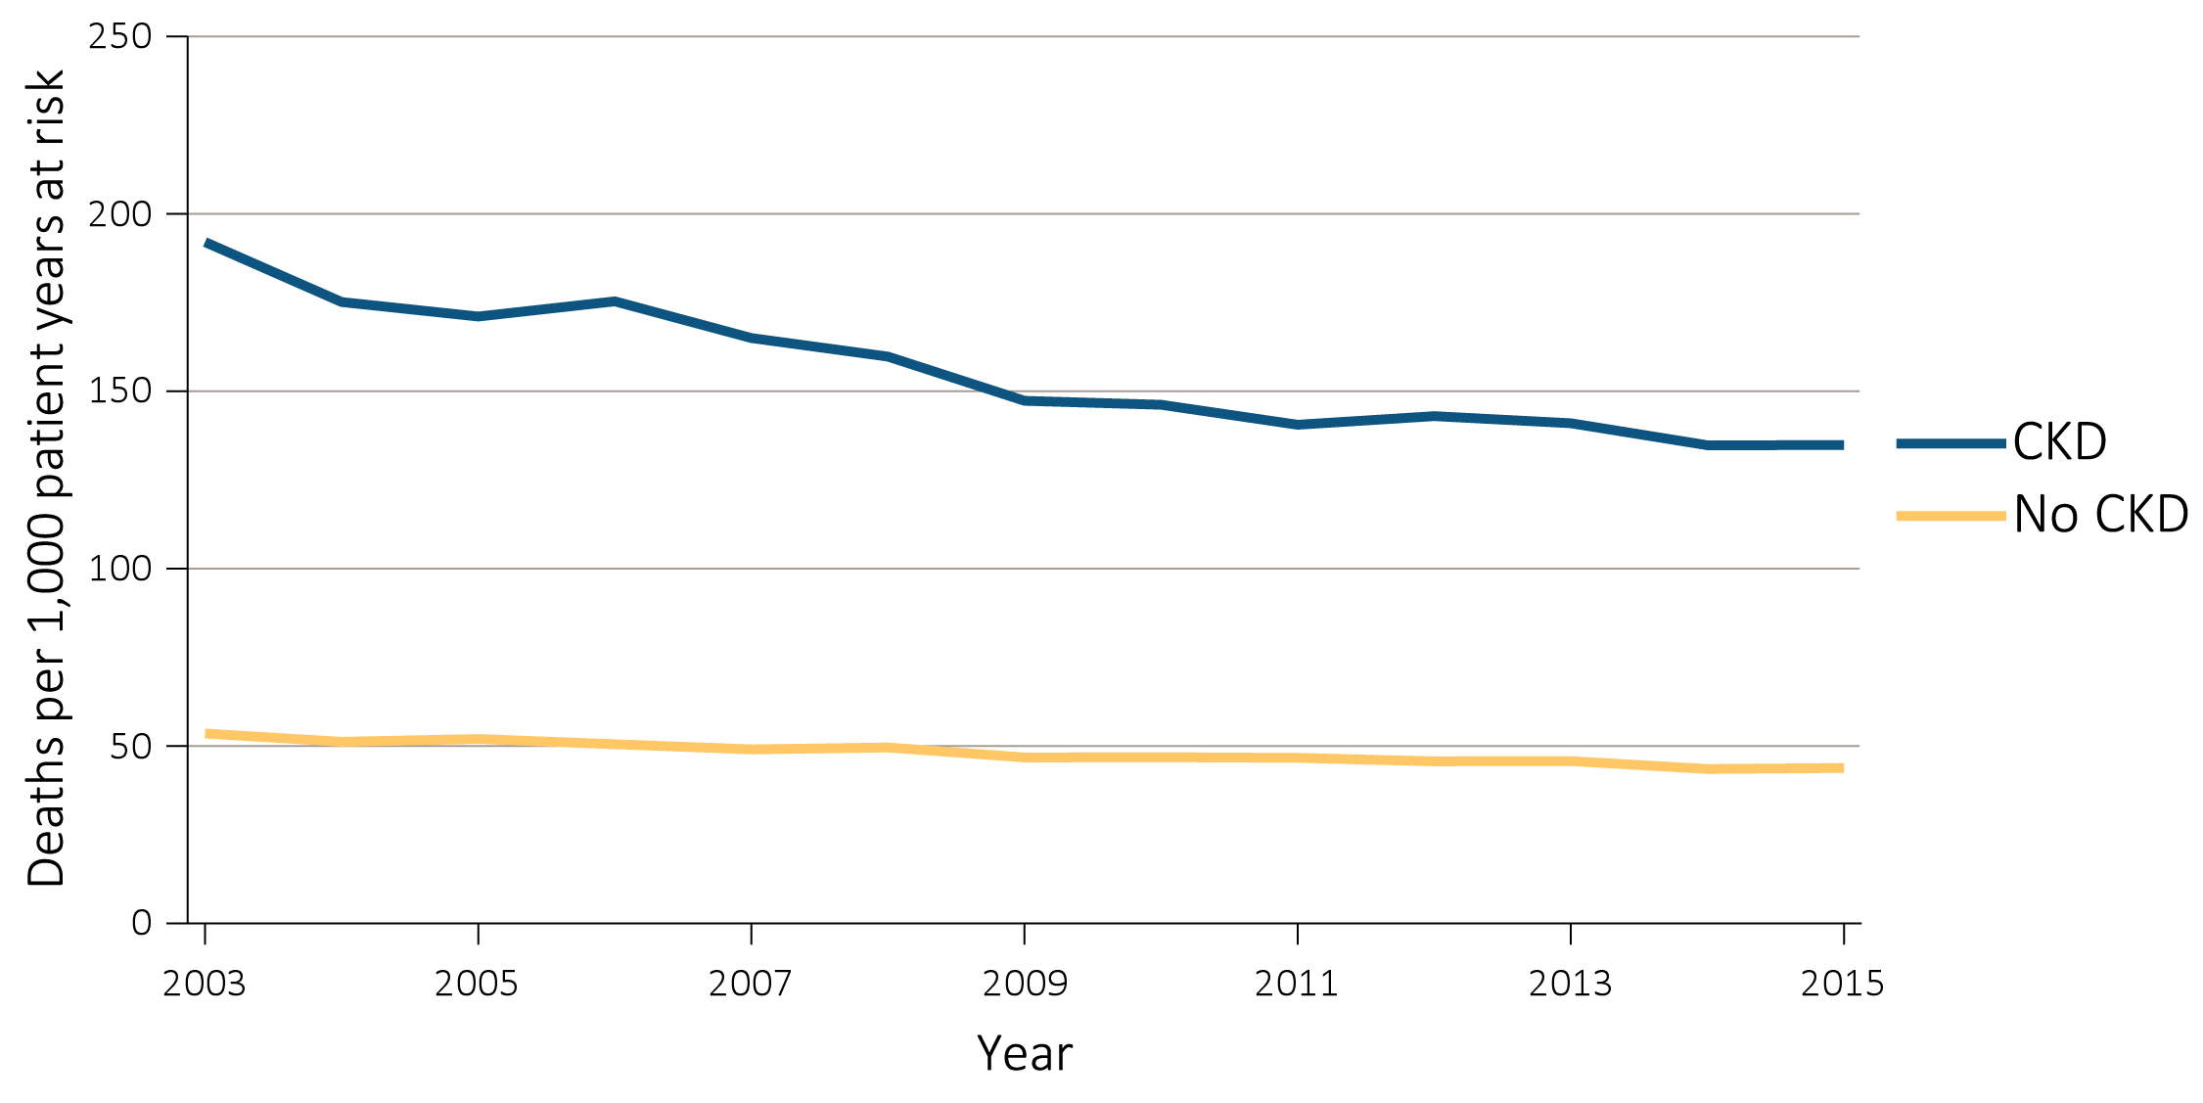
vol 1 Figure 3.1 Unadjusted and adjusted all-cause mortality rates per 1,000 patient-years at risk for Medicare patients aged 66 and older, by CKD status and year, 2003-2015
Unadjusted
Data source: Special analyses, Medicare 5% sample. January 1 of each reported year, point prevalent Medicare patients aged 66 and older. 1b adjusted for age/sex/race and 1c adjusted for age/sex/race/comorbidities. Standard population Medicare 2014 patients. Abbreviation: CKD, chronic kidney disease.

Slide 4
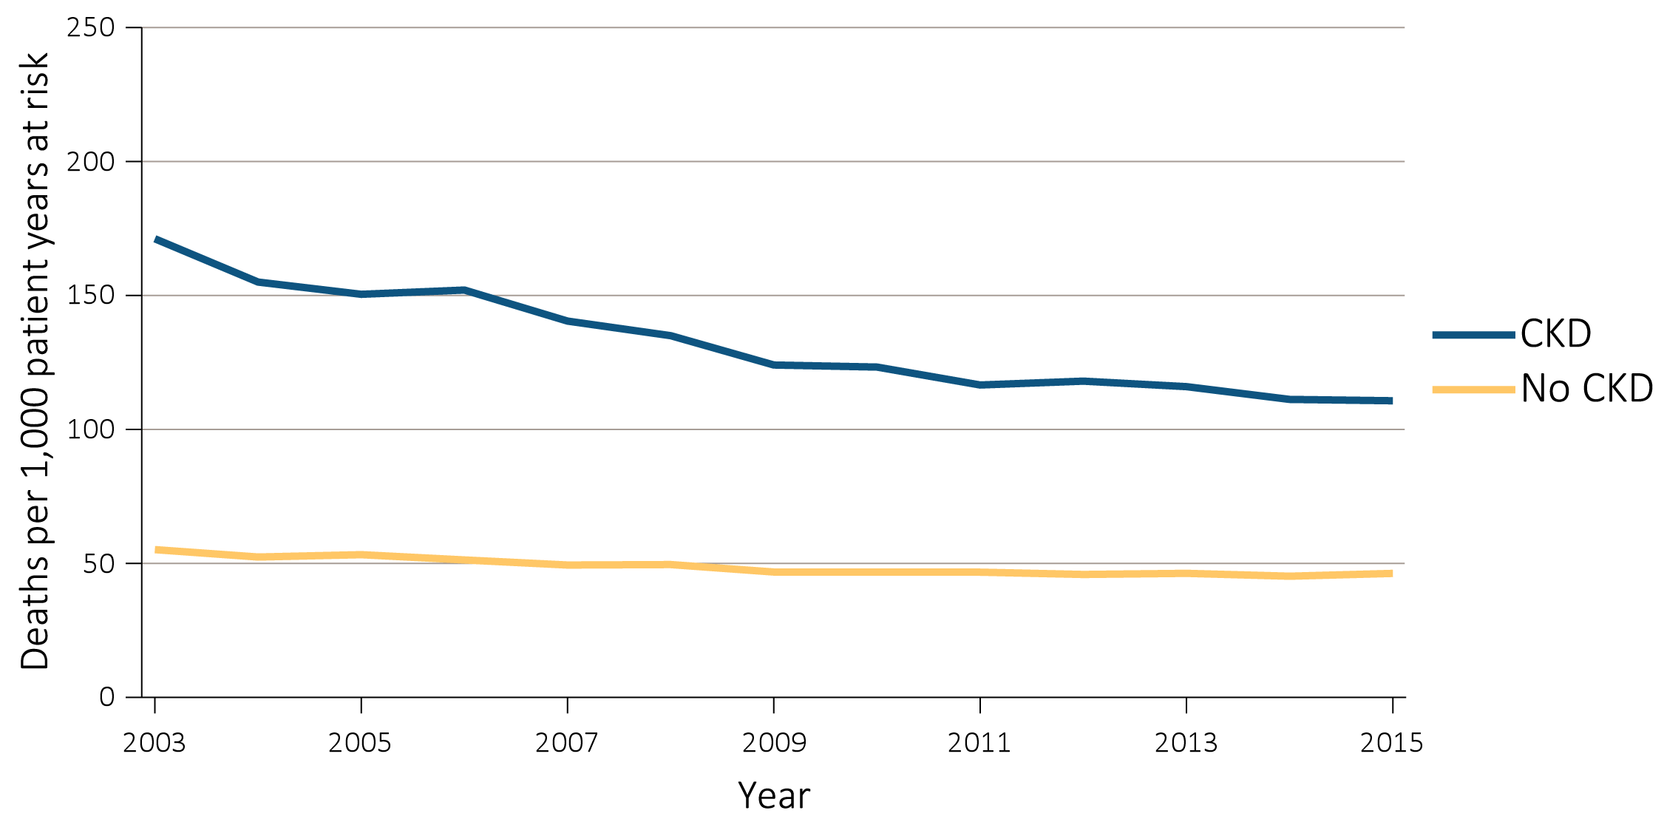
(b) Adjusted
Data source: Special analyses, Medicare 5% sample. January 1 of each reported year, point prevalent Medicare patients aged 66 and older. 1b adjusted for age/sex/race and 1c adjusted for age/sex/race/comorbidities. Standard population Medicare 2014 patients. Abbreviation: CKD, chronic kidney disease.

Slide 5
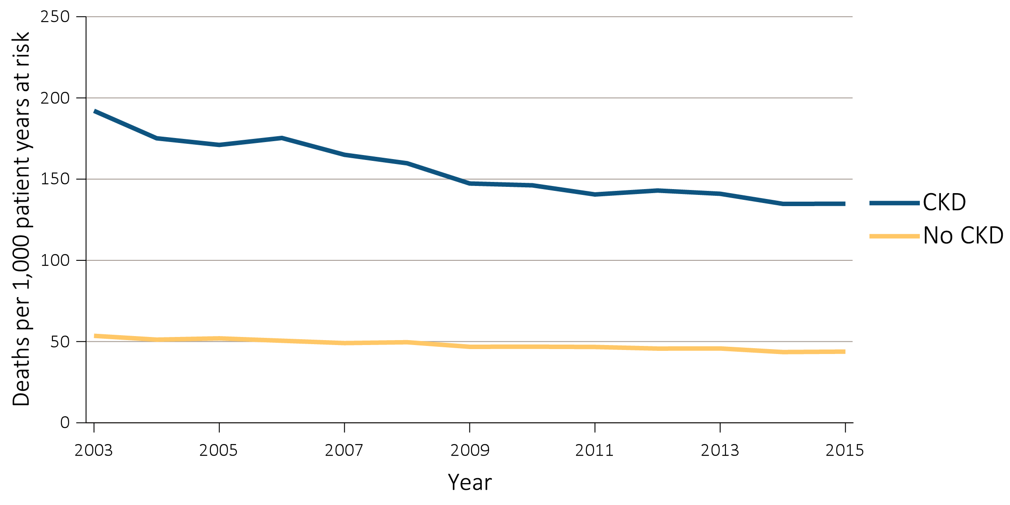
(C) Adjusted for comorbidities
Data source: Special analyses, Medicare 5% sample. January 1 of each reported year, point prevalent Medicare patients aged 66 and older. 1b adjusted for age/sex/race and 1c adjusted for age/sex/race/comorbidities. Standard population Medicare 2014 patients. Abbreviation: CKD, chronic kidney disease.

Slide 6
vol 1 Figure 3.2 Unadjusted and adjusted all-cause mortality rates per 1,000 patient-years at risk for Medicare patients aged 66 and older, by CKD status and stage, 2015
Data source: Special analyses, Medicare 5% sample. January 1 of each reported year, point prevalent Medicare patients aged 66 and older. Adjusted for age/sex/race. Standard population Medicare 2015 patients. See Table A for CKD stage definitions. Abbreviations: CKD, chronic kidney disease; unk/unspc, CKD stage unidentified.

Slide 7
Table A. ICD-9-CM and ICD-10-CM codes for Chronic Kidney Disease (CKD) stages (introduced in 2006)
ICD-9-CM codeª | ICD-10-CM codeª | Stage
585.1 | N18.1 | CKD, Stage 1
585.2 | N18.2 | CKD, Stage 2 (mild)
585.3 | N18.3 | CKD, Stage 3 (moderate)
585.4 | N18.4 | CKD, Stage 4 (severe)
585.5 | N18.5 | CKD, Stage 5 (excludes 585.6: Stage 5, requiring chronic dialysis^{b})
CKD Stage unspecified | CKD Stage unspecified | For these analyses, identified by multiple codes including 585.9, 250.4x, 403.9xm & others
ª For analyses in this chapter, CKD stage estimates require at least one occurrence of a stage-specific code, and the last available CKD stage in a given year is used. ^{b} In USRDS analyses, patients with ICD-9-CM code 585.6 or ICD-10-CM code N 18.6 & with no ESRD 2728 form or other indication of end-stage renal disease (ESRD) are considered to have code 585.5 or N 18.5.

Slide 8
vol 1 Figure 3.3 Adjusted all-cause mortality rates per 1,000 patient-years at risk for Medicare patients aged 66 and older, by age, CKD status, and stage, 2015
Data source: Special analyses, Medicare 5% sample. January 1 of each reported year, point prevalent Medicare patients aged 66 and older. Adjusted for age/sex/race. Standard population Medicare 2015 patients. Abbreviations: CKD, chronic kidney disease; unk/unspc, CKD stage unidentified.

Slide 9
vol 1 Figure 3.4 Adjusted all-cause mortality rates per 1,000 patient-years at risk for Medicare patients aged 66 and older, by sex, CKD status, and stage, 2015
Data source: Special analyses, Medicare 5% sample. January 1 of each reported year, point prevalent Medicare patients aged 66 and older. Adjusted for age/sex/race. Standard population Medicare 2015 patients. Abbreviations: CKD, chronic kidney disease; unk/unspc, CKD stage unidentified.

Slide 10
vol 1 Figure 3.5 Adjusted all-cause mortality rates per 1,000 patient-years at risk for Medicare patients aged 66 and older, by race, CKD status, and stage, 2015
Data source: Special analyses, Medicare 5% sample. January 1 of each reported year, point prevalent Medicare patients aged 66 and older. Adjusted for age/sex/race. Standard population Medicare 2015 patients. Abbreviations: CKD, chronic kidney disease; unk/unspc, CKD stage unidentified.

Slide 11
vol 1 Figure 3.6 Adjusted all-cause mortality rates per 1,000 patient-years at risk for Medicare patients aged 66 and older, by cardiovascular disease and diabetes mellitus, CKD status, and stage, 2015
Data source: Special analyses, Medicare 5% sample. January 1 of each reported year, point prevalent Medicare patients aged 66 and older. Adjusted for age/sex/race. Standard population Medicare 2015 patients. Abbreviations: CKD, chronic kidney disease; CVD, cardiovascular disease; DM, diabetes mellitus; unk/unspc, CKD stage unidentified.

Slide 12
vol 1 Table 3.2 Unadjusted and adjusted all-cause hospitalization rates per 1,000 patient-years at risk for Medicare and Optum ClinformaticsTM patients, by CKD status, 2015
 | Medicare (aged 66+) |  |  |  |  |  | Optum ClinformaticsTM (aged 22+)
 | Unadjusted |  |  | Adjusted |  |  | Unadjusted |  |  | Adjusted
 | No CKD | All CKD |  | No CKD | All CKD |  | No CKD | All CKD |  | No CKD | All CKD
All | 226.8 | 613.8 |  | 231.0 | 581.1 |  | 35.8 | 214.1 |  | 35.9 | 179.8
Age
22-39 | . | . |  | . | . |  | 34.7 | 156.2 |  | 35.5 | 154.6
40-65 | . | . |  | . | . |  | 32.8 | 186.1 |  | 32.8 | 186.4
65+ | . | . |  | . | . |  | 102.7 | 342.0 |  | 100.9 | 343.3
66–69 | 137.7 | 519.7 |  | 138.5 | 521.1 |  | . | . |  | . | .
70–74 | 179.8 | 516.7 |  | 179.5 | 519.9 |  | . | . |  | . | .
75–84 | 261.7 | 610.7 |  | 261.4 | 608.9 |  | . | . |  | . | .
85+ | 413.8 | 750.0 |  | 416.7 | 752.2 |  | . | . |  | . | .
Sex
Male | 219.1 | 603.4 |  | 234.8 | 573.5 |  | 25.5 | 202.0 |  | 25.6 | 161.5
Female | 232.6 | 623.4 |  | 228.8 | 591.8 |  | 46.3 | 230.3 |  | 46.4 | 197.2
Race
White | 230.3 | 612.3 |  | 232.8 | 580.3 |  | 38.0 | 226.4 |  | 37.9 | 188.7
Black/African American | 237.4 | 677.9 |  | 250.2 | 664.3 |  | 28.6 | 225.5 |  | 38.6 | 194.8
Other | 163.9 | 520.0 |  | 179.6 | 491.2 |  | 38.6 | 165.2 |  | 29.0 | 147.4
Data source: Medicare 5% sample and Optum ClinformaticsTM. January 1, 2015 point prevalent Medicare patients, aged 66 and older. Standard population all Medicare patients, 2015. Optum Clinformatics™ commercial insurance patients aged 22 and older who were enrolled in the plan, did not have diagnoses of ESRD, and were alive on January 1, 2015. Adjusted for age/sex/race; rates by one factor are adjusted for the others. .No data available, cell intentionally left blank. Standard population all Optum ClinformaticsTM patients, 2015. Abbreviation: CKD, chronic kidney disease.

Slide 13
vol 1 Figure 3.7 Unadjusted and adjusted all-cause hospitalization rates per 1,000 patient-years at risk for Medicare and Optum ClinformaticsTM patients, by CKD status and year, 2003-2015
Medicare-unadjusted
Data source: Medicare 5% sample and Optum ClinformaticsTM. January 1, 2015 point prevalent Medicare patients, aged 66 and older. Standard Medicare population all patients, 2014. Optum Clinformatics™ commercial insurance patients aged 22 and older who were enrolled in the plan, did not have diagnoses of ESRD, and were alive on January 1, 2015. Adjusted for age/sex/race; rates by one factor are adjusted for the others. Standard Optum ClinformaticsTM population all patients, 2014. Abbreviation: CKD, chronic kidney disease.

Slide 14
vol 1 Figure 3.7 Unadjusted and adjusted all-cause hospitalization rates per 1,000 patient-years at risk for Medicare and Optum ClinformaticsTM patients, by CKD status and year, 2003-2015 (continued)
(b) Medicare adjusted
Data source: Medicare 5% sample and Optum ClinformaticsTM. January 1, 2015 point prevalent Medicare patients, aged 66 and older. Standard Medicare population all patients, 2014. Optum Clinformatics™ commercial insurance patients aged 22 and older who were enrolled in the plan, did not have diagnoses of ESRD, and were alive on January 1, 2015. Adjusted for age/sex/race; rates by one factor are adjusted for the others. Standard Optum ClinformaticsTM population all patients, 2014. Abbreviation: CKD, chronic kidney disease.

Slide 15
vol 1 Figure 3.7 Unadjusted and adjusted all-cause hospitalization rates per 1,000 patient-years at risk for Medicare and Optum ClinformaticsTM patients, by CKD status and year, 2003-2015 (continued)
(c) Optum ClinformaticsTM-unadjusted
Data source: Medicare 5% sample and Optum ClinformaticsTM. January 1, 2015 point prevalent Medicare patients, aged 66 and older. Standard Medicare population all patients, 2014. Optum Clinformatics™ commercial insurance patients aged 22 and older who were enrolled in the plan, did not have diagnoses of ESRD, and were alive on January 1, 2015. Adjusted for age/sex/race; rates by one factor are adjusted for the others. Standard Optum ClinformaticsTM population all patients, 2014. Abbreviation: CKD, chronic kidney disease.

Slide 16
vol 1 Figure 3.7 Unadjusted and adjusted all-cause hospitalization rates per 1,000 patient-years at risk for Medicare and Optum ClinformaticsTM patients, by CKD status and year, 2003-2015 (continued)
(d) Optum ClinformaticsTM-adjusted
Data source: Medicare 5% sample and Optum ClinformaticsTM. January 1, 2015 point prevalent Medicare patients, aged 66 and older. Standard Medicare population all patients, 2014. Optum Clinformatics™ commercial insurance patients aged 22 and older who were enrolled in the plan, did not have diagnoses of ESRD, and were alive on January 1, 2015. Adjusted for age/sex/race; rates by one factor are adjusted for the others. Standard Optum ClinformaticsTM population all patients, 2014. Abbreviation: CKD, chronic kidney disease.

Slide 17
vol 1 Figure 3.8 Adjusted all-cause hospitalization rates per 1,000 patient-years at risk for Medicare and Optum ClinformaticsTM patients aged 66 and older, by CKD status and stage, 2013-2015
Medicare
Data source: Medicare 5% sample and Optum ClinformaticsTM. January 1, 2015 point prevalent Medicare patients, aged 66 and older. Standard Medicare population all patients, 2014. Optum Clinformatics™ commercial insurance patients aged 22 and older who were enrolled in the plan, did not have diagnoses of ESRD, and were alive on January 1, 2015. Adjusted for age/sex/race; rates by one factor are adjusted for the others. Standard population all Optum ClinformaticsTM patients, 2014. See Table A for CKD stage definitions. Abbreviations: CKD, chronic kidney disease unk/unspc, CKD stage unidentified.

Slide 18
vol 1 Figure 3.8 Adjusted all-cause hospitalization rates per 1,000 patient-years at risk for Medicare and Optum ClinformaticsTM patients aged 66 and older, by CKD status and stage, 2013-2015
(b) Optum ClinformaticsTM
Data source: Medicare 5% sample and Optum ClinformaticsTM. January 1, 2015 point prevalent Medicare patients, aged 66 and older. Standard Medicare population all patients, 2014. Optum Clinformatics™ commercial insurance patients aged 22 and older who were enrolled in the plan, did not have diagnoses of ESRD, and were alive on January 1, 2015. Adjusted for age/sex/race; rates by one factor are adjusted for the others. Standard population all Optum ClinformaticsTM patients, 2014. See Table A for CKD stage definitions. Abbreviations: CKD, chronic kidney disease unk/unspc, CKD stage unidentified.

Slide 19
vol 1 Figure 3.9 Adjusted rates of hospitalization for cardiovascular disease per 1,000 patient-years at risk for Medicare and Optum ClinformaticsTM patients aged 66 and older, by CKD status and stage, 2013-2015
Medicare
Data source: Medicare 5% sample and Optum ClinformaticsTM. January 1, 2015 point prevalent Medicare patients, aged 66 and older. Standard Medicare population all patients, 2014. Optum Clinformatics™ commercial insurance patients aged 22 and older who were enrolled in the plan, did not have diagnoses of ESRD, and were alive on January 1, 2015. Adjusted for age/sex/race; rates by one factor are adjusted for the others. Standard Optum ClinformaticsTM population all patients, 2014. See Table A for CKD stage definitions. Abbreviations: CKD, chronic kidney disease unk/unspc, CKD stage unidentified.

Slide 20
vol 1 Figure 3.9 Adjusted rates of hospitalization for cardiovascular disease per 1,000 patient-years at risk for Medicare and Optum ClinformaticsTM patients aged 66 and older, by CKD status and stage, 2013-2015
(b) Optum ClinformaticsTM
Data source: Medicare 5% sample and Optum ClinformaticsTM. January 1, 2015 point prevalent Medicare patients, aged 66 and older. Standard Medicare population all patients, 2014. Optum Clinformatics™ commercial insurance patients aged 22 and older who were enrolled in the plan, did not have diagnoses of ESRD, and were alive on January 1, 2015. Adjusted for age/sex/race; rates by one factor are adjusted for the others. Standard Optum ClinformaticsTM population all patients, 2014. See Table A for CKD stage definitions. Abbreviations: CKD, chronic kidney disease unk/unspc, CKD stage unidentified.

Slide 21
vol 1 Figure 3.10 Adjusted rates of hospitalization for infection per 1,000 patient-years at risk for Medicare and Optum ClinformaticsTM patients aged 66 and older, by CKD status and stage, 2013-2015
Medicare
Data source: Medicare 5% sample and Optum ClinformaticsTM. January 1, 2015 point prevalent Medicare patients, aged 66 and older. Standard Medicare population all patients, 2014. Optum Clinformatics™ commercial insurance patients aged 22 and older who were enrolled in the plan, did not have diagnoses of ESRD, and were alive on January 1, 2015. Adjusted for age/sex/race; rates by one factor are adjusted for the others. Standard population all Optum ClinformaticsTM patients, 2014. . See Table A for CKD stage definitions. Abbreviations: CKD, chronic kidney disease unk/unspc, CKD stage unidentified.

Slide 22
vol 1 Figure 3.10 Adjusted rates of hospitalization for infection per 1,000 patient-years at risk for Medicare and Optum ClinformaticsTM patients aged 66 and older, by CKD status and stage, 2013-2015
(b) Optum ClinformaticsTM
Data source: Medicare 5% sample and Optum ClinformaticsTM. January 1, 2015 point prevalent Medicare patients, aged 66 and older. Standard Medicare population all patients, 2014. Optum Clinformatics™ commercial insurance patients aged 22 and older who were enrolled in the plan, did not have diagnoses of ESRD, and were alive on January 1, 2015. Adjusted for age/sex/race; rates by one factor are adjusted for the others. Standard population all Optum ClinformaticsTM patients, 2014. . See Table A for CKD stage definitions. Abbreviations: CKD, chronic kidney disease unk/unspc, CKD stage unidentified.

Slide 23
vol 1 Figure 3.11 Adjusted rates of hospitalization for causes other than cardiovascular disease and infection per 1,000 patient-years at risk for Medicare and Optum ClinformaticsTM patients aged 66 and older, by CKD status and stage, 2013-2015
Medicare
Data source: Medicare 5% sample and Optum ClinformaticsTM. January 1, 2015 point prevalent Medicare patients, aged 66 and older. Standard Medicare population all patients, 2014. Optum Clinformatics™ commercial insurance patients aged 22 and older who were enrolled in the plan, did not have diagnoses of ESRD, and were alive on January 1, 2015. Adjusted for age/sex/race; rates by one factor are adjusted for the others. Standard Optum ClinformaticsTM population all patients, 2014. See Table A for CKD stage definitions. Abbreviations: CKD, chronic kidney disease unk/unspc, CKD stage unidentified.

Slide 24
vol 1 Figure 3.11 Adjusted rates of hospitalization for causes other than cardiovascular disease and infection per 1,000 patient-years at risk for Medicare and Optum ClinformaticsTM patients aged 66 and older, by CKD status and stage, 2013-2015
(b) Optum ClinformaticsTM
Data source: Medicare 5% sample and Optum ClinformaticsTM. January 1, 2015 point prevalent Medicare patients, aged 66 and older. Standard Medicare population all patients, 2014. Optum Clinformatics™ commercial insurance patients aged 22 and older who were enrolled in the plan, did not have diagnoses of ESRD, and were alive on January 1, 2015. Adjusted for age/sex/race; rates by one factor are adjusted for the others. Standard Optum ClinformaticsTM population all patients, 2014. See Table A for CKD stage definitions. Abbreviations: CKD, chronic kidney disease unk/unspc, CKD stage unidentified.

Slide 25
vol 1 Figure 3.12 Adjusted all-cause hospitalization rates per 1,000 patient-years at risk for Medicare patients aged 66 and older, by age, CKD status, and stage, 2015
Data source: Medicare 5% sample. January 1, 2015 point prevalent Medicare patients aged 66 and older. Adjusted for age/sex/race; rates by one factor are adjusted for the others. Standard population all patients, 2015. See Table A for CKD stage definitions. Abbreviations: CKD, chronic kidney disease; unk/unspc, CKD stage unidentified.

Slide 26
vol 1 Figure 3.13 Adjusted all-cause hospitalization rates per 1,000 patient-years at risk for Medicare patients aged 66 and older, by sex, CKD status, and stage, 2015
Data source: Medicare 5% sample. January 1, 2015 point prevalent Medicare patients aged 66 and older. Adjusted for age/sex/race; rates by one factor are adjusted for the others. Standard population all patients, 2015. See Table A for CKD stage definitions. Abbreviations: CKD, chronic kidney disease; unk/unspc, CKD stage unidentified.

Slide 27
vol 1 Figure 3.14 Adjusted all-cause hospitalization rates per 1,000 patient-years at risk for Medicare patients aged 66 and older, by race, CKD status, and stage, 2015
Data source: Medicare 5% sample. January 1, 2015 point prevalent Medicare patients aged 66 and older. Adjusted for age/sex/race; rates by one factor are adjusted for the others. Standard population all patients, 2015. See Table A for CKD stage definitions. Abbreviations: Af Am, African American; CKD, chronic kidney disease; unk/unspc, CKD stage unidentified.

Slide 28
vol 1 Figure 3.15 Adjusted all-cause hospitalization rates per 1,000 patient-years at risk for Medicare patients aged 66 and older, by cardiovascular disease and diabetes mellitus, CKD status, and stage, 2015
Data source: Medicare 5% sample. January 1, 2015 point prevalent Medicare patients aged 66 and older. Adjusted for age/sex/race; rates by one factor are adjusted for the others. Standard population all patients, 2015. See Table A for CKD stage definitions. Abbreviations: CKD, chronic kidney disease; CVD, cardiovascular disease; DM, diabetes mellitus; unk/unspc, CKD stage unidentified.

Slide 29
vol 1 Table 3.3 Unadjusted percentage of patients readmitted to the hospital within 30 days of discharge, among Medicare patients aged 66 and older who were discharged alive from an all-cause index hospitalization between January 1 and December 1, by CKD status and stage, 2015
 | No CKD (%) | All CKD (%) | Stages 1 or 2 (%) | Stage 3 (%) | Stages 4 or 5 (%) | Stage Unknown /unspecified (%)
All | 15.5 | 21.5 | 20.3 | 21.4 | 23.4 | 23.1
Age
66-69 | 15.2 | 23.8 | 22.5 | 23.2 | 21.0 | 22.1
70-74 | 14.8 | 22.2 | 19.4 | 22.1 | 25.6 | 22.0
75-84 | 15.6 | 22.2 | 20.7 | 22.4 | 23.2 | 21.7
85+ | 15.8 | 20.3 | 19.9 | 20.1 | 22.0 | 20.0
Sex
Male | 16.2 | 21.7 | 21.2 | 21.8 | 23.5 | 20.9
Female | 14.9 | 21.3 | 19.4 | 21.0 | 23.4 | 21.3
Race
White | 15.3 | 21.1 | 19.6 | 21.2 | 22.9 | 20.7
Black/African American | 17.6 | 23.5 | 23.1 | 23.3 | 25.6 | 22.8
Other | 15.5 | 22.8 | 23.8 | 21.1 | 24.6 | 24.2
Rehospitalization
No rehospitalization & died | 4.6 | 6.2 | 5.2 | 5.9 | 8.1 | 6.3
Rehospitalization & died | 1.7 | 2.6 | 2.0 | 2.5 | 3.6 | 2.5
Rehospitalization & lived | 13.7 | 18.8 | 18.2 | 18.9 | 19.7 | 18.5
Data source: Medicare 5% sample. January 1, 2015 point prevalent Medicare patients aged 66 and older, discharged alive from an all-cause index hospitalization between January 1, 2015, and December 1, 2015; unadjusted. Abbreviation: CKD, chronic kidney disease.

Slide 30
vol 1 Figure 3.16 Adjusted percentage of patients readmitted to the hospital within 30 days of discharge, among Medicare CKD patients aged 66 and older who were discharged alive from an all-cause index hospitalization between January 1 and December 1, by year, 2003-2015
Data source: Medicare 5% sample. January 1 of each reported year, point prevalent Medicare patients aged 66 and older with CKD (defined during the prior year), discharged alive from an all-cause index hospitalization between January 1 and December 1 of the reported year. Adjusted for age/sex/race. Standard population 2014. Abbreviations: CKD, chronic kidney disease; Rehosp, rehospitalized.

Slide 31
vol 1 Figure 3.17 Unadjusted percentage of patients readmitted to the hospital within 30 days of discharge, among Medicare patients aged 66 and older who were discharged alive from an all-cause index hospitalization between January 1 and December 1, by CKD status and stage, 2015
Data source: Medicare 5% sample. January 1, 2015 point prevalent Medicare patients aged 66 and older, discharged alive from an all-cause index hospitalization between January 1, 2015, and December 1, 2015, unadjusted. Abbreviations: CKD, chronic kidney disease; Rehosp, rehospitalized; unk/unspc, CKD stage unidentified.

Slide 32
vol 1 Figure 3.18 Unadjusted percentage of patients readmitted to the hospital within 30 days of discharge, among Medicare patients aged 66 and older who were discharged alive from a cardiovascular-related index hospitalization between January 1 and December 1, by CKD status and stage, 2015
Data source: Medicare 5% sample. January 1, 2015 point prevalent Medicare patients aged 66 and older, discharged alive from an CVD index hospitalization between January 1, 2015, and December 1, 2015; unadjusted. Abbreviations: CKD, chronic kidney disease; Rehosp, rehospitalized; unk/unspc, CKD stage unidentified.

Slide 33
vol 1 Figure 3.19 Unadjusted percentage of patients readmitted to the hospital within 30 days of discharge, among Medicare patients aged 66 and older who were discharged alive from an infection-related index hospitalization between January 1 and December 1, by CKD status and stage, 2015
Data source: Medicare 5% sample. January 1, 2015 point prevalent Medicare patients aged 66 and older, discharged alive from an infection index hospitalization between January 1, 2015, and December 1, 2015, unadjusted. Abbreviations: CKD, chronic kidney disease; Rehosp, rehospitalized; unk/unspc, CKD stage unidentified.

Slide 34
vol 1 Figure 3.20 Unadjusted percentage of patients readmitted to the hospital within 30 days of discharge, among Medicare patients aged 66 and older who were discharged alive from a no-cardiovascular and no-infection-related index hospitalization between January 1 and December 1, by CKD status and stage, 2015
Data Source: Medicare 5% sample. January 1, 2015 point prevalent Medicare patients aged 66 and older, discharged alive from an no-cardiovascular and no-infection index hospitalization between January 1, 2015, and December 1, 2015; unadjusted. Abbreviations: CKD, chronic kidney disease; Rehosp, rehospitalized; unk/unspc, CKD stage unidentified.

Slide 35
vol 1 Figure 3.21 Unadjusted percentage of patients readmitted to the hospital within 30 days of discharge, among Medicare patients aged 66 and older who were discharged alive from an all-cause index hospitalization between January 1 and December 1, by age and CKD status, 2015
Data source: Medicare 5% sample. January 1, 2015 point prevalent Medicare patients aged 66 and older, discharged alive from an all-cause index hospitalization between January 1, 2015, and December 1, 2015; unadjusted. Abbreviations: CKD, chronic kidney disease; Rehosp, rehospitalized.

Slide 36
vol 1 Figure 3.22 Unadjusted percentage of patients readmitted to the hospital within 30 days of discharge, among Medicare patients aged 66 and older who were discharged alive from an all-cause index hospitalization between January 1 and December 1, by sex and CKD status, 2015
Data source: Medicare 5% sample. January 1, 2015 point prevalent Medicare patients aged 66 and older, discharged alive from an all-cause index hospitalization between January 1, 2015, and December 1, 2015; unadjusted. Abbreviations: CKD, chronic kidney disease; Rehosp, rehospitalized.

Slide 37
vol 1 Figure 3.23 Unadjusted percentage of patients readmitted to the hospital within 30 days of discharge, among Medicare patients aged 66 and older who were discharged alive from an all-cause index hospitalization between January 1 and December 1, by race and CKD status, 2015
Data Source: Medicare 5% sample. January 1, 2015 point prevalent Medicare patients aged 66 and older, discharged alive from an all-cause index hospitalization between January 1, 2015, and December 1, 2015; unadjusted. Abbreviations: Af Am, African American; CKD, chronic kidney disease; Rehosp, rehospitalized.

