Slide 1
2017 Annual Data Report
Volume 1: Chronic Kidney Disease
Chapter 8:
Transition of Care in CKD

Slide 2
vol 1 Table 8.1 Rates and ratio of incident ESRD Veterans among the veteran population and the U.S. adult population for calendar years 2008-2014 across 5 age strata of 18-34, 35-54, 55-64, 65-74, and 75+ years
(a) 18-34 years
 | 2008 | 2009 | 2010 | 2011 | 2012 | 2013 | 2014
Incident ESRD Veterans | 84 | 83 | 81 | 81 | 69 | 84 | 89
All Veterans | 1,704,278 | 1,660,932 | 1,743,846 | 1,759,591 | 1,825,854 | 1,625,853 | 1,656,336
ESRD rate in Veterans, PM | 49 | 50 | 46 | 46 | 38 | 52 | 54
Incident ESRD in U.S. | 5,532 | 5,758 | 5,564 | 5,497 | 5,607 | 5,491 | 5,619
U.S. Population | 71,037,035 | 71,579,121 | 71,981,752 | 72,914,022 | 73,727,483 | 74,436,376 | 74,980,662
ESRD rate in the U.S., PM | 78 | 80 | 77 | 75 | 76 | 74 | 75
ESRD rate ratio (Vet: U.S.)* | 0.63 | 0.62 | 0.60 | 0.61 | 0.50 | 0.70 | 0.72
Data source: VHA Administrative data, USRDS ESRD Database, CMS Medicare Inpatient and Outpatient data, U.S. Census Bureau; data derived from U.S. veteran incident dialysis patients. *Veterans to U.S. rate ratios. Abbreviations: ESRD, end-stage renal disease; PM, per million; Vet, Veterans

Slide 3
vol 1 Table 8.1 Rates and ratio of incident ESRD Veterans among the veteran population and the U.S. adult population for calendar years 2008-2014 across 5 age strata of 18-34, 35-54, 55-64, 65-74, and 75+ years
(b) 35-54 years
 | 2008 | 2009 | 2010 | 2011 | 2012 | 2013 | 2014
Incident ESRD Veterans | 1,442 | 1,446 | 1,277 | 1,177 | 1,226 | 1,051 | 1,060
All Veterans | 5,942,549 | 5,725,846 | 5,558,510 | 5,386,065 | 5,265,255 | 4,720,849 | 4,583,813
ESRD rate in Veterans, PM | 243 | 253 | 230 | 219 | 233 | 223 | 231
Incident ESRD in U.S. | 25,998 | 26,691 | 26,014 | 25,814 | 25,962 | 25,975 | 26,516
U.S. Population | 87,002,075 | 86,590,351 | 85,977,283 | 85,433,299 | 84,892,906 | 84,384,863 | 83,971,984
ESRD rate in the U.S., PM | 299 | 308 | 303 | 302 | 306 | 308 | 316
ESRD rate ratio (Vet: U.S.)* | 0.81 | 0.82 | 0.76 | 0.72 | 0.76 | 0.72 | 0.73
Data source: VHA Administrative data, USRDS ESRD Database, CMS Medicare Inpatient and Outpatient data, U.S. Census Bureau; data derived from U.S. veteran incident dialysis patients. *Veterans to U.S. rate ratios. Abbreviations: ESRD, end-stage renal disease; PM, per million; Vet, Veterans

Slide 4
vol 1 Table 8.1 Rates and ratio of incident ESRD Veterans among the veteran population and the U.S. adult population for calendar years 2008-2014 across 5 age strata of 18-34, 35-54, 55-64, 65-74, and 75+ years
(c) 55-64 years
 | 2008 | 2009 | 2010 | 2011 | 2012 | 2013 | 2014
Incident ESRD Veterans | 3,342 | 3,511 | 3,357 | 3,247 | 3,084 | 2,769 | 2,610
All Veterans | 5,718,302 | 5,441,739 | 5,340,529 | 5,085,647 | 4,564,636 | 3,976,482 | 3,640,087
ESRD rate in Veterans, PM | 584 | 645 | 629 | 638 | 676 | 696 | 717
Incident ESRD in U.S. | 26,043 | 27,163 | 27,661 | 27,635 | 28,743 | 28,598 | 29,344
U.S. Population | 33,669,357 | 34,868,475 | 36,785,628 | 38,090,424 | 38,614,954 | 39,343,044 | 40,077,581
ESRD rate in the U.S., PM | 773 | 779 | 752 | 726 | 744 | 727 | 732
ESRD rate ratio (Vet: U.S.)* | 0.76 | 0.83 | 0.84 | 0.88 | 0.91 | 0.96 | 0.98
Data source: VHA Administrative data, USRDS ESRD Database, CMS Medicare Inpatient and Outpatient data, U.S. Census Bureau; data derived from U.S. veteran incident dialysis patients. *Veterans to U.S. rate ratios. Abbreviations: ESRD, end-stage renal disease; PM, per million; Vet, Veterans

Slide 5
vol 1 Table 8.1 Rates and ratio of incident ESRD Veterans among the veteran population and the U.S. adult population for calendar years 2008-2014 across 5 age strata of 18-34, 35-54, 55-64, 65-74, and 75+ years
(d) 65-74 years
 | 2008 | 2009 | 2010 | 2011 | 2012 | 2013 | 2014
Incident ESRD Veterans | 3,201 | 3,405 | 3,319 | 3,317 | 3,759 | 4,081 | 4,286
All Veterans | 4,148,572 | 4,152,331 | 4,294,221 | 4,420,436 | 4,798,175 | 4,720,849 | 4,891,968
ESRD rate in Veterans, PM | 772 | 820 | 773 | 750 | 783 | 864 | 876
Incident ESRD in U.S. | 26,073 | 27,251 | 27,885 | 27,169 | 28,399 | 29,805 | 31,188
U.S. Population | 20,098,221 | 20,781,497 | 21,857,563 | 22,495,852 | 24,010,384 | 25,228,428 | 26,398,290
ESRD rate in the U.S., PM | 1,297 | 1,311 | 1,276 | 1,208 | 1,183 | 1,181 | 1,181
ESRD rate ratio (Vet: U.S.)* | 0.59 | 0.63 | 0.61 | 0.62 | 0.66 | 0.73 | 0.74
Data source: VHA Administrative data, USRDS ESRD Database, CMS Medicare Inpatient and Outpatient data, U.S. Census Bureau; data derived from U.S. veteran incident dialysis patients. *Veterans to U.S. rate ratios. Abbreviations: ESRD, end-stage renal disease; PM, per million; Vet, Veterans

Slide 6
vol 1 Table 8.1 Rates and ratio of incident ESRD Veterans among the veteran population and the U.S. adult population for calendar years 2008-2014 across 5 age strata of 18-34, 35-54, 55-64, 65-74, and 75+ years
(e) 75 years or older
 | 2008 | 2009 | 2010 | 2011 | 2012 | 2013 | 2014
Incident ESRD Veterans | 6,178 | 6,053 | 6,045 | 5,502 | 5,356 | 5,135 | 4,750
All Veterans | 4,911,012 | 4,851,671 | 4,839,173 | 4,806,688 | 4,776,945 | 4,544,552 | 4,468,254
ESRD rate in Veterans, PM | 1,258 | 1,248 | 1,249 | 1,145 | 1,121 | 1,130 | 1,063
Incident ESRD in U.S. | 28,849 | 29,384 | 29,466 | 28,605 | 28,001 | 27,849 | 28,011
U.S. Population | 18,671,803 | 18,846,651 | 18,621,790 | 18,870,776 | 19,154,525 | 19,494,613 | 19,844,921
ESRD rate in the U.S., PM | 1,545 | 1,559 | 1,582 | 1,516 | 1,462 | 1,429 | 1,411
ESRD rate ratio (Vet: U.S.)* | 0.81 | 0.80 | 0.79 | 0.76 | 0.77 | 0.79 | 0.75
Data source: VHA Administrative data, USRDS ESRD Database, CMS Medicare Inpatient and Outpatient data, U.S. Census Bureau; data derived from U.S. veteran incident dialysis patients. *Veterans to U.S. rate ratios. Abbreviations: ESRD, end-stage renal disease; PM, per million; Vet, Veterans

Slide 7
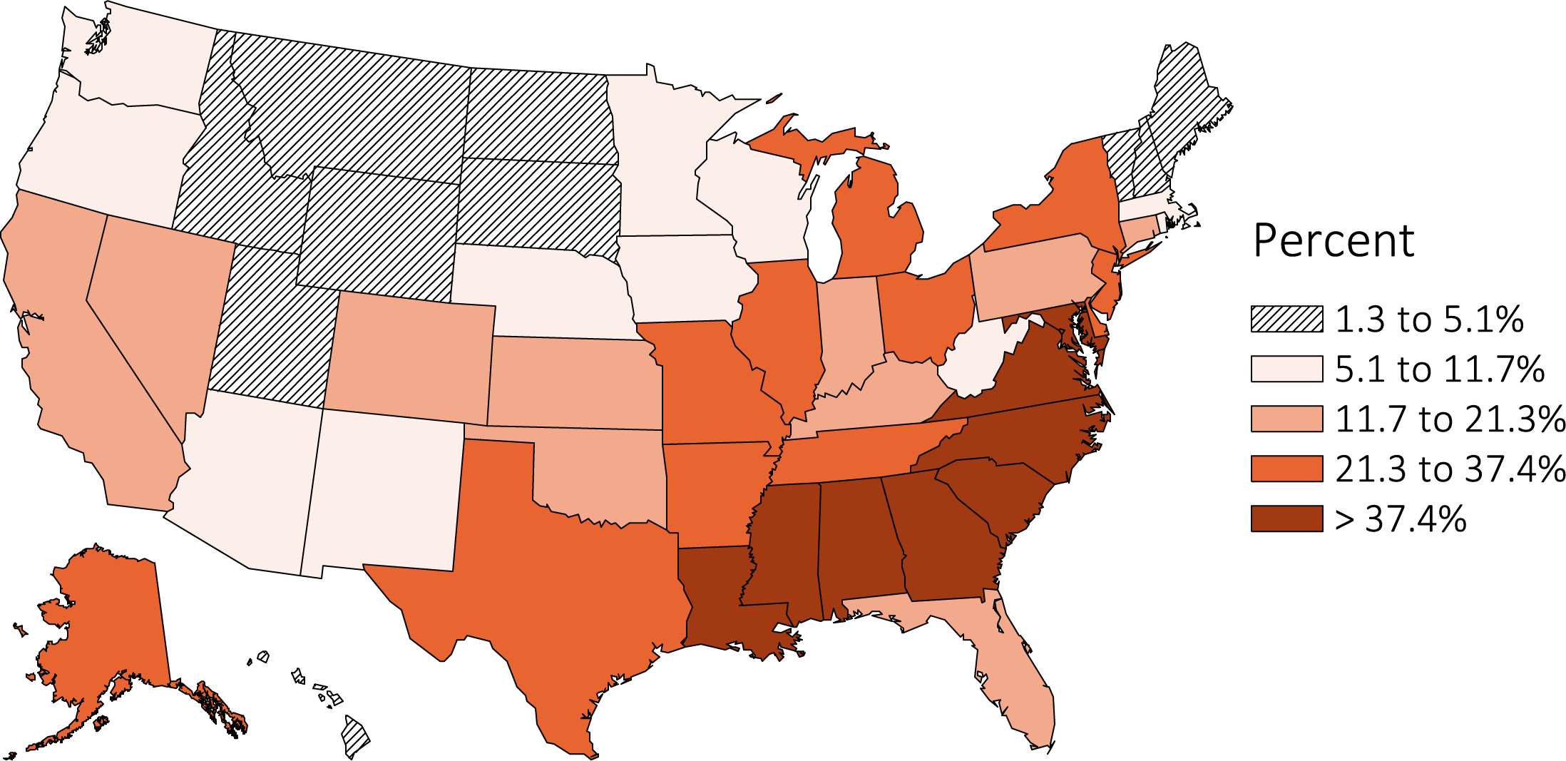
vol 1 Figure 8.1. Distribution of diabetes (%) as the cause of ESRD among 102,477 incident ESRD Veterans across states and territories of the United States, 10/1/2007-3/31/2015
States and territories of the United States of America

Slide 8
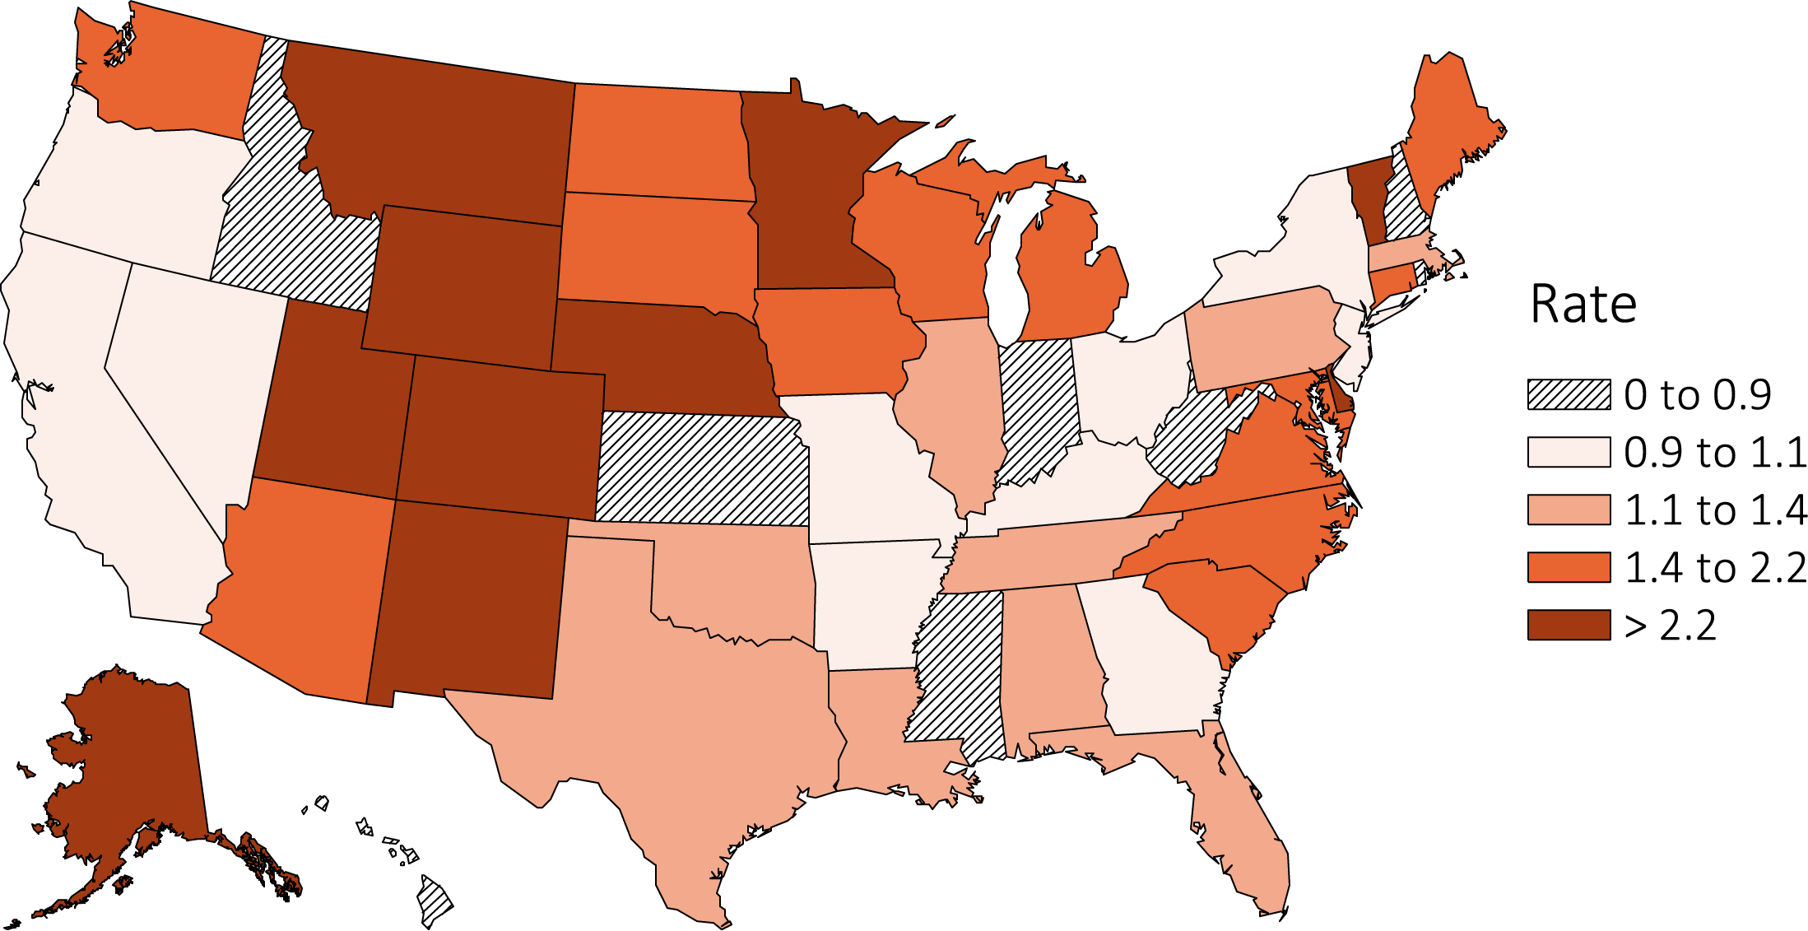
vol 1 Figure 8.2. Distribution of preemptive kidney transplant rates among 102,477 incident ESRD Veterans across states and territories of the United States, 10/1/2007-3/31/2015
States and territories of the United States of America

Slide 9
vol 1 Table 8.2 Baseline characteristics of 102,477 incident ESRD Veterans who transitioned to ESRD between 10/1/2007 and 3/31/2015 according to incidence year at transition to ESRD
 | Incidence Year
 | Total | 2007 | 2008 | 2009 | 2010 | 2011 | 2012 | 2013 | 2014 | 2015
N | 102477 | 3575 | 14247 | 14498 | 14080 | 13326 | 13495 | 13122 | 12797 | 3337
Age (years) | 70.2±12.0 | 69.7±12.1 | 70.1±12.2 | 70.0±12.2 | 70.4±12.1 | 70.3±12.1 | 70.2±11.9 | 70.4±11.7 | 70.1±11.8 | 70.3±11.6
Female (%) | 7 | 6 | 6 | 7 | 6 | 7 | 7 | 7 | 7 | 8
Race (%)
White | 71 | 73 | 72 | 71 | 72 | 71 | 71 | 69 | 69 | 68
Black/African American | 25 | 24 | 24 | 25 | 24 | 25 | 25 | 26 | 27 | 27
American Indian or Alaska Native | 0.87 | 0.73 | 0.90 | 0.90 | 0.82 | 0.83 | 0.92 | 0.85 | 0.95 | 0.81
Asian | 1.09 | 1.17 | 1.12 | 1.10 | 0.90 | 0.98 | 1.11 | 1.19 | 1.16 | 1.41
Native Hawaiian or Pacific Islander | 0.07 | 0.03 | 0.05 | 0.08 | 0.08 | 0.06 | 0.05 | 0.09 | 0.07 | 0.21
Other or Multiracial | 2.06 | 1.90 | 2.16 | 1.65 | 1.81 | 2.11 | 2.19 | 2.58 | 2.09 | 1.71
Unknown | 0.02 | 0 | 0.02 | 0.02 | 0.02 | 0.02 | 0.05 | 0 | 0.01 | 0
Ethnicity (%)
Hispanic | 6 | 7 | 6 | 6 | 7 | 7 | 7 | 6 | 7 | 6
Non-Hispanic | 3 | 3 | 4 | 3 | 3 | 3 | 4 | 4 | 4 | 4
Unknown | 0.02 | 0 | 0.01 | 0.03 | 0.01 | 0 | 0.04 | 0.01 | 0.01 | 0
Non-Hispanic White | 65 | 67 | 66 | 66 | 66 | 65 | 65 | 64 | 63 | 63
Non-Hispanic Black/African-American | 25 | 23 | 24 | 25 | 24 | 25 | 25 | 26 | 27 | 27
Marital Status (%)
Single | 8 | 7 | 7 | 8 | 7 | 8 | 8 | 8 | 9 | 8
Married | 61 | 63 | 62 | 62 | 62 | 61 | 62 | 61 | 60 | 60
Divorced | 21 | 19 | 19 | 20 | 20 | 21 | 21 | 22 | 22 | 23
Widowed | 10 | 11 | 12 | 11 | 11 | 10 | 10 | 9 | 8 | 9
Charlson comorbidity index | 5 (3,7) | 5 (3,7) | 5 (3,7) | 5 (3,7) | 5 (3,7) | 5 (3,7) | 5 (3,7) | 5 (3,7) | 5 (3,7) | 5 (3,7)

Slide 10
vol 1 Table 8.2 Baseline characteristics of 102,477 incident ESRD Veterans who transitioned to ESRD between 10/1/2007 and 3/31/2015 according to incidence year at transition to ESRD
 | Incidence Year
 | Total | 2007 | 2008 | 2009 | 2010 | 2011 | 2012 | 2013 | 2014 | 2015
Comorbidity (%)
Myocardial infarction | 33 | 32 | 33 | 34 | 34 | 33 | 34 | 34 | 32 | 30
Congestive heart failure | 64 | 63 | 64 | 64 | 65 | 64 | 64 | 65 | 63 | 59
Peripheral vascular disease | 53 | 53 | 53 | 53 | 54 | 53 | 53 | 53 | 52 | 51
Dementia | 6 | 6 | 6 | 6 | 6 | 6 | 6 | 6 | 5 | 4
Cerebrovascular disease | 45 | 43 | 45 | 46 | 47 | 46 | 45 | 46 | 44 | 43
Chronic obstructive pulmonary disease | 55 | 51 | 53 | 54 | 55 | 55 | 56 | 56 | 55 | 54
Connective tissue/Rheumatic disease | 9 | 8 | 8 | 9 | 9 | 9 | 9 | 9 | 9 | 9
Peptic ulcer disease | 12 | 10 | 12 | 12 | 12 | 12 | 11 | 12 | 12 | 10
Mild liver disease | 16 | 14 | 14 | 15 | 16 | 16 | 17 | 17 | 18 | 18
Moderate/Severe liver disease | 4 | 3 | 3 | 3 | 4 | 4 | 3 | 4 | 4 | 5
Diabetes without complications | 19 | 20 | 20 | 19 | 19 | 18 | 18 | 18 | 18 | 19
Diabetes with complications | 53 | 51 | 50 | 52 | 53 | 53 | 54 | 55 | 56 | 55
Cancer | 27 | 26 | 26 | 27 | 28 | 27 | 26 | 27 | 27 | 28
Metastatic cancer | 6 | 5 | 6 | 5 | 6 | 6 | 6 | 6 | 5 | 6
Hemiplegia | 6 | 6 | 6 | 6 | 6 | 6 | 6 | 6 | 6 | 7
HIV/AIDS | 1.0 | 0.8 | 1.1 | 1.0 | 0.9 | 1.1 | 1.0 | 1.0 | 1.2 | 1.1
Anemia | 80 | 77 | 79 | 80 | 81 | 80 | 80 | 81 | 82 | 78
Atrial fibrillation | 27 | 25 | 27 | 27 | 28 | 27 | 27 | 27 | 27 | 26
Depression | 29 | 24 | 25 | 27 | 28 | 29 | 31 | 31 | 33 | 33
Hyperlipidemia | 83 | 80 | 80 | 82 | 83 | 84 | 84 | 85 | 85 | 84
Ischemic heart disease | 67 | 67 | 67 | 68 | 68 | 67 | 66 | 67 | 65 | 62
Post-traumatic stress disorder | 7 | 4 | 5 | 6 | 7 | 7 | 8 | 9 | 10 | 10
Initial dialysis modality (%)
Hemodialysis | 81 | 83 | 82 | 83 | 81 | 81 | 80 | 80 | 80 | 80
Home hemodialysis | 0.51 | 0.53 | 0.51 | 0.37 | 0.46 | 0.50 | 0.64 | 0.52 | 0.57 | 0.72
Peritoneal dialysis | 6 | 5 | 5 | 5 | 6 | 6 | 7 | 7 | 7 | 7

Slide 11
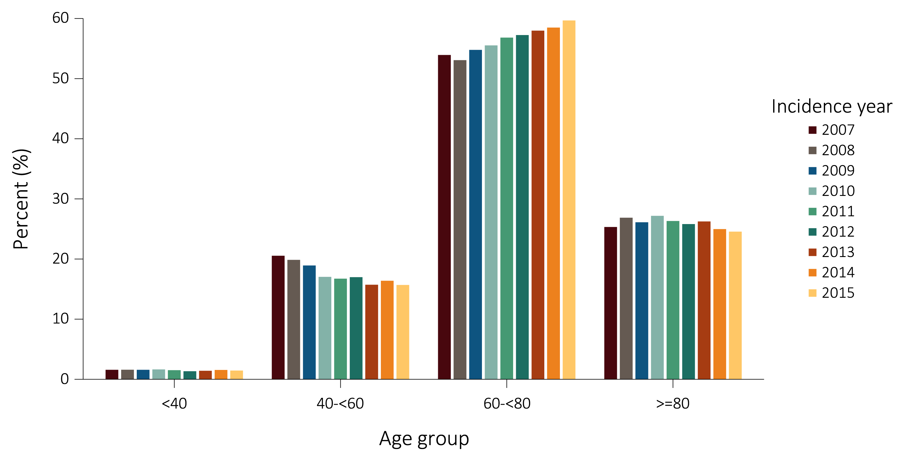
vol 1 Figure 8.3. Secular trends in age stratified by incidence year in 102,477 Veterans who transitioned to ESRD during
10/1/2007-3/31/2015
The drop in the prevalence of incident peritoneal dialysis patients in 2015 may have been influenced by the possibility of seasonal variation. Data for 2015 represent only the winter season, which includes months January to March.

Slide 12
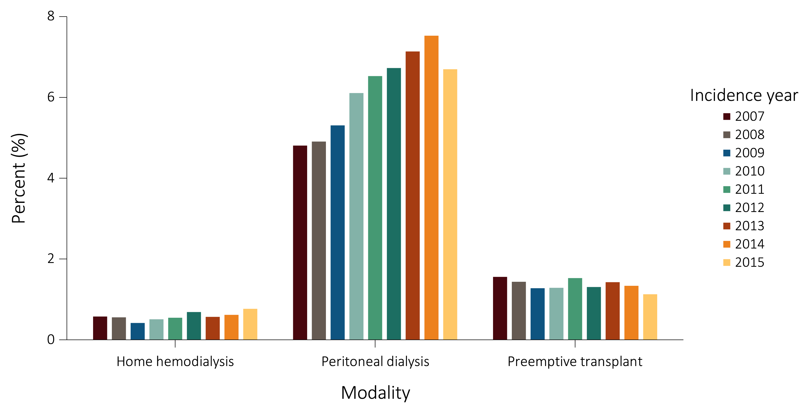
vol 1 Figure 8.4. Secular trends in modality on the first day of transition to ESRD, stratified by incidence year in 102,477 Veterans who transitioned to ESRD during 10/1/2007-3/31/2015
The drop in the prevalence of incident peritoneal dialysis patients in 2015 may have been influenced by the possibility of seasonal variation. Data for 2015 represent only the winter season, which includes months January to March.

Slide 13
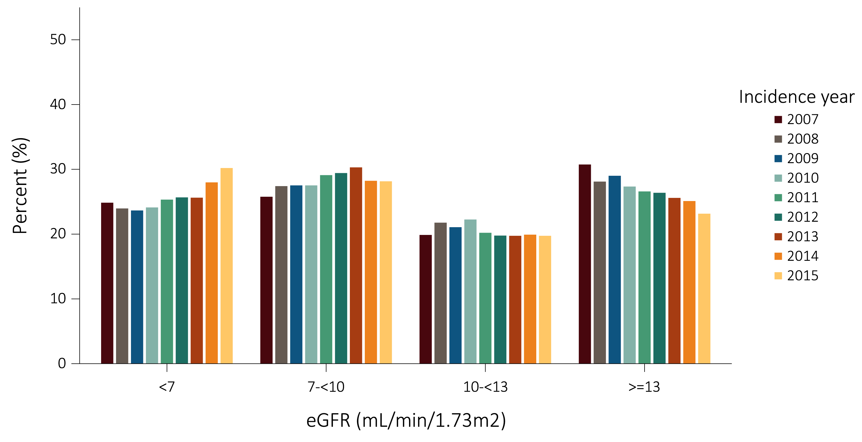
vol 1 Figure 8.5 Secular trends in eGFR in the last 31 days of the prelude (pre-ESRD) time stratified by incidence year in 25,035 Veterans who transitioned to ESRD during 10/1/2007-3/31/2015
(a) All Veterans

Slide 14
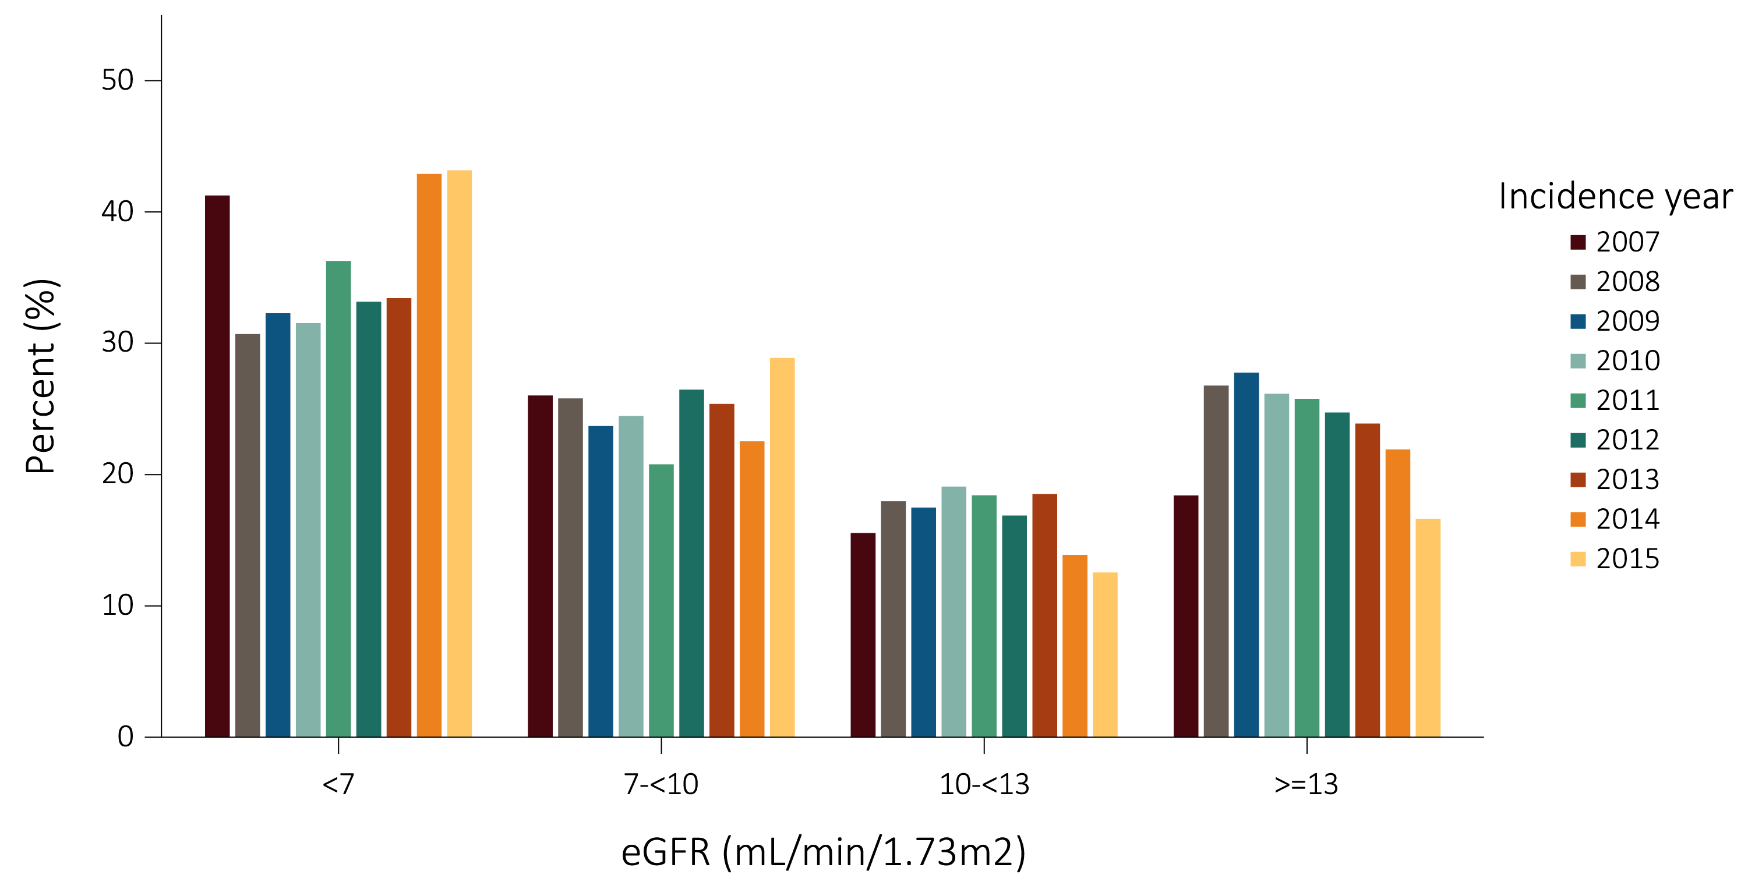
vol 1 Figure 8.5 Secular trends in eGFR in the last 31 days of the prelude (pre-ESRD) time stratified by incidence year in 25,035 Veterans who transitioned to ESRD during 10/1/2007-3/31/2015
(b) Veterans hospitalized by AKI at time of transition

Slide 15
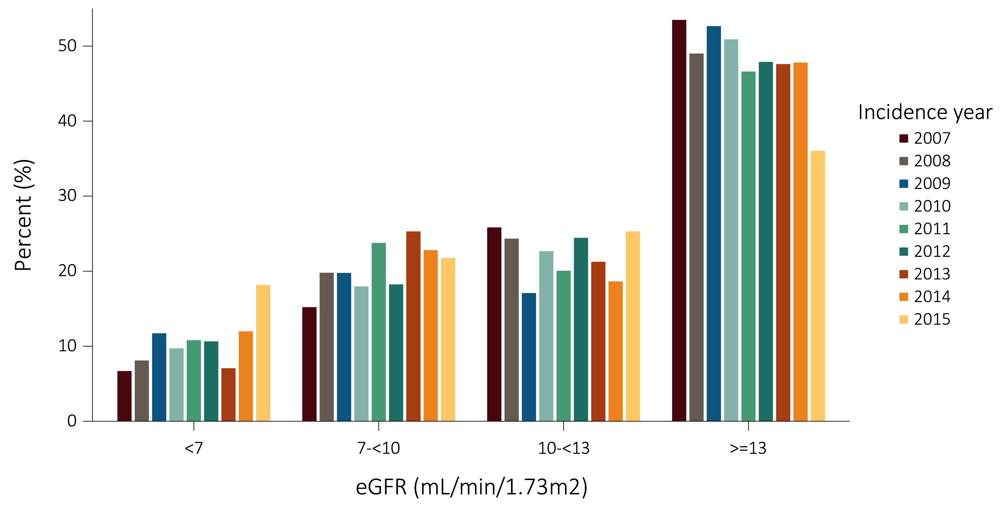
vol 1 Figure 8.5 Secular trends in eGFR in the last 31 days of the prelude (pre-ESRD) time stratified by incidence year in 25,035 Veterans who transitioned to ESRD during 10/1/2007-3/31/2015
(c) Veterans hospitalized by CHF at time of transition

Slide 16
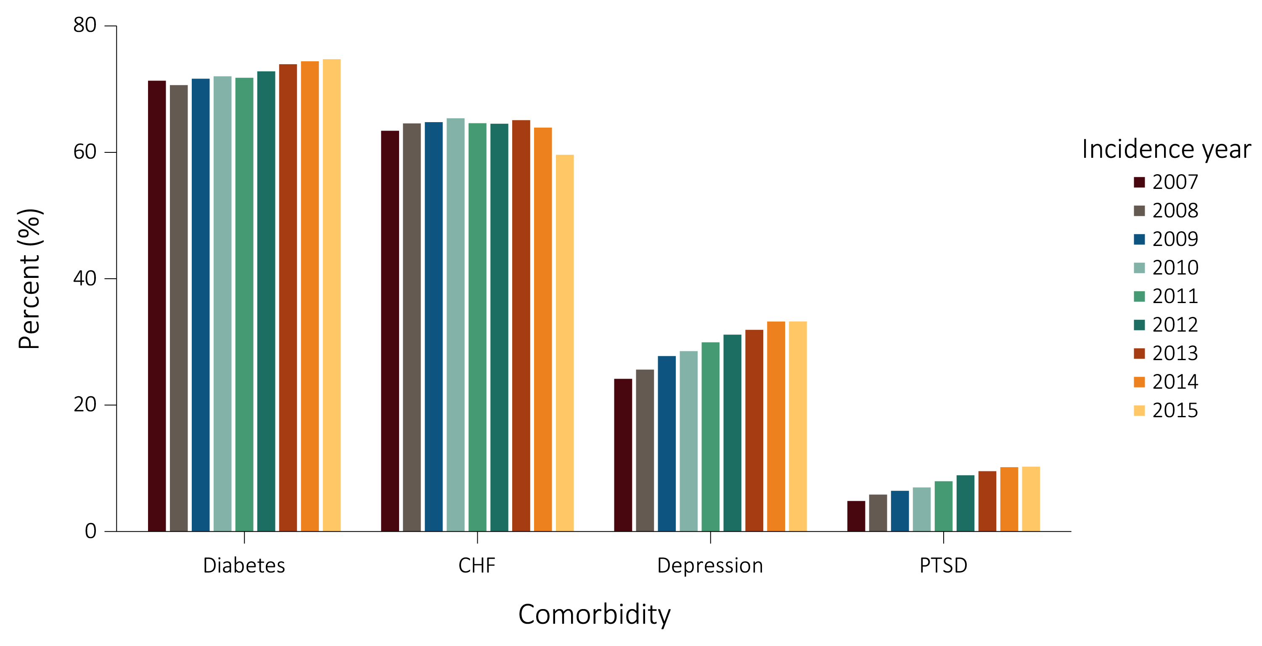
vol 1 Figure 8.6. Secular trends in comorbidities during the prelude (pre-ESRD) time stratified by calendar year in 90,676 who transitioned to ESRD during 10/1/2007-3/31/2015
Abbreviations: CHF, Congestive Heart Failure; and PTSD, Post-Traumatic Stress Disorder

Slide 17
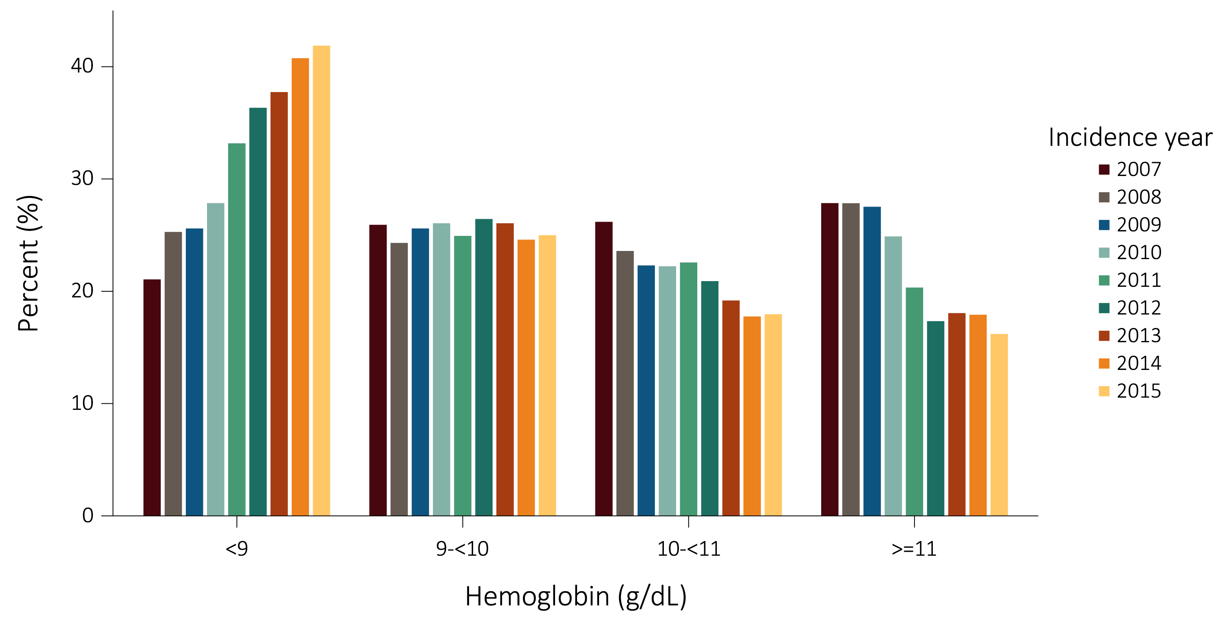
vol 1 Figure 8.7. Secular trends in hemoglobin in the last 31 days of the prelude (pre-ESRD) time stratified by incidence year in 23,333 Veterans who transitioned to ESRD during 10/1/2007-3/31/2015

Slide 18
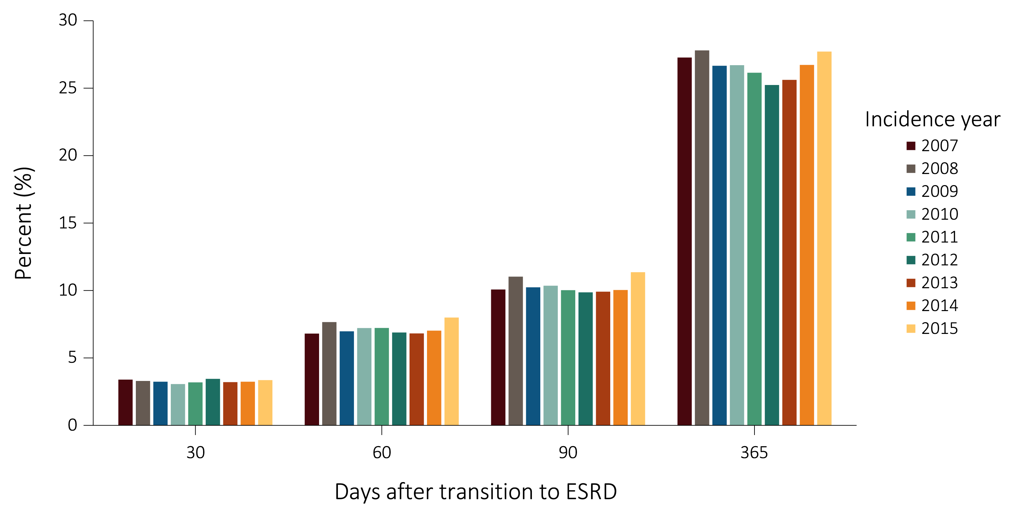
vol 1 Figure 8.8. Secular trends in mortality according to days after transition to ESRD stratified by incidence year in 102,477 Veterans who transitioned to ESRD during 10/1/2007-3/31/2015

Slide 19
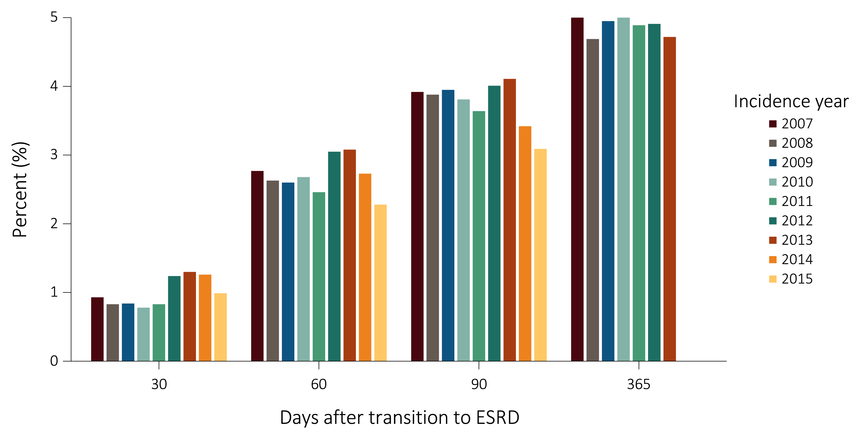
vol 1 Figure 8.9. Secular trends in “recovered-kidney-function” according to days after transition to ESRD stratified by incidence year in 102,477 Veterans who transitioned to ESRD during 10/1/2007-3/31/2015

Slide 20
vol 1 Table 8.3 Status of 102,477 incident ESRD Veterans on Day 1, Day 30, Day 60, and Day 90 after transition to ESRD, 10/1/2007-3/31/2015
 | Day 1 |  | Day 30 |  |  | Day 60 |  | Day 90
Modality | Frequency | % |  | Frequency | % | Frequency | % | Frequency | %
Hemodialysis | 82,985 | 81.0 |  | 82,994 | 81.0 | 82,835 | 80.8 | 78,299 | 76.4
Home Hemodialysis | 527 | 0.5 |  | 527 | 0.5 | 526 | 0.5 | 591 | 0.6
Peritoneal Dialysis | 6,353 | 6.2 |  | 6,354 | 6.2 | 6,352 | 6.2 | 6,793 | 6.6
Uncertain Dialysis* | 11,257 | 11.0 |  | 6,653 | 6.5 | 805 | 0.8 | 454 | 0.4
Transplant | 1,355 | 1.3 |  | 1,405 | 1.4 | 1,474 | 1.4 | 1,542 | 1.5
Discontinued Dialysis |  |  |  | 367 | 0.4 | 512 | 0.5 | 494 | 0.5
Death |  |  |  | 3,148 | 3.1 | 7,135 | 7.0 | 10,324 | 10.1
Lost to Follow-up |  |  |  | 34 | 0.03 | 73 | 0.1 | 103 | 0.1
Recovered Function |  |  |  | 995 | 1.0 | 2,765 | 2.7 | 3,877 | 3.8
Total | 102,477 | 100 |  | 102,477 | 100 | 102,477 | 100 | 102,477 | 100
Data source: VHA Administrative data, USRDS ESRD Database, CMS Medicare Inpatient and Outpatient data. *Uncertain groups have no known dialysis modality.

Slide 21
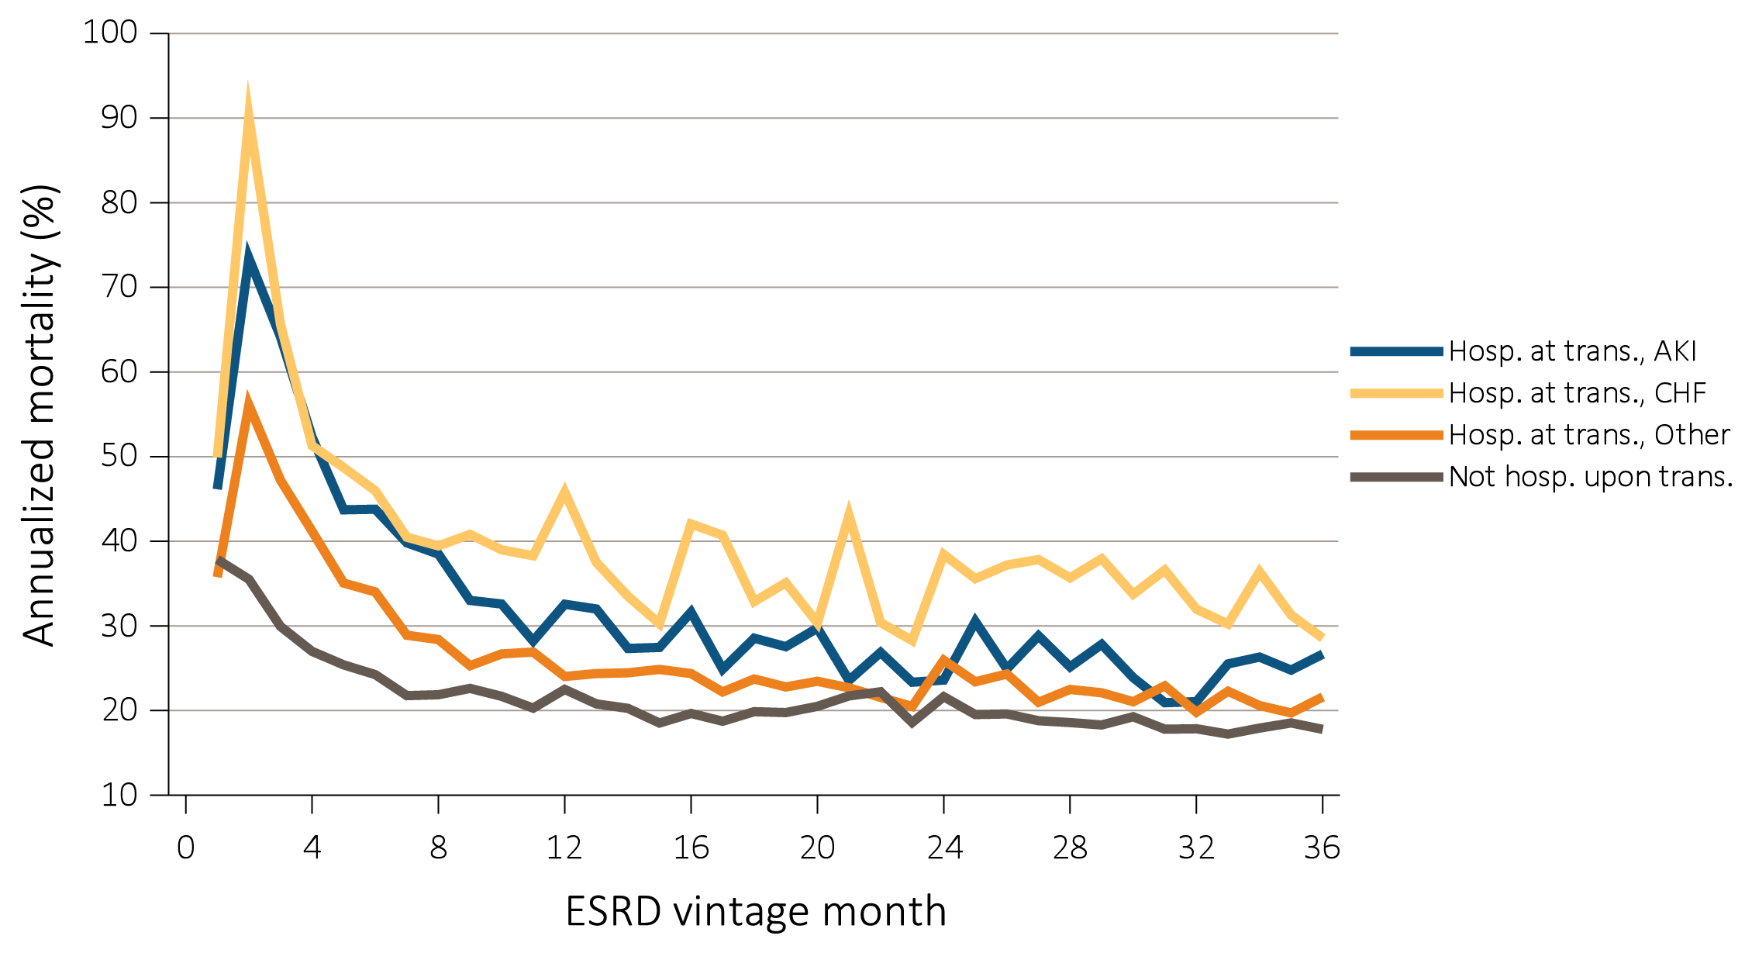
vol 1 Figure 8.10. Annualized unadjusted mortality of incident ESRD Veterans who transitioned to ESRD during 10/1/2007-3/31/2015 and who were followed for up to 36 months, stratified according to cause of hospitalization during transition to ESRD (N=89,527)
*Abbreviations: ESRD, end-stage renal disease; hosp., hospitalization; AKI, acute kidney injury; CHF, congestive heart failure; and trans., transition.

Slide 22
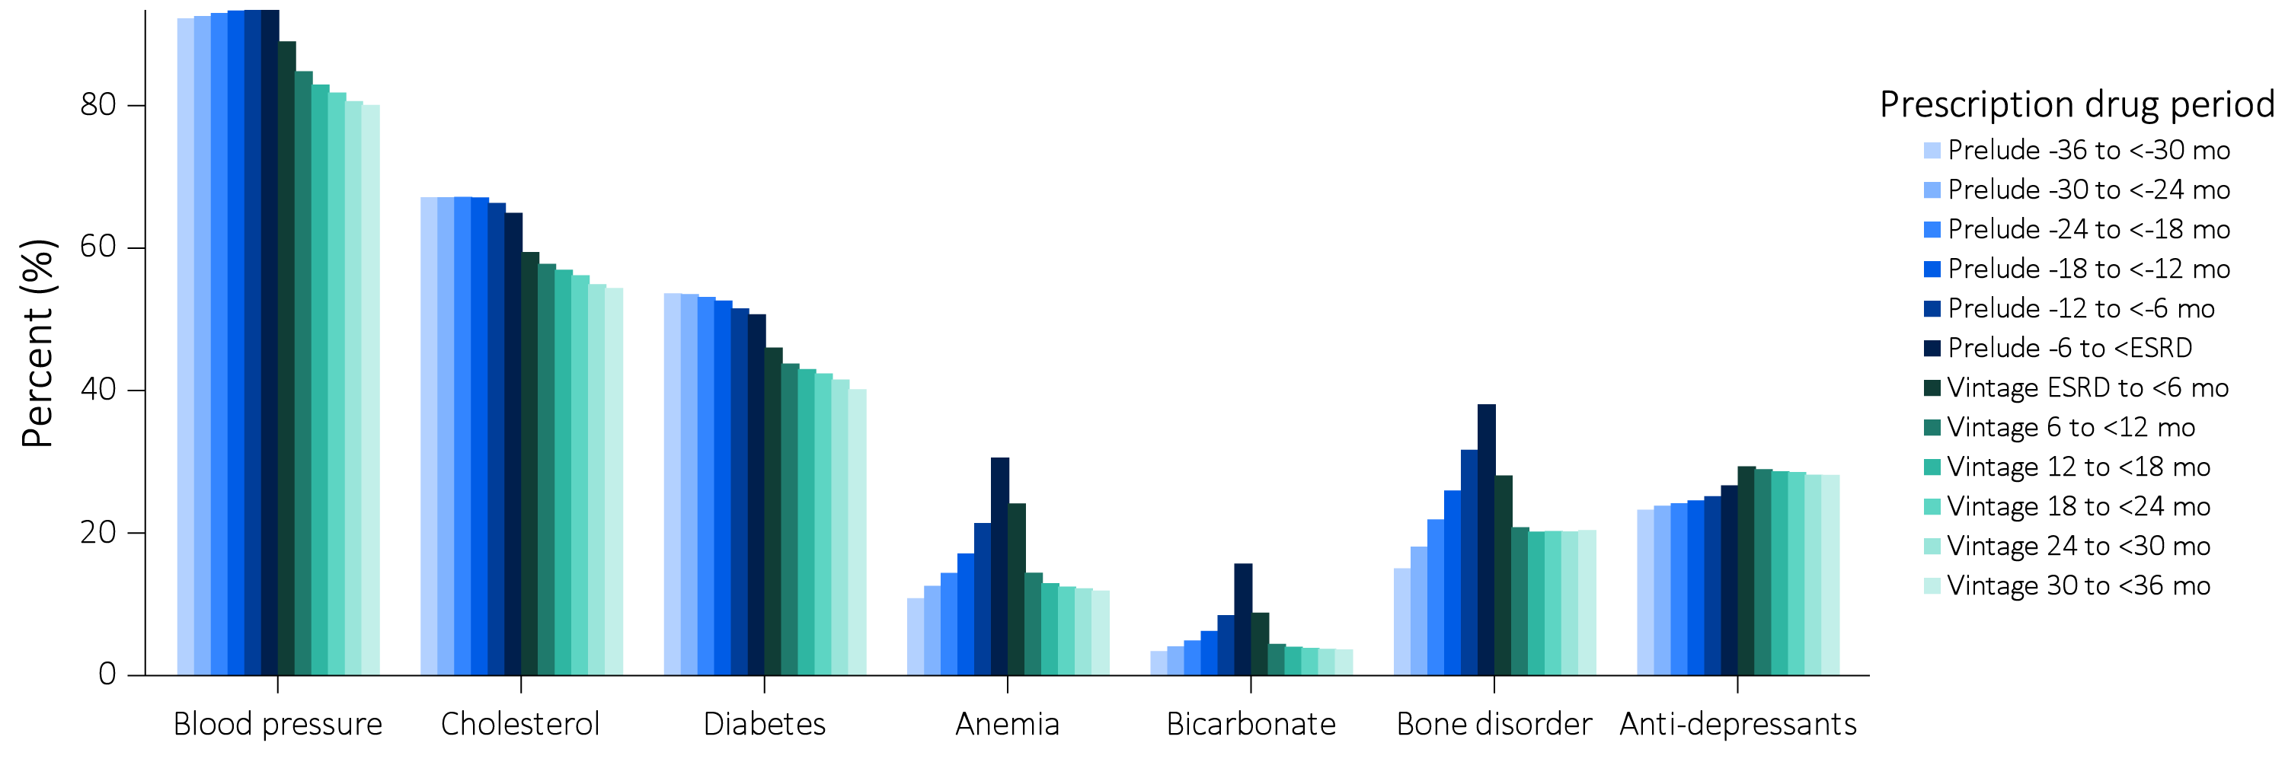
vol 1 Figure 8.11. Prescribed medication to incident ESRD Veterans who transitioned to ESRD during 10/1/2007-3/31/2015, with data up to -36 months prior to transition (prelude) and up to +36 months after transition (vintage) (data were abstracted from 84,004 Veterans)
Abbreviations: ESRD, end-stage renal disease; mo, month.

Slide 23
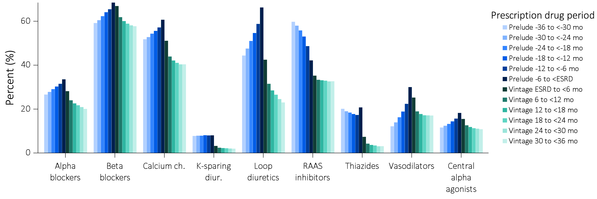
vol 1 Figure 8.12. Granular prescribed medication data for incident ESRD Veterans who transitioned to ESRD during 10/1/2007-3/31/2015, with data up to -36 months prior to transition (prelude) and up to +36 months after transition (vintage) (data were abstracted from 84,004 Veterans)
(a) Prescribed medications 1-9
*Data on EPO, iron and active vitamin D medication use in the vintage period were affected by these medications being administered in commercial HD units, and therefore, were probably not well-captured by either CMS or VA databases. Abbreviations: ESRD, end-stage renal disease; mo, month; Ch, channel; diur, diuretics; Hypoglyc, hypoglycemics; ESA, erythropoietin stimulating agents; and Vit, vitamin.

Slide 24
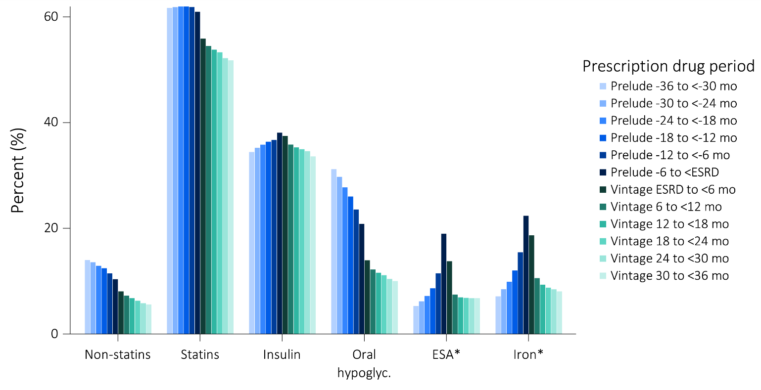
vol 1 Figure 8.12. Granular prescribed medication data for incident ESRD Veterans who transitioned to ESRD during 10/1/2007-3/31/2015, with data up to -36 months prior to transition (prelude) and up to +36 months after transition (vintage) (data were abstracted from 84,004 Veterans)
(b) Prescribed medications 10-15
*Data on EPO, iron and active vitamin D medication use in the vintage period were affected by these medications being administered in commercial HD units, and therefore, were probably not well-captured by either CMS or VA databases. Abbreviations: ESRD, end-stage renal disease; mo, month; Ch, channel; diur, diuretics; Hypoglyc, hypoglycemics; ESA, erythropoietin stimulating agents; and Vit, vitamin.

Slide 25
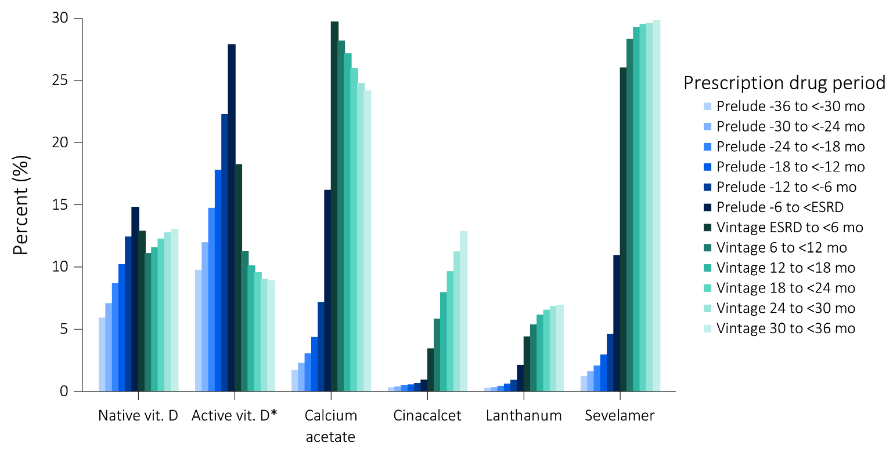
vol 1 Figure 8.12. Granular prescribed medication data for incident ESRD Veterans who transitioned to ESRD during 10/1/2007-3/31/2015, with data up to -36 months prior to transition (prelude) and up to +36 months after transition (vintage) (data were abstracted from 84,004 Veterans)
(c) Prescribed medications 16-21
*Data on EPO, iron and active vitamin D medication use in the vintage period were affected by these medications being administered in commercial HD units, and therefore, were probably not well-captured by either CMS or VA databases. Abbreviations: ESRD, end-stage renal disease; mo, month; Ch, channel; diur, diuretics; Hypoglyc, hypoglycemics; ESA, erythropoietin stimulating agents; and Vit, vitamin.

Slide 26
vol 1 Table 8.4. Hospitalization events in 89,552 incident ESRD Veterans who transitioned to ESRD during 10/1/2007-3/31/2015
Hospitalized Prelude? | Hospitalized at time of ESRD? | Hospitalized after ESRD?
Yes N=77,709 (86%) | Yes* N=48,414 (63%) | Yes N=40,690 (84%)
 |  | No N=7,724 (16%)
 | No N=28,685 (37%) | Yes N=9,111 (32%)
 |  | No N=19,574 (68%)
No N=12,453 (14%) | Yes** N=2,372 (19%) | Yes N=2,372 (100%)
 |  | No N=0 (0%)
 | No N=10,081 (81%) | Yes N=10,081 (100%)
 |  | No N=0 (0%)
Data source: VHA Administrative data, USRDS ESRD Database, CMS Medicare patient and Outpatient data. Data ranging from -60 months prior to transition (prelude) to +24 months after transition (vintage). *Among Veterans who were hospitalized during the transition to ESRD, included were hospitalizations that occurred (1) only during, and (2) both during and before, transition to ESRD. **Veterans who were hospitalized during the transition to ESRD were admitted only on the first day of dialysis treatment. Abbreviations: ESRD, end-stage renal disease.

Slide 27
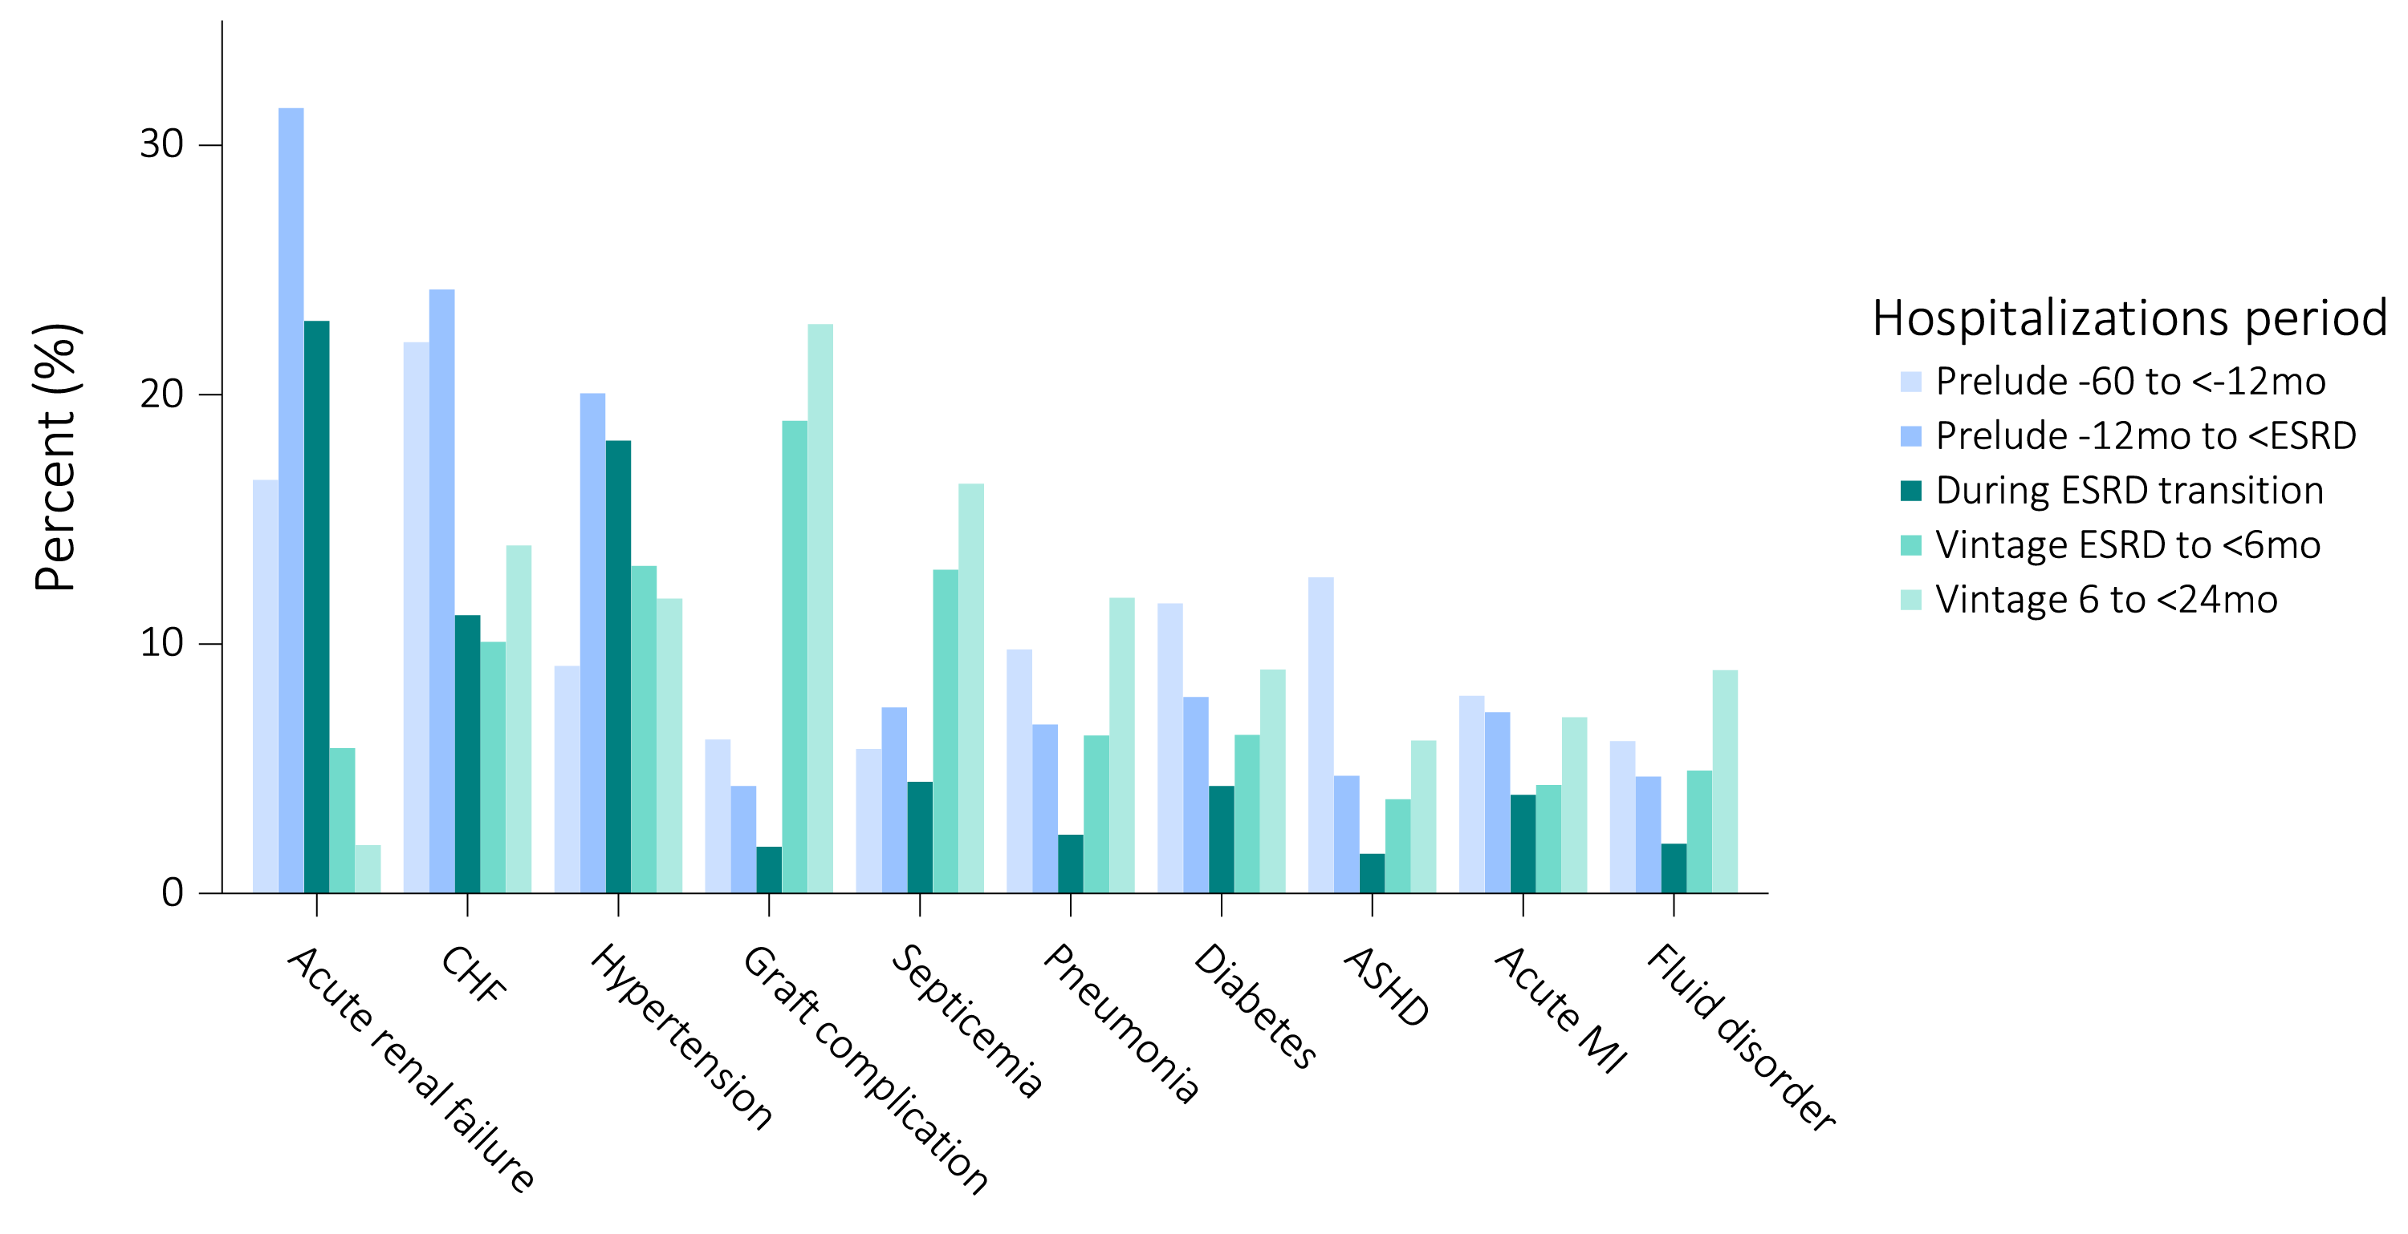
vol 1 Figure 8.13. Top 20 causes of hospitalizations in 89,552 incident ESRD Veterans who were hospitalized at least once during the 60 months prior to ESRD transition (prelude) up to 24 months after ESRD transition (vintage)
(a) Top causes of hospitalizations 1 -10
Abbreviations: ASHD, atherosclerotic heart disease; CHF, congestive heart failure; CKD, chronic kidney disease; CVD, acute cerebrovascular disease; ESRD, end-stage renal disease; GI Hem, gastrointestinal hemorrhage; MI, myocardial infarction; mo, month; Resp Fail, respiratory failure; Skin Inf, skin infection; Rehab, rehabilitation; and surg, surgical.

Slide 28
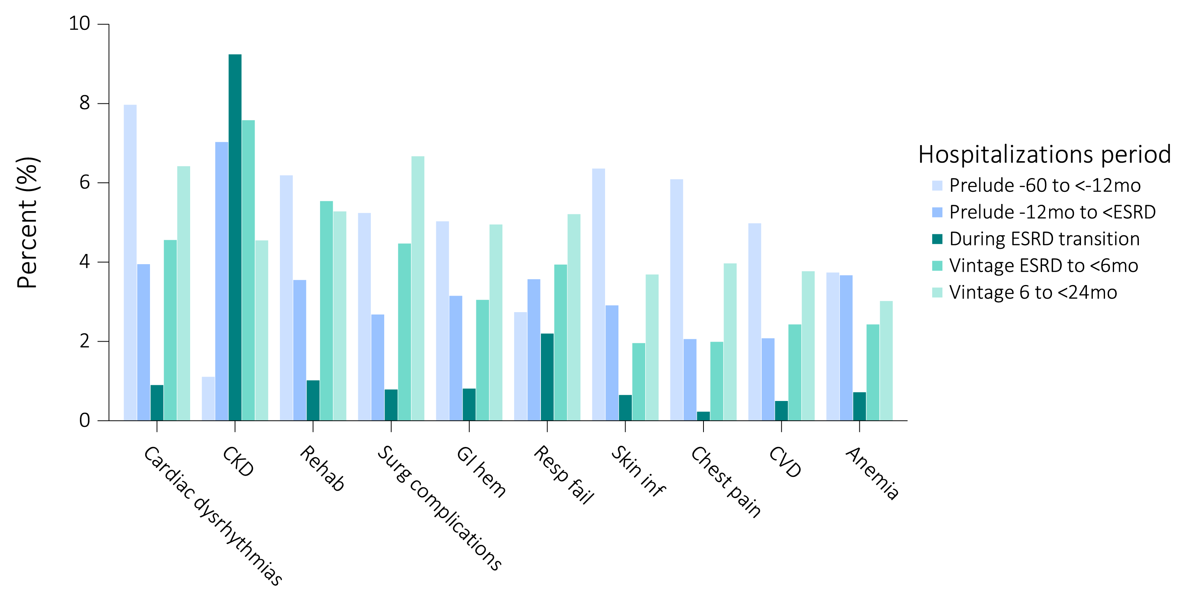
vol 1 Figure 8.13. Top 20 causes of hospitalizations in 89,552 incident ESRD Veterans who were hospitalized at least once during the 60 months prior to ESRD transition (prelude) up to 24 months after ESRD transition (vintage)
(b) Top causes of hospitalizations 11-20
Abbreviations: ASHD, atherosclerotic heart disease; CHF, congestive heart failure; CKD, chronic kidney disease; CVD, acute cerebrovascular disease; ESRD, end-stage renal disease; GI Hem, gastrointestinal hemorrhage; MI, myocardial infarction; mo, month; Resp Fail, respiratory failure; Skin Inf, skin infection; Rehab, rehabilitation; and surg, surgical.

Slide 29
vol 1 Table 8.5. Ranking of the top 20 causes of hospitalization in 89,552 incident ESRD Veterans who were hospitalized at least once during the period of -60 months prior to transition (prelude) to +24 months after transition (vintage)
Cause of hospitalization | Whole cohort | Prelude 60 months to <-12 months | Prelude 12 months to <ESRD | During ESRD Transition | Vintage ESRD to <6 months | Vintage 6 months to <24 months
Acute renal failure | 1 | 2 | 1 | 1 | 8
Congestive heart failure | 2 | 1 | 2 | 3 | 4 | 3
Hypertension | 3 | 6 | 3 | 2 | 2 | 5
Graft complication | 4 | 12 | 11 | 11 | 1 | 1
Septicemia | 5 | 14 | 5 | 5 | 3 | 2
Pneumonia | 6 | 5 | 8 | 8 | 7 | 4
Diabetes | 7 | 4 | 4 | 6 | 6 | 6
Atherosclerotic heart disease | 8 | 3 | 9 | 12 | 15 | 11
Acute myocardial infarction | 9 | 8 | 6 | 7 | 13 | 8
Fluid disorder | 10 | 13 | 10 | 10 | 10 | 7
Cardiac dysrhythmias | 11 | 7 | 12 | 14 | 11 | 10
Chronic kidney disease | 12 |  | 7 | 4 | 5 | 15
Rehabilitation | 13 | 10 | 15 | 13 | 9 | 12
Surgical complications | 14 | 15 | 19 | 16 | 12 | 9
Gastrointestinal hemorrhage | 15 | 16 | 16 | 15 | 16 | 14
Respiratory failure | 16 |  | 14 | 9 | 14 | 13
Skin infection | 17 | 9 | 17 | 18 |  | 18
Chest pain | 18 | 11 |  |  |  | 16
Acute cerebrovascular disease | 19 | 17 |  |  | 19 | 17
Anemia | 20 |  | 13 | 17 | 20
Chronic obstructive pulmonary disease |  | 18 | 18 |  |  | 20
Urinary tract infection |  | 19 | 20 |  | 18
Osteoarthritis |  | 20
Other circulatory disease |  |  |  |  | 17 | 19
Cancer of kidney and renal pelvis |  |  |  | 19
Aortic; peripheral; and visceral artery aneurysms |  |  |  | 20
Data source: VHA Administrative data, USRDS ESRD Database, CMS Medicare Inpatient and Outpatient data.

Slide 30
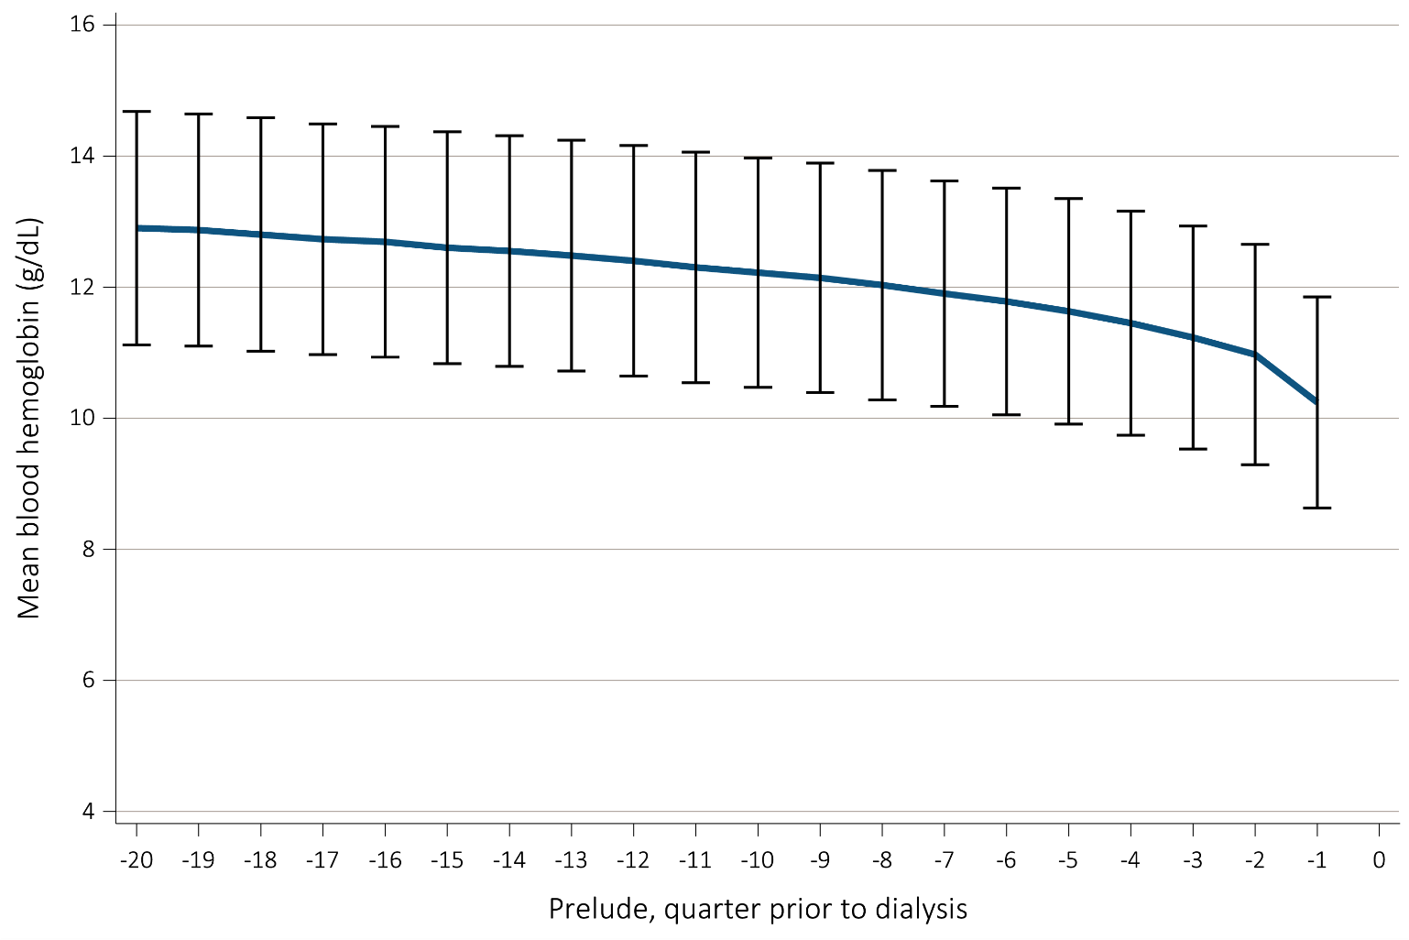
vol 1 Figure 8.14. Trend in blood hemoglobin level during the prelude (pre-ESRD) time over 20 quarters in 55,329 Veterans who later transitioned to ESRD during 10/1/2007-3/31/2015

Slide 31
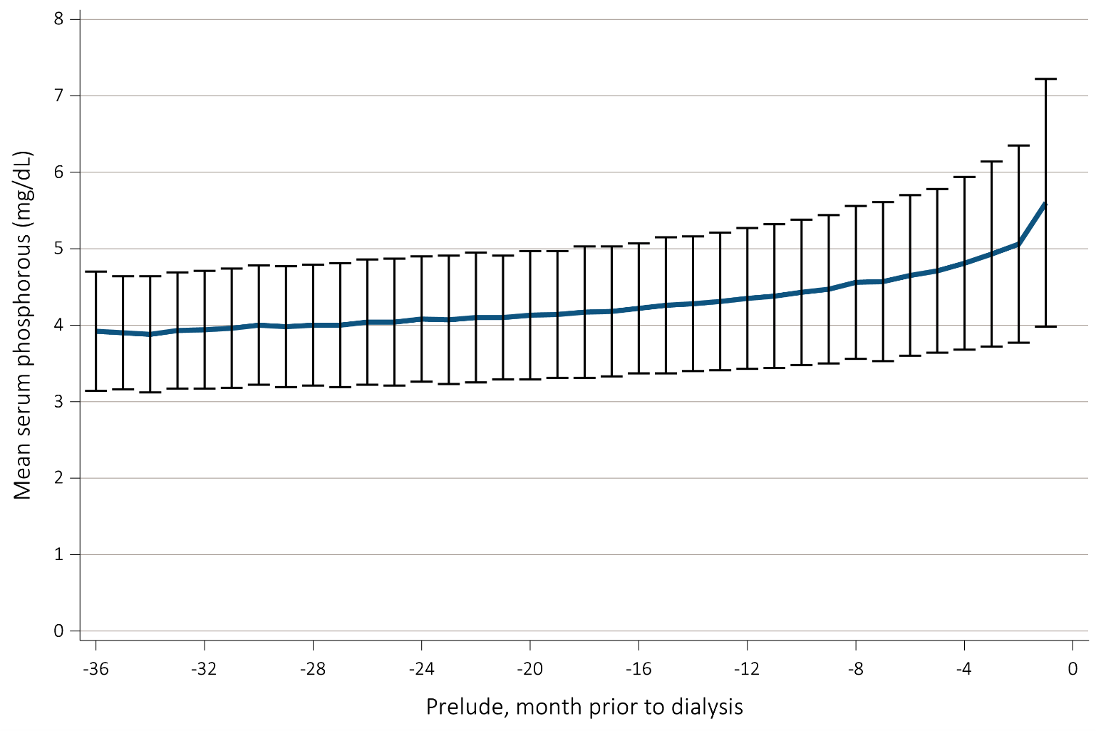
vol 1 Figure 8.15. Trend in serum phosphorus level during the prelude (pre-ESRD) time over 36 months in 29,362 Veterans who transitioned to ESRD during 10/1/2007-3/31/2015

Slide 32
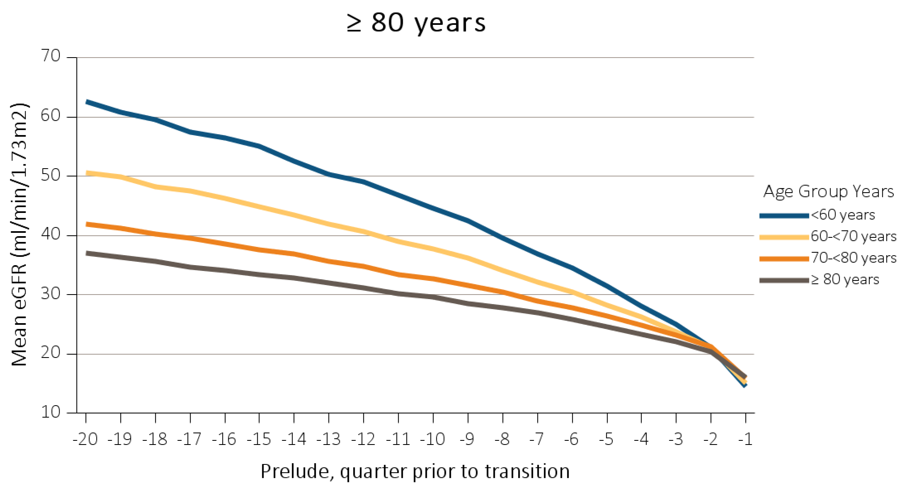
vol 1 Figure 8.16. Trends in eGFR during the prelude (pre-ESRD) time over 20 quarters in 57,615 Veterans who transitioned to ESRD during 10/1/2007-9/31/2015. (a) Stratified by age at incidence. (b) Stratified according to ESRD etiology
(a) Prelude eGFR stratified by age at incidence

Slide 33
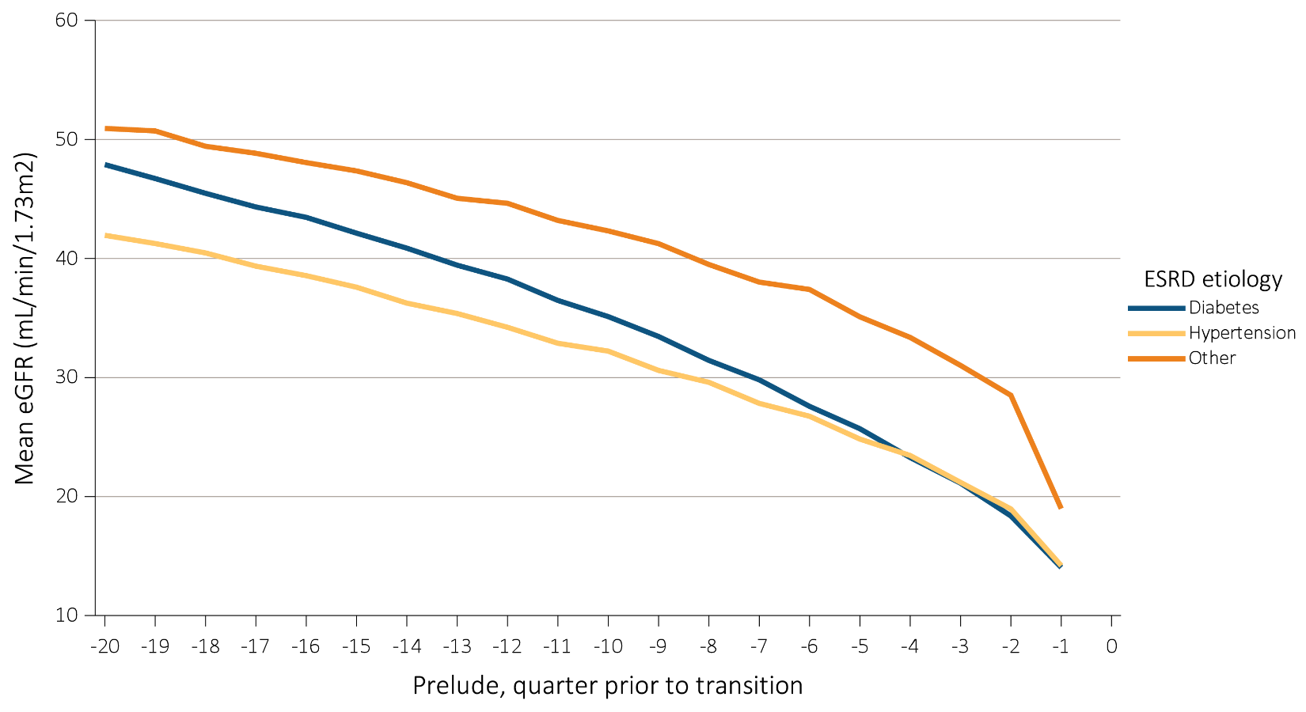
vol 1 Figure 8.16. Trends in eGFR during the prelude (pre-ESRD) time over 20 quarters in 57,615 Veterans who transitioned to ESRD during 10/1/2007-9/31/2015. (a) Stratified by age at incidence. (b) Stratified according to ESRD etiology
(b) Prelude eGFR stratified according to ESRD etiology

Slide 34
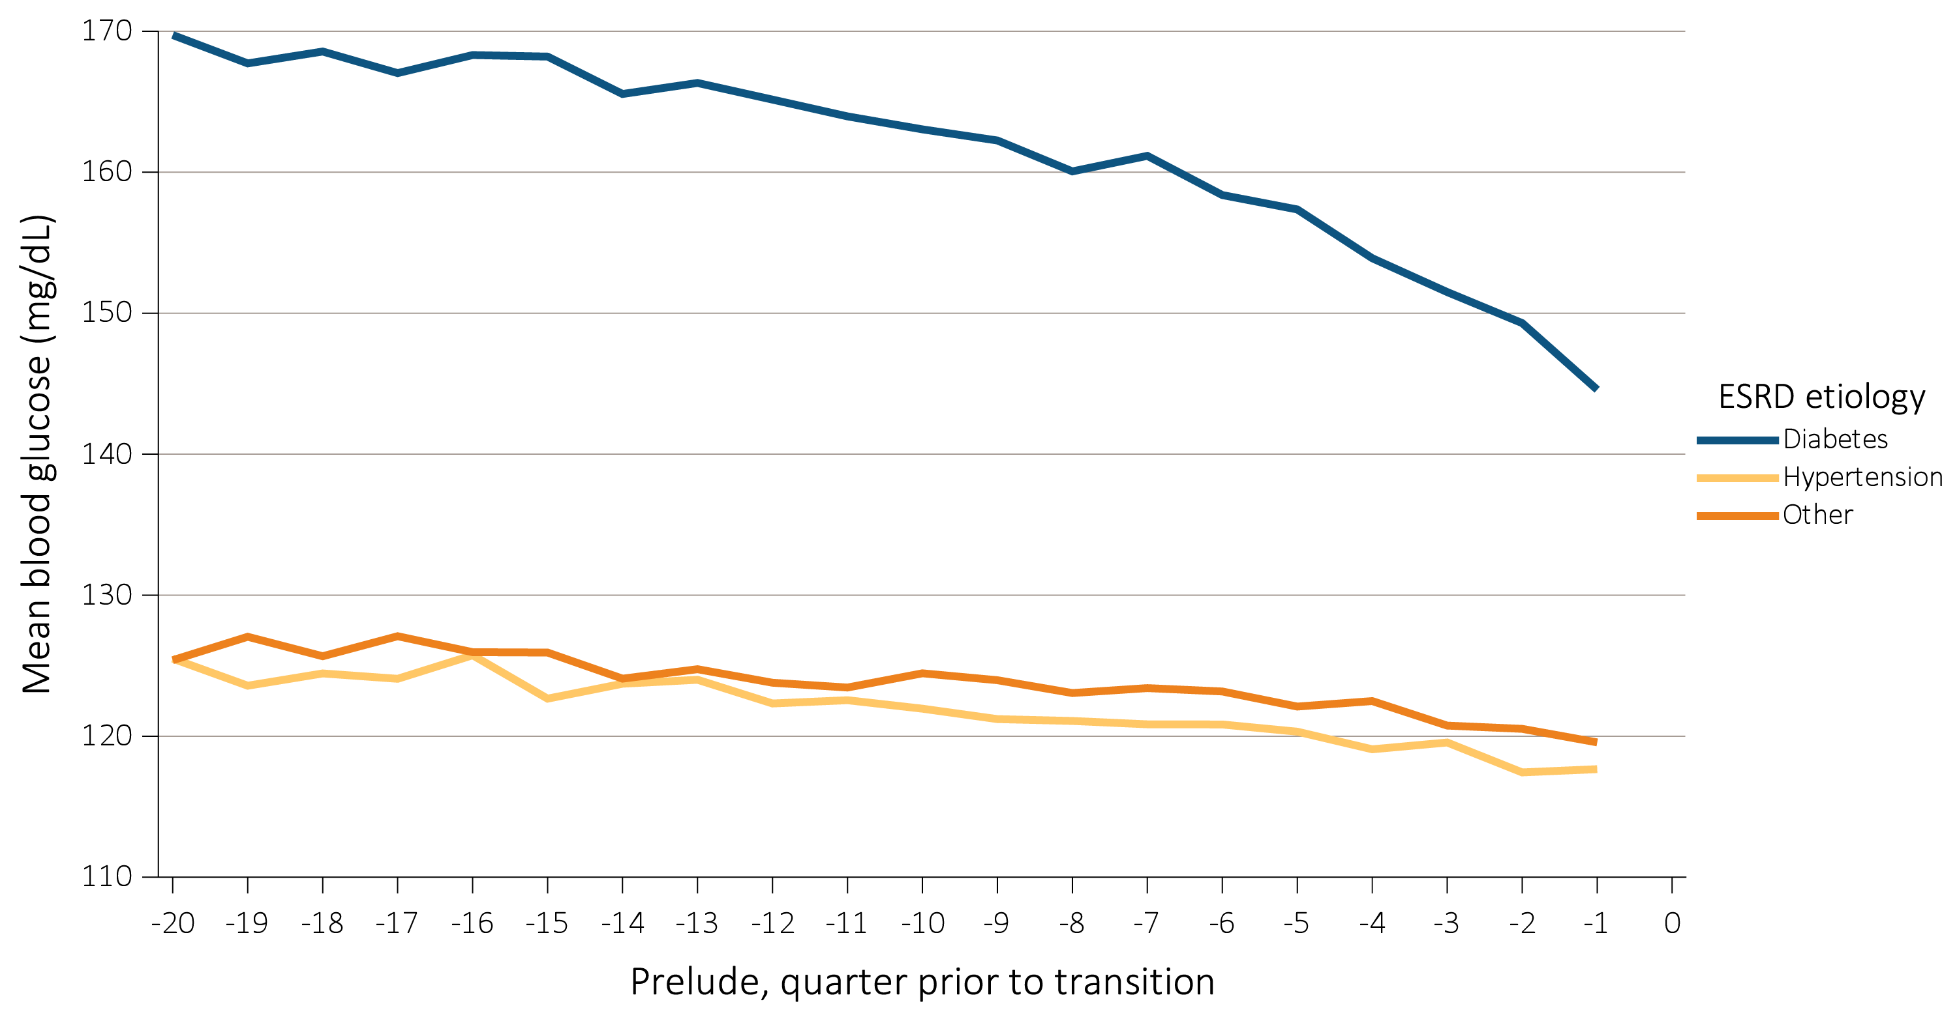
vol 1 Figure 8.17. Trend in blood glucose level during the prelude (pre-ESRD) time over 20 quarters in 57,267 Veterans who transitioned to ESRD during 10/1/2007-3/31/2015

Slide 35
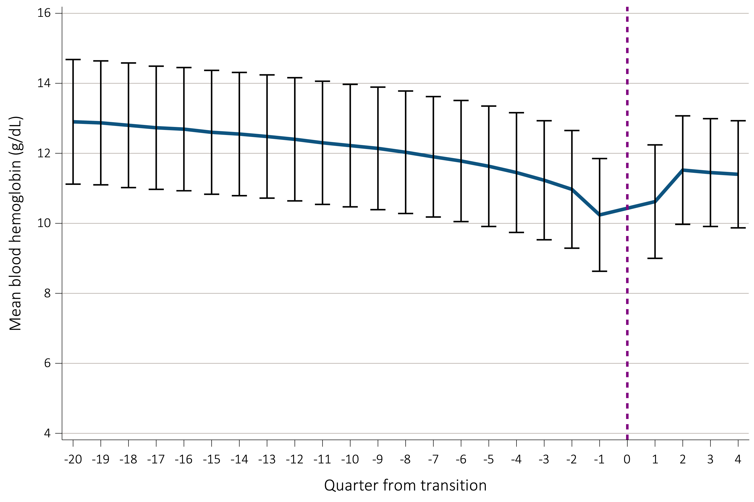
vol 1 Figure 8.18. Pre- and post-ESRD trends in average blood hemoglobin levels in Veterans who transitioned to ESRD during 10/1/2007-3/31/2015 over (a) 20 and 4 quarters (N=58,281), and (b) 8 quarters each (N=54,526)
(a) Blood hemoglobin during transition, -20 to +4 quarters

Slide 36
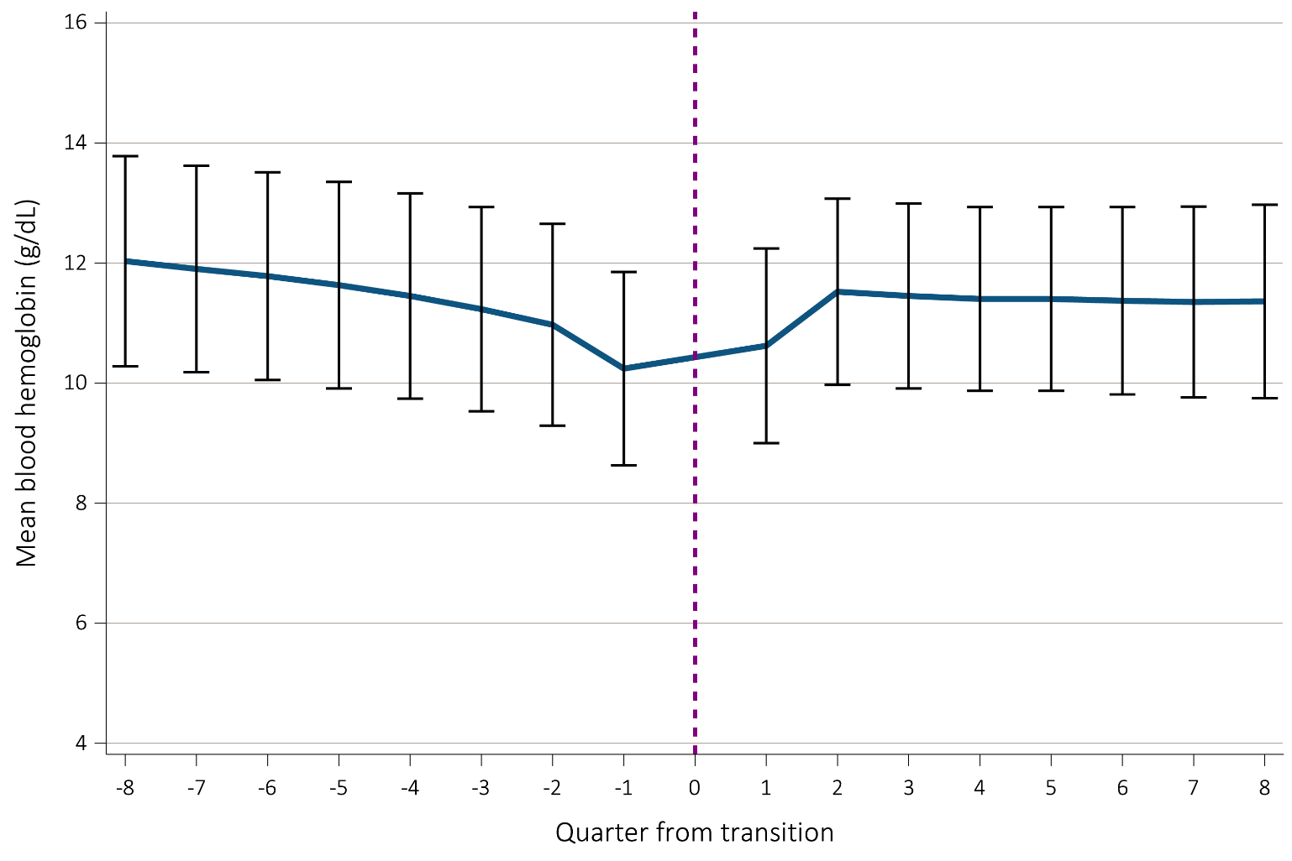
vol 1 Figure 8.18. Pre- and post-ESRD trends in average blood hemoglobin levels in Veterans who transitioned to ESRD during 10/1/2007-3/31/2015 over (a) 20 and 4 quarters (N=58,281), and (b) 8 quarters each (N=54,526)
(b) Blood hemoglobin during transition, -8 to +8 quarters

Slide 37
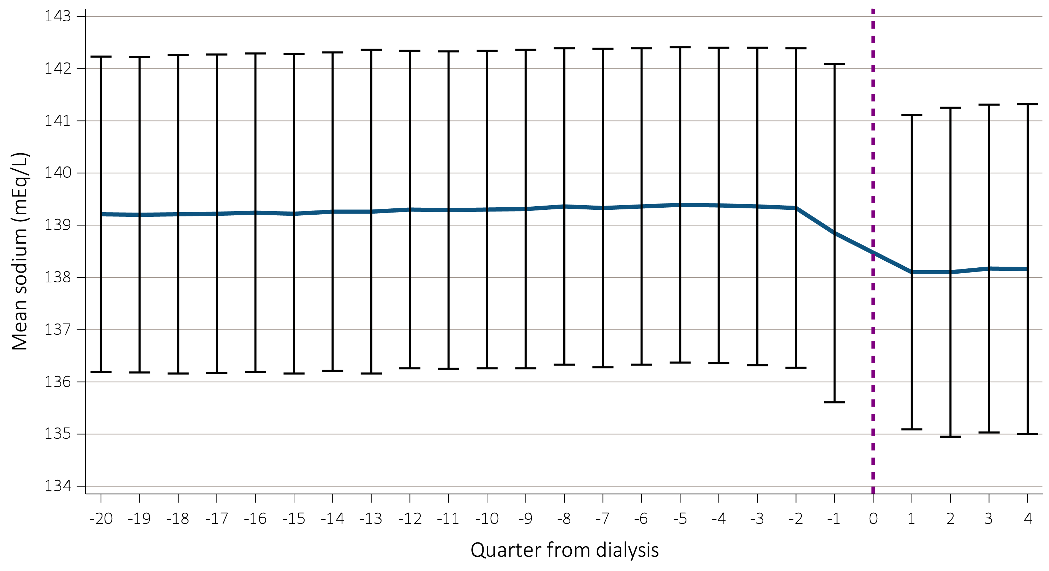
vol 1 Figure 8.19. Pre- and post-ESRD trends in average sodium levels in Veterans who transitioned to ESRD during 10/1/2007-3/31/2015 over (a) 20 and 4 quarters (N=60,372) and (b) 8 quarters each (N=56,729)
(a) Average sodium levels during transition, -20 to +4 quarters

Slide 38
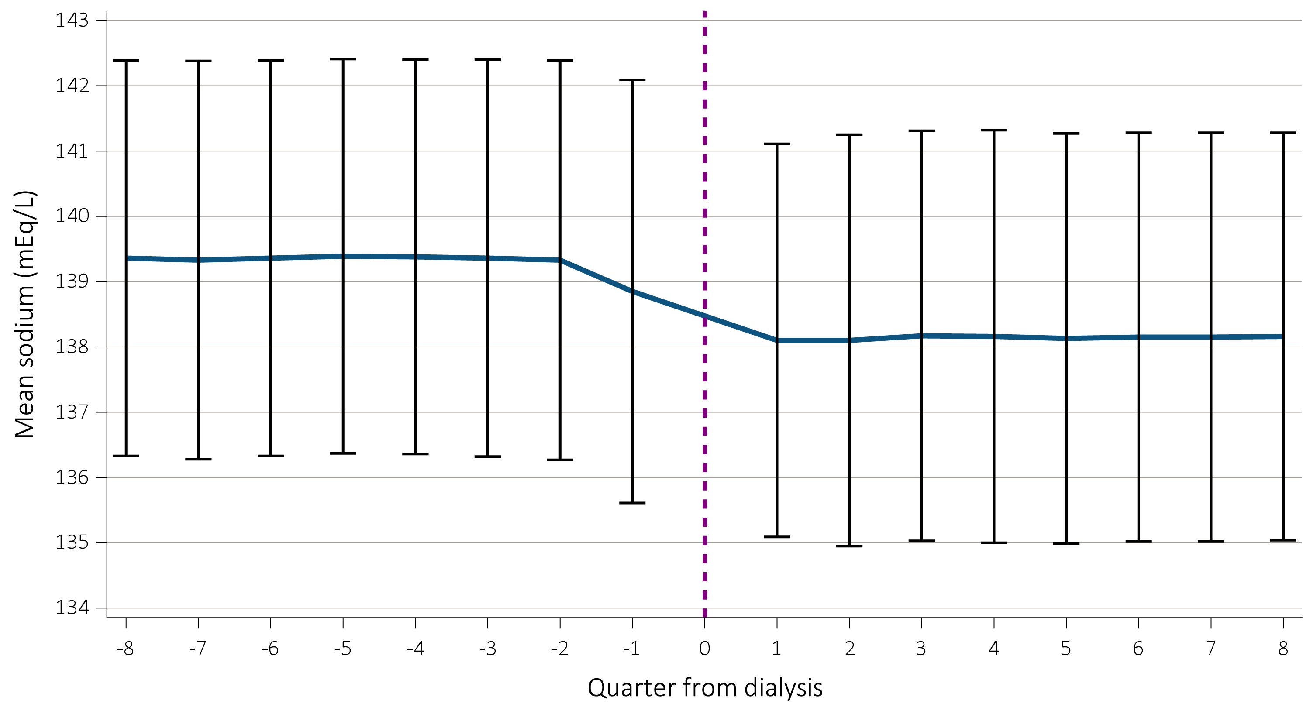
vol 1 Figure 8.19. Pre- and post-ESRD trends in average sodium levels in Veterans who transitioned to ESRD during 10/1/2007-3/31/2015 over (a) 20 and 4 quarters (N=60,372) and (b) 8 quarters each (N=56,729)
(b) Average sodium levels during transition, -8 to +8 quarters

Slide 39
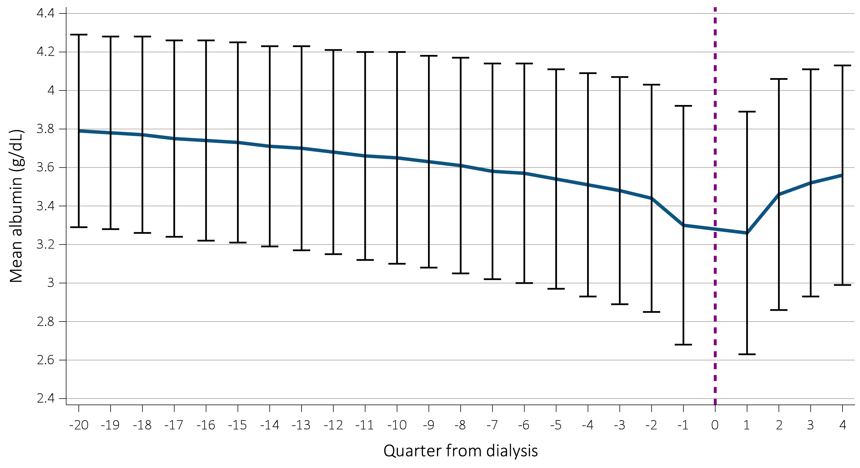
vol 1 Figure 8.20. Pre- and post-ESRD trends in average albumin levels in Veterans who transitioned to ESRD during 10/1/2007-3/31/2015 over (a) 20 and 4 quarters (N=57,277) and (b) 8 quarters each (N=53,634)
(a) Average albumin levels during transition, -20 to +4 quarters

Slide 40
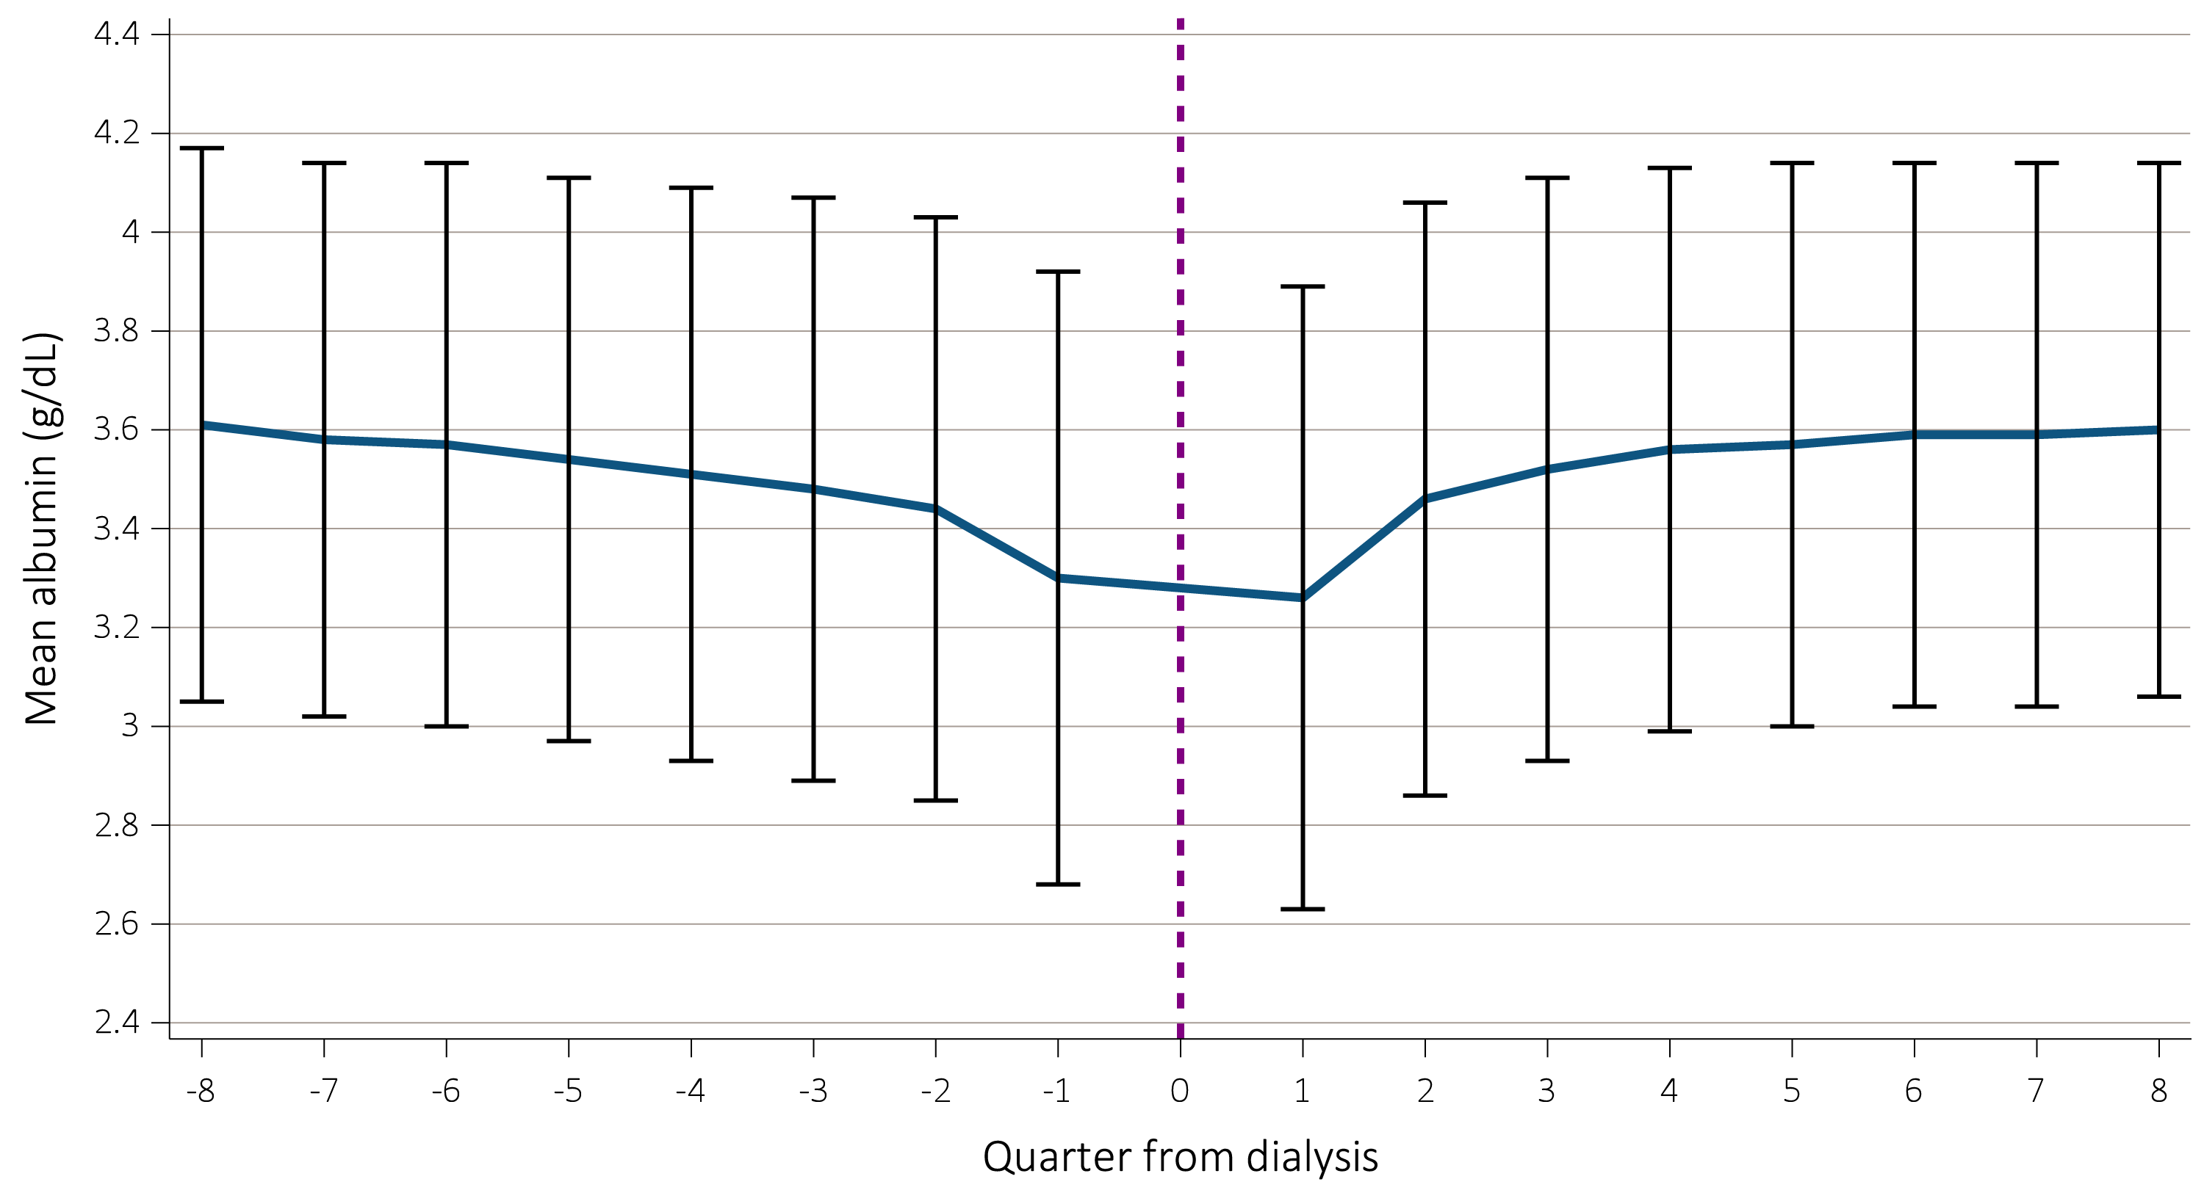
vol 1 Figure 8.20. Pre- and post-ESRD trends in average albumin levels in Veterans who transitioned to ESRD during 10/1/2007-3/31/2015 over (a) 20 and 4 quarters (N=57,277) and (b) 8 quarters each (N=53,634)
(b) Average albumin levels during transition, -8 to +8 quarters

Slide 41
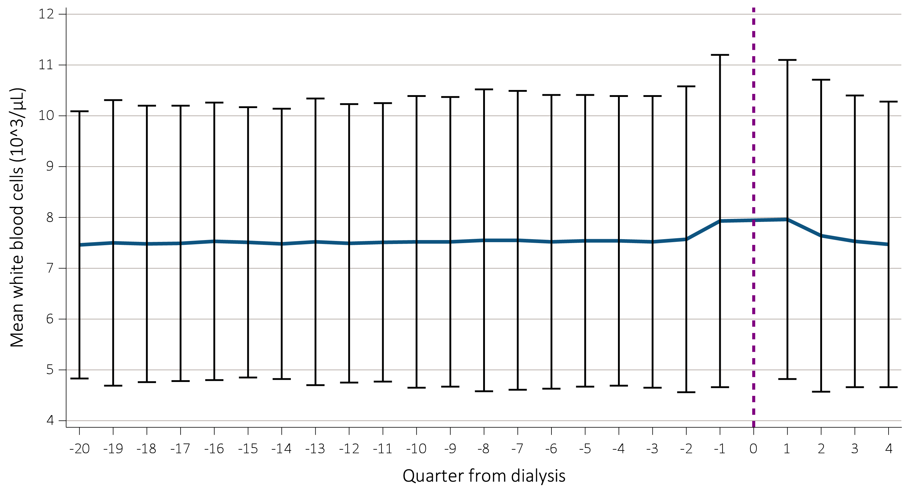
vol 1 Figure 8.21. Pre- and post-ESRD trends in average white blood cells levels in Veterans who transitioned to ESRD during 10/1/2007-3/31/2015 over (a) 20 and 4 quarters (N=58,322) and (b) 8 quarters each (N=54,811)
(a) Average white blood cells levels during transition, -20 to +4 quarters

Slide 42
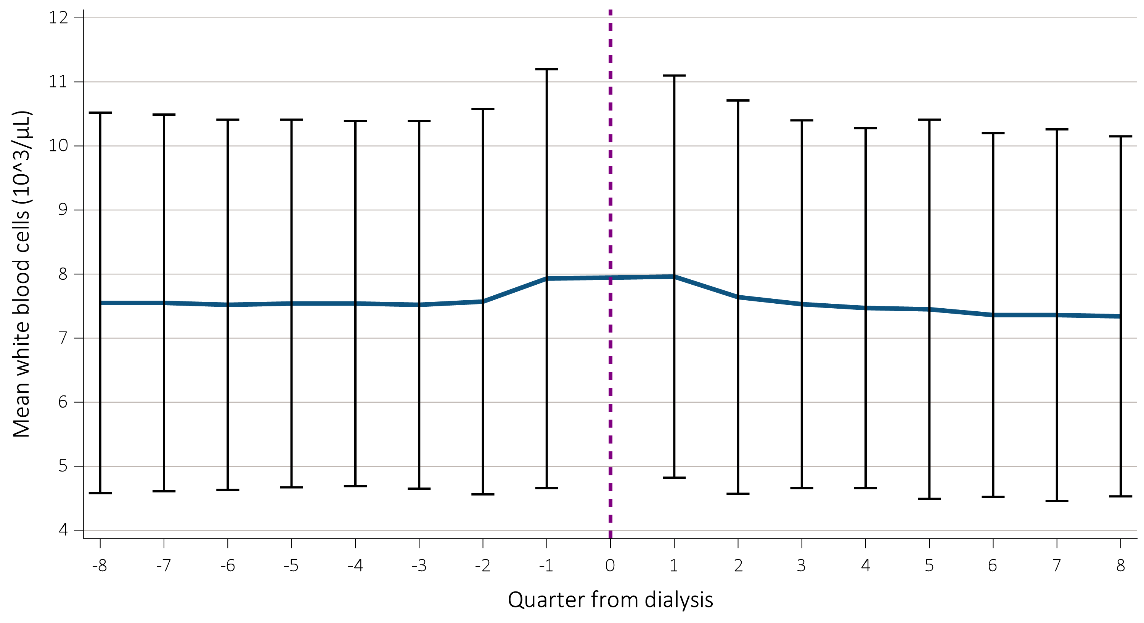
vol 1 Figure 8.21. Pre- and post-ESRD trends in average white blood cells levels in Veterans who transitioned to ESRD during 10/1/2007-3/31/2015 over (a) 20 and 4 quarters (N=58,322) and (b) 8 quarters each (N=54,811)
(b) Average white blood cells levels during transition, -8 to +8 quarters

Slide 43
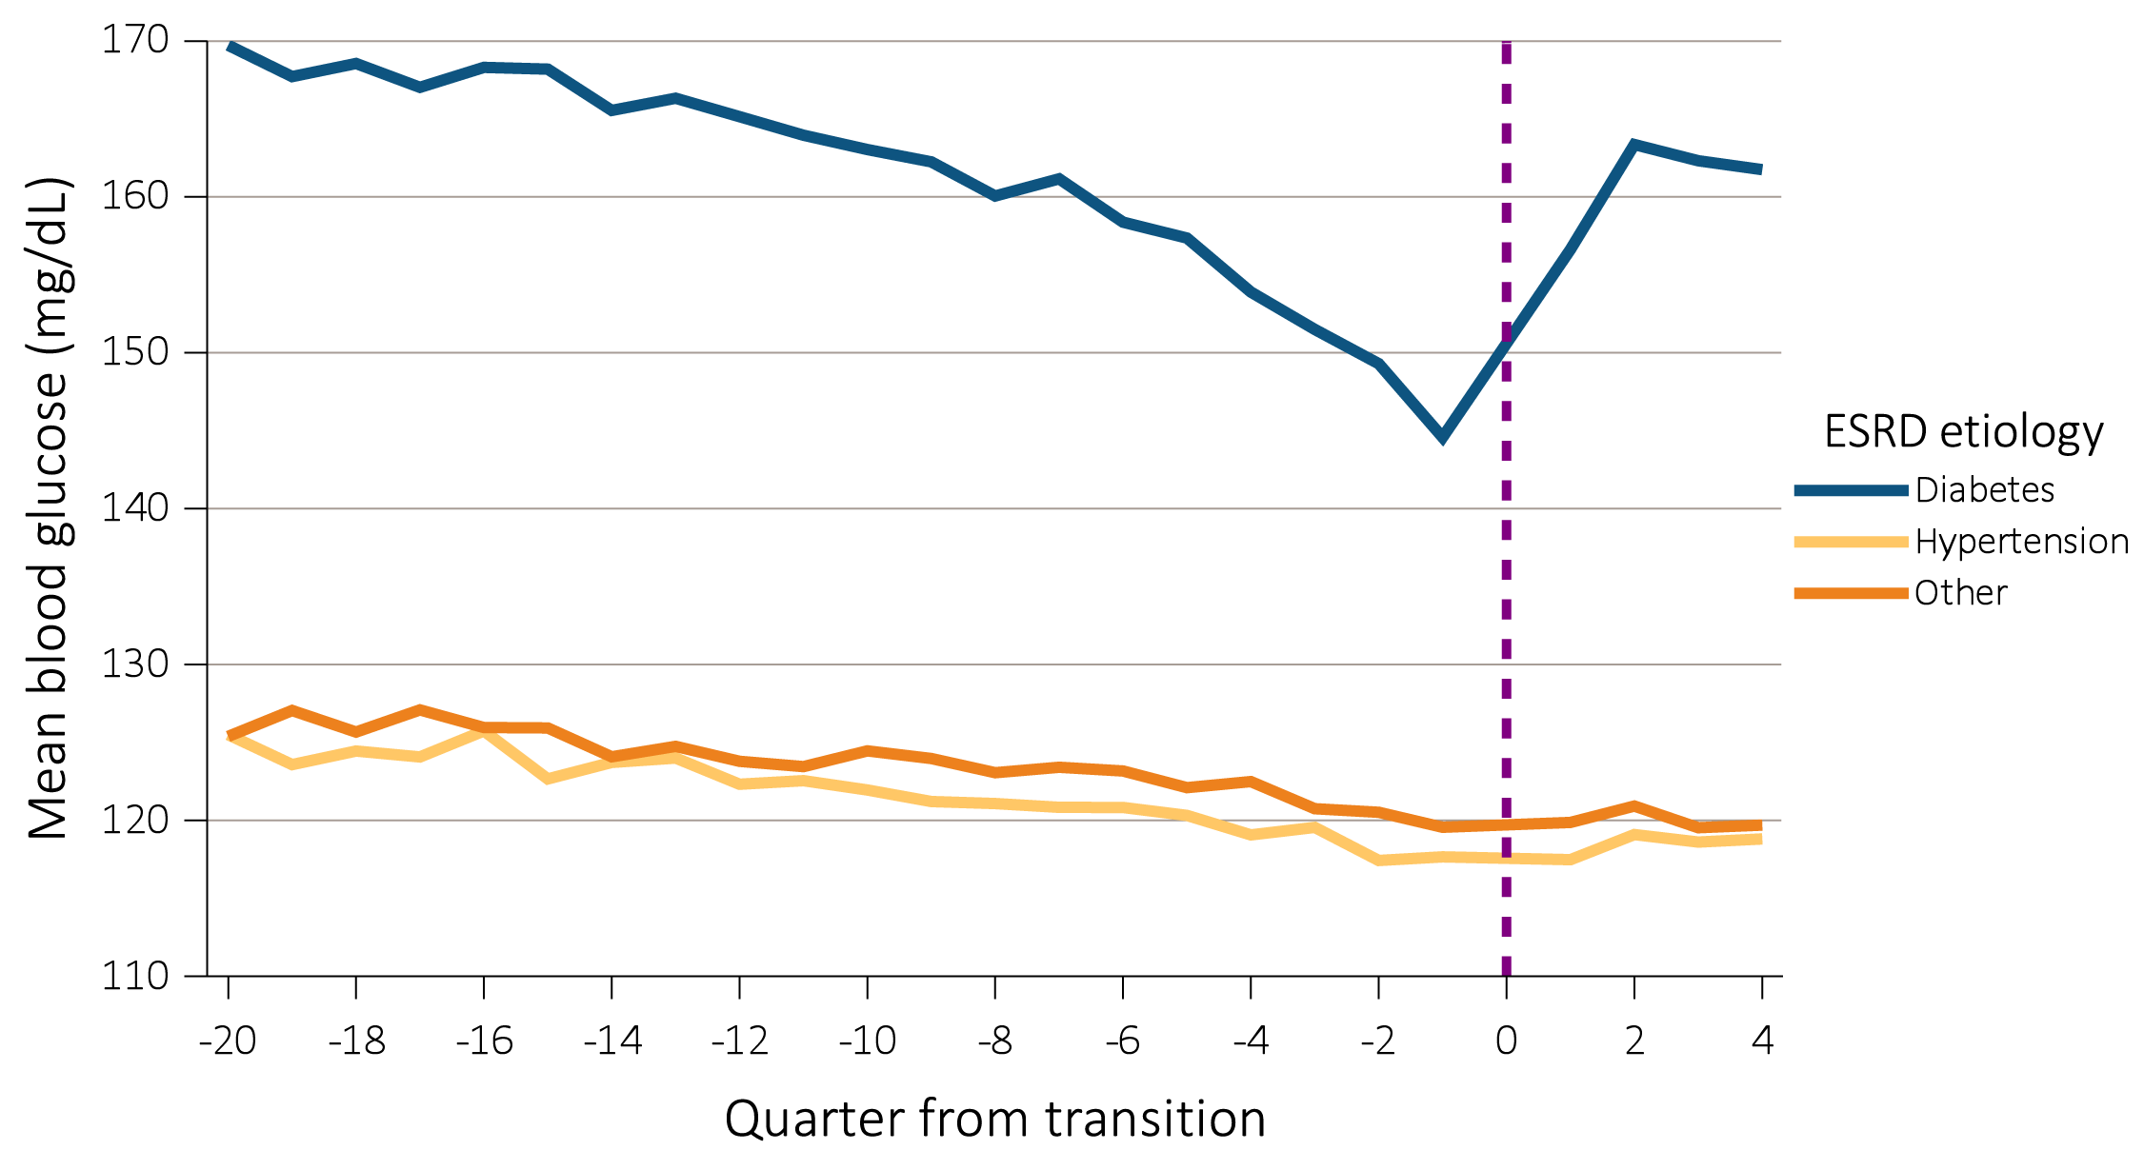
Vol 1 Figure 8.22. Pre- and post-ESRD trends in blood glucose levels by ESRD-reason for (a) 60,103 Veterans who transitioned to ESRD during 10/1/2007-3/31/2015 over 20 and 4 quarters and (b) 56,455 Veterans who transitioned to ESRD during 10/1/2007-3/31/2015 over 8 quarters in each period
(a) Blood glucose levels by ESRD-reason during transition, -20 to +4 quarters

Slide 44
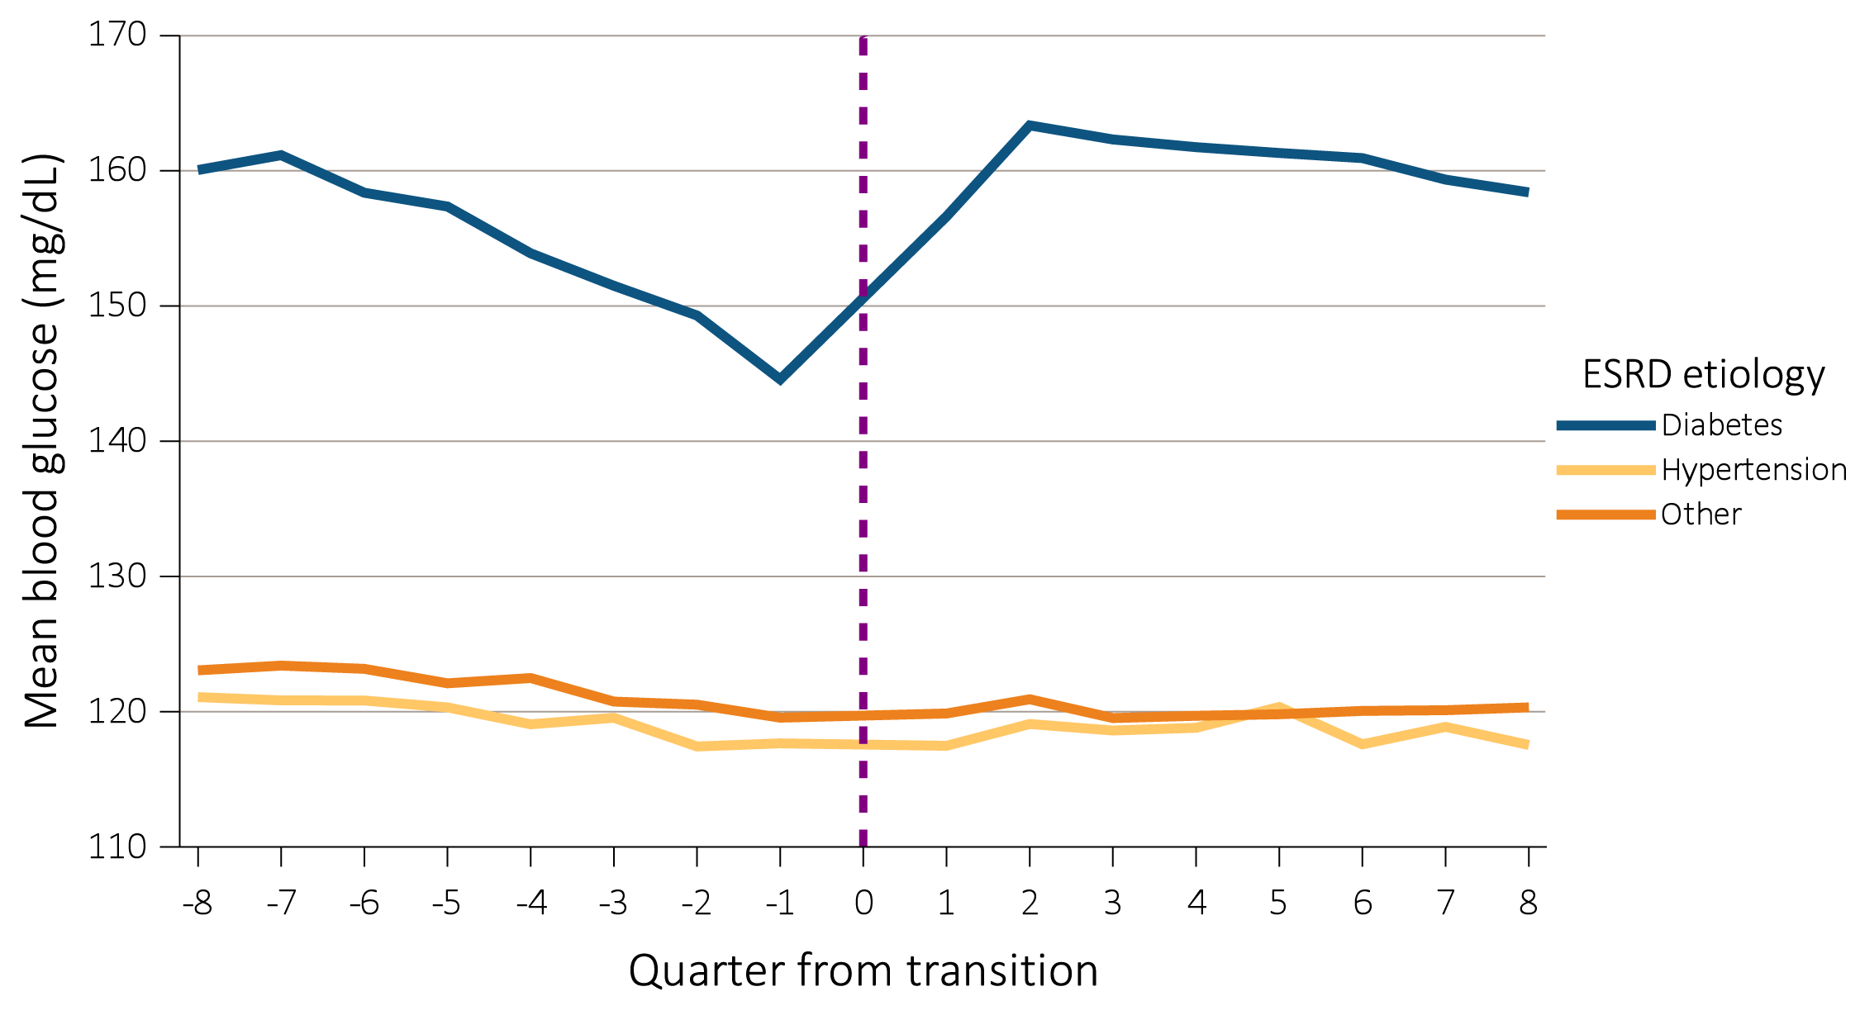
Vol 1 Figure 8.22. Pre- and post-ESRD trends in blood glucose levels by ESRD-reason for (a) 60,103 Veterans who transitioned to ESRD during 10/1/2007-3/31/2015 over 20 and 4 quarters and (b) 56,455 Veterans who transitioned to ESRD during 10/1/2007-3/31/2015 over 8 quarters in each period
(b) Blood glucose levels by ESRD-reason during transition, -8 to +8 quarters

Slide 45
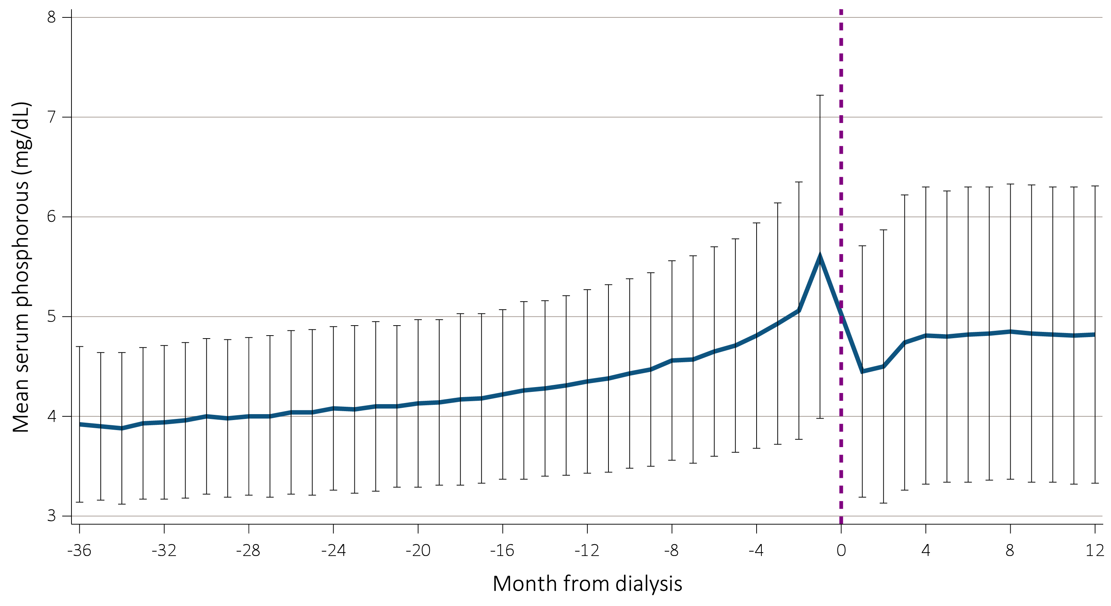
vol 1 Figure 8.23. Trend in mean serum phosphorus level during the prelude (pre-ESRD) and vintage (post-ESRD) times over 36 and 12 months, respectively, in 33,739 Veterans who transitioned to ESRD during 10/1/2007-3/31/2015

Slide 46
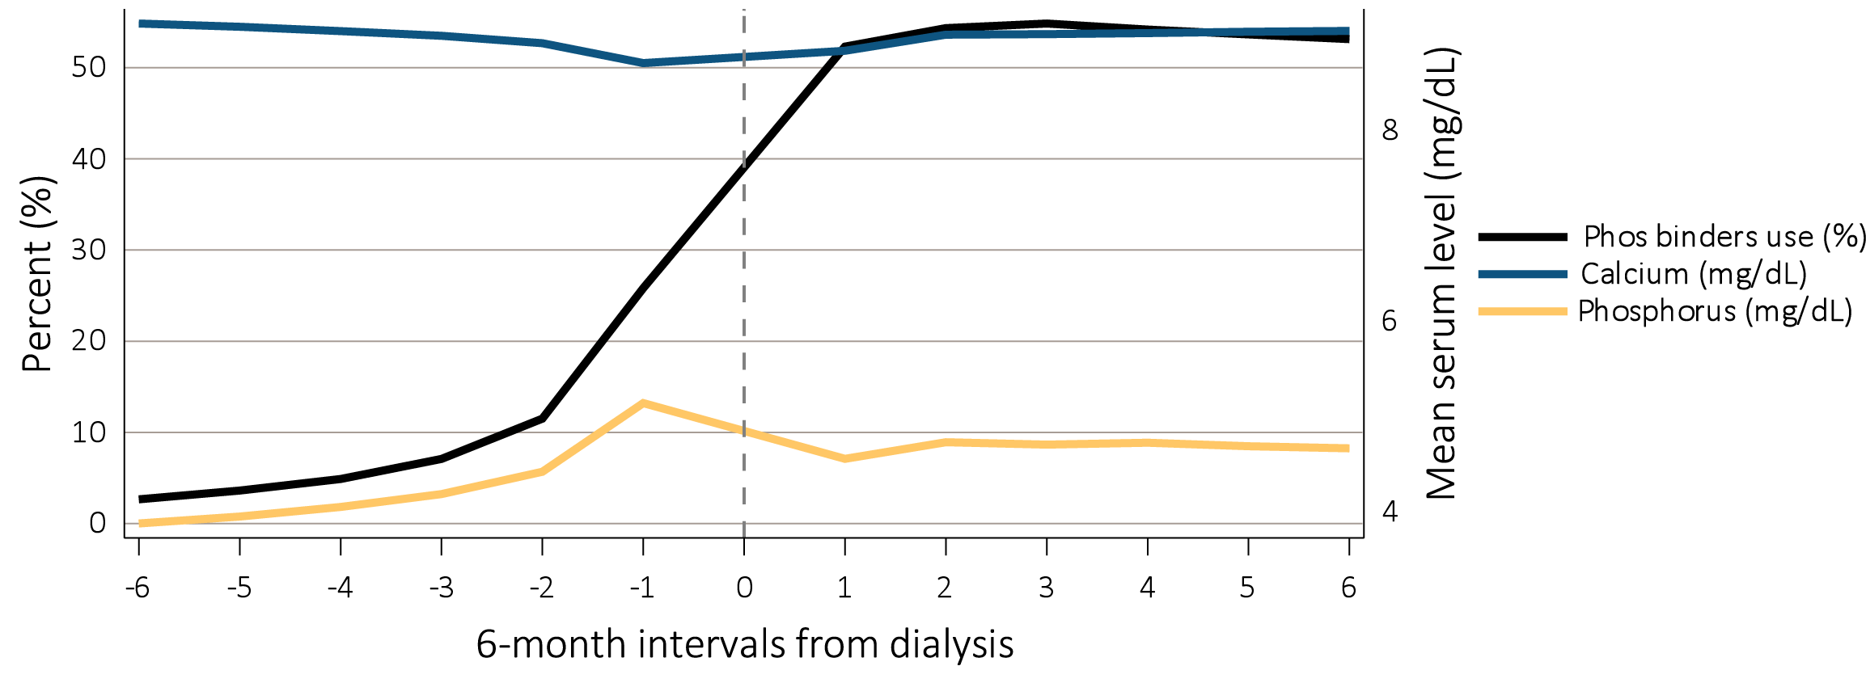
Vol 1 Figure 8.24. Trends in prescribed phosphorus binders, mean serum phosphorus level and mean serum calcium level for incident ESRD Veterans who transitioned to ESRD during 10/1/2007-3/31/2015 (N=84,004; N=37,789; and N=60,007), with data up to -36 months prior to transition (prelude) and up to +36 months after transition (vintage)
Each unit on the x-axis represents a 6-month interval. Negative signs represent time prior to transition to dialysis, and positive signs represent time after transition to dialysis.

Slide 47
vol 1 Table 8.6. Demographic characteristics of the Kaiser Permanente Southern California member population compared to the 2010 U.S. census and California populations
 | KPSC (%) | U.S. census 2010 (%) | California 2010 (%)
Sex
Male | 48.2 | 49.2 | 49.7
Female | 51.8 | 50.8 | 50.3
Age
Under 5 years | 5.8 | 6.5 | 6.8
5-17 years | 19.1 | 17.5 | 18.6
18 to 24 years | 8.7 | 9.9 | 10.5
25 to 44 years | 26.1 | 26.6 | 28.2
45 to 64 years | 28.2 | 26.4 | 24.9
65 years and over | 12.1 | 13.0 | 11.4
Ethnicity
Hispanic | 37.6 | 16.3 | 37.6
Non-Hispanic | 53.0 | 83.7 | 62.4
Unknown | 9.4 | ^ | ^
Race
White | 47.7 | 76.2 | 40.1
Black/African American | 9.8 | 14.6 | 5.8
American Indian/Alaska Native | 0.4 | 0.9 | 0.4
Asian | 9.1 | 5.6 | 12.8
Native Hawaiian/Pacific Islander | 1.0 | 0.2 | 0.3
Other/Multirace | 5.1 | 2.5 | 2.8
Unknown | 26.3 | ^ | ^
Data source: Kaiser Permanente Southern California Electronic Health Records, U.S. Census Bureau. Active KPSC Members (all medical centers) on June 30, 2010. Abbreviations: KPSC, Kaiser Permanente Southern California; US, United States. ^Data not available. available.

Slide 48
vol 1 Table 8.7. Crude and age- and sex-adjusted incidence rates among Kaiser Permanente Southern California members who transitioned to ESRD between 1/1/2007 and 12/31/2014
 | Number of incident ESRD patients | Number of KP-SC members | Crude incidence/ 1,000,000 person years | Age-, Sex-adjusted incidence/1,000,000 person years
2007 | 1,122 | 3,183,804 | 352.4 | 379.9
2008 | 1,101 | 3,200,101 | 344.1 | 362.2
2009 | 1,233 | 3,216,209 | 383.4 | 397.9
2010 | 1,218 | 3,247,766 | 375.0 | 381.3
2011 | 1,124 | 3,387,552 | 331.8 | 336.0
2012 | 1,102 | 3,485,161 | 316.2 | 314.4
2013 | 1,139 | 3,551,617 | 320.7 | 310.9
2014 | 1,221 | 3,667,316 | 332.9 | 317.2
Data source: Kaiser Permanente Southern California Electronic Health Records, U.S. Census Bureau. The United States census 2010 was used as the standard population. Abbreviations: ESRD, end-stage renal disease; KPSC, Kaiser Permanente Southern California.

Slide 49
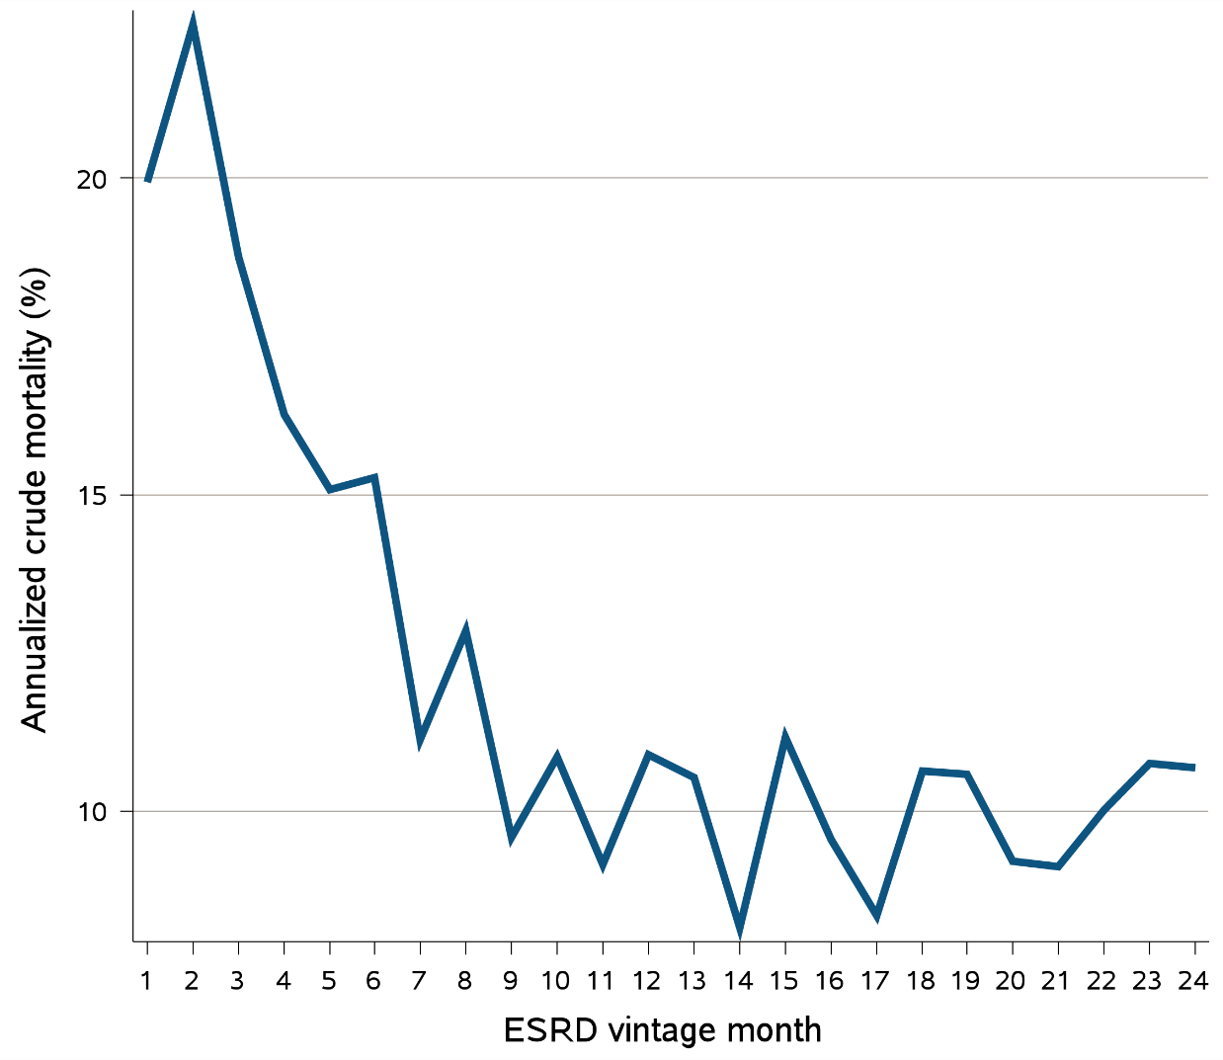
vol 1 Figure 8.25. Annualized unadjusted mortality of the 9,086 incident dialysis patients who transitioned to ESRD during 1/1/2007-12/31/2014 and were followed for up to 24 months
Data source: Kaiser Permanente Southern California Electronic Health Records. Abbreviations: ESRD, end-stage renal disease.

Slide 50
vol 1 Table 8.8. Comparison of hospitalizations for congestive heart failure and acute kidney injury for incident dialysis patients who died at two months vs. alive more than 12 months after ESRD transition
 | Patients died at two months (N=167) | Patients survived more than 12 months (N=7,864)
 | N (%) | N (%)
Primary cause of hospitalization in 6 months prior to ESRD transition
Congestive heart failure | 45 (27.0) | 893 (11.4)
Acute kidney injury | 64 (38.3) | 1529 (19.4)
Hospitalization related diagnosis in 6 months prior to ESRD transition
Congestive heart failure | 95 (56.9) | 2179 (27.7)
Acute kidney injury | 134 (80.2) | 3155 (40.1)
Data source: Kaiser Permanente Southern California Electronic Health Records. Abbreviations: ESRD, end-stage renal disease..

Slide 51
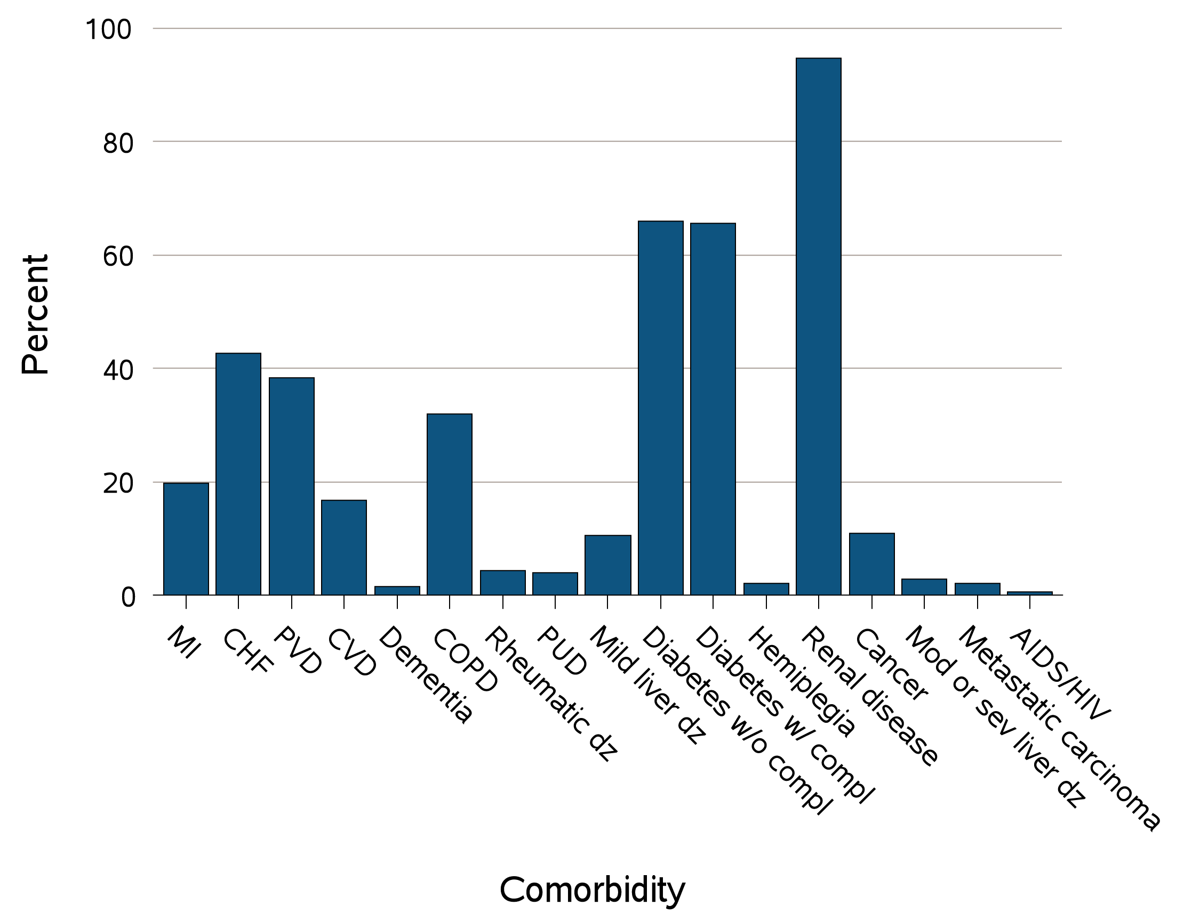
vol 1 Figure 8.26 Selected (a) comorbid conditions for calculation of the (b) Charlson Comorbidity Index, prior to transition to ESRD in 9,086 incident dialysis patients during 1/1/2007-12/31/2014
(a) Comorbid conditions
Data source: Kaiser Permanente Southern California Electronic Health Records. Abbreviations: CHF, congestive heart failure; compl, complications; COPD, chronic obstructive pulmonary disease; CVD, cerebrovascular disease; dz, disease; ESRD, end-stage renal disease; MI, myocardial infarction; Mod, moderate; PVD, peripheral vascular disease; PUD, peptic ulcer disease; sev, severe.

Slide 52
vol 1 Figure 8.26 Selected (a) comorbid conditions for calculation of the (b) Charlson Comorbidity Index, prior to transition to ESRD in 9,086 incident dialysis patients during 1/1/2007-12/31/2014
(b) Charlson Comorbidity Index score
Data source: Kaiser Permanente Southern California Electronic Health Records. Abbreviations: CHF, congestive heart failure; compl, complications; COPD, chronic obstructive pulmonary disease; CVD, cerebrovascular disease; dz, disease; ESRD, end-stage renal disease; MI, myocardial infarction; Mod, moderate; PVD, peripheral vascular disease; PUD, peptic ulcer disease; sev, severe.

Slide 53
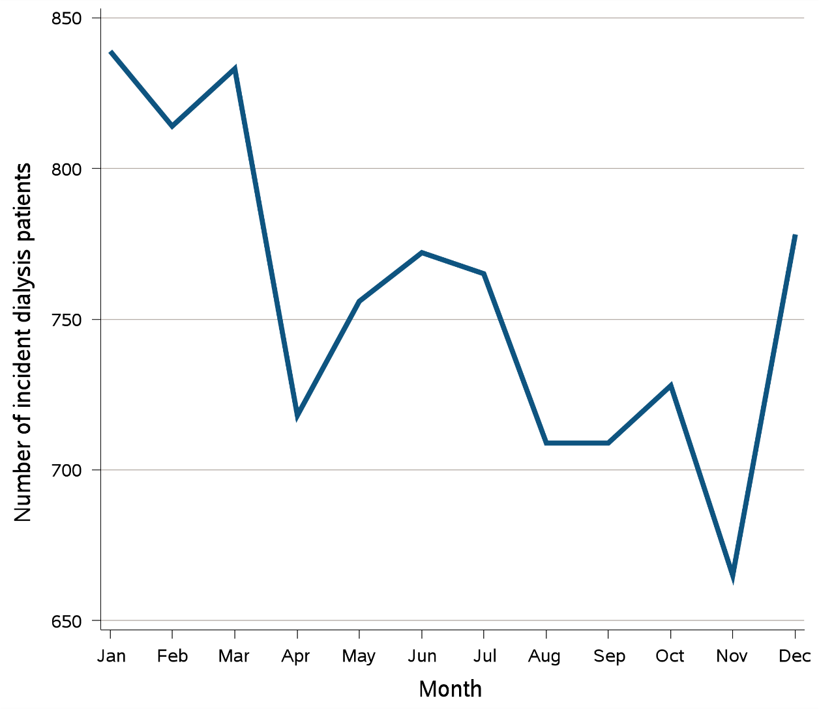
vol 1 Figure 8.27 Seasonal trend among 9,086 incident dialysis patients who transitioned to ESRD during 1/1/2007-12/31/2014
Data source: Kaiser Permanente Southern California Electronic Health Records. Abbreviations: ESRD, end-stage renal disease; Jan, January; Feb, February; Mar, March; Apr, April; Jun, June; Jul, July; Aug, August; Sep, September; Oct, October; Nov, November; Dec, December.

Slide 54
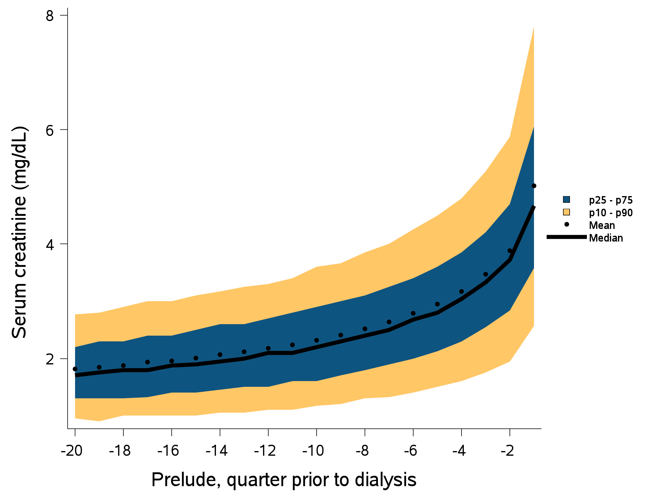
vol 1 Figure 8.28 Trend in serum creatinine level during the prelude (pre-ESRD) period over 20 quarters among 9,086 patients who transitioned to dialysis during 1/1/2007-12/31/2014
Data source: Kaiser Permanente Southern California Electronic Health Records. Abbreviations: ESRD, end-stage renal disease; mg/dL, milligrams per deciliter; p, percentile.

Slide 55
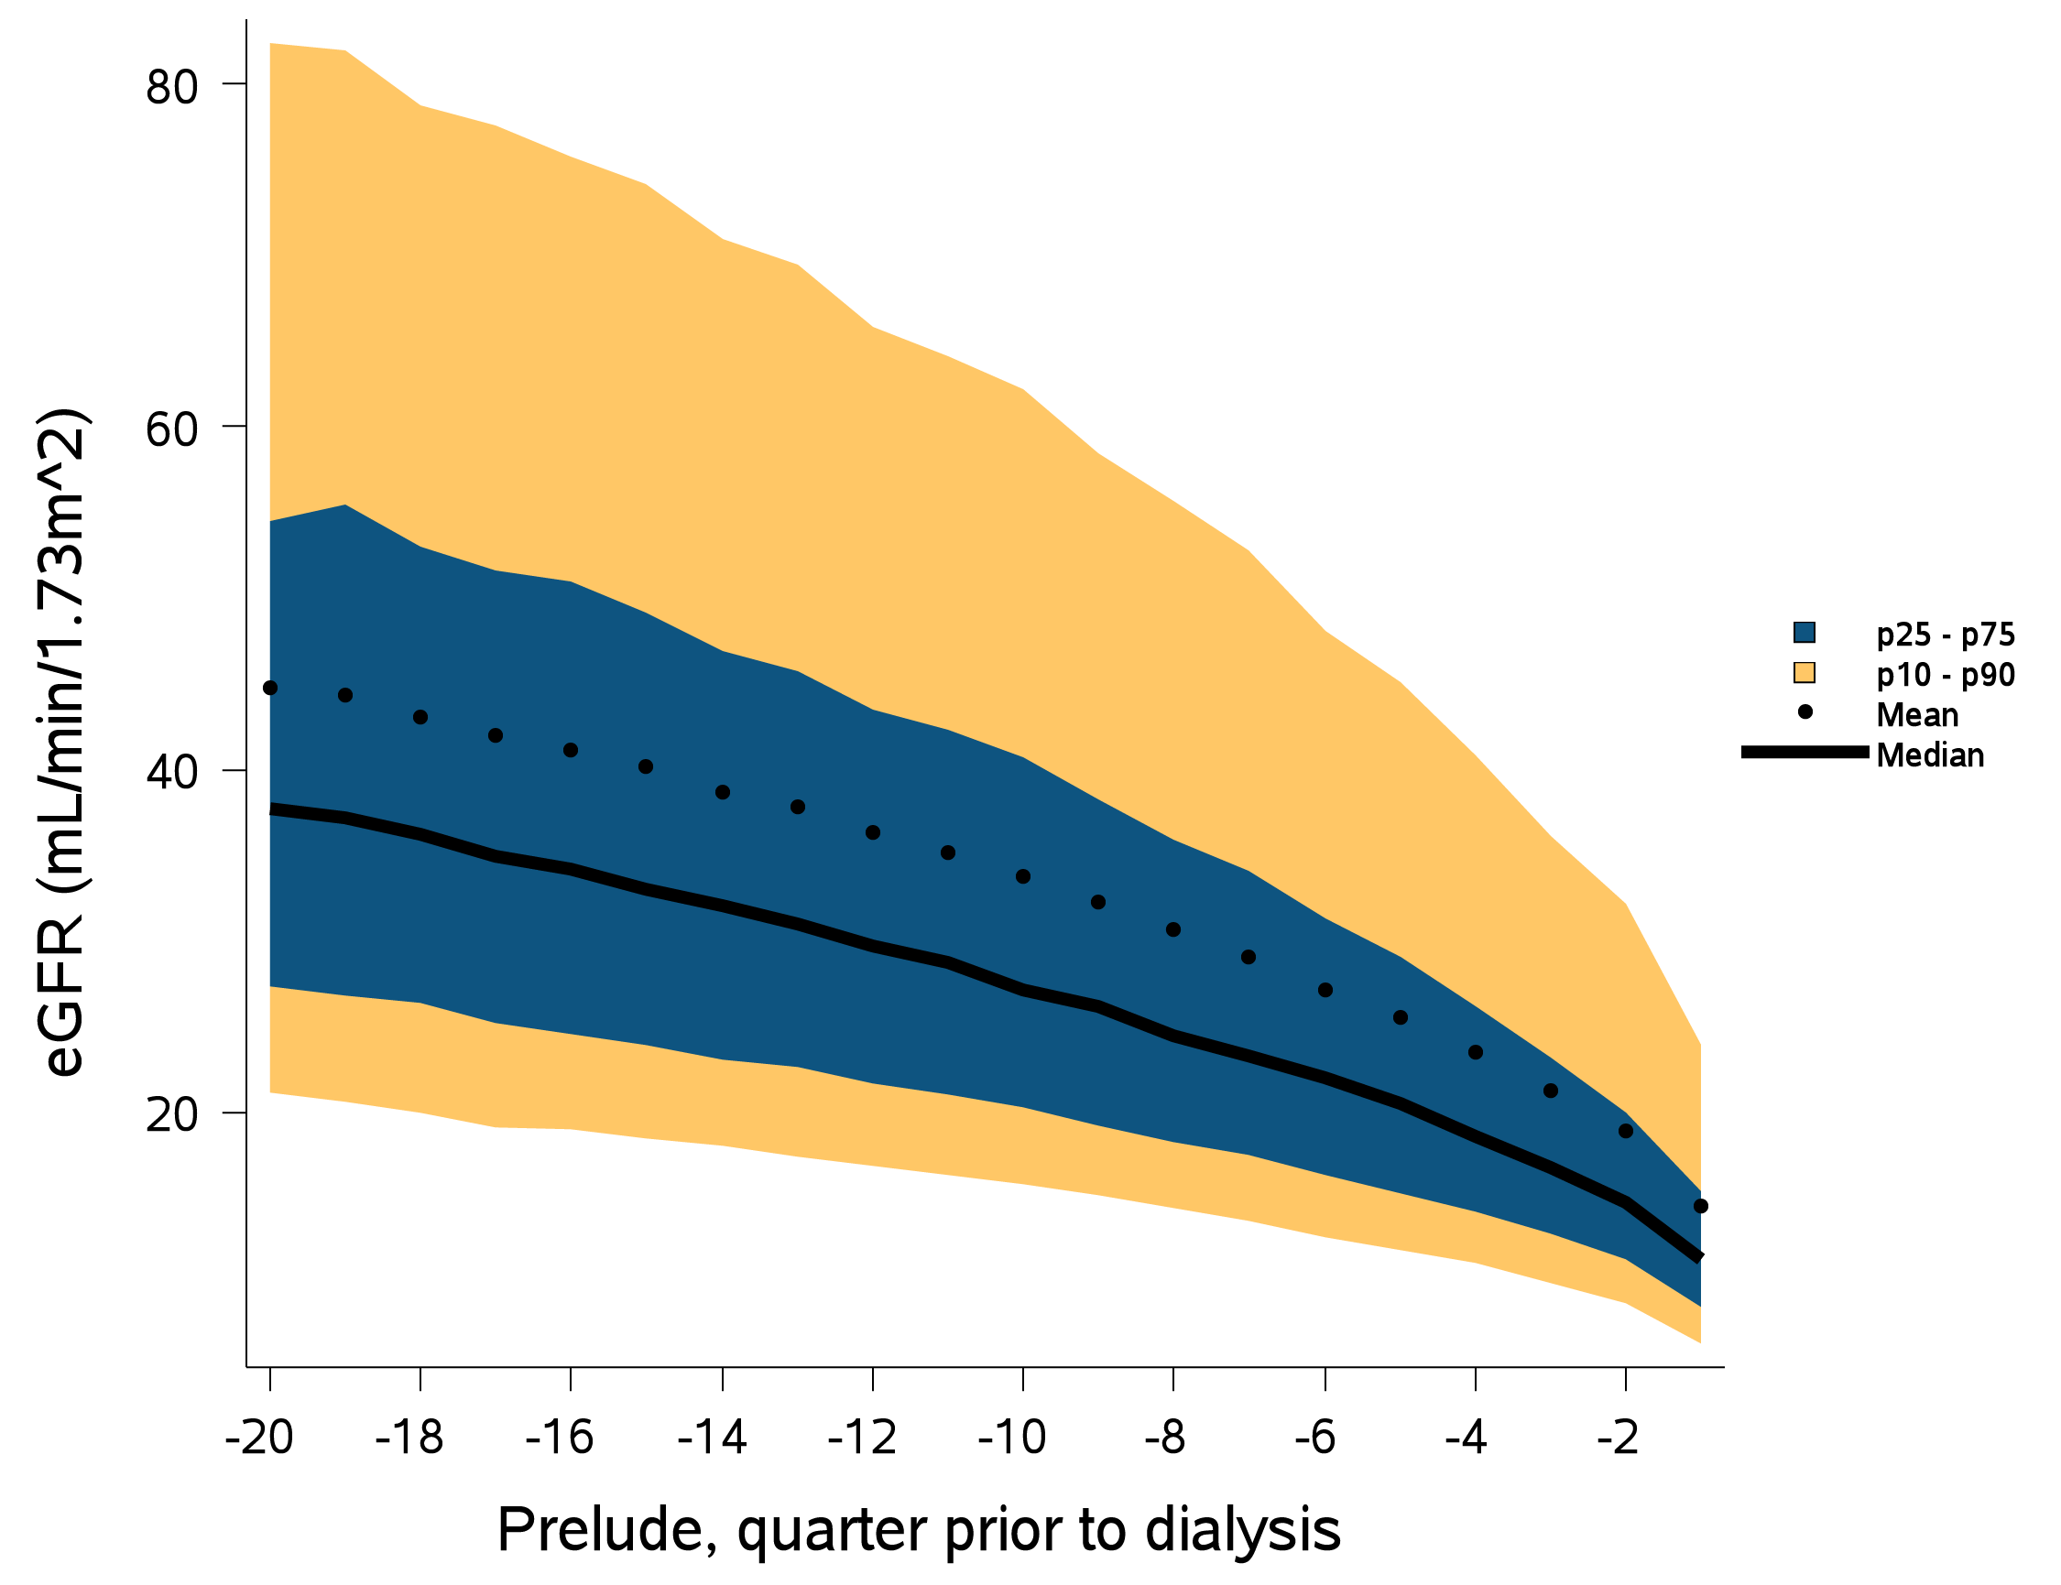
vol 1 Figure 8.29 Trend in eGFR during the prelude (pre-ESRD) period over 20 quarters among 9,086 patients who transitioned to dialysis during 1/1/2007-12/31/2014
Data source: Kaiser Permanente Southern California Electronic Health Records. Abbreviations: eGFR; estimated glomerular filtration rate; ESRD, end-stage renal disease; mL/min/1.73m2, milliliter per minute per 1.73 meters squared; p, percentile.

Slide 56
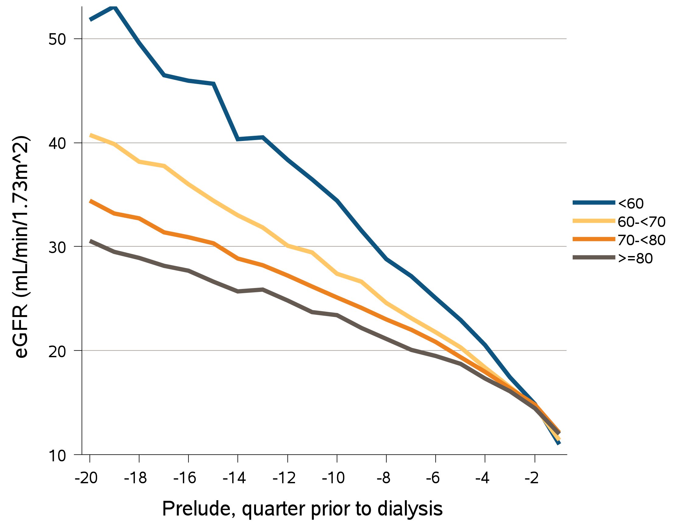
vol Figure 8.30 Trends in eGFR during the prelude (pre-ESRD) period over 20 quarters among 9,086 patients who transitioned to dialysis during 1/1/2007-12/31/2014, stratified by age-at-incidence
Data source: Kaiser Permanente Southern California Electronic Health Records. Abbreviations: eGFR; estimated glomerular filtration rate; ESRD, end-stage renal disease; mL/min/1.73m2, milliliter per minute per 1.73 meters squared.

Slide 57
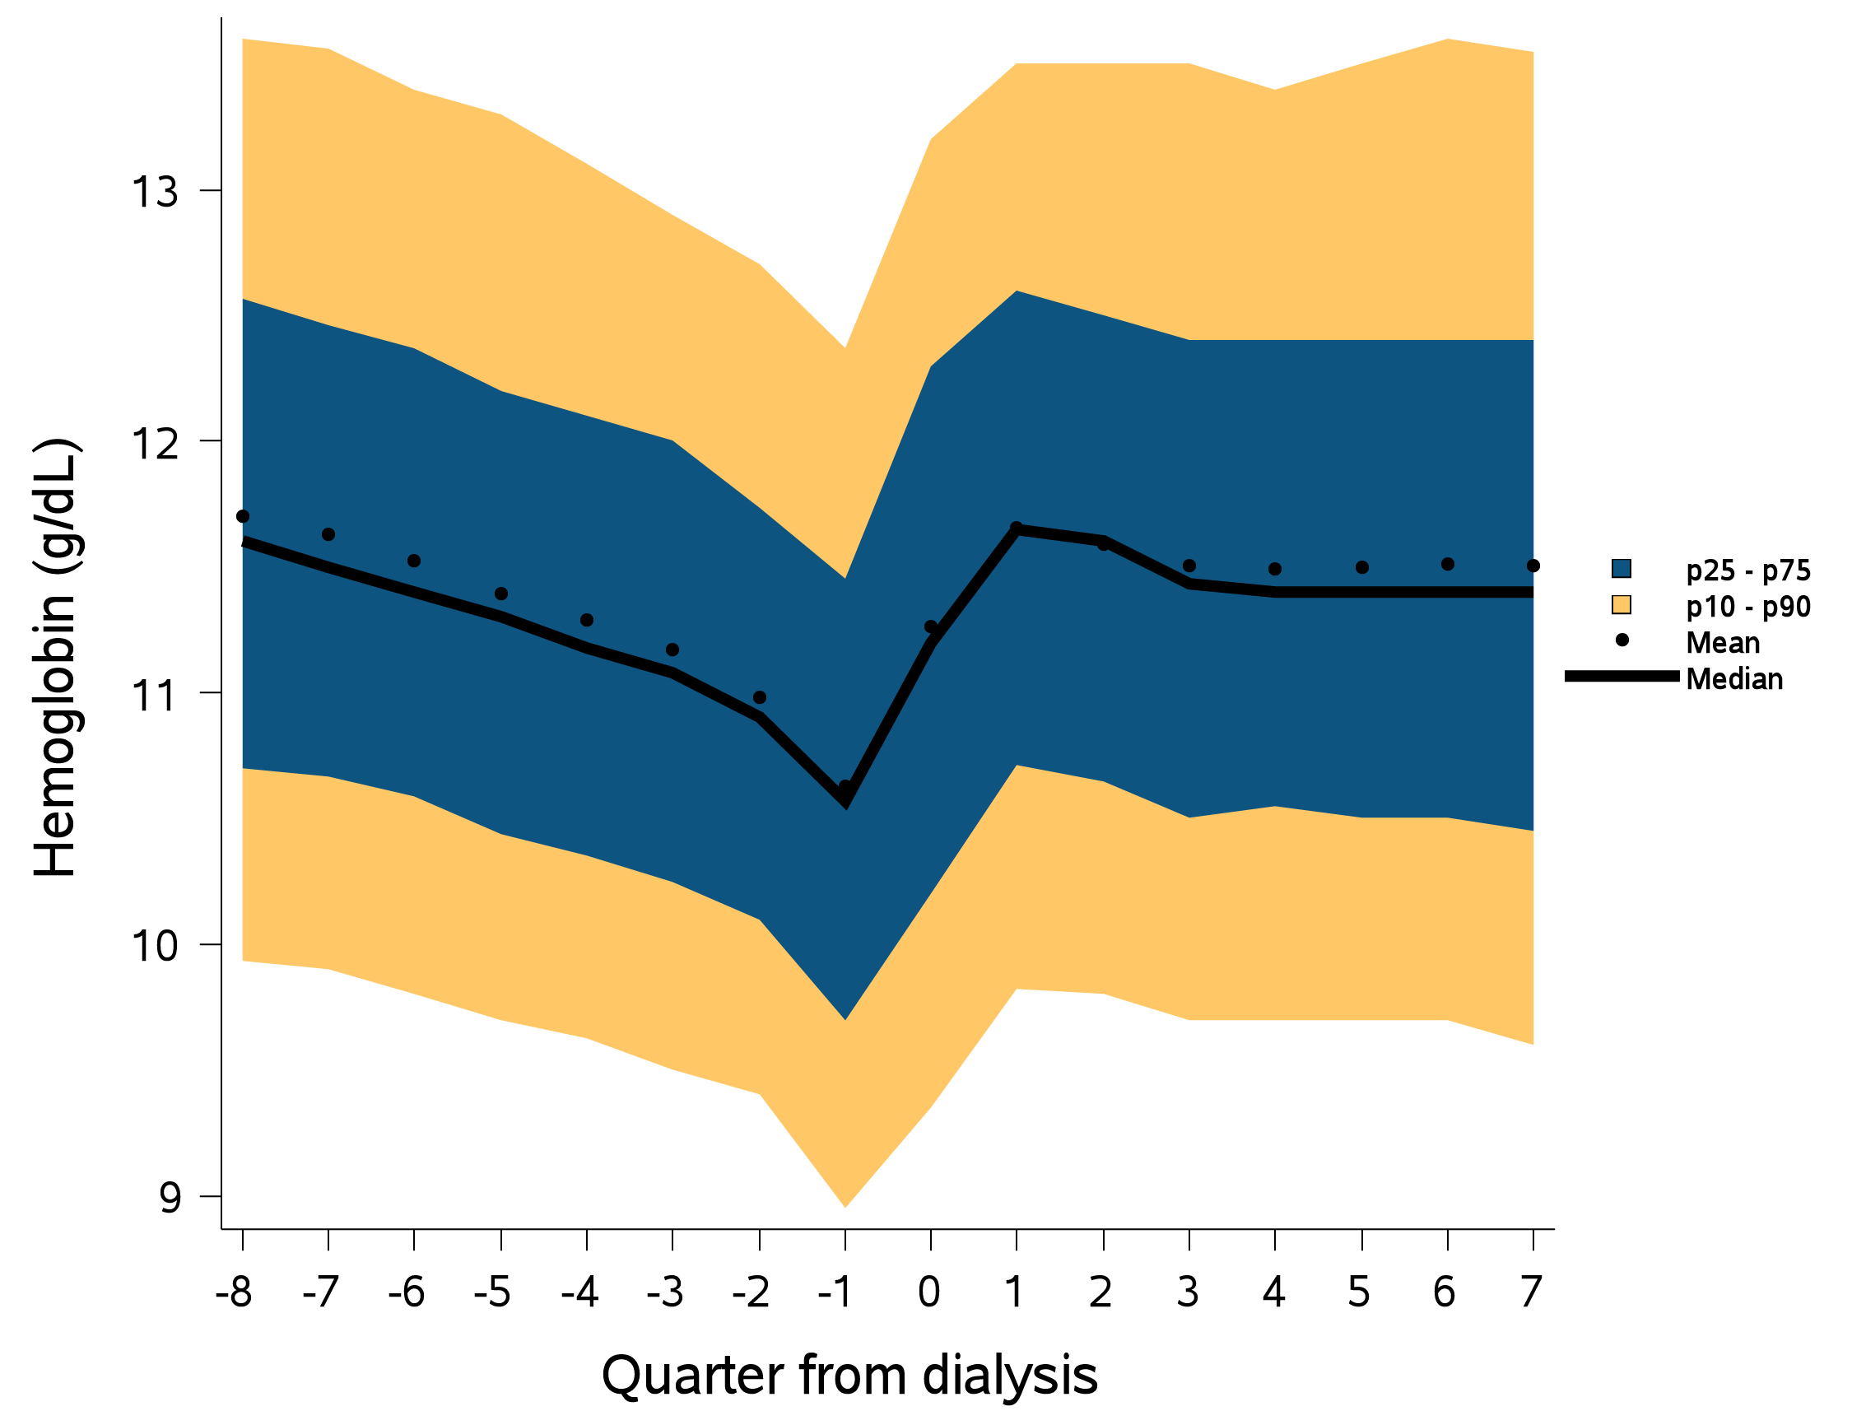
vol 1 Figure 8.31 Trend in hemoglobin levels (g/dL) over 8 quarters each in the prelude (pre-ESRD) and vintage (post-ESRD) periods among 9,086 patients who transitioned to dialysis during 1/1/2007-12/31/2014
Data source: Kaiser Permanente Southern California Electronic Health Records. Abbreviations: ESRD, end-stage renal disease; g/dL, grams per deciliter; p, percentile.

Slide 58
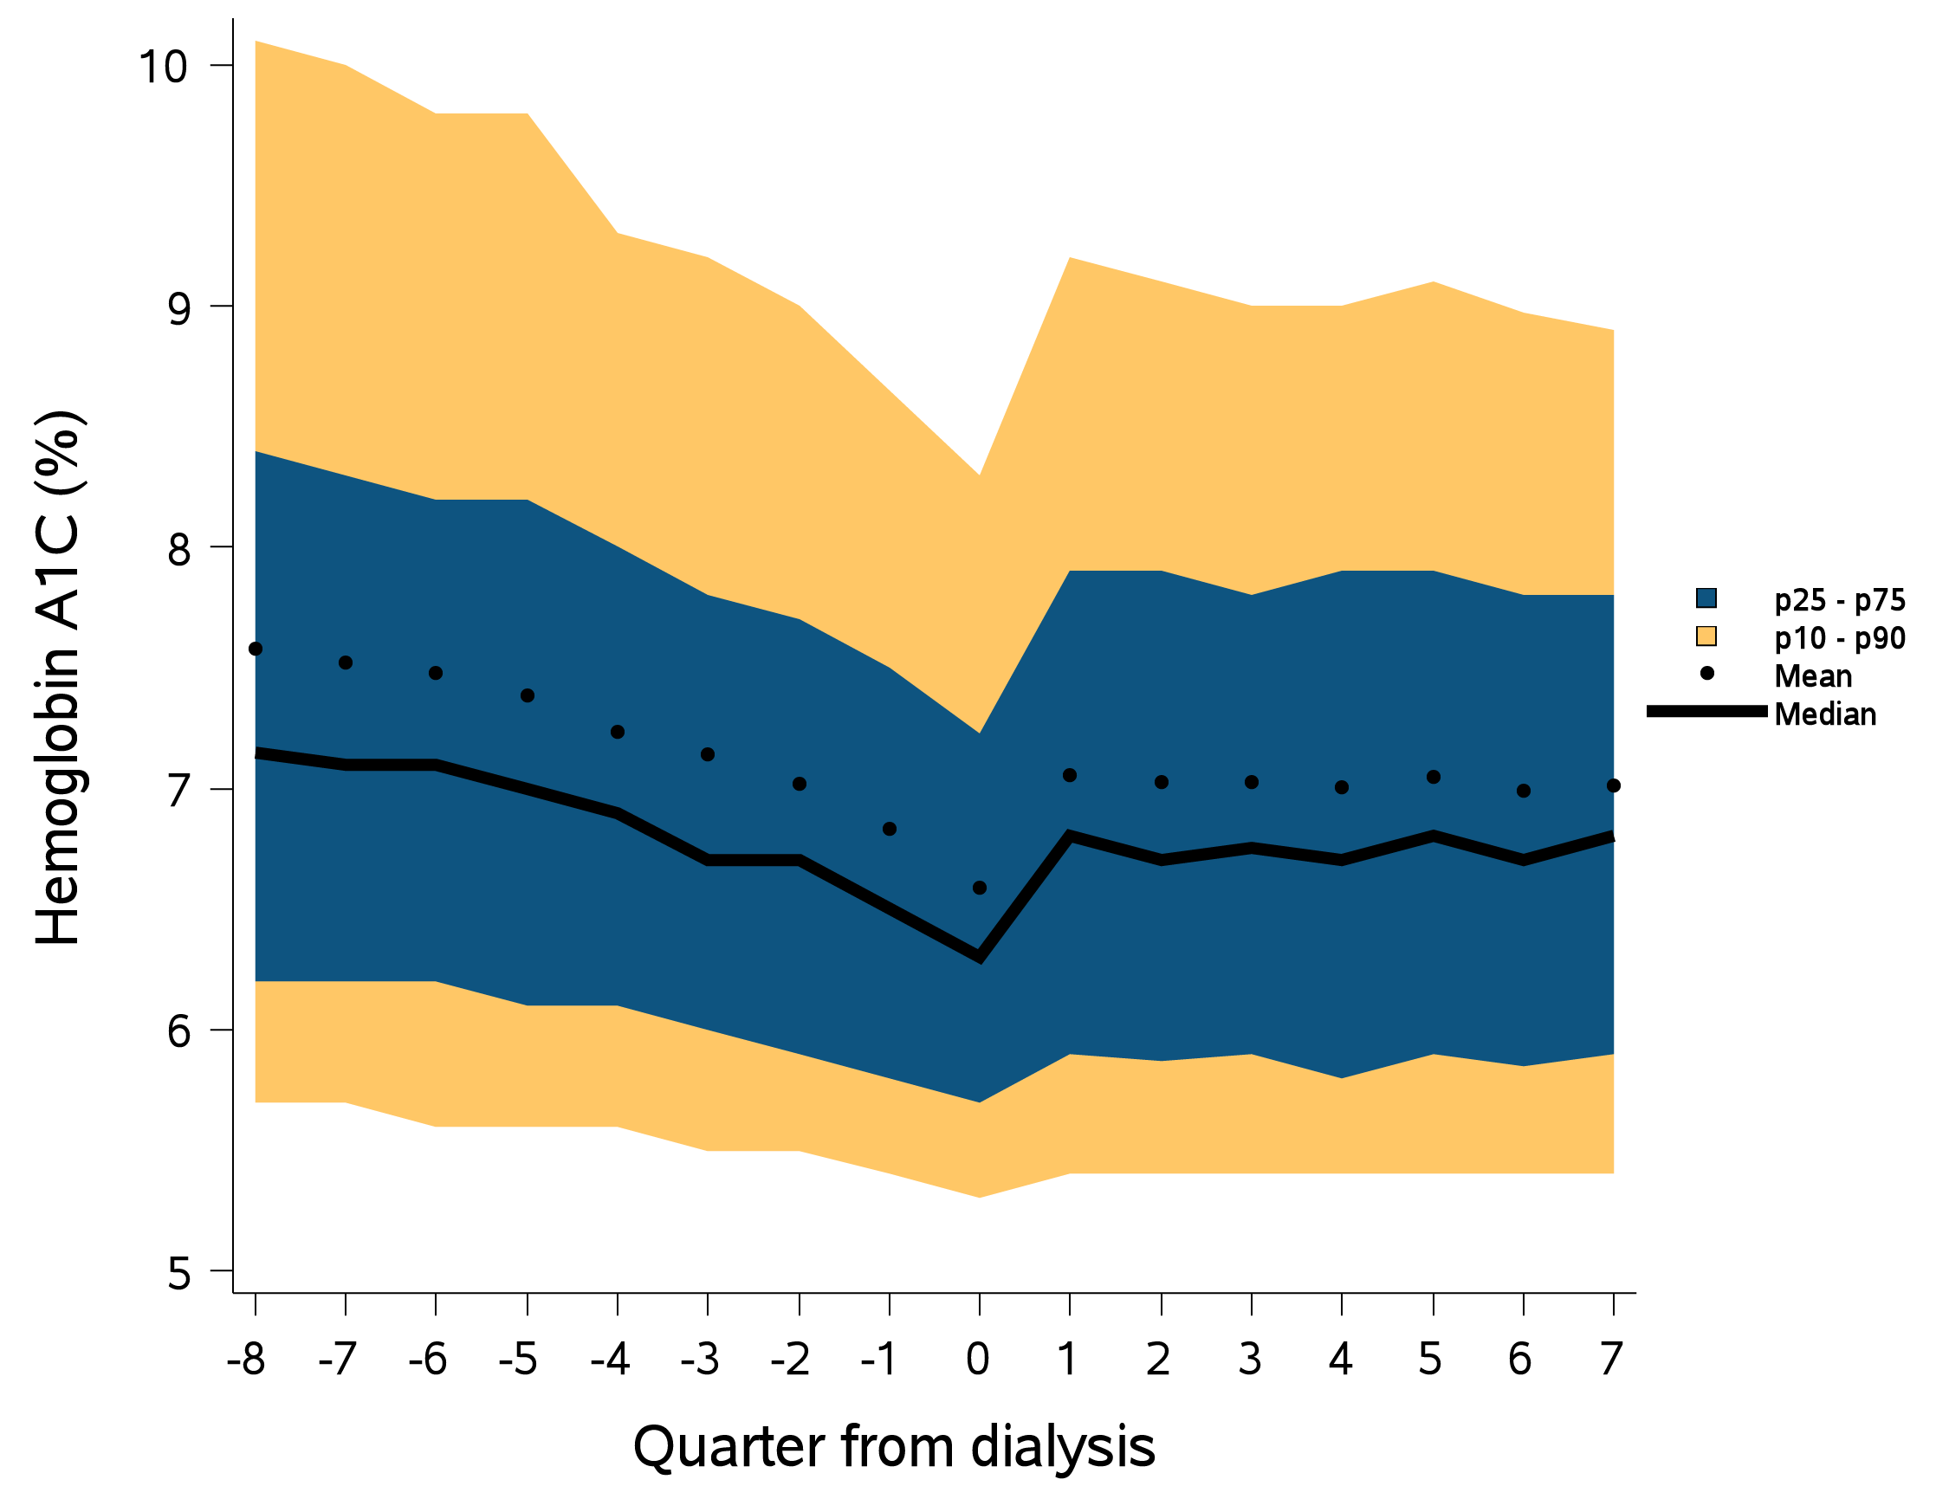
vol 1 Figure 8.32 Trend in hemoglobin A1C levels (%) over 8 quarters each in the prelude (pre-ESRD) and vintage (post-ESRD) periods among 9,086 patients who transitioned to dialysis during 1/1/2007-12/31/2014
Data source: Kaiser Permanente Southern California Electronic Health Records. Abbreviations: ESRD, end-stage renal disease; p, percentile.

Slide 59
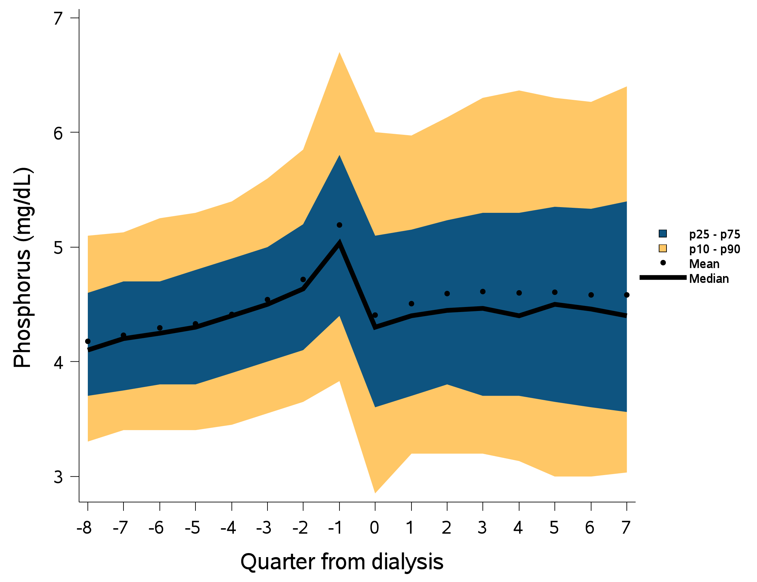
vol 1 Figure 8.33 Trend in phosphorus levels (mg/dL) over 8 quarters each in the prelude (pre-ESRD) and vintage (post-ESRD) periods among 9,086 patients who transitioned to dialysis during 1/1/2007-12/31/2014
Data source: Kaiser Permanente Southern California Electronic Health Records. Abbreviations: ESRD, end-stage renal disease; mg/dL, milligrams per deciliter; p, percentile.

Slide 60
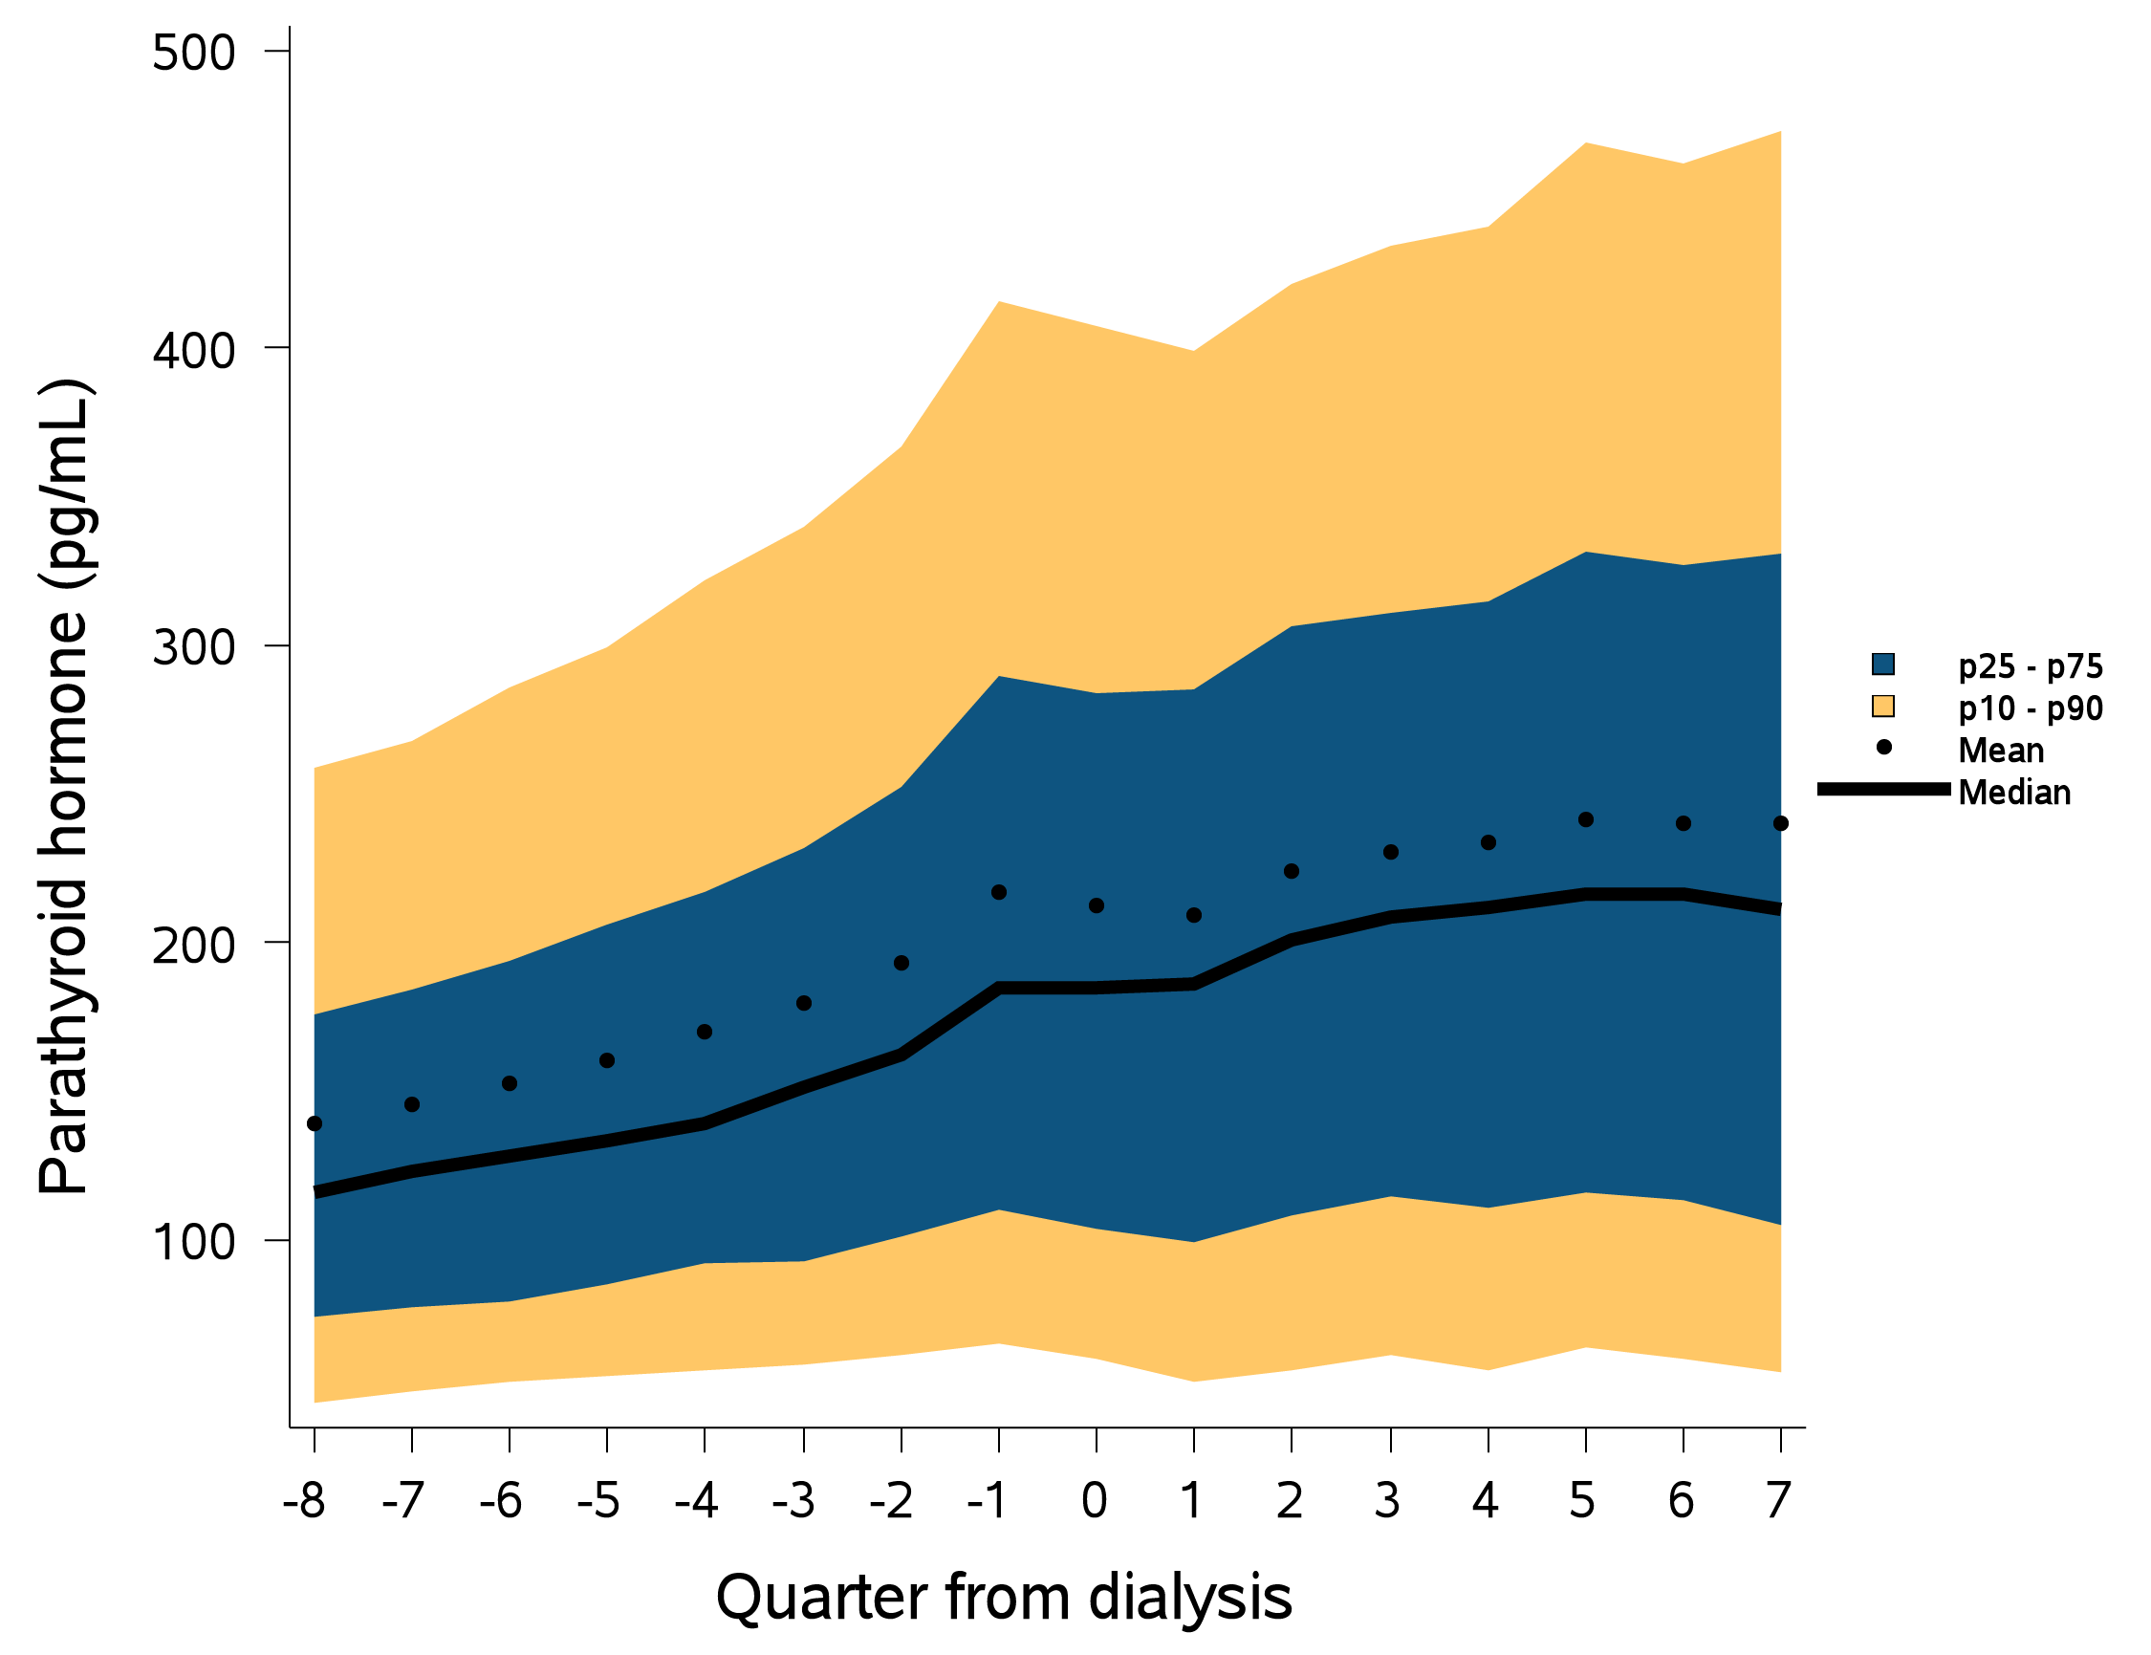
vol 1 Figure 8.34 Trend in parathyroid hormone levels (pg/mL) over 8 quarters each in the prelude (pre-ESRD) and vintage (post-ESRD) periods among 9,086 patients who transitioned to dialysis during 1/1/2007-12/31/2014
Data source: Kaiser Permanente Southern California Electronic Health Records. Abbreviations: ESRD, end-stage renal disease; pg/dL, picograms per deciliter; p, percentile.

Slide 61
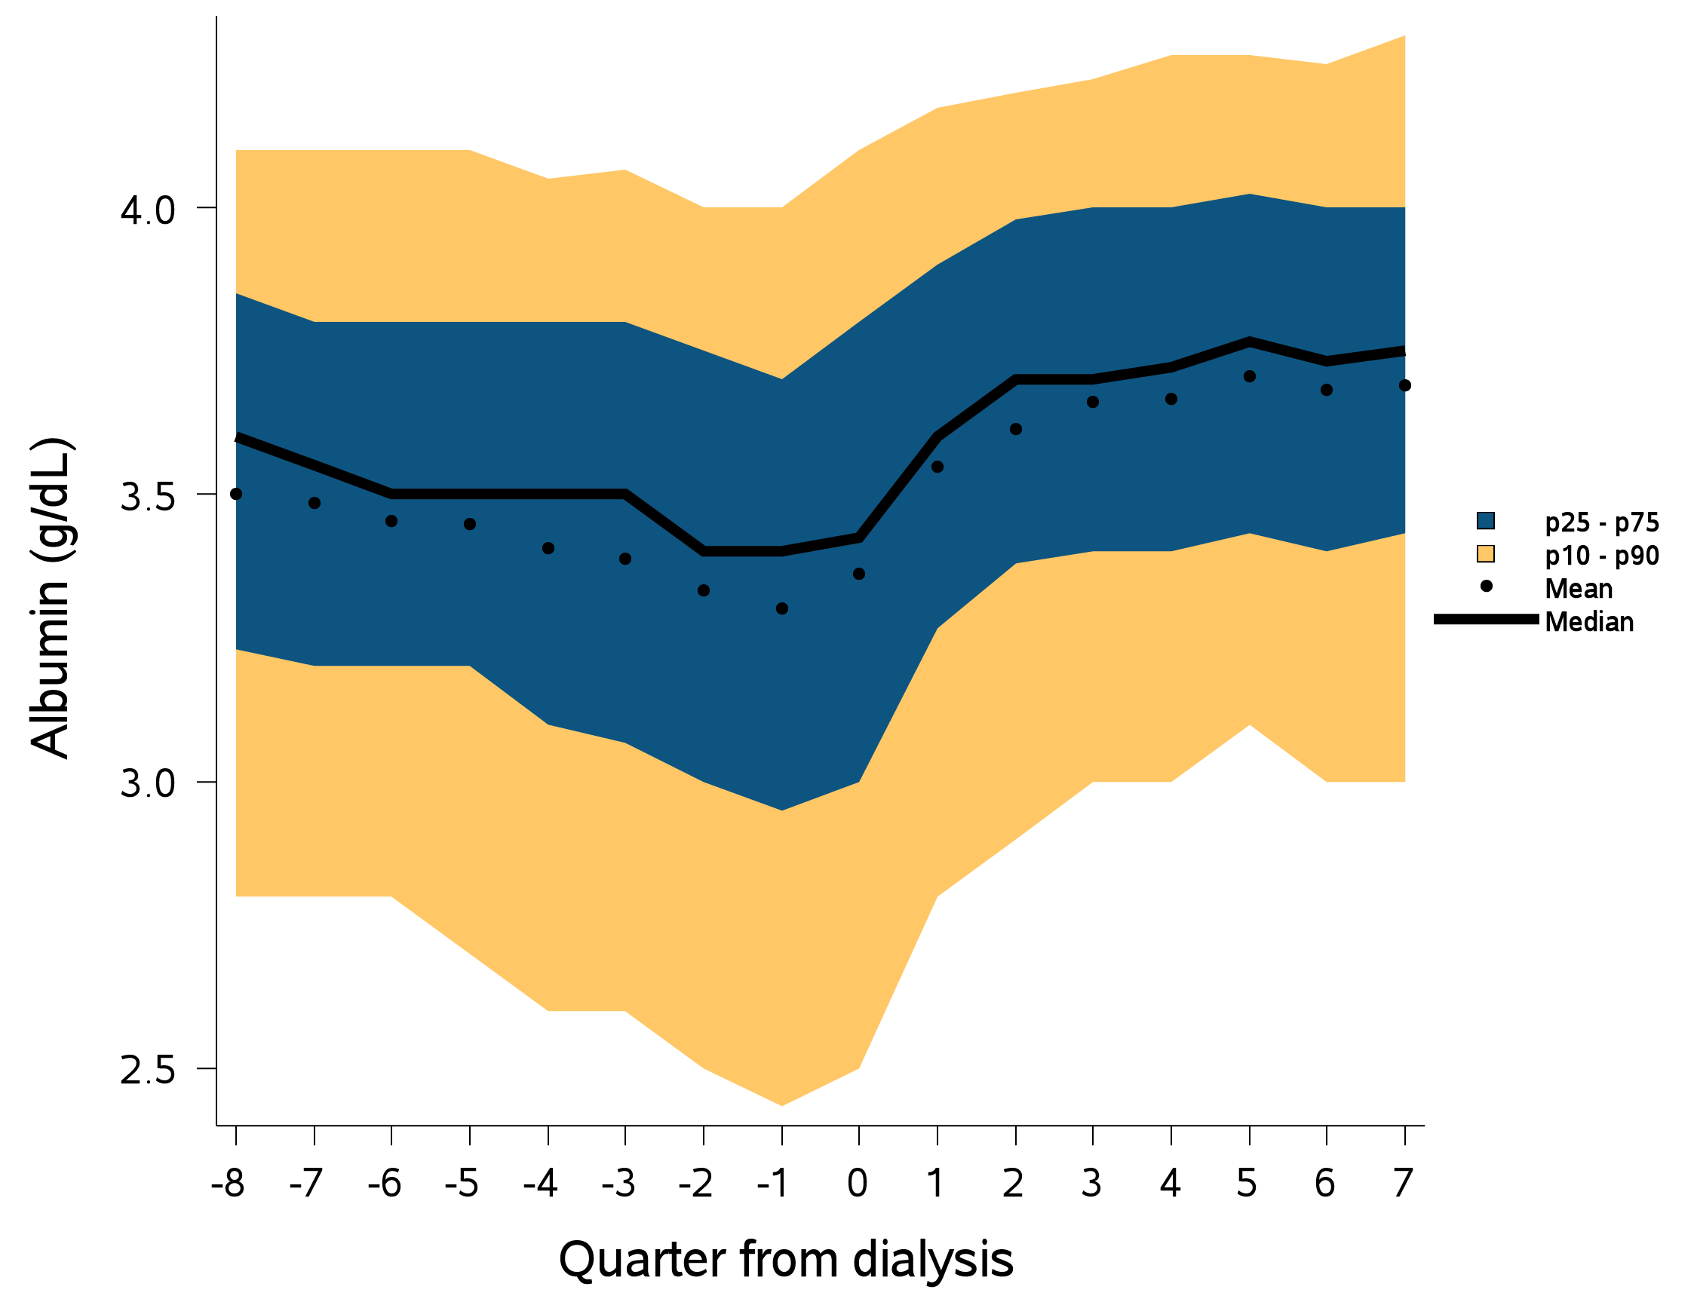
vol 1 Figure 8.35 Trend in albumin levels (g/dL) over 8 quarters each in the prelude (pre-ESRD) and vintage (post-ESRD) periods among 9,086 patients who transitioned to dialysis during 1/1/2007-12/31/2014
Data source: Kaiser Permanente Southern California Electronic Health Records. Abbreviations: ESRD, end-stage renal disease; g/dL, grams per deciliter; p, percentile.

