Slide 1
2017 Annual Data Report
Volume 2: End-Stage Renal Disease
Chapter 2:
Clinical Indicators and Preventive Care

Slide 2
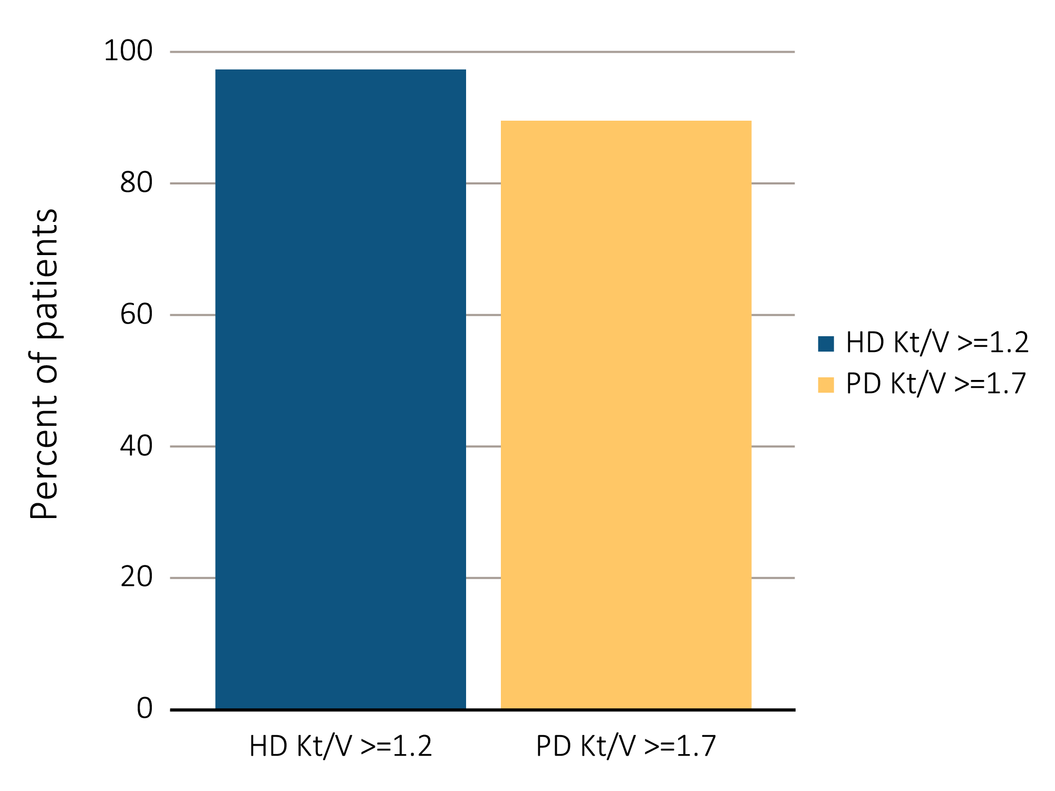
vol 2 Figure 2.1 ESRD clinical indicator levels among prevalent hemodialysis versus peritoneal dialysis patients in CROWNWeb data, May 2016: (a) percentage of patients meeting clinical care guidelines for dialysis adequacy; (b) percent distribution of Hgb levels; (c) percentage of patients with serum calcium >10.2 mg/dL; (d) percent distribution of serum albumin levels.
(a) Percentage of prevalent hemodialysis and peritoneal dialysis patients meeting
clinical care guidelines for dialysis adequacy, by modality
Data Source: Special analyses, USRDS ESRD Database. Results shown are for laboratory values reported to CROWNWeb for May 2016, restricted to patients as follows: (a) dialysis patients initiating treatment for ESRD at least 1 year prior to May 1, 2016, and who were alive through May 31, 2016; (b) dialysis patients initiating treatment for ESRD at least 90 days prior to May 1, 2016, who were ≥18 years old as of May 1, 2016, and who were alive through May 31, 2016; (c) hemodialysis and peritoneal dialysis patients initiating treatment for ESRD at least 90 days prior to May 1, 2016, who were ≥18 years old as of May 1, 2016, and who were alive through May 31, 2016; and (d) dialysis patients initiating treatment for ESRD at least 90 days prior to May 1, 2016, who were >=18 years old as of May 1, 2016, and who were alive through May 31, 2016. Abbreviations: CROWNWeb, Consolidated Renal Operations in a Web-Enabled Network; ESRD, end-stage renal disease; HD, hemodialysis; Hgb, hemoglobin; Kt/V, see Glossary; PD, peritoneal dialysis.

Slide 3
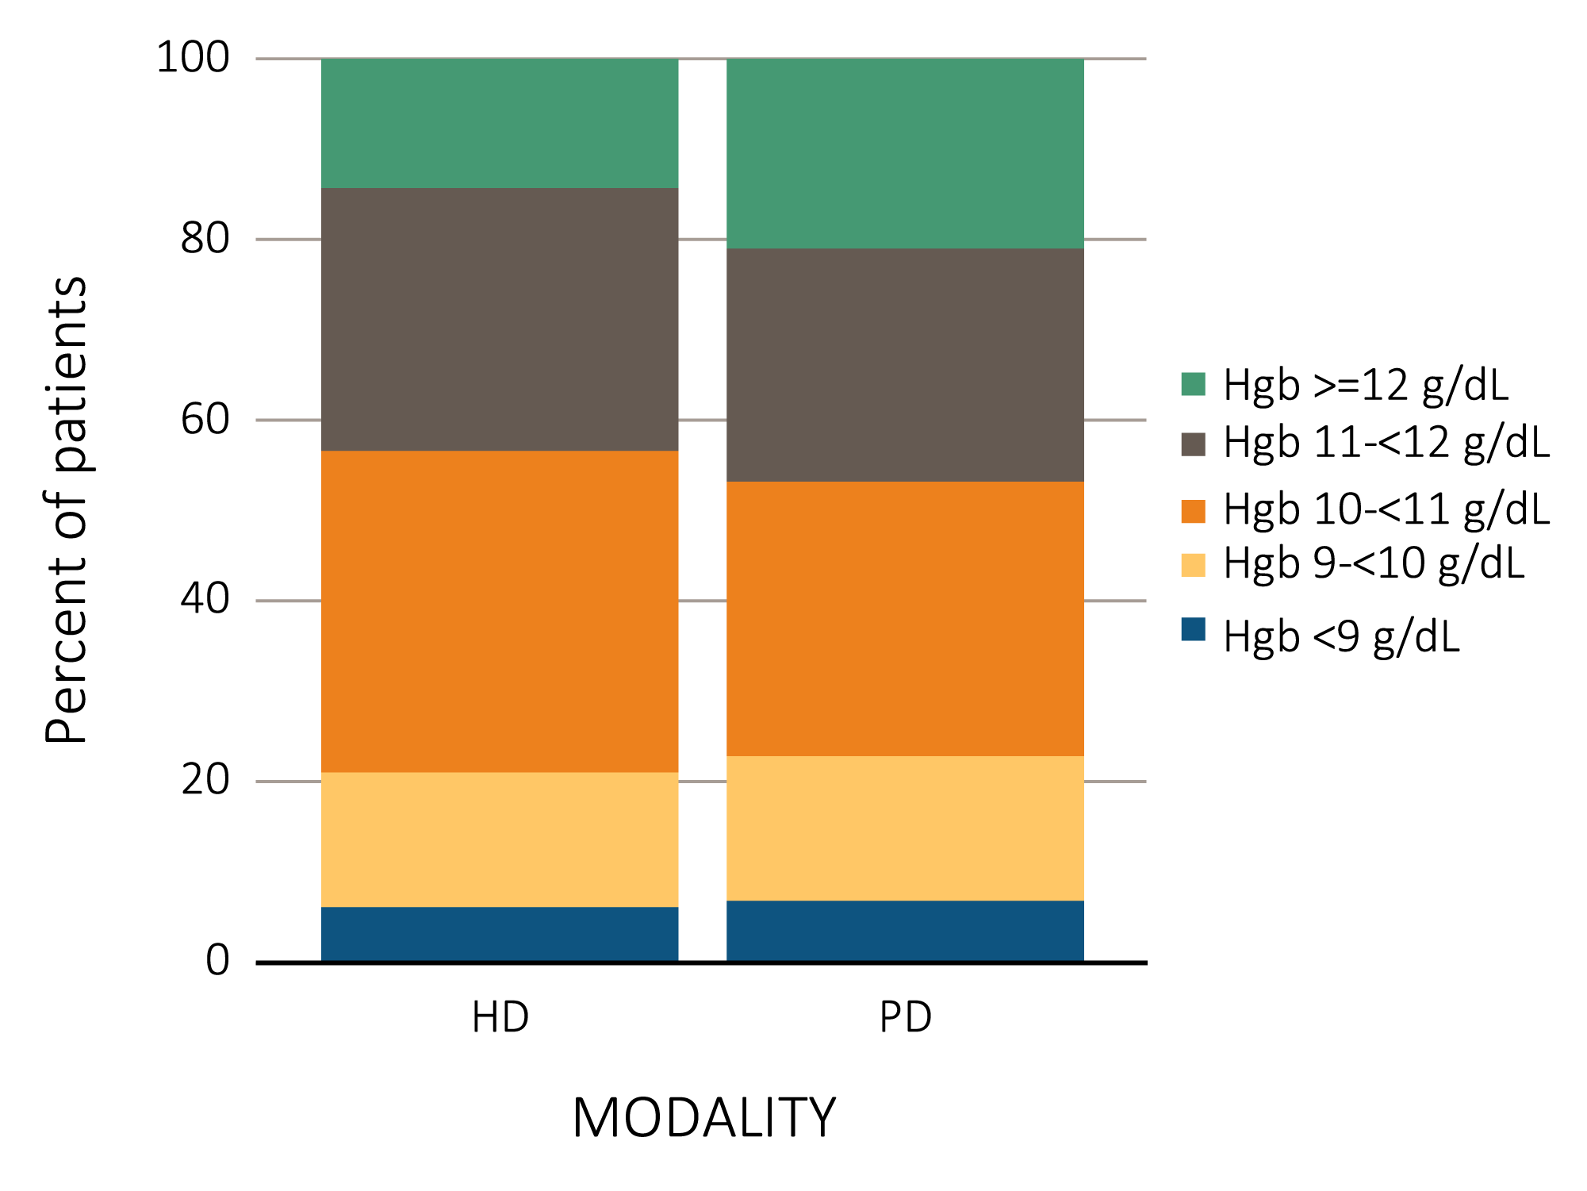
vol 2 Figure 2.1 ESRD clinical indicator levels among prevalent hemodialysis versus peritoneal dialysis patients in CROWNWeb data, May 2016: (a) percentage of patients meeting clinical care guidelines for dialysis adequacy; (b) percent distribution of Hgb levels; (c) percentage of patients with serum calcium >10.2 mg/dL; (d) percent distribution of serum albumin levels.
(b) Percent distribution of Hgb levels among prevalent hemodialysis and peritoneal dialysis patients
Data Source: Special analyses, USRDS ESRD Database. Results shown are for laboratory values reported to CROWNWeb for May 2016, restricted to patients as follows: (a) dialysis patients initiating treatment for ESRD at least 1 year prior to May 1, 2016, and who were alive through May 31, 2016; (b) dialysis patients initiating treatment for ESRD at least 90 days prior to May 1, 2016, who were ≥18 years old as of May 1, 2016, and who were alive through May 31, 2016; (c) hemodialysis and peritoneal dialysis patients initiating treatment for ESRD at least 90 days prior to May 1, 2016, who were ≥18 years old as of May 1, 2016, and who were alive through May 31, 2016; and (d) dialysis patients initiating treatment for ESRD at least 90 days prior to May 1, 2016, who were >=18 years old as of May 1, 2016, and who were alive through May 31, 2016. Abbreviations: CROWNWeb, Consolidated Renal Operations in a Web-Enabled Network; ESRD, end-stage renal disease; HD, hemodialysis; Hgb, hemoglobin; Kt/V, see Glossary; PD, peritoneal dialysis.

Slide 4
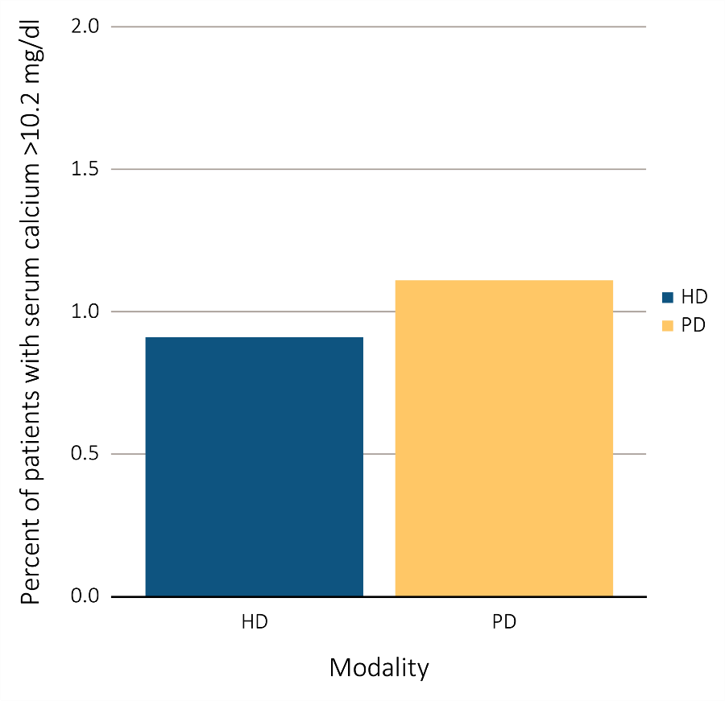
vol 2 Figure 2.1 ESRD clinical indicator levels among prevalent hemodialysis versus peritoneal dialysis patients in CROWNWeb data, May 2016: (a) percentage of patients meeting clinical care guidelines for dialysis adequacy; (b) percent distribution of Hgb levels; (c) percentage of patients with serum calcium >10.2 mg/dL; (d) percent distribution of serum albumin levels.
(c) Percentage of dialysis patients with serum calcium >10.2 mg/dL, by modality
Data Source: Special analyses, USRDS ESRD Database. Results shown are for laboratory values reported to CROWNWeb for May 2016, restricted to patients as follows: (a) dialysis patients initiating treatment for ESRD at least 1 year prior to May 1, 2016, and who were alive through May 31, 2016; (b) dialysis patients initiating treatment for ESRD at least 90 days prior to May 1, 2016, who were ≥18 years old as of May 1, 2016, and who were alive through May 31, 2016; (c) hemodialysis and peritoneal dialysis patients initiating treatment for ESRD at least 90 days prior to May 1, 2016, who were ≥18 years old as of May 1, 2016, and who were alive through May 31, 2016; and (d) dialysis patients initiating treatment for ESRD at least 90 days prior to May 1, 2016, who were >=18 years old as of May 1, 2016, and who were alive through May 31, 2016. Abbreviations: CROWNWeb, Consolidated Renal Operations in a Web-Enabled Network; ESRD, end-stage renal disease; HD, hemodialysis; Hgb, hemoglobin; Kt/V, see Glossary; PD, peritoneal dialysis.

Slide 5
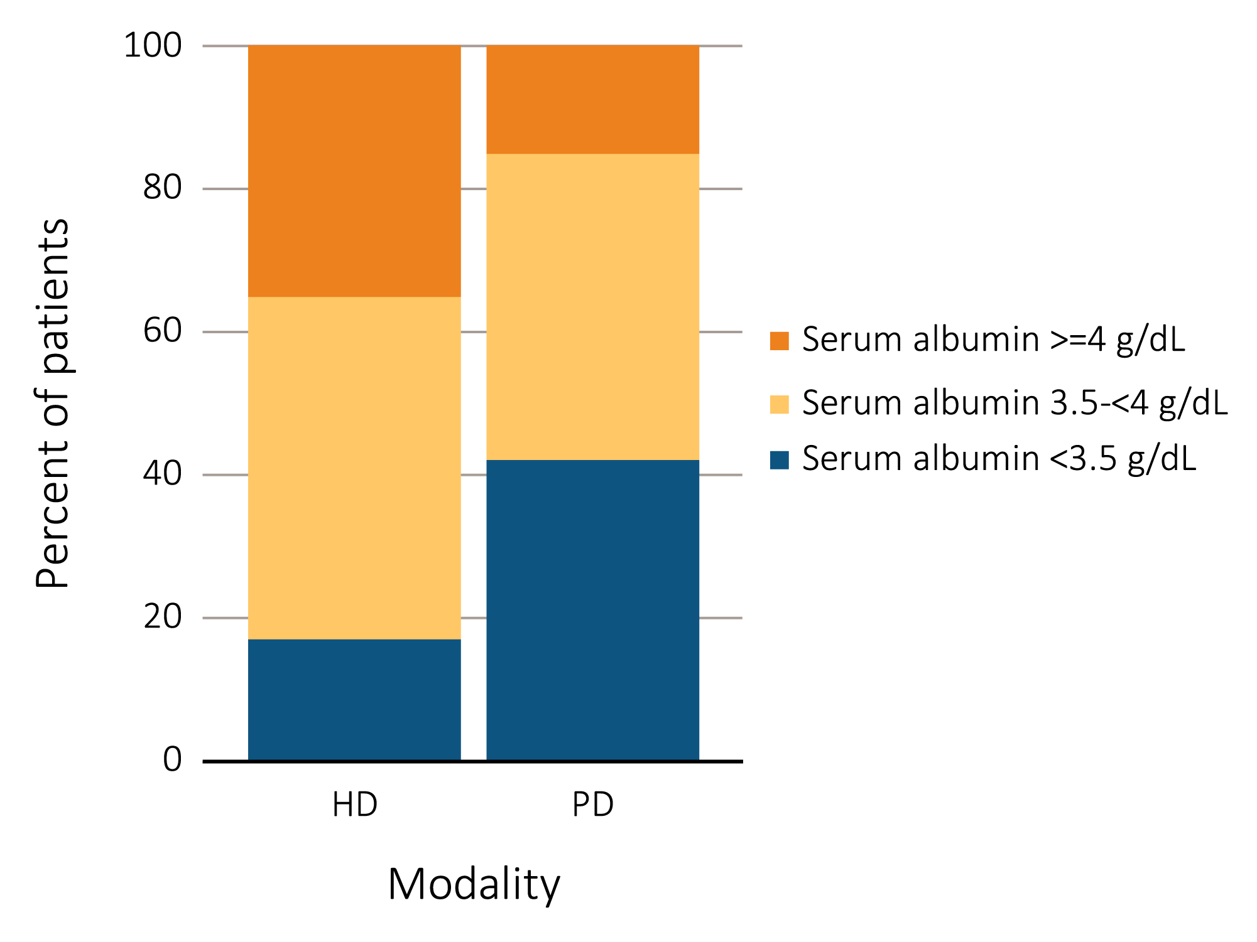
vol 2 Figure 2.1 ESRD clinical indicator levels among prevalent hemodialysis versus peritoneal dialysis patients in CROWNWeb data, May 2016: (a) percentage of patients meeting clinical care guidelines for dialysis adequacy; (b) percent distribution of Hgb levels; (c) percentage of patients with serum calcium >10.2 mg/dL; (d) percent distribution of serum albumin levels.
(d) Percent distribution of serum albumin levels among prevalent hemodialysis
and peritoneal dialysis patients
Data Source: Special analyses, USRDS ESRD Database. Results shown are for laboratory values reported to CROWNWeb for May 2016, restricted to patients as follows: (a) dialysis patients initiating treatment for ESRD at least 1 year prior to May 1, 2016, and who were alive through May 31, 2016; (b) dialysis patients initiating treatment for ESRD at least 90 days prior to May 1, 2016, who were ≥18 years old as of May 1, 2016, and who were alive through May 31, 2016; (c) hemodialysis and peritoneal dialysis patients initiating treatment for ESRD at least 90 days prior to May 1, 2016, who were ≥18 years old as of May 1, 2016, and who were alive through May 31, 2016; and (d) dialysis patients initiating treatment for ESRD at least 90 days prior to May 1, 2016, who were >=18 years old as of May 1, 2016, and who were alive through May 31, 2016. Abbreviations: CROWNWeb, Consolidated Renal Operations in a Web-Enabled Network; ESRD, end-stage renal disease; HD, hemodialysis; Hgb, hemoglobin; Kt/V, see Glossary; PD, peritoneal dialysis.

Slide 6
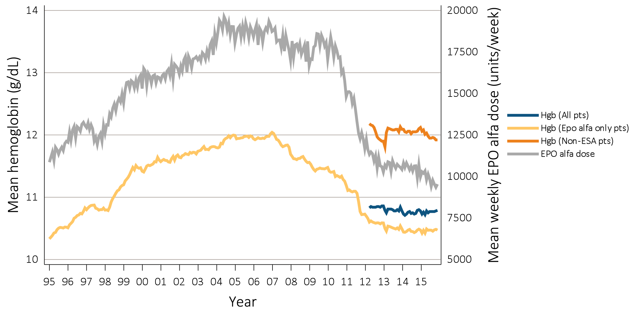
vol 2 Figure 2.2 Anemia measures among adult hemodialysis patients on dialysis ≥90 days: (a) mean monthly Hgb level and mean weekly EPO alfa dose (averaged over a month), (b) mean monthly Hgb level and mean monthly darbepoetin dose, (c) mean monthly Hgb level and mean monthly PEG-EPO beta dose, and (d) percent ESA use monthly, Medicare claims, 1995-2015
(a) Mean monthly Hgb level and mean weekly epoetin alfa dose
Data Source: Special analyses, USRDS ESRD Database. Mean monthly Hgb level among (a)EPO alfa- (b)darbepoetin (c)PEG-EPO beta patients on dialysis ≥ 90 days (1995-2015) or (a) mean monthly Hgb level among all adult hemodialysis patients (April 2012 to December 2015 only) who, within the given month had a Hgb claim (only 1st reported Hgb value in a month were used) and were on dialysis ≥ 90 days; analyses were restricted to patients ≥ 18 years old and who had been on dialysis ≥ 90 days at the start of the month. Average weekly (EPO alfa, Figure 2.2.a) or monthly (darbepoetin and PEG-EPO beta, Figures 2.2.b and c) doses are shown for hemodialysis patients who within a given month had a corresponding ESA claim. EPO alfa dose is expressed as mean EPO alfa units per week averaged over all of a patient’s EPO alfa claims w/in a given month. Darbepoetin and PEG-EPO beta dose are expressed as mean units per month over all of a patient’s corresponding Darbepoetin or PEG-EPO beta claims within a given month; (d) Monthly ESA use in all hemodialysis patients who were ≥ 18 years and on dialysis ≥ 90 days. Abbreviations: EPO alfa, erythropoietin alfa; PEG-EPO beta, pegylated erythropoetin beta; ESA, erythropoiesis-stimulating agents; Hgb, hemoglobin.

Slide 7
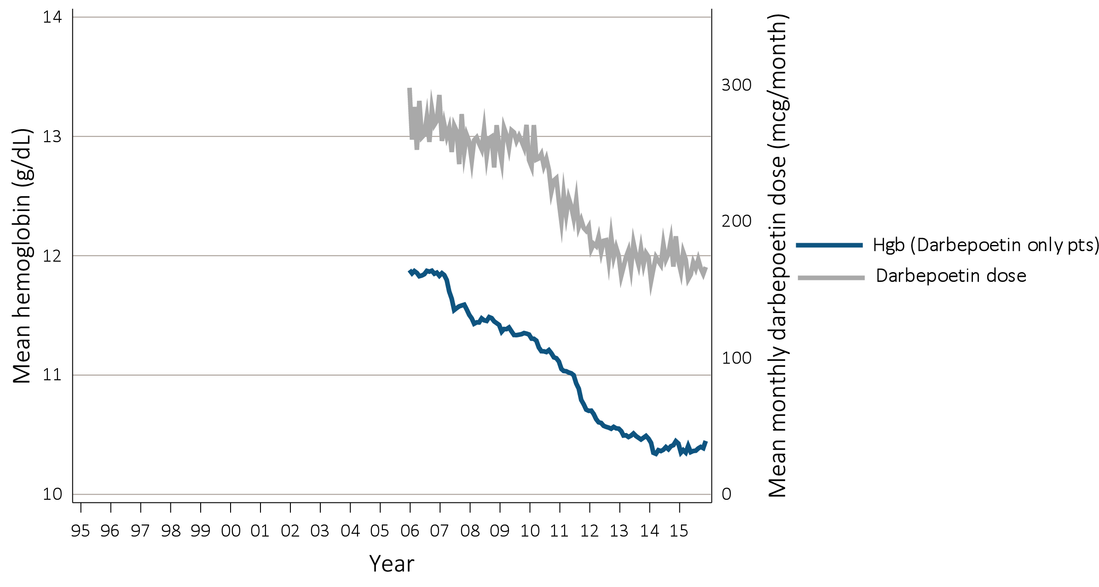
vol 2 Figure 2.2 Anemia measures among adult hemodialysis patients on dialysis ≥90 days: (a) mean monthly Hgb level and mean weekly EPO alfa dose (averaged over a month), (b) mean monthly Hgb level and mean monthly darbepoetin dose, (c) mean monthly Hgb level and mean monthly PEG-EPO beta dose, and (d) percent ESA use monthly, Medicare claims, 1995-2015
(b) Mean monthly Hgb level and mean monthly darbepoetin dose
Data Source: Special analyses, USRDS ESRD Database. Mean monthly Hgb level among (a)EPO alfa- (b)darbepoetin (c)PEG-EPO beta patients on dialysis ≥ 90 days (1995-2015) or (a) mean monthly Hgb level among all adult hemodialysis patients (April 2012 to December 2015 only) who, within the given month had a Hgb claim (only 1st reported Hgb value in a month were used) and were on dialysis ≥ 90 days; analyses were restricted to patients ≥ 18 years old and who had been on dialysis ≥ 90 days at the start of the month. Average weekly (EPO alfa, Figure 2.2.a) or monthly (darbepoetin and PEG-EPO beta, Figures 2.2.b and c) doses are shown for hemodialysis patients who within a given month had a corresponding ESA claim. EPO alfa dose is expressed as mean EPO alfa units per week averaged over all of a patient’s EPO alfa claims w/in a given month. Darbepoetin and PEG-EPO beta dose are expressed as mean units per month over all of a patient’s corresponding Darbepoetin or PEG-EPO beta claims within a given month; (d) Monthly ESA use in all hemodialysis patients who were ≥ 18 years and on dialysis ≥ 90 days. Abbreviations: EPO alfa, erythropoietin alfa; PEG-EPO beta, pegylated erythropoetin beta; ESA, erythropoiesis-stimulating agents; Hgb, hemoglobin.

Slide 8
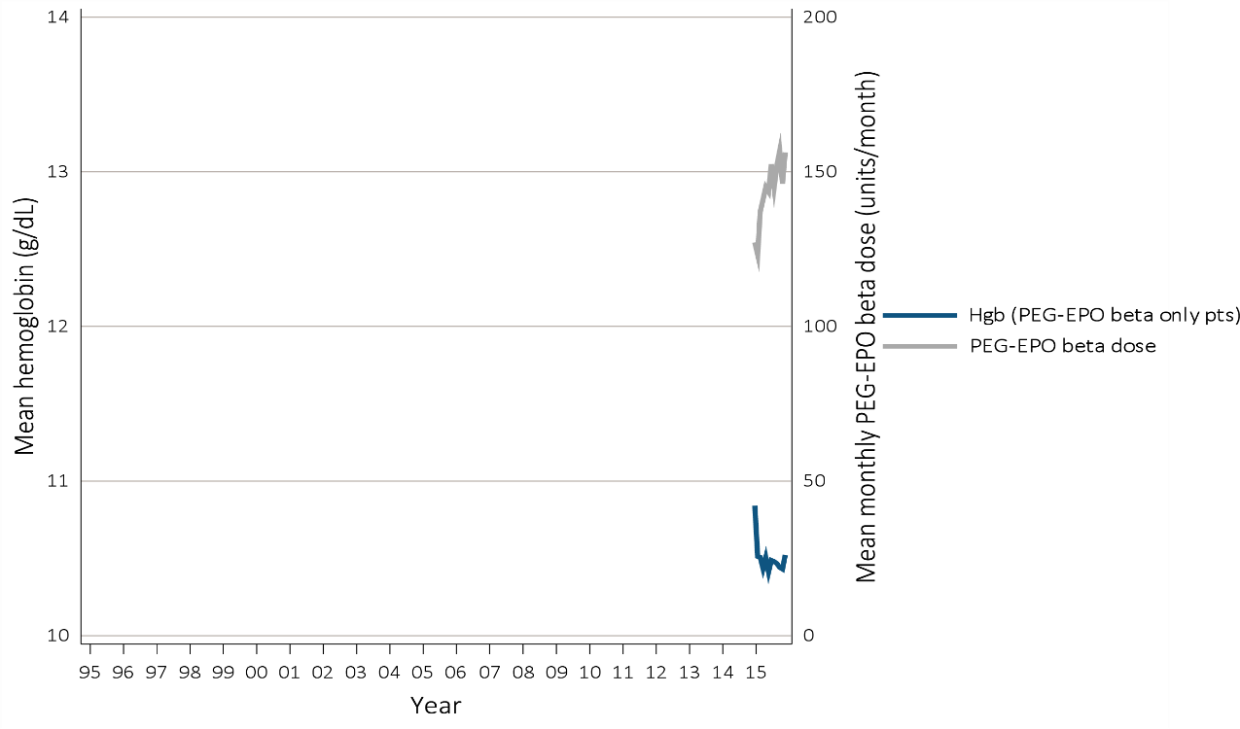
vol 2 Figure 2.2 Anemia measures among adult hemodialysis patients on dialysis ≥90 days: (a) mean monthly Hgb level and mean weekly EPO alfa dose (averaged over a month), (b) mean monthly Hgb level and mean monthly darbepoetin dose, (c) mean monthly Hgb level and mean monthly PEG-EPO beta dose, and (d) percent ESA use monthly, Medicare claims, 1995-2015
(c) Mean monthly Hgb level and mean monthly PEG-EPO beta-dose
Data Source: Special analyses, USRDS ESRD Database. Mean monthly Hgb level among (a)EPO alfa- (b)darbepoetin (c)PEG-EPO beta patients on dialysis ≥ 90 days (1995-2015) or (a) mean monthly Hgb level among all adult hemodialysis patients (April 2012 to December 2015 only) who, within the given month had a Hgb claim (only 1st reported Hgb value in a month were used) and were on dialysis ≥ 90 days; analyses were restricted to patients ≥ 18 years old and who had been on dialysis ≥ 90 days at the start of the month. Average weekly (EPO alfa, Figure 2.2.a) or monthly (darbepoetin and PEG-EPO beta, Figures 2.2.b and c) doses are shown for hemodialysis patients who within a given month had a corresponding ESA claim. EPO alfa dose is expressed as mean EPO alfa units per week averaged over all of a patient’s EPO alfa claims w/in a given month. Darbepoetin and PEG-EPO beta dose are expressed as mean units per month over all of a patient’s corresponding Darbepoetin or PEG-EPO beta claims within a given month; (d) Monthly ESA use in all hemodialysis patients who were ≥ 18 years and on dialysis ≥ 90 days. Abbreviations: EPO alfa, erythropoietin alfa; PEG-EPO beta, pegylated erythropoetin beta; ESA, erythropoiesis-stimulating agents; Hgb, hemoglobin.

Slide 9
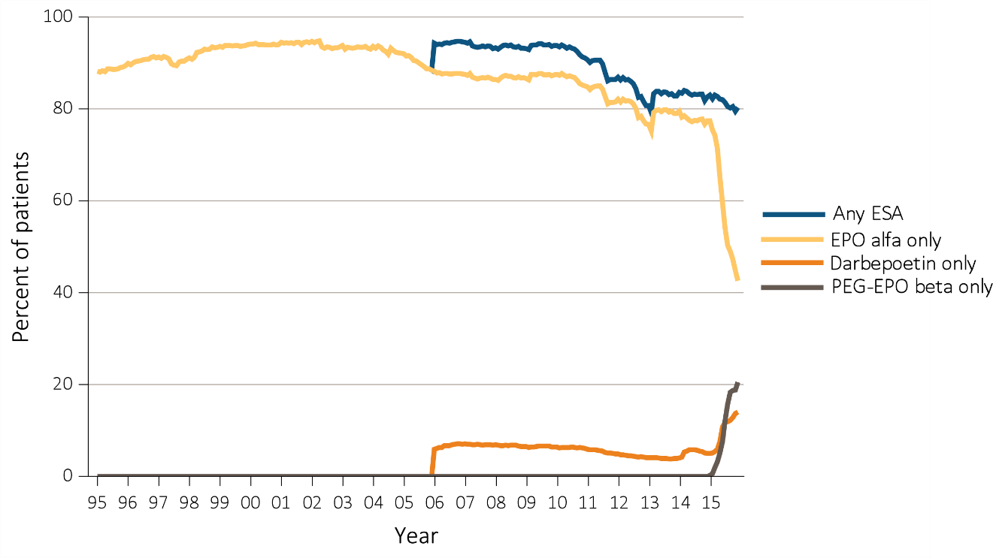
vol 2 Figure 2.2 Anemia measures among adult hemodialysis patients on dialysis ≥90 days: (a) mean monthly Hgb level and mean weekly EPO alfa dose (averaged over a month), (b) mean monthly Hgb level and mean monthly darbepoetin dose, (c) mean monthly Hgb level and mean monthly PEG-EPO beta dose, and (d) percent ESA use monthly, Medicare claims, 1995-2015
(d) Percent monthly ESA dose
Data Source: Special analyses, USRDS ESRD Database. Mean monthly Hgb level among (a)EPO alfa- (b)darbepoetin (c)PEG-EPO beta patients on dialysis ≥ 90 days (1995-2015) or (a) mean monthly Hgb level among all adult hemodialysis patients (April 2012 to December 2015 only) who, within the given month had a Hgb claim (only 1st reported Hgb value in a month were used) and were on dialysis ≥ 90 days; analyses were restricted to patients ≥ 18 years old and who had been on dialysis ≥ 90 days at the start of the month. Average weekly (EPO alfa, Figure 2.2.a) or monthly (darbepoetin and PEG-EPO beta, Figures 2.2.b and c) doses are shown for hemodialysis patients who within a given month had a corresponding ESA claim. EPO alfa dose is expressed as mean EPO alfa units per week averaged over all of a patient’s EPO alfa claims w/in a given month. Darbepoetin and PEG-EPO beta dose are expressed as mean units per month over all of a patient’s corresponding Darbepoetin or PEG-EPO beta claims within a given month; (d) Monthly ESA use in all hemodialysis patients who were ≥ 18 years and on dialysis ≥ 90 days. Abbreviations: EPO alfa, erythropoietin alfa; PEG-EPO beta, pegylated erythropoetin beta; ESA, erythropoiesis-stimulating agents; Hgb, hemoglobin.

Slide 10
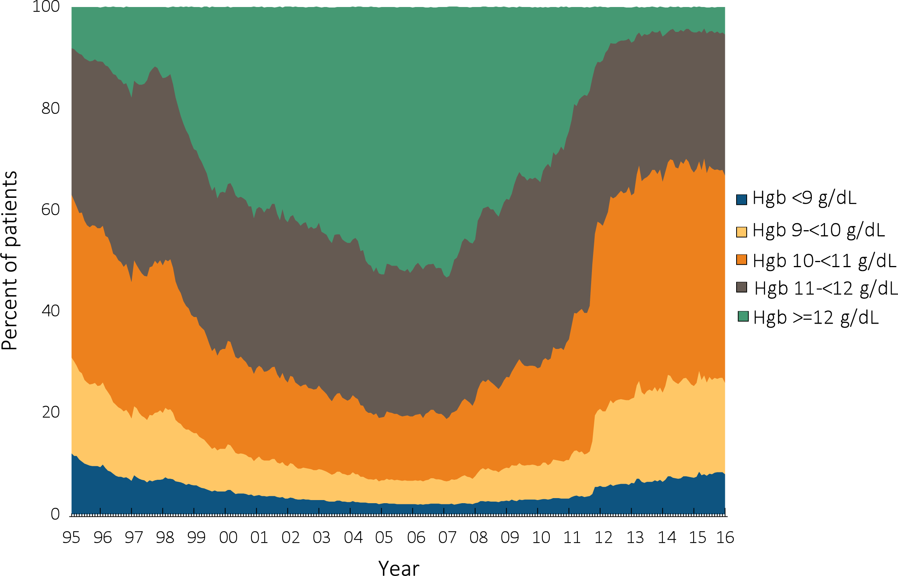
vol 2 Figure 2.3 Distribution of monthly Hgb levels in ESA-treated adult hemodialysis patients on dialysis ≥90 days, Medicare claims, 1995-2015
Data Source: Special analyses, USRDS ESRD Database. Distribution of monthly Hgb levels among hemodialysis patients within a given month who had claims for Hgb level and ESA use, were on dialysis ≥90 days and ≥18 years old at the start of the month. Abbreviations: ESA, erythropoiesis-stimulating agents; Hgb, hemoglobin.

Slide 11
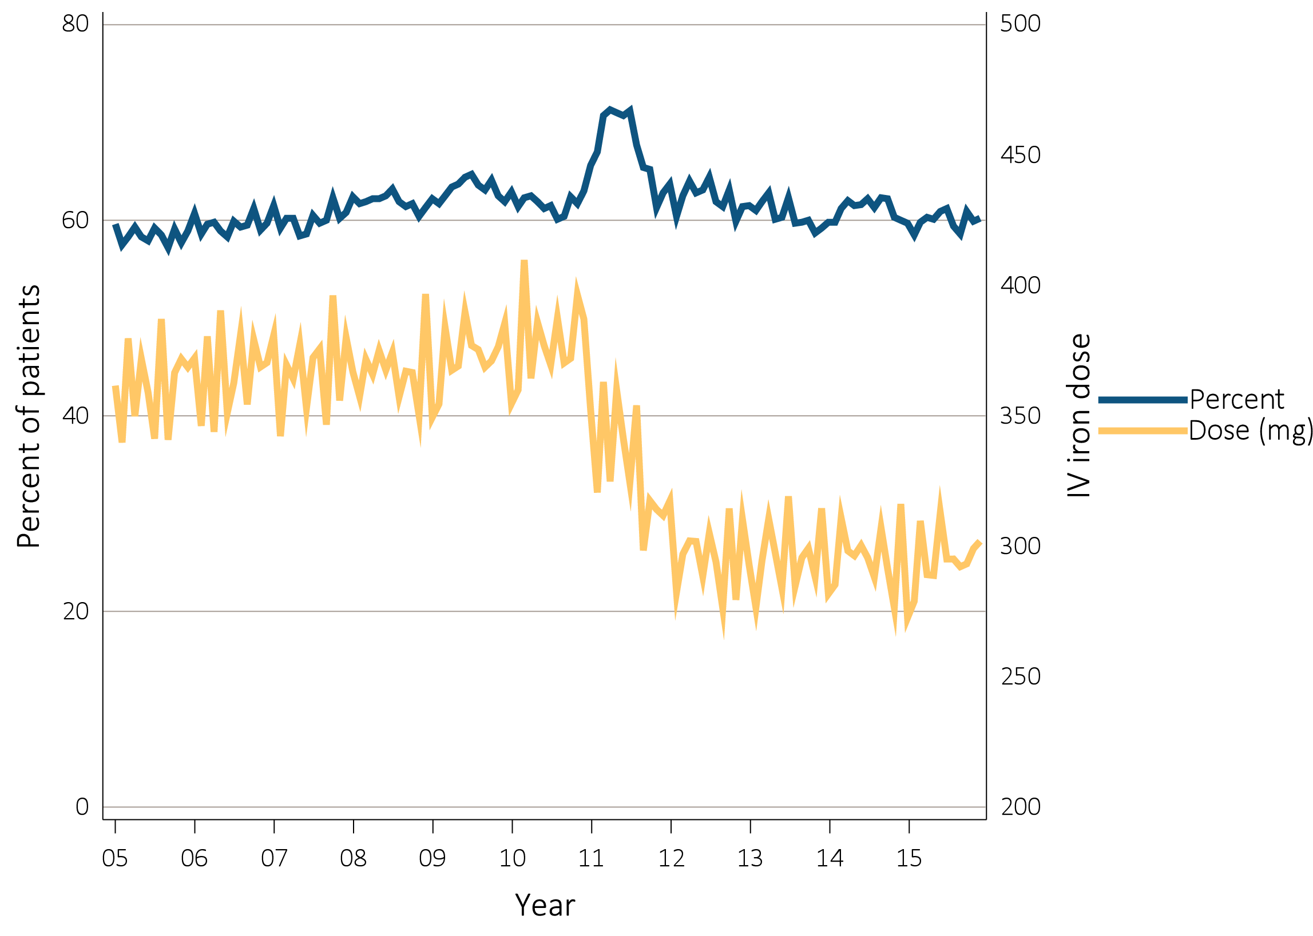
vol 2 Figure 2.4 Monthly percent IV iron use and mean monthly IV iron dose in adult hemodialysis patients on dialysis ≥90 days, Medicare claims, 2005-2015
Data Source: Special analyses, USRDS ESRD Database. Monthly IV iron use is among hemodialysis patients on dialysis ≥90 days and ≥18 years old at the start of the given month. Mean IV iron dose was calculated as the average number of mg of IV iron given to all such patients during a month, among patients receiving iron during the month. Abbreviation: IV, intravenous.

Slide 12
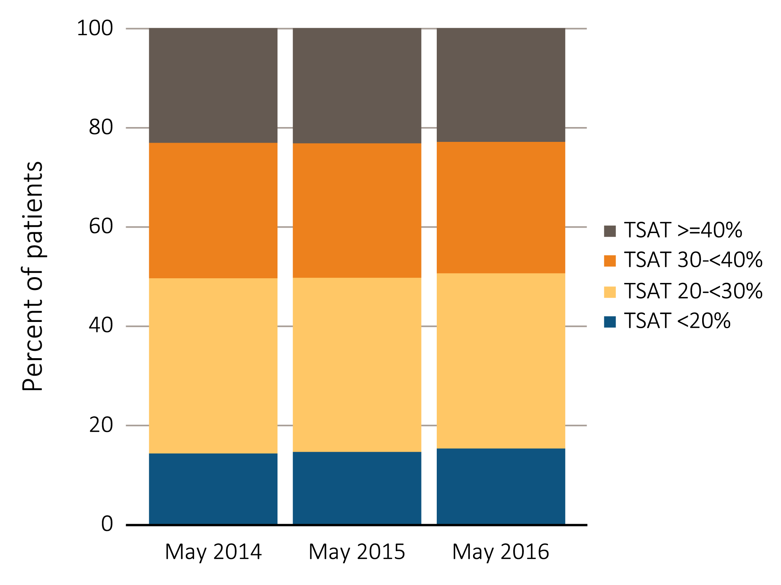
vol 2 Figure 2.5 Distribution of TSAT levels in adult hemodialysis patients on dialysis for at least 90 days, CROWNWeb data, May 2014, 2015, and 2016
Data Source: Special analyses, USRDS ESRD Database. CROWNWeb clinical extracts for May 2014, May 2015 and May 2016. Dialysis patients on treatment for ESRD at least 90 days before the time of measurement of TSAT level for that year, ≥18 years old as of May 1 of that year and who were alive through May 31 of that year. Abbreviations: CROWNWeb, Consolidated Renal Operations in a Web-Enabled Network; TSAT, transferrin saturation.

Slide 13
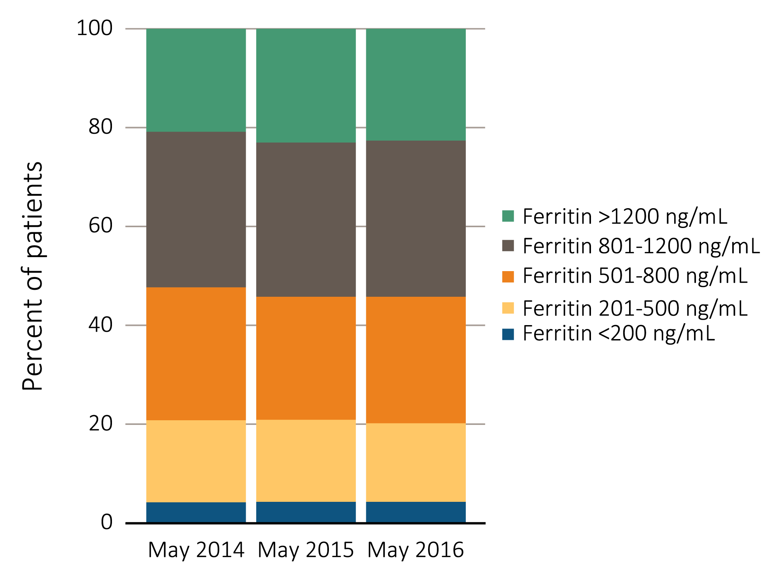
vol 2 Figure 2.6 Distribution of the most recent value of serum ferritin level taken between March and May in adult hemodialysis patients on dialysis for at least 90 days, CROWNWeb data, 2013-2016
Data Source: Special analyses, USRDS ESRD Database. CROWNWeb clinical extracts for March to May for years 2014, 2015 and 2016. Dialysis patients initiating treatment for ESRD at least 90 days before the time of measurement of serum ferritin for that year, ≥18 years old as of May 1 of that year and who were alive through May 31 of that year. Abbreviation: CROWNWeb, Consolidated Renal Operations in a Web-Enabled Network.

Slide 14
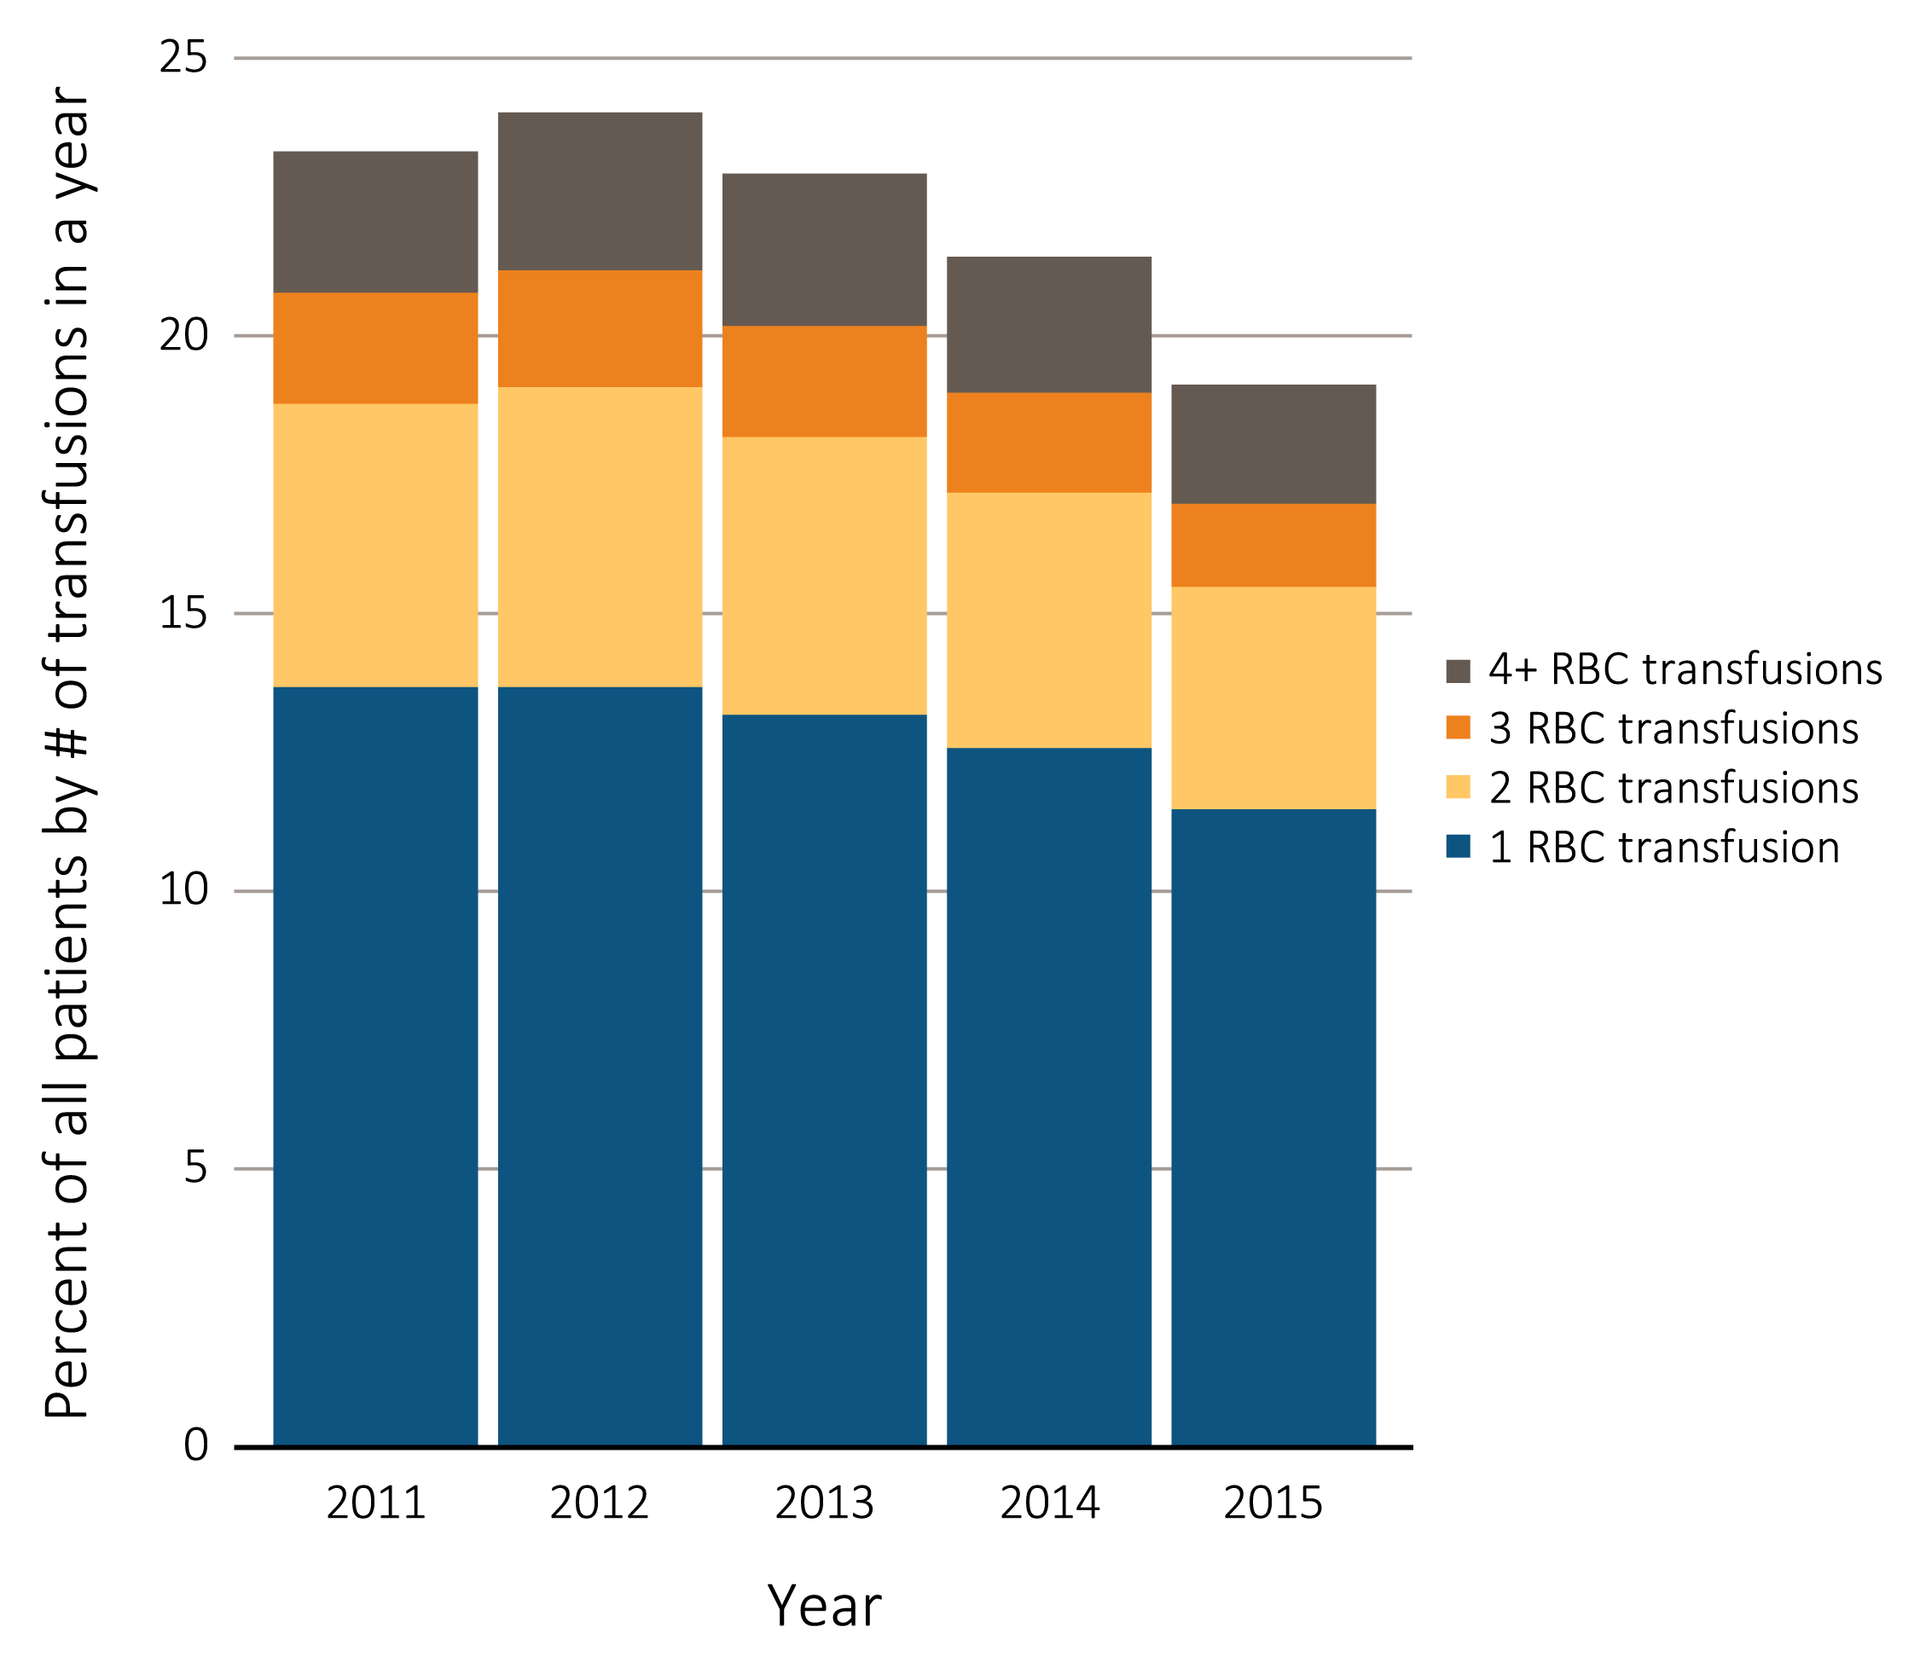
vol 2 Figure 2.7 Percentage of all adult hemodialysis patients (a) by number of red blood cell transfusions received in a year, and (b) with ≥1 claims for a red blood cell transfusion in a month, overall and by vintage, from Medicare claims, 2011-2015
(a) Percent of patients, by number of red blood cell transfusions received in a year
Data Source: Special analyses, USRDS ESRD Database. The percentage of hemodialysis patients ≥18 years old at the start of the month with ≥1 red blood cell transfusion claims in a given month among hemodialysis patients having a claim for at least one dialysis session during the month. Additional analysis of RBC transfusion claims completed for patients on dialysis for < 90 days or ≥ 90 days. Abbreviation: RBC, red blood cell.

Slide 15
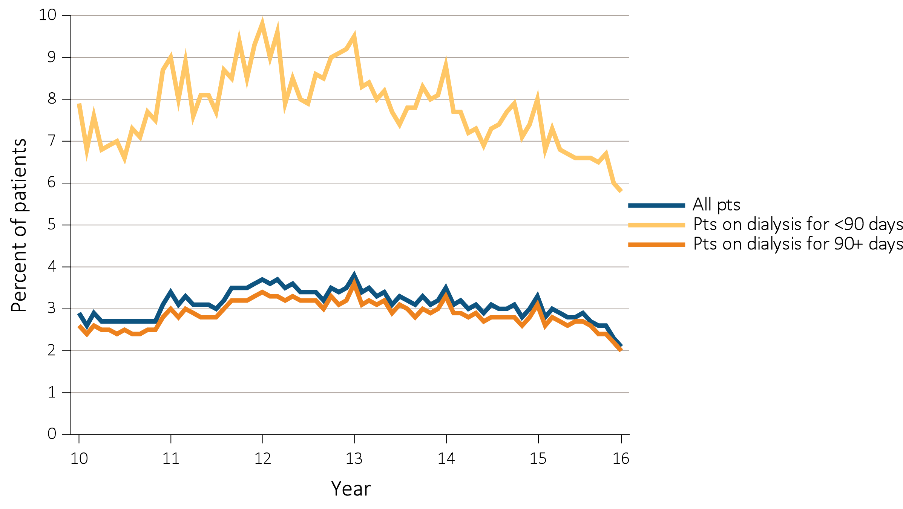
vol 2 Figure 2.7 Percentage of all adult hemodialysis patients (a) by number of red blood cell transfusions received in a year, and (b) with ≥1 claims for a red blood cell transfusion in a month, overall and by vintage, from Medicare claims, 2011-2015
(b) Percent of all patients, patients on dialysis <90 days, or patients on dialysis ≥90 days, who had one or more claims for a red blood cell transfusion in a month
Data Source: Special analyses, USRDS ESRD Database. The percentage of hemodialysis patients ≥18 years old at the start of the month with ≥1 red blood cell transfusion claims in a given month among hemodialysis patients having a claim for at least one dialysis session during the month. Additional analysis of RBC transfusion claims completed for patients on dialysis for < 90 days or ≥ 90 days. Abbreviation: RBC, red blood cell.

Slide 16
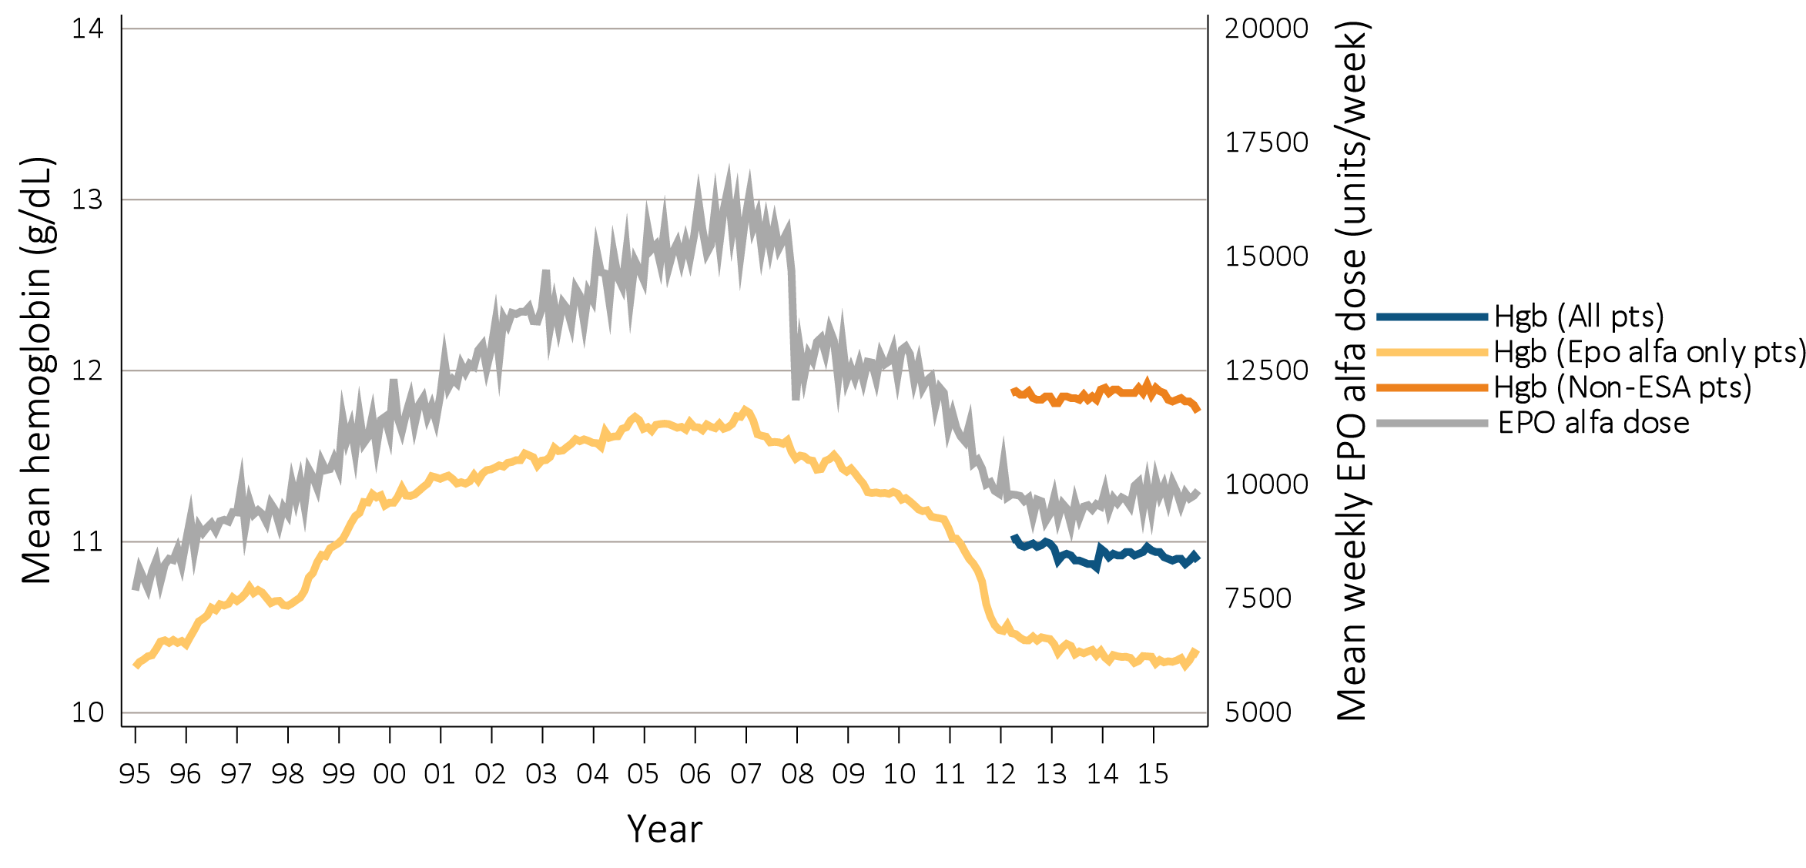
vol 2 Figure 2.8 Anemia measures among adult peritoneal dialysis patients on dialysis ≥90 days: (a) mean monthly Hgb level and mean weekly EPO alfa dose (averaged over a month), (b) mean monthly Hgb and mean monthly darbepoetin dose, and (c) percent ESA use monthly, Medicare claims, 1995-2015
(a) Mean monthly Hgb level and mean weekly epoetin alfa dose
Data Source: Special analyses, USRDS ESRD Database. Mean monthly Hgb level among (a) EPO alfa- and (b) darbepoetin on dialysis ≥ 90 days (1995-2015) or (b) mean monthly Hgb level among all adult peritoneal dialysis patients (April 2012 to December 2015 only) who, within the given month, had a Hgb claim (only 1st reported Hgb value in a month were used) and were on dialysis ≥ 90 days; analyses were restricted to patients ≥ 18 years old and who had been on dialysis ≥ 90 days at the start of the month. Average weekly (EPO alfa, Figure 2.2.a) or monthly (darbepoetin, Figure 2.2.b) doses are shown for peritoneal dialysis patients who within a given month had a corresponding ESA claim. EPO alfa dose is expressed as mean EPO alfa units per week averaged over all a patient’s EPO alfa claims within a given month. Darbepoetin dose is expressed as mean units per month over all of a patient’s corresponding Darbepoetin claims within a given month. PEG-EPO beta dose and Hgb Figure excluded due to small numbers. (c) Monthly ESA use (EPO alfa, Darbepoetin, or PEG-EPO beta) in all hemodialysis patients who were ≥ 18 years and on dialysis ≥ 90 days. Abbreviations: EPO alfa, erythropoietin alfa; PEG-EPO beta, pegylated erythropoetin beta; ESA, erythropoiesis-stimulating agents; Hgb, hemoglobin.

Slide 17
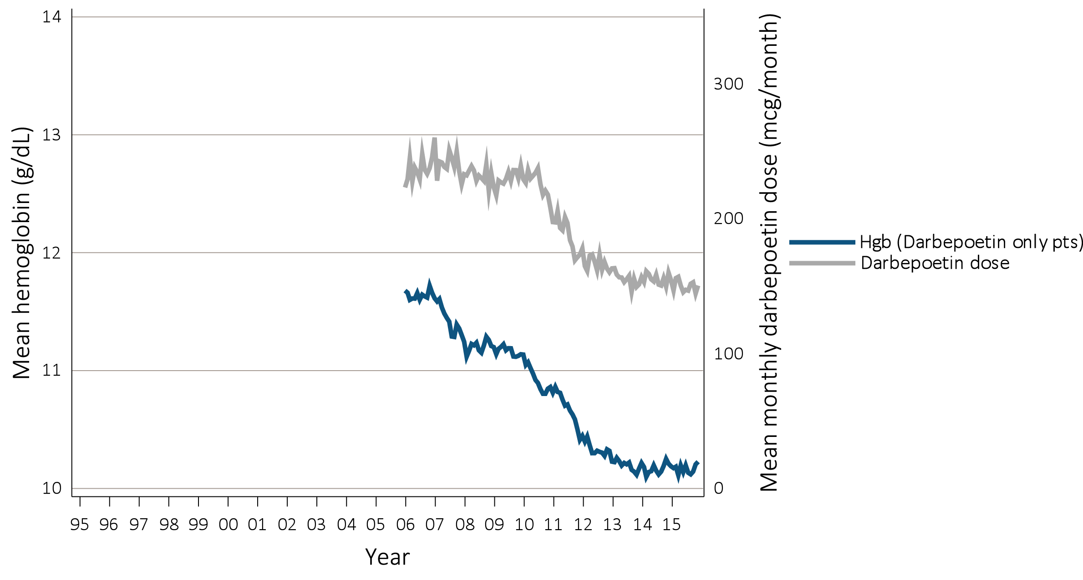
vol 2 Figure 2.8 Anemia measures among adult peritoneal dialysis patients on dialysis ≥90 days: (a) mean monthly Hgb level and mean weekly EPO alfa dose (averaged over a month), (b) mean monthly Hgb and mean monthly darbepoetin dose, and (c) percent ESA use monthly, Medicare claims, 1995-2015
(b) Mean monthly Hgb level and mean monthly darbepoetin dose
Data Source: Special analyses, USRDS ESRD Database. Mean monthly Hgb level among (a) EPO alfa- and (b) darbepoetin on dialysis ≥ 90 days (1995-2015) or (b) mean monthly Hgb level among all adult peritoneal dialysis patients (April 2012 to December 2015 only) who, within the given month, had a Hgb claim (only 1st reported Hgb value in a month were used) and were on dialysis ≥ 90 days; analyses were restricted to patients ≥ 18 years old and who had been on dialysis ≥ 90 days at the start of the month. Average weekly (EPO alfa, Figure 2.2.a) or monthly (darbepoetin, Figure 2.2.b) doses are shown for peritoneal dialysis patients who within a given month had a corresponding ESA claim. EPO alfa dose is expressed as mean EPO alfa units per week averaged over all a patient’s EPO alfa claims within a given month. Darbepoetin dose is expressed as mean units per month over all of a patient’s corresponding Darbepoetin claims within a given month. PEG-EPO beta dose and Hgb Figure excluded due to small numbers. (c) Monthly ESA use (EPO alfa, Darbepoetin, or PEG-EPO beta) in all hemodialysis patients who were ≥ 18 years and on dialysis ≥ 90 days. Abbreviations: EPO alfa, erythropoietin alfa; PEG-EPO beta, pegylated erythropoetin beta; ESA, erythropoiesis-stimulating agents; Hgb, hemoglobin.

Slide 18
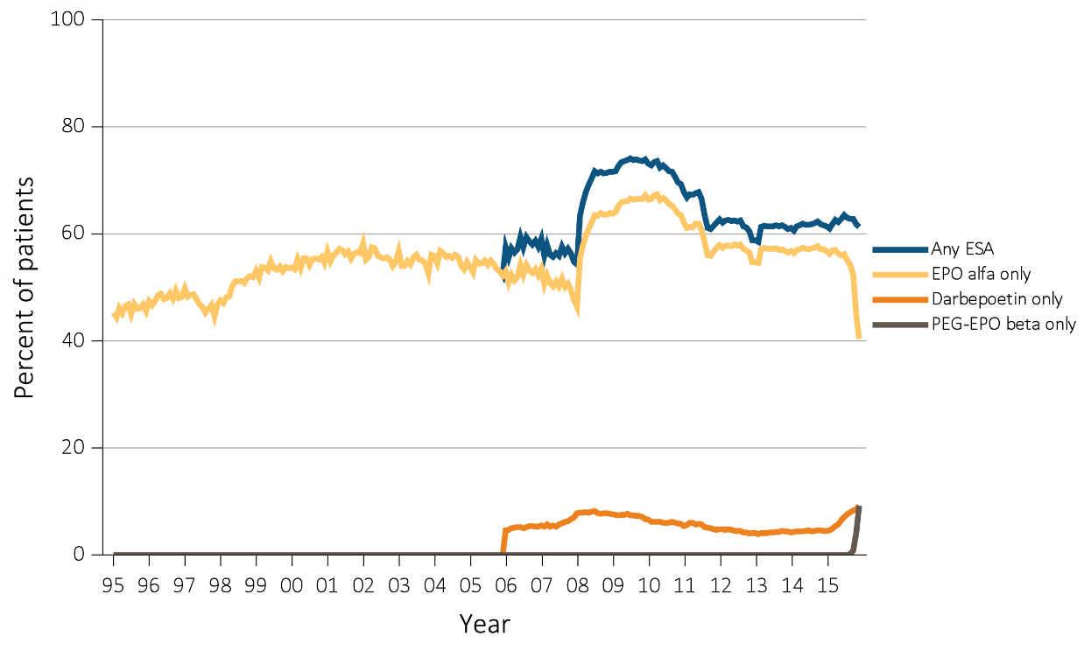
vol 2 Figure 2.8 Anemia measures among adult peritoneal dialysis patients on dialysis ≥90 days: (a) mean monthly Hgb level and mean weekly EPO alfa dose (averaged over a month), (b) mean monthly Hgb and mean monthly darbepoetin dose, and (c) percent ESA use monthly, Medicare claims, 1995-2015
(c) Percent ESA use monthly
Data Source: Special analyses, USRDS ESRD Database. Mean monthly Hgb level among (a) EPO alfa- and (b) darbepoetin on dialysis ≥ 90 days (1995-2015) or (b) mean monthly Hgb level among all adult peritoneal dialysis patients (April 2012 to December 2015 only) who, within the given month, had a Hgb claim (only 1st reported Hgb value in a month were used) and were on dialysis ≥ 90 days; analyses were restricted to patients ≥ 18 years old and who had been on dialysis ≥ 90 days at the start of the month. Average weekly (EPO alfa, Figure 2.2.a) or monthly (darbepoetin, Figure 2.2.b) doses are shown for peritoneal dialysis patients who within a given month had a corresponding ESA claim. EPO alfa dose is expressed as mean EPO alfa units per week averaged over all a patient’s EPO alfa claims within a given month. Darbepoetin dose is expressed as mean units per month over all of a patient’s corresponding Darbepoetin claims within a given month. PEG-EPO beta dose and Hgb Figure excluded due to small numbers. (c) Monthly ESA use (EPO alfa, Darbepoetin, or PEG-EPO beta) in all hemodialysis patients who were ≥ 18 years and on dialysis ≥ 90 days. Abbreviations: EPO alfa, erythropoietin alfa; PEG-EPO beta, pegylated erythropoetin beta; ESA, erythropoiesis-stimulating agents; Hgb, hemoglobin.

Slide 19
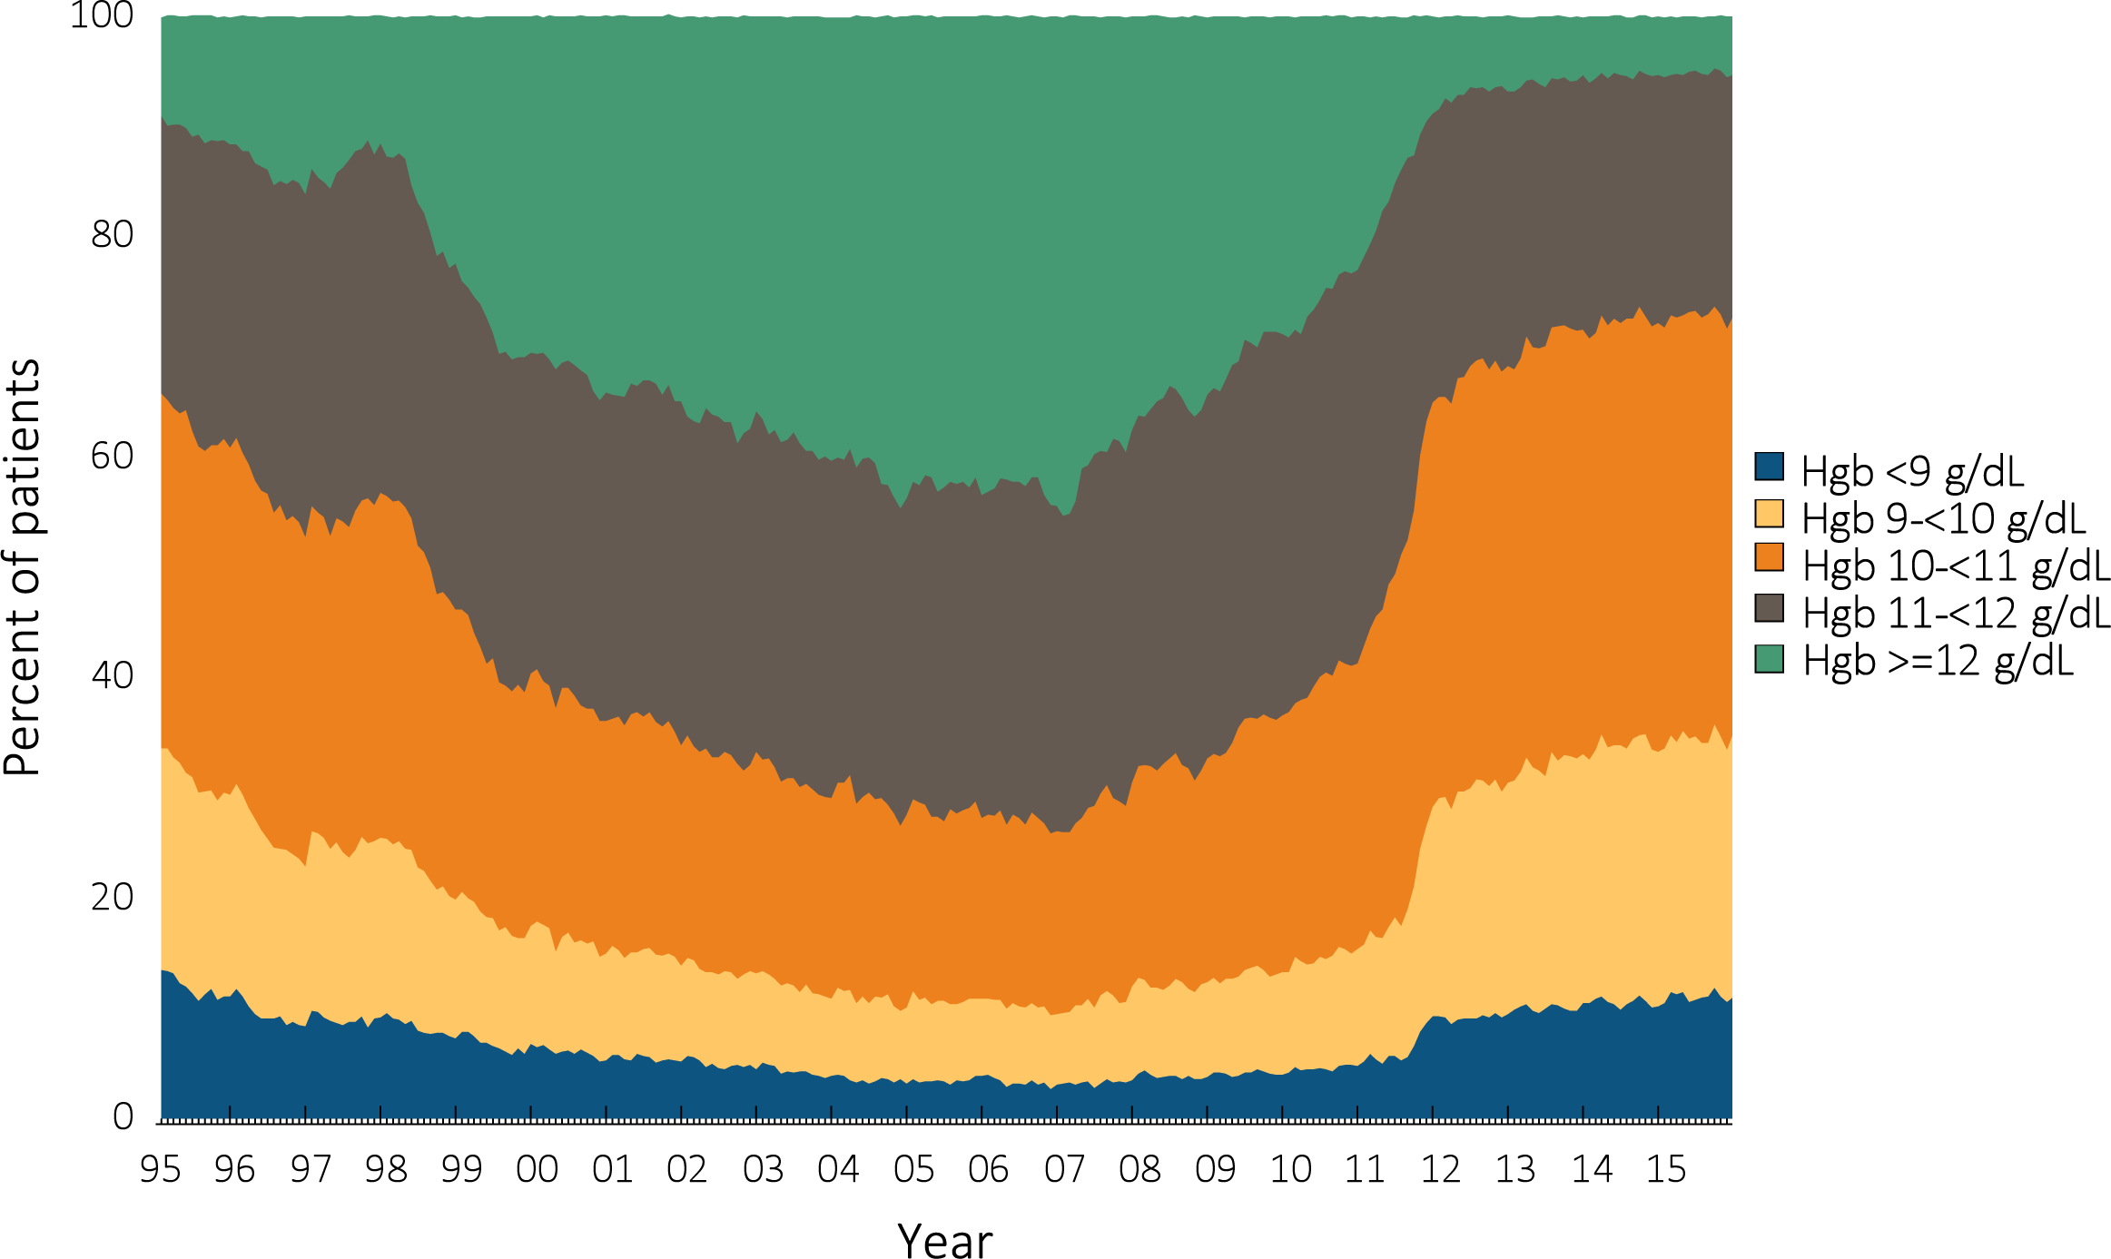
vol 2 Figure 2.9 Distribution of monthly Hgb levels in ESA-treated adult peritoneal dialysis patients on dialysis ≥90 days, Medicare claims, 1995-2015
Data Source: Special analyses, USRDS ESRD Database. Distribution of Hgb levels among peritoneal dialysis patients within a given month who had claims for Hgb level and ESA use, were on dialysis ≥90 days and ≥18 years old at the start of the month. Abbreviations: ESA, erythropoiesis-stimulating agents; Hgb, hemoglobin.

Slide 20
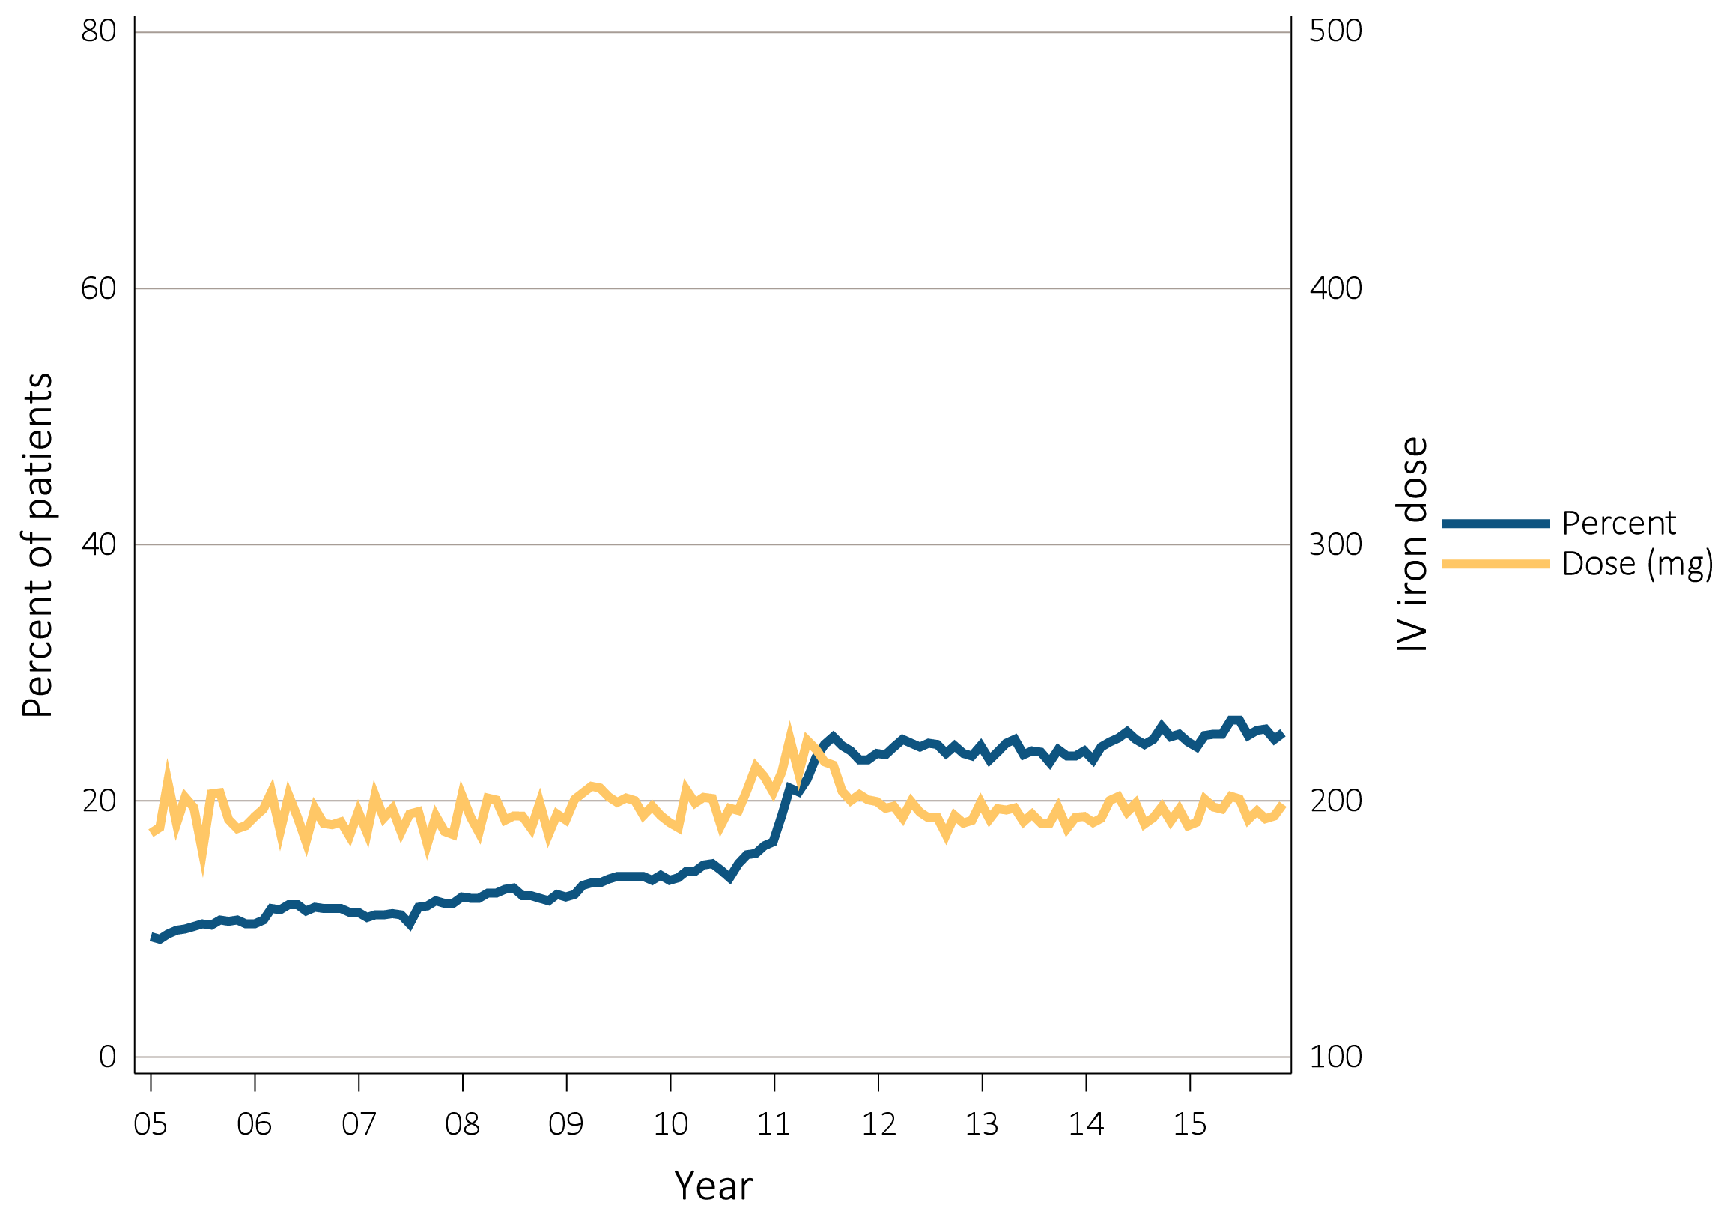
vol 2 Figure 2.10 Monthly IV iron use and mean monthly IV iron dose in adult peritoneal dialysis patients on dialysis ≥90 days, Medicare claims, 2005-2015
Data Source: Special analyses, USRDS ESRD Database. Monthly IV iron use is among peritoneal dialysis patients on dialysis ≥90 days and ≥18 years old at the start of the given month. Mean IV iron dose was calculated as the average number of mg of IV iron given to all such patients during a month, among patients receiving iron during the month. Abbreviation: IV, intravenous.

Slide 21
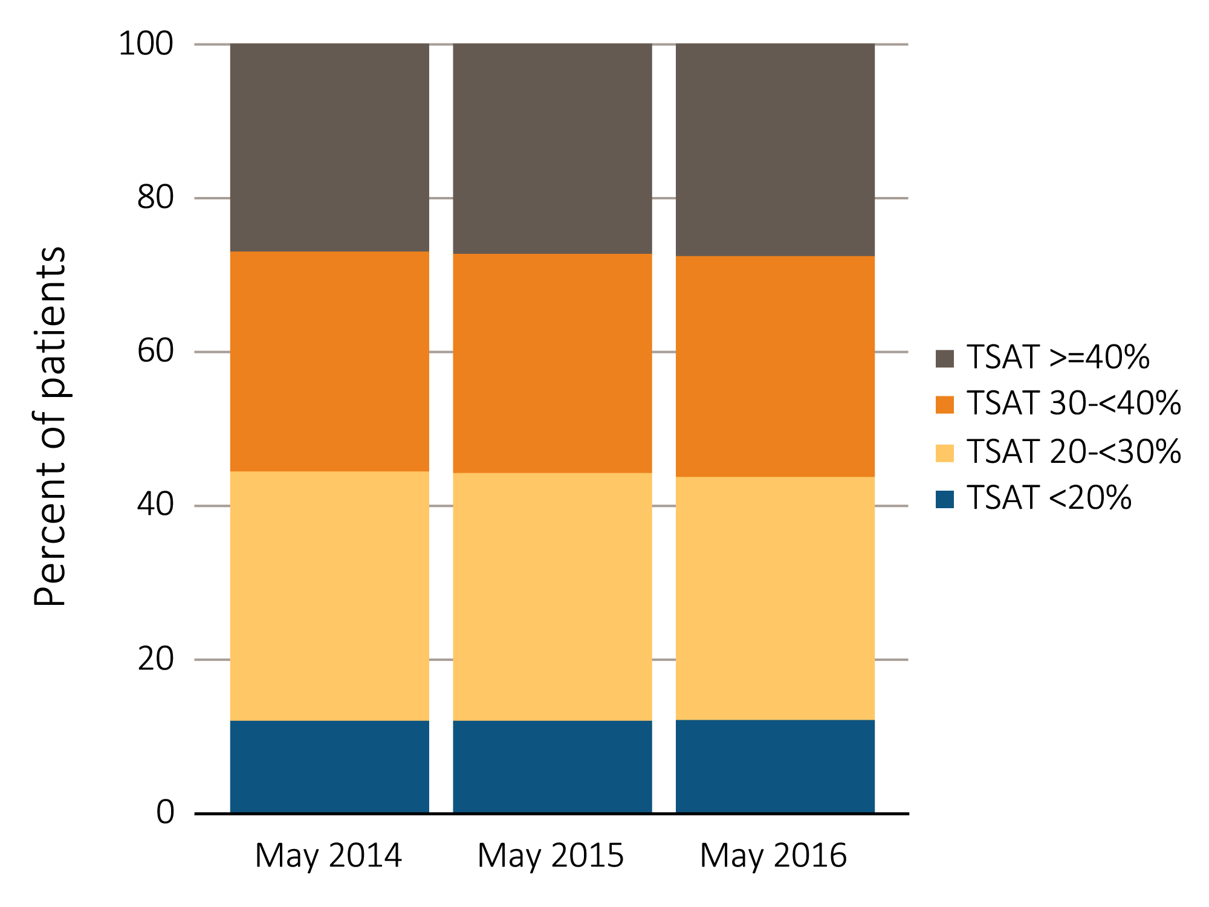
vol 2 Figure 2.11 Distribution of TSAT levels in adult peritoneal dialysis patients on dialysis for at least 90 days, CROWNWeb data, May 2014, 2015, and 2016
Data Source: Special analyses, USRDS ESRD Database. CROWNWeb clinical extracts for March to May for years 2014, 2015 and 2016. Dialysis patients on treatment for ESRD at least 90 days at the time of measurement of TSAT level for that year, ≥18 years old as of May 1st of that year, and who were alive through May 31 of that year. Abbreviations: CROWNWeb, Consolidated Renal Operations in a Web-Enabled Network; TSAT, transferrin saturation.

Slide 22
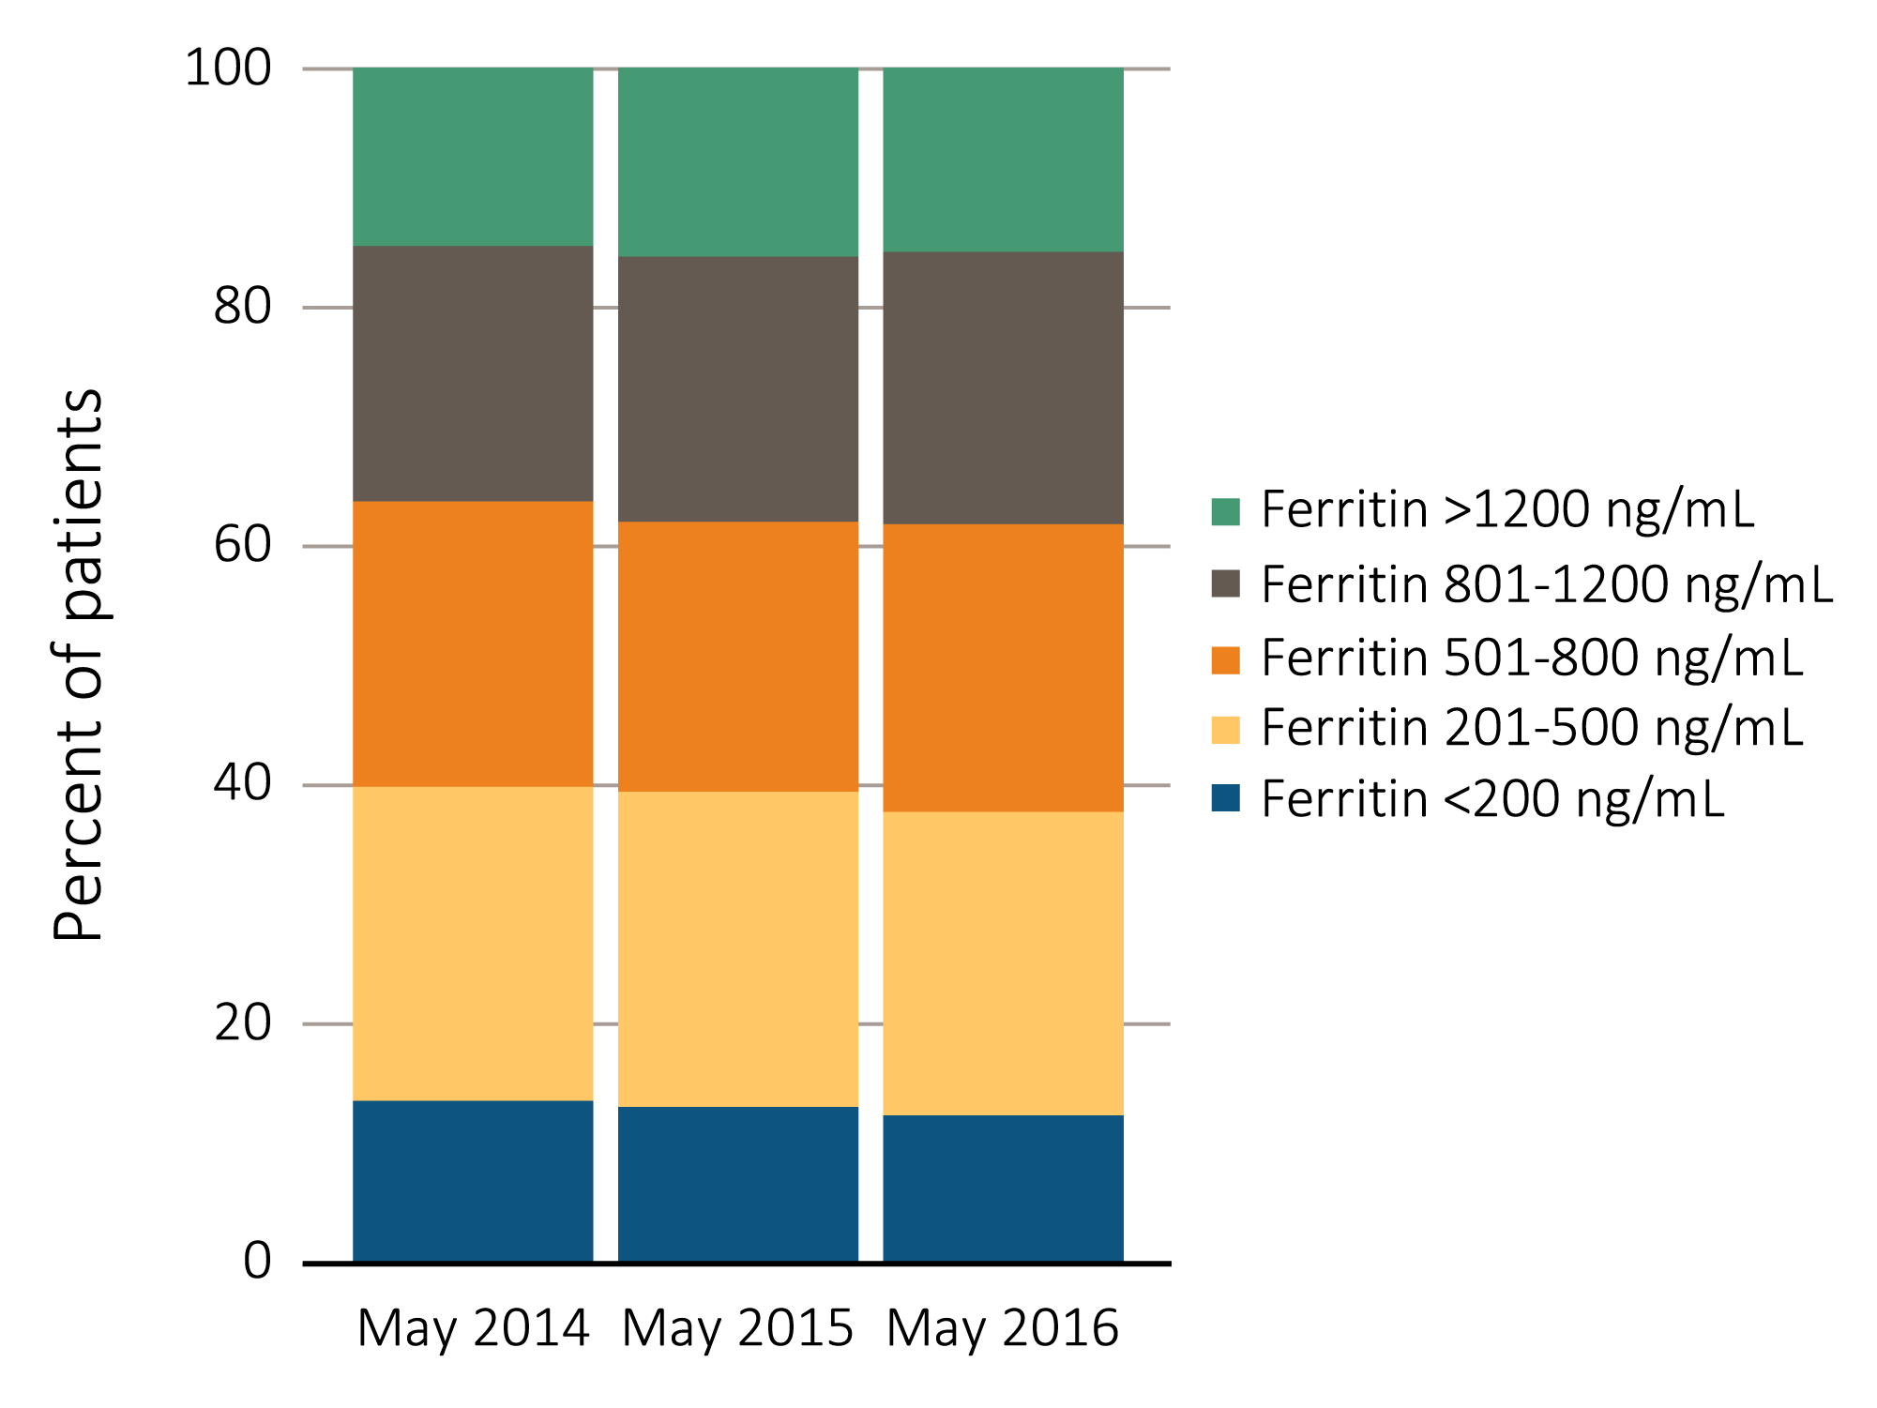
vol 2 Figure 2.12 Distribution of the most recent serum ferritin level taken between March and May in adult peritoneal dialysis patients on dialysis for at least 90 days, CROWNWeb data, May 2014, 2015, and 2016
Data Source: Special analyses, USRDS ESRD Database. CROWNWeb clinical extracts for March to May for years 2014, 2015 and 2016. Dialysis patients on treatment for ESRD at least 90 days at the time of measurement of serum ferritin for that year, ≥18 years old as of May 1 of that year, and who were alive through May 31 of that year. Abbreviation: CROWNWeb, Consolidated Renal Operations in a Web-Enabled Network.

Slide 23
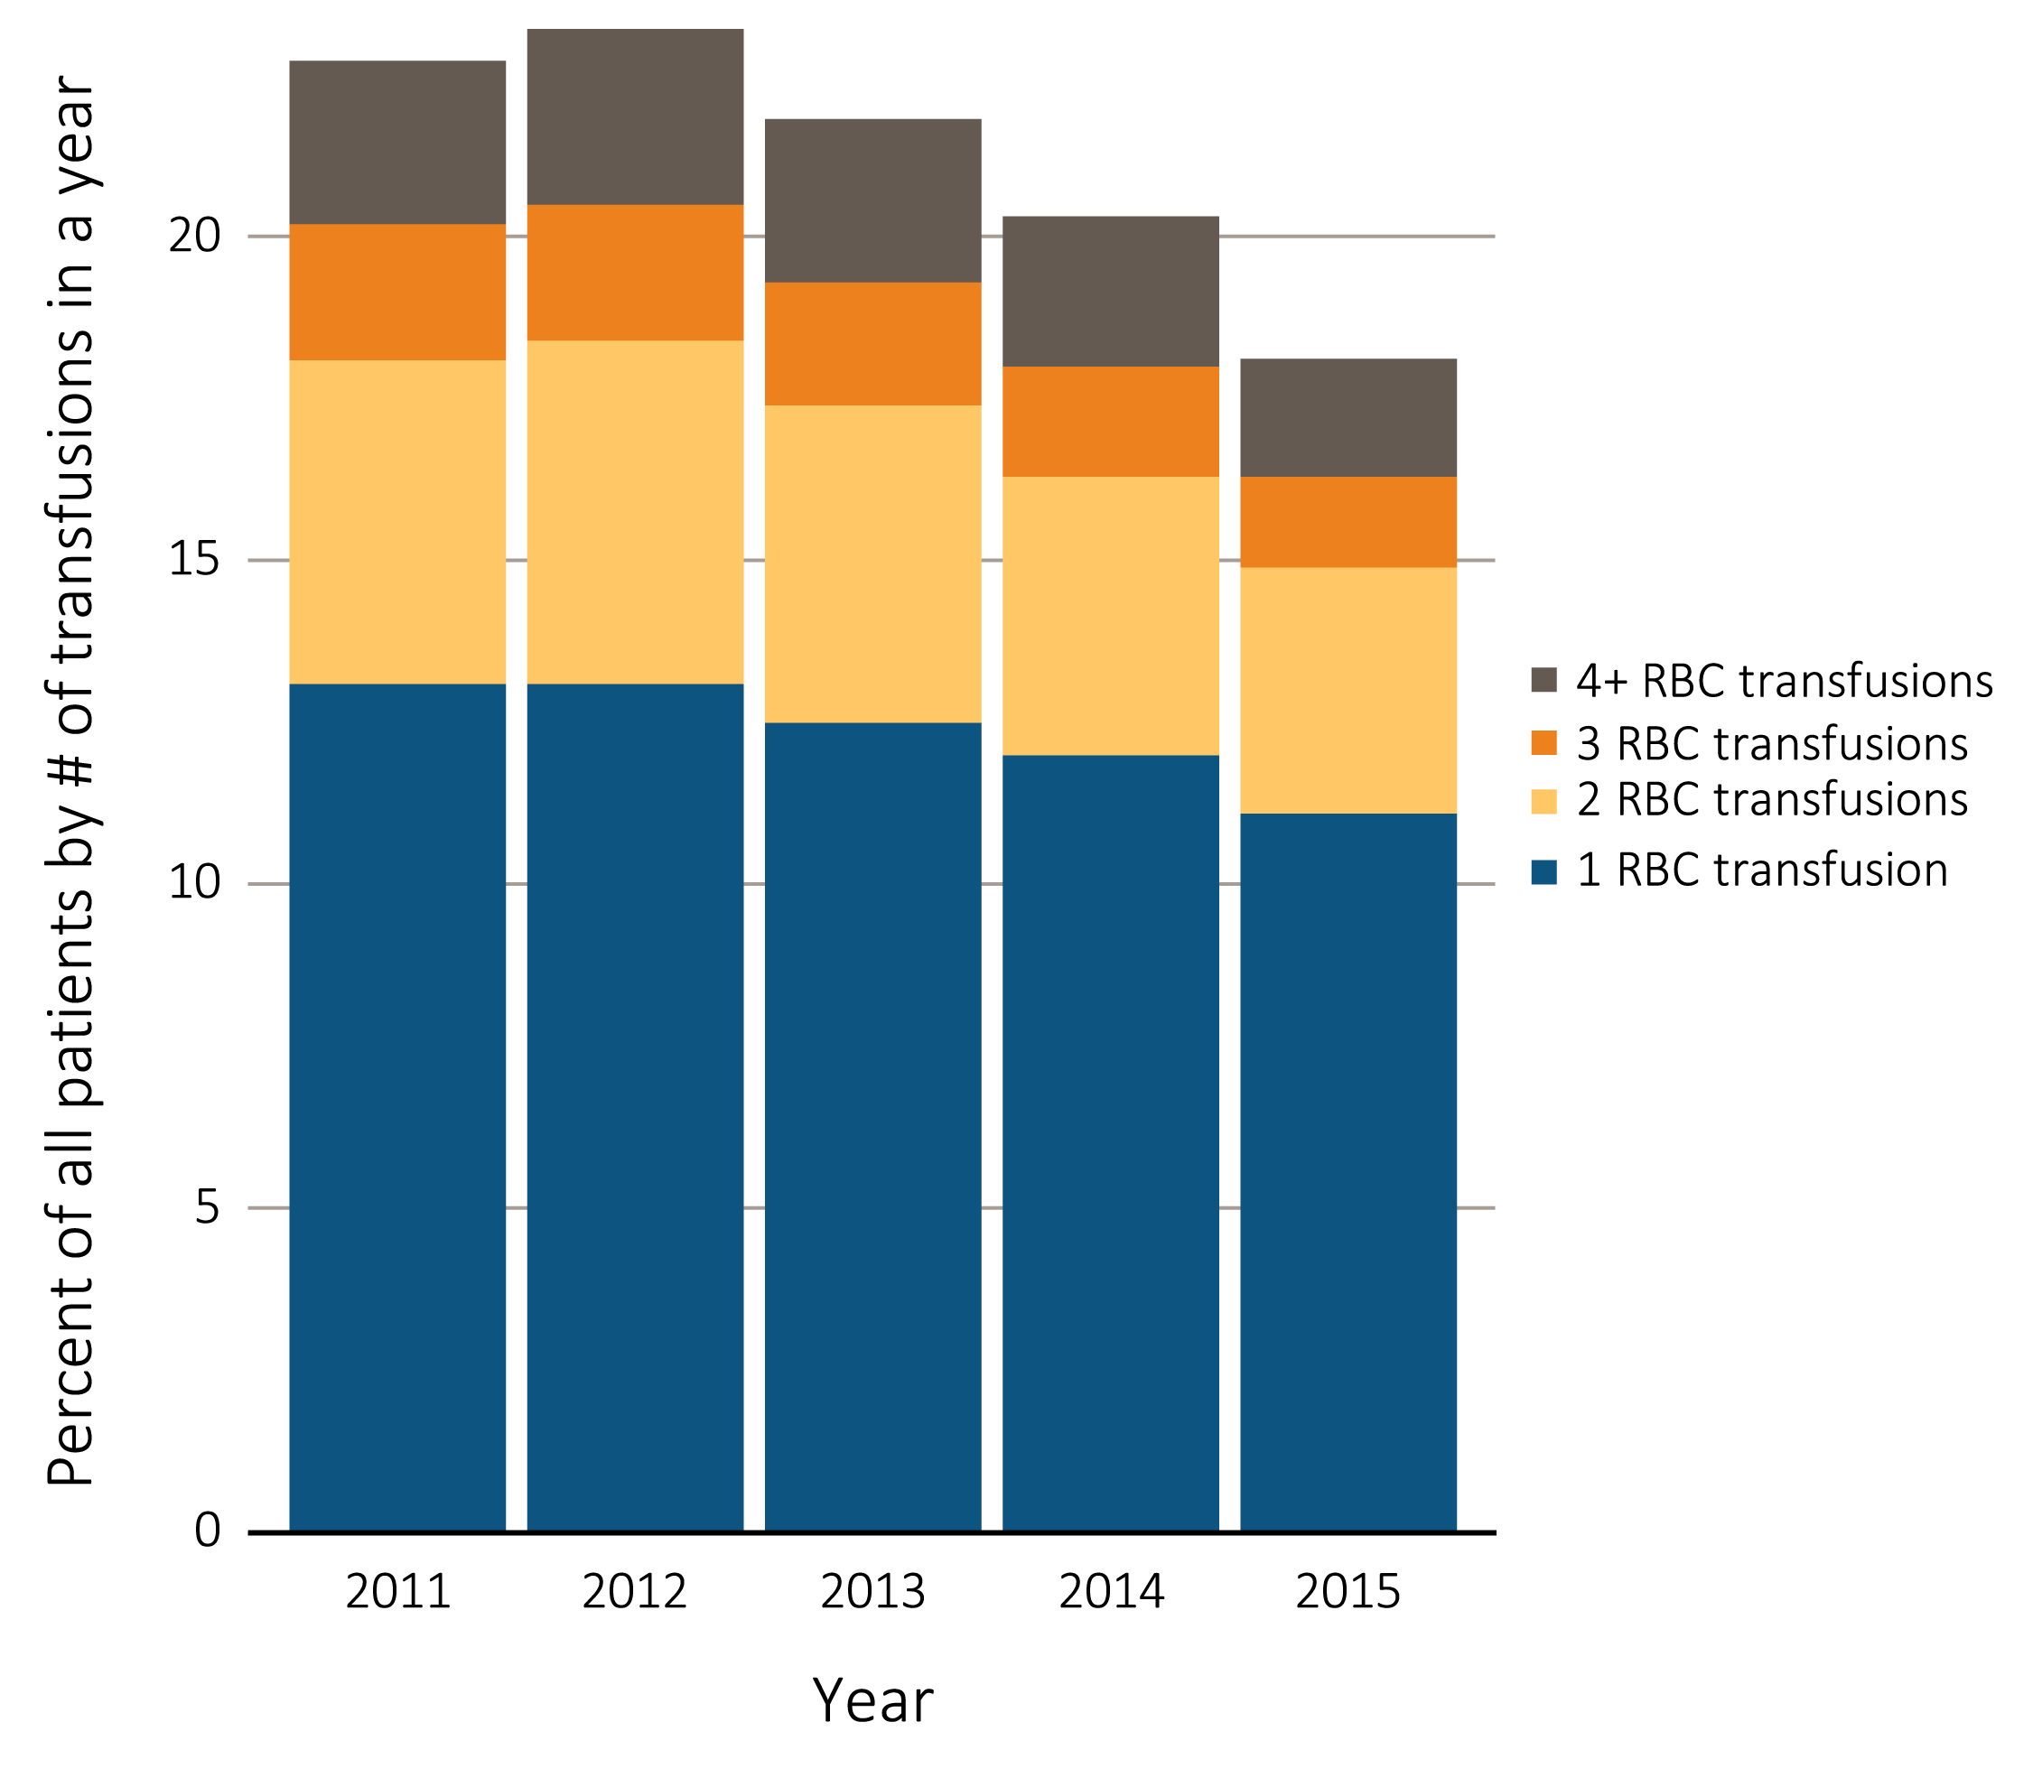
vol 2 Figure 2.13 Percentage of all adult peritoneal dialysis patients (a) by number of red blood cell transfusions received in a year, and (b) with ≥1 claims for a red blood cell transfusion in a month, from Medicare claims data overall, within 90 days and after at least 90 days of first PD session, 2010-2015
(a) Number of red blood cell transfusions received in a year
Data Source: Special analyses, USRDS ESRD Database. The percentage of peritoneal dialysis patients with ≥1 red blood cell transfusion claims in a given month was among peritoneal dialysis patients having a claim for at least one dialysis session during the month, and who were ≥18 years old at the start of the month. Additional analysis of RBC transfusion claims completed for patients on dialysis for < 90 days or ≥ 90 days. Abbreviation: RBC, red blood cell.

Slide 24
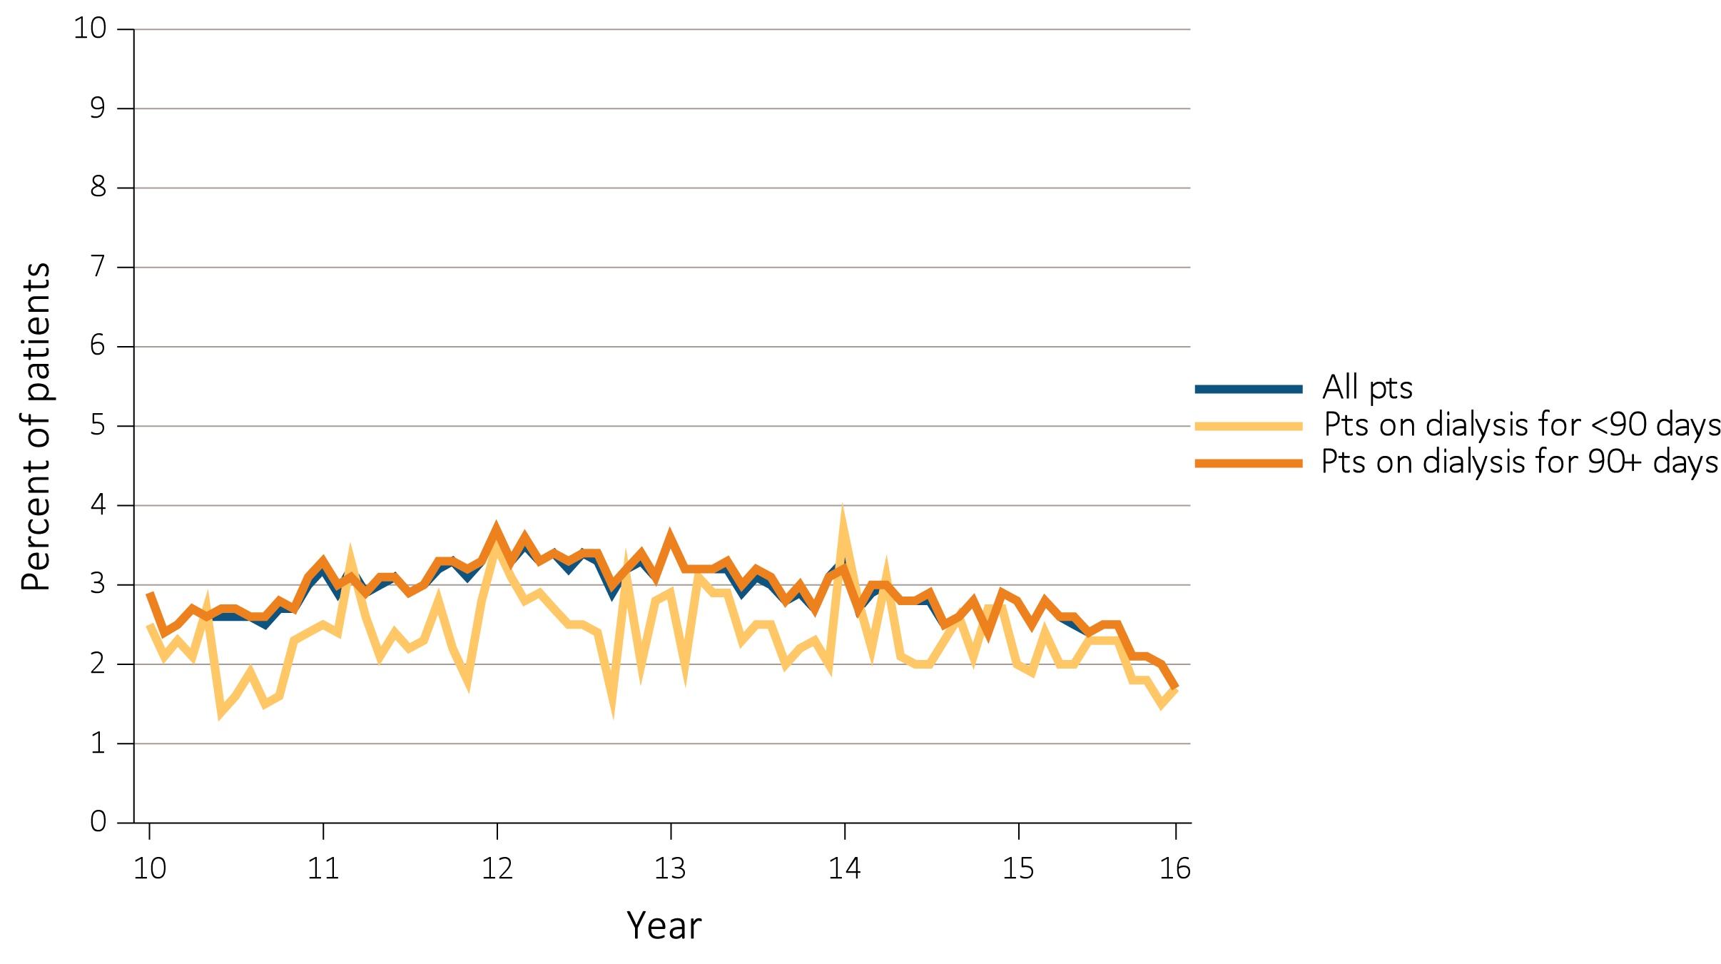
vol 2 Figure 2.13 Percentage of all adult peritoneal dialysis patients (a) by number of red blood cell transfusions received in a year, and (b) with ≥1 claims for a red blood cell transfusion in a month, from Medicare claims data overall, within 90 days and after at least 90 days of first PD session, 2010-2015
(b) Percent of all patients, patients on dialysis <90 days, or patients on dialysis ≥ 90 days, who had ≥1 claim for a red blood cell transfusion in a month
Data Source: Special analyses, USRDS ESRD Database. The percentage of peritoneal dialysis patients with ≥1 red blood cell transfusion claims in a given month was among peritoneal dialysis patients having a claim for at least one dialysis session during the month, and who were ≥18 years old at the start of the month. Additional analysis of RBC transfusion claims completed for patients on dialysis for < 90 days or ≥ 90 days. Abbreviation: RBC, red blood cell.

Slide 25
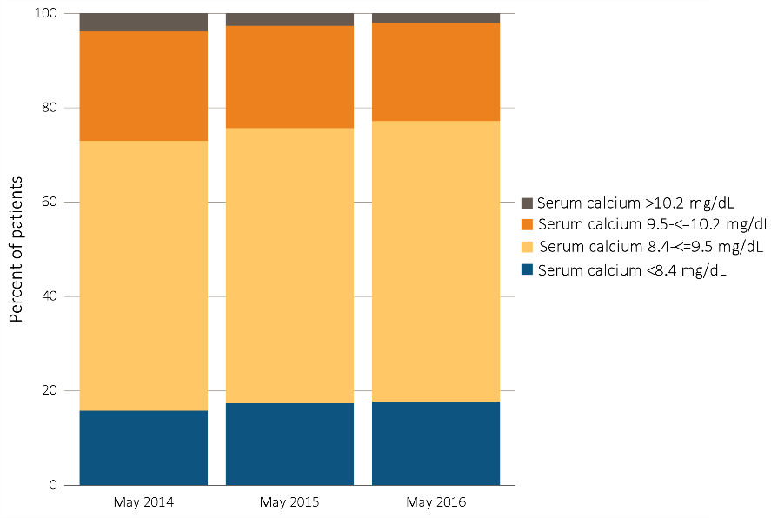
vol 2 Figure 2.14 Distribution of serum calcium levels in adult hemodialysis patients on dialysis for at least 1 year, CROWNWeb data, May 2014, 2015, and 2016
Special analyses, USRDS ESRD Database. CROWNWeb clinical extracts for March to May for years 2014, 2015 and 2016. Dialysis patients on treatment for ESRD at least 1 year at the time of measurement of serum calcium for that year, ≥18 years old as of May 1 of that year and who were alive through May 31 of that year. Abbreviation: CROWNWeb, Consolidated Renal Operations in a Web-Enabled Network.

Slide 26
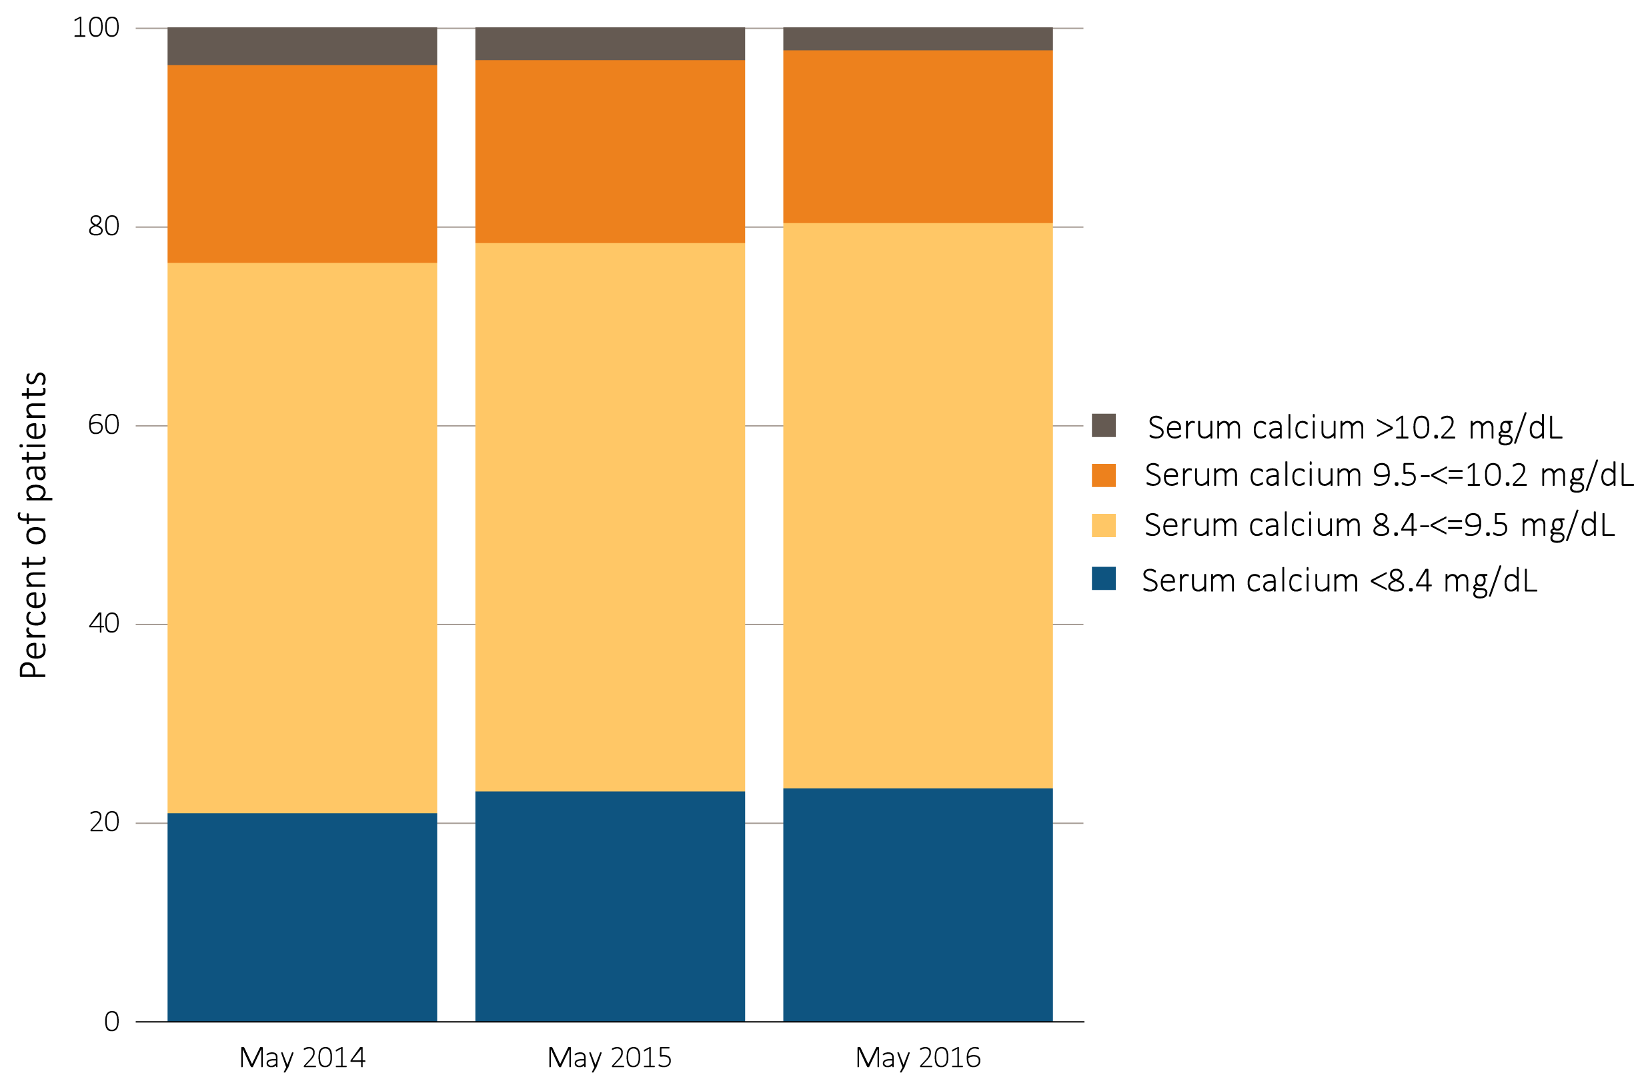
vol 2 Figure 2.15 Distribution of serum calcium levels in adult peritoneal dialysis patients on dialysis for at least 1 year, CROWNWeb data, May 2014, 2015, and 2016
Data Source: Special analyses, USRDS ESRD Database. CROWNWeb clinical extracts for March to May for years 2014, 2015 and 2016. Dialysis patients on treatment for ESRD at least 1 year at the time of measurement of serum calcium for that year, ≥18 years old as of May 1 of that year and who were alive through May 31 of that year. Abbreviation: CROWNWeb, Consolidated Renal Operations in a Web-Enabled Network.

Slide 27
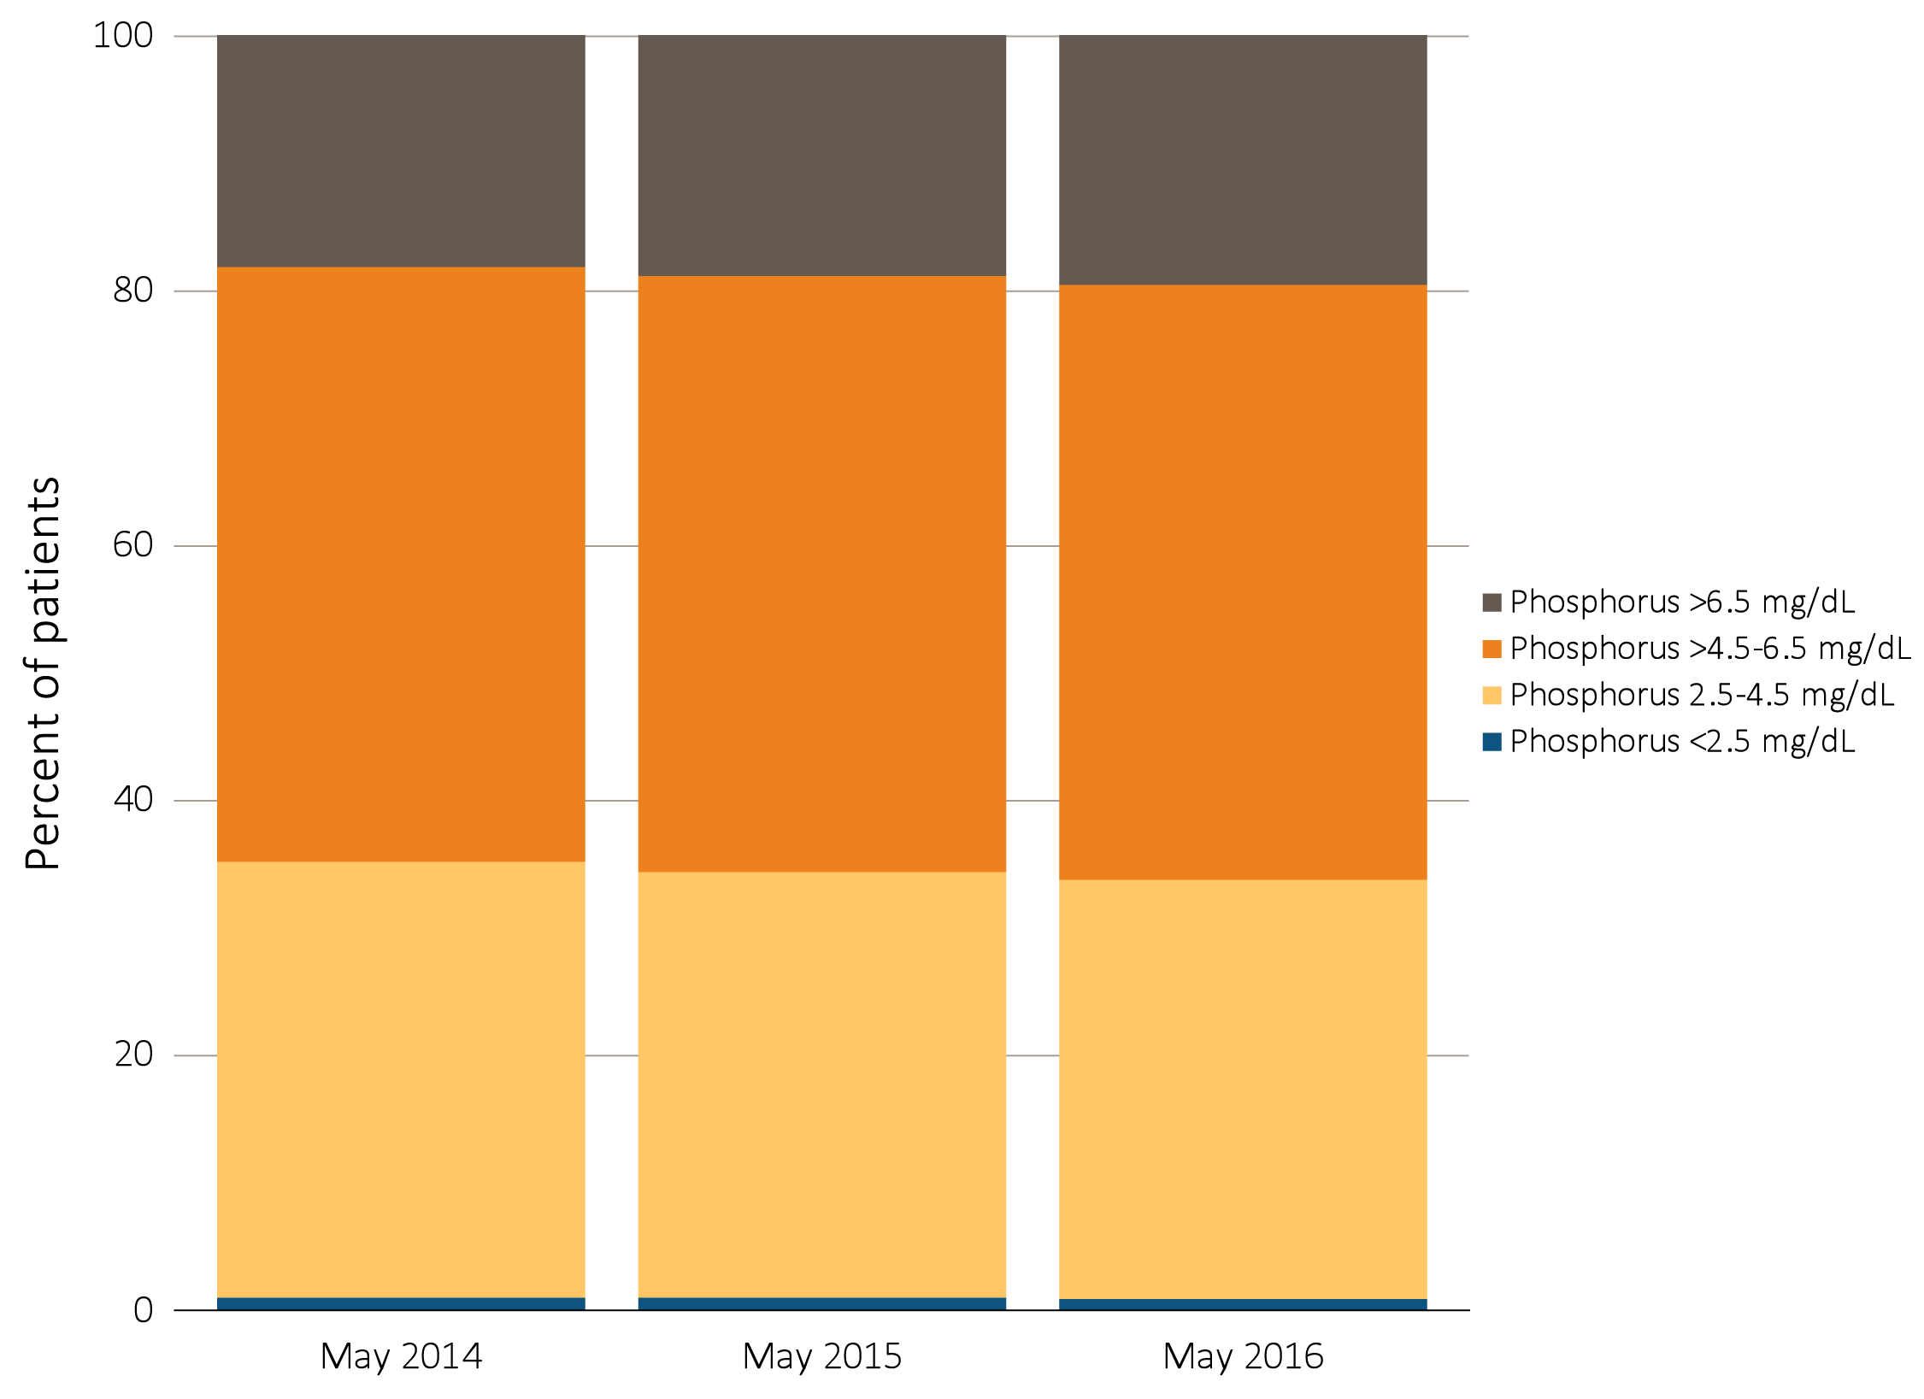
vol 2 Figure 2.16 Distribution of serum phosphorus levels in adult hemodialysis patients on dialysis for at least 1 year, CROWNWeb data, May 2014, 2015, and 2016
Data Source: Special analyses, USRDS ESRD Database. CROWNWeb clinical extracts for May 2014, May 2015, and May 2016. Dialysis patients on treatment for ESRD at least 1 year at the time of measurement of serum phosphorus for that year, ≥18 years old as of May 1 of that year and who were alive through May 31 of that year. Abbreviation: CROWNWeb, Consolidated Renal Operations in a Web-Enabled Network.

Slide 28
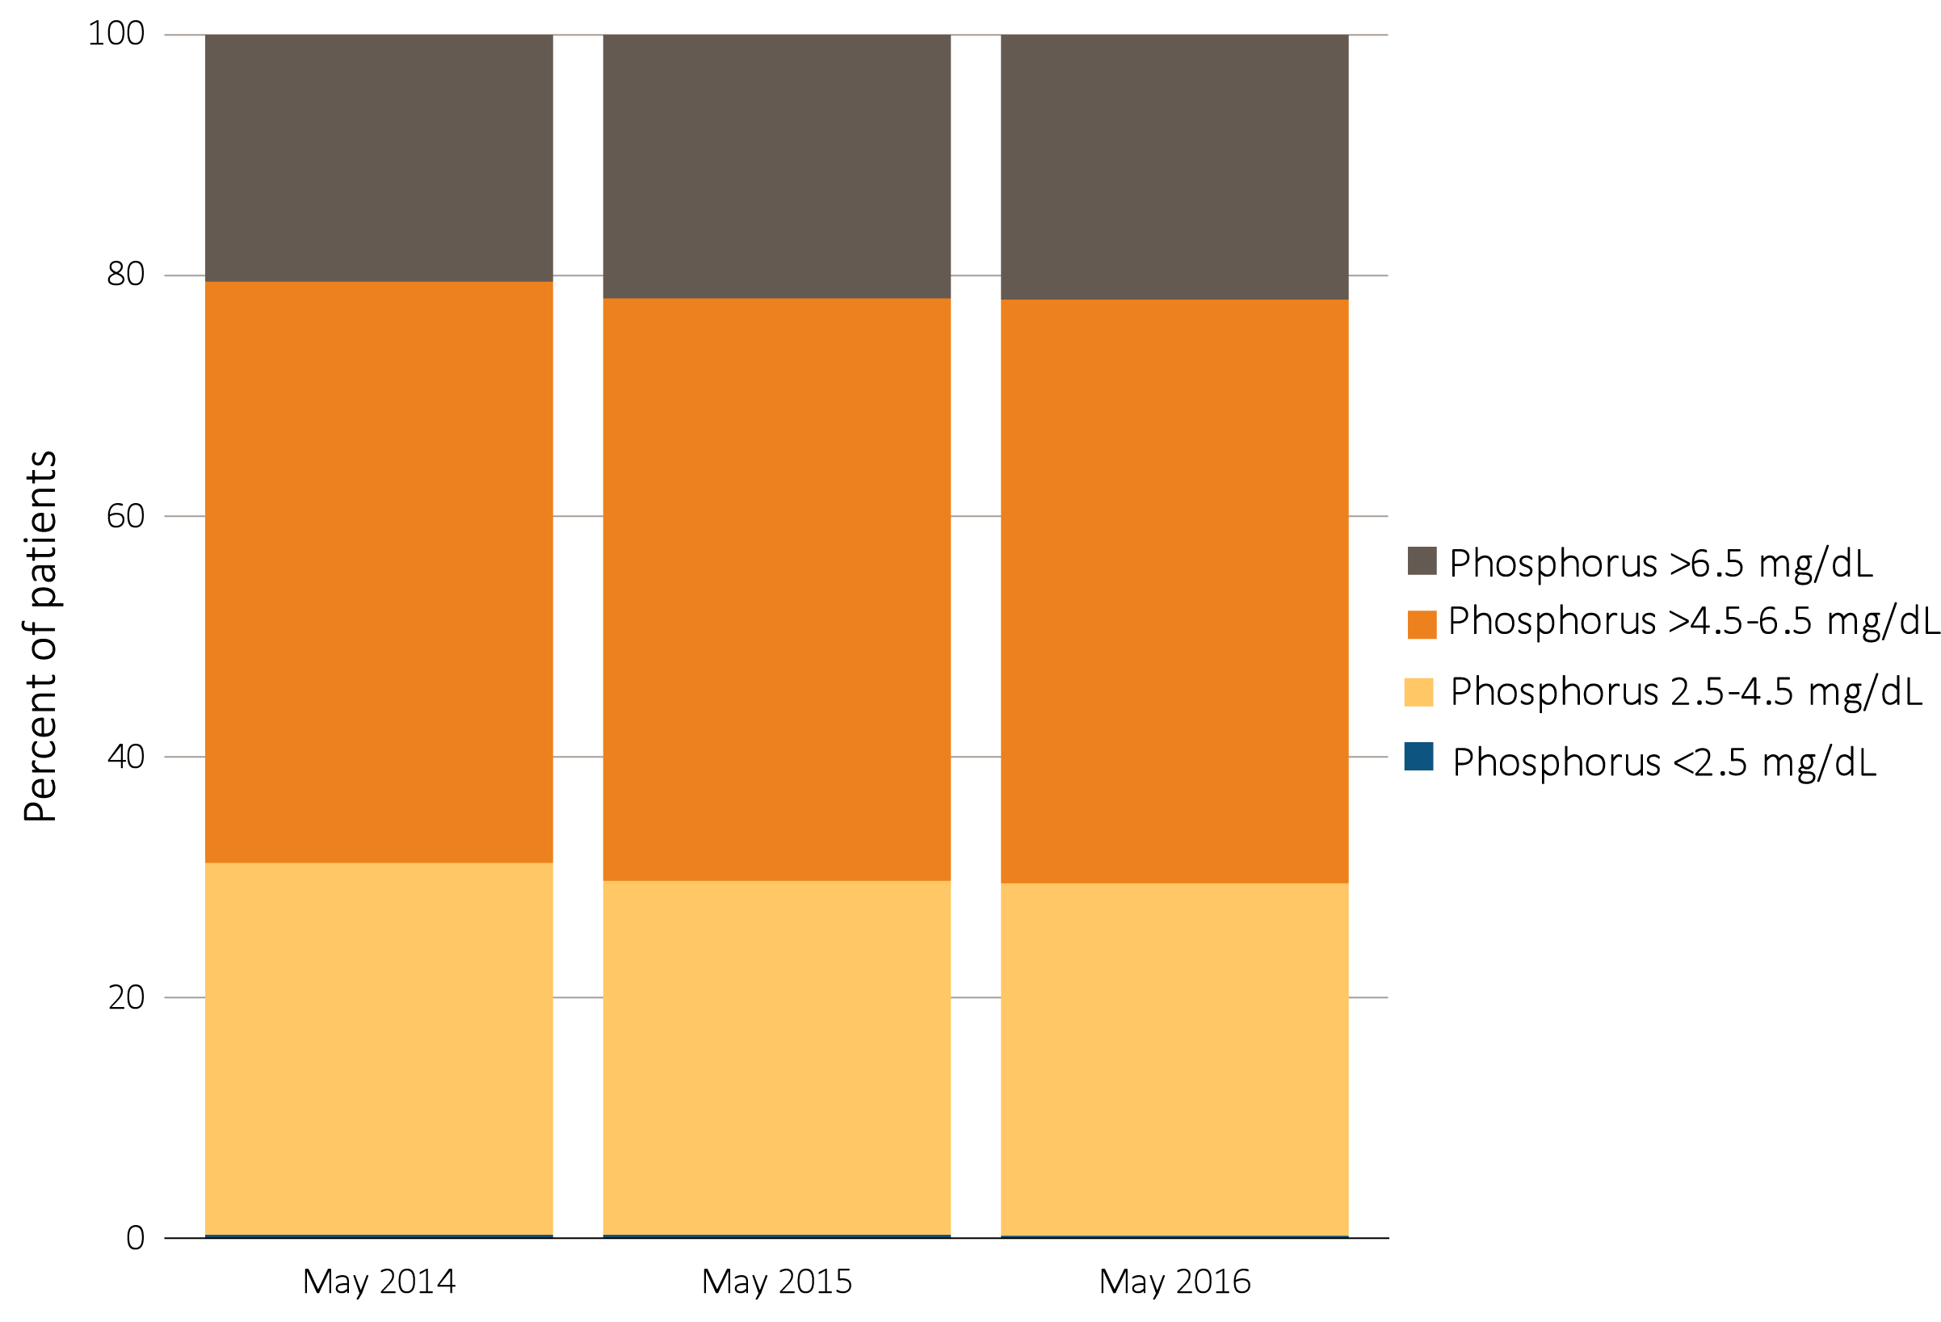
vol 2 Figure 2.17 Distribution of serum phosphorus levels in adult peritoneal dialysis patients on dialysis for at least 1 year, CROWNWEB data,
May 2014, 2015, and 2016
Data Source: Special analyses, USRDS ESRD Database. CROWNWeb clinical extracts for May 2014, May 2015, and May 2016. Dialysis patients on treatment for ESRD at least 1 year at the time of measurement of serum phosphorus for that year, ≥18 years old as of May 1 of that year and who were alive through May 31 of that year. Abbreviation: CROWNWeb, Consolidated Renal Operations in a Web-Enabled Network.

Slide 29
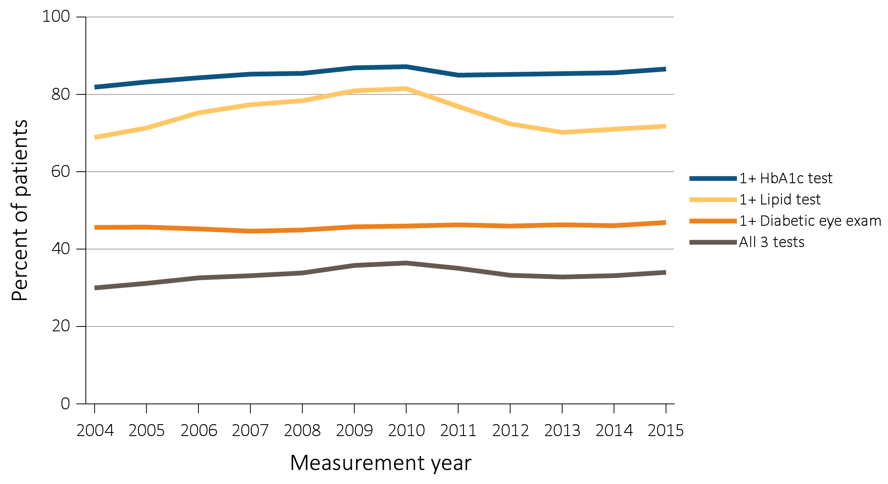
vol 2 Figure 2.18 Diabetes-related care among ESRD patients with diabetes mellitus aged 18-75 years, Medicare claims, 2004-2015
Data Source: Special analyses, USRDS ESRD Database. Point prevalent Medicare ESRD patients aged 18 to 75 years with a diagnosis claim for diabetes mellitus in the previous year; diabetes-related care in the measurement year. Abbreviations: ESRD, end-stage renal disease; HbA1c, glycosylated hemoglobin.

Slide 30
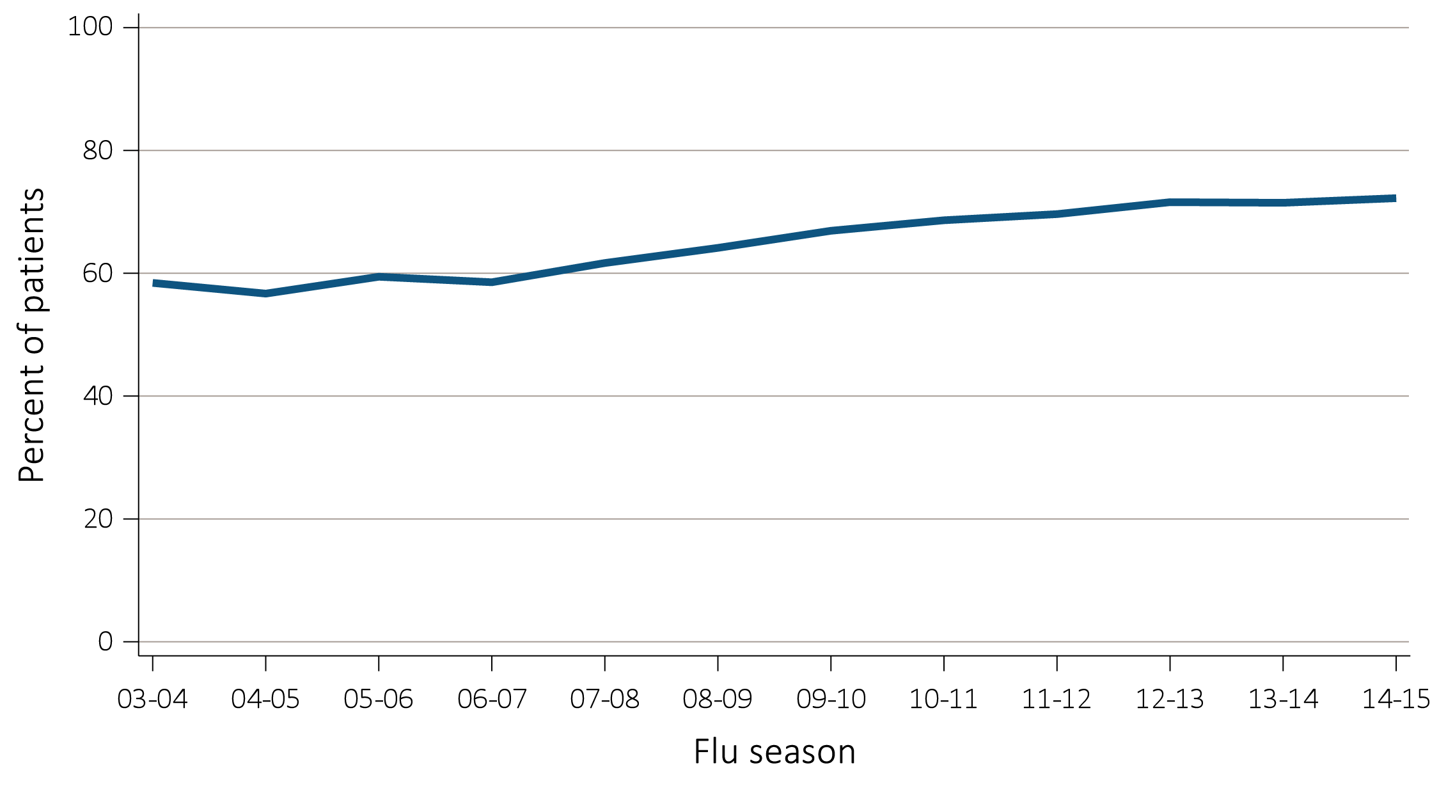
vol 2 Figure 2.19 Percentage of ESRD patients with a claim for seasonal influenza vaccination (August 1-April 30 of subsequent year), (a) overall, (b) by age, (c) by race (d) by ethnicity, and (e) by ESRD treatment modality, Medicare data, 2003-2015
(a) Overall
Data Source: Special analyses, USRDS ESRD Database. ESRD patients initiating treatment for ESRD at least 90 days before seasonal period: August 1-April 30 for influenza. (c) Native Hawaiian/Pacific Islander, multiracial, and other/unknown races excluded due to small number of flu vaccination claims. Abbreviations: Af Am, African American; AI, American Indian; AN, Alaska Native; ESRD, end-stage renal disease; HD, hemodialysis; PD, peritoneal dialysis; Tx, transplant.

Slide 31
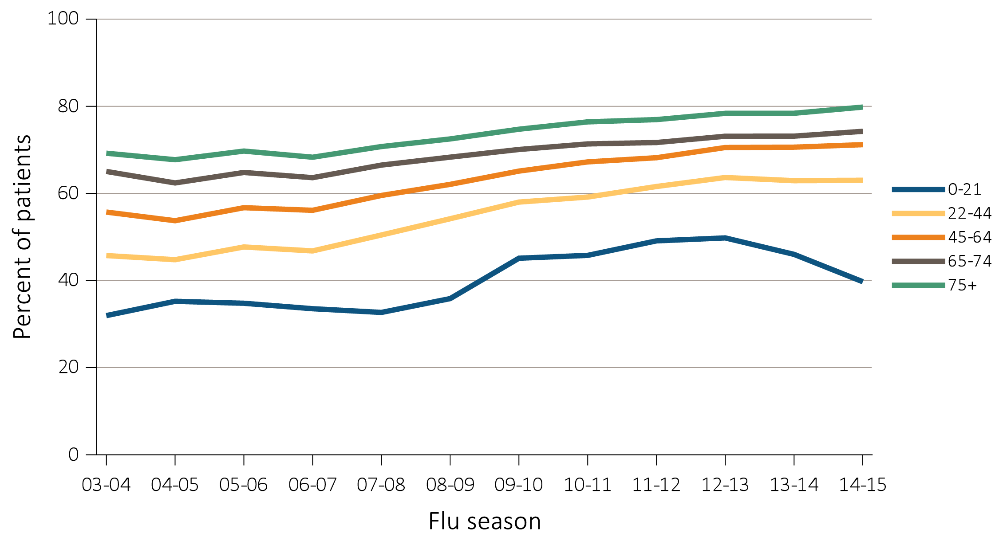
vol 2 Figure 2.19 Percentage of ESRD patients with a claim for seasonal influenza vaccination (August 1-April 30 of subsequent year), (a) overall, (b) by age, (c) by race (d) by ethnicity, and (e) by ESRD treatment modality, Medicare data, 2003-2015
(b) Age
Data Source: Special analyses, USRDS ESRD Database. ESRD patients initiating treatment for ESRD at least 90 days before seasonal period: August 1-April 30 for influenza. (c) Native Hawaiian/Pacific Islander, multiracial, and other/unknown races excluded due to small number of flu vaccination claims. Abbreviations: Af Am, African American; AI, American Indian; AN, Alaska Native; ESRD, end-stage renal disease; HD, hemodialysis; PD, peritoneal dialysis; Tx, transplant.

Slide 32
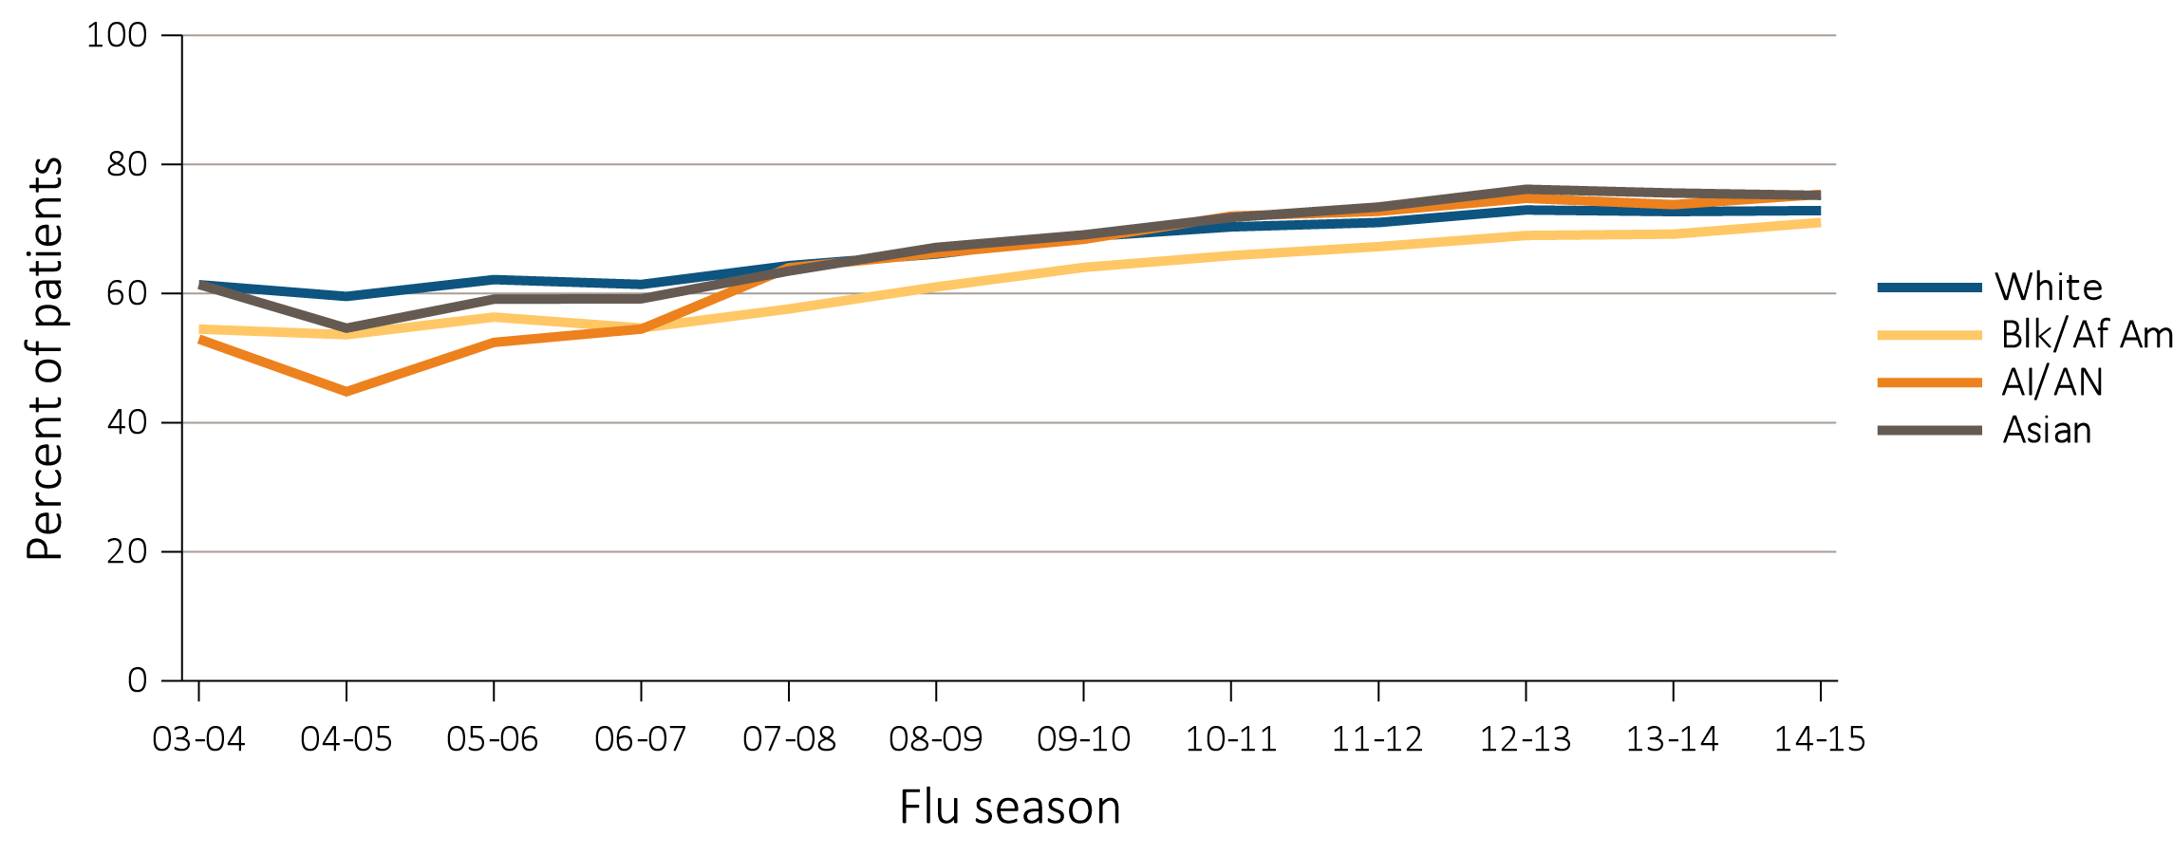
vol 2 Figure 2.19 Percentage of ESRD patients with a claim for seasonal influenza vaccination (August 1-April 30 of subsequent year), (a) overall, (b) by age, (c) by race (d) by ethnicity, and (e) by ESRD treatment modality, Medicare data, 2003-2015
(c) Race
Data Source: Special analyses, USRDS ESRD Database. ESRD patients initiating treatment for ESRD at least 90 days before seasonal period: August 1-April 30 for influenza. (c) Native Hawaiian/Pacific Islander, multiracial, and other/unknown races excluded due to small number of flu vaccination claims. Abbreviations: Af Am, African American; AI, American Indian; AN, Alaska Native; ESRD, end-stage renal disease; HD, hemodialysis; PD, peritoneal dialysis; Tx, transplant.

Slide 33
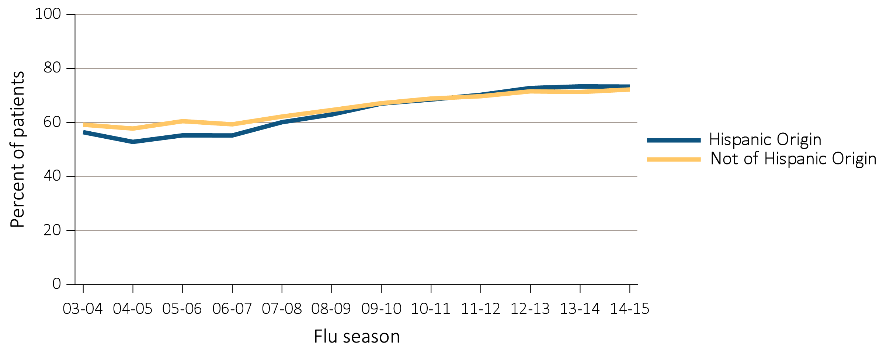
vol 2 Figure 2.19 Percentage of ESRD patients with a claim for seasonal influenza vaccination (August 1-April 30 of subsequent year), (a) overall, (b) by age, (c) by race (d) by ethnicity, and (e) by ESRD treatment modality, Medicare data, 2003-2015
(d) Ethnicity
Data Source: Special analyses, USRDS ESRD Database. ESRD patients initiating treatment for ESRD at least 90 days before seasonal period: August 1-April 30 for influenza. (c) Native Hawaiian/Pacific Islander, multiracial, and other/unknown races excluded due to small number of flu vaccination claims. Abbreviations: Af Am, African American; AI, American Indian; AN, Alaska Native; ESRD, end-stage renal disease; HD, hemodialysis; PD, peritoneal dialysis; Tx, transplant.

Slide 34
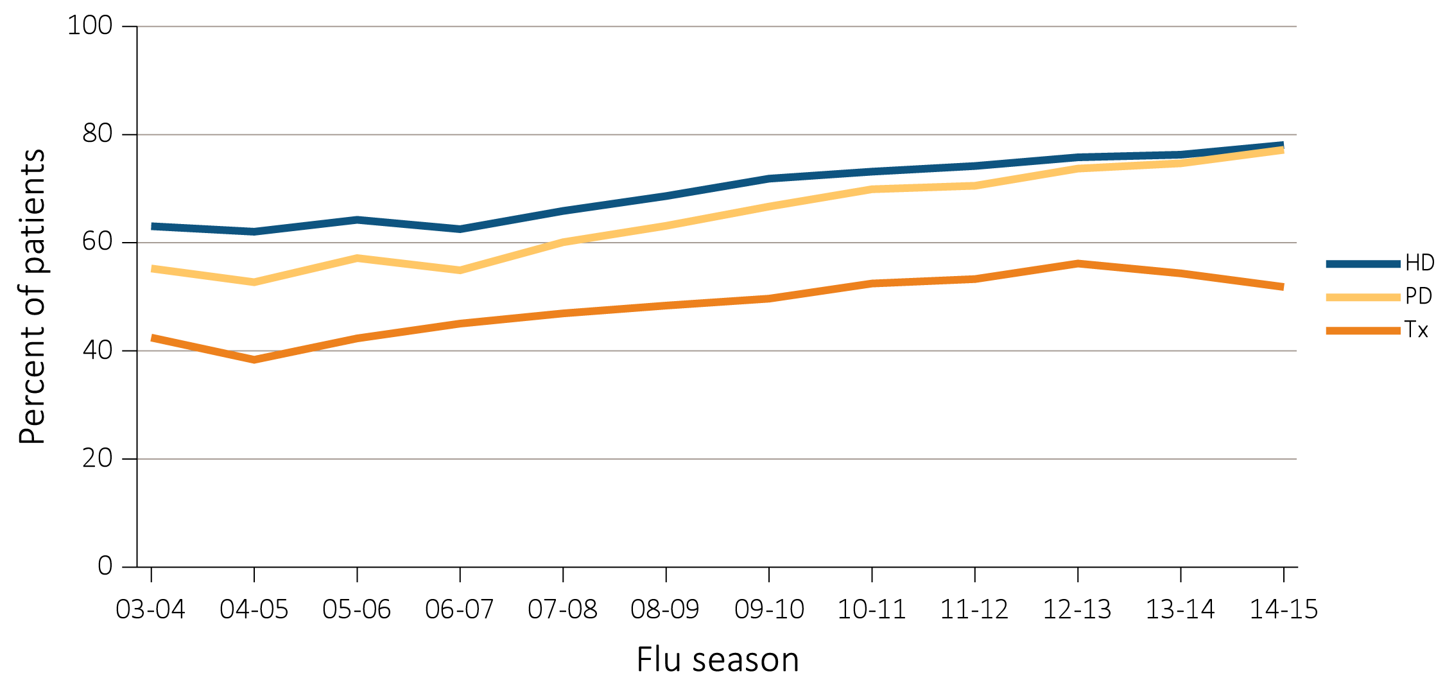
vol 2 Figure 2.19 Percentage of ESRD patients with a claim for seasonal influenza vaccination (August 1-April 30 of subsequent year), (a) overall, (b) by age, (c) by race (d) by ethnicity, and (e) by ESRD treatment modality, Medicare data, 2003-2015
(e) Modality
Data Source: Special analyses, USRDS ESRD Database. ESRD patients initiating treatment for ESRD at least 90 days before seasonal period: August 1-April 30 for influenza. (c) Native Hawaiian/Pacific Islander, multiracial, and other/unknown races excluded due to small number of flu vaccination claims. Abbreviations: Af Am, African American; AI, American Indian; AN, Alaska Native; ESRD, end-stage renal disease; HD, hemodialysis; PD, peritoneal dialysis; Tx, transplant.

