Slide 1
2017 Annual Data Report
Volume 2: End-Stage Renal Disease
Chapter 3:
Vascular Access

Slide 2
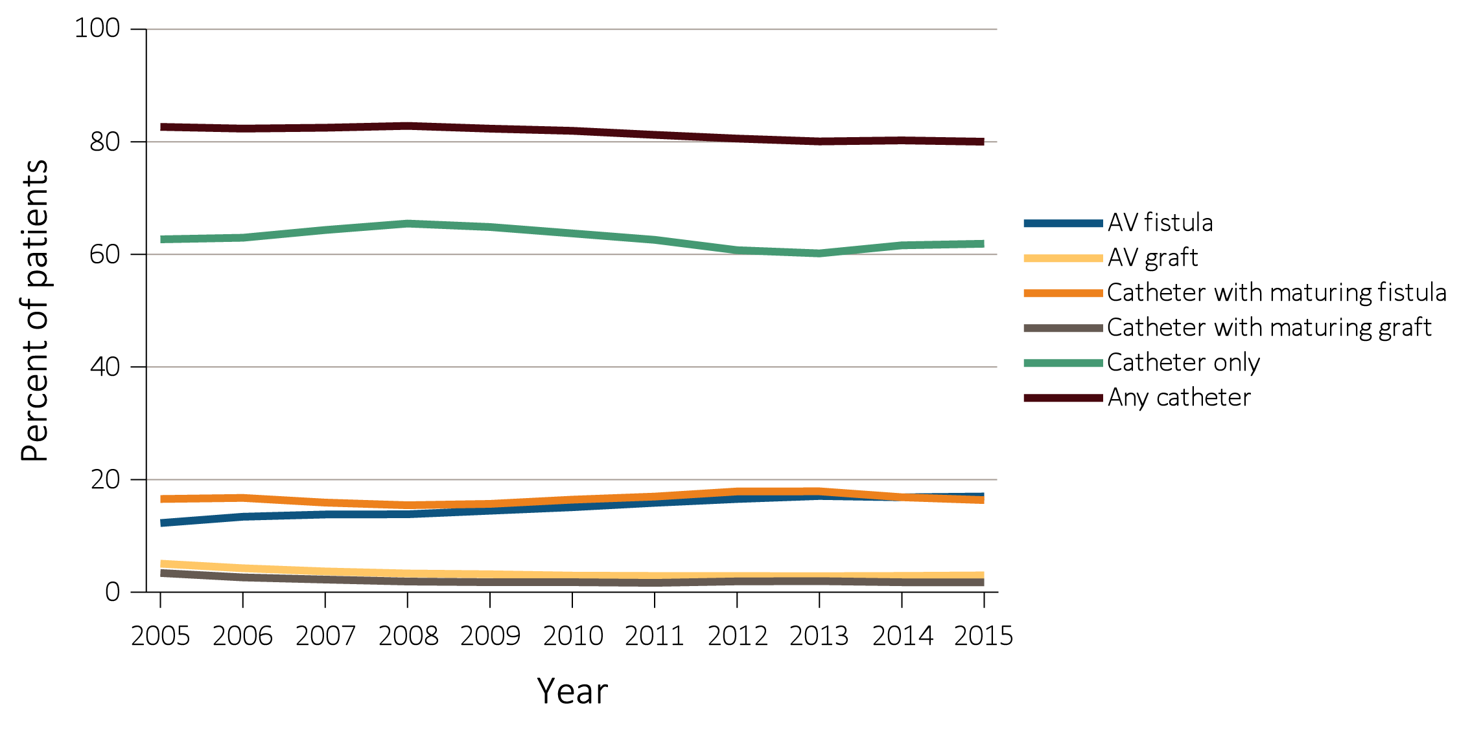
vol 2 Figure 3.1 Vascular access use at hemodialysis initiation, from the ESRD Medical Evidence form (CMS 2728), 2005-2015
Data Source: Special analyses, USRDS ESRD Database. ESRD patients initiating hemodialysis in 2005-2015. Abbreviations: AV, arteriovenous; CMS, Centers for Medicare & Medicaid; ESRD, end-stage renal disease.

Slide 3
vol 2 Table 3.1 Vascular access used at hemodialysis initiation by patient characteristics from the ESRD Medical Evidence form (CMS 2728), 2015
 | AV fistula | AV graft | Catheter with maturing fistula | Catheter with maturing graft | Catheter only
All | 17.0 | 3.0 | 16.4 | 1.8 | 61.9
Age
0-21 | 7.5 | 0.8 | 9.2 | 0.6 | 81.9
22-44 | 13.5 | 1.9 | 16.2 | 1.7 | 66.6
45-64 | 16.9 | 2.6 | 17.6 | 1.7 | 61.2
65-74 | 18.7 | 3.4 | 16.5 | 1.8 | 59.6
75+ | 17.0 | 3.5 | 14.6 | 1.9 | 62.9
Sex
Male | 18.7 | 2.2 | 16.9 | 1.4 | 60.7
Female | 14.6 | 4.0 | 15.6 | 2.2 | 63.5
Race
White | 17.4 | 2.4 | 16.2 | 1.5 | 62.6
Black/African American | 15.5 | 4.5 | 16.4 | 2.5 | 61.1
American Indian or Alaska Native | 19.1 | 1.7 | 22.7 | 0.8 | 55.8
Asian | 20.3 | 3.3 | 16.5 | 1.6 | 58.3
Native Hawaiian or Pacific Islander | 17.1 | 2.5 | 18.9 | 1.4 | 60.0
Ethnicity
Hispanic | 14.8 | 2.0 | 16.8 | 1.3 | 65.2
Non-Hispanic | 17.4 | 3.2 | 16.3 | 1.8 | 61.3
Race/Ethnicity
Non-Hispanic White | 18.1 | 2.5 | 16.1 | 1.5 | 61.8
Non-Hispanic Black/African American | 15.4 | 4.5 | 16.4 | 2.5 | 61.1
Primary Cause of ESRD
Diabetes | 17.8 | 3.1 | 18.8 | 1.9 | 58.4
Hypertension | 17.2 | 3.2 | 15.5 | 1.9 | 62.2
Glomerulonephritis | 18.4 | 2.6 | 14.0 | 1.5 | 63.6
Cystic Kidney | 40.2 | 4.8 | 15.5 | 1.4 | 38.1
Other Urologic | 13.5 | 2.5 | 13.1 | 1.4 | 69.5
Other Cause | 8.8 | 2.1 | 10.4 | 1.3 | 77.3
Unknown/Missing | 12.8 | 1.9 | 12.1 | 1.2 | 72.0
Comorbidities
Diabetes | 16.9 | 3.0 | 17.8 | 1.9 | 60.3
Congestive heart failure | 12.9 | 2.6 | 17.2 | 1.9 | 65.4
Atherosclerotic heart disease | 16.2 | 3.1 | 18.6 | 1.9 | 60.1
Cerebrovascular disease | 14.7 | 3.5 | 17.0 | 2.7 | 62.0
Peripheral vascular disease | 15.1 | 2.9 | 18.3 | 2.2 | 61.5
Hypertension | 17.6 | 3.1 | 16.8 | 1.8 | 60.8
Other cardiac disease | 13.7 | 2.6 | 16.5 | 1.8 | 65.3
Data Source: Special analyses, USRDS ESRD Database. Abbreviations: AV, arteriovenous; CMS, Centers for Medicare & Medicaid; ESRD, end-stage renal disease.

Slide 4
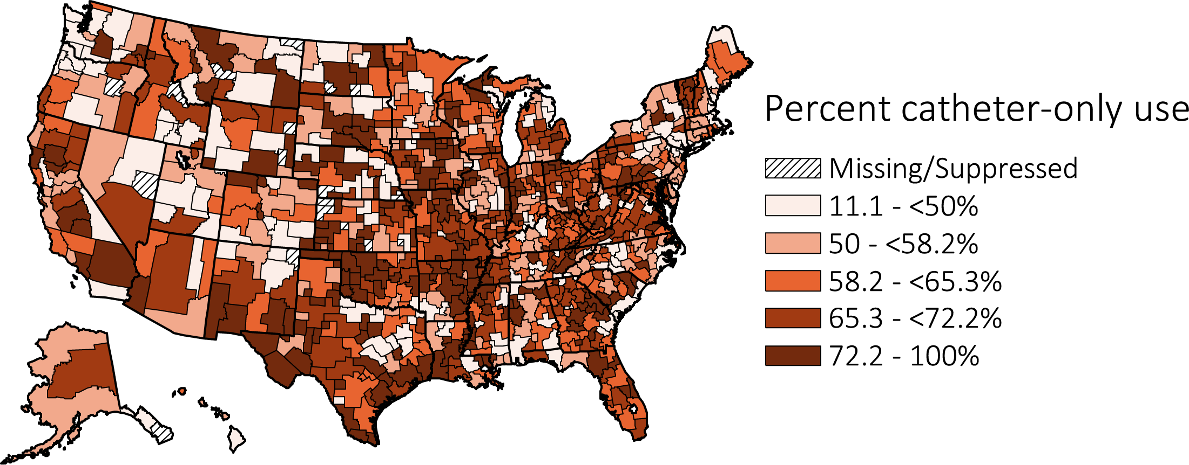
vol 2 Figure 3.2 Geographic variation in percentage of catheter-only use at hemodialysis initiation, from the ESRD Medical Evidence form (CMS 2728), 2015
Data Source: Special analyses, USRDS ESRD Database. Abbreviations: CMS, Centers for Medicare & Medicaid; ESRD, end-stage renal disease.

Slide 5
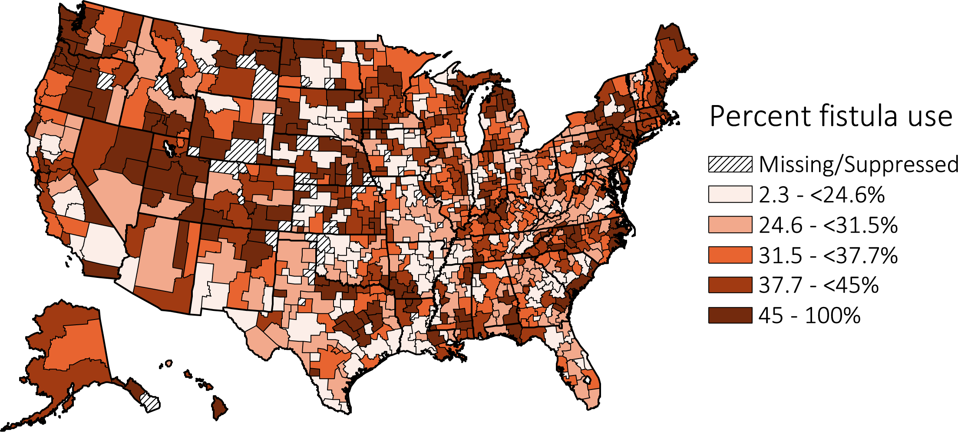
vol 2 Figure 3.3 Geographic variation in percentage of AV fistula use at hemodialysis initiation, from the ESRD Medical Evidence form (CMS 2728), 2015
Special analyses, USRDS ESRD Database. AV fistula use includes not only AV fistulas, but also catheters with a maturing fistula. Abbreviations: AV, arteriovenous; CMS, Centers for Medicare & Medicaid; ESRD, end-stage renal disease.

Slide 6
vol 2 Table 3.2 Distribution of type of vascular access in use among prevalent hemodialysis patients in 2016, from CROWNWeb data, May 2016
 | AV fistula | AV graft | Catheter
All | 62.9 | 17.7 | 19.4
Age
0-21 | 45.6 | 5.7 | 48.6
22-44 | 64.5 | 14.8 | 20.7
45-64 | 64.9 | 16.8 | 18.4
65-74 | 62.3 | 18.5 | 19.1
75+ | 59.2 | 20.3 | 20.5
Sex
Male | 68.8 | 13.7 | 17.5
Female | 55.2 | 23.0 | 21.9
Race
White | 65.6 | 13.8 | 20.6
Black/ African American | 57.6 | 24.3 | 18.1
American Indian or Alaska Native | 75.3 | 10.6 | 14.1
Asian | 67.3 | 16.1 | 16.6
Native Hawaiian or Pacific Islander | 67.3 | 15.3 | 17.4
Other or Multiracial | 61.4 | 13.7 | 24.9
Ethnicity
Hispanic | 68.5 | 14.5 | 17.1
Non-Hispanic | 61.7 | 18.4 | 19.9
Race/Ethnicity
Non-Hispanic White | 64.2 | 13.6 | 22.2
Non-Hispanic Black/African-American | 57.6 | 24.4 | 18.0
Primary Cause of ESRD
Diabetes | 63.4 | 17.4 | 19.3
Hypertension | 63.0 | 18.7 | 18.3
Glomerulonephritis | 64.9 | 17.7 | 17.4
Cystic Kidney | 68.9 | 15.6 | 15.6
Other Urologic | 60.7 | 16.8 | 22.4
Other Cause | 56.5 | 16.6 | 26.9
Unknown/Missing | 58.8 | 17.1 | 24.2
Data Source: Special analyses, USRDS ESRD Database. CROWNWeb data, catheter = any catheter use; fistula and graft use shown are without the use of a catheter. Abbreviations: AV, arteriovenous; CROWNWeb, Consolidated Renal Operations in a Web-enabled Network; CROWNWeb, Consolidated Renal Operations in a Web-enabled Network; ESRD, end-stage renal disease.

Slide 7
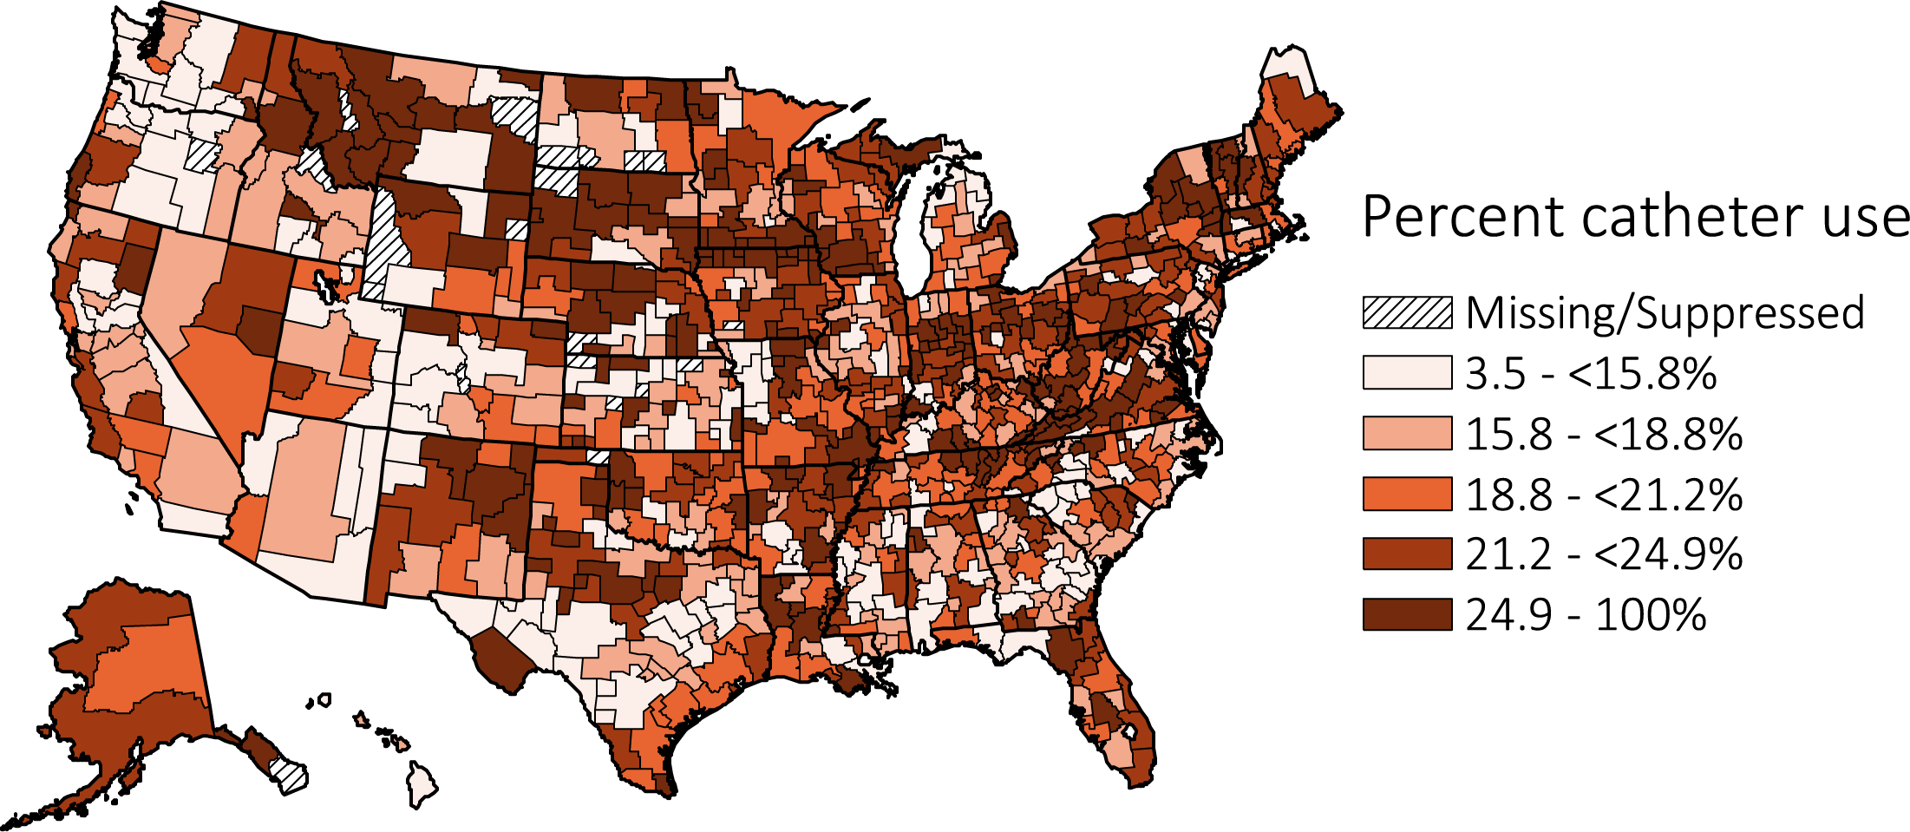
vol 2 Figure 3.4 Geographic variation in percentage catheter use among prevalent hemodialysis patients by Health Service Area, from CROWNWeb data, May 2016
Data Source: Special analyses, USRDS ESRD Database. Abbreviation: CROWNWeb, Consolidated Renal Operations in a Web-enabled Network.

Slide 8
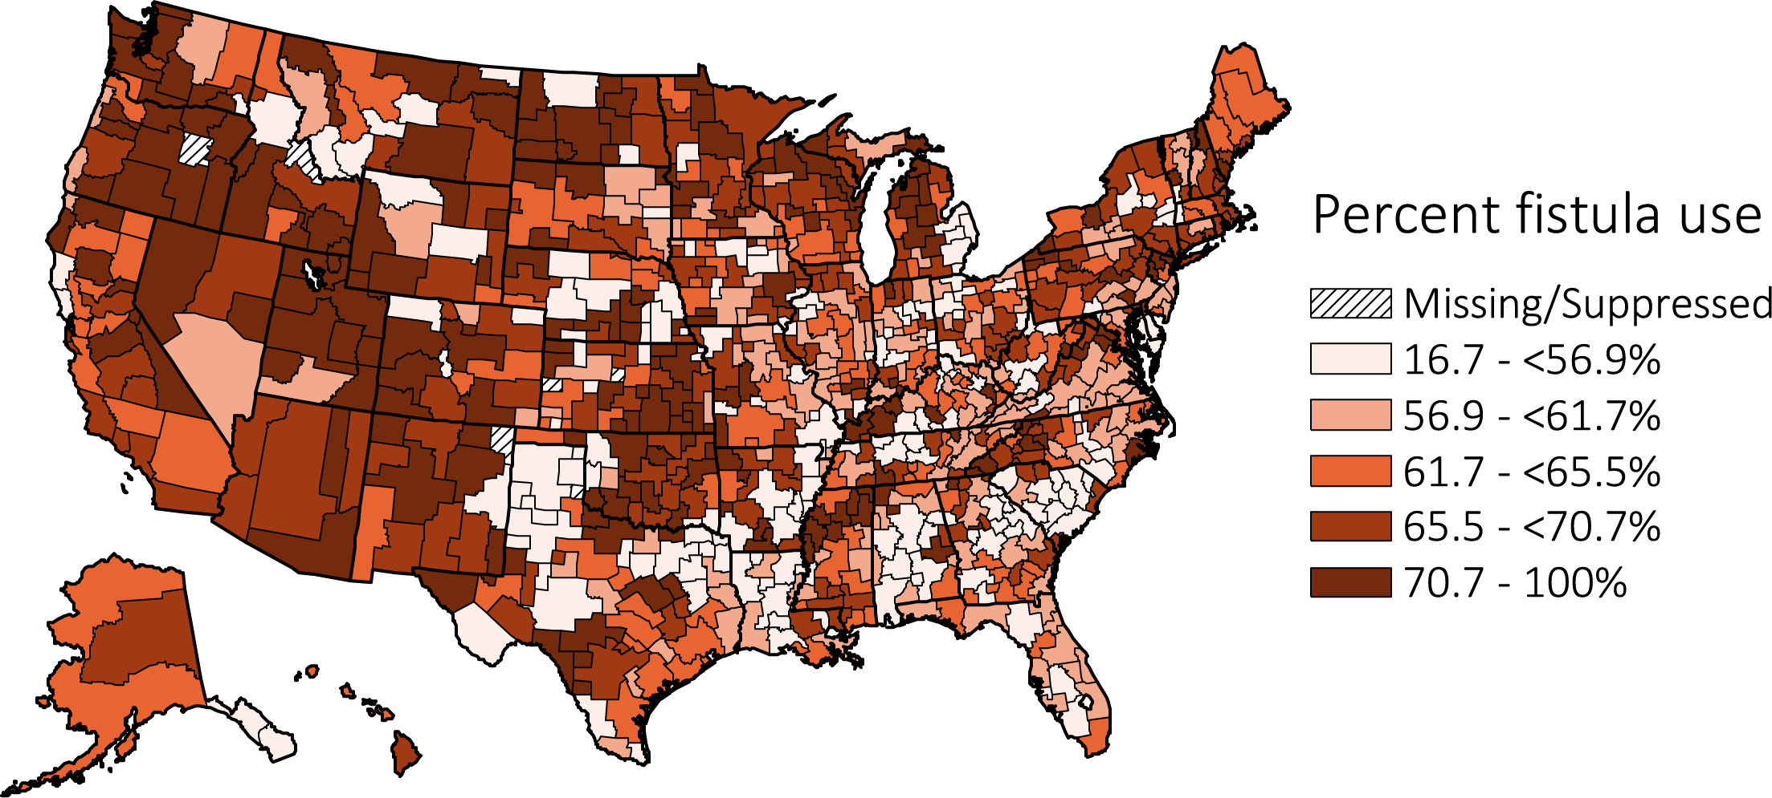
vol 2 Figure 3.5 Geographic variation in percentage AV fistula use among prevalent hemodialysis patients by Health Service Area, from CROWNWeb data, May 2016
Data Source: Special analyses, USRDS ESRD Database. Abbreviations: AV, arteriovenous; CROWNWeb, Consolidated Renal Operations in a Web-enabled Network.

Slide 9
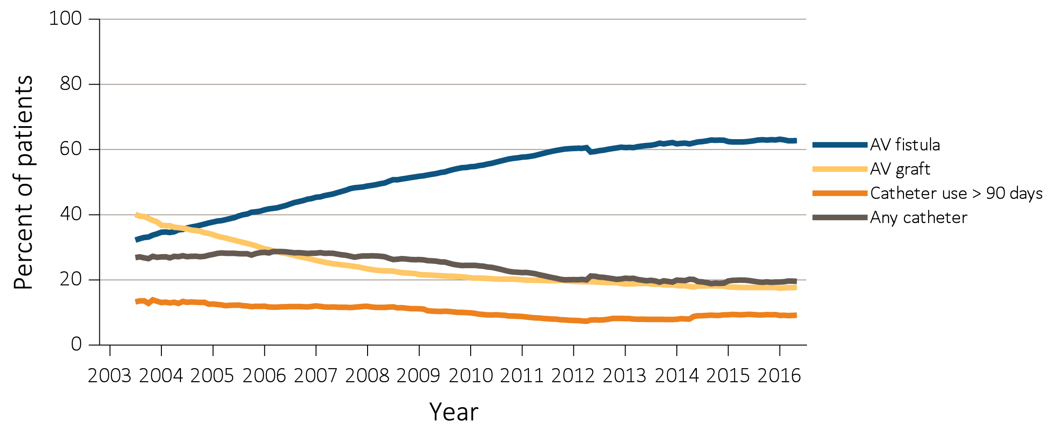
vol 2 Figure 3.6 Trends in vascular access type use among ESRD prevalent patients, 2003-2016
Data Source: Special analyses, USRDS ESRD Database and Fistula First data. Fistula First data reported from July 2003 through April 2012, CROWNWeb data are reported from June 2012 through May 2016. Abbreviations: AV, arteriovenous; CROWNWeb, Consolidated Renal Operations in a Web-enabled Network; ESRD, end-stage renal disease.

Slide 10
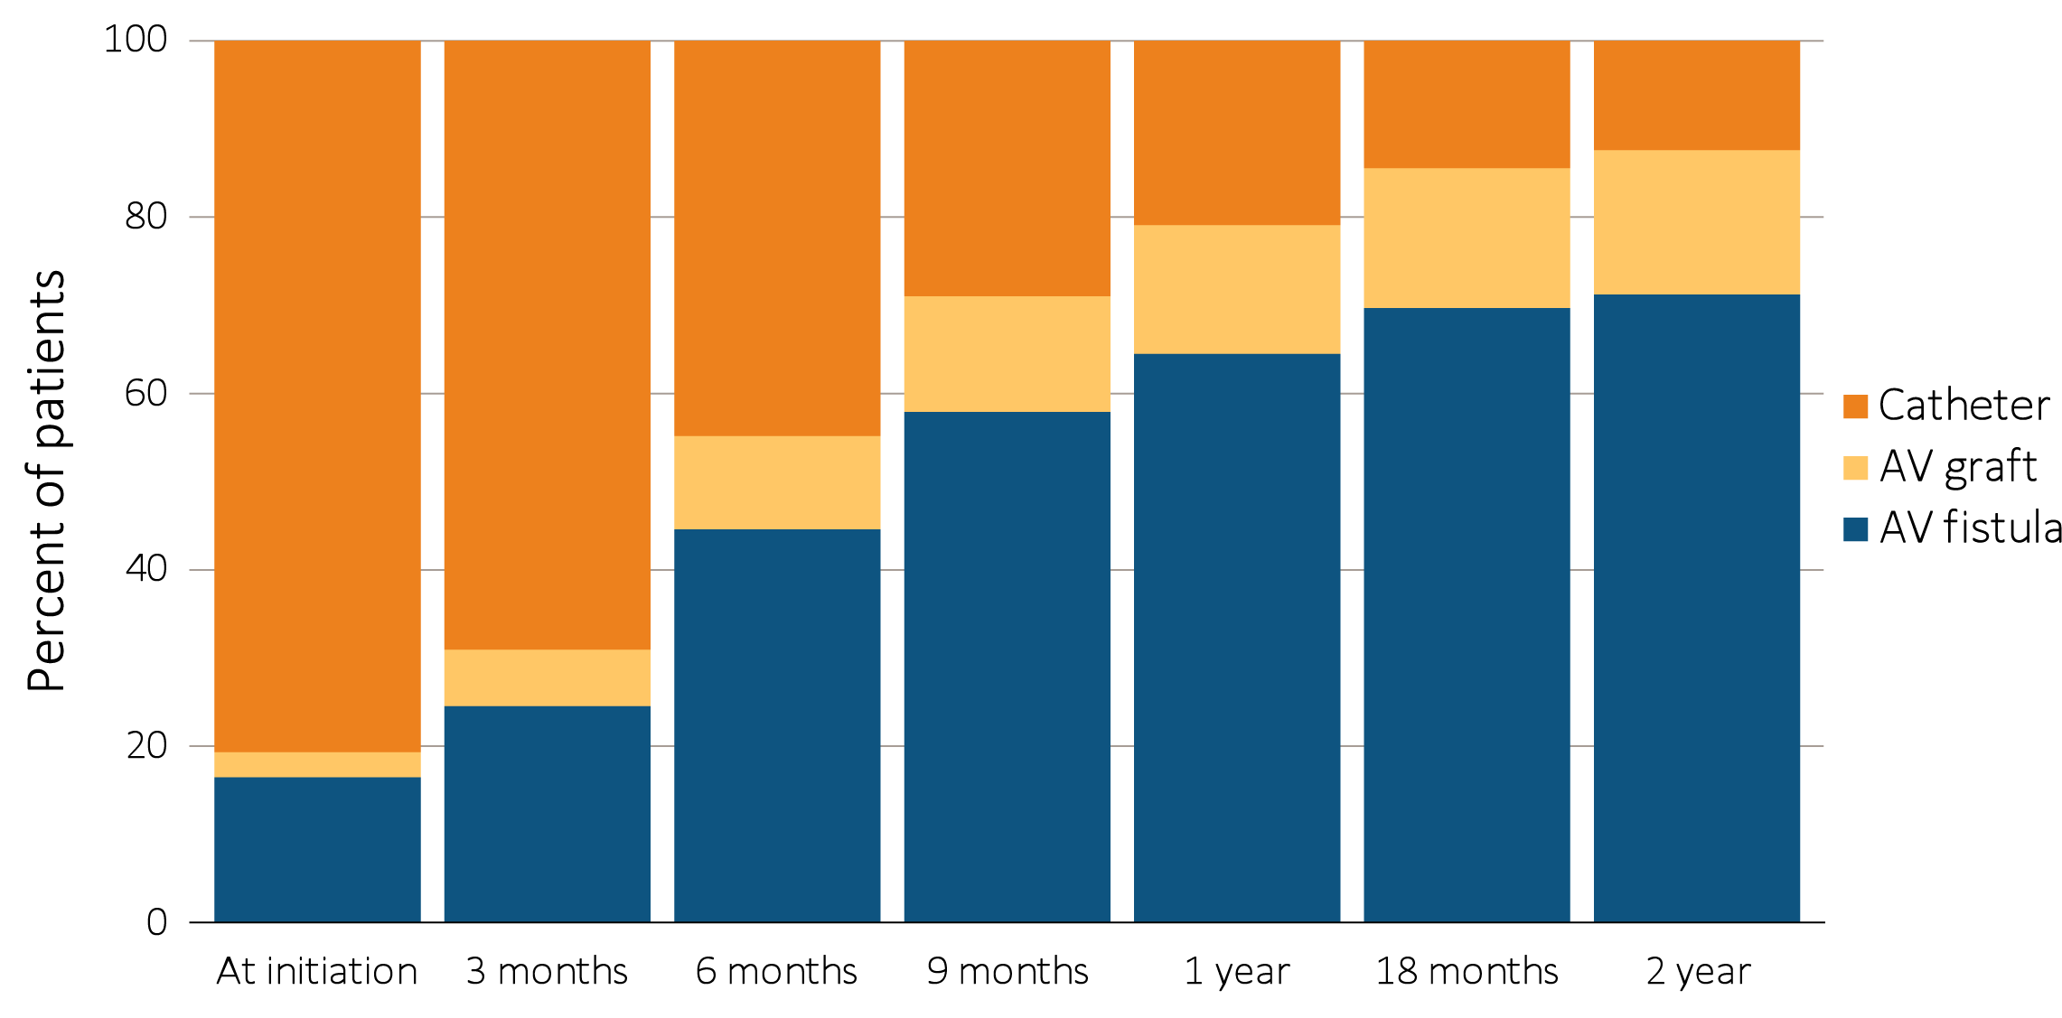
vol 2 Figure 3.7 Change in type of vascular access during the first year of dialysis among patients starting ESRD via hemodialysis in 2013 quarterly: (a) type of vascular access in use (cross-sectional), and (b) longitudinal changes in vascular access use and other outcomes, ESRD Medical Evidence form (CMS 2728) and CROWNWeb, 2013-2016
(a) Type of vascular access in use (cross-sectional)
Data Source: Special analyses, USRDS ESRD Database. Data from January 1, 2013 to May 30, 2016: (a) Medical Evidence form (CMS 2728) at initiation and CROWNWeb for subsequent time periods. (b) ESRD patients initiating hemodialysis (N =101,453). Patients with a maturing AV fistula / AV graft with a catheter in place were classified as having a catheter. Abbreviations: AV, arteriovenous; CMS, Centers for Medicare & Medicaid; CROWNWeb, Consolidated Renal Operations in a Web-enabled Network; ESRD, end-stage renal disease; HD, hemodialysis; PD, peritoneal dialysis.

Slide 11
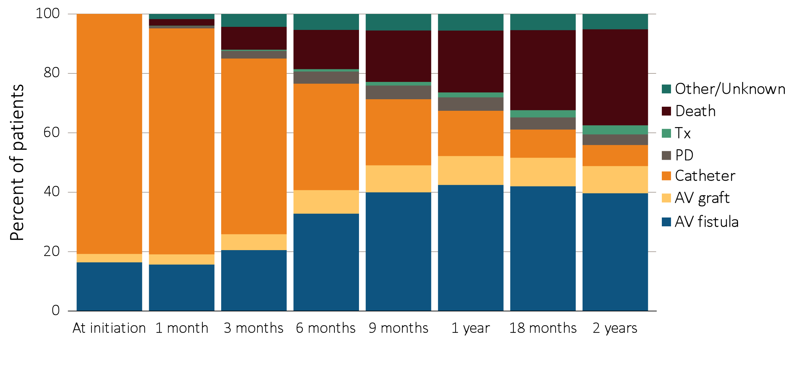
vol 2 Figure 3.7 Change in type of vascular access during the first year of dialysis among patients starting ESRD via hemodialysis in 2013 quarterly: (a) type of vascular access in use (cross-sectional), and (b) longitudinal changes in vascular access use and other outcomes, ESRD Medical Evidence form (CMS 2728) and CROWNWeb, 2013-2016
(b) Longitudinal changes in vascular access use and other outcomes
Data Source: Special analyses, USRDS ESRD Database. Data from January 1, 2013 to May 30, 2016: (a) Medical Evidence form (CMS 2728) at initiation and CROWNWeb for subsequent time periods. (b) ESRD patients initiating hemodialysis (N =101,453). Patients with a maturing AV fistula / AV graft with a catheter in place were classified as having a catheter. Abbreviations: AV, arteriovenous; CMS, Centers for Medicare & Medicaid; CROWNWeb, Consolidated Renal Operations in a Web-enabled Network; ESRD, end-stage renal disease; HD, hemodialysis; PD, peritoneal dialysis.

Slide 12
vol 2 Table 3.3 Cross-sectional distributions of vascular access use, quarterly during the first two years of hemodialysis, among patients new to hemodialysis in 2013, by age group, from the ESRD Medical Evidence form (CMS 2728) and CROWNWeb, 2013-2016
Age | Access type | Time
 |  | At initiation | 3 months | 6 months | 9 months | 1 year | 18 months | 2 years
0-21 | AV fistula | 7.7 | 12.9 | 31.7 | 45.4 | 50.4 | 59.9 | 58.5
 | AV graft | 0.6 | 0.8 | 2.5 | 3.3 | 3.5 | 3.5 | 4.9
 | Catheter | 91.7 | 86.4 | 65.8 | 51.3 | 46.0 | 36.6 | 36.6
22-44 | AV fistula | 13.5 | 22.5 | 44.6 | 59.6 | 67.2 | 73.0 | 74.6
 | AV graft | 1.8 | 4.3 | 7.5 | 9.5 | 10.8 | 12.3 | 13.0
 | Catheter | 84.7 | 73.2 | 47.9 | 31.0 | 22.0 | 14.7 | 12.4
45-64 | AV fistula | 17.3 | 25.3 | 46.1 | 60.1 | 67.1 | 72.6 | 74.1
 | AV graft | 2.6 | 5.5 | 9.2 | 11.7 | 13.2 | 14.4 | 15.0
 | Catheter | 80.1 | 69.2 | 44.7 | 28.2 | 19.7 | 13.0 | 10.9
65-74 | AV fistula | 18.6 | 27.1 | 46.6 | 59.1 | 65.5 | 70.7 | 72.0
 | AV graft | 3.1 | 6.9 | 11.0 | 13.5 | 15.0 | 16.2 | 16.8
 | Catheter | 78.3 | 66.1 | 42.4 | 27.4 | 19.4 | 13.1 | 11.2
75+ | AV fistula | 17.3 | 24.9 | 43.6 | 56.1 | 61.6 | 66.0 | 67.5
 | AV graft | 3.5 | 8.5 | 14.0 | 16.9 | 18.5 | 19.6 | 19.8
 | Catheter | 79.2 | 66.6 | 42.4 | 27.0 | 20.0 | 14.5 | 12.6
Data Source: Special analyses, USRDS ESRD Database. Medical Evidence form (CMS 2728) at initiation and CROWNWeb for subsequent time periods. Abbreviations: AV, arteriovenous; CMS, Centers for Medicare & Medicaid; CROWNWeb, Consolidated Renal Operations in a Web-enabled Network; ESRD, end-stage renal disease.

Slide 13
vol 2 Table 3.4 Cross-sectional distributions of vascular access use, quarterly during the first two years of hemodialysis among patients new to hemodialysis in 2013, by race, from the ESRD Medical Evidence form (CMS-2728) and CROWNWeb, 2013-2016
Race/Ethnicity | Access type | Time
 |  | At initiation | 3 months | 6 months | 9 months | 1 year | 18 months | 2 years
White | AV fistula | 17.6 | 26.0 | 47.0 | 60.7 | 67.6 | 72.9 | 74.5
 | AV graft | 2.3 | 5.4 | 8.9 | 11.1 | 12.3 | 13.3 | 13.5
 | Catheter | 80.1 | 68.6 | 44.1 | 28.3 | 20.2 | 13.9 | 12.0
Black/African American | AV fistula | 15.5 | 22.5 | 40.0 | 52.6 | 58.7 | 63.9 | 65.5
 | AV graft | 4.2 | 8.9 | 14.7 | 18.0 | 20.0 | 21.7 | 22.4
 | Catheter | 80.3 | 68.6 | 45.2 | 29.3 | 21.3 | 14.4 | 12.1
American Indian or Alaska Native | AV fistula | 15.0 | 26.0 | 53.6 | 70.1 | 77.3 | 82.3 | 84.0
 | AV graft | 2.2 | 4.3 | 6.2 | 6.7 | 8.0 | 7.8 | 8.9
 | Catheter | 82.9 | 69.7 | 40.2 | 23.2 | 14.7 | 9.9 | 7.2
Asian | AV fistula | 20.1 | 29.1 | 51.5 | 64.5 | 70.4 | 75.8 | 76.6
 | AV graft | 2.8 | 7.0 | 10.3 | 12.5 | 14.4 | 14.6 | 15.0
 | Catheter | 77.1 | 63.9 | 38.2 | 23.0 | 15.3 | 9.7 | 8.3
Native Hawaiian or Pacific Islander | AV fistula | 18.6 | 28.5 | 48.8 | 61.3 | 69.7 | 77.1 | 77.2
 | AV graft | 2.3 | 4.5 | 6.1 | 9.2 | 10.2 | 11.2 | 13.3
 | Catheter | 79.0 | 67.1 | 45.1 | 29.5 | 20.1 | 11.7 | 9.5
Other or Multiracial | AV fistula | 16.0 | 11.9 | 38.8 | 55.6 | 61.5 | 60.0 | 60.9
 | AV graft | 4.0 | 6.0 | 3.8 | 4.9 | 5.1 | 6.7 | 15.6
 | Catheter | 80.0 | 82.1 | 57.5 | 39.5 | 33.3 | 33.3 | 23.4
Hispanic | AV fistula | 14.5 | 23.1 | 45.0 | 60.5 | 67.8 | 73.9 | 75.6
 | AV graft | 1.9 | 4.7 | 8.5 | 10.6 | 11.9 | 13.4 | 13.7
 | Catheter | 83.7 | 72.2 | 46.5 | 28.9 | 20.3 | 12.7 | 10.7
Non-Hispanic | AV fistula | 17.6 | 25.5 | 45.2 | 58.1 | 64.5 | 69.6 | 71.0
 | AV graft | 3.0 | 6.7 | 11.0 | 13.6 | 15.2 | 16.4 | 17.0
 | Catheter | 79.4 | 67.7 | 43.8 | 28.3 | 20.3 | 14.1 | 12.0
Non-Hispanic White | AV fistula | 18.5 | 26.9 | 47.6 | 60.7 | 67.4 | 72.4 | 74.0
 | AV graft | 2.4 | 5.6 | 9.1 | 11.2 | 12.4 | 13.2 | 13.5
 | Catheter | 79.1 | 67.5 | 43.4 | 28.0 | 20.1 | 14.4 | 12.5
Non-Hispanic African American | AV fistula | 15.5 | 22.4 | 40.0 | 52.6 | 58.7 | 63.9 | 65.5
 | AV graft | 4.2 | 9.0 | 14.8 | 18.1 | 20.0 | 21.7 | 22.5
 | Catheter | 80.3 | 68.5 | 45.2 | 29.3 | 21.3 | 14.4 | 12.0
Data Source: Special analyses, USRDS ESRD Database. Medical Evidence form (CMS 2728) at initiation and CROWNWeb for subsequent time periods. Abbreviations: AV, arteriovenous; CMS, Centers for Medicare & Medicaid; CROWNWeb, Consolidated Renal Operations in a Web-enabled Network; ESRD, end-stage renal disease.

Slide 14
vol 2 Table 3.5 Cross-sectional distributions of vascular access use, quarterly during the first two years of hemodialysis among patients new to hemodialysis in 2013, by sex, from the ESRD Medical Evidence form (CMS 2728) and CROWNWeb, 2013-2016
Sex | Access type | Time
 |  | At initiation | 3 months | 6 months | 9 months | 1 year | 18 months | 2 years
Male | AV fistula | 18.7 | 28.5 | 50.9 | 65.0 | 71.4 | 76.3 | 77.7
 | AV graft | 2.1 | 4.9 | 8.0 | 9.9 | 11.0 | 11.9 | 12.3
 | Catheter | 79.2 | 66.7 | 41.1 | 25.2 | 17.6 | 11.8 | 10.0
Female | AV fistula | 14.9 | 20.6 | 37.6 | 49.9 | 56.7 | 62.3 | 64.0
 | AV graft | 3.8 | 8.5 | 14.1 | 17.5 | 19.4 | 21.1 | 21.9
 | Catheter | 81.3 | 70.9 | 48.4 | 32.7 | 23.9 | 16.6 | 14.2
Data Source: Special analyses, USRDS ESRD Database. Medical Evidence form (CMS 2728) at initiation and CROWNWeb for subsequent time periods. Abbreviations: AV, arteriovenous; CMS, Centers for Medicare & Medicaid; CROWNWeb, Consolidated Renal Operations in a Web-enabled Network; ESRD, end-stage renal disease.

Slide 15
vol 2 Table 3.6 Odds ratios and 95% confidence intervals from logistic regression models of AV fistula use at hemodialysis initiation, and AV fistula or graft use at hemodialysis initiation, from the CMS 2728, 2015
 | AV fistula use at initiation |  |  |  | AV fistula or graft use at initiation
Predictors | Odds ratio | 95% confidence interval |  |  | Odds ratio | 95% confidence interval
 |  | Lower bound | Upper bound |  |  | Lower bound | Upper bound
Pre-ESRD nephrology care
0 months | 0.06 | 0.05 | 0.06 |  | 0.07 | 0.06 | 0.07
>0 - <6 months | 0.30 | 0.28 | 0.32 |  | 0.32 | 0.30 | 0.33
6 - 12 months | 0.62 | 0.59 | 0.64 |  | 0.64 | 0.61 | 0.66
>12 months | Ref |  |  |  | Ref
Unknown | 0.19 | 0.18 | 0.20 |  | 0.19 | 0.18 | 0.21
Age 0-21 | 0.34 | 0.26 | 0.46 |  | 0.32 | 0.24 | 0.42
22-44 | 0.87 | 0.81 | 0.93 |  | 0.83 | 0.78 | 0.88
45-64 | Ref |  |  |  | Ref
65-74 | 1.03 | 0.99 | 1.08 |  | 1.08 | 1.04 | 1.13
75+ | 0.88 | 0.84 | 0.92 |  | 0.95 | 0.91 | 1.00
Sex Female | 0.71 | 0.69 | 0.74 |  | 0.83 | 0.81 | 0.86
Male | Ref |  |  |  | Ref
Race
White | Ref |  |  |  | Ref
Black/African American | 0.99 | 0.94 | 1.03 |  | 1.18 | 1.13 | 1.22
American Indian or Alaska Native | 0.97 | 0.81 | 1.15 |  | 0.94 | 0.79 | 1.12
Asian | 1.09 | 1.00 | 1.19 |  | 1.12 | 1.02 | 1.22
Native Hawaiian or Pacific Islander | 0.95 | 0.81 | 1.12 |  | 0.95 | 0.81 | 1.11
Other or Multiracial | 0.97 | 0.70 | 1.33 |  | 0.97 | 0.71 | 1.31
Ethnicity Hispanic | 0.98 | 0.93 | 1.04 |  | 0.97 | 0.92 | 1.02
Non-Hispanic | Ref |  |  |  | Ref
Diabetes as cause of ESRD | 0.97 | 0.94 | 1.01 |  | 0.98 | 0.95 | 1.01
Facility census < 20 | Ref |  |  |  | Ref
20-50 | 0.95 | 0.92 | 0.99 |  | 0.94 | 0.90 | 0.97
51-100 | 0.83 | 0.77 | 0.89 |  | 0.80 | 0.75 | 0.86
101-200 | 0.22 | 0.11 | 0.46 |  | 0.37 | 0.23 | 0.62
>200 | 0.21 | 0.10 | 0.44 |  | 0.16 | 0.08 | 0.33
ESRD network (vs. average network)
1 CT, ME, MA, NH, RI, VT | 1.20 | 1.10 | 1.29 |  | 1.19 | 1.10 | 1.28
2 NY | 1.12 | 1.05 | 1.19 |  | 1.11 | 1.04 | 1.18
3 NJ, PR, VI | 0.87 | 0.80 | 0.95 |  | 0.86 | 0.80 | 0.93
4 DE, PA | 1.01 | 0.94 | 1.09 |  | 1.01 | 0.94 | 1.09
5 VA, WV, MD, DC | 0.92 | 0.86 | 0.99 |  | 0.90 | 0.84 | 0.96
6 GA, NC, SC | 1.02 | 0.96 | 1.08 |  | 0.97 | 0.92 | 1.03
7 FL | 0.74 | 0.69 | 0.79 |  | 0.74 | 0.69 | 0.79
8 AL, MS, TN | 1.00 | 0.93 | 1.08 |  | 1.04 | 0.98 | 1.12
9 IN, KY, OH | 0.94 | 0.89 | 1.00 |  | 0.93 | 0.88 | 0.99
10 IL | 0.90 | 0.83 | 0.98 |  | 0.97 | 0.90 | 1.05
11 MN, MI, ND, SD, WI | 0.94 | 0.88 | 1.01 |  | 0.91 | 0.85 | 0.97
12 IA, KS, MO, NE | 0.80 | 0.73 | 0.88 |  | 0.81 | 0.74 | 0.88
13 AR, LA, OK | 1.04 | 0.96 | 1.13 |  | 0.99 | 0.92 | 1.07
14 TX | 0.76 | 0.71 | 0.81 |  | 0.77 | 0.73 | 0.82
15 AZ, CO, NV, NM, UT, WY | 1.26 | 1.17 | 1.35 |  | 1.21 | 1.13 | 1.30
16 AK, ID, MT, OR, WA | 1.36 | 1.25 | 1.48 |  | 1.38 | 1.27 | 1.50
17 AS, GU, MP, HI, Northern CA | 1.29 | 1.20 | 1.39 |  | 1.37 | 1.28 | 1.47
18 Southern CA | 1.10 | 1.03 | 1.18 |  | 1.12 | 1.05 | 1.19
Data Source: Special analyses, USRDS ESRD Database. For more on ESRD networks, see http://www.cms.gov/About-CMS/Agency-Information/RegionalOffices/RegionalMap.html. Abbreviations: AV, arteriovenous; CMS, Centers for Medicare & Medicaid; CMS 2728, CMS ESRD Medical Evidence form2728; ESRD, end-stage renal disease.

Slide 16
vol 2 Table 3.7 Distribution of number of days between AV fistula placement and first successful use*, overall and by patient characteristics, for new AV fistulas created in 2014-2015 (excludes patients not yet ESRD when fistula was placed), from Medicare claims and CROWNWeb, 2014-2016
 | Total AV fistula placements | Percentage of failed placements | Number of days between AV fistula placement and first use
 |  |  | Average | Median | 25th percentile | 75th percentile
Overall | 43,530 | 35.9 | 132 | 111 | 75 | 166
Age
0-21 | 167 | 29.3 | 137 | 106 | 75 | 159
22-44 | 5,011 | 31.5 | 130 | 106 | 69 | 162
45-64 | 16,284 | 34.0 | 131 | 109 | 73 | 167
65-74 | 12,297 | 36.7 | 136 | 116 | 79 | 169
75+ | 9,771 | 40.3 | 130 | 112 | 77 | 163
Race
White | 26,881 | 35.1 | 132 | 112 | 77 | 165
Black/African American | 13,973 | 38.5 | 133 | 111 | 71 | 170
American Indian or Alaska Native | 592 | 30.4 | 137 | 115 | 81 | 165
Asian | 1,450 | 29.4 | 124 | 108 | 69 | 152
Native Hawaiian or Pacific Islander | 458 | 31.9 | 131 | 110 | 72 | 180
Other or Multiracial | 128 | 34.4 | 116 | 97 | 27 | 156
Unknown | 27 | 29.6 | 167 | 143 | 54 | 228
Ethnicity
Hispanic | 6,211 | 31.4 | 128 | 108 | 75 | 158
Non-Hispanic | 37,192 | 36.6 | 133 | 113 | 75 | 168
Race/Ethnicity
Non-Hispanic White | 20,937 | 36.2 | 133 | 113 | 78 | 167
Non-Hispanic Black/African American | 13,776 | 38.4 | 133 | 111 | 71 | 170
Sex
Male | 24,495 | 34.8 | 113 | 104 | 71 | 144
Female | 18,654 | 46.9 | 123 | 112 | 75 | 161
Primary Cause of ESRD
Diabetes | 20,308 | 36.0 | 135 | 113 | 77 | 169
Hypertension | 13,312 | 36.1 | 131 | 111 | 75 | 164
Glomerulonephritis | 3852 | 33.1 | 126 | 105 | 68 | 160
Cystic kidney | 710 | 32 | 128 | 109 | 69 | 162
Other urologic | 625 | 34.9 | 124 | 107 | 66 | 156
Other cause | 3631 | 38.8 | 131 | 110 | 74 | 164
Unknown cause | 1092 | 34.6 | 131 | 108 | 70 | 165
Data Source: Special analyses, USRDS ESRD Database. *Fistulas places between June 1, 2014 and May 31, 2015, with follow-up through the June 2016; date of first use was the date the given access was first reported in CROWNWeb to be in use in a particular patient. Abbreviations: AV, arteriovenous; CROWNWeb, Consolidated Renal Operations in a Web-enabled Network; ESRD, end-stage renal disease.

