Slide 1
2017 Annual Data Report
Volume 2: End-Stage Renal Disease
Chapter 4:
Hospitalization

Slide 2
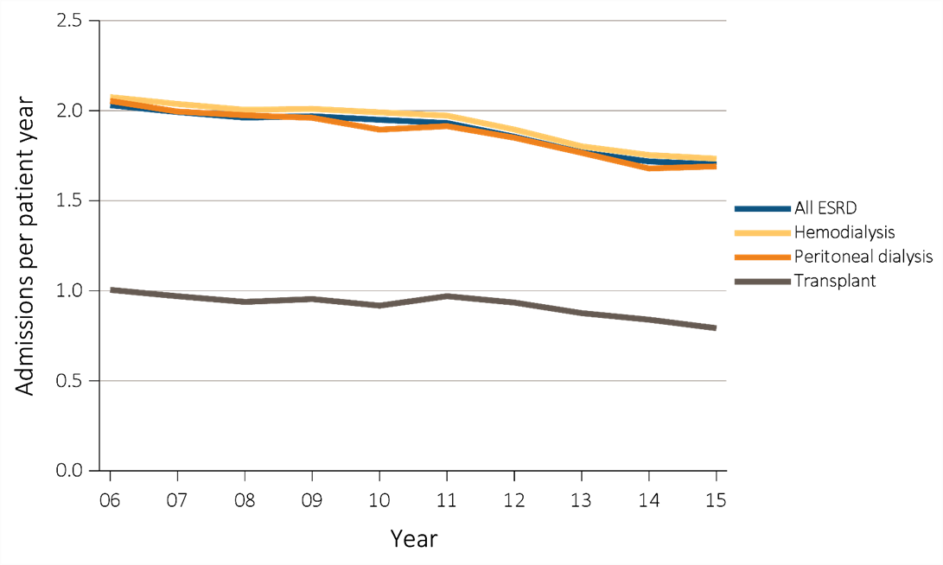
vol 2 Figure 4.1 Adjusted hospitalization rates for ESRD patients, by treatment modality, 2006-2015
Data Source: Reference Tables G.1, G.3, G.4, G.5, G.6, G.8, G.9, G.10, and special analyses, USRDS ESRD Database. Period prevalent ESRD patients; adjusted for age, sex, race, primary cause of kidney failure, & their two-way interactions; standard population: ESRD patients, 2011. Abbreviation: ESRD, end-stage renal disease.

Slide 3

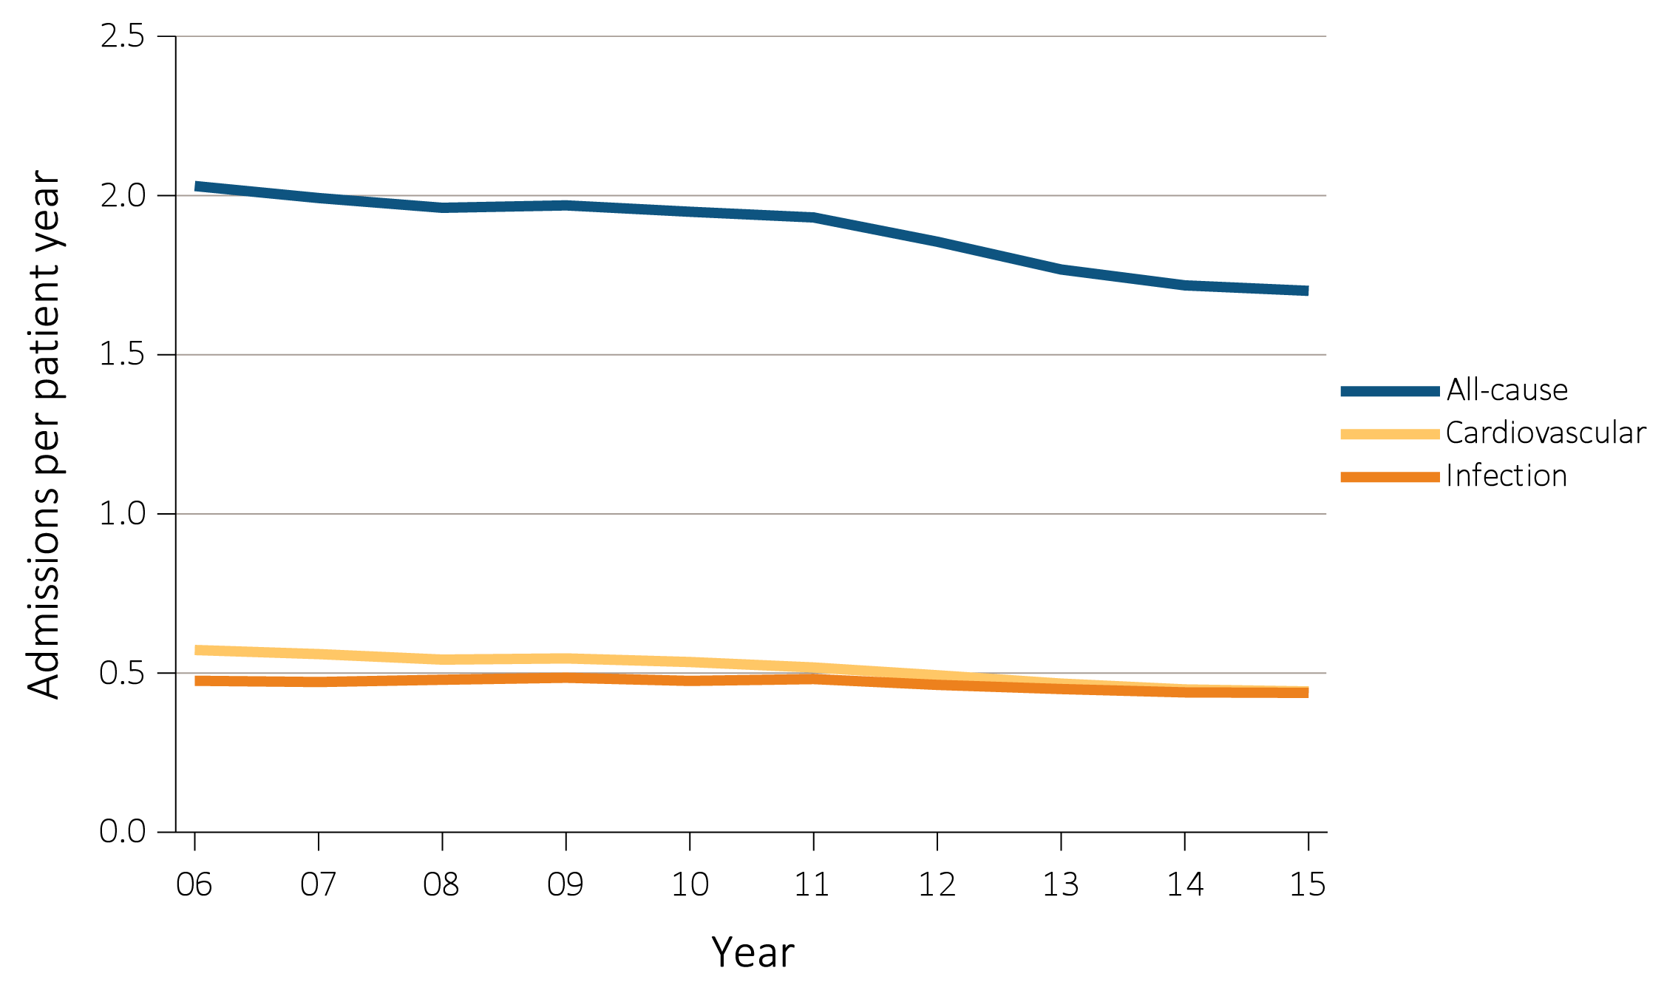
vol 2 Figure 4.2 Adjusted all-cause & cause-specific hospitalization rates for ESRD patients, by treatment modality, 2006-2015
Data Source: Reference Tables G.1, G.3, G.4, G.5, and special analyses, USRDS ESRD Database. Period prevalent ESRD patients; adjusted for age, sex, race, primary cause of kidney failure, & their two-way interactions; standard population: ESRD patients, 2011. Abbreviation: ESRD, end-stage renal disease.

Slide 4

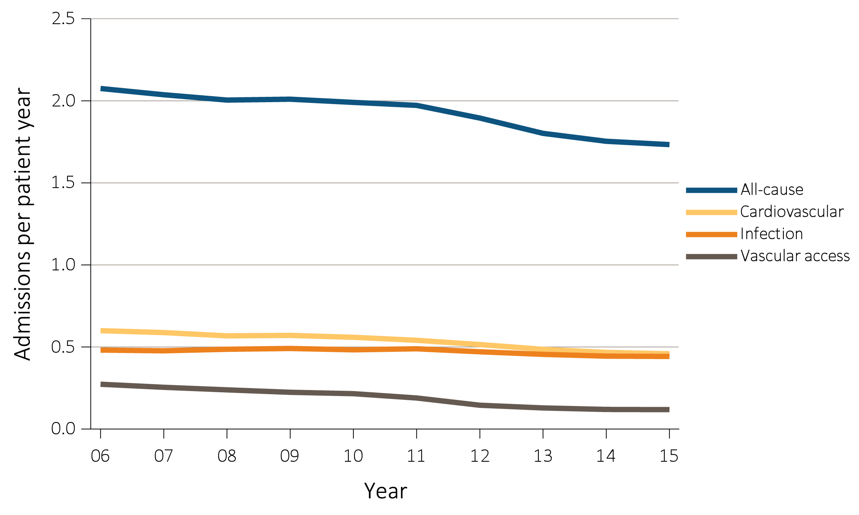
vol 2 Figure 4.2 Adjusted all-cause & cause-specific hospitalization rates for ESRD patients, by treatment modality, 2006-2015
Data Source: Reference Tables G.1, G.3, G.4, G.5, and special analyses, USRDS ESRD Database. Period prevalent ESRD patients; adjusted for age, sex, race, primary cause of kidney failure, & their two-way interactions; standard population: ESRD patients, 2011. Abbreviation: ESRD, end-stage renal disease.

Slide 5
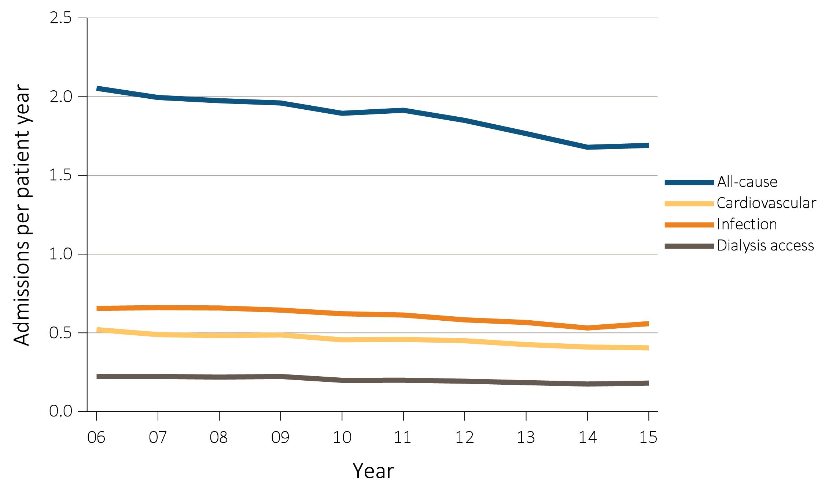
vol 2 Figure 4.2 Adjusted all-cause & cause-specific hospitalization rates for ESRD patients, by treatment modality, 2006-2015
(c) Peritoneal dialysis
Data Source: Reference Tables G.1, G.3, G.4, G.5, and special analyses, USRDS ESRD Database. Period prevalent ESRD patients; adjusted for age, sex, race, primary cause of kidney failure, & their two-way interactions; standard population: ESRD patients, 2011. Abbreviation: ESRD, end-stage renal disease.

Slide 6
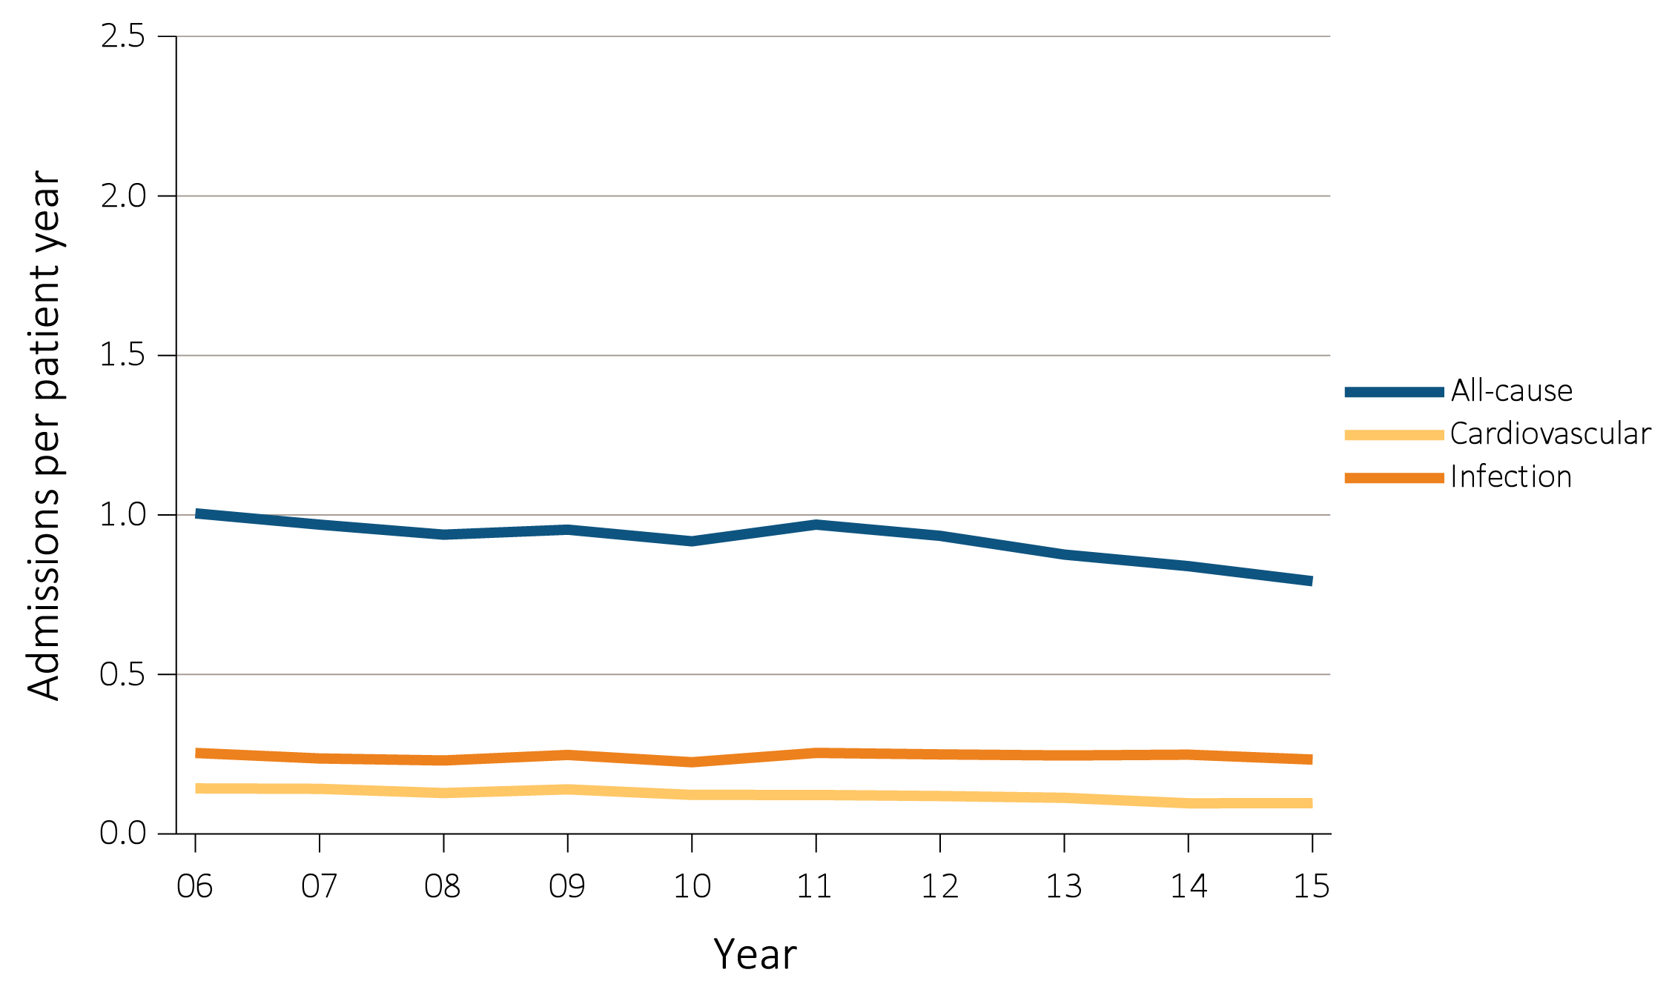
Data Source: Reference Tables G.1, G.3, G.4, G.5, and special analyses, USRDS ESRD Database. Period prevalent ESRD patients; adjusted for age, sex, race, primary cause of kidney failure, & their two-way interactions; standard population: ESRD patients, 2011. Abbreviation: ESRD, end-stage renal disease.
vol 2 Figure 4.2 Adjusted all-cause & cause-specific hospitalization rates for ESRD patients, by treatment modality, 2006-2015
(d) Transplant

Slide 7
vol 2 Table 4.1 Adjusted rates of all-cause & cause-specific hospitalization per patient year for adult hemodialysis patients, 2006-2015
 | All | Cardiovascular |  |  | Any infection |  | Vascular access infection
2006-2007 | 2.04 | 0.59 |  |  | 0.48 |  | 0.25
2008-2009 | 2.01 | 0.57 |  |  | 0.49 |  | 0.22
2010-2011 | 1.97 | 0.54 |  |  | 0.49 |  | 0.19
2012-2013 | 1.80 | 0.49 |  |  | 0.45 |  | 0.13
2014-2015 | 1.73 | 0.46 |  |  | 0.44 |  | 0.12
2014-2015, by patient characteristics
Age
22-44 | 1.93 | 0.44 |  |  | 0.45 |  | 0.15
45-64 | 1.69 | 0.44 |  |  | 0.42 |  | 0.12
65-74 | 1.74 | 0.48 |  |  | 0.45 |  | 0.11
75+ | 1.79 | 0.49 |  |  | 0.49 |  | 0.11
Sex
Male | 1.58 | 0.43 |  |  | 0.41 |  | 0.10
Female | 1.92 | 0.50 |  |  | 0.48 |  | 0.14
Race
White | 1.76 | 0.45 |  |  | 0.47 |  | 0.11
Black/African American | 1.76 | 0.48 |  |  | 0.41 |  | 0.14
American Indian or Alaska Native | 1.54 | 0.33 |  |  | 0.49 |  | 0.09
Asian | 1.22 | 0.34 |  |  | 0.33 |  | 0.10
Native Hawaiian or Pacific Islander | 1.19 | 0.34 |  |  | 0.34 |  | 0.08
Other or Multiracial | 1.60 | 0.44 |  |  | 0.46 |  | 0.10
Ethnicity
Hispanic | 1.57 | 0.42 |  |  | 0.41 |  | 0.11
Non-Hispanic | 1.76 | 0.47 |  |  | 0.45 |  | 0.12
Non-Hispanic White | 1.86 | 0.48 |  |  | 0.50 |  | 0.11
Non-Hispanic Black/African American | 1.74 | 0.48 |  |  | 0.41 |  | 0.13
Cause of Renal Failure
Diabetes | 1.96 | 0.50 |  |  | 0.50 |  | 0.13
Hypertension | 1.60 | 0.46 |  |  | 0.38 |  | 0.11
Glomerulonephritis | 1.47 | 0.39 |  |  | 0.38 |  | 0.11
Other Cause | 1.70 | 0.40 |  |  | 0.47 |  | 0.12
Vintage
<1 year | 1.79 | 0.47 |  |  | 0.49 |  | 0.13
1-<2 years | 1.70 | 0.45 |  |  | 0.43 |  | 0.10
2-<5 years | 1.71 | 0.47 |  |  | 0.42 |  | 0.10
5+ years | 1.75 | 0.45 |  |  | 0.45 |  | 0.14
Data Source: Reference Tables G.3, G.13, and special analyses, USRDS ESRD Database. Period prevalent hemodialysis patients aged 22 & older; adjusted for age, sex, race, ethnicity, primary cause of kidney failure, & their two-way interactions. Rates by one factor adjusted for the remaining three; standard population, hemodialysis patients, 2011. See Vol. 2, ESRD Analytical Methods for principal ICD-9-CM diagnosis codes included in each cause of hospitalization category.

Slide 8
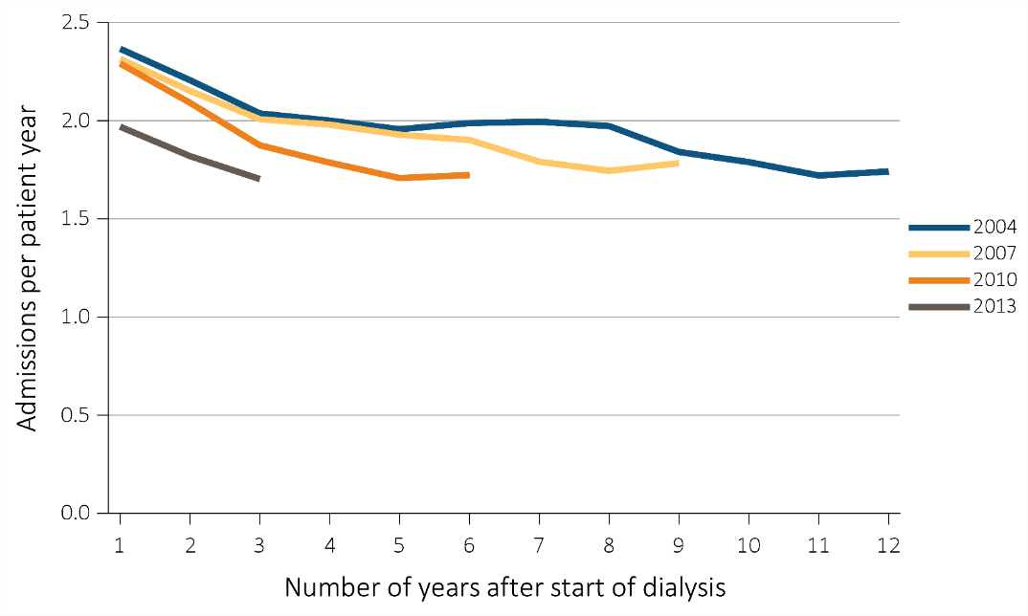
vol 2 Figure 4.3 Adjusted all-cause hospitalization rates by treatment modality and number of years after start of dialysis, for cohorts of incident patients in 2004, 2007, 2010, and 2013
Hemodialysis patients
Data Source: Special analyses, USRDS ESRD Database. Period prevalent ESRD patients, adjusted for age, sex, race, ethnicity, primary cause of kidney failure; standard population: ESRD patients, 2011.

Slide 9
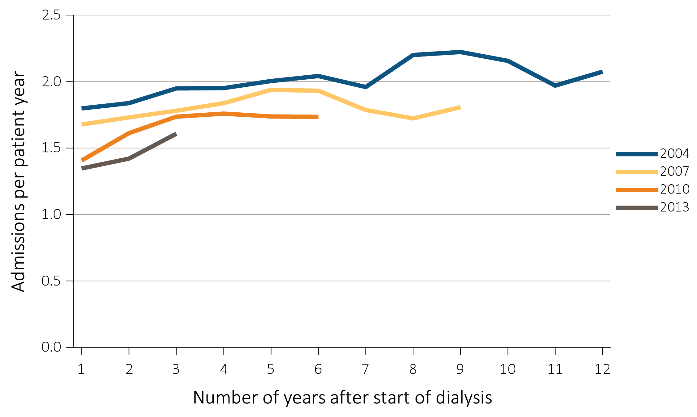
vol 2 Figure 4.3 Adjusted all-cause hospitalization rates by treatment modality and number of years after start of dialysis, for cohorts of incident patients in 2004, 2007, 2010, and 2013
(b) Peritoneal dialysis patients
Data Source: Special analyses, USRDS ESRD Database. Period prevalent ESRD patients, adjusted for age, sex, race, ethnicity, primary cause of kidney failure; standard population: ESRD patients, 2011.

Slide 10
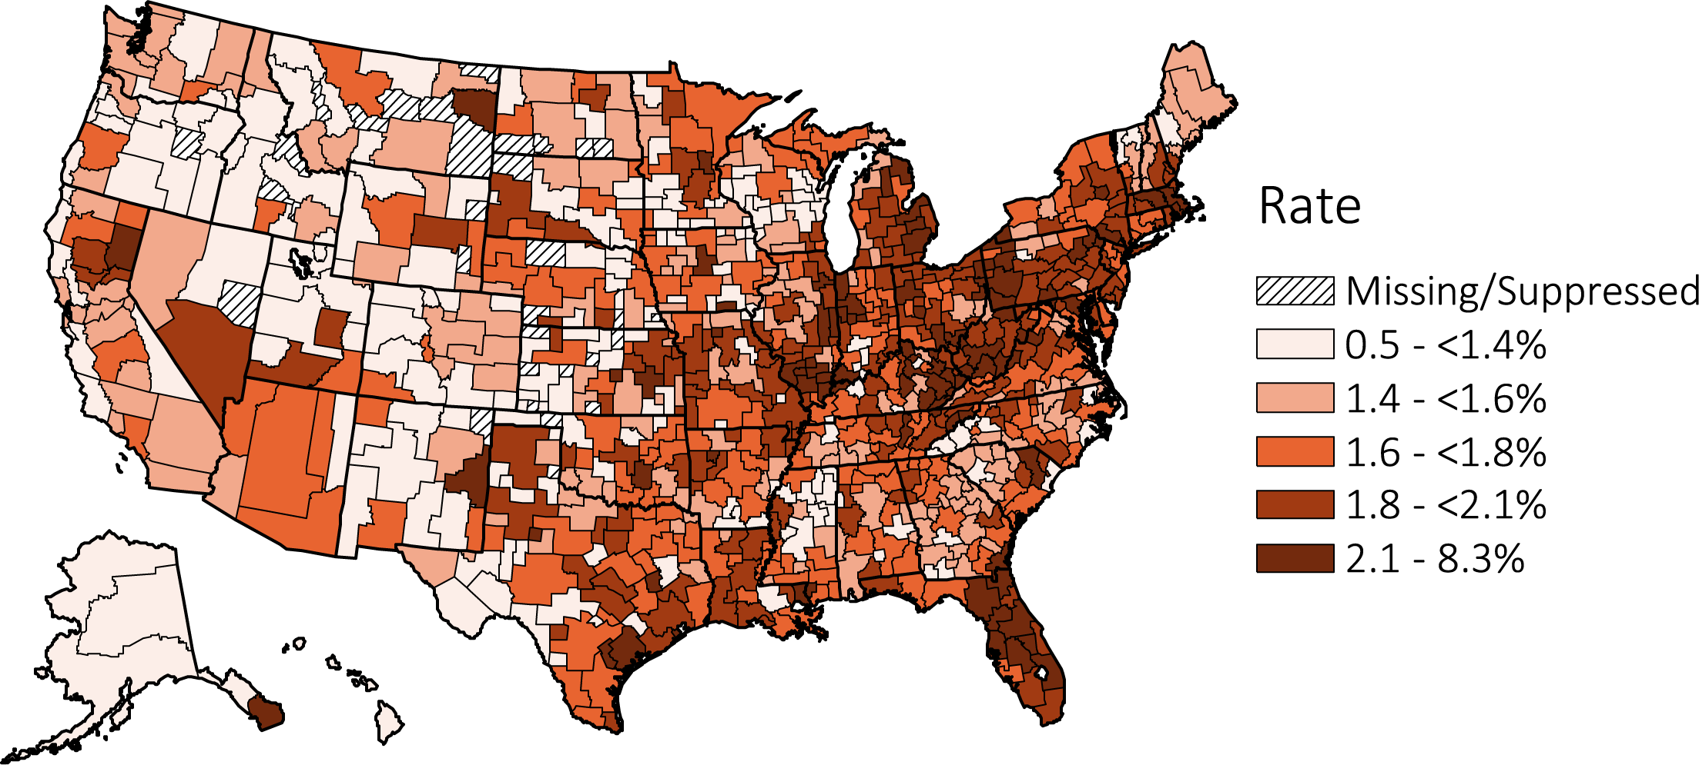
vol 2 Figure 4.4 Map of the hospitalization rates of ESRD, by Health Service Area, in the U.S. population, 2014-2015
Unadjusted
Data Source: Reference Tables G.1, G.3, G.4, G.5, and special analyses, USRDS ESRD Database. Period prevalent ESRD patients; adjusted for age, sex, race, & primary cause of kidney failure; standard population: ESRD patients, 2011. Values for HSAs with 10 or fewer patients are suppressed. Abbreviation: ESRD, end-stage renal disease.

Slide 11
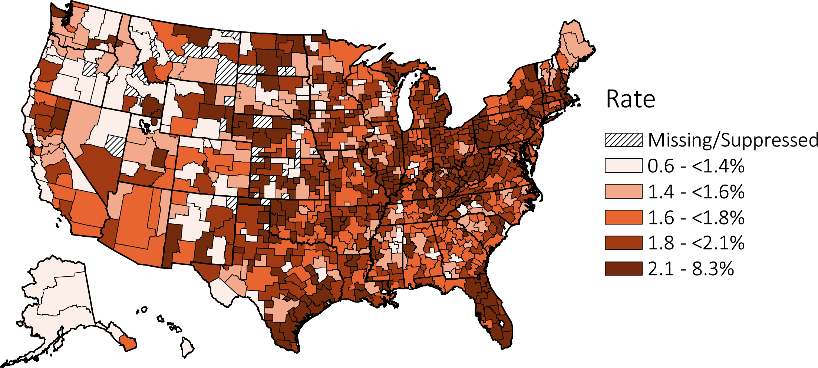
vol 2 Figure 4.4 Map of the hospitalization rates of ESRD, by Health Service Area, in the U.S. population, 2014-2015
(b) Adjusted
Data Source: Reference Tables G.1, G.3, G.4, G.5, and special analyses, USRDS ESRD Database. Period prevalent ESRD patients; adjusted for age, sex, race, & primary cause of kidney failure; standard population: ESRD patients, 2011. Values for HSAs with 10 or fewer patients are suppressed. Abbreviation: ESRD, end-stage renal disease.

Slide 12
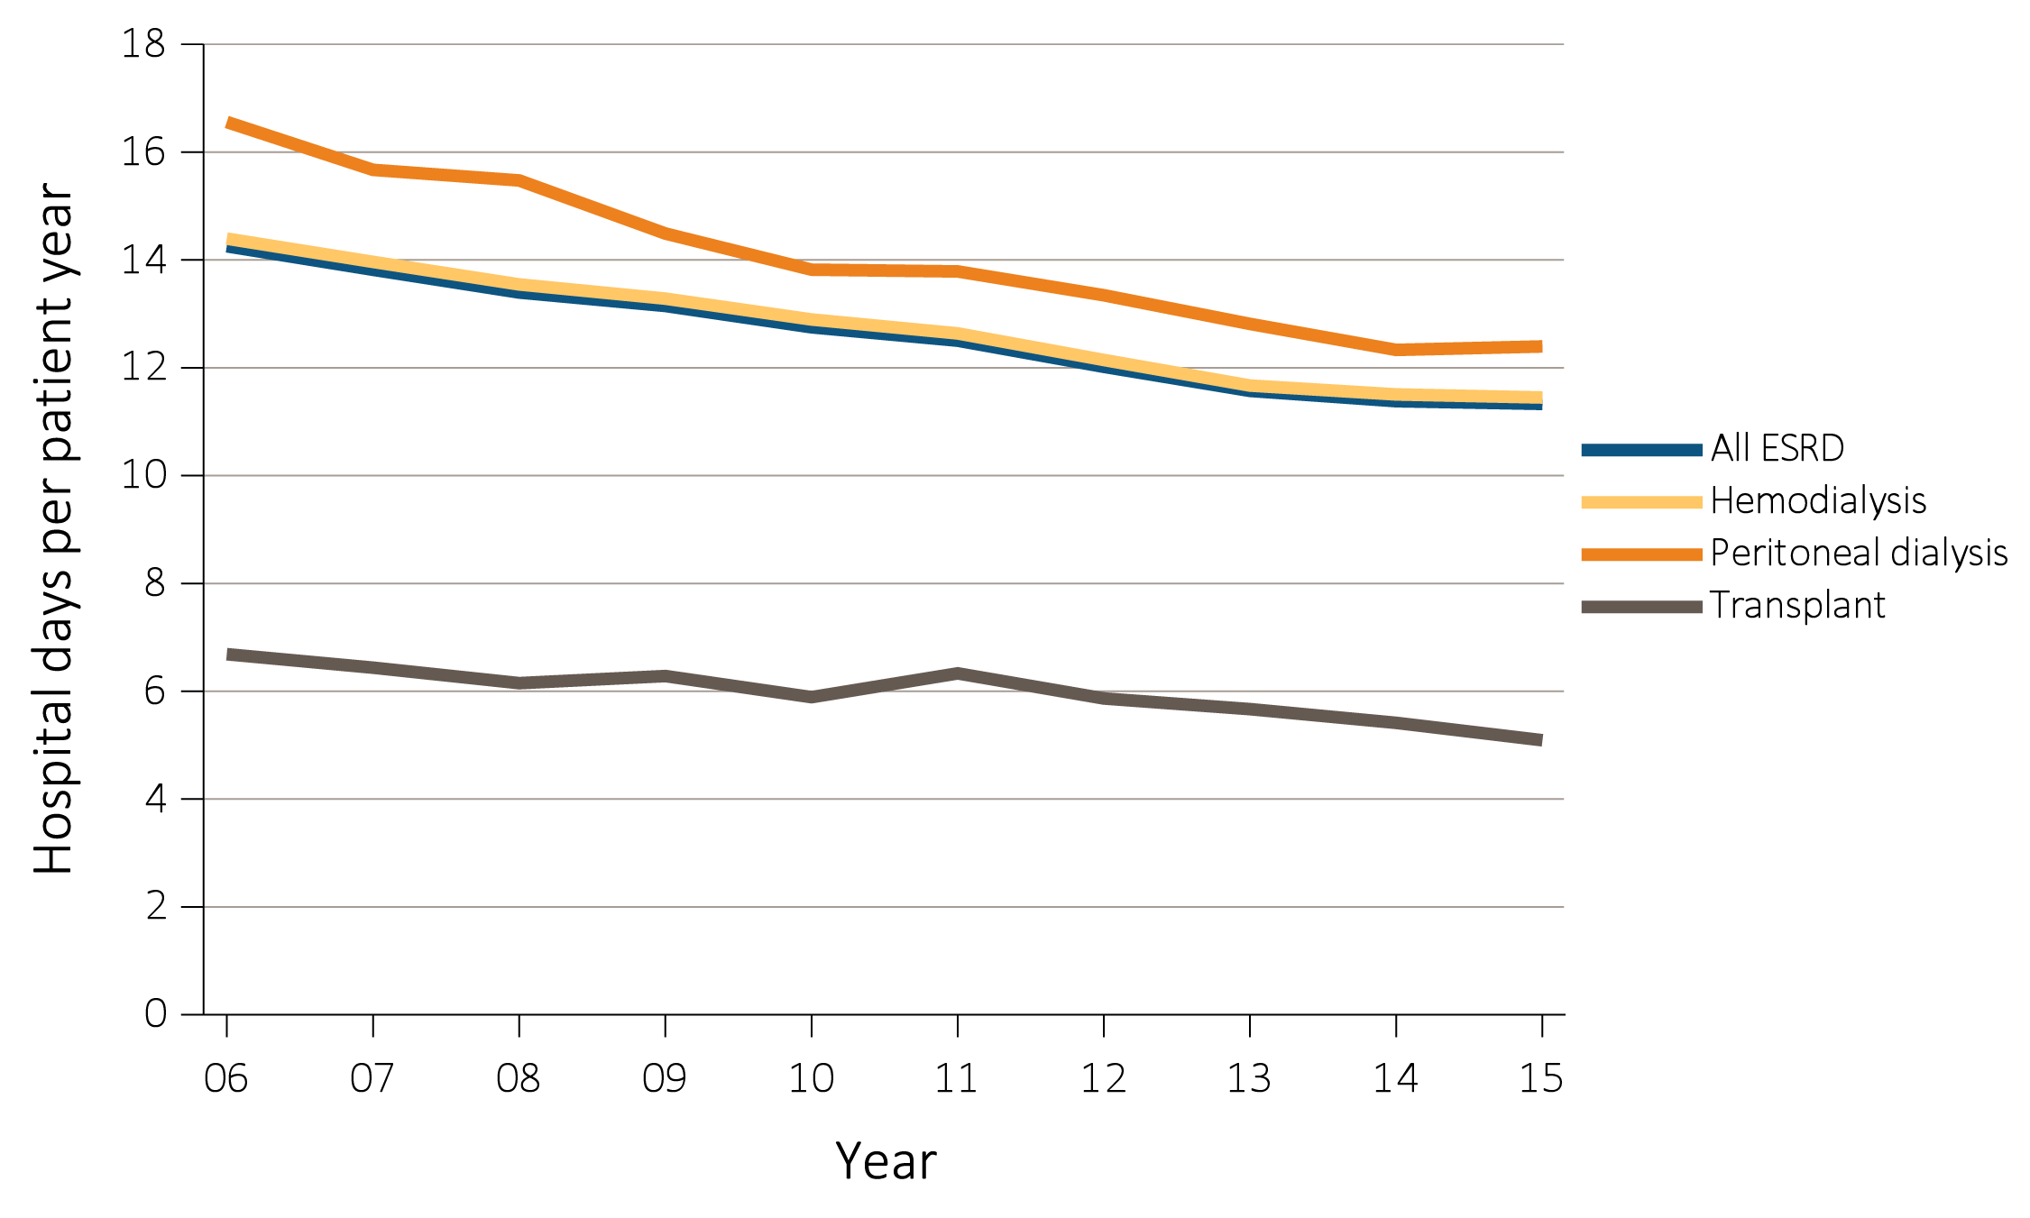
vol 2 Figure 4.5 Adjusted hospital days for ESRD patients, by treatment modality, 2006-2015
Data Source: Reference Tables G.1, G.3, G.4, G.5, G.6, G.8, G.9, G.10, and special analyses, USRDS ESRD Database. Period prevalent ESRD patients; adjusted for age, sex, race, primary cause of kidney failure, & their two-way interactions. standard population: ESRD patients, 2011. Abbreviation: ESRD, end-stage renal disease.

Slide 13
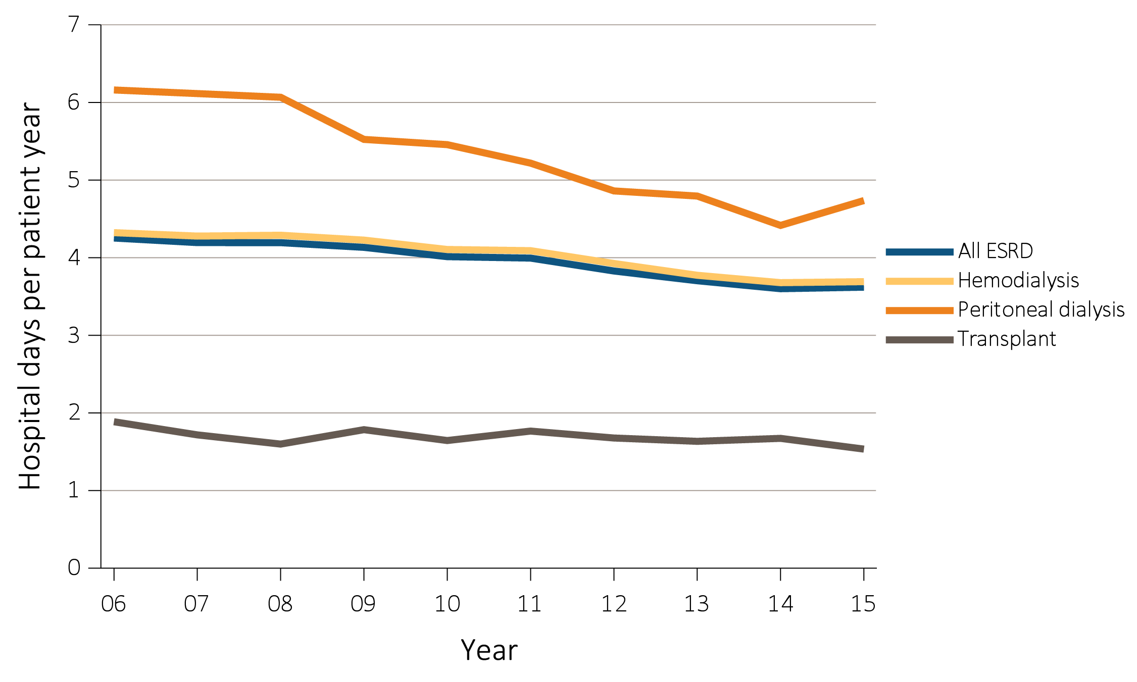
vol 2 Figure 4.6 Adjusted hospital days for infection & cardiovascular causes, for ESRD patients by their treatment modality, 2006-2015
Infection
Data Source: Special analyses, USRDS ESRD Database. Period prevalent hemodialysis patients, all ages, 2015; adjusted for age, sex, race, primary cause of kidney failure, & their two-way interactions. Includes live hospital discharges from January 1 to December 1, 2015. Cause-specific hospitalizations are defined by principal ICD-9-CM codes. See Vol. 2, ESRD Analytical Methods for principal ICD-9-CM diagnosis codes included in each cause of hospitalization category. Abbreviation: ESRD, end-stage renal disease.

Slide 14
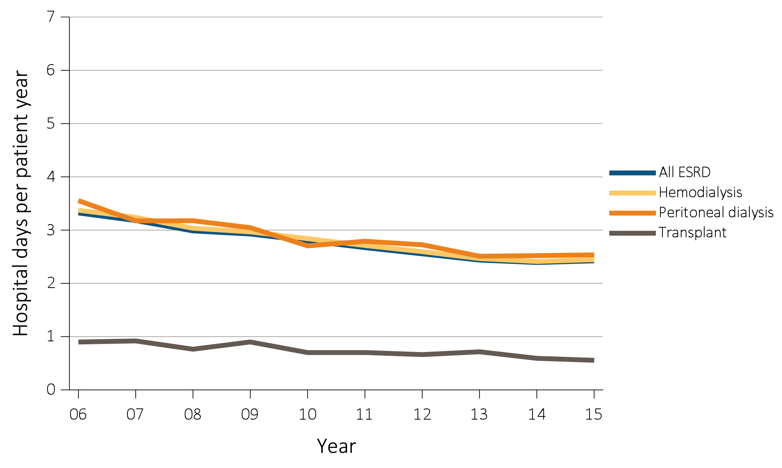
vol 2 Figure 4.6 Adjusted hospital days for infection & cardiovascular causes, for ESRD patients by their treatment modality, 2006-2015
(b) Cardiovascular
Data Source: Special analyses, USRDS ESRD Database. Period prevalent hemodialysis patients, all ages, 2015; adjusted for age, sex, race, primary cause of kidney failure, & their two-way interactions. Includes live hospital discharges from January 1 to December 1, 2015. Cause-specific hospitalizations are defined by principal ICD-9-CM codes. See Vol. 2, ESRD Analytical Methods for principal ICD-9-CM diagnosis codes included in each cause of hospitalization category. Abbreviation: ESRD, end-stage renal disease.

Slide 15
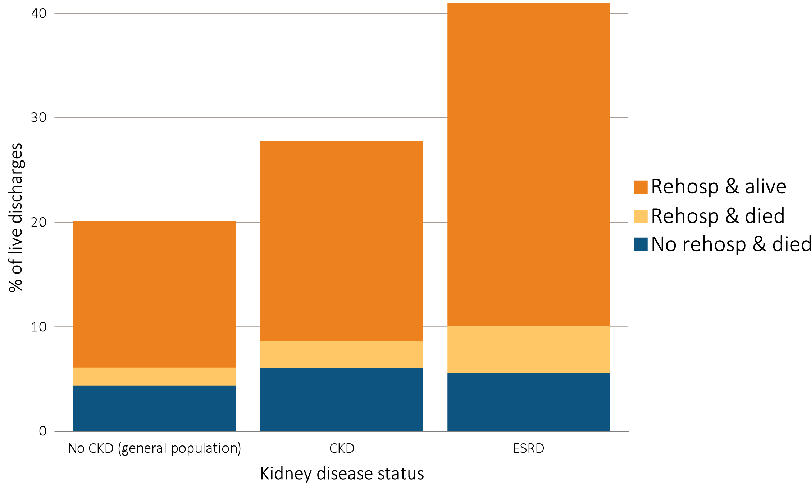
vol 2 Figure 4.7 Proportion of patients aged 66 & older discharged alive from the hospital who were either rehospitalized or died within 30 days of discharge, by kidney disease status, 2015
Data Source: Special analyses, USRDS ESRD Database and Medicare 5% sample. January 1, 2015 point prevalent Medicare patients aged 66 & older on December 31, 2013. For general Medicare: January 1, 2015 point prevalent, Medicare patients aged 66 & older, discharged alive from an all-cause index hospitalization between January 1, 2015, and December 1, 2014, unadjusted. CKD determined using claims for 2014. Abbreviations: CKD, chronic kidney disease; ESRD, end-stage renal disease; rehosp, rehospitalization.

Slide 16
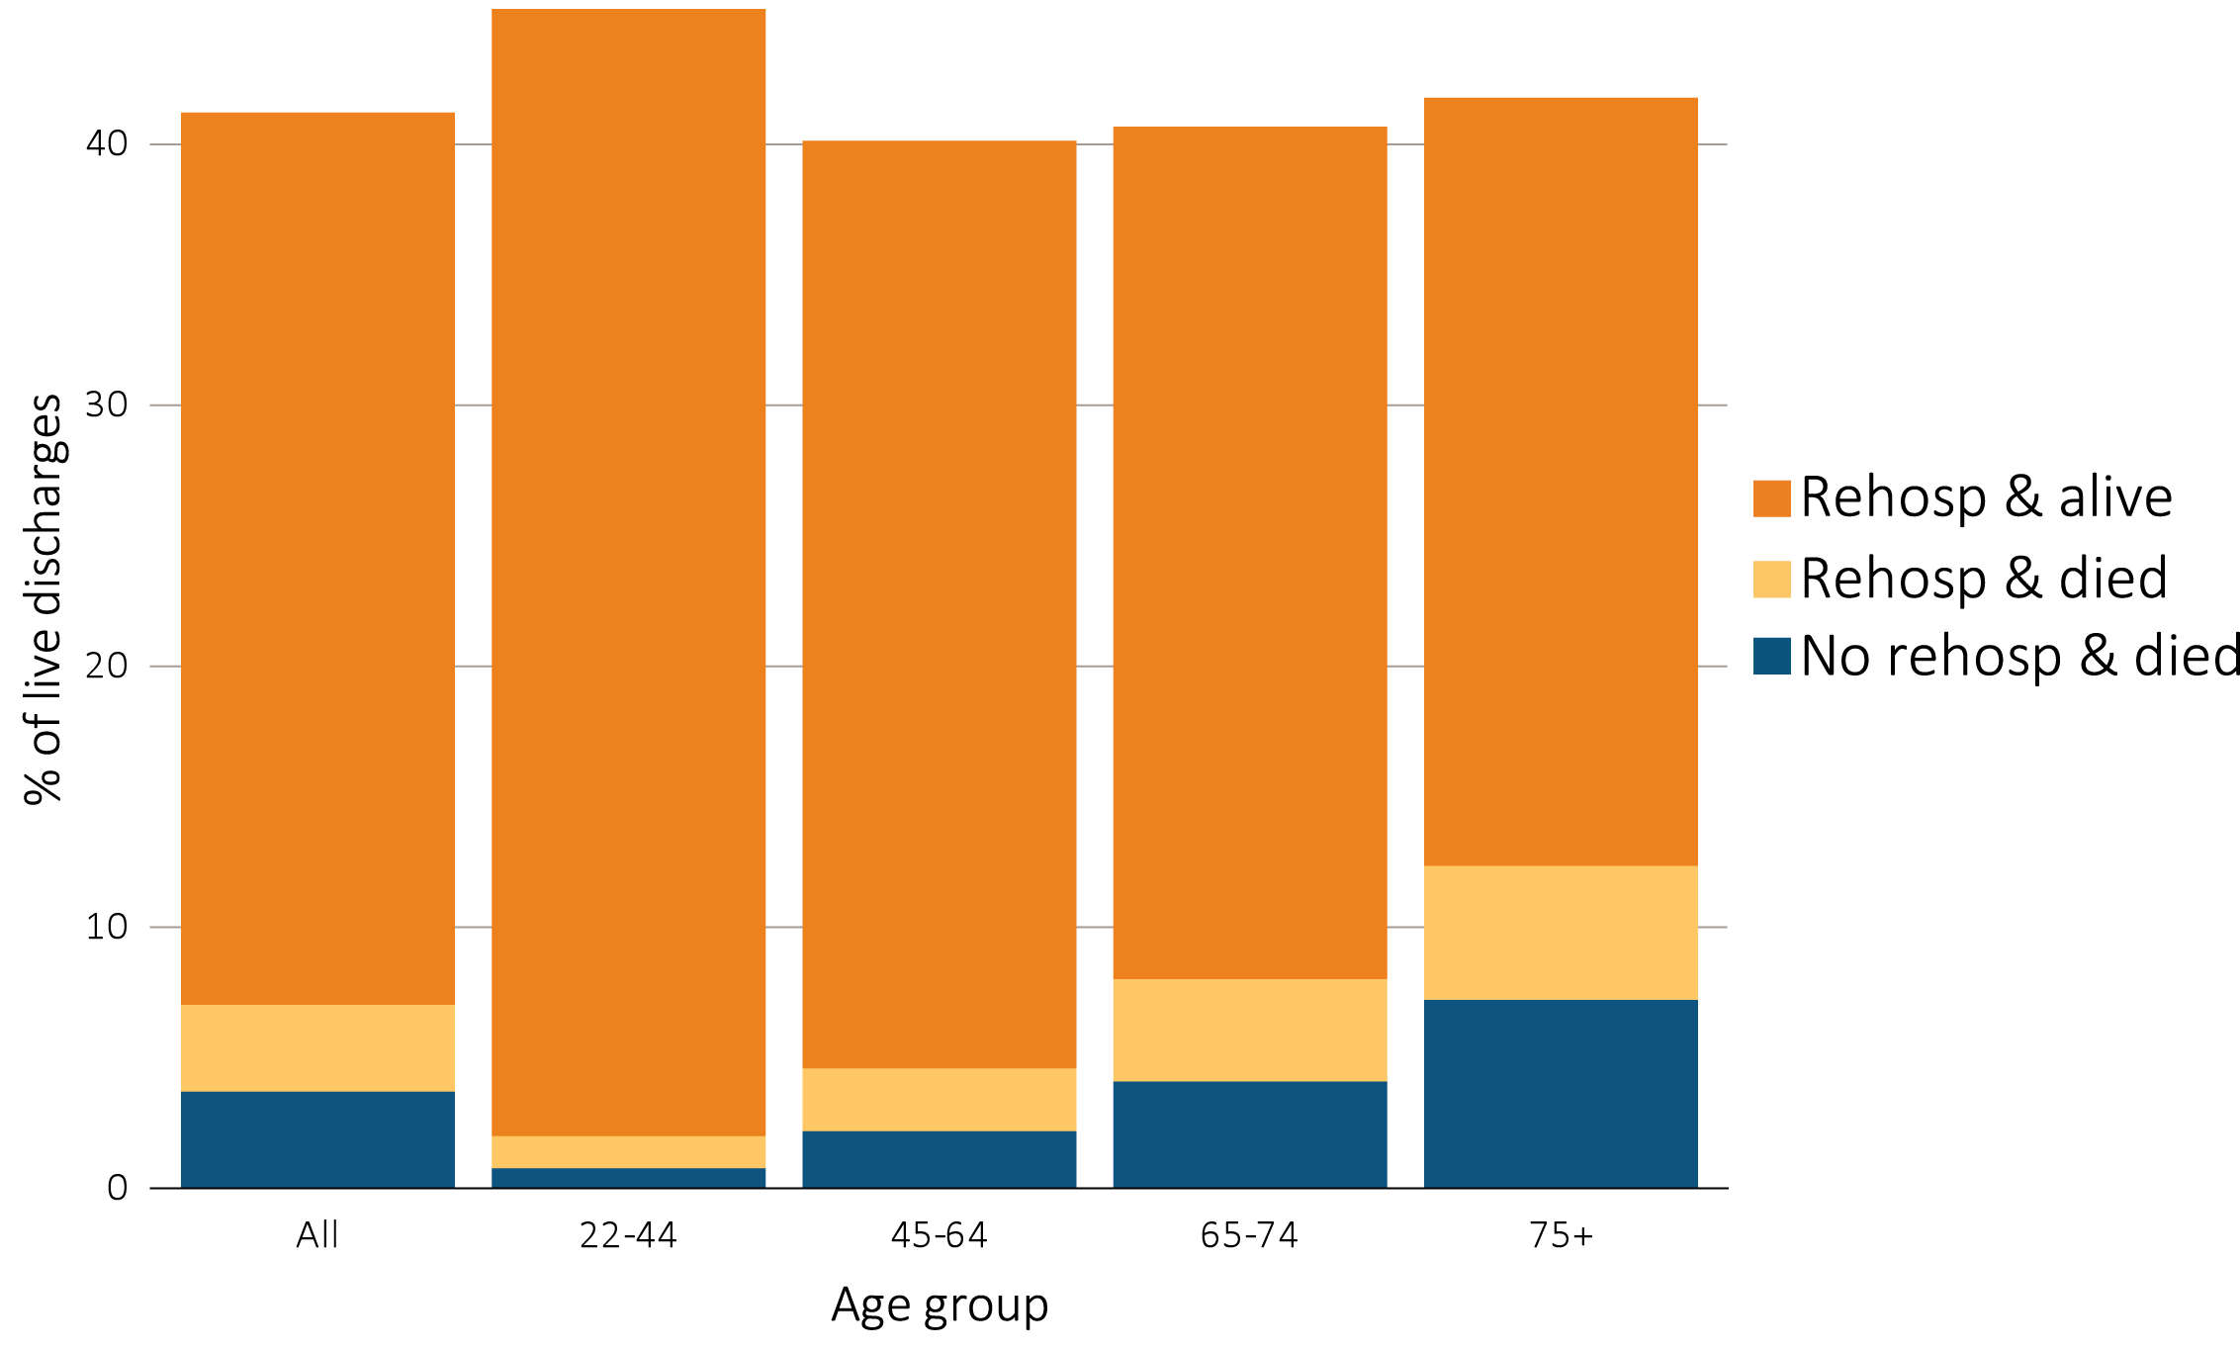
vol 2 Figure 4.8 Proportion of hemodialysis patients discharged alive from the hospital who either were rehospitalized or died within 30 days of discharge, by demographic characteristics, 2015
Data Source: Special analyses, USRDS ESRD Database. Period prevalent hemodialysis patients, all ages, 2015, unadjusted. Patients less than age 22 are not represented as a group due to insufficient sample size. Includes live hospital discharges from January 1 to December 1, 2015. Cause-specific hospitalizations are defined by principal ICD-9-CM codes. See Vol. 2, ESRD Analytical Methods for principal ICD-9-CM diagnosis codes included in each cause of hospitalization category. Af Am, African American; AI, American Indian; AN, Alaska Native; NH, Native Hawaiian; NH Black/Af Am, Non-Hispanic Black/African American; NH White, Non-Hispanic White; Other, other, multiracial, or unidentified race; PI, Pacific Islander; rehosp, rehospitalization.

Slide 17
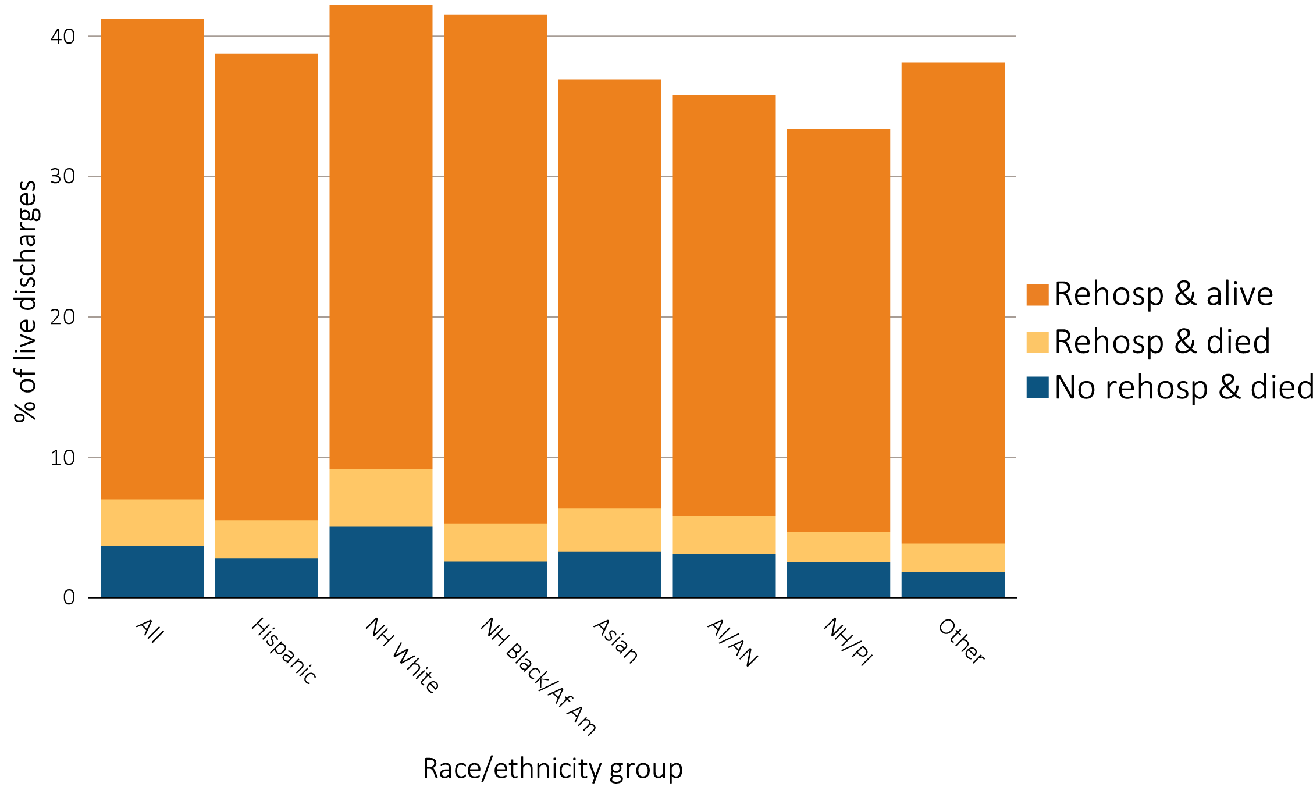
vol 2 Figure 4.8 Proportion of hemodialysis patients discharged alive from the hospital who either were rehospitalized or died within 30 days of discharge, by demographic characteristics, 2015
Data Source: Special analyses, USRDS ESRD Database. Period prevalent hemodialysis patients, all ages, 2015, unadjusted. Patients less than age 22 are not represented as a group due to insufficient sample size. Includes live hospital discharges from January 1 to December 1, 2015. Cause-specific hospitalizations are defined by principal ICD-9-CM codes. See Vol. 2, ESRD Analytical Methods for principal ICD-9-CM diagnosis codes included in each cause of hospitalization category. Af Am, African American; AI, American Indian; AN, Alaska Native; NH, Native Hawaiian; NH Black/Af Am, Non-Hispanic Black/African American; NH White, Non-Hispanic White; Other, other, multiracial, or unidentified race; PI, Pacific Islander; rehosp, rehospitalization.

Slide 18
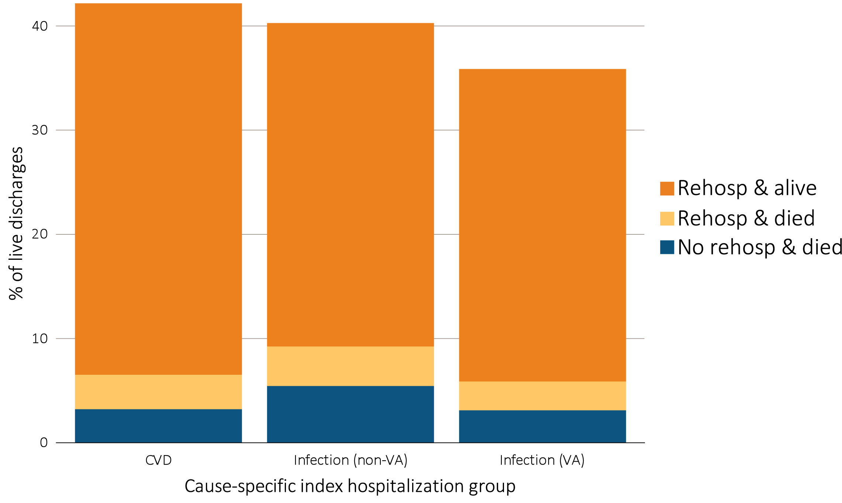
vol 2 Figure 4.9 Proportion of hemodialysis patients discharged alive that either were rehospitalized or died within 30 days of discharge, by cause of index hospitalization, 2015
Data Source: Special analyses, USRDS ESRD Database. Period prevalent hemodialysis patients, all ages, 2015, unadjusted. Includes live hospital discharges from January 1 to December 1, 2015. Cause-specific hospitalizations are defined by principal ICD-9-CM codes. See Vol. 2, ESRD Analytical Methods for principal ICD-9-CM diagnosis codes included in each cause of hospitalization category. Abbreviations: CVD, cardiovascular disease; rehosp, rehospitalization; VA, vascular access.

Slide 19
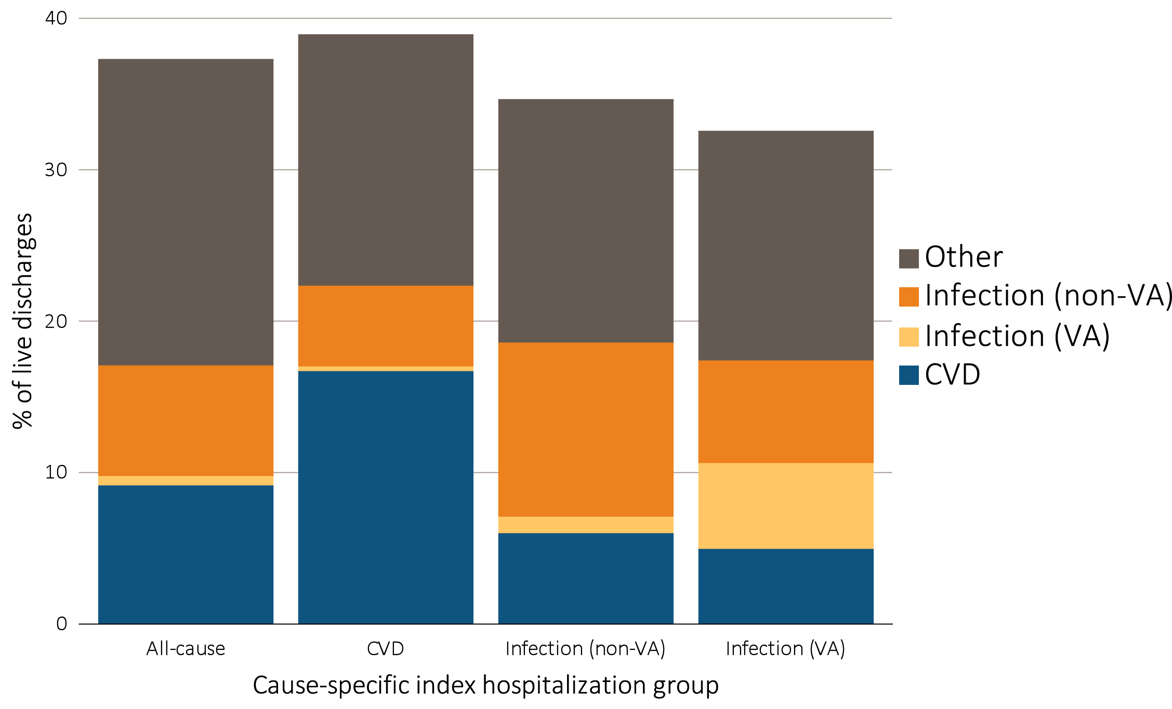
vol 2 Figure 4.10 Proportion of hemodialysis patients with cause-specific rehospitalizations within 30 days of discharge, by cause of index hospitalization, 2015
Data Source: Special analyses, USRDS ESRD Database. Period prevalent hemodialysis patients, all ages, 2015, unadjusted. Includes live hospital discharges from January 1 to December 1, 2015. Cause-specific hospitalizations are defined by principal ICD-9-CM codes. See Vol. 2, ESRD Analytical Methods for principal ICD-9-CM diagnosis codes included in each cause of hospitalization category. Abbreviations: CVD, cardiovascular disease; VA, vascular access.

Slide 20
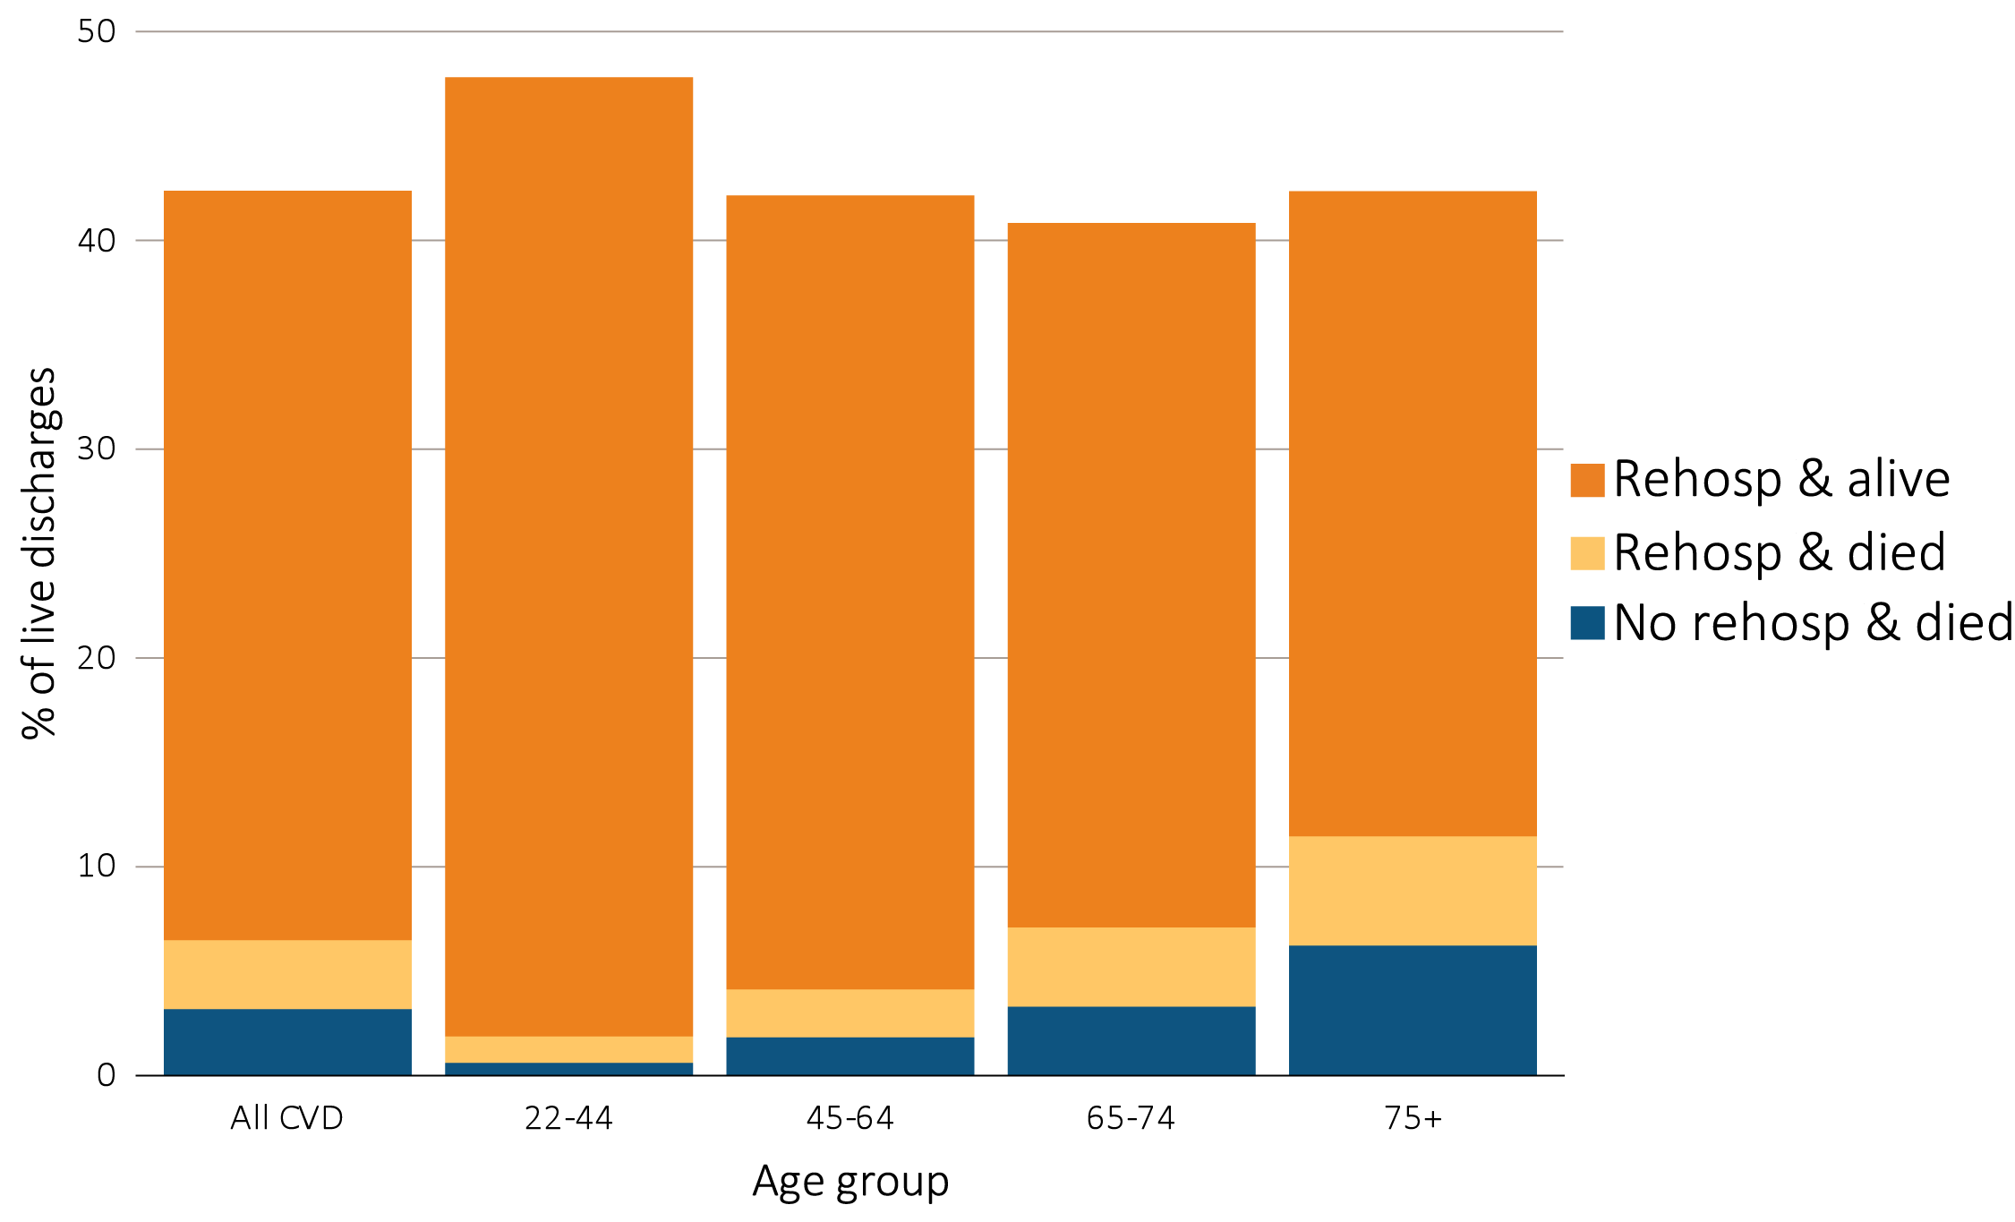
vol 2 Figure 4.11 Proportion of hemodialysis patients discharged alive who were either rehospitalized or died within 30 days of discharge for cardiovascular index hospitalization, by age, 2015
Data Source: Special analyses, USRDS ESRD Database. Period prevalent hemodialysis patients, all ages, 2015, unadjusted. Patients less than age 22 are not represented as a group due to insufficient sample size. Includes live hospital discharges from January 1 to December 1, 2015. Cause-specific hospitalizations are defined by principal ICD-9-CM codes. See Vol. 2, ESRD Analytical Methods for principal ICD-9-CM diagnosis codes included in each cause of hospitalization category. Abbreviation: rehosp, rehospitalization.

Slide 21
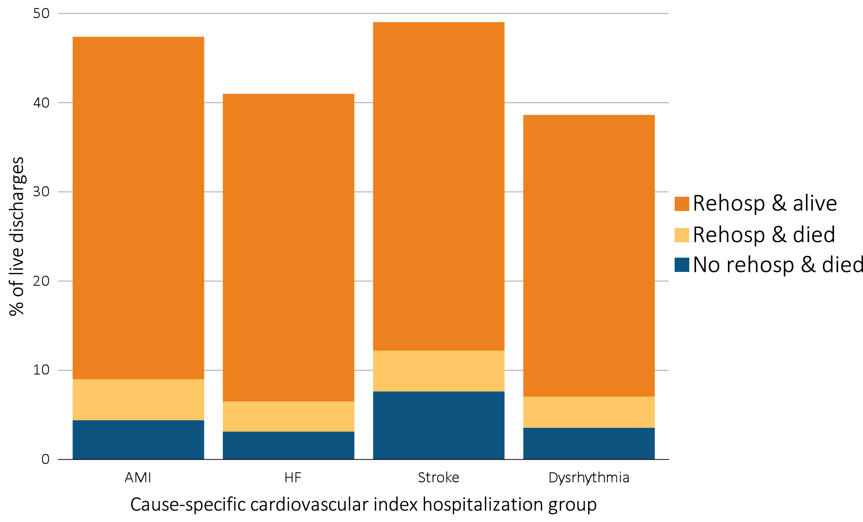
vol 2 Figure 4.12 Proportion of hemodialysis patients discharged alive who were either rehospitalized or died within 30 days of discharge for cardiovascular index hospitalization, by cause-specific cardiovascular index hospitalization, 2015
Data Source: Special analyses, USRDS ESRD Database. Period prevalent hemodialysis patients, all ages, 2015, unadjusted. Includes live hospital discharges from January 1 to December 1, 2015. Cause-specific hospitalizations are defined by principal ICD-9-CM codes. See Vol. 2, ESRD Analytical Methods for principal ICD-9-CM diagnosis codes included in each cause of hospitalization category. Abbreviations: AMI, acute myocardial infarction; HF, heart failure; rehosp, rehospitalization.

