Slide 1
2017 Annual Data Report
Volume 2: End-Stage Renal Disease
Chapter 5:
Mortality

Slide 2
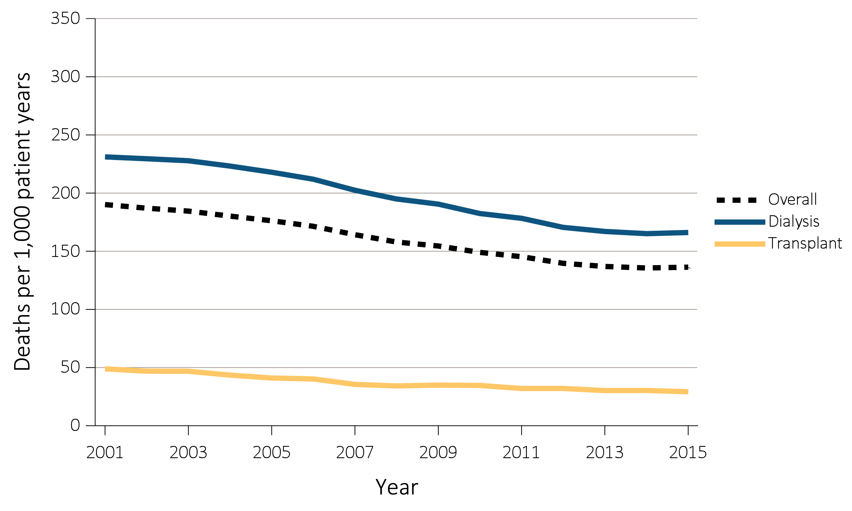
vol 2 Figure 5.1 Adjusted all-cause mortality by treatment modality (a) overall, dialysis, and transplant, and (b) hemodialysis and peritoneal dialysis, for period-prevalent patients, 2001-2015
(a) Overall, dialysis, and transplant
Data Source: Reference Tables H.2_adj, H4_adj, H.8_adj, H.9_adj, and H.10_adj; and special analyses, USRDS ESRD Database. Adjusted for age, sex, race, ethnicity, primary diagnosis and vintage. Reference population: period prevalent ESRD patients, 2011. Abbreviations: HD, hemodialysis; PD, peritoneal dialysis.

Slide 3
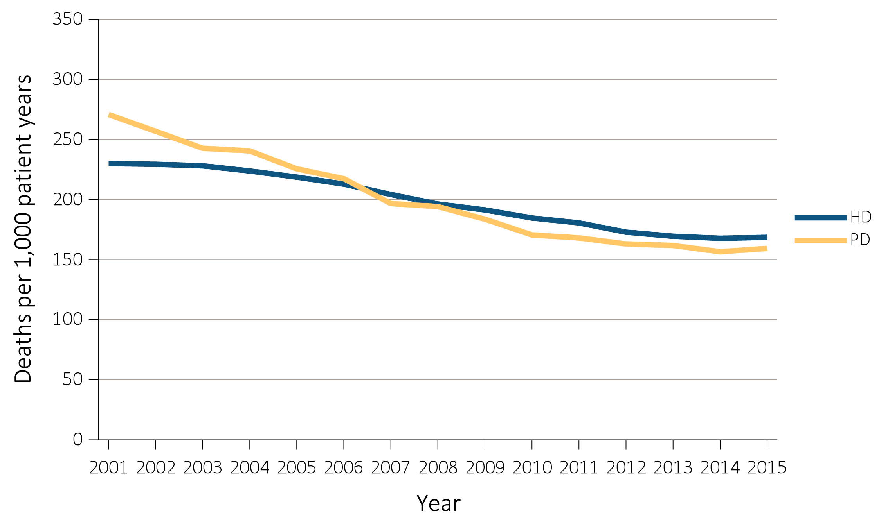
vol 2 Figure 5.1 Adjusted all-cause mortality by treatment modality (a) overall, dialysis, and transplant, and (b) hemodialysis and peritoneal dialysis, for period-prevalent patients, 2001-2015
(b) Hemodialysis and peritoneal dialysis
Data Source: Reference Tables H.2_adj, H4_adj, H.8_adj, H.9_adj, and H.10_adj; and special analyses, USRDS ESRD Database. Adjusted for age, sex, race, ethnicity, primary diagnosis and vintage. Reference population: period prevalent ESRD patients, 2011. Abbreviations: HD, hemodialysis; PD, peritoneal dialysis.

Slide 4
vol 2 Table 5.1 Unadjusted and adjusted all-cause mortality by ESRD network and modality, 2013-2015
 |  | Deaths per 1000 patient-years
 |  | Total ESRD |  | Hemodialysis |  |  |  | Peritoneal dialysis |  |  | Transplant
Network | States in Network | Adjusted | Unadjusted |  | Adjusted | Unadjusted | Adjusted |  | Unadjusted | Adjusted |  | Unadjusted
1 | CT, MA, ME, NH, RI, VT | 126.3 | 133.9 |  | 158.4 | 202.7 | 166.6 |  | 158.7 | 29.7 |  | 35.0
2 | NY | 128.1 | 130.3 |  | 157.9 | 177.1 | 133.4 |  | 121.7 | 27.2 |  | 29.2
3 | NJ, PR | 144.7 | 141.7 |  | 181.6 | 190.0 | 164.8 |  | 119.9 | 30.3 |  | 33.7
4 | DE, PA | 137.8 | 155.5 |  | 174.3 | 217.9 | 166.2 |  | 160.8 | 28.8 |  | 35.6
5 | MD, DC, VA, WV | 135.7 | 136.1 |  | 171.2 | 183.3 | 158.3 |  | 119.9 | 31.5 |  | 35.5
6 | NC, SC, GA | 141.1 | 135.2 |  | 173.2 | 170.6 | 165.2 |  | 128.0 | 29.5 |  | 30.9
7 | FL | 142.7 | 154.3 |  | 180.3 | 204.8 | 166.8 |  | 143.0 | 28.7 |  | 32.7
8 | AL, MS, TN | 151.2 | 149.0 |  | 184.7 | 187.8 | 182.0 |  | 141.1 | 35.0 |  | 37.2
9 | IN, KY, OH | 147.1 | 162.8 |  | 180.4 | 220.4 | 175.7 |  | 162.8 | 31.5 |  | 36.3
10 | IL | 133.5 | 135.7 |  | 170.6 | 189.2 | 168.4 |  | 151.7 | 27.2 |  | 29.8
11 | MI, MN, ND, SD, WI | 131.8 | 138.2 |  | 168.1 | 204.4 | 164.2 |  | 159.8 | 31.0 |  | 37.3
12 | IA, KS, MO, NE | 135.3 | 144.4 |  | 173.2 | 210.4 | 172.6 |  | 168.9 | 29.1 |  | 34.8
13 | AR, LA, OK | 159.3 | 156.1 |  | 199.3 | 199.5 | 171.0 |  | 138.5 | 33.6 |  | 38.3
14 | TX | 145.2 | 134.5 |  | 176.1 | 170.1 | 165.5 |  | 122.7 | 30.9 |  | 30.0
15 | AZ, CO, NV, NM, UT, WY | 124.2 | 125.9 |  | 159.1 | 175.5 | 149.0 |  | 137.5 | 28.7 |  | 33.1
16 | AK, ID, MT, OR, WA | 126.2 | 125.3 |  | 159.0 | 187.1 | 139.5 |  | 123.8 | 27.5 |  | 32.4
17 | Northern CA, HI, GU, AS | 124.6 | 118.4 |  | 156.7 | 161.3 | 136.8 |  | 106.8 | 24.2 |  | 25.8
18 | Southern CA | 128.4 | 122.6 |  | 155.8 | 160.1 | 133.1 |  | 96.4 | 25.9 |  | 26.1
Overall |  | 136.6 | 138.3 |  | 169.9 | 186.3 | 159.5 |  | 133.9 | 29.3 |  | 32.8
Data Source: Special analyses, USRDS ESRD Database. Adjusted (age, sex, race, ethnicity, vintage, and primary diagnosis) all-cause mortality among 2013-2015 period prevalent patients. Reference population: period prevalent ESRD patients, 2011. Abbreviation: ESRD, end-stage renal disease.

Slide 5
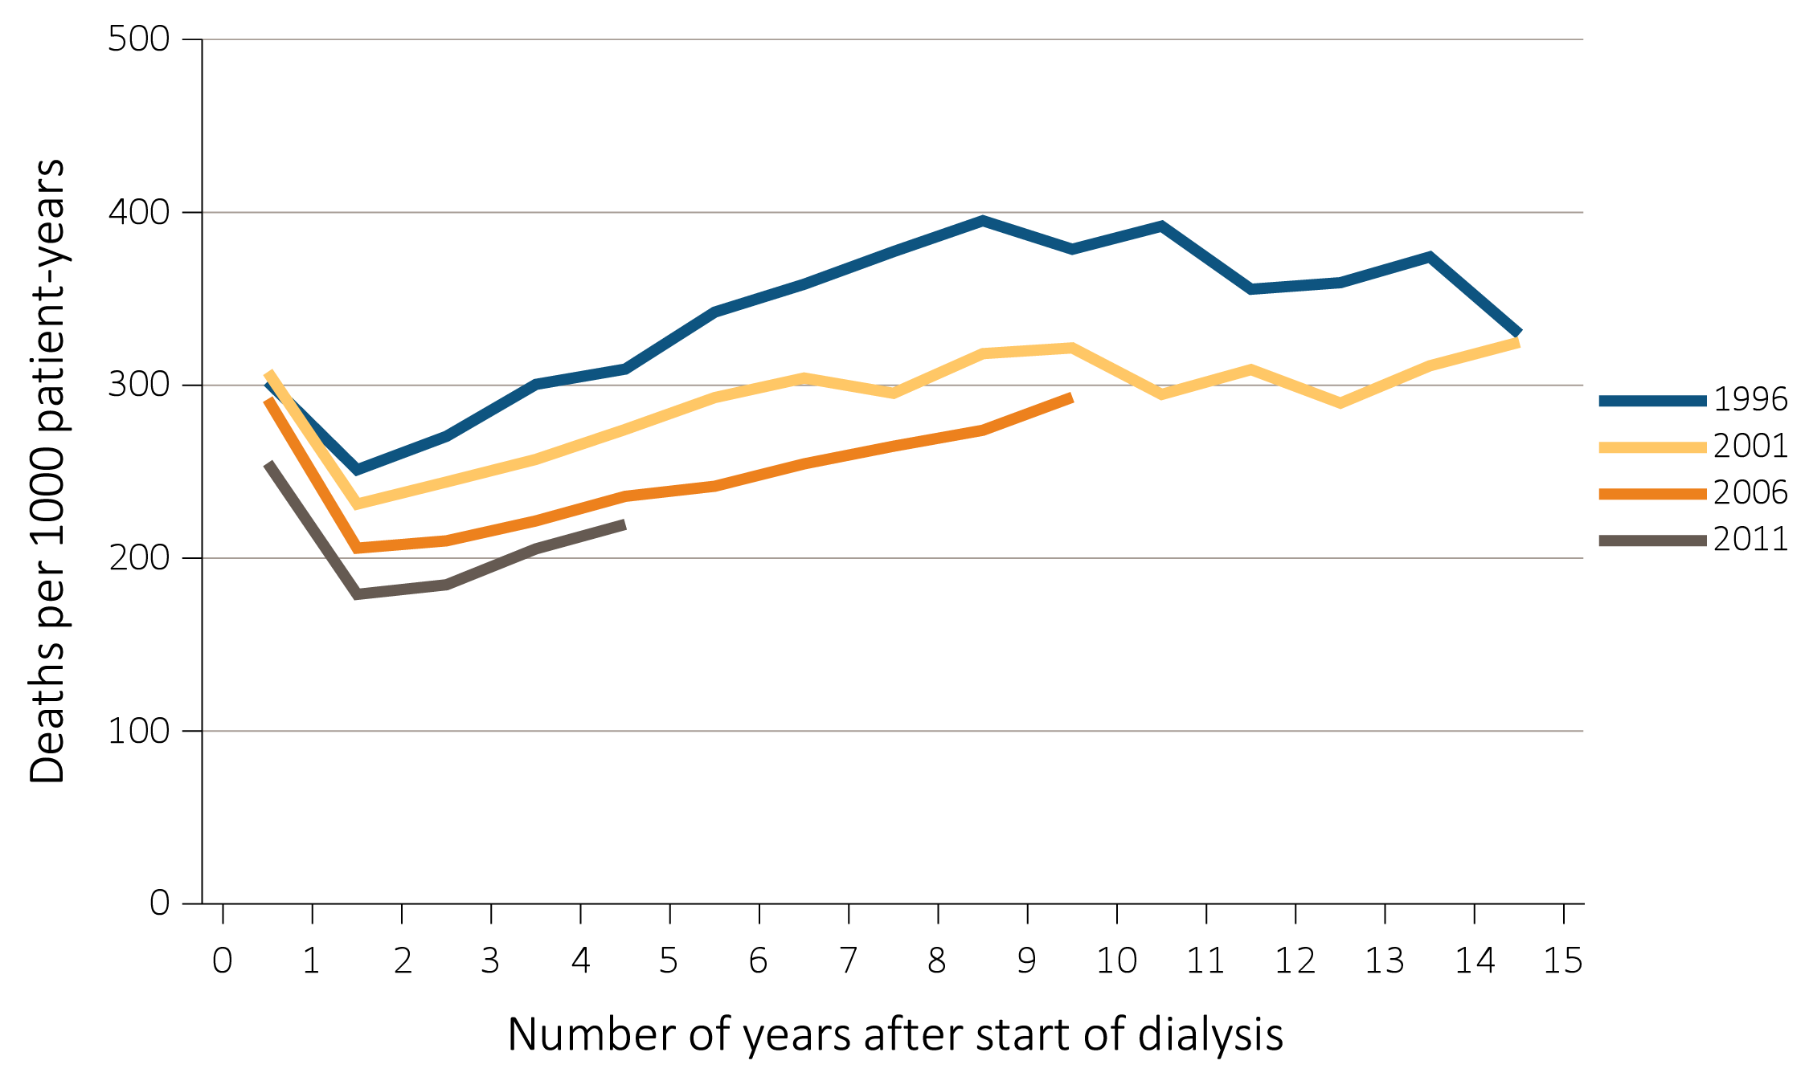
vol 2 Figure 5.2 Adjusted all-cause mortality by treatment modality, cohort (year of ESRD onset), and number of years after start of dialysis among incident (a) hemodialysis patients and (b) peritoneal dialysis patients, 1996, 2001, 2006, and 2011
(a) Hemodialysis patients
Data Source: Special analyses, USRDS ESRD Database. Adjusted for age, sex, race, and primary diagnosis. Ref: period prevalent ESRD patients, 2011. Abbreviation: ESRD, end-stage renal disease.

Slide 6
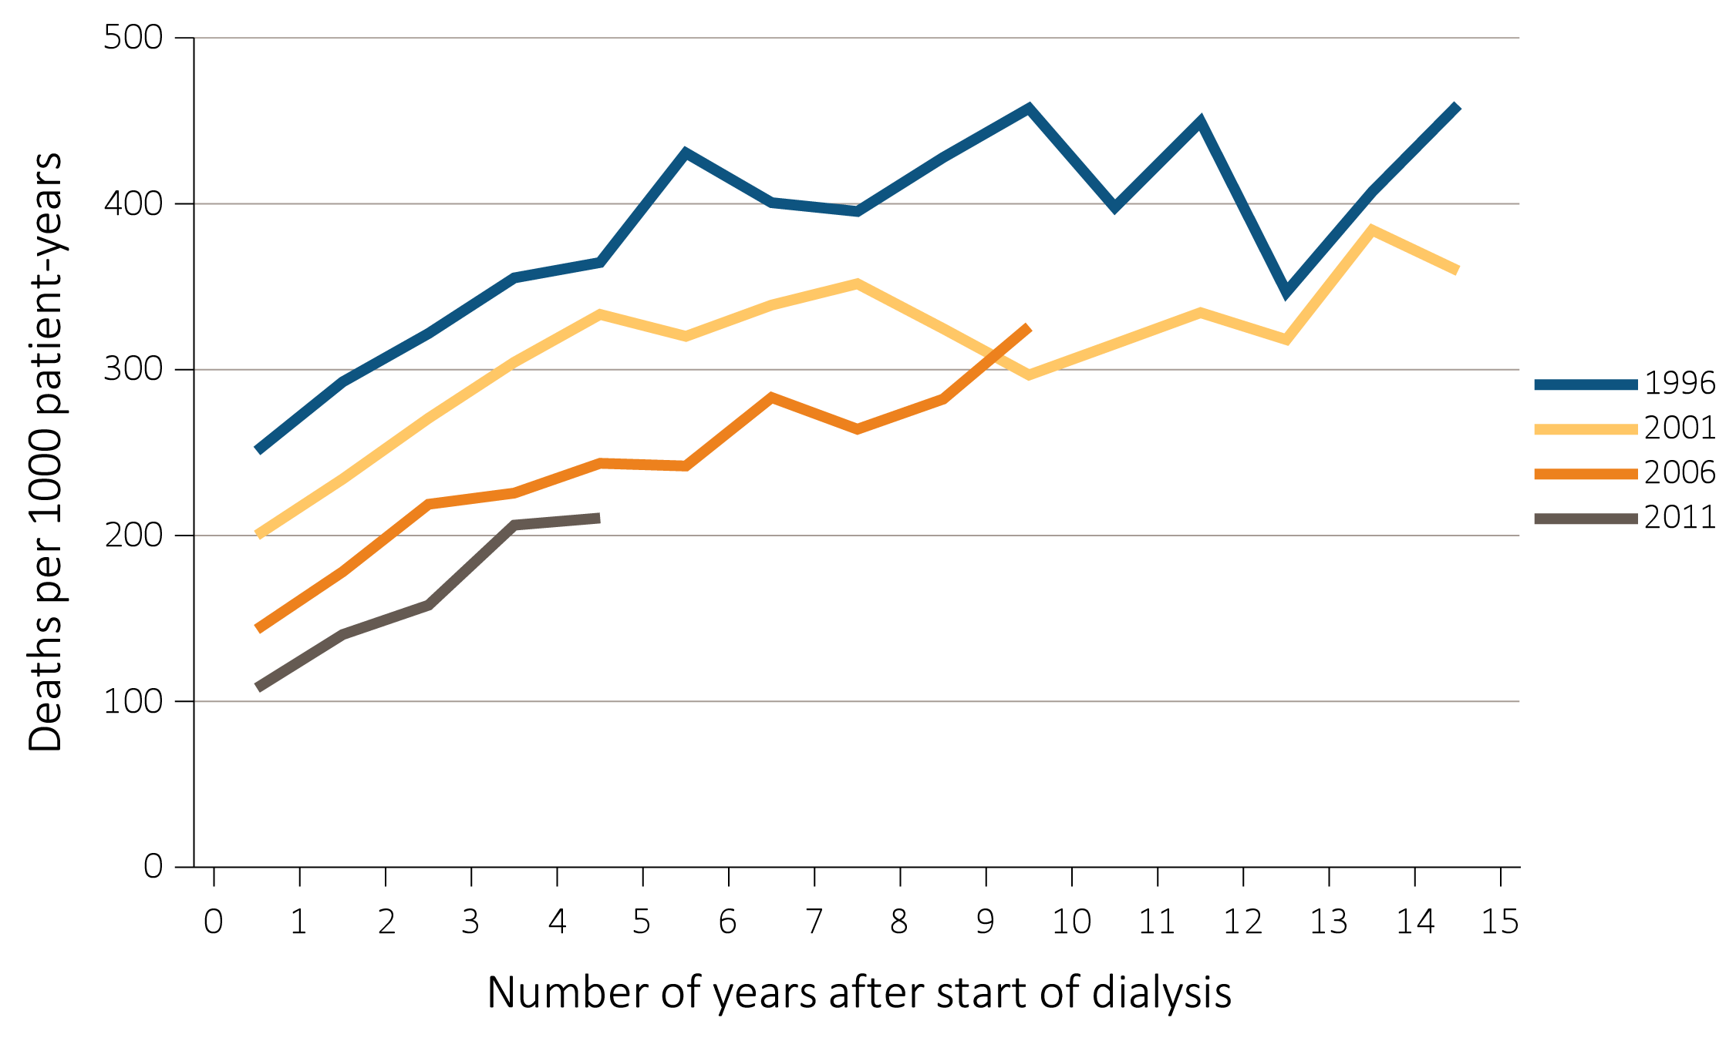
vol 2 Figure 5.2 Adjusted all-cause mortality by treatment modality, cohort (year of ESRD onset), and number of years after start of dialysis among incident (a) hemodialysis patients and (b) peritoneal dialysis patients, 1996, 2001, 2006, and 2011
(b) Peritoneal dialysis patients
Data Source: Special analyses, USRDS ESRD Database. Adjusted for age, sex, race, and primary diagnosis. Ref: period prevalent ESRD patients, 2011. Abbreviation: ESRD, end-stage renal disease.

Slide 7
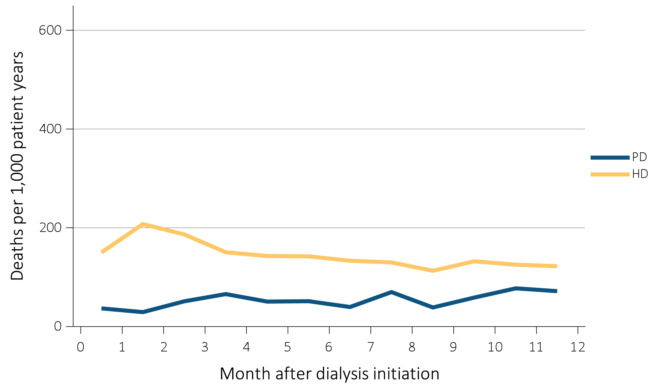
vol 2 Figure 5.3 Adjusted mortality by treatment modality and number of months after treatment initiation among ESRD patients (a) under age 65 and (b) aged 65 and over, 2014
(a) Under age 65
Data Source: Special analyses, USRDS ESRD Database. Adjusted (age, race, sex, ethnicity, and primary diagnosis) mortality among 2013 incident ESRD patients during the first year of therapy. Reference population: incident ESRD patients, 2011. Abbreviations: ESRD, end-stage renal disease; HD, hemodialysis; PD, peritoneal dialysis.

Slide 8
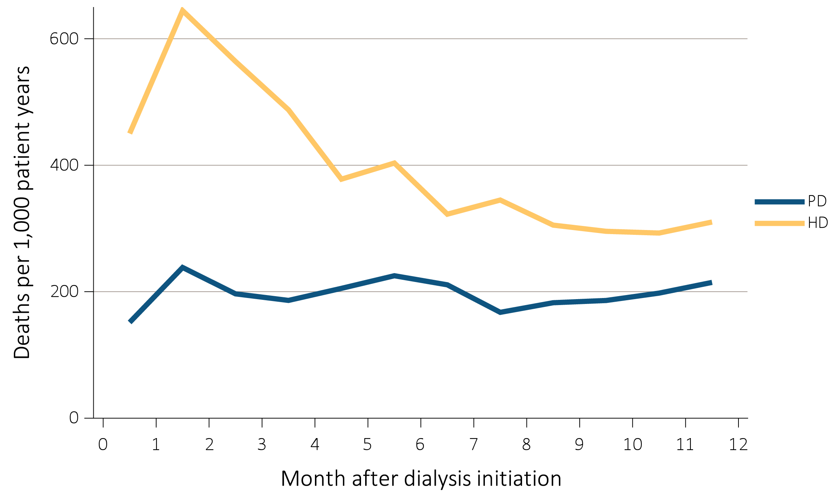
vol 2 Figure 5.3 Adjusted mortality by treatment modality and number of months after treatment initiation among ESRD patients (a) under age 65 and (b) aged 65 and over, 2014
(b) Aged 65 and older
Data Source: Special analyses, USRDS ESRD Database. Adjusted (age, race, sex, ethnicity, and primary diagnosis) mortality among 2013 incident ESRD patients during the first year of therapy. Reference population: incident ESRD patients, 2011. Abbreviations: ESRD, end-stage renal disease; HD, hemodialysis; PD, peritoneal dialysis.

Slide 9
vol 2 Table 5.2 Adjusted all-cause mortality (a) by age and race, and (b) by age and sex, among ESRD patients, 2015
(a) Age and race (deaths per 1,000 patient-years)
Age | Race | ESRD | Dialysis | Transplant
0-21 | White | 10 | 32 | 5
 | Black/African American | 18 | 37 | 6
 | Other | 8 | 23 | 6
22-44 | White | 33 | 64 | 10
 | Black/African American | 44 | 56 | 12
 | Other | 18 | 36 | 5
45-64 | White | 110 | 159 | 37
 | Black/African American | 100 | 115 | 37
 | Other | 74 | 103 | 22
65-74 | White | 211 | 253 | 86
 | Black/African American | 175 | 189 | 84
 | Other | 142 | 166 | 62
75+ | White | 358 | 379 | 141
 | Black/African American | 272 | 278 | 148
 | Other | 235 | 244 | 113
Data Source: Special analyses, USRDS ESRD Database. (a) Adjusted (race and primary diagnosis) all-cause mortality among 2015 period prevalent patients. (b) Adjusted (sex and primary diagnosis) all-cause mortality among 2015 period prevalent patients. Reference population: period prevalent ESRD patients, 2011. Abbreviation: ESRD, end-stage renal disease.

Slide 10
vol 2 Table 5.2 Adjusted all-cause mortality (a) by age and race, and (b) by age and sex, among ESRD patients, 2015
(b) Age and sex (deaths per 1,000 patient-years)
Age | Sex | ESRD | Dialysis | Transplant
0-21 | Male | 10 | 32 | 4
 | Female | 12 | 34 | 5
22-44 | Male | 34 | 57 | 10
 | Female | 39 | 67 | 11
45-64 | Male | 106 | 144 | 39
 | Female | 109 | 148 | 33
65-74 | Male | 208 | 249 | 88
 | Female | 198 | 227 | 79
75+ | Male | 359 | 382 | 147
 | Female | 330 | 344 | 131
Data Source: Special analyses, USRDS ESRD Database. (a) Adjusted (race and primary diagnosis) all-cause mortality among 2015 period prevalent patients. (b) Adjusted (sex and primary diagnosis) all-cause mortality among 2015 period prevalent patients. Reference population: period prevalent ESRD patients, 2011. Abbreviation: ESRD, end-stage renal disease.

Slide 11
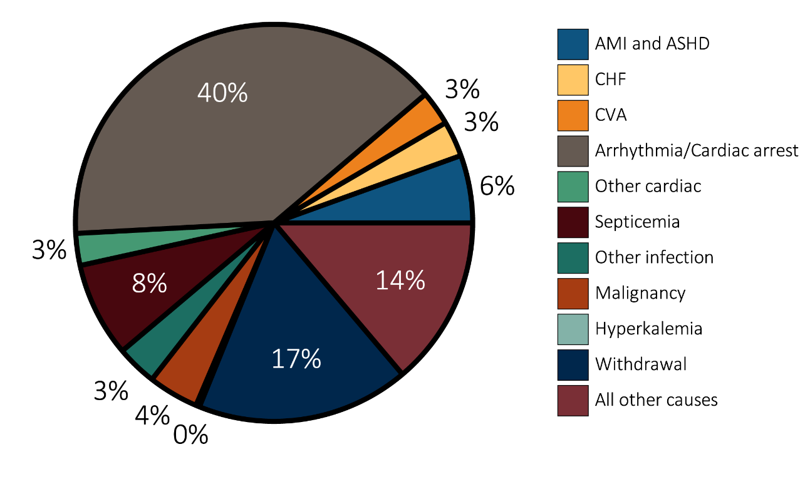
vol 2 Figure 5.4 Unadjusted percentages of deaths in 2014 by cause, with and without missing data, by modality among dialysis patients and transplant recipients
(a) Dialysis patients, excludes missing/unknown causes of death
Data Source: Special analysis using Reference table H.12_Dialysis and H.12_Tx. Mortality among 2014 prevalent patients. (a) Dialysis patients, denominator excludes missing/unknown causes of death. (b) Transplant recipients, denominator excludes missing/unknown causes of death. (c) Dialysis patients, denominator includes missing/unknown causes of death. (d) Transplant recipients, denominator includes missing/unknown causes of death. Abbreviations: ASHD, atherosclerotic heart disease; AMI, acute myocardial infarction; CHF, congestive heart failure; CVA, cerebrovascular accident.

Slide 12
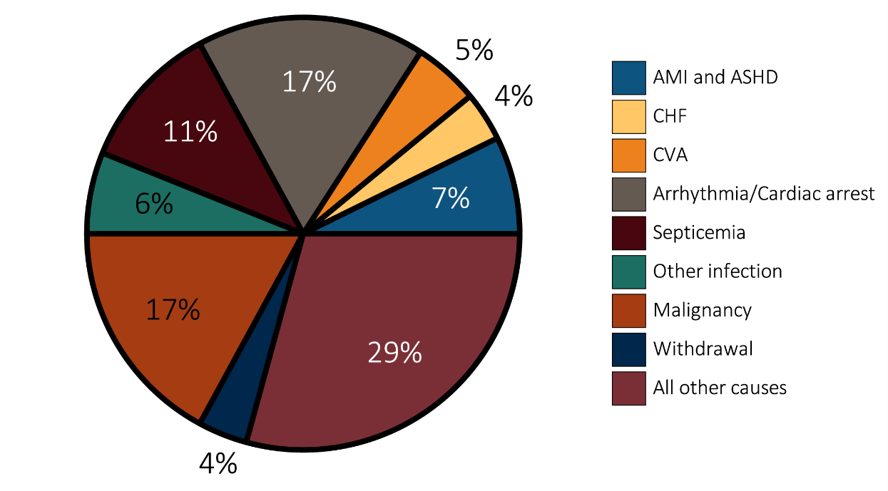
vol 2 Figure 5.4 Unadjusted percentages of deaths in 2014 by cause, with and without missing data, by modality among dialysis patients and transplant recipients
(b) Transplant patients, denominator excludes missing/unknown causes of death
Data Source: Special analysis using Reference table H.12_Dialysis and H.12_Tx. Mortality among 2014 prevalent patients. (a) Dialysis patients, denominator excludes missing/unknown causes of death. (b) Transplant recipients, denominator excludes missing/unknown causes of death. (c) Dialysis patients, denominator includes missing/unknown causes of death. (d) Transplant recipients, denominator includes missing/unknown causes of death. Abbreviations: ASHD, atherosclerotic heart disease; AMI, acute myocardial infarction; CHF, congestive heart failure; CVA, cerebrovascular accident.

Slide 13
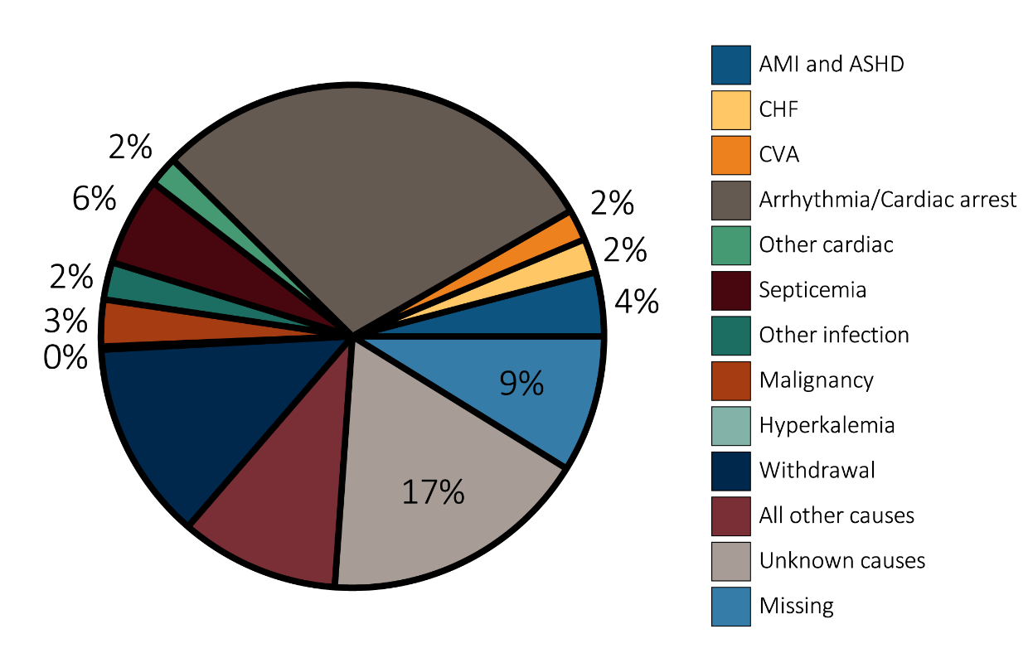
vol 2 Figure 5.4 Unadjusted percentages of deaths in 2014 by cause, with and without missing data, by modality among dialysis patients and transplant recipients
(c) Dialysis patients, denominator includes missing/unknown causes of death
Data Source: Special analysis using Reference table H.12_Dialysis and H.12_Tx. Mortality among 2014 prevalent patients. (a) Dialysis patients, denominator excludes missing/unknown causes of death. (b) Transplant recipients, denominator excludes missing/unknown causes of death. (c) Dialysis patients, denominator includes missing/unknown causes of death. (d) Transplant recipients, denominator includes missing/unknown causes of death. Abbreviations: ASHD, atherosclerotic heart disease; AMI, acute myocardial infarction; CHF, congestive heart failure; CVA, cerebrovascular accident.

Slide 14
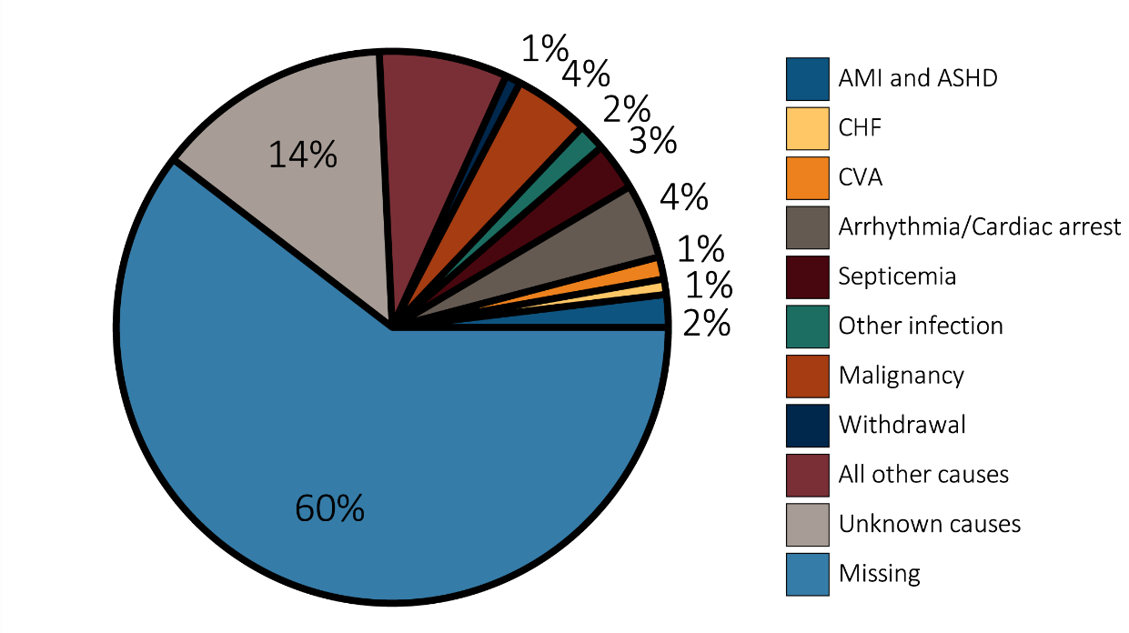
vol 2 Figure 5.4 Unadjusted percentages of deaths in 2014 by cause, with and without missing data, by modality among dialysis patients and transplant recipients
(d) Transplant recipients, denominator includes missing/unknown causes of death
Data Source: Special analysis using Reference table H.12_Dialysis and H.12_Tx. Mortality among 2014 prevalent patients. (a) Dialysis patients, denominator excludes missing/unknown causes of death. (b) Transplant recipients, denominator excludes missing/unknown causes of death. (c) Dialysis patients, denominator includes missing/unknown causes of death. (d) Transplant recipients, denominator includes missing/unknown causes of death. Abbreviations: ASHD, atherosclerotic heart disease; AMI, acute myocardial infarction; CHF, congestive heart failure; CVA, cerebrovascular accident.

Slide 15
vol 2 Table 5.3 Adjusted survival by treatment modality and incident cohort year (year of ESRD onset)
 | 3 months (%) | 12 months (%) | 24 months (%) | 36 months (%) | 60 months (%)
Hemodialysis
2002 | 91.2 | 75.0 | 61.4 | 51.0 | 36.0
2004 | 91.1 | 75.2 | 62.3 | 52.1 | 37.5
2006 | 91.3 | 75.9 | 63.5 | 53.7 | 39.1
2008 | 91.6 | 76.9 | 64.9 | 55.2 | 40.6
2010 | 91.8 | 77.8 | 66.2 | 56.8 | 41.8
Peritoneal dialysis
2002 | 95.8 | 82.8 | 68.2 | 56.9 | 41.5
2004 | 96.2 | 85.0 | 71.9 | 60.8 | 45.7
2006 | 97.0 | 86.7 | 74.0 | 62.7 | 47.5
2008 | 97.5 | 88.6 | 76.5 | 66.4 | 50.4
2010 | 97.4 | 89.3 | 77.8 | 67.6 | 51.7
Deceased-donor transplant
2002 | 95.0 | 89.8 | 84.3 | 79.3 | 68.5
2004 | 96.2 | 90.5 | 85.4 | 79.7 | 69.7
2006 | 96.0 | 91.4 | 86.9 | 82.7 | 72.6
2008 | 96.8 | 92.7 | 88.5 | 84.4 | 74.4
2010 | 97.2 | 93.1 | 89.3 | 85.4 | 75.6
Living donor transplant
2002 | 97.5 | 94 | 89.8 | 85.9 | 77.4
2004 | 98.3 | 95.3 | 92.1 | 88.6 | 81.4
2006 | 98.7 | 96.3 | 93.7 | 90.8 | 83.6
2008 | 98.6 | 96.8 | 94.4 | 91.4 | 85.7
2010 | 99.2 | 97.5 | 95.8 | 93.0 | 87.6
Data Source: Reference Tables I.1_adj-I.36_adj. Adjusted survival probabilities, from day one, in the ESRD population. Reference population: incident ESRD patients, 2011. Adjusted for age, sex, race, Hispanic ethnicity, and primary diagnosis. Abbreviation: ESRD, end-stage renal disease.

Slide 16
vol 2 Table 5.4 Expected remaining lifetime (years) by age, sex, and treatment modality of prevalent dialysis patients and transplant patients, and the general U.S. population, 2013
 | ESRD patients 2013 |  |  |  | General U.S. population 2013
 | Dialysis |  | Transplant
Age | Male | Female | Male | Female | Male | Female
0-14 | 23.8 | 23.1 | 59.3 | 60.3 | 70.7 | 75.4
15-19 | 21.8 | 19.1 | 47.6 | 48.7 | 59.7 | 64.4
20-24 | 18.8 | 16.1 | 43.4 | 44.5 | 55.0 | 59.5
25-29 | 16.2 | 14.1 | 39.4 | 40.7 | 50.3 | 54.6
30-34 | 14.1 | 12.6 | 35.1 | 36.6 | 45.7 | 49.7
35-39 | 12.6 | 11.5 | 31.1 | 33.0 | 41.0 | 45.0
40-44 | 11.0 | 10.3 | 27.2 | 28.9 | 36.5 | 40.3
45-49 | 9.3 | 8.8 | 23.3 | 25.2 | 32.0 | 35.6
50-54 | 7.9 | 7.7 | 19.9 | 21.8 | 27.7 | 31.1
55-59 | 6.6 | 6.6 | 16.7 | 18.4 | 23.7 | 26.8
60-64 | 5.5 | 5.7 | 13.9 | 15.4 | 19.9 | 22.6
65-69 | 4.6 | 4.8 | 11.4 | 12.7 | 16.2 | 18.6
70-74 | 3.8 | 4.0 | 9.4 | 10.3 | 12.8 | 14.8
75-79 | 3.2 | 3.5 | 7.6ª | 8.6ª | 9.8 | 11.4
80-84 | 2.6 | 2.9 |  |  | 7.1 | 8.4
85+ | 2.1 | 2.3 |  |  | 3.8 | 4.4
Data Source: Reference Table H.13; special analyses, USRDS ESRD Database; and National Vital Statistics Report. “Table 7. Life expectancy at selected ages, by race, Hispanic origin, race for non-Hispanic population, and sex: United States, 2013 (2016).” Expected remaining lifetimes (years) of the general U.S. population and of period prevalent dialysis and transplant patients. ªCell values combine ages 75+. Abbreviation: ESRD, end-stage renal disease.

Slide 17
vol 2 Table 5.5 Adjusted mortality (deaths per 1,000 patient-years) by age, sex, treatment modality, and comorbidity among ESRD patients and the general Medicare population, 2014
Age | Sex | Dialysis | Transplant | All Medicare | Cancer | Diabetes | CHF | CVA/TIA | AMI
65-74 | Male | 223 | 66 | 27 | 73 | 40 | 112 | 72 | 87
 | Female | 211 | 60 | 18 | 64 | 31 | 101 | 57 | 94
75+ | Male | 338 | 126 | 92 | 140 | 112 | 238 | 168 | 210
 | Female | 317 | 105 | 84 | 132 | 103 | 228 | 155 | 207
Data Source: Special analyses, USRDS ESRD Database and Medicare 5% sample. Adjusted for race. Medicare data limited to patients with at least one month of Medicare eligibility in 2014. Reference population: Medicare patients, 2014. Abbreviations: AMI, acute myocardial infarction; CHF, congestive heart failure; CMS, Centers for Medicare & Medicaid; CVA/TIA, cerebrovascular accident/transient ischemic attack; ESRD, end-stage renal disease.

Slide 18
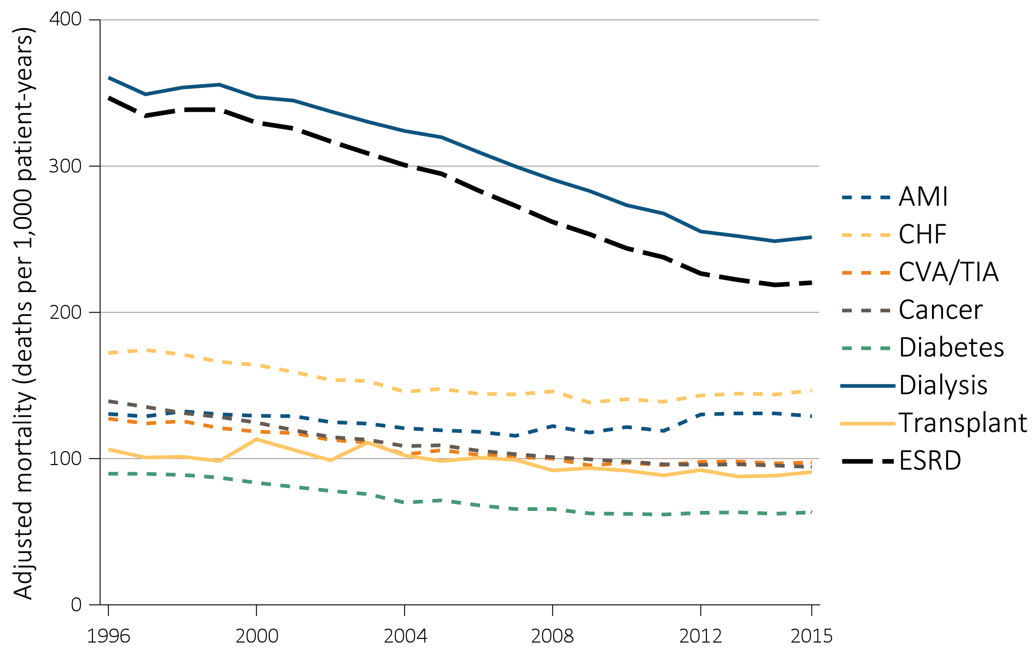
vol 2 Figure 5.5 Adjusted mortality (deaths per 1,000 patient-years) by calendar year, treatment modality, and comorbidity among ESRD patients and comorbidity-specific Medicare populations aged 65 & older, 1996-2015
Data Source: Special analyses, USRDS ESRD Database and Medicare 5% sample. Unadjusted and adjusted (sex and race) mortality rates starting with the January 1 point prevalent sample in the ESRD and general populations, aged 65 and older (per 1,000 patient-years at risk). Reference population: period prevalent ESRD patients, 2012. Abbreviations: AMI, acute myocardial infarction; CHF, congestive heart failure; CVA/TIA, cerebrovascular accident/transient ischemic attack; ESRD, end-stage renal disease.

