Slide 1
2017 Annual Data Report
Volume 2: End-Stage Renal Disease
Chapter 7: ESRD among Children, Adolescents,
and Young Adults

Slide 2
vol 2 Figure 7.1 (a) Incidence and, (b) December 31st point prevalence of ESRD among pediatric patients (aged 0–21 years), by modality, 1996-2015
(a) Incidence
Data Source: Special analyses, USRDS ESRD Database. Peritoneal dialysis consists of continuous ambulatory peritoneal dialysis and continuous cycling peritoneal dialysis. All consists of hemodialysis, peritoneal dialysis, uncertain dialysis, and transplant. Abbreviations: ESRD, end-stage renal disease; HD, hemodialysis; PD, peritoneal dialysis; Tx, transplant.

Slide 3
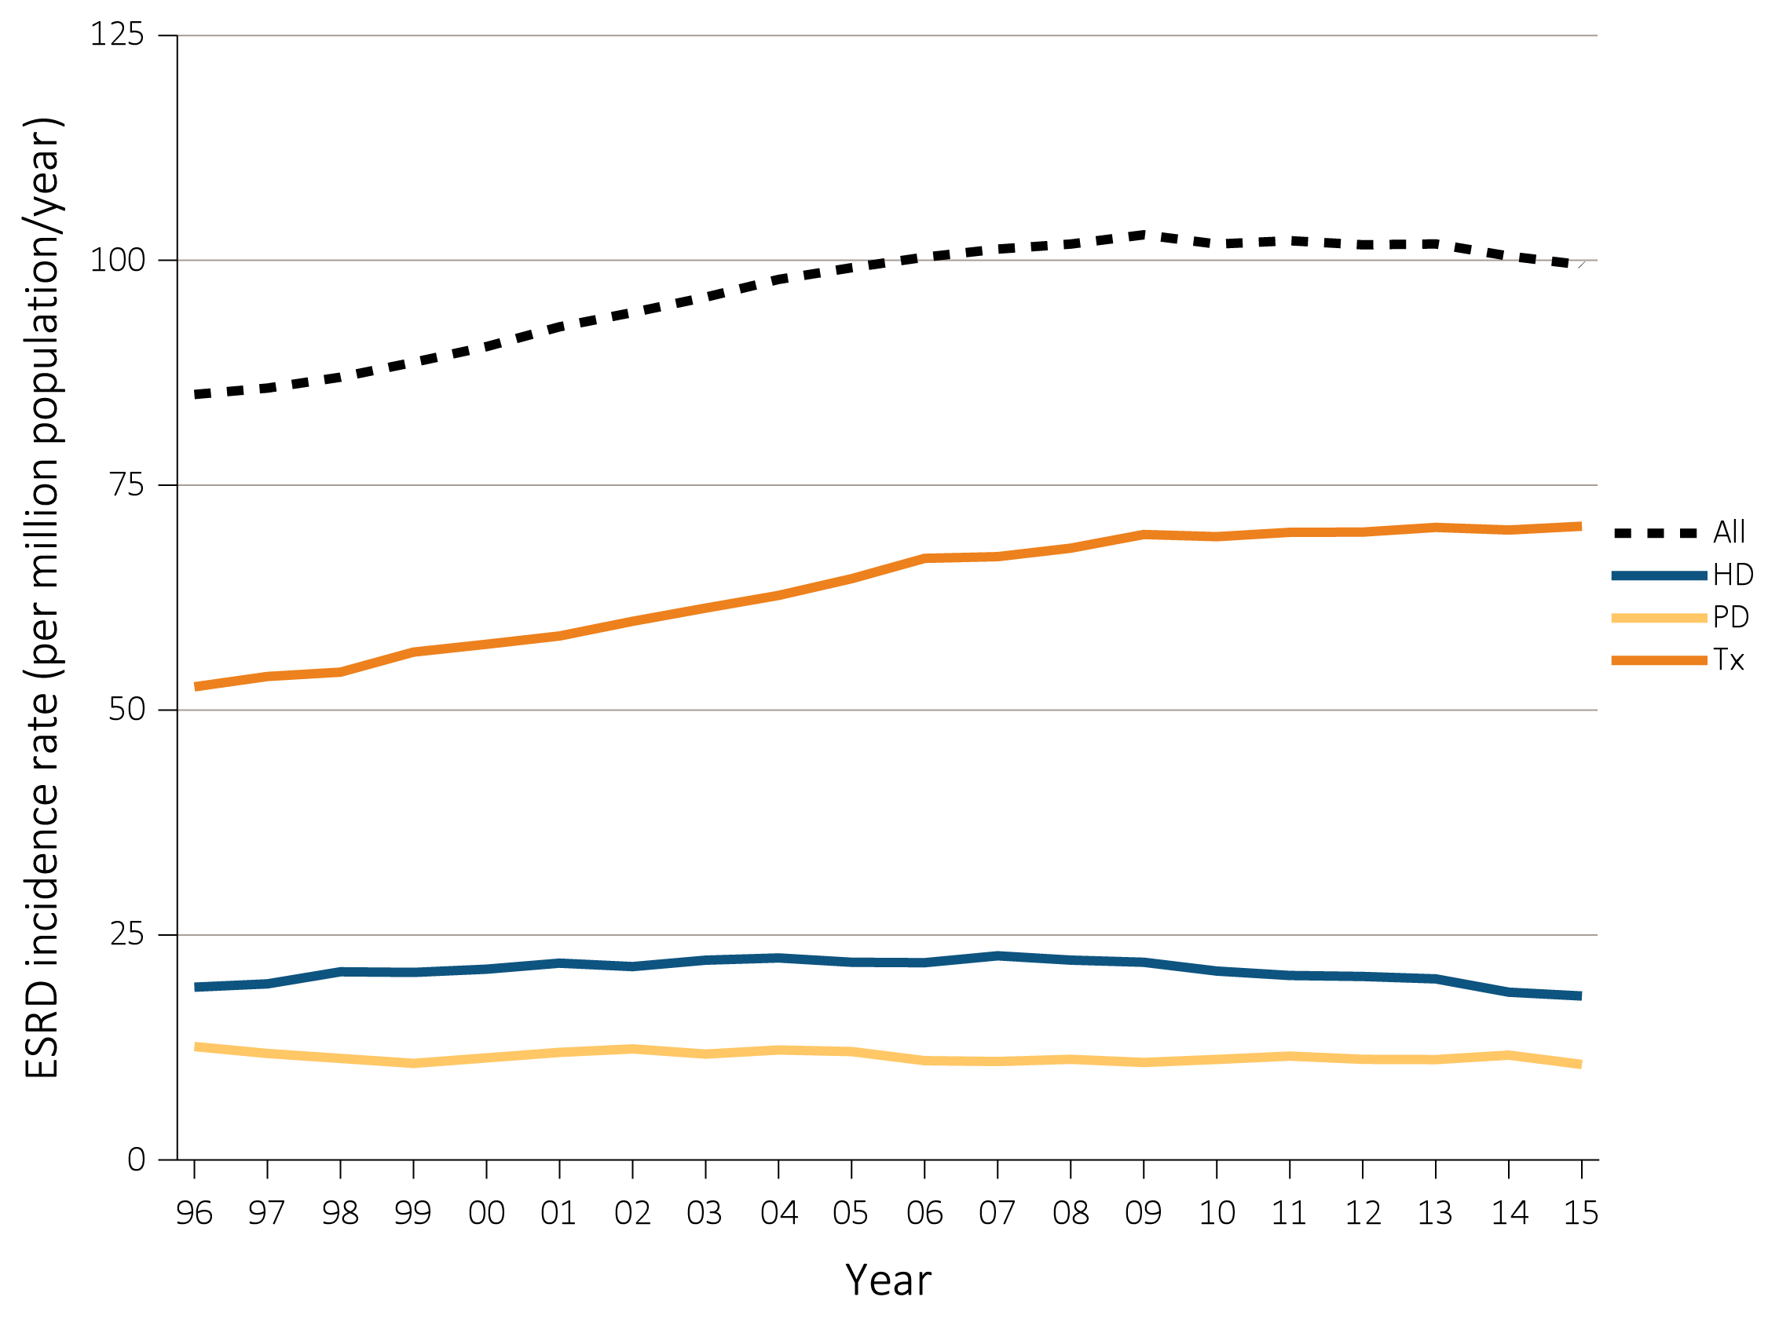
vol 2 Figure 7.1 (a) Incidence and, (b) December 31st point prevalence of ESRD among pediatric patients (aged 0–21 years), by modality, 1996-2015
(b) Point prevalence
Data Source: Special analyses, USRDS ESRD Database. Peritoneal dialysis consists of continuous ambulatory peritoneal dialysis and continuous cycling peritoneal dialysis. All consists of hemodialysis, peritoneal dialysis, uncertain dialysis, and transplant. Abbreviations: ESRD, end-stage renal disease; HD, hemodialysis; PD, peritoneal dialysis; Tx, transplant.

Slide 4
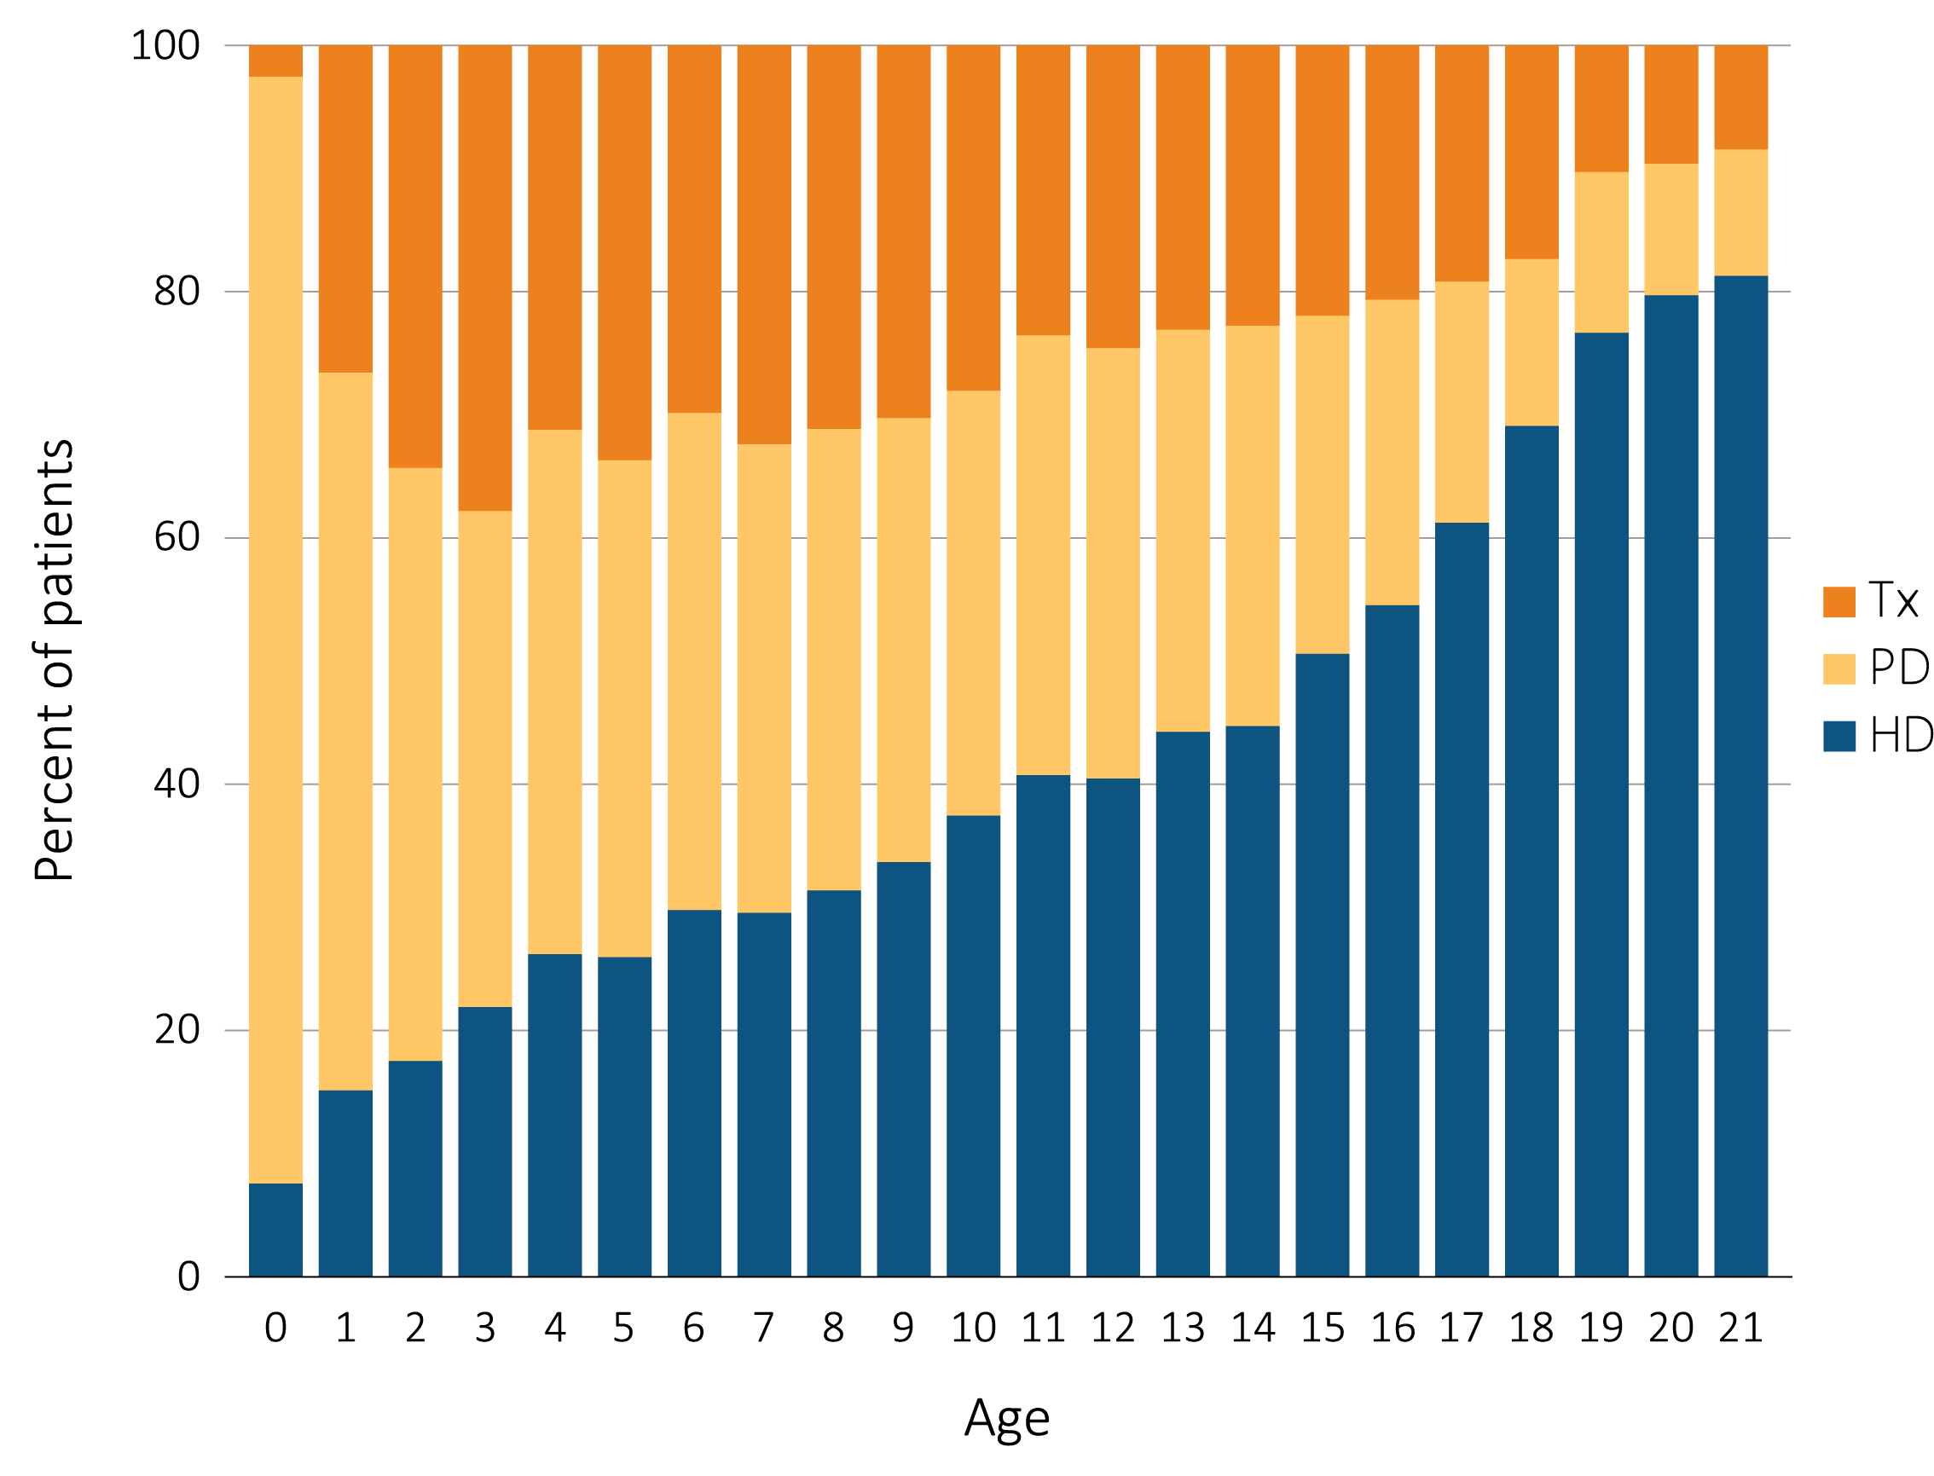
vol 2 Figure 7.2 Cross-sectional trends in pediatric ESRD modality at initiation, by patient (a) age, (b) weight, and (c) race, 1996-2015
(a) Age
Data Source: Special analyses, USRDS ESRD Database. Includes incident ESRD patients in 1996-2015. Abbreviations: ESRD, end-stage renal disease; HD, hemodialysis; PD, peritoneal dialysis; Tx, transplant.

Slide 5
vol 2 Figure 7.2 Cross-sectional trends in pediatric ESRD modality at initiation, by patient (a) age, (b) weight, and (c) race, 1996-2015
(b) Weight
Data Source: Special analyses, USRDS ESRD Database. Includes incident ESRD patients in 1996-2015. Abbreviations: ESRD, end-stage renal disease; HD, hemodialysis; PD, peritoneal dialysis; Tx, transplant.

Slide 6
vol 2 Figure 7.2 Cross-sectional trends in pediatric ESRD modality at initiation, by patient (a) age, (b) weight, and (c) race, 1996-2015
(c) race
Data Source: Special analyses, USRDS ESRD Database. Includes incident ESRD patients in 1996-2015. Abbreviations: ESRD, end-stage renal disease; HD, hemodialysis; PD, peritoneal dialysis; Tx, transplant.

Slide 7
vol 2 Figure 7.3 Distribution of reported incident pediatric ESRD patients by primary cause of ESRD, by age in (a) 2006-2010 and (b) 2011-2015
(a) 2006-2010 (period A)
Data Source: Special analyses, USRDS ESRD Database. Abbreviations: CAKUT, congenital anomalies of the kidney and urinary tract; C/H/C, cystic/heriditary/congenital diseases; ESRD, end-stage renal disease; GN, glomerulonephritis

Slide 8
vol 2 Figure 7.3 Distribution of reported incident pediatric ESRD patients by primary cause of ESRD, by age in (a) 2006-2010 and (b) 2011-2015
(b) 2011-2015 (period)
Data Source: Special analyses, USRDS ESRD Database. Abbreviations: CAKUT, congenital anomalies of the kidney and urinary tract; C/H/C, cystic/hereditary/congenital diseases; ESRD, end-stage renal disease; GN, glomerulonephritis

Slide 9
vol 2 Table 7.1 Distribution of reported incident pediatric ESRD patients by primary cause of ESRD (aged 0-21 years), and by demographic characteristics
(a) 2006-2010 (period A)
 | Total Patients |  | Percent Incidence |  | Median Age |  | Percent Males |  | Percent White |  | Percent Black/ African American |  | Percent Other Race
Primary Disease Groups | A | B | A | B | A | B | A | B | A | B | A | B | A | B
All ESRD, (reference) | 8221 | 7340 | 100 | 100 | 16 | 16 | 56.6 | 56.5 | 66 | 66.3 | 24.8 | 23.9 | 9.2 | 9.9
CAKUT | 1662 | 1617 | 20.2 | 22 | 12 | 11 | 69.9 | 68.7 | 76.4 | 74.2 | 17.1 | 19.5 | 6.6 | 6.2
Congenital obstructive uropathies | 721 | 712 | 8.8 | 9.7 | 11 | 11 | 83.4 | 82.4 | 74.1 | 69.9 | 20.7 | 24.4 | 5.3 | 5.6
Renal hypoplasia, dysplasia, oligonephronia | 745 | 737 | 9.1 | 10 | 10 | 10 | 63.8 | 59.6 | 75.8 | 75.2 | 16.8 | 17.9 | 7.4 | 6.9
Chronic pyelonephritis, reflux nephropathy | 196 | 168 | 2.4 | 2.3 | 16 | 17 | 43.9 | 50.6 | 86.7 | 88.1 | 5.1 | 6 | 8.2 | 6
Cystic/Hereditary/Congenital Diseases | 954 | 921 | 11.6 | 12.5 | 14 | 13 | 58.8 | 59.3 | 79.1 | 76.9 | 15.9 | 15.9 | 4.9 | 7.3
Polycystic kidneys, adult type (dominant) | 46 | 48 | 0.6 | 0.7 | 18 | 18 | 47.8 | 39.6 | 78.3 | 83.3 | 19.6 | 14.6 | 2.2 | 2.1
Polycystic, infantile (recessive) | 145 | 151 | 1.8 | 2.1 | 4 | 1 | 47.6 | 49 | 77.2 | 79.5 | 19.3 | 13.2 | 3.4 | 7.3
Medullary cystic disease, including nephronophthisis | 113 | 112 | 1.4 | 1.5 | 13 | 12 | 40.7 | 42.9 | 89.4 | 77.7 | 5.3 | 12.5 | 5.3 | 9.8
Hereditary nephritis, Alports syndrome | 186 | 162 | 2.3 | 2.2 | 17 | 17 | 86.6 | 87.7 | 73.1 | 75.9 | 20.4 | 17.3 | 6.5 | 6.8
Cystinosis | 59 | 40 | 0.7 | 0.5 | 13 | 11 | 49.2 | 62.5 | 96.6 | 82.5 | 3.4 | 12.5 | 0 | 5
Primary oxalosis | 19 | 17 | 0.2 | 0.2 | 6 | 11 | 52.6 | 70.6 | 78.9 | 70.6 | 5.3 | 11.8 | 15.8 | 17.6
Congenital nephrotic syndrome | 124 | 135 | 1.5 | 1.8 | 2 | 3 | 58.1 | 49.6 | 78.2 | 82.2 | 15.3 | 11.9 | 6.5 | 5.9
Drash syndrome, mesangial sclerosis | 29 | 21 | 0.4 | 0.3 | 1 | 1 | 55.2 | 52.4 | 79.3 | 81 | 17.2 | 14.3 | 3.4 | 4.8
Other (congenital malformation syndromes) | 204 | 208 | 2.5 | 2.8 | 14 | 13 | 58.3 | 63 | 84.8 | 76.9 | 9.8 | 13.9 | 5.4 | 9.1
Sickle cell disease/anemia | 22 | 15 | 0.3 | 0.2 | 20 | 20 | 63.6 | 73.3 | 9.1 | 0 | 90.9 | 100 | 0 | 0
Primary Glomerular Disease | 1985 | 1603 | 24.1 | 21.8 | 18 | 18 | 55.1 | 55.5 | 61.1 | 65.4 | 31.4 | 26.9 | 7.5 | 7.6
Glomerulonephritis (GN) (histologically not examined) | 399 | 290 | 4.9 | 4.0 | 19 | 19 | 61.2 | 58.3 | 66.2 | 72.1 | 24.3 | 19.3 | 9.5 | 8.6
Focal glomerulosclerosis, focal sclerosing GN | 1017 | 849 | 12.4 | 11.6 | 17 | 17 | 55 | 56.8 | 53.3 | 59.4 | 41.5 | 34.9 | 5.2 | 5.8
Membranous nephropathy | 48 | 39 | 0.6 | 0.5 | 18 | 19 | 45.8 | 69.2 | 54.2 | 61.5 | 39.6 | 33.3 | 6.3 | 5.1
Membranoproliferative GN type 1, diffuse MPGN | 105 | 70 | 1.3 | 1.0 | 17 | 17 | 43.8 | 45.7 | 66.7 | 75.7 | 21.9 | 14.3 | 11.4 | 10
Dense deposit disease, MPGN type 2 | 33 | 26 | 0.4 | 0.4 | 16 | 16 | 54.5 | 53.8 | 90.9 | 84.6 | 3 | 7.7 | 6.1 | 7.7
IgA nephropathy | 208 | 187 | 2.5 | 2.5 | 19 | 18 | 65.4 | 58.8 | 73.6 | 74.9 | 14.9 | 10.2 | 11.5 | 15
IgM nephropathy | 19 | 15 | 0.2 | 0.2 | 19 | 19 | 63.2 | 60 | 63.2 | 66.7 | 36.8 | 26.7 | 0 | 6.7
With lesion of rapidly progressive GN | 64 | 47 | 0.8 | 0.6 | 15 | 16 | 32.8 | 27.7 | 71.9 | 72.3 | 15.6 | 17 | 12.5 | 10.6
Other proliferative GN | 92 | 80 | 1.1 | 1.1 | 16 | 17 | 39.1 | 41.3 | 76.1 | 66.3 | 15.2 | 30 | 8.7 | 3.8
Data Source: Special analyses, USRDS ESRD Database. Abbreviations: ANCA, anti-neutrophil cytoplasmic antibody; AIDS, acquired-immune deficiency syndrome; CAKUT, congenital anomalies of the kidney and urinary tract; congenital obstructive uropathy, combination of congenital ureteropelvic junction obstruction, congenital ureterovesical junction obstruction, and other congenital anomalies; ESRD, end-stage renal disease; GN glomerulonephritis; IgA immunoglobulin A; IgM, immunoglobulin M; incl., including; MPGN, membranoproliferative glomerulonephritis; SBE, sub-acute bacterial endocarditis. Diagnoses with 10 or fewer total patients for year categories are suppressed.

Slide 10
vol 2 Table 7.1 Distribution of reported incident pediatric ESRD patients by primary cause of ESRD (aged 0-21 years), and by demographic characteristics
 | Total Patients |  | Percent Incidence |  | Median Age |  | Percent Males |  | Percent White |  | Percent Black/ African American |  | Percent Other Race
Primary Disease Groups | A | B | A | B | A | B | A | B | A | B | A | B | A | B
Secondary Glomerular Disease/Vasculitis | 1045 | 788 | 12.7 | 10.7 | 18 | 19 | 31.3 | 28.2 | 53.4 | 54.3 | 39.4 | 39.2 | 7.2 | 6.5
Lupus erythematosus, (SLE nephritis) | 613 | 462 | 7.5 | 6.3 | 19 | 19 | 19.9 | 19 | 39.6 | 38.7 | 50.9 | 53.7 | 9.5 | 7.6
Henoch-Schonlein (IgA Vasculitis) | 36 | 27 | 0.4 | 0.4 | 17 | 13 | 58.3 | 48.1 | 88.9 | 85.2 | 5.6 | 7.4 | 5.6 | 7.4
Hemolytic uremic syndrome | 147 | 100 | 1.8 | 1.4 | 9 | 11 | 46.3 | 37 | 81 | 81 | 15 | 14 | 4.1 | 5
Polyarteritis and other vasculitis | 46 | 39 | 0.6 | 0.5 | 15 | 15 | 39.1 | 30.8 | 67.4 | 79.5 | 21.7 | 15.4 | 10.9 | 5.1
ANCA-associated vasculitis | 59 | 69 | 0.7 | 0.9 | 16 | 17 | 45.8 | 44.9 | 86.4 | 75.4 | 11.9 | 17.4 | 1.7 | 7.2
Goodpastures syndrome | 57 | 47 | 0.7 | 0.6 | 19 | 19 | 38.6 | 46.8 | 89.5 | 97.9 | 7 | 0 | 3.5 | 2.1
Secondary GN, other | 28 | 16 | 0.3 | 0.2 | 18 | 19 | 60.7 | 37.5 | 78.6 | 68.8 | 17.9 | 25 | 3.6 | 6.3
AIDS nephropathy | 52 | 20 | 0.6 | 0.3 | 20 | 21 | 55.8 | 50 | 7.7 | 0 | 92.3 | 100 | 0 | 0
Tubulointerstitial Diseases | 279 | 206 | 3.4 | 2.8 | 16 | 17 | 59.9 | 56.3 | 75.6 | 75.2 | 17.9 | 17.5 | 6.5 | 7.3
Chronic interstitial nephritis | 82 | 65 | 1 | 0.9 | 17 | 18 | 57.3 | 56.9 | 76.8 | 78.5 | 18.3 | 13.8 | 4.9 | 7.7
Tubular necrosis | 176 | 118 | 2.1 | 1.6 | 16 | 14 | 61.9 | 53.4 | 77.3 | 73.7 | 15.9 | 18.6 | 6.8 | 7.6
Transplant Complications | 150 | 87 | 1.8 | 1.2 | 16 | 16 | 55.3 | 62.1 | 74 | 66.7 | 17.3 | 25.3 | 8.7 | 8
Kidney transplant complication | 54 | * | 0.7 | 0.1 | 16 | 18 | 61.1 | 57.1 | 74.1 | 71.4 | 20.4 | 0 | 5.6 | 28.6
Other transplant complication | 89 | 77 | 1.1 | 1 | 16 | 16 | 52.8 | 62.3 | 74.2 | 66.2 | 16.9 | 27.3 | 9 | 6.5
Diabetes | 108 | 83 | 1.3 | 1.1 | 20 | 20 | 43.5 | 39.8 | 56.5 | 37.3 | 38.9 | 56.6 | 4.6 | 6
Diabetes with renal manifestations Type 2 | 48 | 40 | 0.6 | 0.5 | 20 | 20 | 41.7 | 40 | 56.3 | 42.5 | 37.5 | 52.5 | 6.3 | 5
Diabetes with renal manifestations Type 1 | 60 | 43 | 0.7 | 0.6 | 20 | 20 | 45 | 39.5 | 56.7 | 32.6 | 40 | 60.5 | 3.3 | 7
Neoplasms/Tumors | 48 | 46 | 0.6 | 0.6 | 9 | 9 | 50 | 39.1 | 70.8 | 80.4 | 18.8 | 10.9 | 10.4 | 8.7
Renal tumor | 35 | 35 | 0.4 | 0.5 | 7 | 4 | 51.4 | 34.3 | 68.6 | 74.3 | 25.7 | 14.3 | 5.7 | 11.4
Hypertensive/Large Vessel Disease | 15 | 17 | 0.2 | 0.2 | 14 | 18 | 73.3 | 58.8 | 80 | 94.1 | 13.3 | 5.9 | 6.7 | 0
Miscellaneous Conditions | 856 | 964 | 10.4 | 13.1 | 19 | 18 | 60.4 | 61.2 | 63.1 | 62.7 | 31.2 | 29.6 | 5.7 | 7.8
Acquired obstructive uropathy | 48 | 70 | 0.6 | 1 | 17 | 15 | 79.2 | 68.6 | 79.2 | 74.3 | 14.6 | 18.6 | 6.3 | 7.1
Nephrolithiasis | 18 | 14 | 0.2 | 0.2 | 18 | 15 | 33.3 | 35.7 | 88.9 | 85.7 | 0 | 14.3 | 11.1 | 0
Unspecified with renal failure | 495 | 505 | 6 | 6.9 | 20 | 20 | 62 | 65.1 | 51.5 | 51.1 | 44 | 43 | 4.4 | 5.9
Traumatic or surgical loss of kidney(s) | 16 | 19 | 0.2 | 0.3 | 9 | 12 | 50 | 57.9 | 75 | 57.9 | 6.3 | 31.6 | 18.8 | 10.5
Other renal disorders | 231 | 309 | 2.8 | 4.2 | 15 | 14 | 57.6 | 55.3 | 75.8 | 77.7 | 16.5 | 12 | 7.8 | 10.4
Nephropathy caused by other agents | 45 | 39 | 0.5 | 0.5 | 18 | 15 | 55.6 | 51.3 | 91.1 | 71.8 | 6.7 | 20.5 | 2.2 | 7.7
Etiology Uncertain | 824 | 514 | 10 | 7 | 16 | 16 | 58.3 | 50.8 | 75.1 | 70.8 | 18.7 | 19.3 | 6.2 | 9.9
Missing | 295 | 494 | 3.6 | 6.7 | 14 | 15 | 61.7 | 60.1 | 14.2 | 43.5 | 6.1 | 10.9 | 79.7 | 45.5
(b) 2011-2015 (period B)
Data Source: Special analyses, USRDS ESRD Database. Abbreviations: ANCA, anti-neutrophil cytoplasmic antibody; AIDS, acquired-immune deficiency syndrome; CAKUT, congenital anomalies of the kidney and urinary tract; congenital obstructive uropathy, combination of congenital ureteropelvic junction obstruction, congenital ureterovesical junction obstruction, and other congenital anomalies; ESRD, end-stage renal disease; GN glomerulonephritis; IgA immunoglobulin A; IgM, immunoglobulin M; incl., including; MPGN, membranoproliferative glomerulonephritis; SBE, sub-acute bacterial endocarditis. Diagnoses with 10 or fewer total patients for year categories are suppressed.

Slide 11
Table 7.2 Proportion of missing, unknown, and unspecified etiology of ESRD in children and adolescents, by age group
 | 0-4 | 5-9 | 10-13 | 14-17 | 18-21 | All
ESRD etiology missing, unknown, or unspecified | 10.9% | 14.4% | 19.0% | 19.3% | 27.0% | 20.6%
Data Source: Special analyses, USRDS ESRD Database.

Slide 12
vol 2 Figure 7.4 Growth status at the time of ESRD initiation by (a) Stature and (b) Body Mass Index (BMI)
(a) Stature
Data Source: Special analyses, USRDS ESRD Database. (a) Stature reported for age <21 per growth percentile guidelines. Percentiles for children greater or equal to 24 months of age and up to less than 20 years of age are calculated following Centers for Disease Control and Prevention (CDC) growth charts. Percentiles for children less than 24 months of age are calculated following World Health Organization (WHO) growth charts. Short stature is defined as height less than 3rd percentile for sex and age. (b) BMI categories are defined differently for patients younger than 18 (underweight: BMI < 5th percentile; Normal: 5th percentile ≤ BMI < 85th percentile; Overweight: 85th percentile ≤ BMI < 95th percentile; and obese: BMI ≥ 95th percentile) and patients 18 and older (underweight: BMI < 18.5; Normal: 18.5 ≤ BMI < 25 percentile; Overweight: 25 ≤ BMI < 30; and obese: BMI ≥ 30). Abbreviations: ESRD, end-stage renal disease; BMI, body mass index.

Slide 13
vol 2 Figure 7.4 Growth status at the time of ESRD initiation by (a) Stature and (b) Body Mass Index (BMI)
(b) BMI
Data Source: Special analyses, USRDS ESRD Database. (a) Stature reported for age <21 per growth percentile guidelines. Percentiles for children greater or equal to 24 months of age and up to less than 20 years of age are calculated following Centers for Disease Control and Prevention (CDC) growth charts. Percentiles for children less than 24 months of age are calculated following World Health Organization (WHO) growth charts. Short stature is defined as height less than 3rd percentile for sex and age. (b) BMI categories are defined differently for patients younger than 18 (underweight: BMI < 5th percentile; Normal: 5th percentile ≤ BMI < 85th percentile; Overweight: 85th percentile ≤ BMI < 95th percentile; and obese: BMI ≥ 95th percentile) and patients 18 and older (underweight: BMI < 18.5; Normal: 18.5 ≤ BMI < 25 percentile; Overweight: 25 ≤ BMI < 30; and obese: BMI ≥ 30). Abbreviations: ESRD, end-stage renal disease; BMI, body mass index.

Slide 14
vol 2 Figure 7.5 One-year adjusted all-cause hospitalization admissions per 1000 patient years in incident pediatric patients (aged 0-21 years), by (a) age and (b) modality, 2005-2009 and 2010-2014
(a) Age
Data Source: Special analyses, USRDS ESRD Database. Includes incident pediatric ESRD patients in the years 2005-2014, surviving the first 90 days after ESRD initiation and followed from day 90. Adjusted for sex, race, primary cause of ESRD, and Hispanic ethnicity. Reference population: incident ESRD patients aged 0-21, 2010-2011. Abbreviations: ESRD, end-stage renal disease; HD, hemodialysis; PD, peritoneal dialysis; Tx, transplant.

Slide 15
vol 2 Figure 7.5 One-year adjusted all-cause hospitalization admissions per 1000 patient years in incident pediatric patients (aged 0-21 years), by (a) age and (b) modality, 2005-2009 and 2010-2014
(b) Modality
Data Source: Special analyses, USRDS ESRD Database. Includes incident pediatric ESRD patients in the years 2005-2014, surviving the first 90 days after ESRD initiation and followed from day 90. Adjusted for sex, race, primary cause of ESRD, and Hispanic ethnicity. Reference population: incident ESRD patients aged 0-21, 2010-2011. Abbreviations: ESRD, end-stage renal disease; HD, hemodialysis; PD, peritoneal dialysis; Tx, transplant.

Slide 16
vol 2 Figure 7.6 One-year adjusted cardiovascular hospitalization admissions per 1000 patient years in incident pediatric patients (aged 0-21 years), by (a) age and (b) modality 2005-2009 and 2010-2014
(a) Age
Data Source: Special analyses, USRDS ESRD Database. Includes incident pediatric ESRD patients in the years 2005-2014, surviving the first 90 days after ESRD initiation and followed from day 90. Reference population: incident ESRD patients aged 0-21, 2010-2011. Adjusted for sex, race, primary cause of ESRD, and Hispanic ethnicity. Abbreviations: ESRD, end-stage renal disease; HD, hemodialysis; PD, peritoneal dialysis; Tx, transplant.

Slide 17
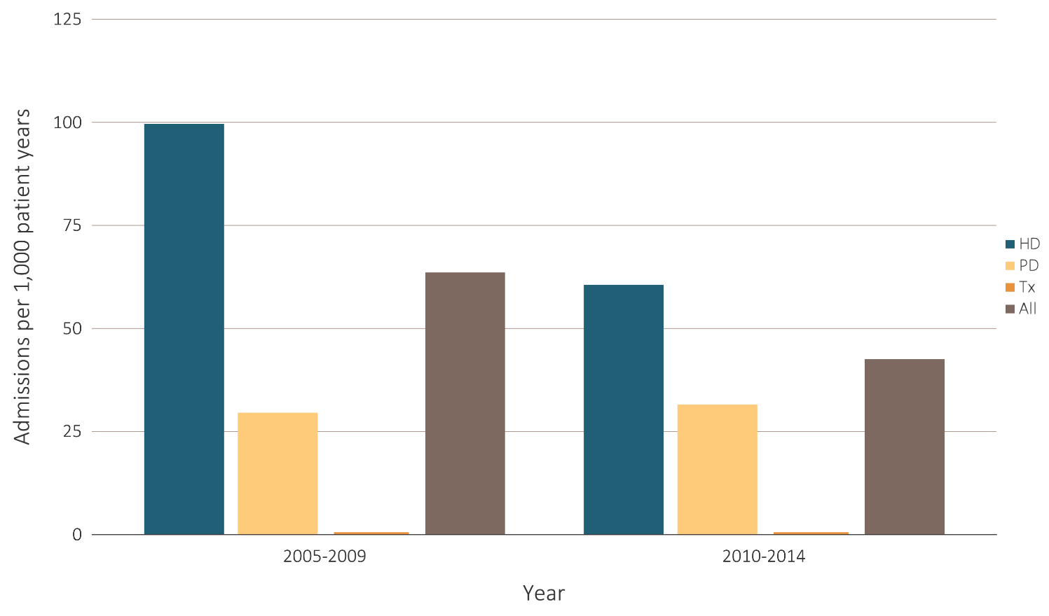
vol 2 Figure 7.6 One-year adjusted cardiovascular hospitalization admissions per 1000 patient years in incident pediatric patients (aged 0-21 years), by (a) age and (b) modality 2005-2009 and 2010-2014
(b) Modality
Data Source: Special analyses, USRDS ESRD Database. Includes incident pediatric ESRD patients in the years 2005-2014, surviving the first 90 days after ESRD initiation and followed from day 90. Reference population: incident ESRD patients aged 0-21, 2010-2011. Adjusted for sex, race, primary cause of ESRD, and Hispanic ethnicity. Abbreviations: ESRD, end-stage renal disease; HD, hemodialysis; PD, peritoneal dialysis; Tx, transplant.

Slide 18
vol 2 Figure 7.7 One-year adjusted hospitalization admissions per 1000 patient years for infection in incident pediatric patients (aged 0-21 years), by (a) age and (b) modality, 2005-2009 and 2010-2014
(a) Age
Data Source: Special analyses, USRDS ESRD Database. Includes incident pediatric ESRD patients in the years 2005-2014, surviving the first 90 days after ESRD initiation and followed from day 90. Adjusted for sex, race, primary cause of ESRD, and Hispanic ethnicity. Reference population: incident ESRD patients aged 0-21, 2010-2011. Abbreviations: ESRD, end-stage renal disease; HD, hemodialysis; PD, peritoneal dialysis; Tx, transplant.

Slide 19
vol 2 Figure 7.7 One-year adjusted hospitalization admissions per 1000 patient years for infection in incident pediatric patients (aged 0-21 years), by (a) age and (b) modality, 2005-2009 and 2010-2014
(b) Modality
Data Source: Special analyses, USRDS ESRD Database. Includes incident pediatric ESRD patients in the years 2005-2014, surviving the first 90 days after ESRD initiation and followed from day 90. Adjusted for sex, race, primary cause of ESRD, and Hispanic ethnicity. Reference population: incident ESRD patients aged 0-21, 2010-2011. Abbreviations: ESRD, end-stage renal disease; HD, hemodialysis; PD, peritoneal dialysis; Tx, transplant.

Slide 20
vol 2 Figure 7.8 One-year adjusted all-cause mortality rates in incident pediatric patients with ESRD by (a) age with comparison to young adults (aged 0-29 years), and (b) modality (aged 0-21 years only), 2005-2009 and 2010-2014
(a) Age
Data Source: Special analyses, USRDS ESRD Database. Incident dialysis and transplant patients defined at the onset of dialysis or the day of transplant without the 60-day rule; followed to December 31, 2015. Adjusted for age, sex, race, Hispanic ethnicity, and primary cause of ESRD. Reference population: incident ESRD patients aged 0-21, 2010-2011. Abbreviations: ESRD, end-stage renal disease; HD, hemodialysis; PD, peritoneal dialysis; Tx, transplant.

Slide 21
vol 2 Figure 7.8 One-year adjusted all-cause mortality rates in incident pediatric patients with ESRD by (a) age with comparison to young adults (aged 0-29 years), and (b) modality (aged 0-21 years only), 2005-2009 and 2010-2014
(b) Modality
Data Source: Special analyses, USRDS ESRD Database. Incident dialysis and transplant patients defined at the onset of dialysis or the day of transplant without the 60-day rule; followed to December 31, 2015. Adjusted for age, sex, race, Hispanic ethnicity, and primary cause of ESRD. Reference population: incident ESRD patients aged 0-21, 2010-2011. Abbreviations: ESRD, end-stage renal disease; HD, hemodialysis; PD, peritoneal dialysis; Tx, transplant.

Slide 22
Table 7.3 Expected remaining lifetime in years of prevalent patients by initial ESRD modality, 2014
Age group | Dialysis patients | Transplant patients | General population
0-4 | 23.6 | 56.9 | 77.1
5-9 | 24.3 | 56.3 | 72.3
10-13 | 24.1 | 52.2 | 67.8
14-17 | 20.9 | 48.8 | 63.9
18-21 | 17.7 | 45.2 | 60.0
22-29 | 16.0 | 42.0 | 54.2
Data Source: Special analyses, USRDS ESRD Database, USA SSA (Social Security Administration) Period Life Table 2014. Includes period prevalent ESRD dialysis and transplant patients in 2014.

Slide 23
vol 2 Figure 7.9 One-year adjusted cardiovascular mortality rates in incident pediatric patients with ESRD (aged 0-21 years), by (a) age and (b) modality, 2005-2009 and 2010-2014
(a) Age
Data Source: Special analyses, USRDS ESRD Database. Incident dialysis and transplant patients defined at the onset of dialysis or the day of transplant without the 60-day rule; followed to December 31, 2015. Adjusted for age, sex, race, Hispanic ethnicity, and primary cause of ESRD. Reference population: incident ESRD patients aged 0-21, 2010-2011. Abbreviations: ESRD, end-stage renal disease; HD, hemodialysis; PD, peritoneal dialysis; Tx, transplant.

Slide 24
vol 2 Figure 7.9 One-year adjusted cardiovascular mortality rates in incident pediatric patients with ESRD (aged 0-21 years), by (a) age and (b) modality, 2005-2009 and 2010-2014
(b) Modality
Data Source: Special analyses, USRDS ESRD Database. Incident dialysis and transplant patients defined at the onset of dialysis or the day of transplant without the 60-day rule; followed to December 31, 2015. Adjusted for age, sex, race, Hispanic ethnicity, and primary cause of ESRD. Reference population: incident ESRD patients aged 0-21, 2010-2011. Abbreviations: ESRD, end-stage renal disease; HD, hemodialysis; PD, peritoneal dialysis; Tx, transplant.

Slide 25
vol 2 Figure 7.10 One-year adjusted rates of mortality due to infection in incident pediatric patients with ESRD (aged 0-21 years), by (a) age and (b) modality, 2005-2009 and 2010-2014
(a) Age
Data Source: Special analyses, USRDS ESRD Database. Incident dialysis and transplant patients defined at the onset of dialysis or the day of transplant without the 60-day rule; followed to December 31, 2015. Adjusted for age, sex, race, Hispanic ethnicity, and primary cause of ESRD. Reference population: incident ESRD patients aged 0-21, 2010-2011. Abbreviations: ESRD, end-stage renal disease; HD, hemodialysis; PD, peritoneal dialysis; Tx, transplant.

Slide 26
vol 2 Figure 7.10 One-year adjusted rates of mortality due to infection in incident pediatric patients with ESRD (aged 0-21 years), by (a) age and (b) modality, 2005-2009 and 2010-2014
(b) Modality
Data Source: Special analyses, USRDS ESRD Database. Incident dialysis and transplant patients defined at the onset of dialysis or the day of transplant without the 60-day rule; followed to December 31, 2015. Adjusted for age, sex, race, Hispanic ethnicity, and primary cause of ESRD. Reference population: incident ESRD patients aged 0-21, 2010-2011. Abbreviations: ESRD, end-stage renal disease; HD, hemodialysis; PD, peritoneal dialysis; Tx, transplant.

Slide 27
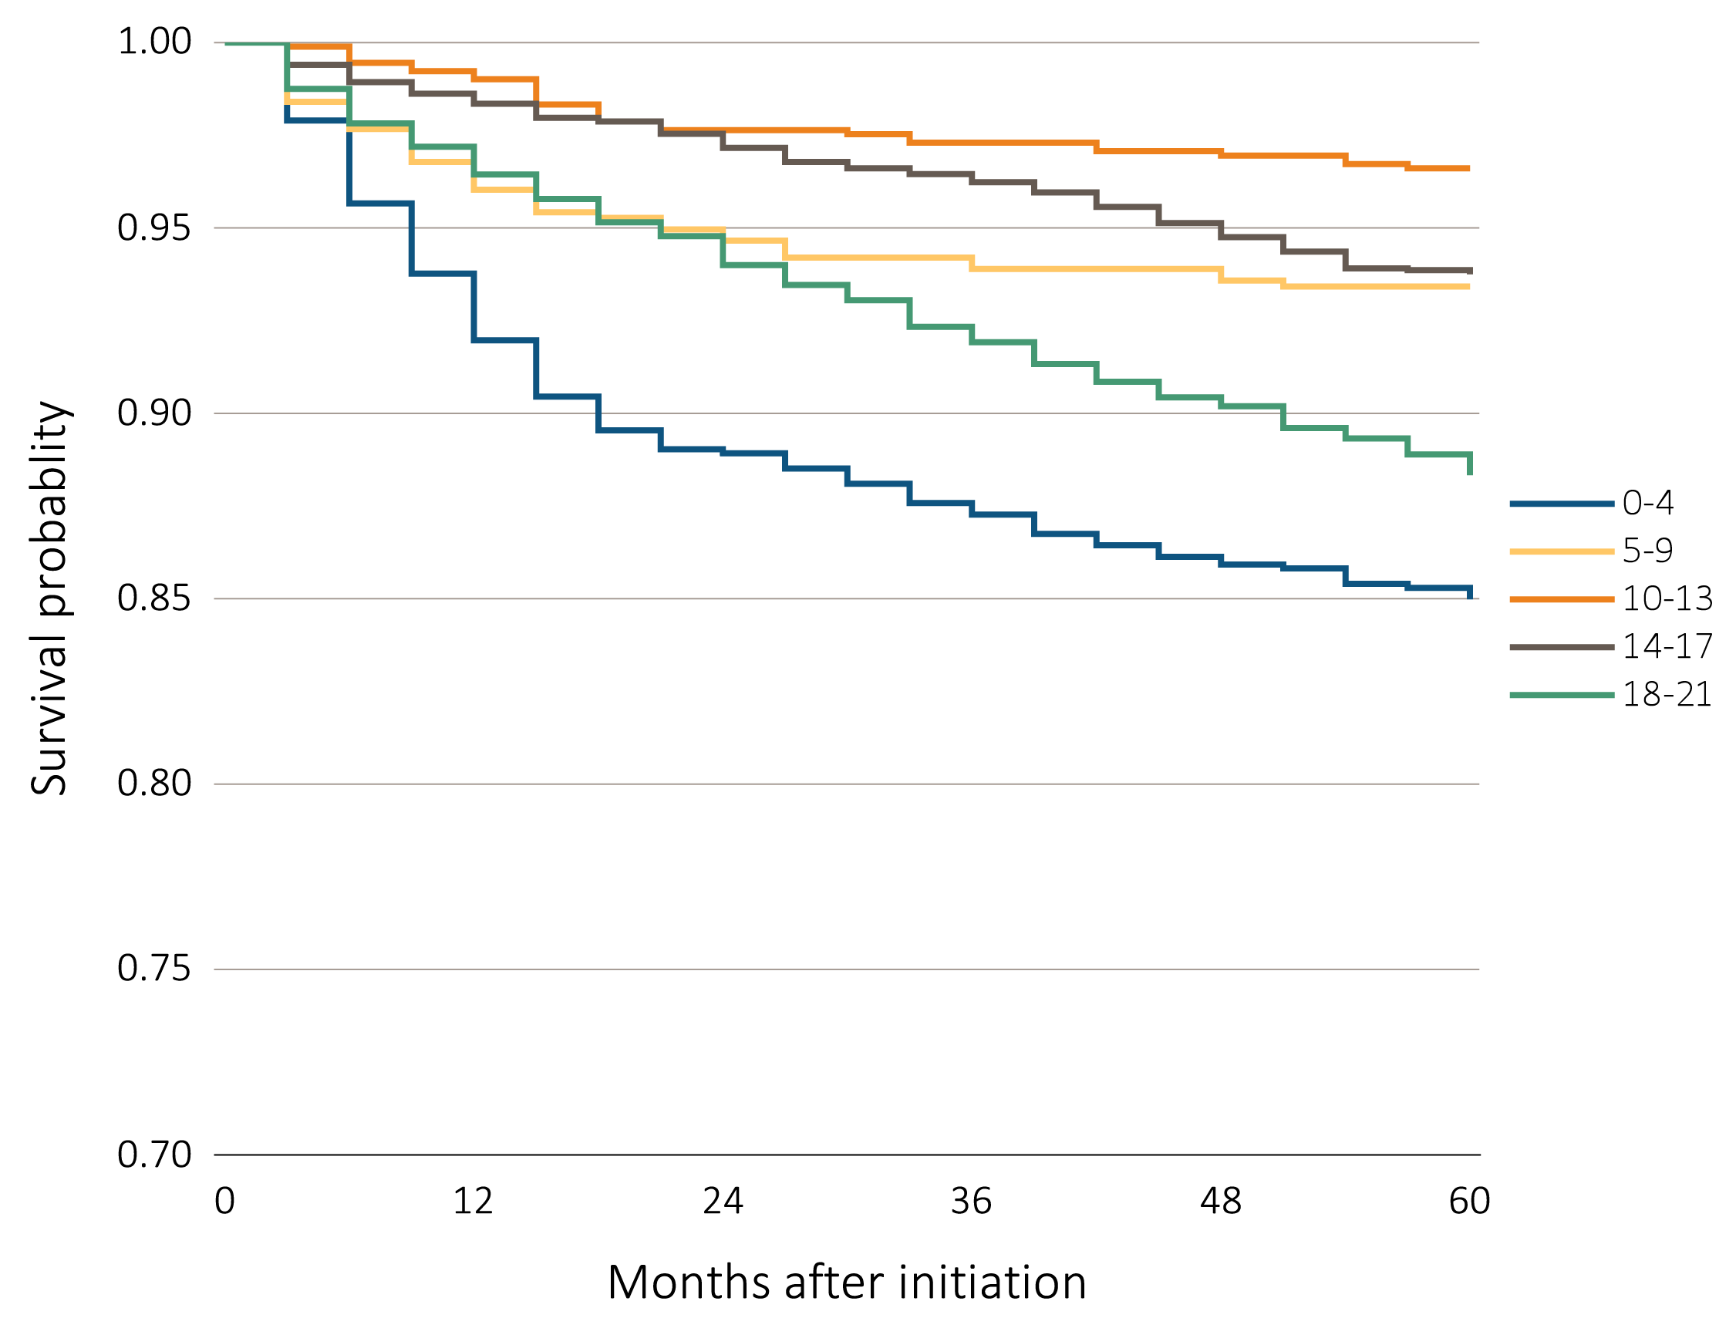
vol 2 Figure 7.11 Adjusted five-year survival in incident pediatric patients (aged 0-21 years) from day 1, by (a) age and (b) modality, 2006-2010
(a) Age
Data Source: Special analyses, USRDS ESRD Database. Incident dialysis and transplant patients defined at the onset of dialysis or the day of transplant without the 60-day rule; followed to December 31, 2015. Adjusted for age, sex, race, Hispanic ethnicity, and primary cause of ESRD. Reference population: incident ESRD patients aged 0-21, 2010-2011. Abbreviations: ESRD, end-stage renal disease; HD, hemodialysis; PD, peritoneal dialysis; Tx, transplant.

Slide 28
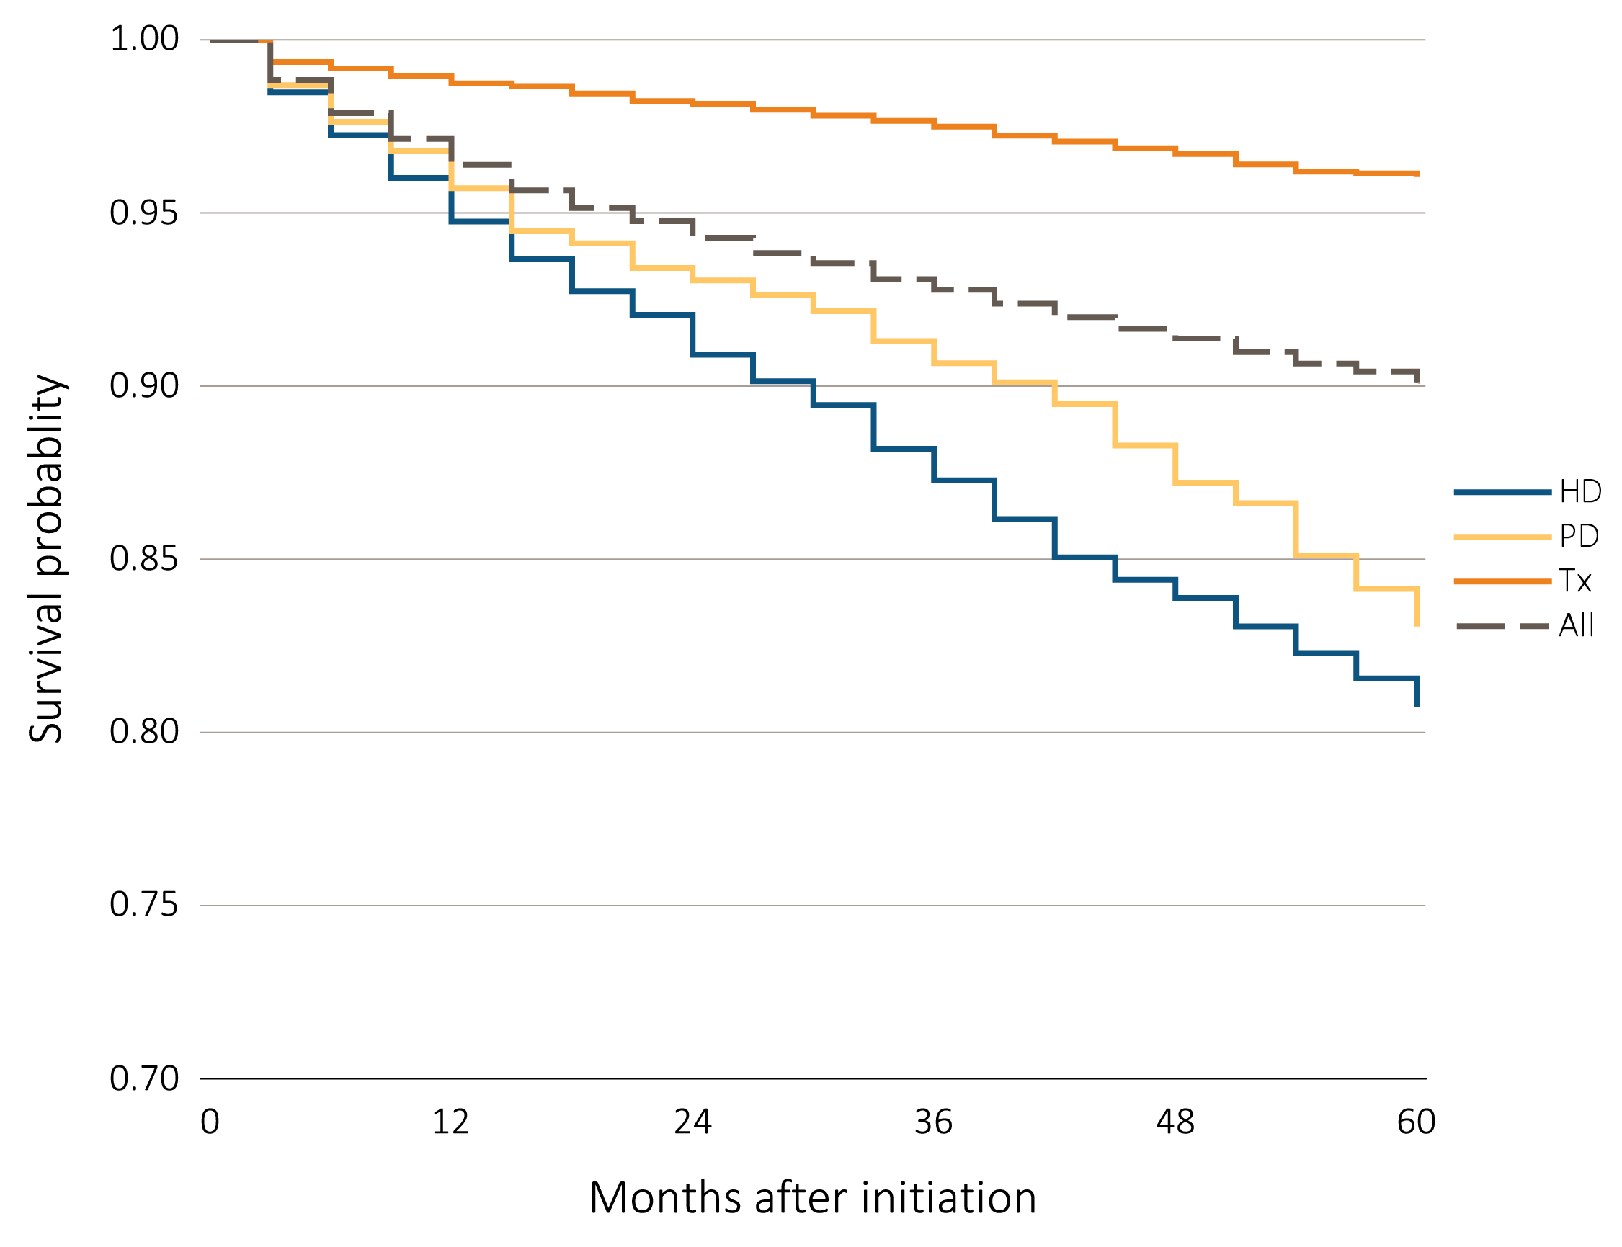
vol 2 Figure 7.11 Adjusted five-year survival in incident pediatric patients (aged 0-21 years) from day 1, by (a) age and (b) modality, 2006-2010
(b) Modality
Data Source: Special analyses, USRDS ESRD Database. Incident dialysis and transplant patients defined at the onset of dialysis or the day of transplant without the 60-day rule; followed to December 31, 2015. Adjusted for age, sex, race, Hispanic ethnicity, and primary cause of ESRD. Reference population: incident ESRD patients aged 0-21, 2010-2011. Abbreviations: ESRD, end-stage renal disease; HD, hemodialysis; PD, peritoneal dialysis; Tx, transplant.

Slide 29
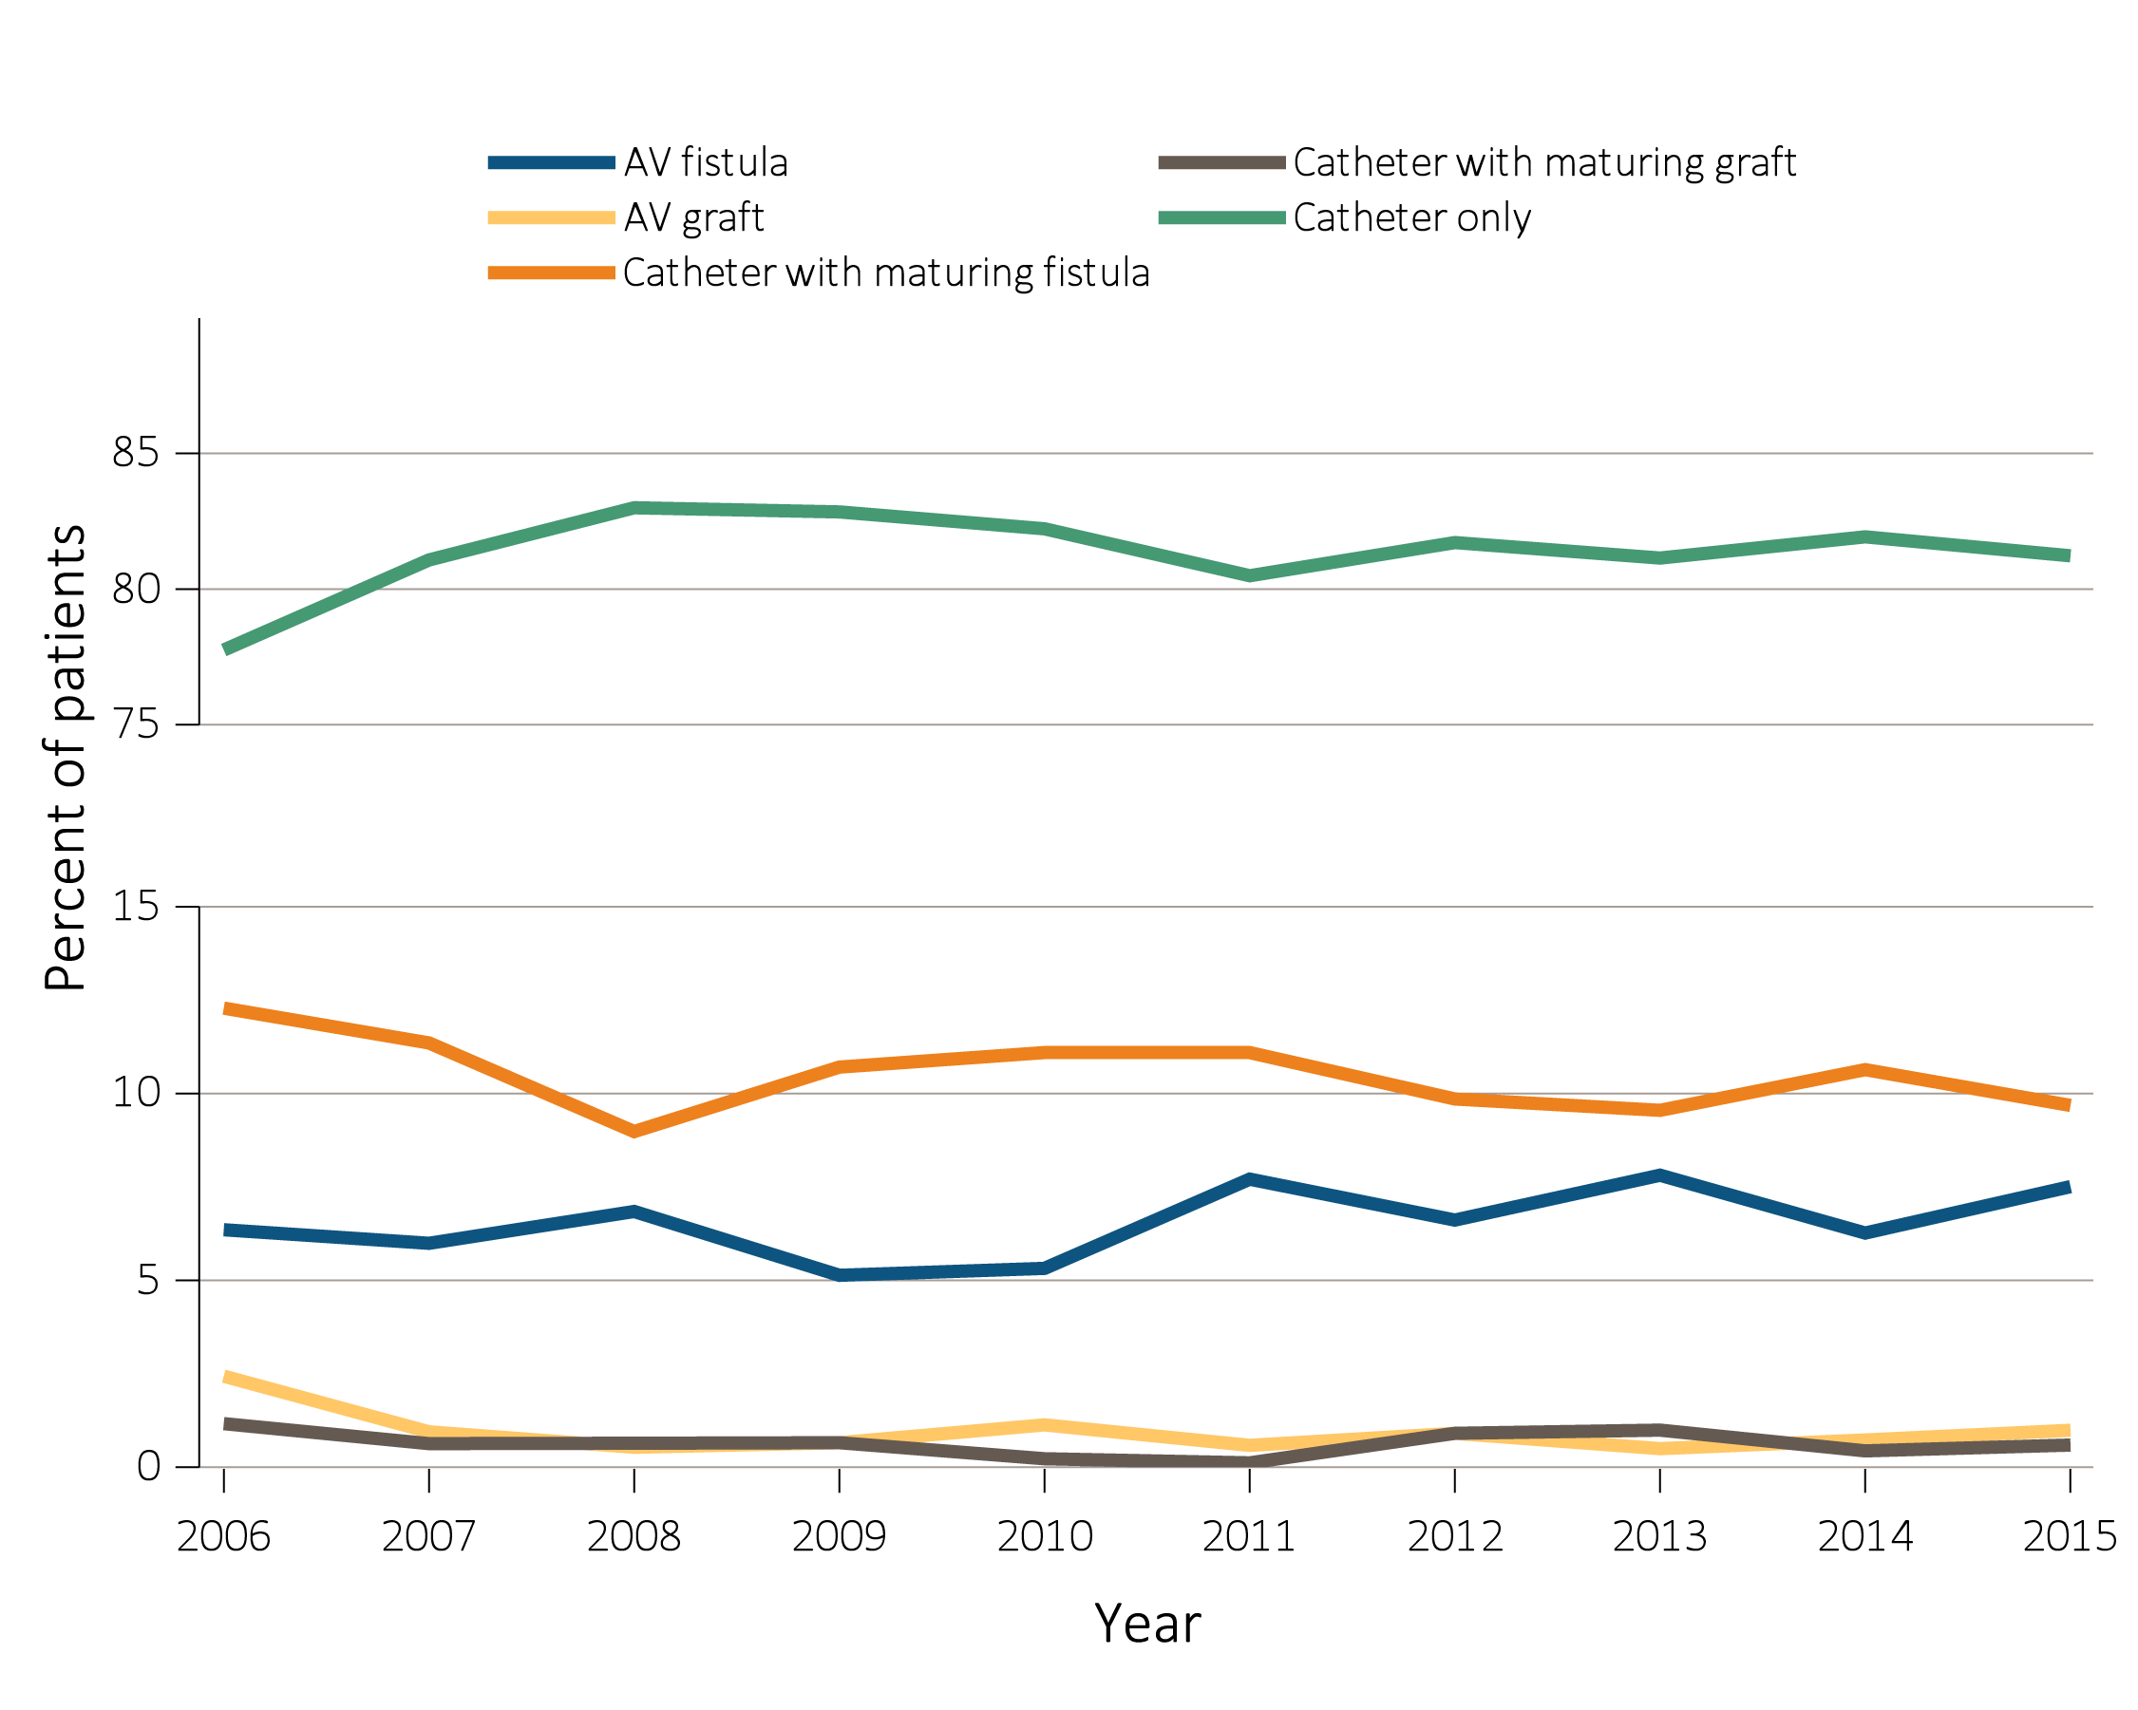
vol 2 Figure 7.12 Vascular access type at initiation of incident pediatric hemodialysis patients (aged 0-21 years) by (a) year and (b) age, 2006-2015
(a) Year
Data Source: Special analyses, USRDS ESRD Database. ESRD patients initiating hemodialysis in 2006-2015. Abbreviations: AV, arteriovenous; ESRD, end-stage renal disease.

Slide 30
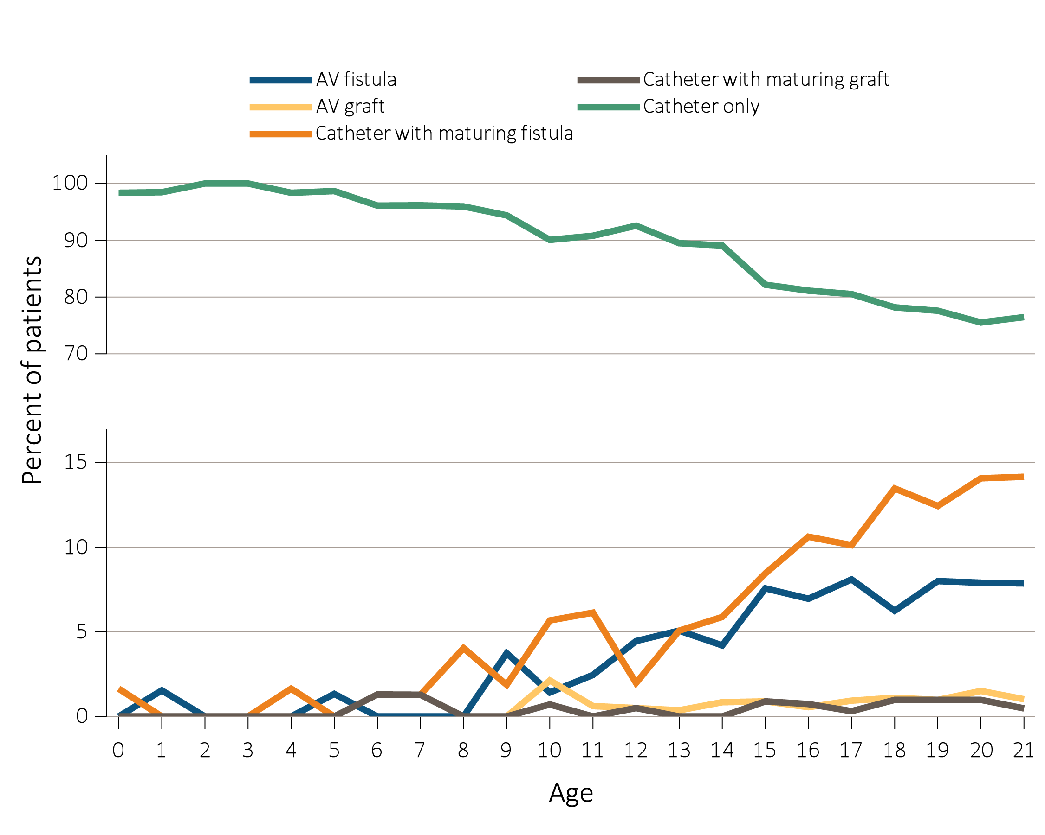
vol 2 Figure 7.12 Vascular access type at initiation of incident pediatric hemodialysis patients (aged 0-21 years) by (a) year and (b) age, 2006-2015
(b) Age
Data Source: Special analyses, USRDS ESRD Database. ESRD patients initiating hemodialysis in 2006-2015. Abbreviations: AV, arteriovenous; ESRD, end-stage renal disease.

Slide 31
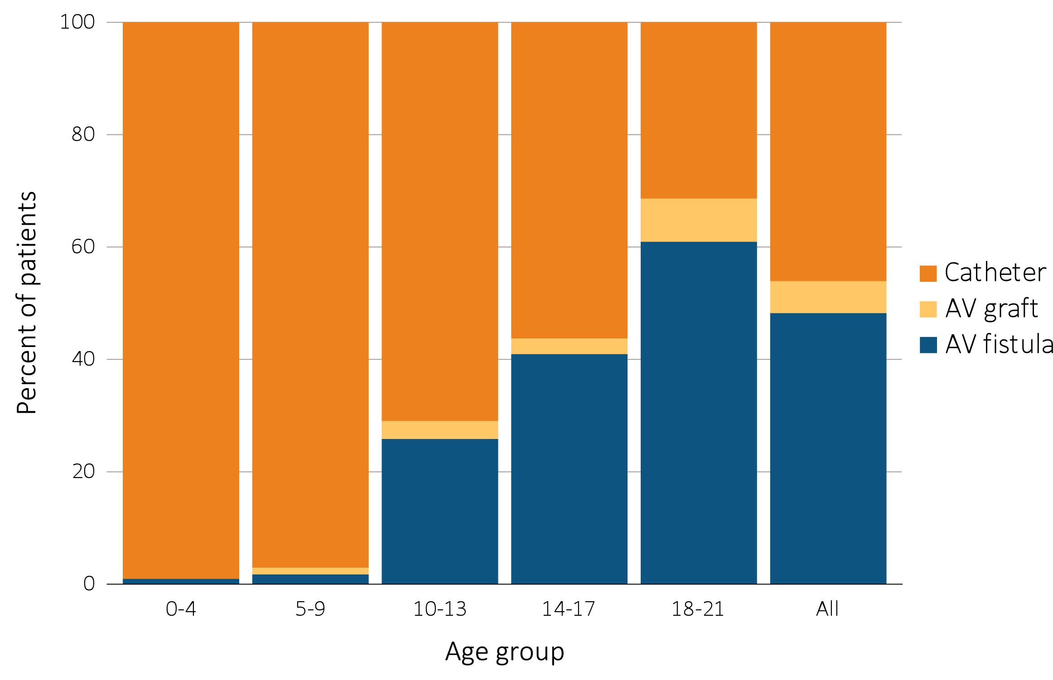
vol 2 Figure 7.13 Distribution of vascular access type in prevalent pediatric hemodialysis patients (aged 0-21 years* as of May 31, 2016)
Data Source: Special analyses, CROWNWeb clinical extracts for May 2016. Hemodialysis patients initiating treatment for ESRD at least 90 days prior to May 1, 2016, *who were <22 years old as May 1, 2016, and who were alive through May 31, 2016; Catheter=any catheter use; fistula and graft use shown are without the use of a catheter. Abbreviations: AVF, arteriovenous fistula; AVG, arteriovenous graft; ESRD, end-stage renal disease

Slide 32
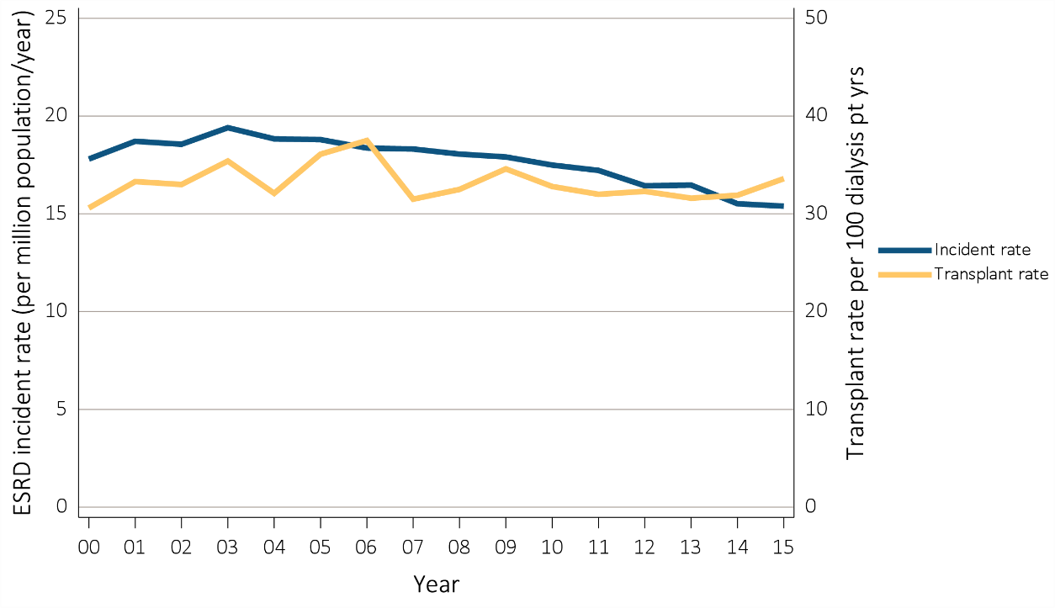
vol 2 Figure 7.14 Trends in pediatric transplantation (aged 0-21 years), by (a) ESRD incident and kidney transplant rates, (b) kidney transplant counts and waiting list times, (c) kidney transplant counts by donor type, (d) kidney transplant counts, patients 0-17 years, (e) and kidney transplant counts, patients 18-21 years
(a) ESRD incident and kidney transplant rates
Data Source: (a) Reference Tables A1, E9, and M1. The rate of ESRD per million among the U.S. population aged 0-21 years and the rate of transplantation in dialysis patients aged 0-21 years at the time of transplant, 1996–2015. (b) Special analyses, USRDS ESRD Database. The waiting list count provides the number of pediatric candidates aged 0-21 years on the Organ Procurement and Transplantation Network kidney transplant waiting list on December 31 of each year for first and subsequent kidney alone or kidney plus pancreas transplantation. Candidates listed at more than one center on December 31 are counted only once. There are no data available for median waiting list time for patients with prior transplants listed after 2012. (c-e) Reference Tables E8, E8(2), E8(3). This figure represents kidney alone and kidney plus pancreas transplant counts for all pediatric candidates. Abbreviations: ESRD, end-stage renal disease; pt, patient; Tx, transplant; yrs, years.

Slide 33
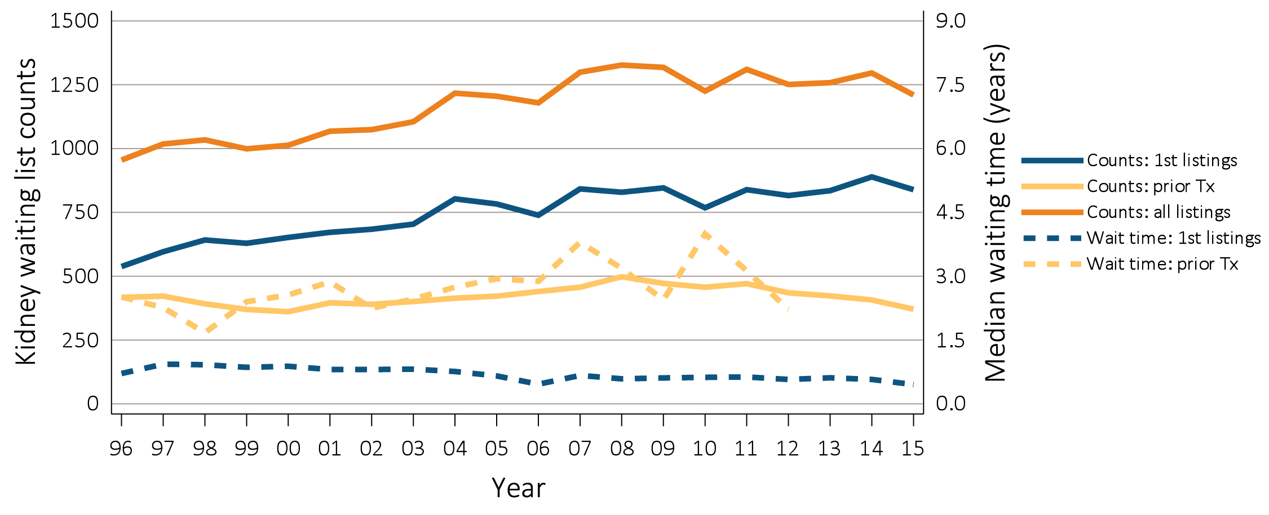
vol 2 Figure 7.14 Trends in pediatric transplantation (aged 0-21 years), by (a) ESRD incident and kidney transplant rates, (b) kidney transplant counts and waiting list times, (c) kidney transplant counts by donor type, (d) kidney transplant counts, patients 0-17 years, (e) and kidney transplant counts, patients 18-21 years
(b) Kidney transplant counts and waiting list items
Data Source: (a) Reference Tables A1, E9, and M1. The rate of ESRD per million among the U.S. population aged 0-21 years and the rate of transplantation in dialysis patients aged 0-21 years at the time of transplant, 1996–2015. (b) Special analyses, USRDS ESRD Database. The waiting list count provides the number of pediatric candidates aged 0-21 years on the Organ Procurement and Transplantation Network kidney transplant waiting list on December 31 of each year for first and subsequent kidney alone or kidney plus pancreas transplantation. Candidates listed at more than one center on December 31 are counted only once. There are no data available for median waiting list time for patients with prior transplants listed after 2012. (c-e) Reference Tables E8, E8(2), E8(3). This figure represents kidney alone and kidney plus pancreas transplant counts for all pediatric candidates. Abbreviations: ESRD, end-stage renal disease; pt, patient; Tx, transplant; yrs, years.

Slide 34
vol 2 Figure 7.14 Trends in pediatric transplantation (aged 0-21 years), by (a) ESRD incident and kidney transplant rates, (b) kidney transplant counts and waiting list times, (c) kidney transplant counts by donor type, (d) kidney transplant counts, patients 0-17 years, (e) and kidney transplant counts, patients 18-21 years
(c) Kidney transplant counts by donor types
Data Source: (a) Reference Tables A1, E9, and M1. The rate of ESRD per million among the U.S. population aged 0-21 years and the rate of transplantation in dialysis patients aged 0-21 years at the time of transplant, 1996–2015. (b) Special analyses, USRDS ESRD Database. The waiting list count provides the number of pediatric candidates aged 0-21 years on the Organ Procurement and Transplantation Network kidney transplant waiting list on December 31 of each year for first and subsequent kidney alone or kidney plus pancreas transplantation. Candidates listed at more than one center on December 31 are counted only once. There are no data available for median waiting list time for patients with prior transplants listed after 2012. (c-e) Reference Tables E8, E8(2), E8(3). This figure represents kidney alone and kidney plus pancreas transplant counts for all pediatric candidates. Abbreviations: ESRD, end-stage renal disease; pt, patient; Tx, transplant; yrs, years.

Slide 35
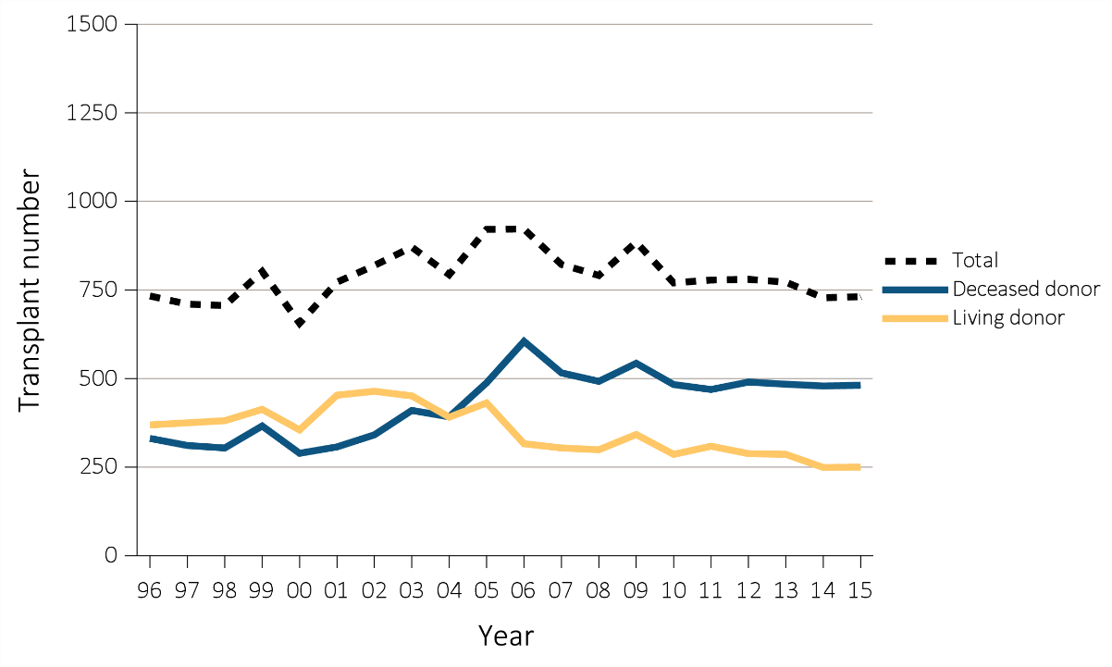
vol 2 Figure 7.14 Trends in pediatric transplantation (aged 0-21 years), by (a) ESRD incident and kidney transplant rates, (b) kidney transplant counts and waiting list times, (c) kidney transplant counts by donor type, (d) kidney transplant counts, patients 0-17 years, (e) and kidney transplant counts, patients 18-21 years
(d) Kidney transplant counts, patients 0-17 years
Data Source: (a) Reference Tables A1, E9, and M1. The rate of ESRD per million among the U.S. population aged 0-21 years and the rate of transplantation in dialysis patients aged 0-21 years at the time of transplant, 1996–2015. (b) Special analyses, USRDS ESRD Database. The waiting list count provides the number of pediatric candidates aged 0-21 years on the Organ Procurement and Transplantation Network kidney transplant waiting list on December 31 of each year for first and subsequent kidney alone or kidney plus pancreas transplantation. Candidates listed at more than one center on December 31 are counted only once. There are no data available for median waiting list time for patients with prior transplants listed after 2012. (c-e) Reference Tables E8, E8(2), E8(3). This figure represents kidney alone and kidney plus pancreas transplant counts for all pediatric candidates. Abbreviations: ESRD, end-stage renal disease; pt, patient; Tx, transplant; yrs, years.

Slide 36
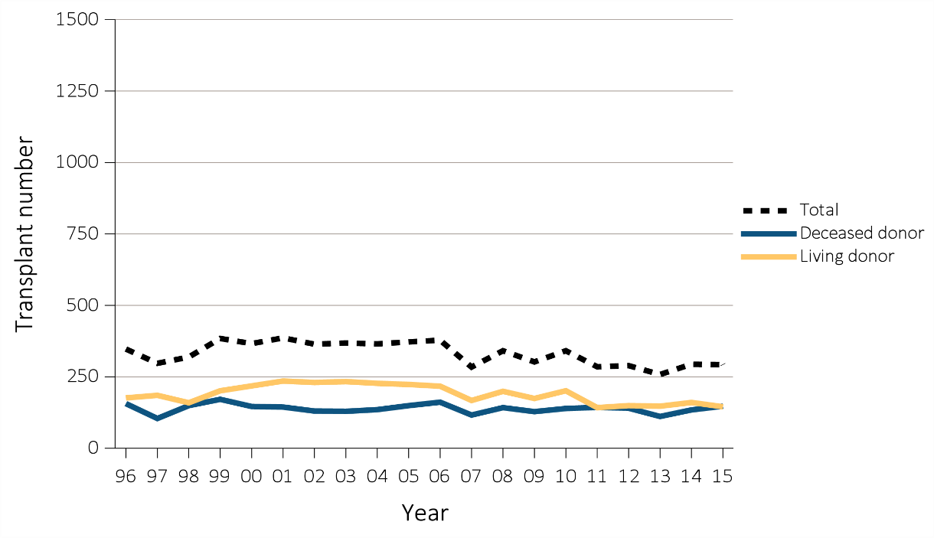
vol 2 Figure 7.14 Trends in pediatric transplantation (aged 0-21 years), by (a) ESRD incident and kidney transplant rates, (b) kidney transplant counts and waiting list times, (c) kidney transplant counts by donor type, (d) kidney transplant counts, patients 0-17 years, (e) and kidney transplant counts, patients 18-21 years
(e) Kidney transplant counts, patients 18-21 years
Data Source: (a) Reference Tables A1, E9, and M1. The rate of ESRD per million among the U.S. population aged 0-21 years and the rate of transplantation in dialysis patients aged 0-21 years at the time of transplant, 1996–2015. (b) Special analyses, USRDS ESRD Database. The waiting list count provides the number of pediatric candidates aged 0-21 years on the Organ Procurement and Transplantation Network kidney transplant waiting list on December 31 of each year for first and subsequent kidney alone or kidney plus pancreas transplantation. Candidates listed at more than one center on December 31 are counted only once. There are no data available for median waiting list time for patients with prior transplants listed after 2012. (c-e) Reference Tables E8, E8(2), E8(3). This figure represents kidney alone and kidney plus pancreas transplant counts for all pediatric candidates. Abbreviations: ESRD, end-stage renal disease; pt, patient; Tx, transplant; yrs, years.

Slide 37
vol 2 Figure 7.15 Annual rates of living and deceased donor transplants in pediatric dialysis patients (aged 0-21 years), by (a-b) age (c) race, 1996-2015
(a) Age with living donor
Data Source: Special analyses, USRDS ESRD Database. Includes transplant year between 1996–2015. Abbreviations: ESRD, end-stage renal disease; pt, patient; yrs, years.

Slide 38
vol 2 Figure 7.15 Annual rates of living and deceased donor transplants in pediatric dialysis patients (aged 0-21 years), by (a-b) age and (c) race, 1996-2015
(b) Age with deceased donor
Data Source: Special analyses, USRDS ESRD Database. Includes transplant year between 1996–2015. Abbreviations: ESRD, end-stage renal disease; pt, patient; yrs, years.

Slide 39
vol 2 Figure 7.15 Annual rates of living and deceased donor transplants in pediatric dialysis patients (aged 0-21 years), by (a-b) age and (c) race, 1996-2015
(c) Race
Data Source: Special analyses, USRDS ESRD Database. Includes transplant year between 1996–2015. Abbreviations: ESRD, end-stage renal disease; pt, patient; yrs, years.

Slide 40
vol 2 Figure 7.16 Median waiting time from incident hemodialysis or peritoneal dialysis to first transplant, by (a) modality, (b) age, (c) primary cause of ESRD, (d) race, and (e) donor type, 1996-2014
(a) Modality
Data Source: Special analyses, USRDS ESRD Database. Incident dialysis and transplant patients defined at the onset of dialysis or the day of transplant with the 60-day rule. Includes pediatric patients (aged 0-21 years) starting initiation of HD or PD in 1996-2014 and having the first transplant before 12/31/2016. Abbreviations: CAKUT, congenital anomalies of the kidney and urinary tract; C/H/C, Cystic/Hereditary/Congenital disease. ESRD, end-stage renal disease; HD, hemodialysis; PD, peritoneal dialysis. Note that the percentage of unknown donor type is 1.32% in 1996, 1.11% in 1997, 0.44% in 1998, 0.54% in 1999, 0.22% in 2000, 0.10% in 2001, 0.30% in 2002, 0.10% in 2003, 0.10% in 2004, 0.23% in 2006, 0.14% in 2011, and 0% in 2005, 2007-2010, 2012-2014.

Slide 41
vol 2 Figure 7.16 Median waiting time from incident hemodialysis or peritoneal dialysis to first transplant, by (a) modality, (b) age, (c) primary cause of ESRD, (d) race, and (e) donor type, 1996-2014
(b) Age
Data Source: Special analyses, USRDS ESRD Database. Incident dialysis and transplant patients defined at the onset of dialysis or the day of transplant with the 60-day rule. Includes pediatric patients (aged 0-21 years) starting initiation of HD or PD in 1996-2014 and having the first transplant before 12/31/2016. Abbreviations: CAKUT, congenital anomalies of the kidney and urinary tract; C/H/C, Cystic/Hereditary/Congenital disease. ESRD, end-stage renal disease; HD, hemodialysis; PD, peritoneal dialysis. Note that the percentage of unknown donor type is 1.32% in 1996, 1.11% in 1997, 0.44% in 1998, 0.54% in 1999, 0.22% in 2000, 0.10% in 2001, 0.30% in 2002, 0.10% in 2003, 0.10% in 2004, 0.23% in 2006, 0.14% in 2011, and 0% in 2005, 2007-2010, 2012-2014.

Slide 42
vol 2 Figure 7.16 Median waiting time from incident hemodialysis or peritoneal dialysis to first transplant, by (a) modality, (b) age, (c) primary cause of ESRD, (d) race, and (e) donor type, 1996-2014
(c) Primary cause of ESRD
Data Source: Special analyses, USRDS ESRD Database. Incident dialysis and transplant patients defined at the onset of dialysis or the day of transplant with the 60-day rule. Includes pediatric patients (aged 0-21 years) starting initiation of HD or PD in 1996-2014 and having the first transplant before 12/31/2016. Abbreviations: CAKUT, congenital anomalies of the kidney and urinary tract; C/H/C, Cystic/Hereditary/Congenital disease. ESRD, end-stage renal disease; HD, hemodialysis; PD, peritoneal dialysis. Note that the percentage of unknown donor type is 1.32% in 1996, 1.11% in 1997, 0.44% in 1998, 0.54% in 1999, 0.22% in 2000, 0.10% in 2001, 0.30% in 2002, 0.10% in 2003, 0.10% in 2004, 0.23% in 2006, 0.14% in 2011, and 0% in 2005, 2007-2010, 2012-2014.

Slide 43
vol 2 Figure 7.16 Median waiting time from incident hemodialysis or peritoneal dialysis to first transplant, by (a) modality, (b) age, (c) primary cause of ESRD, (d) race, and (e) donor type, 1996-2014
(d) Race
Data Source: Special analyses, USRDS ESRD Database. Incident dialysis and transplant patients defined at the onset of dialysis or the day of transplant with the 60-day rule. Includes pediatric patients (aged 0-21 years) starting initiation of HD or PD in 1996-2014 and having the first transplant before 12/31/2016. Abbreviations: CAKUT, congenital anomalies of the kidney and urinary tract; C/H/C, Cystic/Hereditary/Congenital disease. ESRD, end-stage renal disease; HD, hemodialysis; PD, peritoneal dialysis. Note that the percentage of unknown donor type is 1.32% in 1996, 1.11% in 1997, 0.44% in 1998, 0.54% in 1999, 0.22% in 2000, 0.10% in 2001, 0.30% in 2002, 0.10% in 2003, 0.10% in 2004, 0.23% in 2006, 0.14% in 2011, and 0% in 2005, 2007-2010, 2012-2014.

Slide 44
vol 2 Figure 7.16 Median waiting time from incident hemodialysis or peritoneal dialysis to first transplant, by (a) modality, (b) age, (c) primary cause of ESRD, (d) race, and (e) donor type, 1996-2014
(e) Donor type
Data Source: Special analyses, USRDS ESRD Database. Incident dialysis and transplant patients defined at the onset of dialysis or the day of transplant with the 60-day rule. Includes pediatric patients (aged 0-21 years) starting initiation of HD or PD in 1996-2014 and having the first transplant before 12/31/2016. Abbreviations: CAKUT, congenital anomalies of the kidney and urinary tract; C/H/C, Cystic/Hereditary/Congenital disease. ESRD, end-stage renal disease; HD, hemodialysis; PD, peritoneal dialysis. Note that the percentage of unknown donor type is 1.32% in 1996, 1.11% in 1997, 0.44% in 1998, 0.54% in 1999, 0.22% in 2000, 0.10% in 2001, 0.30% in 2002, 0.10% in 2003, 0.10% in 2004, 0.23% in 2006, 0.14% in 2011, and 0% in 2005, 2007-2010, 2012-2014.

Slide 45
vol 2 Table 7.4 Adjusted ten-year outcomes for kidney transplants in pediatric patients (aged 0-21 years), by donor type and year, 1996-2005
 | Adjusted ten-year outcomes (Probabilities)
 | Deceased |  |  |  | Living
Year | All-cause graft failure | Return to dialysis or retransplant | Death |  | All-cause graft failure | Return to dialysis or retransplant | Death
1996 | 0.64 | 0.61 | 0.12 |  | 0.52 | 0.50 | 0.12
1997 | 0.62 | 0.58 | 0.13 |  | 0.50 | 0.47 | 0.16
1998 | 0.56 | 0.54 | 0.10 |  | 0.49 | 0.47 | 0.10
1999 | 0.58 | 0.55 | 0.10 |  | 0.50 | 0.48 | 0.14
2000 | 0.58 | 0.54 | 0.10 |  | 0.52 | 0.49 | 0.16
2001 | 0.56 | 0.53 | 0.11 |  | 0.49 | 0.47 | 0.14
2002 | 0.51 | 0.47 | 0.06 |  | 0.43 | 0.40 | 0.14
2003 | 0.53 | 0.50 | 0.11 |  | 0.43 | 0.40 | 0.12
2004 | 0.58 | 0.55 | 0.08 |  | 0.44 | 0.42 | 0.07
2005 | 0.54 | 0.51 | 0.09 |  | 0.49 | 0.46 | 0.12
Data Source: Deceased: Reference Tables F6, F18, I30. Live: Reference Tables F12, F24, I36. Probabilities for all-cause graft failure and return to dialysis or repeat transplant are adjusted for age, sex, race, primary cause of ESRD, and first versus subsequent transplant. All-cause graft failure includes repeat transplant, return to dialysis, and death. The death outcome is not censored at graft failure, and includes deaths that occur after repeat transplant or return to dialysis. Probabilities of death are adjusted for age, sex, race, Hispanic ethnicity, and primary cause of ESRD. The reference population for all-cause graft failure and return to dialysis or repeat transplantation is all pediatric patients receiving a kidney alone transplant in 2011. The reference population for death is incident pediatric ESRD patients in 2011. Abbreviation: ESRD, end-stage renal disease.

Slide 46
vol 2 Figure 7.17 Trends in incident rates of ESRD in young adults (aged 22-29 years), by modality, 1996-2015
Data Source: Special analyses, USRDS ESRD Database. Peritoneal dialysis consists of continuous ambulatory peritoneal dialysis and continuous cycling peritoneal dialysis. Abbreviations: ESRD, end-stage renal disease; HD, hemodialysis; PD, peritoneal dialysis; Tx, transplant.

Slide 47
vol 2 Figure 7.18 One-year unadjusted cardiovascular hospitalization admissions per 1000 patient years in young adults with incident ESRD (aged 22-29 years), by modality, 2005-2009 and 2010-2014
Data Source: Special analyses, USRDS ESRD Database. Includes incident pediatric ESRD patients in the years 2005-2014, surviving the first 90 days after ESRD initiation and followed from day 90. Abbreviations: ESRD, end-stage renal disease; HD, hemodialysis; PD, peritoneal dialysis; Tx, transplant.

Slide 48
vol 2 Figure 7.19 One-year adjusted cardiovascular mortality rates in young adults with incident ESRD (aged 22-29 years), by modality, 2005-2009 and 2010-2014
Data Source: Special analyses, USRDS ESRD Database. Incident dialysis and transplant patients defined at the onset of dialysis or the day of transplant without the 60-day rule; followed to December 31, 2015. Adjusted for age, sex, race, Hispanic ethnicity, and primary cause of ESRD. Reference population: incident ESRD patients aged 22-29, 2010-2011. Abbreviations: ESRD, end-stage renal disease; HD, hemodialysis; PD, peritoneal dialysis; Tx, transplant.

Slide 49
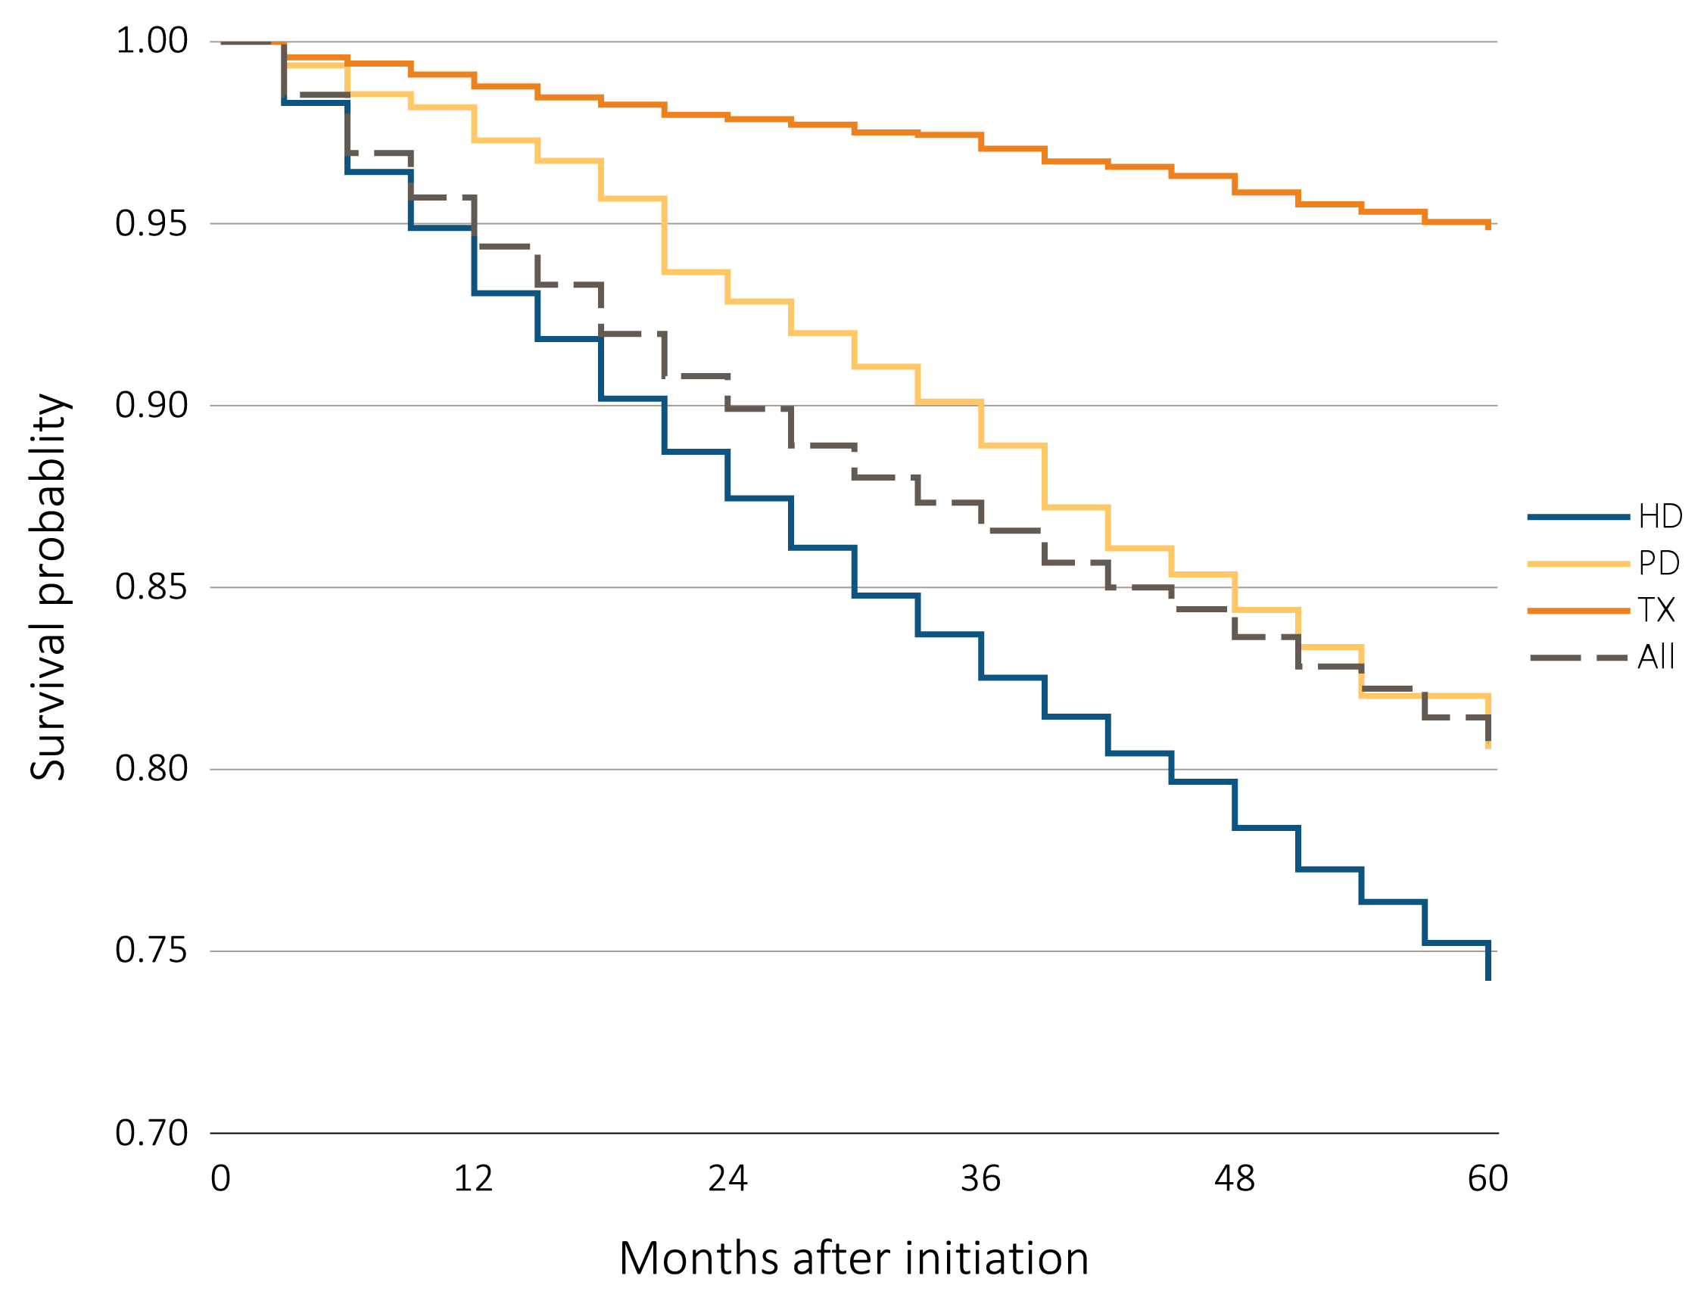
vol 2 Figure 7.20 Adjusted five-year survival probability of young adults with incident ESRD (aged 22-29 years), by modality and months after initiation, 2006–2010
Data Source: Special analyses, USRDS ESRD Database. Incident dialysis and transplant patients defined at the onset of dialysis or the day of transplant without the 60-day rule; followed to December 31, 2015. Adjusted for age, sex, race, Hispanic ethnicity, and primary cause of ESRD. Reference population: incident ESRD patients aged 22-29, 2010-2011. Abbreviations: ESRD, end-stage renal disease; HD, hemodialysis; PD, peritoneal dialysis; Tx, transplant.

