Slide 1
2017 Annual Data Report
Volume 2: End-Stage Renal Disease
Chapter 12:
End-of-life Care for Patients
with ESRD: 2000-2014

Slide 2
vol 2 Table 12.1 Characteristics of decedents with ESRD by death year, 2000-2014
 | 2000 | 2001 | 2002 | 2003 | 2004 | 2005 | 2006 | 2007 | 2008 | 2009 | 2010 | 2011 | 2012 | 2013 | 2014 | Total
n | 72,803 | 76,882 | 79,501 | 82,432 | 84,109 | 85,835 | 87,539 | 87,569 | 88,379 | 89,894 | 90,620 | 91,831 | 91,847 | 92,794 | 95,621 | 1,297,656
% | 5.6 | 5.9 | 6.1 | 6.4 | 6.5 | 6.6 | 6.7 | 6.7 | 6.8 | 6.9 | 7.0 | 7.1 | 7.1 | 7.2 | 7.4
Age (mean) | 67.48 (13.73) | 67.57 (13.82) | 67.83 (13.82) | 67.93 (13.79) | 68.12 (13.74) | 68.31 (13.81) | 68.45 (13.78) | 68.61 (13.76) | 68.75 (13.65) | 68.73 (13.65) | 69.02 (13.54) | 69.13 (13.44) | 69.20 (13.37) | 69.24 (13.21) | 69.22 (13.11) | 68.55 (13.62)
Age Category
0-19 | 0.17 | 0.15 | 0.15 | 0.18 | 0.15 | 0.16 | 0.14 | 0.1 | 0.12 | 0.11 | 0.13 | 0.08 | 0.09 | 0.08 | 0.08 | 0.12
20-44 | 6.43 | 6.29 | 6.14 | 5.73 | 5.56 | 5.41 | 5.15 | 5.08 | 4.78 | 4.77 | 4.35 | 4.26 | 4.16 | 3.97 | 3.96 | 5.01
45-64 | 27.94 | 28.29 | 28.07 | 28.68 | 28.75 | 28.62 | 29.08 | 28.70 | 28.72 | 29.04 | 28.92 | 28.78 | 28.32 | 28.05 | 27.92 | 28.53
65-74 | 28.60 | 27.92 | 27.49 | 26.96 | 26.65 | 26.15 | 25.73 | 25.86 | 26.33 | 26.46 | 26.59 | 26.87 | 27.67 | 28.45 | 28.96 | 27.10
75-84 | 28.50 | 28.65 | 28.76 | 28.77 | 28.90 | 28.99 | 28.62 | 28.51 | 27.93 | 27.38 | 27.27 | 27.01 | 26.67 | 26.58 | 26.53 | 27.89
≥85 | 8.36 | 8.70 | 9.39 | 9.69 | 9.99 | 10.67 | 11.28 | 11.75 | 12.12 | 12.24 | 12.74 | 13.00 | 13.08 | 12.87 | 12.56 | 11.34
Race
Native American | 1.23 | 1.11 | 1.14 | 1.12 | 1.11 | 1.16 | 1.08 | 1.08 | 1.14 | 1.14 | 1.06 | 1.04 | 1.02 | 0.92 | 0.95 | 1.08
Asian | 2.79 | 2.81 | 2.87 | 3.01 | 3.03 | 3.20 | 3.24 | 3.39 | 3.27 | 3.45 | 3.50 | 3.66 | 3.67 | 3.66 | 3.89 | 3.32
Black/African American | 28.15 | 28.30 | 27.95 | 28.14 | 28.37 | 28.04 | 27.67 | 27.45 | 27.33 | 27.13 | 26.72 | 26.38 | 26.15 | 26.03 | 25.91 | 27.26
White | 65.95 | 65.91 | 66.16 | 65.78 | 65.53 | 66.26 | 67.07 | 67.26 | 67.41 | 67.52 | 68.05 | 68.25 | 68.67 | 69.07 | 68.92 | 67.26
Unknown | 0.20 | 0.14 | 0.14 | 0.13 | 0.12 | 0.11 | 0.08 | 0.06 | 0.10 | 0.09 | 0.08 | 0.09 | 0.12 | 0.09 | 0.11 | 0.11
Other | 1.68 | 1.74 | 1.75 | 1.82 | 1.84 | 1.24 | 0.86 | 0.76 | 0.75 | 0.67 | 0.59 | 0.57 | 0.36 | 0.23 | 0.23 | 0.97
Hispanic
No | 72.84 | 76.38 | 79.05 | 80.55 | 81.89 | 82.88 | 83.82 | 84.60 | 84.79 | 84.78 | 84.97 | 84.84 | 84.45 | 84.60 | 84.27 | 82.55
Yes | 8.57 | 9.18 | 9.53 | 9.99 | 10.20 | 10.49 | 10.57 | 10.62 | 10.92 | 11.30 | 11.40 | 11.87 | 11.90 | 11.72 | 11.98 | 10.75
Unknown | 15.43 | 11.80 | 9.18 | 7.24 | 5.79 | 4.74 | 3.79 | 3.22 | 2.62 | 2.33 | 2.04 | 1.71 | 1.57 | 1.45 | 1.33 | 4.67
Missing | 3.16 | 2.64 | 2.25 | 2.23 | 2.11 | 1.89 | 1.82 | 1.57 | 1.67 | 1.59 | 1.58 | 1.57 | 2.08 | 2.23 | 2.42 | 2.03
Sex
Female | 47.83 | 47.55 | 47.47 | 46.87 | 46.28 | 45.94 | 45.77 | 45.30 | 44.86 | 44.27 | 44.18 | 43.83 | 43.61 | 43.72 | 43.35 | 45.28
Male | 52.17 | 52.45 | 52.53 | 53.13 | 53.67 | 54.02 | 54.20 | 54.67 | 55.12 | 55.71 | 55.81 | 56.16 | 56.39 | 56.27 | 56.65 | 54.70
Missing | 0.00 | 0.00 | n/a | 0.01 | 0.05 | 0.04 | 0.03 | 0.03 | 0.02 | 0.02 | 0.02 | 0.01 | 0.00 | 0.01 | 0.00 | 0.02
Last Treatment Modality
Hemodialysis | 86.77 | 87.4 | 88.2 | 88.46 | 88.65 | 88.76 | 88.92 | 89.2 | 89.08 | 89.02 | 88.92 | 88.33 | 87.79 | 88.00 | 87.24 | 88.33
Peritoneal Dialysis | 7.61 | 7.04 | 6.44 | 6.02 | 5.82 | 5.32 | 5.07 | 4.74 | 4.72 | 4.46 | 4.5 | 4.83 | 5.24 | 5.64 | 6.08 | 5.52
Transplant | 4.66 | 4.67 | 4.55 | 4.73 | 4.69 | 4.99 | 5.06 | 5.18 | 5.19 | 5.55 | 5.63 | 5.86 | 6.15 | 6.14 | 6.43 | 5.34
Missing | 0.95 | 0.89 | 0.82 | 0.79 | 0.84 | 0.93 | 0.95 | 0.88 | 1.01 | 0.97 | 0.96 | 0.97 | 0.82 | 0.21 | 0.25 | 0.81
Medicare Parts A & B as ESRD Payer for Last 3-months of Life (Yes) | 73.40 | 73.37 | 74.37 | 74.98 | 74.93 | 74.31 | 73.15 | 71.52 | 69.56 | 68.81 | 68.02 | 66.92 | 66.69 | 65.80 | 63.79 | 70.43
Data Source: Special analyses, USRDS ESRD Database. Denominator is all decedents. Abbreviation: ESRD, end-stage renal disease.

Slide 3
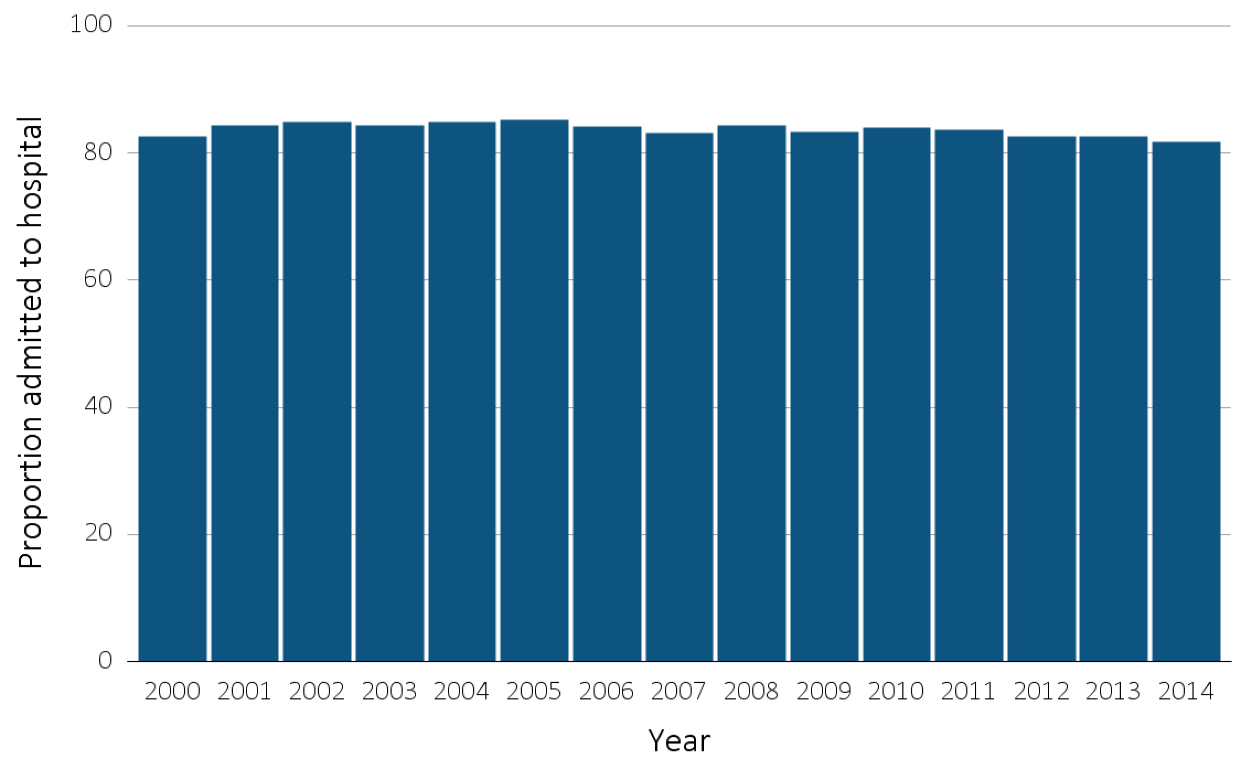
vol 2 Figure 12.1 Hospital admission during the last 90 days of life among Medicare beneficiaries with ESRD, 2000-2014
Data Source: Special analyses, USRDS ESRD Database. Denominator is all decedents with Medicare Parts A and B throughout the last 90 days of life. Includes hospital stays in both short- and long-stay hospitals. Abbreviation: ESRD, end-stage renal disease.

Slide 4
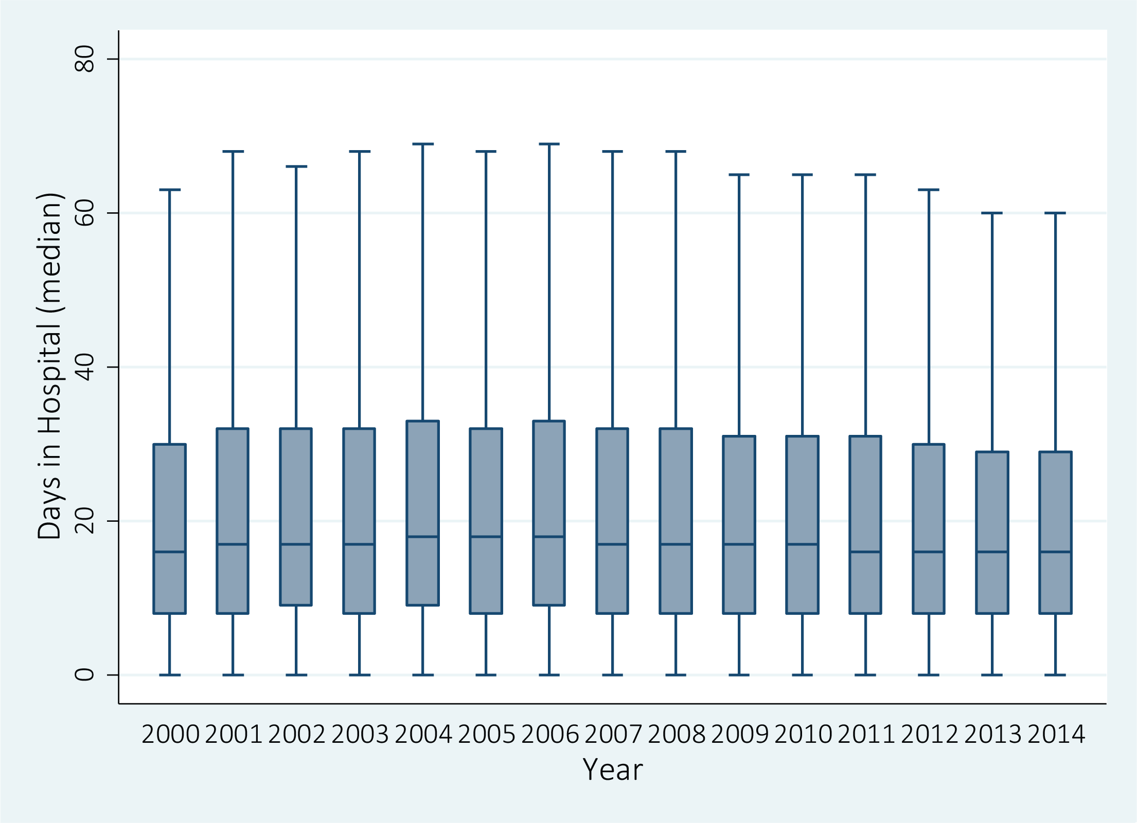
vol 2 Figure 12.2 Days spent in the hospital during the last 90 days of life among Medicare beneficiaries with ESRD, 2000-2014
Data Source: Special Analyses, USRDS ESRD Database. Denominator is all decedents with Medicare Parts A and B throughout the last 90 days of life who were admitted to the hospital at least once. Includes hospital stays in both short- and long-stay hospitals. Explanation of box plot: The lower border of the box is the first quartile and the upper border is the third quartile of the distribution, the length of the box is the interquartile range and the line in the middle of the box is the median value. The whiskers (vertical lines above and below each box) extend from the lowest value of the distribution that is ≥ the first quartile minus 1.5 times the interquartile range at the bottom to the highest value of the distribution that is ≤ the third quartile plus 1.5 times the interquartile range at the top. Values outside this range (outliers) are not plotted. Abbreviation: ESRD, end-stage renal disease.

Slide 5
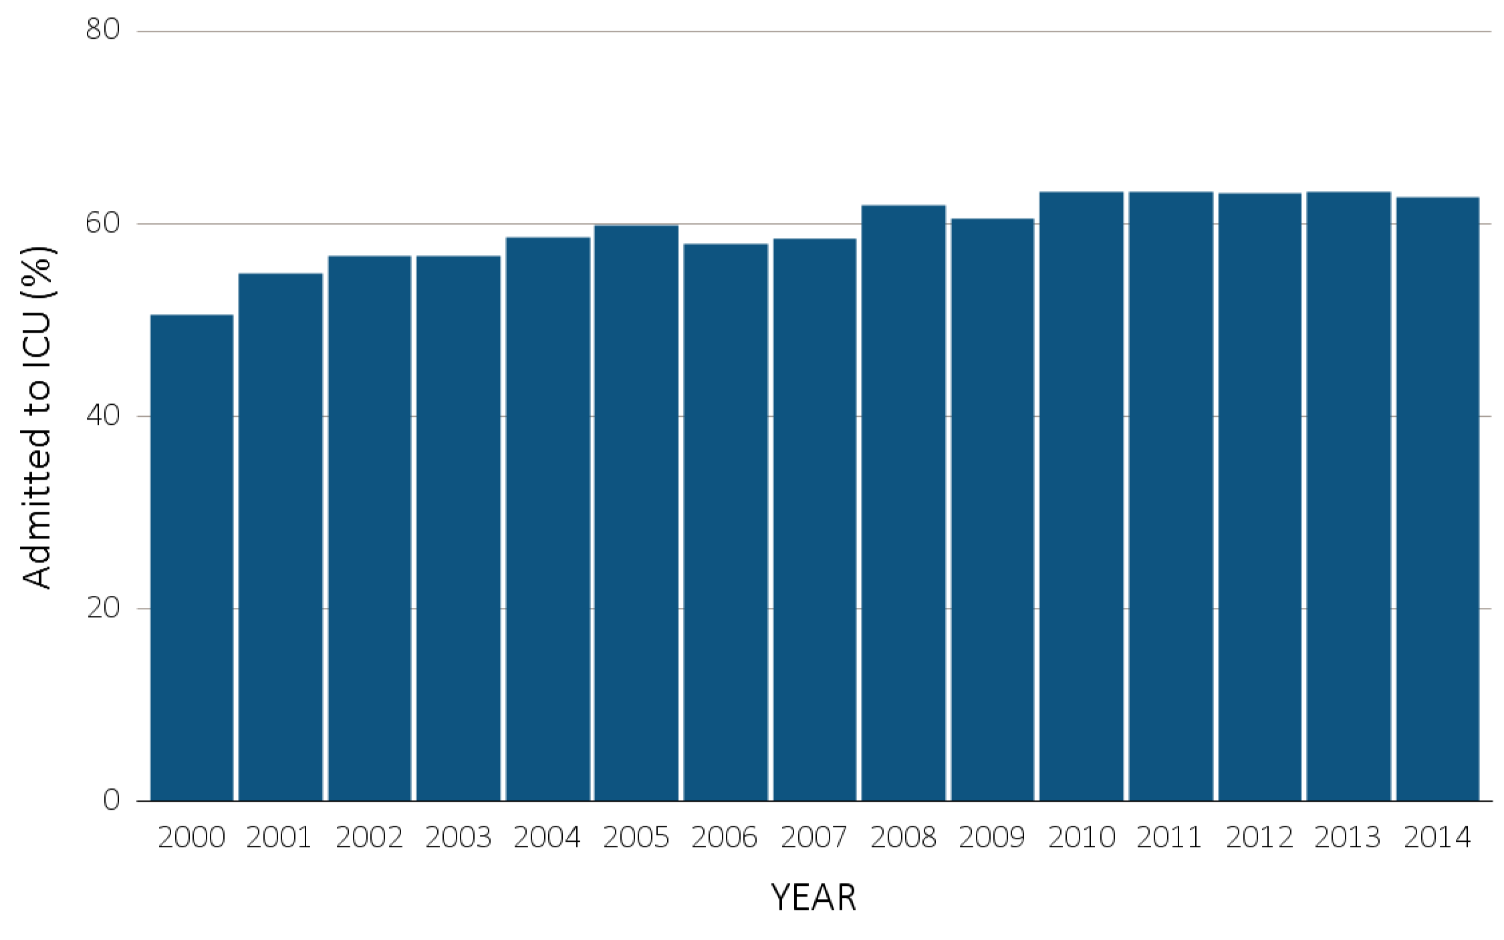
vol 2 Figure 12.3 ICU admission during the last 90 days of life among Medicare beneficiaries with ESRD overall, and by age, race, ethnicity, sex, and modality, 2000-2014
(a) ICU admission by year, overall
Data Source: Special Analyses, USRDS ESRD Database. Denominator is all decedents with Medicare Parts A and B throughout the last 90 days of life. ICU admission was identified using ICU revenue center codes in Medicare Institutional claims. Abbreviations: ESRD, end-stage renal disease; ICU, Intensive care unit.

Slide 6
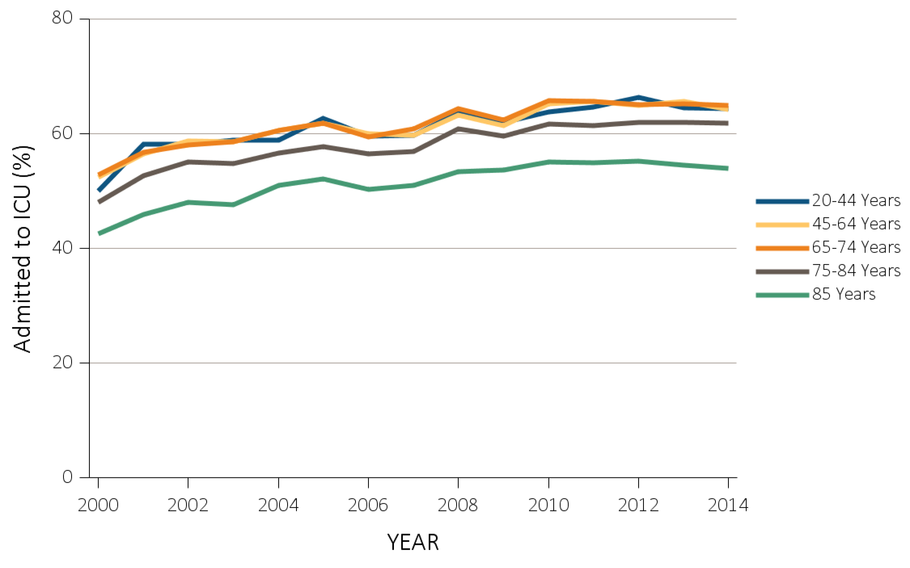
vol 2 Figure 12.3 ICU admission during the last 90 days of life among Medicare beneficiaries with ESRD overall, and by age, race, ethnicity, sex, and modality, 2000-2014
(b) ICU admission by age
Data Source: Special Analyses, USRDS ESRD Database. Denominator is all decedents with Medicare Parts A and B throughout the last 90 days of life. ICU admission was identified using ICU revenue center codes in Medicare Institutional claims. Abbreviations: ESRD, end-stage renal disease; ICU, Intensive care unit.

Slide 7
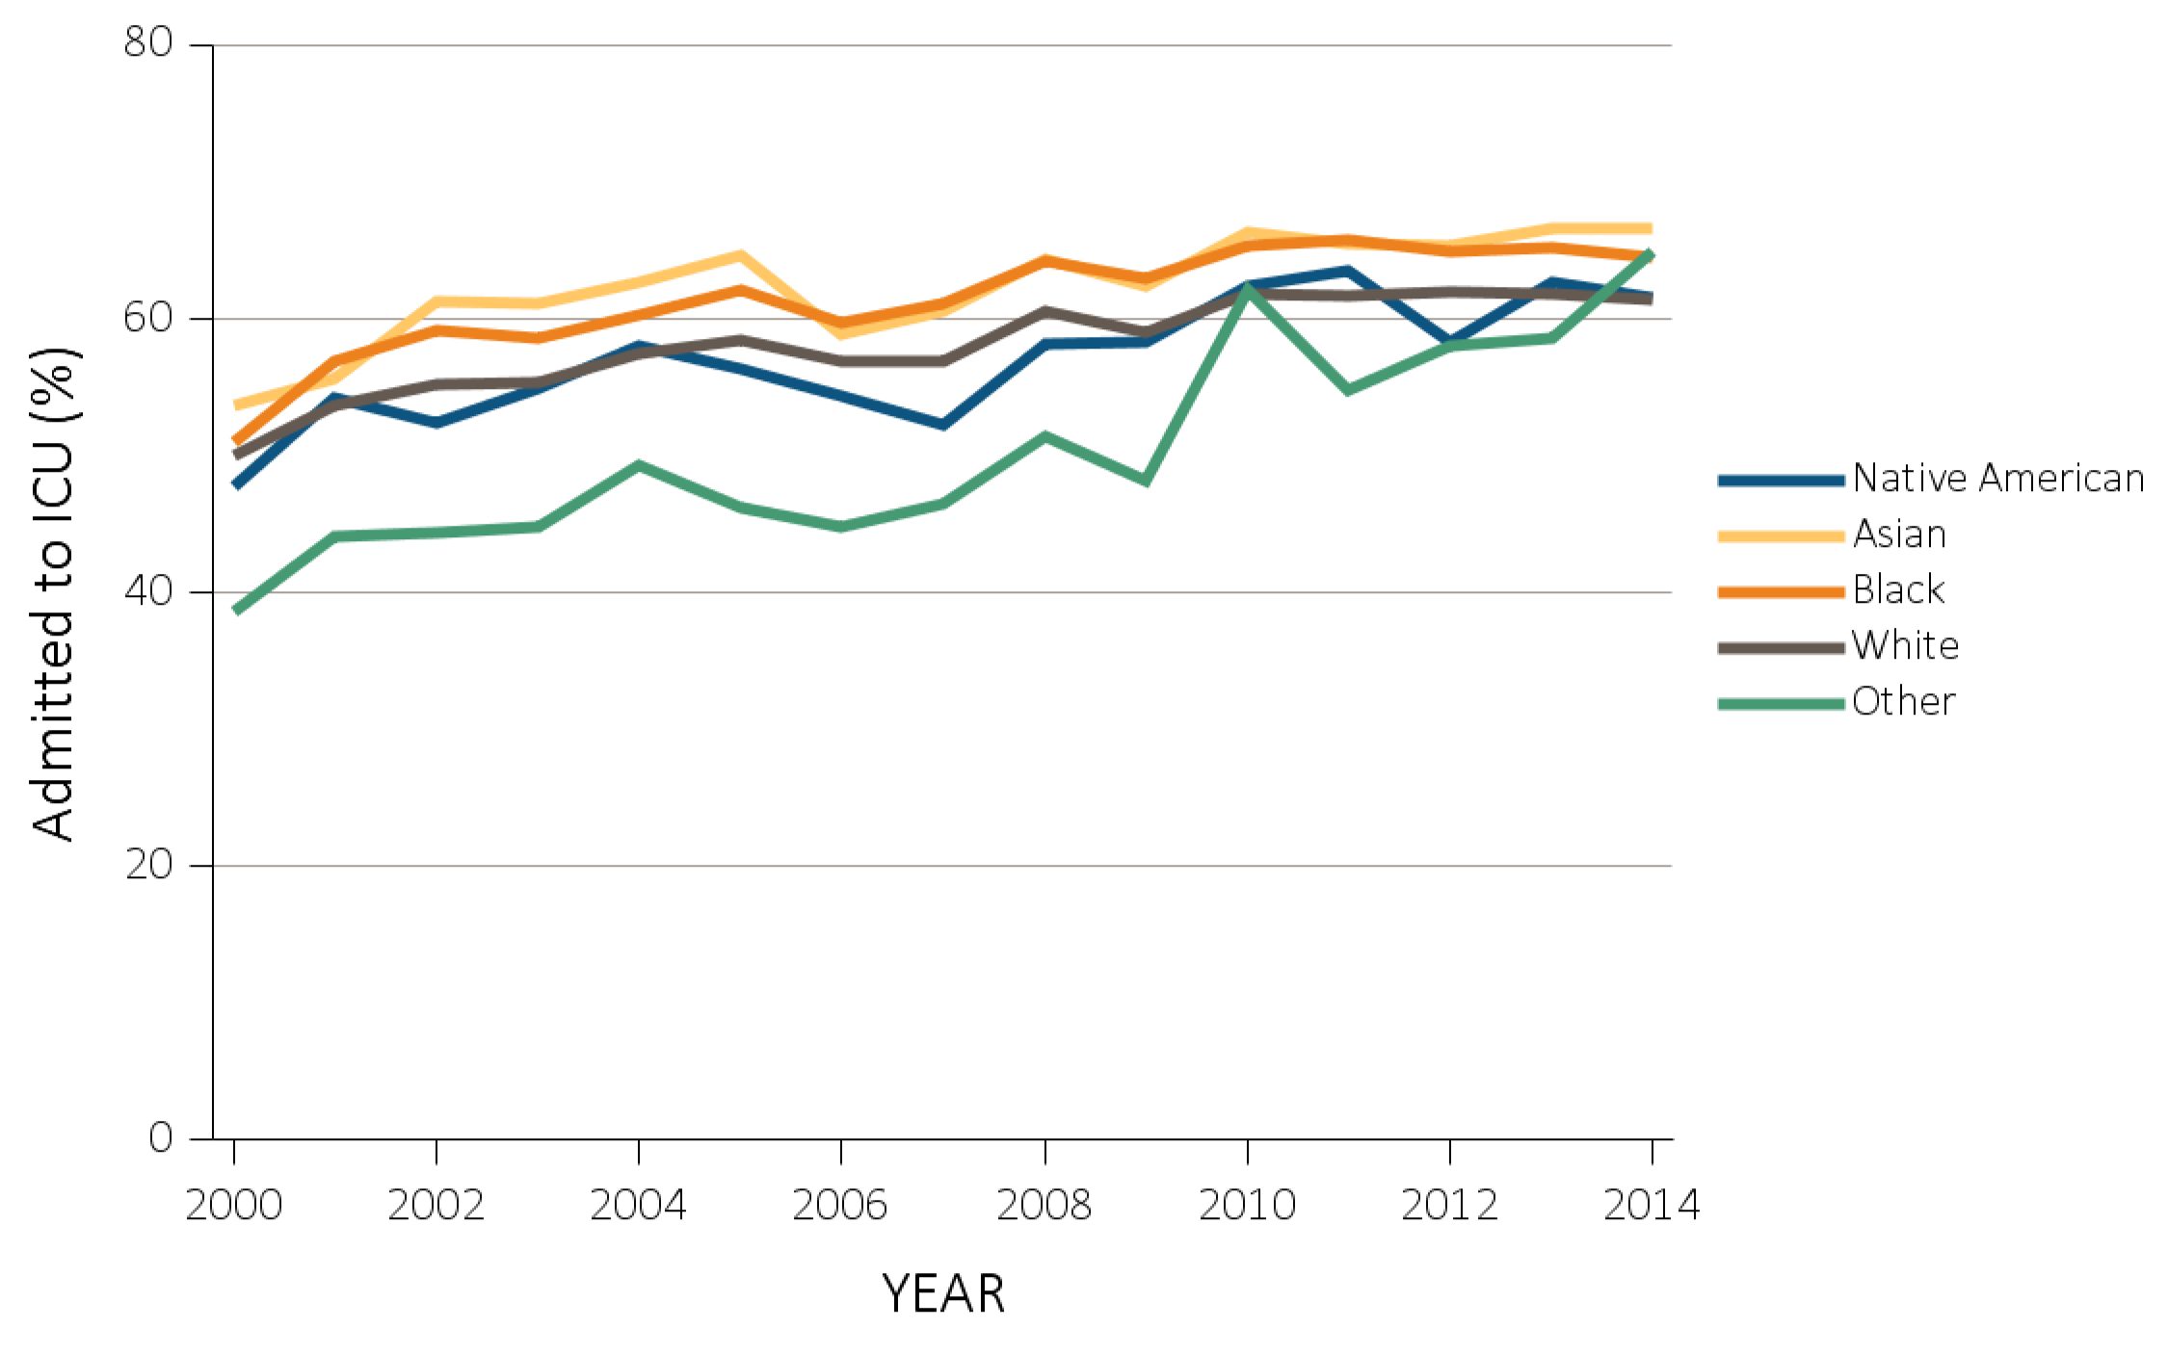
vol 2 Figure 12.3 ICU admission during the last 90 days of life among Medicare beneficiaries with ESRD overall, and by age, race, ethnicity, sex, and modality, 2000-2014
(c) ICU admission by race
Data Source: Special Analyses, USRDS ESRD Database. Denominator is all decedents with Medicare Parts A and B throughout the last 90 days of life. ICU admission was identified using ICU revenue center codes in Medicare Institutional claims. Abbreviations: ESRD, end-stage renal disease; ICU, Intensive care unit.

Slide 8
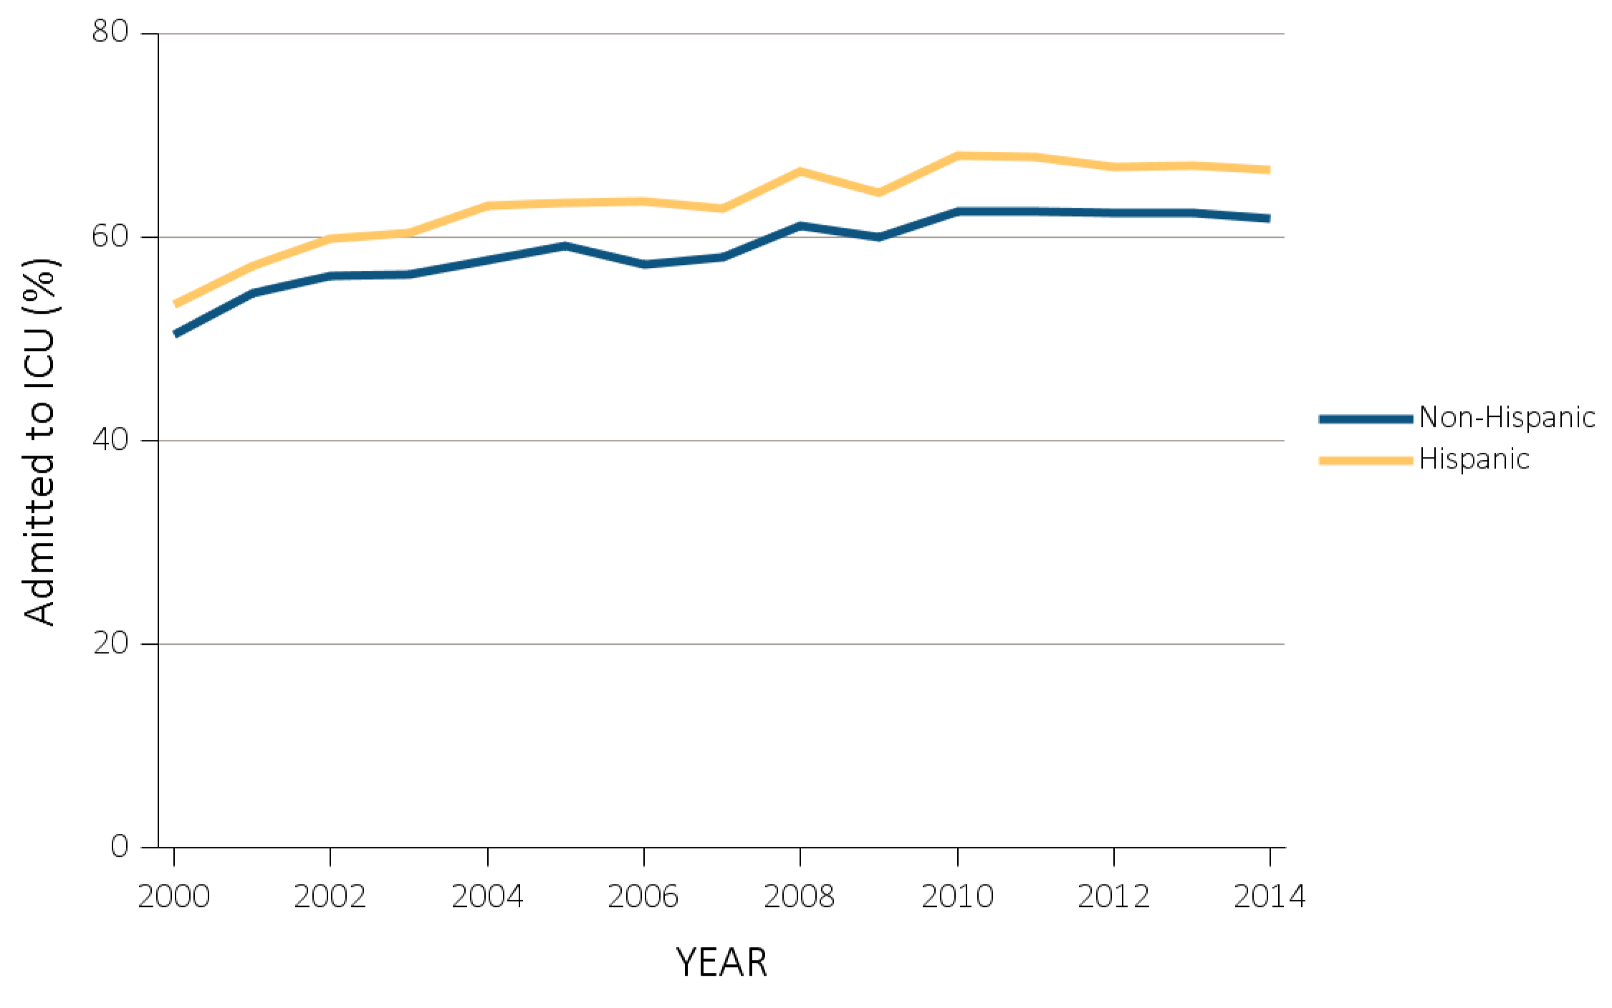
vol 2 Figure 12.3 ICU admission during the last 90 days of life among Medicare beneficiaries with ESRD overall, and by age, race, ethnicity, sex, and modality, 2000-2014
(d) ICU admission by ethnicity
Data Source: Special Analyses, USRDS ESRD Database. Denominator is all decedents with Medicare Parts A and B throughout the last 90 days of life. ICU admission was identified using ICU revenue center codes in Medicare Institutional claims. Abbreviations: ESRD, end-stage renal disease; ICU, Intensive care unit.

Slide 9
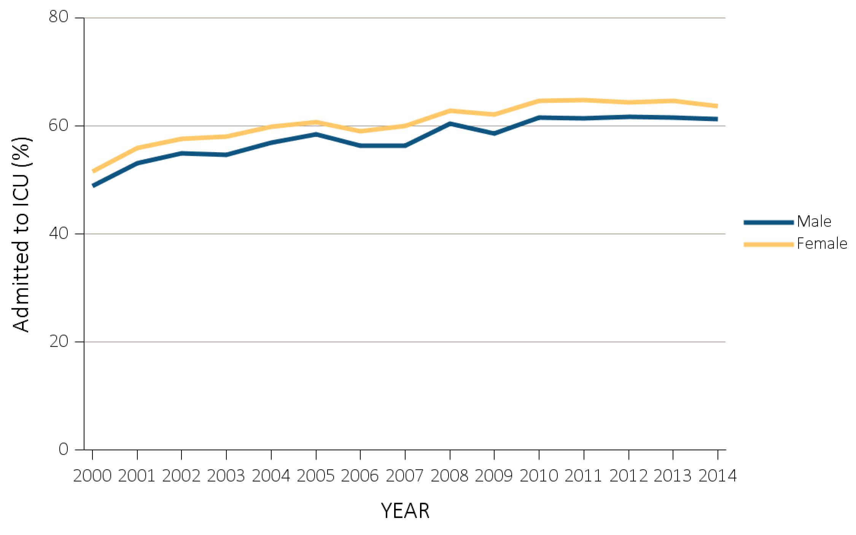
vol 2 Figure 12.3 ICU admission during the last 90 days of life among Medicare beneficiaries with ESRD overall, and by age, race, ethnicity, sex, and modality, 2000-2014
(e) ICU admission by sex
Data Source: Special Analyses, USRDS ESRD Database. Denominator is all decedents with Medicare Parts A and B throughout the last 90 days of life. ICU admission was identified using ICU revenue center codes in Medicare Institutional claims. Abbreviations: ESRD, end-stage renal disease; ICU, Intensive care unit.

Slide 10
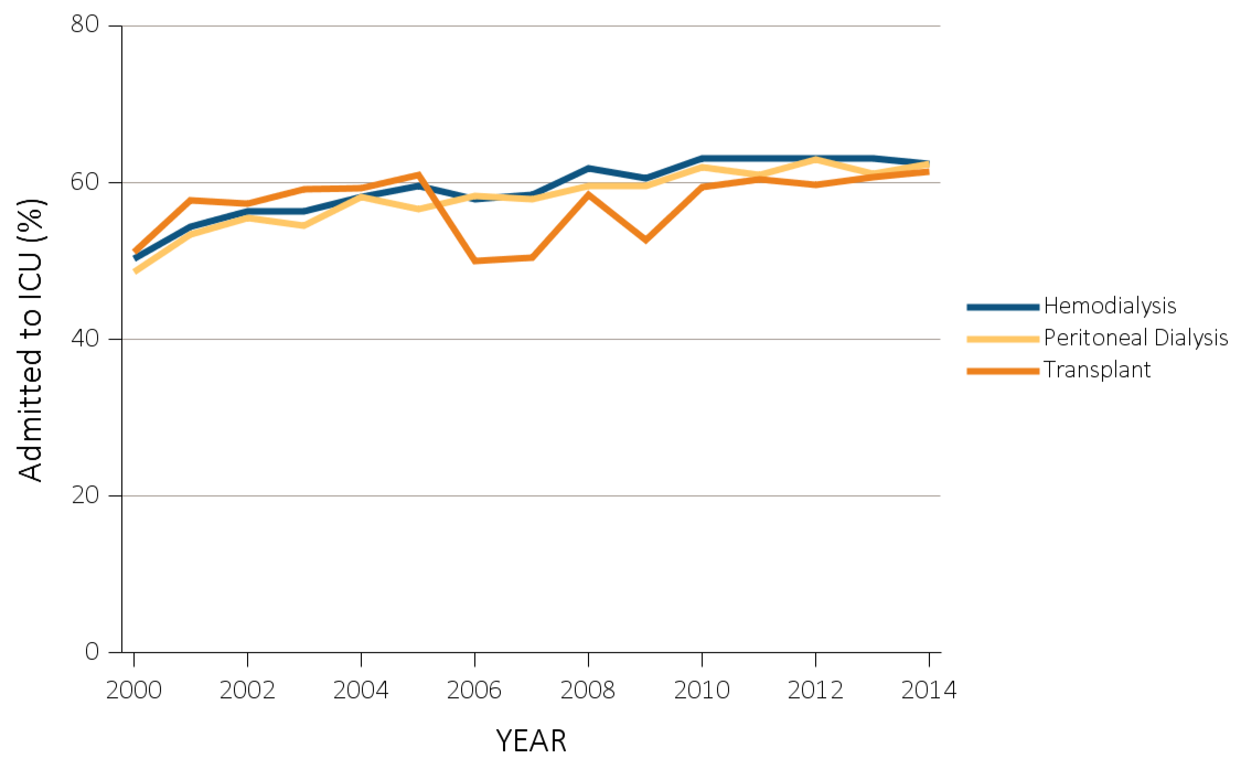
vol 2 Figure 12.3 ICU admission during the last 90 days of life among Medicare beneficiaries with ESRD overall, and by age, race, ethnicity, sex, and modality, 2000-2014
(f) ICU admission by modality
Data Source: Special Analyses, USRDS ESRD Database. Denominator is all decedents with Medicare Parts A and B throughout the last 90 days of life. ICU admission was identified using ICU revenue center codes in Medicare Institutional claims. Abbreviations: ESRD, end-stage renal disease; ICU, Intensive care unit.

Slide 11
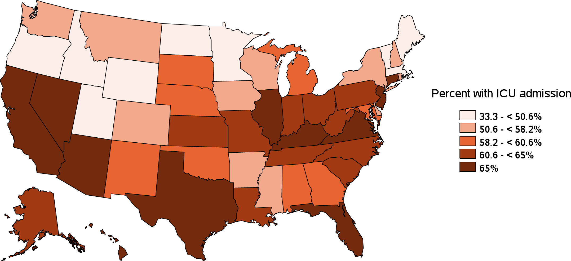
vol 2 Figure 12.3 ICU admission during the last 90 days of life among Medicare beneficiaries with ESRD overall, and by age, race, ethnicity, sex, and modality, 2000-2014
(g) ICU admission by state
Data Source: Special Analyses, USRDS ESRD Database. Denominator is all decedents with Medicare Parts A and B throughout the last 90 days of life. ICU admission was identified using ICU revenue center codes in Medicare Institutional claims. Abbreviations: ESRD, end-stage renal disease; ICU, Intensive care unit.

Slide 12
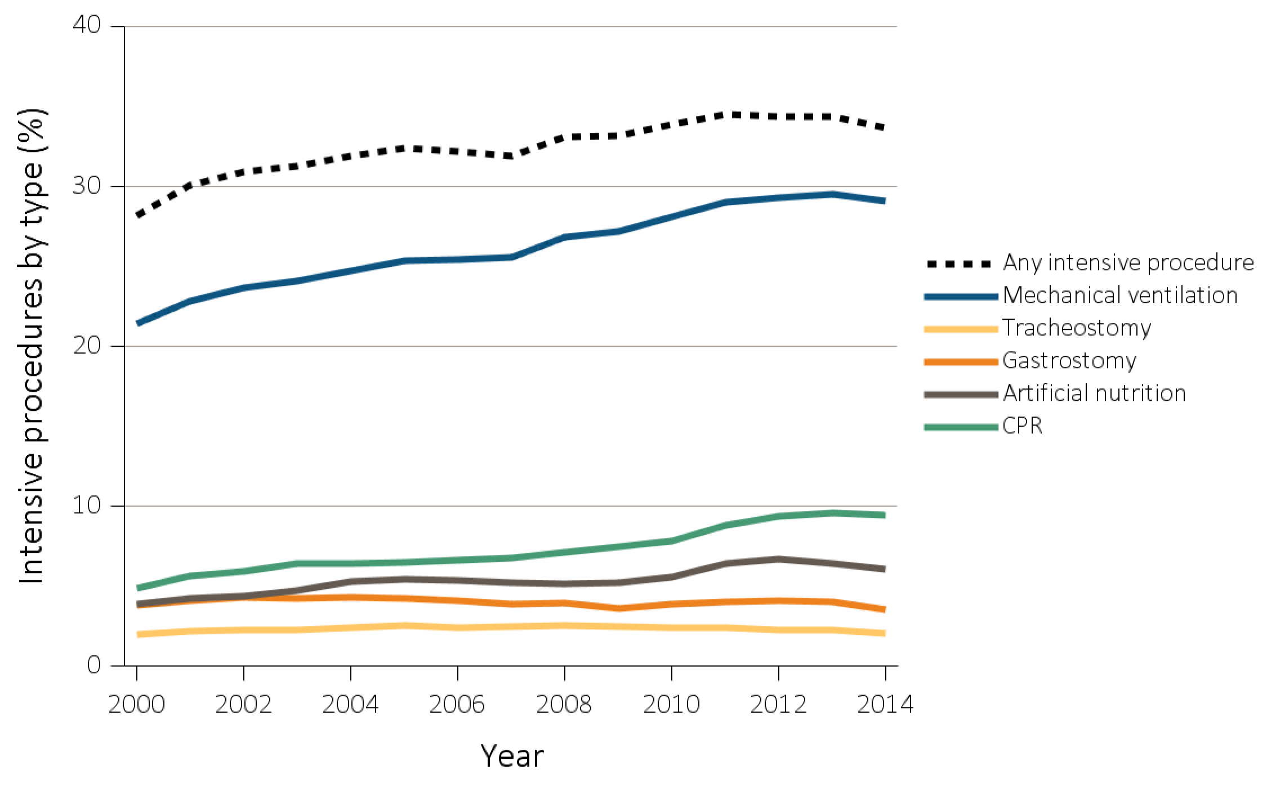
vol 2 Figure 12.4 Intensive procedures during the last 90 days of life among Medicare beneficiaries with ESRD overall, and by age, race, ethnicity, sex, and modality, 2000-2014
(a) Intensive procedures by sub-type and year, overall
Data Source: Special analyses, USRDS ESRD Database. Denominator population is all decedents with Medicare Parts A and B throughout the last 90 days of life. Intensive procedures were identified by ICD-9 procedure code search of Medicare Institutional claims from short- and long-stay hospitals. The yellow line in panel (a) denotes the percentage of patients who were intubated or received mechanical ventilation. Abbreviation: ESRD, end-stage renal disease.

Slide 13
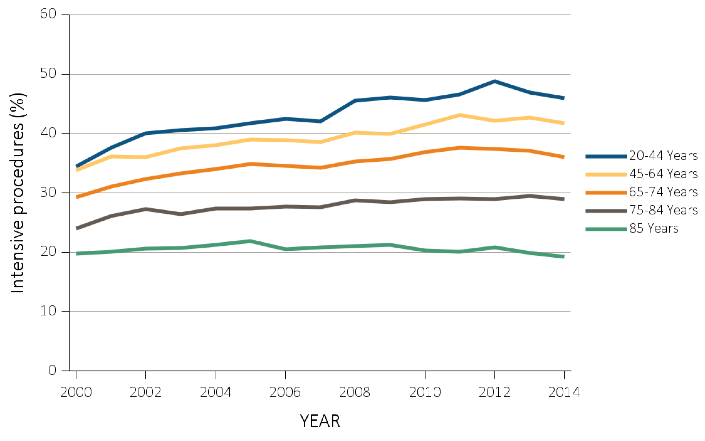
vol 2 Figure 12.4 Intensive procedures during the last 90 days of life among Medicare beneficiaries with ESRD overall, and by age, race, ethnicity, sex, and modality, 2000-2014
(b) Intensive procedures by age
Data Source: Special analyses, USRDS ESRD Database. Denominator population is all decedents with Medicare Parts A and B throughout the last 90 days of life. Intensive procedures were identified by ICD-9 procedure code search of Medicare Institutional claims from short- and long-stay hospitals. The yellow line in panel (a) denotes the percentage of patients who were intubated or received mechanical ventilation. Abbreviation: ESRD, end-stage renal disease.

Slide 14
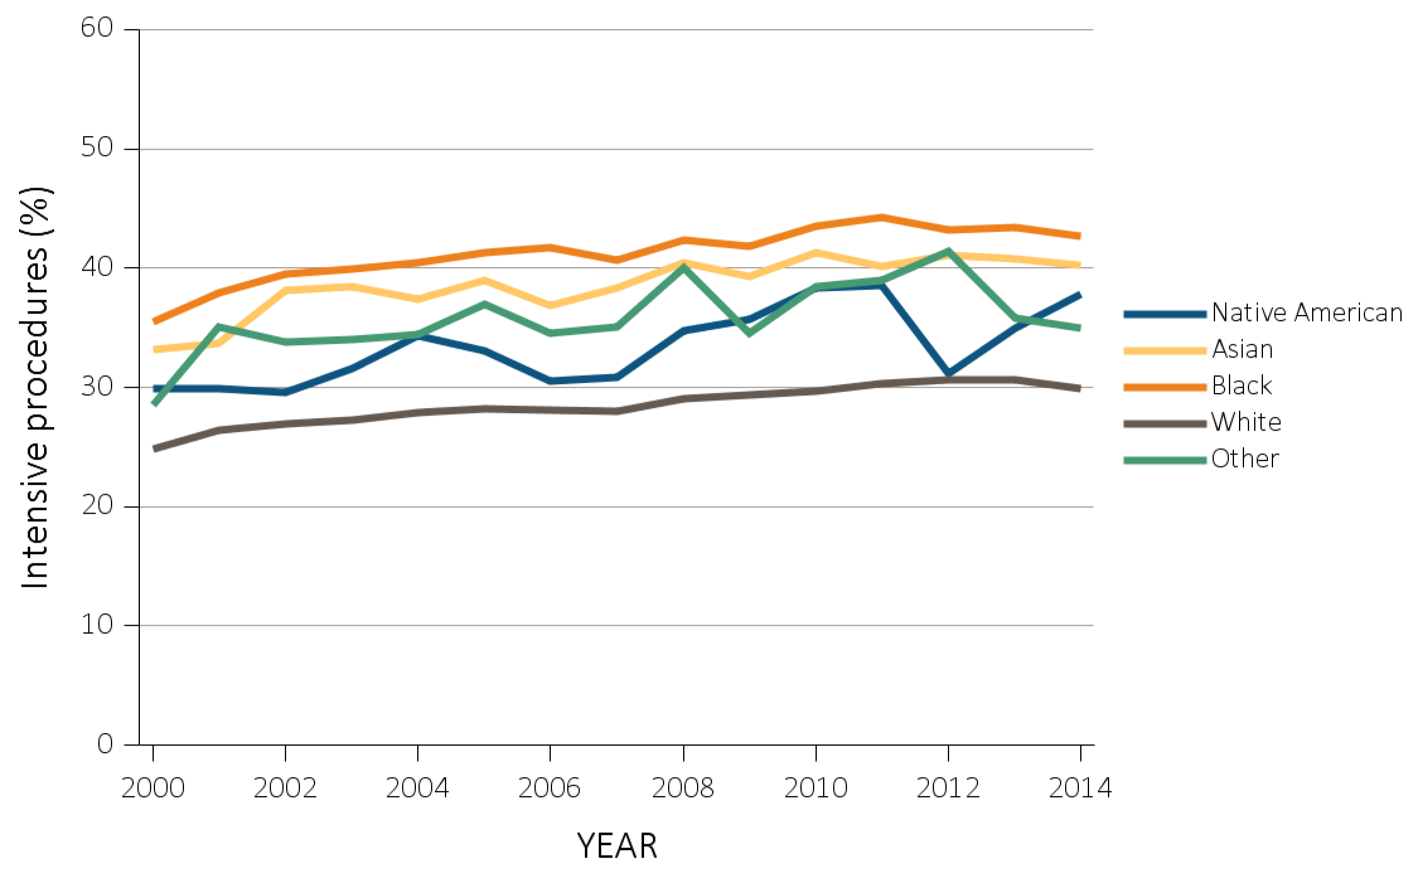
vol 2 Figure 12.4 Intensive procedures during the last 90 days of life among Medicare beneficiaries with ESRD overall, and by age, race, ethnicity, sex, and modality, 2000-2014
(c) Intensive procedures by race
Data Source: Special analyses, USRDS ESRD Database. Denominator population is all decedents with Medicare Parts A and B throughout the last 90 days of life. Intensive procedures were identified by ICD-9 procedure code search of Medicare Institutional claims from short- and long-stay hospitals. The yellow line in panel (a) denotes the percentage of patients who were intubated or received mechanical ventilation. Abbreviation: ESRD, end-stage renal disease.

Slide 15
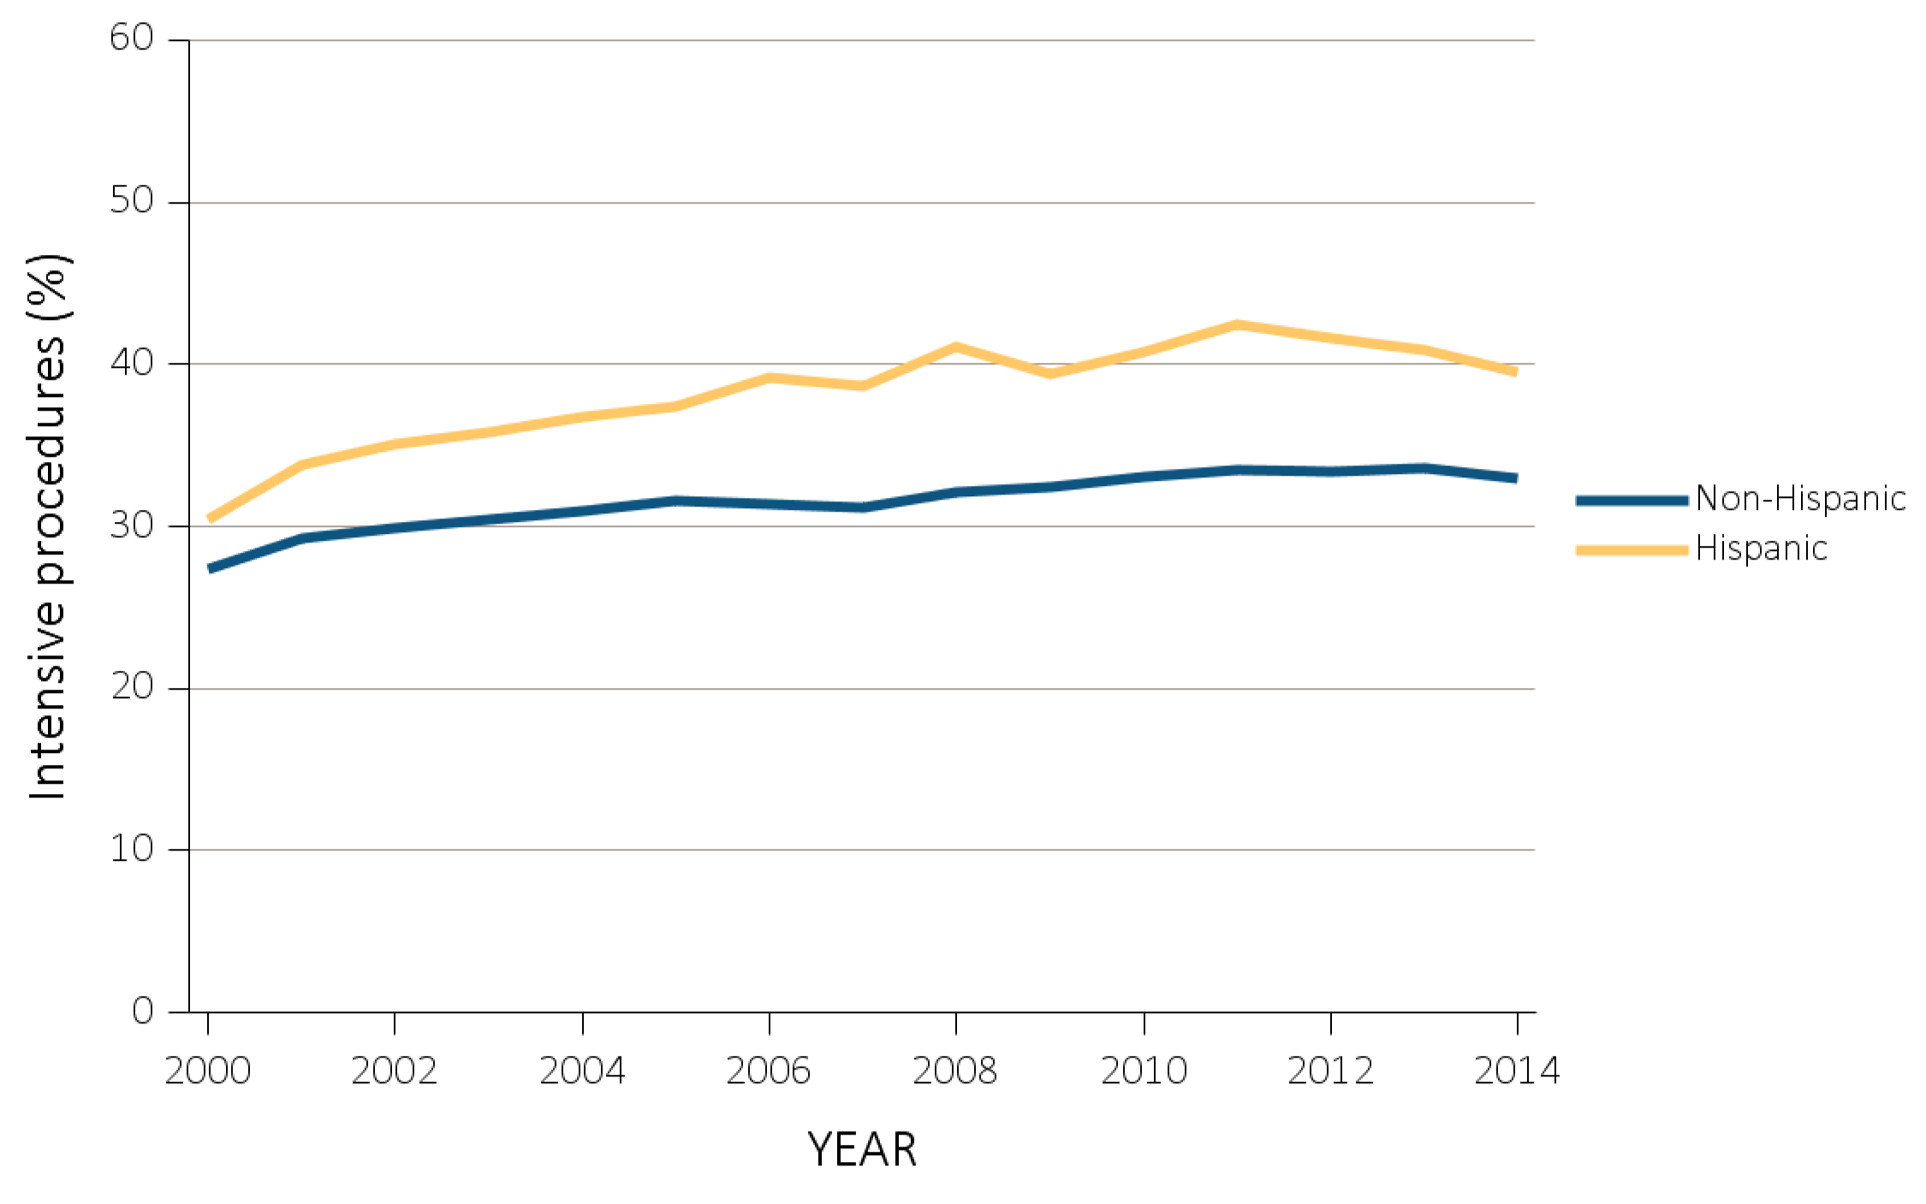
vol 2 Figure 12.4 Intensive procedures during the last 90 days of life among Medicare beneficiaries with ESRD overall, and by age, race, ethnicity, sex, and modality, 2000-2014
(d) Intensive procedures by ethnicity
Data Source: Special analyses, USRDS ESRD Database. Denominator population is all decedents with Medicare Parts A and B throughout the last 90 days of life. Intensive procedures were identified by ICD-9 procedure code search of Medicare Institutional claims from short- and long-stay hospitals. The yellow line in panel (a) denotes the percentage of patients who were intubated or received mechanical ventilation. Abbreviation: ESRD, end-stage renal disease.

Slide 16
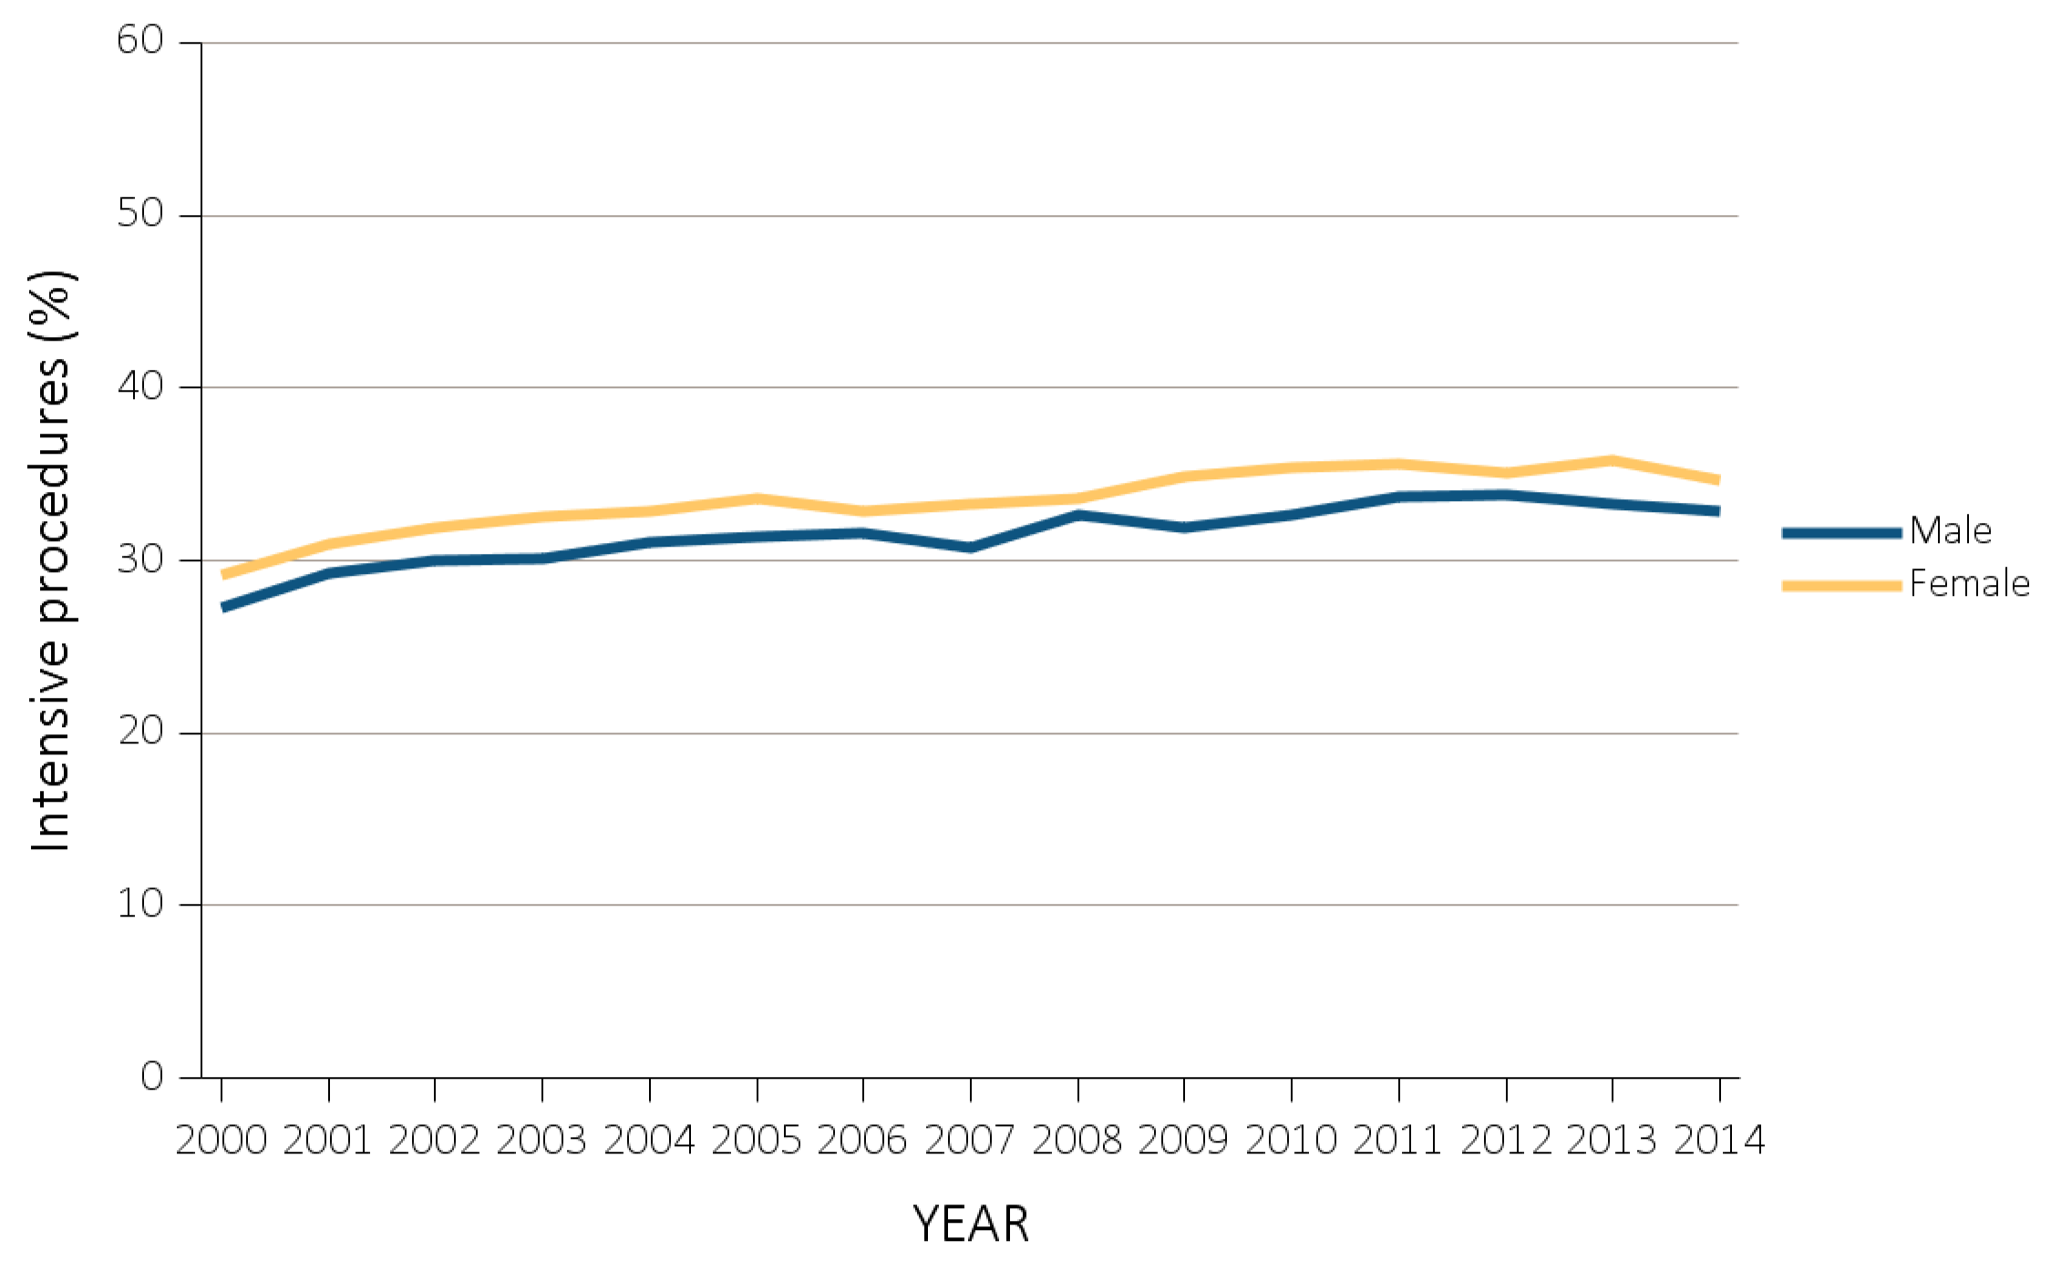
vol 2 Figure 12.4 Intensive procedures during the last 90 days of life among Medicare beneficiaries with ESRD overall, and by age, race, ethnicity, sex, and modality, 2000-2014
(e) Intensive procedures by sex
Data Source: Special analyses, USRDS ESRD Database. Denominator population is all decedents with Medicare Parts A and B throughout the last 90 days of life. Intensive procedures were identified by ICD-9 procedure code search of Medicare Institutional claims from short- and long-stay hospitals. The yellow line in panel (a) denotes the percentage of patients who were intubated or received mechanical ventilation. Abbreviation: ESRD, end-stage renal disease.

Slide 17
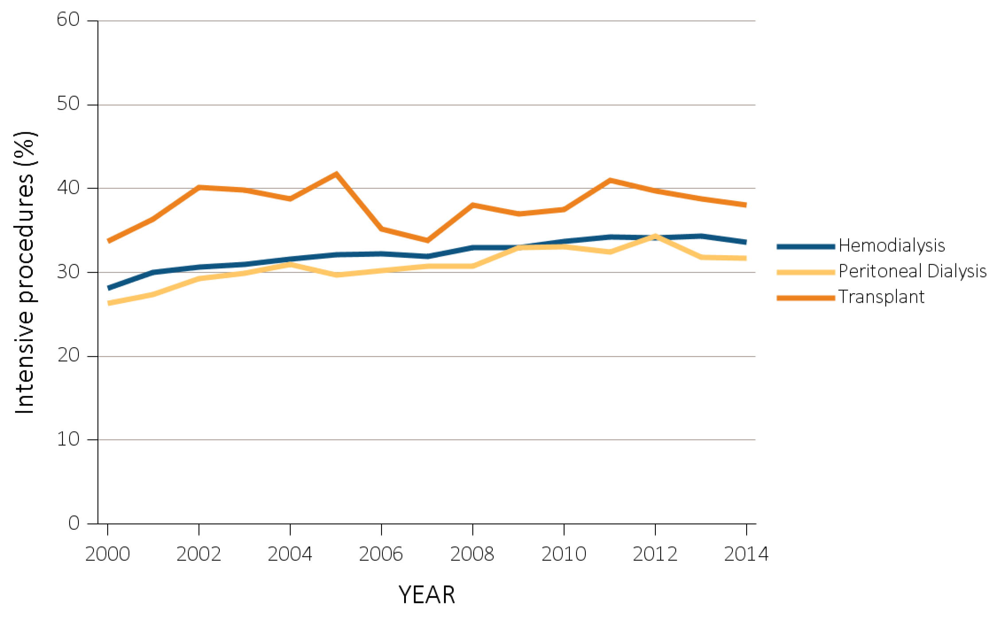
vol 2 Figure 12.4 Intensive procedures during the last 90 days of life among Medicare beneficiaries with ESRD overall, and by age, race, ethnicity, sex, and modality, 2000-2014
(f) Intensive procedures by modality
Data Source: Special analyses, USRDS ESRD Database. Denominator population is all decedents with Medicare Parts A and B throughout the last 90 days of life. Intensive procedures were identified by ICD-9 procedure code search of Medicare Institutional claims from short- and long-stay hospitals. The yellow line in panel (a) denotes the percentage of patients who were intubated or received mechanical ventilation. Abbreviation: ESRD, end-stage renal disease.

Slide 18
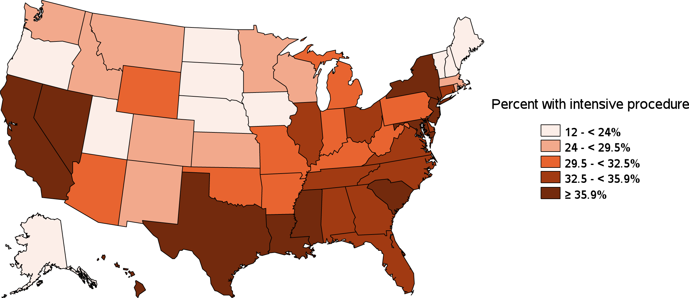
vol 2 Figure 12.4 Intensive procedures during the last 90 days of life among Medicare beneficiaries with ESRD overall, and by age, race, ethnicity, sex, and modality, 2000-2014
(g) Intensive procedures by state
Data Source: Special analyses, USRDS ESRD Database. Denominator population is all decedents with Medicare Parts A and B throughout the last 90 days of life. Intensive procedures were identified by ICD-9 procedure code search of Medicare Institutional claims from short- and long-stay hospitals. The yellow line in panel (a) denotes the percentage of patients who were intubated or received mechanical ventilation. Abbreviation: ESRD, end-stage renal disease.

Slide 19
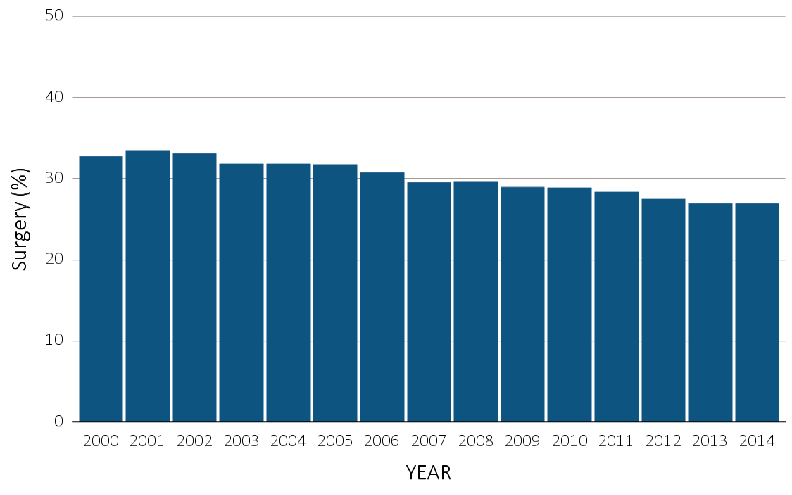
vol 2 Figure 12.5 Inpatient surgical procedures among Medicare beneficiaries with ESRD overall, and by age, race, ethnicity, sex, and modality, 2000-2014
(a) Inpatient surgical procedures by year, overall
Data Source: Special Analyses, USRDS ESRD Database. Denominator population is all decedents with Medicare Parts A and B throughout the last 90 days of life. Abbreviation: ESRD, end-stage renal disease.

Slide 20
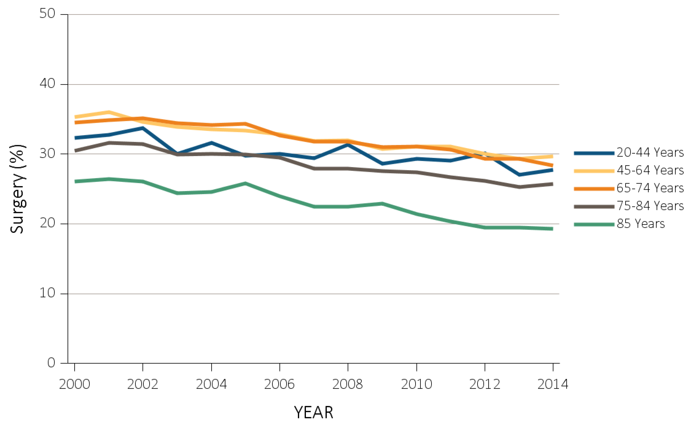
vol 2 Figure 12.5 Inpatient surgical procedures among Medicare beneficiaries with ESRD overall, and by age, race, ethnicity, sex, and modality, 2000-2014
(b) Inpatient surgical procedures by age
Data Source: Special Analyses, USRDS ESRD Database. Denominator population is all decedents with Medicare Parts A and B throughout the last 90 days of life. Abbreviation: ESRD, end-stage renal disease.

Slide 21
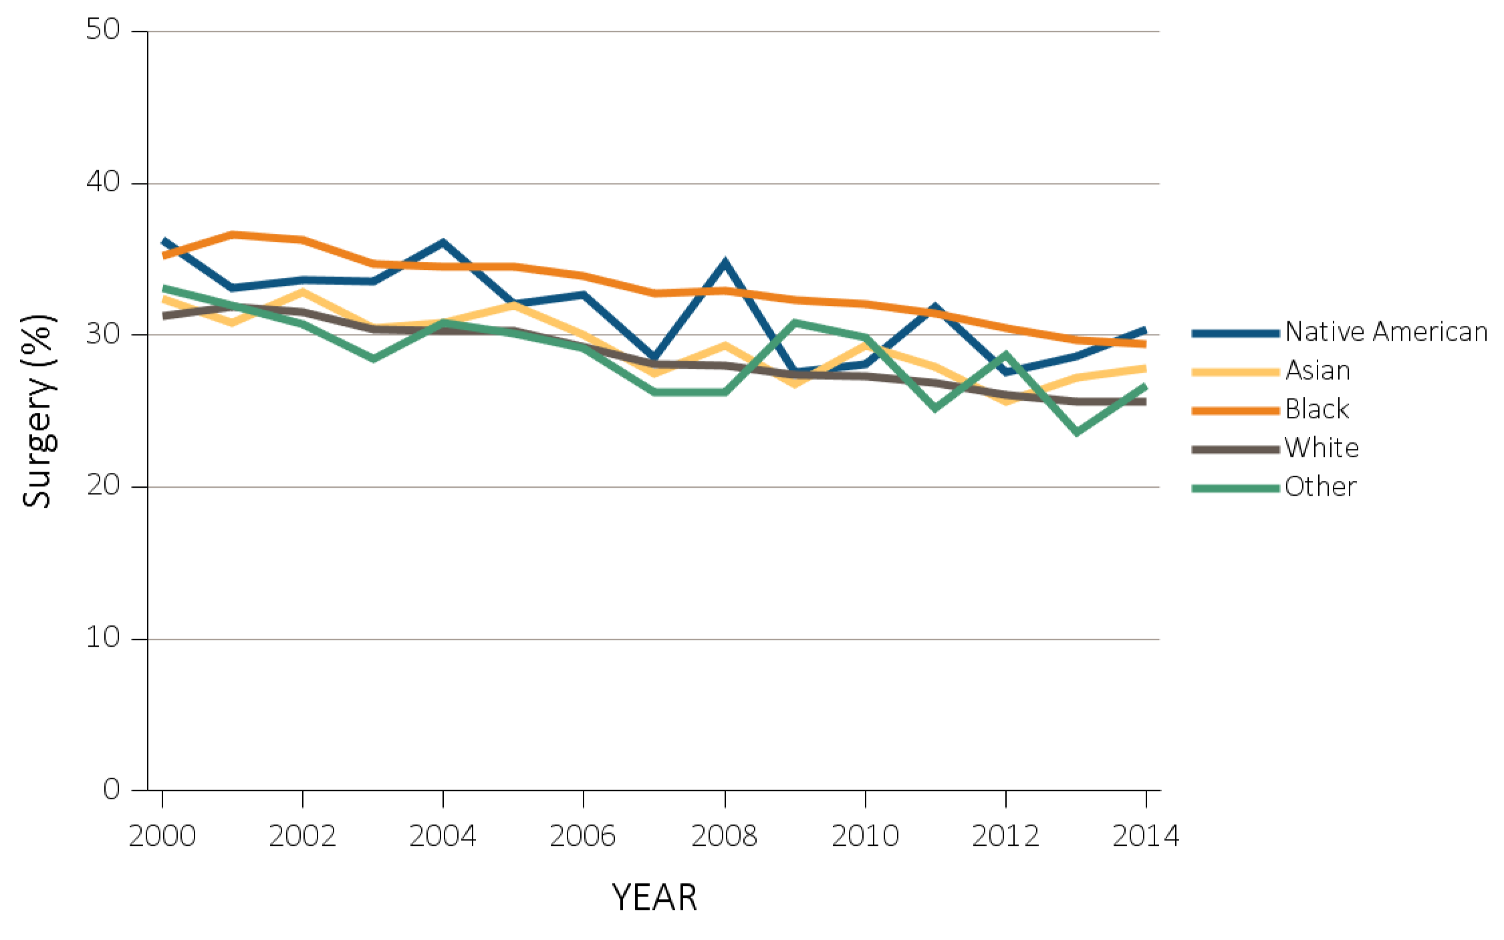
vol 2 Figure 12.5 Inpatient surgical procedures among Medicare beneficiaries with ESRD overall, and by age, race, ethnicity, sex, and modality, 2000-2014
(c) Inpatient surgical procedures by race
Data Source: Special Analyses, USRDS ESRD Database. Denominator population is all decedents with Medicare Parts A and B throughout the last 90 days of life. Abbreviation: ESRD, end-stage renal disease.

Slide 22
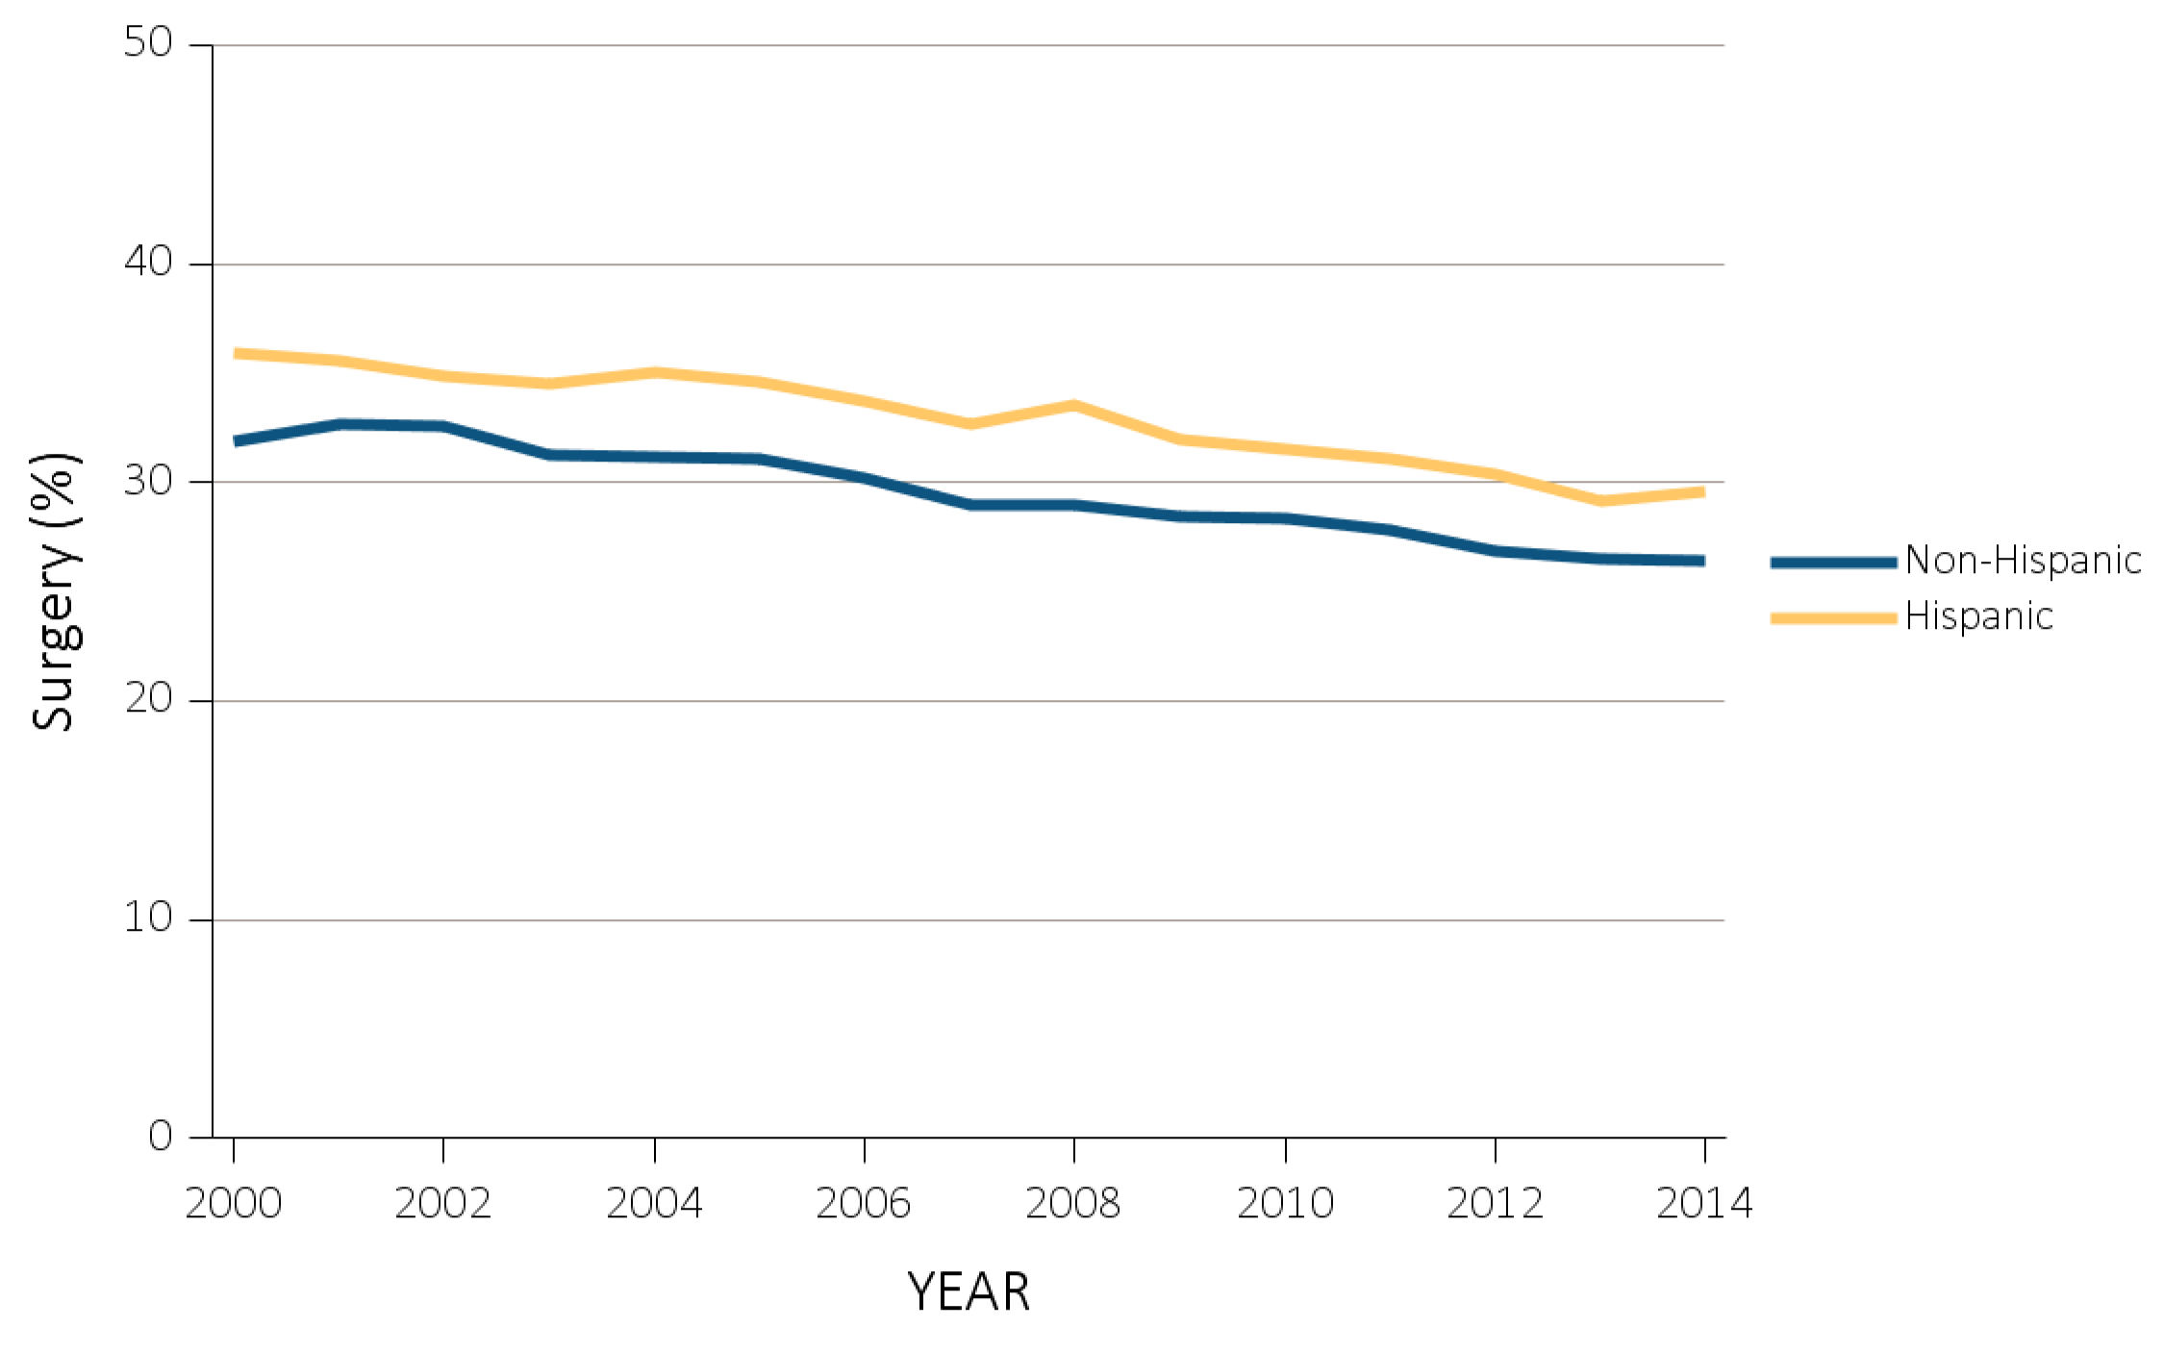
vol 2 Figure 12.5 Inpatient surgical procedures among Medicare beneficiaries with ESRD overall, and by age, race, ethnicity, sex, and modality, 2000-2014
(d) Inpatient surgical procedures by ethnicity
Data Source: Special Analyses, USRDS ESRD Database. Denominator population is all decedents with Medicare Parts A and B throughout the last 90 days of life. Abbreviation: ESRD, end-stage renal disease.

Slide 23
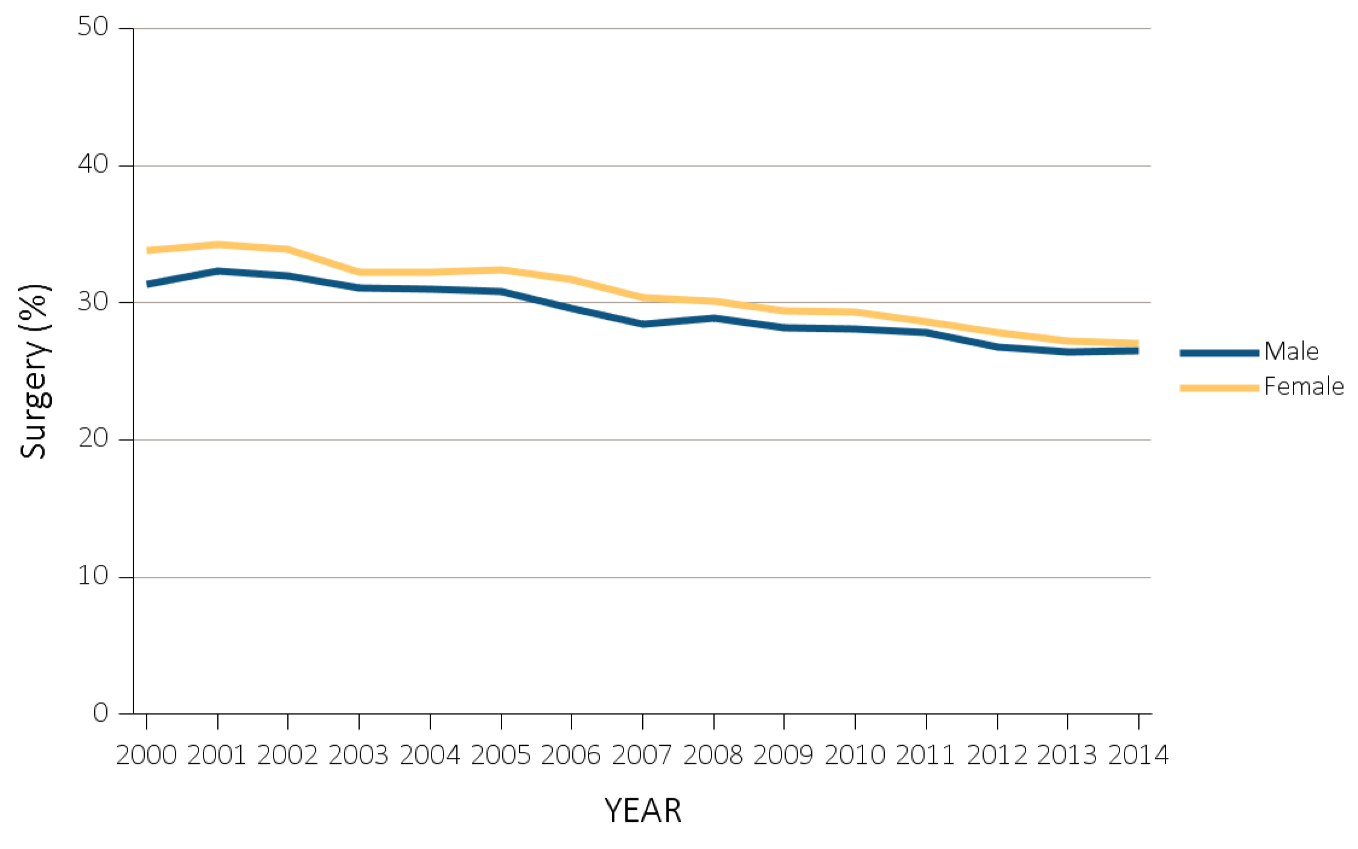
vol 2 Figure 12.5 Inpatient surgical procedures among Medicare beneficiaries with ESRD overall, and by age, race, ethnicity, sex, and modality, 2000-2014
(e) Inpatient surgical procedures by sex
Data Source: Special Analyses, USRDS ESRD Database. Denominator population is all decedents with Medicare Parts A and B throughout the last 90 days of life. Abbreviation: ESRD, end-stage renal disease.

Slide 24
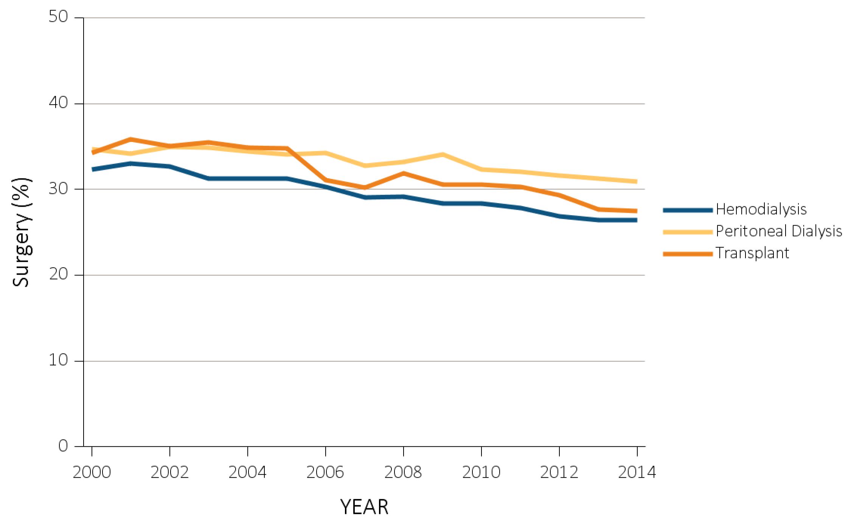
vol 2 Figure 12.5 Inpatient surgical procedures among Medicare beneficiaries with ESRD overall, and by age, race, ethnicity, sex, and modality, 2000-2014
Data Source: Special Analyses, USRDS ESRD Database. Denominator population is all decedents with Medicare Parts A and B throughout the last 90 days of life. Abbreviation: ESRD, end-stage renal disease.

Slide 25
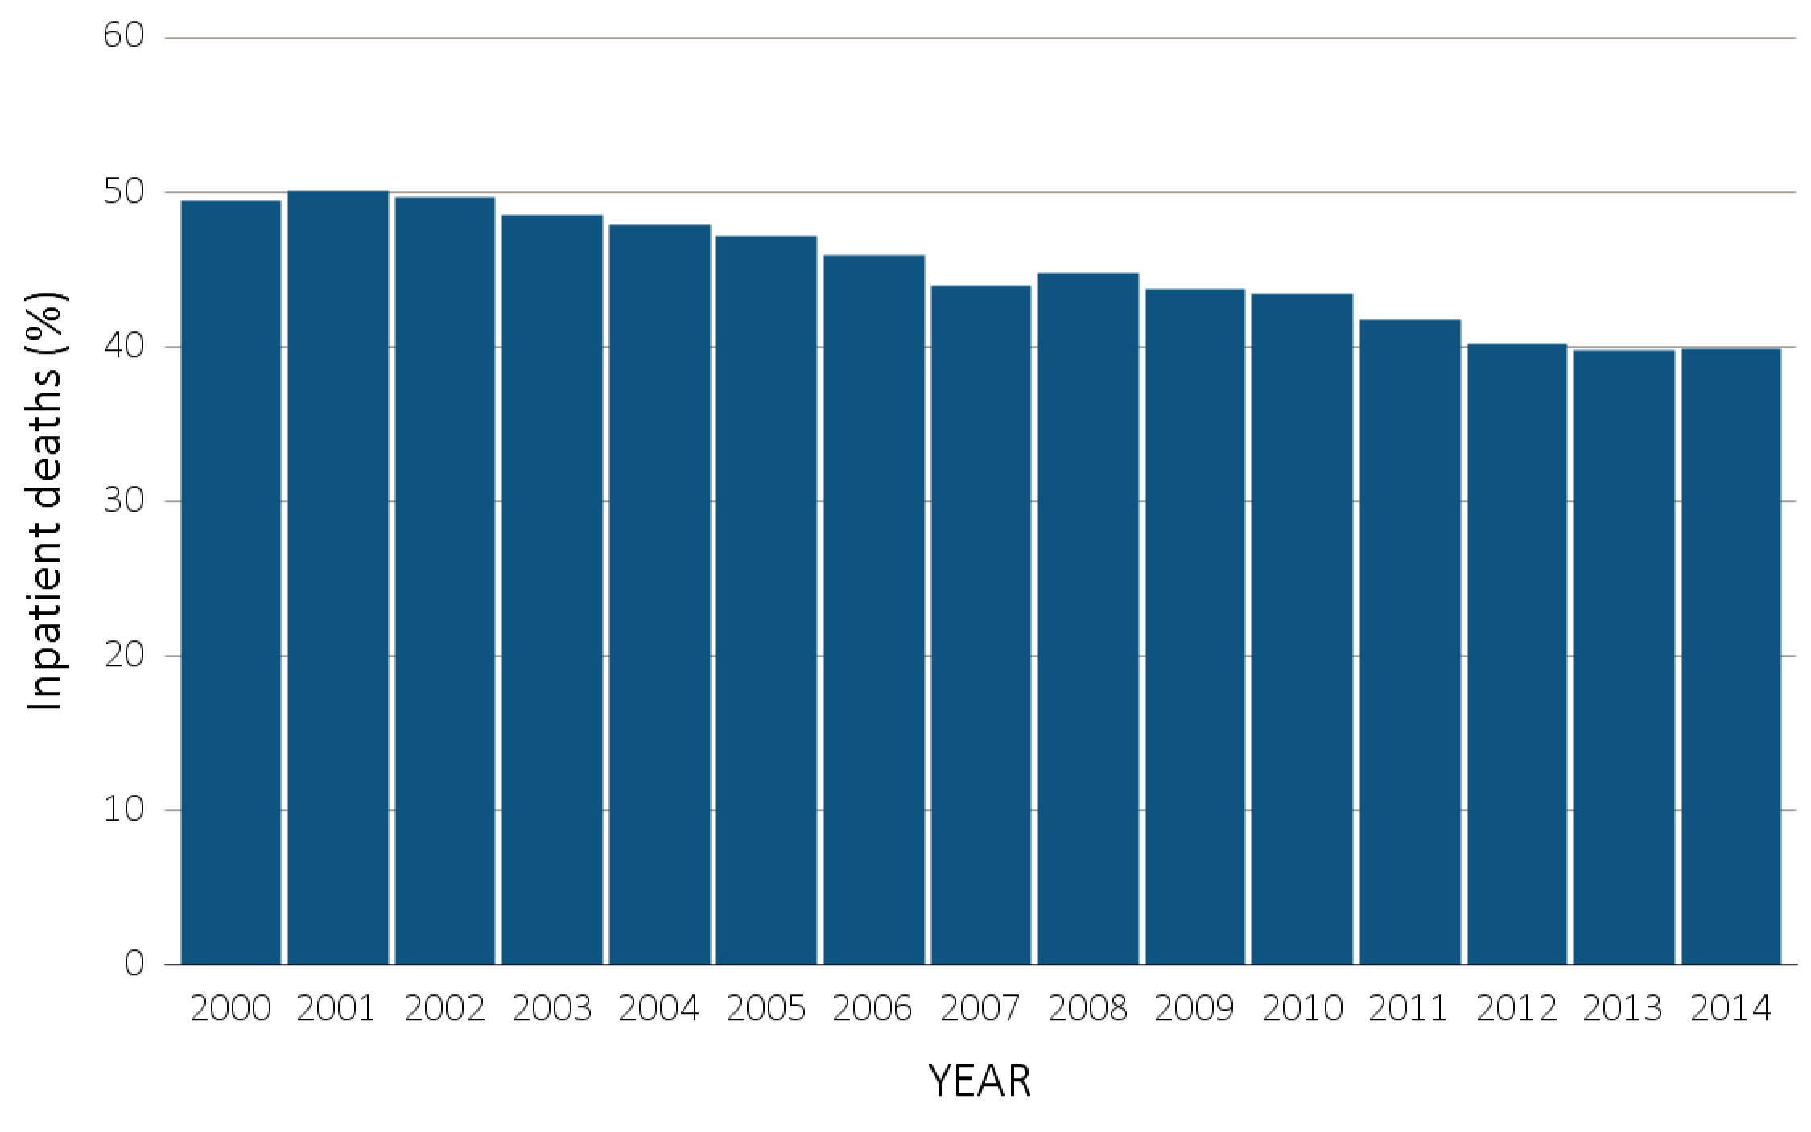
vol 2 Figure 12.6 Inpatient deaths among Medicare beneficiaries with ESRD overall, and by age, race, ethnicity, sex, and modality, 2000-2014
(a) Inpatient deaths by year, overall
Data Source: Special Analyses, USRDS ESRD Database. Denominator population is all decedents with Medicare Parts A and B throughout the last 90 days of life. Includes deaths occurring in short- and long-stay hospitals. Abbreviation: ESRD, end-stage renal disease.

Slide 26
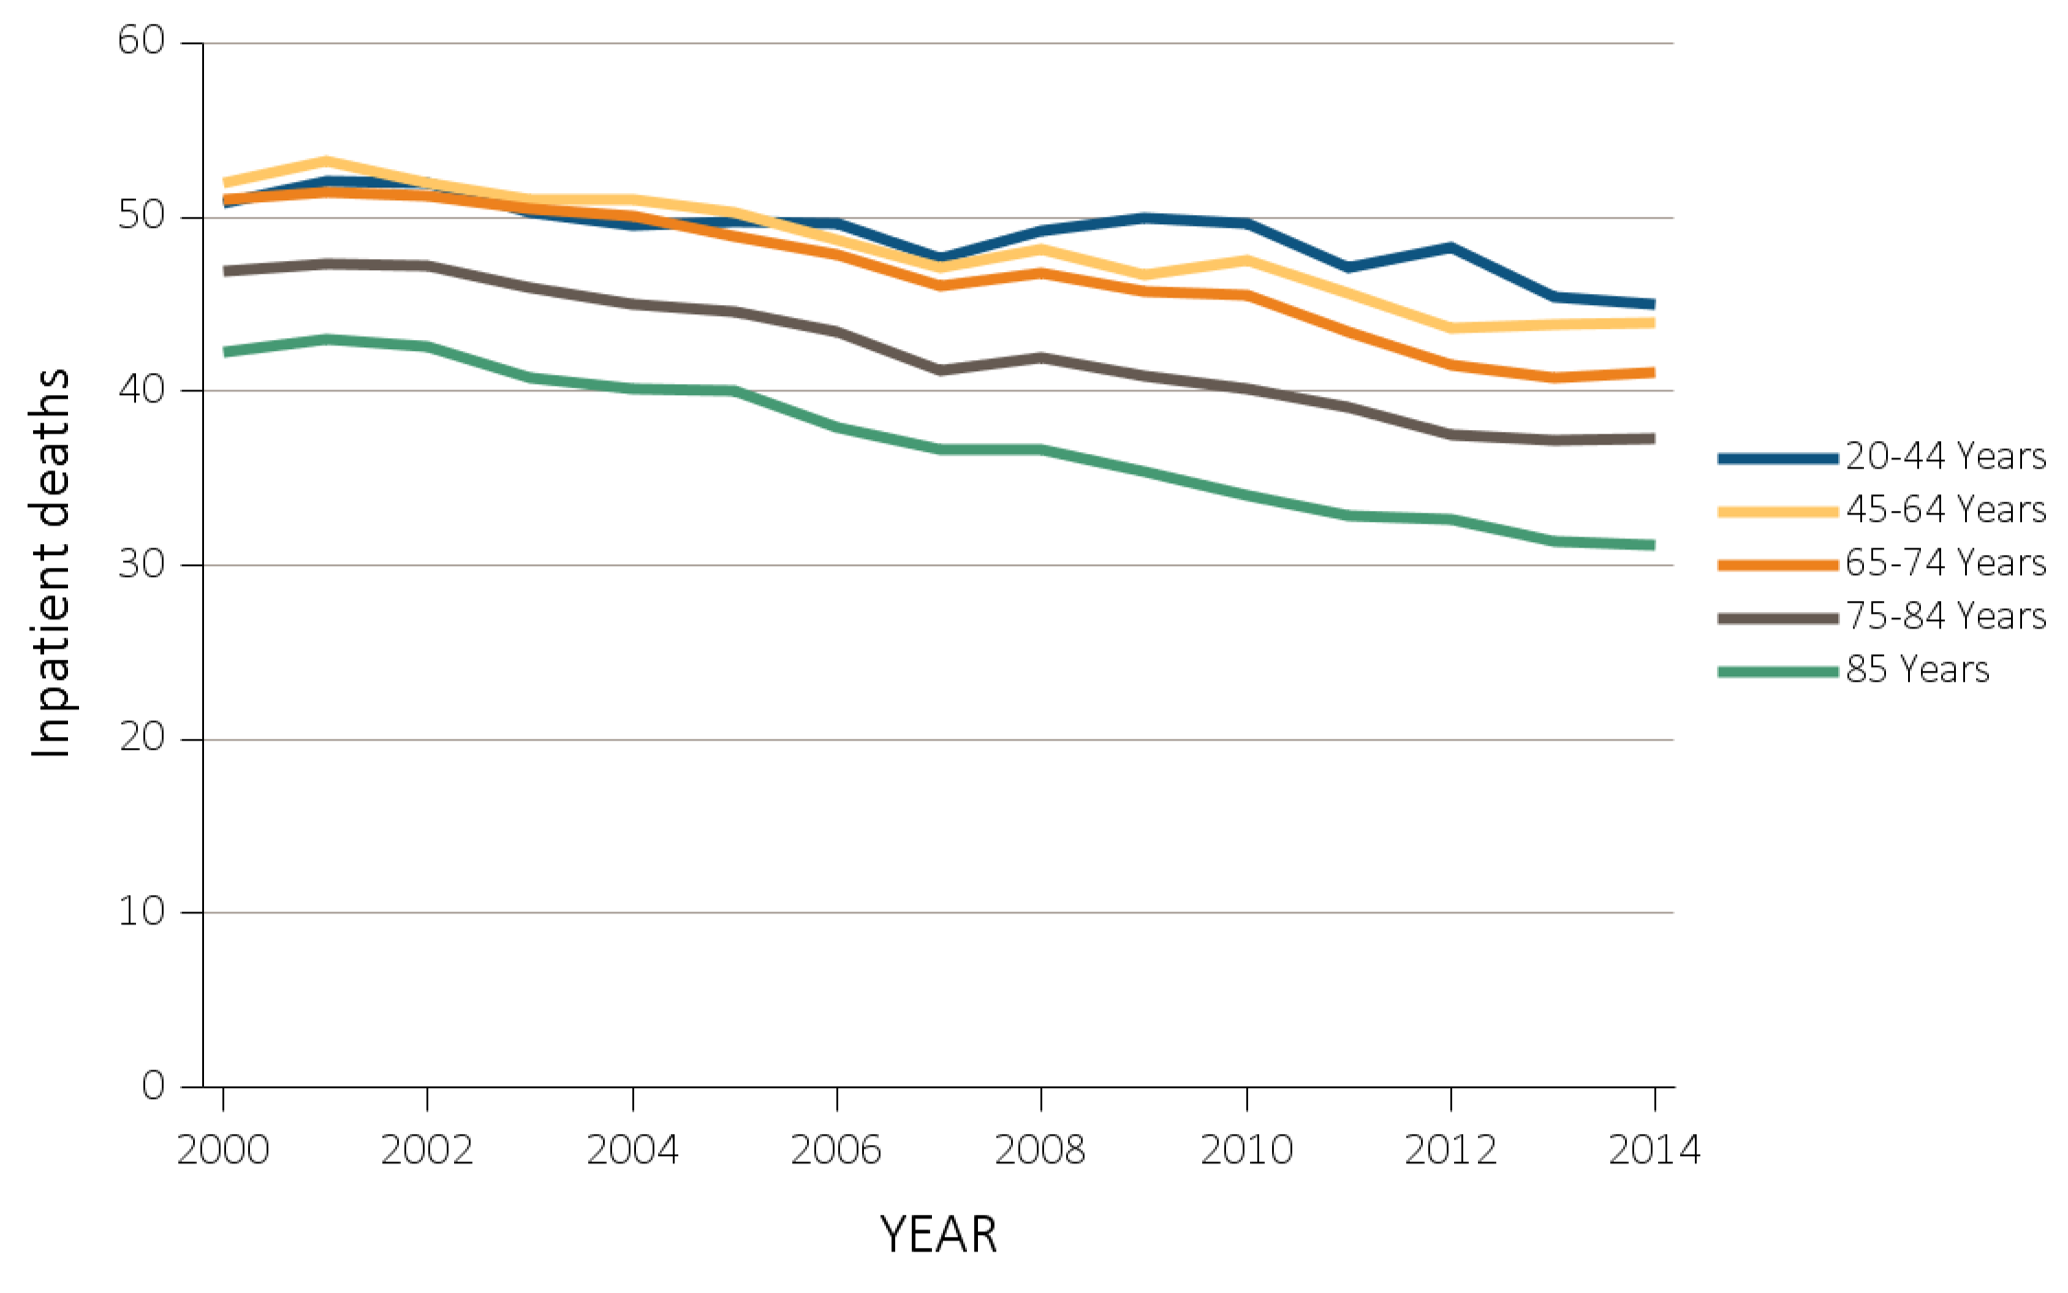
vol 2 Figure 12.6 Inpatient deaths among Medicare beneficiaries with ESRD overall, and by age, race, ethnicity, sex, and modality, 2000-2014
(b) Inpatient deaths by age
Data Source: Special Analyses, USRDS ESRD Database. Denominator population is all decedents with Medicare Parts A and B throughout the last 90 days of life. Includes deaths occurring in short- and long-stay hospitals. Abbreviation: ESRD, end-stage renal disease.

Slide 27
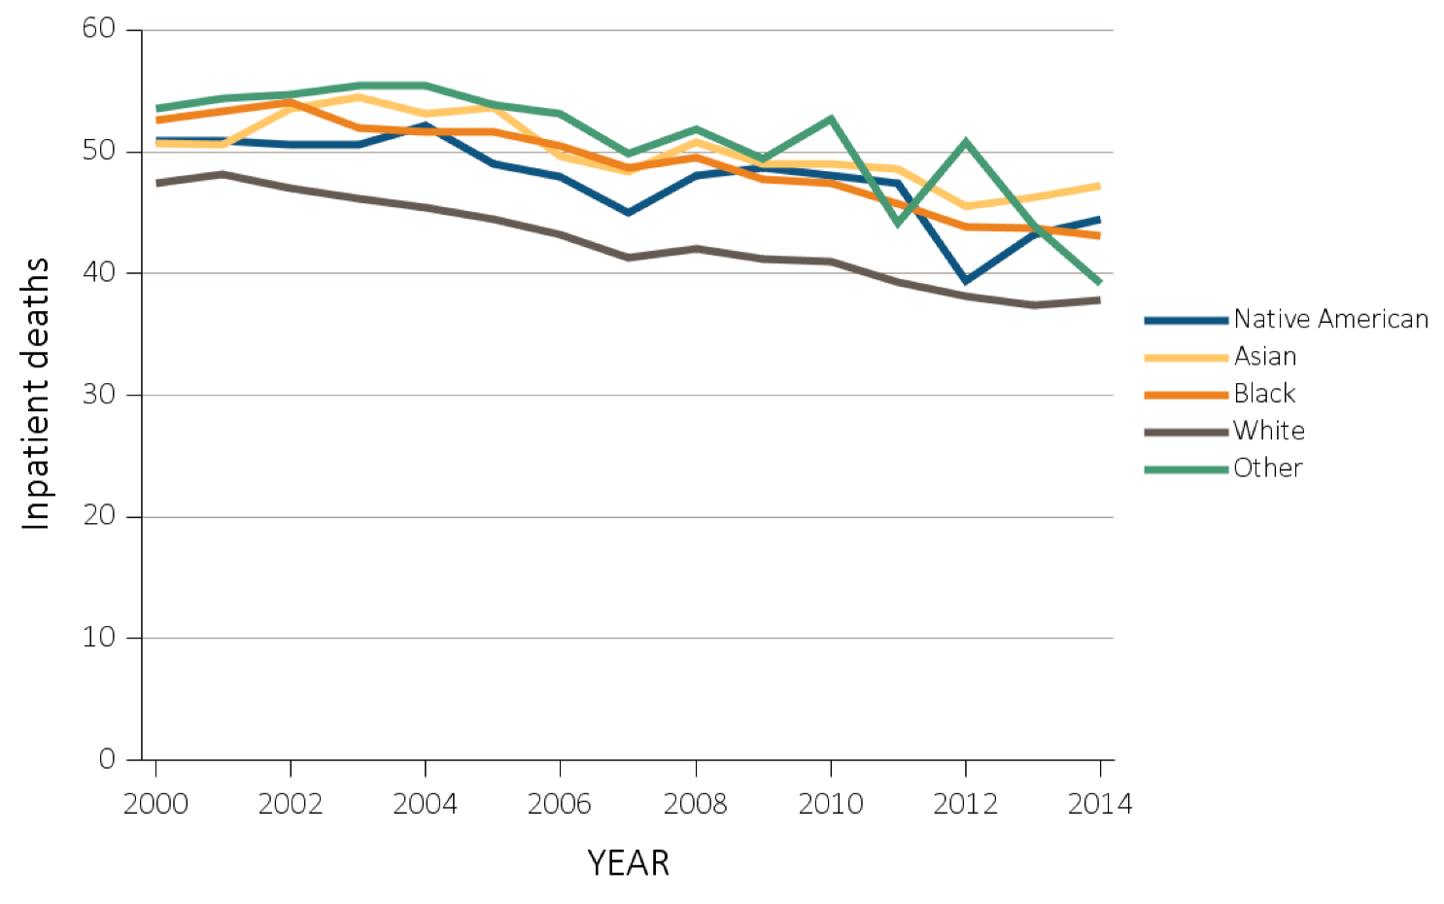
vol 2 Figure 12.6 Inpatient deaths among Medicare beneficiaries with ESRD overall, and by age, race, ethnicity, sex, and modality, 2000-2014
(c) Inpatient deaths by race
Data Source: Special Analyses, USRDS ESRD Database. Denominator population is all decedents with Medicare Parts A and B throughout the last 90 days of life. Includes deaths occurring in short- and long-stay hospitals. Abbreviation: ESRD, end-stage renal disease.

Slide 28
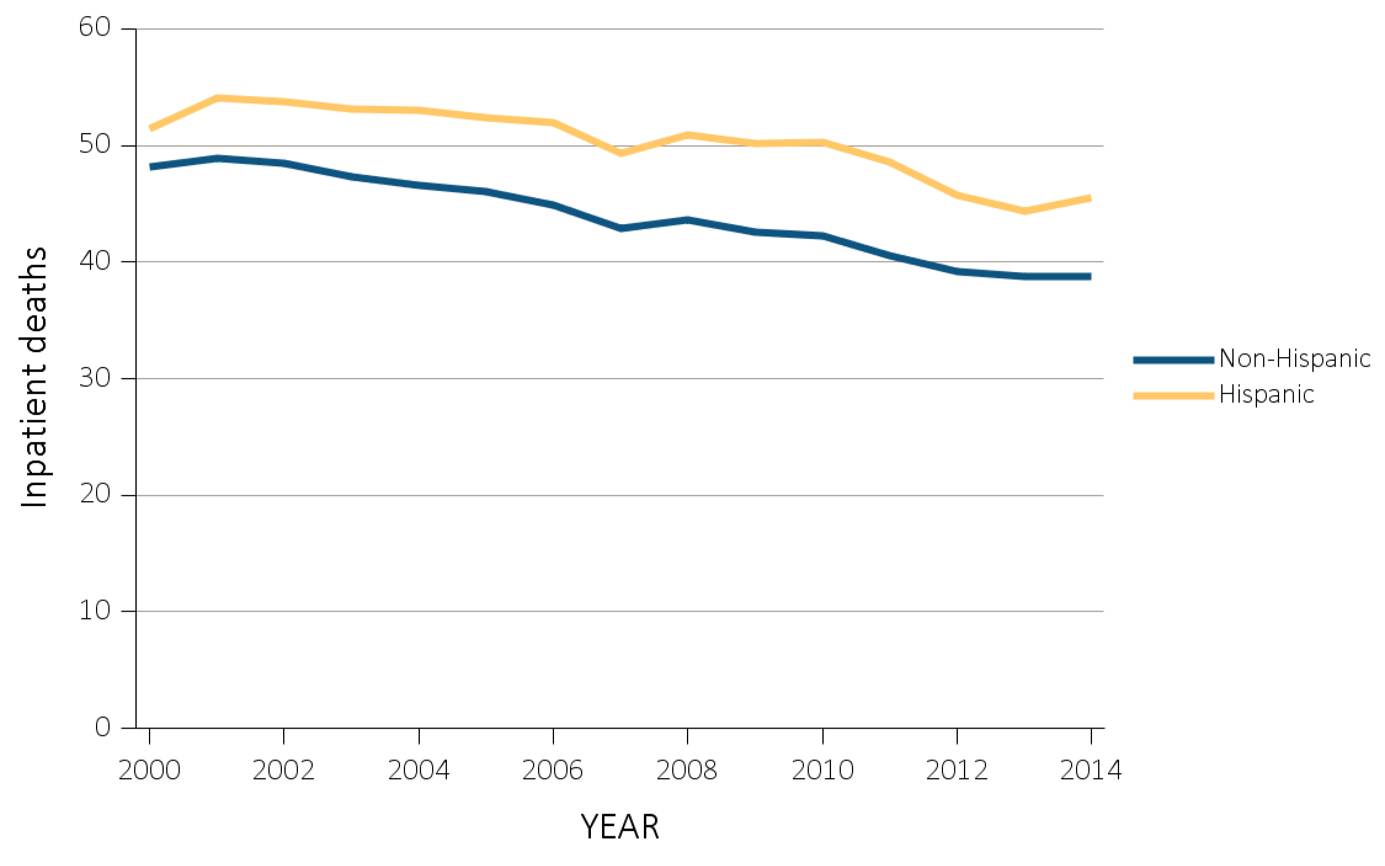
vol 2 Figure 12.6 Inpatient deaths among Medicare beneficiaries with ESRD overall, and by age, race, ethnicity, sex, and modality, 2000-2014
(d) Inpatient deaths by ethnicity
Data Source: Special Analyses, USRDS ESRD Database. Denominator population is all decedents with Medicare Parts A and B throughout the last 90 days of life. Includes deaths occurring in short- and long-stay hospitals. Abbreviation: ESRD, end-stage renal disease.

Slide 29
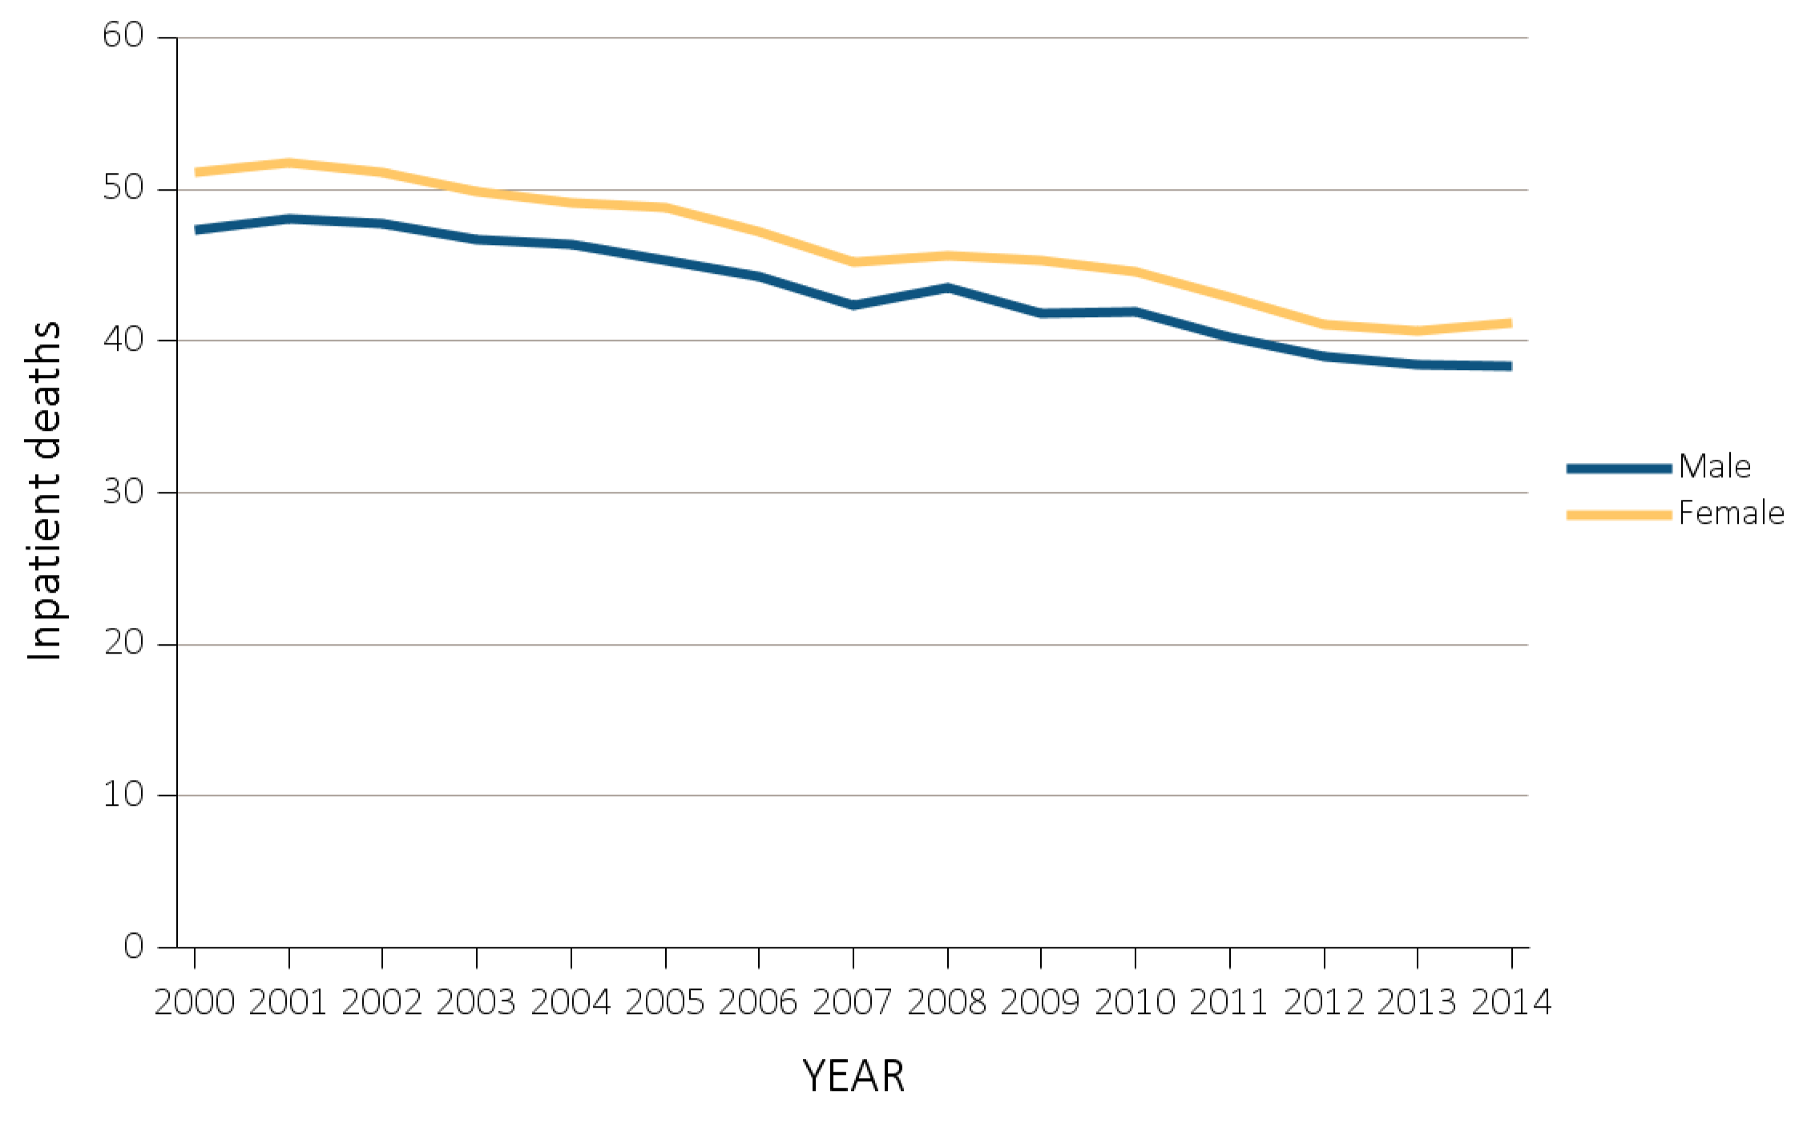
vol 2 Figure 12.6 Inpatient deaths among Medicare beneficiaries with ESRD overall, and by age, race, ethnicity, sex, and modality, 2000-2014
(e) Inpatient deaths by sex
Data Source: Special Analyses, USRDS ESRD Database. Denominator population is all decedents with Medicare Parts A and B throughout the last 90 days of life. Includes deaths occurring in short- and long-stay hospitals. Abbreviation: ESRD, end-stage renal disease.

Slide 30
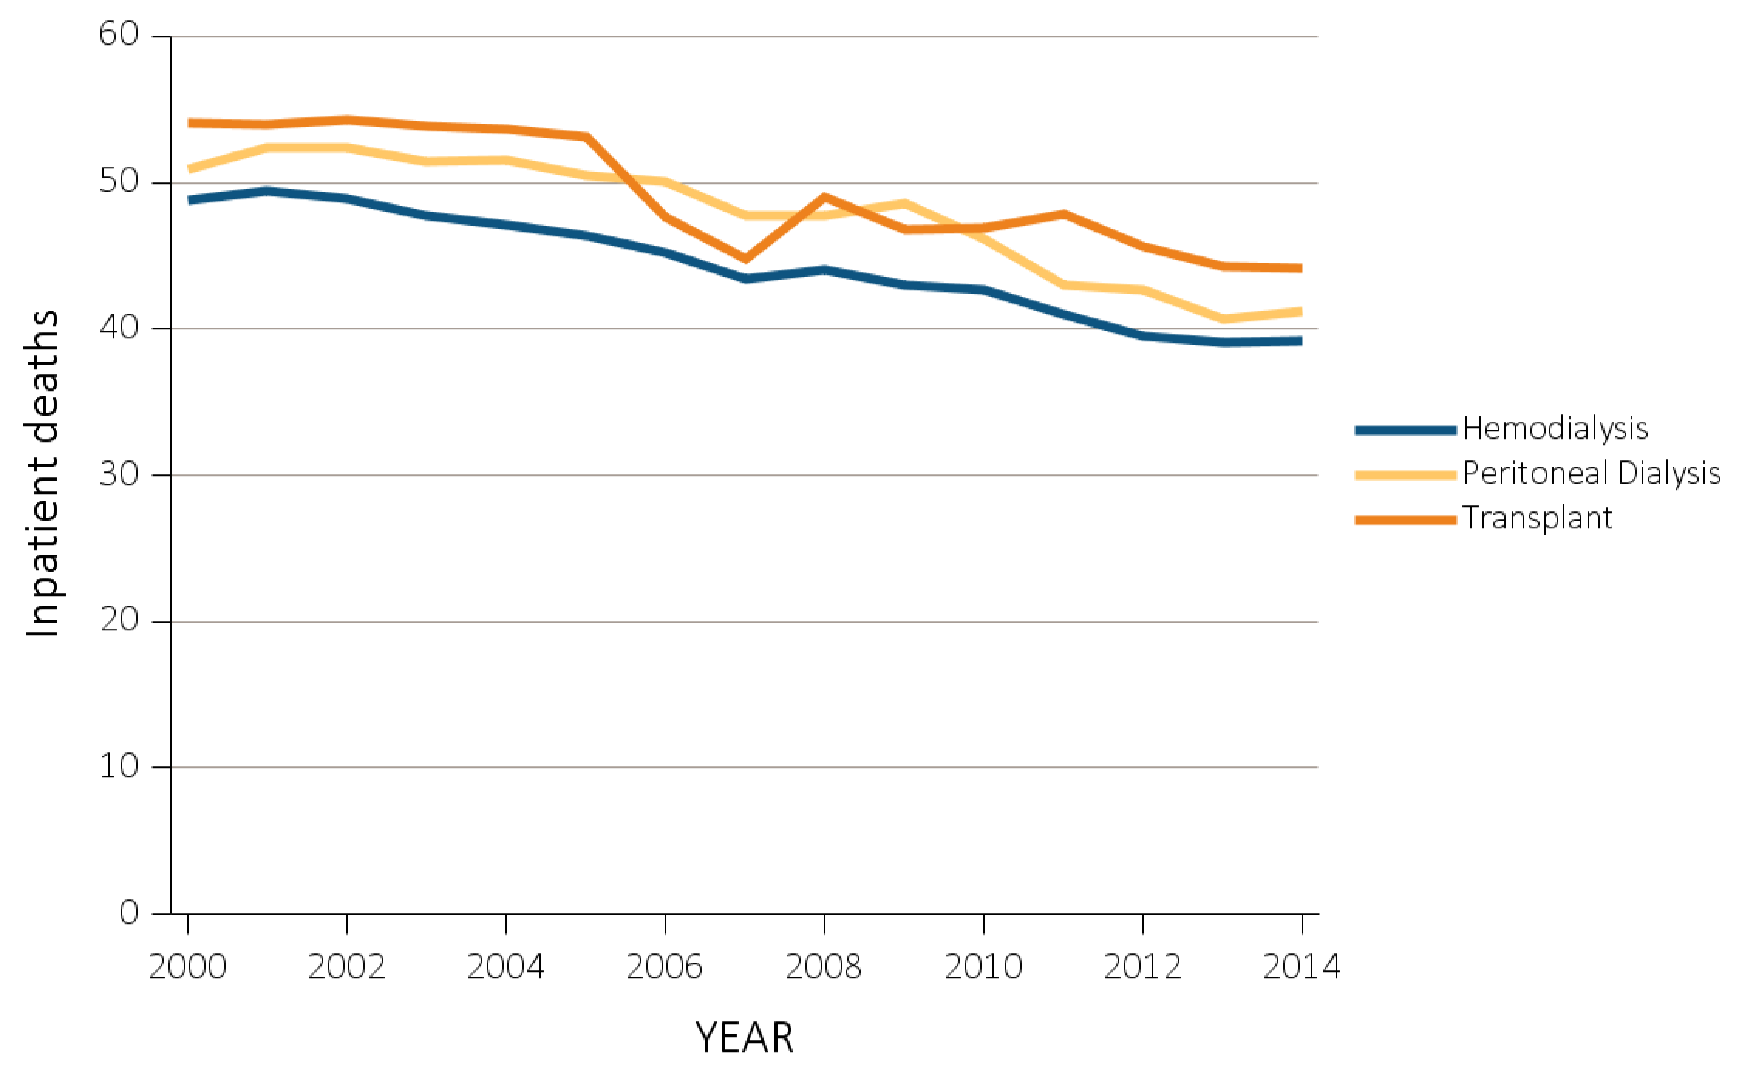
vol 2 Figure 12.6 Inpatient deaths among Medicare beneficiaries with ESRD overall, and by age, race, ethnicity, sex, and modality, 2000-2014
(f) Inpatient deaths by modality
Data Source: Special Analyses, USRDS ESRD Database. Denominator population is all decedents with Medicare Parts A and B throughout the last 90 days of life. Includes deaths occurring in short- and long-stay hospitals. Abbreviation: ESRD, end-stage renal disease.

Slide 31
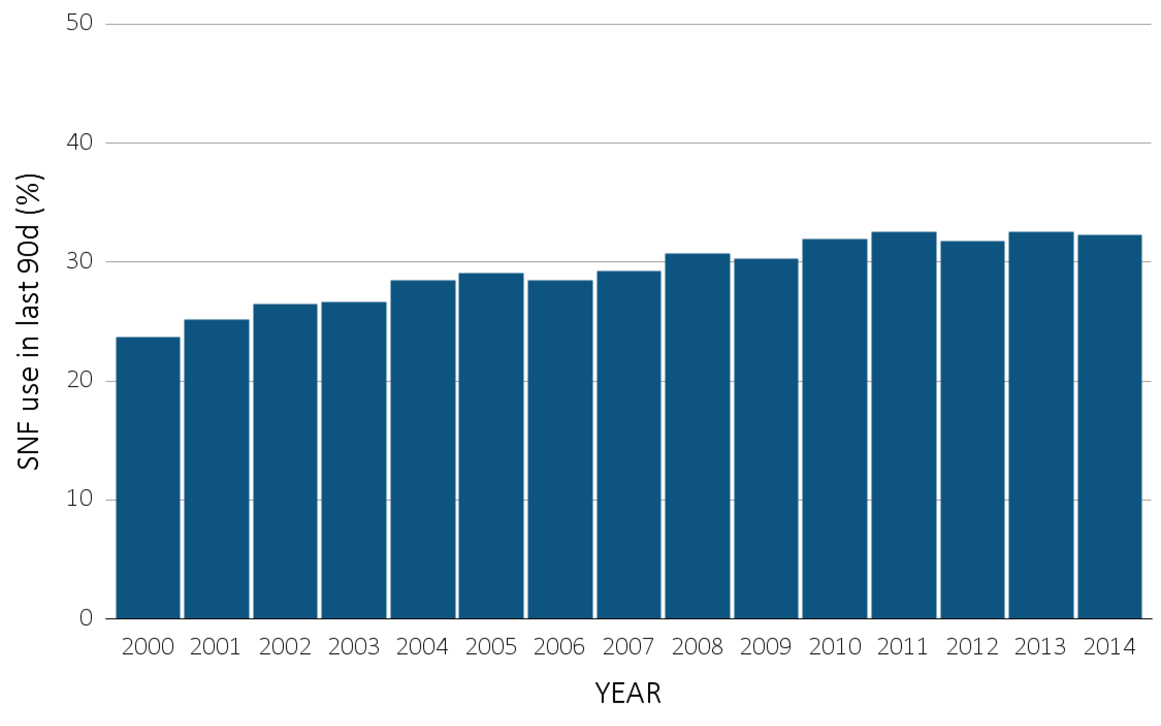
vol 2 Figure 12.7 Skilled nursing facility utilization among Medicare beneficiaries with ESRD overall, and by age, race, ethnicity, sex, and modality, 2000-2014
(a) Skilled nursing facility utilization by year, overall
Data Source: Special Analyses, USRDS ESRD Database. Denominator population is all decedents with Medicare Parts A and B throughout the last 90 days of life. Abbreviation: ESRD, end-stage renal disease.

Slide 32
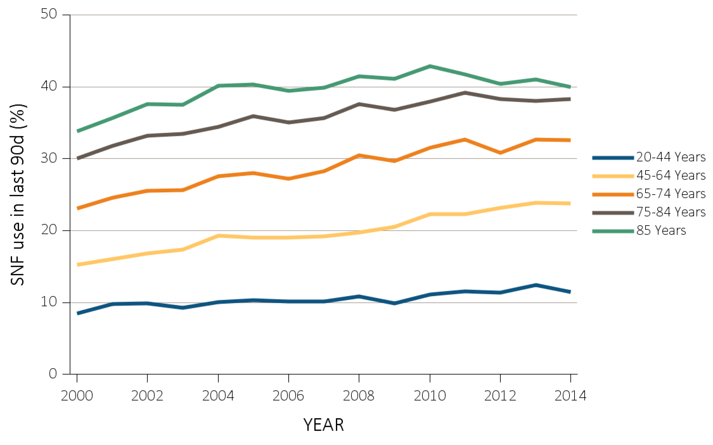
vol 2 Figure 12.7 Skilled nursing facility utilization among Medicare beneficiaries with ESRD overall, and by age, race, ethnicity, sex, and modality, 2000-2014
(b) Skilled nursing facility utilization by age
Data Source: Special Analyses, USRDS ESRD Database. Denominator population is all decedents with Medicare Parts A and B throughout the last 90 days of life. Abbreviation: ESRD, end-stage renal disease.

Slide 33
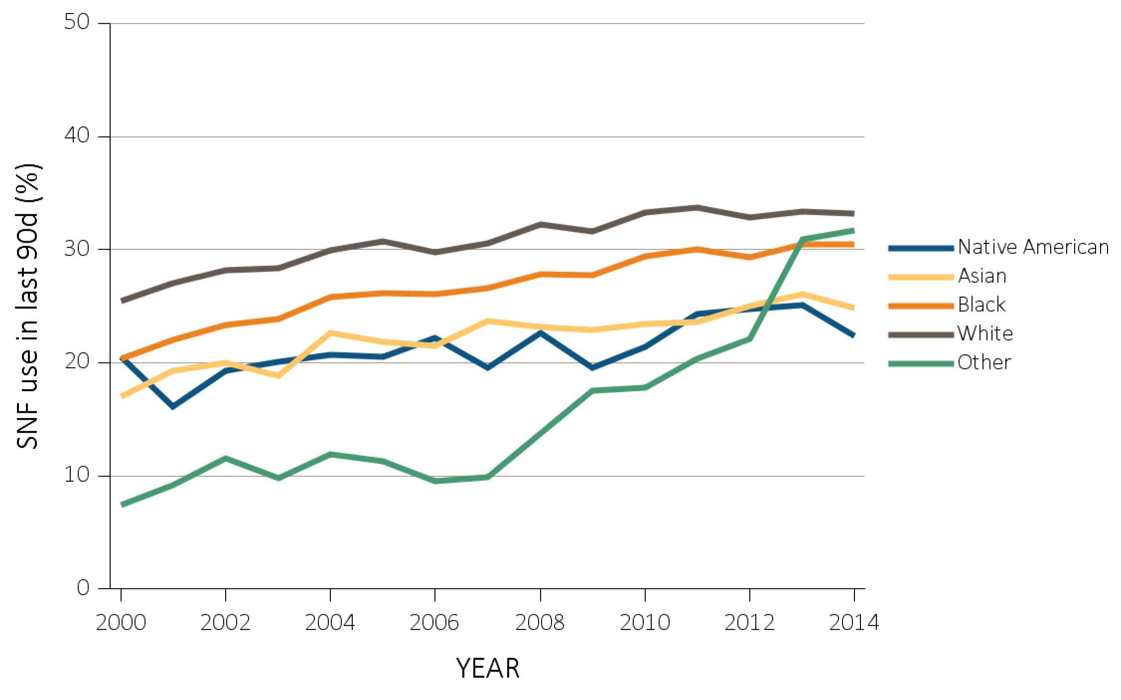
vol 2 Figure 12.7 Skilled nursing facility utilization among Medicare beneficiaries with ESRD overall, and by age, race, ethnicity, sex, and modality, 2000-2014
(c) Skilled nursing facility utilization by race
Data Source: Special Analyses, USRDS ESRD Database. Denominator population is all decedents with Medicare Parts A and B throughout the last 90 days of life. Abbreviation: ESRD, end-stage renal disease.

Slide 34
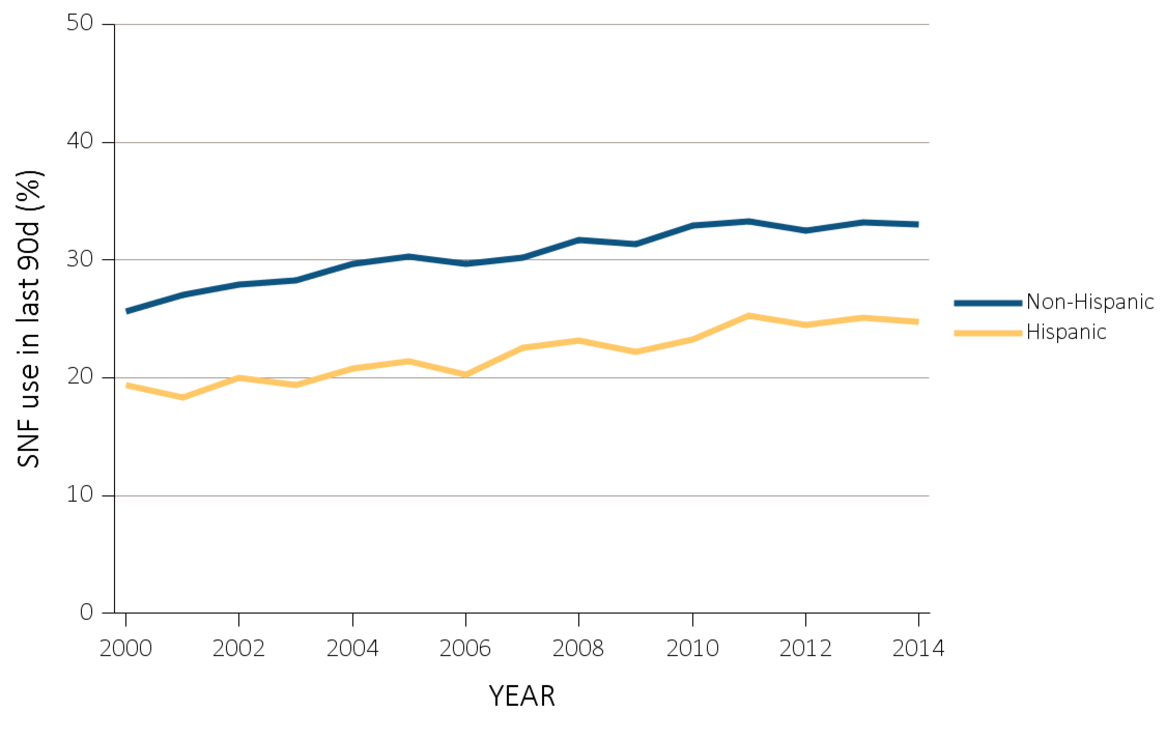
vol 2 Figure 12.7 Skilled nursing facility utilization among Medicare beneficiaries with ESRD overall, and by age, race, ethnicity, sex, and modality, 2000-2014
(d) Skilled nursing facility utilization by ethnicity
Data Source: Special Analyses, USRDS ESRD Database. Denominator population is all decedents with Medicare Parts A and B throughout the last 90 days of life. Abbreviation: ESRD, end-stage renal disease.

Slide 35
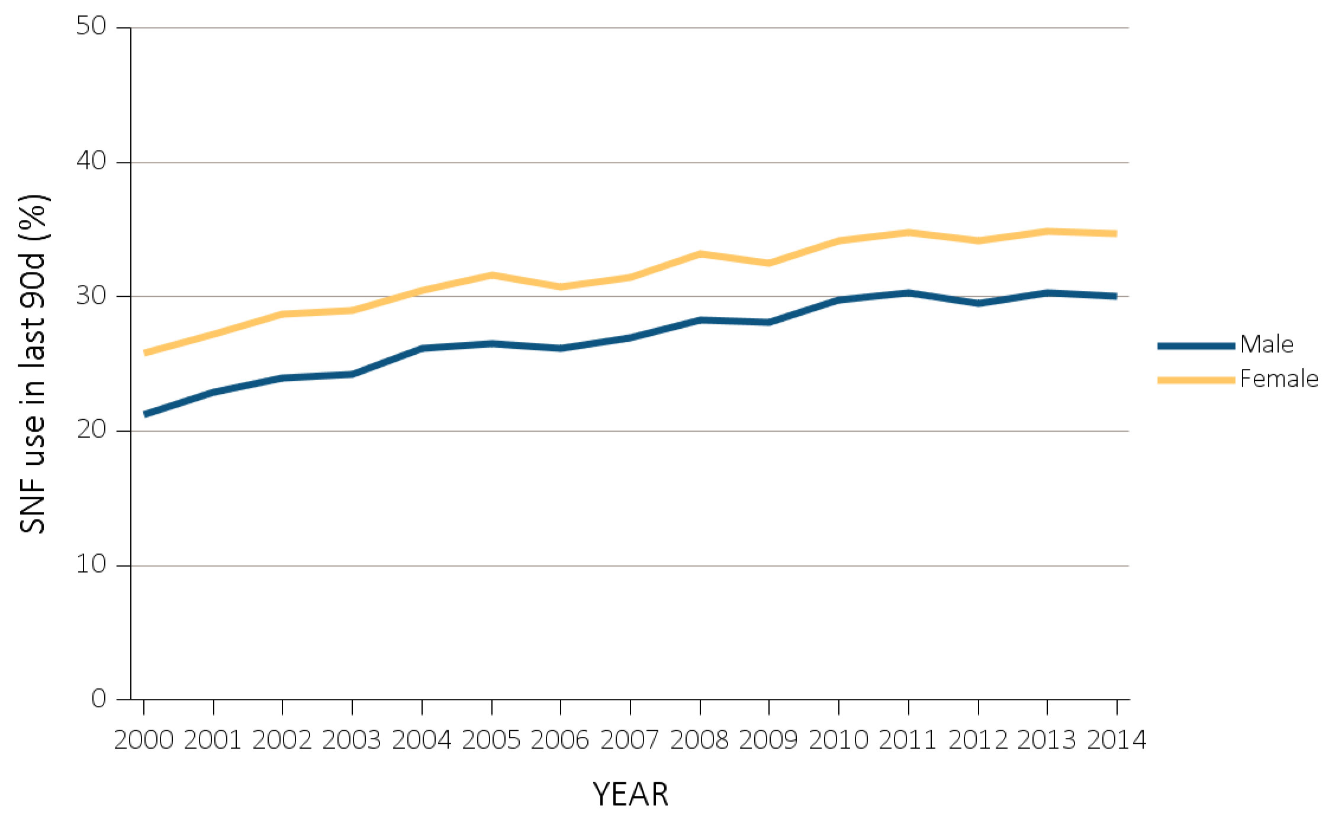
vol 2 Figure 12.7 Skilled nursing facility utilization among Medicare beneficiaries with ESRD overall, and by age, race, ethnicity, sex, and modality, 2000-2014
(e) Skilled nursing facility utilization by sex
Data Source: Special Analyses, USRDS ESRD Database. Denominator population is all decedents with Medicare Parts A and B throughout the last 90 days of life. Abbreviation: ESRD, end-stage renal disease.

Slide 36
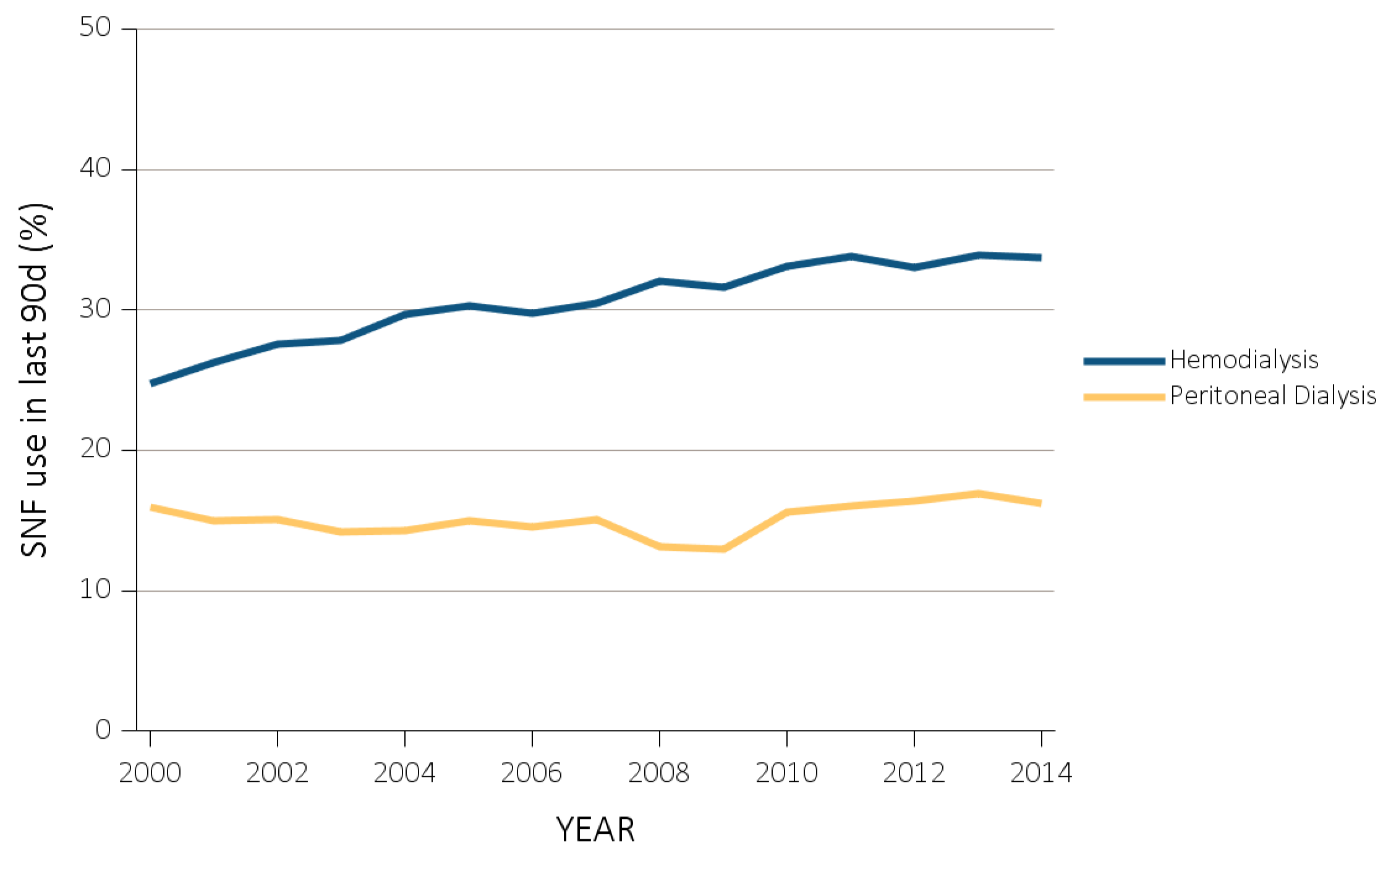
vol 2 Figure 12.7 Skilled nursing facility utilization among Medicare beneficiaries with ESRD overall, and by age, race, ethnicity, sex, and modality, 2000-2014
(f) Skilled nursing facility utilization by modality
Data Source: Special Analyses, USRDS ESRD Database. Denominator population is all decedents with Medicare Parts A and B throughout the last 90 days of life. Abbreviation: ESRD, end-stage renal disease.

Slide 37
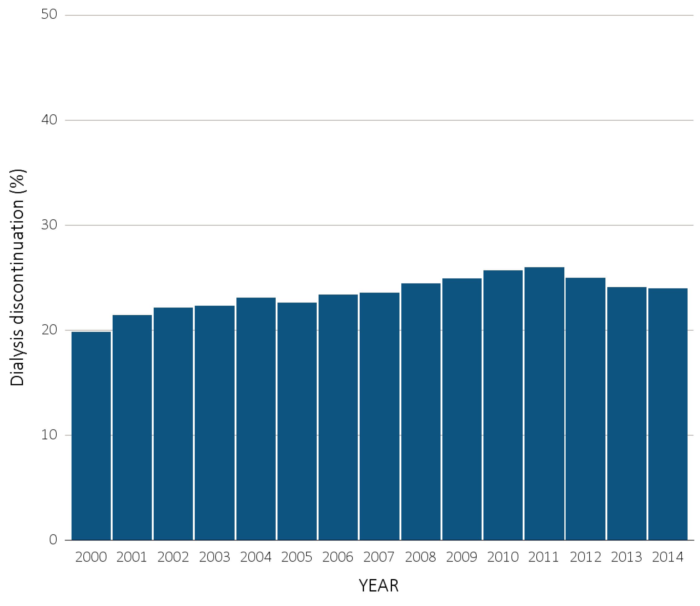
vol 2 Figure 12.8 Dialysis discontinuation before death among decedents overall, and by age, race, ethnicity, sex, and modality, 2000-2014
(a) Dialysis discontinuation by year, overall
Data Source: Special analyses, USRDS ESRD Database. Denominator population is all patients with complete data on dialysis discontinuation from the CMS ESRD Death Notification form (CMS 2746). Abbreviation: ESRD, end-stage renal disease.

Slide 38
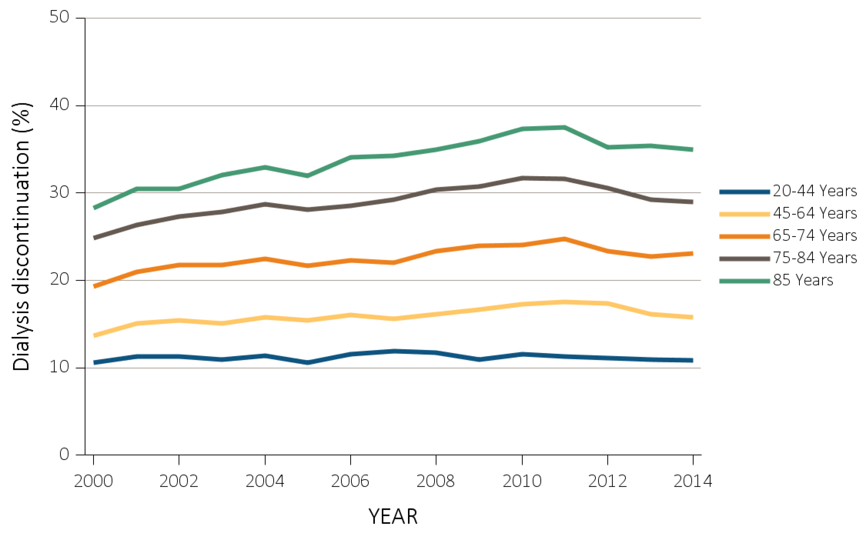
vol 2 Figure 12.8 Dialysis discontinuation before death among decedents overall, and by age, race, ethnicity, sex, and modality, 2000-2014
(b) Dialysis discontinuation by age
Data Source: Special analyses, USRDS ESRD Database. Denominator population is all patients with complete data on dialysis discontinuation from the CMS ESRD Death Notification form (CMS 2746). Abbreviation: ESRD, end-stage renal disease.

Slide 39
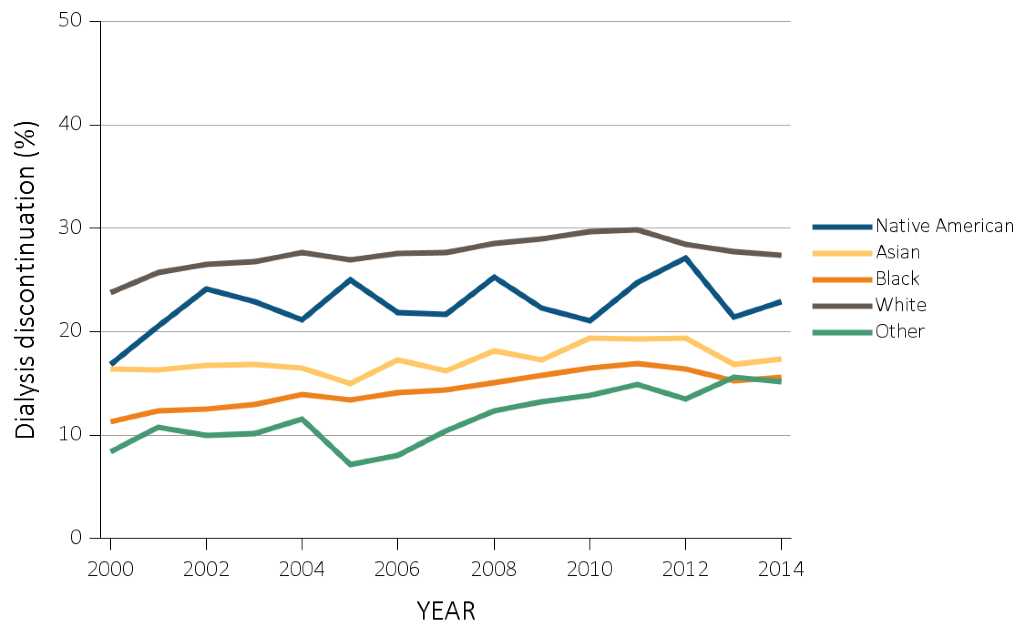
vol 2 Figure 12.8 Dialysis discontinuation before death among decedents overall, and by age, race, ethnicity, sex, and modality, 2000-2014
(c) Dialysis discontinuation by race
Data Source: Special analyses, USRDS ESRD Database. Denominator population is all patients with complete data on dialysis discontinuation from the CMS ESRD Death Notification form (CMS 2746). Abbreviation: ESRD, end-stage renal disease.

Slide 40
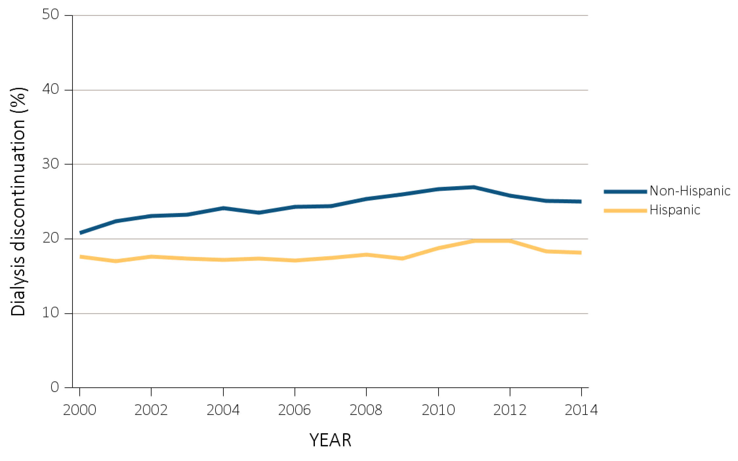
vol 2 Figure 12.8 Dialysis discontinuation before death among decedents overall, and by age, race, ethnicity, sex, and modality, 2000-2014
(d) Dialysis discontinuation by ethnicity
Data Source: Special analyses, USRDS ESRD Database. Denominator population is all patients with complete data on dialysis discontinuation from the CMS ESRD Death Notification form (CMS 2746). Abbreviation: ESRD, end-stage renal disease.

Slide 41
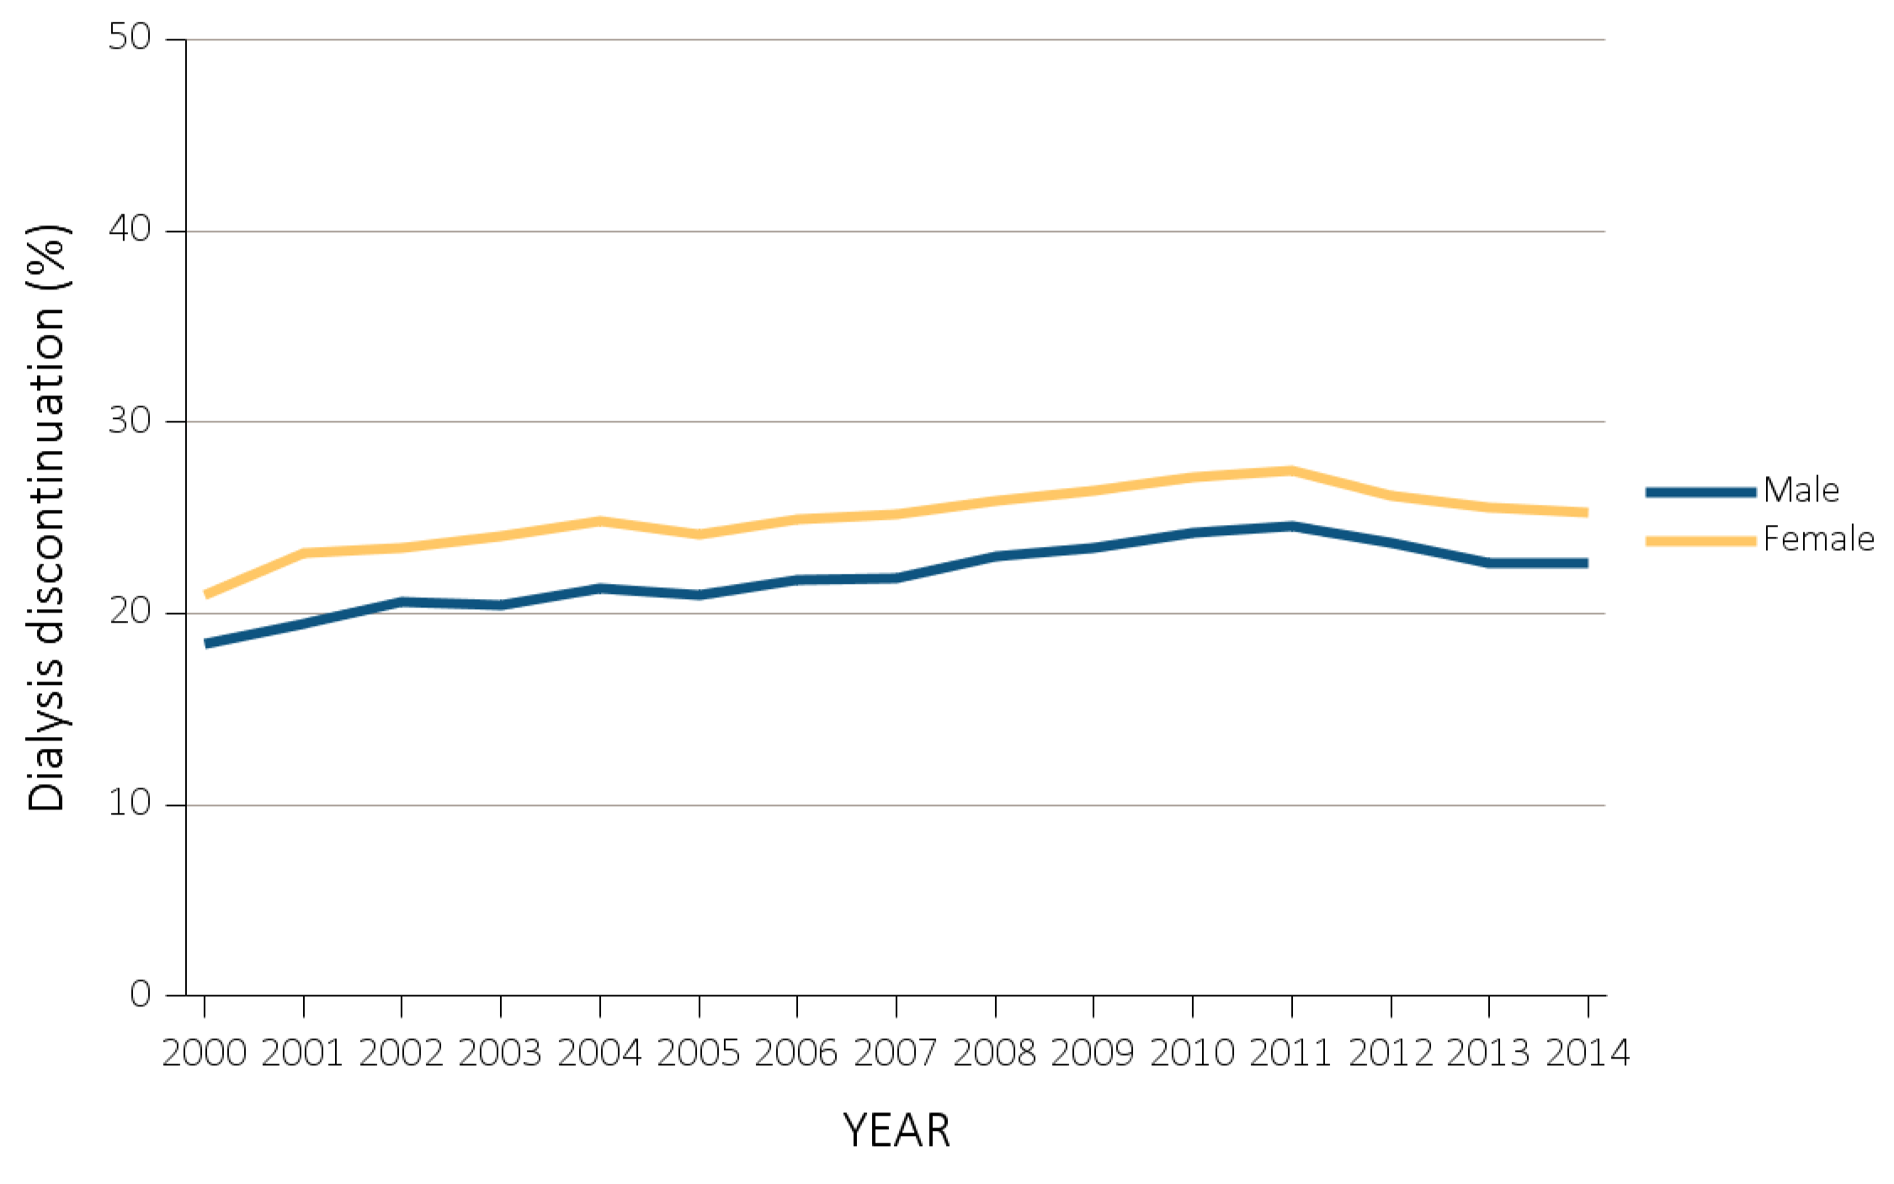
vol 2 Figure 12.8 Dialysis discontinuation before death among decedents overall, and by age, race, ethnicity, sex, and modality, 2000-2014
(e) Dialysis discontinuation by sex
Data Source: Special analyses, USRDS ESRD Database. Denominator population is all patients with complete data on dialysis discontinuation from the CMS ESRD Death Notification form (CMS 2746). Abbreviation: ESRD, end-stage renal disease.

Slide 42
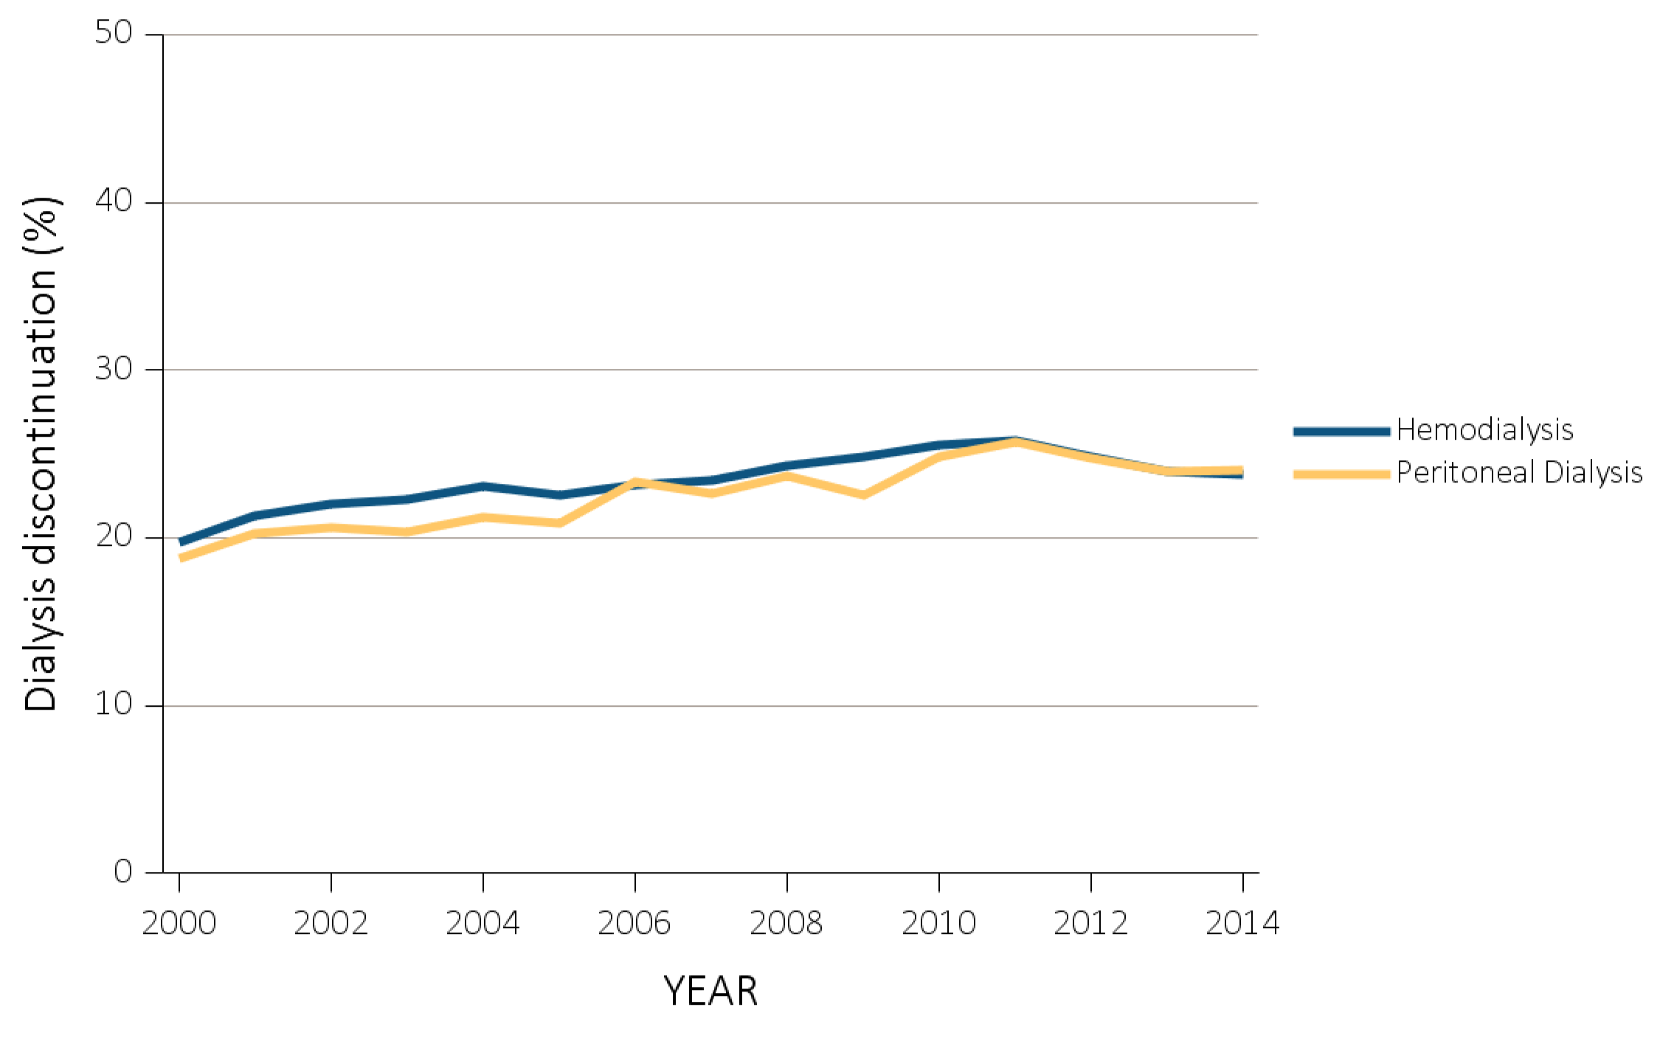
vol 2 Figure 12.8 Dialysis discontinuation before death among decedents overall, and by age, race, ethnicity, sex, and modality, 2000-2014
(f) Dialysis discontinuation by modality
Data Source: Special analyses, USRDS ESRD Database. Denominator population is all patients with complete data on dialysis discontinuation from the CMS ESRD Death Notification form (CMS 2746). Abbreviation: ESRD, end-stage renal disease.

Slide 43
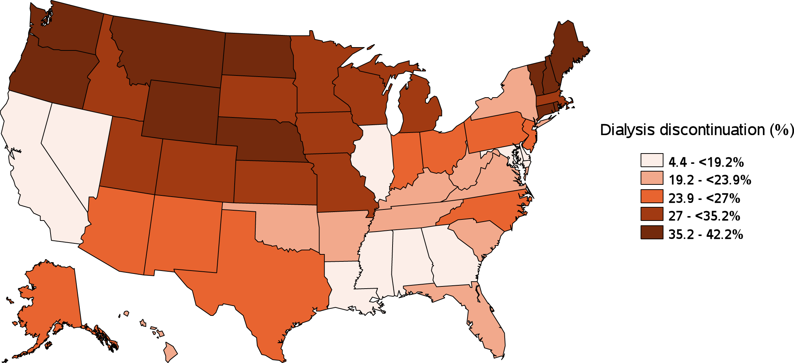
vol 2 Figure 12.8 Dialysis discontinuation before death among decedents overall, and by age, race, ethnicity, sex, and modality, 2000-2014
(g) Dialysis discontinuation by state
Data Source: Special analyses, USRDS ESRD Database. Denominator population is all patients with complete data on dialysis discontinuation from the CMS ESRD Death Notification form (CMS 2746). Abbreviation: ESRD, end-stage renal disease.

Slide 44
vol 2 Table 12.2 Characteristics of patients with ESRD who resided in nursing home during the last year of life, 2000-2010
 | 2000 | 2001 | 2002 | 2003 | 2004 | 2005 | 2006 | 2007 | 2008 | 2009 | 2010 | total
N | 23,237 | 25,789 | 27,216 | 28,743 | 30,307 | 31,205 | 33,323 | 33,518 | 33,452 | 34,480 | 33,337 | 33,4607
Age, mean (std) | 71.93 (11.32) | 71.89 (11.45) | 72.13 (11.50) | 72.25 (11.45) | 72.14( 11.59) | 72.44( 11.54) | 72.07 (11.90) | 72.06 (11.96) | 72.09 (11.87) | 72.07 (11.85) | 71.96 (11.86) | 72.10 (11.69)
Age Category
20-44 | 2.50 | 2.51 | 2.52 | 2.19 | 2.33 | 2.14 | 2.41 | 2.38 | 2.21 | 1.97 | 2.04 | 2.28
45-64 | 18.93 | 19.48 | 19.04 | 19.94 | 20.38 | 19.94 | 21.82 | 21.92 | 22.22 | 22.82 | 23.36 | 21.05
65-74 | 31.85 | 31.05 | 30.41 | 29.31 | 29.22 | 28.56 | 27.3 | 27.45 | 27.78 | 28.04 | 28.13 | 28.84
75-84 | 36.17 | 36.36 | 36.57 | 36.67 | 36.02 | 36.81 | 35.48 | 34.74 | 34.1 | 33.28 | 32.36 | 35.21
>=85 | 10.54 | 10.60 | 11.46 | 11.9 | 12.05 | 12.56 | 12.99 | 13.52 | 13.69 | 13.9 | 14.12 | 12.62
Vintage, mean (std) | 0.96 (1.57) | 0.99 (1.57) | 1.01 (1.61) | 1.03 (1.69) | 1.04 (1.70) | 1.05 (1.72) | 1.08 (1.75) | 1.12 (1.78) | 1.18 (1.83) | 1.20 (1.91) | 1.22 (1.91) | 1.09 (1.75)
Vintage Category
<1yr | 70.50 | 69.96 | 69.57 | 70 | 69.64 | 69.68 | 68.78 | 67.44 | 66.11 | 65.92 | 65.62 | 68.31
1-3yrs | 17.78 | 17.65 | 18.17 | 17.09 | 17.02 | 17.02 | 17.41 | 18.12 | 18.76 | 18.21 | 18.26 | 17.79
>3yr | 8.64 | 8.99 | 9.34 | 9.77 | 10.03 | 9.97 | 10.31 | 10.91 | 11.48 | 11.98 | 12.27 | 10.45
Missing | 3.08 | 3.39 | 2.93 | 3.14 | 3.31 | 3.32 | 3.5 | 3.53 | 3.65 | 3.9 | 3.85 | 3.44
Race
Native American | 1.11 | 0.88 | 1.04 | 0.89 | 0.93 | 0.87 | 0.89 | 0.85 | 0.94 | 0.87 | 0.86 | 0.91
Asian | 1.99 | 2.16 | 2.07 | 2.2 | 2.23 | 2.27 | 2.38 | 2.53 | 2.37 | 2.48 | 2.48 | 2.31
Black | 25.83 | 26.13 | 26 | 26.16 | 26.76 | 26.37 | 26.58 | 26.74 | 26.51 | 27 | 26.65 | 26.47
White | 70.49 | 70.13 | 70.15 | 69.96 | 69.3 | 70.01 | 69.83 | 69.57 | 69.85 | 69.27 | 69.68 | 69.81
Other | 0.59 | 0.71 | 0.75 | 0.79 | 0.77 | 0.47 | 0.32 | 0.3 | 0.34 | 0.37 | 0.33 | 0.5
Hispanic
Non-hispanic | 77.28 | 80.59 | 83.25 | 84.33 | 85.71 | 86.36 | 87.41 | 87.73 | 88.04 | 88.26 | 88.46 | 85.61
Hispanic | 6.53 | 6.65 | 6.92 | 7.23 | 7.05 | 7.68 | 7.38 | 7.81 | 7.93 | 7.93 | 8.09 | 7.44
Missing/Unknown | 16.19 | 12.76 | 9.83 | 8.45 | 7.24 | 5.96 | 5.21 | 4.45 | 4.03 | 3.81 | 3.45 | 6.95
Sex
Male | 46.67 | 47.28 | 47.33 | 47.97 | 49.1 | 48.96 | 49.78 | 50.24 | 50.83 | 51.69 | 51.76 | 49.43
Female | 53.33 | 52.72 | 52.67 | 52.03 | 50.9 | 51.04 | 50.22 | 49.76 | 49.17 | 48.31 | 48.24 | 50.57
Last Treatment Modality
Hemodialysis | 92.09 | 92.50 | 93.5 | 93.72 | 93.7 | 94.15 | 94.02 | 94.26 | 94.27 | 94.36 | 94.08 | 93.77
Peritoneal Dialysis | 4.83 | 4.11 | 3.57 | 3.14 | 2.98 | 2.53 | 2.48 | 2.21 | 2.09 | 1.74 | 2.07 | 2.78
Transplant | 2.08 | 2.27 | 1.99 | 2.24 | 2.46 | 2.39 | 2.55 | 2.77 | 2.87 | 3.21 | 3.11 | 2.58
Missing/uncertain on modality | 1.00 | 1.12 | 0.94 | 0.9 | 0.85 | 0.93 | 0.95 | 0.75 | 0.78 | 0.69 | 0.73 | 0.86
Impaired Decision Making
No | 63.72 | 63.93 | 63.69 | 63.52 | 63.18 | 63.81 | 64.74 | 64.92 | 64.64 | 64.06 | 66.31 | 64.28
Yes | 36.28 | 36.07 | 36.31 | 36.48 | 36.82 | 36.19 | 35.24 | 34.64 | 34.86 | 35.52 | 33.27 | 35.54
Missing | N/A | N/A | N/A | N/A | N/A | 0.01 | 0.02 | 0.44 | 0.5 | 0.43 | 0.41 | 0.18
Legal Guardian
No | 98.80 | 98.89 | 99.06 | 99.5 | 99.51 | 99.5 | 99.53 | 99.53 | 99.62 | 99.53 | 99.6 | 99.4
Yes | 1.20 | 1.11 | 0.94 | 0.5 | 0.49 | 0.5 | 0.47 | 0.47 | 0.38 | 0.47 | 0.4 | 0.6
Data Source: Includes only patients with a record in the Minimum Data Set that was linked to USRDS between 2000 and 2010. Denominator population is patients with ESRD who died between 2000 and 2010, who were at least 20 years of age at the time of death, received treatment for ESRD for at least 90days, had an advance directive assessment recorded in the Minimum Dataset in the last year of life, and complete demographic information. Abbreviation: ESRD, end-stage renal disease.

Slide 45
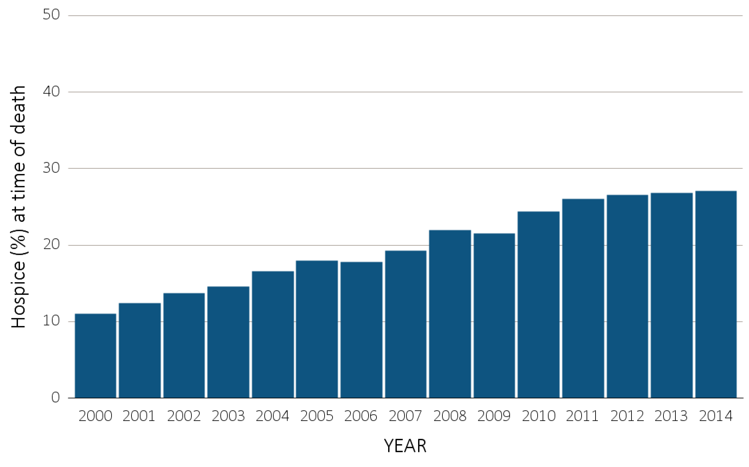
vol 2 Figure 12.9 Hospice utilization at the time of death among Medicare beneficiaries with ESRD overall, and by age, race, ethnicity, sex, modality, and whether dialysis was discontinued, 2000-2014
(a) Hospice utilization by year, overall
Data Source: Special Analyses, USRDS ESRD Database. Denominator population is all decedents with Medicare Parts A and B throughout the last 90 days of life. Receipt of hospice care at the time of death was defined as having a claim in the Hospice SAF on or after the date of death or Discharge Status from hospice=40, 41, or 42. Abbreviation: ESRD, end-stage renal disease.

Slide 46
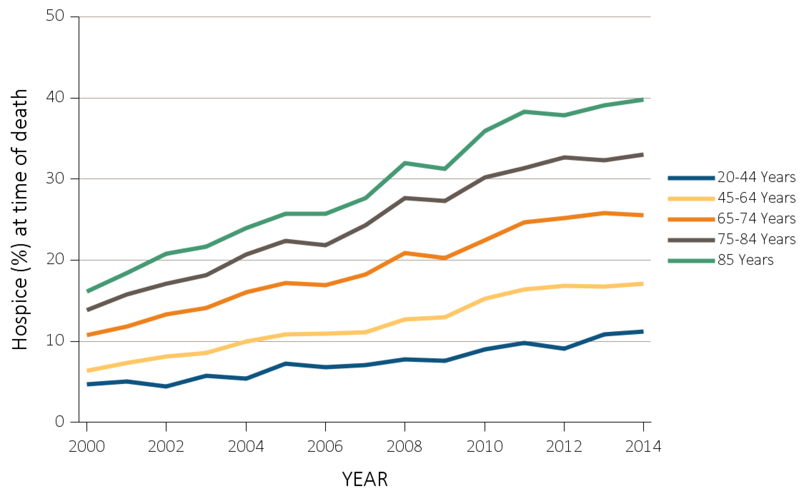
vol 2 Figure 12.9 Hospice utilization at the time of death among Medicare beneficiaries with ESRD overall, and by age, race, ethnicity, sex, modality, and whether dialysis was discontinued, 2000-2014
(b) Hospice utilization by age
Data Source: Special Analyses, USRDS ESRD Database. Denominator population is all decedents with Medicare Parts A and B throughout the last 90 days of life. Receipt of hospice care at the time of death was defined as having a claim in the Hospice SAF on or after the date of death or Discharge Status from hospice=40, 41, or 42. Abbreviation: ESRD, end-stage renal disease.

Slide 47
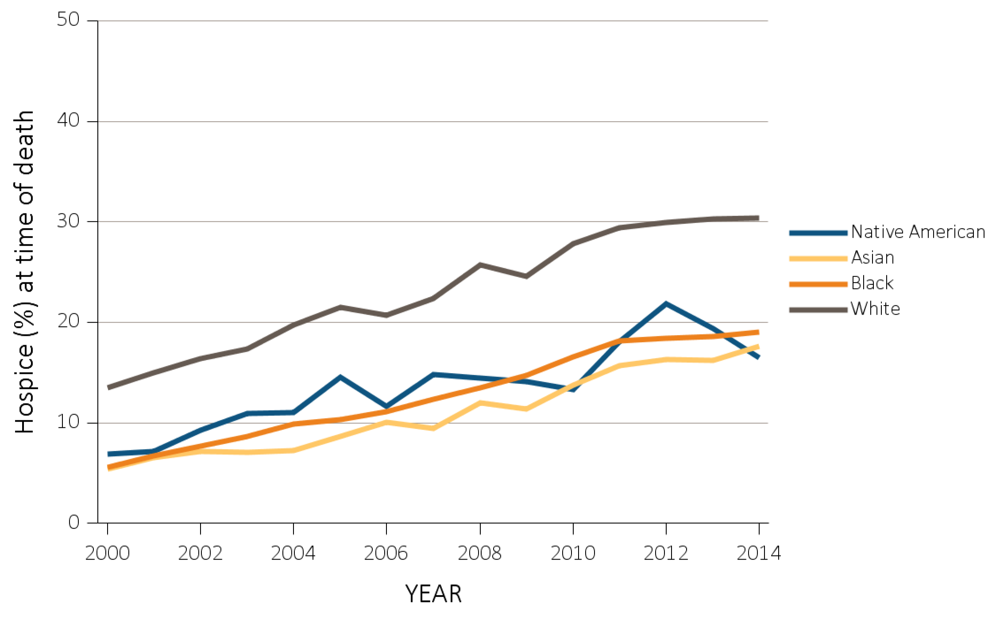
vol 2 Figure 12.9 Hospice utilization at the time of death among Medicare beneficiaries with ESRD overall, and by age, race, ethnicity, sex, modality, and whether dialysis was discontinued, 2000-2014
(c) Hospice utilization by race
Data Source: Special Analyses, USRDS ESRD Database. Denominator population is all decedents with Medicare Parts A and B throughout the last 90 days of life. Receipt of hospice care at the time of death was defined as having a claim in the Hospice SAF on or after the date of death or Discharge Status from hospice=40, 41, or 42. Abbreviation: ESRD, end-stage renal disease.

Slide 48
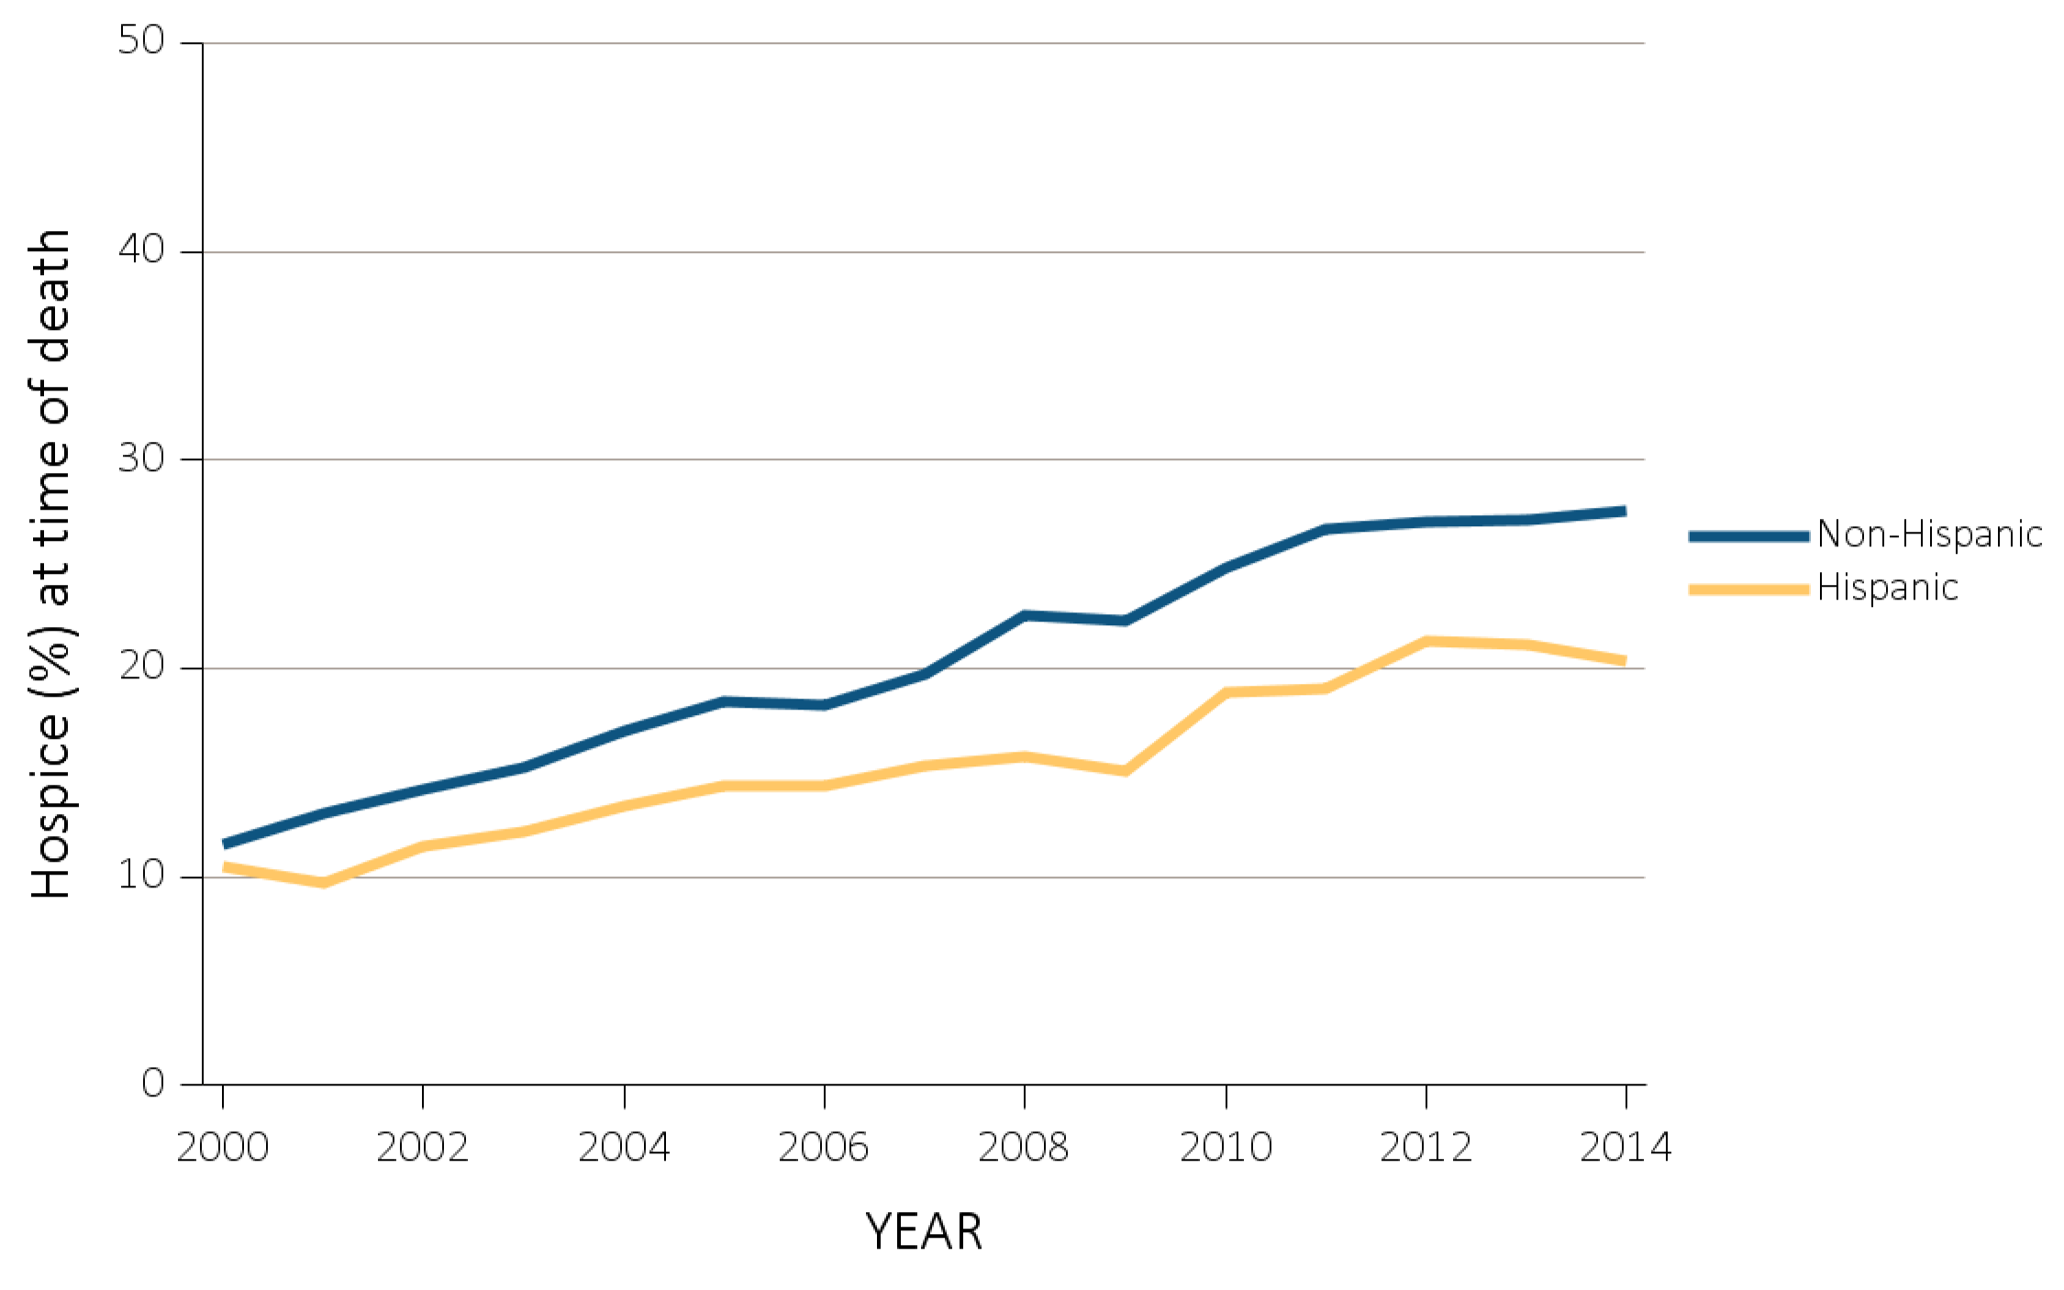
vol 2 Figure 12.9 Hospice utilization at the time of death among Medicare beneficiaries with ESRD overall, and by age, race, ethnicity, sex, modality, and whether dialysis was discontinued, 2000-2014
(d) Hospice utilization by ethnicity
Data Source: Special Analyses, USRDS ESRD Database. Denominator population is all decedents with Medicare Parts A and B throughout the last 90 days of life. Receipt of hospice care at the time of death was defined as having a claim in the Hospice SAF on or after the date of death or Discharge Status from hospice=40, 41, or 42. Abbreviation: ESRD, end-stage renal disease.

Slide 49
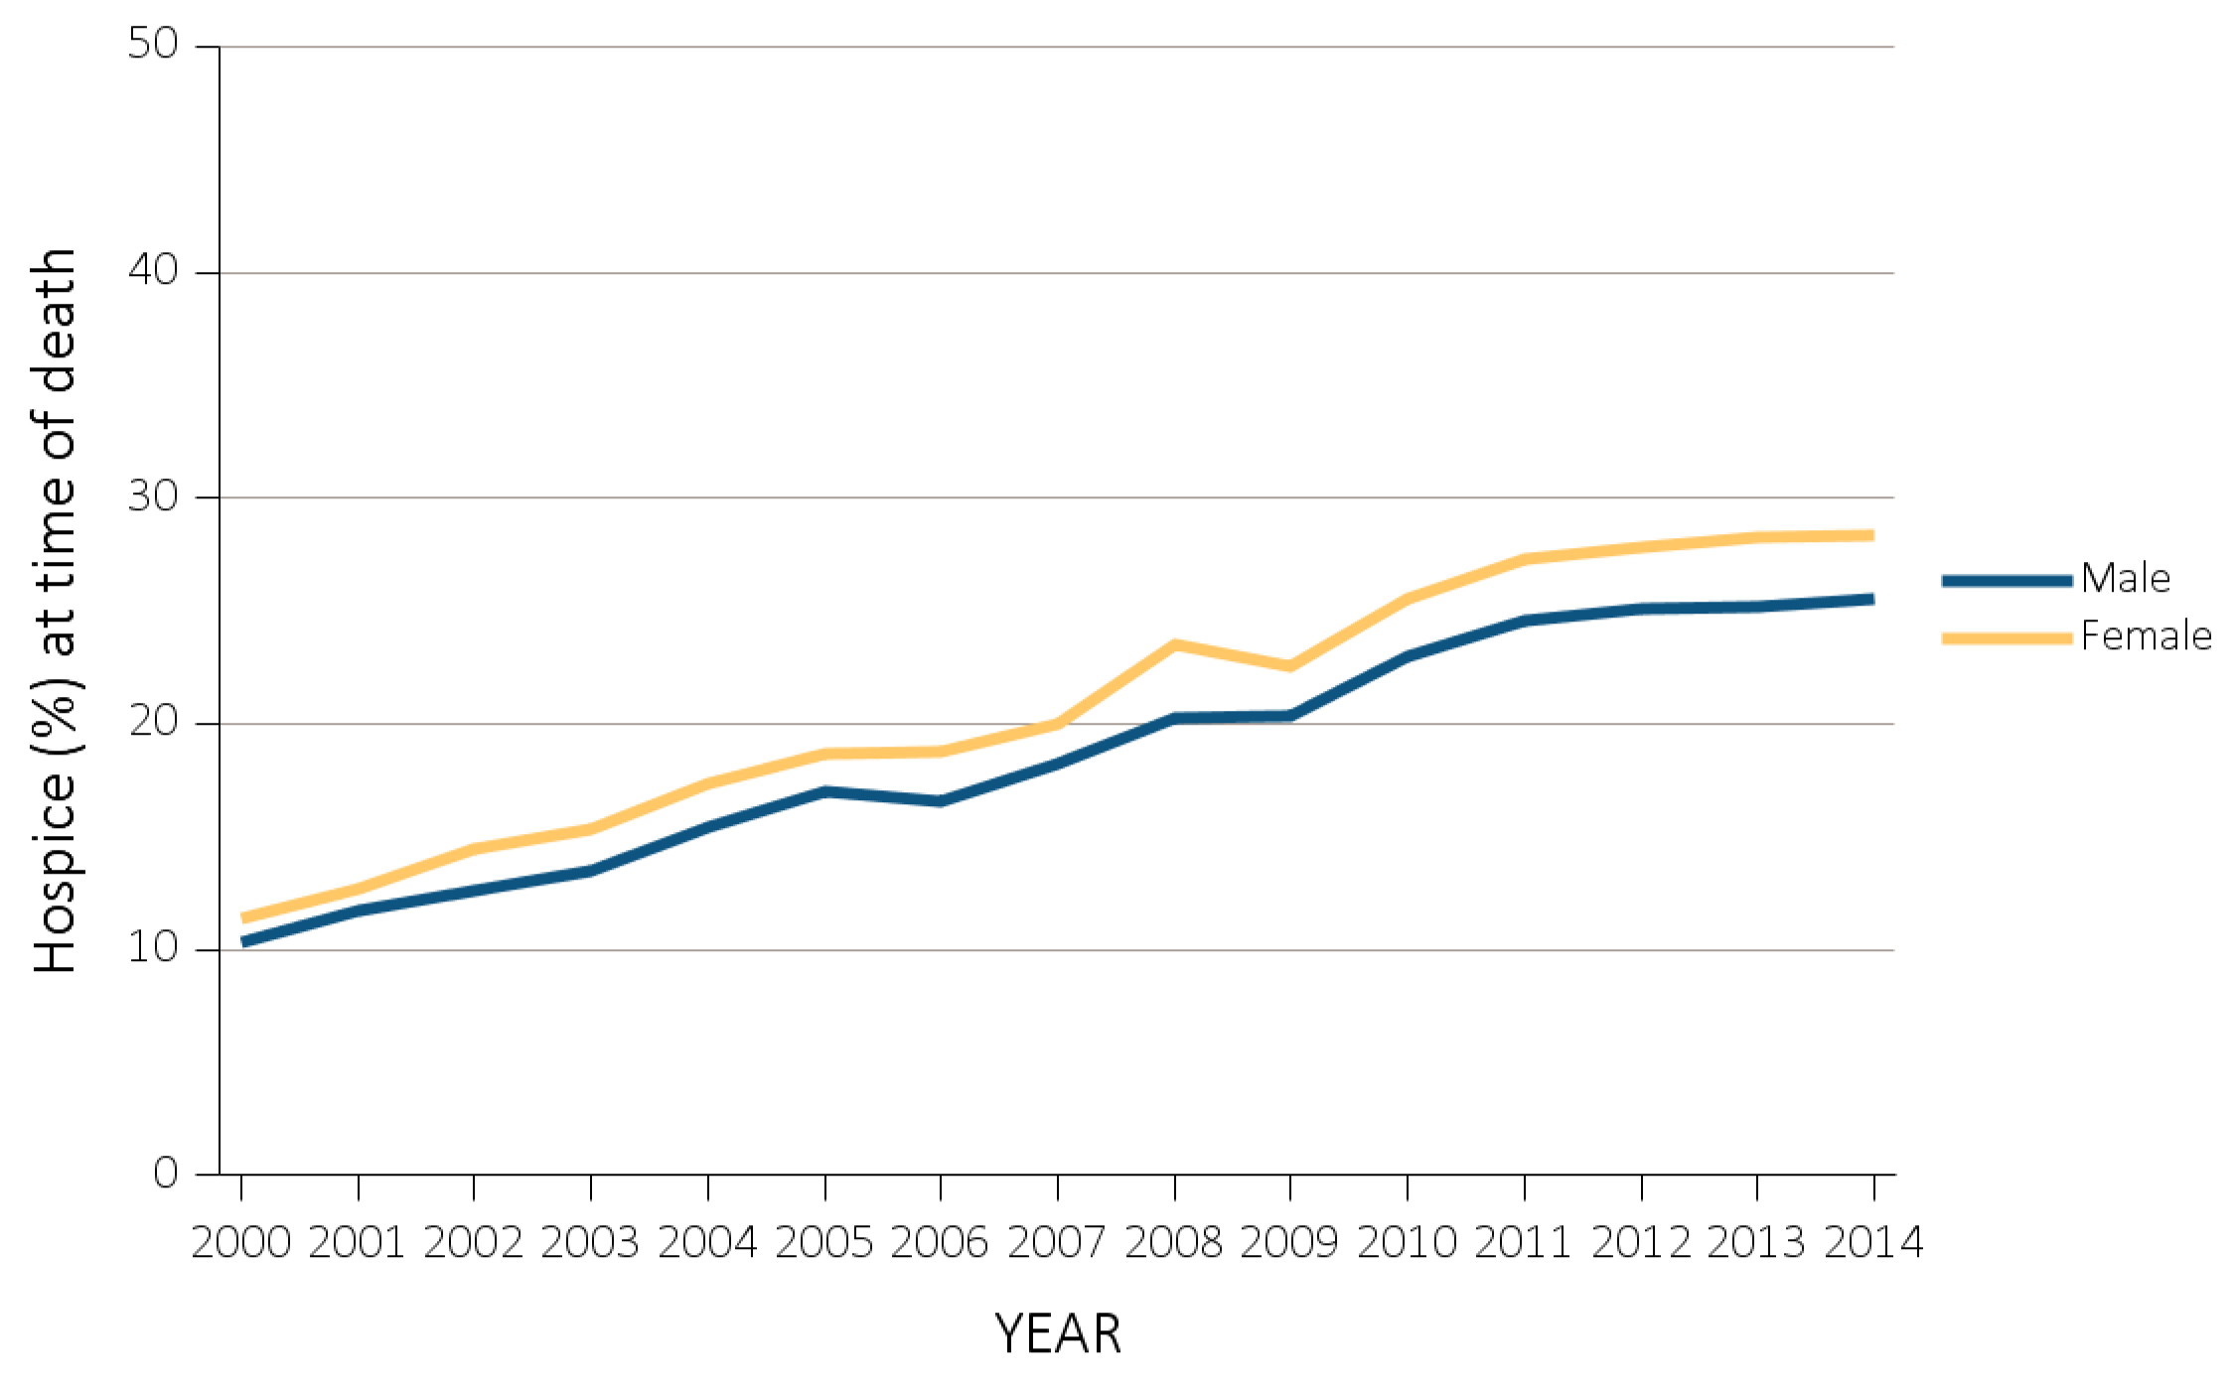
vol 2 Figure 12.9 Hospice utilization at the time of death among Medicare beneficiaries with ESRD overall, and by age, race, ethnicity, sex, modality, and whether dialysis was discontinued, 2000-2014
(e) Hospice utilization by sex
Data Source: Special Analyses, USRDS ESRD Database. Denominator population is all decedents with Medicare Parts A and B throughout the last 90 days of life. Receipt of hospice care at the time of death was defined as having a claim in the Hospice SAF on or after the date of death or Discharge Status from hospice=40, 41, or 42. Abbreviation: ESRD, end-stage renal disease.

Slide 50
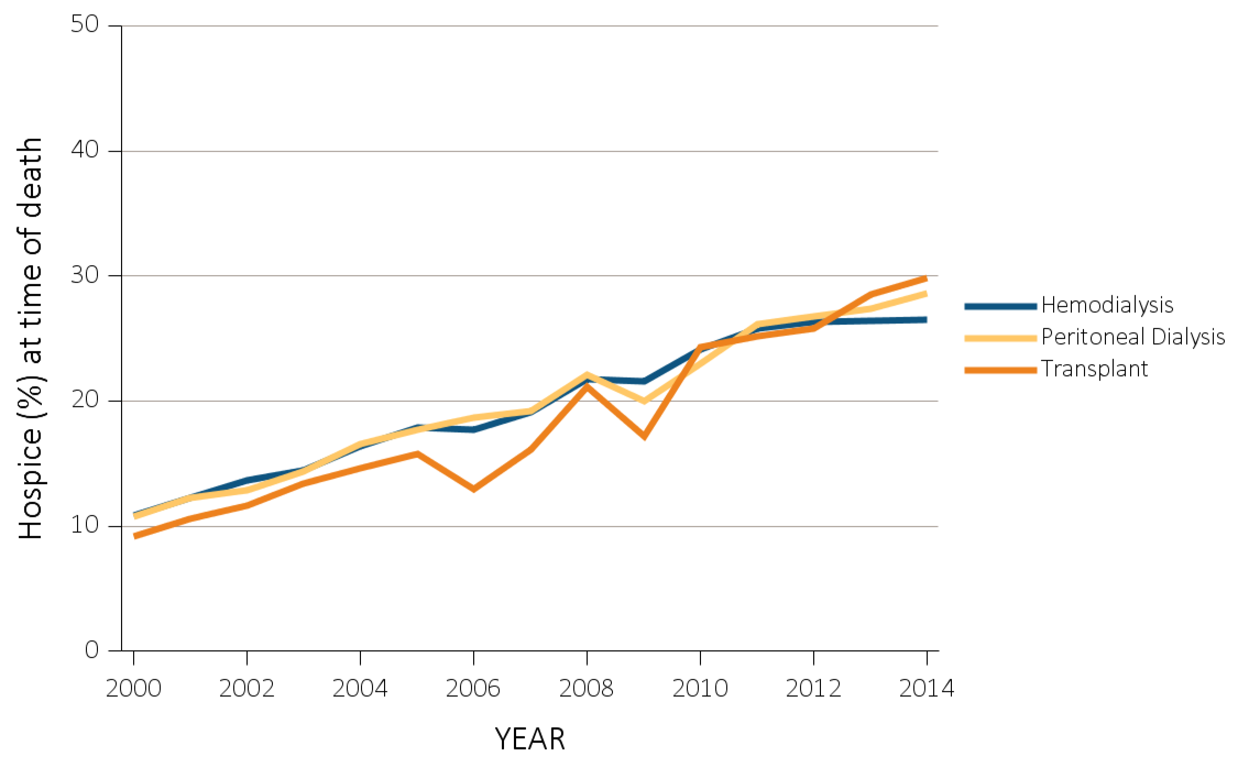
vol 2 Figure 12.9 Hospice utilization at the time of death among Medicare beneficiaries with ESRD overall, and by age, race, ethnicity, sex, modality, and whether dialysis was discontinued, 2000-2014
(f) Hospice utilization by modality
Data Source: Special Analyses, USRDS ESRD Database. Denominator population is all decedents with Medicare Parts A and B throughout the last 90 days of life. Receipt of hospice care at the time of death was defined as having a claim in the Hospice SAF on or after the date of death or Discharge Status from hospice=40, 41, or 42. Abbreviation: ESRD, end-stage renal disease.

Slide 51
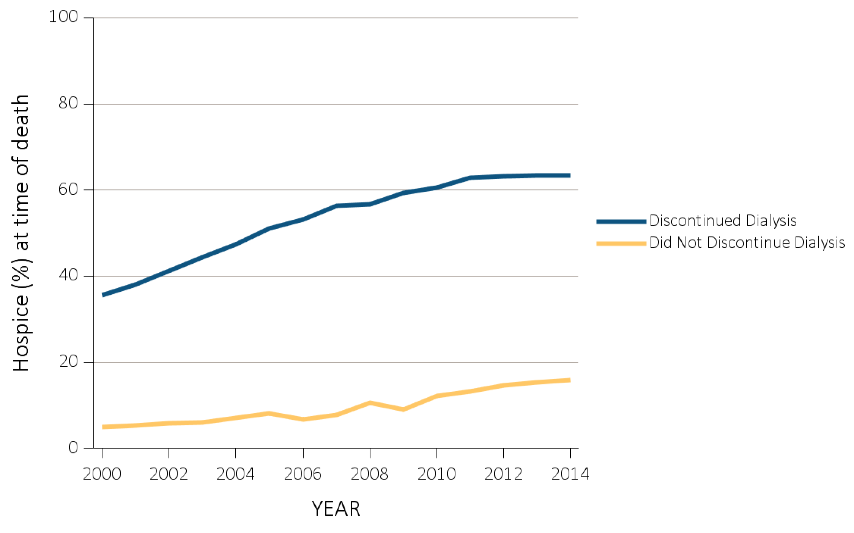
vol 2 Figure 12.9 Hospice utilization at the time of death among Medicare beneficiaries with ESRD overall, and by age, race, ethnicity, sex, modality, and whether dialysis was discontinued, 2000-2014
(g) Hospice utilization by whether patients discontinued dialysis before death
Data Source: Special Analyses, USRDS ESRD Database. Denominator population is all decedents with Medicare Parts A and B throughout the last 90 days of life. Receipt of hospice care at the time of death was defined as having a claim in the Hospice SAF on or after the date of death or Discharge Status from hospice=40, 41, or 42. Abbreviation: ESRD, end-stage renal disease.

Slide 52
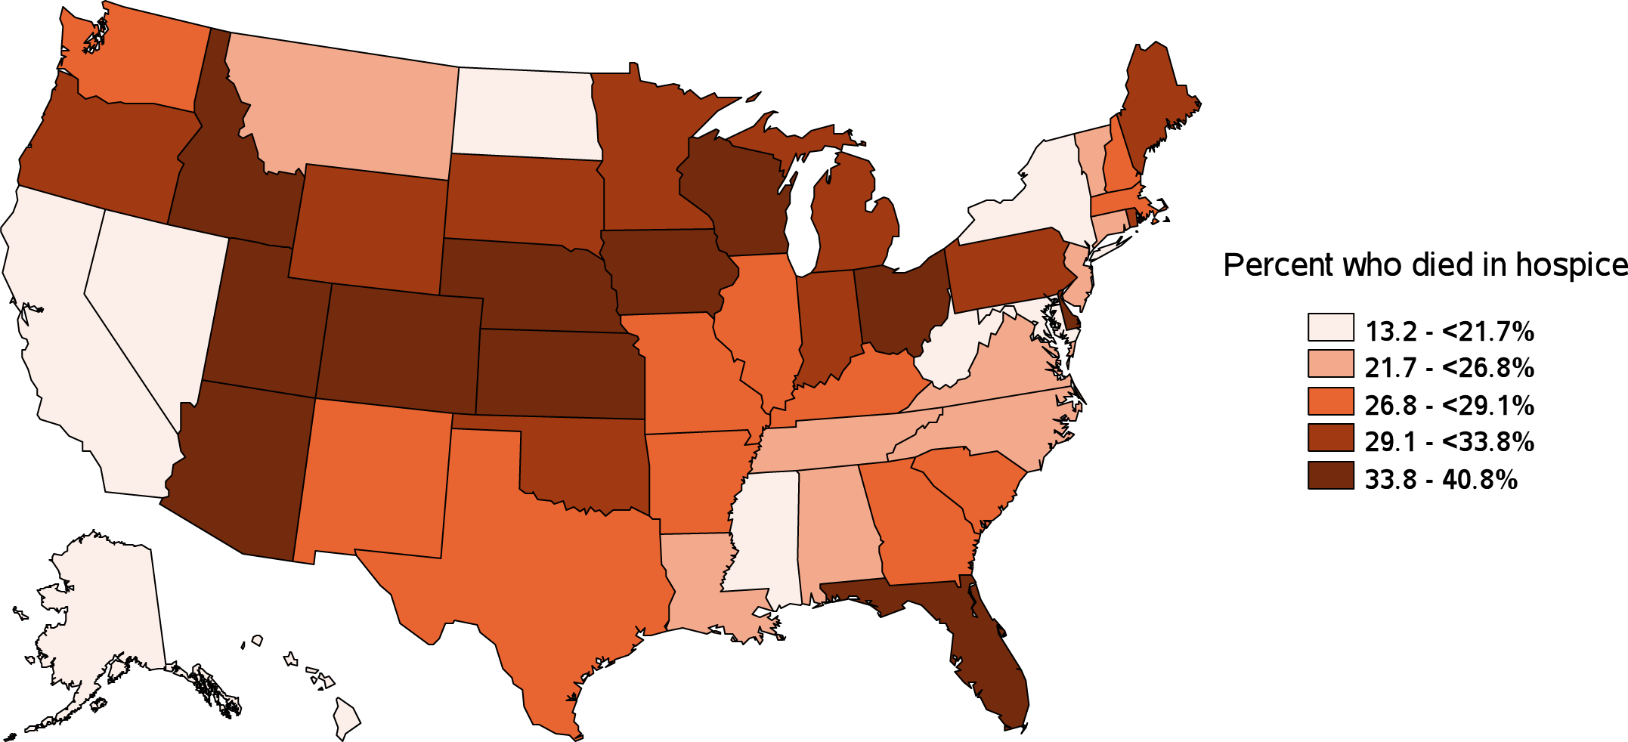
vol 2 Figure 12.9 Hospice utilization at the time of death among Medicare beneficiaries with ESRD overall, and by age, race, ethnicity, sex, modality, and whether dialysis was discontinued, 2000-2014
(h) Hospice utilization by state
Data Source: Special Analyses, USRDS ESRD Database. Denominator population is all decedents with Medicare Parts A and B throughout the last 90 days of life. Receipt of hospice care at the time of death was defined as having a claim in the Hospice SAF on or after the date of death or Discharge Status from hospice=40, 41, or 42. Abbreviation: ESRD, end-stage renal disease.

Slide 53
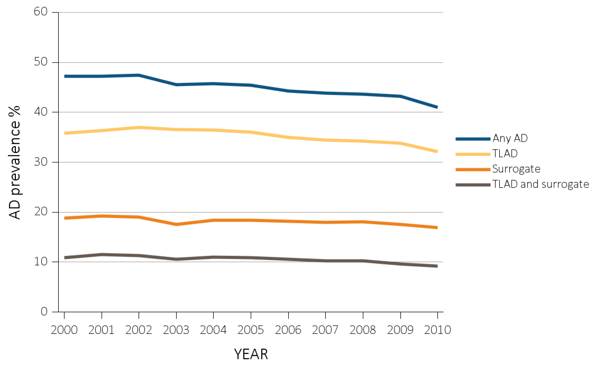
vol 2 Figure 12.10 Advance directive prevalence before death among Nursing Home ESRD decedents with ESRD overall, and by age, race, ethnicity, sex, modality, vintage, and impaired decision making, 2000-2010
(a) Advance directive prevalence by year, overall
Data Source: Special Analyses, USRDS ESRD Database. Denominator population is all decedents with Medicare Parts A and B throughout the last 90 days of life. Receipt of hospice care at the time of death was defined as having a claim in the Hospice SAF on or after the date of death or Discharge Status from hospice=40, 41, or 42. Abbreviation: ESRD, end-stage renal disease.

Slide 54

vol 2 Figure 12.10 Advance directive prevalence before death among Nursing Home ESRD decedents with ESRD overall, and by age, race, ethnicity, sex, modality, vintage, and impaired decision making, 2000-2010
(b) Advance directive prevalence by age
Data Source: Special Analyses, USRDS ESRD Database. Denominator population is all decedents with Medicare Parts A and B throughout the last 90 days of life. Receipt of hospice care at the time of death was defined as having a claim in the Hospice SAF on or after the date of death or Discharge Status from hospice=40, 41, or 42. Abbreviation: ESRD, end-stage renal disease.

Slide 55

vol 2 Figure 12.10 Advance directive prevalence before death among Nursing Home ESRD decedents with ESRD overall, and by age, race, ethnicity, sex, modality, vintage, and impaired decision making, 2000-2010
(c) Advance directive prevalence by race
Data Source: Special Analyses, USRDS ESRD Database. Denominator population is all decedents with Medicare Parts A and B throughout the last 90 days of life. Receipt of hospice care at the time of death was defined as having a claim in the Hospice SAF on or after the date of death or Discharge Status from hospice=40, 41, or 42. Abbreviation: ESRD, end-stage renal disease.

Slide 56

vol 2 Figure 12.10 Advance directive prevalence before death among Nursing Home ESRD decedents with ESRD overall, and by age, race, ethnicity, sex, modality, vintage, and impaired decision making, 2000-2010
(d) Advance directive prevalence by ethnicity
Data Source: Special Analyses, USRDS ESRD Database. Denominator population is all decedents with Medicare Parts A and B throughout the last 90 days of life. Receipt of hospice care at the time of death was defined as having a claim in the Hospice SAF on or after the date of death or Discharge Status from hospice=40, 41, or 42. Abbreviation: ESRD, end-stage renal disease.

Slide 57

vol 2 Figure 12.10 Advance directive prevalence before death among Nursing Home ESRD decedents with ESRD overall, and by age, race, ethnicity, sex, modality, vintage, and impaired decision making, 2000-2010
(e) Advance directive prevalence by sex
Data Source: Special Analyses, USRDS ESRD Database. Denominator population is all decedents with Medicare Parts A and B throughout the last 90 days of life. Receipt of hospice care at the time of death was defined as having a claim in the Hospice SAF on or after the date of death or Discharge Status from hospice=40, 41, or 42. Abbreviation: ESRD, end-stage renal disease.

Slide 58

vol 2 Figure 12.10 Advance directive prevalence before death among Nursing Home ESRD decedents with ESRD overall, and by age, race, ethnicity, sex, modality, vintage, and impaired decision making, 2000-2010
(f) Advance directive prevalence by modality
Data Source: Special Analyses, USRDS ESRD Database. Denominator population is all decedents with Medicare Parts A and B throughout the last 90 days of life. Receipt of hospice care at the time of death was defined as having a claim in the Hospice SAF on or after the date of death or Discharge Status from hospice=40, 41, or 42. Abbreviation: ESRD, end-stage renal disease.

Slide 59

vol 2 Figure 12.10 Advance directive prevalence before death among Nursing Home ESRD decedents with ESRD overall, and by age, race, ethnicity, sex, modality, vintage, and impaired decision making, 2000-2010
(g) Advance directive prevalence by vintage
Data Source: Special Analyses, USRDS ESRD Database. Denominator population is all decedents with Medicare Parts A and B throughout the last 90 days of life. Receipt of hospice care at the time of death was defined as having a claim in the Hospice SAF on or after the date of death or Discharge Status from hospice=40, 41, or 42. Abbreviation: ESRD, end-stage renal disease.

Slide 60

vol 2 Figure 12.10 Advance directive prevalence before death among Nursing Home ESRD decedents with ESRD overall, and by age, race, ethnicity, sex, modality, vintage, and impaired decision making, 2000-2010
(h) Advance directive prevalence by impaired decision making
Data Source: Special Analyses, USRDS ESRD Database. Denominator population is all decedents with Medicare Parts A and B throughout the last 90 days of life. Receipt of hospice care at the time of death was defined as having a claim in the Hospice SAF on or after the date of death or Discharge Status from hospice=40, 41, or 42. Abbreviation: ESRD, end-stage renal disease.

Slide 61

vol 2 Figure 12.11 Percent with treatment limitation in advance directives, 2000-2010
Data Source: Special Analyses, USRDS ESRD Database. Denominator population is all decedents with Medicare Parts A and B throughout the last 90 days of life. Receipt of hospice care at the time of death was defined as having a claim in the Hospice SAF on or after the date of death or Discharge Status from hospice=40, 41, or 42. Abbreviation: DNR, do not resuscitate; ESRD, end-stage renal disease.

Slide 62

vol 2 Figure 12.12 Type of treatment limitations listed in advance directives, 2000-2010
Data Source: Special Analyses, USRDS ESRD Database. Denominator population is all decedents with Medicare Parts A and B throughout the last 90 days of life. Receipt of hospice care at the time of death was defined as having a claim in the Hospice SAF on or after the date of death or Discharge Status from hospice=40, 41, or 42. Abbreviation: DNR, do not resuscitate; ESRD, end-stage renal disease.

Slide 63

vol 2 Figure 12.13 Prevalence of advance directive components, by decision-making status, 2000-2010
Data Source: Special Analyses, USRDS ESRD Database. Denominator population is all decedents with Medicare Parts A and B throughout the last 90 days of life. Receipt of hospice care at the time of death was defined as having a claim in the Hospice SAF on or after the date of death or Discharge Status from hospice=40, 41, or 42.

Slide 64

vol 2 Figure 12.14 Prevalence of impaired decision-making capacity, by patient characteristics
(a) Prevalence of impaired decision making capacity, by sex
Data Source: Special Analyses, USRDS ESRD Database. Denominator population is all decedents with Medicare Parts A and B throughout the last 90 days of life. Receipt of hospice care at the time of death was defined as having a claim in the Hospice SAF on or after the date of death or Discharge Status from hospice=40, 41, or 42.

Slide 65

vol 2 Figure 12.14 Prevalence of impaired decision-making capacity, by patient characteristics
(b) Prevalence of impaired decision making capacity, by age at death
Data Source: Special Analyses, USRDS ESRD Database. Denominator population is all decedents with Medicare Parts A and B throughout the last 90 days of life. Receipt of hospice care at the time of death was defined as having a claim in the Hospice SAF on or after the date of death or Discharge Status from hospice=40, 41, or 42.

Slide 66

vol 2 Figure 12.14 Prevalence of impaired decision-making capacity, by patient characteristics
(c) Prevalence of impaired decision making capacity, by modality
Data Source: Special Analyses, USRDS ESRD Database. Denominator population is all decedents with Medicare Parts A and B throughout the last 90 days of life. Receipt of hospice care at the time of death was defined as having a claim in the Hospice SAF on or after the date of death or Discharge Status from hospice=40, 41, or 42.

Slide 67

vol 2 Figure 12.14 Prevalence of impaired decision-making capacity, by patient characteristics
(d) Prevalence of impaired decision making capacity, by race
Data Source: Special Analyses, USRDS ESRD Database. Denominator population is all decedents with Medicare Parts A and B throughout the last 90 days of life. Receipt of hospice care at the time of death was defined as having a claim in the Hospice SAF on or after the date of death or Discharge Status from hospice=40, 41, or 42.

Slide 68

vol 2 Figure 12.14 Prevalence of impaired decision-making capacity, by patient characteristics
(e) Prevalence of impaired decision making capacity, by vintage
Data Source: Special Analyses, USRDS ESRD Database. Denominator population is all decedents with Medicare Parts A and B throughout the last 90 days of life. Receipt of hospice care at the time of death was defined as having a claim in the Hospice SAF on or after the date of death or Discharge Status from hospice=40, 41, or 42.

Slide 69

vol 2 Figure 12.15 Costs in the (a) last 30 days of life, and (b) last 7 days of life in relation to timing of hospice care, 2014
(a) Last 30 days of life
Data Source: Special Analyses, USRDS ESRD Database. Denominator population is all decedents with Medicare Parts A and B throughout the last 90 days of life exclusive of those patients without any costs during the last 30 days of life and those with negative costs. Date of the first claim in the Hospice SAF (HCFASAF=H) within the last 90 days of life is taken as the date of first receipt of hospice services. Timing of hospice referral in relation to death was categorized as 0-2 days, 3-5 days 6-14 days and 15-90 days). Explanation of box plot: the lower border of the box is the first quartile and the upper border is the third quartile of the distribution, the length of the box is the interquartile range, and the line in the middle of the box is the median value. The whiskers extend from the lowest value of the distribution that is ≥ the first quartile minus 1.5 times the interquartile range at the bottom to the highest value of the distribution that is ≤ the third quartile plus 1.5 times the interquartile range at the top. Values outside this range (outliers) are not plotted.

Slide 70

vol 2 Figure 12.15 Costs in the (a) last 30 days of life, and (b) last 7 days of life in relation to timing of hospice care, 2014
(b) Last 7 days of life
Data Source: Special Analyses, USRDS ESRD Database. Denominator population is all decedents with Medicare Parts A and B throughout the last 90 days of life exclusive of those patients without any costs during the last 30 days of life and those with negative costs. Date of the first claim in the Hospice SAF (HCFASAF=H) within the last 90 days of life is taken as the date of first receipt of hospice services. Timing of hospice referral in relation to death was categorized as 0-2 days, 3-5 days 6-14 days and 15-90 days). Explanation of box plot: the lower border of the box is the first quartile and the upper border is the third quartile of the distribution, the length of the box is the interquartile range, and the line in the middle of the box is the median value. The whiskers extend from the lowest value of the distribution that is ≥ the first quartile minus 1.5 times the interquartile range at the bottom to the highest value of the distribution that is ≤ the third quartile plus 1.5 times the interquartile range at the top. Values outside this range (outliers) are not plotted.

