Slide 1
2018 Annual Data Report
Volume 1: Chronic Kidney Disease
Chapter 6: CKD among Children and Adolescents
2018 Annual Data Report
Volume 1 CKD, Chapter 6

Slide 2

vol 1 Table 6.1 Demographic characteristics of pediatric patients among Optum Clinformatics™, 2016
 | All children |  | Children with CKD
 | Sample count | Percent (%) | Count | Percent (% of all children)
All | 1,970,375 | 100 | 5,285 | 0.27
Age
0-4 | 308,099 | 15.6 | 1,122 | 0.36
5-9 | 445,408 | 22.6 | 1,027 | 0.23
10-13 | 392,978 | 19.9 | 839 | 0.21
14-17 | 411,582 | 20.9 | 1,085 | 0.26
18-21 | 412,308 | 20.9 | 1,212 | 0.29
Sex
Male | 1,007,120 | 51.1 | 2,491 | 0.25
Female | 963,175 | 48.9 | 2,794 | 0.29
Unknown | 80 | <0.01 | 0 | 0.00
Race/Ethnicity
White | 1,265,505 | 64.2 | 3,459 | 0.27
Black/African American | 149,789 | 7.6 | 342 | 0.23
Asian | 104,525 | 5.3 | 239 | 0.23
Hispanic | 244,113 | 12.4 | 626 | 0.26
Unknown/Missing | 206,443 | 10.5 | 619 | 0.30
Comorbidity
Diabetes Mellitus | 6,546 | 0.3 | 217 | 3.32
Hypertension | 3,483 | 0.2 | 463 | 13.29
Cardiovascular Disease | 17,549 | 0.9 | 543 | 3.09
Data Source: Special analyses, Optum Clinformatics™ (aged <22) alive & eligible for all of 2016. CVD is defined as presence of any of the following comorbidities: cerebrovascular accident, peripheral vascular disease, atherosclerotic heart disease, heart failure, dysrhythmia or other cardiac comorbidities. Abbreviation: CKD, chronic kidney disease.

Slide 3
vol 1 Table 6.2 Prevalence of comorbid conditions by diagnosis codes (CKD, CVD), (a) total & (b) one or more, among Optum Clinformatics™ pediatric patients, 2016
(a) total
 | Clinformatics™
 | Sample count | Cases per 10,000
All
Total CKD | 5,285 | 27
Total CVD | 17,549 | 89
Total DM | 6,546 | 33
Data Source: Special analyses, Optum Clinformatics™ (aged <22) alive & eligible for all of 2016. Abbreviations: CKD, chronic kidney disease; CVD, cardiovascular disease; DM, diabetes mellitus. CVD is defined as presence of any of the following comorbidities: cerebrovascular accident, peripheral vascular disease, atherosclerotic heart disease, congestive heart failure, dysrhythmia or other cardiac comorbidities.

Slide 4
vol 1 Table 6.2 Prevalence of comorbid conditions by diagnosis codes (CKD, CVD), (a) total & (b) one or more, among Optum Clinformatics™ pediatric patients, 2016
(b) Combinations of CKD, CVD, or DM diagnoses
 |  | Clinformatics™
 |  | Sample count | Cases per 10,000
All
Only CKD |  | 4,564 | 23
Only CVD |  | 16,731 | 85
Only DM |  | 6,054 | 31
CKD & DM, no CVD |  | 178 | 1
CKD & CVD, no DM |  | 504 | 3
DM & CVD, no CKD |  | 275 | 1
CKD & CVD & DM |  | 39 | <1
At least one comorbidity |  | 28,345 | 144
At least two comorbidities |  | 996 | 5
No CKD, no CVD, no DM |  | 1,942,030 | 9,856
Data Source: Special analyses, Optum Clinformatics™ (aged <22) alive & eligible for all of 2016. Abbreviations: CKD, chronic kidney disease; CVD, cardiovascular disease; DM, diabetes mellitus. CVD is defined as presence of any of the following comorbidities: cerebrovascular accident, peripheral vascular disease, atherosclerotic heart disease, congestive heart failure, dysrhythmia or other cardiac comorbidities.

Slide 5
vol 1 Table 6.3 Unadjusted and adjusted all-cause hospitalization rates (per 1,000 patient years at risk) for Clinformatics™ patients aged <22, by CKD status, 2016
 | Unadjusted |  | Adjusted
 | No CKD | All CKD | No CKD | All CKD
All | 28.3 | 325.8 | 22.4 | 273.0
0-4 | 95.2 | 482.5 | 55.9 | 366.4
5-9 | 5.4 | 216.0 | 5.6 | 218.6
10-13 | 6.3 | 174.1 | 6.7 | 174.2
14-17 | 14.1 | 227.8 | 14.9 | 228.1
18-21 | 20.1 | 345.0 | 21.3 | 343.3
Male | 26.9 | 346.9 | 20.8 | 275.5
Female | 29.8 | 304.9 | 24.0 | 268.0
White | 12.7 | 247.4 | 13.7 | 244.0
Blk/Af Am | 14.0 | 267.1 | 15.1 | 262.8
Other | 44.8 | 407.5 | 36.2 | 303.8
Data source: Special analyses, Optum Clinformatics™. January 1, 2016 point prevalent patients, aged <22. Optum Clinformatics™ commercial insurance patients aged <22 who were enrolled in the plan, did not have diagnoses of ESRD, and were alive on January 1, 2016. Adj: for age/sex/race. Standard population: all patients, 2010-2011. Abbreviations: Blk/Af Am, Black/African American; CKD, chronic kidney disease.

Slide 6
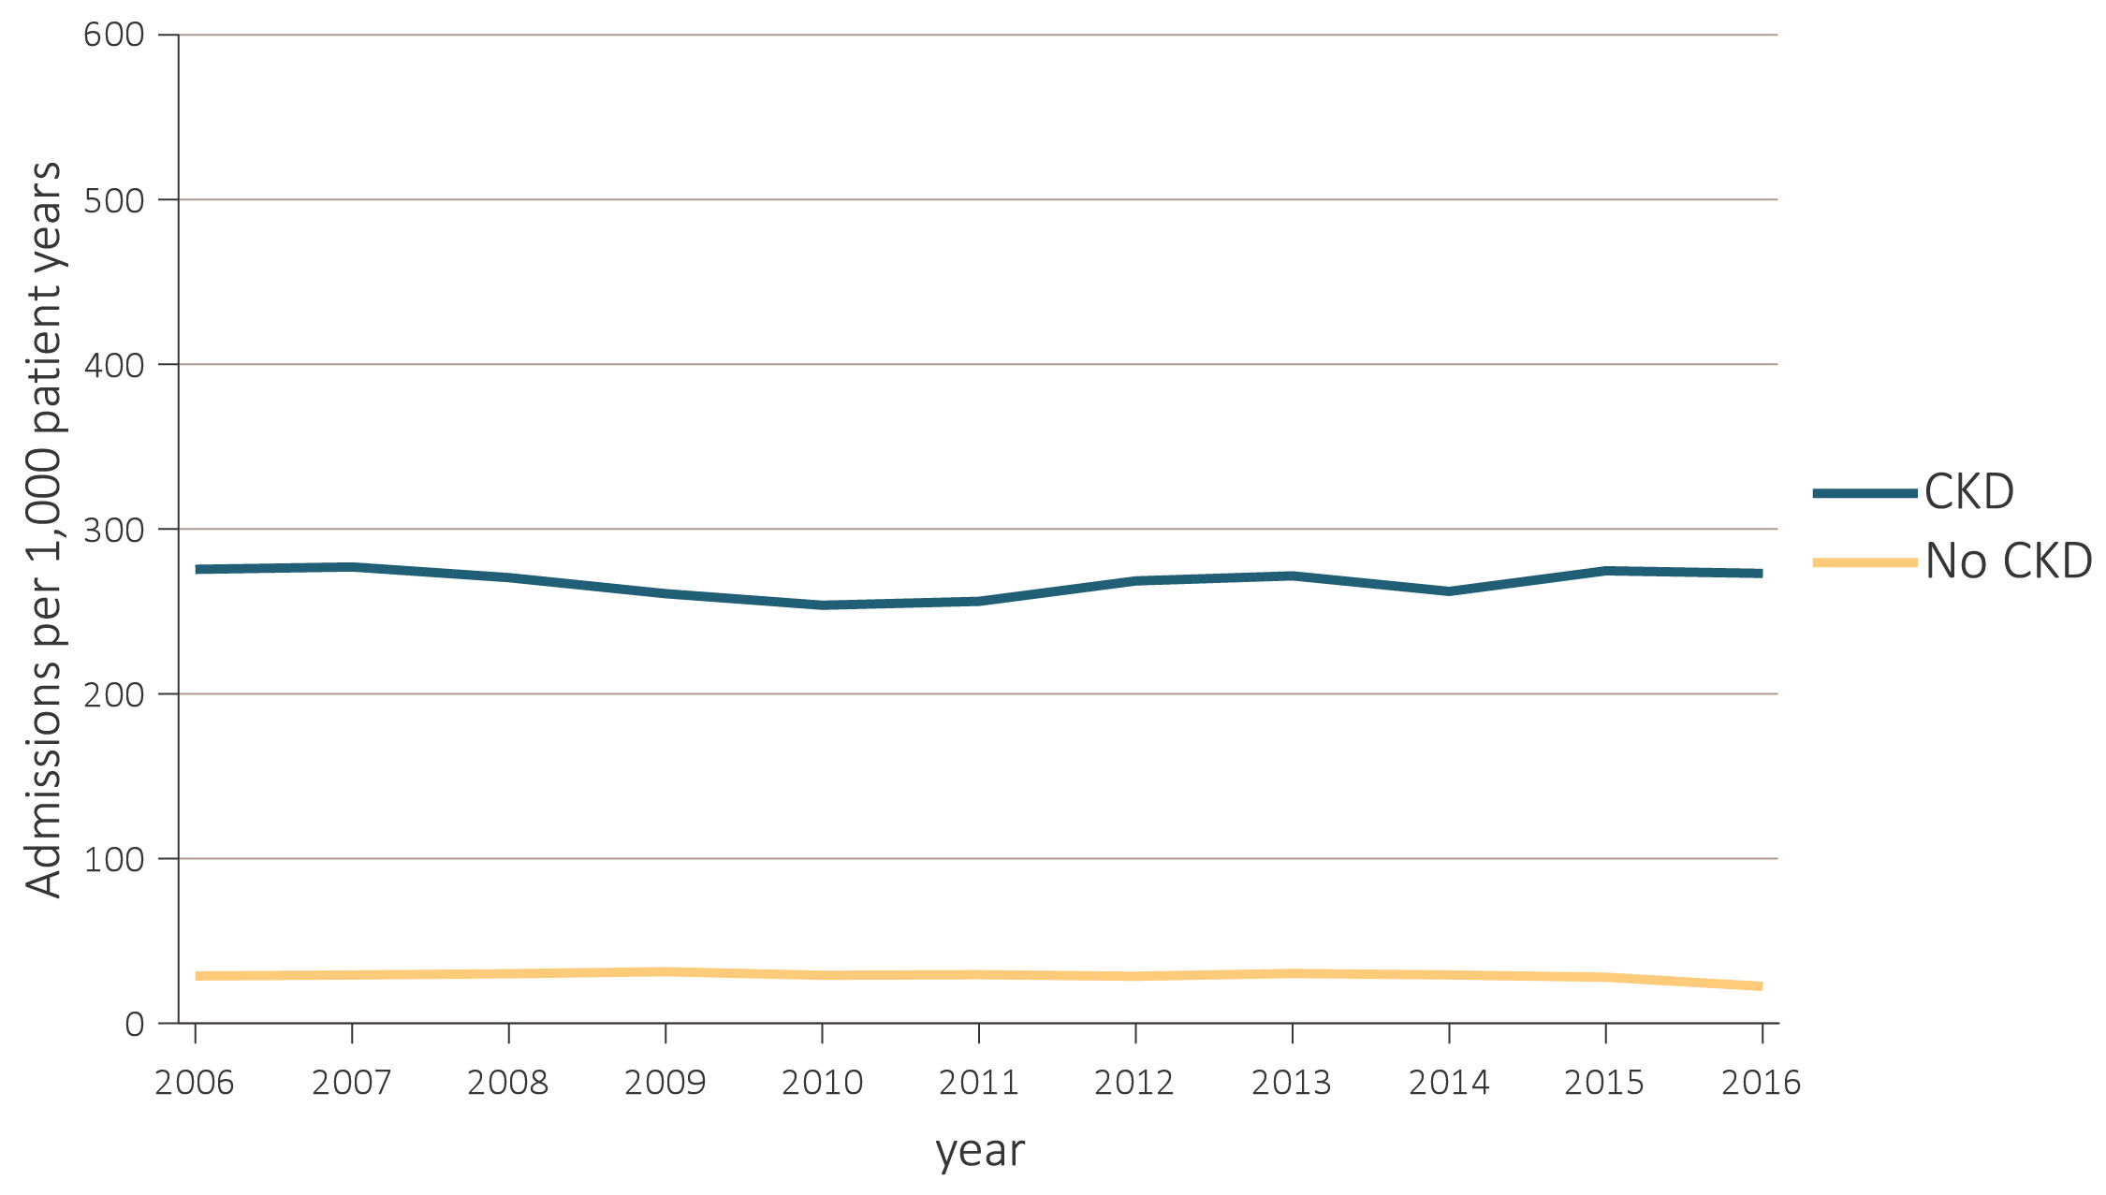
vol 1 Figure 6.1 Adjusted all-cause hospitalization rates (per 1,000 patient years at risk) for Clinformatics™ patients aged <22, by CKD status and year, 2006-2016
Data source: Clinfomatics™. January 1, 2016 point prevalent Clinformatics™ patients age <22. Adj: age/sex/race. Ref: 2010-2011 patients. Abbreviations: CKD, chronic kidney disease.

Slide 7
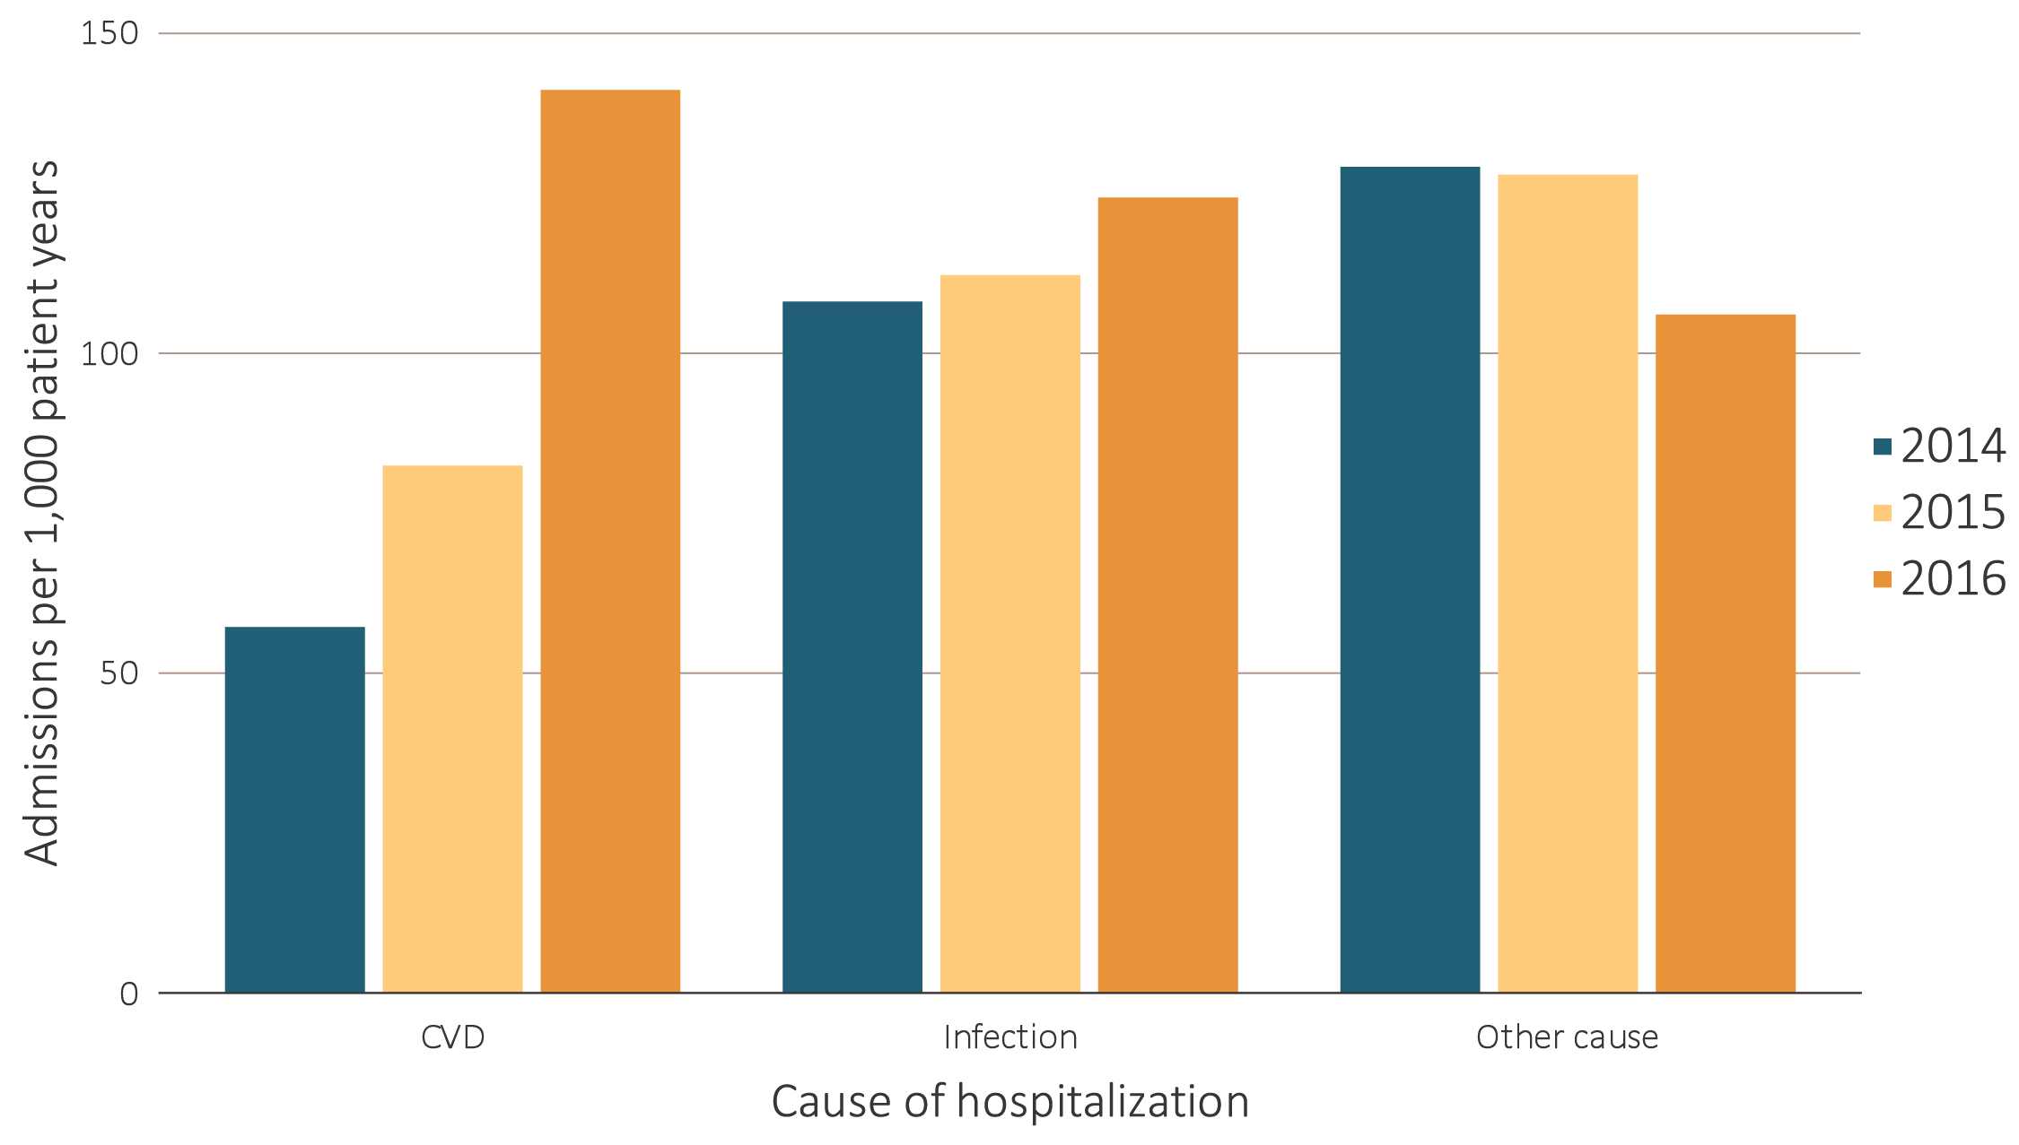
vol 1 Figure 6.2 Adjusted rates of hospitalization (per 1,000 patient years at risk) for Clinformatics™ patients aged < 22 with CKD, by cause, 2014-2016
Data source: Clinformatics™. January 1, 2016 point prevalent Clinformatics™ patients, age < 22 . Adj: age/sex/race; rates by one factor are adjusted for the others. Ref: all patients, 2010-2011. Abbreviations: CKD, chronic kidney disease; CVD, cardiovascular disease.

Slide 8
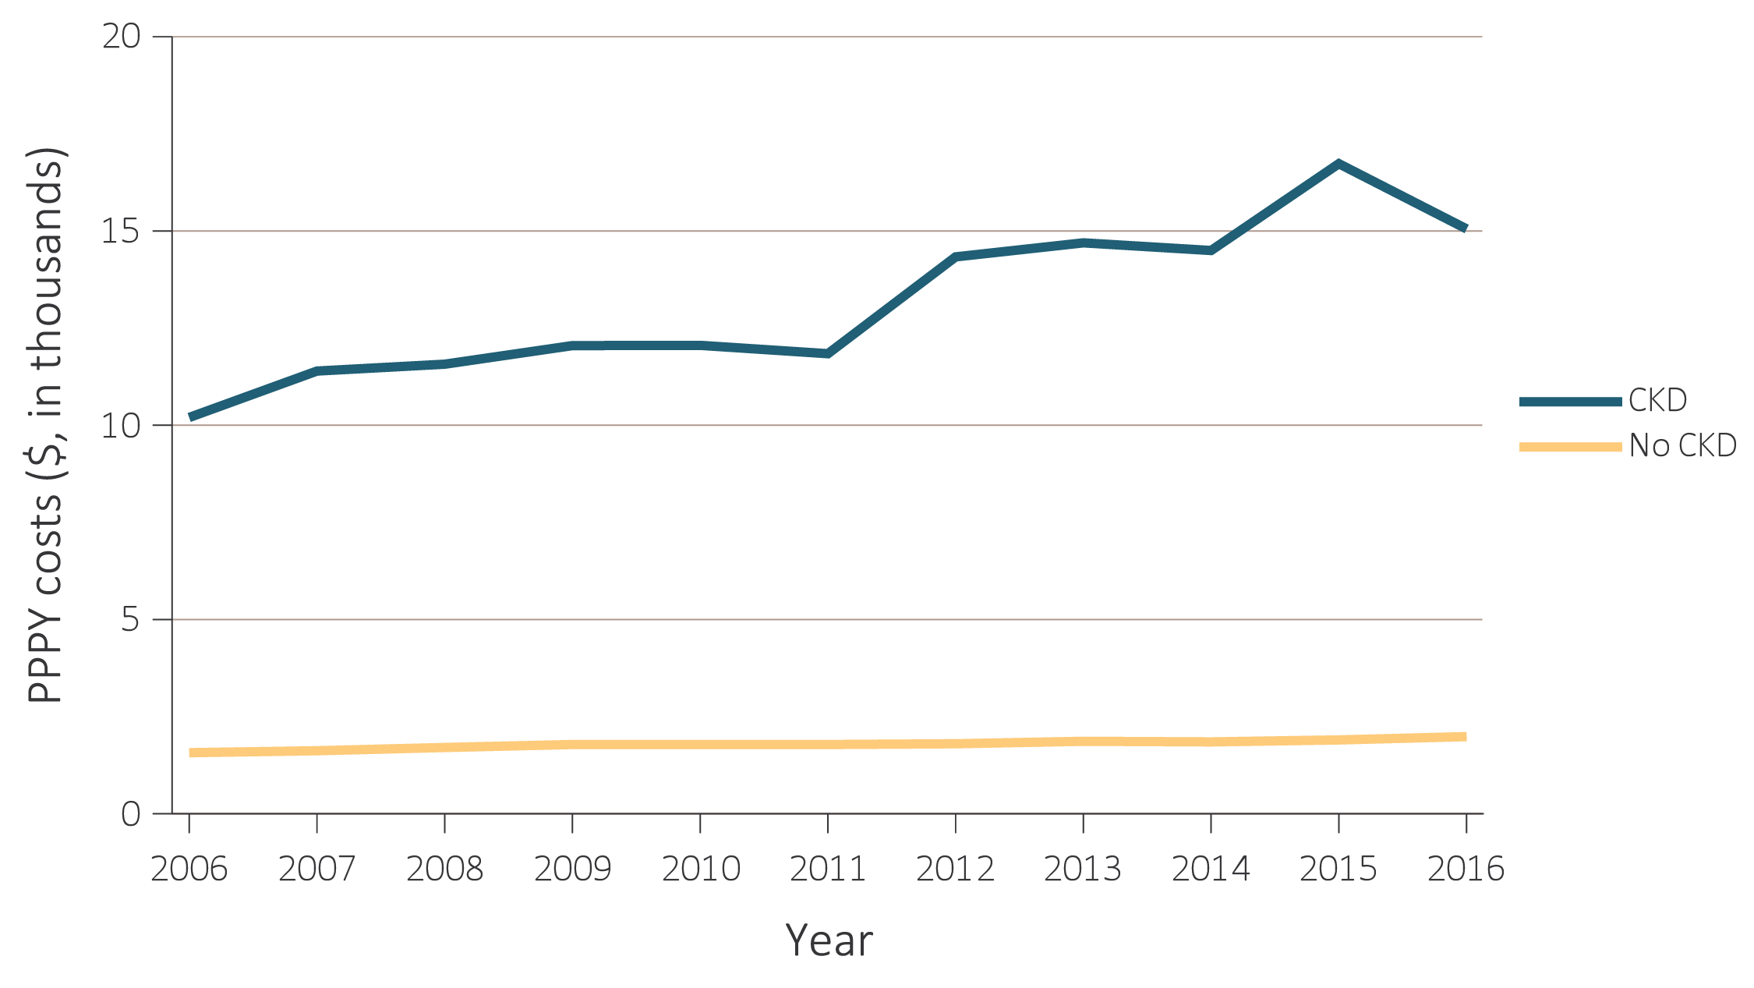
vol 1 Figure 6.3 Per person per year Commercial spending ($, in thousands) for Clinformatics™ patients aged <22, by CKD status, and year, 2006-2016
Data Source: Optum Clinformatics™. Abbreviations: CKD, chronic kidney disease; PPPY, per person per year.

