Slide 1
2018 Annual Data Report
Volume 1: Chronic Kidney Disease
Chapter 8: Prescription Drug Coverage in Patients with CKD
2018 Annual Data Report Volume 1 CKD, Chapter 8

Slide 2
vol 1 Figure 7.1 Sources of prescription drug coverage in Medicare enrollees, by population, 2016
Data source: Medicare 5% sample. Point prevalent Medicare enrollees alive on January 1, 2016. Abbreviations: CKD, chronic kidney disease; LIS, Medicare Low-income Subsidy; Part D, Medicare prescription drug coverage benefit.

Slide 3
vol 1 Table 8.1 General Medicare and CKD patients enrolled in Part D
 | General Medicare (%) | All CKD (%)
2011 | 55.7 | 59.3
2012 | 57.6 | 60.5
2013 | 65.7 | 69.3
2014 | 66.3 | 71.1
2015 | 67.1 | 71.9
2016 | 69.5 | 73.7
Data source: Medicare 5% sample. Point prevalent Medicare enrollees alive on January 1. Abbreviations: CKD, chronic kidney disease; Part D, Medicare prescription drug coverage benefit.

Slide 4
vol 1 Table 8.2 Medicare Part D parameters for defined standard benefit, 2011 & 2016
Data source: Table adapted from http://www.q1medicare.com/PartD-The-2016-Medicare-Part-D-Outlook.php. Medicare Part D Enrollment Patterns. ªThe catastrophic coverage amount is the greater of 5% of medication cost or the values shown in the chart above. In 2016, beneficiaries were charged $2.95 for those generic or preferred multisource drugs with a retail price less than $59 and 5% for those with a retail price over $59. For brand name drugs, beneficiaries paid $7.4 for those drugs with a retail price less than $148 and 5% for those with a retail price over $148. In 2016, beneficiaries received a 50% discount on brand name drugs from manufacturers plus 5% coverage from their Part D plans; plans also paid 42% of generic drug costs in the gap. Abbreviation: Part D, Medicare prescription drug coverage benefit.

Slide 5
vol 1 Figure 8.2 Sources of prescription drug coverage in Medicare enrollees, by age, 2016
(a) All general Medicare enrollees
Data source: Medicare 5% sample. Point prevalent Medicare enrollees alive on January 1, 2016. Abbreviations: CKD, chronic kidney disease; LIS, Medicare Low-income Subsidy; Part D, Medicare prescription drug coverage benefit.

Slide 6
(b) Enrollees with CKD
Data source: Medicare 5% sample. Point prevalent Medicare enrollees alive on January 1, 2016. Abbreviations: CKD, chronic kidney disease; LIS, Medicare Low-income Subsidy; Part D, Medicare prescription drug coverage benefit.

Slide 7
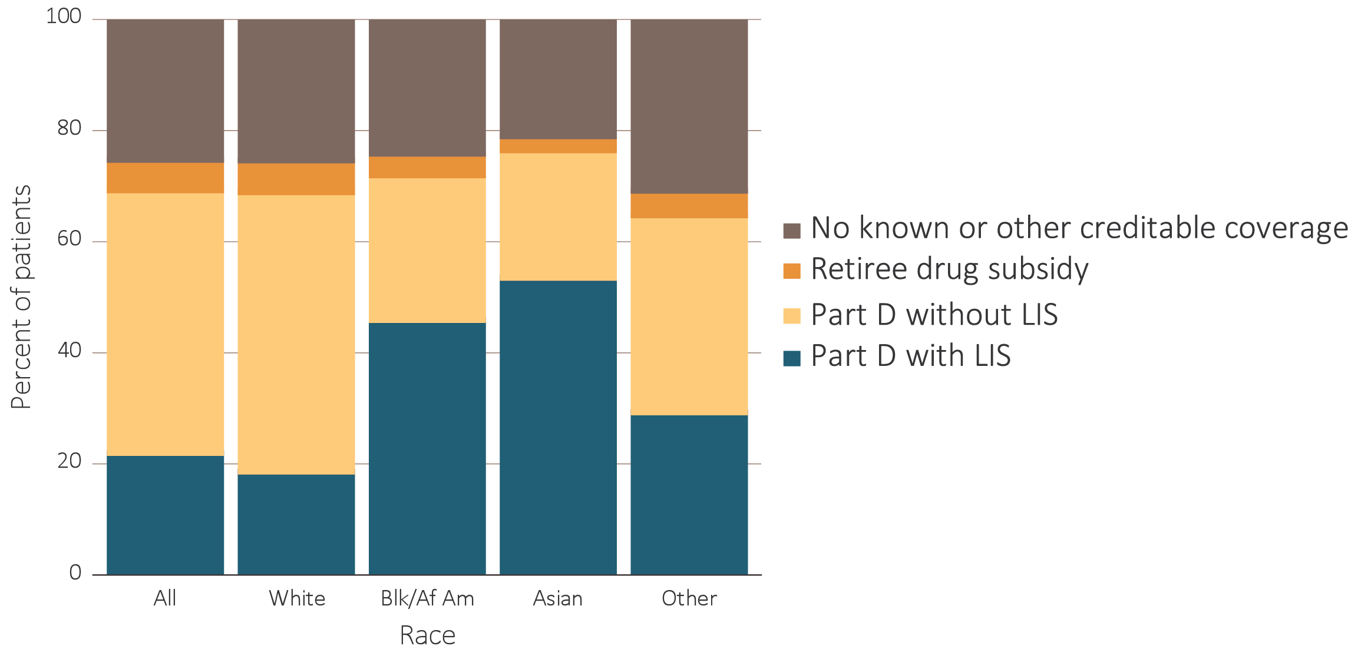
vol 1 Figure 8.3 Sources of prescription drug coverage in Medicare enrollees, by race, 2016
Data source: Medicare 5% sample. Point prevalent Medicare enrollees alive on January 1, 2016. Abbreviations: Blk/Af Am, Black/African American; CKD, chronic kidney disease; LIS, Medicare Low-income Subsidy; Part D, Medicare prescription drug coverage benefit.

Slide 8
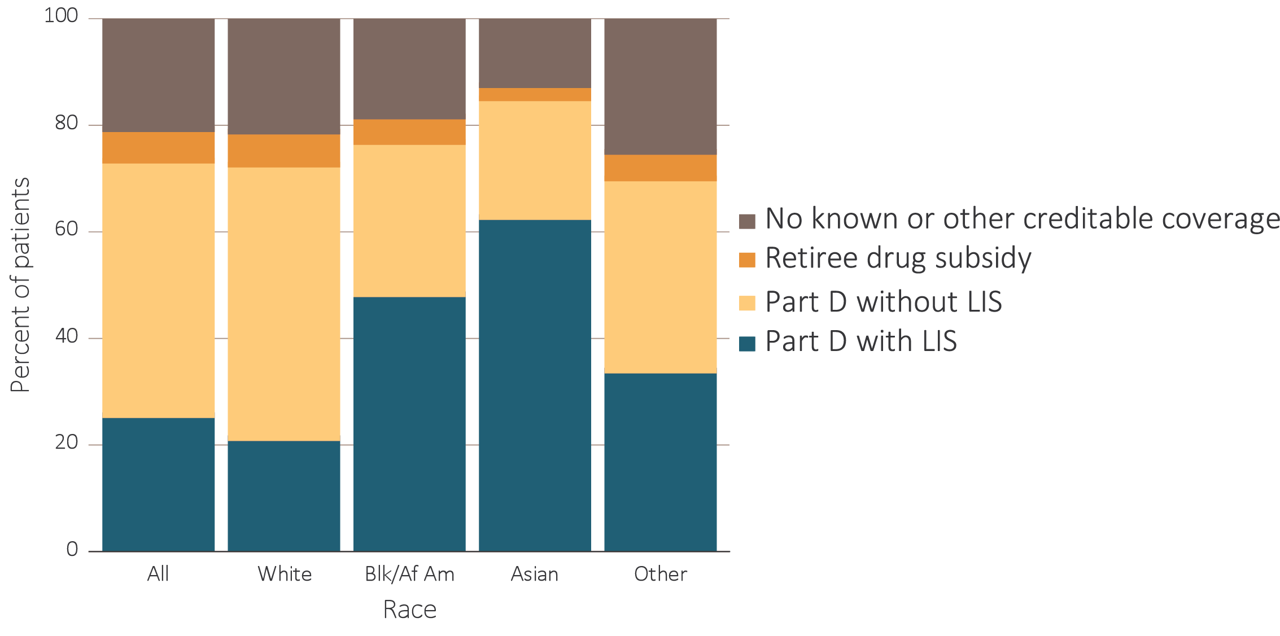
vol 1 Figure 8.3 Sources of prescription drug coverage in Medicare enrollees, by race, 2016
(b) Enrollees with CKD
Data source: Medicare 5% sample. Point prevalent Medicare enrollees alive on January 1, 2016. Abbreviations: Blk/Af Am, Black/African American; CKD, chronic kidney disease; LIS, Medicare Low-income Subsidy; Part D, Medicare prescription drug coverage benefit.

Slide 9
vol 1 Table 8.3 Medicare Part D enrollees with the Low-income Subsidy, by age & race, 2016
 | General Medicare (%) | All CKD (%)
 | Part D with Low-income Subsidy | Part D with Low-income Subsidy
All | 32.9 | 36.1
White
All ages | 27.0 | 29.3
20-44 | 92.4 | 94.2
45-64 | 75.4 | 76.8
65-74 | 15.1 | 23.2
75+ | 18.8 | 23.7
Black/African American
All ages | 63.8 | 62.8
20-44 | 95.2 | 96.6
45-64 | 85.4 | 85.5
65-74 | 44.8 | 50.5
75+ | 52.7 | 58.2
Asian
All ages | 70.0 | 73.8
20-44 | 93.1 | 93.1
45-64 | 85.3 | 84.1
65-74 | 60.0 | 63.8
75+ | 73.9 | 77.2
Other races
All ages | 45.2 | 48.5
20-44 | 94.9 | 96.5
45-64 | 80.6 | 81.9
65-74 | 30.4 | 35.3
75+ | 39.8 | 47.7
Data source: Medicare 5% sample. Point prevalent Medicare enrollees alive on January 1, 2016. Abbreviations: CKD, chronic kidney disease; Part D, Medicare prescription drug coverage benefit.

Slide 10
vol 1 Figure 8.4 Distribution of Low-income Subsidy categories in Part D general Medicare and CKD patients, 2016
Data source: Medicare 5% sample. Point prevalent Medicare enrollees alive on January 1, 2016. Abbreviations: CKD, chronic kidney disease; Part D, Medicare prescription drug coverage benefit.

Slide 11
vol 1 Table 8.4 Total estimated Medicare Part D spending for fee-for-service beneficiaries (in billions),2011-2016
 | General Medicare |  | All CKD
Year | Medicare spending (in billions) | Medicare spending / PPPY | Medicare spending (in billions) | Medicare spending / PPPY
2011 | $40.1 | $2,689 | $5.2 | $3,978
2012 | $35.7 | $2,610 | $4.8 | $3,918
2013 | $45.7 | $2,584 | $6.8 | $3,947
2014 | $50.5 | $2,806 | $7.7 | $4,229
2015 | $54.2 | $2,970 | $8.7 | $4,545
2016 | $56.9 | $3,027 | $11.8 | $4,941
Data source: Medicare Part D claims. Medicare totals include Part D claims for Part D enrollees with traditional Medicare (Parts A & B). CKD totals include Medicare CKD patients, as determined from claims. Abbreviations: CKD, chronic kidney disease; Part D, Medicare prescription drug coverage benefit; PPPY, per person per year.

Slide 12
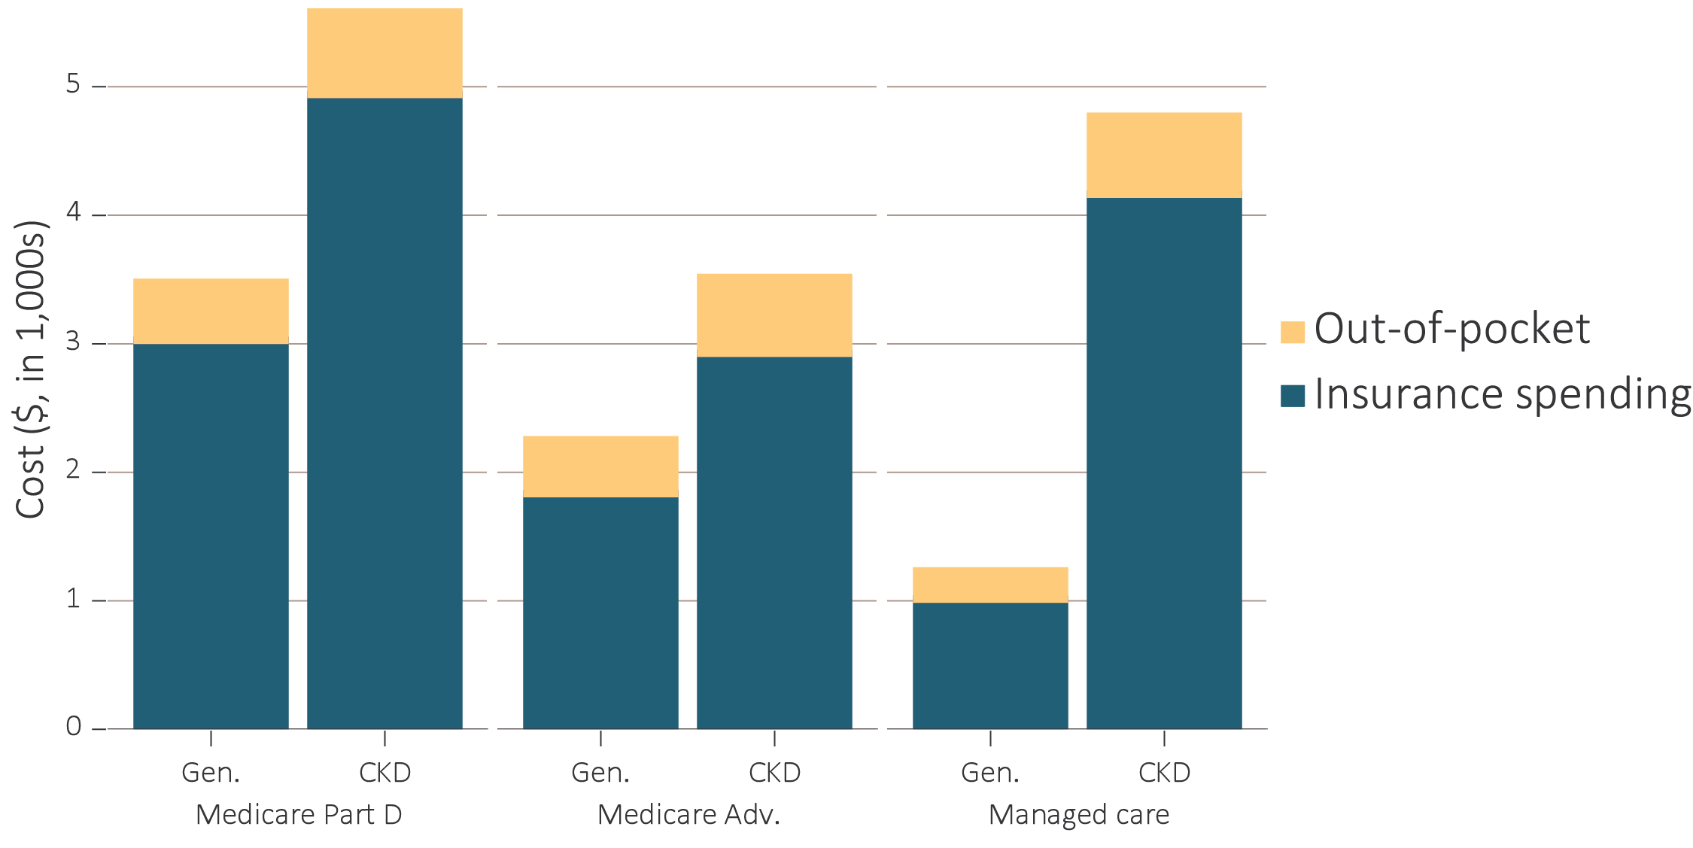
vol 1 Figure 8.5 Per person per year & out-of-pocket costs (in $1,000s) for enrollees, 2016
(a) All enrollees by type of insurance and modality
Data source: Medicare Part D claims and Optum Clinformatics™ claims. Medicare totals include Part D claims for Part D enrollees with traditional Medicare (Parts A & B). CKD totals include Medicare CKD patients as determined from claims. Costs are per person per year for calendar year 2016. Medicare total is the sum of Medicare net payment plus Low-income Supplement amount. Abbreviations: Gen., general enrollees; CKD, chronic kidney disease; LIS, Medicare Low-income Subsidy; Medicare adv., Medicare Advantage plans; Part D, Medicare prescription drug coverage benefit.

Slide 13
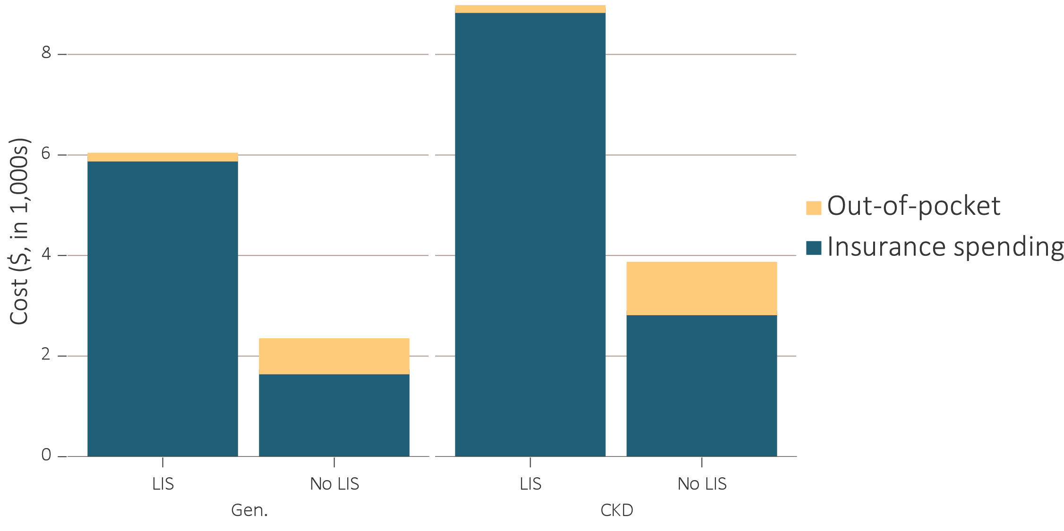
vol 1 Figure 8.5 Per person per year & out-of-pocket costs (in $1,000s) for enrollees, 2016
Data source: Medicare Part D claims and Optum Clinformatics™ claims. Medicare totals include Part D claims for Part D enrollees with traditional Medicare (Parts A & B). CKD totals include Medicare CKD patients as determined from claims. Costs are per person per year for calendar year 2016. Medicare total is the sum of Medicare net payment plus Low-income Supplement amount. Abbreviations: Gen., general enrollees; CKD, chronic kidney disease; LIS, Medicare Low-income Subsidy; Medicare adv., Medicare Advantage plans; Part D, Medicare prescription drug coverage benefit.

Slide 14
vol 1 Table 8.5 Per person per year spending ($) for enrollees, 2016
(a) Medicare Part D
Data source: Medicare Part D claims and Optum Clinformatics™ claims. CKD determined from claims. Costs are per person per year for calendar year 2016. Medicare PPPY is the sum of Medicare net payment and the Low-income Supplement amount. LIS status is determined from the Part D enrollment. A person is classified as LIS if they are eligible for the LIS for at least one month during 2016. Abbreviations: CKD, chronic kidney disease; LIS, Medicare Low-income Subsidy; NA, not applicable; Part D, Medicare prescription drug coverage benefit.

Slide 15
vol 1 Table 8.5 Per person per year spending ($) for enrollees, 2016
(b) Medicare Advantage and Managed Care
Data source: Medicare Part D claims and Optum Clinformatics™ claims. CKD determined from claims. Costs are per person per year for calendar year 2016. Medicare PPPY is the sum of Medicare net payment and the Low-income Supplement amount. LIS status is determined from the Part D enrollment. A person is classified as LIS if they are eligible for the LIS for at least one month during 2016. Abbreviations: CKD, chronic kidney disease; LIS, Medicare Low-income Subsidy; NA, not applicable; Part D, Medicare prescription drug coverage benefit.

Slide 16
vol 1 Table 8.6 Top 15 drug classes received by CKD cohorts in different health plans, by percent of patients, 2016
Rank | Drug class | Percent of patients
1 | Lipid-lowering agents | 65.2%
2 | Antibacterials | 60.2%
3 | Renin-angiotensin-aldosterone system Inhibitors | 59.2%
4 | β-adrenergic blocking agents | 54.6%
5 | Analgesics and antipyretics | 49.5%
6 | Diuretics | 46.0%
7 | Antiulcer agents and acid suppressants | 42.3%
8 | Antidiabetic agents | 42.1%
9 | Calcium-channel blocking agents | 38.0%
10 | Psychotherapeutic agents | 37.6%
11 | Antithrombotic agents | 31.1%
12 | Anticonvulsants | 27.7%
13 | Thyroid and antithyroid agents | 25.5%
14 | Anxiolytics, sedatives, and hypnotics | 23.3%
15 | Adrenals | 22.1%
Data source: Medicare Part D claims and Optum Clinformatics™ claims. CKD patients with Medicare Part D stand-alone prescription drug plans in the Medicare 5% sample. Diabetic Consumables refers to blood glucose test strips, blood glucose meters/sensors, lancets, needles, pen needles etc. Abbreviations: CKD, chronic kidney disease; Part D, Medicare prescription drug coverage benefit.

Slide 17
vol 1 Table 8.6 Top 15 drug classes received by CKD cohorts in different health plans, by percent of patients, 2016
Rank | Drug class | Percent of patients
1 | Lipid-lowering agents | 53.0%
2 | Renin-angiotensin-aldosterone system Inhibitors | 50.4%
3 | Antibacterials | 44.3%
4 | β-adrenergic blocking agents | 40.6%
5 | Analgesics and antipyretics | 36.7%
6 | Diuretics | 33.4%
7 | Calcium-channel blocking agents | 31.2%
8 | Antiulcer agents and acid suppressants | 30.3%
9 | Antidiabetic agents | 29.8%
10 | Psychotherapeutic agents | 26.3%
11 | Antithrombotic agents | 21.1%
12 | Vaccines | 20.4%
13 | Diabetic consumables | 19.5%
14 | Thyroid and antithyroid agents | 18.8%
15 | Anticonvulsants | 18.3%
Data source: Medicare Part D claims and Optum Clinformatics™ claims. CKD patients with Medicare Part D stand-alone prescription drug plans in the Medicare 5% sample. Diabetic Consumables refers to blood glucose test strips, blood glucose meters/sensors, lancets, needles, pen needles etc. Abbreviations: CKD, chronic kidney disease; Part D, Medicare prescription drug coverage benefit.

Slide 18
vol 1 Table 8.6 Top 15 drug classes received by CKD cohorts in different health plans, by percent of patients, 2016
Rank | Drug class | Percent of patients
1 | Antibacterials | 48.5%
2 | Renin-angiotensin-aldosterone system Inhibitors | 48.2%
3 | Lipid-lowering agents | 45.0%
4 | Analgesics and antipyretics | 41.8%
5 | β-adrenergic blocking agents | 31.2%
6 | Antidiabetic agents | 30.6%
7 | Calcium-channel blocking agents | 24.6%
8 | Diuretics | 23.8%
9 | Psychotherapeutic agents | 23.7%
10 | Antiulcer agents and acid suppressants | 20.6%
11 | Adrenals | 18.9%
12 | Anxiolytics, sedatives, and hypnotics | 18.7%
13 | Diabetic consumables | 18.0%
14 | Anticonvulsants | 15.4%
15 | Thyroid and antithyroid agents | 14.2%
Data source: Medicare Part D claims and Optum Clinformatics™ claims. CKD patients with Medicare Part D stand-alone prescription drug plans in the Medicare 5% sample. Diabetic Consumables refers to blood glucose test strips, blood glucose meters/sensors, lancets, needles, pen needles etc. Abbreviations: CKD, chronic kidney disease; Part D, Medicare prescription drug coverage benefit.

Slide 19
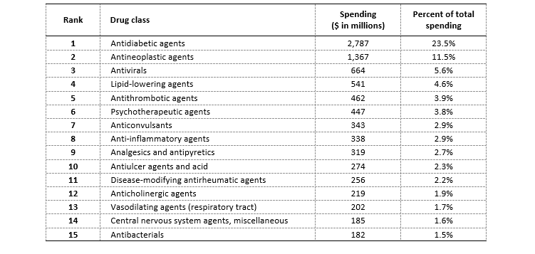
vol 1 Table 8.7 Top 15 drug classes received by different CKD cohorts (Medicare Part D/Medicare Advantage programs/Managed Care health plans), by insurance spending, 2016
(a) Medicare Part D
Data source: Medicare Part D claims and Optum Clinformatics™ claims. CKD patients with Medicare Part D stand-alone prescription drug plans in the Medicare 5% sample. Medicare Part D spending represents the sum of the Medicare covered amount and the Low- income Subsidy amount. Diabetic Consumables refers to blood glucose test strips, blood glucose meters/sensors, lancets, needles, pen needles etc. Abbreviations: CKD, chronic kidney disease; Part D, Medicare prescription drug coverage benefit.

Slide 20
vol 1 Table 8.7 Top 15 drug classes received by different CKD cohorts (Medicare Part D/Medicare Advantage programs/Managed Care health plans), by insurance spending, 2016
(b) Medicare Advantage
Rank | Drug class | Spending ($ in millions) | Percent of total spending
1 | Antidiabetic agents | 210 | 18.9%
2 | Antineoplastic agents | 126 | 11.3%
3 | Lipid-lowering agents | 71 | 6.4%
4 | Antivirals | 49 | 4.5%
5 | Antithrombotic agents | 49 | 4.4%
6 | Diabetes consumables | 48 | 4.3%
7 | Anti-inflammatory agents | 36 | 3.3%
8 | Psychotherapeutic agents | 34 | 3.0%
9 | Analgesics and antipyretics | 29 | 2.7%
10 | Anticonvulsants | 28 | 2.6%
11 | Renin-angiotensin-aldosterone system inhibitors | 24 | 2.2%
12 | Anticholinergic agents | 24 | 2.1%
13 | Disease-modifying antirheumatic agents | 22 | 2.0%
14 | Antiulcer agents and acid | 21 | 1.9%
15 | Vasodilating agents | 19 | 1.7%
Data source: Medicare Part D claims and Optum Clinformatics™ claims. CKD patients with Medicare Part D stand-alone prescription drug plans in the Medicare 5% sample. Medicare Part D spending represents the sum of the Medicare covered amount and the Low- income Subsidy amount. Diabetic Consumables refers to blood glucose test strips, blood glucose meters/sensors, lancets, needles, pen needles etc. Abbreviations: CKD, chronic kidney disease; Part D, Medicare prescription drug coverage benefit.

Slide 21
vol 1 Table 8.7 Top 15 drug classes received by different CKD cohorts (Medicare Part D/Medicare Advantage programs/Managed Care health plans), by insurance spending, 2016
(c) Managed Care
Rank | Drug class | Spending ($ in millions) | Percent of total spending
1 | Antidiabetic agents | 72 | 23.2%
2 | Antineoplastic agents | 43 | 14.0%
3 | Antivirals | 23 | 7.3%
4 | Disease-modifying antirheumatic agents | 16 | 5.1%
5 | Lipid-lowering agents | 15 | 5.0%
6 | Antithrombotic agents | 11 | 3.4%
7 | Analgesics and antipyretics | 9 | 2.7%
8 | Psychotherapeutic agents | 8 | 2.4%
9 | Diabetic consumables | 7 | 2.3%
10 | Anticonvulsants | 6 | 1.8%
11 | Anti-inflammatory agents | 6 | 1.8%
12 | Immunomodulatory agents | 5 | 1.7%
13 | Renin-angiotensin-aldosterone system inhibitors | 5 | 1.6%
14 | Antibacterials | 5 | 1.5%
15 | Skin and mucous membrane agents, miscellaneous | 4 | 1.4%
Data source: Medicare Part D claims and Optum Clinformatics™ claims. CKD patients with Medicare Part D stand-alone prescription drug plans in the Medicare 5% sample. Medicare Part D spending represents the sum of the Medicare covered amount and the Low- income Subsidy amount. Diabetic Consumables refers to blood glucose test strips, blood glucose meters/sensors, lancets, needles, pen needles etc. Abbreviations: CKD, chronic kidney disease; Part D, Medicare prescription drug coverage benefit.

Slide 22
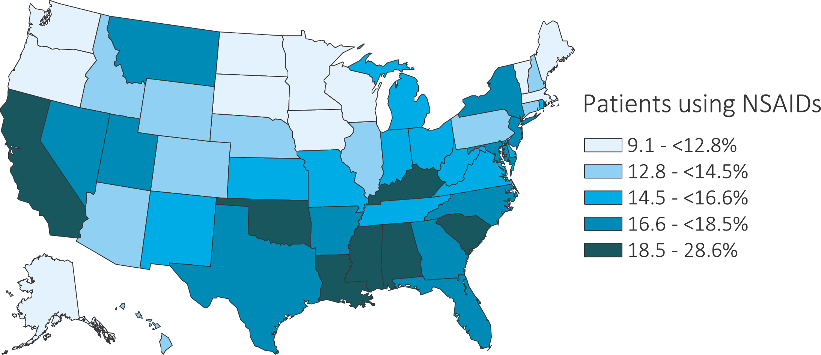
vol 1 Figure 8.6 Estimated utilization rate of prescription NSAIDs, by state, Medicare CKD Patients, 2016
Data source: Medicare Part D claims. CKD patients with Medicare Part D stand-alone prescription drug plans in the Medicare 5% sample. Abbreviations: CKD, chronic kidney disease; NSAIDs, nonsteroidal anti-inflammatory agents; Part D, Medicare prescription drug coverage benefit. NSAIDs filled under Medicare Part D represent a fraction of actual NSAID use.

Slide 23
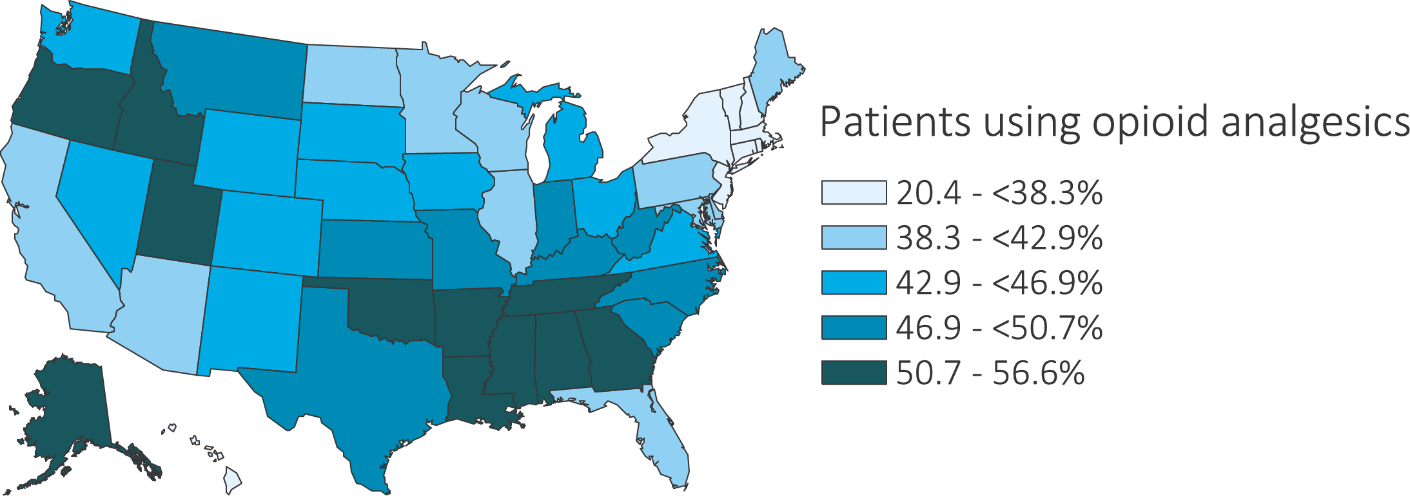
vol 1 Figure 8.7 Estimated utilization rate of opioid analgesics, by state, Medicare CKD Patients, 2016
Data source: Medicare Part D claims. CKD patients with Medicare Part D stand-alone prescription drug plans in the Medicare 5% sample. Abbreviations: CKD, chronic kidney disease; Part D, Medicare prescription drug coverage benefit.

Slide 24
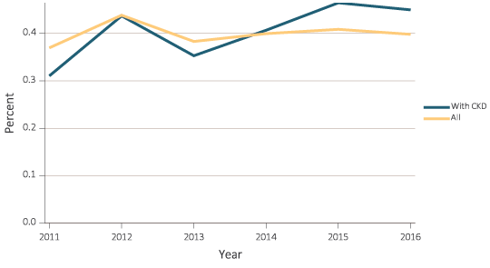
vol 1 Figure 8.8 Estimated prevalence of HIV and HCV in Medicare Part D enrollees, 2011-2016
(a) HIV
Data source: Medicare Part D claims. CKD patients with Medicare Part D stand-alone prescription drug plans in the Medicare 5% sample. Abbreviations: CKD, chronic kidney disease; HCV, hepatitis C; HIV, human immunodeficiency virus; Part D, Medicare prescription drug coverage benefit.

Slide 25
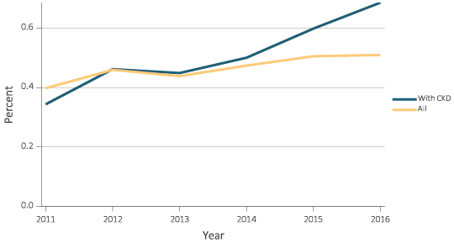
vol 1 Figure 8.8 Estimated prevalence of HIV and HCV in Medicare Part D enrollees, 2011-2016
(b) HCV
Data source: Medicare Part D claims. CKD patients with Medicare Part D stand-alone prescription drug plans in the Medicare 5% sample. Abbreviations: CKD, chronic kidney disease; HCV, hepatitis C; HIV, human immunodeficiency virus; Part D, Medicare prescription drug coverage benefit.

Slide 26
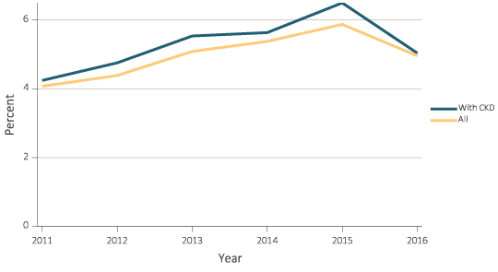
vol 1 Figure 8.9 Estimated utilization rate of prescription antivirals in Medicare Part D enrollees, 2011-2016
(a) All antivirals
Data source: Medicare Part D claims. CKD patients with Medicare Part D stand-alone prescription drug plans in the Medicare 5% sample. Abbreviations: CKD, chronic kidney disease; Part D, Medicare prescription drug coverage benefit.

Slide 27
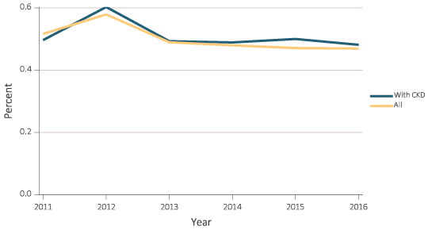
vol 1 Figure 8.9 Estimated utilization rate of prescription antivirals in Medicare Part D enrollees, 2011-2016
(b) Antiretrovirals
Data source: Medicare Part D claims. CKD patients with Medicare Part D stand-alone prescription drug plans in the Medicare 5% sample. Abbreviations: CKD, chronic kidney disease; Part D, Medicare prescription drug coverage benefit.

Slide 28
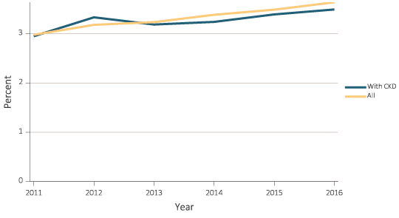
vol 1 Figure 8.9 Estimated utilization rate of prescription antivirals in Medicare Part D enrollees, 2011-2016
(c) Nucleosides and Nucleotides
Data source: Medicare Part D claims. CKD patients with Medicare Part D stand-alone prescription drug plans in the Medicare 5% sample. Abbreviations: CKD, chronic kidney disease; Part D, Medicare prescription drug coverage benefit.

Slide 29
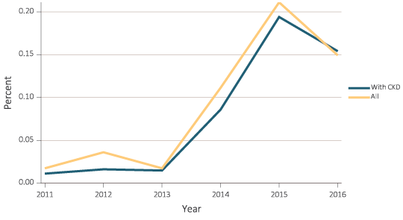
vol 1 Figure 8.9 Estimated utilization rate of prescription antivirals in Medicare Part D enrollees, 2011-2016
(d) Protease Inhibitors
Data source: Medicare Part D claims. CKD patients with Medicare Part D stand-alone prescription drug plans in the Medicare 5% sample. Abbreviations: CKD, chronic kidney disease; Part D, Medicare prescription drug coverage benefit.

Slide 30
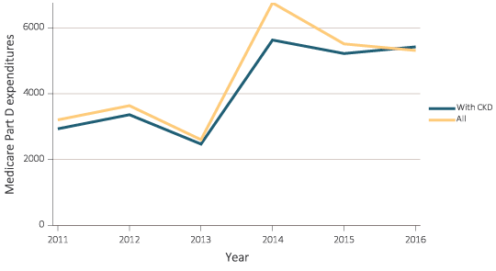
vol 1 Figure 8.10 Estimated PPPY Medicare Part D spending on antivirals in Medicare Part D enrollees, 2011-2016
(a) All antivirals
Data source: Medicare Part D claims. CKD patients with Medicare Part D stand-alone prescription drug plans in the Medicare 5% sample. Abbreviations: CKD, chronic kidney disease; Part D, Medicare prescription drug coverage benefit; PPPY, per person per year.

Slide 31
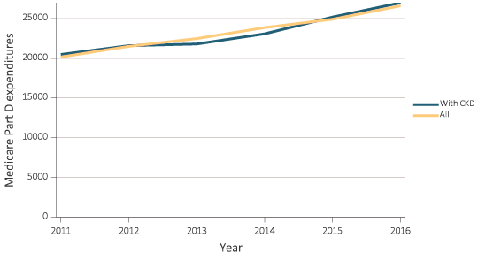
vol 1 Figure 8.10 Estimated PPPY Medicare Part D spending on antivirals in Medicare Part D enrollees, 2011-2016
Data source: Medicare Part D claims. CKD patients with Medicare Part D stand-alone prescription drug plans in the Medicare 5% sample. Abbreviations: CKD, chronic kidney disease; Part D, Medicare prescription drug coverage benefit; PPPY, per person per year.

Slide 32
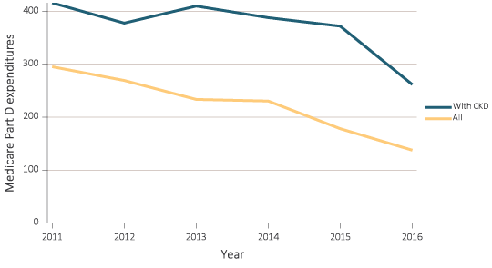
vol 1 Figure 8.10 Estimated PPPY Medicare Part D spending on antivirals in Medicare Part D enrollees, 2011-2016
Data source: Medicare Part D claims. CKD patients with Medicare Part D stand-alone prescription drug plans in the Medicare 5% sample. Abbreviations: CKD, chronic kidney disease; Part D, Medicare prescription drug coverage benefit; PPPY, per person per year.

Slide 33
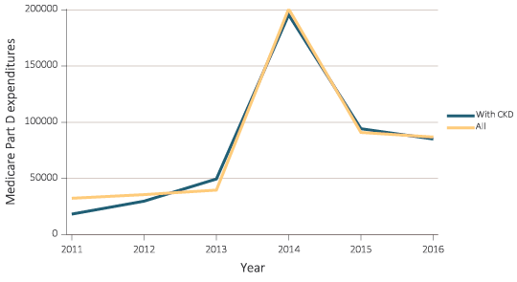
vol 1 Figure 8.10 Estimated PPPY Medicare Part D spending on antivirals in Medicare Part D enrollees, 2011-2016
Data source: Medicare Part D claims. CKD patients with Medicare Part D stand-alone prescription drug plans in the Medicare 5% sample. Abbreviations: CKD, chronic kidney disease; Part D, Medicare prescription drug coverage benefit; PPPY, per person per year.

