Slide 1
2018 Annual Data Report
Volume 2: End-Stage Renal Disease
Chapter 6: Transplantation

Slide 2
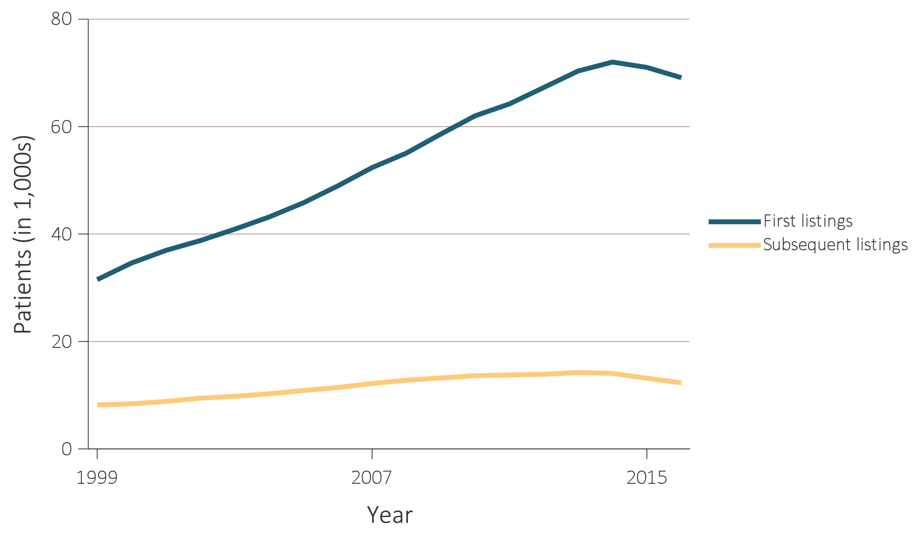
vol 2 Figure 6.1 Number of patients wait-listed for kidney transplant, 1999-2016
Data Source: Reference Table E.3. Number of patients wait-listed for kidney transplant. Waiting list counts include all candidates listed for a kidney transplant on December 31 of each year. Note that trends may be influenced by changes to the kidney allocation system (KAS) policy that were implemented in December 2014, as more fully described in the text.

Slide 3
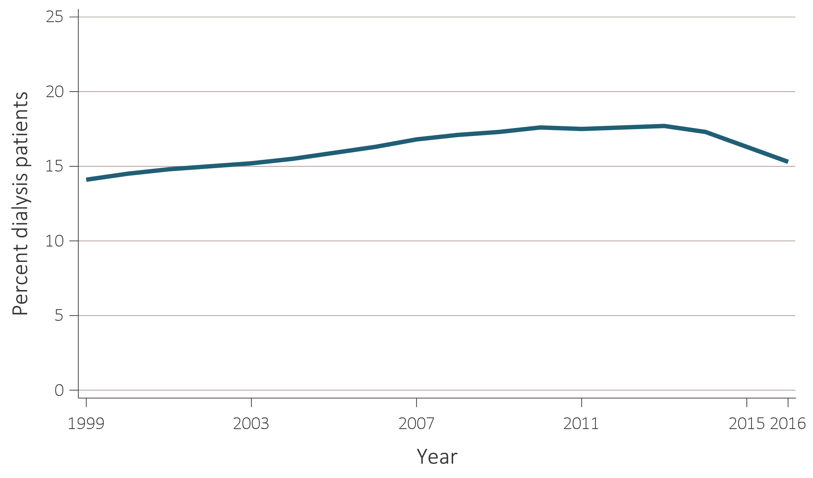
vol 2 Figure 6.2 Percentage of dialysis patients who were wait-listed, 1999-2016
Data Source: Reference Table E.4. Percentage of dialysis patients on the kidney waiting list is for all dialysis patients. Note that trends may be influenced by changes to the kidney allocation system (KAS) policy that were implemented in December 2014 as described more fully in the text above.

Slide 4
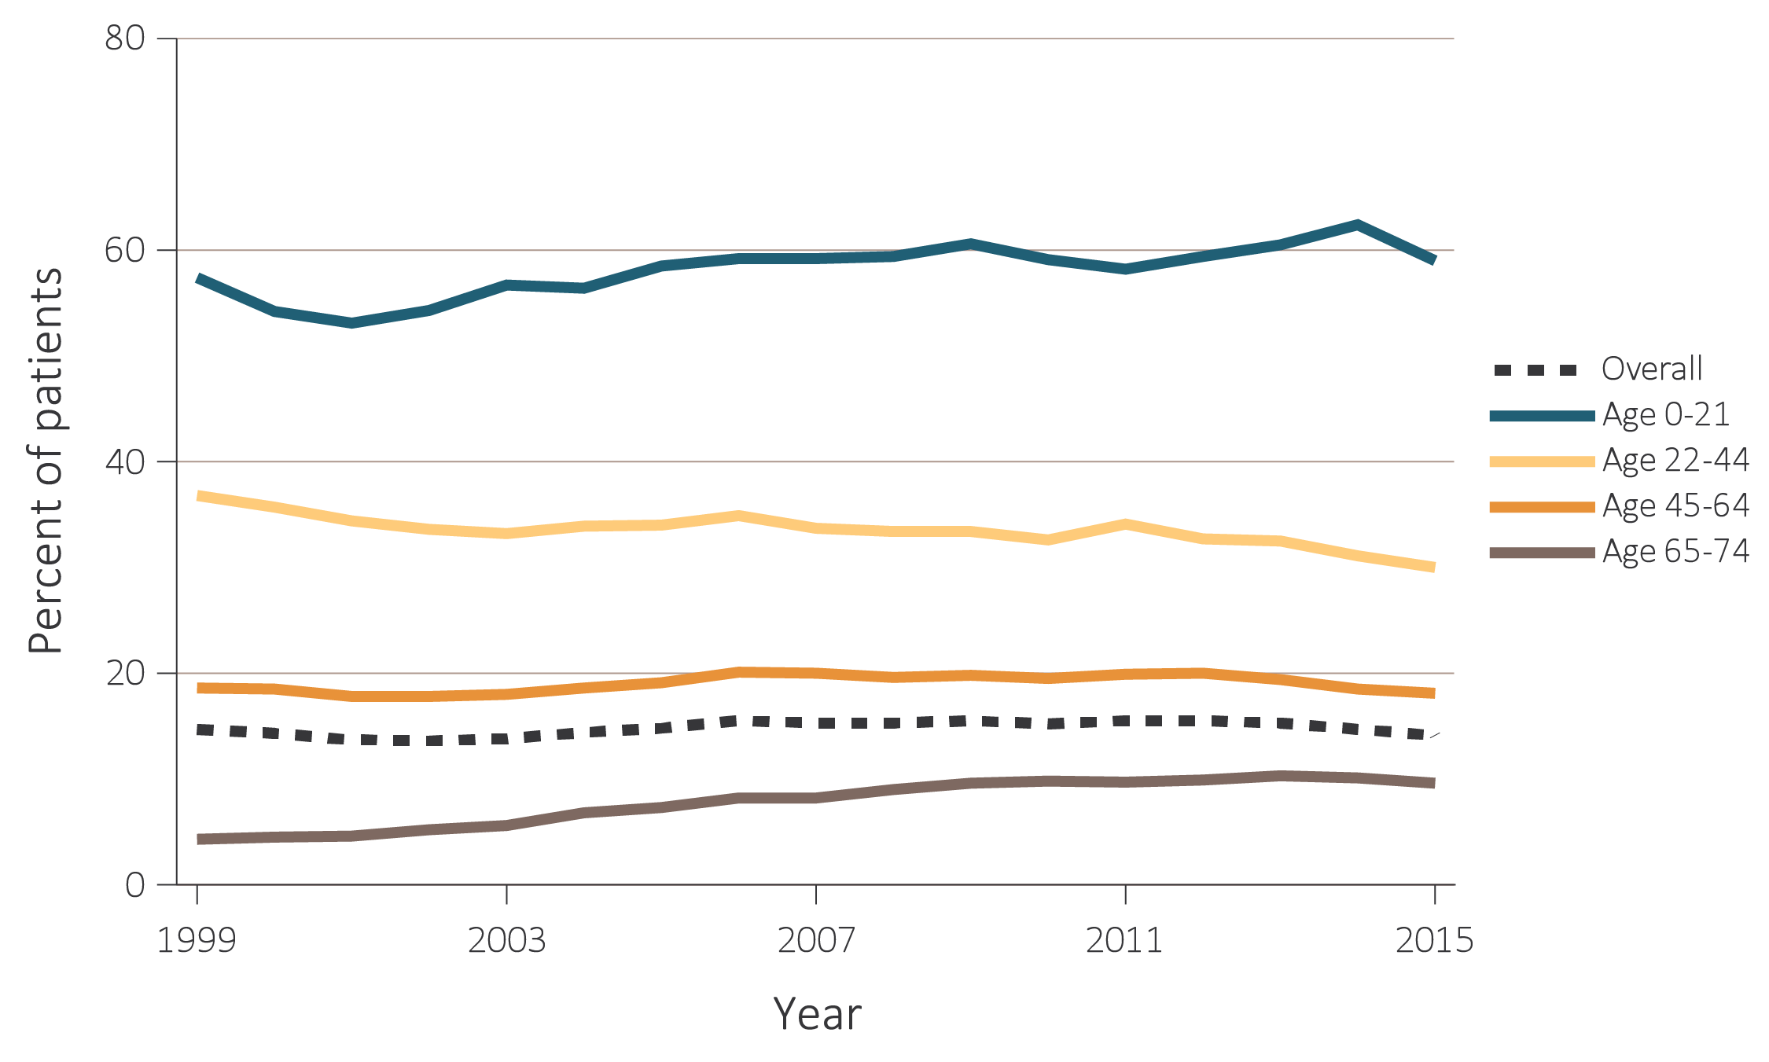
vol 2 Figure 6.3 Percentage of incident patients who were wait-listed or received a kidney transplant within one year of ESRD initiation, by age, 1999-2015
Data Source: Reference Table E.5(2). Waiting list or transplantation among incident ESRD patients by age (0-74 years). Note that trends may be influenced by changes to the kidney allocation system (KAS) policy that were implemented in December 2014, as more fully described in the text above. Abbreviation: ESRD, end-stage renal disease.

Slide 5
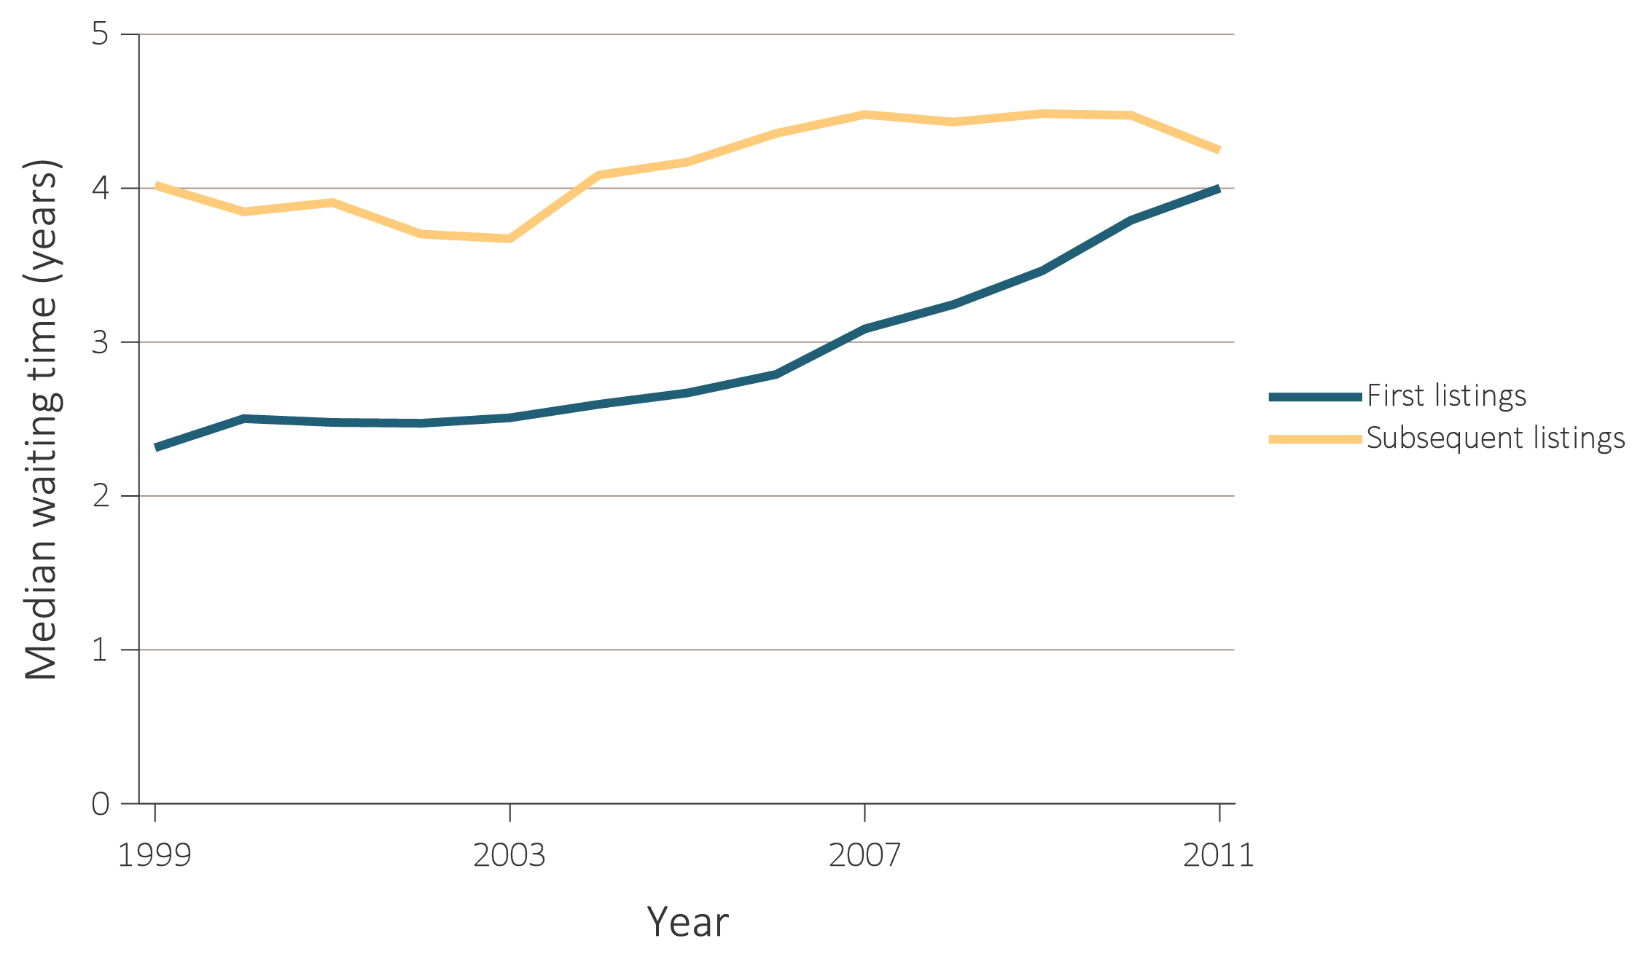
vol 2 Figure 6.4 Median waiting time for kidney transplant, 1999-2011
Data Source: Reference Tables E.2. Median waiting time to kidney transplant. Median waiting time is calculated for all candidates enrolled on the waiting list in a given year.

Slide 6
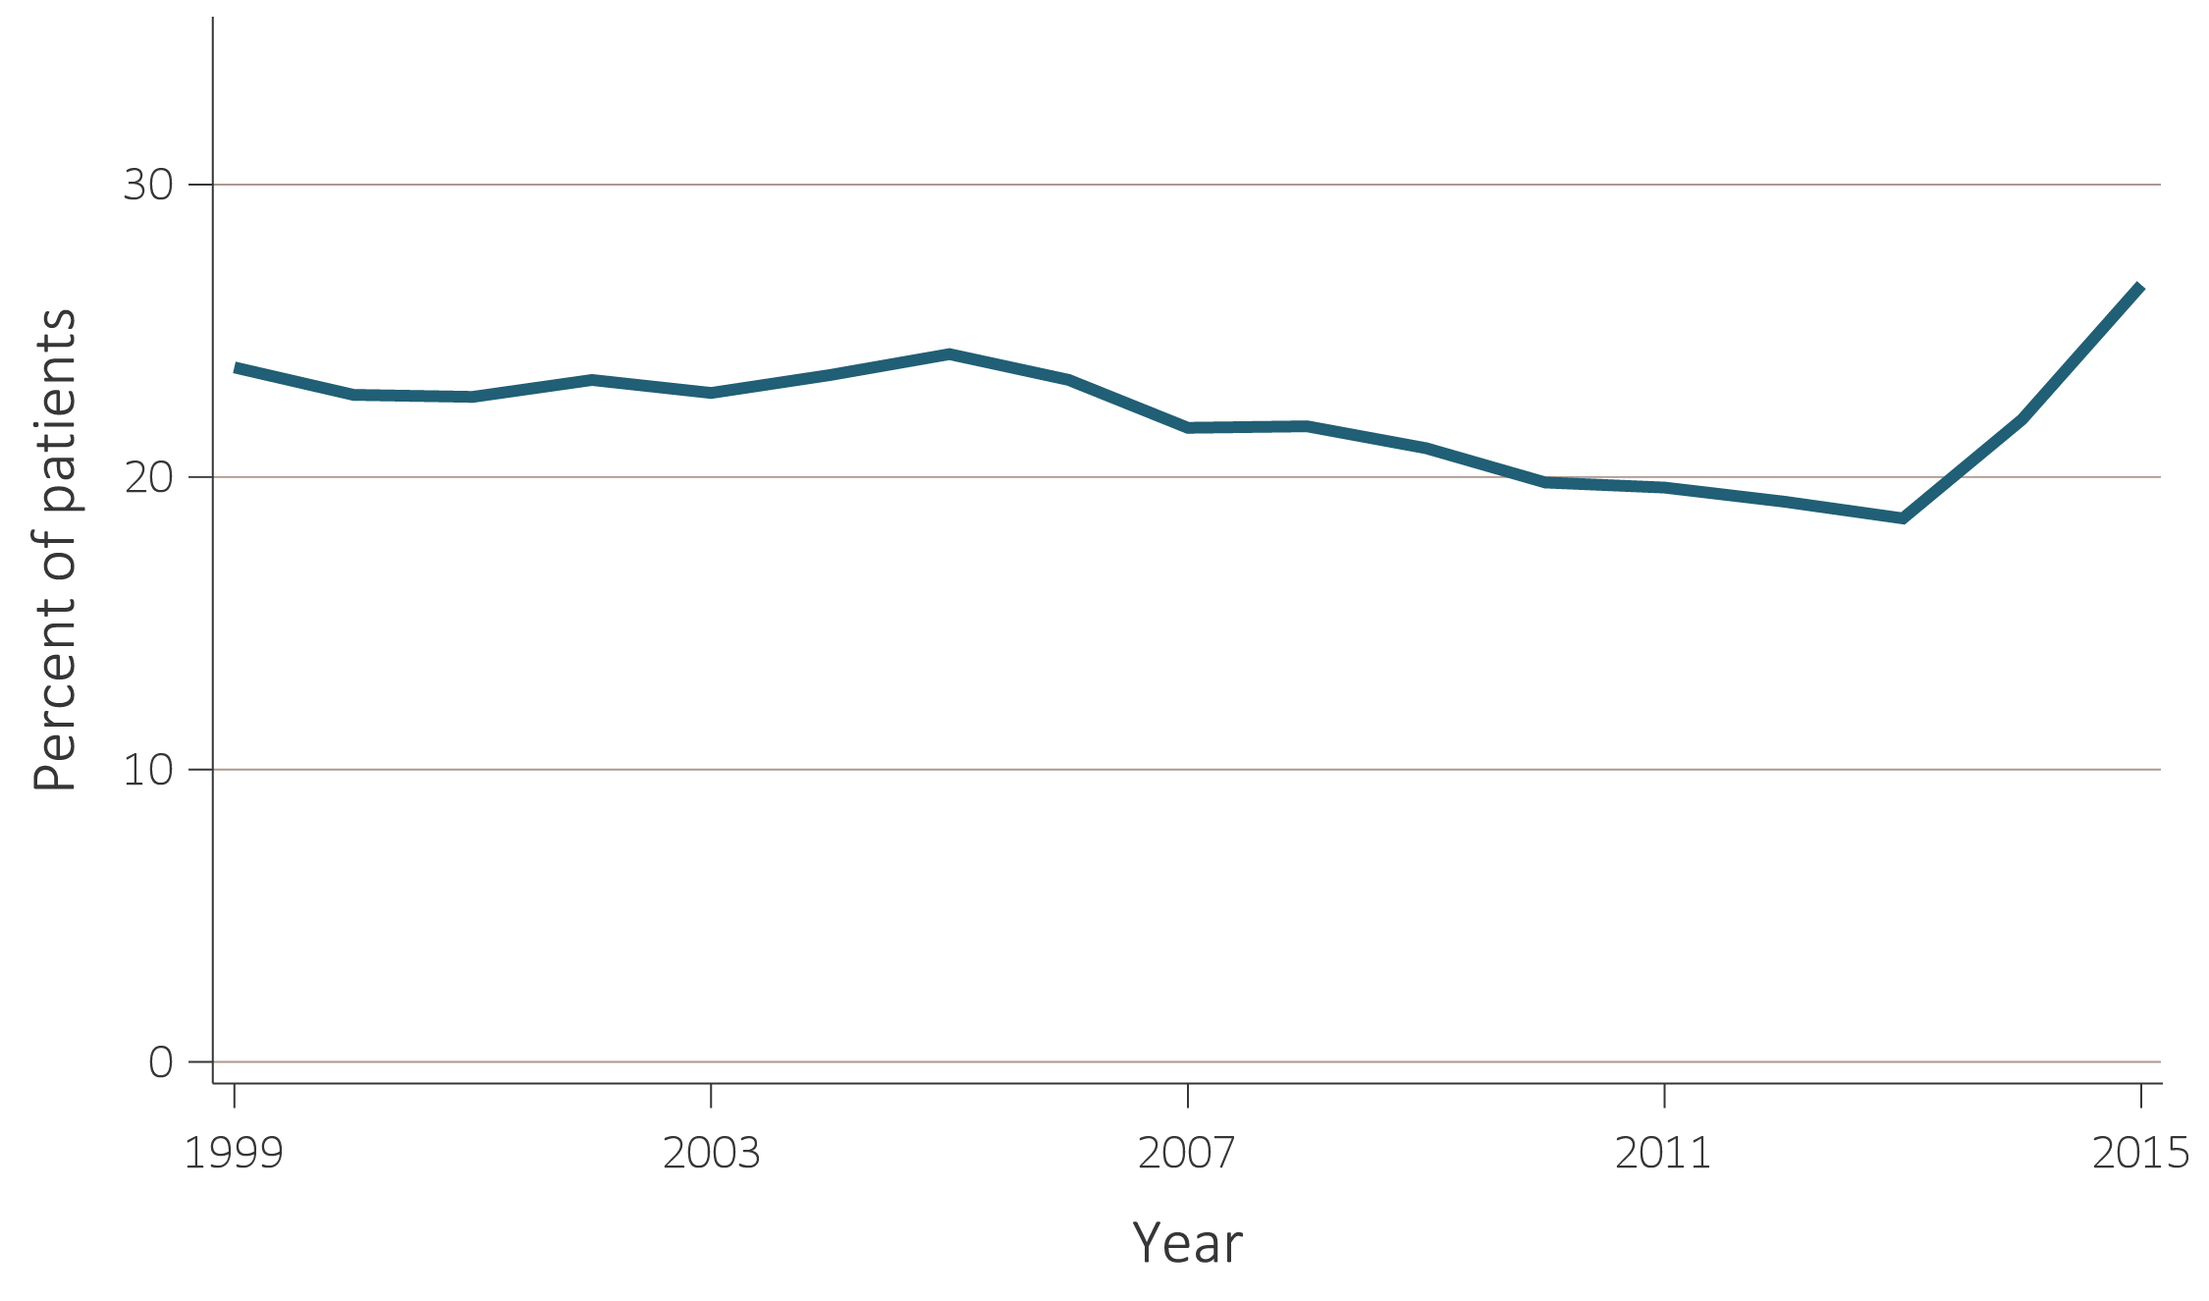
vol 2 Figure 6.5 Percent of patients transplanted (living or deceased-donor) within one year of wait-listing, 1999-2015
Data Source: Special analyses, USRDS ESRD Database and the Organ Procurement and Transplantation Network (OPTN). Abbreviation: ESRD, end-stage renal disease.

Slide 7
vol 2 Table 6.1 Reported outcomes within three years since first listing in 2013, by blood type, PRA, and age
Patient characteristics |  |  | Number who received a living-donor transplant | Outcomes of patients who did not receive a living-donor transplant
Blood Type | PRA | Age |  | Total number of patients | Received a deceased-donor transplant (%) | Still on waiting list (%) | Removed from waiting list at death or reason other than transplant (%)
Blood Type A | PRA<20 | 0≤Age≤21 | 122 | 233 | 73 | 18 | 9
 |  | 22≤Age≤44 | 540 | 1,268 | 34 | 47 | 19
 |  | 45≤Age≤64 | 764 | 3,694 | 28 | 49 | 24
 |  | Age≥65 | 234 | 1,349 | 30 | 37 | 34
 | PRA≥20 | 0≤Age≤21 | * | * | 50 | * | *
 |  | 22≤Age≤44 | 27 | 107 | 36 | 46 | 18
 |  | 45≤Age≤64 | 36 | 242 | 40 | 37 | 23
 |  | Age≥65 | * | 76 | 30 | 28 | 42
Blood Type B | PRA<20 | 0≤Age≤21 | 34 | 117 | 65 | 28 | 7
 |  | 22≤Age≤44 | 176 | 706 | 19 |  | 18
 |  | 45≤Age≤64 | 255 | 1,734 | 16 | 61 | 23
 |  | Age≥65 | 71 | 586 | 15 | 48 | 37
 | PRA≥20 | 0≤Age≤21 | * | * | 75 | . | *
 |  | 22≤Age≤44 | * | 55 | 20 | 71 | 9
 |  | 45≤Age≤64 | 17 | 111 | 29 | 49 | 23
 |  | Age≥65 | * | 34 | * | 35 | 41
Blood Type AB | PRA≥0 | 0≤Age≤21 | 15 | 36 | 89 | * | *
 |  | 22≤Age≤44 | 60 | 157 | 57 | 31 | 11
 |  | 45≤Age≤64 | 94 | 461 | 51 | 30 | 19
 |  | Age≥65 | 22 | 171 | 54 | 20 | 26
Blood Type O | PRA<20 | 0≤Age≤21 | 128 | 388 | 65 | 27 | 7
 |  | 22≤Age≤44 | 639 | 2,196 | 19 | 62 | 19
 |  | 45≤Age≤64 | 839 | 5,686 | 17 | 59 | 24
 |  | Age≥65 | 232 | 1,876 | 17 | 46 | 37
 | PRA≥20 | 0≤Age≤21 | * | 20 | 60 | * | *
 |  | 22≤Age≤44 | 35 | 156 | 27 | 53 | 20
 |  | 45≤Age≤64 | 38 | 335 | 26 | 48 | 26
 |  | Age≥65 | * | 88 | 30 | 40 | 31
All |  |  | 4,378 | 21,882 | 24% | 51% | 24
Data Source: Special analyses, USRDS ESRD Database and the Organ Procurement and Transplantation Network (OPTN). Reported outcomes within three years since first listing in 2013, by blood type, PRA, and age. PRA is not dichotomized due to small sample size. * Suppressed due to inadequate sample size. A dot (.) represents a zero value. Abbreviations: ESRD, end-stage renal disease; PRA, panel reactive antibodies.

Slide 8
vol 2 Table 6.2 Reported outcomes within five years since first listing in 2011, by blood type, PRA, and age
Patient characteristics |  |  | Number who received a living-donor transplant | Outcomes of patients who did not receive a living-donor transplant
Blood Type | PRA | Age |  | Total number of patients | Received a deceased-donor transplant (%) | Still on waiting list (%) | Removed from waiting list at death or reason other than transplant (%)
Blood Type A | PRA<20 | 0≤Age≤21 | 105 | 241 | 81 | 8 | 10
 |  | 22≤Age≤44 | 543 | 1,233 | 54 | 22 | 24
 |  | 45≤Age≤64 | 873 | 3,469 | 46 | 20 | 34
 |  | Age≥65 | 224 | 1,215 | 41 | 10 | 49
 | PRA≥20 | 0≤Age≤21 | * | * | 100 | . | .
 |  | 22≤Age≤44 | 23 | 79 | 63 | 19 | 18
 |  | 45≤Age≤64 | 39 | 236 | 52 | 17 | 31
 |  | Age≥65 | * | 69 | 49 | * | 45
Blood Type B | PRA<20 | 0≤Age≤21 | 46 | 93 | 76 | 11 | 13
 |  | 22≤Age≤44 | 177 | 585 | 35 | 36 | 29
 |  | 45≤Age≤64 | 316 | 1,557 | 28 | 35 | 37
 |  | Age≥65 | 63 | 516 | 26 | 19 | 55
 | PRA≥20 | 0≤Age≤21 | * | * | 40 | 20 | 40
 |  | 22≤Age≤44 | 15 | 40 | 28 | 30 | 43
 |  | 45≤Age≤64 | 17 | 121 | 35 | 31 | 34
 |  | Age≥65 | * | 36 | 39 | 11 | 50
Blood Type AB | PRA≥0 | 0≤Age≤21 | 13 | 37 | 84 | * | *
 |  | 22≤Age≤44 | 58 | 151 | 70 | 10 | 21
 |  | 45≤Age≤64 | 91 | 433 | 64 | 10 | 27
 |  | Age≥65 | 25 | 170 | 55 | 5 | 40
Blood Type O | PRA<20 | 0≤Age≤21 | 160 | 419 | 77 | 12 | 11
 |  | 22≤Age≤44 | 666 | 2,036 | 33 | 37 | 29
 |  | 45≤Age≤64 | 940 | 5,083 | 29 | 32 | 39
 |  | Age≥65 | 220 | 1,707 | 27 | 19 | 54
 | PRA≥20 | 0≤Age≤21 | * | 22 | 64 | 23 | 14
 |  | 22≤Age≤44 | 34 | 150 | 37 | 29 | 34
 |  | 45≤Age≤64 | 43 | 351 | 39 | 20 | 40
 |  | Age≥65 | * | 115 | 30 | 12 | 58
All |  |  | 4,691 | 20,164 | 39 | 25 | 37
Data Source: Special analyses, USRDS ESRD Database and the Organ Procurement and Transplantation Network (OPTN). Reported outcomes within five years since first listing in 2011, by blood type, PRA, and age. PRA is not dichotomized due to small sample size. * Suppressed due to inadequate sample size. A dot (.) represents a zero value. Abbreviations: ESRD, end-stage renal disease; PRA, panel reactive antibodies.

Slide 9
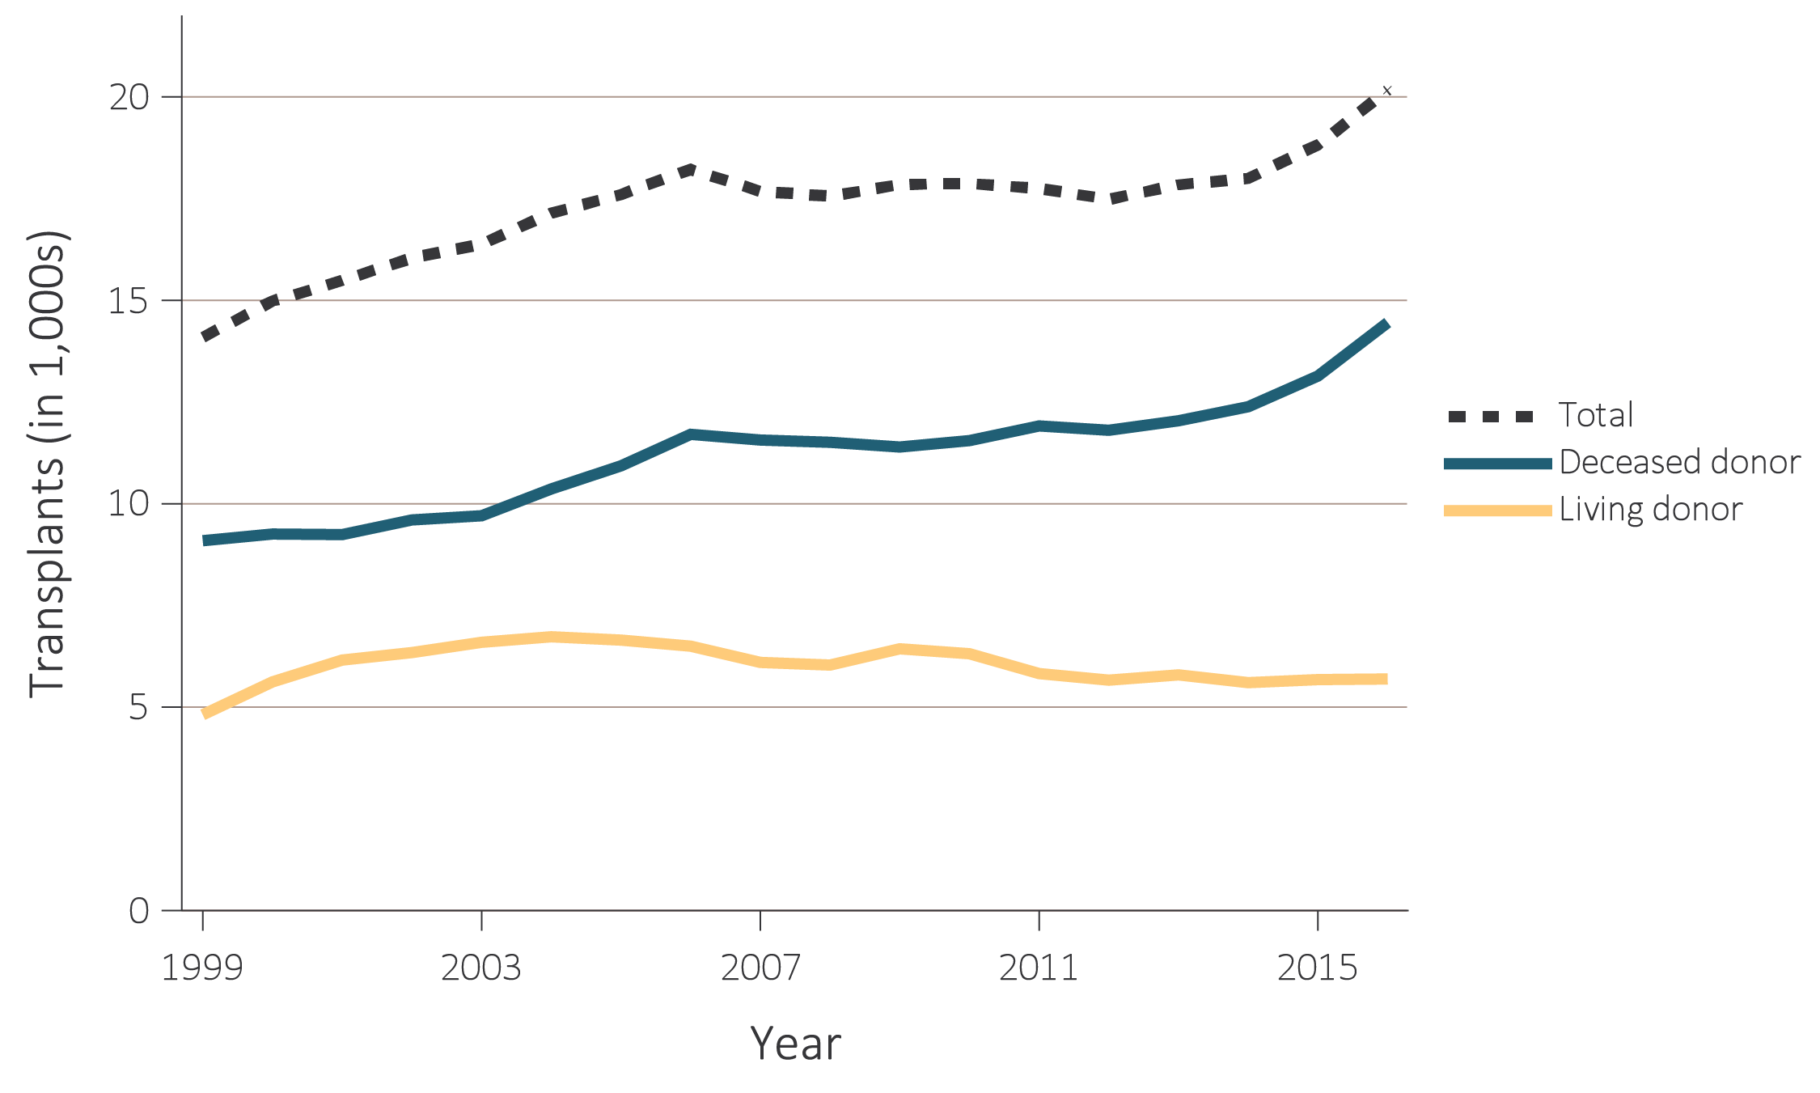
vol 2 Figure 6.6 Number of kidney transplants by donor type, 1999-2016
Data Source: Reference Tables E.8, E.8(2), and E.8(3). Number of kidney transplants by donor type. Note that trends may be influenced by changes to the kidney allocation system (KAS) policy that were implemented in December 2014.

Slide 10
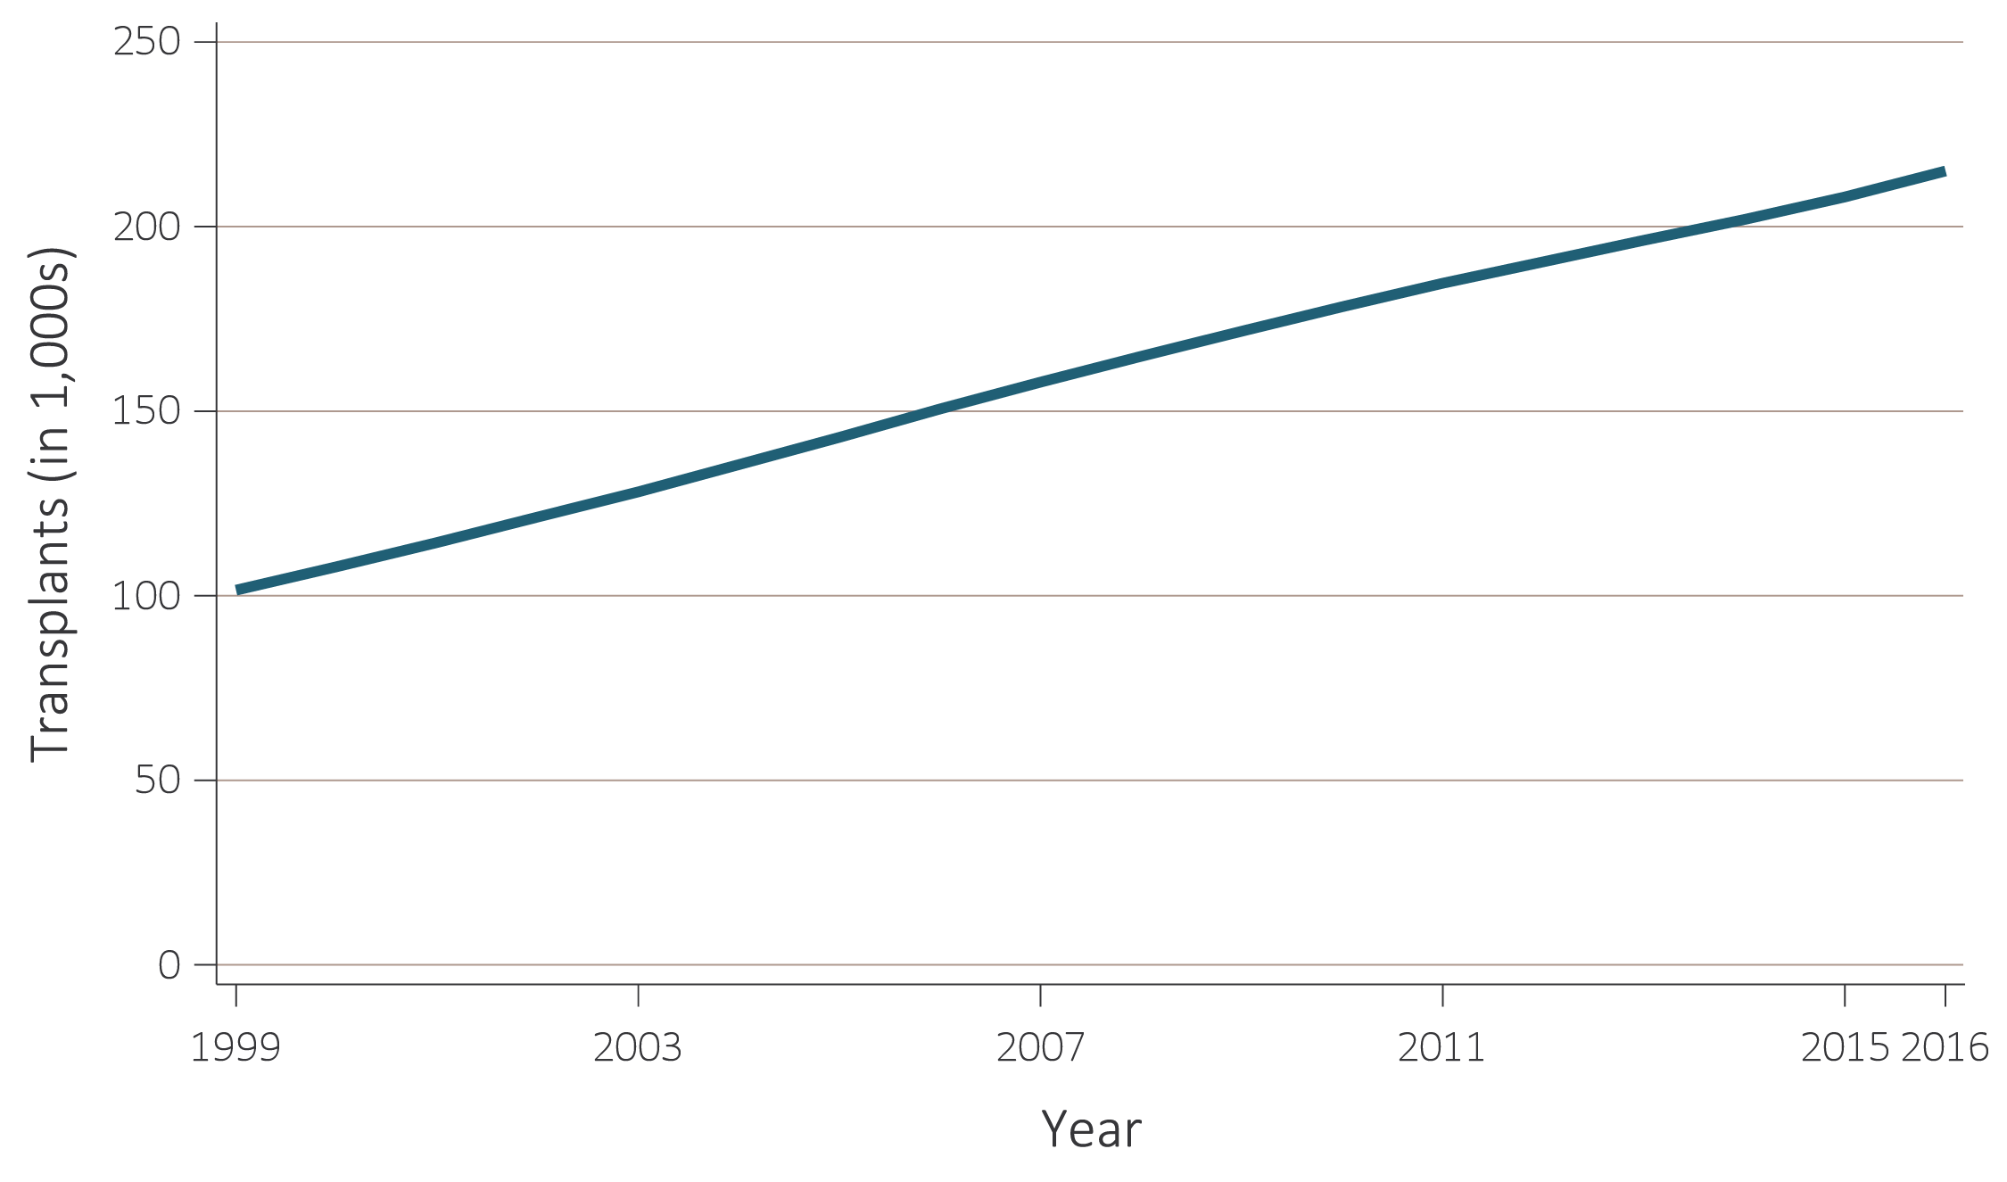
vol 2 Figure 6.7 Number of patients with a functioning kidney transplant, 1999-2016
Data Source: Reference Table D.9. Prevalent counts of patients with a functioning kidney transplant as of December 31 of each year. Note that trends may be influenced by changes to the kidney allocation system (KAS) policy that were implemented in December 2014.

Slide 11
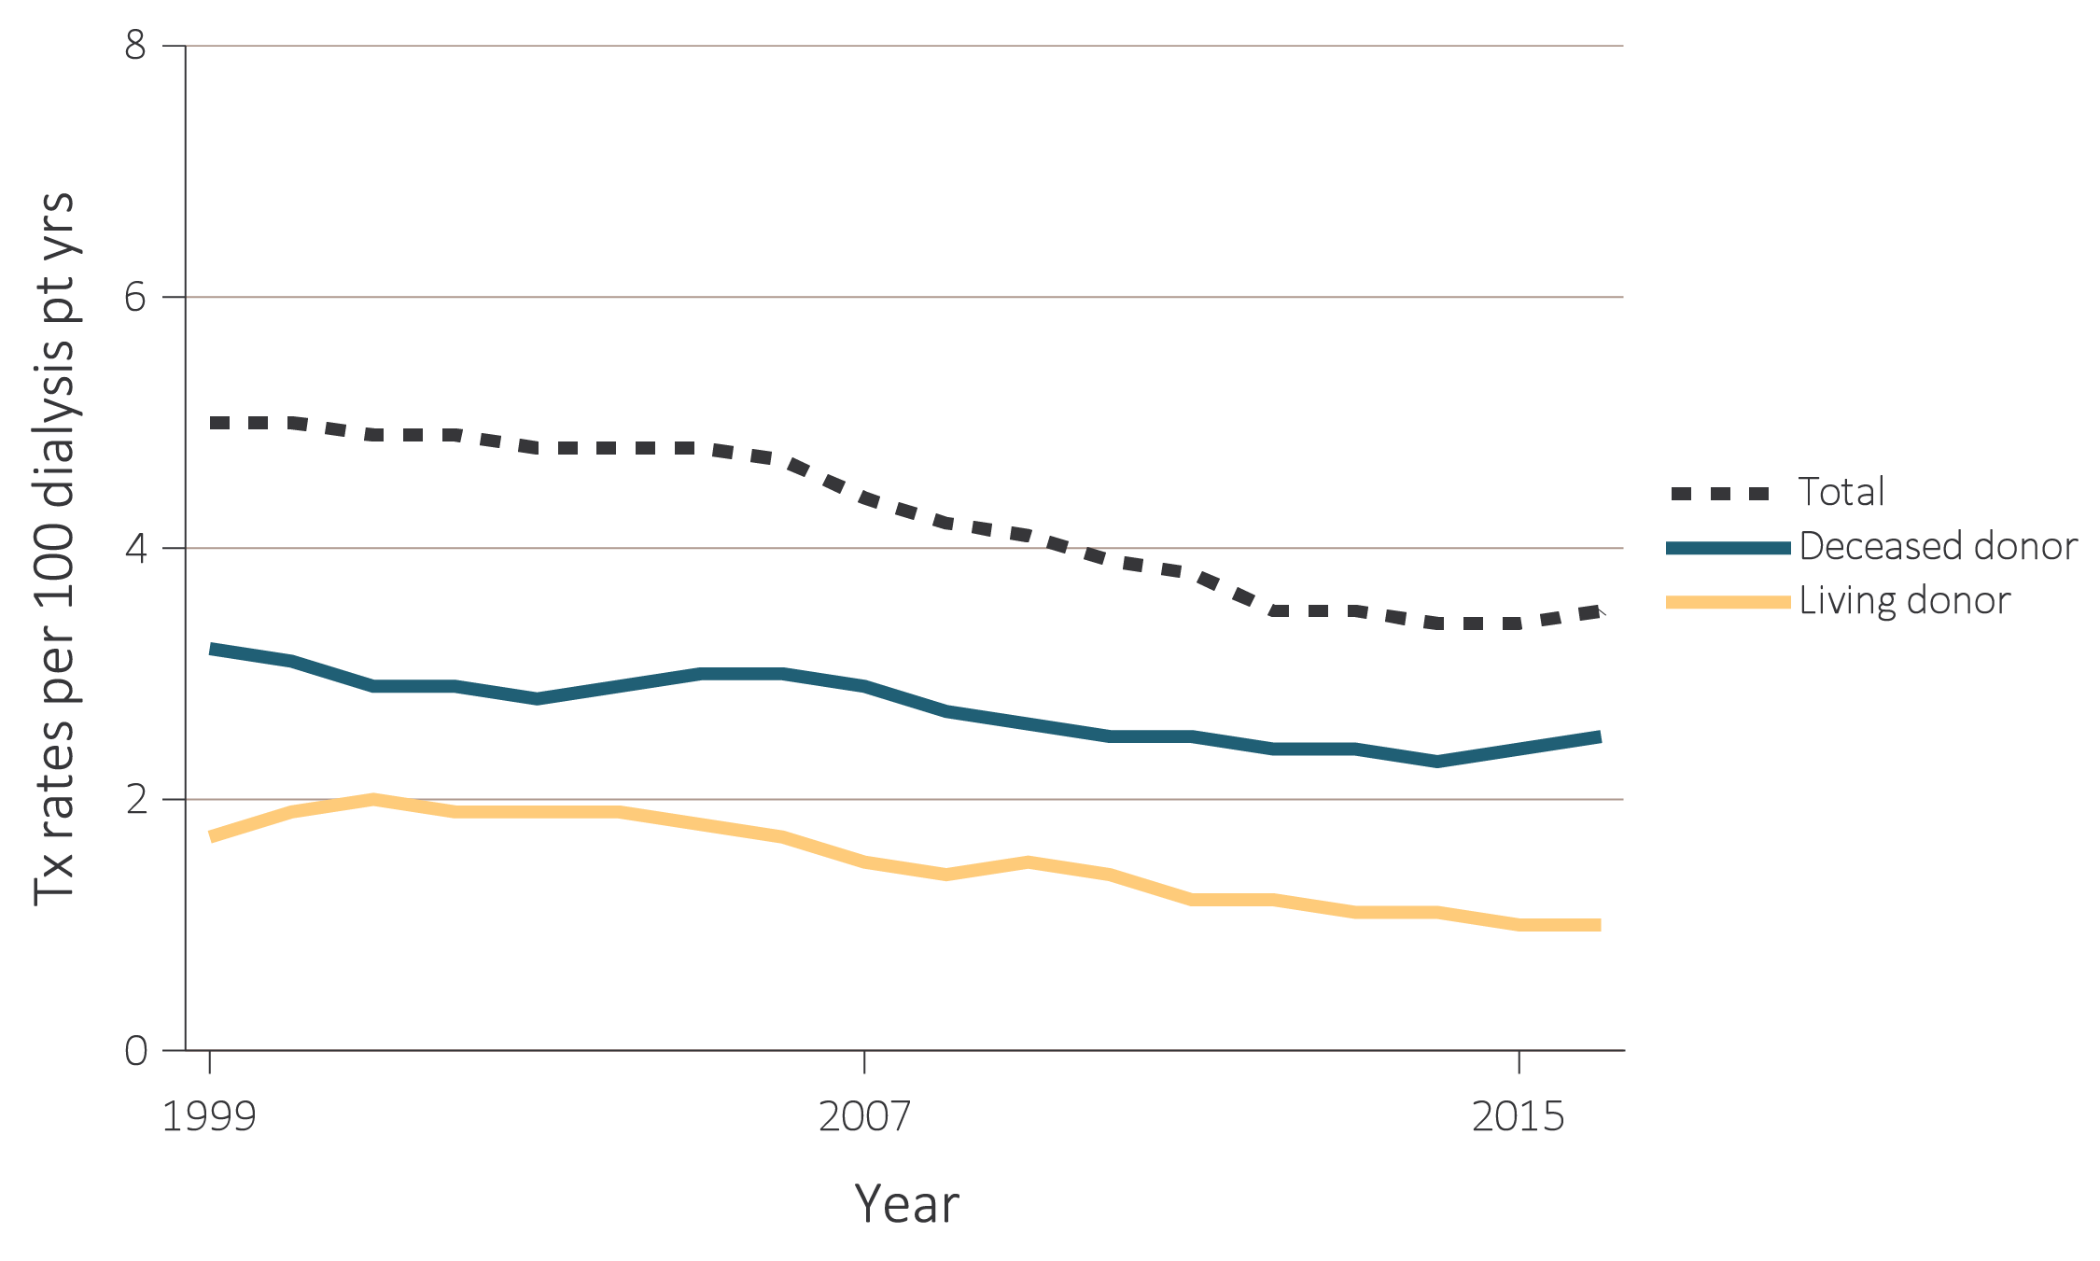
vol 2 Figure 6.8 Unadjusted kidney transplant rates, by donor type, 1999-2016
Data Source: Reference Table E.9. Unadjusted transplant rates are for all dialysis patients. Note that trends may be influenced by changes to the kidney allocation system (KAS) policy that were implemented in December 2014. Abbreviations: pt yrs, patient-years; tx, transplant.

Slide 12
vol 2 Table 6.3 Unadjusted kidney transplant rates, all donor types, by age, sex, race, and primary cause of ESRD, per 100 dialysis patient-years, 2007-2016
 | 2007 | 2008 | 2009 | 2010 | 2011 | 2012 | 2013 | 2014 | 2015 | 2016
Age
0-21 | 31.6 | 32.5 | 34.7 | 32.8 | 32.0 | 32.5 | 31.6 | 31.9 | 33.4 | 34.4
22-44 | 9.5 | 8.8 | 8.7 | 8.1 | 7.7 | 7.6 | 7.3 | 7.2 | 8.6 | 8.5
45-64 | 5.4 | 5.1 | 4.9 | 4.8 | 4.5 | 4.2 | 4.3 | 4.1 | 4.0 | 4.3
65-74 | 2.5 | 2.6 | 2.6 | 2.6 | 2.6 | 2.5 | 2.4 | 2.4 | 2.2 | 2.4
75 and older | 0.4 | 0.3 | 0.4 | 0.4 | 0.4 | 0.4 | 0.3 | 0.4 | 0.3 | 0.3
Sex
Male | 4.9 | 4.6 | 4.4 | 4.3 | 4.1 | 3.9 | 3.8 | 3.7 | 3.7 | 3.7
Female | 3.8 | 3.7 | 3.7 | 3.5 | 3.3 | 3.1 | 3.1 | 3.0 | 3.1 | 3.3
Race
White | 5.2 | 4.9 | 4.8 | 4.5 | 4.3 | 4.1 | 4.0 | 3.9 | 3.7 | 3.9
Black/African American | 3.0 | 2.9 | 2.9 | 2.9 | 2.8 | 2.5 | 2.5 | 2.4 | 2.7 | 2.7
American Indian/Alaska Native | 2.9 | 3.5 | 3.6 | 2.8 | 3.0 | 2.4 | 2.1 | 2.6 | 3.0 | 2.8
Asian | 5.2 | 5.4 | 5.0 | 4.9 | 4.7 | 4.6 | 4.6 | 4.6 | 4.9 | 5.1
Native Hawaiian or Pacific Islander | 3.3 | 3.2 | 3.1 | 2.9 | 2.4 | 2.4 | 2.2 | 2.6 | 2.6 | 2.4
Other or Multiracial | 4.9 | 5.2 | 6.1 | 6.9 | 6.7 | 6.6 | 3.0 | 4.1 | 3.6 | 4.7
Unknown | 12.5 | 13.3 | 11.1 | 8.6 | 9.4 | 8.3 | 8.4 | 12.3 | 12.2 | 10.2
Primary Cause of ESRD
Diabetes | 3.0 | 2.8 | 2.7 | 2.6 | 2.5 | 2.3 | 2.3 | 2.2 | 2.0 | 2.1
Hypertension | 3.0 | 2.9 | 2.8 | 2.7 | 2.5 | 2.5 | 2.5 | 2.4 | 2.5 | 2.6
Glomerulonephritis | 8.5 | 8.2 | 8.1 | 8.2 | 7.8 | 7.4 | 7.2 | 7.0 | 7.6 | 7.4
All | 4.4 | 4.2 | 4.1 | 3.9 | 3.8 | 3.5 | 3.5 | 3.4 | 3.4 | 3.5
Data Source: Reference Table E.9. Note that trends may be influenced by changes to the kidney allocation system (KAS) policy that were implemented in December 2014. Abbreviation: ESRD, end-stage renal disease.

Slide 13
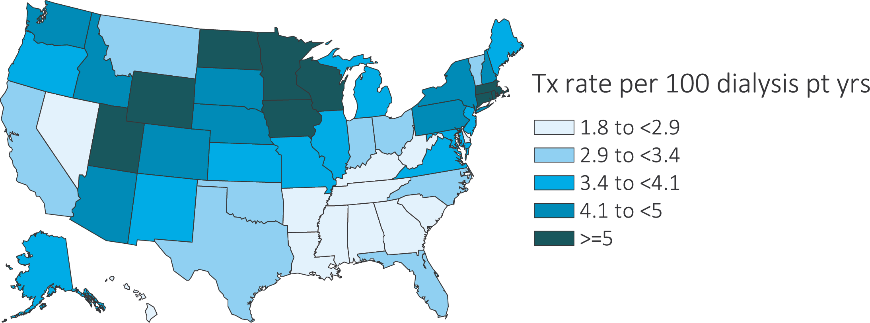
vol 2 Figure 6.9 Geographic distribution of unadjusted transplant rate by state, 2016
Data Source: Special analyses, USRDS ESRD Database. Geographic distribution of unadjusted transplant rate by state, 2016. Note that trends may be influenced by changes to the kidney allocation system (KAS) policy that were implemented in December 2014. Abbreviations: pt yrs; patient-years; tx, transplant.

Slide 14
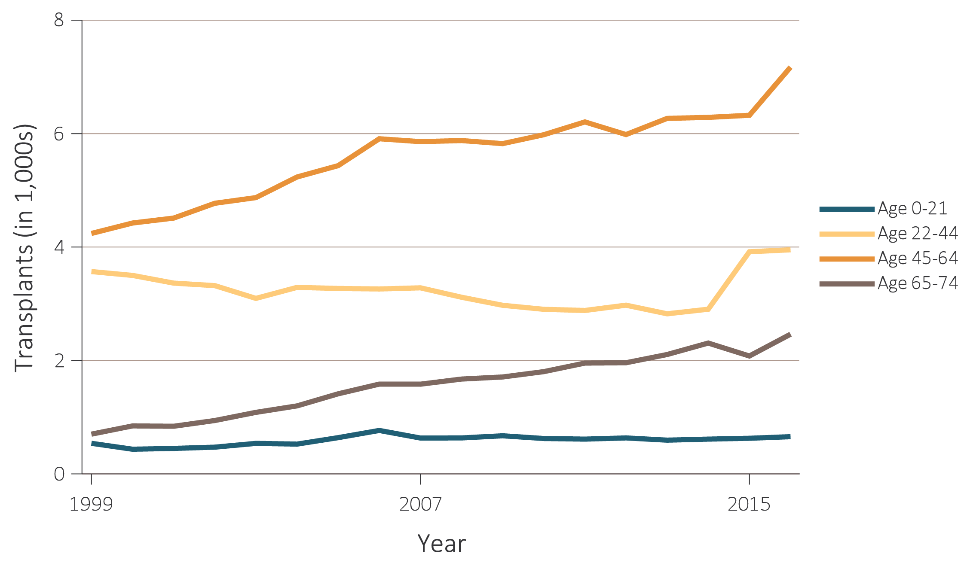
vol 2 Figure 6.10 Number of deceased-donor transplants and unadjusted transplant rates among deceased-donor kidney recipients, by recipient age, 1999-2016
(a) Number of transplants by age
Data Source: Reference Tables E.8(2) and E.9(2). (a) Deceased-donor kidney transplant counts by recipient age. (b) Unadjusted deceased-donor kidney transplant rates by recipient age. Note that trends may be influenced by changes to the kidney allocation system (KAS) policy that were implemented in December 2014. Abbreviations: pt yrs, patient-years; tx, transplant.

Slide 15
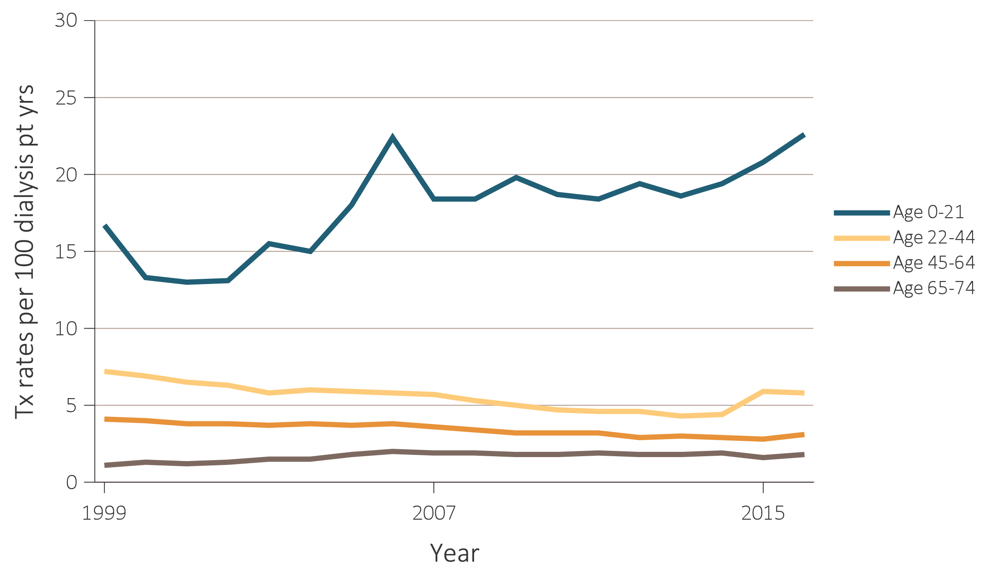
vol 2 Figure 6.10 Number of deceased-donor transplants and unadjusted transplant rates among deceased-donor kidney recipients, by recipient age, 1999-2016
(b) Transplant rates by age
Data Source: Reference Tables E.8(2) and E.9(2). (a) Deceased-donor kidney transplant counts by recipient age. (b) Unadjusted deceased-donor kidney transplant rates by recipient age. Note that trends may be influenced by changes to the kidney allocation system (KAS) policy that were implemented in December 2014. Abbreviations: pt yrs, patient-years; tx, transplant.

Slide 16
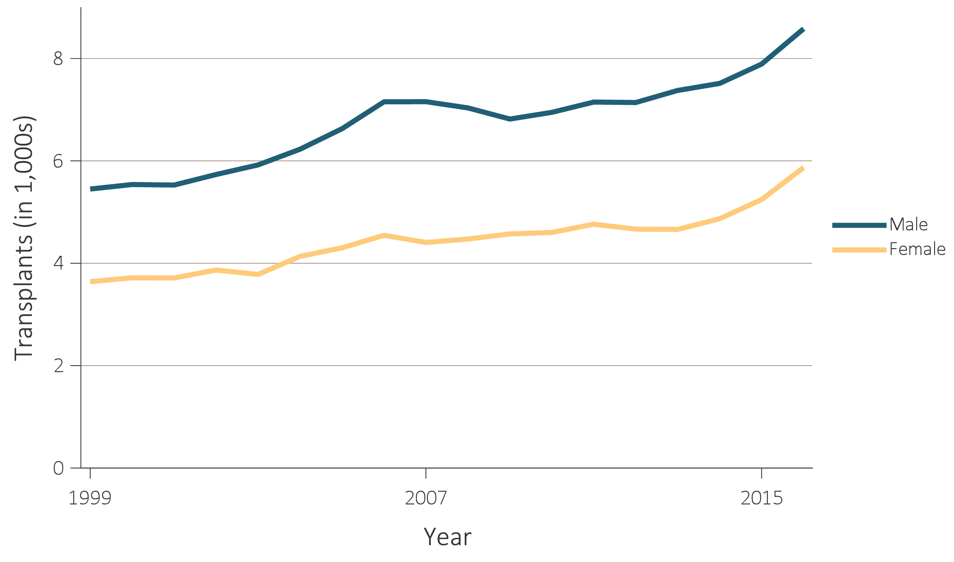
vol 2 Figure 6.11 Number of deceased-donor transplants and unadjusted transplant rates among deceased-donor kidney recipients, by recipient sex, 1999-2016
(a) Number of transplants by sex
Data Source: Reference Tables E.8(2) and E.9(2). (a) Deceased-donor kidney transplant counts by recipient sex. (b) Unadjusted deceased-donor kidney transplant rates by recipient sex. Note that trends may be influenced by changes to the kidney allocation system (KAS) policy that were implemented in December 2014. Abbreviation: pt yrs; patient-years; tx, transplant.

Slide 17
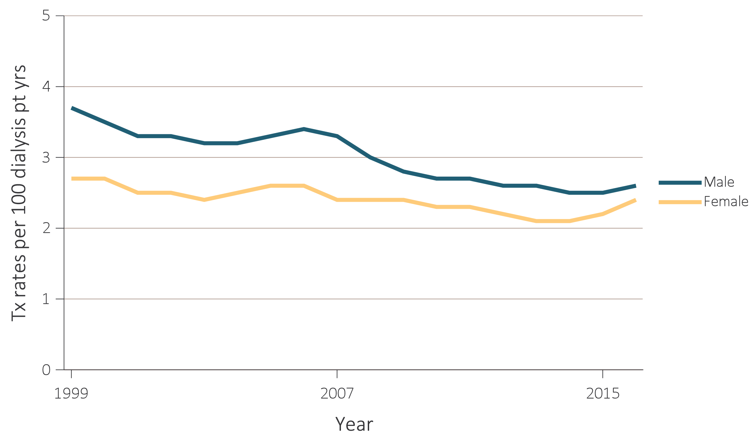
vol 2 Figure 6.11 Number of deceased-donor transplants and unadjusted transplant rates among deceased-donor kidney recipients, by recipient sex, 1999-2016
(b) Transplant rates by sex
Data Source: Reference Tables E.8(2) and E.9(2). (a) Deceased-donor kidney transplant counts by recipient sex. (b) Unadjusted deceased-donor kidney transplant rates by recipient sex. Note that trends may be influenced by changes to the kidney allocation system (KAS) policy that were implemented in December 2014. Abbreviation: pt yrs; patient-years; tx, transplant.

Slide 18
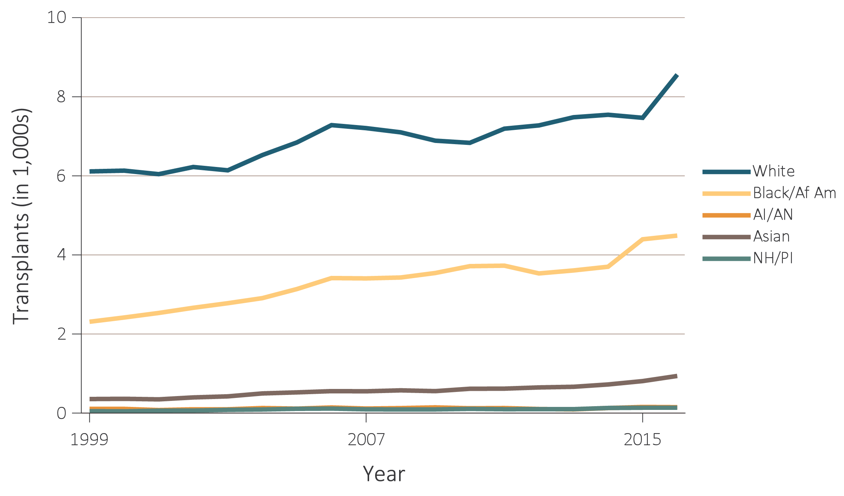
vol 2 Figure 6.12 Number of deceased-donor transplants and unadjusted transplant rates among deceased-donor kidney recipients, by recipient race, 1999-2016
(a) Number of transplants by race
Data Source: Reference Tables E.8(2) and E.9(2). (a) Deceased-donor kidney transplant counts by recipient race. (b) Unadjusted deceased-donor kidney transplant rates by recipient race. Note that trends may be influenced by changes to the kidney allocation system (KAS) policy that were implemented in December 2014. Abbreviations: AI/AN, American Indian or Alaska Native; Black/Af Am, Black/African American; NH/PI, Native Hawaiian or Pacific Islander; pt yrs, patient-years; tx, transplant.

Slide 19
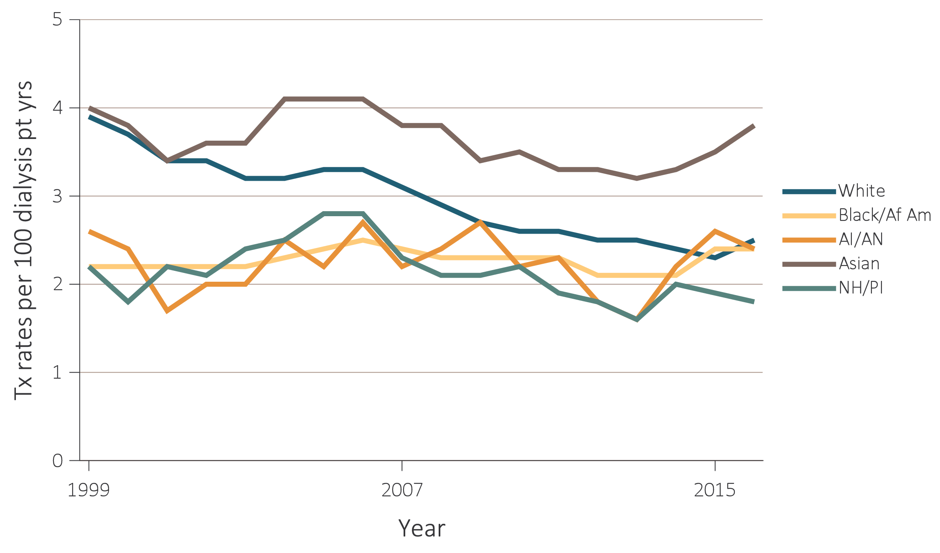
vol 2 Figure 6.12 Number of deceased-donor transplants and unadjusted transplant rates among deceased-donor kidney recipients, by recipient race, 1999-2016
(b) Transplant rates by race
Data Source: Reference Tables E.8(2) and E.9(2). (a) Deceased-donor kidney transplant counts by recipient race. (b) Unadjusted deceased-donor kidney transplant rates by recipient race. Note that trends may be influenced by changes to the kidney allocation system (KAS) policy that were implemented in December 2014. Abbreviations: AI/AN, American Indian or Alaska Native; Black/Af Am, Black/African American; NH/PI, Native Hawaiian or Pacific Islander; pt yrs, patient-years; tx, transplant.

Slide 20
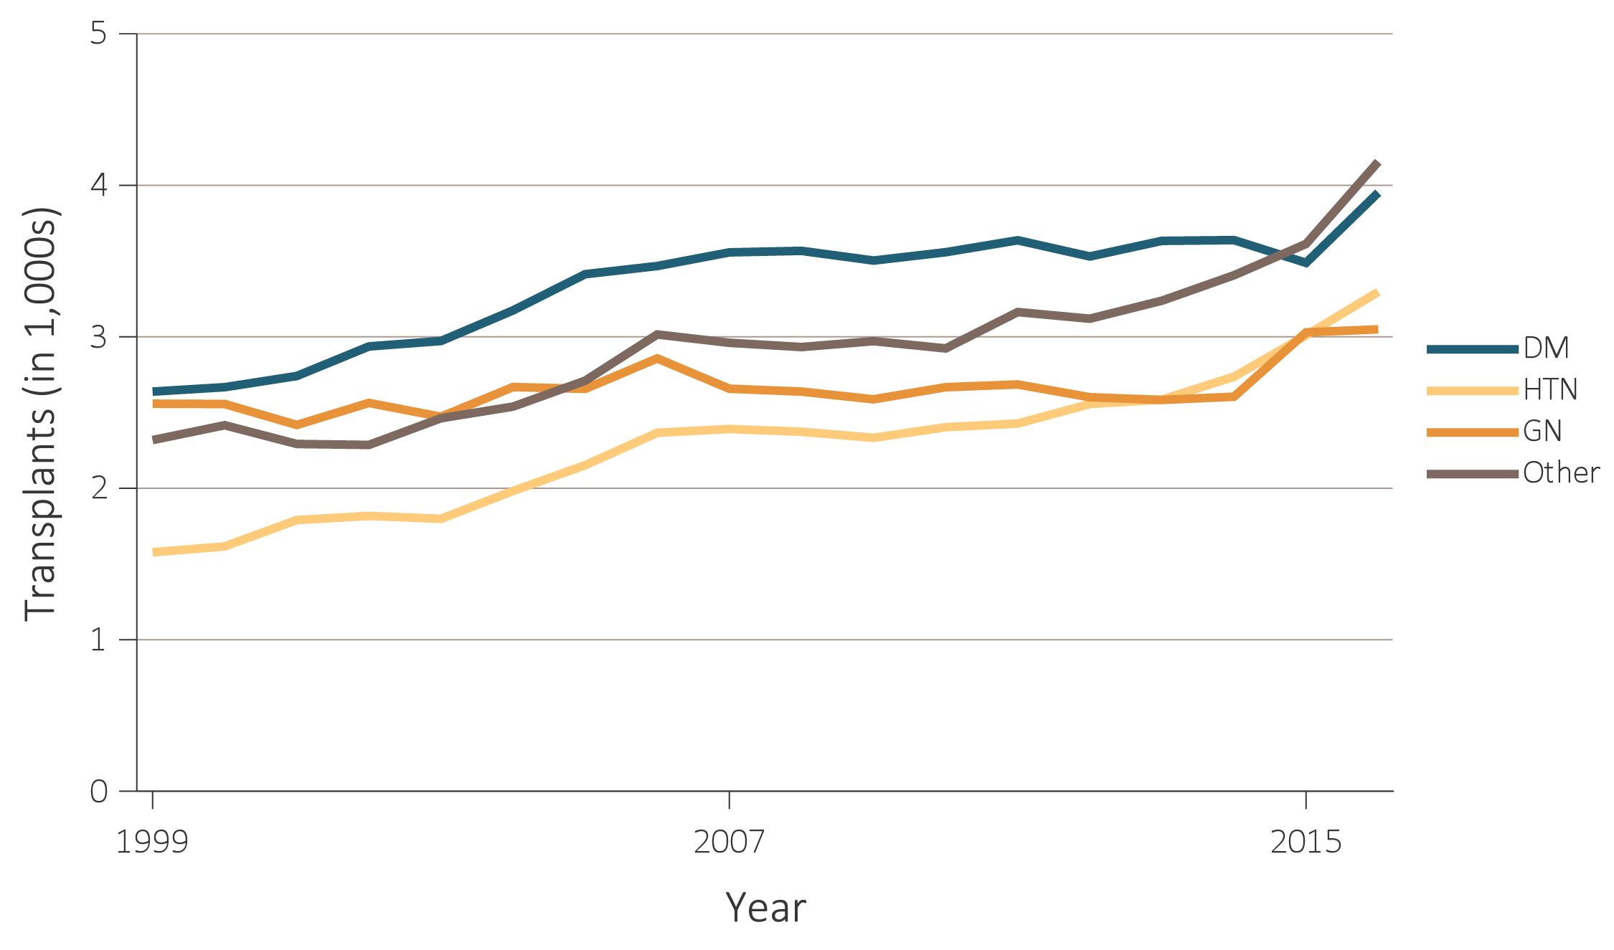
vol 2 Figure 6.13 Number of deceased-donor transplants and unadjusted transplant rates among deceased-donor kidney recipients, by recipient primary cause of ESRD, 1999-2016
(a) Number of transplants by primary cause of ESRD
Data Source: Reference Tables E.8(2) and E.9(2). (a) Deceased-donor kidney transplant counts by recipient primary cause of ESRD. (b) Unadjusted deceased-donor kidney transplant rates by recipient primary cause of ESRD. Note that trends may be influenced by changes to the kidney allocation system (KAS) policy that were implemented in December 2014. Abbreviations: DM, diabetes mellitus; ESRD, end-stage renal disease; GN, glomerulonephritis; HTN, hypertension; pt yrs, patient-years; tx, transplant.

Slide 21
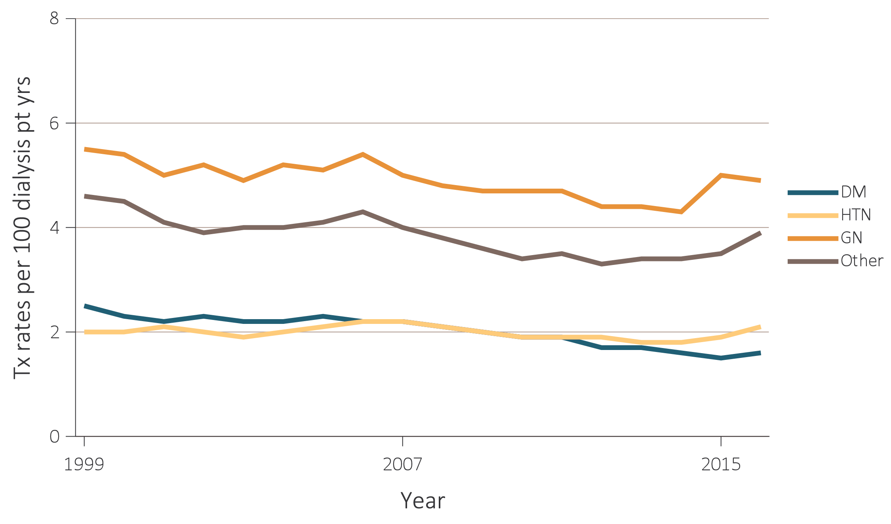
vol 2 Figure 6.13 Number of deceased-donor transplants and unadjusted transplant rates among deceased-donor kidney recipients, by recipient primary cause of ESRD, 1999-2016
(b) Transplant rates by primary cause of ESRD
Data Source: Reference Tables E.8(2) and E.9(2). (a) Deceased-donor kidney transplant counts by recipient primary cause of ESRD. (b) Unadjusted deceased-donor kidney transplant rates by recipient primary cause of ESRD. Note that trends may be influenced by changes to the kidney allocation system (KAS) policy that were implemented in December 2014. Abbreviations: DM, diabetes mellitus; ESRD, end-stage renal disease; GN, glomerulonephritis; HTN, hypertension; pt yrs, patient-years; tx, transplant.

Slide 22
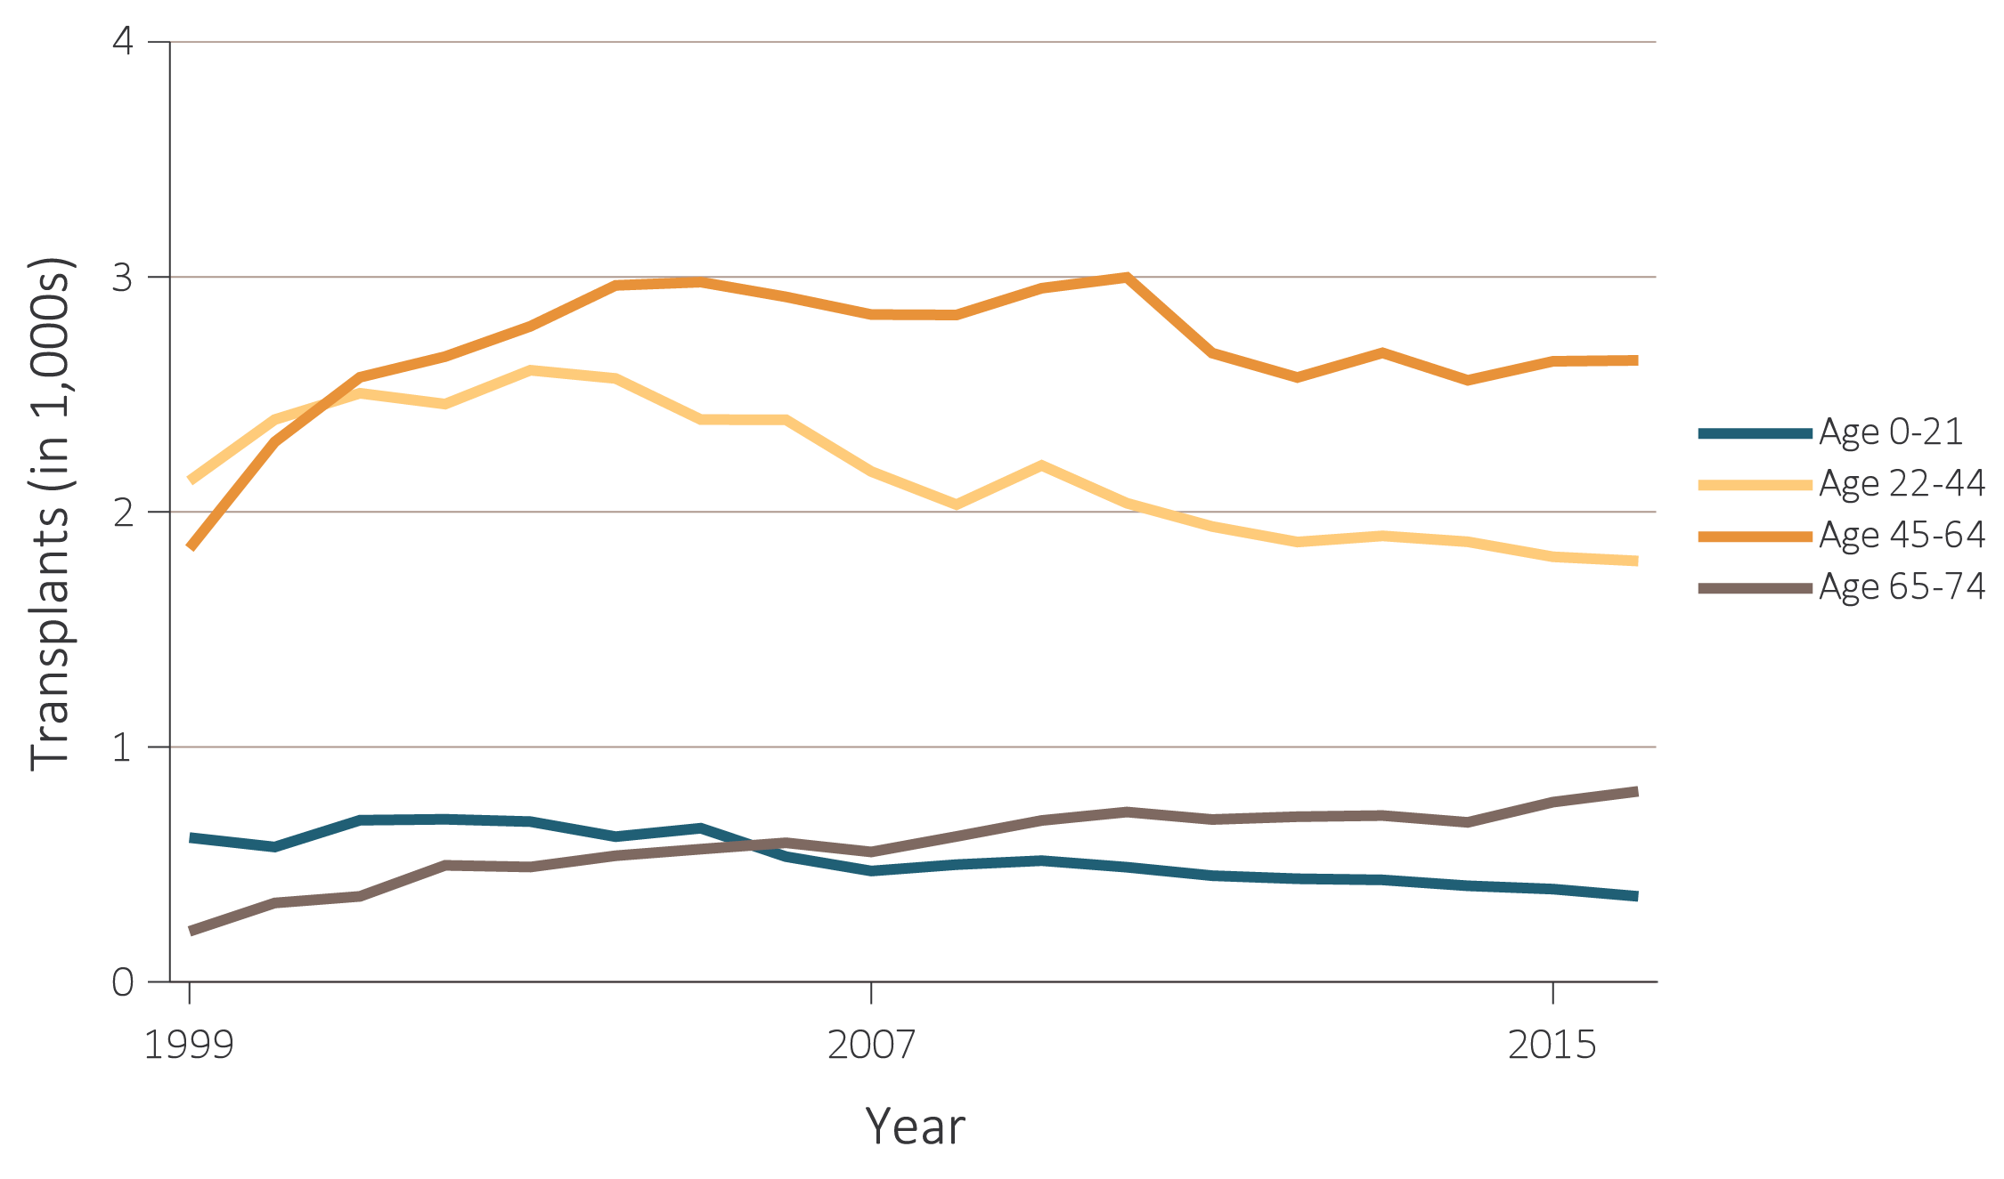
vol 2 Figure 6.14 Number of living-donor transplants and unadjusted transplant rates among living-donor kidney recipients, by recipient age, 1999-2016
(a) Number of transplants by age
Data Source: Reference Tables E.8(3) and E.9(3). (a) Living-donor kidney transplant counts by recipient age. (b) Unadjusted living-donor kidney transplant rates by recipient age. Note that trends may be influenced by changes to the kidney allocation system (KAS) policy that were implemented in December 2014. Abbreviation: pt yrs, patient-years; tx, transplant.

Slide 23
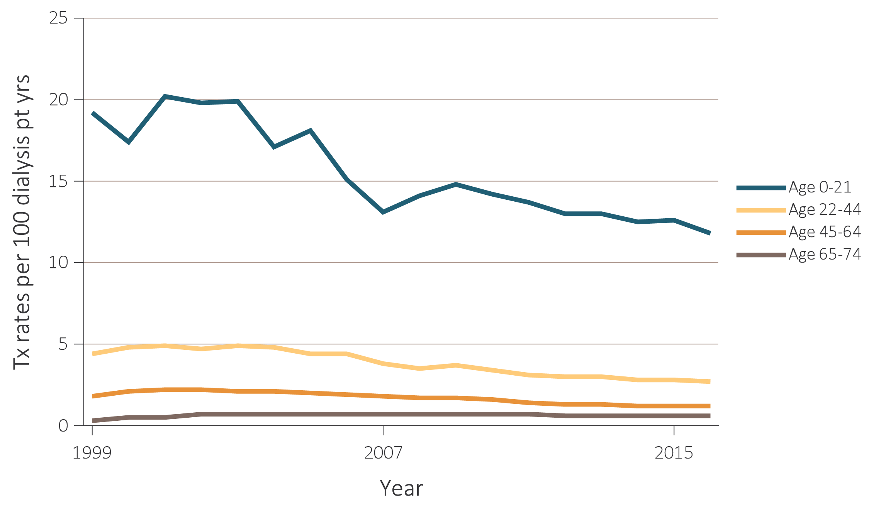
vol 2 Figure 6.14 Number of living-donor transplants and unadjusted transplant rates among living-donor kidney recipients, by recipient age, 1999-2016
(b) Transplant rates by age
Data Source: Reference Tables E.8(3) and E.9(3). (a) Living-donor kidney transplant counts by recipient age. (b) Unadjusted living-donor kidney transplant rates by recipient age. Note that trends may be influenced by changes to the kidney allocation system (KAS) policy that were implemented in December 2014. Abbreviation: pt yrs, patient-years; tx, transplant.

Slide 24
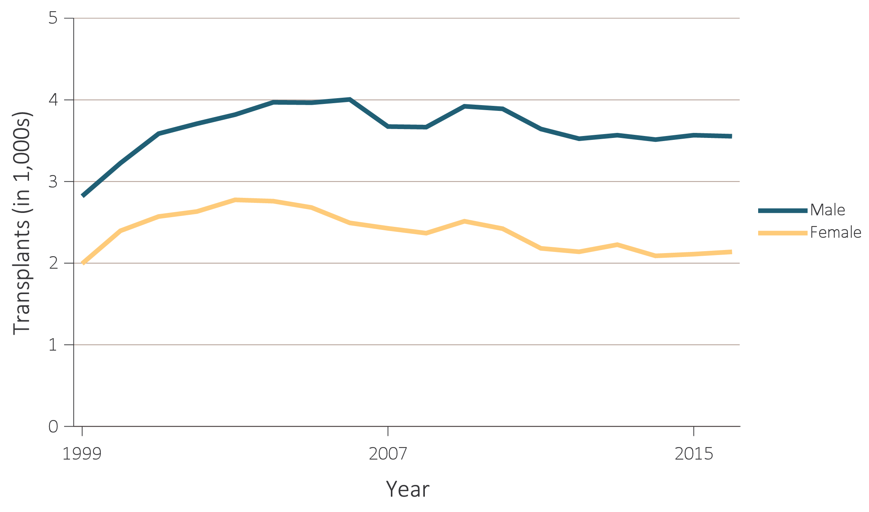
vol 2 Figure 6.15 Number of living-donor transplants and unadjusted transplant rates among living-donor kidney recipients, by recipient sex, 1999-2016
(a) Number of transplants by sex
Data Source: Reference Tables E.8(3) and E.9(3). (a) Living-donor kidney transplant counts by recipient sex. (b) Unadjusted living-donor kidney transplant rates by recipient sex. Note that trends may be influenced by changes to the kidney allocation system (KAS) policy that were implemented in December 2014. Abbreviation: pt yrs, patient-years; tx, transplant.

Slide 25
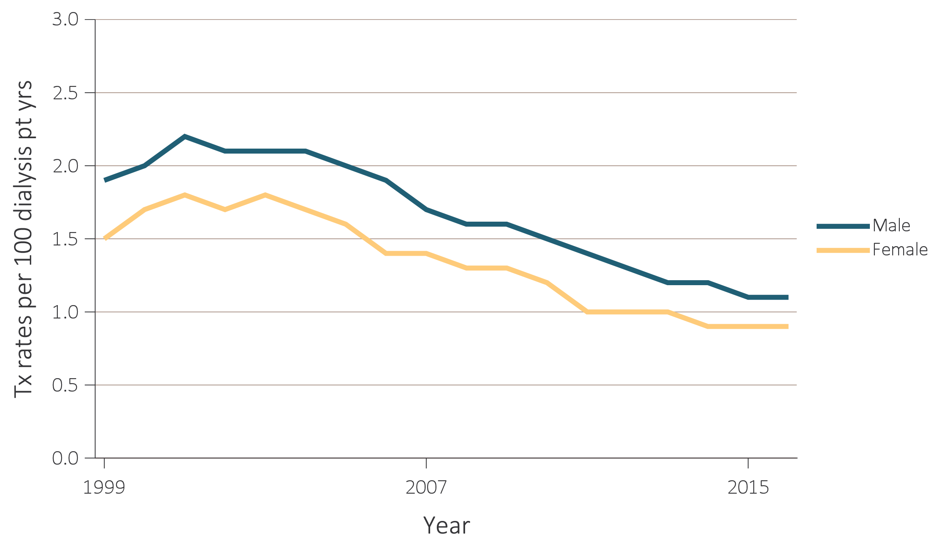
vol 2 Figure 6.15 Number of living-donor transplants and unadjusted transplant rates among living-donor kidney recipients, by recipient sex, 1999-2016
(b) Transplant rates by sex
Data Source: Reference Tables E.8(3) and E.9(3). (a) Living-donor kidney transplant counts by recipient sex. (b) Unadjusted living-donor kidney transplant rates by recipient sex. Note that trends may be influenced by changes to the kidney allocation system (KAS) policy that were implemented in December 2014. Abbreviation: pt yrs, patient-years; tx, transplant.

Slide 26
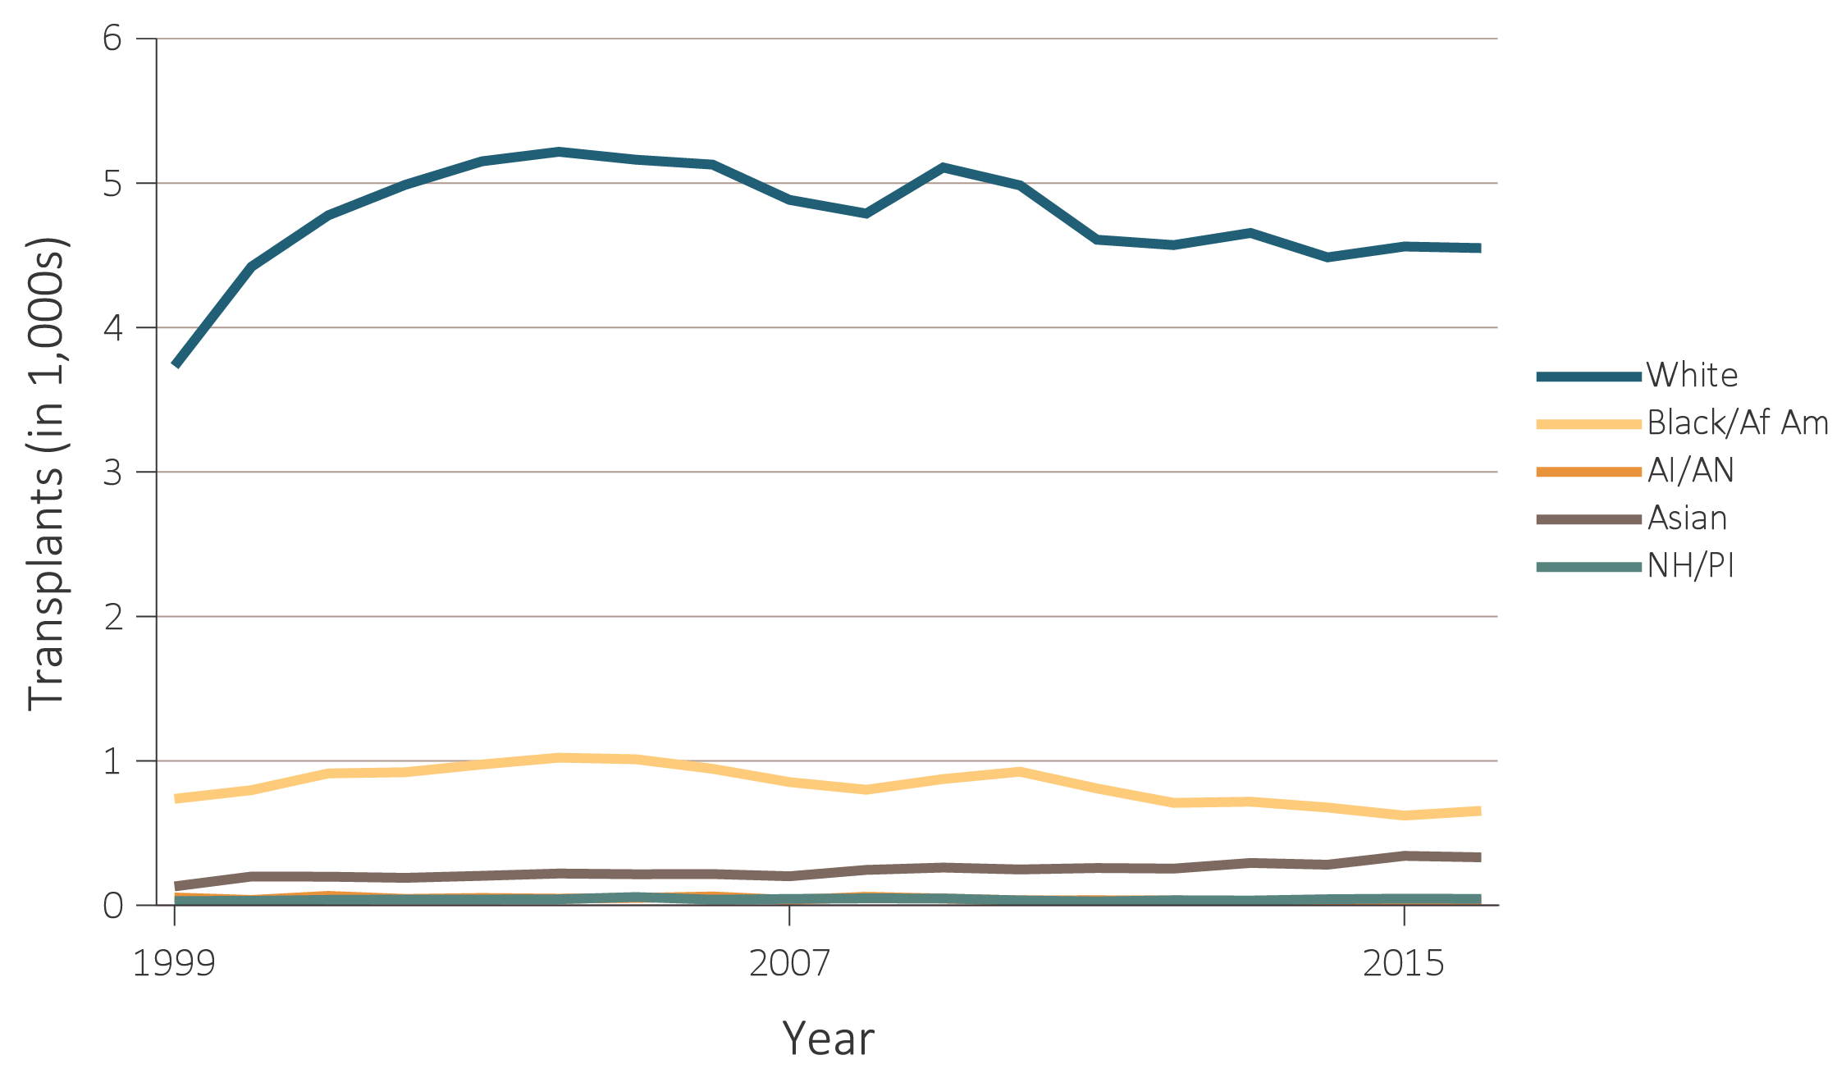
vol 2 Figure 6.16 Number of living-donor transplants and unadjusted transplant rates among living-donor kidney recipients, by recipient race, 1999-2016
(a) Number of transplants by race
Data Source: Reference Tables E.8(3) and E.9(3). (a) Living-donor kidney transplant counts by recipient race. (b) Unadjusted living-donor kidney transplant rates by recipient race. Note that trends may be influenced by changes to the kidney allocation system (KAS) policy that were implemented in December 2014. Abbreviations: AI/AN, American Indian or Alaska Native; Black/Af Am, Black/African American; NH/PI, Native Hawaiian or Pacific Islander; pt yrs, patient-years; tx, transplant.

Slide 27
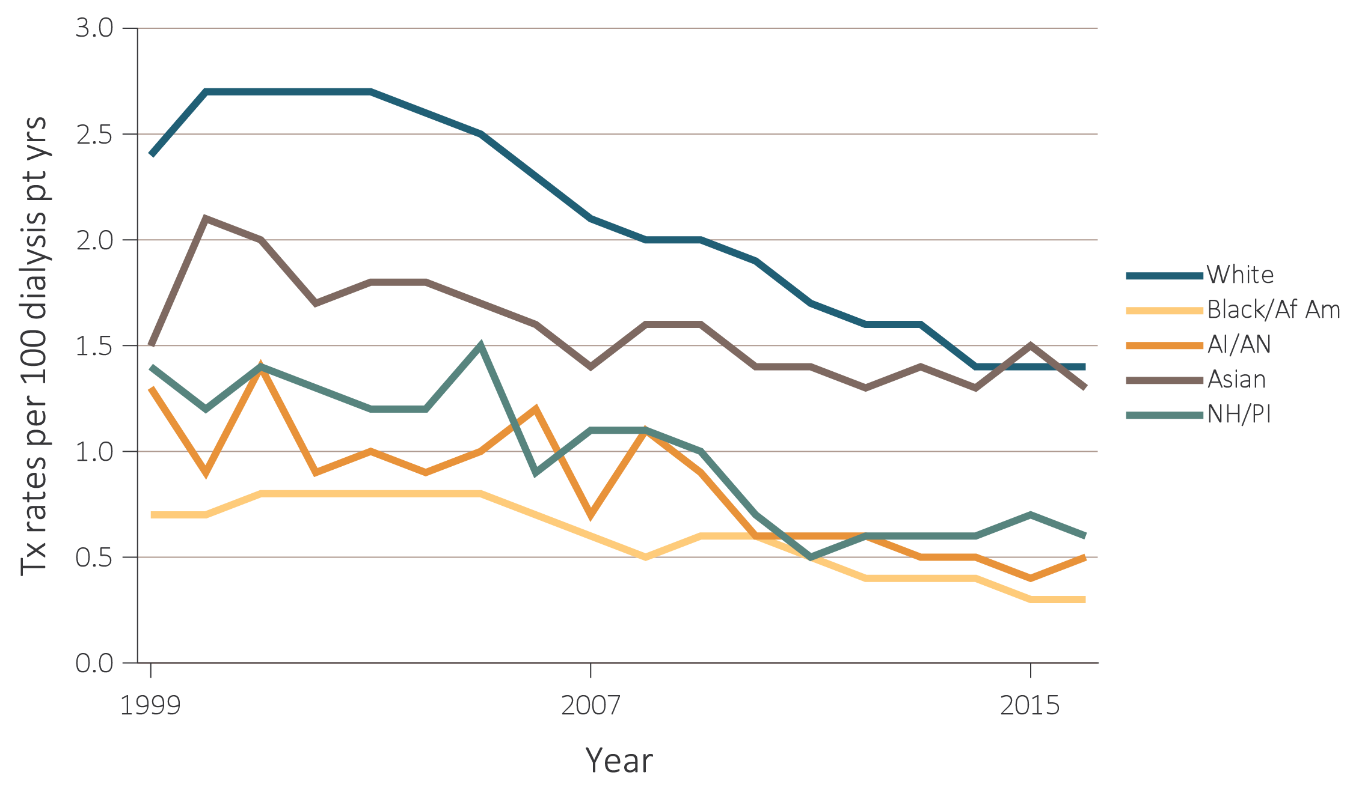
vol 2 Figure 6.16 Number of living-donor transplants and unadjusted transplant rates among living-donor kidney recipients, by recipient race, 1999-2016
(b) Transplant rates by race
Data Source: Reference Tables E.8(3) and E.9(3). (a) Living-donor kidney transplant counts by recipient race. (b) Unadjusted living-donor kidney transplant rates by recipient race. Note that trends may be influenced by changes to the kidney allocation system (KAS) policy that were implemented in December 2014. Abbreviations: AI/AN, American Indian or Alaska Native; Black/Af Am, Black/African American; NH/PI, Native Hawaiian or Pacific Islander; pt yrs, patient-years; tx, transplant.

Slide 28
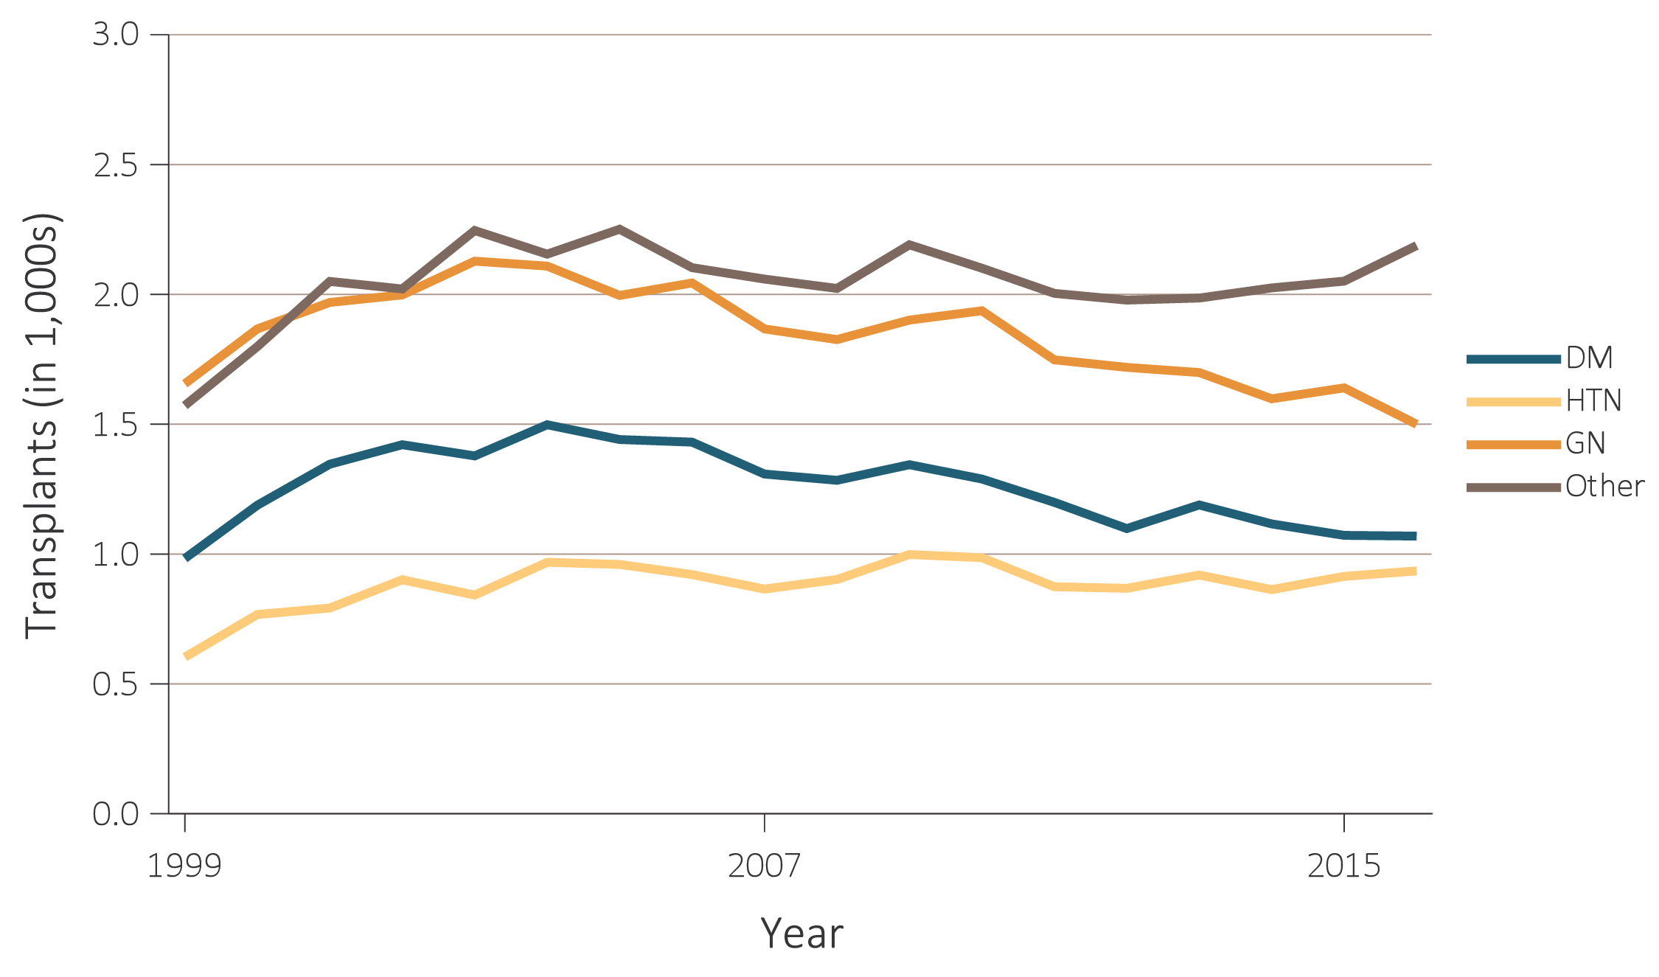
vol 2 Figure 6.17 Number of living-donor transplants and unadjusted transplant rates among living-donor kidney recipients, by recipient primary cause of ESRD, 1999-2016
(a) Number of transplants by primary cause of ESRD
Data Source: Reference Tables E.8(3) and E.9(3). (a) Living-donor kidney transplant counts by recipient primary cause of ESRD. (b) Unadjusted living-donor kidney transplant rates by recipient primary cause of ESRD. Note that trends may be influenced by changes to the kidney allocation system (KAS) policy that were implemented in December 2014. Abbreviations: DM, diabetes mellitus; ESRD, end-stage renal disease; GN, glomerulonephritis; HTN, hypertension; pt yrs, patient-years; tx, transplant.

Slide 29
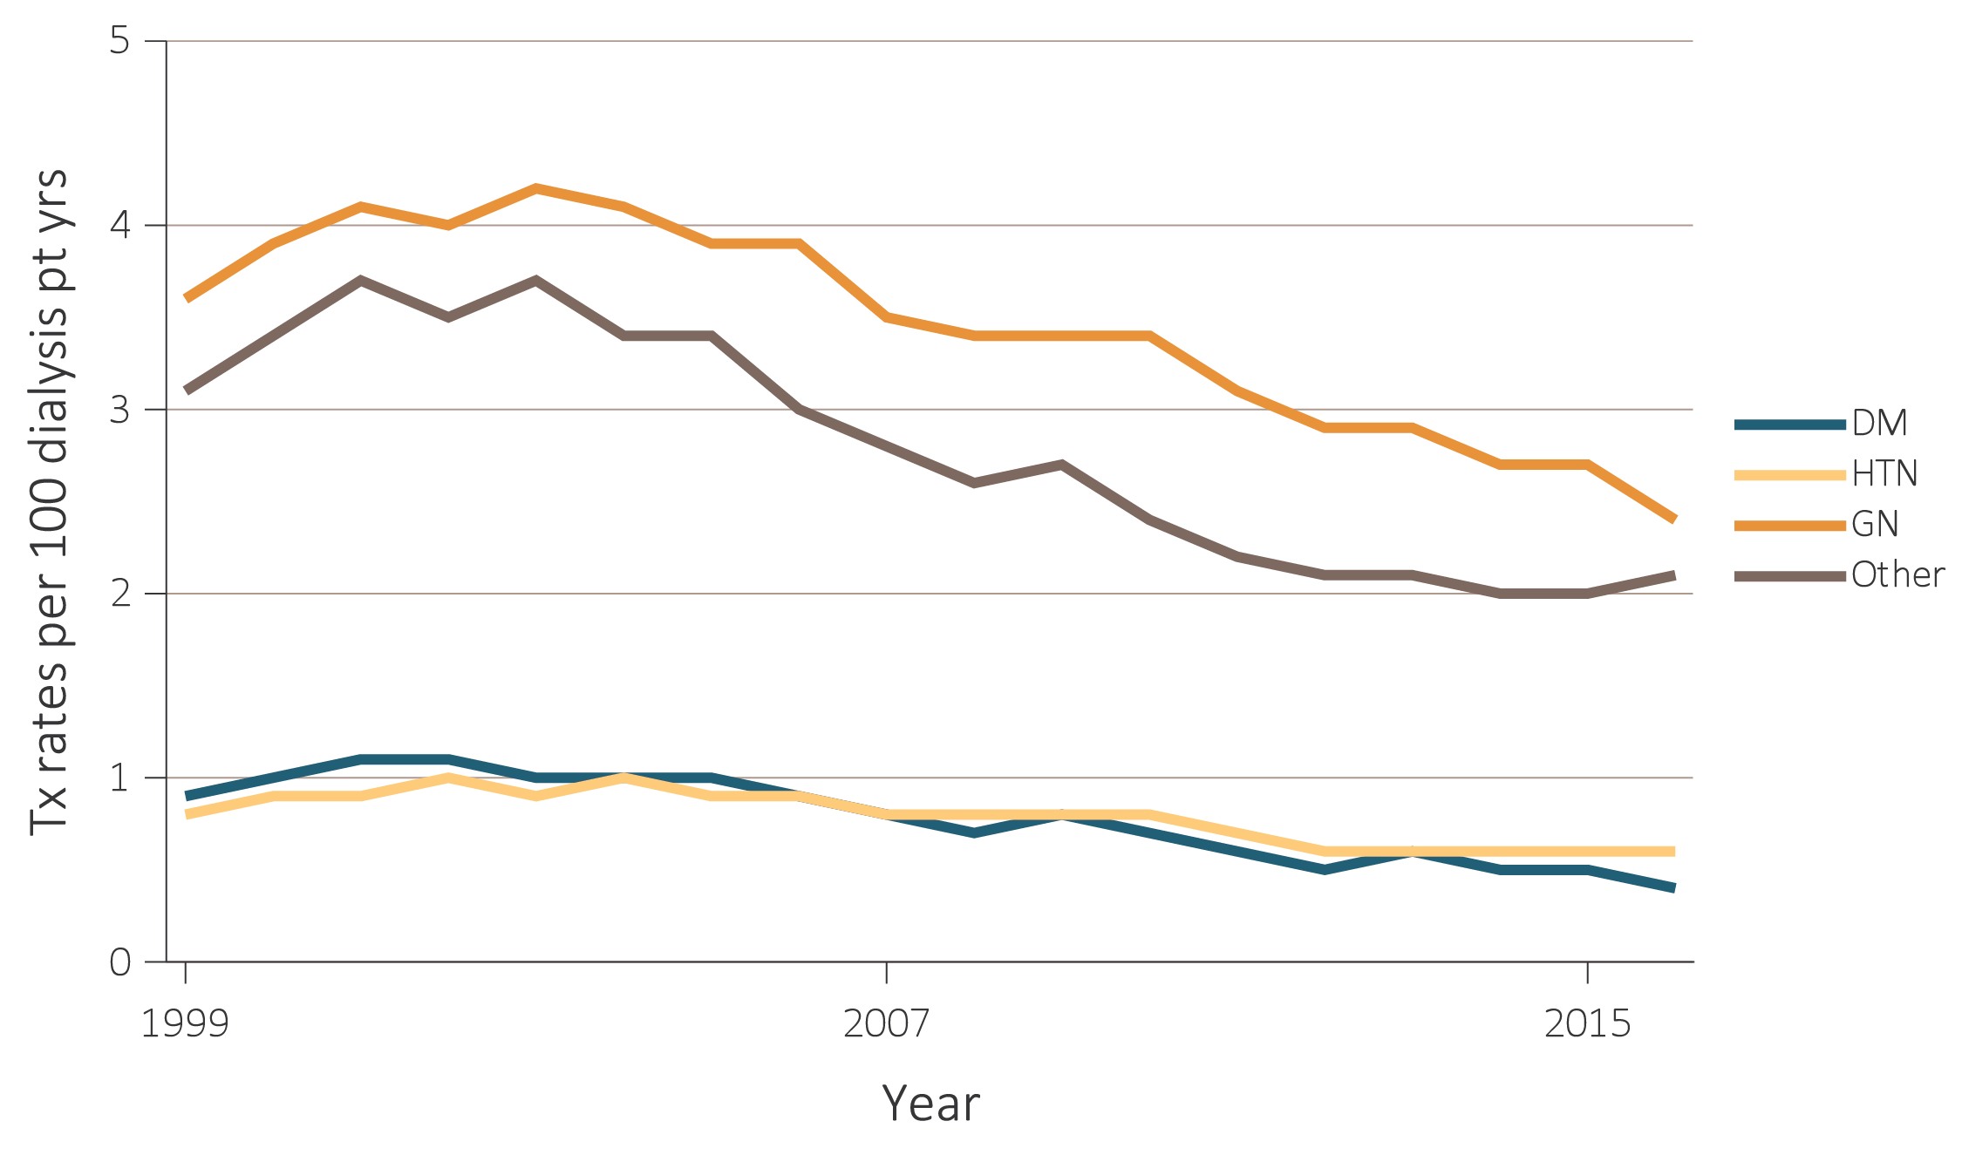
vol 2 Figure 6.17 Number of living-donor transplants and unadjusted transplant rates among living-donor kidney recipients, by recipient primary cause of ESRD, 1999-2016
(b) Transplant rates by primary cause of ESRD
Data Source: Reference Tables E.8(3) and E.9(3). (a) Living-donor kidney transplant counts by recipient primary cause of ESRD. (b) Unadjusted living-donor kidney transplant rates by recipient primary cause of ESRD. Note that trends may be influenced by changes to the kidney allocation system (KAS) policy that were implemented in December 2014. Abbreviations: DM, diabetes mellitus; ESRD, end-stage renal disease; GN, glomerulonephritis; HTN, hypertension; pt yrs, patient-years; tx, transplant.

Slide 30
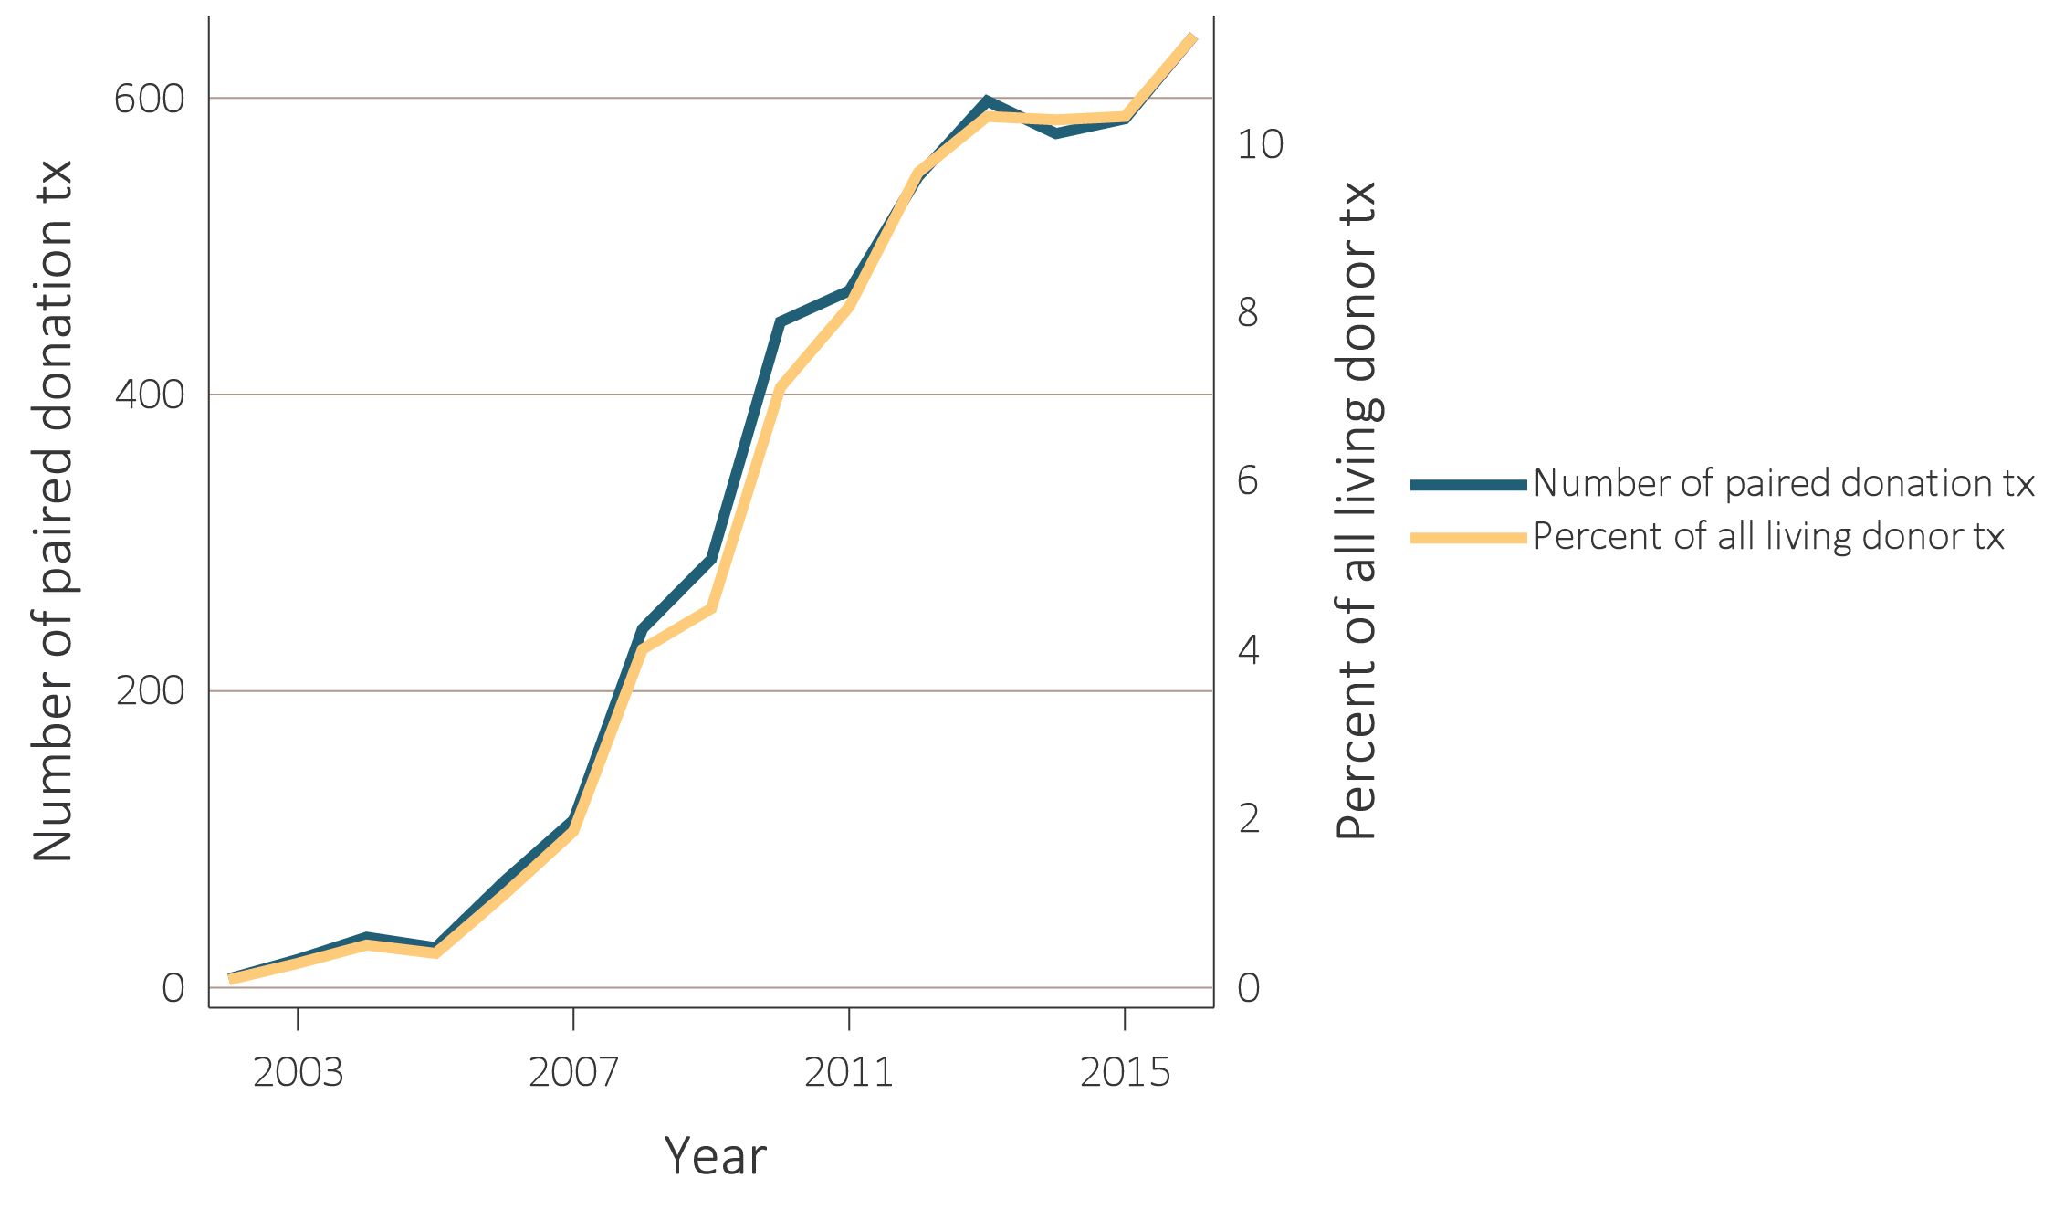
vol 2 Figure 6.18 Number of paired donation transplants and percent of all living-donor transplants, 2002-2016
Data Source: Data are obtained from the Organ Procurement and Transplantation Network (OPTN). Paired donation transplant counts and percent of all living-donor transplants. Note that trends may be influenced by changes to the kidney allocation system (KAS) policy that were implemented in December 2014. Abbreviation: tx, transplant.

Slide 31
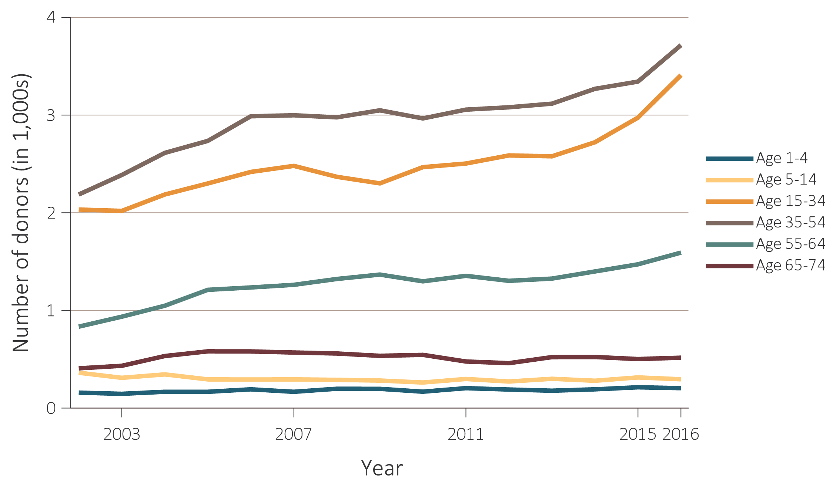
vol 2 Figure 6.19 Number of deceased kidney donors and unadjusted kidney donation rates, by donor age, 2002-2016
(a) Number of donors by age
Data Source: Data on the annual number of deaths in the U.S. population are obtained from the Centers for Disease Control and Prevention; the deceased-donor data are obtained from the Organ Procurement and Transplantation Network (OPTN). Deceased-donor kidney donation counts and rates by donor age. Note that trends may be influenced by changes to the kidney allocation system (KAS) policy that were implemented in December 2014.

Slide 32
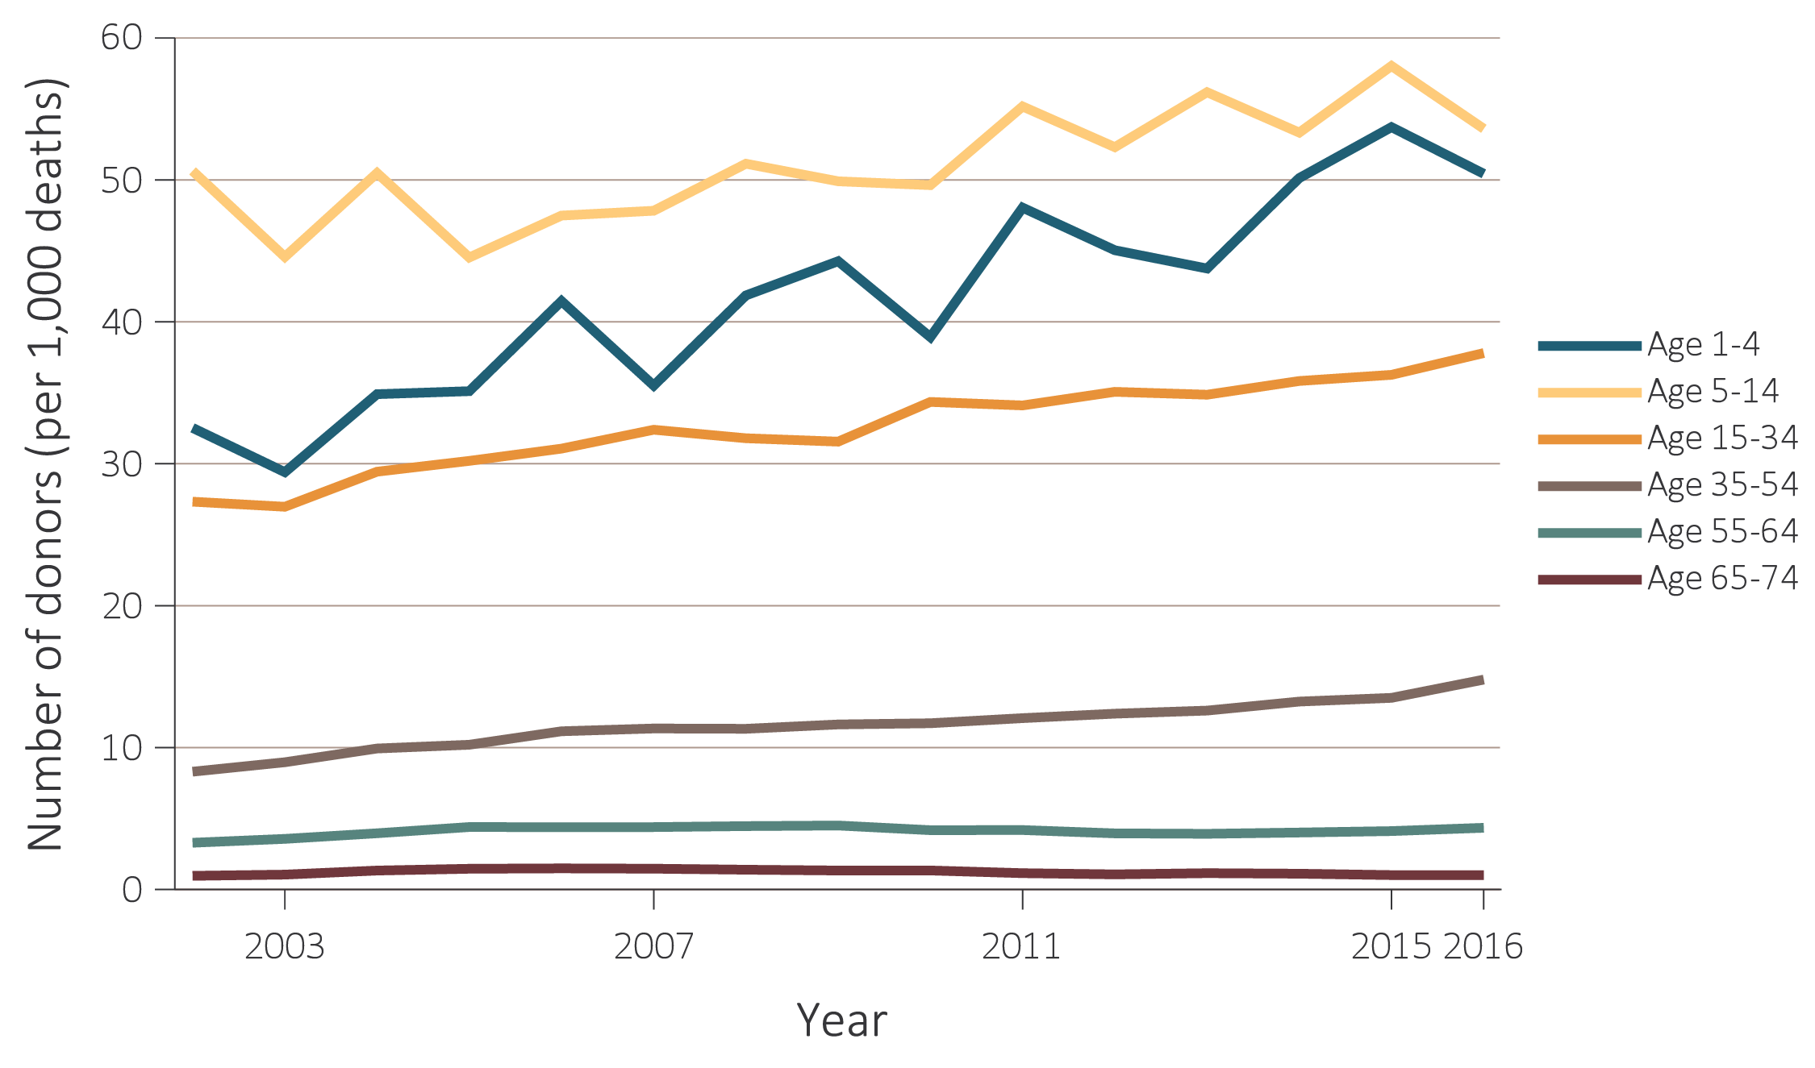
vol 2 Figure 6.19 Number of deceased kidney donors and unadjusted kidney donation rates, by donor age, 2002-2016
(b) Donation rates by age
Data Source: Data on the annual number of deaths in the U.S. population are obtained from the Centers for Disease Control and Prevention; the deceased-donor data are obtained from the Organ Procurement and Transplantation Network (OPTN). Deceased-donor kidney donation counts and rates by donor age. Note that trends may be influenced by changes to the kidney allocation system (KAS) policy that were implemented in December 2014.

Slide 33
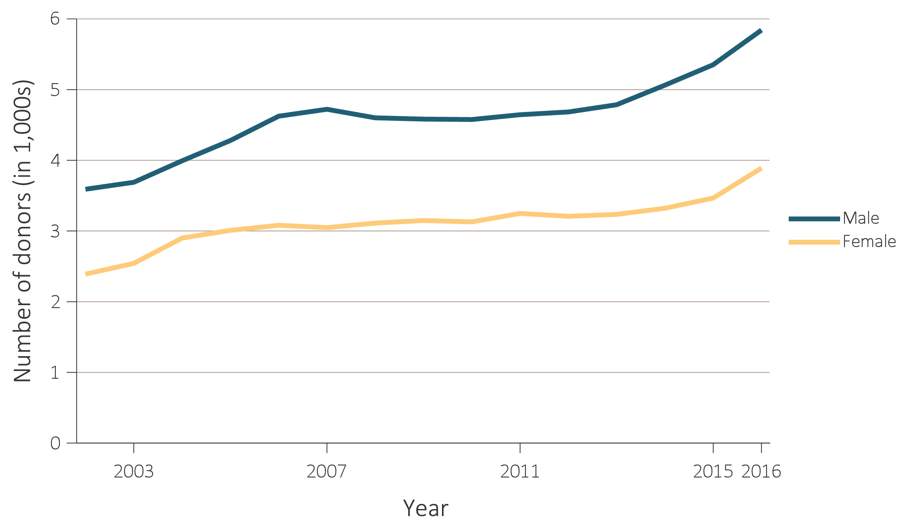
vol 2 Figure 6.20 Number of deceased kidney donors and unadjusted kidney donation rates, by donor sex, 2002-2016
(a) Number of donors by sex
Data Source: Data on the annual number of deaths in the U.S. population are obtained from the Centers for Disease Control and Prevention; the deceased-donor data are obtained from the Organ Procurement and Transplantation Network (OPTN). Deceased-donor kidney donation counts and rates by donor sex. Note that trends may be influenced by changes to the kidney allocation system (KAS) policy that were implemented in December 2014.

Slide 34
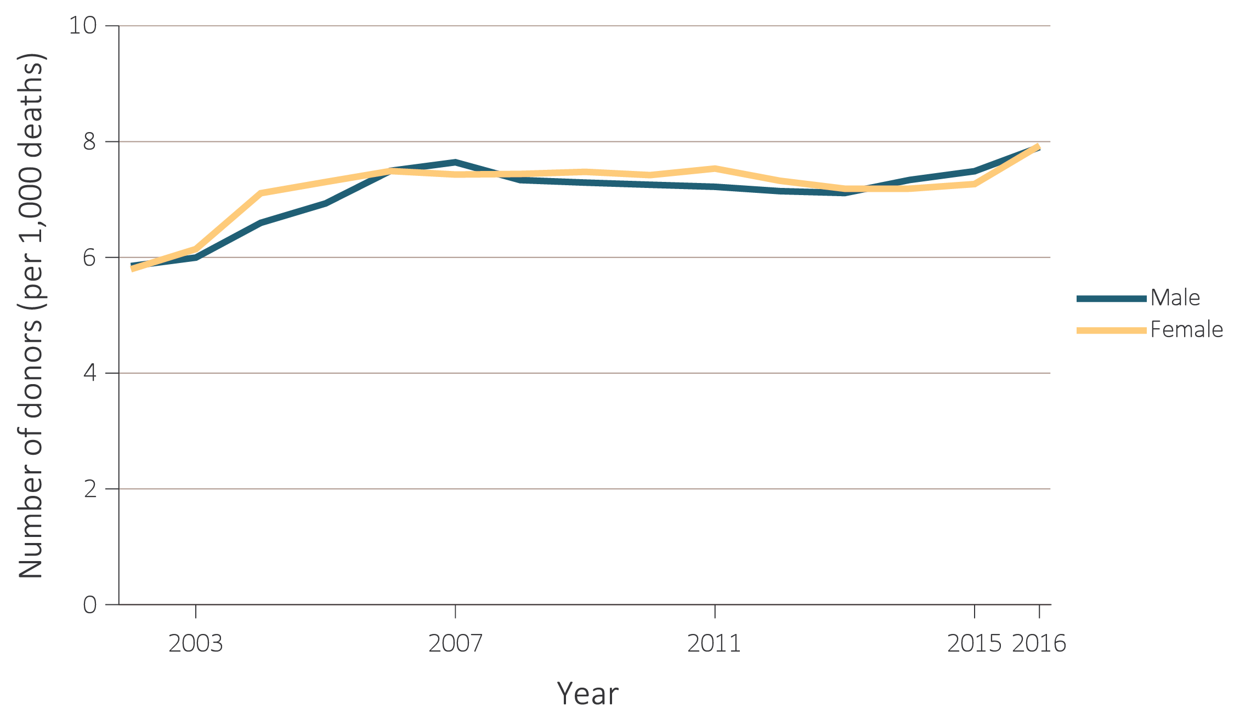
vol 2 Figure 6.20 Number of deceased kidney donors and unadjusted kidney donation rates, by donor sex, 2002-2016
(b) Donation rates by sex
Data Source: Data on the annual number of deaths in the U.S. population are obtained from the Centers for Disease Control and Prevention; the deceased-donor data are obtained from the Organ Procurement and Transplantation Network (OPTN). Deceased-donor kidney donation counts and rates by donor sex. Note that trends may be influenced by changes to the kidney allocation system (KAS) policy that were implemented in December 2014.

Slide 35
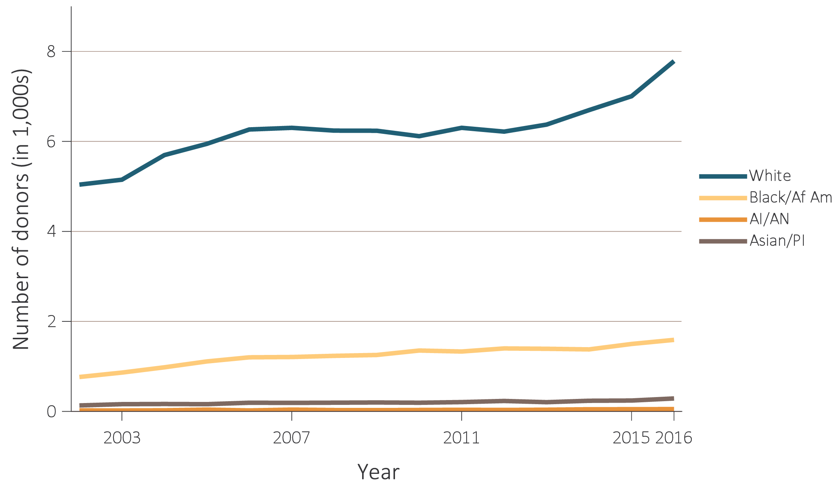
vol 2 Figure 6.21 Number of deceased kidney donors and unadjusted kidney donation rates, by donor race, 2002-2016
(a) Number of donors by race
Data Source: The U.S. death population data are obtained from the Centers for Disease Control and Prevention; the deceased-donor data are obtained from the Organ Procurement and Transplantation Network (OPTN). Deceased-donor kidney donation counts and rates by donor race. Note that trends may be influenced by changes to the kidney allocation system (KAS) policy that were implemented in December 2014. Abbreviations: AI/AN, American Indian or Alaska Native; Asian/PI, Asian/Pacific Islander; Black/Af Am, Black/African American.

Slide 36
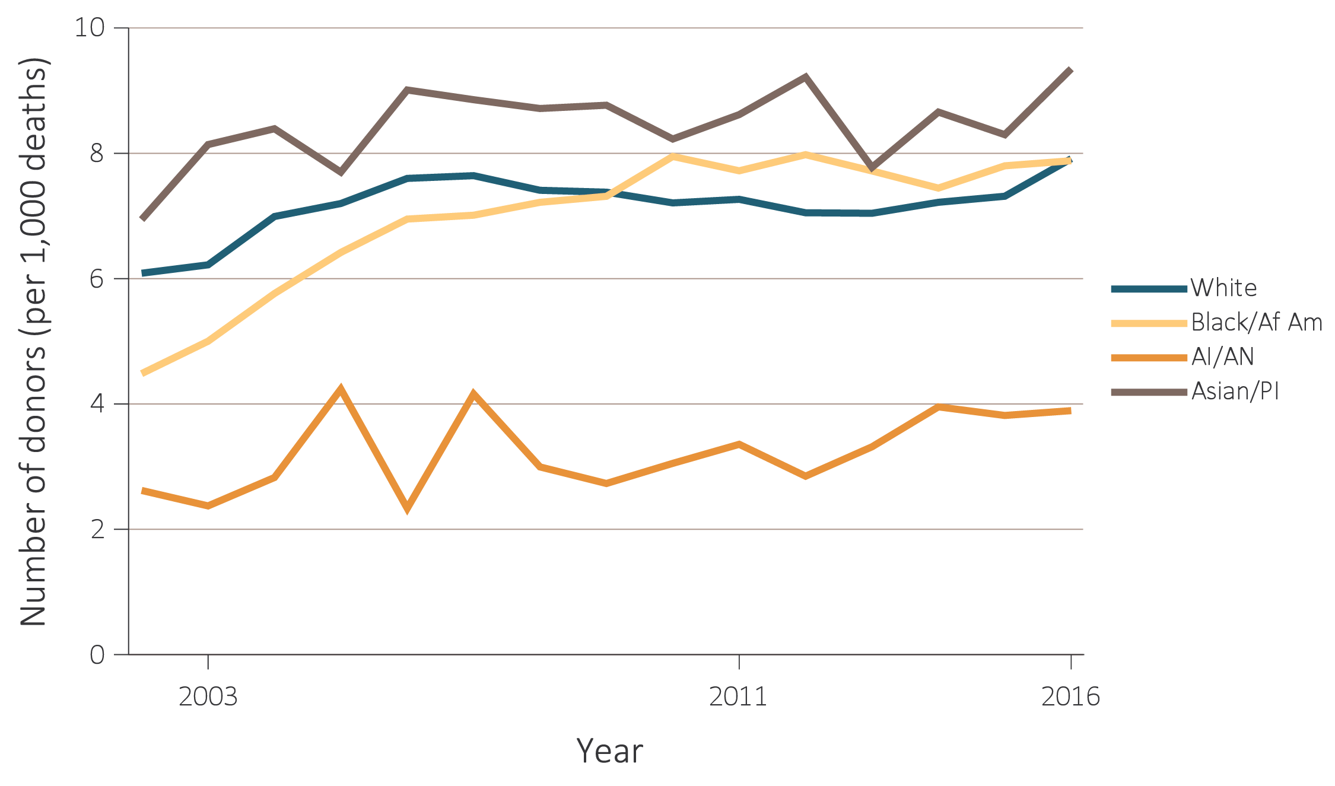
vol 2 Figure 6.21 Number of deceased kidney donors and unadjusted kidney donation rates, by donor race, 2002-2016
(b) Donation rates by race
Data Source: The U.S. death population data are obtained from the Centers for Disease Control and Prevention; the deceased-donor data are obtained from the Organ Procurement and Transplantation Network (OPTN). Deceased-donor kidney donation counts and rates by donor race. Note that trends may be influenced by changes to the kidney allocation system (KAS) policy that were implemented in December 2014. Abbreviations: AI/AN, American Indian or Alaska Native; Asian/PI, Asian/Pacific Islander; Black/Af Am, Black/African American.

Slide 37
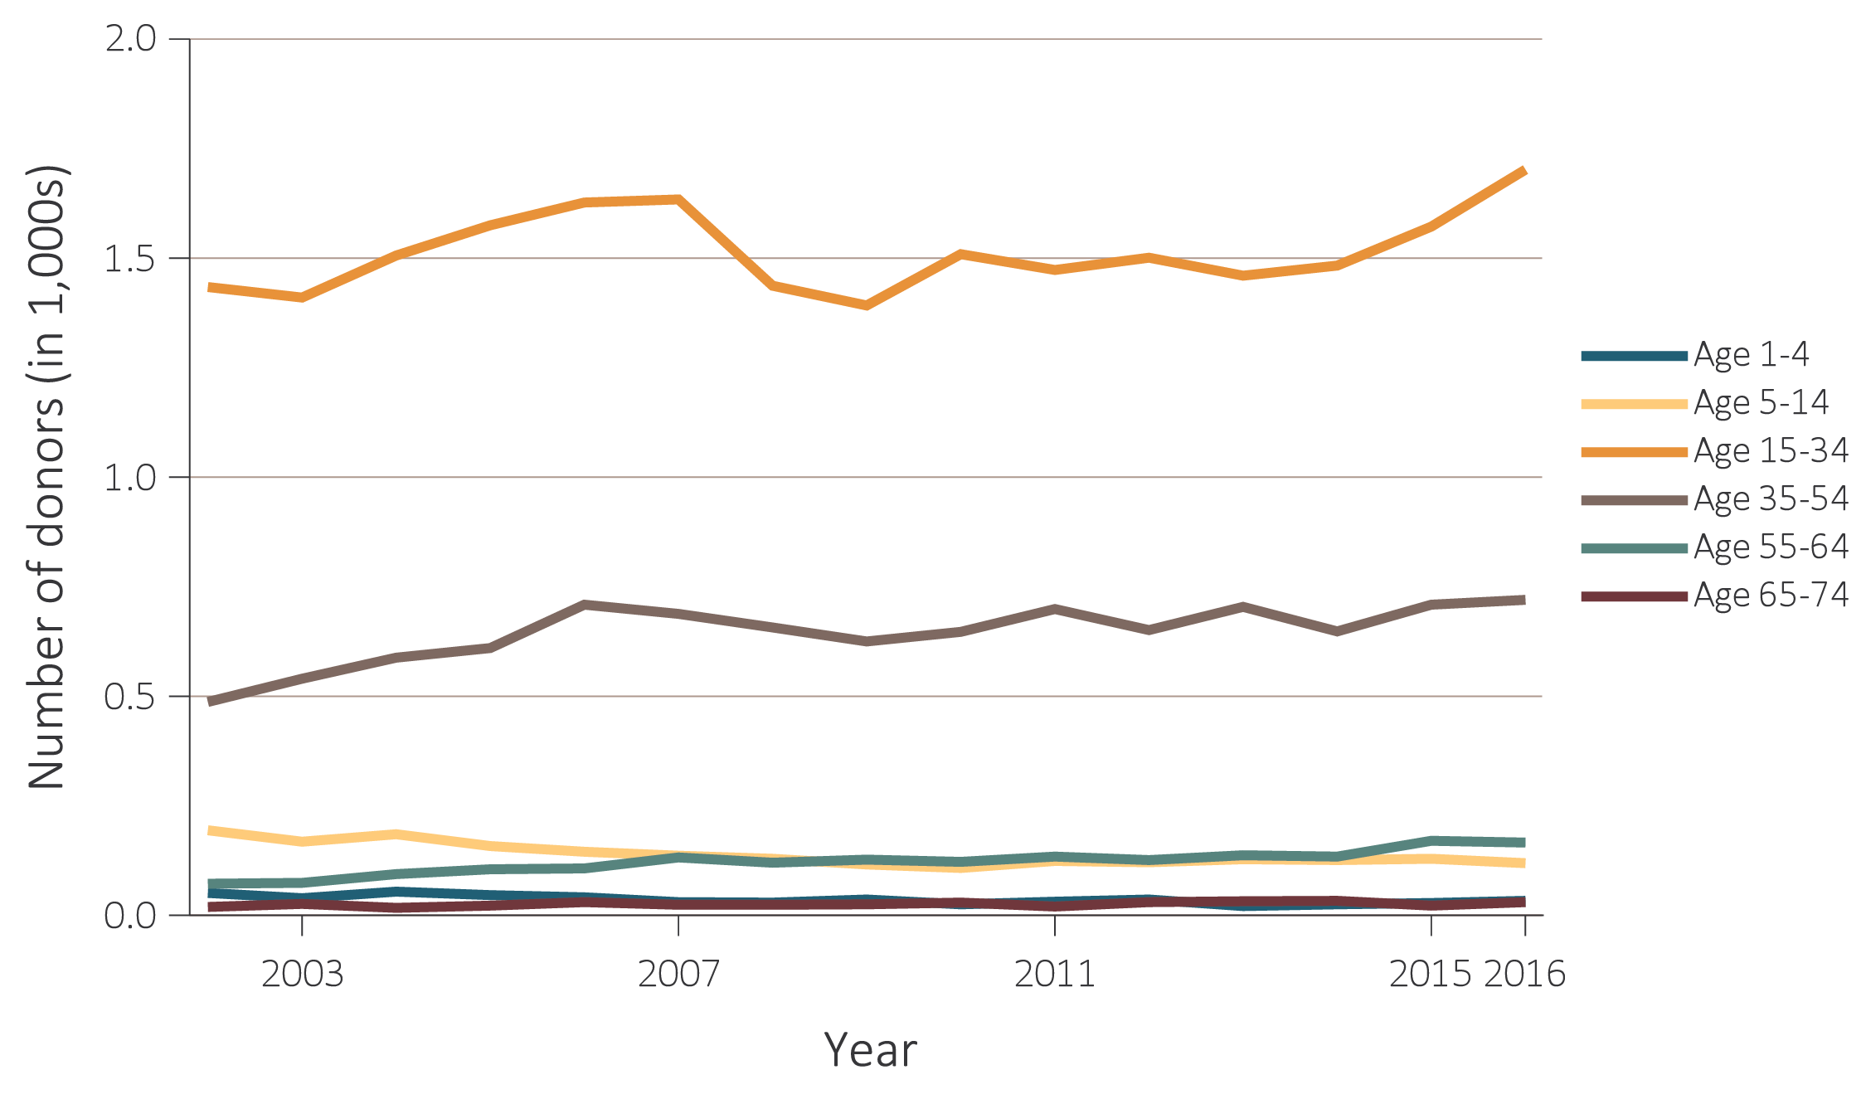
vol 2 Figure 6.22 Number of deceased kidney donors and unadjusted kidney donation rates, for traumatic deaths, by donor age, 2002-2016
(a) Number of donors by age
Data Source: Data on the annual number of deaths in the U.S. population are obtained from the Centers for Disease Control and Prevention; the deceased-donor data are obtained from the Organ Procurement and Transplantation Network (OPTN). Deceased-donor kidney donation counts and rates by donor age. Note that trends may be influenced by changes to the kidney allocation system (KAS) policy that were implemented in December 2014.

Slide 38
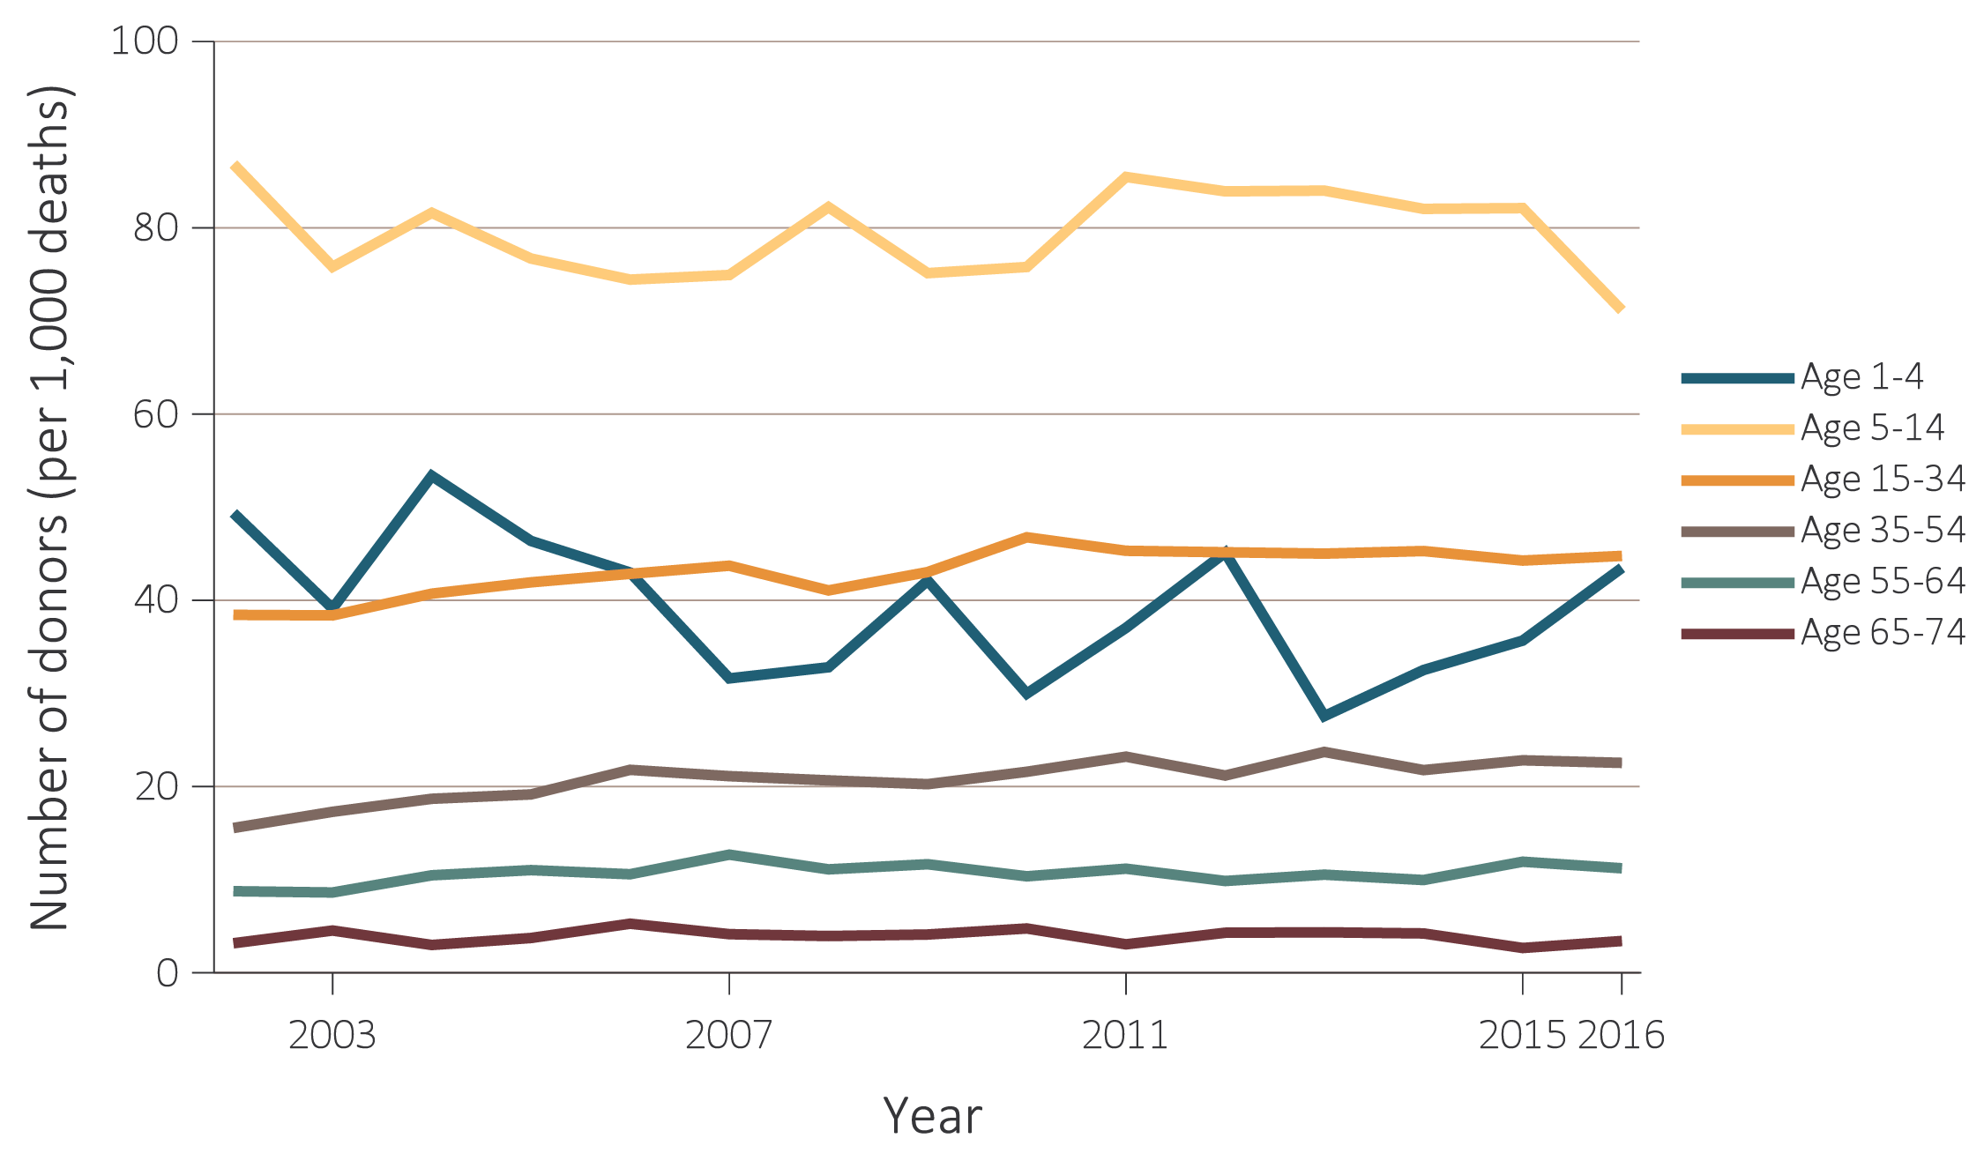
vol 2 Figure 6.22 Number of deceased kidney donors and unadjusted kidney donation rates, for traumatic deaths, by donor age, 2002-2016
(b) Donation rates by age
Data Source: Data on the annual number of deaths in the U.S. population are obtained from the Centers for Disease Control and Prevention; the deceased-donor data are obtained from the Organ Procurement and Transplantation Network (OPTN). Deceased-donor kidney donation counts and rates by donor age. Note that trends may be influenced by changes to the kidney allocation system (KAS) policy that were implemented in December 2014.

Slide 39
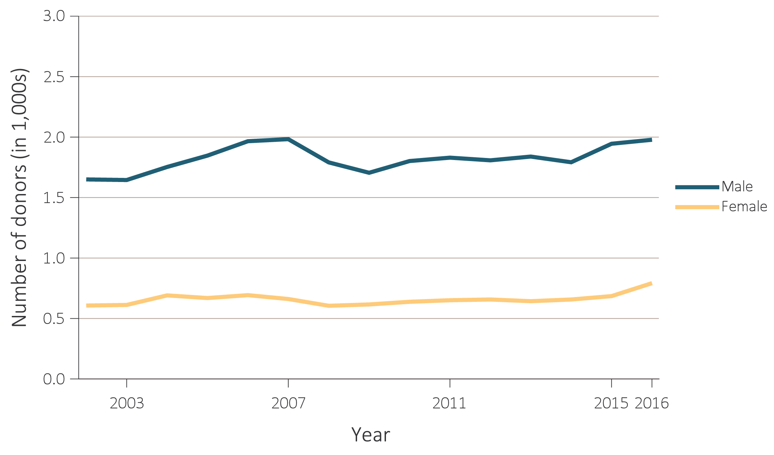
vol 2 Figure 6.23 Number of deceased kidney donors and unadjusted kidney donation rates, for traumatic deaths, by donor sex, 2002-2016
(a) Number of donors by sex
Data Source: Data on the annual number of deaths in the U.S. population are obtained from the Centers for Disease Control and Prevention; the deceased-donor data are obtained from the Organ Procurement and Transplantation Network (OPTN). Deceased-donor kidney donation counts and rates by donor sex. Note that trends may be influenced by changes to the kidney allocation system (KAS) policy that were implemented in December 2014.

Slide 40
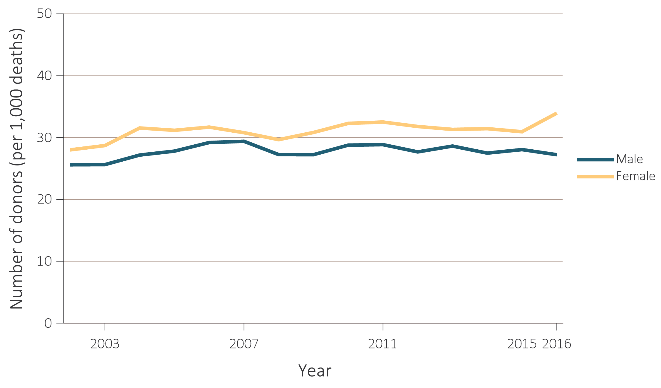
vol 2 Figure 6.23 Number of deceased kidney donors and unadjusted kidney donation rates, for traumatic deaths, by donor sex, 2002-2016
(b) Donation rates by sex
Data Source: Data on the annual number of deaths in the U.S. population are obtained from the Centers for Disease Control and Prevention; the deceased-donor data are obtained from the Organ Procurement and Transplantation Network (OPTN). Deceased-donor kidney donation counts and rates by donor sex. Note that trends may be influenced by changes to the kidney allocation system (KAS) policy that were implemented in December 2014.

Slide 41
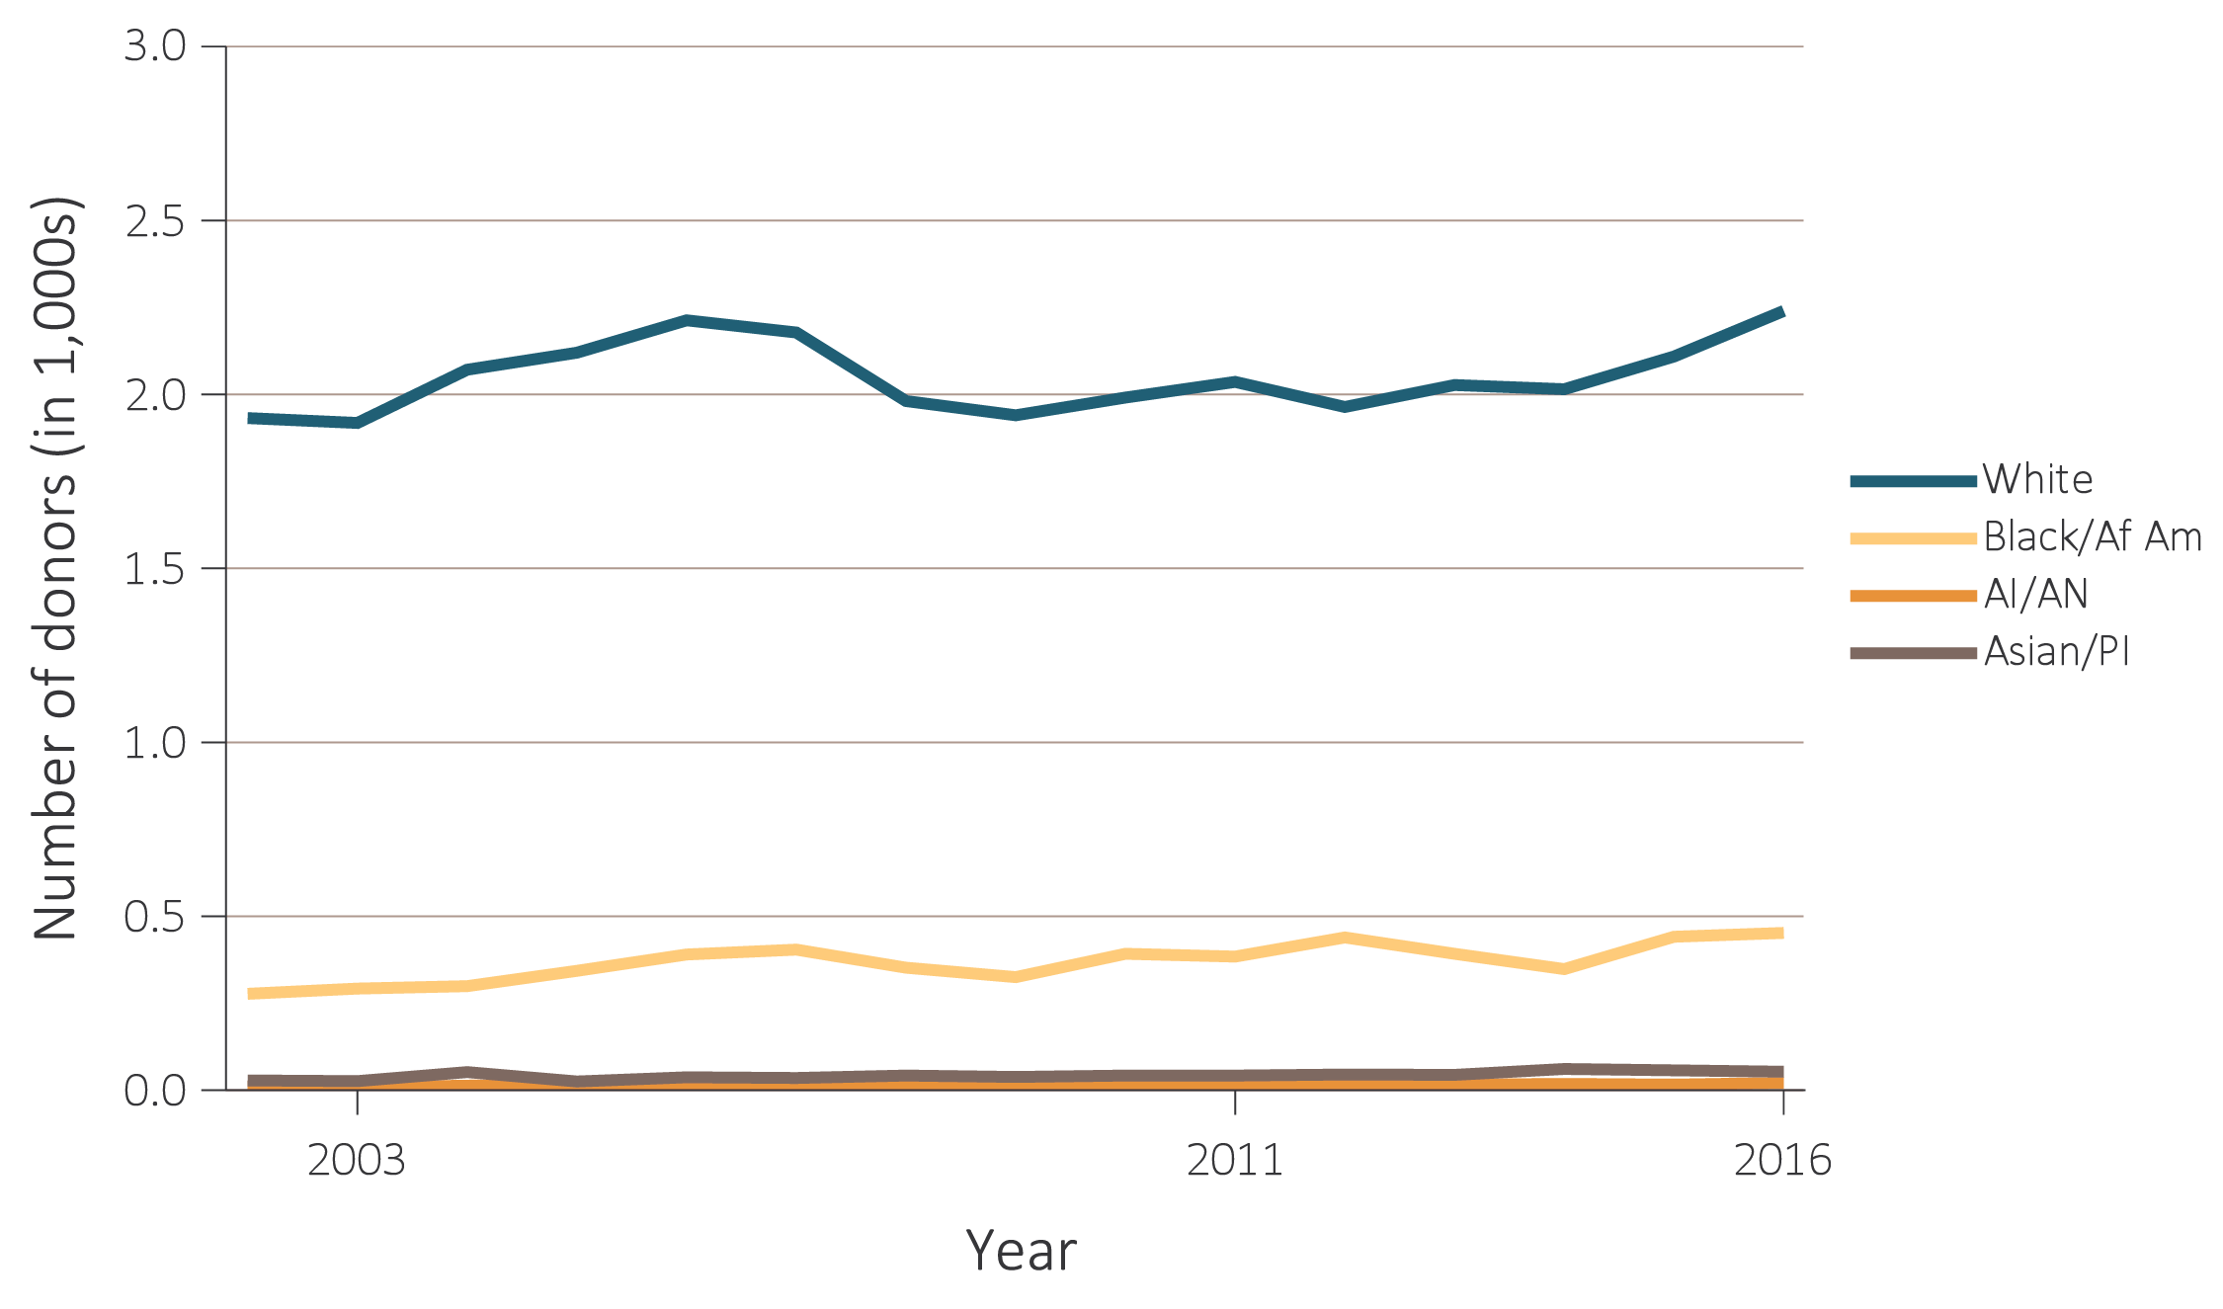
vol 2 Figure 6.24 Number of deceased kidney donors and unadjusted kidney donation rates, for traumatic deaths, by donor race, 2002-2016
(a) Number of donors by race
Data Source: The U.S. death population data are obtained from the Centers for Disease Control and Prevention; the deceased-donor data are obtained from the Organ Procurement and Transplantation Network (OPTN). Deceased-donor kidney donation counts and rates by donor race. Note that trends may be influenced by changes to the kidney allocation system (KAS) policy that were implemented in December 2014. Abbreviations: AI/AN, American Indian or Alaska Native; Asian/PI, Asian/Pacific Islander; Black/Af Am, Black/African American.

Slide 42
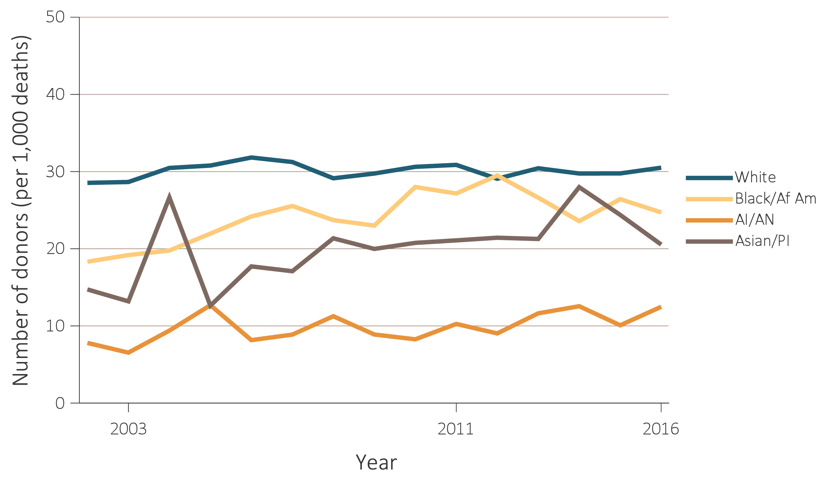
vol 2 Figure 6.24 Number of deceased kidney donors and unadjusted kidney donation rates, for traumatic deaths, by donor race, 2002-2016
(b) Donation rates by race
Data Source: The U.S. death population data are obtained from the Centers for Disease Control and Prevention; the deceased-donor data are obtained from the Organ Procurement and Transplantation Network (OPTN). Deceased-donor kidney donation counts and rates by donor race. Note that trends may be influenced by changes to the kidney allocation system (KAS) policy that were implemented in December 2014. Abbreviations: AI/AN, American Indian or Alaska Native; Asian/PI, Asian/Pacific Islander; Black/Af Am, Black/African American.

Slide 43
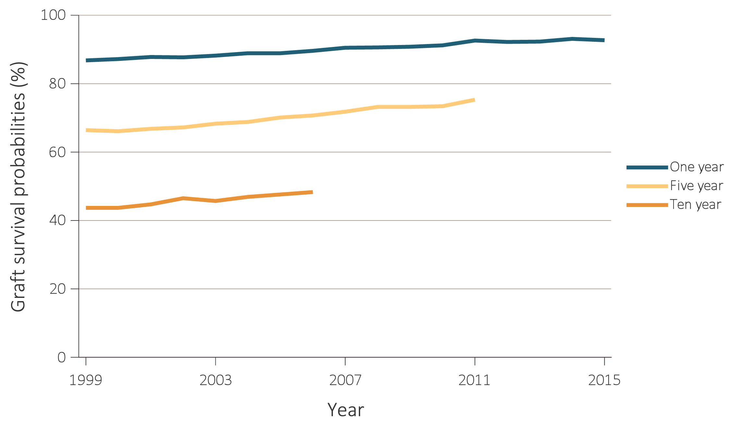
vol 2 Figure 6.25 Trends in 1-, 5-, & 10-year kidney transplant graft survival, 1999-2015
(a) Deceased donor
Data Source: Reference Tables F.2, F.14, F.5, F.17, F.6, F.18. Outcomes among recipients of a first-time deceased-donor kidney transplant, unadjusted. Note that trends may be influenced by changes to the kidney allocation system (KAS) policy that were implemented in December 2014.

Slide 44
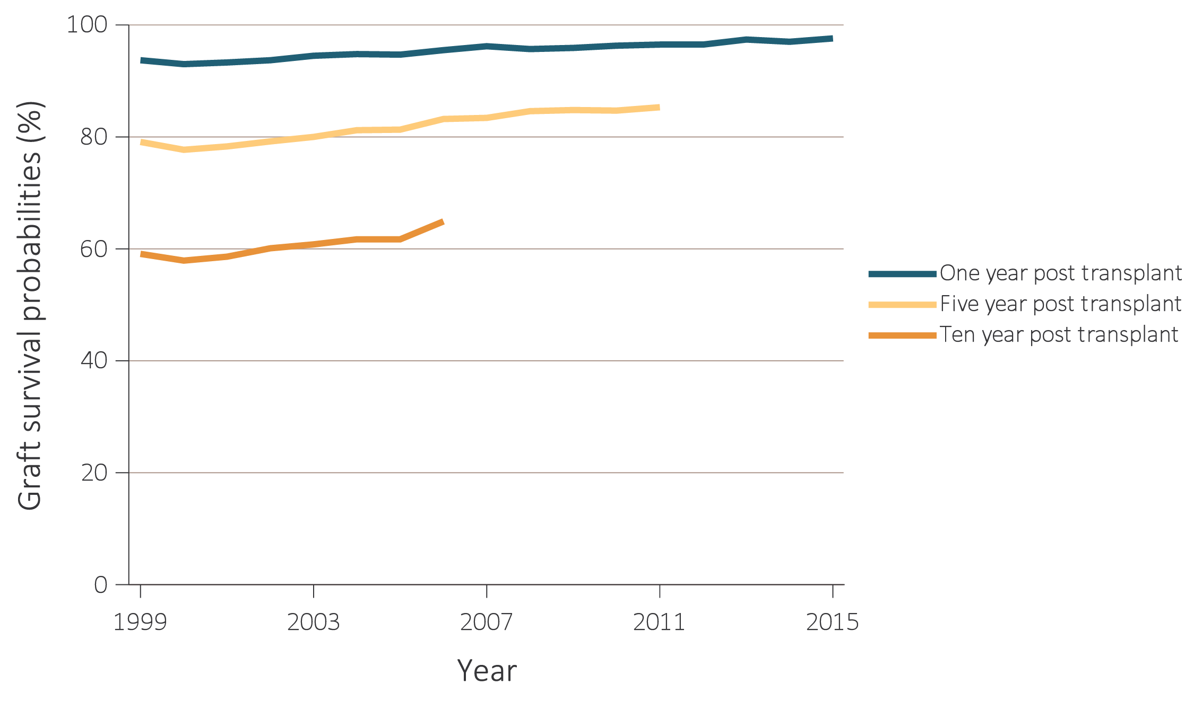
vol 2 Figure 6.25 Trends in 1-, 5-, & 10-year kidney transplant graft survival, 1999-2015
(b) Living donor
Data Source: Reference Tables F.2, F.14, F.5, F.17, F.6, F.18. Outcomes among recipients of a first-time deceased-donor kidney transplant, unadjusted. Note that trends may be influenced by changes to the kidney allocation system (KAS) policy that were implemented in December 2014.

Slide 45
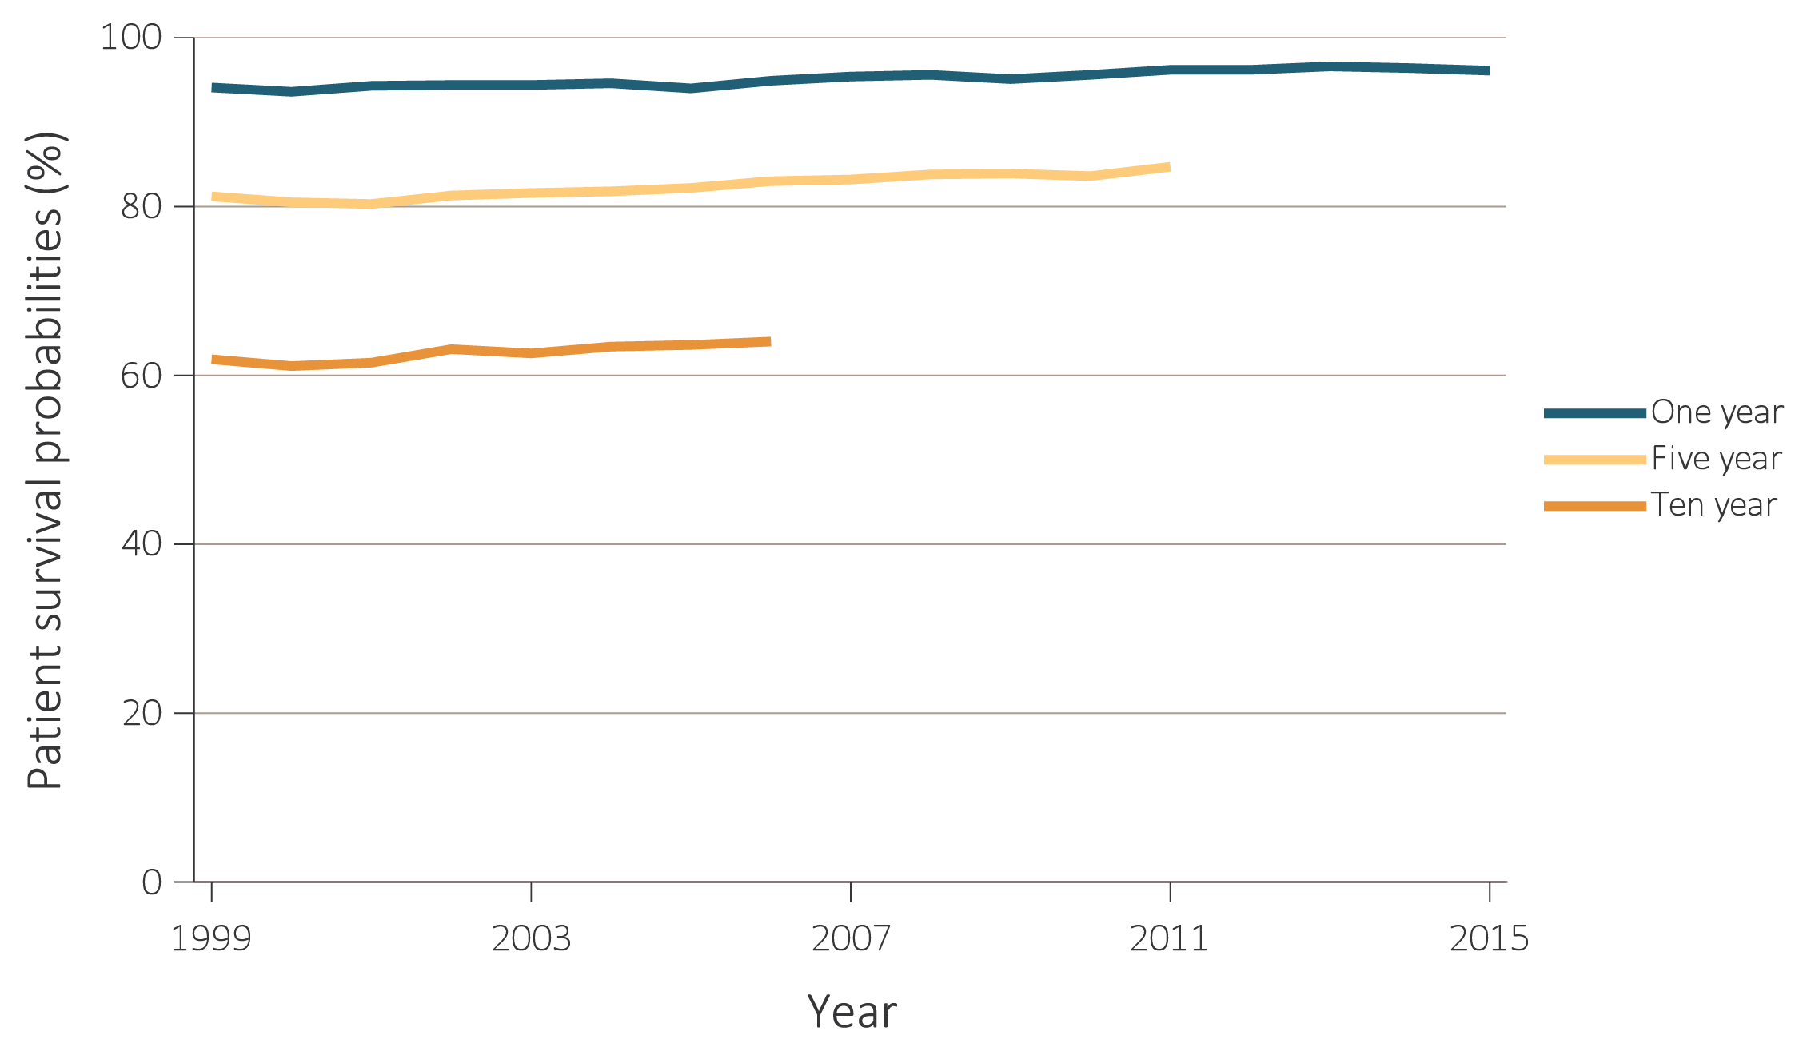
vol 2 Figure 6.26 Trends in 1-, 5-, & 10-year kidney transplant patient survival, 1999-2015
(a) Deceased donor
Data Source: Reference Tables I.26, I.29, I.30, I.32, I.35, I.36. Survival probabilities among recipients of a first-time living-donor kidney transplant, unadjusted. Note that trends may be influenced by changes to the kidney allocation system (KAS) policy that were implemented in December 2014.

Slide 46
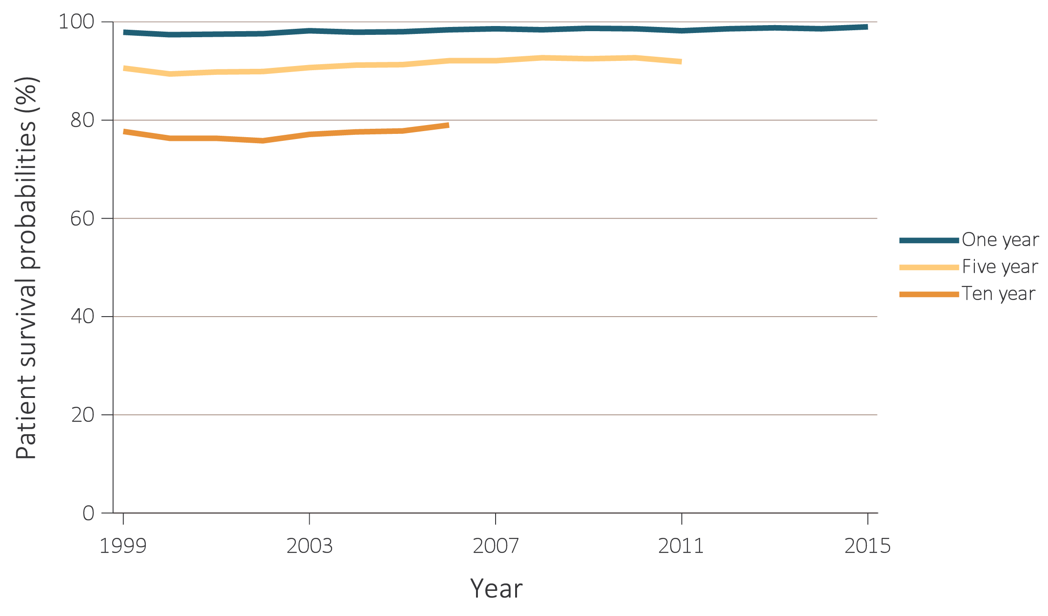
vol 2 Figure 6.26 Trends in 1-, 5-, & 10-year kidney transplant patient survival, 1999-2015
(b) Living donor
Data Source: Reference Tables I.26, I.29, I.30, I.32, I.35, I.36. Survival probabilities among recipients of a first-time living-donor kidney transplant, unadjusted. Note that trends may be influenced by changes to the kidney allocation system (KAS) policy that were implemented in December 2014.

