Slide 1
2018 Annual Data Report
Volume 2: End-Stage Renal Disease
Chapter 7: ESRD among Children, Adolescents,
and Young Adults

Slide 2
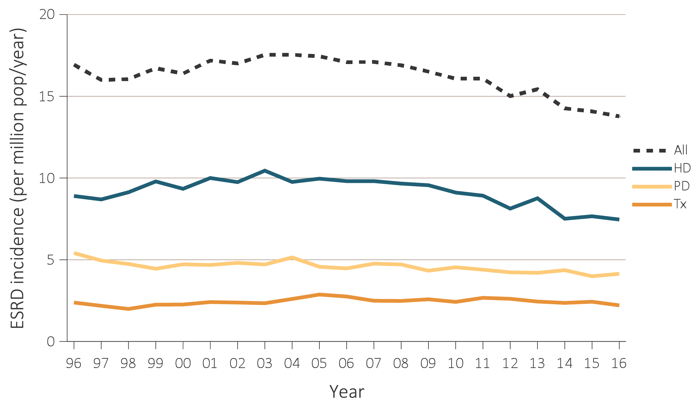
vol 2 Figure 7.1 (a, c) Incidence, and (b, d) December 31 point prevalence of ESRD among pediatric patients (aged 0–21 years) per million population per year, by modality and race, 1996-2016
(a) Incidence by modality
Data Source: Special analyses, USRDS ESRD Database. Peritoneal dialysis consists of continuous ambulatory peritoneal dialysis and continuous cycling peritoneal dialysis. All consists of hemodialysis, peritoneal dialysis, uncertain dialysis, and transplant. Abbreviations: ESRD, end-stage renal disease; HD, hemodialysis; PD, peritoneal dialysis; Tx, transplant.

Slide 3
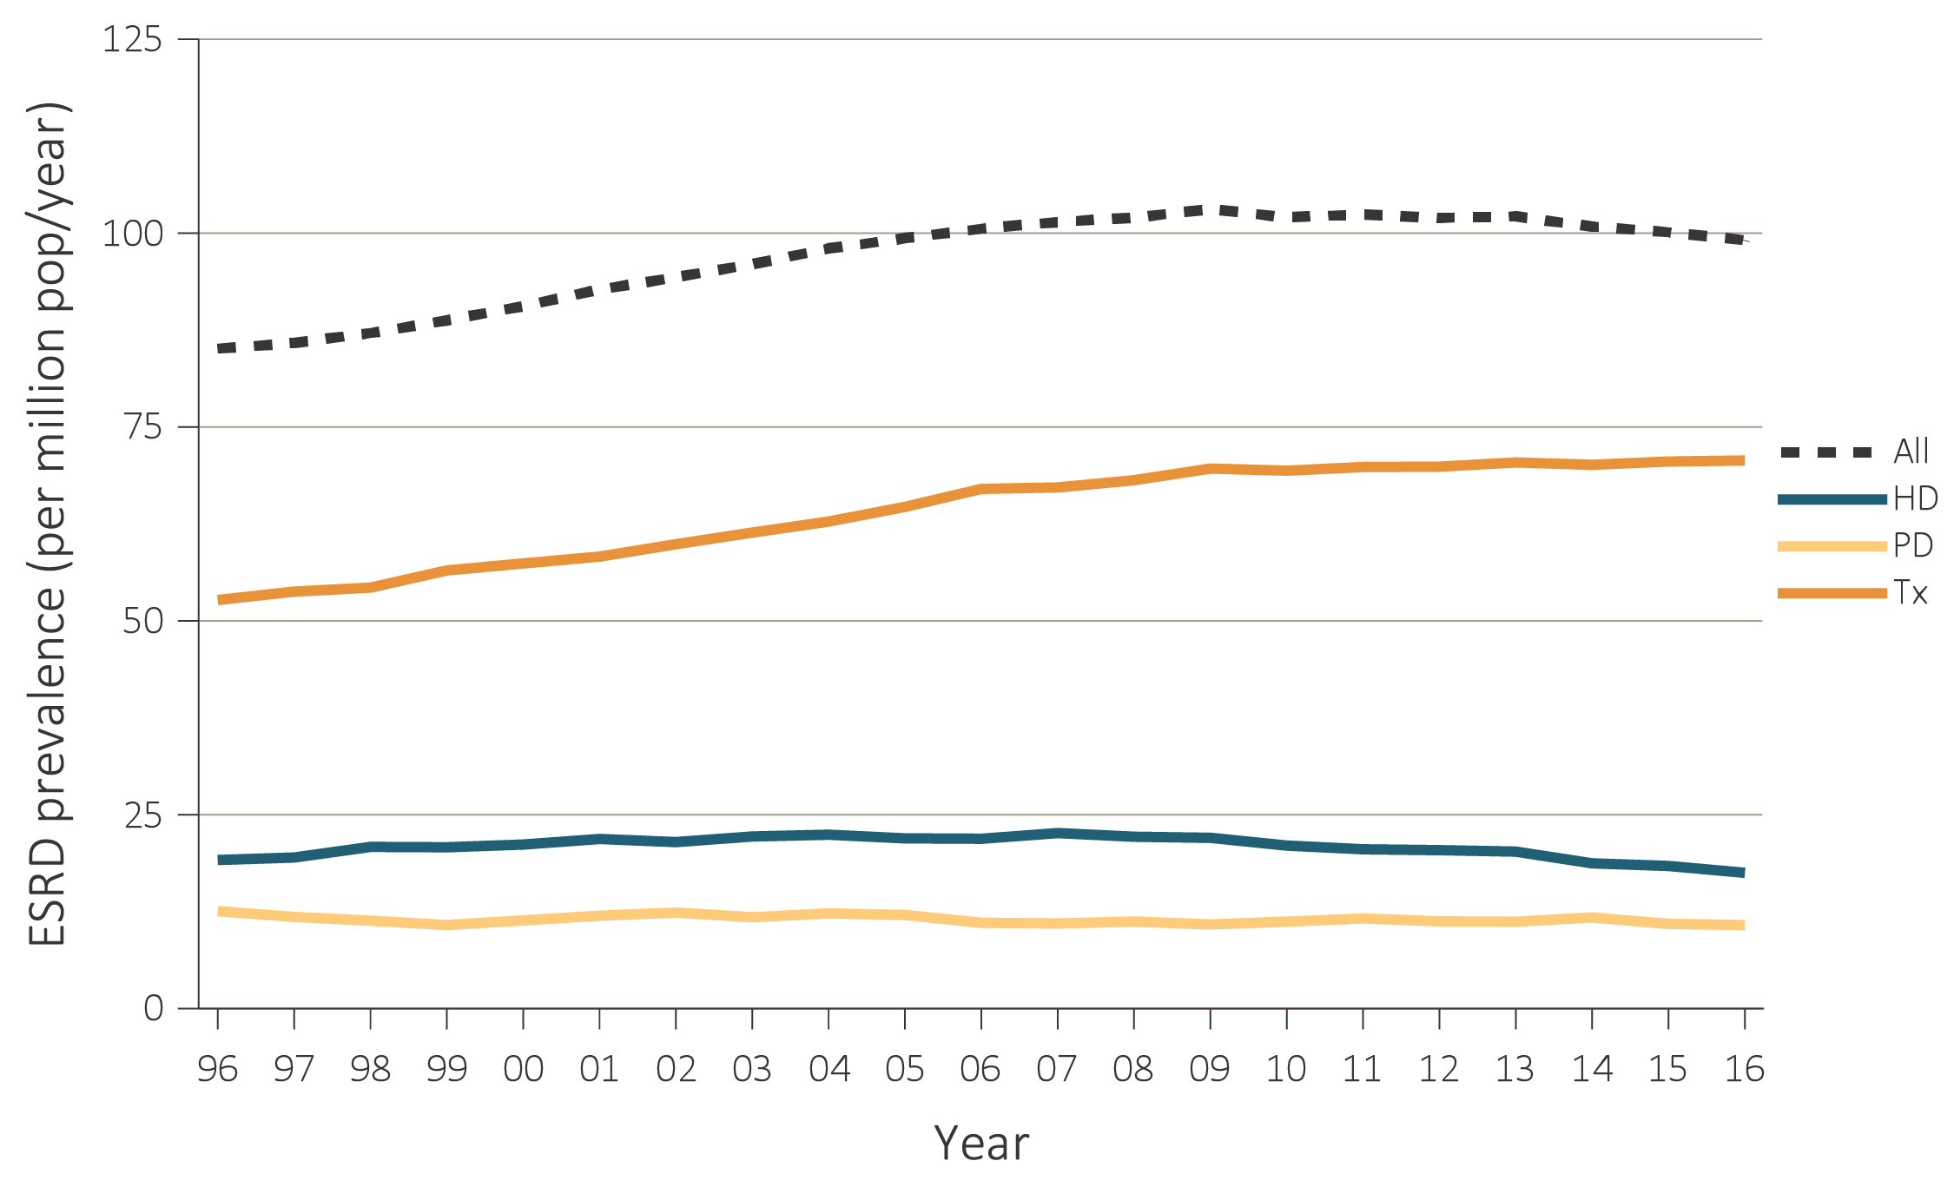
vol 2 Figure 7.1 (a, c) Incidence, and (b, d) December 31 point prevalence of ESRD among pediatric patients (aged 0–21 years) per million population per year, by modality and race, 1996-2016
(b) Point prevalence by modality
Data Source: Special analyses, USRDS ESRD Database. Peritoneal dialysis consists of continuous ambulatory peritoneal dialysis and continuous cycling peritoneal dialysis. All consists of hemodialysis, peritoneal dialysis, uncertain dialysis, and transplant. Abbreviations: ESRD, end-stage renal disease; HD, hemodialysis; PD, peritoneal dialysis; Tx, transplant.

Slide 4
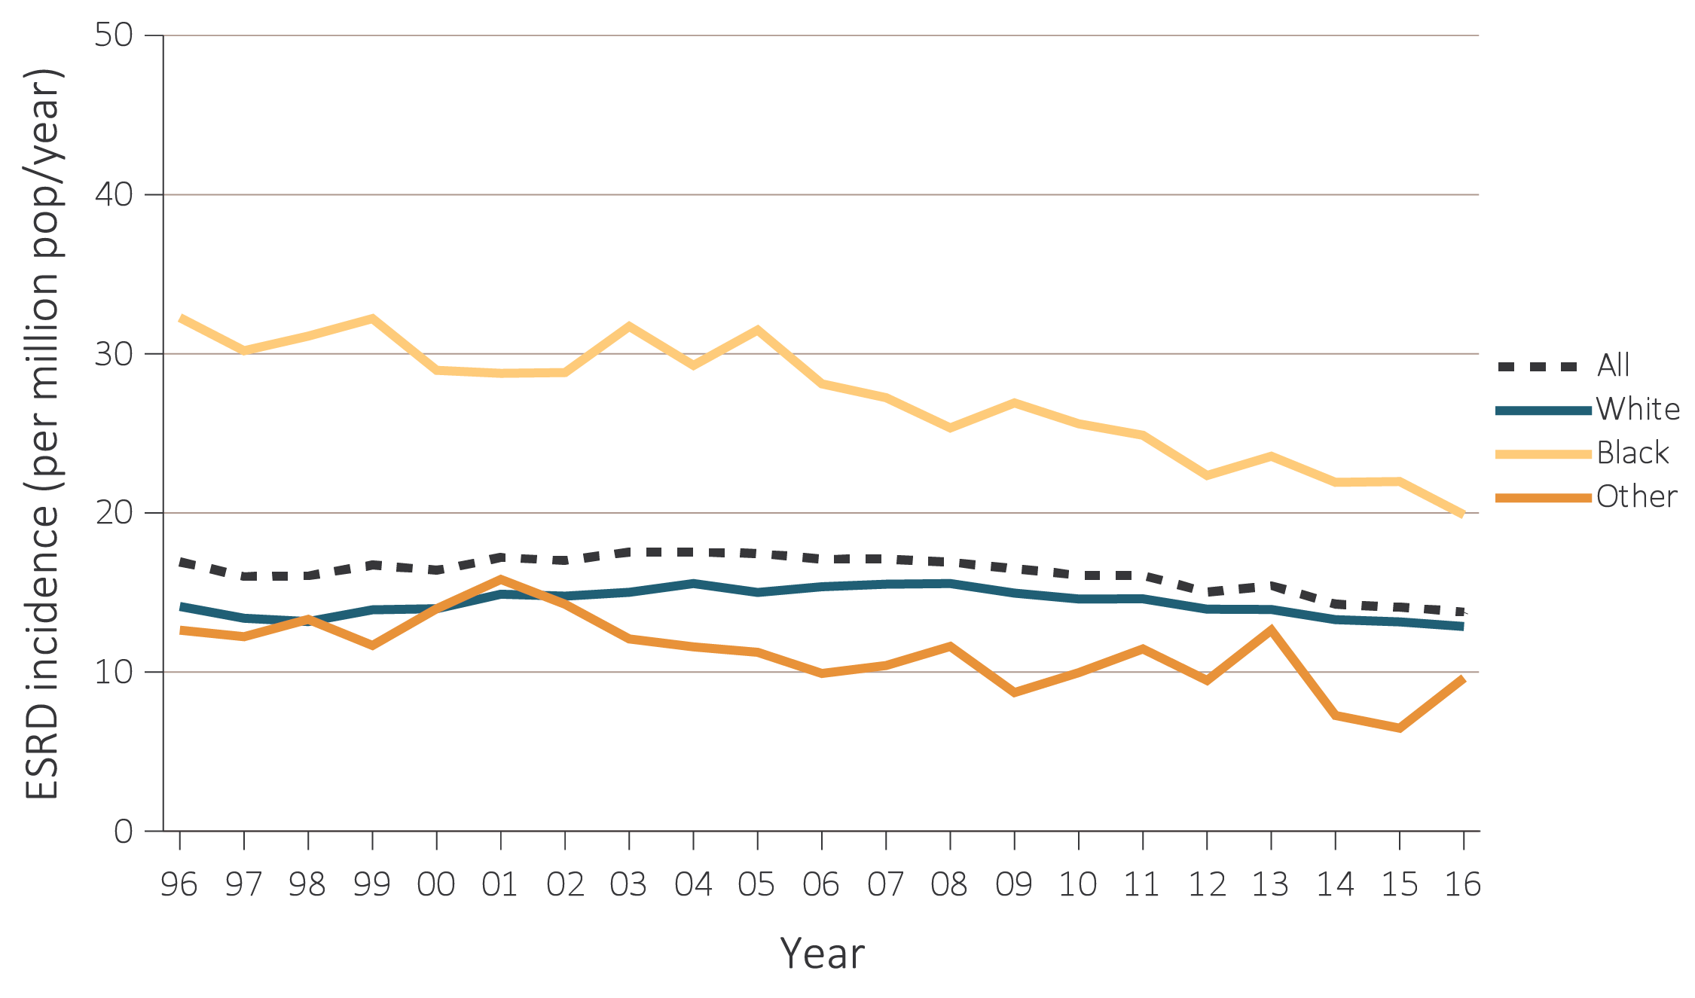
vol 2 Figure 7.1 (a, c) Incidence, and (b, d) December 31 point prevalence of ESRD among pediatric patients (aged 0–21 years) per million population per year, by modality and race, 1996-2016
(c) Incidence by race
Data Source: Special analyses, USRDS ESRD Database. Peritoneal dialysis consists of continuous ambulatory peritoneal dialysis and continuous cycling peritoneal dialysis. All consists of hemodialysis, peritoneal dialysis, uncertain dialysis, and transplant. Abbreviations: ESRD, end-stage renal disease; HD, hemodialysis; PD, peritoneal dialysis; Tx, transplant.

Slide 5
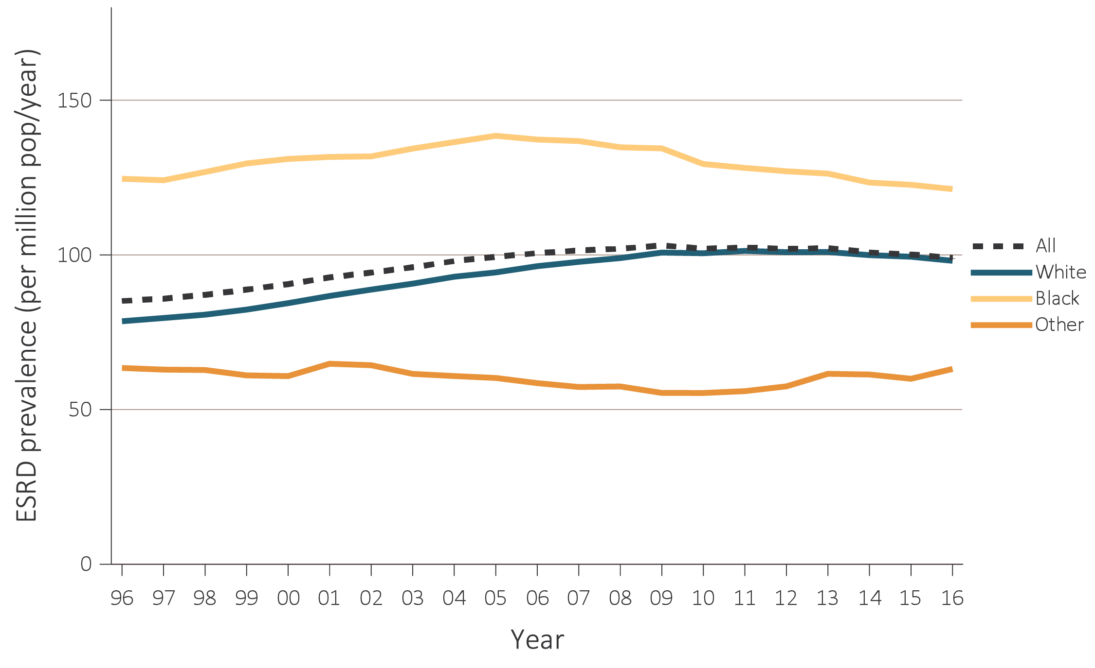
vol 2 Figure 7.1 (a, c) Incidence, and (b, d) December 31 point prevalence of ESRD among pediatric patients (aged 0–21 years) per million population per year, by modality and race, 1996-2016
(d) Point prevalence by race
Data Source: Special analyses, USRDS ESRD Database. Peritoneal dialysis consists of continuous ambulatory peritoneal dialysis and continuous cycling peritoneal dialysis. All consists of hemodialysis, peritoneal dialysis, uncertain dialysis, and transplant. Abbreviations: ESRD, end-stage renal disease; HD, hemodialysis; PD, peritoneal dialysis; Tx, transplant.

Slide 6
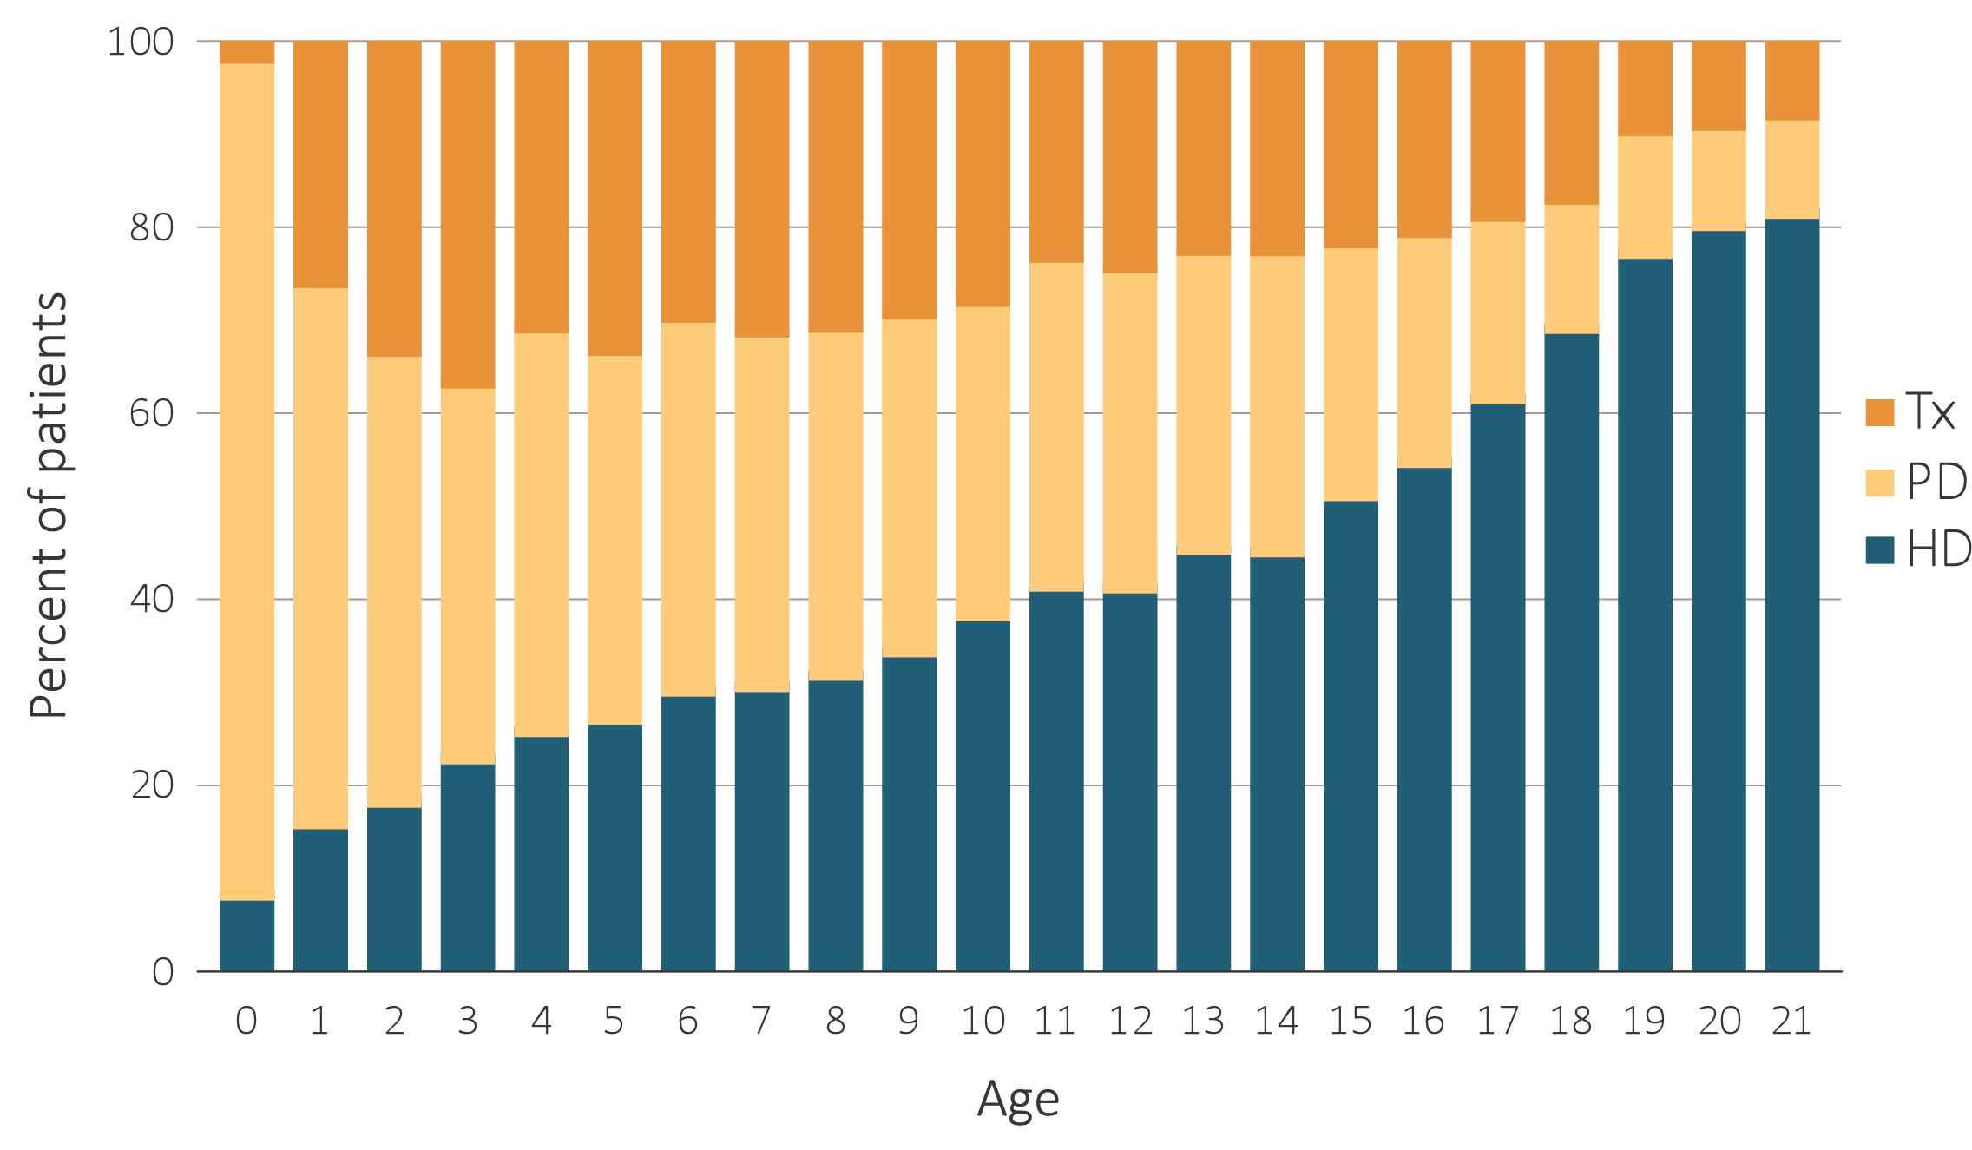
vol 2 Figure 7.2 Cross-sectional distribution in pediatric ESRD modality at initiation, by patient (a) age, (b) weight, and (c) race, 1996-2016
(a) Age
Data Source: Special analyses, USRDS ESRD Database. Includes incident ESRD patients in 1996-2016. Abbreviations: ESRD, end-stage renal disease; HD, hemodialysis; PD, peritoneal dialysis; Tx, transplant.

Slide 7
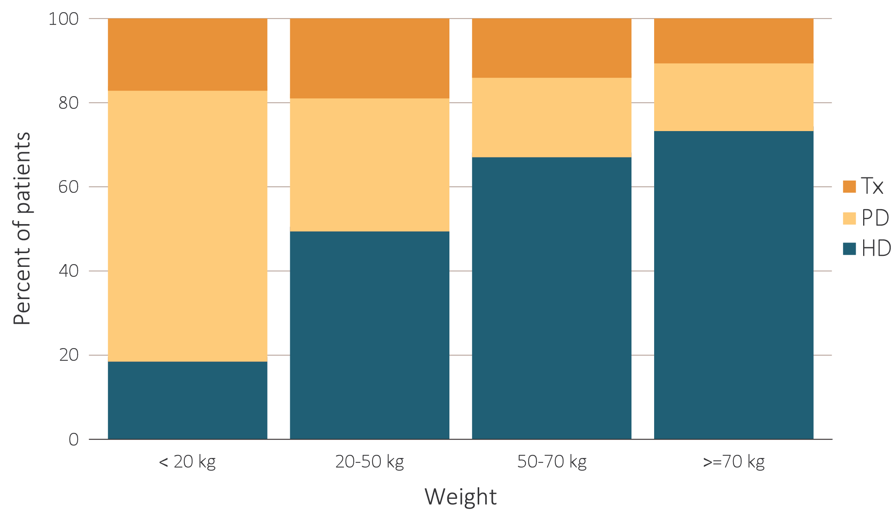
vol 2 Figure 7.2 Cross-sectional distribution in pediatric ESRD modality at initiation, by patient (a) age, (b) weight, and (c) race, 1996-2016
(b) Weight
Data Source: Special analyses, USRDS ESRD Database. Includes incident ESRD patients in 1996-2016. Abbreviations: ESRD, end-stage renal disease; HD, hemodialysis; PD, peritoneal dialysis; Tx, transplant.

Slide 8
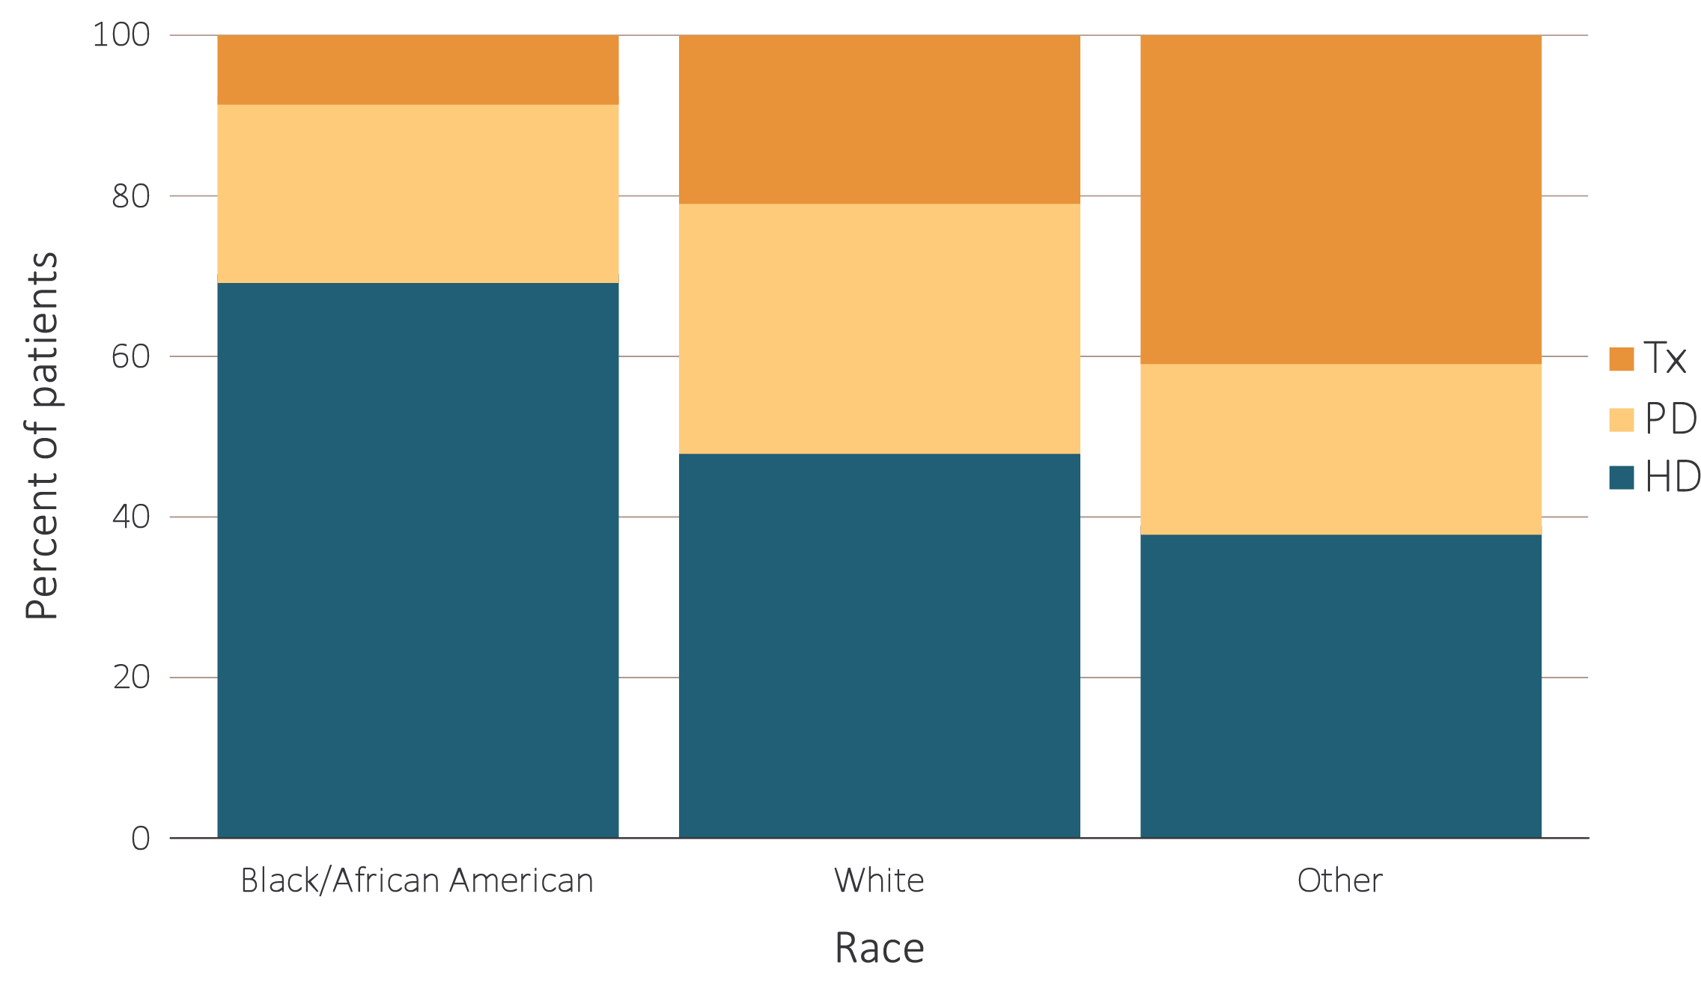
vol 2 Figure 7.2 Cross-sectional distribution in pediatric ESRD modality at initiation, by patient (a) age, (b) weight, and (c) race, 1996-2016
(c) Race
Data Source: Special analyses, USRDS ESRD Database. Includes incident ESRD patients in 1996-2016. Abbreviations: ESRD, end-stage renal disease; HD, hemodialysis; PD, peritoneal dialysis; Tx, transplant.

Slide 9
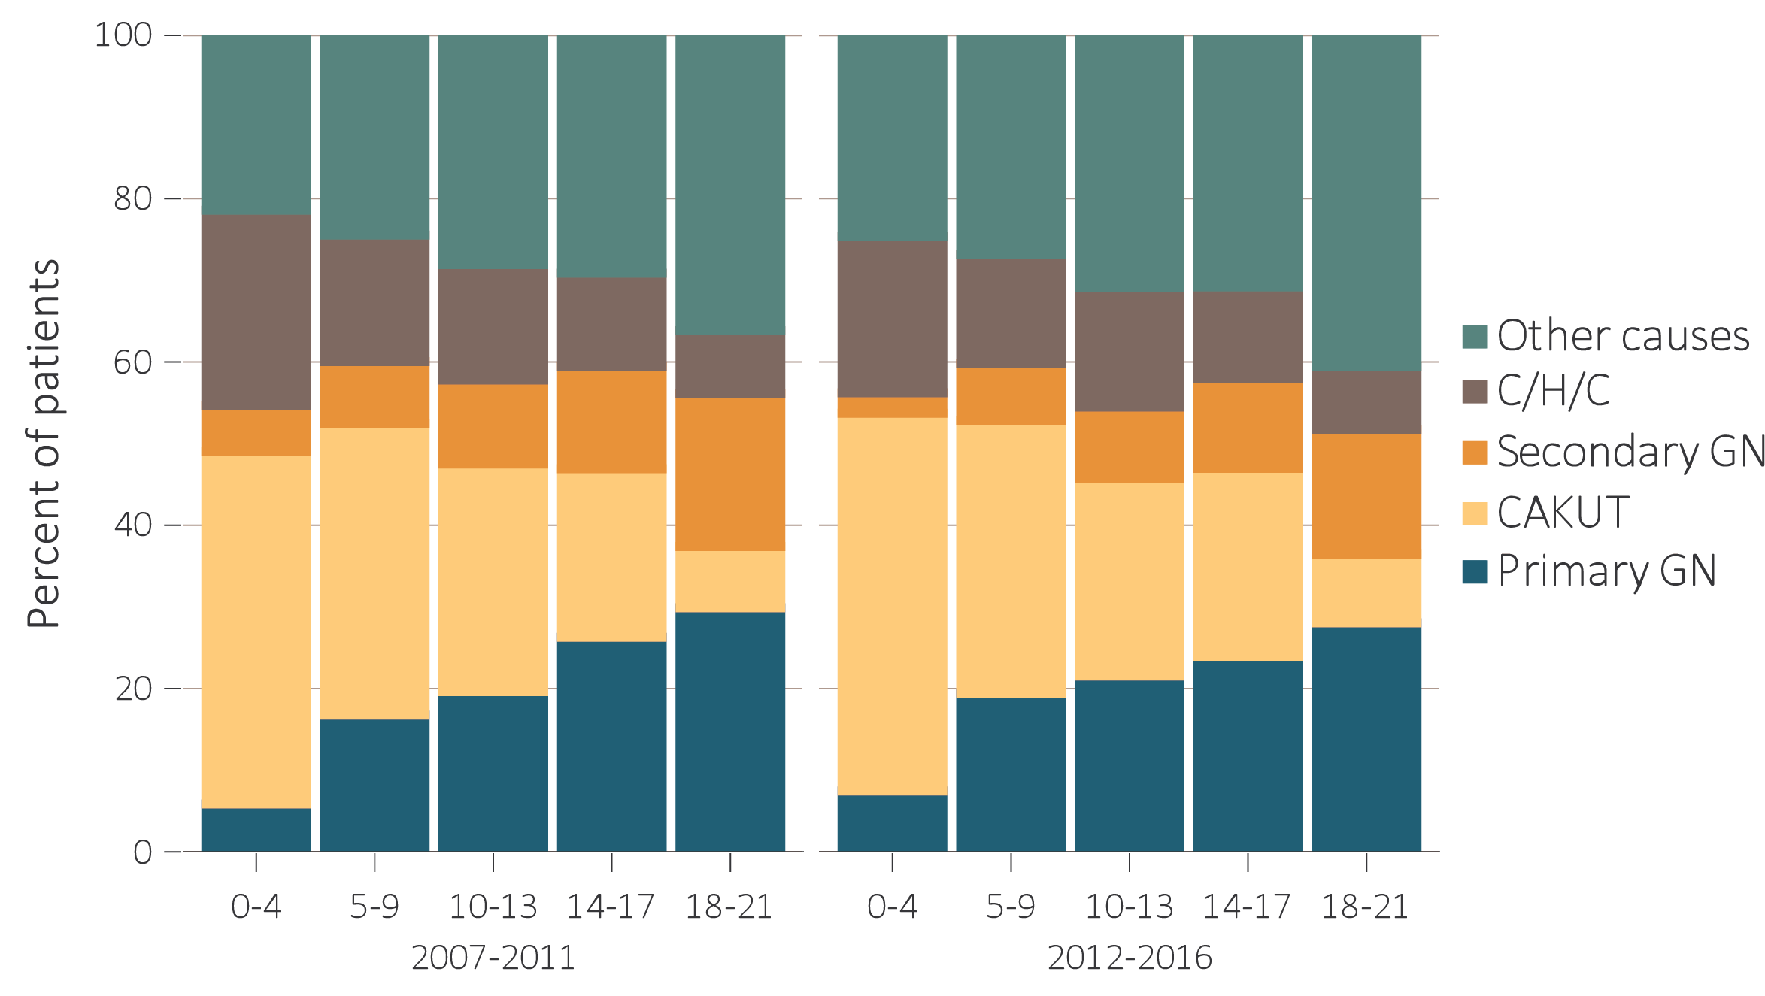
vol 2 Figure 7.3 Distribution of reported incident pediatric ESRD patients by primary cause of ESRD, by age in 2007-2011 and 2012-2016
Data Source: Special analyses, USRDS ESRD Database. Abbreviations: CAKUT, congenital anomalies of the kidney and urinary tract; C/H/C, cystic/hereditary/congenital diseases; ESRD, end-stage renal disease; GN, glomerulonephritis

Slide 10
vol 2 Table 7.1 Distribution of reported incident pediatric ESRD patients by primary cause of ESRD (aged 0-21 years), and by demographic characteristics 2007-2011 (Period A) and 2012-2016 (Period B)
 | Total patients |  | Percent incidence |  | Median age |  | Percent males |  | Percent White |  | Percent Black/ African American |  | Percent Other race
Primary Disease Groups | A | B | A | B | A | B | A | B | A | B | A | B | A | B
All ESRD, (reference) | 8,154 | 7,176 | 100.0 | 100.0 | 16 | 16 | 56.3 | 56.9 | 66.1 | 66.2 | 24.6 | 23.5 | 9.3 | 10.3
CAKUT | 1,682 | 1,574 | 20.6 | 21.9 | 11 | 11 | 70.1 | 68.7 | 75.6 | 74.8 | 17.8 | 18.9 | 6.5 | 6.2
Congenital obstructive uropathies | 739 | 665 | 9.1 | 9.3 | 11 | 10 | 83.6 | 83.2 | 72.4 | 71.1 | 22.2 | 23.9 | 5.4 | 5.0
Renal hypoplasia, dysplasia, oligonephronia | 749 | 744 | 9.2 | 10.4 | 9 | 9 | 63.0 | 59.0 | 76.4 | 75.7 | 16.6 | 17.3 | 7.1 | 7.0
Chronic pyelonephritis, reflux nephropathy | 194 | 165 | 2.4 | 2.3 | 16 | 16 | 45.9 | 54.5 | 85.1 | 86.1 | 6.2 | 6.1 | 8.8 | 7.9
Cystic/Hereditary/Congenital Diseases | 1,002 | 839 | 12.3 | 11.7 | 13 | 13 | 59.5 | 59.1 | 78.2 | 77.8 | 15.7 | 15.7 | 6.1 | 6.4
Polycystic kidneys, adult type (dominant) | 49 | 45 | .6 | .6 | 18 | 18 | 53.1 | 35.6 | 77.6 | 84.4 | 20.4 | 11.1 | 2.0 | 4.4
Polycystic, infantile (recessive) | 159 | 134 | 1.9 | 1.9 | 4 | 2 | 47.8 | 47.8 | 76.7 | 80.6 | 17.6 | 14.2 | 5.7 | 5.2
Medullary cystic disease, including nephronophthisis | 118 | 107 | 1.4 | 1.5 | 13 | 12 | 43.2 | 43.9 | 86.4 | 77.6 | 6.8 | 13.1 | 6.8 | 9.3
Tuberous sclerosis | * | 13 | .1 | .2 | 19 | 15 | 60.0 | 46.2 | 60.0 | 53.8 | 40.0 | 46.2 | 0 | 0
Hereditary nephritis, Alports syndrome | 180 | 142 | 2.2 | 2.0 | 17 | 17 | 85.0 | 88.7 | 73.3 | 74.6 | 19.4 | 19.0 | 7.2 | 6.3
Cystinosis | 60 | 38 | .7 | .5 | 13 | 11 | 51.7 | 57.9 | 93.3 | 86.8 | 6.7 | 7.9 | 0 | 5.3
Primary oxalosis | 18 | 15 | .2 | .2 | 12 | 11 | 66.7 | 73.3 | 88.9 | 66.7 | 0 | 13.3 | 11.1 | 20.0
Congenital nephrotic syndrome | 135 | 127 | 1.7 | 1.8 | 3 | 6 | 57.8 | 48.8 | 78.5 | 83.5 | 13.3 | 13.4 | 8.1 | 3.1
Drash syndrome, mesangial sclerosis | 29 | 15 | .4 | .2 | 1 | 1 | 55.2 | 46.7 | 82.8 | 73.3 | 17.2 | 20.0 | 0 | 6.7
Other (congenital malformation syndromes) | 226 | 188 | 2.8 | 2.6 | 13 | 16 | 60.2 | 66.0 | 81.0 | 79.8 | 11.5 | 12.2 | 7.5 | 8.0
Sickle cell disease/anemia | 22 | 13 | .3 | .2 | 20 | 20 | 63.6 | 69.2 | 9.1 | 7.7 | 90.9 | 92.3 | 0 | 0
Primary Glomerular Disease | 1,902 | 1,603 | 23.3 | 22.3 | 18 | 17 | 55.0 | 55.4 | 61.6 | 64.6 | 30.8 | 27.7 | 7.6 | 7.7
Glomerulonephritis (GN) (histologically not examined) | 372 | 312 | 4.6 | 4.3 | 19 | 18 | 60.2 | 57.1 | 68.8 | 67.6 | 21.8 | 23.4 | 9.4 | 9.0
Focal glomerulosclerosis, focal sclerosing GN | 989 | 828 | 12.1 | 11.5 | 17 | 17 | 56.0 | 55.9 | 53.6 | 60.5 | 40.7 | 34.3 | 5.7 | 5.2
Membranous nephropathy | 39 | 44 | .5 | .6 | 17 | 19 | 51.3 | 72.7 | 43.6 | 59.1 | 46.2 | 36.4 | 10.3 | 4.5
Membranoproliferative GN type 1, diffuse MPGN | 108 | 61 | 1.3 | .9 | 17 | 17 | 45.4 | 45.9 | 66.7 | 72.1 | 22.2 | 16.4 | 11.1 | 11.5
Dense deposit disease, MPGN type 2 | 29 | 24 | .4 | .3 | 16 | 16 | 58.6 | 50.0 | 86.2 | 87.5 | 3.4 | 8.3 | 10.3 | 4.2
IgA nephropathy | 194 | 169 | 2.4 | 2.4 | 19 | 19 | 62.4 | 60.9 | 74.7 | 75.1 | 14.9 | 8.3 | 10.3 | 16.6
IgM nephropathy | 18 | 12 | .2 | .2 | 19 | 19 | 55.6 | 66.7 | 61.1 | 66.7 | 38.9 | 25.0 | 0 | 8.3
With lesion of rapidly progressive GN | 64 | 45 | .8 | .6 | 16 | 16 | 25.0 | 35.6 | 76.6 | 68.9 | 12.5 | 20.0 | 10.9 | 11.1
Other proliferative GN | 89 | 108 | 1.1 | 1.5 | 17 | 16 | 39.3 | 44.4 | 75.3 | 62.0 | 15.7 | 30.6 | 9.0 | 7.4
Secondary Glomerular Disease/Vasculitis | 1,092 | 769 | 13.4 | 10.7 | 18 | 18 | 28.7 | 29.5 | 55.3 | 56.2 | 37.9 | 36.5 | 6.8 | 7.3
Lupus erythematosus, (SLE nephritis) | 611 | 405 | 7.5 | 5.6 | 19 | 19 | 17.3 | 20.0 | 39.4 | 39.5 | 52.2 | 53.1 | 8.3 | 7.4
Data Source: Special analyses, USRDS ESRD Database. Abbreviations: ANCA, anti-neutrophil cytoplasmic antibody; AIDS, acquired-immune deficiency syndrome; CAKUT, congenital anomalies of the kidney and urinary tract; congenital obstructive uropathy, combination of congenital ureteropelvic junction obstruction, congenital ureterovesical junction obstruction, and other congenital anomalies; ESRD, end-stage renal disease; GN glomerulonephritis; IgA, immunoglobulin A; IgM, immunoglobulin M; incl., including; MPGN, membranoproliferative glomerulonephritis; SLE, secondary lupus erythematosus.* Diagnoses with 10 or fewer total patients for year categories are suppressed.

Slide 11
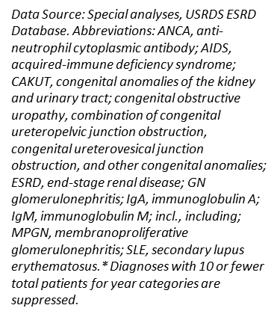
vol 2 Table 7.1 Distribution of reported incident pediatric ESRD patients by primary cause of ESRD (aged 0-21 years), and by demographic characteristics 2007-2011 (Period A) and 2012-2016 (Period B) (continued)
 | Total patients |  | Percent incidence |  | Median age |  | Percent males |  | Percent White |  | Percent Black/ African American |  | Percent Other race
Primary Disease Groups | A | B | A | B | A | B | A | B | A | B | A | B | A | B
Henoch-Schonlein (IgA Vasculitis) | 34 | 26 | .4 | .4 | 17 | 15 | 58.8 | 42.3 | 88.2 | 80.8 | 5.9 | 7.7 | 5.9 | 11.5
Hemolytic uremic syndrome | 136 | 98 | 1.7 | 1.4 | 9 | 9 | 40.4 | 37.8 | 81.6 | 77.6 | 14.0 | 16.3 | 4.4 | 6.1
Polyarteritis and other vasculitis | 118 | 86 | 1.4 | 1.2 | 14 | 15 | 37.3 | 25.6 | 75.4 | 76.7 | 17.8 | 11.6 | 6.8 | 11.6
ANCA-associated vasculitis | 65 | 83 | .8 | 1.2 | 16 | 17 | 43.1 | 49.4 | 86.2 | 72.3 | 10.8 | 20.5 | 3.1 | 7.2
Goodpasture syndrome | 55 | 35 | .7 | .5 | 19 | 19 | 36.4 | 54.3 | 89.1 | 97.1 | 5.5 | 0 | 5.5 | 2.9
Secondary GN, other | 27 | 13 | .3 | .2 | 18 | 18 | 55.6 | 46.2 | 77.8 | 76.9 | 14.8 | 23.1 | 7.4 | 0
AIDS nephropathy | 40 | 16 | .5 | .2 | 20 | 21 | 57.5 | 50.0 | 5.0 | 0 | 95.0 | 100.0 | 0 | 0
Tubulointerstitial Diseases | 286 | 234 | 3.5 | 3.3 | 17 | 16 | 59.4 | 58.5 | 75.2 | 76.1 | 17.5 | 17.1 | 7.3 | 6.8
Chronic interstitial nephritis | 81 | 86 | 1.0 | 1.2 | 17 | 17 | 58.0 | 53.5 | 75.3 | 77.9 | 17.3 | 15.1 | 7.4 | 7.0
Acute interstitial nephritis | * | 21 | .1 | .3 | 20 | 17 | 55.6 | 52.4 | 55.6 | 66.7 | 44.4 | 28.6 | 0 | 4.8
Tubular necrosis | 185 | 113 | 2.3 | 1.6 | 15 | 12 | 59.5 | 61.9 | 77.3 | 76.1 | 15.7 | 16.8 | 7.0 | 7.1
Transplant Complications | 145 | 92 | 1.8 | 1.3 | 16 | 17 | 57.2 | 57.6 | 71.7 | 68.5 | 20.0 | 25.0 | 8.3 | 6.5
Kidney transplant complication | 60 | * | .7 | .1 | 16 | 18 | 63.3 | 66.7 | 73.3 | 83.3 | 21.7 | 0 | 5.0 | 16.7
Other transplant complication | 79 | 83 | 1.0 | 1.2 | 16 | 16 | 53.2 | 56.6 | 70.9 | 67.5 | 20.3 | 26.5 | 8.9 | 6.0
Diabetes | 101 | 80 | 1.2 | 1.1 | 20 | 20 | 41.6 | 36.3 | 53.5 | 42.5 | 42.6 | 52.5 | 4.0 | 5.0
Diabetes with renal manifestations Type 2 | 47 | 39 | .6 | .5 | 20 | 20 | 38.3 | 38.5 | 59.6 | 43.6 | 38.3 | 51.3 | 2.1 | 5.1
Diabetes with renal manifestations Type 1 | 54 | 41 | .7 | .6 | 20 | 20 | 44.4 | 34.1 | 48.1 | 41.5 | 46.3 | 53.7 | 5.6 | 4.9
Neoplasms/Tumors | 48 | 39 | .6 | .5 | 8 | 10 | 41.7 | 53.8 | 70.8 | 76.9 | 20.8 | 10.3 | 8.3 | 12.8
Renal tumor | 39 | 28 | .5 | .4 | 7 | 5 | 41.0 | 53.6 | 71.8 | 71.4 | 25.6 | 10.7 | 2.6 | 17.9
Hypertensive/Large Vessel Disease | 19 | 41 | .2 | .6 | 14 | 18 | 57.9 | 61.0 | 78.9 | 82.9 | 10.5 | 9.8 | 10.5 | 7.3
Renal artery stenosis | * | 19 | .1 | .3 | 14 | 20 | 62.5 | 57.9 | 75.0 | 63.2 | 12.5 | 21.1 | 12.5 | 15.8
Renal artery occlusion | * | 21 | .1 | .3 | 11 | 11 | 44.4 | 61.9 | 77.8 | 100.0 | 11.1 | 0 | 11.1 | 0
Miscellaneous Conditions | 888 | 1,025 | 10.9 | 14.3 | 19 | 18 | 60.1 | 60.4 | 63.9 | 63.7 | 29.7 | 28.8 | 6.4 | 7.5
Acquired obstructive uropathy | 50 | 104 | .6 | 1.4 | 17 | 14 | 72.0 | 66.3 | 80.0 | 74.0 | 16.0 | 21.2 | 4.0 | 4.8
Nephrolithiasis | 16 | 16 | .2 | .2 | 18 | 15 | 31.3 | 43.8 | 93.8 | 87.5 | 0 | 12.5 | 6.3 | 0
Traumatic or surgical loss of kidney(s) | 15 | 34 | .2 | .5 | 9 | 15 | 66.7 | 55.9 | 73.3 | 70.6 | 13.3 | 17.6 | 13.3 | 11.8
Other renal disorders | 246 | 311 | 3.0 | 4.3 | 15 | 14 | 54.5 | 55.9 | 77.6 | 74.3 | 13.8 | 14.8 | 8.5 | 10.9
Nephropathy caused by other agents | 46 | 51 | .6 | .7 | 17 | 16 | 58.7 | 49.0 | 89.1 | 74.5 | 8.7 | 19.6 | 2.2 | 5.9
Unspecified with renal failure | 507 | 503 | 6.2 | 7.0 | 20 | 20 | 62.9 | 63.8 | 52.1 | 53.1 | 42.6 | 41.0 | 5.3 | 6.0
Etiology Uncertain | 689 | 342 | 8.4 | 4.8 | 16 | 16 | 59.1 | 54.7 | 73.7 | 70.2 | 18.9 | 19.9 | 7.4 | 9.9
Missing | 300 | 538 | 3.7 | 7.5 | 15 | 15 | 63.7 | 59.9 | 20.7 | 40.9 | 7.0 | 9.9 | 72.3 | 49.3

Slide 12
Table 7.2 Proportion of missing, unknown, and unspecified etiology of ESRD in children and adolescents, by age group, 2012-2016
 | 0-4 | 5-9 | 10-13 | 14-17 | 18-21 | All
ESRD etiology missing, unknown, or unspecified | 10.4% | 13.8% | 15.3% | 17.9% | 26.1% | 19.3%
Data Source: Special analyses, USRDS ESRD Database. Abbreviation: ESRD, end-stage renal disease.

Slide 13
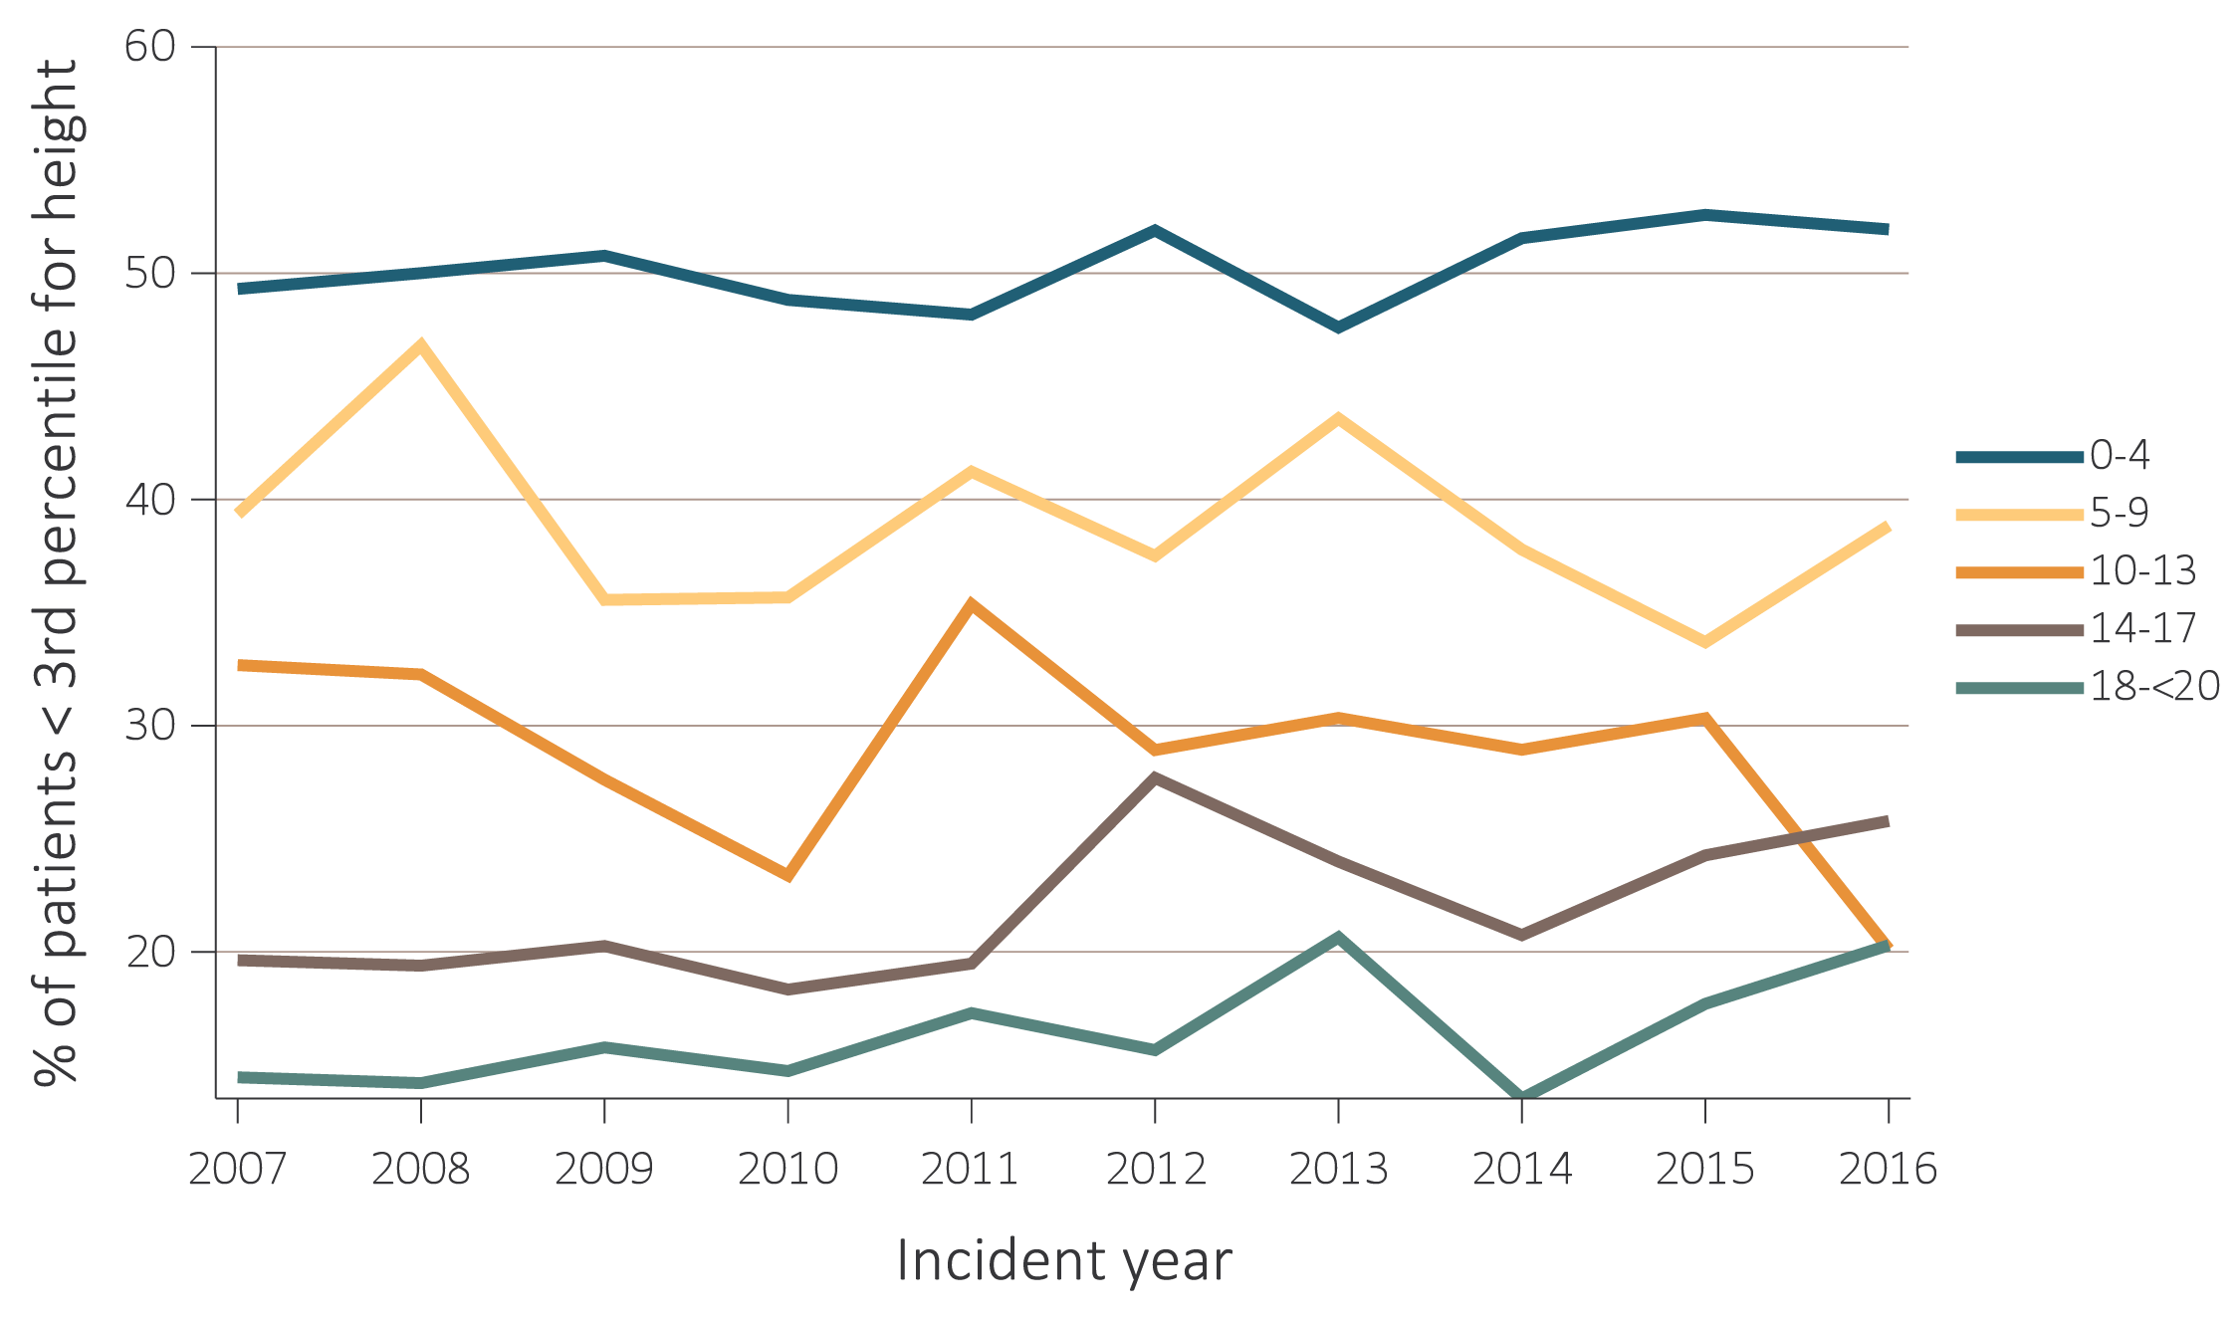
vol 2 Figure 7.4 Growth status at the time of ESRD initiation by (a) stature and (b) body mass index (BMI)
(a) Stature
Data Source: Special analyses, USRDS ESRD Database. (a) Stature reported for age <20 per growth percentile guidelines. Percentiles for children greater or equal to 24 months of age and up to less than 20 years of age are calculated following Centers for Disease Control and Prevention (CDC) growth charts. Percentiles for children less than 24 months of age are calculated following World Health Organization (WHO) growth charts. Short stature is defined as height less than 3rd percentile for sex and age. (b) BMI categories are defined differently for patients younger than 18 (underweight: BMI < 5th percentile; Normal: 5th percentile ≤ BMI < 85th percentile; Overweight: 85th percentile ≤ BMI < 95th percentile; and obese: BMI ≥ 95th percentile) and patients 18 and older (underweight: BMI < 18.5; Normal: 18.5 ≤ BMI < 25 percentile; Overweight: 25 ≤ BMI < 30; and obese: BMI ≥ 30). Abbreviations: ESRD, end-stage renal disease; BMI, body mass index.

Slide 14
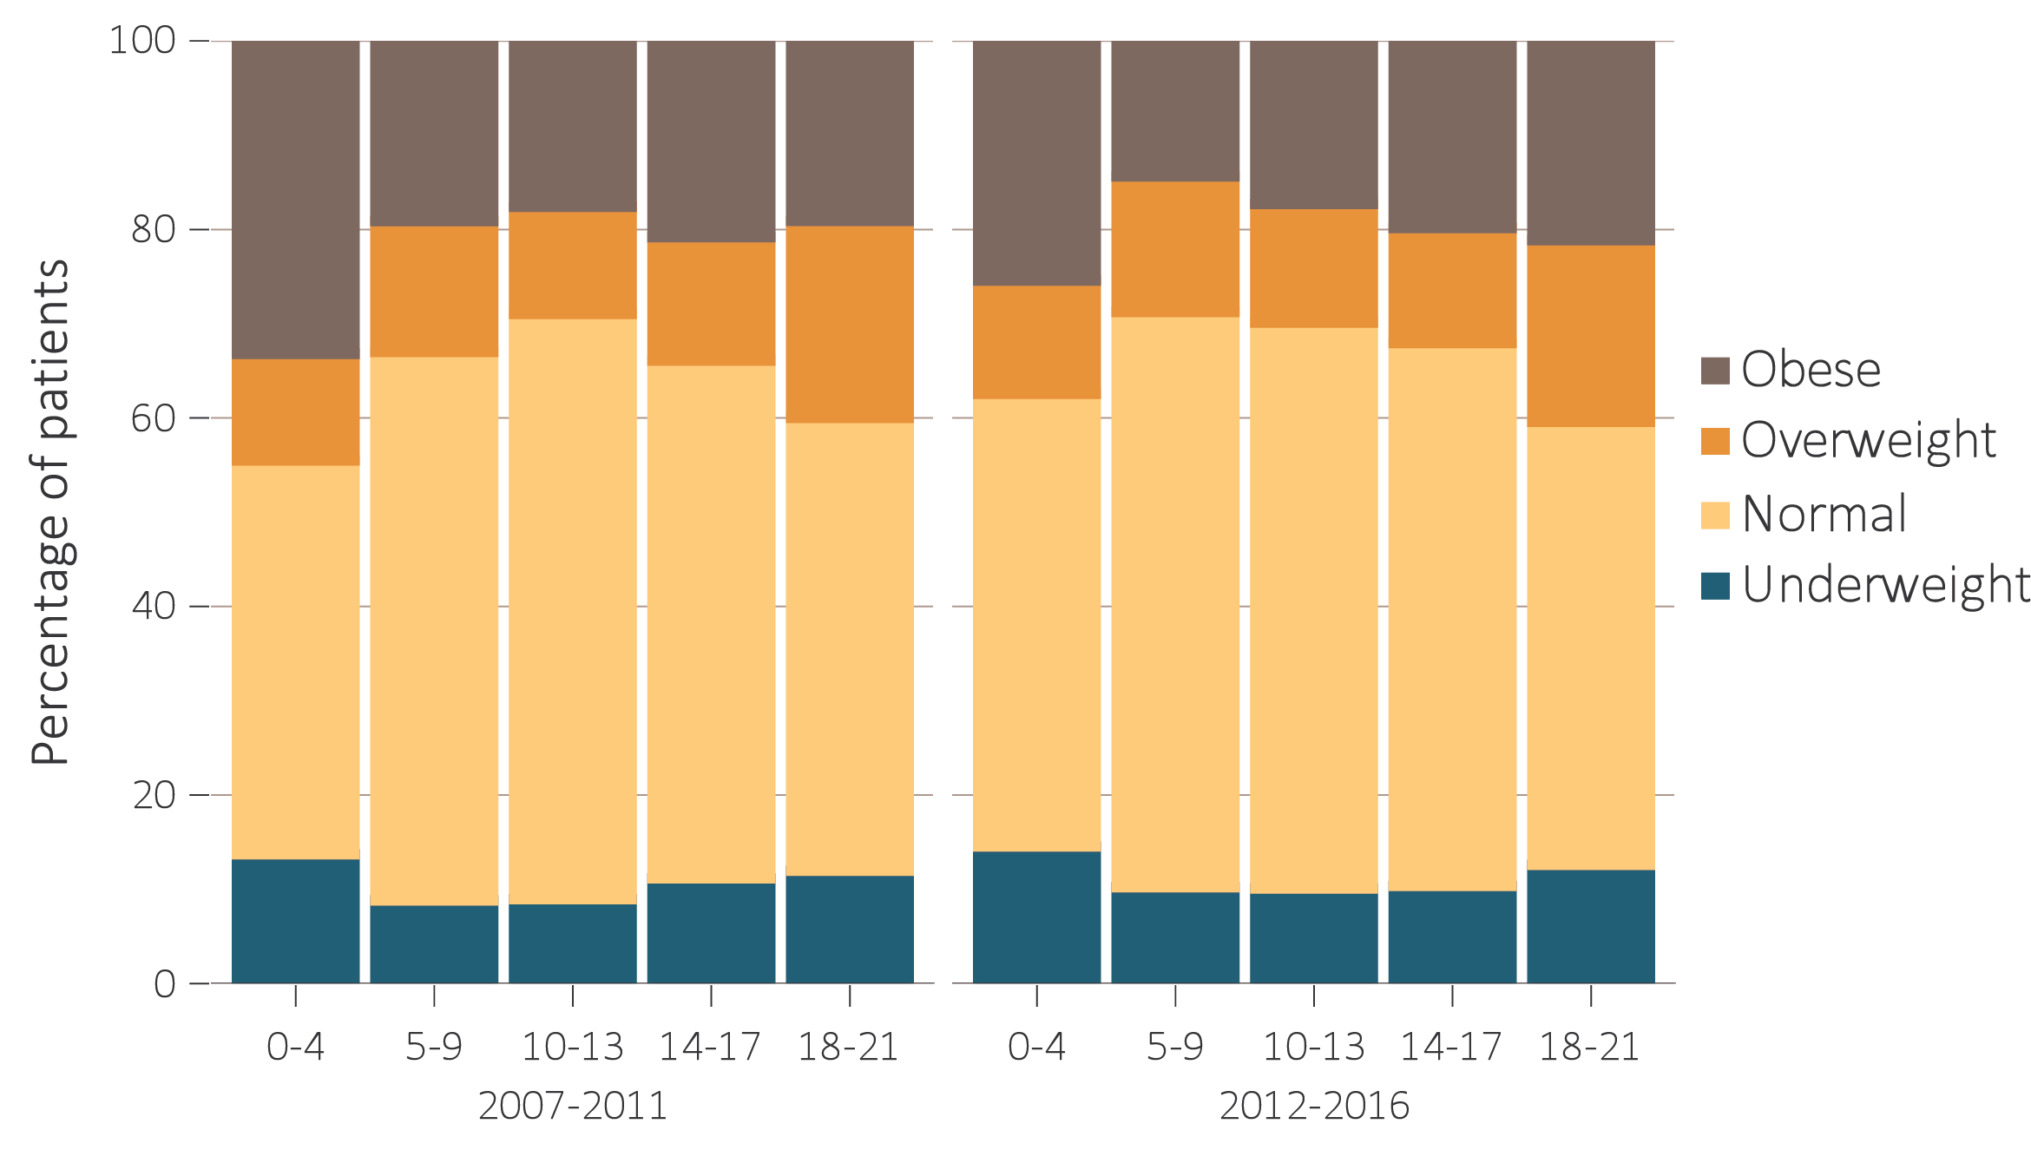
vol 2 Figure 7.4 Growth status at the time of ESRD initiation by (a) stature and (b) body mass index (BMI)
(b) BMI
Data Source: Special analyses, USRDS ESRD Database. (a) Stature reported for age <20 per growth percentile guidelines. Percentiles for children greater or equal to 24 months of age and up to less than 20 years of age are calculated following Centers for Disease Control and Prevention (CDC) growth charts. Percentiles for children less than 24 months of age are calculated following World Health Organization (WHO) growth charts. Short stature is defined as height less than 3rd percentile for sex and age. (b) BMI categories are defined differently for patients younger than 18 (underweight: BMI < 5th percentile; Normal: 5th percentile ≤ BMI < 85th percentile; Overweight: 85th percentile ≤ BMI < 95th percentile; and obese: BMI ≥ 95th percentile) and patients 18 and older (underweight: BMI < 18.5; Normal: 18.5 ≤ BMI < 25 percentile; Overweight: 25 ≤ BMI < 30; and obese: BMI ≥ 30). Abbreviations: ESRD, end-stage renal disease; BMI, body mass index.

Slide 15
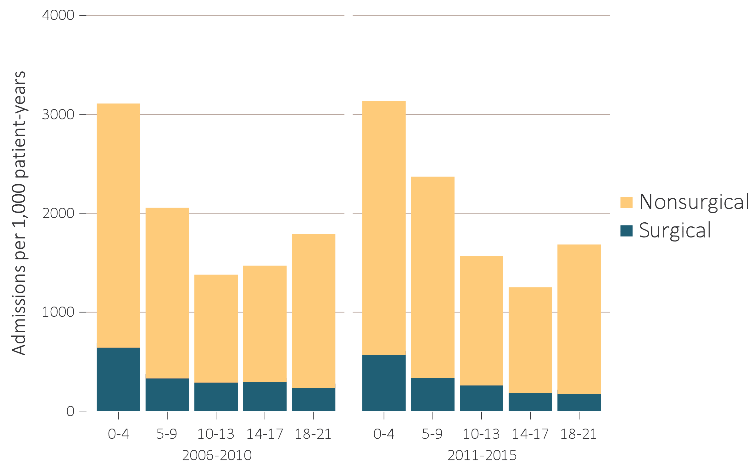
vol 2 Figure 7.5 One-year adjusted all-cause hospitalizations in incident pediatric patients (aged 0-21 years), by (a) age and (b) modality, 2006-2010 and 2011-2015
Data Source: Special analyses, USRDS ESRD Database. Includes incident pediatric ESRD patients in the years 2006-2015, surviving the first 90 days after ESRD initiation and followed from day 90. (a) Adjusted for sex, race, primary cause of ESRD, and Hispanic ethnicity. (b) Adjusted for age, sex, race, primary cause of ESRD and Hispanic ethnicity. Reference population: incident ESRD patients aged 0-21, 2010-2011. Abbreviations: ESRD, end-stage renal disease; HD, hemodialysis; PD, peritoneal dialysis; Tx, transplant.

Slide 16
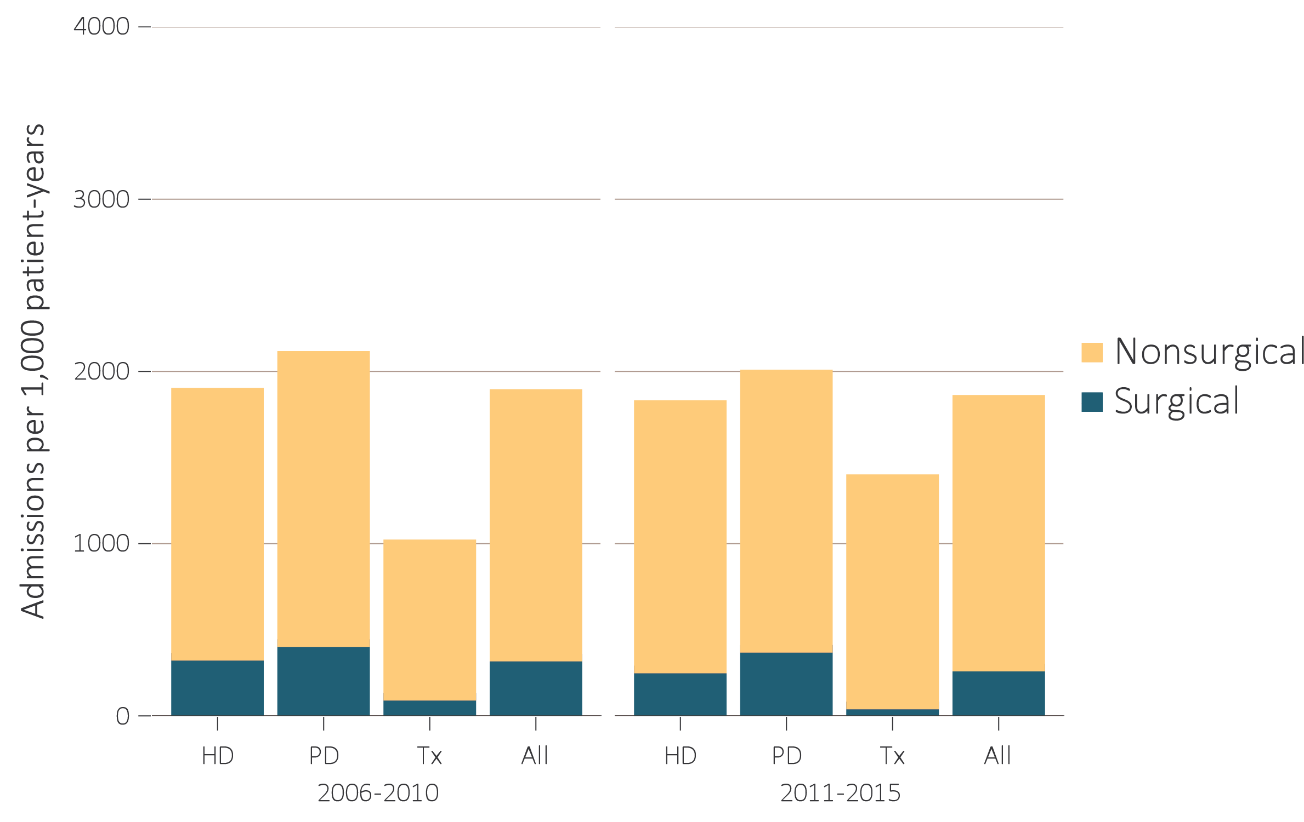
vol 2 Figure 7.5 One-year adjusted all-cause hospitalizations in incident pediatric patients (aged 0-21 years), by (a) age and (b) modality, 2006-2010 and 2011-2015
Data Source: Special analyses, USRDS ESRD Database. Includes incident pediatric ESRD patients in the years 2006-2015, surviving the first 90 days after ESRD initiation and followed from day 90. (a) Adjusted for sex, race, primary cause of ESRD, and Hispanic ethnicity. (b) Adjusted for age, sex, race, primary cause of ESRD and Hispanic ethnicity. Reference population: incident ESRD patients aged 0-21, 2010-2011. Abbreviations: ESRD, end-stage renal disease; HD, hemodialysis; PD, peritoneal dialysis; Tx, transplant.

Slide 17
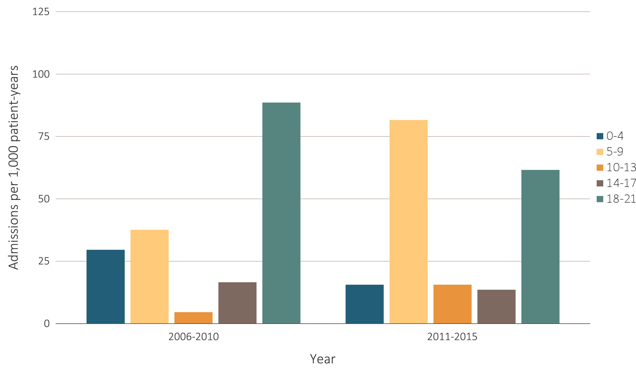
vol 2 Figure 7.6 One-year cardiovascular hospitalizations in incident pediatric patients (aged 0-21 years), by (a) age and (b) modality 2006-2010 and 2011-2015
Data Source: Special analyses, USRDS ESRD Database. Includes incident pediatric ESRD patients in the years 2006-2015, surviving the first 90 days after ESRD initiation and followed from day 90. Reference population: incident ESRD patients aged 0-21, 2010-2011. (a) Adjusted for sex, race, primary cause of ESRD, and Hispanic ethnicity. (b) Adjusted for age, sex, race, primary cause of ESRD and Hispanic ethnicity. Abbreviations: ESRD, end-stage renal disease; HD, hemodialysis; PD, peritoneal dialysis; Tx, transplant. When examining CVD associated hospitalizations, hypertension is not considered a CVD diagnosis.

Slide 18
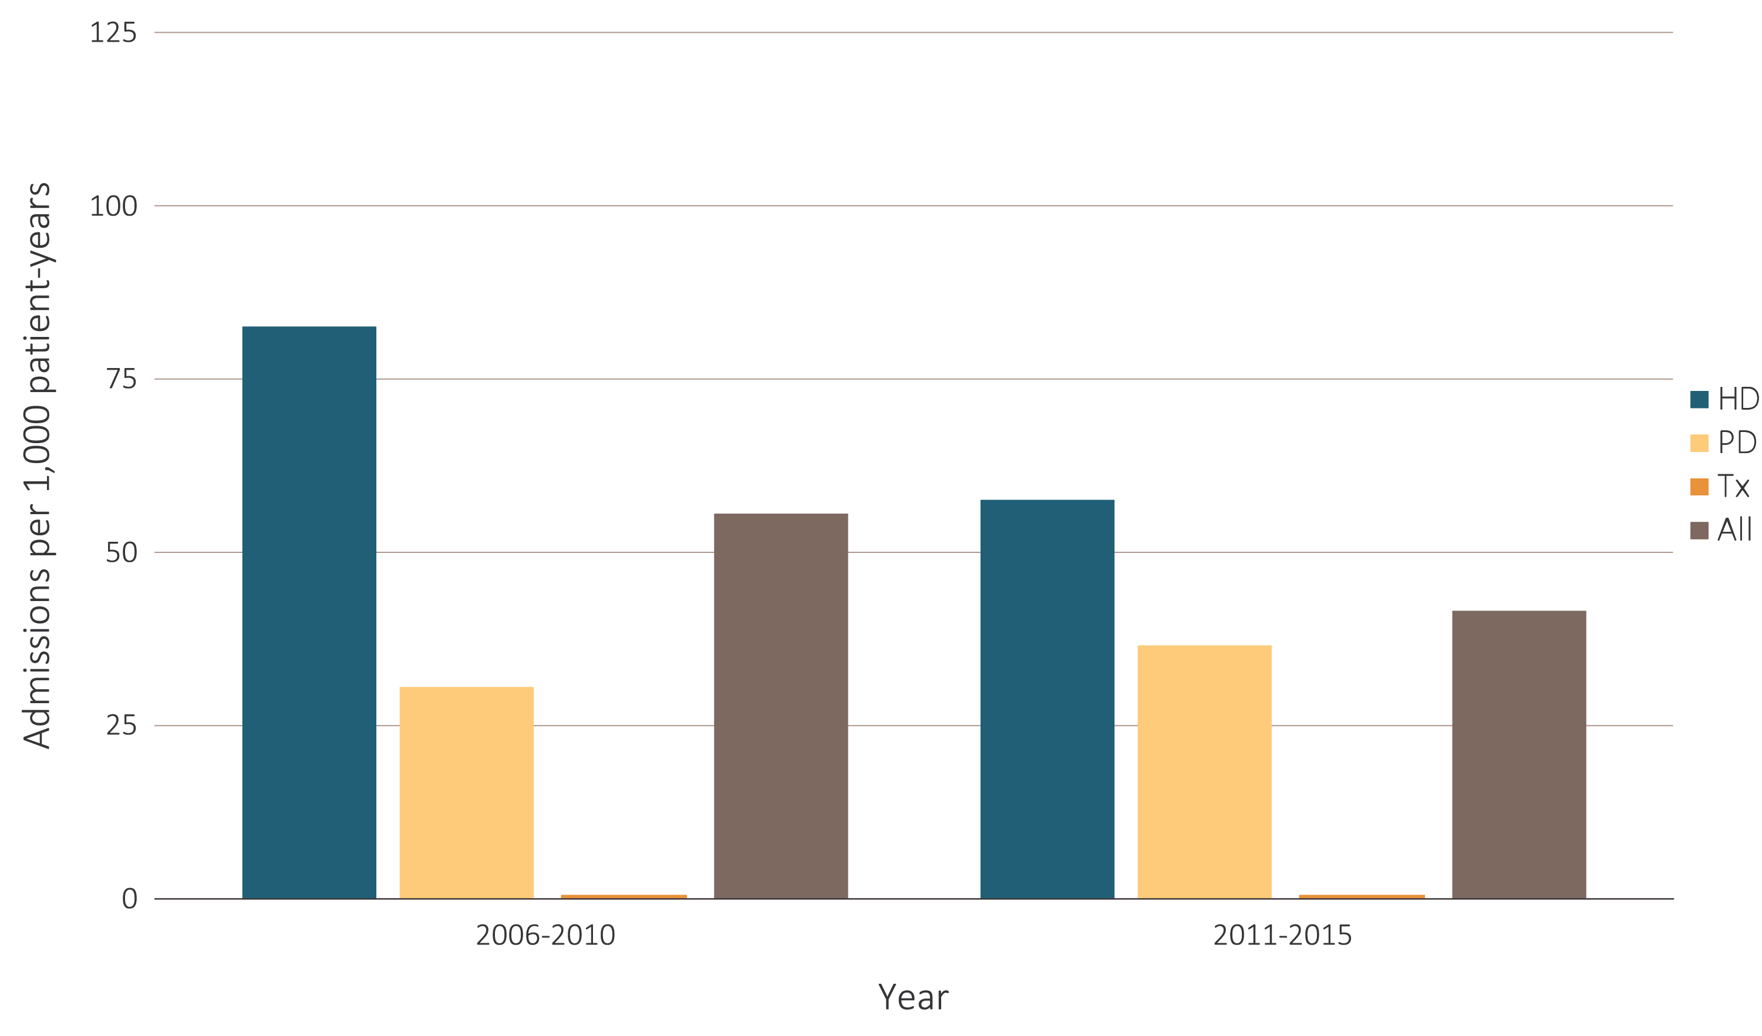
vol 2 Figure 7.6 One-year cardiovascular hospitalizations in incident pediatric patients (aged 0-21 years), by (a) age and (b) modality 2006-2010 and 2011-2015
Data Source: Special analyses, USRDS ESRD Database. Includes incident pediatric ESRD patients in the years 2006-2015, surviving the first 90 days after ESRD initiation and followed from day 90. Reference population: incident ESRD patients aged 0-21, 2010-2011. (a) Adjusted for sex, race, primary cause of ESRD, and Hispanic ethnicity. (b) Adjusted for age, sex, race, primary cause of ESRD and Hispanic ethnicity. Abbreviations: ESRD, end-stage renal disease; HD, hemodialysis; PD, peritoneal dialysis; Tx, transplant. When examining CVD associated hospitalizations, hypertension is not considered a CVD diagnosis.

Slide 19
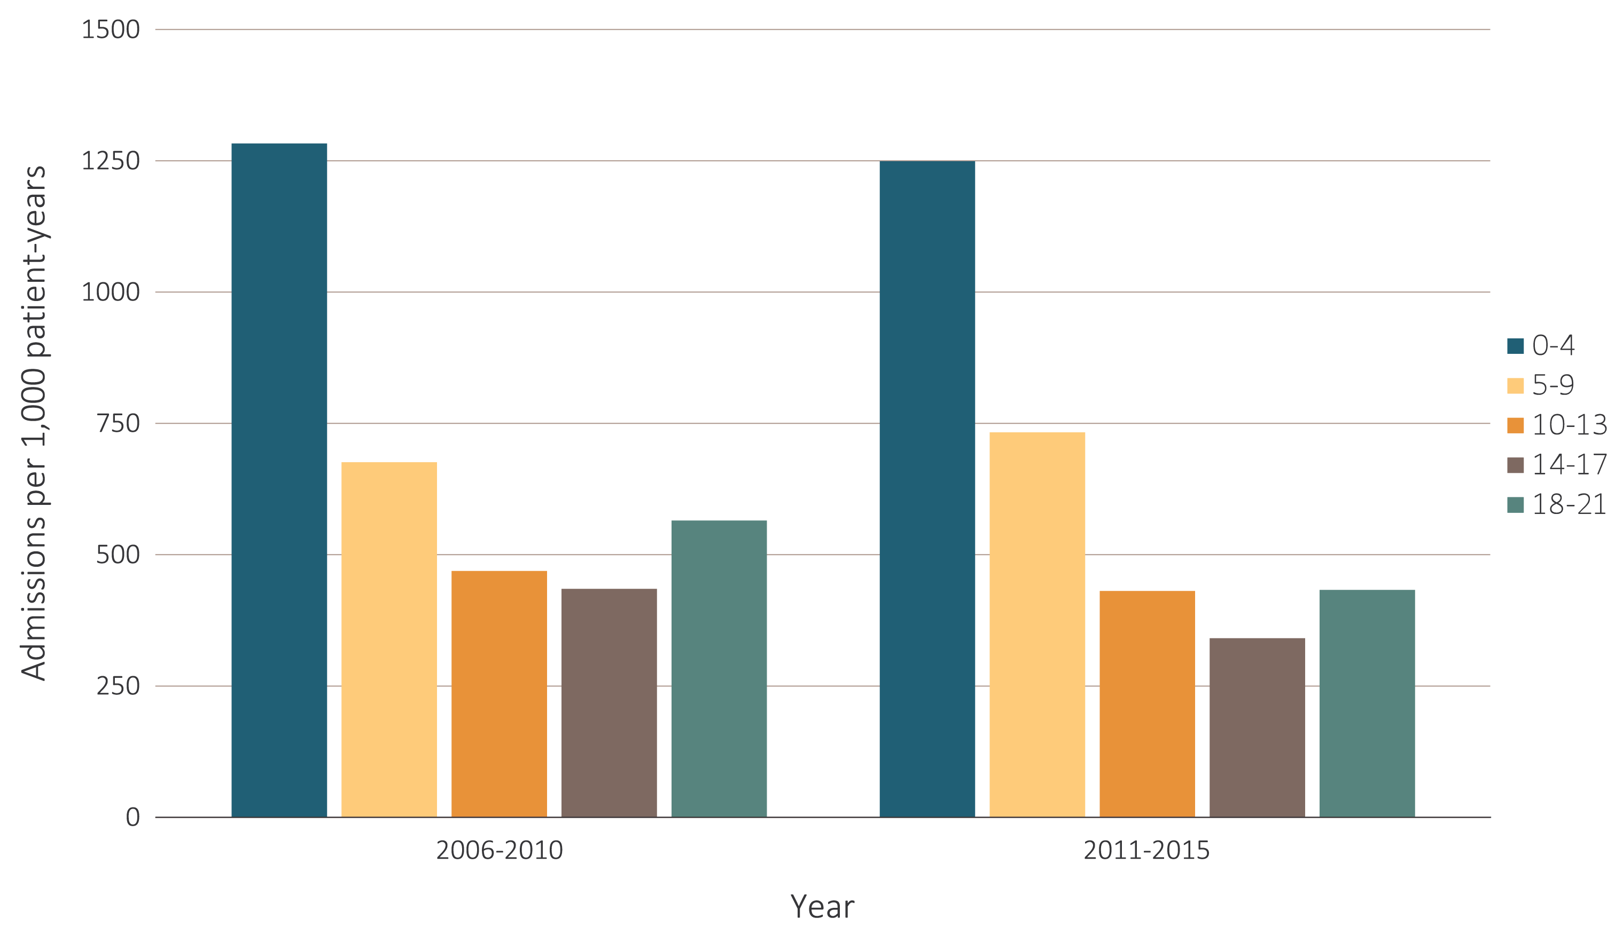
vol 2 Figure 7.7 One-year adjusted hospitalizations for infection in incident pediatric patients (aged 0-21 years), by (a) age and (b) modality, 2006-2010 and 2011-2015
Data Source: Special analyses, USRDS ESRD Database. Includes incident pediatric ESRD patients in the years 2006-2015, surviving the first 90 days after ESRD initiation and followed from day 90. (a) Adjusted for sex, race, primary cause of ESRD, and Hispanic ethnicity. (b) Adjusted for age, sex, race, primary cause of ESRD and Hispanic ethnicity. Reference population: incident ESRD patients aged 0-21, 2010-2011. Abbreviations: ESRD, end-stage renal disease; HD, hemodialysis; PD, peritoneal dialysis; Tx, transplant.

Slide 20
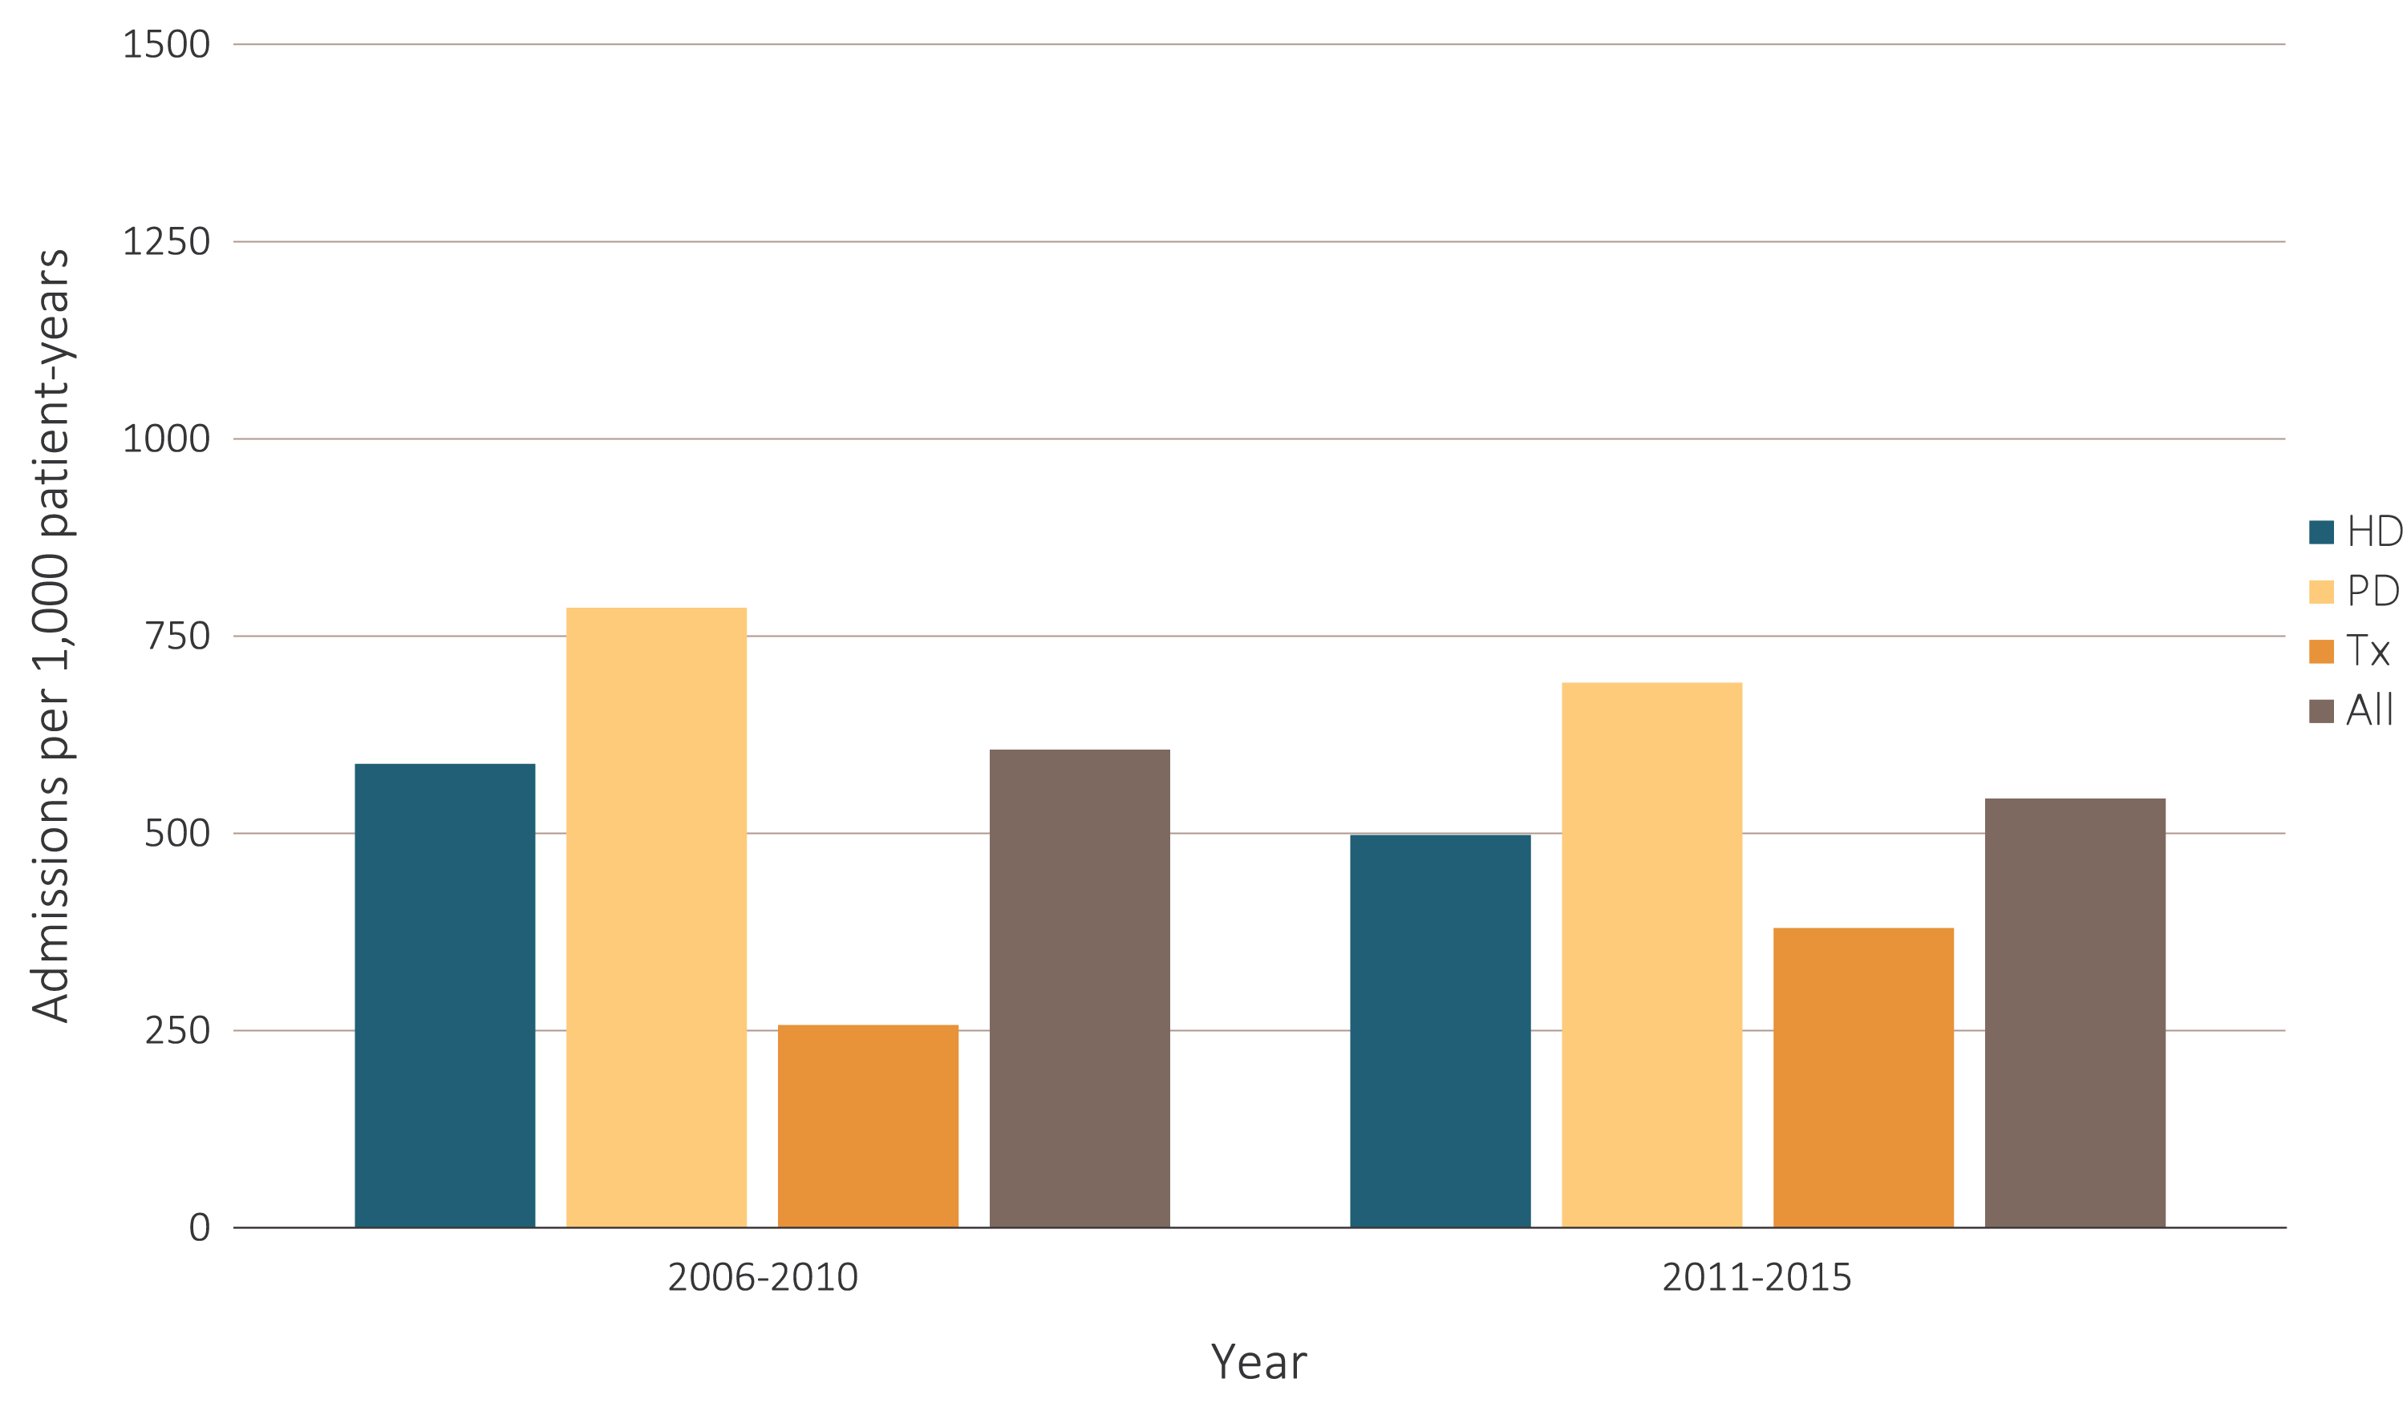
vol 2 Figure 7.7 One-year adjusted hospitalizations for infection in incident pediatric patients (aged 0-21 years), by (a) age and (b) modality, 2006-2010 and 2011-2015
Data Source: Special analyses, USRDS ESRD Database. Includes incident pediatric ESRD patients in the years 2006-2015, surviving the first 90 days after ESRD initiation and followed from day 90. (a) Adjusted for sex, race, primary cause of ESRD, and Hispanic ethnicity. (b) Adjusted for age, sex, race, primary cause of ESRD and Hispanic ethnicity. Reference population: incident ESRD patients aged 0-21, 2010-2011. Abbreviations: ESRD, end-stage renal disease; HD, hemodialysis; PD, peritoneal dialysis; Tx, transplant.

Slide 21
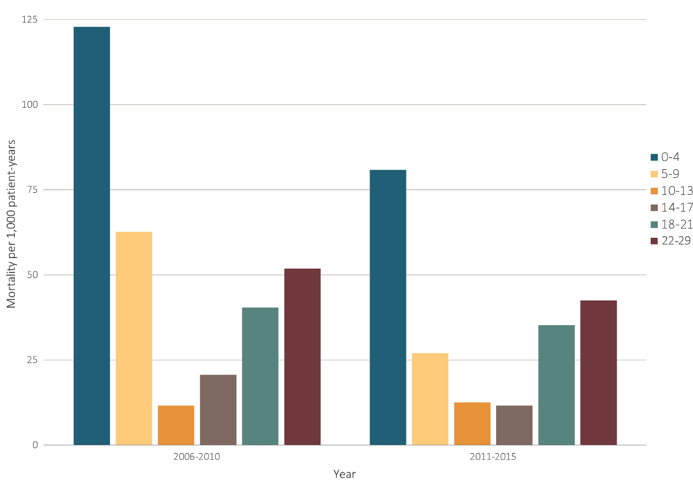
vol 2 Figure 7.8 One-year adjusted all-cause mortality in incident pediatric patients with ESRD by (a) age with comparison to young adults (aged 0-29 years), 2006-2010 and 2011-2015 and (b) modality, 2006-2015(aged 0-21 years only)
Data Source: Special analyses, USRDS ESRD Database. Incident dialysis and transplant patients defined at the onset of dialysis or the day of transplant without the 60-day rule; followed to December 31, 2016. (a) Adjusted for sex, race, primary cause of ESRD, and Hispanic ethnicity. (b) Adjusted for age, sex, race, primary cause of ESRD and Hispanic ethnicity. Reference population: incident ESRD patients aged 0-21, 2010-2011. Abbreviations: ESRD, end-stage renal disease; HD, hemodialysis; PD, peritoneal dialysis; Tx, transplant.

Slide 22
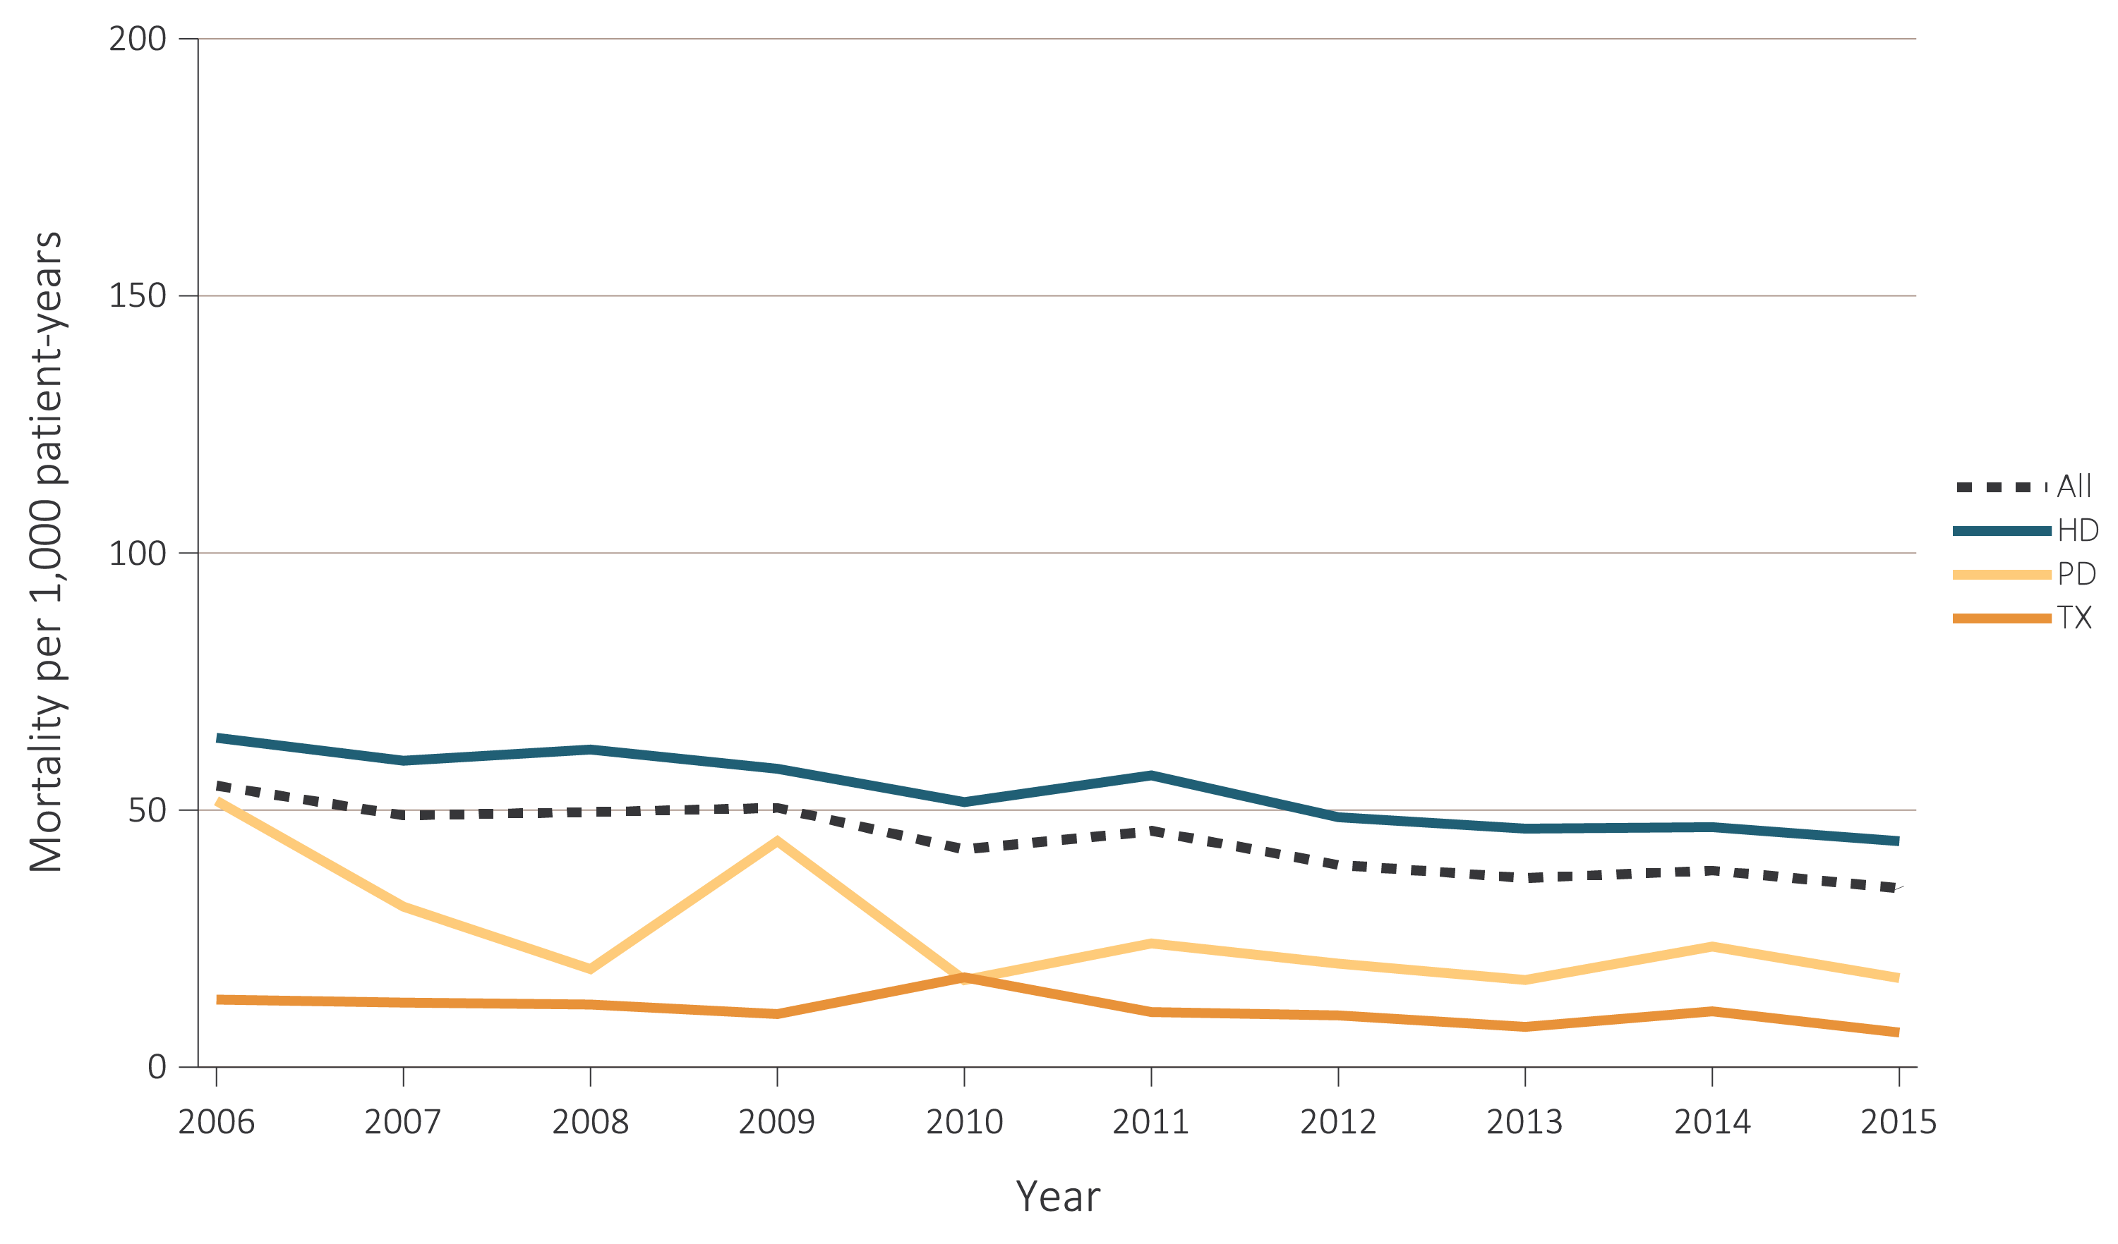
vol 2 Figure 7.8 One-year adjusted all-cause mortality in incident pediatric patients with ESRD by (a) age with comparison to young adults (aged 0-29 years), 2006-2010 and 2011-2015 and (b) modality, 2006-2015(aged 0-21 years only)
Data Source: Special analyses, USRDS ESRD Database. Incident dialysis and transplant patients defined at the onset of dialysis or the day of transplant without the 60-day rule; followed to December 31, 2016. (a) Adjusted for sex, race, primary cause of ESRD, and Hispanic ethnicity. (b) Adjusted for age, sex, race, primary cause of ESRD and Hispanic ethnicity. Reference population: incident ESRD patients aged 0-21, 2010-2011. Abbreviations: ESRD, end-stage renal disease; HD, hemodialysis; PD, peritoneal dialysis; Tx, transplant.

Slide 23
vol 2 Table 7.3 Expected remaining lifetime in years of prevalent patients by initial ESRD modality, 2015
Age group | Dialysis patients | Transplant patients | General population
0-4 | 22.0 | 57.7 | 77.0
5-9 | 22.8 | 56.2 | 72.1
10-13 | 23.3 | 52.1 | 67.6
14-17 | 20.6 | 48.9 | 63.7
18-21 | 17.6 | 45.6 | 59.8
22-29 | 15.7 | 42.3 | 54.1
Data Source: Special analyses, USRDS ESRD Database, USA SSA (Social Security Administration) Period Life Table 2015. Includes period prevalent ESRD dialysis and transplant patients in 2015. Abbreviation: ESRD, end-stage renal disease.

Slide 24
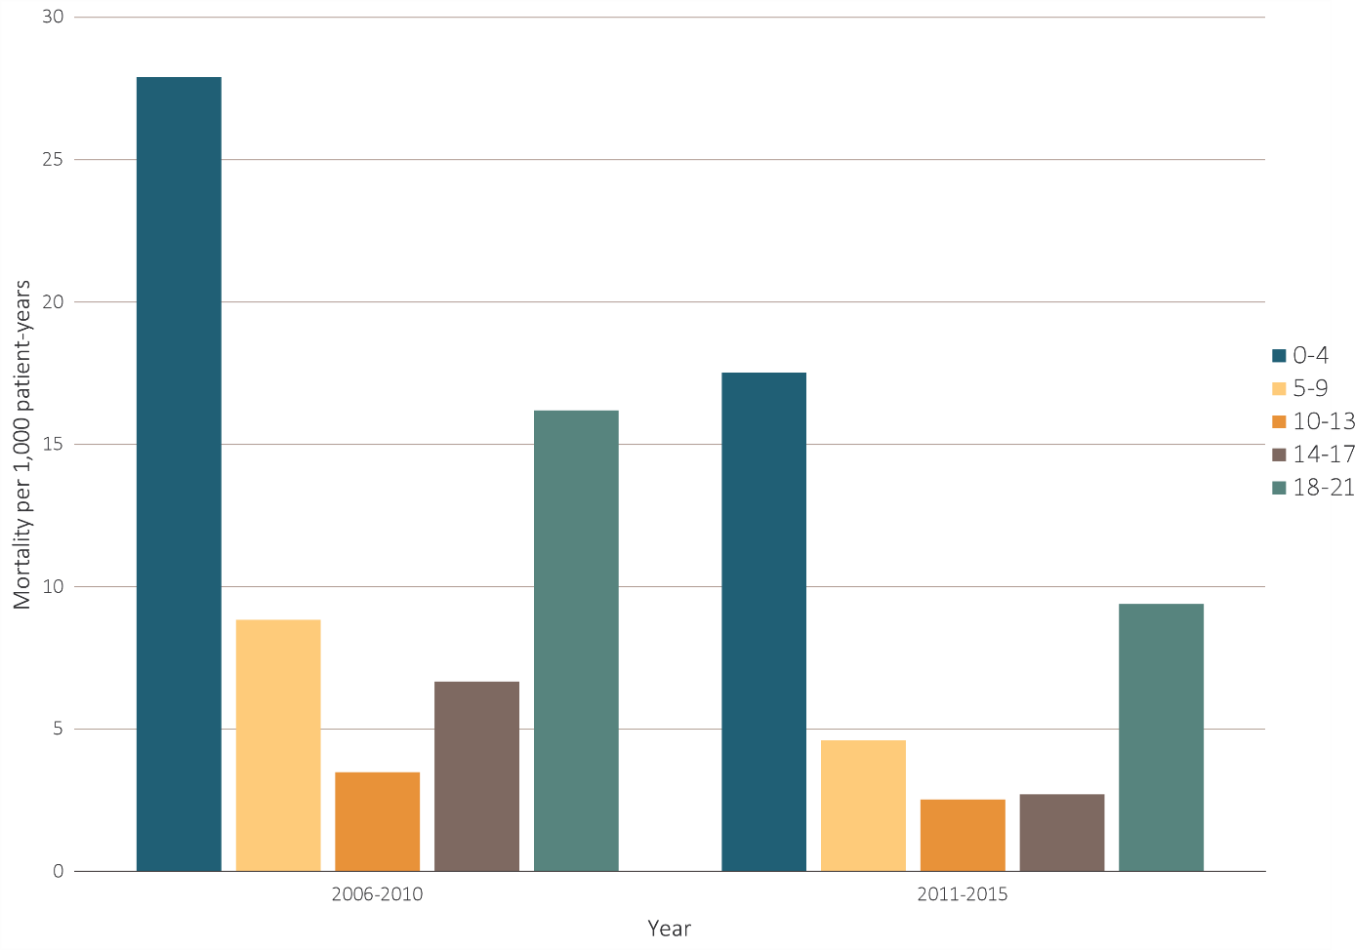
vol 2 Figure 7.9 One-year adjusted cardiovascular mortality in incident pediatric patients with ESRD (aged 0-21 years), by (a) age and (b) modality, 2006-2010 and 2011-2015
Data Source: Special analyses, USRDS ESRD Database. Incident dialysis and transplant patients defined at the onset of dialysis or the day of transplant without the 60-day rule; followed to December 31, 2016. (a) Adjusted for sex, race, primary cause of ESRD, and Hispanic ethnicity. (b) Adjusted for age, sex, race, primary cause of ESRD and Hispanic ethnicity. Reference population: incident ESRD patients aged 0-21, 2010-2011. Abbreviations: ESRD, end-stage renal disease; HD, hemodialysis; PD, peritoneal dialysis; Tx, transplant. When examining CVD associated mortality, hypertension is not considered a CVD diagnosis.

Slide 25
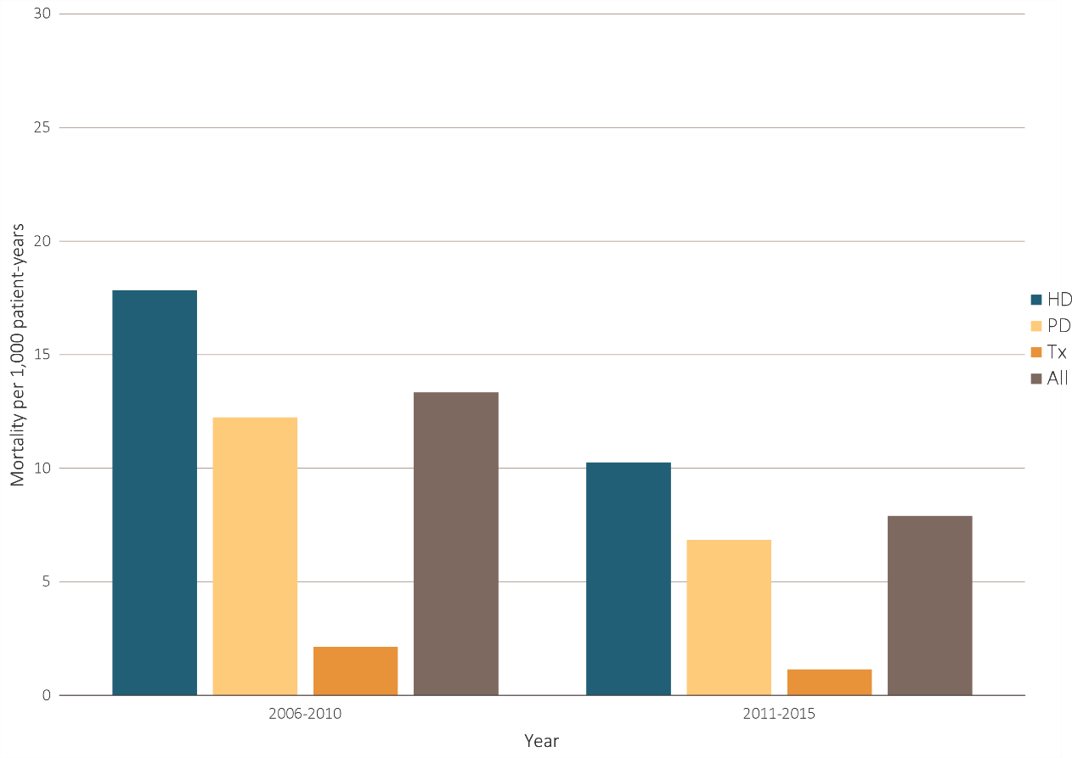
vol 2 Figure 7.9 One-year adjusted cardiovascular mortality in incident pediatric patients with ESRD (aged 0-21 years), by (a) age and (b) modality, 2006-2010 and 2011-2015
Data Source: Special analyses, USRDS ESRD Database. Incident dialysis and transplant patients defined at the onset of dialysis or the day of transplant without the 60-day rule; followed to December 31, 2016. (a) Adjusted for sex, race, primary cause of ESRD, and Hispanic ethnicity. (b) Adjusted for age, sex, race, primary cause of ESRD and Hispanic ethnicity. Reference population: incident ESRD patients aged 0-21, 2010-2011. Abbreviations: ESRD, end-stage renal disease; HD, hemodialysis; PD, peritoneal dialysis; Tx, transplant. When examining CVD associated mortality, hypertension is not considered a CVD diagnosis.

Slide 26
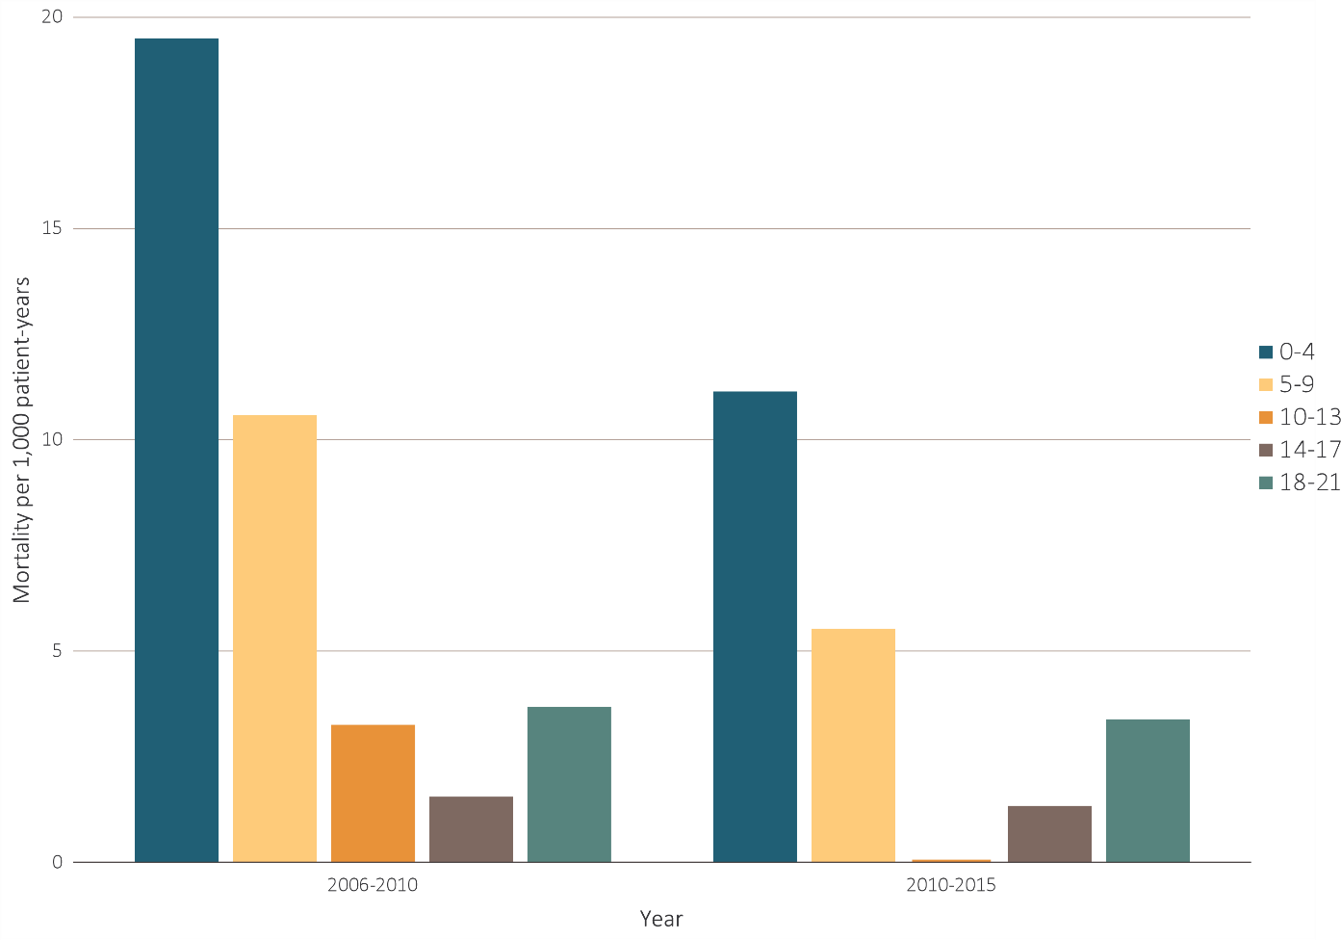
vol 2 Figure 7.10 One-year adjusted mortality due to infection in incident pediatric patients with ESRD (aged 0-21 years), by (a) age and (b) modality, 2006-2010 and 2011-2015
Data Source: Special analyses, USRDS ESRD Database. Incident dialysis and transplant patients defined at the onset of dialysis or the day of transplant without the 60-day rule; followed to December 31, 2016. (a) Adjusted for sex, race, primary cause of ESRD, and Hispanic ethnicity. (b) Adjusted for age, sex, race, primary cause of ESRD and Hispanic ethnicity. Reference population: incident ESRD patients aged 0-21, 2010-2011. Abbreviations: ESRD, end-stage renal disease; HD, hemodialysis; PD, peritoneal dialysis; Tx, transplant.

Slide 27
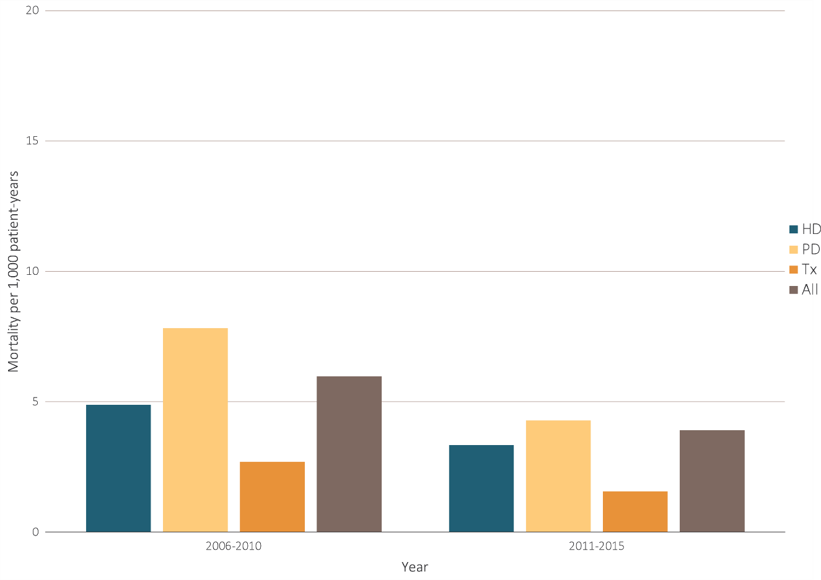
vol 2 Figure 7.10 One-year adjusted mortality due to infection in incident pediatric patients with ESRD (aged 0-21 years), by (a) age and (b) modality, 2006-2010 and 2011-2015
Data Source: Special analyses, USRDS ESRD Database. Incident dialysis and transplant patients defined at the onset of dialysis or the day of transplant without the 60-day rule; followed to December 31, 2016. (a) Adjusted for sex, race, primary cause of ESRD, and Hispanic ethnicity. (b) Adjusted for age, sex, race, primary cause of ESRD and Hispanic ethnicity. Reference population: incident ESRD patients aged 0-21, 2010-2011. Abbreviations: ESRD, end-stage renal disease; HD, hemodialysis; PD, peritoneal dialysis; Tx, transplant.

Slide 28
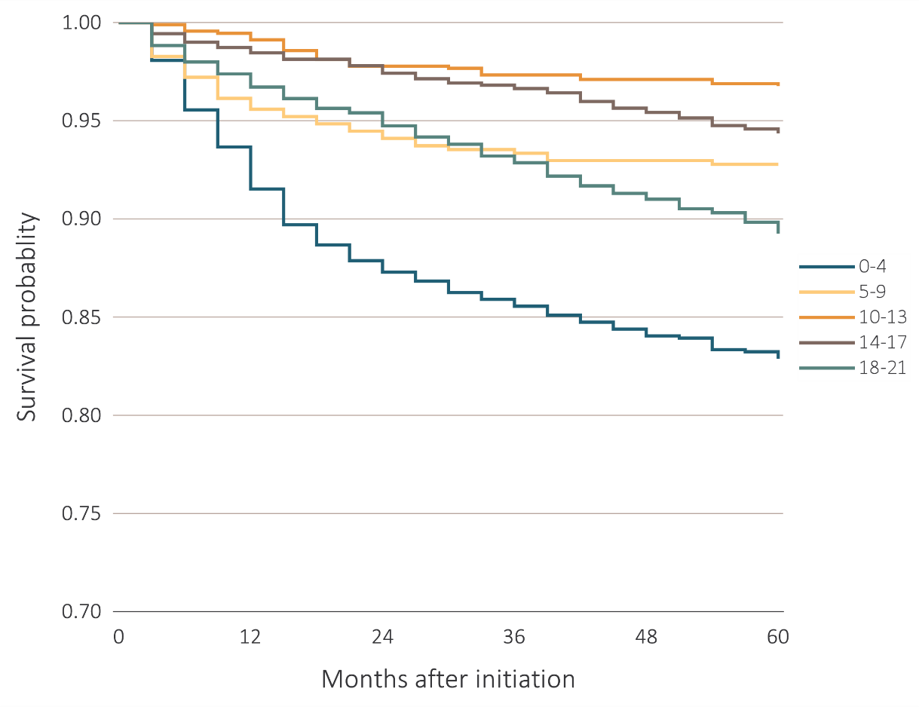
vol 2 Figure 7.11 Adjusted five-year survival in incident pediatric patients (aged 0-21 years) from day 1, by (a) age and (b) modality, 2007-2011
Data Source: Special analyses, USRDS ESRD Database. Incident dialysis and transplant patients defined at the onset of dialysis or the day of transplant without the 60-day rule; followed to December 31, 2016. (a) Adjusted for sex, race, primary cause of ESRD, and Hispanic ethnicity. (b) Adjusted for age, sex, race, primary cause of ESRD and Hispanic ethnicity. Reference population: incident ESRD patients aged 0-21, 2010-2011. Abbreviations: ESRD, end-stage renal disease; HD, hemodialysis; PD, peritoneal dialysis; Tx, transplant.

Slide 29
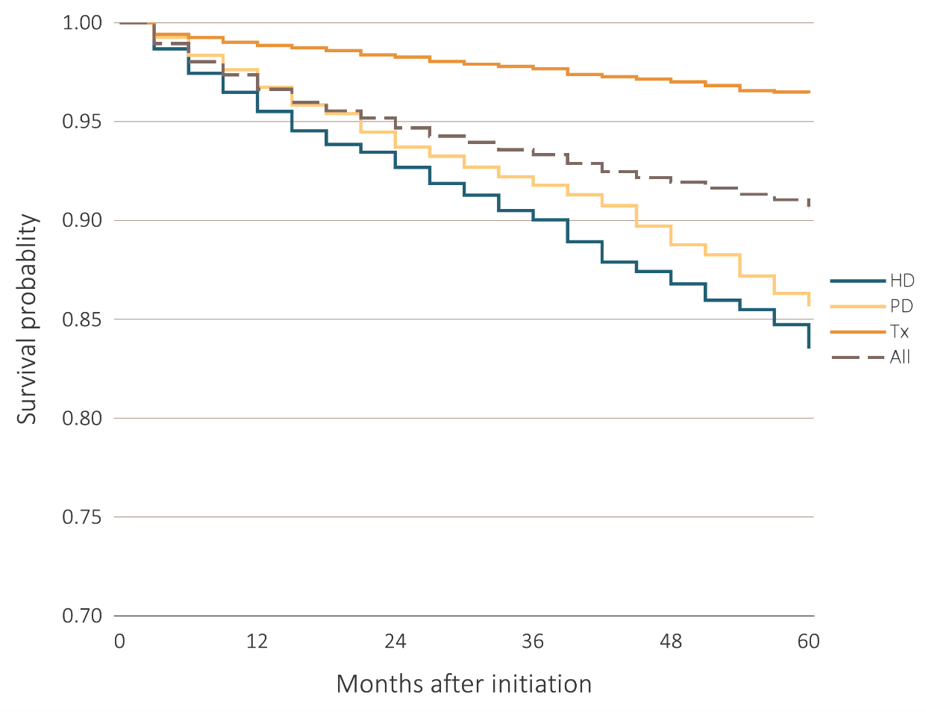
vol 2 Figure 7.11 Adjusted five-year survival in incident pediatric patients (aged 0-21 years) from day 1, by (a) age and (b) modality, 2007-2011
Data Source: Special analyses, USRDS ESRD Database. Incident dialysis and transplant patients defined at the onset of dialysis or the day of transplant without the 60-day rule; followed to December 31, 2016. (a) Adjusted for sex, race, primary cause of ESRD, and Hispanic ethnicity. (b) Adjusted for age, sex, race, primary cause of ESRD and Hispanic ethnicity. Reference population: incident ESRD patients aged 0-21, 2010-2011. Abbreviations: ESRD, end-stage renal disease; HD, hemodialysis; PD, peritoneal dialysis; Tx, transplant.

Slide 30
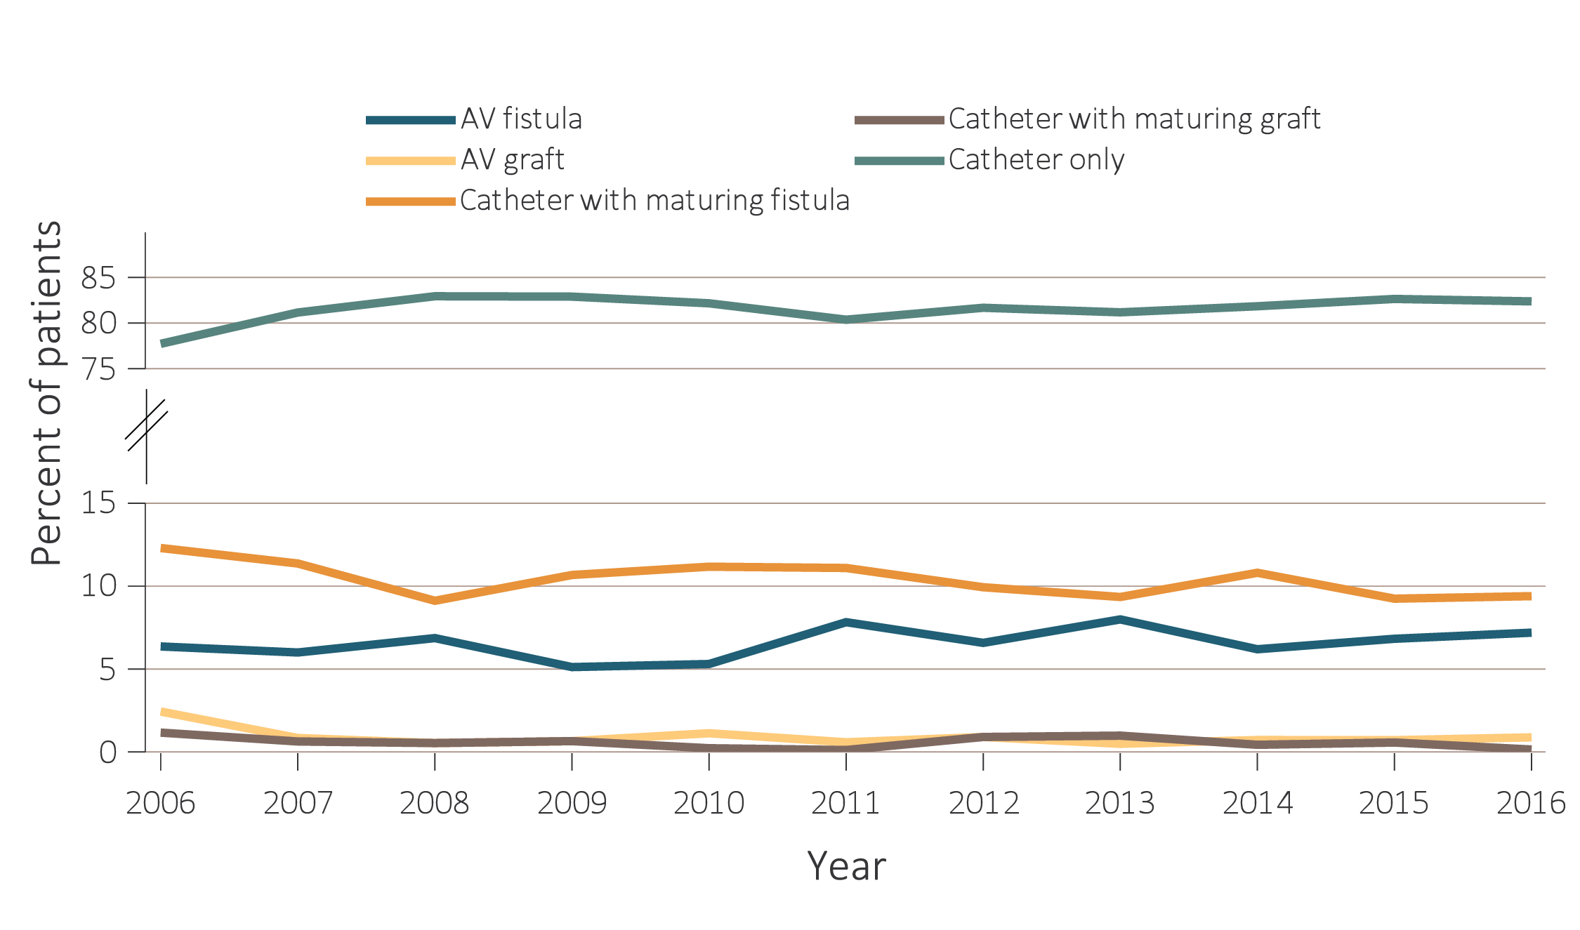
vol 2 Figure 7.12 Vascular access type at initiation of incident pediatric hemodialysis patients (aged 0-21 years) by (a) year and (b) age, 2006-2016
(a) Year
Data Source: Special analyses, USRDS ESRD Database. ESRD patients initiating hemodialysis in 2006-2015. Abbreviations: AV, arteriovenous; ESRD, end-stage renal disease.

Slide 31
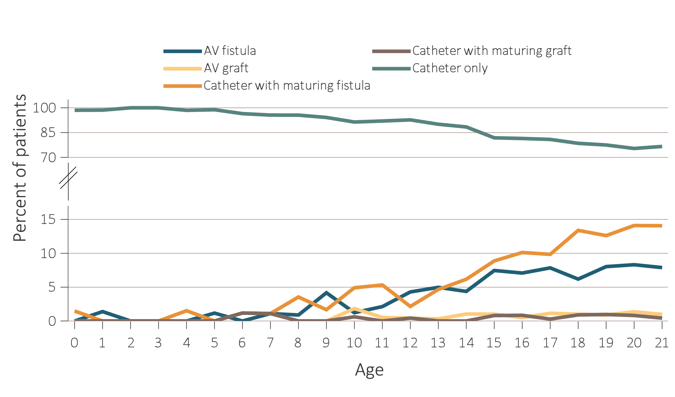
vol 2 Figure 7.12 Vascular access type at initiation of incident pediatric hemodialysis patients (aged 0-21 years) by (a) year and (b) age, 2006-2016
(b) Age (all years combined)
Data Source: Special analyses, USRDS ESRD Database. ESRD patients initiating hemodialysis in 2006-2015. Abbreviations: AV, arteriovenous; ESRD, end-stage renal disease.

Slide 32
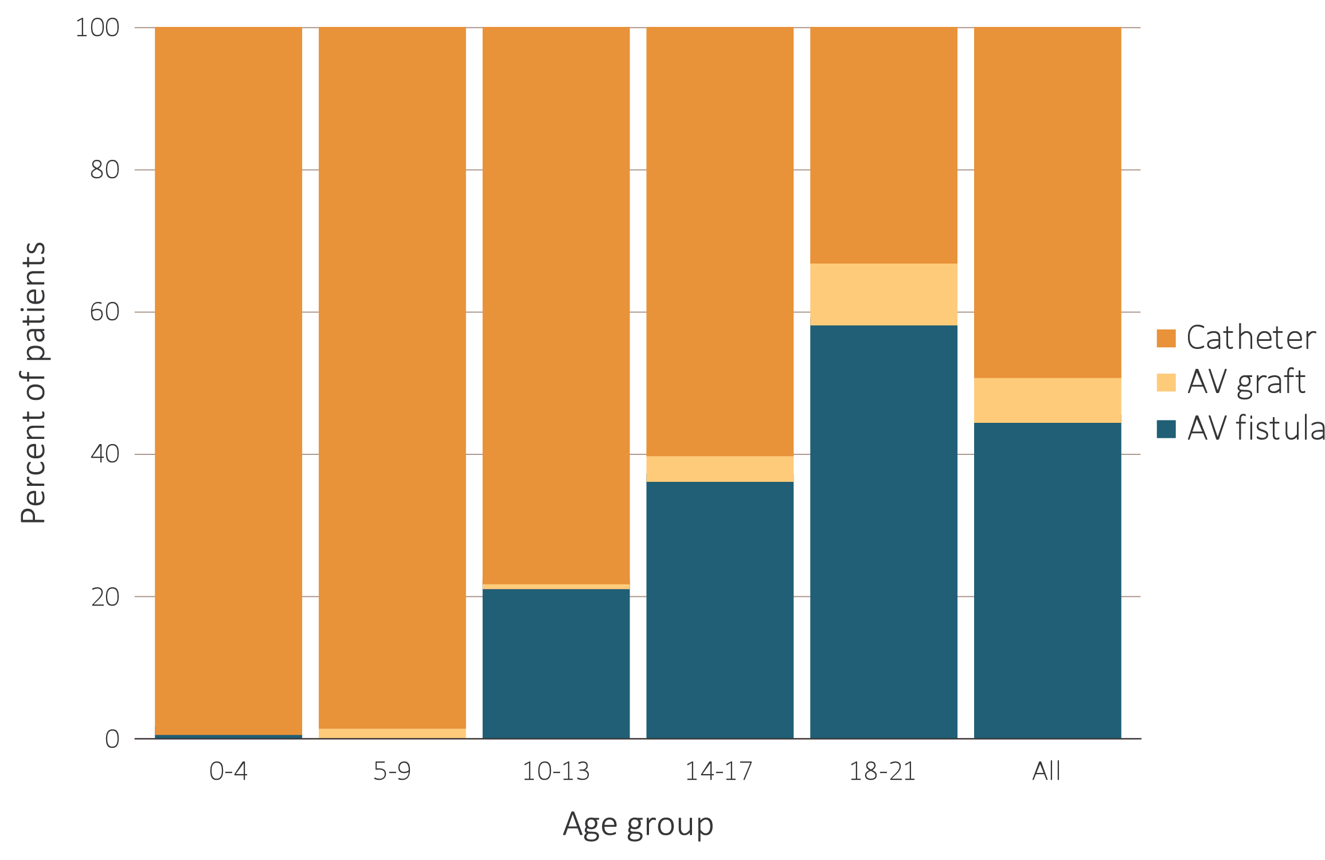
vol 2 Figure 7.13 Distribution of vascular access type in prevalent pediatric hemodialysis patients (aged 0-21 years* as of May 31, 2017)
Data Source: Special analyses, CROWNWeb clinical extracts for May 2017. Hemodialysis patients initiating treatment for ESRD at least 90 days prior to May 1, 2017, *who were <22 years old as of May 1, 2017, and who were alive through May 31, 2017; Catheter=any catheter use; fistula and graft use shown are without the use of a catheter. Abbreviations: AV, arteriovenous; ESRD, end-stage renal disease.

Slide 33
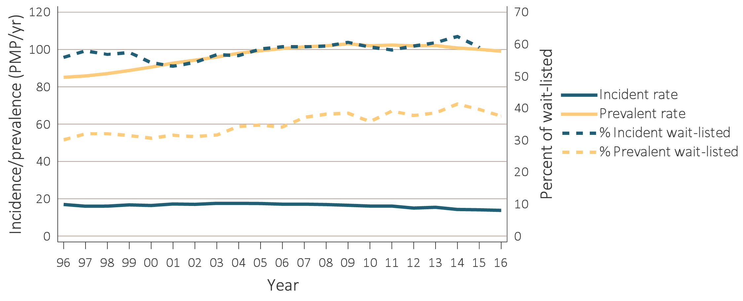
vol 2 Figure 7.14 Trends in pediatric transplantation (aged 0-21 years), by (a) ESRD incident and prevalent rates, and percent of patients wait-listed, (b) kidney transplant counts and waiting list times, (c) kidney transplant counts by donor type (aged 0-21 years), (d) kidney transplant counts, (aged 0-17 years), (e) and kidney transplant counts, (aged 18-21 years)
(a) ESRD incident rate, prevalent rate, and percent of patients wait-listed
Data Source: (a) Reference Tables E4 and E5(2). Incidence and December 31st point prevalence of ESRD among pediatric patients (aged 0–21 years) per million population per year, 1996–2016, percent of pediatric patients either wait-listed or receiving a kidney within one year of ESRD initiation date, 1996-2015 and percent of prevalent dialysis pediatric patients wait-listed for a kidney, 1996–2016. (b) Special analyses, USRDS ESRD Database. The waiting list count provides the number of pediatric candidates aged 0-21 years on the Organ Procurement and Transplantation Network kidney transplant waiting list on December 31 of each year for first and subsequent kidney alone or kidney plus pancreas transplantation. Candidates listed at more than one center on December 31 are counted only once. There are no data available for median waiting list time for patients with prior transplants listed after 2012. (c-e) Reference Tables E8, E8(2), E8(3). This figure represents kidney alone and kidney plus pancreas transplant counts for all pediatric candidates. Abbreviations: ESRD, end-stage renal disease; PMP, per million population; Tx, transplant; yr, year.

Slide 34
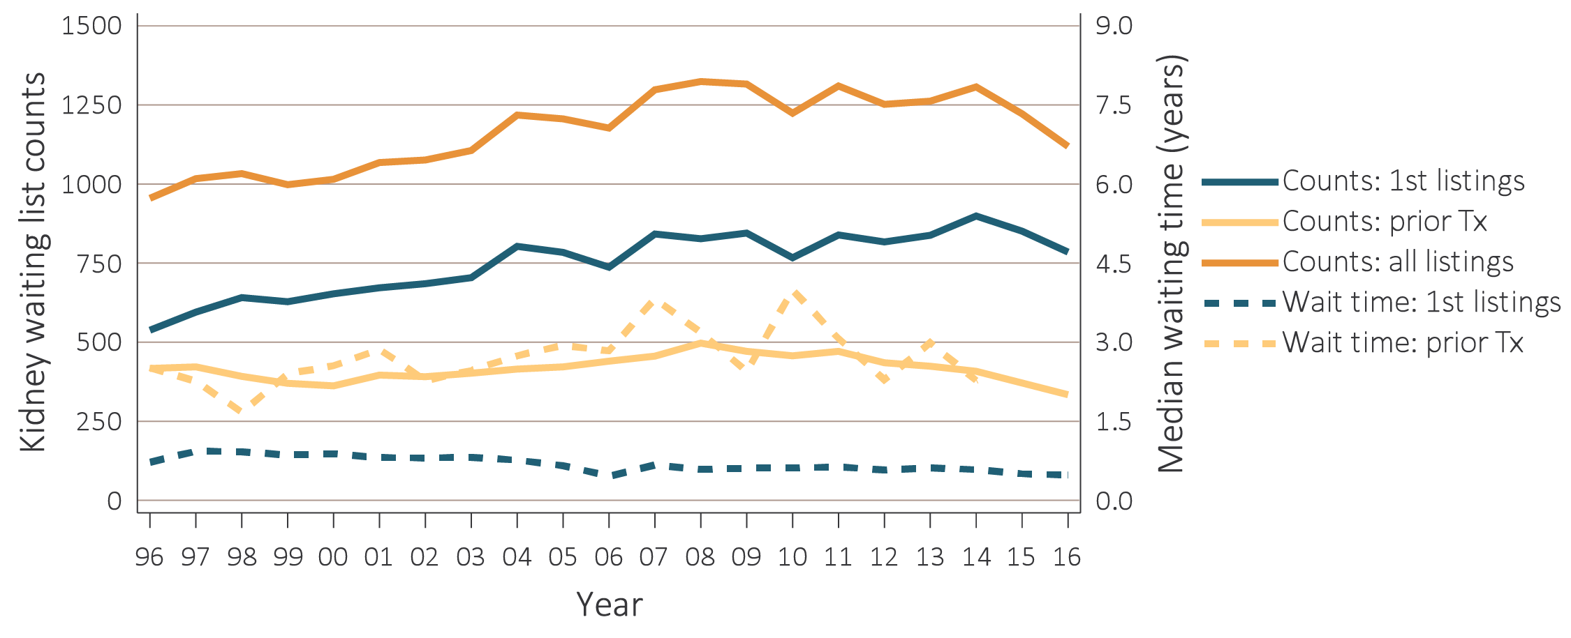
vol 2 Figure 7.14 Trends in pediatric transplantation (aged 0-21 years), by (a) ESRD incident and prevalent rates, and percent of patients wait-listed, (b) kidney transplant counts and waiting list times, (c) kidney transplant counts by donor type (aged 0-21 years), (d) kidney transplant counts, (aged 0-17 years), (e) and kidney transplant counts, (aged 18-21 years)
(b) Kidney transplant counts and waiting list times
Data Source: (a) Reference Tables E4 and E5(2). Incidence and December 31st point prevalence of ESRD among pediatric patients (aged 0–21 years) per million population per year, 1996–2016, percent of pediatric patients either wait-listed or receiving a kidney within one year of ESRD initiation date, 1996-2015 and percent of prevalent dialysis pediatric patients wait-listed for a kidney, 1996–2016. (b) Special analyses, USRDS ESRD Database. The waiting list count provides the number of pediatric candidates aged 0-21 years on the Organ Procurement and Transplantation Network kidney transplant waiting list on December 31 of each year for first and subsequent kidney alone or kidney plus pancreas transplantation. Candidates listed at more than one center on December 31 are counted only once. There are no data available for median waiting list time for patients with prior transplants listed after 2012. (c-e) Reference Tables E8, E8(2), E8(3). This figure represents kidney alone and kidney plus pancreas transplant counts for all pediatric candidates. Abbreviations: ESRD, end-stage renal disease; PMP, per million population; Tx, transplant; yr, year.

Slide 35
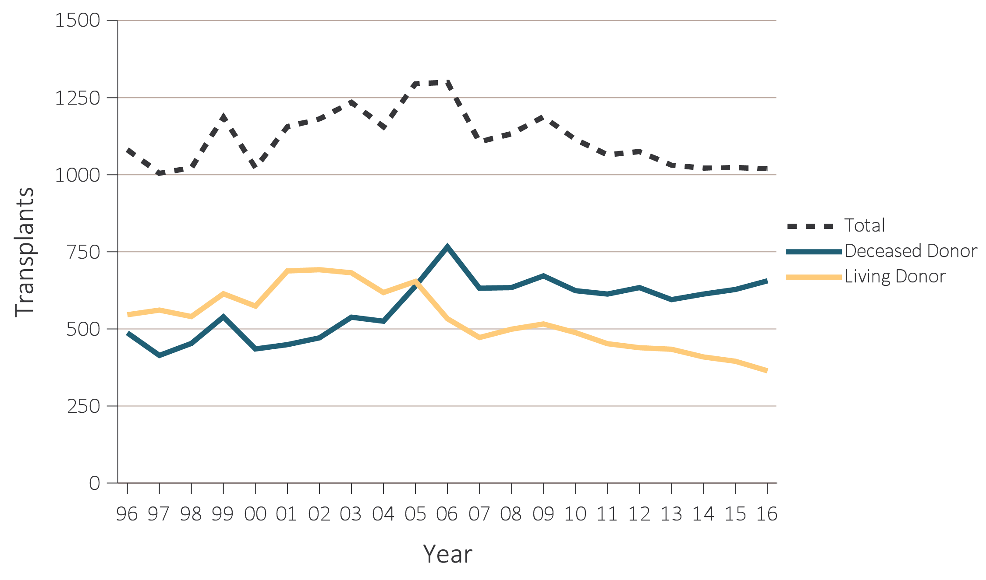
vol 2 Figure 7.14 Trends in pediatric transplantation (aged 0-21 years), by (a) ESRD incident and prevalent rates, and percent of patients wait-listed, (b) kidney transplant counts and waiting list times, (c) kidney transplant counts by donor type (aged 0-21 years), (d) kidney transplant counts, (aged 0-17 years), (e) and kidney transplant counts, (aged 18-21 years)
(c) Kidney transplant counts by donor type
Data Source: (a) Reference Tables E4 and E5(2). Incidence and December 31st point prevalence of ESRD among pediatric patients (aged 0–21 years) per million population per year, 1996–2016, percent of pediatric patients either wait-listed or receiving a kidney within one year of ESRD initiation date, 1996-2015 and percent of prevalent dialysis pediatric patients wait-listed for a kidney, 1996–2016. (b) Special analyses, USRDS ESRD Database. The waiting list count provides the number of pediatric candidates aged 0-21 years on the Organ Procurement and Transplantation Network kidney transplant waiting list on December 31 of each year for first and subsequent kidney alone or kidney plus pancreas transplantation. Candidates listed at more than one center on December 31 are counted only once. There are no data available for median waiting list time for patients with prior transplants listed after 2012. (c-e) Reference Tables E8, E8(2), E8(3). This figure represents kidney alone and kidney plus pancreas transplant counts for all pediatric candidates. Abbreviations: ESRD, end-stage renal disease; PMP, per million population; Tx, transplant; yr, year.

Slide 36
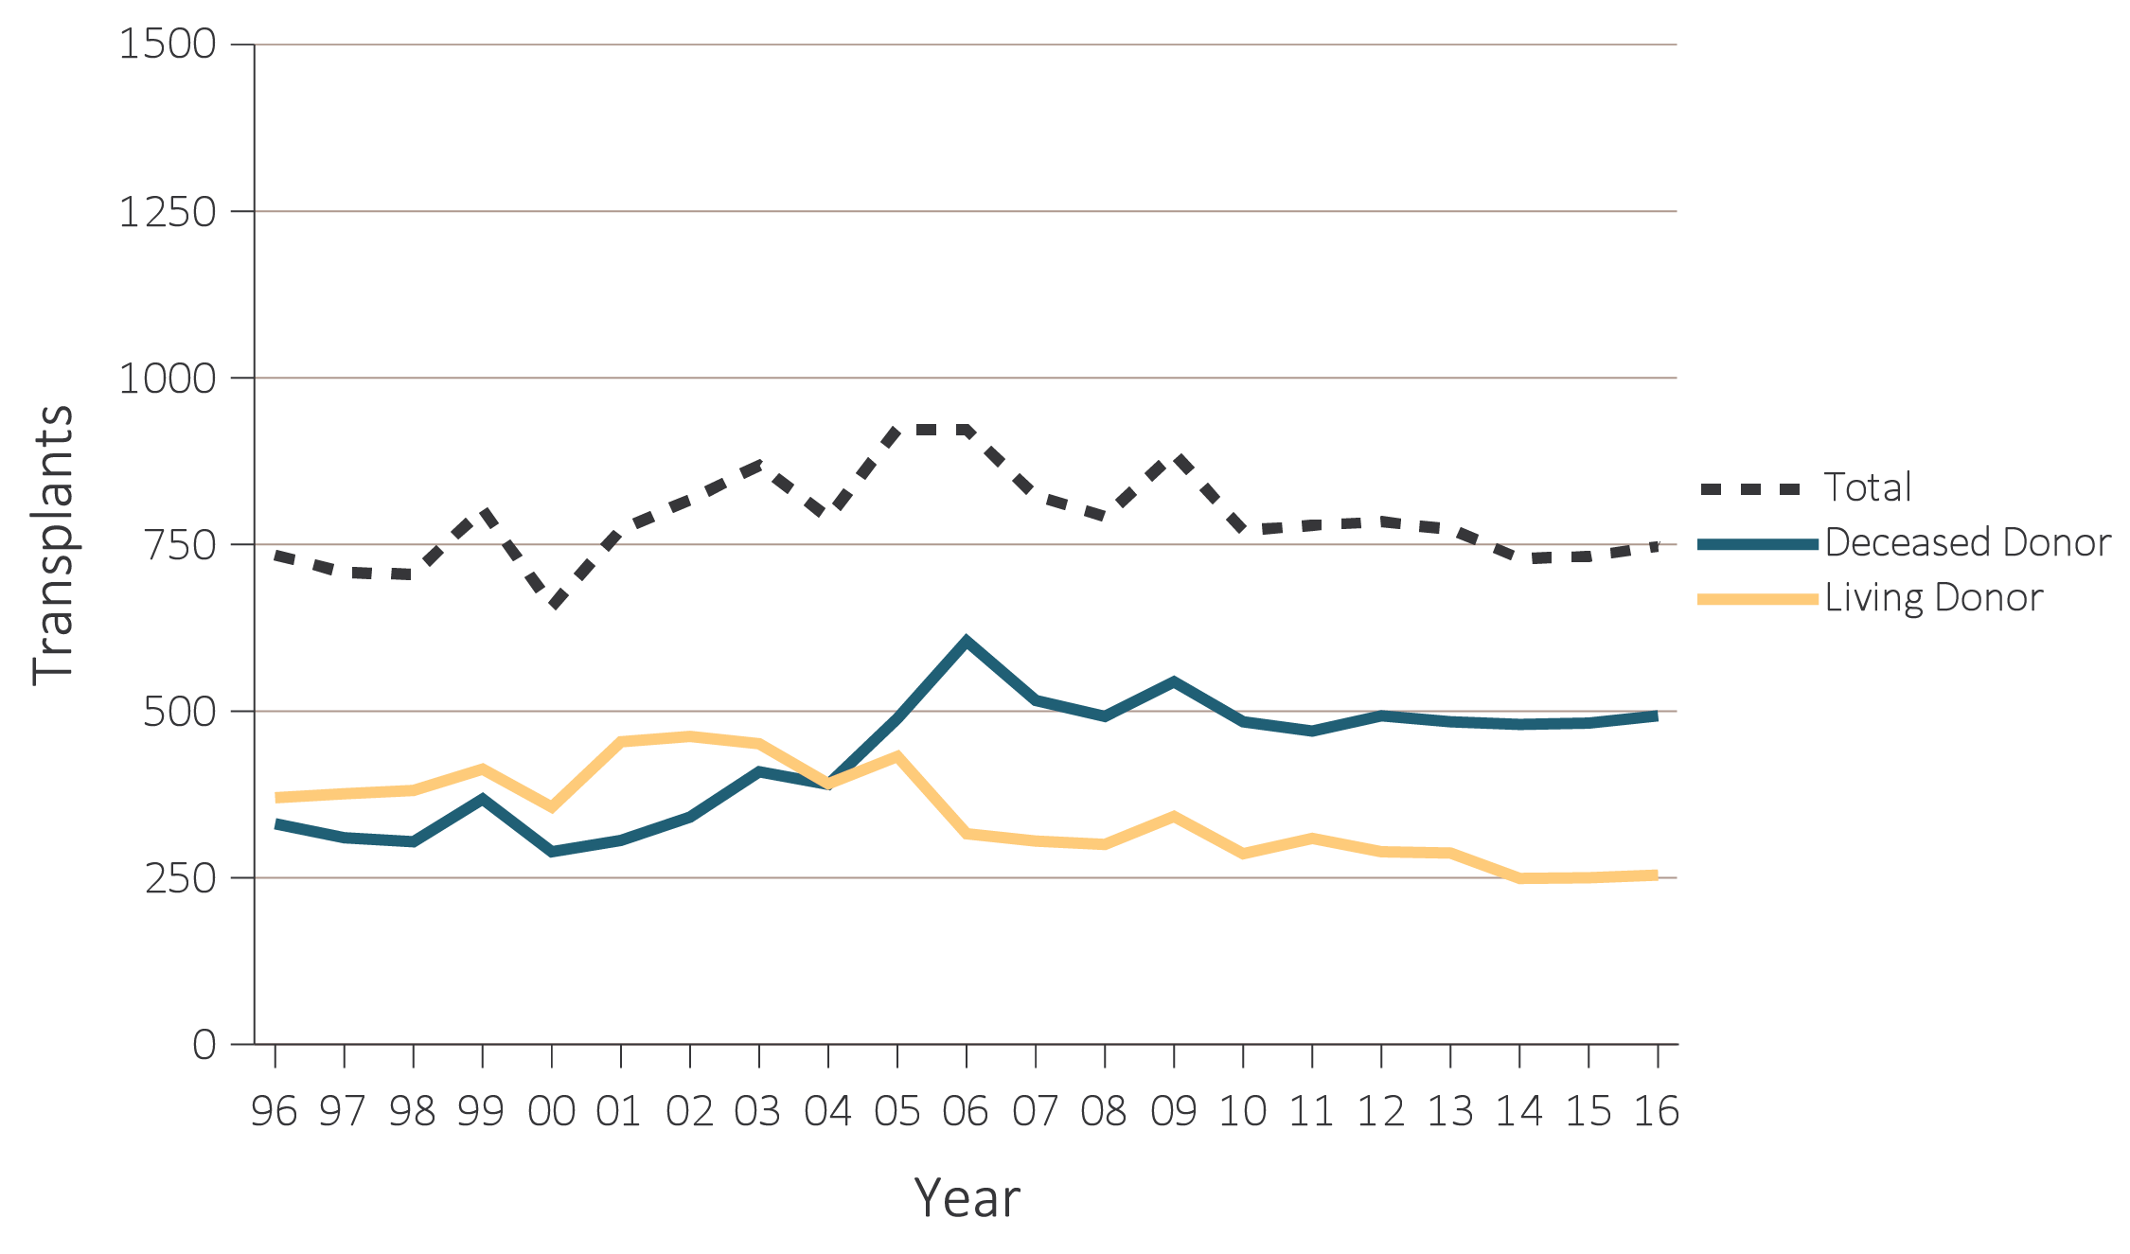
vol 2 Figure 7.14 Trends in pediatric transplantation (aged 0-21 years), by (a) ESRD incident and prevalent rates, and percent of patients wait-listed, (b) kidney transplant counts and waiting list times, (c) kidney transplant counts by donor type (aged 0-21 years), (d) kidney transplant counts, (aged 0-17 years), (e) and kidney transplant counts, (aged 18-21 years)
(d) Kidney transplant counts, patients 0-17 years
Data Source: (a) Reference Tables E4 and E5(2). Incidence and December 31st point prevalence of ESRD among pediatric patients (aged 0–21 years) per million population per year, 1996–2016, percent of pediatric patients either wait-listed or receiving a kidney within one year of ESRD initiation date, 1996-2015 and percent of prevalent dialysis pediatric patients wait-listed for a kidney, 1996–2016. (b) Special analyses, USRDS ESRD Database. The waiting list count provides the number of pediatric candidates aged 0-21 years on the Organ Procurement and Transplantation Network kidney transplant waiting list on December 31 of each year for first and subsequent kidney alone or kidney plus pancreas transplantation. Candidates listed at more than one center on December 31 are counted only once. There are no data available for median waiting list time for patients with prior transplants listed after 2012. (c-e) Reference Tables E8, E8(2), E8(3). This figure represents kidney alone and kidney plus pancreas transplant counts for all pediatric candidates. Abbreviations: ESRD, end-stage renal disease; PMP, per million population; Tx, transplant; yr, year.

Slide 37
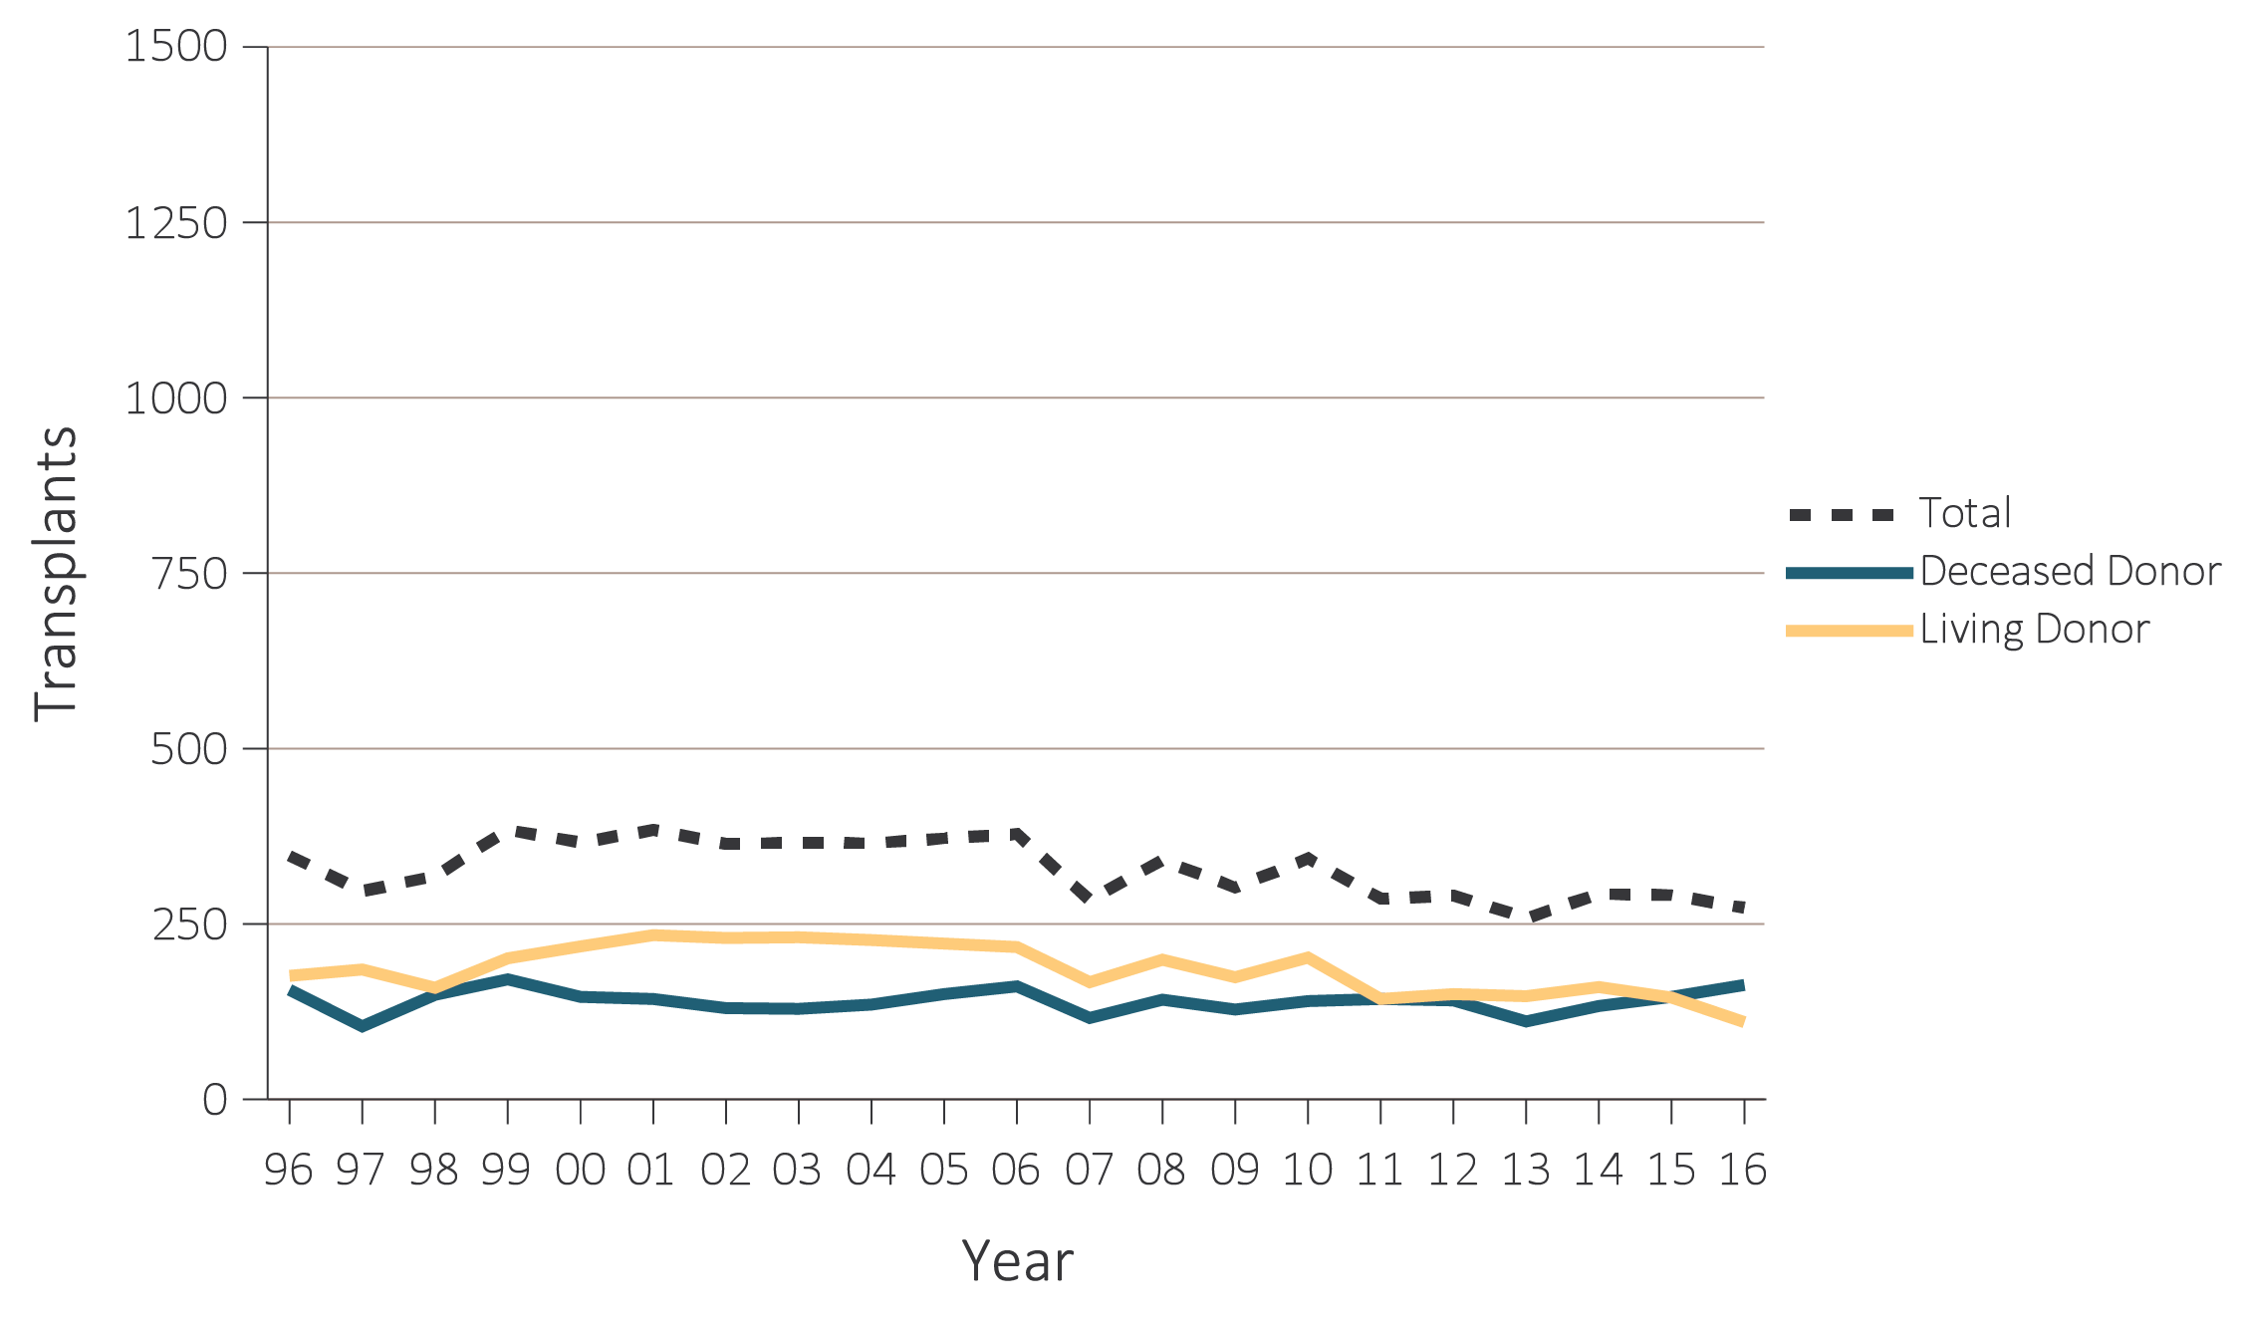
vol 2 Figure 7.14 Trends in pediatric transplantation (aged 0-21 years), by (a) ESRD incident and prevalent rates, and percent of patients wait-listed, (b) kidney transplant counts and waiting list times, (c) kidney transplant counts by donor type (aged 0-21 years), (d) kidney transplant counts, (aged 0-17 years), (e) and kidney transplant counts, (aged 18-21 years)
(e) Kidney transplant counts, patients 18-21 years
Data Source: (a) Reference Tables E4 and E5(2). Incidence and December 31st point prevalence of ESRD among pediatric patients (aged 0–21 years) per million population per year, 1996–2016, percent of pediatric patients either wait-listed or receiving a kidney within one year of ESRD initiation date, 1996-2015 and percent of prevalent dialysis pediatric patients wait-listed for a kidney, 1996–2016. (b) Special analyses, USRDS ESRD Database. The waiting list count provides the number of pediatric candidates aged 0-21 years on the Organ Procurement and Transplantation Network kidney transplant waiting list on December 31 of each year for first and subsequent kidney alone or kidney plus pancreas transplantation. Candidates listed at more than one center on December 31 are counted only once. There are no data available for median waiting list time for patients with prior transplants listed after 2012. (c-e) Reference Tables E8, E8(2), E8(3). This figure represents kidney alone and kidney plus pancreas transplant counts for all pediatric candidates. Abbreviations: ESRD, end-stage renal disease; PMP, per million population; Tx, transplant; yr, year.

Slide 38
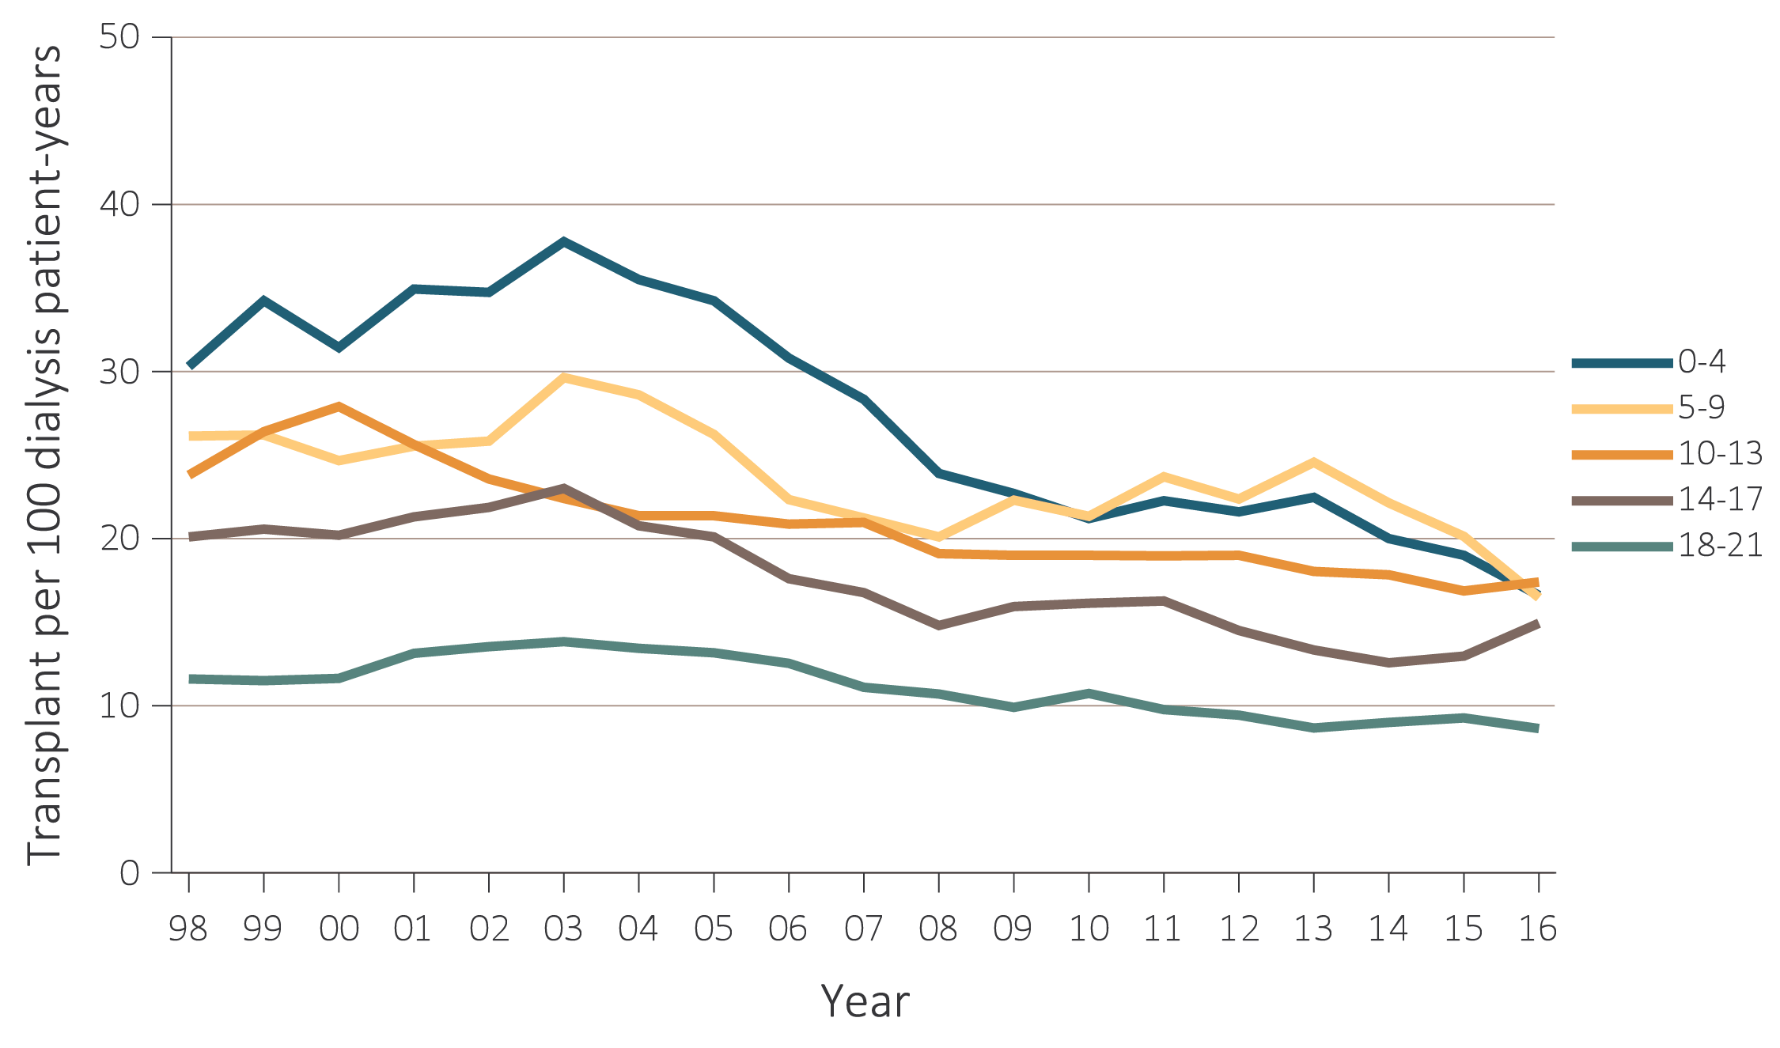
vol 2 Figure 7.15 Annual average rates of transplants in pediatric dialysis patients (aged 0-21 years), by (a) living donor by age, (b) deceased donor by age, (c) living door by race, (d) deceased donor by race, 1998-2016
(a) Living donor transplants by Age
Data Source: Special analyses, USRDS ESRD Database. Includes transplant year between 1998–2016. Three-year rolling average rate is the mean among the rates of the current year and of the two years prior. Abbreviations: Blk/AfAm; Black/African American; ESRD, end-stage renal disease.

Slide 39
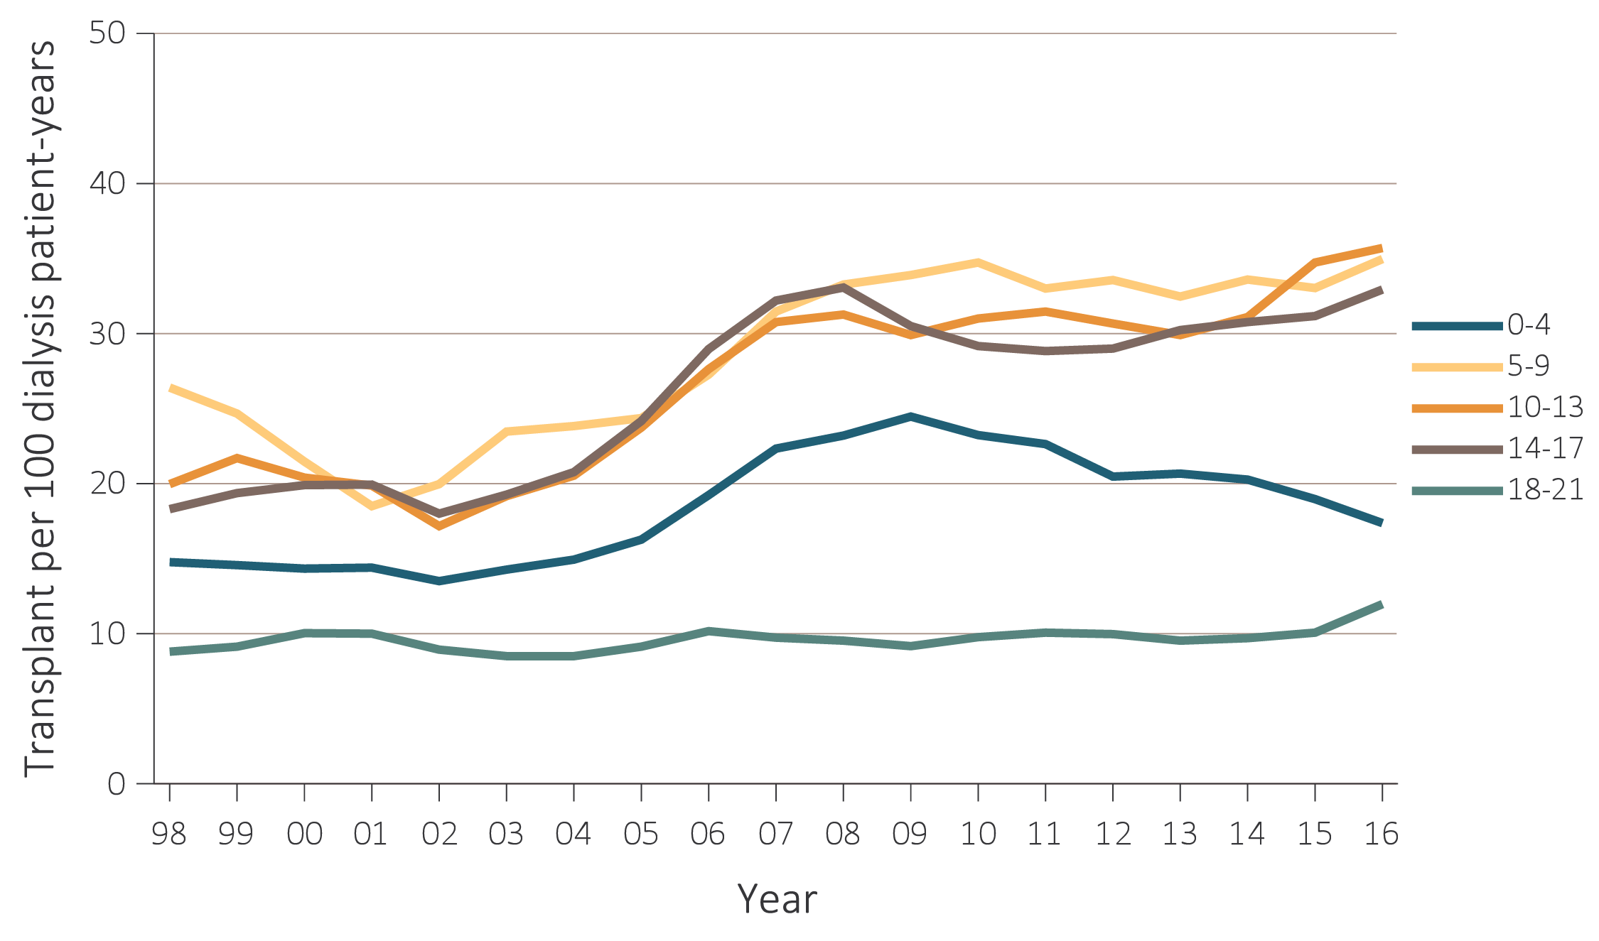
vol 2 Figure 7.15 Annual average rates of transplants in pediatric dialysis patients (aged 0-21 years), by (a) living donor by age, (b) deceased donor by age, (c) living door by race, (d) deceased donor by race, 1998-2016
(b) Deceased donor transplants by Age
Data Source: Special analyses, USRDS ESRD Database. Includes transplant year between 1998–2016. Three-year rolling average rate is the mean among the rates of the current year and of the two years prior. Abbreviations: Blk/AfAm; Black/African American; ESRD, end-stage renal disease.

Slide 40
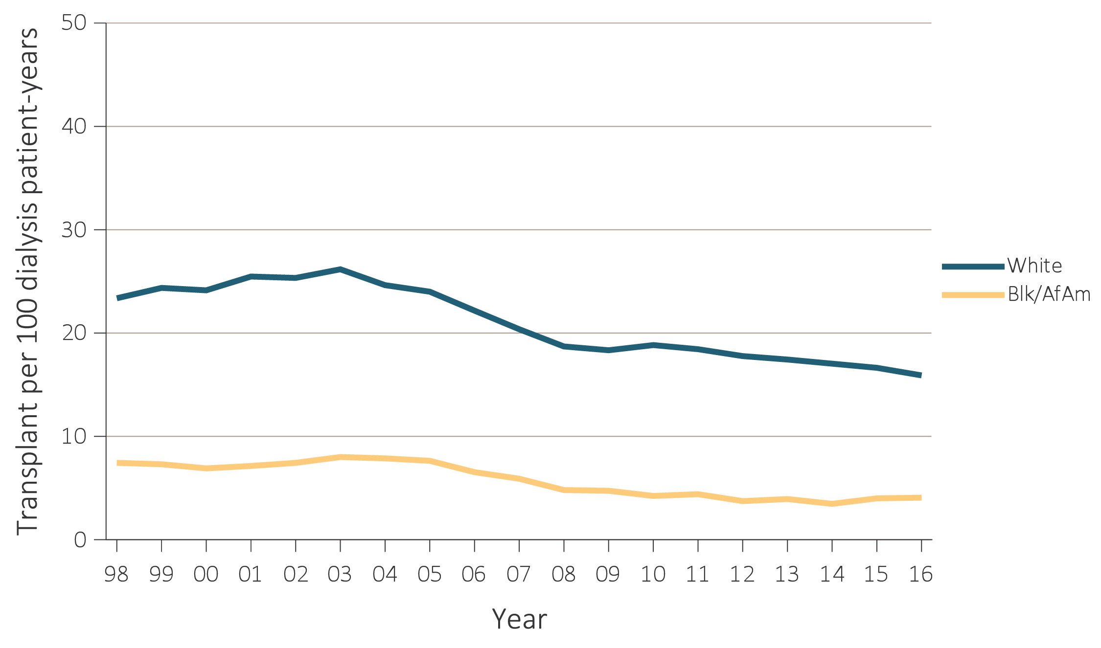
vol 2 Figure 7.15 Annual average rates of transplants in pediatric dialysis patients (aged 0-21 years), by (a) living donor by age, (b) deceased donor by age, (c) living door by race, (d) deceased donor by race, 1998-2016
(c) Living donor transplants by Race
Data Source: Special analyses, USRDS ESRD Database. Includes transplant year between 1998–2016. Three-year rolling average rate is the mean among the rates of the current year and of the two years prior. Abbreviations: Blk/AfAm; Black/African American; ESRD, end-stage renal disease.

Slide 41
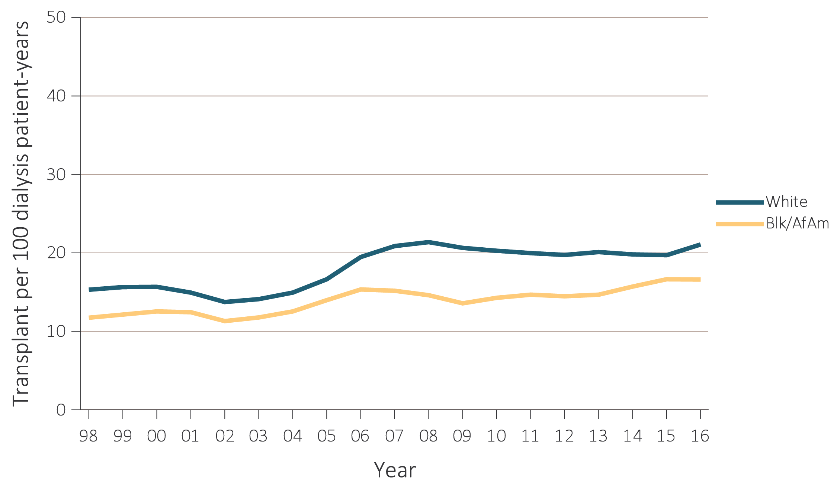
vol 2 Figure 7.15 Annual average rates of transplants in pediatric dialysis patients (aged 0-21 years), by (a) living donor by age, (b) deceased donor by age, (c) living door by race, (d) deceased donor by race, 1998-2016
(d) Deceased donor transplants by Race
Data Source: Special analyses, USRDS ESRD Database. Includes transplant year between 1998–2016. Three-year rolling average rate is the mean among the rates of the current year and of the two years prior. Abbreviations: Blk/AfAm; Black/African American; ESRD, end-stage renal disease.

Slide 42
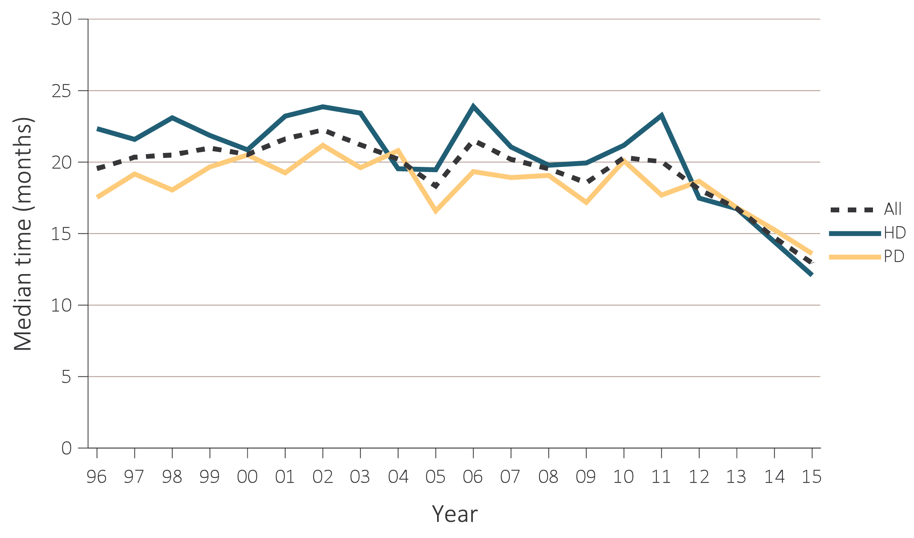
vol 2 Figure 7.16 Median time from incident dialysis to first transplant, by (a) modality, (b) age, (c) primary cause of ESRD, (d) race, and (e) donor type, 1996-2015
(a) Modality
Data Source: Special analyses, USRDS ESRD Database. Sample restricted to children initiating ESRD care with dialysis. Time 0 is defined at the date of initiation of dialysis with the 60 day rule. Includes pediatric patients (aged 0-21 years) starting initiation of HD or PD in 1996-2015 and having the first transplant before 12/31/2017. Abbreviations: CAKUT, congenital anomalies of the kidney and urinary tract; C/H/C, Cystic/Hereditary/Congenital disease. Blk/AfAm, Black/African American; ESRD, end-stage renal disease; HD, hemodialysis; PD, peritoneal dialysis. Note that the percentage of unknown donor type is 1.32% in 1996, 1.00% in 1997, 0.44% in 1998, 0.54% in 1999, 0.22% in 2000, 0.10% in 2001, 0.30% in 2002, 0.10% in 2003, 0.10% in 2004, 0.22% in 2006, 0.13% in 2011, and 0% in 2005, 2007-2010, 2012-2015.

Slide 43
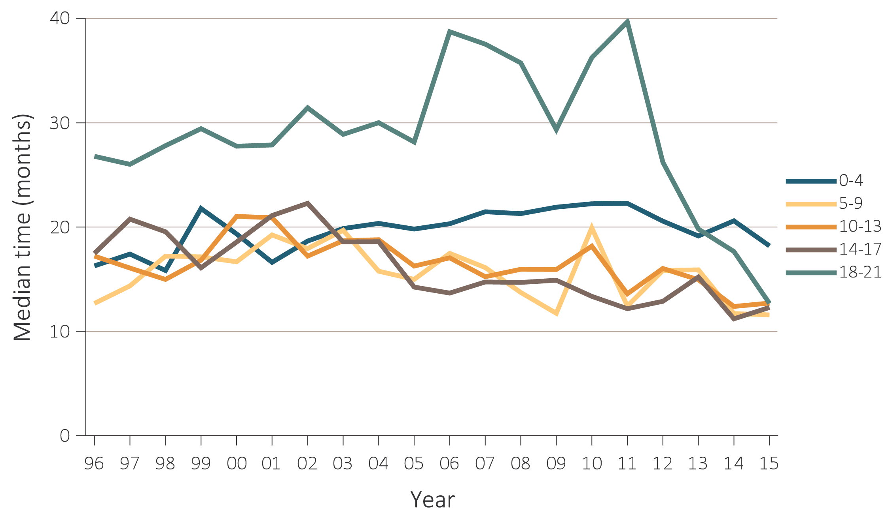
vol 2 Figure 7.16 Median time from incident dialysis to first transplant, by (a) modality, (b) age, (c) primary cause of ESRD, (d) race, and (e) donor type, 1996-2015
(b) Age
Data Source: Special analyses, USRDS ESRD Database. Sample restricted to children initiating ESRD care with dialysis. Time 0 is defined at the date of initiation of dialysis with the 60 day rule. Includes pediatric patients (aged 0-21 years) starting initiation of HD or PD in 1996-2015 and having the first transplant before 12/31/2017. Abbreviations: CAKUT, congenital anomalies of the kidney and urinary tract; C/H/C, Cystic/Hereditary/Congenital disease. Blk/AfAm, Black/African American; ESRD, end-stage renal disease; HD, hemodialysis; PD, peritoneal dialysis. Note that the percentage of unknown donor type is 1.32% in 1996, 1.00% in 1997, 0.44% in 1998, 0.54% in 1999, 0.22% in 2000, 0.10% in 2001, 0.30% in 2002, 0.10% in 2003, 0.10% in 2004, 0.22% in 2006, 0.13% in 2011, and 0% in 2005, 2007-2010, 2012-2015.

Slide 44
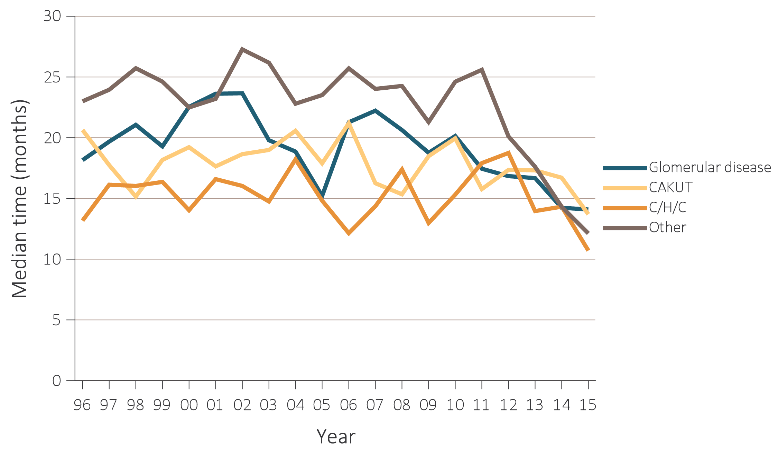
vol 2 Figure 7.16 Median time from incident dialysis to first transplant, by (a) modality, (b) age, (c) primary cause of ESRD, (d) race, and (e) donor type, 1996-2015
(c) Primary cause of ESRD
Data Source: Special analyses, USRDS ESRD Database. Sample restricted to children initiating ESRD care with dialysis. Time 0 is defined at the date of initiation of dialysis with the 60 day rule. Includes pediatric patients (aged 0-21 years) starting initiation of HD or PD in 1996-2015 and having the first transplant before 12/31/2017. Abbreviations: CAKUT, congenital anomalies of the kidney and urinary tract; C/H/C, Cystic/Hereditary/Congenital disease. Blk/AfAm, Black/African American; ESRD, end-stage renal disease; HD, hemodialysis; PD, peritoneal dialysis. Note that the percentage of unknown donor type is 1.32% in 1996, 1.00% in 1997, 0.44% in 1998, 0.54% in 1999, 0.22% in 2000, 0.10% in 2001, 0.30% in 2002, 0.10% in 2003, 0.10% in 2004, 0.22% in 2006, 0.13% in 2011, and 0% in 2005, 2007-2010, 2012-2015.

Slide 45
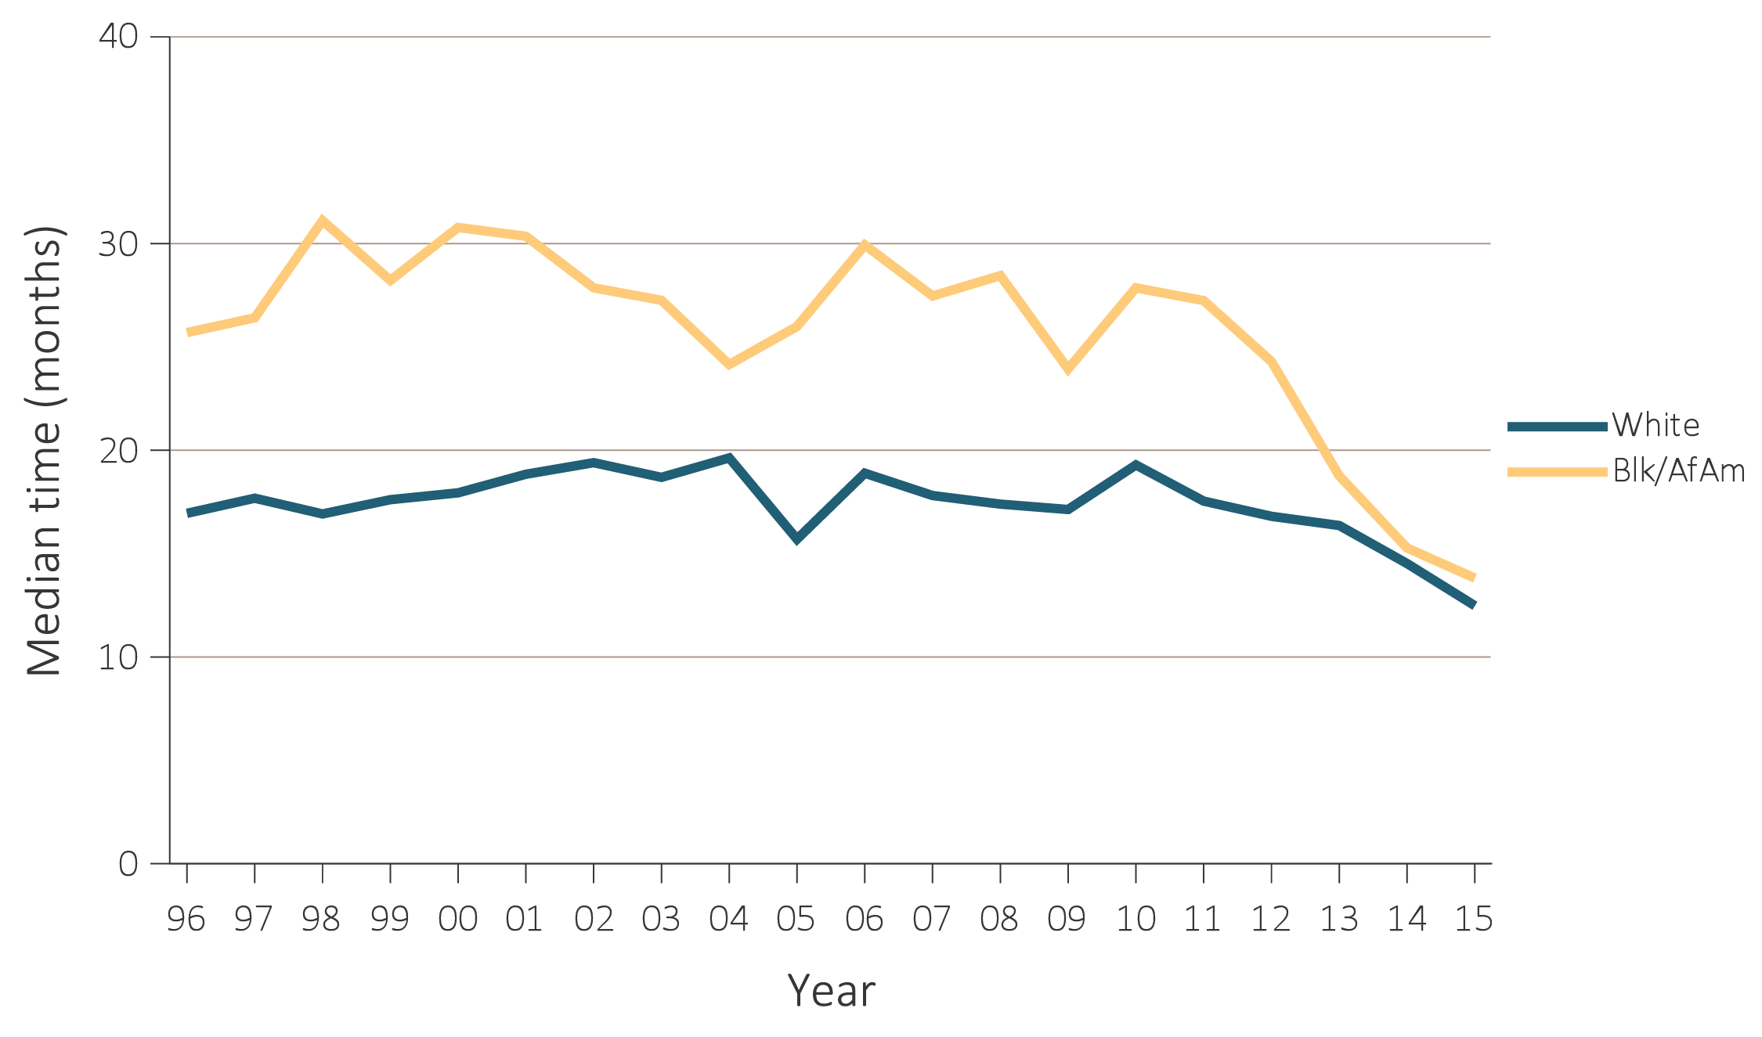
vol 2 Figure 7.16 Median time from incident dialysis to first transplant, by (a) modality, (b) age, (c) primary cause of ESRD, (d) race, and (e) donor type, 1996-2015
(d) Race
Data Source: Special analyses, USRDS ESRD Database. Sample restricted to children initiating ESRD care with dialysis. Time 0 is defined at the date of initiation of dialysis with the 60 day rule. Includes pediatric patients (aged 0-21 years) starting initiation of HD or PD in 1996-2015 and having the first transplant before 12/31/2017. Abbreviations: CAKUT, congenital anomalies of the kidney and urinary tract; C/H/C, Cystic/Hereditary/Congenital disease. Blk/AfAm, Black/African American; ESRD, end-stage renal disease; HD, hemodialysis; PD, peritoneal dialysis. Note that the percentage of unknown donor type is 1.32% in 1996, 1.00% in 1997, 0.44% in 1998, 0.54% in 1999, 0.22% in 2000, 0.10% in 2001, 0.30% in 2002, 0.10% in 2003, 0.10% in 2004, 0.22% in 2006, 0.13% in 2011, and 0% in 2005, 2007-2010, 2012-2015.

Slide 46
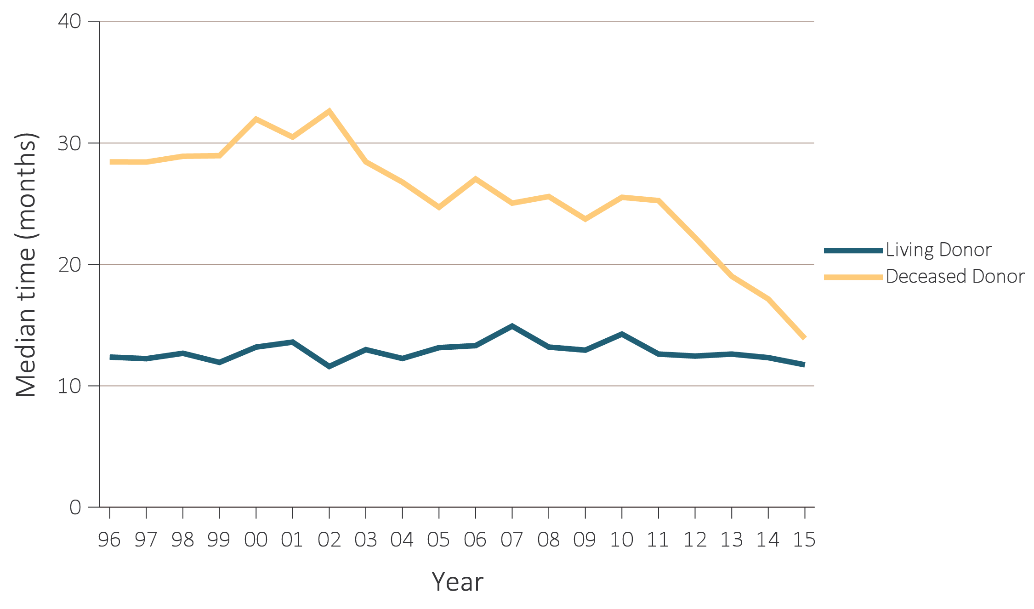
vol 2 Figure 7.16 Median time from incident dialysis to first transplant, by (a) modality, (b) age, (c) primary cause of ESRD, (d) race, and (e) donor type, 1996-2015
(e) Donor type
Data Source: Special analyses, USRDS ESRD Database. Sample restricted to children initiating ESRD care with dialysis. Time 0 is defined at the date of initiation of dialysis with the 60 day rule. Includes pediatric patients (aged 0-21 years) starting initiation of HD or PD in 1996-2015 and having the first transplant before 12/31/2017. Abbreviations: CAKUT, congenital anomalies of the kidney and urinary tract; C/H/C, Cystic/Hereditary/Congenital disease. Blk/AfAm, Black/African American; ESRD, end-stage renal disease; HD, hemodialysis; PD, peritoneal dialysis. Note that the percentage of unknown donor type is 1.32% in 1996, 1.00% in 1997, 0.44% in 1998, 0.54% in 1999, 0.22% in 2000, 0.10% in 2001, 0.30% in 2002, 0.10% in 2003, 0.10% in 2004, 0.22% in 2006, 0.13% in 2011, and 0% in 2005, 2007-2010, 2012-2015.

Slide 47
vol 2 Table 7.4 Adjusted outcomes for deceased donor kidney transplants in pediatric patients (aged 0-21 years) by year, 1996-2015
 | One year post-transplant |  |  |  | Five years post-transplant |  |  |  | Ten years post-transplant
Year | Probability of all-cause graft failure (%) | Probability of return to dialysis or repeat transplant (%) | Probability of death (%) |  | Probability of all-cause graft failure (%) | Probability of return to dialysis or repeat transplant (%) | Probability of death (%) |  | Probability of all-cause graft failure (%) | Probability of return to dialysis or repeat transplant (%) | Probability of death (%)
1996 | 15.9 | 13.7 | 2.0 |  | 43.6 | 40.5 | 8.6 |  | 65.5 | 62.4 | 15.9
1997 | 12.9 | 11.2 | 2.6 |  | 39.2 | 36.6 | 6.3 |  | 63.2 | 59.7 | 15.1
1998 | 14.8 | 13.4 | 2.0 |  | 38.4 | 36.3 | 6.1 |  | 57.8 | 55.7 | 11.2
1999 | 14.2 | 11.8 | 2.2 |  | 37.6 | 34.8 | 4.7 |  | 59.2 | 56.3 | 14.2
2000 | 11.7 | 9.9 | 1.4 |  | 41.0 | 38.6 | 5.3 |  | 59.9 | 56.6 | 11.3
2001 | 11.5 | 10.7 | 1.7 |  | 36.6 | 34.8 | 6.0 |  | 57.0 | 54.1 | 12.3
2002 | 10.2 | 9.0 | 0.9 |  | 35.7 | 33.1 | 3.7 |  | 52.0 | 48.6 | 7.1
2003 | 10.5 | 8.7 | 2.5 |  | 36.7 | 34.1 | 7.0 |  | 54.4 | 51.2 | 14.6
2004 | 8.7 | 6.7 | 1.7 |  | 37.7 | 35.0 | 4.9 |  | 59.4 | 56.6 | 8.8
2005 | 9.4 | 8.0 | 2.2 |  | 35.2 | 32.5 | 5.6 |  | 55.6 | 52.6 | 10.3
2006 | 9.0 | 7.9 | 1.4 |  | 32.9 | 31.1 | 3.8 |  | 53.2 | 50.9 | 8.2
2007 | 7.8 | 6.4 | 2.2 |  | 31.4 | 29.0 | 6.0
2008 | 9.1 | 7.4 | 1.8 |  | 28.2 | 25.2 | 4.4
2009 | 7.6 | 6.5 | 1.1 |  | 29.3 | 27.1 | 4.3
2010 | 6.7 | 5.6 | 1.1 |  | 23.9 | 22.6 | 2.7
2011 | 4.3 | 4.1 | 0.3 |  | 23.8 | 22.7 | 2.6
2012 | 5.4 | 4.2 | 0.9
2013 | 5.8 | 5.4 | 0.4
2014 | 5.5 | 5.1 | 0.3
2015 | 3.0 | 2.6 | 0.2
Data Source: Reference Tables F2, F5, F6, F14, F17, F18, I26, I29, I30. Probabilities for all-cause graft failure and return to dialysis or repeat transplant are adjusted for age, sex, race, primary cause of ESRD, and first versus subsequent transplant. All-cause graft failure includes repeat transplant, return to dialysis, and death. The death outcome is not censored at graft failure, and includes deaths that occur after repeat transplant or return to dialysis. Probabilities of death are adjusted for age, sex, race, Hispanic ethnicity, and primary cause of ESRD. The reference population for all-cause graft failure and return to dialysis or repeat transplantation is all pediatric patients receiving a kidney alone transplant in 2011. The reference population for death is incident pediatric ESRD patients in 2011. Abbreviation: ESRD, end-stage renal disease.

Slide 48
vol 2 Table 7.5 Adjusted outcomes for living donor kidney transplants in pediatric patients (aged 0-21 years) by year, 1996-2015
 | One year post-transplant |  |  |  | Five years post-transplant |  |  |  | Ten years post-transplant
Year | Probability of all-cause graft failure (%) | Probability of return to dialysis or repeat transplant (%) | Probability of death (%) |  | Probability of all-cause graft failure (%) | Probability of return to dialysis or repeat transplant (%) | Probability of death (%) |  | Probability of all-cause graft failure (%) | Probability of return to dialysis or repeat transplant (%) | Probability of death (%)
1996 | 9.2 | 8.0 | 1.8 |  | 30.1 | 28.0 | 5.9 |  | 51.1 | 49.1 | 12.0
1997 | 8.0 | 7.1 | 1.1 |  | 29.6 | 26.2 | 9.5 |  | 48.8 | 45.9 | 15.1
1998 | 7.1 | 6.5 | 0.8 |  | 25.3 | 24.1 | 2.5 |  | 48.5 | 46.3 | 9.8
1999 | 7.3 | 6.5 | 1.0 |  | 27.4 | 25.6 | 5.9 |  | 49.6 | 47.2 | 13.0
2000 | 8.3 | 7.7 | 1.6 |  | 28.4 | 26.6 | 7.3 |  | 51.2 | 48.2 | 14.7
2001 | 7.5 | 6.7 | 1.1 |  | 26.6 | 24.2 | 5.4 |  | 48.8 | 45.9 | 13.1
2002 | 6.4 | 5.5 | 1.6 |  | 25.6 | 23.6 | 7.1 |  | 42.0 | 39.8 | 13.1
2003 | 6.8 | 5.6 | 1.5 |  | 25.1 | 22.9 | 5.3 |  | 42.7 | 39.9 | 11.1
2004 | 5.9 | 4.9 | 1.0 |  | 25.8 | 23.3 | 3.9 |  | 43.7 | 41.0 | 6.2
2005 | 7.0 | 6.4 | 1.1 |  | 27.4 | 25.6 | 5.7 |  | 47.7 | 45.5 | 11.3
2006 | 3.9 | 3.7 | 0.3 |  | 20.8 | 19.4 | 2.4 |  | 39.4 | 37.3 | 6.0
2007 | 4.7 | 3.9 | 0.8 |  | 23.2 | 21.3 | 4.1
2008 | 5.3 | 4.5 | 1.5 |  | 21.5 | 19.4 | 4.7
2009 | 5.0 | 3.9 | 0.9 |  | 18.9 | 17.3 | 1.7
2010 | 3.9 | 3.2 | 0.6 |  | 20.3 | 18.6 | 1.3
2011 | 4.0 | 3.2 | 1.2 |  | 17.2 | 16.1 | 2.8
2012 | 5.5 | 4.4 | 1.7
2013 | 3.3 | 1.6 | 1.2
2014 | 4.7 | 3.8 | 1.0
2015 | 3.1 | 3.0 | 0.0
Data Source: Reference Tables F8, F11, F12, F20, F23, F24, I32, I35, I36. Probabilities for all-cause graft failure and return to dialysis or repeat transplant are adjusted for age, sex, race, primary cause of ESRD, and first versus subsequent transplant. All-cause graft failure includes repeat transplant, return to dialysis, and death. The death outcome is not censored at graft failure, and includes deaths that occur after repeat transplant or return to dialysis. Probabilities of death are adjusted for age, sex, race, Hispanic ethnicity, and primary cause of ESRD. The reference population for all-cause graft failure and return to dialysis or repeat transplantation is all pediatric patients receiving a kidney alone transplant in 2011. The reference population for death is incident pediatric ESRD patients in 2011. Abbreviation: ESRD, end-stage renal disease.

Slide 49
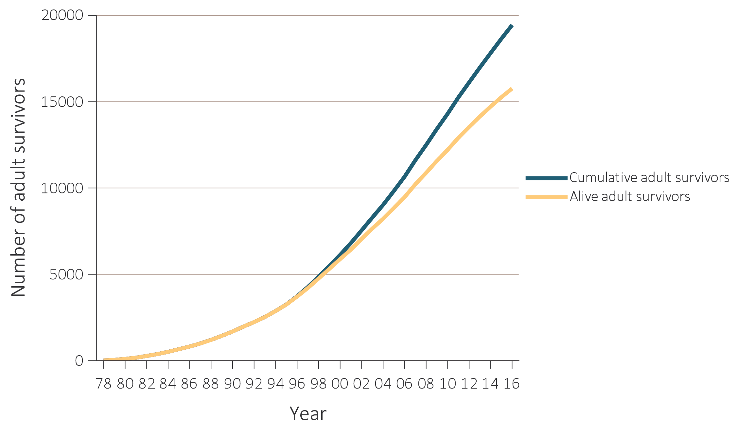
vol 2 Figure 7.17 Prevalent adult survivors of childhood onset ESRD, 1978-2016
Data Source: Special analyses, USRDS ESRD Database. Survivorship cohort is defined as the patients with ESRD incidence in childhood who survive to adulthood by the end of each year and with ESRD onset year on and after 1978. Cumulative adult survivors include patients who reached adulthood but died by the end of each year. Alive adult survivors excludes patients who died during the year. Abbreviation: ESRD, end-stage renal disease.

Slide 50
vol 2 Table 7.6 Initiation characteristics and treatment modality of adult survivors of childhood onset ESRD, inclusive of patients initiating ESRD care between 1995 and 2016
Survivorship Cohort | All (N=13,981)
 | Frequency | Percent
Age of ESRD onset
Less than 5 | 537 | 3.8%
5-9 | 1287 | 9.2%
10-13 | 2906 | 20.8%
14-18 | 9251 | 66.2%
Sex
Male | 7823 | 56.0%
Female | 6158 | 44.0%
Race
White | 9526 | 68.1%
Black | 3533 | 25.3%
Other/Unknown | 922 | 6.6%
Ethnicity
Hispanic | 3580 | 25.6%
Non-Hispanic | 10354 | 74.1%
Unknown | 47 | 0.3%
BMI Category
Underweight | 1434 | 10.3%
Healthy Weight | 7994 | 57.2%
Overweight | 2109 | 15.1%
Obesity | 2444 | 17.5%
Cause of ESRD
Glomerulonephritis / Secondary GN / Vasculitis | 5557 | 39.7%
Cystic / Hereditary / Congenital | 1589 | 11.4%
Other | 6835 | 48.9%
ESRD onset year
1995-2004 | 8244 | 59.0%
2005-2015 | 5737 | 41.0%
Modality at initiation
HD | 7251 | 51.9%
PD | 4160 | 29.8%
TX | 2514 | 18.0%
Cumulative time on HD (months) | 52.5 (SD=52.3)
Cumulative time on PD (months) | 28.0 (SD=29.0)
Cumulative time with functioning transplant (months) | 112.6 (SD=66.6)
Number of transplants | 1.1 (SD=0.6)
Co-existing conditions at ESRD incidence
Heart Failure | 276 | 2.0%
Coronary Artery and Cardiac Disease | 302 | 2.2%
Other Vascular Disease | 110 | 0.8%
Hypertension | 6048 | 43.3%
Diabetes | 254 | 1.8%
Other | 2727 | 19.5%
Data Source: USRDS ESRD Database. Survivorship cohort is defined as the patients with ESRD incidence in childhood that survive to adulthood by the end of 2016 and with ESRD onset year after 1994 and with completed 2728 form information, including patients who reached adulthood but died by the end of 2016. Abbreviation: ESRD, end-stage renal disease; GN, Glomerulonephritis; HD, hemodialysis; PD, peritoneal dialysis.

