Slide 1

2018 Annual Data Report
Volume 2: End-Stage Renal Disease
Chapter 8:
Cardiovascular Disease in Patients with ESRD

Slide 2
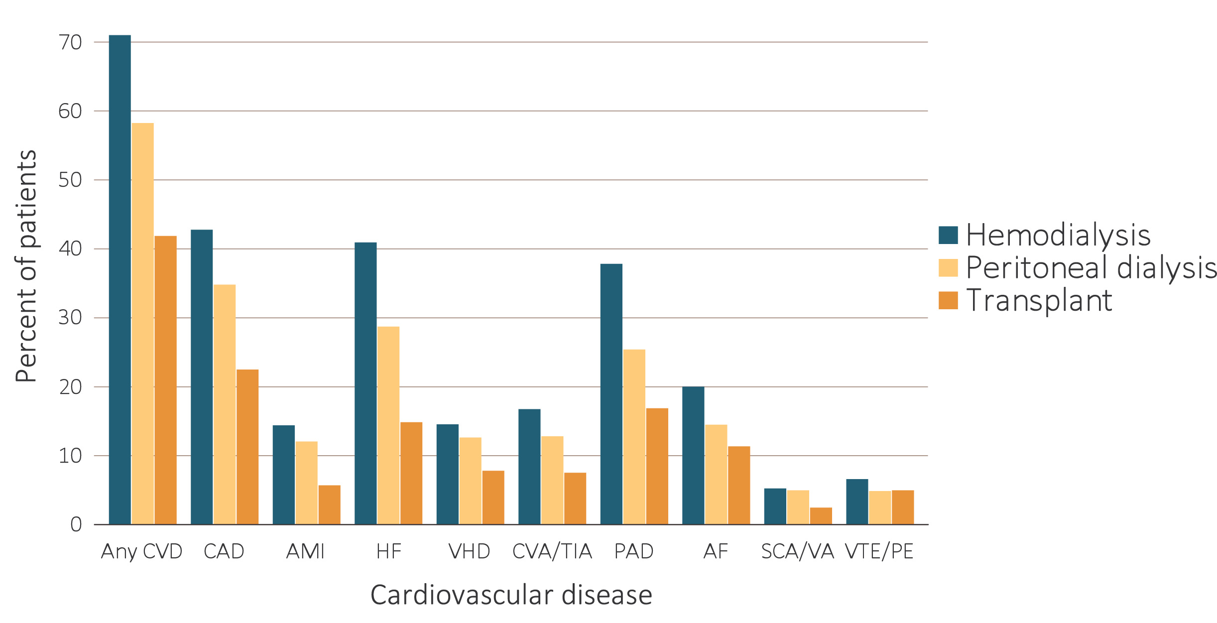
vol 2 Figure 8.1 Prevalence of cardiovascular diseases in adult ESRD patients, by treatment modality, 2016
Data Source: Special analyses, USRDS ESRD Database. Point prevalent hemodialysis, peritoneal dialysis, and transplant patients aged 22 and older, who are continuously enrolled in Medicare Parts A and B, and with Medicare as primary payer from January 1, 2016 to December 31, 2016, and ESRD service date is at least 90 days prior to January 1, 2016. Abbreviations: AF, atrial fibrillation; AMI, acute myocardial infarction; CAD, coronary artery disease; CVA/TIA, cerebrovascular accident/transient ischemic attack; CVD, cardiovascular disease; HF, heart failure; PAD, peripheral arterial disease; SCA/VA, sudden cardiac arrest and ventricular arrhythmias; VHD, valvular heart disease; VTE/PE, venous thromboembolism and pulmonary embolism.

Slide 3
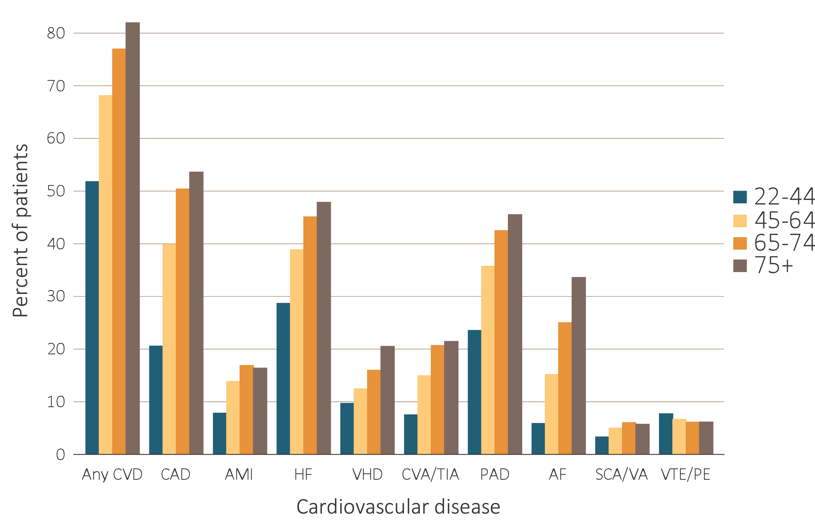
vol 2 Figure 8.2 Prevalence of cardiovascular diseases in adult ESRD patients, by age, 2016
(a) Hemodialysis patients
Data Source: Special analyses, USRDS ESRD Database. Point prevalent hemodialysis and peritoneal dialysis patients aged 22 and older, who are continuously enrolled in Medicare Parts A and B, and with Medicare as primary payer from January 1, 2016 to December 31, 2016, and ESRD service date is at least 90 days prior to January 1, 2016. Abbreviations: AF, atrial fibrillation; AMI, acute myocardial infarction; CAD, coronary artery disease; CVA/TIA, cerebrovascular accident/transient ischemic attack; CVD, cardiovascular disease; HD, hemodialysis; HF, heart failure; PAD, peripheral arterial disease; PD, peritoneal dialysis; SCA/VA, sudden cardiac arrest and ventricular arrhythmias; VHD, valvular heart disease; VTE/PE, venous thromboembolism and pulmonary embolism.

Slide 4
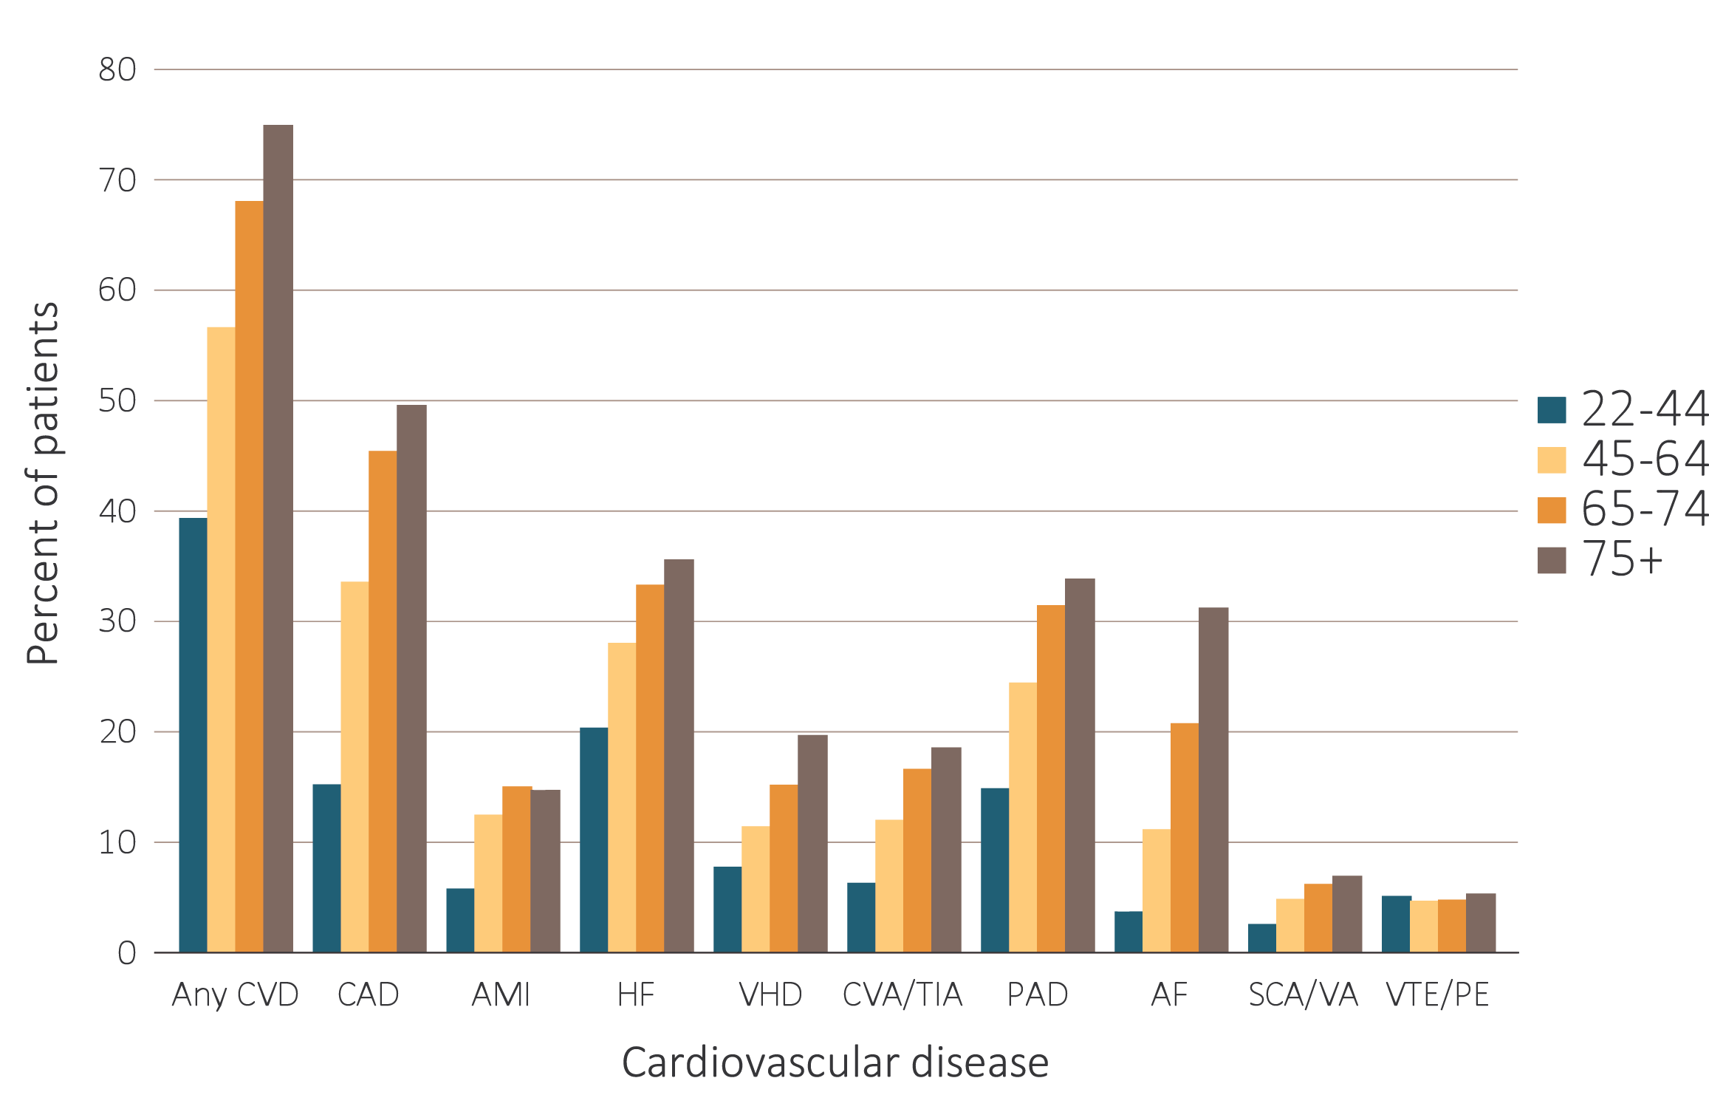
vol 2 Figure 8.2 Prevalence of cardiovascular diseases in adult ESRD patients, by age, 2016
(b) Peritoneal dialysis patients
Data Source: Special analyses, USRDS ESRD Database. Point prevalent hemodialysis and peritoneal dialysis patients aged 22 and older, who are continuously enrolled in Medicare Parts A and B, and with Medicare as primary payer from January 1, 2016 to December 31, 2016, and ESRD service date is at least 90 days prior to January 1, 2016. Abbreviations: AF, atrial fibrillation; AMI, acute myocardial infarction; CAD, coronary artery disease; CVA/TIA, cerebrovascular accident/transient ischemic attack; CVD, cardiovascular disease; HD, hemodialysis; HF, heart failure; PAD, peripheral arterial disease; PD, peritoneal dialysis; SCA/VA, sudden cardiac arrest and ventricular arrhythmias; VHD, valvular heart disease; VTE/PE, venous thromboembolism and pulmonary embolism.

Slide 5
vol 2 Table 8.1 Prevalence of (a) cardiovascular comorbidities & (b) cardiovascular procedures in adult ESRD patients, by treatment modality, age, race, & sex, 2016 (cont.)
Cardiovascular comorbidities
 | # Patients | Percentage of patients (%)
 |  | Overall | 22-44 | 45-64 | 65-74 | 75+ | White | Black | AI/AN | Asian | NH/PI | Other | Male | Female
Any CVD
Hemodialysis | 218,720 | 70.6 | 51.4 | 67.8 | 76.6 | 81.6 | 66.9 | 61.3 | 72.7 | 68.3 | 67.1 | 52.0 | 68.9 | 72.7
Peritoneal dialysis | 22,023 | 57.7 | 38.7 | 56.2 | 67.6 | 74.5 | 49.8 | 51.3 | 60.0 | 54.5 | 51.1 | 35.0 | 60.7 | 54.3
Transplant | 75,313 | 41.4 | 17.9 | 37.2 | 55.2 | 65.7 | 33.8 | 40.1 | 42.6 | 39.7 | 37.0 | 28.0 | 43.6 | 38.2
Coronary artery disease (CAD)
Hemodialysis | 218,720 | 42.3 | 20.2 | 39.5 | 50.0 | 53.2 | 41.8 | 34.3 | 46.2 | 37.5 | 39.0 | 29.5 | 42.6 | 42.0
Peritoneal dialysis | 22,023 | 34.4 | 14.8 | 33.1 | 45.0 | 49.1 | 29.5 | 25.8 | 37.4 | 28.6 | 31.9 | 15.0 | 39.2 | 28.7
Transplant | 75,313 | 22.1 | 5.6 | 19.2 | 31.7 | 38.0 | 19.5 | 21.8 | 23.3 | 19.0 | 19.4 | 12.0 | 24.9 | 17.9
Acute myocardial infarction (AMI)
Hemodialysis | 218,720 | 14.0 | 7.5 | 13.5 | 16.5 | 16.0 | 13.3 | 11.5 | 15.3 | 12.3 | 12.0 | 7.0 | 14.0 | 14.0
Peritoneal dialysis | 22,023 | 11.6 | 5.4 | 12.0 | 14.6 | 14.3 | 8.4 | 8.8 | 12.8 | 9.5 | 12.8 | 10.0 | 13.3 | 9.7
Transplant | 75,313 | 5.3 | 1.6 | 4.8 | 7.3 | 8.4 | 3.3 | 4.9 | 5.8 | 4.3 | 3.0 | 4.0 | 5.9 | 4.3
Heart failure (HF)
Hemodialysis | 218,720 | 40.4 | 28.3 | 38.5 | 44.7 | 47.5 | 35.8 | 32.8 | 40.8 | 40.8 | 38.6 | 27.3 | 38.5 | 43.1
Peritoneal dialysis | 22,023 | 28.3 | 19.9 | 27.6 | 32.7 | 35.2 | 23.4 | 22.5 | 28.3 | 29.5 | 23.4 | 20.0 | 29.3 | 26.9
Transplant | 75,313 | 14.4 | 6.0 | 12.4 | 19.5 | 24.9 | 11.4 | 12.7 | 14.1 | 16.2 | 10.9 | 12.7 | 14.8 | 13.9
Valvular heart disease (VHD)
Hemodialysis | 218,720 | 14.1 | 9.3 | 12.1 | 15.6 | 20.1 | 13.6 | 9.6 | 15.4 | 12.7 | 12.0 | 10.1 | 13.0 | 15.6
Peritoneal dialysis | 22,023 | 12.2 | 7.3 | 11.0 | 14.7 | 19.3 | 10.0 | 9.2 | 13.0 | 10.9 | 8.5 | 10.0 | 12.0 | 12.4
Transplant | 75,313 | 7.4 | 2.2 | 5.4 | 10.9 | 16.0 | 6.2 | 4.6 | 7.9 | 6.3 | 7.8 | 6.7 | 7.1 | 7.8
Cerebrovascular accident/transient ischemic attack (CVA/TIA)
Hemodialysis | 218,720 | 16.3 | 7.1 | 14.6 | 20.3 | 21.1 | 15.1 | 11.4 | 16.5 | 16.4 | 12.6 | 8.8 | 14.9 | 18.2
Peritoneal dialysis | 22,023 | 12.4 | 5.9 | 11.6 | 16.2 | 18.1 | 9.4 | 6.3 | 13.3 | 11.1 | 10.6 | 15.0 | 12.2 | 12.5
Transplant | 75,313 | 7.1 | 1.9 | 5.6 | 10.6 | 13.4 | 6.0 | 6.5 | 7.3 | 6.8 | 6.3 | 7.3 | 7.0 | 7.2
Peripheral artery disease (PAD)
Hemodialysis | 218,720 | 37.4 | 23.2 | 35.3 | 42.1 | 45.2 | 30.5 | 31.9 | 39.0 | 36.0 | 34.9 | 25.6 | 37.0 | 37.9
Peritoneal dialysis | 22,023 | 25.0 | 14.4 | 24.0 | 31.0 | 33.4 | 17.2 | 23.8 | 27.0 | 21.9 | 14.9 | 25.0 | 26.9 | 22.8
Transplant | 75,313 | 16.5 | 6.2 | 14.9 | 22.1 | 26.5 | 11.6 | 17.6 | 16.9 | 16.0 | 16.0 | 10.0 | 18.1 | 14.1
Atrial fibrillation (AF)
Hemodialysis | 218,720 | 19.6 | 5.5 | 14.8 | 24.6 | 33.2 | 19.3 | 11.3 | 23.2 | 15.1 | 16.3 | 7.9 | 20.2 | 18.9
Peritoneal dialysis | 22,023 | 14.1 | 3.3 | 10.7 | 20.3 | 30.8 | 12.5 | 7.1 | 16.4 | 9.2 | 8.5 | 15.0 | 16.8 | 10.9
Transplant | 75,313 | 10.9 | 1.6 | 7.3 | 17.2 | 27.1 | 8.0 | 7.4 | 12.3 | 7.8 | 7.2 | 4.7 | 12.2 | 9.0

Slide 6
vol 2 Table 8.1 Prevalence of (a) cardiovascular comorbidities & (b) cardiovascular procedures in adult ESRD patients, by treatment modality, age, race, & sex, 2016
(b) Cardiovascular procedures
 | # Patients | Percentage of patients (%)
 |  | Overall | 22-44 | 45-64 | 65-74 | 75+ | White | Blk/Af Am | AI/AN | Asian | NH/PI | Other | Male | Female
Cardiac arrest and ventricular arrhythmias (SCA/VA)
Hemodialysis | 218,720 | 4.8 | 2.9 | 4.6 | 5.7 | 5.4 | 3.6 | 2.6 | 4.8 | 5.0 | 3.5 | 2.2 | 5.2 | 4.3
Peritoneal dialysis | 22,023 | 4.6 | 2.1 | 4.4 | 5.8 | 6.5 | 3.4 | 2.9 | 4.6 | 4.7 | 2.1 | 5.0 | 5.4 | 3.6
Transplant | 75,313 | 2.0 | 0.6 | 1.6 | 3.1 | 3.8 | 1.5 | 1.5 | 2.1 | 2.0 | 2.7 | 2.0 | 2.3 | 1.6
Venous thromboembolism and pulmonary embolism (VTE/PE)
Hemodialysis | 218,720 | 6.2 | 7.3 | 6.3 | 5.8 | 5.8 | 4.0 | 3.3 | 5.4 | 7.5 | 6.3 | 4.4 | 5.5 | 7.1
Peritoneal dialysis | 22,023 | 4.4 | 4.7 | 4.3 | 4.3 | 4.9 | 1.7 | 3.8 | 4.2 | 5.7 | 4.3 | 5.0 | 4.0 | 5.0
Transplant | 75,313 | 4.6 | 3.3 | 4.1 | 5.6 | 6.0 | 1.7 | 3.2 | 4.4 | 5.7 | 2.9 | 4.0 | 4.6 | 4.4
Revascularization – percutaneous coronary interventions (PCI)
Hemodialysis | 92,625 | 4.9 | 4.4 | 5.6 | 5.0 | 3.6 | 4.8 | 5.6 | 5.1 | 4.5 | 6.1 | 7.5 | 5.0 | 4.8
Peritoneal dialysis | 7,570 | 6.1 | 6.1 | 6.9 | 5.7 | 5.2 | 4.5 | 0.0 | 6.6 | 5.1 | 13.3 | 0.0 | 6.5 | 5.6
Transplant | 16,615 | 3.3 | 4.2 | 3.5 | 3.1 | 2.9 | 3.2 | 2.3 | 3.5 | 2.4 | 2.0 | 11.1 | 3.4 | 3.1
Revascularization – coronary artery bypass graft (CABG)
Hemodialysis | 92,625 | 1.7 | 1.7 | 2.4 | 1.7 | 0.7 | 1.6 | 1.7 | 1.9 | 1.4 | 1.7 | 0.0 | 2.1 | 1.3
Peritoneal dialysis | 7,570 | 3.4 | 2.8 | 3.9 | 4.1 | 1.4 | 2.8 | 8.1 | 3.6 | 2.7 | 6.7 | 0.0 | 3.9 | 2.5
Transplant | 16,615 | 1.0 | 0.4 | 1.1 | 1.1 | 0.6 | 1.3 | 1.2 | 1.1 | 0.5 | 1.0 | 0.0 | 1.1 | 0.8
Implantable cardioverter defibrillators & cardiac resynchronization therapy with defibrillator devices (ICD/CRT-D)
Hemodialysis | 88,377 | 0.9 | 0.9 | 1.0 | 1.0 | 0.7 | 0.6 | 1.0 | 1.0 | 0.9 | 1.1 | 1.6 | 1.2 | 0.6
Peritoneal dialysis | 6,181 | 1.1 | 0.6 | 1.2 | 1.3 | 0.8 | 1.4 | 1.9 | 1.2 | 0.8 | 9.1 | 0.0 | 1.4 | 0.7
Transplant | 10,851 | 0.8 | 0.1 | 0.7 | 0.9 | 1.0 | 1.0 | 0.0 | 0.8 | 0.6 | 0.0 | 5.3 | 1.0 | 0.4
Carotid artery stenting and carotid artery endarterectomy (CAS/CEA)
Hemodialysis | 130,581 | 0.4 | 0.1 | 0.3 | 0.5 | 0.4 | 0.2 | 0.4 | 0.5 | 0.2 | 0.0 | 0.0 | 0.4 | 0.4
Peritoneal dialysis | 10,445 | 0.6 | 0.1 | 0.4 | 0.9 | 0.6 | 0.0 | 2.0 | 0.6 | 0.4 | 0.0 | 0.0 | 0.6 | 0.5
Transplant | 24,331 | 0.4 | 0.1 | 0.2 | 0.5 | 0.6 | 0.3 | 0.8 | 0.5 | 0.2 | 0.0 | 3.3 | 0.5 | 0.3
Data Source: Special analyses, USRDS ESRD Database. Point prevalent hemodialysis, peritoneal dialysis, and transplant patients aged 22 and older, who are continuously enrolled in Medicare Parts A and B, and with Medicare as primary payer from January 1, 2016 to December 31, 2016, and ESRD service date is at least 90 days prior to January 1, 2016. (a) The denominators for all cardiovascular comorbidities are patients described above by modality. (b) The denominators for PCI and CABG are patients with CAD by modality. The denominator for ICD/CRT-D is patients with HF by modality. The denominator for CAS/CEA is patients with CAD, CVA/TIA, or PAD by modality. *Values for cells with 10 or fewer patients are suppressed. Abbreviations: AF, atrial fibrillation; AI/AN, American Indian or Alaska Native; AMI, acute myocardial infarction; Blk/Af Am, Black African American; CABG, coronary artery bypass grafting; CAD, coronary artery disease; CAS/CEA, carotid artery stenting and carotid artery endarterectomy; CVA/TIA, cerebrovascular accident/transient ischemic attack; CVD, cardiovascular disease; ESRD, end-stage renal disease; HF, heart failure; ICD/CRT-D, implantable cardioverter defibrillators/cardiac resynchronization therapy with defibrillator devices; NH/PI, Native Hawaiian or Pacific Islander; PAD, peripheral arterial disease; PCI, percutaneous coronary interventions; SCA/VA, sudden cardiac arrest and ventricular arrhythmias; VHD, valvular heart disease; VTE/PE, venous thromboembolism and pulmonary embolism.

Slide 7
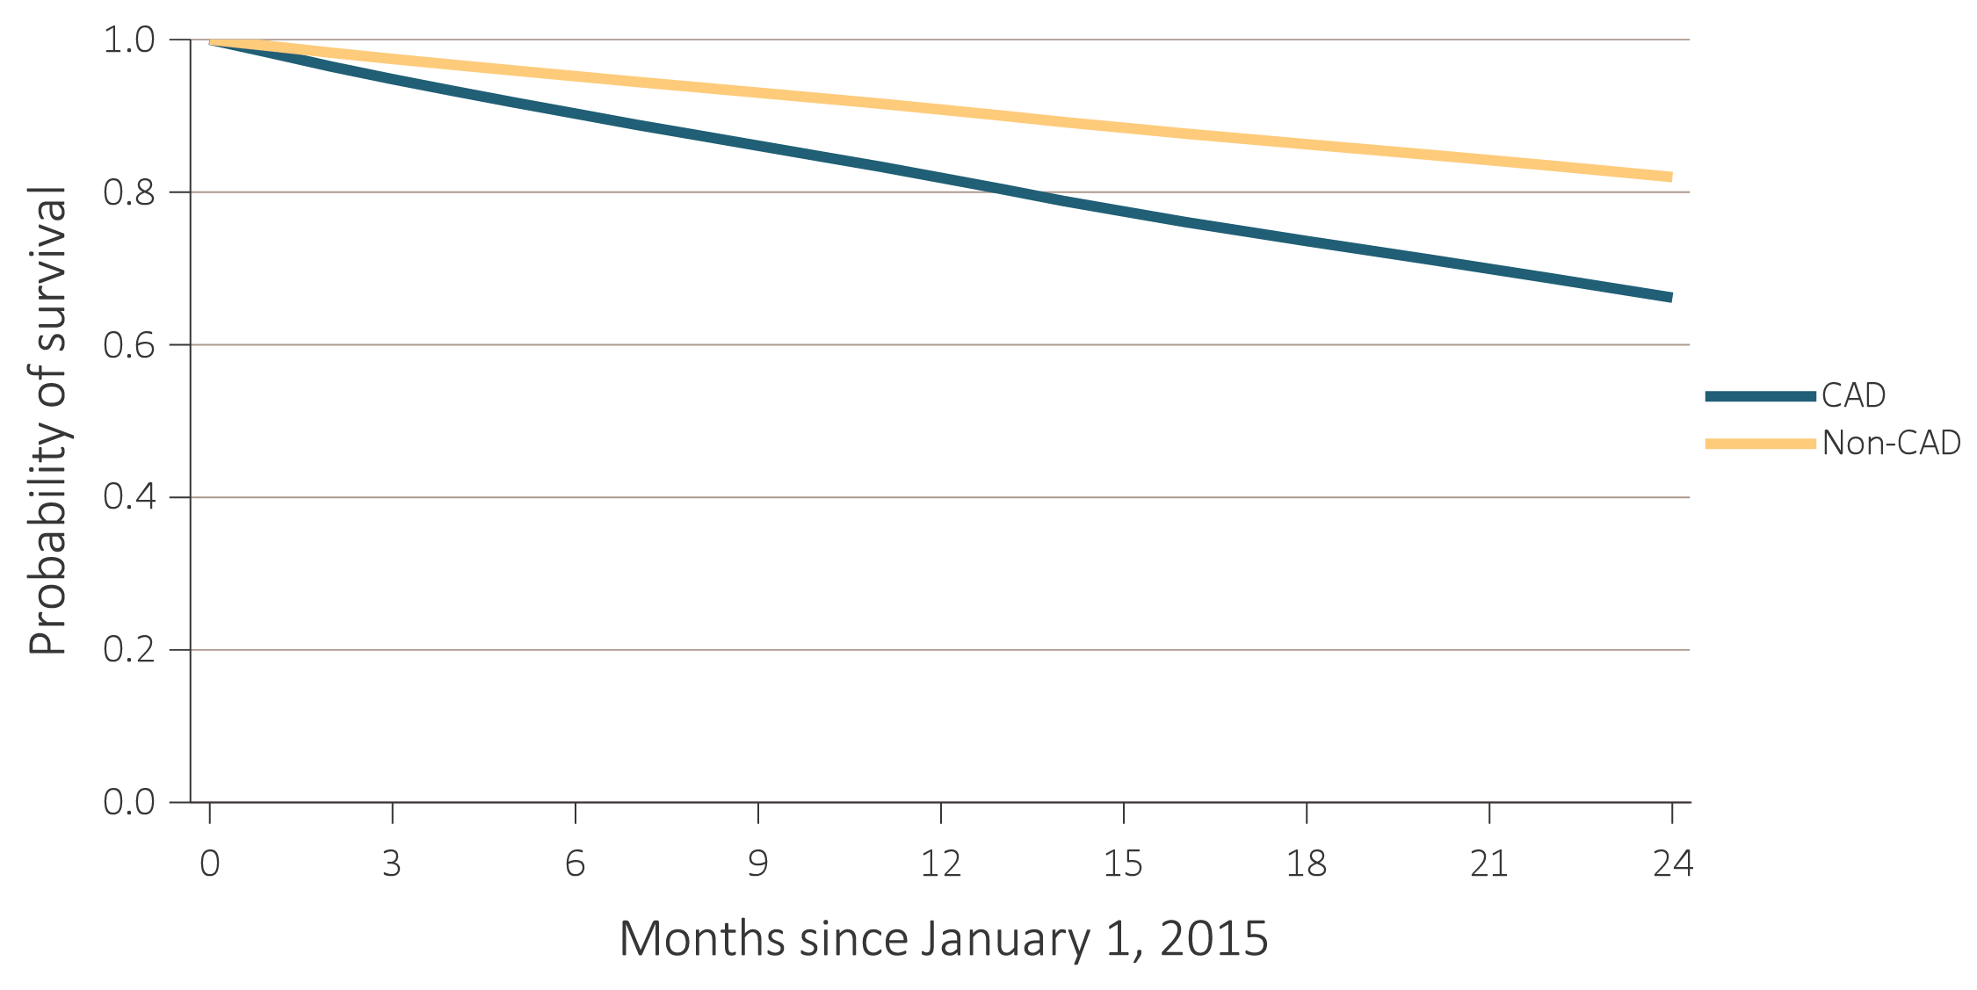
vol 2 Figure 8.3 Probability of survival of adult ESRD patients with or without a cardiovascular disease, adjusted for age and sex, 2015-2016
(a) Coronary artery disease (CAD)
Data Source: Special analyses, USRDS ESRD Database. Point prevalent hemodialysis, peritoneal dialysis, and transplant patients aged 22 and older, who are continuously enrolled in Medicare Parts A and B, and with Medicare as primary payer from January 1, 2014 to December 31, 2014, and whose first ESRD service date is at least 90 days prior to January 1, 2014, and survived past 2014. Abbreviations: AF, atrial fibrillation; AMI, acute myocardial infarction; CAD, coronary artery disease; CVA/TIA, cerebrovascular accident/transient ischemic attack; ESRD, end-stage renal disease; HF, heart failure; PAD, peripheral arterial disease; SCA/VA, sudden cardiac arrest and ventricular arrhythmias; VHD, valvular heart disease; VTE/PE, venous thromboembolism and pulmonary embolism.

Slide 8
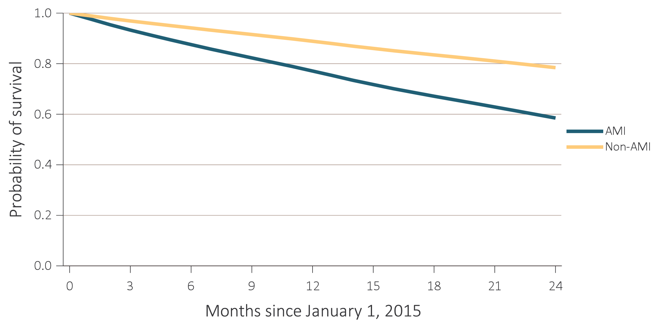
vol 2 Figure 8.3 Probability of survival of adult ESRD patients with or without a cardiovascular disease, adjusted for age and sex, 2015-2016
(b) Acute myocardial infarction (AMI)
Data Source: Special analyses, USRDS ESRD Database. Point prevalent hemodialysis, peritoneal dialysis, and transplant patients aged 22 and older, who are continuously enrolled in Medicare Parts A and B, and with Medicare as primary payer from January 1, 2014 to December 31, 2014, and whose first ESRD service date is at least 90 days prior to January 1, 2014, and survived past 2014. Abbreviations: AF, atrial fibrillation; AMI, acute myocardial infarction; CAD, coronary artery disease; CVA/TIA, cerebrovascular accident/transient ischemic attack; ESRD, end-stage renal disease; HF, heart failure; PAD, peripheral arterial disease; SCA/VA, sudden cardiac arrest and ventricular arrhythmias; VHD, valvular heart disease; VTE/PE, venous thromboembolism and pulmonary embolism.

Slide 9

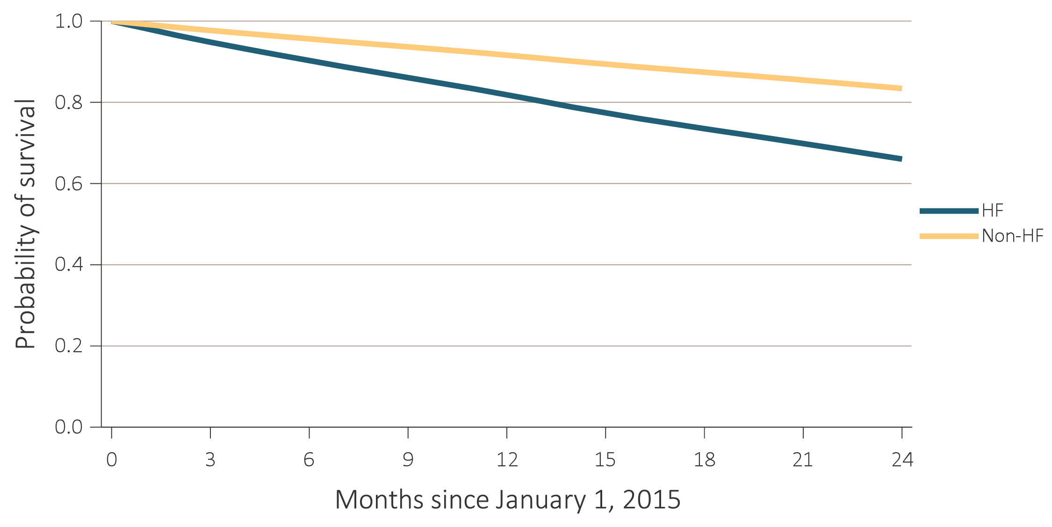
(c) Heart failure (HF)
Data Source: Special analyses, USRDS ESRD Database. Point prevalent hemodialysis, peritoneal dialysis, and transplant patients aged 22 and older, who are continuously enrolled in Medicare Parts A and B, and with Medicare as primary payer from January 1, 2014 to December 31, 2014, and whose first ESRD service date is at least 90 days prior to January 1, 2014, and survived past 2014. Abbreviations: AF, atrial fibrillation; AMI, acute myocardial infarction; CAD, coronary artery disease; CVA/TIA, cerebrovascular accident/transient ischemic attack; ESRD, end-stage renal disease; HF, heart failure; PAD, peripheral arterial disease; SCA/VA, sudden cardiac arrest and ventricular arrhythmias; VHD, valvular heart disease; VTE/PE, venous thromboembolism and pulmonary embolism.

Slide 10
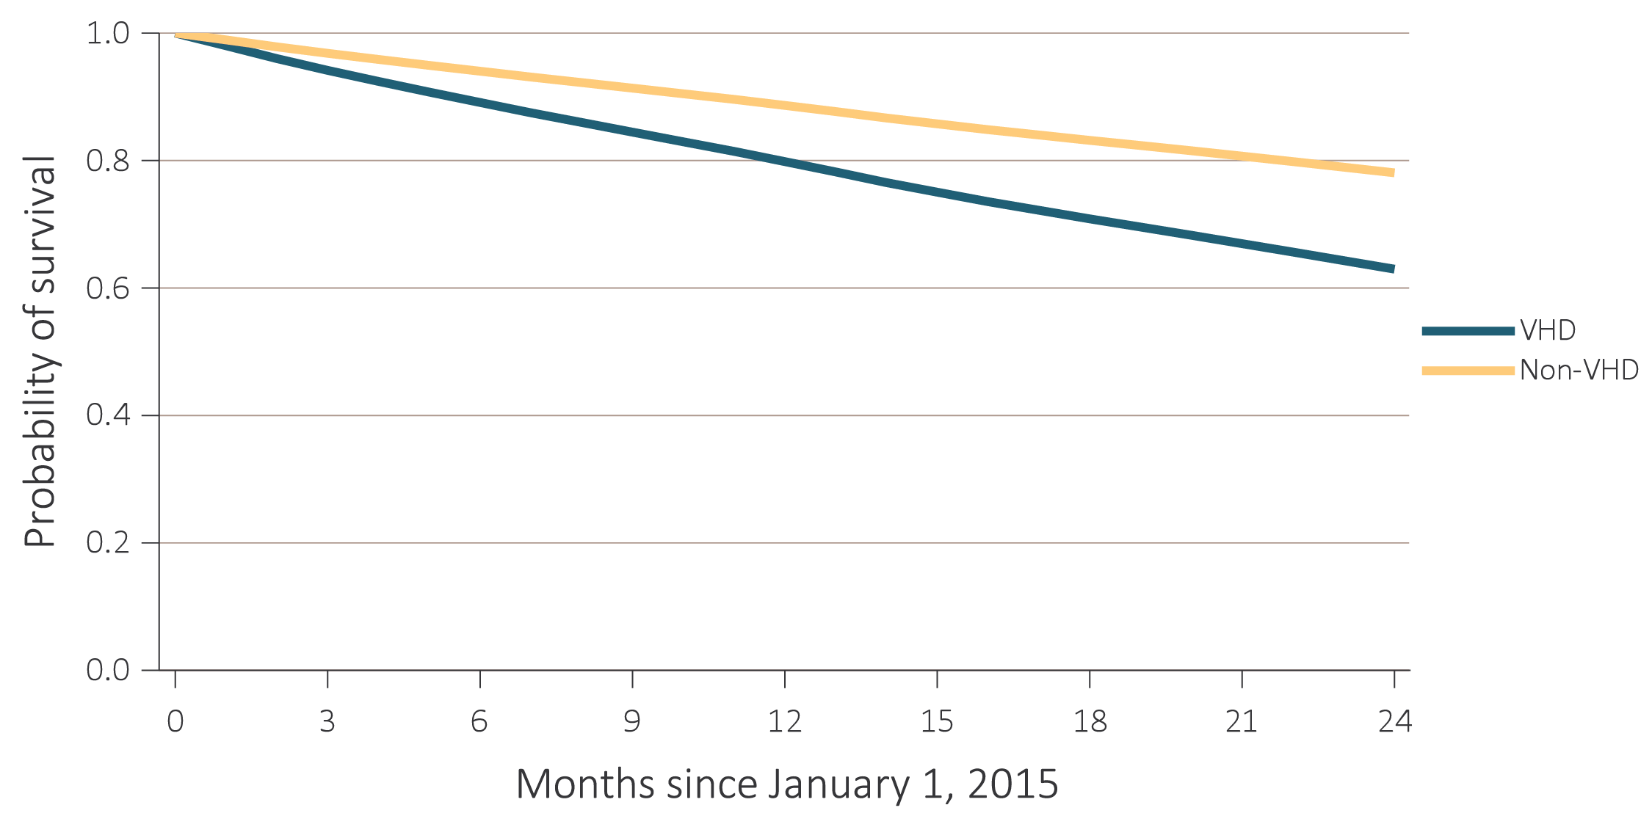
(d) Valvular heart disease (VHD)
Data Source: Special analyses, USRDS ESRD Database. Point prevalent hemodialysis, peritoneal dialysis, and transplant patients aged 22 and older, who are continuously enrolled in Medicare Parts A and B, and with Medicare as primary payer from January 1, 2014 to December 31, 2014, and whose first ESRD service date is at least 90 days prior to January 1, 2014, and survived past 2014. Abbreviations: AF, atrial fibrillation; AMI, acute myocardial infarction; CAD, coronary artery disease; CVA/TIA, cerebrovascular accident/transient ischemic attack; ESRD, end-stage renal disease; HF, heart failure; PAD, peripheral arterial disease; SCA/VA, sudden cardiac arrest and ventricular arrhythmias; VHD, valvular heart disease; VTE/PE, venous thromboembolism and pulmonary embolism.

Slide 11
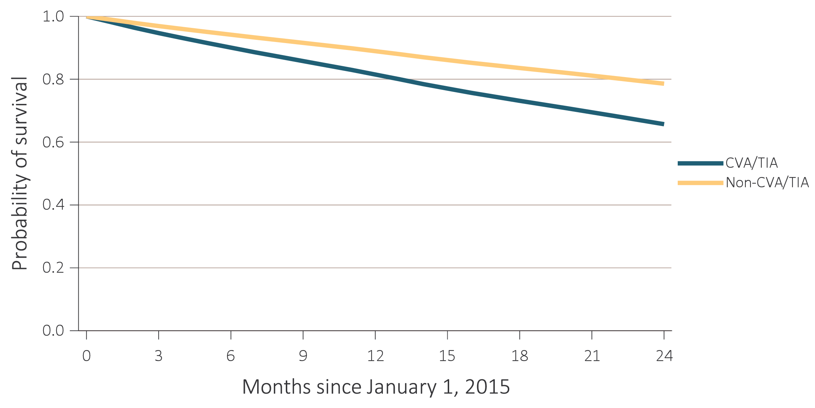
(e) Cerebrovascular accident/transient ischemic attack (CVA/TIA)
Data Source: Special analyses, USRDS ESRD Database. Point prevalent hemodialysis, peritoneal dialysis, and transplant patients aged 22 and older, who are continuously enrolled in Medicare Parts A and B, and with Medicare as primary payer from January 1, 2014 to December 31, 2014, and whose first ESRD service date is at least 90 days prior to January 1, 2014, and survived past 2014. Abbreviations: AF, atrial fibrillation; AMI, acute myocardial infarction; CAD, coronary artery disease; CVA/TIA, cerebrovascular accident/transient ischemic attack; ESRD, end-stage renal disease; HF, heart failure; PAD, peripheral arterial disease; SCA/VA, sudden cardiac arrest and ventricular arrhythmias; VHD, valvular heart disease; VTE/PE, venous thromboembolism and pulmonary embolism.

Slide 12
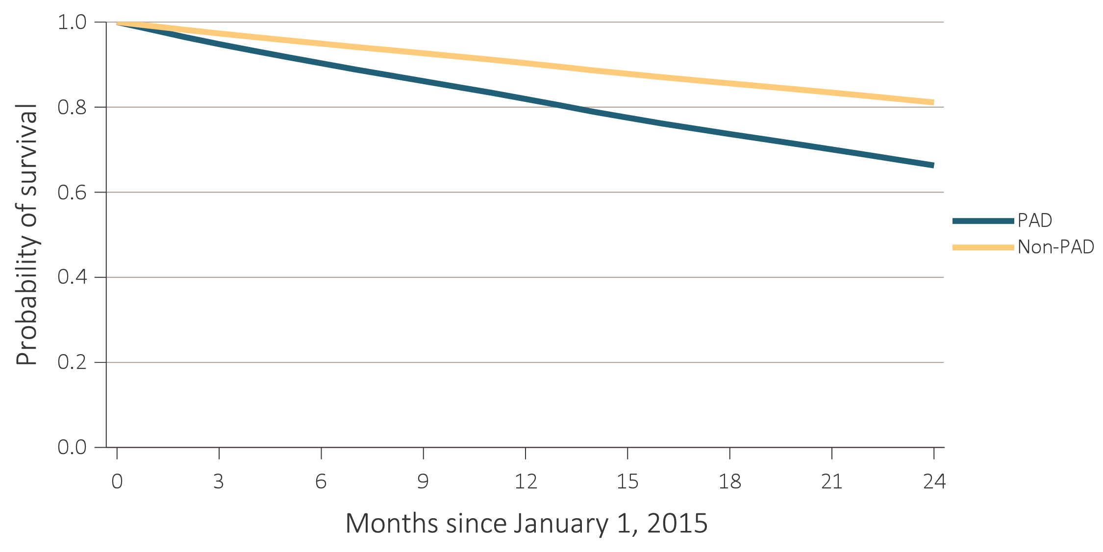
(f) Peripheral arterial disease (PAD)
Data Source: Special analyses, USRDS ESRD Database. Point prevalent hemodialysis, peritoneal dialysis, and transplant patients aged 22 and older, who are continuously enrolled in Medicare Parts A and B, and with Medicare as primary payer from January 1, 2014 to December 31, 2014, and whose first ESRD service date is at least 90 days prior to January 1, 2014, and survived past 2014. Abbreviations: AF, atrial fibrillation; AMI, acute myocardial infarction; CAD, coronary artery disease; CVA/TIA, cerebrovascular accident/transient ischemic attack; ESRD, end-stage renal disease; HF, heart failure; PAD, peripheral arterial disease; SCA/VA, sudden cardiac arrest and ventricular arrhythmias; VHD, valvular heart disease; VTE/PE, venous thromboembolism and pulmonary embolism.

Slide 13
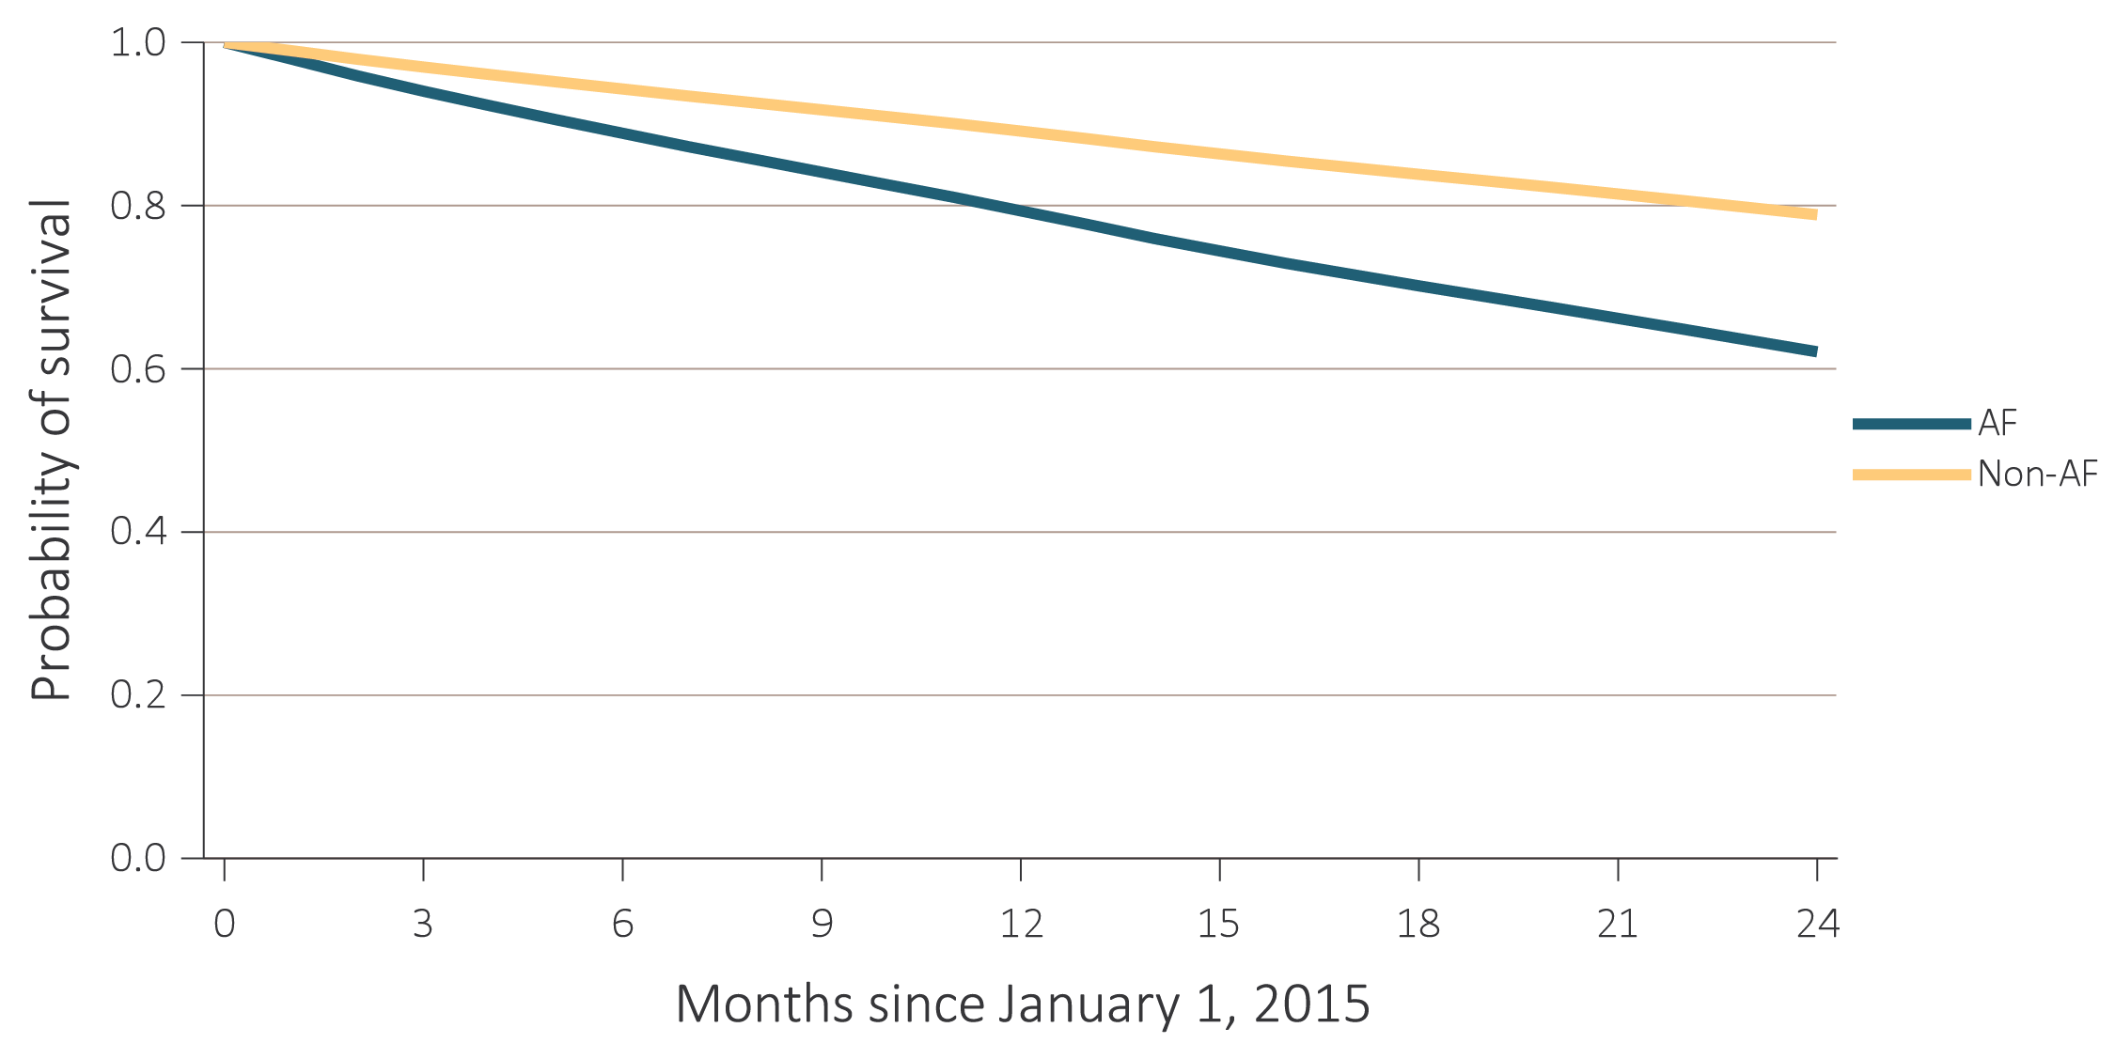
(g) Atrial fibrillation (AF)
Data Source: Special analyses, USRDS ESRD Database. Point prevalent hemodialysis, peritoneal dialysis, and transplant patients aged 22 and older, who are continuously enrolled in Medicare Parts A and B, and with Medicare as primary payer from January 1, 2014 to December 31, 2014, and whose first ESRD service date is at least 90 days prior to January 1, 2014, and survived past 2014. Abbreviations: AF, atrial fibrillation; AMI, acute myocardial infarction; CAD, coronary artery disease; CVA/TIA, cerebrovascular accident/transient ischemic attack; ESRD, end-stage renal disease; HF, heart failure; PAD, peripheral arterial disease; SCA/VA, sudden cardiac arrest and ventricular arrhythmias; VHD, valvular heart disease; VTE/PE, venous thromboembolism and pulmonary embolism.

Slide 14
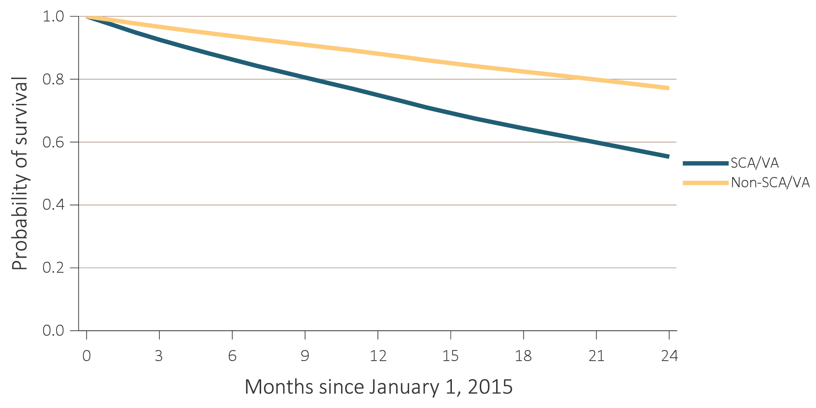
(h) Sudden cardiac arrest and ventricular arrhythmias (SCA/VA)
Data Source: Special analyses, USRDS ESRD Database. Point prevalent hemodialysis, peritoneal dialysis, and transplant patients aged 22 and older, who are continuously enrolled in Medicare Parts A and B, and with Medicare as primary payer from January 1, 2014 to December 31, 2014, and whose first ESRD service date is at least 90 days prior to January 1, 2014, and survived past 2014. Abbreviations: AF, atrial fibrillation; AMI, acute myocardial infarction; CAD, coronary artery disease; CVA/TIA, cerebrovascular accident/transient ischemic attack; ESRD, end-stage renal disease; HF, heart failure; PAD, peripheral arterial disease; SCA/VA, sudden cardiac arrest and ventricular arrhythmias; VHD, valvular heart disease; VTE/PE, venous thromboembolism and pulmonary embolism.

Slide 15
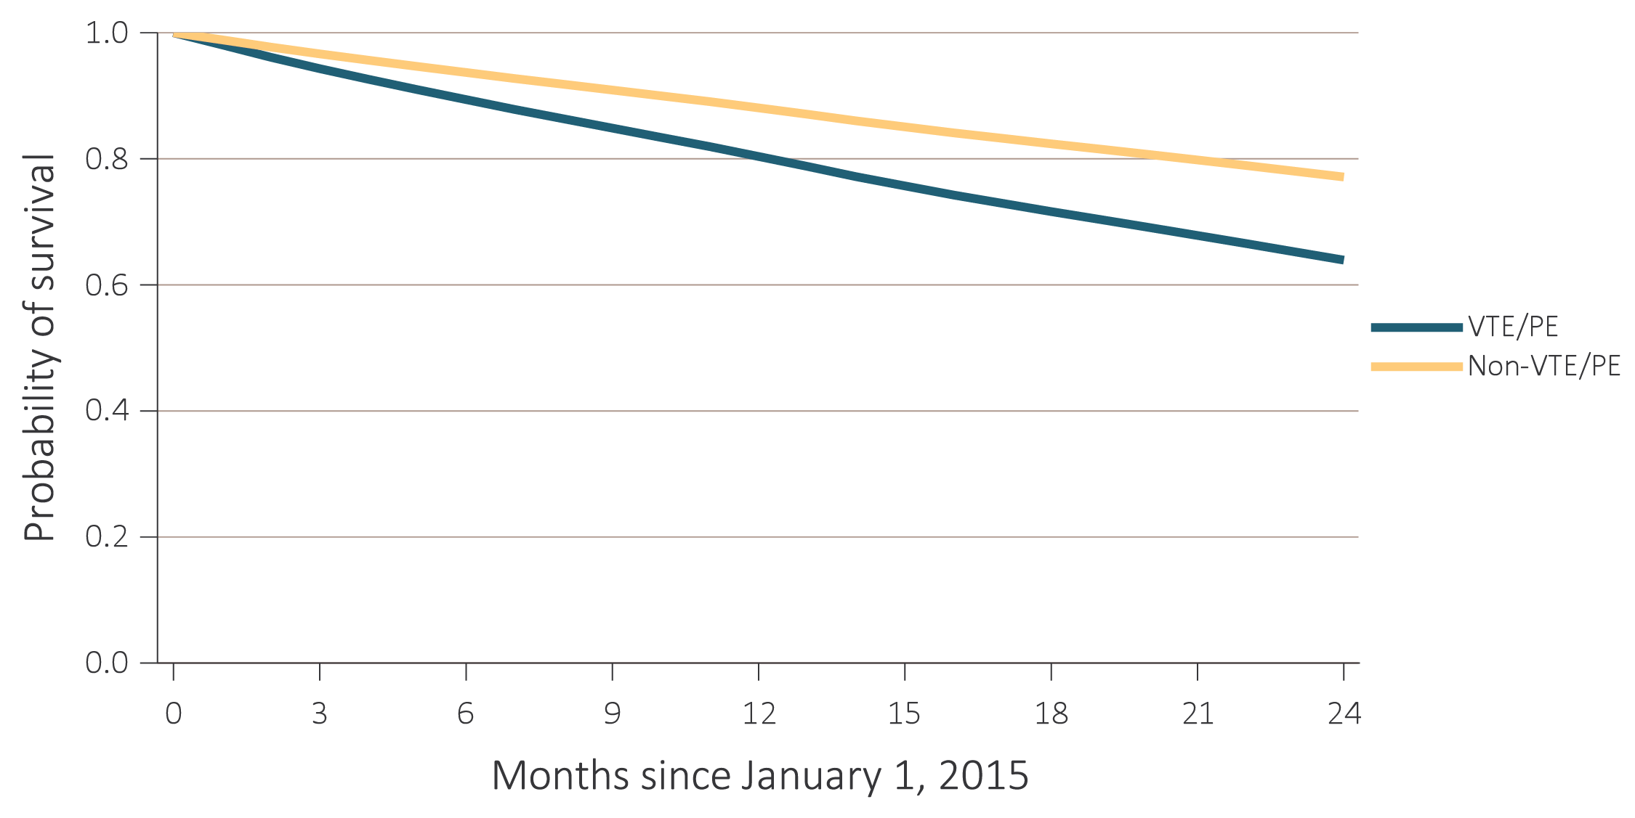
(i) Venous thromboembolism and pulmonary embolism (VTE/PE)
Data Source: Special analyses, USRDS ESRD Database. Point prevalent hemodialysis, peritoneal dialysis, and transplant patients aged 22 and older, who are continuously enrolled in Medicare Parts A and B, and with Medicare as primary payer from January 1, 2014 to December 31, 2014, and whose first ESRD service date is at least 90 days prior to January 1, 2014, and survived past 2014. Abbreviations: AF, atrial fibrillation; AMI, acute myocardial infarction; CAD, coronary artery disease; CVA/TIA, cerebrovascular accident/transient ischemic attack; ESRD, end-stage renal disease; HF, heart failure; PAD, peripheral arterial disease; SCA/VA, sudden cardiac arrest and ventricular arrhythmias; VHD, valvular heart disease; VTE/PE, venous thromboembolism and pulmonary embolism.

Slide 16
vol 2 Table 8.2 Two-year survival of adult ESRD patients with or without a cardiovascular disease, adjusted for age and sex, 2015-2016
 | Presence of cardiovascular disease
Cardiovascular disease | Survival when present (%) | Survival when not present (%)
CAD | 66.2 | 82.0
AMI | 58.5 | 78.4
HF | 66.0 | 83.4
VHD | 63.0 | 78.1
CVA/TIA | 65.7 | 78.6
PAD | 66.3 | 81.1
AF | 62.1 | 78.9
SCA/VA | 55.3 | 77.2
VTE/PE | 63.9 | 77.1
Data Source: Special analyses, USRDS ESRD Database. Point prevalent hemodialysis, peritoneal dialysis, and transplant patients aged 22 and older, who are continuously enrolled in Medicare Parts A and B, and with Medicare as primary payer from January 1, 2014 to December 31, 2014, and whose first ESRD service date is at least 90 days prior to January 1, 2014, and survived past 2014. Abbreviations: AF, atrial fibrillation; AMI, acute myocardial infarction; CAD, coronary artery disease; CVA/TIA, cerebrovascular accident/transient ischemic attack; ESRD, end-stage renal disease; HF, heart failure; PAD, peripheral arterial disease; SCA/VA, sudden cardiac arrest and ventricular arrhythmias; VHD, valvular heart disease; VTE/PE, venous thromboembolism and pulmonary embolism.

Slide 17
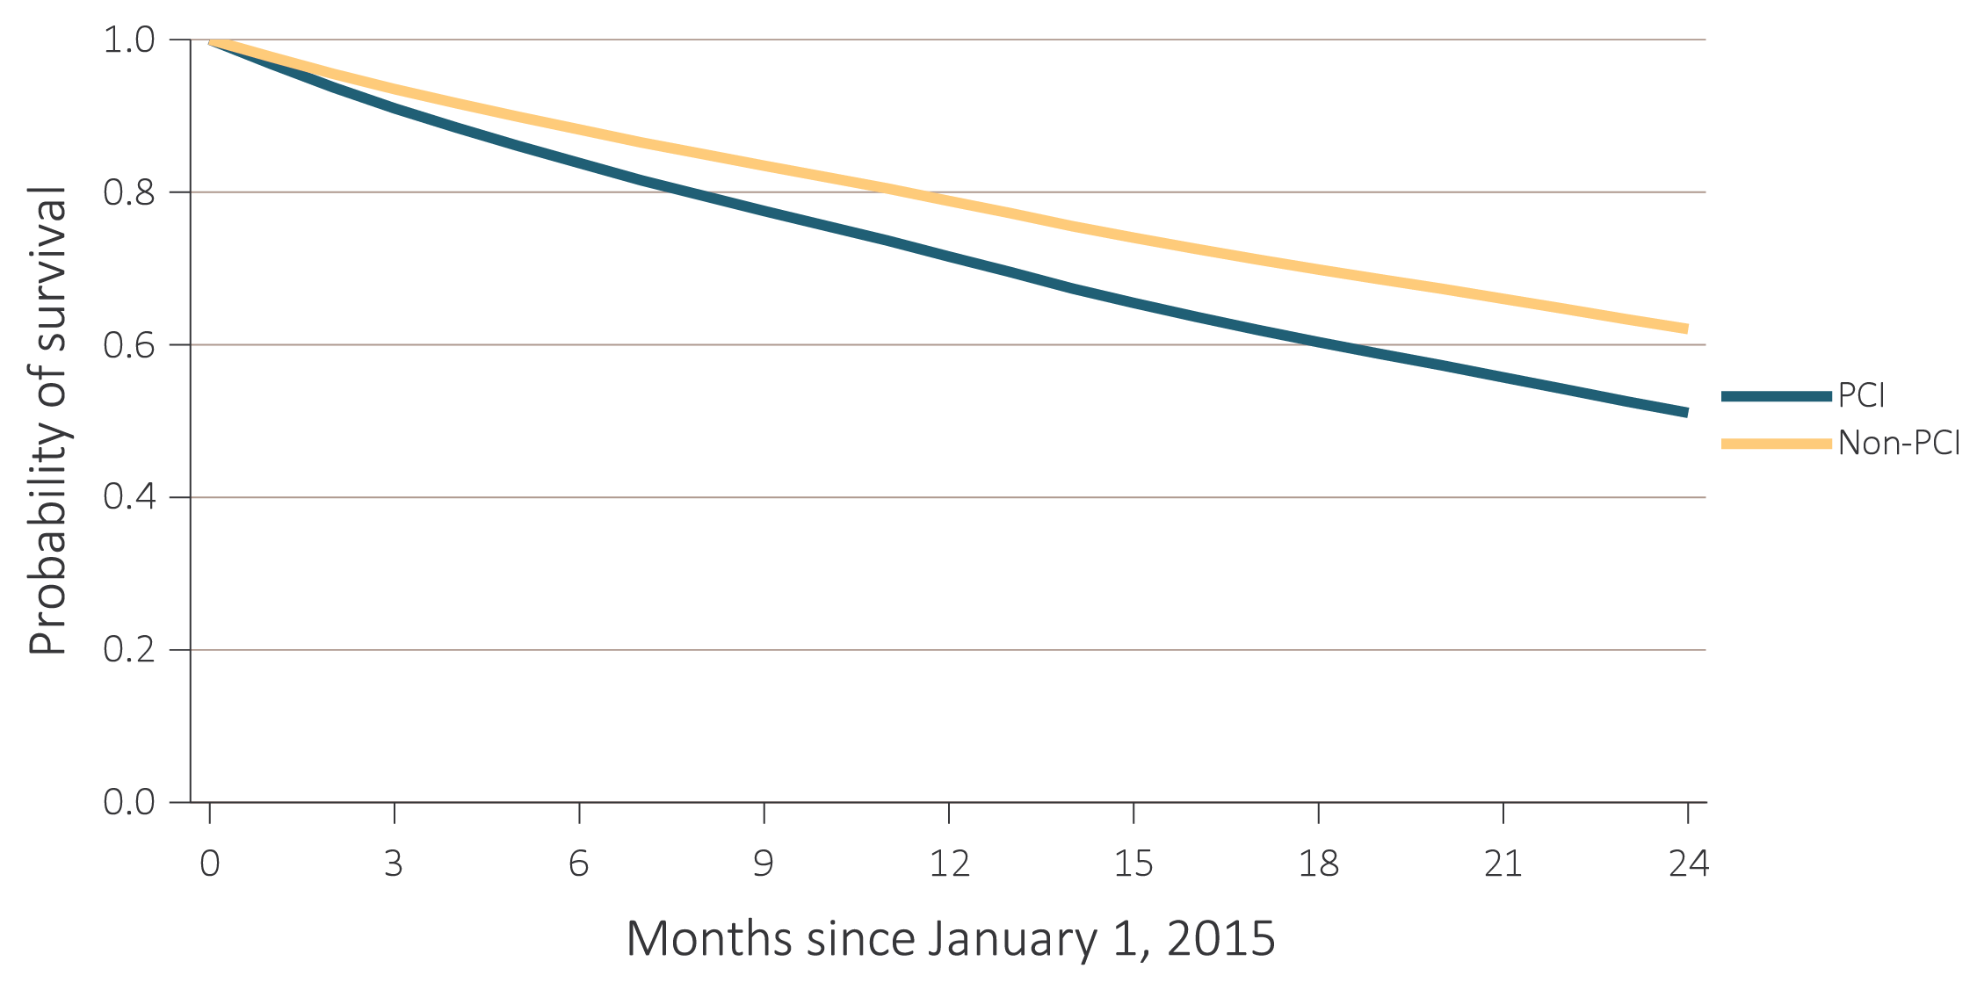
vol 2 Figure 8.4 Probability of survival of adult ESRD patients with or without a completed cardiovascular procedure, adjusted for age and sex, 2015-2016
(a) Percutaneous coronary interventions (PCI)
Data Source: Special analyses, USRDS ESRD Database. Point prevalent hemodialysis, peritoneal dialysis, and transplant patients aged 22 and older, who are continuously enrolled in Medicare Parts A and B, and with Medicare as primary payer from January 1, 2014 to December 31, 2014, and whose first ESRD service date is at least 90 days prior to January 1, 2014, and survived past 2014. Abbreviations: CABG, coronary artery bypass grafting; CAS/CEA, carotid artery stunting and carotid artery endarterectomy; ICD/CRT-D, implantable cardioverter defibrillators/cardiac resynchronization therapy with defibrillator devices; PCI, percutaneous coronary interventions.

Slide 18
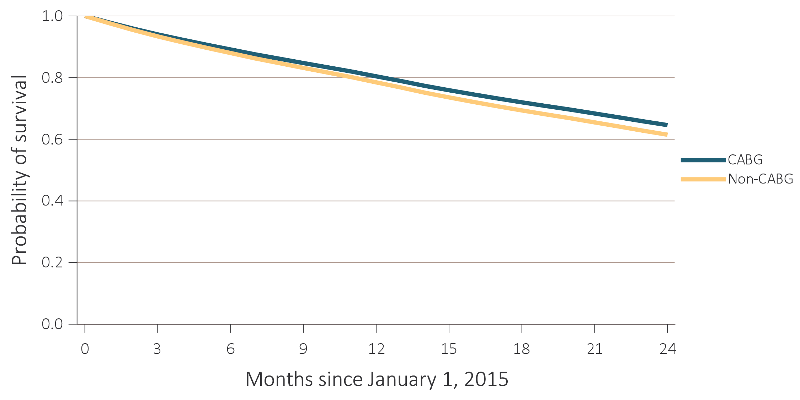
vol 2 Figure 8.4 Probability of survival of adult ESRD patients with or without a completed cardiovascular procedure, adjusted for age and sex, 2015-2016
(b) Coronary artery bypass grafting (CABG)
Data Source: Special analyses, USRDS ESRD Database. Point prevalent hemodialysis, peritoneal dialysis, and transplant patients aged 22 and older, who are continuously enrolled in Medicare Parts A and B, and with Medicare as primary payer from January 1, 2014 to December 31, 2014, and whose first ESRD service date is at least 90 days prior to January 1, 2014, and survived past 2014. Abbreviations: CABG, coronary artery bypass grafting; CAS/CEA, carotid artery stunting and carotid artery endarterectomy; ICD/CRT-D, implantable cardioverter defibrillators/cardiac resynchronization therapy with defibrillator devices; PCI, percutaneous coronary interventions.

Slide 19
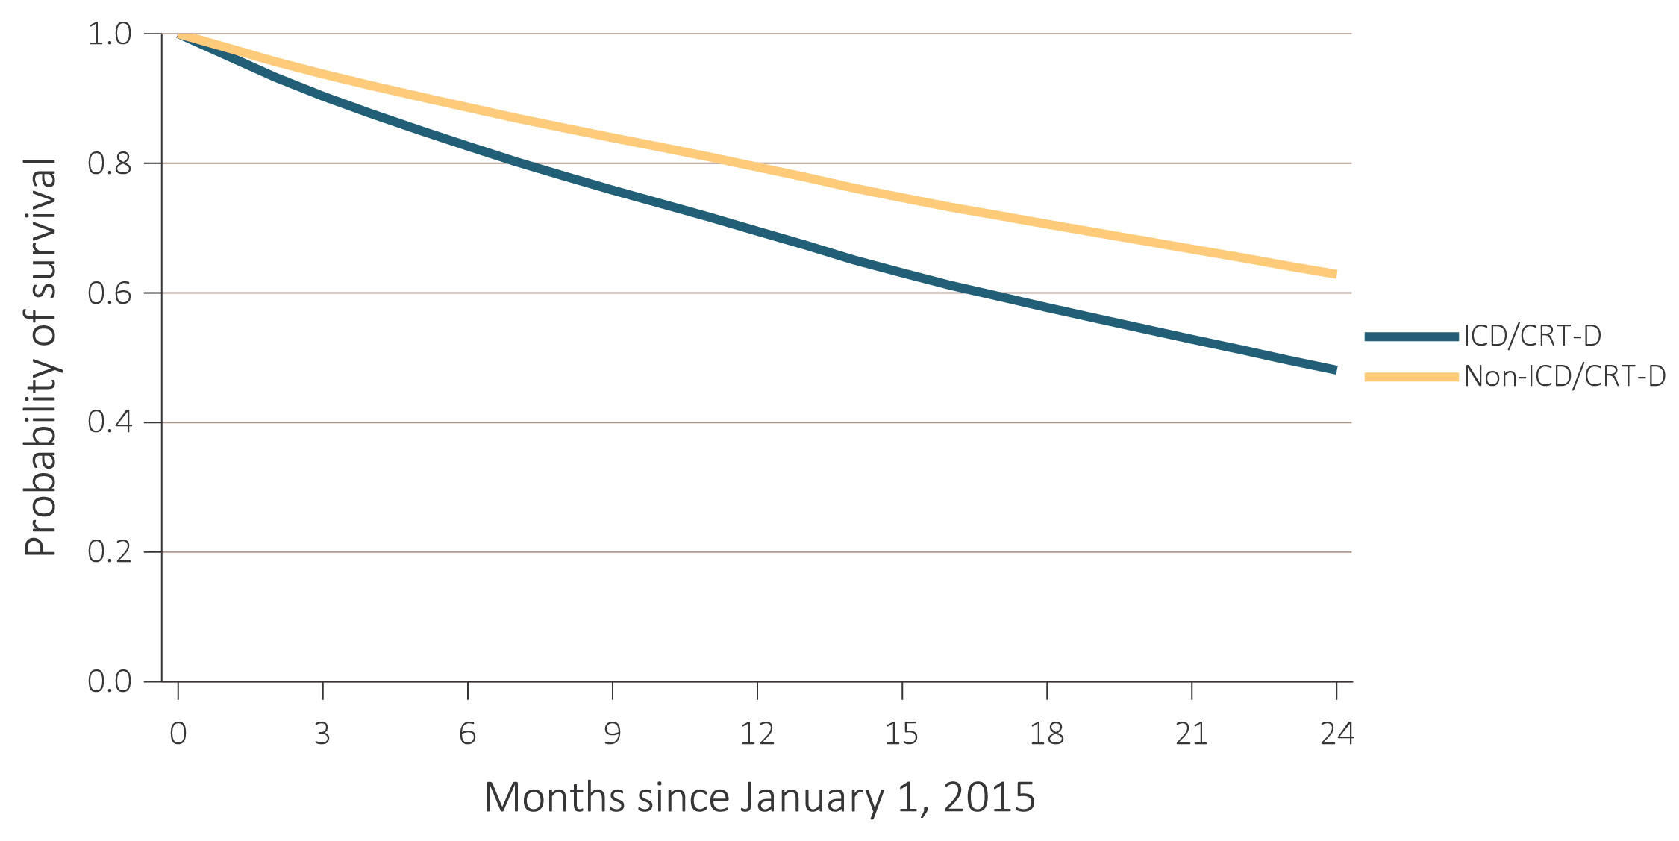
vol 2 Figure 8.4 Probability of survival of adult ESRD patients with or without a completed cardiovascular procedure, adjusted for age and sex, 2015-2016
(c) Implantable cardioverter defibrillators/cardiac resynchronization therapy with defibrillator devices (ICD/CRT-D)
Data Source: Special analyses, USRDS ESRD Database. Point prevalent hemodialysis, peritoneal dialysis, and transplant patients aged 22 and older, who are continuously enrolled in Medicare Parts A and B, and with Medicare as primary payer from January 1, 2014 to December 31, 2014, and whose first ESRD service date is at least 90 days prior to January 1, 2014, and survived past 2014. Abbreviations: CABG, coronary artery bypass grafting; CAS/CEA, carotid artery stunting and carotid artery endarterectomy; ICD/CRT-D, implantable cardioverter defibrillators/cardiac resynchronization therapy with defibrillator devices; PCI, percutaneous coronary interventions.

Slide 20
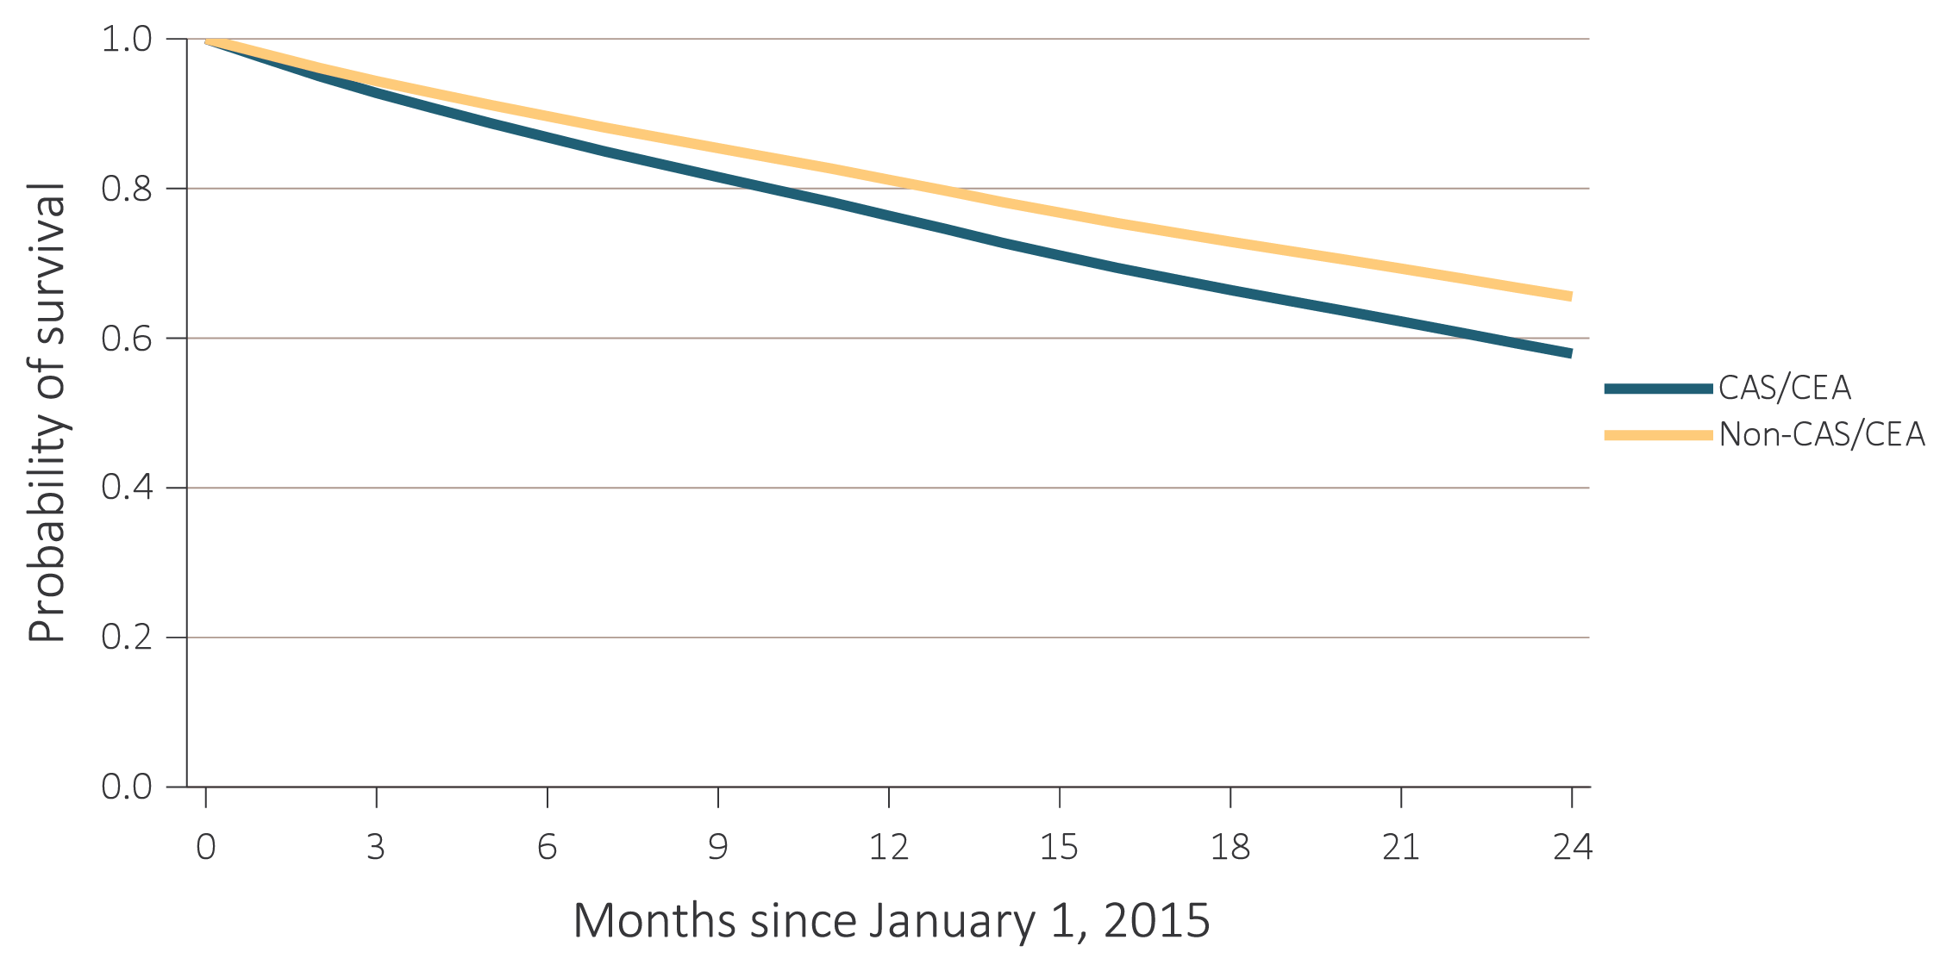
vol 2 Figure 8.4 Probability of survival of adult ESRD patients with or without a completed cardiovascular procedure, adjusted for age and sex, 2015-2016
(d) Carotid artery stenting and carotid endarterectomy (CAS/CEA)
Data Source: Special analyses, USRDS ESRD Database. Point prevalent hemodialysis, peritoneal dialysis, and transplant patients aged 22 and older, who are continuously enrolled in Medicare Parts A and B, and with Medicare as primary payer from January 1, 2014 to December 31, 2014, and whose first ESRD service date is at least 90 days prior to January 1, 2014, and survived past 2014. Abbreviations: CABG, coronary artery bypass grafting; CAS/CEA, carotid artery stunting and carotid artery endarterectomy; ICD/CRT-D, implantable cardioverter defibrillators/cardiac resynchronization therapy with defibrillator devices; PCI, percutaneous coronary interventions.

Slide 21
vol 2 Table 8.3 Two-year survival of adult ESRD patients with or without a completed cardiovascular procedure, adjusted for age and sex, 2015-2016
 | Presence of cardiovascular procedure
Cardiovascular procedure | Survival when present (%) | Survival when not present (%)
PCI | 51.1 | 62.1
CABG | 64.6 | 61.5
ICD/CRT-D | 48.1 | 62.9
CAS/CEA | 57.9 | 65.6
Data Source: Special analyses, USRDS ESRD Database. Point prevalent hemodialysis, peritoneal dialysis, and transplant patients aged 22 and older, who are continuously enrolled in Medicare Parts A and B, and with Medicare as primary payer from January 1, 2014 to December 31, 2014, and whose first ESRD service date is at least 90 days prior to January 1, 2014, and survived past 2014. Abbreviations: CABG, coronary artery bypass grafting; CAS/CEA, carotid artery stunting and carotid artery endarterectomy; ESRD, end-stage renal disease; ICD/CRT-D, implantable cardioverter defibrillators/cardiac resynchronization therapy with defibrillator devices; PCI, percutaneous coronary interventions.

Slide 22
vol 2 Table 8.4 Cardiovascular pharmacological treatments by (a) comorbidities and (b) procedures in adult ESRD patients, by modality, 2016 (cont.)
(a) Cardiovascular comorbidities
 | # Patients | Percentage of patients (%)
 |  | Beta- blockers | Statins | P2Y12 inhibitors | Warfarin | Direct oral anticoagulants | ACEIs/ ARBs
Any CVD
Hemodialysis | 154,310 | 60.8 | 48.6 | 20.0 | 13.0 | 3.6 | 35.9
Peritoneal dialysis | 12,713 | 61.0 | 49.1 | 18.5 | 11.4 | 3.1 | 41.6
Transplant | 31,208 | 59.1 | 53.9 | 13.5 | 13.7 | 6.7 | 33.0
Coronary artery disease (CAD)
Hemodialysis | 92,625 | 64.7 | 56.6 | 27.6 | 13.4 | 4.0 | 37.5
Peritoneal dialysis | 7,570 | 63.3 | 56.7 | 26.1 | 11.8 | 3.3 | 42.0
Transplant | 16,615 | 63.6 | 60.4 | 20.6 | 12.2 | 6.5 | 34.2
Acute myocardial infarction (AMI)
Hemodialysis | 30,572 | 69.3 | 61.9 | 36.5 | 15.0 | 4.5 | 41.1
Peritoneal dialysis | 2,559 | 68.0 | 61.5 | 36.3 | 13.6 | 3.9 | 44.9
Transplant | 3,976 | 68.3 | 63.8 | 30.1 | 15.2 | 8.5 | 35.2
Heart failure (HF)
Hemodialysis | 88,377 | 66.2 | 50.6 | 21.8 | 14.2 | 4.2 | 39.6
Peritoneal dialysis | 6,181 | 66.2 | 50.4 | 20.6 | 13.5 | 3.7 | 44.4
Transplant | 10,851 | 65.9 | 55.9 | 14.9 | 16.5 | 8.6 | 34.6
Valvular heart disease (VHD)
Hemodialysis | 30,906 | 63.9 | 49.7 | 22.1 | 18.0 | 4.8 | 37.9
Peritoneal dialysis | 2,687 | 62.4 | 49.0 | 19.2 | 16.8 | 4.8 | 41.5
Transplant | 5,561 | 61.0 | 53.5 | 14.1 | 17.7 | 7.9 | 33.3
Cerebrovascular accident/transient ischemic attack (CVA/TIA)
Hemodialysis | 35,710 | 64.2 | 58.3 | 28.1 | 13.8 | 4.4 | 38.8
Peritoneal dialysis | 2,726 | 63.2 | 57.3 | 26.4 | 12.9 | 3.3 | 44.3
Transplant | 5,347 | 59.2 | 59.8 | 20.9 | 14.3 | 7.2 | 34.4
Peripheral artery disease (PAD)
Hemodialysis | 81,792 | 60.4 | 51.3 | 24.5 | 13.4 | 3.9 | 35.3
Peritoneal dialysis | 5,501 | 60.6 | 52.4 | 24.3 | 12.0 | 3.3 | 41.4
Transplant | 12,394 | 59.2 | 55.4 | 18.2 | 12.5 | 5.9 | 33.9
Atrial fibrillation (AF)
Hemodialysis | 42,853 | 61.0 | 49.5 | 18.3 | 32.5 | 9.4 | 30.5
Peritoneal dialysis | 3,098 | 60.7 | 50.4 | 16.7 | 31.5 | 9.4 | 35.2
Transplant | 8,222 | 63.1 | 51.8 | 9.5 | 32.6 | 17.8 | 32.0
Data Source: Special analyses, USRDS ESRD Database. Point prevalent hemodialysis, peritoneal dialysis, and transplant patients aged 22 and older, who are continuously enrolled in Medicare Parts A and B, and with Medicare as primary payer from January 1, 2014 to December 31, 2014, and whose first ESRD service date is at least 90 days prior to January 1, 2014, and survived past 2014. Abbreviations: AF, atrial fibrillation; AMI, acute myocardial infarction; CAD, coronary artery disease; CVA/TIA, cerebrovascular accident/transient ischemic attack; ESRD, end-stage renal disease; HF, heart failure; PAD, peripheral arterial disease; SCA/VA, sudden cardiac arrest and ventricular arrhythmias; VHD, valvular heart disease; VTE/PE, venous thromboembolism and pulmonary embolism.

Slide 23
vol 2 Table 8.4 Cardiovascular pharmacological treatments by (a) comorbidities and (b) procedures in adult ESRD patients, by modality, 2016
(b) Cardiovascular procedures
 | # Patients | Percentage of patients (%)
 |  | Beta- blockers | Statins | P2Y12 inhibitors | Warfarin | Direct Oral Anticoagulants | ACEIs/ ARBs
Cardiac arrest and ventricular arrhythmias (SCA/VA)
Hemodialysis | 10,531 | 67.7 | 52.7 | 25.2 | 19.5 | 5.7 | 38.1
Peritoneal dialysis | 1,003 | 62.5 | 50.9 | 22.5 | 18.4 | 5.2 | 40.1
Transplant | 1,540 | 65.3 | 54.4 | 16.8 | 19.9 | 9.6 | 33.7
Venous thromboembolism and pulmonary embolism (VTE/PE)
Hemodialysis | 13,522 | 58.8 | 45.0 | 18.2 | 38.7 | 9.7 | 32.8
Peritoneal dialysis | 978 | 59.5 | 45.3 | 14.3 | 40.2 | 10.1 | 38.4
Transplant | 3,428 | 56.1 | 47.2 | 9.0 | 42.4 | 17.0 | 30.8
Revascularization – percutaneous coronary interventions (PCI)
Hemodialysis | 4,553 | 75.1 | 73.1 | 77.1 | 12.5 | 3.8 | 49.5
Peritoneal dialysis | 466 | 70.4 | 70.0 | 71.5 | 11.4 | 3.9 | 45.7
Transplant | 542 | 74.7 | 72.3 | 72.1 | 11.3 | 6.1 | 43.5
Revascularization – coronary artery bypass graft (CABG)
Hemodialysis | 1,612 | 76.4 | 75.9 | 39.9 | 17.6 | 4.1 | 47.3
Peritoneal dialysis | 257 | 74.3 | 73.2 | 38.1 | 12.1 | 3.5 | 47.9
Transplant | 162 | 69.1 | 67.3 | 30.2 | 15.4 | 5.6 | 34.0
Implantable cardioverter defibrillators & cardiac resynchronization therapy with defibrillator (ICD/CRT-D)
Hemodialysis | 848 | 72.2 | 55.1 | 28.9 | 27.0 | 8.0 | 46.8
Peritoneal dialysis | 74 | 66.2 | 56.8 | 32.4 | 14.9 | 6.8 | 41.9
Transplant | 92 | 70.7 | 62.0 | 27.2 | 22.8 | 12.0 | 41.3
Carotid artery stenting and carotid artery endarterectomy (CAS/CEA)
Hemodialysis | 465 | 66.0 | 68.8 | 51.0 | 13.8 | 2.6 | 42.6
Peritoneal dialysis | 58 | 65.5 | 60.3 | 37.9 | 12.1 | 0.0 | 41.4
Transplant | 94 | 69.1 | 64.9 | 34.0 | 18.1 | 12.8 | 34.0
Data Source: Special analyses, USRDS ESRD Database. Point prevalent hemodialysis, peritoneal dialysis, and transplant patients aged 22 and older, who are continuously enrolled in Medicare Parts A, B, and D, and with Medicare as primary payer from January 1, 2016 to December 31, 2016, and ESRD service date is at least 90 days prior to January 1, 2016. Abbreviations: ACEIs/ARBs, Angiotensin converting enzyme inhibitors and angiotensin receptor blockers; AF, atrial fibrillation; AMI, acute myocardial infarction; CAD, coronary artery disease; CABG, coronary artery bypass grafting; CAS/CEA, carotid artery stenting and carotid endarterectomy; CVA/TIA, cerebrovascular accident/transient ischemic attack; CVD, cardiovascular disease; ESRD, end-stage renal disease; HF, heart failure; ICD/CRT-D, implantable cardioverter defibrillators/cardiac resynchronization therapy with defibrillator devices; PAD, peripheral arterial disease; PCI, percutaneous coronary interventions; SCA/VA, sudden cardiac arrest and ventricular arrhythmias; VHD, valvular heart disease; VTE/PE, venous thromboembolism and pulmonary embolism.

Slide 24
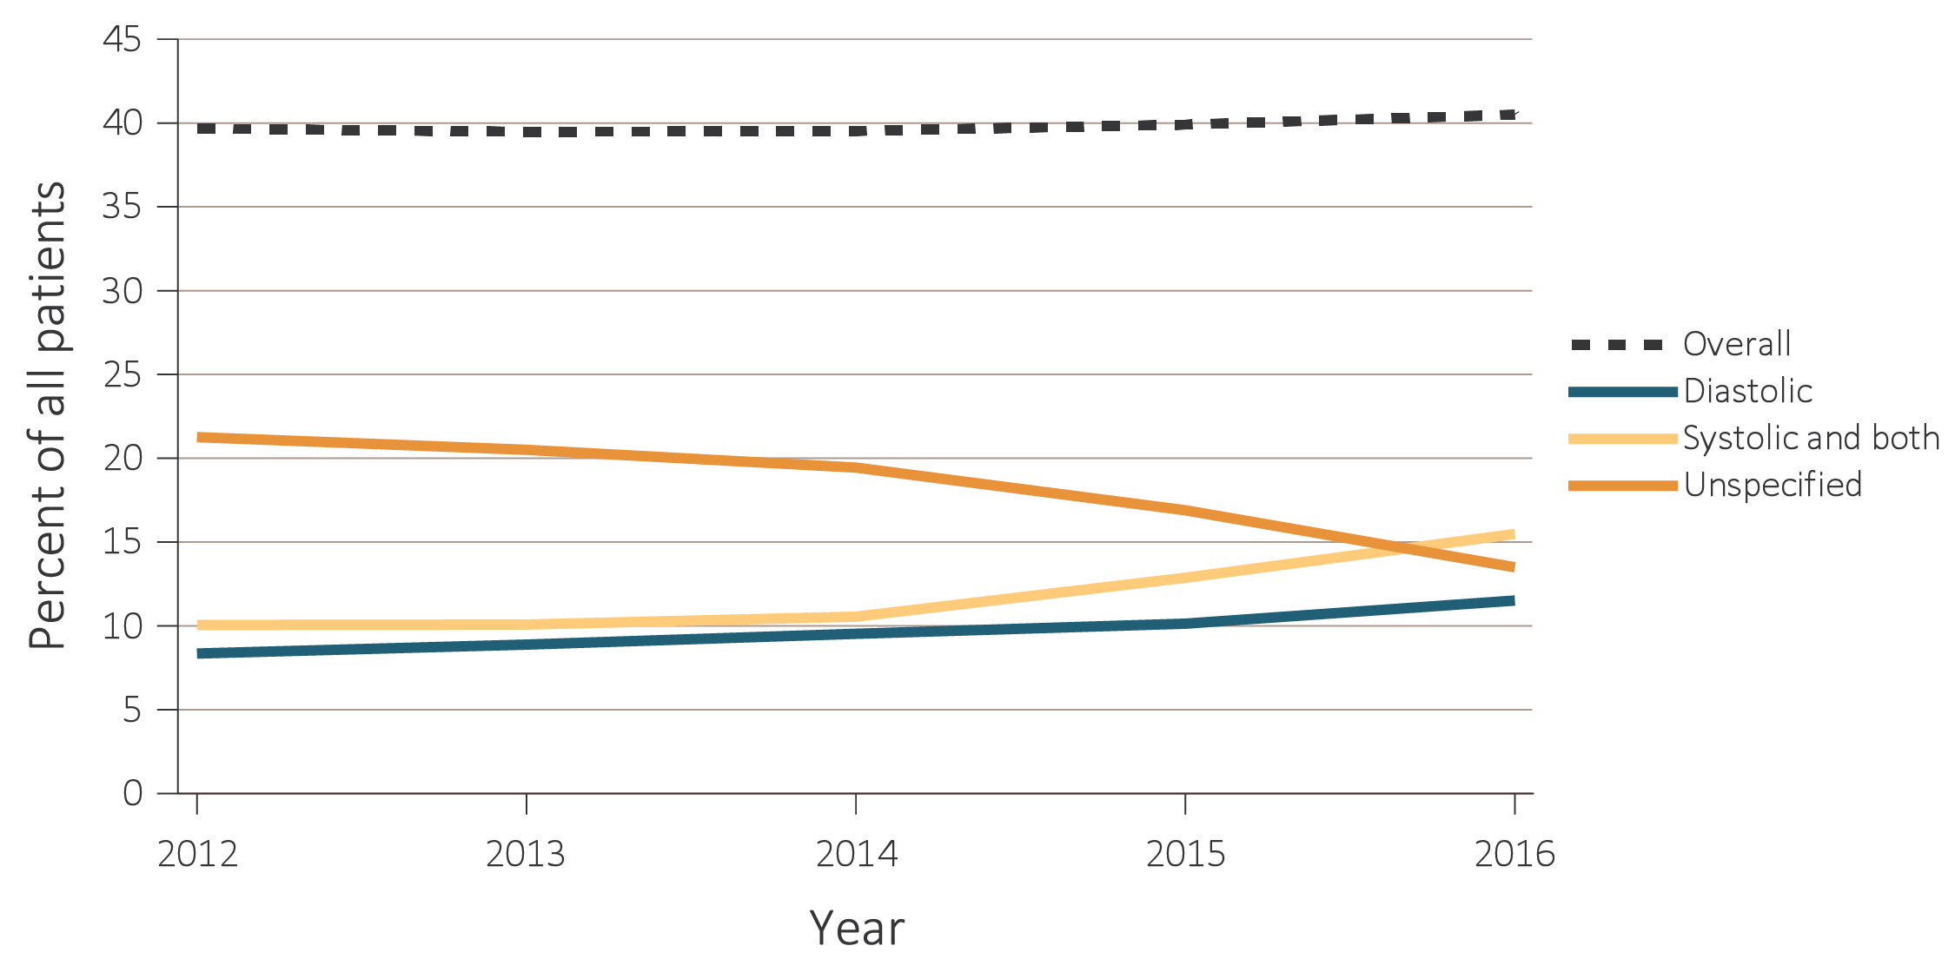
vol 2 Figure 8.5 Heart failure in adult ESRD patients by modality, 2012-2016
(a) Hemodialysis patients
Data Source: Special analyses, USRDS ESRD Database. Point prevalent hemodialysis and peritoneal dialysis patients aged 22 and older, who are continuously enrolled in Medicare Parts A and B, and with Medicare as primary payer from January 1, 2012 to December 31, 2016, and ESRD service date is at least 90 days prior to January 1, 2012. Abbreviation: ESRD, end-stage renal disease.

Slide 25
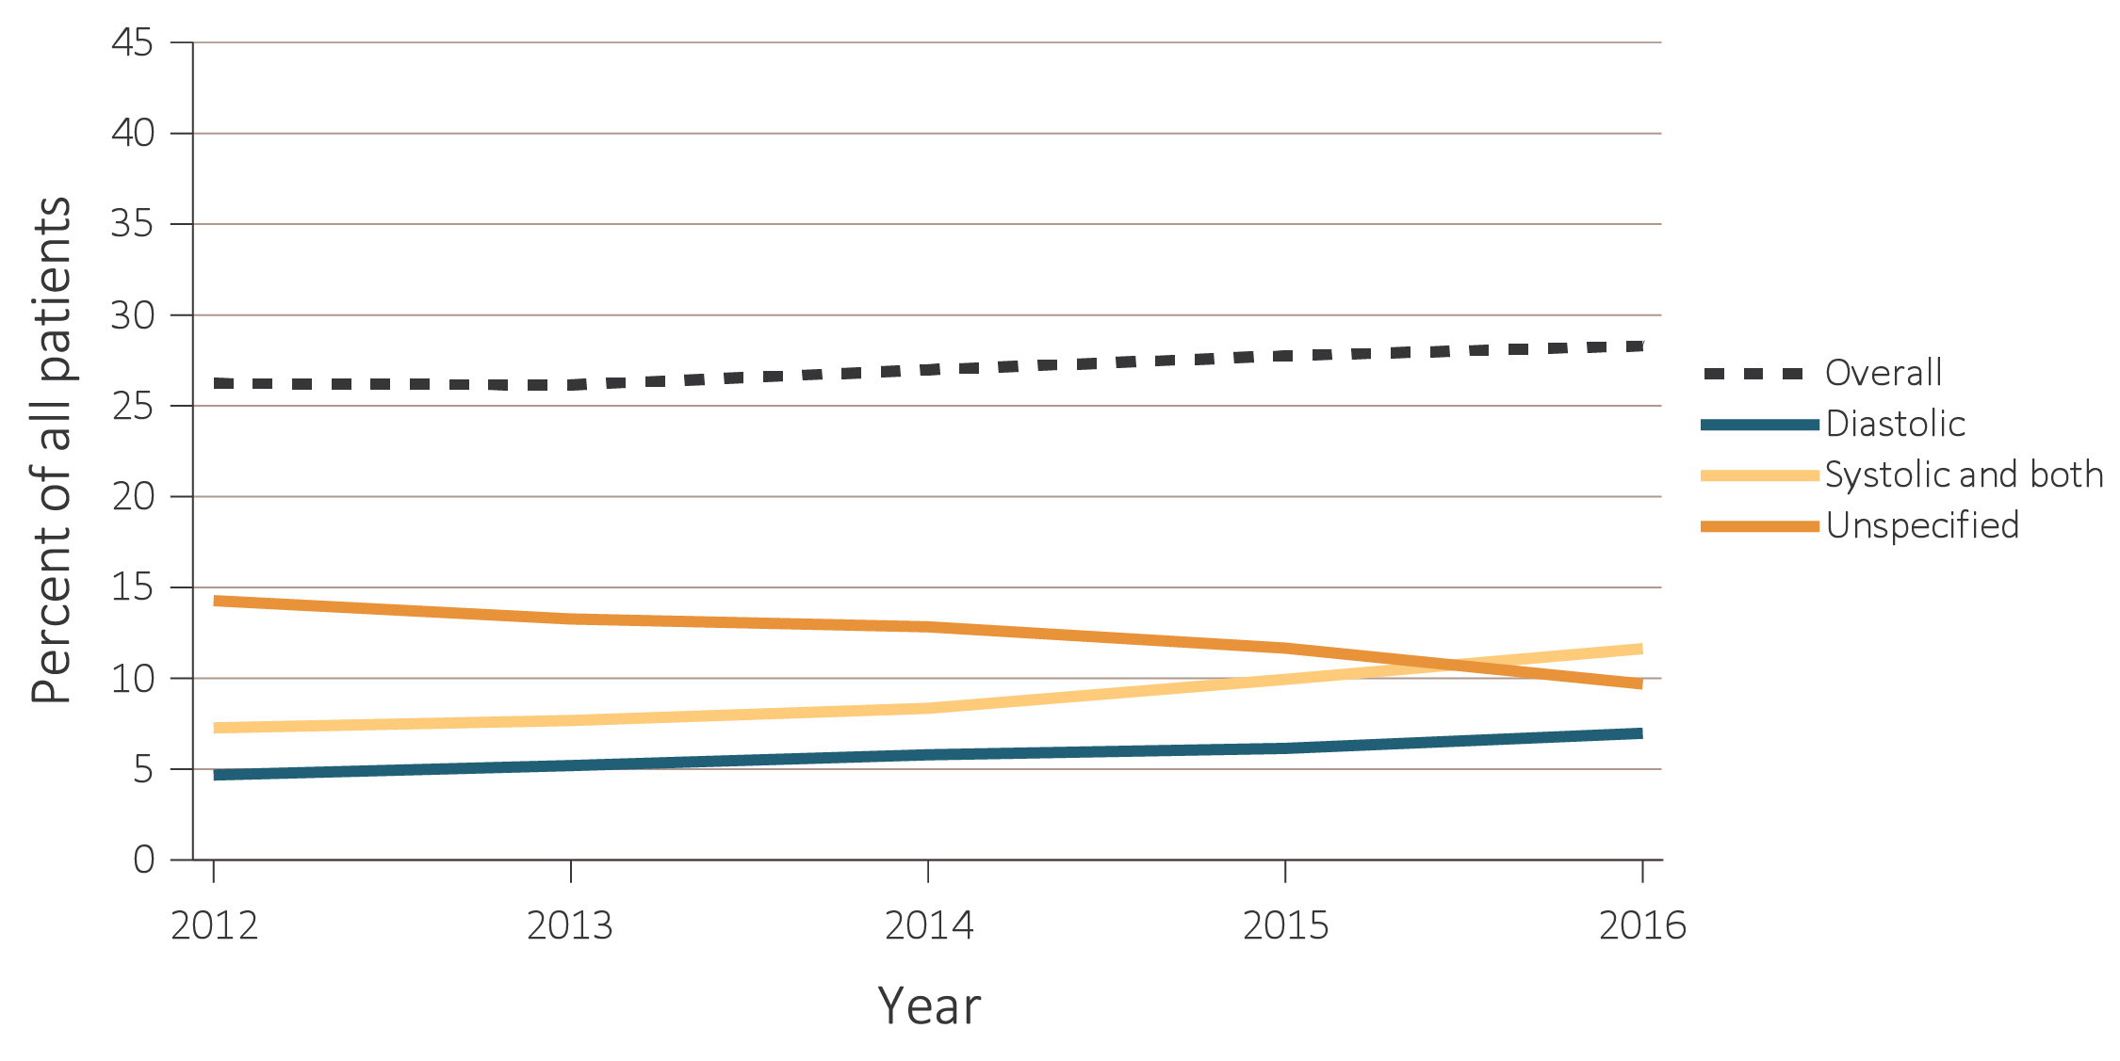
vol 2 Figure 8.5 Heart failure in adult ESRD patients by modality, 2012-2016
(b) Peritoneal dialysis patients
Data Source: Special analyses, USRDS ESRD Database. Point prevalent hemodialysis and peritoneal dialysis patients aged 22 and older, who are continuously enrolled in Medicare Parts A and B, and with Medicare as primary payer from January 1, 2012 to December 31, 2016, and ESRD service date is at least 90 days prior to January 1, 2012. Abbreviation: ESRD, end-stage renal disease.

